Slide 1



Super Tau Charm Lattice
ST20_49/55
Pantaleo Raimondi
La Biodola, May 27-2013

Slide 2
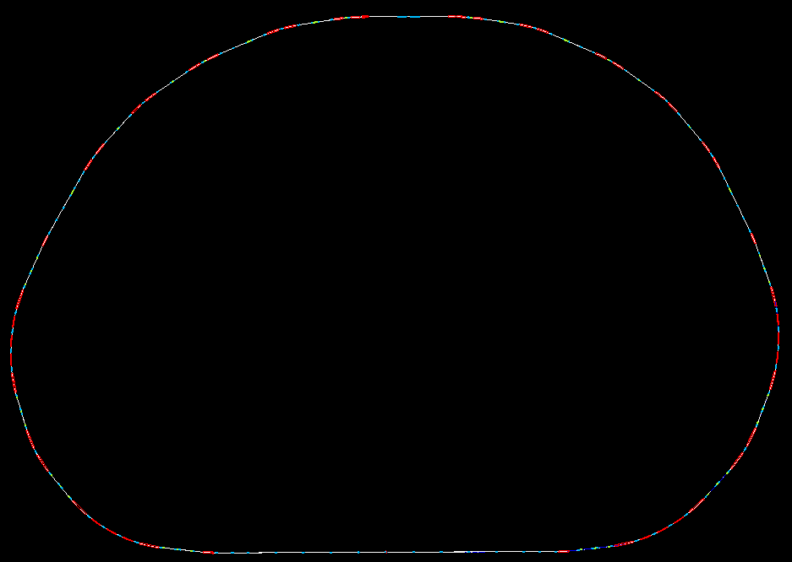
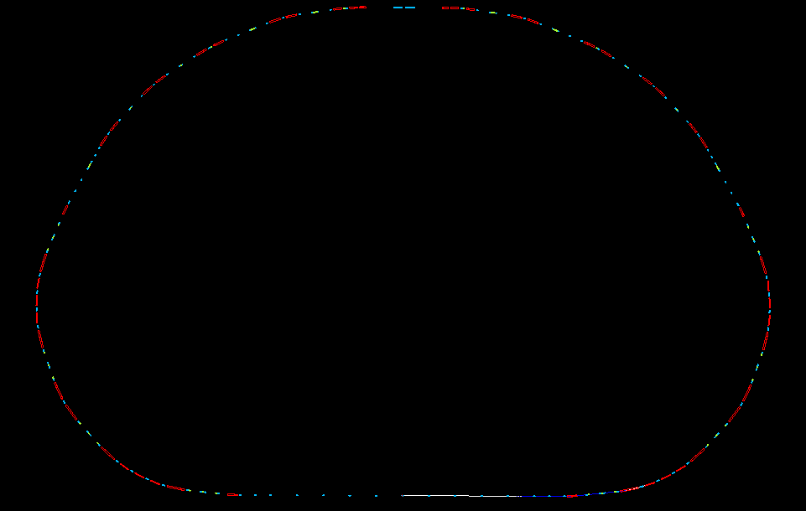
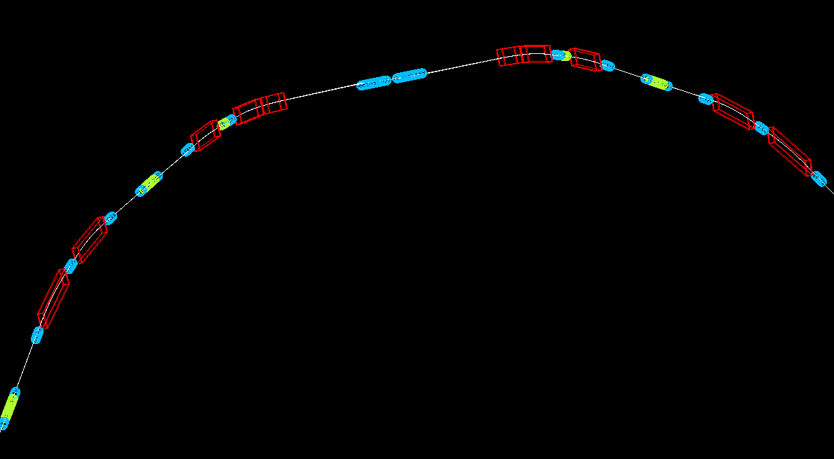
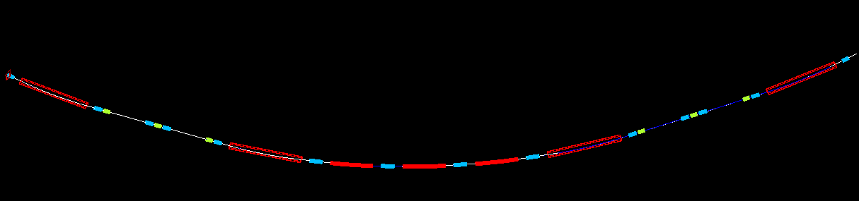
Lattice ST20_49
IP
Dipole
Sextupoles
Quadrupoles
Final Focus Left
Final Focus right
Final Doublet Zoom in
ARC cell
ARC cell
ARC cell
Dipole with gradient
ARC cell
Straight section: RF, INJ, tune, Spin rot, …
ARC cell

Slide 3
Twiss function and Curly H: ARCS

Slide 4
Arc Twiss Functions
X Sexts mux=3pi muy=pi
X Octupoles
Y Sexts mux=3pi muy=pi
All sextupoles are paired
The sextupoles pairs are interleaved, this generates X and Y tune shift vs Jx and Jy
The X tune shift dependence from Jx is canceled by the octupoles pair
The Y tune shift from Jy is canceled by having a proper value of alfay at the X sextupoles
(or a proper R43 between them)
The cross term is very small and can be zeroed by choosing the proper z-location for the octupoles
As result the ARC optics is virtually linear for several hundred beam sigmas (x and y and dE/E)

Slide 5
Arc Tracking
ARC dynamic aperture several times larger than physical aperture
Energy acceptance larger than +/-4%

Slide 6
Arc Twiss Functions
Among all the present ARC designs, the SuperTC one has the the best ratio between:
dipole length/total length.
Among the 7bend achromats it provides the smallest emittance and has the minimum number of sextupoles with the smaller integrated gradient (large disp and betas)
All the dipoles have a curvature radius of 15m (=> total dipole length is about 100m), this is the best compromise between damping time and average polarization)

Slide 7
Twiss function and Curly H: Final Focus

Slide 8
Final Focus Twiss Functions
Crab Sext
Y Sexts mux=muy=pi
X Sexts mux=muy=pi
Y Off Phase Sexts
X Off Phase Sexts
The main (Final Doublet Phase) sextupoles are paired
The Off Phase (IP Phase) sextupoles correct the third order chromaticity, their residual geometric aberrations are very small (a third sextupole further reduces them). Thanks to these sexts, the FF bandwidth becomes about 3 times larger.

Slide 9
Final Doublet Twiss function
The FD are very long and weak in order to minimize the effect of the fringe fields.
3 Octupoles per side (focusing: D-F-D) do locally cancel the tune shifts dependences from Jx/Jy (including the cross term), originated by the fringes and the kynematic terms in the IP area (details on next talk)

Slide 10
The Final Focus optic is a scaled down version of the SuperB one.
The geometric constraints for the polarization are not necessary.
The dipoles have fields very close (between 80-100%) to the ARC ones in order to maximize the polarization (exact match not possible).
The length of the dipoles is as long as possible to maximize the dispersion across the sextupoles.
Further lengthening of the dipoles increases the FF Curl-H and its contribution to the overall emittance.
The ARC emittance is about 2.4nm, including the FF the overall Ring emittance goes up to 2.8nm ( version st20_55)

Slide 11
The straight sections opposite to the Final Focus will be modified in order to accommodate the injection section and the Siberian Snake.
The ARC sextupoles can easily cope with the additional chromaticity.
There is more than enough drift spaces left for the RF. Further drift spaces are available in the FF matching section (for Fbck, diag, etc.)
The vertical separation (necessary on the opposite side of the IP) can be made in different ways. The possibility of tilting sligthly the two rings (like in the SuperB) seems the easiest at the moment.
The Basic Layout, the number and characteristics (size, field, etc) of the magnets are not going to change much when going to the TDR phase.
The present lattice allows us a good estimate of the cost and performances of the SuperTC project

Slide 12
Minimization of the Dynamic Aperture reduction due to
Fringe Fields and Crab Sextupoles in the
Super Tau/Charm
Pantaleo Raimondi
La Biodola, May 27-2013

Slide 13
Ring Tracking without Fringes and Crab Sexts off
X detuning
Y detuning
Cross detuning
Ring lattice pratically linear.
Bandwidth flat.
Detuning with amplitude zeroed on an area at least 4 times larger than the physical acceptance

Slide 14
Fringe fields are very weak third order non linearities, ultimately related to the fact that the magnetic fields do satisfy the Maxwell Equations.
However in Super Flavor Factories their effect is very large and strongly reduces the DA, due to the strong FD quads and Beta Functions.
First cure is simply to make the FD quads as long and weak as possible, since all the terms do scale with the gradient (b2 in the formulas)
Second cure: since their main effect is to generate a strong detuning with amplitude, some non linear magnets has to be added/modified in order to reduce it.
Fringe Fields Kicks at entrance/exit (-/+) of a quadrupole

Slide 15
Final Doublet Fringe compensation
Oct Cross Detuning
Oct X Detuning
Oct y Detuning
The most efficient solution is to have 3 octupoles to cancel the detuning due to fringes and kynematic term (about ¼ of the fringes).
The added complexity is very modest, since at lest 2 octupoles are anyway needed to compensate the residual on-axis detuning and magnets/lattce imperfections.

Slide 16
Detuning with amplitude
ST20_49
ST20_39

Slide 17
The present solution is almost 100% effective in eliminating the DA reduction due to fringes and kynematic.
In addition the octupoles can be optimized in order to reduce all the detuning due to lattice errors/imperfections on the real machine.
The FD quads have to be very long and weak, this has disadvantages and advantages.
Main disadvantage is that the IR becomes very busy.
Advantages are:
- Easier to make lower gradients and larger aperture magnets
- Less SR and lower Critical Energy of the X-Rays
E. Paoloni made a very nice first draft of the IR (see logo).
More optimization seems possible and several solutions for the FD quads are under study (e.g. Permanent or SuperConducting)

Slide 18
X detuning
Y detuning
Cross detuning
The crab sextupoles are very strong and the optics between them (this means the whole section that includes the left and right Final Focus Optics) have to be as much linear as possible. This also has to be true for off energy particle.
This is already true for ST20_49, in particular the adopted solution for the Fringe-Fields greatly helps.
The tracking through with fringe fields included shows a very good linear behaviour

Slide 19
X detuning
Y detuning
Cross detuning
Crabs at 50% of the geometrical value
The ST20_55 differs very little from the ST20_49. The FF optics has been reoptimized with the Crab sextupoles ON. They strongly enhance the residual non-linearities, so they can be more easily spotted and further reduced.
A sextupole has been added to compensate for the aberrations induced by the off-phase sext (see previous talk).
Beta functions and phase advance between the Y and X Chromatic Correction Sections have now optimal values.
The FF linear and non linear chromaticity has been readjusted (is not exactly zero anymore) to improve the off-energy behaviour.

Slide 20
The DA reduction due to the Crabs Sextupoles is still large, but the effect on the lifetime has not yet studied since the optimization (49=>55) is very recent. However the transverse acceptance (at full Crab) is still larger than the physical aperture and the energy acceptance is above +/-1%
S. Liuzzo and M. Boscolo will analize and work on it.
A further round of optimization (Simone/Eugene/Pavel/Anton etc.) is needed.
My general feeling/impression is that there are enough “tuning knobs” to trim (as done from st20_49 to st20_55) to obtain a solution with very good DA at optimal Crab Sexts strength (about 90% of the geometrical value).

