Slide 1

Charm with the LHCb Detector
Michael D Sokoloff
University of Cincinnati
Outline of Talk
LHCb today – the detector and some physics results
The LHCb upgrade – beyond 2018 (“official” estimates)
LHCb charm sensitivity circa 2018 (personal estimates)
Conclusion

Slide 2
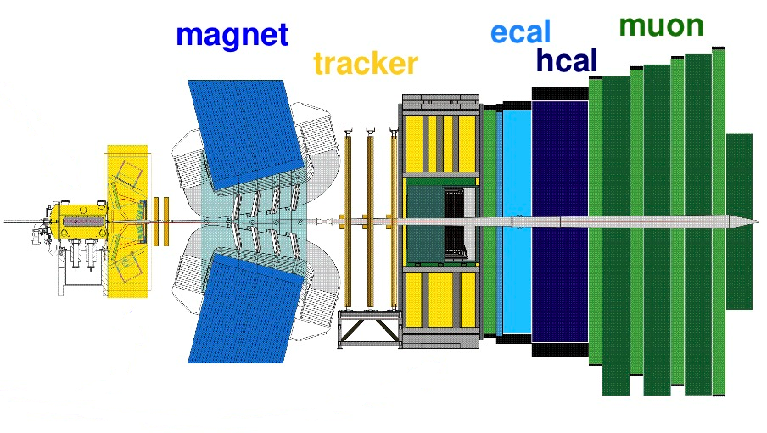
The LHCb Detector
Brasil, China,
France, Germany,
Ireland, Italy,
Netherlands, Pakistan, Poland, Romania, Russia, Spain, Switzerland, UK, Ukraine, US, CERN
~ 60 institutes
~ 750 members
> 100 papers
velo
rich1
rich 2
MWPC+GEM: π/μ separation

Slide 3
The LHCb Trigger
2012
11 MHz beam crossing rate
950 kHz L0 accept rate
(Search for high p_{T} μ, γ, e
and h candidates)
Hlt1: 80 kHz
(limited track reco and
impact parameter cuts)
Hlt2: 5 kHz
(more global event reco)
Also introduced “deferred” triggering; 25% gain in rate

Slide 4
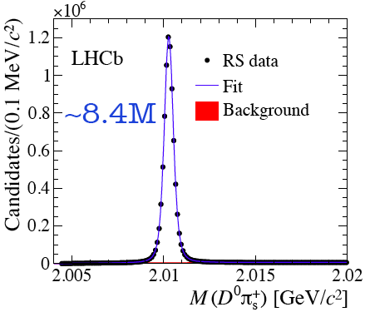
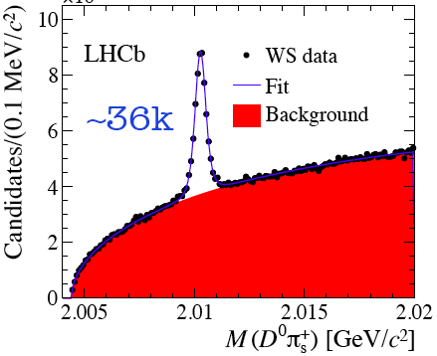

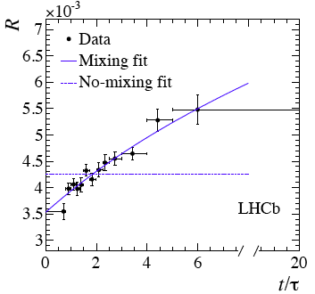
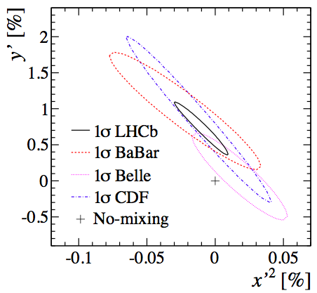
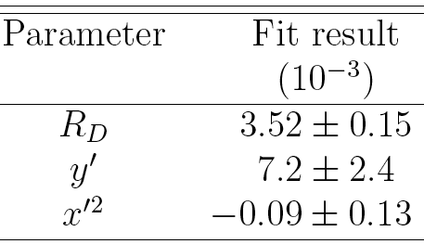
D⁰ – D⁰ oscillations
LHC is also a charm factory and charm is the only “up type” quark where we can search for NP
LHCb has the world’s largest sample of c-hadron decays in charged modes (x10 current B factories)
First observation of charm mixing in time dependent D⁰→Kπ RS & WS decays by a single measurement (9σ)
LHCb
PRL 110, 101802 (2013)

Slide 5
CP violation in charm decays
Charm is the only “up type” quark where we can search for NP
CP violation in SCS decays is a preferred place for studies (CPV ~ 0 expected in SM)
At the end of 2011 LHCb presented 3.5σ evidence for direct CPV in 0.6/fb sample
ΔA_{CP} = A_{CP}(KK) - A_{CP}(ππ)
based on D* prompt (with π soft tag)
In Moriond QCD2013 two new analyses were presented:
D* prompt sample, updated with full 2011 reprocessed data (1/fb)
D⁰ from a sample of B→D μ± X (1/fb) , with D⁰ flavor tagged by the sign of the μ
Independent samples, totally different systematics

Slide 6
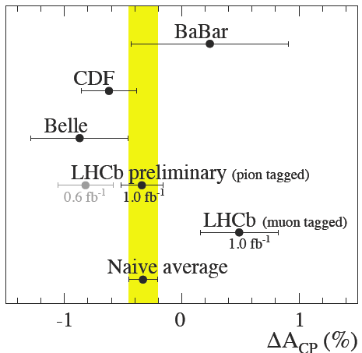


ΔA_{CP} with prompt D*
The result is closer to zero that the result in 2011, but the shift is consistent with originating from the larger statistics
LHCb-CONF-2013-003
ΔA_{CP} with semileptonic tag
arXiv:1303.2614
The results are statistically compatible (2.2 σ)
LHCb results combined
New preliminary world average
→ Previous evidence for CPV in charm not confirmed

Slide 9
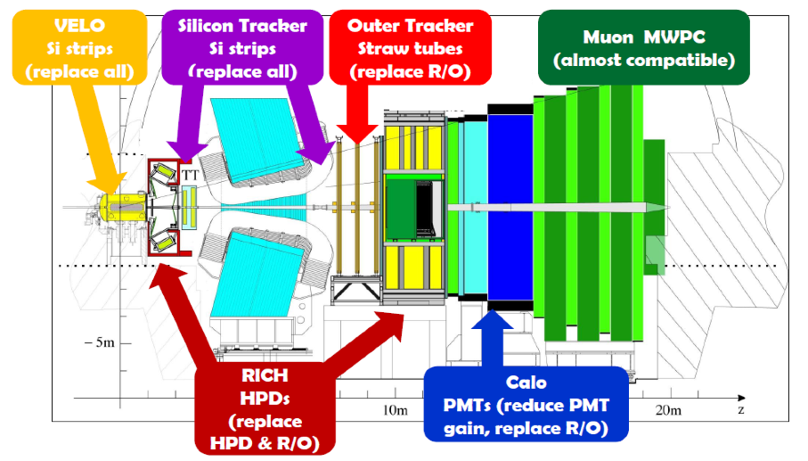
LHCb detector modifications for the Upgrade
VELO
Si Strips
(replace all)
Silicon Tracker
Si Strips
(replace all)
Outer Tracker
Straw Tubes
(replace R/O)
Muon MWPC
(almost compatible)
Alternative option:
Central Tracker (fibers)
RICH
HPDS
(replace
HPDs & R/O)
Calo
PMTs (reduce PMT gain, replace R/O)

Slide 10
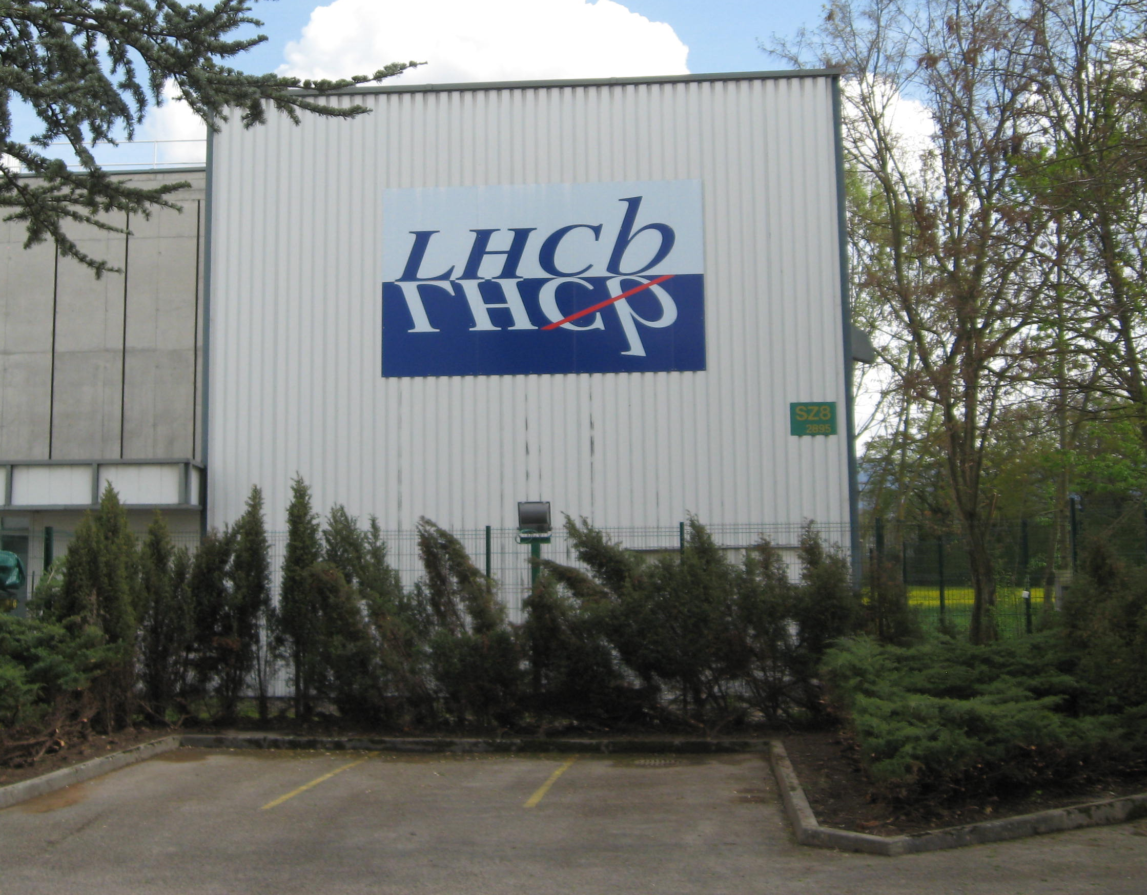
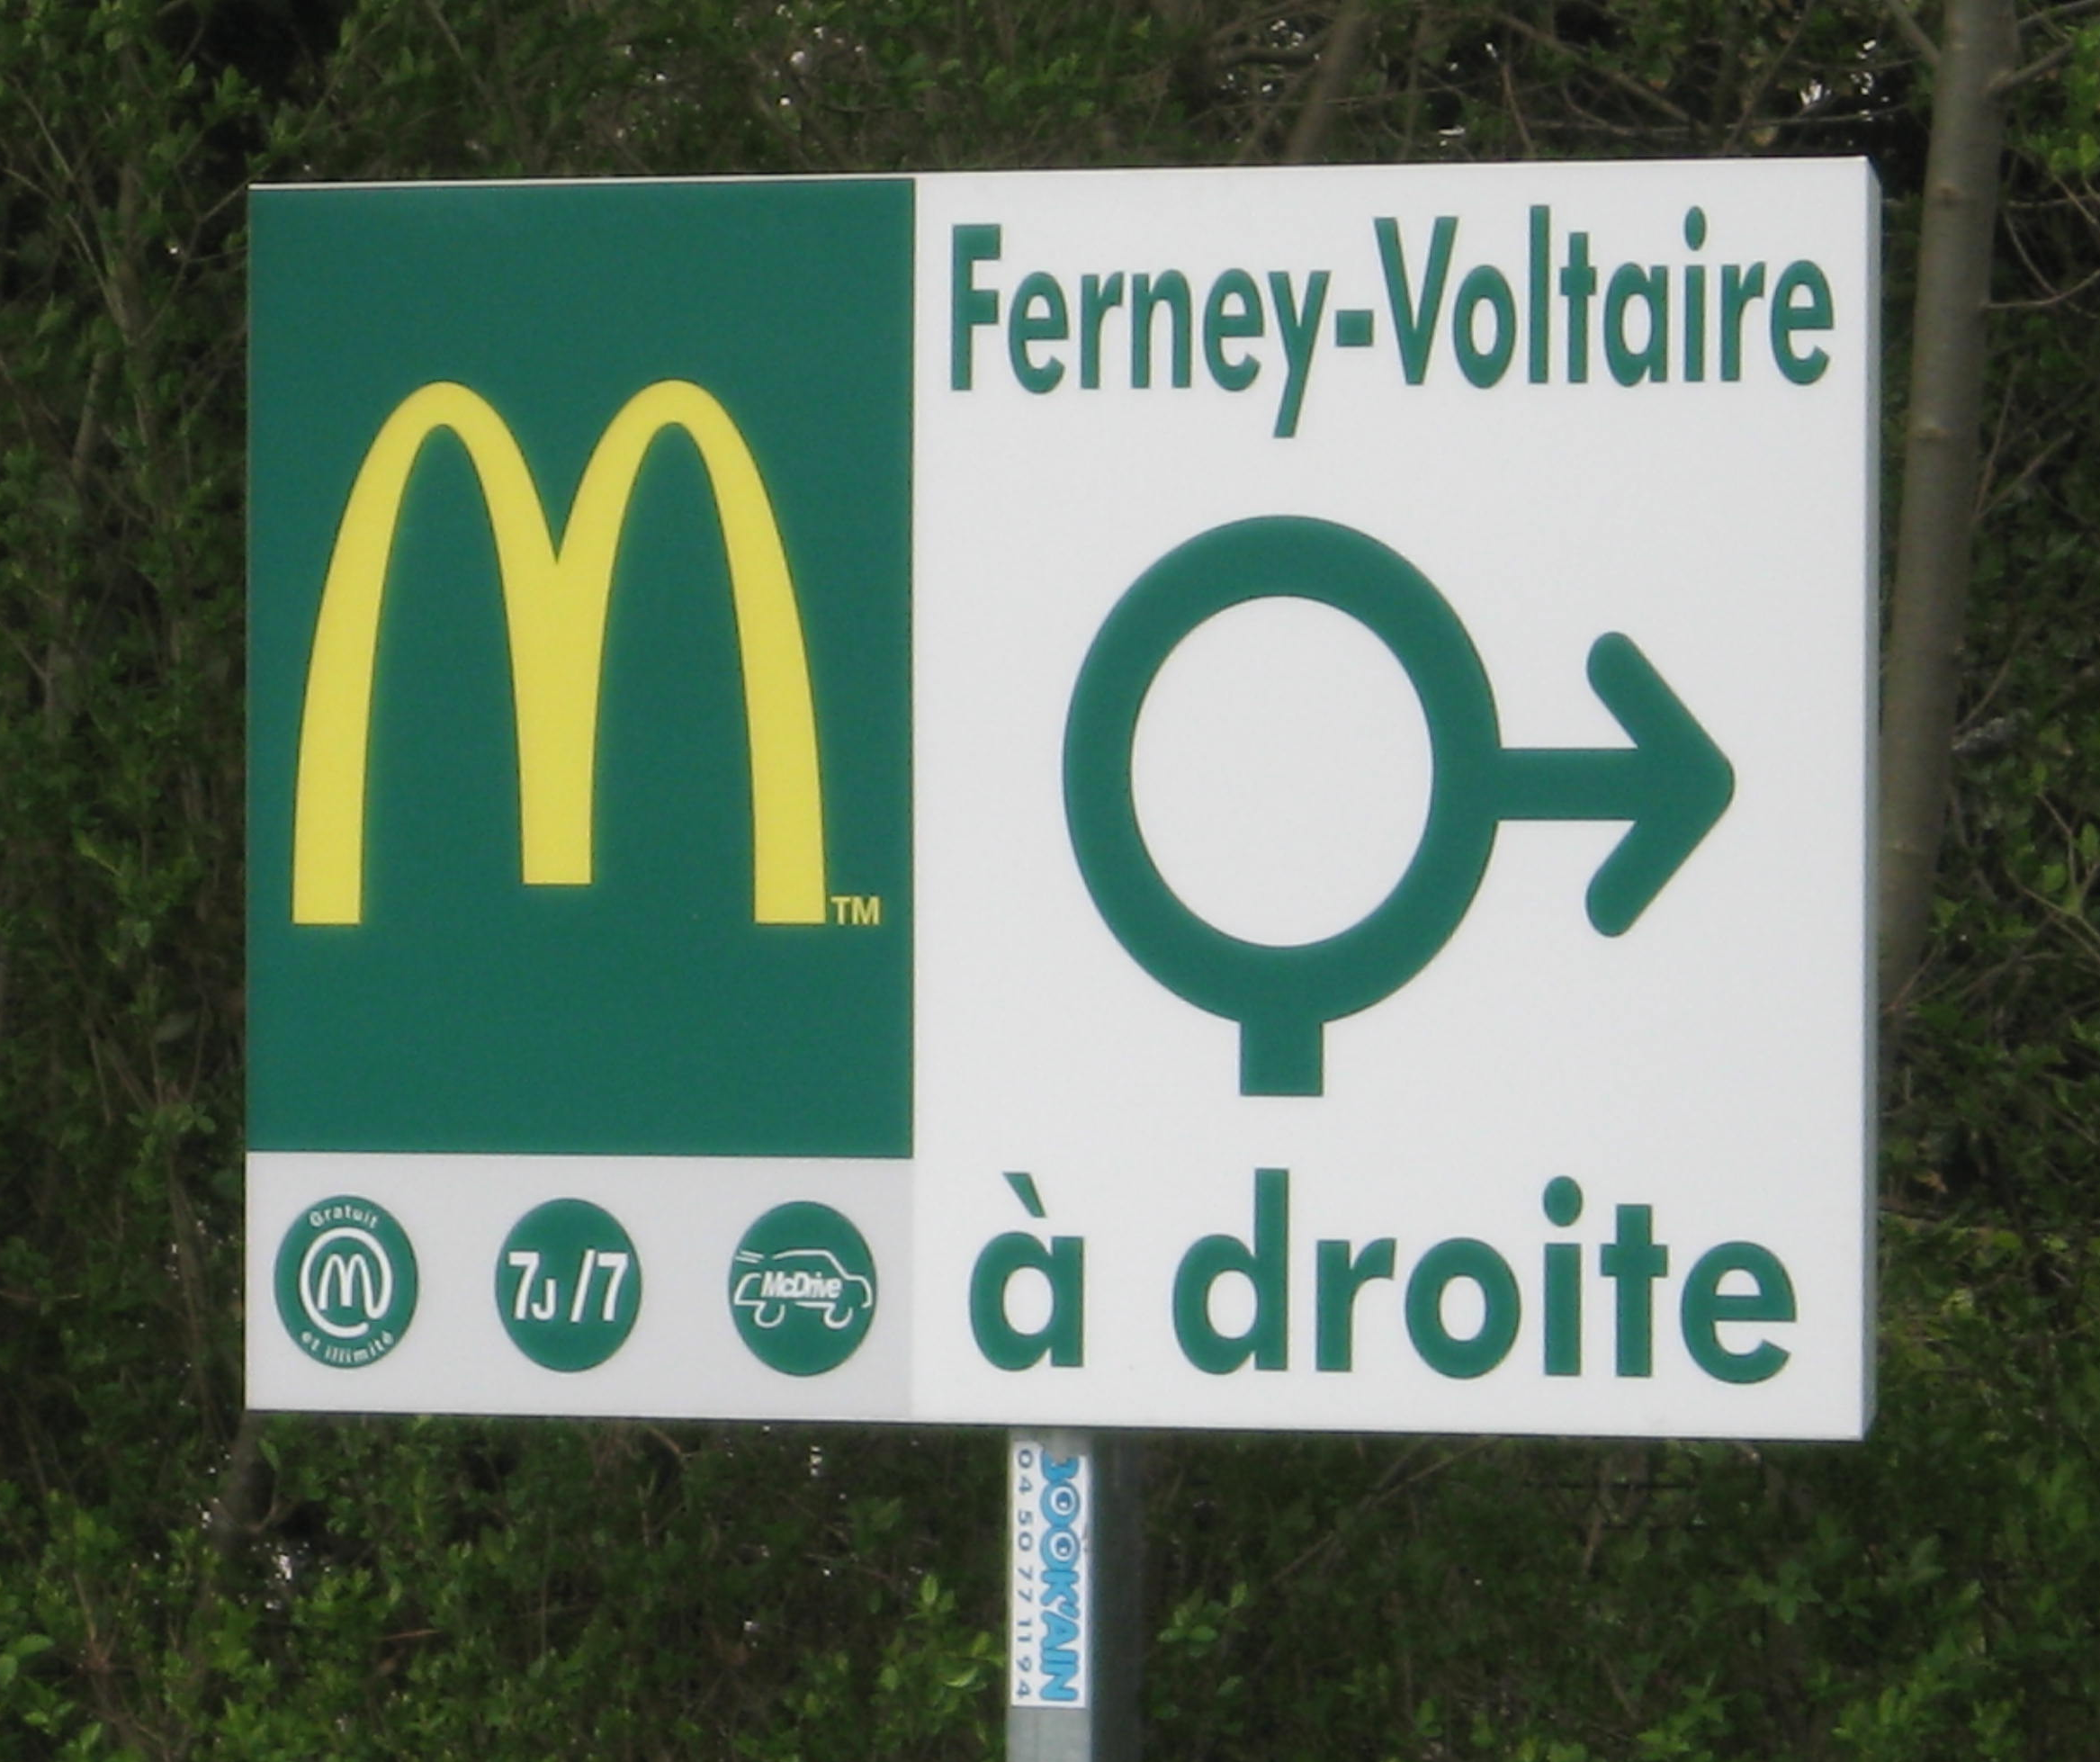
McDonalds, LHCb, & Charm Physics

Slide 12




Learning to Say Billions

Slide 13
Some Assumptions for the Upgrade Era
The starting points for signal yields are usually signals observed by LHCb in 2011 data, but there can be large variations depending on the cleanliness desired for a particular analysis.
The projected yields assume the integrated luminosity increases by a factor of 50, the charm cross section increases by a factor of 1.8, and that removing the L0 trigger increases the yield by a common factor of 2. Removing the L0 trigger may have a greater effect on higher multiplicity decays, but this remains to be demonstrated.
The projections for physics sensitivity are based on results from other experiments scaled by sqrt(n).
Projecting systematic uncertainties is challenging (a polite euphemism), so they are not quantified.
  My religious belief is that they can generally be controlled at the level of the statistical errors.
These assumptions need to be reviewed in detail, but the overall picture leads to some robust conclusions.

Slide 14
Some Quick Comments
I have probably made some mistakes projecting yields, statistical uncertainties, etc.
Event yields come from stripping level cuts which are generally looser than those used for analysis.
Statistical error sensitivity projections assume the same signal-to-background as in existing analyses. If future analyses require tighter selection criteria to control systematics, the statistical errors will be larger.

Slide 15
Projections for D⁰ Decays with 50 ab⁻¹

Slide 16
Projections for D⁺ and D_{S} Decays with 50 ab⁻¹

Slide 17
Relative Trigger x Reco Efficiencies

Slide 18
Measurements with D⁰ Decays with 50 ab⁻¹

Slide 19
CPV Measurements with D⁺ Decays with 50 ab⁻¹
Phase-space integrated CPV
Model-dependent amplitude Dalitz plot analyses
Model-independent Dalitz plot angular moments analyses
  About the same sensitivity as model-dependent analyses for the main resonant amplitudes

Slide 20
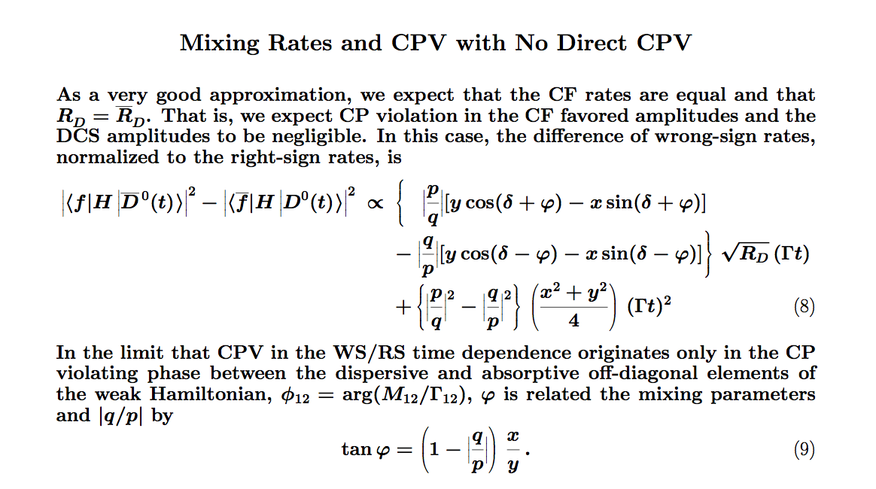
CPV in Wrong-Sign D⁰ → Kπ

Slide 21
Unofficial LHCb Statistical Sensitivities Circa 2015
Assume 5 fb⁻¹ @ 13 TeV; charm cross sections grow linearly with √s. Mostly scale from 2011/2012 analyses.
10⁶ WS D⁰ → Kπ
  (x’²,y’) ± (0.004, 0.08)%
  D⁰-D⁰ WS rate asymmetry (like |q/p|) ±1%
3.7 x 10⁶ D⁰ → K⁻K⁺, 1.7 x 10⁶ D⁰ → π⁻π⁺
  y_{CP}, A_{Γ} ± 0.02%
20 x 10⁶ D⁰ → K_{S}ππ
  (x,y) ± (0.045, 0.030)%
Many systematic uncertainties cancel in CPV measurements, e.g., A_{Γ} from D⁰ → K⁻K^{+.}

Slide 22
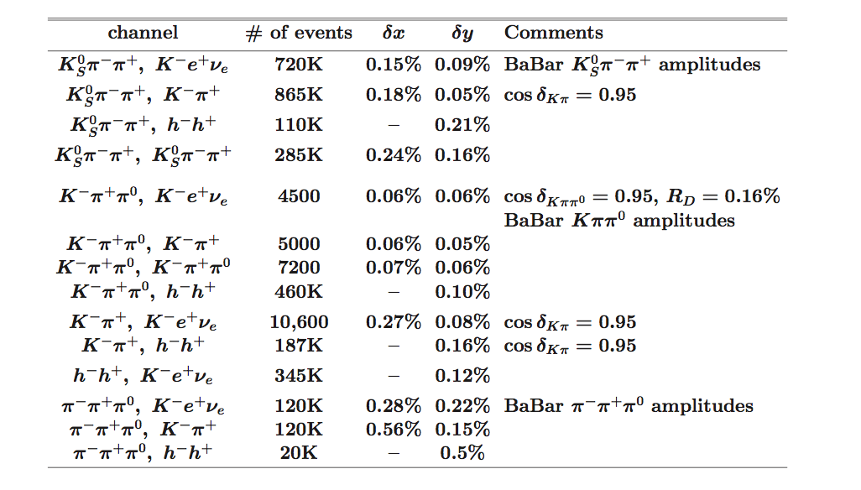
Mixing: As Good As It Gets with 500 fb⁻¹ at 3770

Slide 23
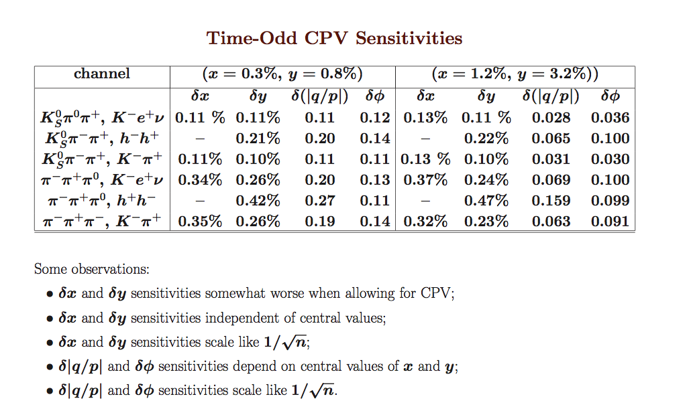
CPV: As Good As It Gets with 500 fb⁻¹ at 3770

Slide 24
Summary
LHCb is doing forefront charm physics with the 1st 1 fb⁻¹.
The next 2 fb⁻¹ are being analyzed. Signals in some channels have improved significantly due to trigger improvements.
Increased charm cross-sections and improved trigger performance will enhance charm per unit luminosity in the period 2015 – 2018.
Upgrade plans for post Long Stop 2 are progressing.
  Physics reach will increase sensitivities by up to an order of magnitude.
Stay tuned.

Slide 25
Backup Material

Slide 26
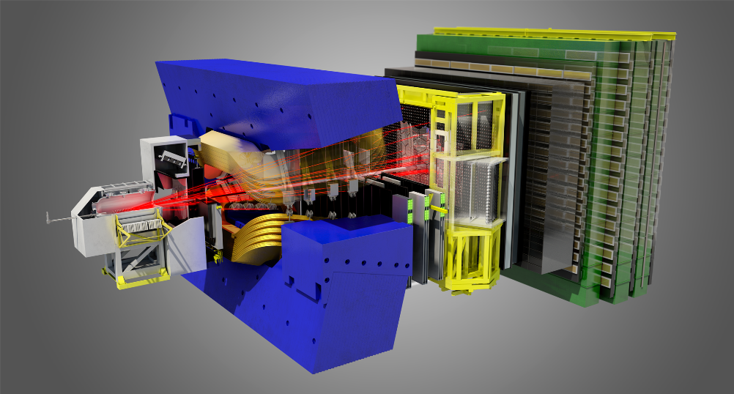
A Look at the Detector

Slide 28
 | 2011-12 | 2015 | 2016 | 2017 | 2018 ?
Collected Luminosity per year | 3/fb | 1/fb | 1.5/fb | 1.5/fb | 1.5/fb
Luminosity (scaled to 14 TeV) | 1.5/fb
Integrated Luminosity (14 TeV) | 1.5/fb | 2.5/fb | 4/fb | 5.5/fb | 7/fb
Statistics w.r.t. 2011-12 |  | X 1.7 | X 2.7 | X 3.7 | X 4.7
LS1.5 ?
LS2 ?
LS2 ?

Slide 29
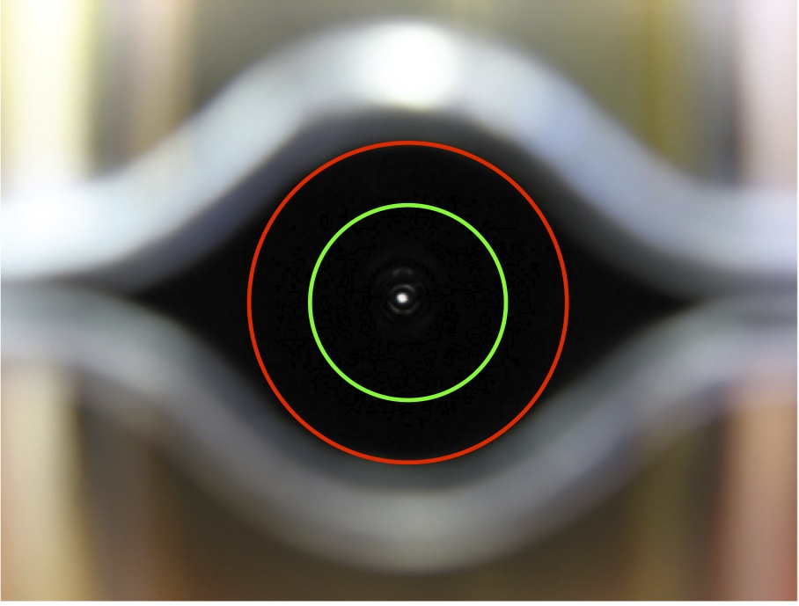
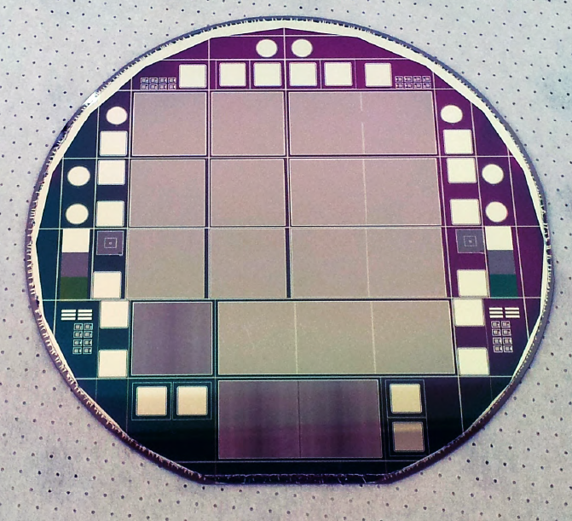
VELO upgrade
Now 5.5 mm
Important progresses on several items:
New apertures studies → smaller beam pipe (approved by LMC) will allow better IP resolution
R&D on micro-channel cooling well advanced (critical item for both solutions), but studies continuing also on more standard option
RF foil samples machined in Nikhef with new technology (goal: 0.15 mm thickness)
Sensor studies and tests (Pixel and Strips)
Modules 0 prototyping and simulations ongoing
Upgrade 3.5 mm

Slide 30
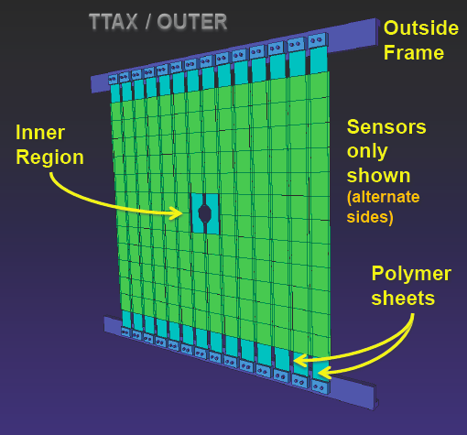
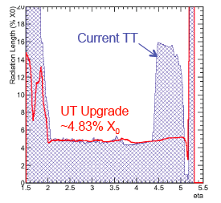
Trigger Tracker upgrade
  Trigger Tracker (silicon detector) of vital importance to:
  give first measurement of p in HLT
  K_{s} and Λ reconstruction
  remove track ghosts
  Technological challenges:
  long ladders (cooling, mechanics)
  coverage at low η
  low material budget
  Optimizing the current layout to profit from magnetic field, to measure momentum of tracks
  Custom chip (SALT) under preparation: 2 foundry submissions already completed, 3rd (with FE and ADC blocks) ready by mid 2013

Slide 31
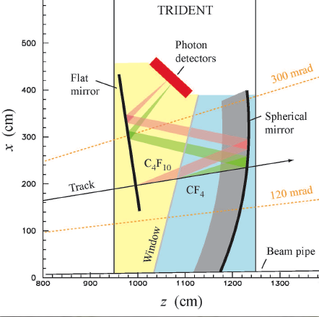
RICH upgrade
Currently two options under evaluation:
Modification of the current RICH 1 optics to cope with high occupancy : sizeable increase in the amount of PM
Integration of RICH 1&2 in a single vessel (TRIDENT, which could host in LS3 the TORCH for the low momentum PID) : more photon yield, less PM but a new mechanical structure
Detailed studies on performances, costing and feasibility undergoing
Roadmap toward a decision on RICH layout :
April 4th, first review of options
4 reviewers appointed (2 external)
June 2nd , RICH review meeting
June 20th , proposal for ratification to the LHCb TB
Several other activities ongoing on :
optoelectronics chain
FEE chip developments and tests
PM characterization
mechanics

Slide 32
CALO
SPD&PS removed (less material in front of ECAL)
Adaptation of ECAL and HCAL FEE electronics for 40 MHz operation is well advanced
(in particular FE ASIC design to reduce PM gain)
Study of radiation hardness of inner ECAL modules for operation at 2 10³³cm⁻²s⁻¹ : possibility of their replacement (test undergone during 2012-13 data taking)
MUON
Removal of M1 (due to occupancy)
Adaptation of off-detector electronics for 40 MHz operation – decision taken to remove all legacy-based elements
Extensive tests made with special runs: high occupancy rates in inner regions do not affect severely the muon id and some benchmark channels
Smaller size logical pads could be necessary at high luminosity (not in baseline solution)
Electronics & Data Processing
External review of “Readout Architecture” successfully passed in December 2012
Readout board projects (TELL40 & TFC) very well advanced
Intense work on trigger (LLT+HLT) and on farm online architecture. Several new ideas under test/evaluation (HLT splitting, low level track triggers, use of GPU, use of PCIe)
Studies on computing framework for the upgrade
Machine interface
LMC gave ok on reducing VELO radius. Operation of LHCb at upgrade compatible without installation of TAS.

Slide 33
Precise Measurement of D⁰ Mass and D Meson
Mass Differences arXiv:1304.6865
Momentum scale systematics tend to dominate D⁰ measurements.
M(D⁰) = (1864.75±0.15±0.11) MeV/c² based on D⁰ → K⁻K⁻K⁺π⁺
[best previous measurement (1864.85±0.18) MeV/c²]
M(D⁺) – M(D⁰) = (4.76±0.12±0.07) MeV/c²
[best previous measurement(4.7±0.3) MeV/c²]
M(D_{s}) – M(D⁺) = (98.68±0.03±0.04) MeV/c²
[best previous measurement (98.4±0.3) MeV/c²]

