Slide 1




τ/charm Accelerator Overview
M. Biagini, INFN-LNF
on behalf of the τ/charm Accelerator study group
Elba Meeting, May 27th 2013

Slide 2
Outline
From SuperB to tau/charm
Tau/charm main features
Beam parameters
Rings layout
Rings lattice
Injection system
Workshop agenda
Conclusions

Slide 3
From SuperB to τ/charm
It is a natural evolution of the SuperB project, once established that the budget allocated was not sufficient to entirely cover its construction and operation, to have a transition to a smaller and cheaper, but still frontline, accelerator such as the Tau/charm
The new design is based on a symmetric beams collision. This makes the design a lot simpler. For example, for SuperB a state-of-the-art design of the first superconducting quadrupole doublet in the Final Focus, able to cope with the high gradients required and the small space available was developed. For the Tau/charm this elements will have more relaxed characteristics, and the symmetric FF will easy the design

Slide 4
From SuperB to τ/charm
Most of the work done for SuperB can still be used for the Tau/charm project, making the “downgrade” a more easy and fast job. Tools which have been “ad hoc” created for SuperB can be readapted and all the experience gained will make the design process easier and faster
The scope of the present design is to have a dedicated and optimized project, re-using all the competences, studies and tools developed for SuperB, keeping costs in the allocated budget (250 Meuro)
The possibility to use the injection Linac for a SASE FEL facility is still valid and is part of the design

Slide 5
Accelerator study group
LNF team
CabibboLab team
M. Biagini
M. Boscolo
A. Chiarucci
A. Clozza
A. Drago
S. Guiducci
C. Ligi
G. Mazzitelli
R. Ricci
C. Sanelli
M. Serio
S. Tomassini
S. Bini
F. Cioeta
D. Cittadino
M. D’Agostino
M. Del Franco
A. Delle Piane
E. Di Pasquale
G. Frascadore
S. Gazzana
R. Gargana
S. Incremona
A. Michelotti
L. Sabbatini
ESRF & Pisa team
P. Raimondi
S. Liuzzo
E. Paoloni
LNS team
G. Schillaci
M. Sedita

Slide 6
τ/charm Factory main features
Energy tunable in the range E_{cm} = 1-4.6 GeV
10³⁵ cm⁻² s⁻¹ peak luminosity at the τ/charm threshold and upper
Symmetric beam energies
Longitudinal polarization in the electron beam (60-70%)
Possibility of e⁻e⁻ collisions (to be studied)
Beam parameters for reasonable lifetimes and beam currents
Damping times of the order of 30-50 msec (wigglers are needed at lower beam energy)
Low power consumption → lower running costs
Injection system scaled from the SuperB one

Slide 7
Beam parameters
Beam parameters to reach a baseline luminosity of 10³⁵ cm⁻² s⁻¹ @ 2 GeV/beam have been chosen
An upgrade to 2x10³⁵ cm⁻² s⁻¹ can be possible by increasing the beam current
Design features are the same as for the SuperB design:
  “Large Piwinski angle & crab waist sextupoles” collision scheme
  Low H-emittance lattice
  Small H-V coupling → ultra low V-emittance
  Small IP β functions and beam sizes
  Beam-beam tune shifts < 0.1
  Same RF frequency as PEP-II (re-use of cavities)
  Low beam power

Slide 8
Table of parameters
@ 2 GeV/beam for L = 1x10³⁵ and 2x10³⁵
Parameter | Units
LUMINOSITY | cm⁻² s⁻¹ | 1.00E+35 | 2.00E+35
cm Energy | GeV | 4.0 | 4.0
Beam Energy | GeV | 2.0 | 2.0
Boost |  | 0 | 0
Circumference | m | 330.16 | 330.16
X-Angle (full) | mrad | 60 | 60
Hourglass reduction factor |  | 0.87 | 0.86
Tune shift x |  | 0.004 | 0.005
Tune shift y |  | 0.088 | 0.119
β_{x} @ IP | cm | 6 | 6
β_{y} @ IP | cm | 0.06 | 0.06
σ_{x} @ IP | microns | 17.56 | 18.35
σ_{y} @ IP | microns | 0.088 | 0.092
Coupling (full current) | % | 0.25 | 0.25
Emittance x (with IBS) | nm | 5.14 | 5.61
Emittance y (with IBS) | pm | 12.8 | 14.0
Bunch length (with IBS) | mm | 6.9 | 7.2
Beam current | mA | 1735 | 2565
Buckets distance | # | 1 | 1
Ion gap | % | 2 | 2
RF frequency | Hz | 4.76E+08 | 4.76E+08
Revolution frequency | Hz | 9.08E+05 | 9.08E+05
Harmonic number | # | 524 | 524
Number of bunches | # | 513 | 513
Bunch current | mA | 3.38 | 5.00
N. Particle/bunch | # | 2.33E+10 | 3.44E+10
E loss/turn | MeV | 0.09 | 0.09
Beam power | MW | 0.16 | 0.24
Trans. damping time (no wigg) | msec | 34/48 | 34/48
Tau depolarization | sec | 1435 | 1435
Polarization | % | 62 | 65
The baseline design is for L=10³⁵, with possibility to increase currents to reach 2x10³⁵ cm⁻² s⁻¹
Intra Beam Scattering and Hourglass factors are included
Beam power is about 15 times less than the SuperB baseline one (4 MW (HER) and 2MW (LER) of RF power)
Note: in the luminosity formula there is a +5% factor (by D. Shatilov simulations)
In evolution

Slide 9
Rings layout
The equal beam energies simplify the design with respect to the SuperB one, and result in a more compact and cheaper complex
One Siberian Snake (SS) in the electron ring will rotate the spin to have longitudinal polarization at the IP (in SuperB this was accomplished by 2 Spin Rotator sections). The polarization is optimal (about 65%) at 2 GeV
The magnetic structure of the two rings is identical, except for the SS insertion in the electron ring, installed in the long straight section opposite to the IP
The rings will cross with a large horizontal crossing angle both at the IP and at the point opposite to the IP. The geometry of the two rings crossing is in progress

Slide 10
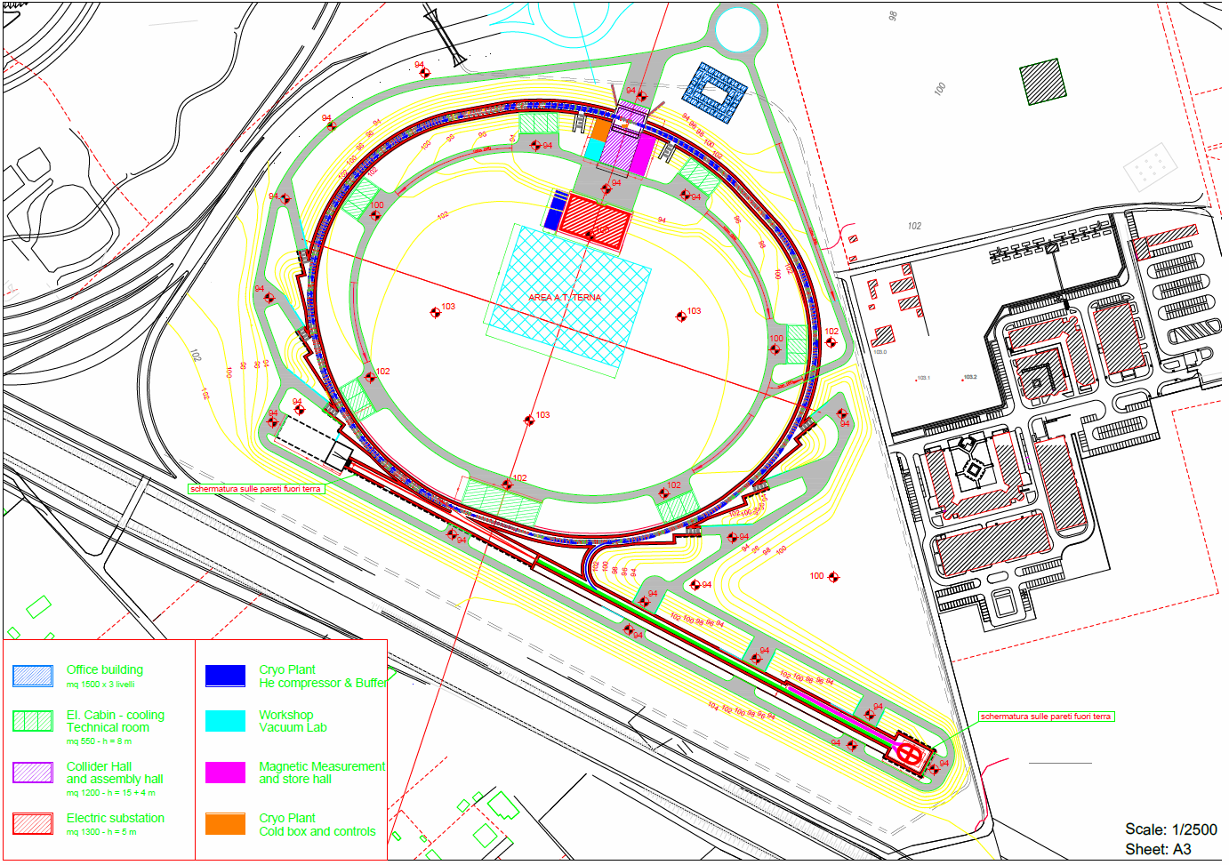
Super-B Layout @ Tor Vergata

Slide 11
Tau-Charm Layout @ Tor Vergata

Slide 12
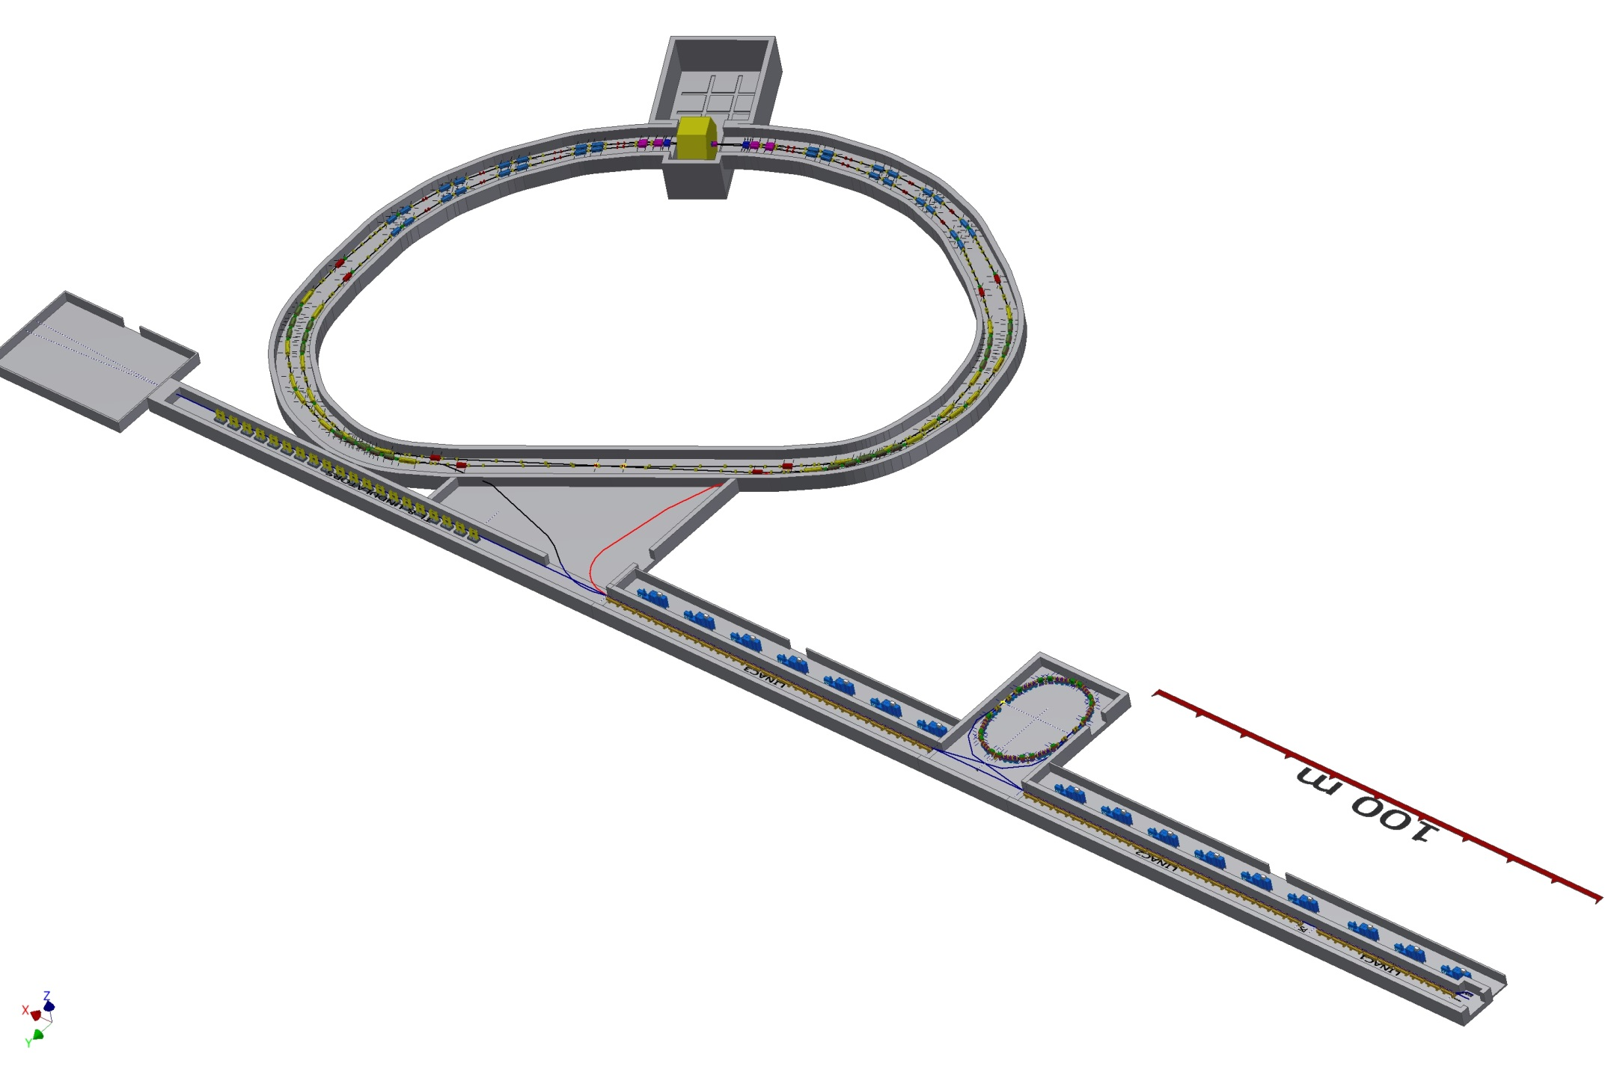
τ-charm complex view
IP
Storage Rings
(preliminary)
FEL OPTION
Damping Ring
TLs
LINAC
Talk by E. Di Pasquale

Slide 13
Rings lattice @ 2 GeV
The lattice has to provide the minimum emittance in order to reach the goal luminosity
The arcs layout is similar to the SuperB lattice
The number of magnets and their layout is similar to the ESRF arc cell
Some of the dipoles have a gradient component, so X and Y damping times are different
The Final Focus has been re-optimized for the lower energy and to have beams passing as much as possible on-axis in the first doublet to avoid SR in the detector. Particular care is taken to cancel as much as possible non-linearities between the crab sextupoles
The present FF design includes octupoles to compensate for the first doublet fringing fields
Optimization of the dynamic aperture, also with errors, is in progress
Tolerances to magnet errors have been studied and a table of acceptable values produced
Details in Raimondi’s, Liuzzo’s and Paoloni’s talks tomorrow
In evolution

Slide 14
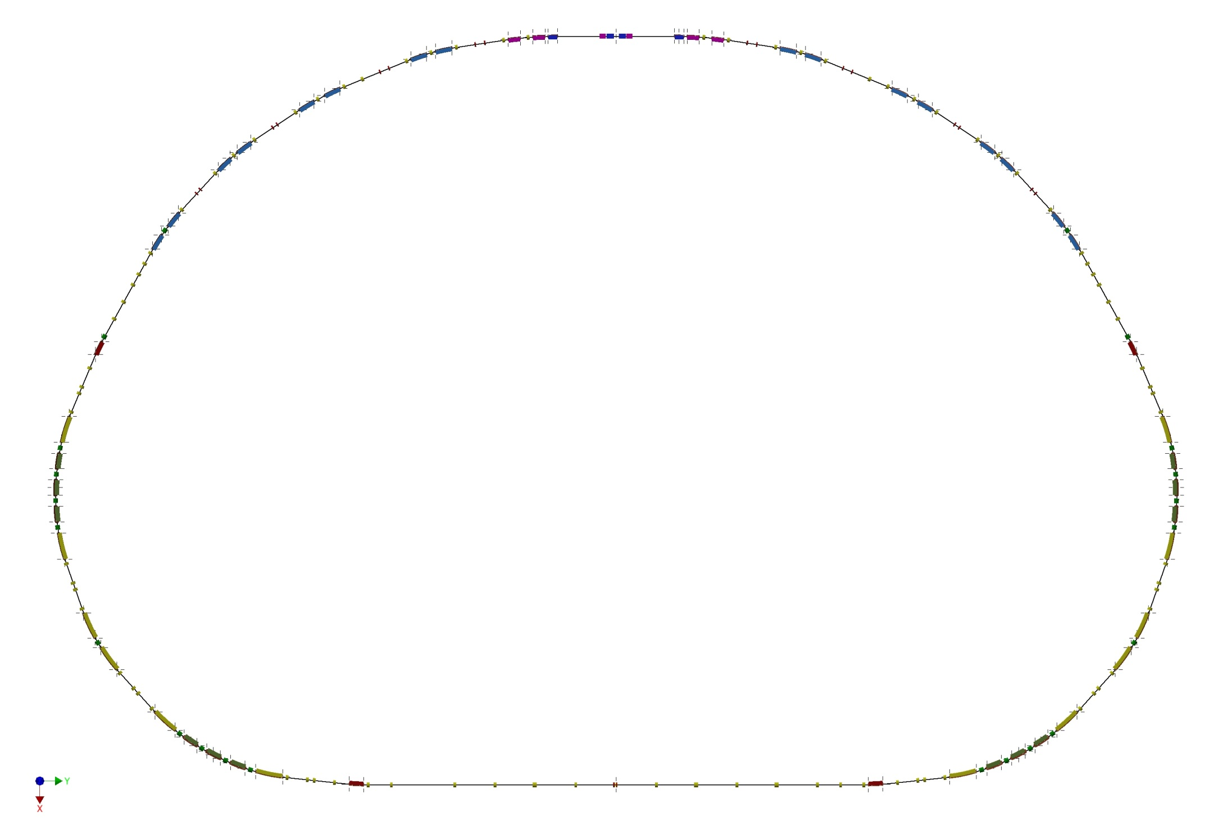
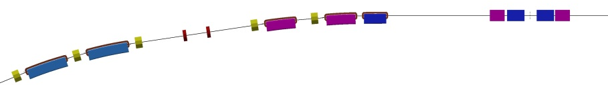
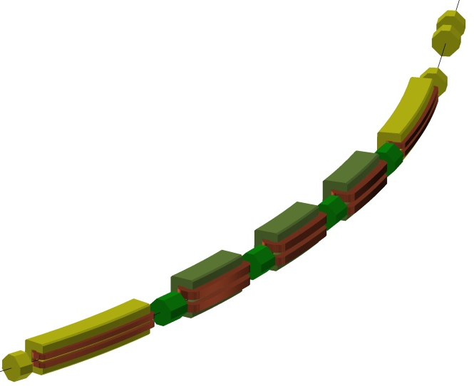
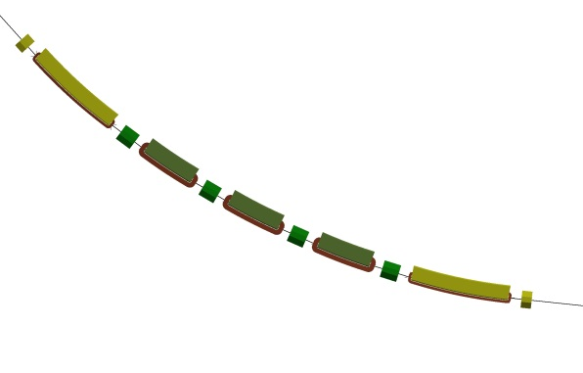
Main Rings layout
IP

Slide 15
Positron Ring
In evolution

Slide 16
Max Amplitude X and Y versus tune
Good Point: (0.595,0.56), below half integer
Good Point: (0.525,0.595), above half integer
Good Point: (0.56,0.595), above half integer
With fringe fields. With Errors. Tune changed with matching routine.

Slide 17
Dynamic Aperture at Best Points
different errors set

Slide 18
IR layout
Preliminary IR layout, estimation of radiation and apertures in the first doublet
In evolution
E. Paoloni

Slide 19
Estimation of tolerance to errors
Lattice manipulations and correction scheme
BPM
Correctors H and V
Skew quadrupoles
Girders (hypothetical)
Merged Magnets (sextupoles and quadrupoles)
Tune changed (Q_{x}, Q_{y}) : (0.6, 0.6) -> (0.58, 0.62)

Slide 20
Errors studied
Misalignments (quad, sext, girders)
Rotations about z (quad, girders)
Integral field errors (dipoles, quad, sext)
All are taken from a truncated Gaussian (2 sigma)
dipole
quadrupole
misalignment
pinch
roll
sextupole
Girder
ensamble

Slide 21
Final Chosen tolerated Values
Error kind | Studied | Allowed
Dipole field | 10^-4 | 10^-4
Dipole rotation | 400 μrad | 300 μrad
Girder Rotation | 400 μrad | 350 μrad
Girder DX | 200 μm | 200 μm
Girder DY | 200 μm | 130 μm
Quadrupole field | 2*10^-4 | 2*10^-4
Quadrupole rotation | 400 μrad | 150 μrad
Quadrupole DX | 100 μm | 100 μm
Quadrupole DY | 100 μm | 90 μm
Sextupole field | 2*10^-4 | 2*10^-4
Sextupole DX | 100 μm | 100 μm
Sextupole DY | 100 μm | 100 μm
BPM offset X and Y | 100 μm | 100 μm
In evolution

Slide 22
First design of MR magnets
Dipole
Gradient dipole
C. Sanelli

Slide 23
Tau-Charm Injection System
The preliminary layout of the injection system is based on the design of the SuperB injection system
The same design for the linac and damping ring lattice is used
The main difference with respect to the SuperB design is the fact that only positrons are stored in the Damping Ring (DR)
As for the SuperB case, the linac can be used to accelerate electron pulses for an FEL synchrotron light source
Details in S. Guiducci’s talk

Slide 24
Tau-Charm Injection System
Bunch Compressor
Polarized gun
Positron Source
Gun
DR
SHB
e⁺
FEL Line
Gun
0.6 GeV
1.0 GeV
1.3 GeV
e⁻
e⁻
FEL photoinjector
Linac L1
e⁻
Linac L2
Linac L3
Bypass
e⁺
Total electron linac energy 2.9 GeV
Total positron linac energy 2.3 GeV
To MRs
 | Linac L1 | Linac L2 | Linac L3
N. of klystrons | 3 | 6 | 7
N. of cavities | 9 | 18 | 21
Max. Energy (GeV) | 0.62 | 1.24 | 1.45
The number of klystrons and cavities allows to reach the maximum positron energy of 2.3 GeV also with one klystron off

Slide 25
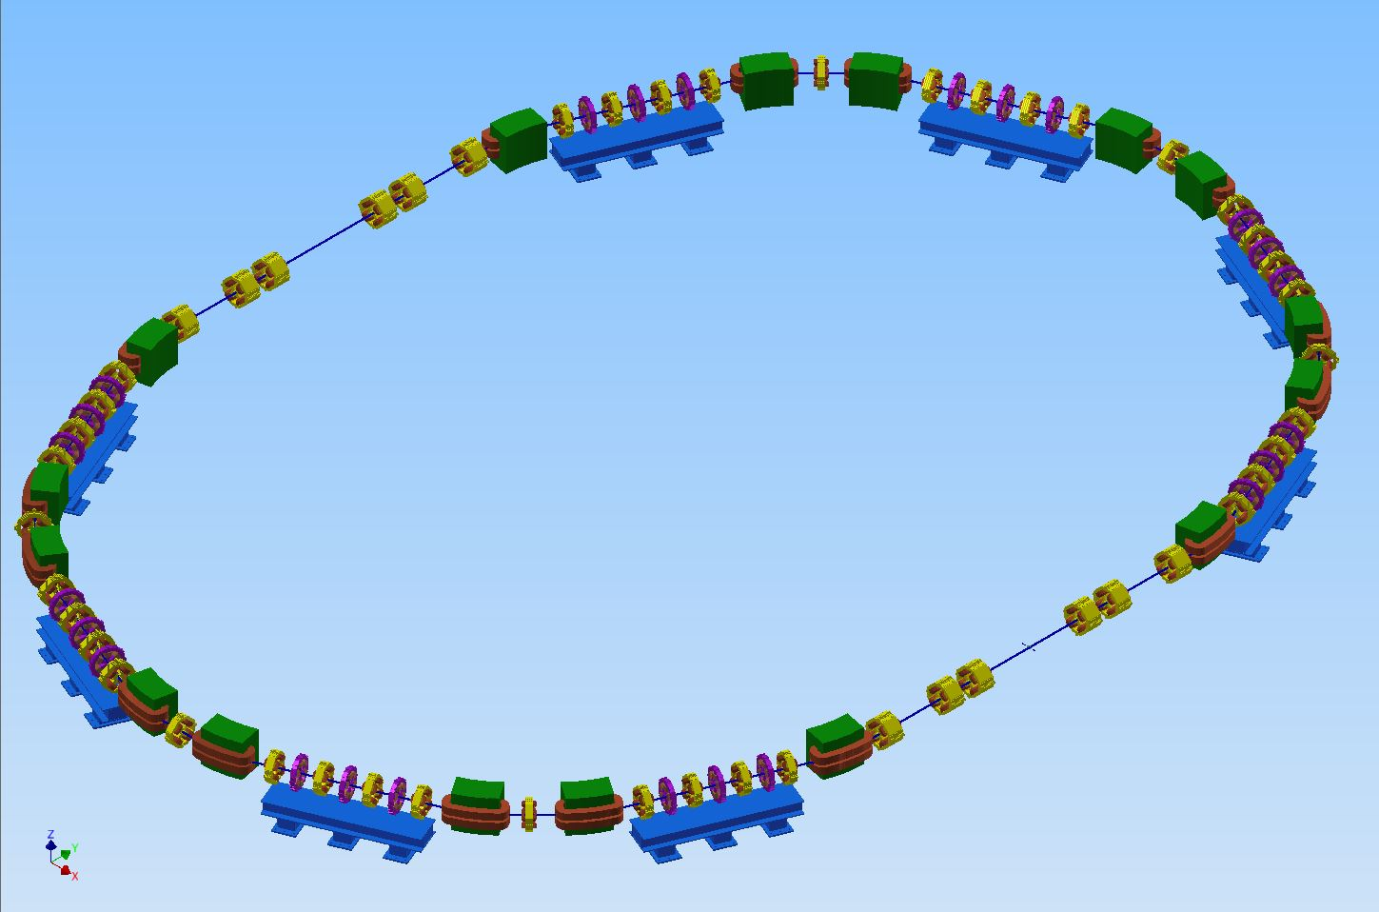
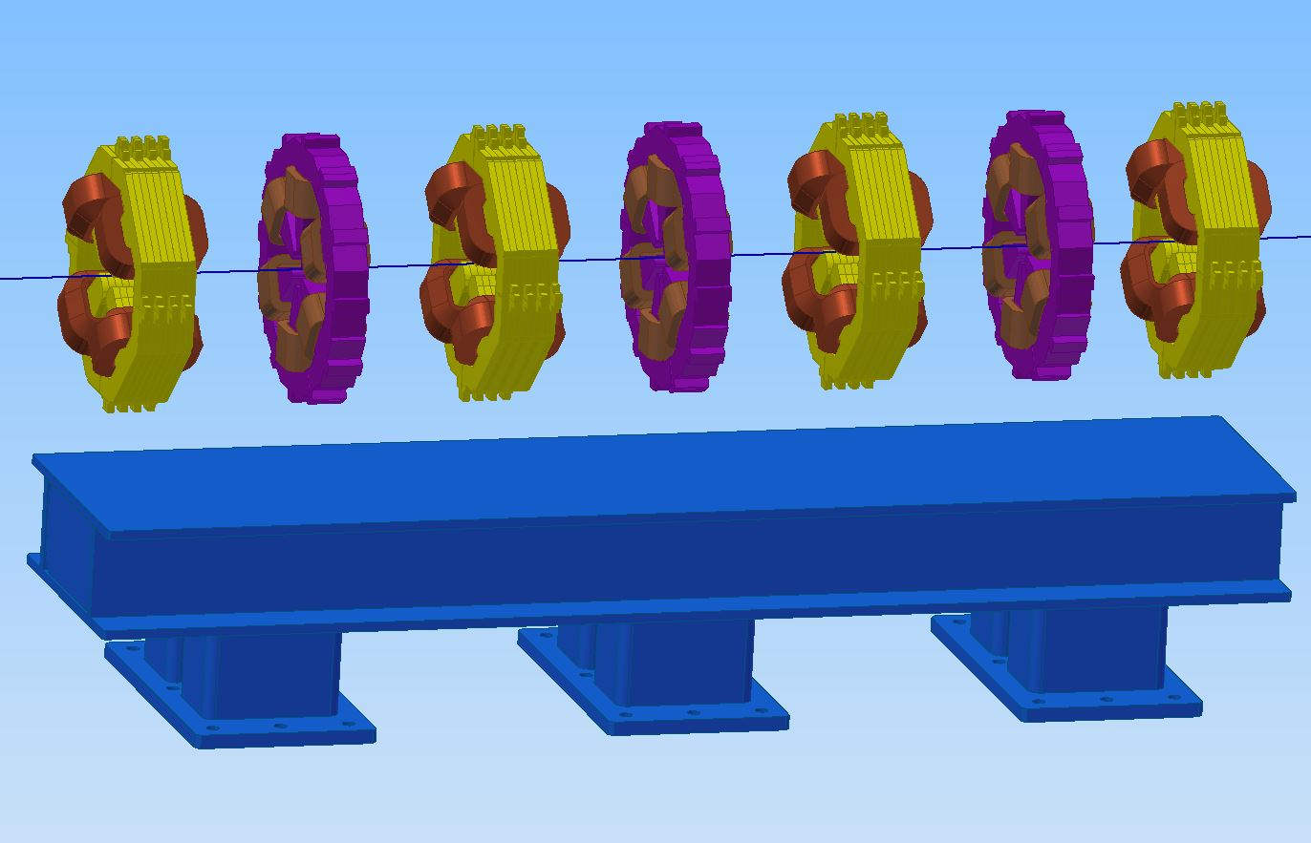
Positron Damping Ring
The preliminary magnetic layout of the damping ring is completed
The mechanical design of magnets and supports is in progress
The mechanical layout is ready for next step: vacuum, diagnostic, radio frequency, survey and alignment

Slide 26
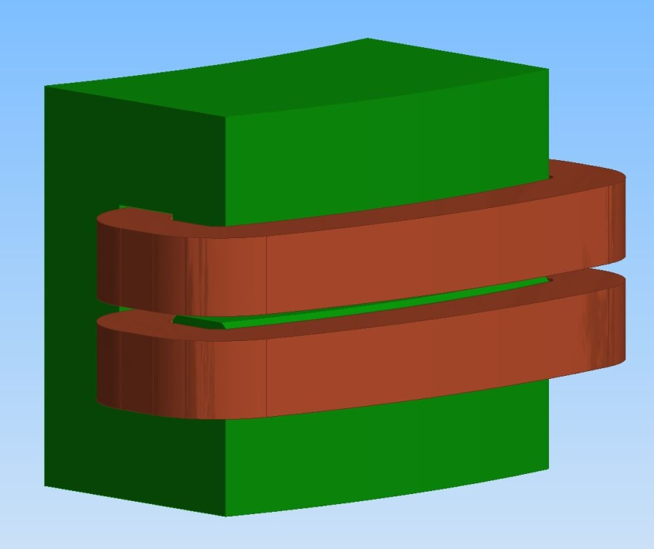
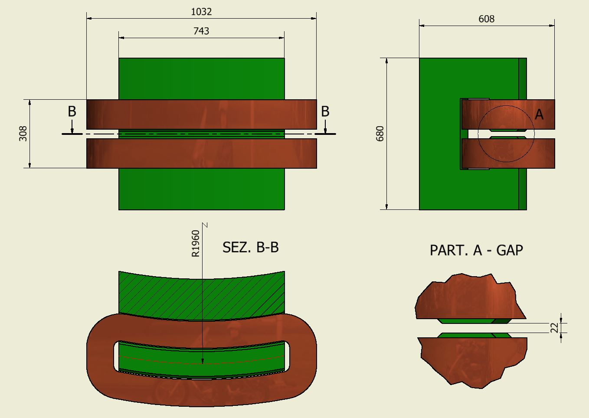
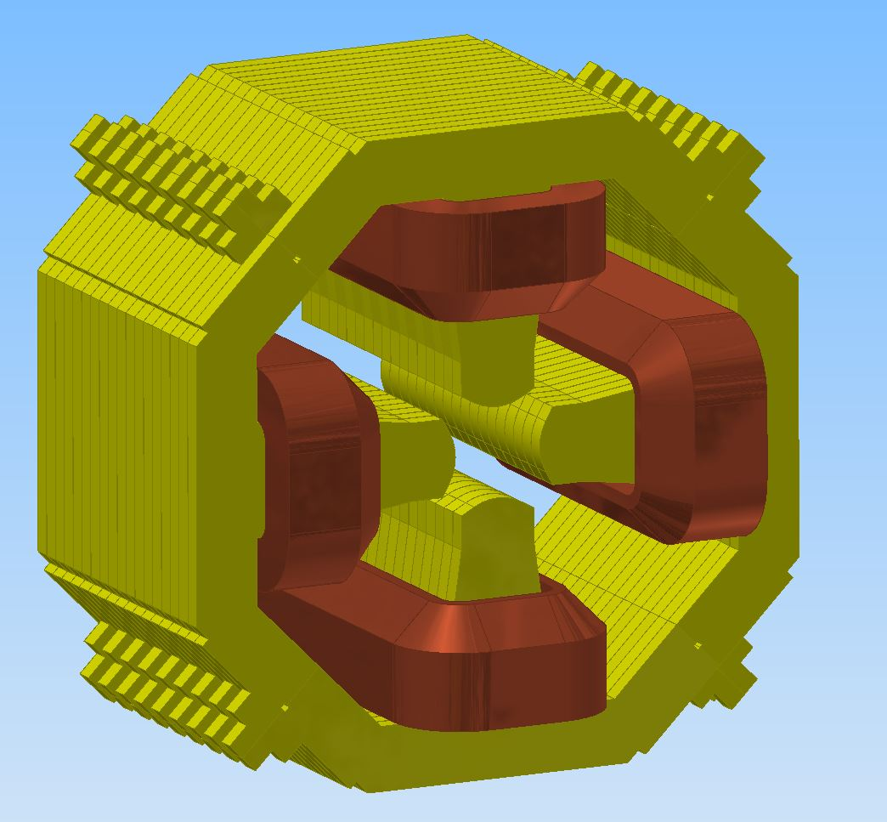
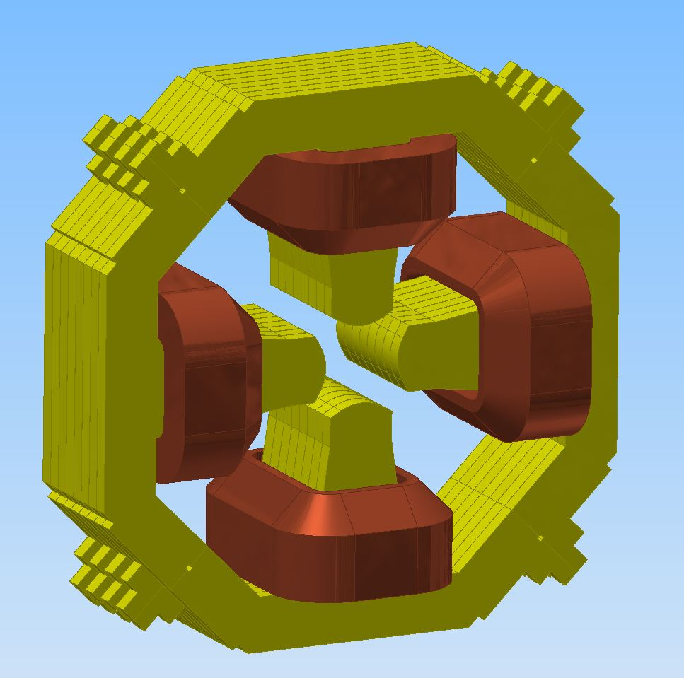
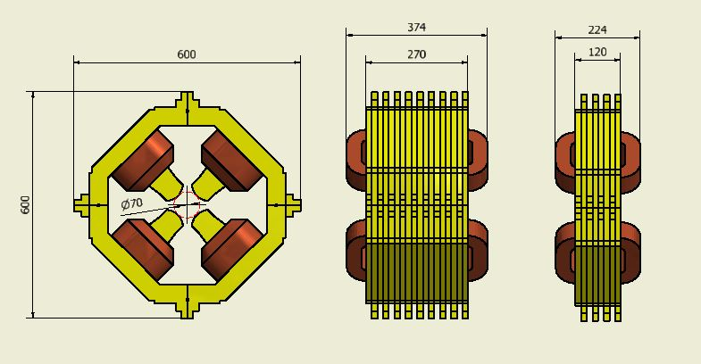
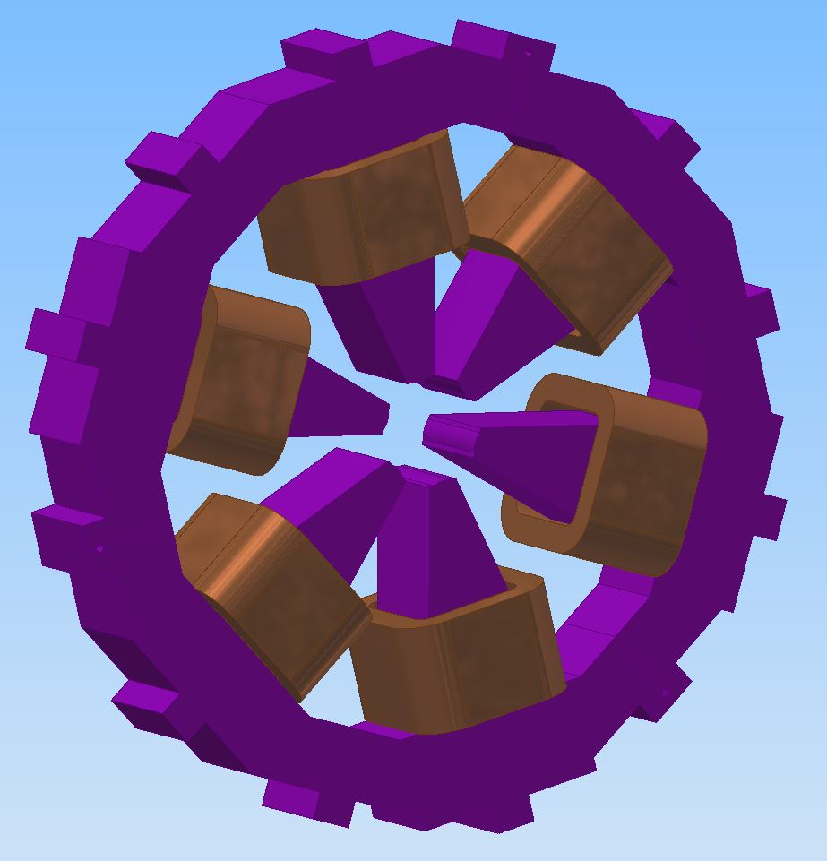
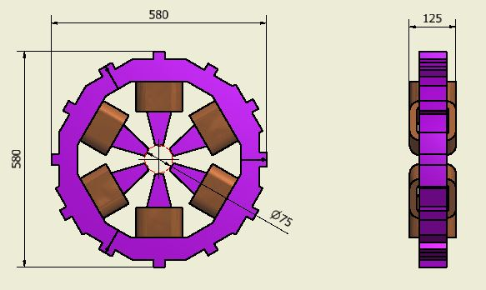
DR magnets design
Dipoles
Long
And short
Quadrupoles
Sextupoles

Slide 27
This workshop
Plenary talks today on similar accelerators by our BINP, IHEP, KEKB colleagues
Parallel sessions mainly focused on discussing lattice, layout and polarization issues
Some technical talks on preliminary estimations of subsystems
P. Raimondi (ESRF) Lattice overview
P. Raimondi (ESRF) Reduction of the doublets fringe field effects
A. Bogomyagkov (BINP) Concept of compact e+e- factory
with beam energy from 0.5 GeV to 2 GeV
S. Liuzzo (ESRF) Dynamic aperture
S. Liuzzo (ESRF) Errors tolerances
E. Paoloni (PI) First doublet design
M. Pivi (IMS) e-cloud instability and remediation techniques
Round Table discussion on lattice and layout
Polarization issues
M. Boscolo (LNF) Lifetimes
S. Guiducci (LNF) Injection system
A. Drago (LNF) Feedbacks
C. Sanelli (LNF) Methodology of the costing estimate
A. Michelotti (CabibboLab) Controls !CHAOS
E. Di Pasquale (CabibboLab) Mechanical Layout
F. Cioeta (CabibboLab) Vacuum system
M. Del Franco (CabibboLab) Alignments

Slide 28
Conclusions
A design for a Tau/charm factory is in progress, based on the previous work done for the SuperB Factory
A consistent set of parameters has been found for a baseline luminosity of 10³⁵ cm⁻² s⁻¹ @ 4 GeV cm energy, with possibility to increase currents to reach 2x10³⁵ cm⁻² s⁻¹
Preliminary layout and lattice have been studied
Interaction Region layout and backgrounds evaluation has started
Injection system was re-scaled and adapted
Study of the technical aspects and engineering has just started, needs a consolidated lattice
We need to cover some competences, such as impedance budget, RF, magnets, tracking, instabilities…
We hope to be able to produce by Summer a short document on the accelerator design

