Slide 1
CluCou an ultra-low mass
Drift Chamber with
Particle Identification capabilities
F. Grancagnolo
INFN – Lecce
Workshop on Tau-Charm at High Luminosity
Elba 26÷31/05/2013

Slide 2
outline
Mu2e drift chamber: an inspiring example
New materials and a new assembly technique
A proposal for a Flavor Factory
Expected performance
A bonus: Particle Identification
An extra bonus: Trigger
A hint for a high precision muon spectrometer

Slide 3
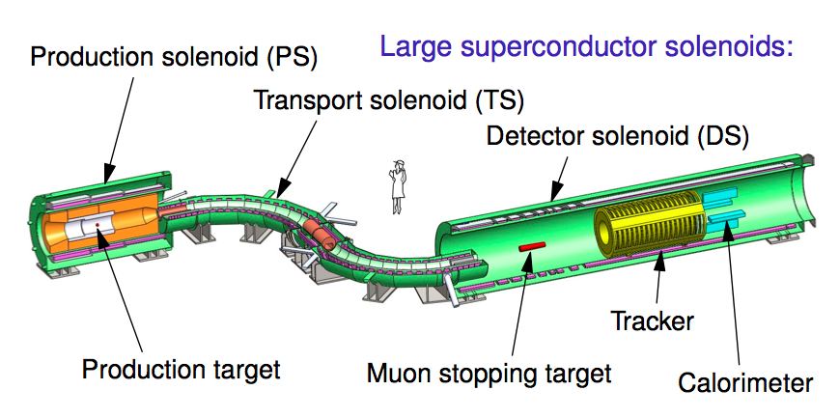
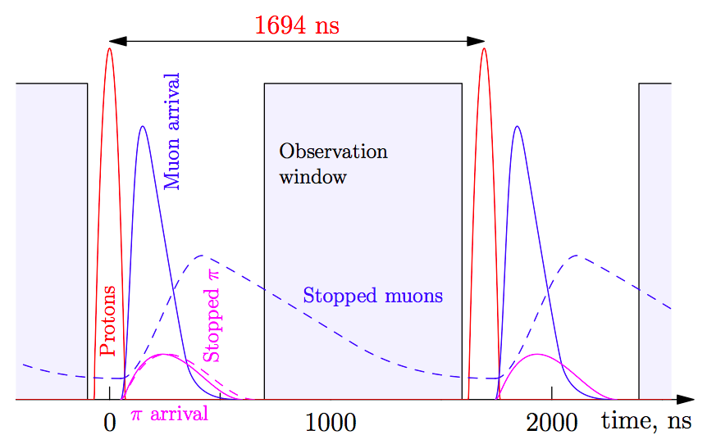
Mu2e at Fermilab
A search for charged lepton flavor violation in
muon to electron conversion
with a single event sensitivity of 10⁻¹⁷.

Slide 4
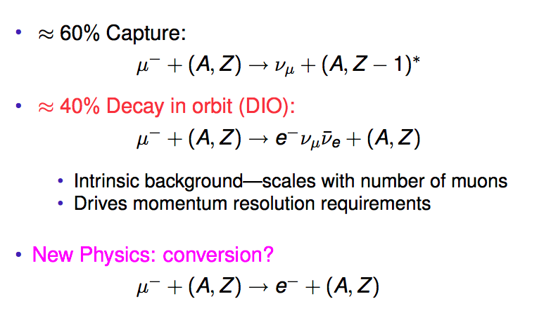
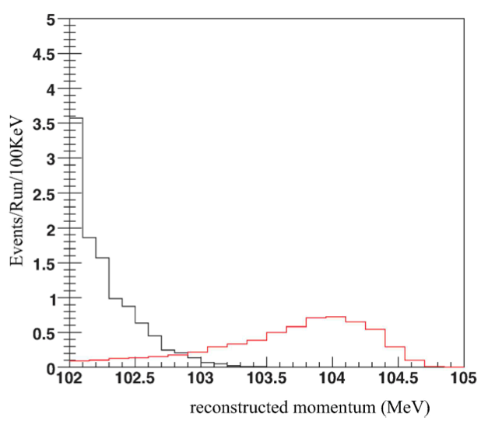
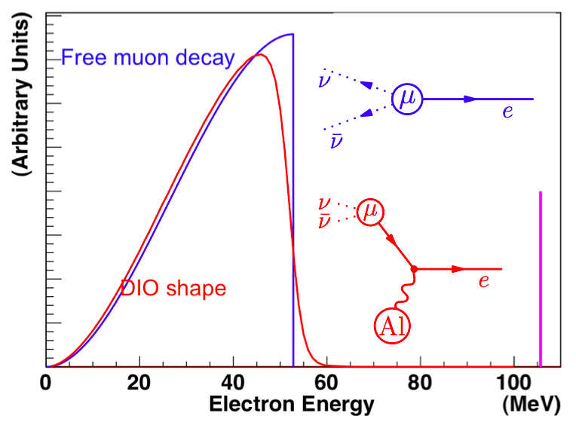
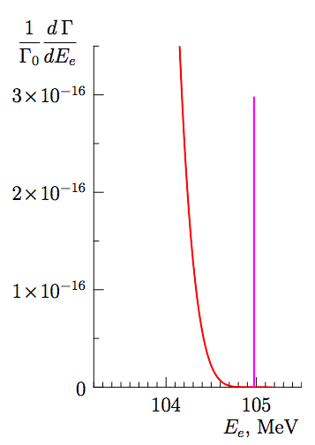
Mu2e at Fermilab
Tracker requirements:
momentum resolution ≈ 10⁻³
very low mass to limit dE/dx

Slide 5
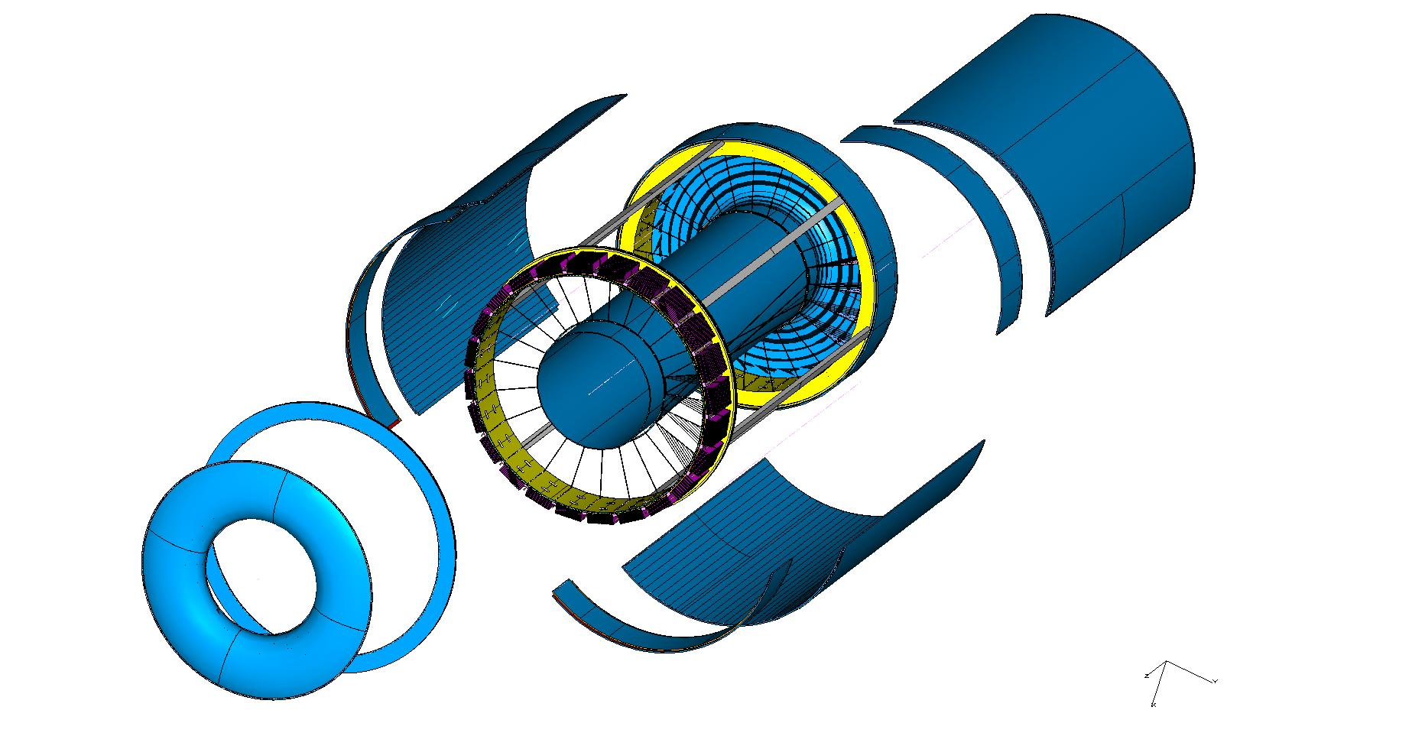
The Mu2e I-Tracker
Wire Cage
Gas envelope
F.E. electronics
Gas containment
Gas envelope can freely deform without affecting
the internal wire position and tension.
Wire support
Wire cage structure not subject to differential
pressure can be light and feed-through-less.

Slide 6
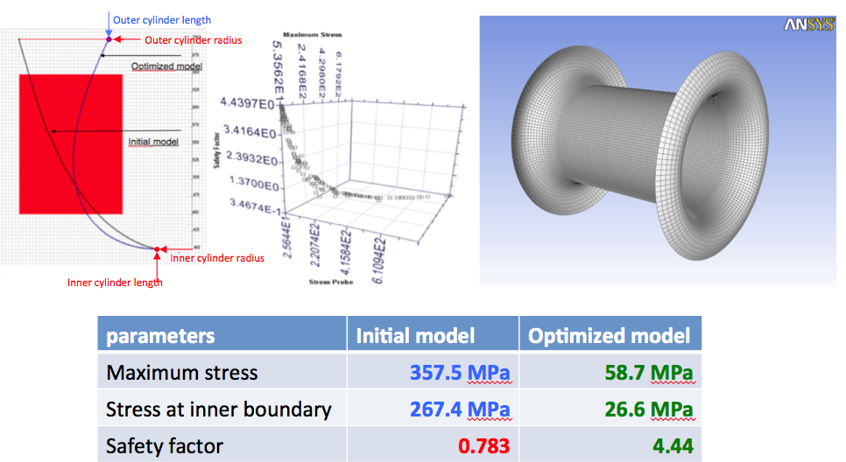
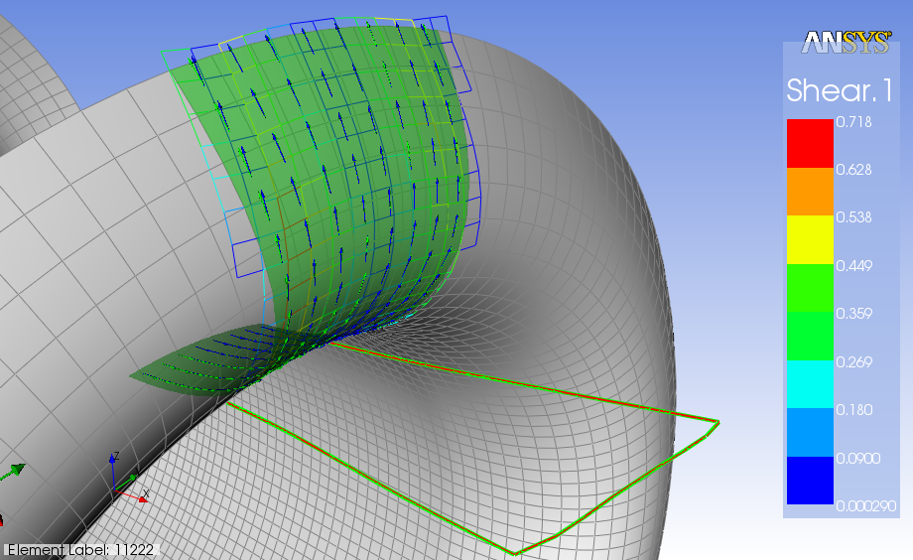
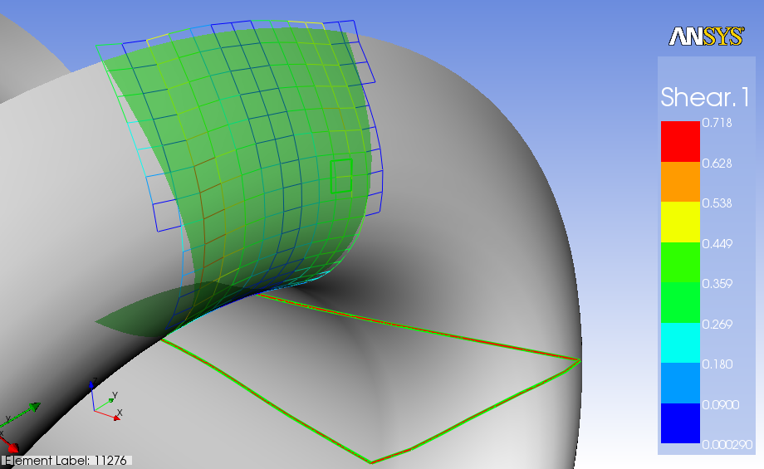
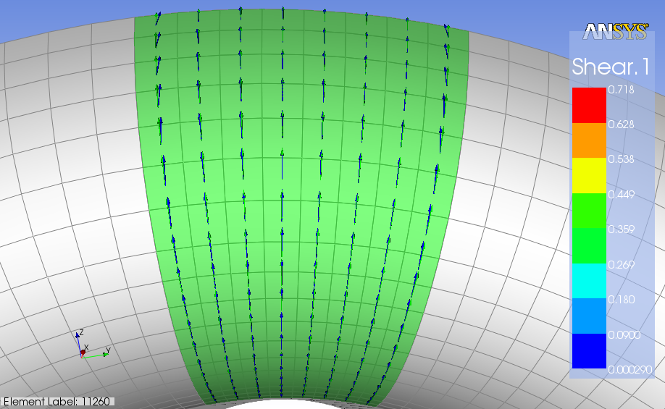
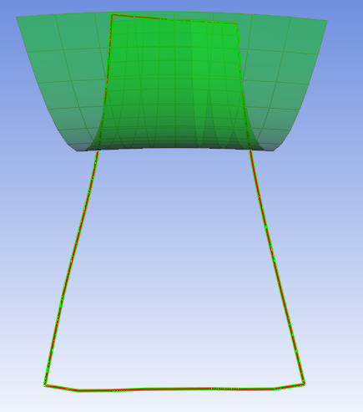
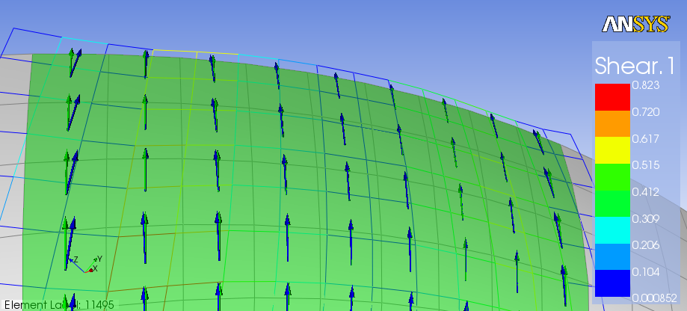
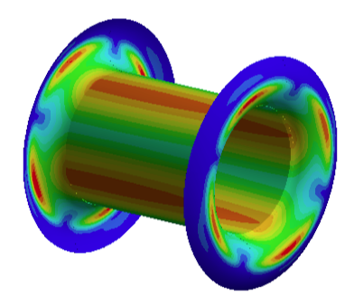
The Mu2e I-Tracker
Gas Envelope
A structural multivariate analysis software (ModeFrontier®) has enabled to find the optimal shape for the profile of the end plates by minimizing maximum stress and stress on inner cylinder
  ANSYS ACP® has chosen the proper unidirectional prepreg to form ply,
  draping of the laminates and flat-wrap of the optimized model
  Solve buckling problems
  of inner cylinder by
  increasing the moment of
  inertia with use of proper
  light core composite
  sandwich
End plates:
4-ply 38μm/ply
orthotropic (0/90/90/0)
0.021 g/cm²
6×10⁻⁴ X₀
Inner cylinder:
2 C-fiber skins, 2-ply,
C-foam core, 5 mm
0.036 g/cm²
8×10⁻⁴ X₀

Slide 7
The Mu2e I-Tracker
Wire Cage (wire support structure)
A feed-through-less chamber allows for reducing wire spacing,
i.e. smaller cells and larger field to sense wires ratios.
Larger field to sense wires ratios allows for thinner field wires,
thus reducing wire contribution to multiple scattering and
total wire tension on wire support structure.
Large number of wires, however, would require complicated
and time consuming assembly procedures and, therefore the
need for a novel approach to the problem

Slide 8

The Wiring Technique
The Old Way
The Three Μοῖραι (Fates)
Κλωϑϖ
Λαχεσις
Ατροπος
Bernardo Strozzi – Le tre Parche – Venezia, circa 1620

Slide 9
The Wiring Technique
The Old Way
A novel approach: the Wiring Robot
The Three Μοῖραι (Fates)
Κλωϑϖ
Lachesis
Λαχεσις
Atropos
Clotho
Ατροπος
Bernardo Strozzi – Le tre Parche – Venezia, circa 1620

Slide 10
The Wiring Robot
digital
microscope
compensating
flywheel
winding
drum
e.m. brake
wire spool
rotation
axis
nose
e.m. friction
wire pulleys
step motors
torquemeter
translation
axis

Slide 11
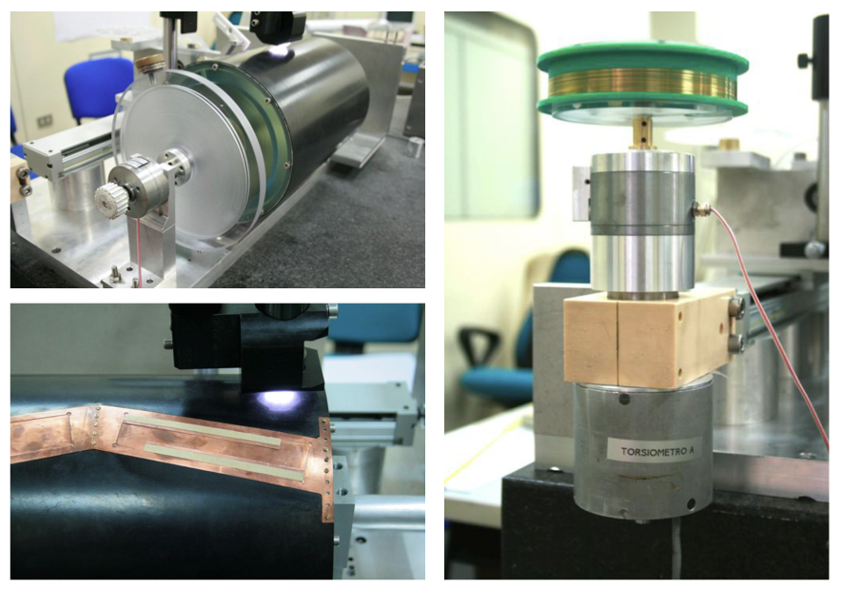
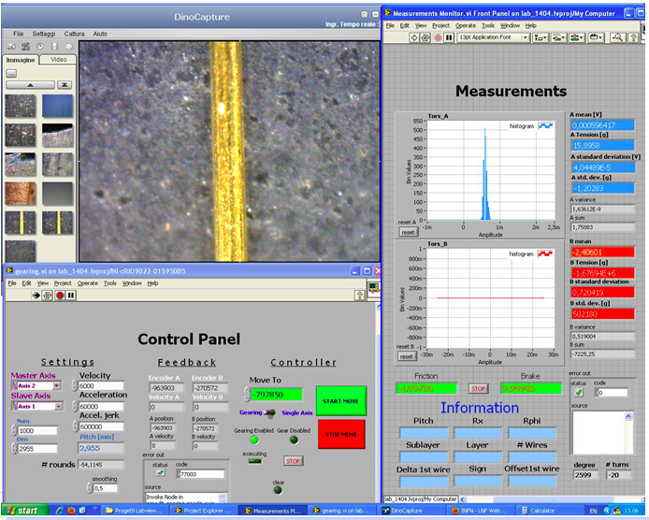
The Wiring Robot
The monitor

Slide 12
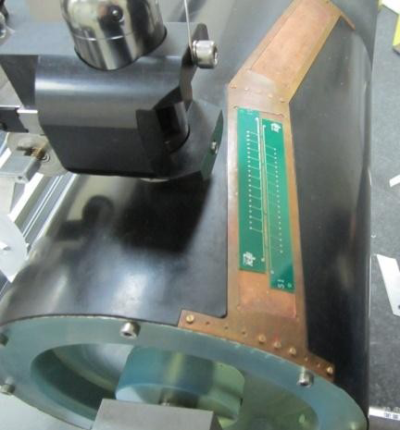
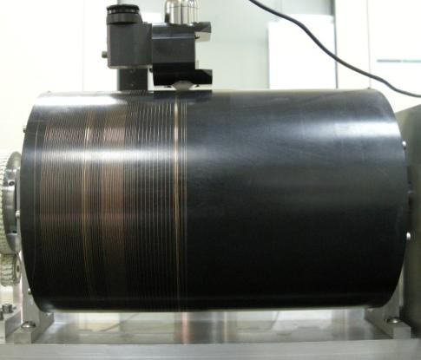
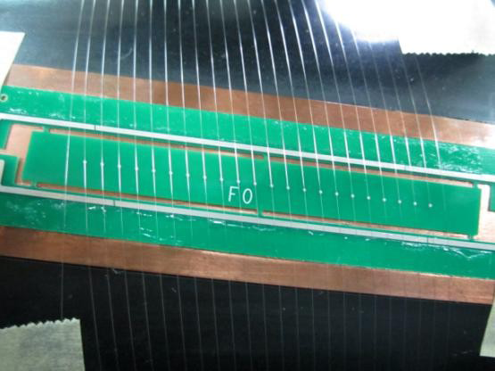
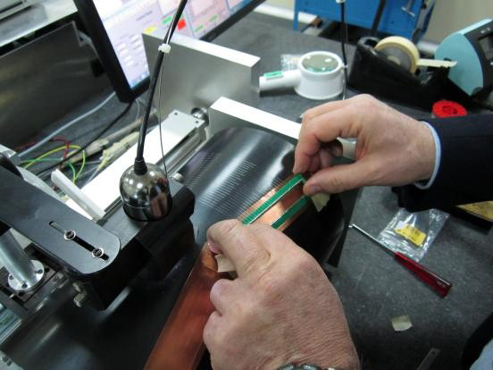
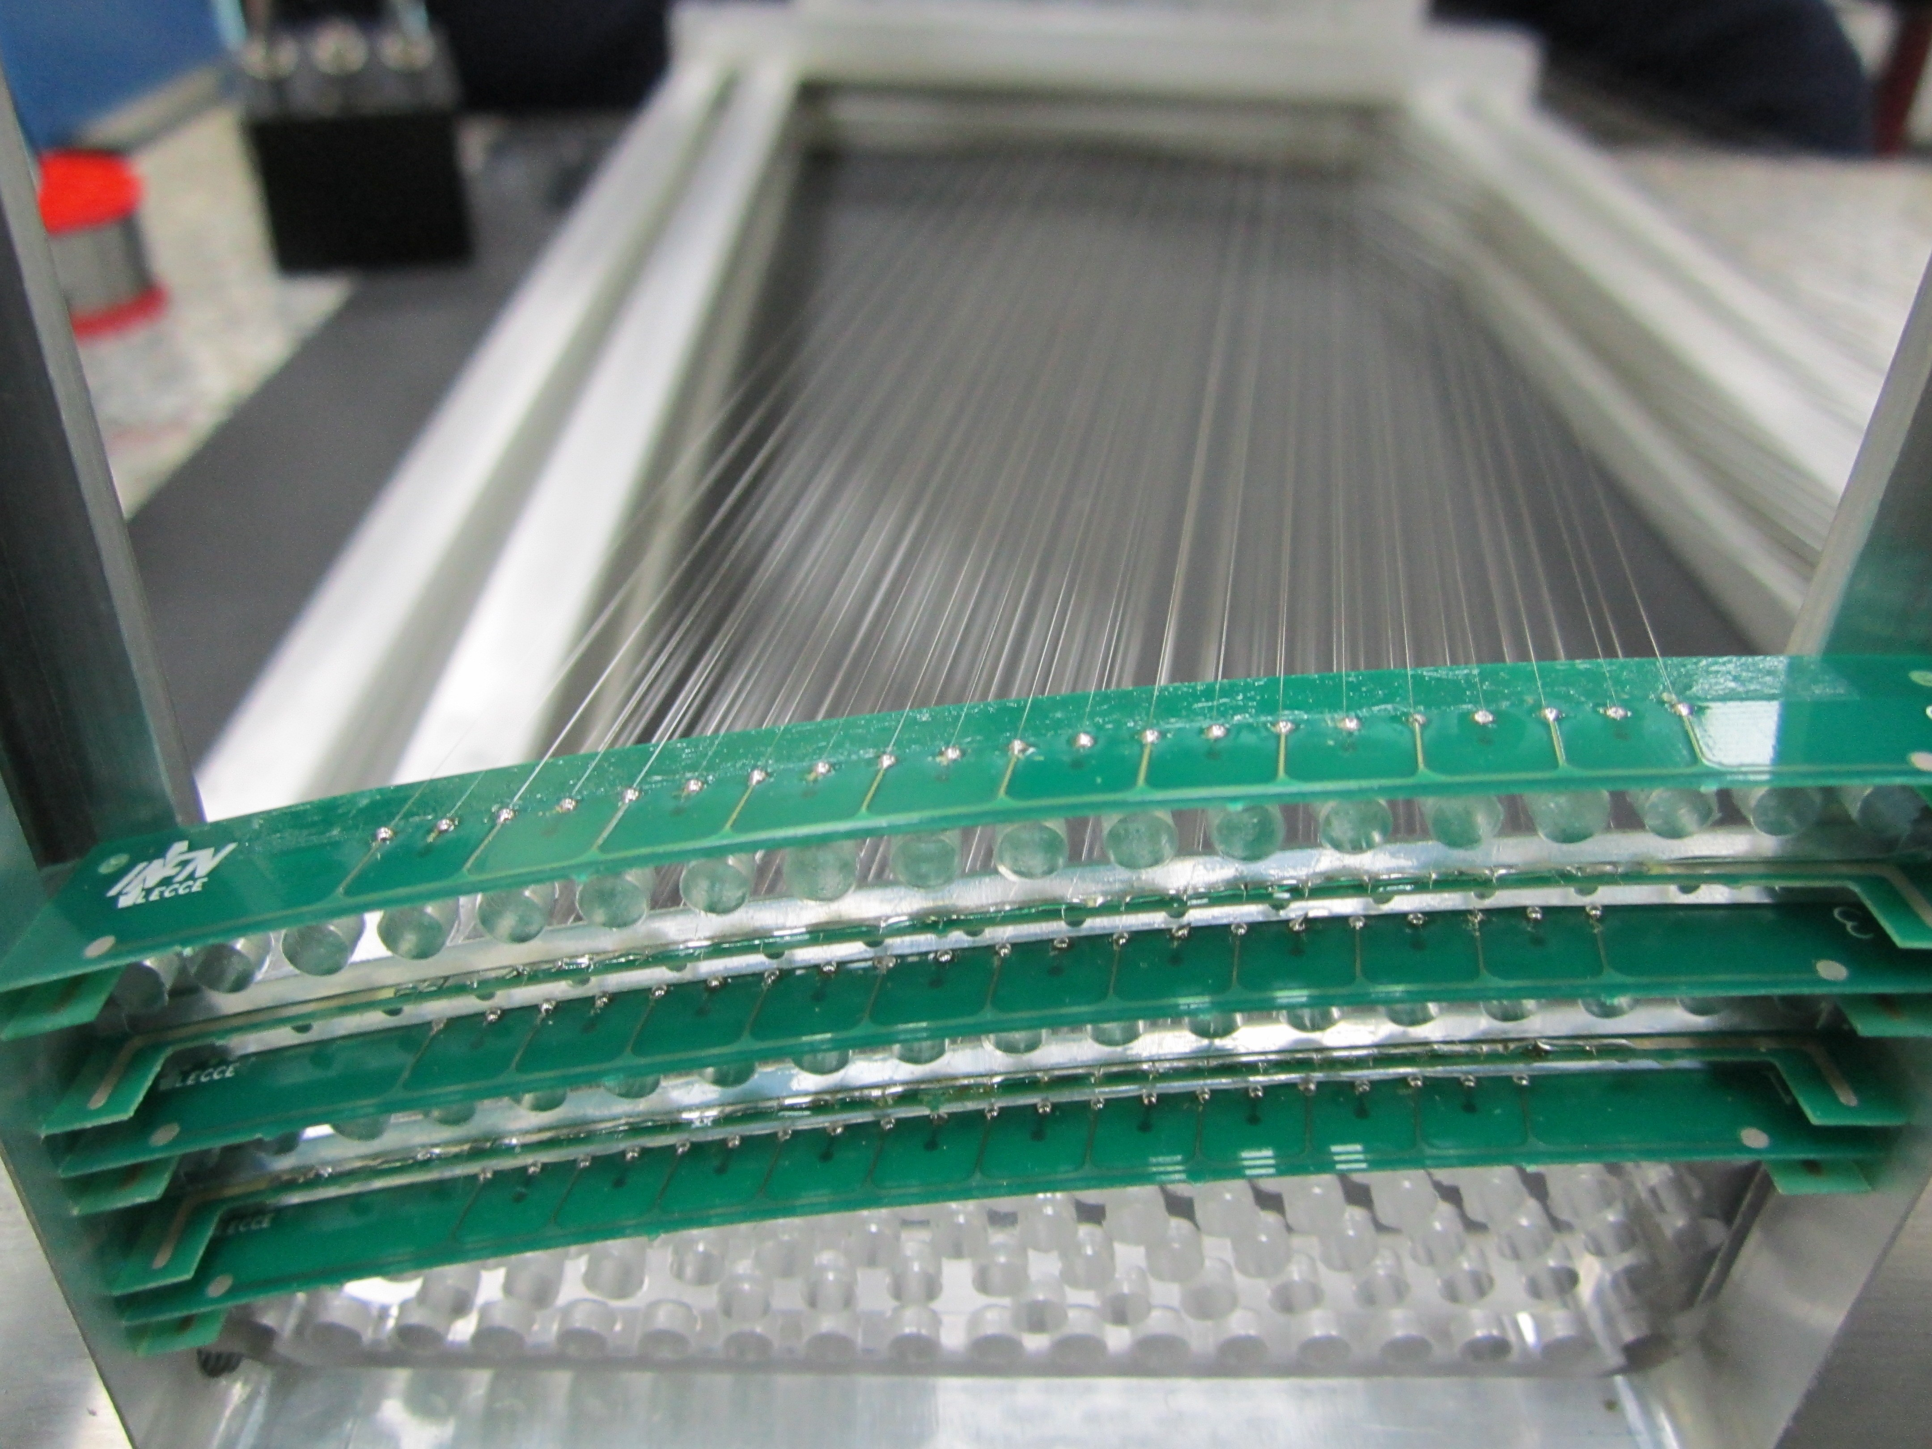
The Wiring Procedure
1
2
3
4
5
1. Place the wire boards on the winding drum
2. Start automatic winding
with the required
angle and pitch
3. Solder the wires on the pads
4. Cut the wires and remove
the wire layer
5. Place the new layer onto
the spacer

Slide 13
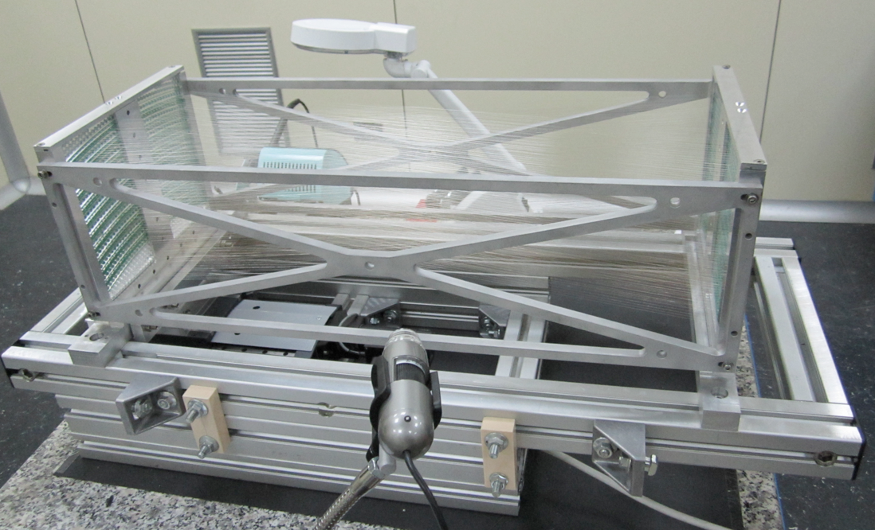
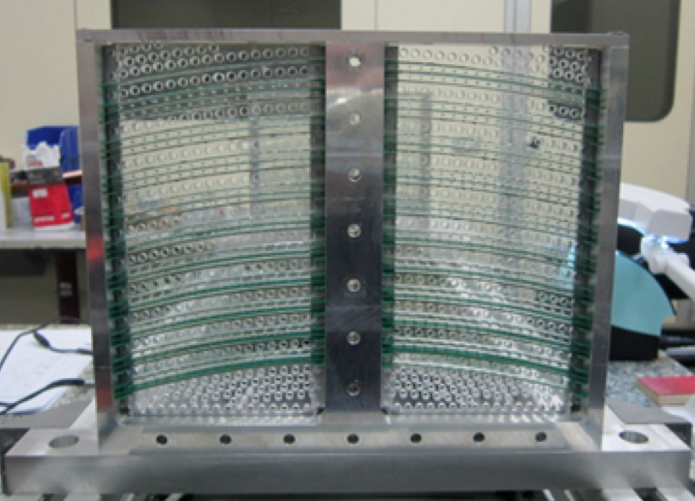
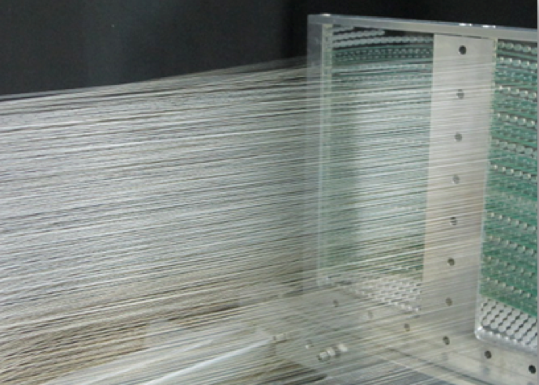
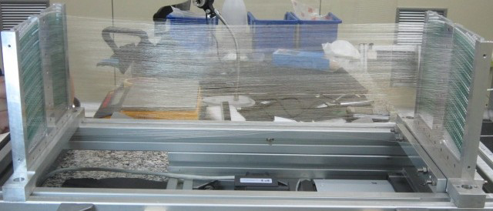
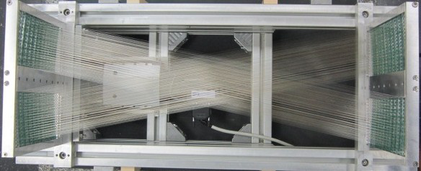
The Mu2e Prototype
side view
top view
1344 wires
1144 field 40 μm Al(Ag)
200 sense 20 μm Mo or W(Au)
cell size 6 mm ÷ 8 mm stereo angle ± 200 mrad
length ≈ 60 cm
A similar prototype (200 cm long) is under
construction for the drift chamber of the
upgrade of MEG experiment at PSI

Slide 14
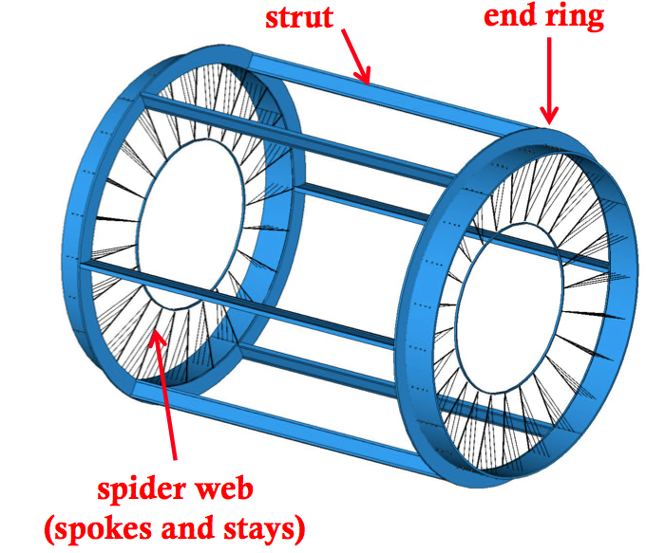
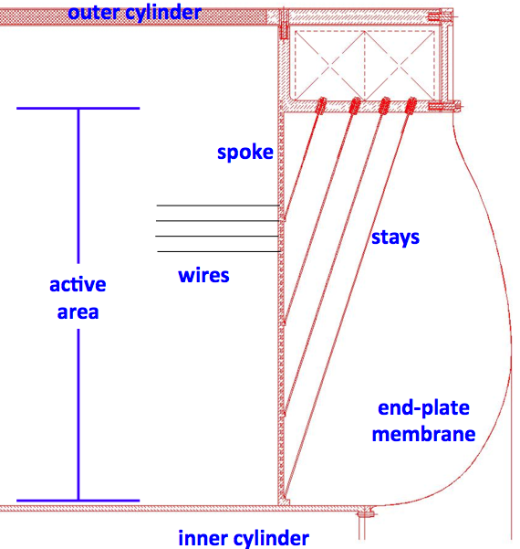
The Mu2e I-Tracker
Wire Cage (wire support structure)
strut
“L” shaped
end ring
struts
spider web:
spokes and stays

Slide 15
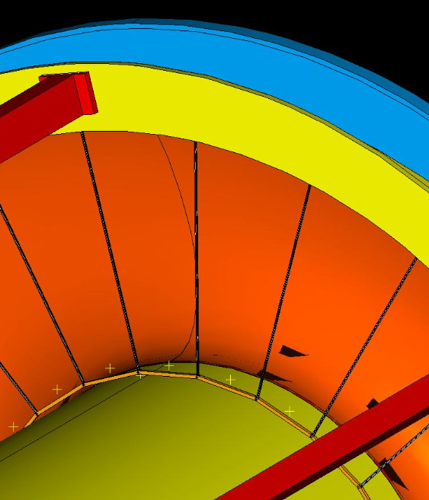
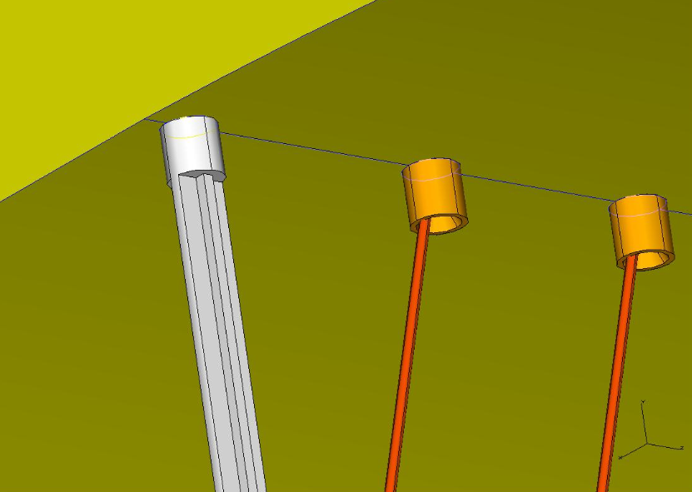
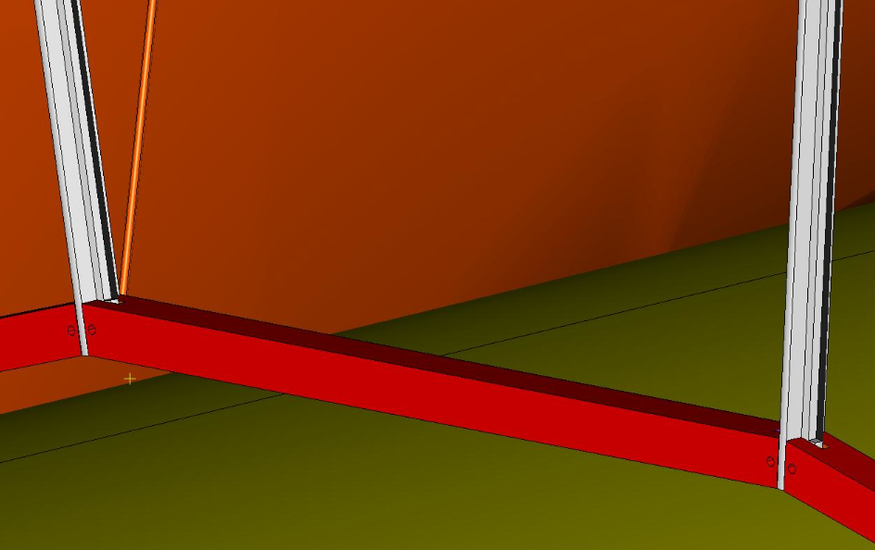
The Mu2e I-Tracker
Wire Cage (wire support structure)
strut
stays
spoke
spoke
retainer

Slide 16
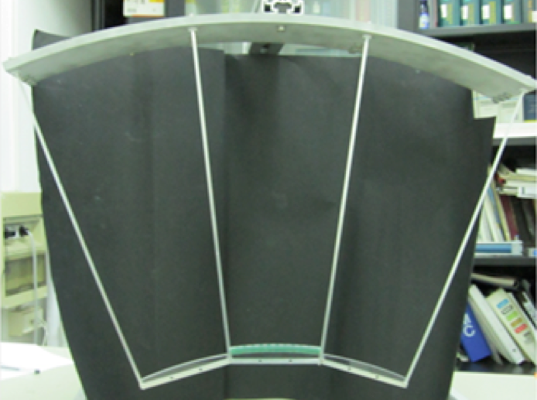
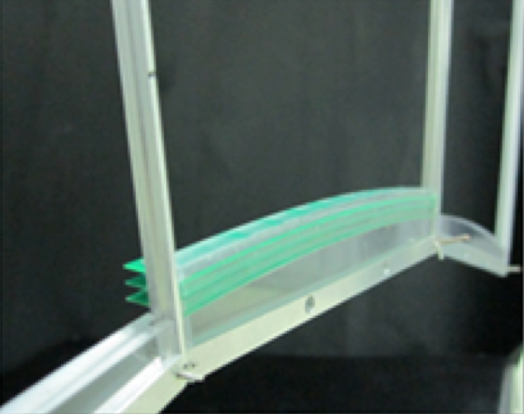
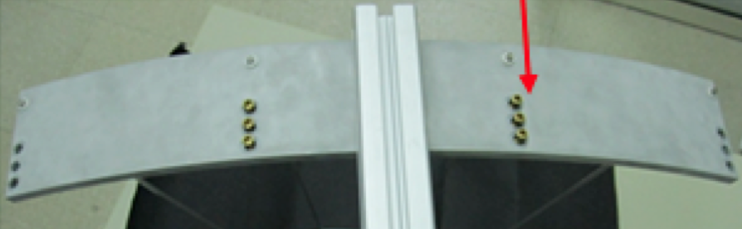
The Mu2e I-Tracker
Wire Cage (wire support structure)
structural
simulation
model
scale 1:1
model
to test
validity
of principle
tightnening
screws

Slide 17
The Mu2e I-Tracker
Total Material Budget
 | Wire Cage |  |  | Gas Vessel |  | TOTAL
 | description | [g/cm²] | X₀ [10⁻³] | [g/cm²] | X₀ [10⁻³] | [g/cm²] | X₀ [10⁻³]
Upstream End-Plate | Spokes + Stays | 0.009 | 0.2 | 0.021 | 0.6 | 0.182 | 6.0
 | Spacers | 0.065 | 1.6
 | Wires board | 0.081 | 2.9
 | R/O components | 0.027 | 1.2
Downstream End-Plate | Total above | 0.182 | 5.9 | 0.021 | 0.6 | 0.276 | 10.3
 | R/O + HV comp. | 0.074 | 3.2
 | R/O + HV cables | 0.020 | 1.2
Inner Cylinder | Connecting rings |  |  | 0.021 | 0.6 | 0.057 | 1.5
 | Sandwich |  |  | 0.036 | 0.8
Gas | 1 m track equivalent |  |  |  |  | 0.040 | 0.6
Wires | 1 m track equivalent |  |  |  |  | 0.030 | 3.3

Slide 18
A proposal for a Flavor Factory
Extend the main features of the Mu2e solution to the τ/c factory by taking into account:
  Constraints dictated by different geometry
  Constraints dictated by different kinematics

Slide 19
A proposal for a Flavor Factory
  Constraints dictated by different geometry
  Under the assumption of a symmetric machine and, then, no vertex detector, inner radius determined by the final focus and by beam pipe. Assume L constant with R and R_{in} = 10 cm.
  Outer radius is limited by cost of calorimeter and size of cryostat for the solenoid. Assume R_{out} = 110 cm.
  Length determined by clearance between final quadrupoles. Assume L = 220 cm.
  Full stereo (low track multiplicity => easy track finding), as opposed to axial-stereo mix, to avoid dead regions and variable gain along z.
  Choose stereo configuration with constant angular displacement (π/4) as opposed to constant stereo angle or constant stereo drop, for easier construction.

Slide 20
A proposal for a Flavor Factory
  Constraints dictated by different kinematics
  Momentum resolution, if dominated by multiple scattering, doesn’t improve with spatial resolution or number of measurements, but improves with B field: choose B as large as possible.
  In contrast, B must be limited to minimize the number of curling tracks. R_{out} = 1. 1 m , B = 1 T => p_{t,curl} < 165 MeV/c.
  Also, minimum p_{t} tracks (at least 12 points, R_{min} = 24 cm), p_{t} > 36 MeVc (to be compared with the minimum momentum to emerge from the beam pipe)

Slide 21
A proposal for a Flavor Factory
16 co-axial super-layers, each one made of 6 para-axial layers at alternating sign stereo angles, arranged in 8 equal azimuthal sectors;
stereo angles ramging from ±40 mrad (at inner radius) to ±360 mrad (at outer radius);
10 square drift cells per sector on first super-layer with 5 cells increment on each successive super-layer to keep cell size constant as a function of super-layer radius;
average cell size 9.5 mm at z = 0 growing to +8.2% at z = ±L/2;
ratio of field wires to sense wires = 5 : 1;
36480 sense wires – 186960 field and guard wires;
sense wires 20 μm diameter gold plated W (20g /180 μm sag);
field and guard wires 40 (50) μm diameter silver plated Al (16g /180 μm sag);
total wire tension about 4 Ton.

Slide 22
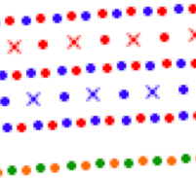
A proposal for a Flavor Factory
+ stereo angle
drift
cell
- stereo angle
guard layer
field and guard wires:
40 μm and 50 μm Al(Ag)
sense wires:
20 μm W(Au)
average cell full width: 9.5 mm at z=0 (10.3 mm at z=±L/2)
average stereo angle 200 mrad (40÷360 mrad)

Slide 23
A proposal for a Flavor Factory
Expected Performance
Wire and gas contribution to multiple scattering per 1 m track:
sense wires (W) 0.006 g/cm² or 8.7x10⁻⁴ X₀
field wires (Al) 0.021 g/cm² or 8.8x10⁻⁴ X₀
gas (90/10) 0.040 g/cm² or 6.3x10⁻⁴ X₀
Total 0.067 g/cm² or 2.4x10⁻³ X₀
Hermeticity: require at least 12 points => R_{min} = 24 cm
down to p = 36 MeV/c

Slide 24
A proposal for a Flavor Factory
Expected Performance: Track parameters resolutions
n = 96, B = 1 T, R_{out} = 1.1 m, l = 2.4x10⁻³ X₀, σ = 150 μm, σ_{z} = 750 μm
measurement
multiple scattering

Slide 25
A proposal for a Flavor Factory
Expected Performance: Invariant Mass
n = 96, B = 1 T, R_{out} = 1.1 m, l = 2.4x10⁻³ X₀, σ = 150 μm, σ_{z} = 750 μm
Invariant mass depends on Δp
and Δp dominated by the the contribution to the transverse
momentum due to the multiple scattering inside the chamber
at the level of a few tenths of a %.

Slide 26
A proposal for a Flavor Factory
Expected Performance: Vertex extrapolation resolutions
n = 96, B = 1 T, R_{out} = 1.1 m, l = 2.4x10⁻³ X₀, σ = 150 μm, σ_{z} = 750 μm
measurement
multiple scattering
Multiple scattering due to
2 mm Be beam pipe at 2 cm radius

Slide 27
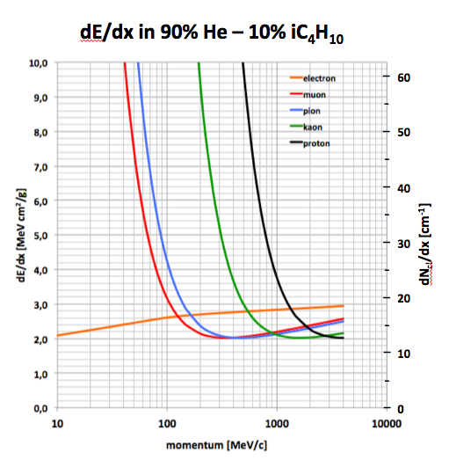
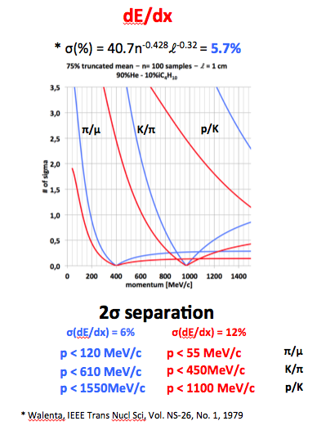
A proposal for a Flavor Factory
Expected Performance: Particle Identification
n = 96, B = 1 T, R_{out} = 1.1 m, l = 2.4x10⁻³ X₀, σ = 150 μm, σ_{z} = 750 μm

Slide 28
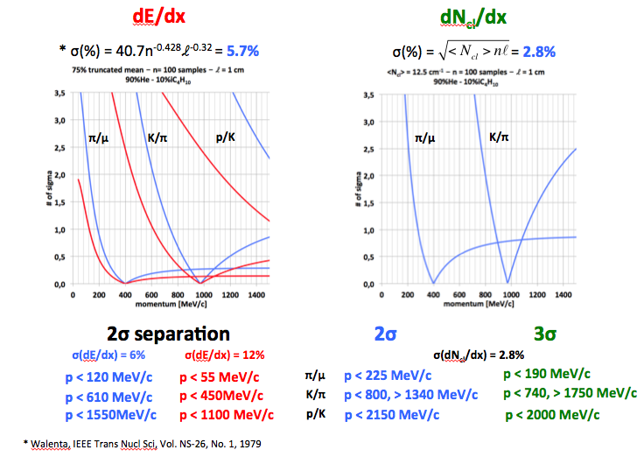
A proposal for a Flavor Factory
Expected Performance: Particle Identification
n = 96, B = 1 T, R_{out} = 1.1 m, l = 2.4x10⁻³ X₀, σ = 150 μm, σ_{z} = 750 μm

Slide 29
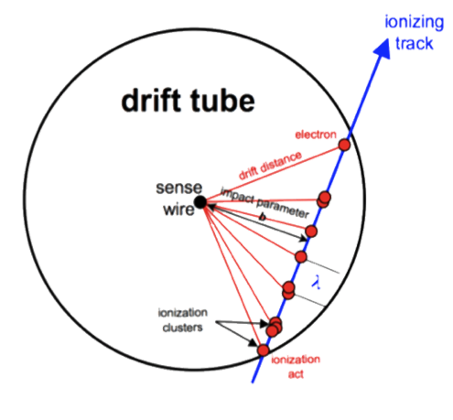
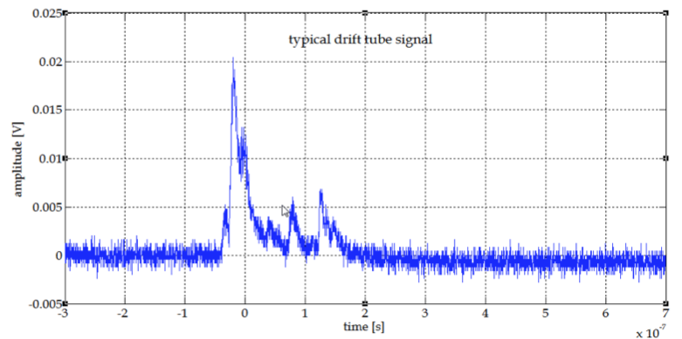
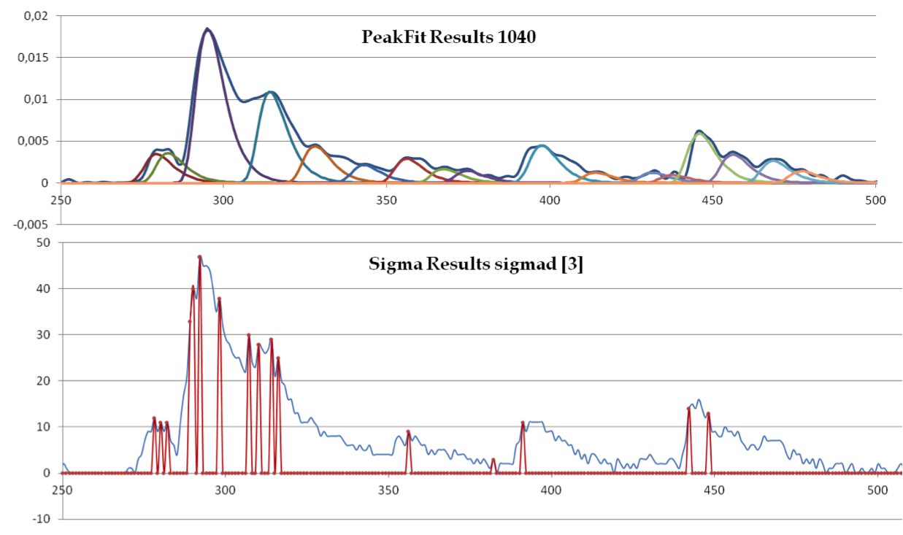
Cluster Counting
Peaks found by
PEAKFIT
software
Single electron peaks must
be associated in clusters
according to their relative
time difference (cluster
separation vs diffusion).
Peaks
reconstructed
by ON-LINE
software

Slide 30
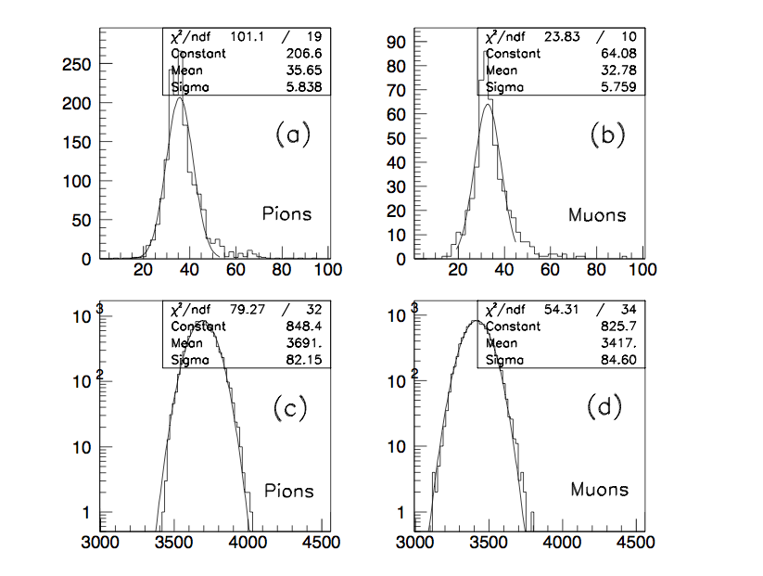
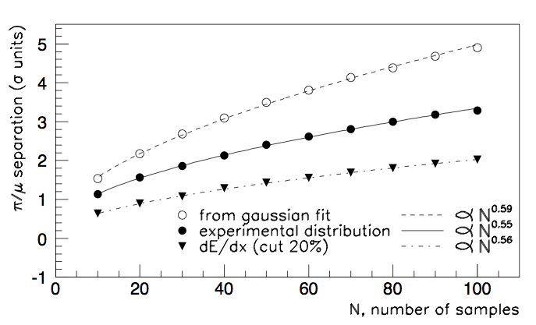
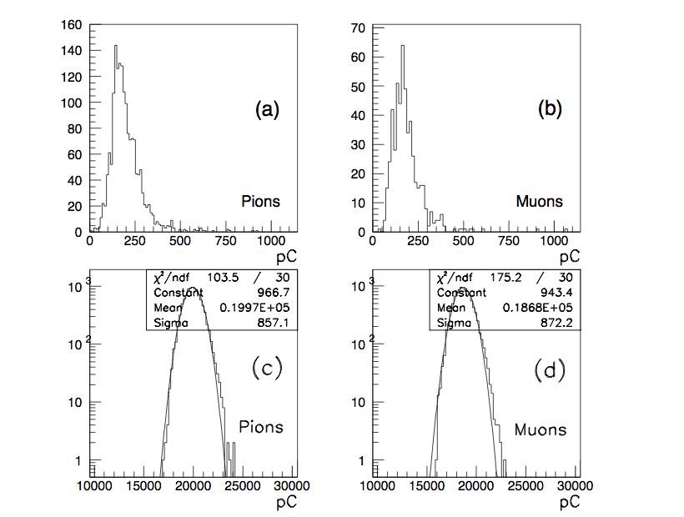
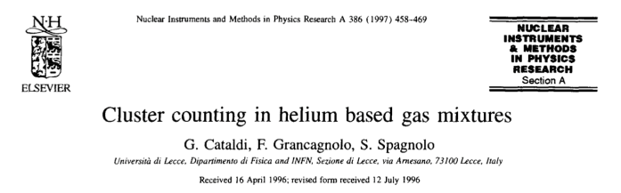
Cluster Counting
1994 beam test at PSI:
squared drift tube with side, 2.6cm at 45°;
20 µm W sense wires;
95%He - 5%iC4H10 (~8.4 clusters/cm);
200 MeV/c π (βγ=1.4) and μ (βγ =1.9);
preamplifier bandwidth 1.7 GHz
8 bit ADC @ 2Gs/s
dE/dx
100 samples 3.7 cm
parametrization
gives σ = 4.3% or
≈ 2.8σ separation
20% truncated mean
gives σ = 6% or
≈ 2σ separation
dN_{cl}/dx
Teory distribution gives σ = 2.4% or
≈ 5σ separation
Experimental
distribution
gives σ = 3.7% or
≈ 3.2σ separation
NIM A386 (1997) 458-469

Slide 31
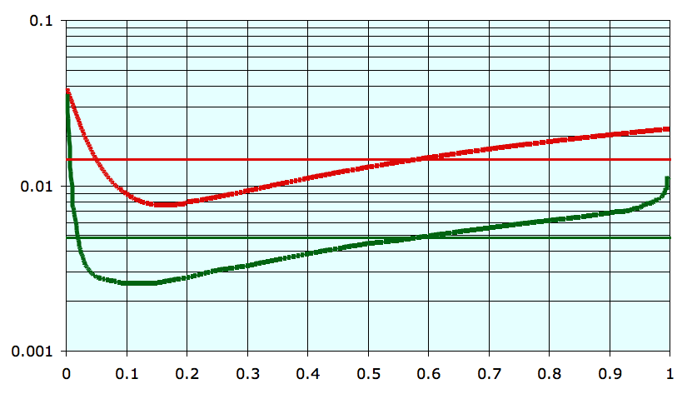
Cluster Timing: Spatial resolution
Besides Cluster Counting, for particle identification, one can use the drift time of each individual ionization cluster, following in time the first one, to improve the drift distance resolution at impact parameters close to the wire, where ionization statistics fluctuations contribute most.
1 cm
drift
tube
<σ> = 150 μm
First cluster only
All clusters
(only the first few
Contribute)
<σ> = 50 μm

Slide 32
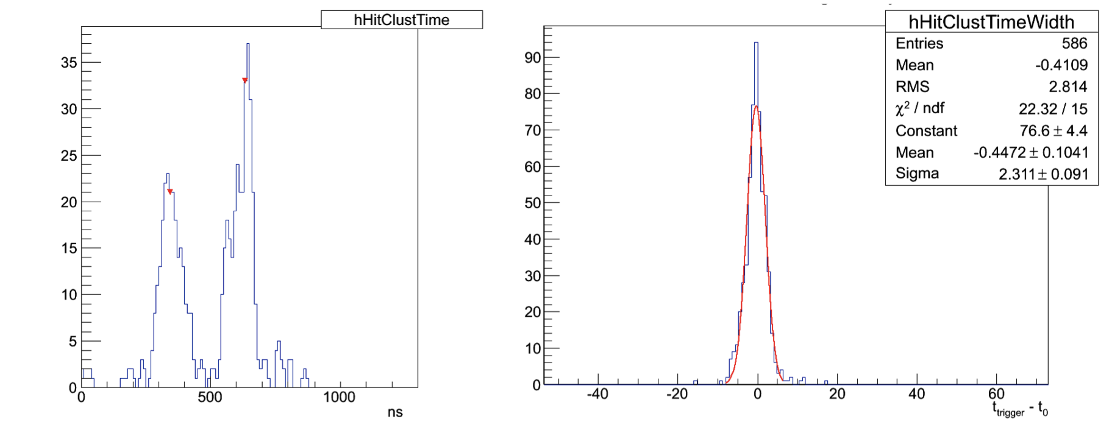
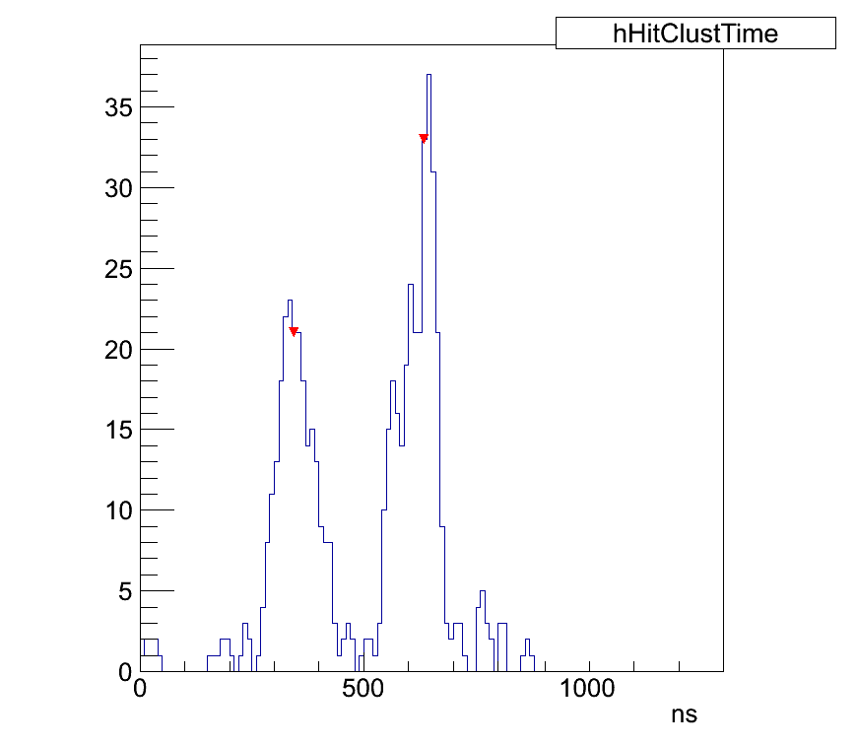
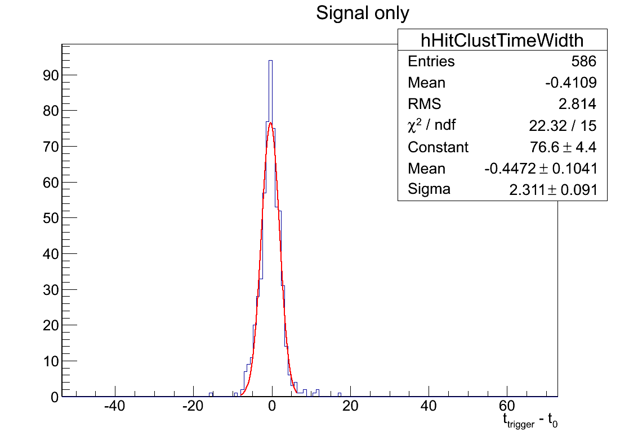
Cluster Timing: Trigger capability
In a drift tube, the last cluster in a hit always comes from a drift distance equivalent to the cell radius, independently of the impact parameter and of the track angle. For square drift cells, this is smeared by the field at the boundary and by the track angle. It, however, can be used to determine the timing of the event without the need for an external trigger.
Mu2e drift chamber simulation
2 tracks
single
track
σ ≈ 2.3 ns
The last cluster always come from a radius eq. To the cell radius. As its impact parameter is known its time can be used to obtain timing information on the event.
This technique can be used either to filter hits that do not not belong to a certain track or to determine the t₀ of the track without the need for an external detector. A few preliminary results obtained with the Mu2e simuation are shown below.

Slide 33
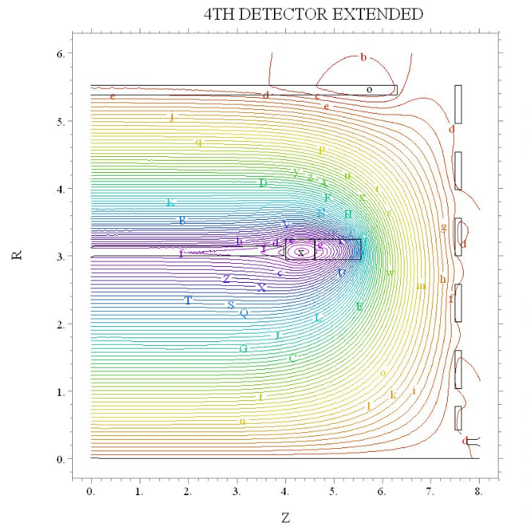
Double Solenoid: 4th Concept at ILC
No flux return
Moderate cost for
outer solenoid
High precision muon
detector

Slide 34
CONCLUSIONS
An ultra-low mass drift chamber for a tau/charm factory with a transparency of 0.067 g/cm² or 2.4x10⁻³ X₀ (gas + wires) can be built
The large number of wires (225,000) is not a problem with the wiring scheme proposed and tested
Resolutions in momentum and in invariant mass of a few per mille can be reached
Particle identification at the level of a few percent with cluster counting and trigger possibility with cluster timing exist
A suggestion for a novel approach to muon identification has been given

