Slide 1
The round table
Original questions and new questions

Slide 2
Accelerator original questions
Is a symmetric machine a strong limitation?
For charm CPV use Dalitz plot correlations (Bondar)
To be checked with appropriate MC
A taken decision
A possible asset by inverting beam charge?

Slide 3
competition

Slide 4
Uniform efficiency over the dalitz plot…(?)

Slide 5
Accelerator original questions
Is the polarization still an asset?
Polarized beams allow to be sensitive to tau polarization
Triple product for tau production involve tau’s low momentum…
Tau spin may be used for correlations with decay products
Polarization as an asset to decrease background and enhance the signal yield. MC needed
Relevant for “difficult” tau decays
single energy

Slide 6
Accelerator original questions
Is the quoted luminosity value confortable?
Two independent lattice design with similar ring’s length came to the same conclusion

Slide 7
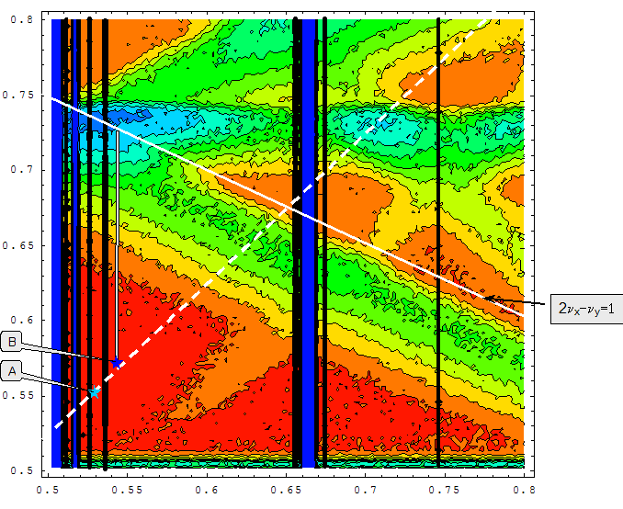
Luminosity tune scan
CW advantage:
BB coupling resonances are suppressed
Wide red area corresponds to 10³⁵ cm⁻²s⁻¹

Slide 8
Accelerator original questions
Are there critical issues that require some further studies?
Final focus design and background
Polarization implementation
Is the coexistence with an X-FEL operation mode pacific?
NOT discussed
Is the luminosity at low energy competitive?
To be explored

Slide 9
Accelerator additional question
Is the cost “projection” realistic ?
IT tau charm points to a bare cost below 190
BINP layout is valued similarly
Enough to proceed to engineered components evaluation

Slide 10
Very preliminary cost
Item 800 m 2.5 GeV 400 m 2.1 GeV
_____________________M€_________ M€__________
Detector 100 100
Collider 250 100 (1/2, less spin rot. and damping wig.)
Linac 40 30
Pol.e source 1 1
Building, tunnels, 50 10 (renovation of equipment)
engineering, etc.
Civil engineering (IT) 35
__________________________________________
TOTAL 441 241 (141 + 35)

Slide 11
Physics original questions
Are there unique discovery physics cases?
Mainly on CPV and Flavor violation
Lepton universality to be better explored
Accessible NP scales to be investigated systematically
Is there an ideal window of opportunity?
What is the progress achievable on “standard measurements” for example in charm decays and charmonium states?

Slide 12
Late evening estimates of NP scale reach
Ingredients
Dimension six operators with a scale LAMBDA
Heff=i(1/☹^2) O_6
Dimensional analysis for Sigma and assuming 100 “rare” events ( before cuts…) or BR of the order of 10^-9
Production, four fermions: 4-6 TeV
Production, two fermions: 25 TeV
Branching ratios 10^-9 in decays, four fermions: 30 TeV
Branching ratios 10^-9 in decays, two fermions: 300 TeV
(units h=c=1=…2pi..)
Interference effects gives much higher limits but need more data

Slide 13
Luminosity and threshold production
Luminosity wins for the number of events
Threshold conditions may strongly reduce background ( phase space and PID of neutrals)
MC needed
…. Detector needed…

Slide 14
Physics original questions
Is there an ideal window of opportunity?
Probably before possible SuperkekB upgrade ( 25 ??)
… but also tau charm may get an upgrade…
What is the progress achievable on “standard measurements” for example in charm decays and charmonium states?
PANDA energy resolution on charmonium in p-pbar mode cannot be challenged.
Gamma gamma may provide non 1- states
Definite QCD progress ( alfa, fragmentation functions, Passemar’s talk)

Slide 15
τCHEAP (/ttʃiːp/) or (tch ēp) Tau CHarm European Accelerator Project
e+
e-
!!!!!!

Slide 16
τCHEAT (/ttʃiːt/) or (tch ēt) Tau CHarm European Accelerator Trap
e+
e-
!!!!!!

