Slide 1
Future Muon Colliders: A Perspective
  ILC and More Workshop
  Lake Como, Italy
  May 16-17, 2013

Slide 2
Why Muons?
What’s so special about Muons?
Muons are Heavy Leptons
M_{μ}/M_{e} = 207

Slide 3
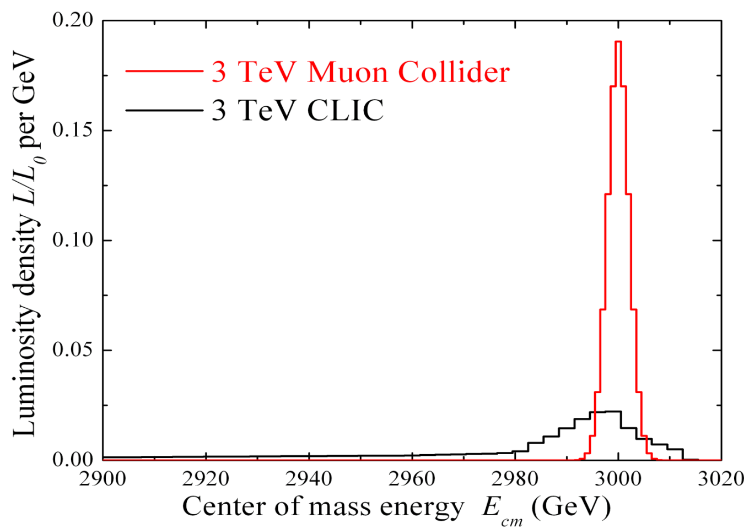
Beamstrahlung Effects
Reduced beamstrahlung for muons results in enhanced energy resolution at the collision
MC: 95% of Luminosity in dE/E ~ 0.1%
CLIC: 30% of Luminosity in dE/E ~ 1.0%

Slide 4
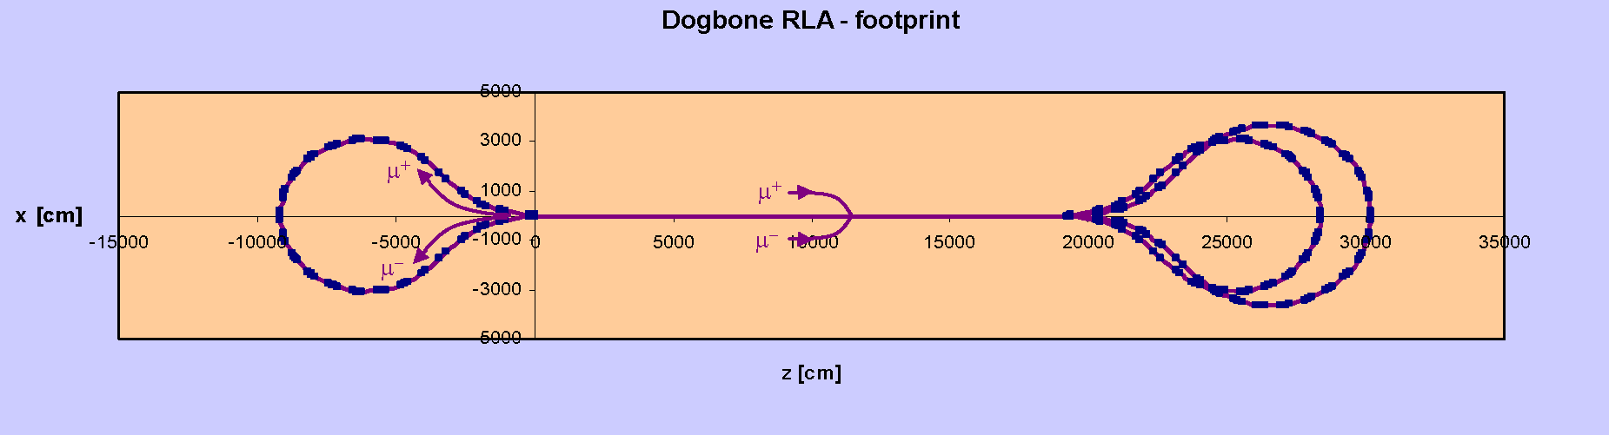
The Key Muon Advantage
Reduced Synchrotron Radiation:
Reuse of accelerating rf (reduce both operating and construction costs)
Smaller footprint (can fit on existing lab sites)

Slide 5
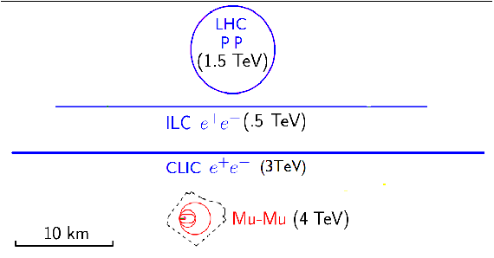
Machine Footprints
A 4 TeV μ⁺ μ⁻ Collider can fit on an existing laboratory site.

Slide 6
Muons: The Downside
Muon decay:
The muon half-life at rest is: τ = 2.2μs
Must capture and accelerate the muons quickly.
1/3 of the beam energy is dissipated in the machine as e⁺’s and e⁻’s. This an important issue for the storage ring and the Interaction Points (IPs).

Slide 7
Muon Collider Concept
Muon Collider Block Diagram
Proton source:
For example PROJECT X Stage IV at 4 MW, with 2±1 ns long bunches
Goal:
Produce a high intensity μ beam whose 6D phase space is reduced by a factor of ~10⁶-10⁷ from its value at the production target
Collider: √s = 3 TeV
Circumference 4.5km
L = 3×10³⁴ cm⁻²s⁻¹
μ/bunch = 2x10¹²
σ(p)/p = 0.1%
ε_{⊥N} = 25 μm, ε_{//N}=72 mm
β* = 5mm
Rep. Rate = 12 Hz

Slide 8
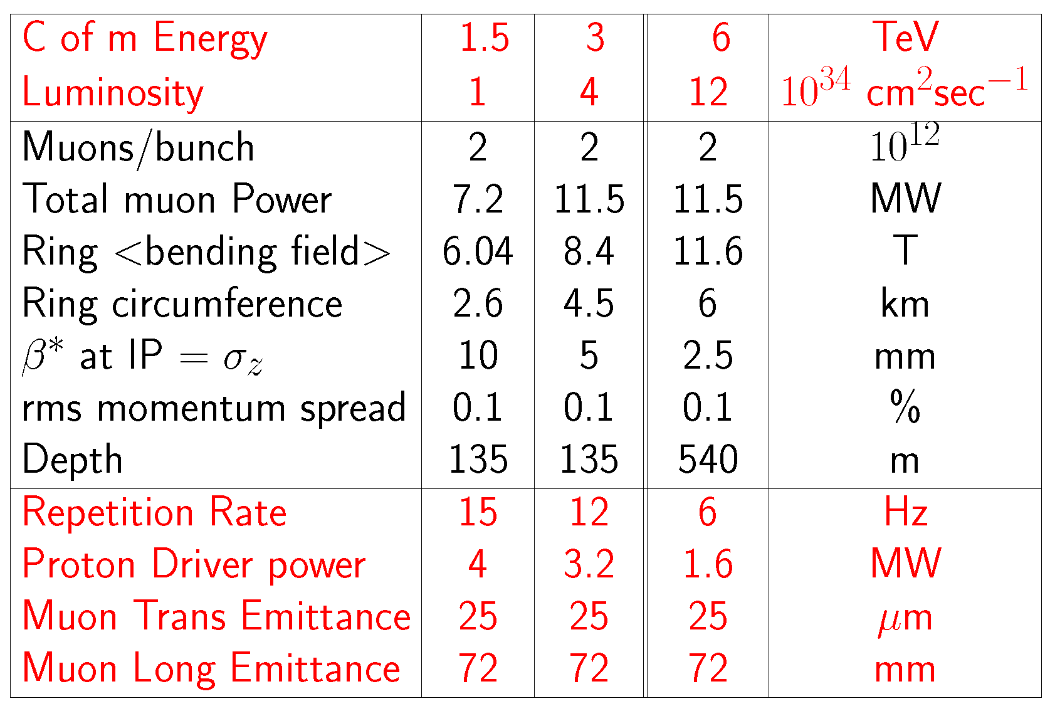
Muon Collider Parameters

Slide 9
The Neutrino Factory
The muons in a storage ring decay such that:
μ⁺ → e⁺ ν_{e} ν_{μ} and μ⁻ → e⁻ ν_{e} ν_{μ}
Further, the ν’s are projected forward with an opening angle ~ 1/γ.
This gives rise to a very powerful ν beam capable of being projected over long baseline distances.

Slide 10
Neutrino Factory Concept
464 m
IDS-NF
IDS-NF:
4 MW Proton Source
(eg, Project X Stage IV) with ~2ns long bunches
_________________________________________________________________________________________________________________
MAP
Muon Accelerator Staging Study:
Utilize Project X Stage II beam starting at 1MW
IDS-NF:
10 GeV Ring pointed at a magnetized detector @2500km
________________________________________________________________________________________________________________
MAP
Muon Accelerator Staging Study:
Studying a ~5GeV ring delivering
νs to Homestake
ν Factory Goal:
O(10²¹) μ/year
within the
accelerator
acceptance

Slide 11
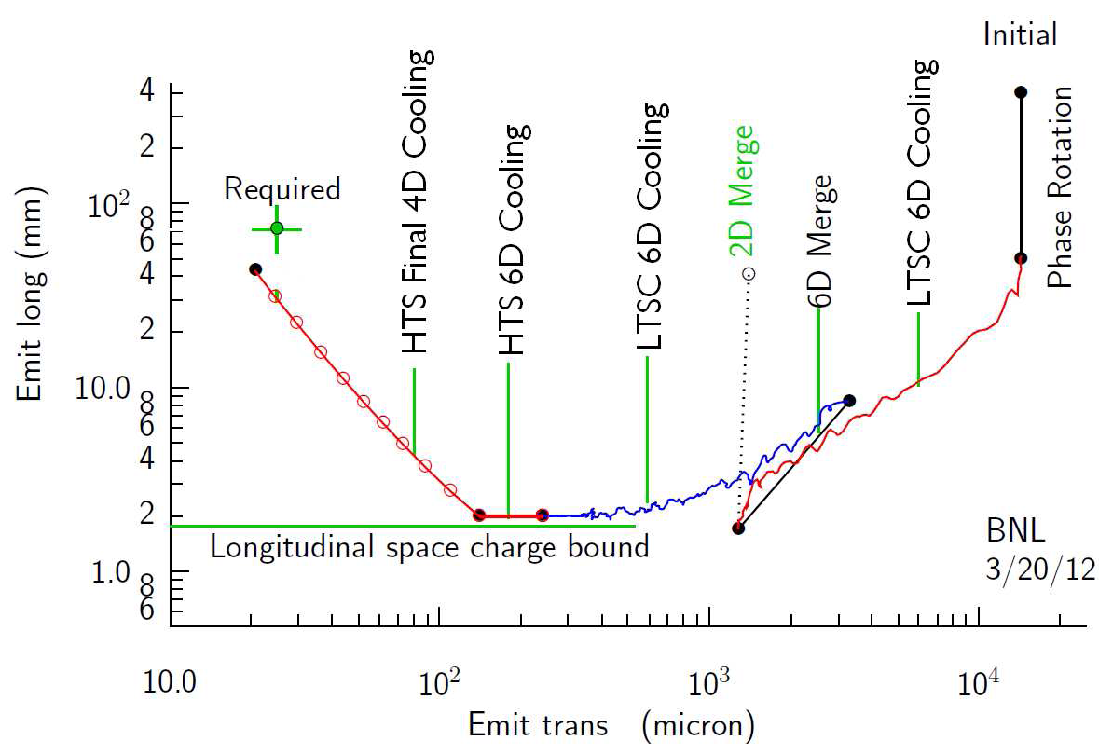
The MC Cooling Scenario

Slide 12
A Muon-Based Higgs Factory and Energy Frontier Collider
Exquisite Energy
Resolution
Allows Direct
Measurement
of Higgs Width

Slide 13
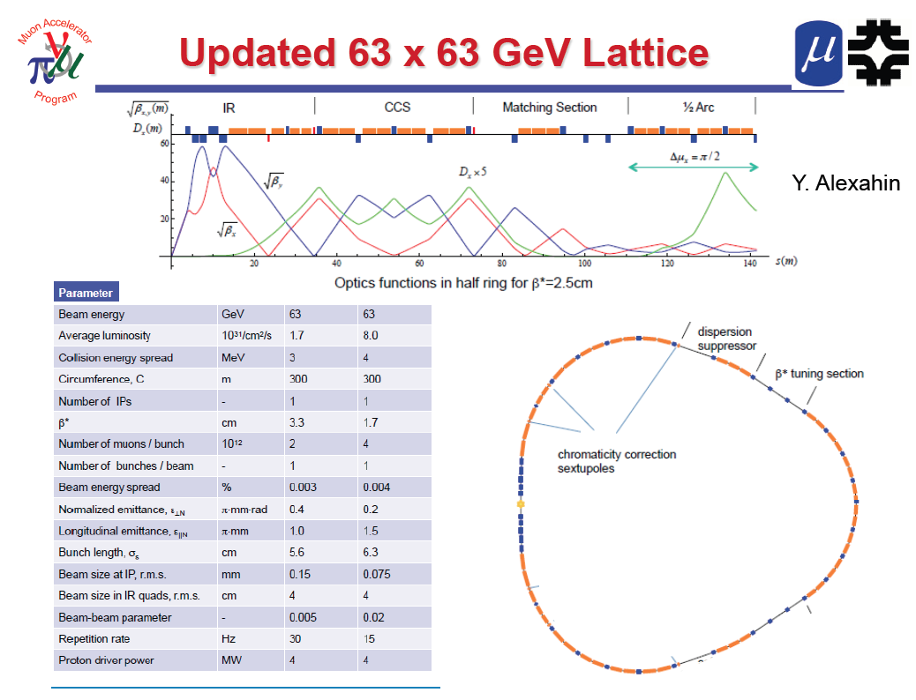
One IP in
the latest
design

Slide 14
Muon Collider R&D
The Technology Challenges

Slide 15
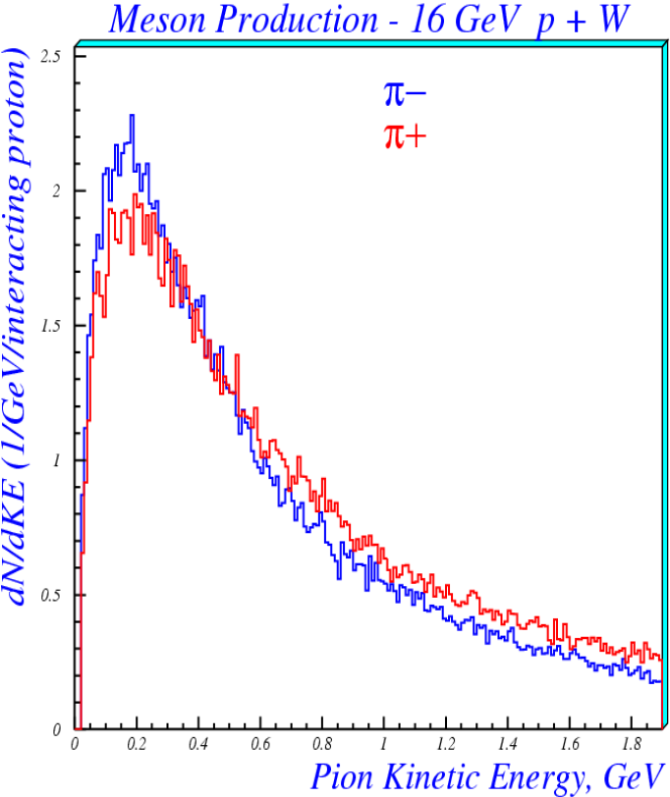
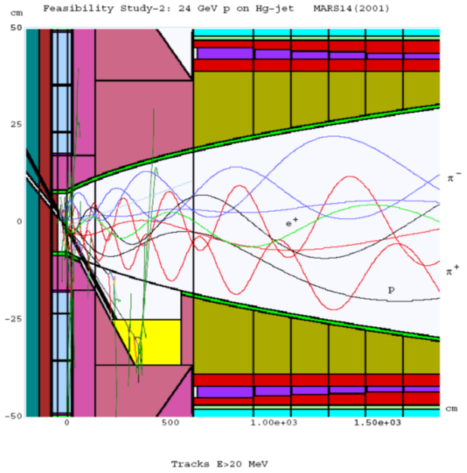
Production of Intense
Muon Beams
Muon beams produced as tertiary beams: p → π → μ

Slide 16
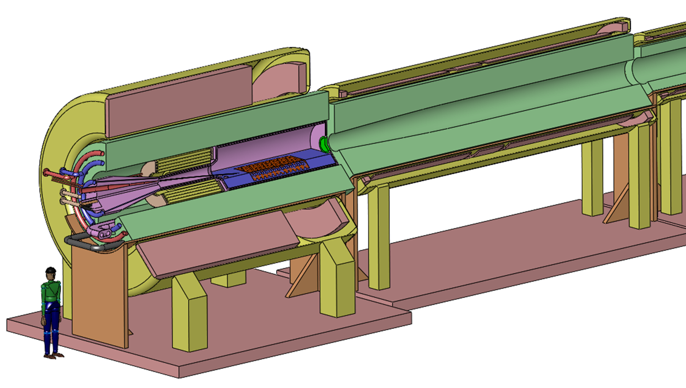
The Capture Solenoid
A Neutrino Factory and/or Muon Collider Facility requires challenging magnet design in several areas:
  Target Capture SC Solenoid (15T with large aperture)
  Stored Energy ~ 3 GJ
  10MW, 5T resistive
  coil in high radiation
  environment
  Liquid Hg Jet
  Possible application
  for High
  Temperature
  Superconducting
  magnet technology

Slide 17
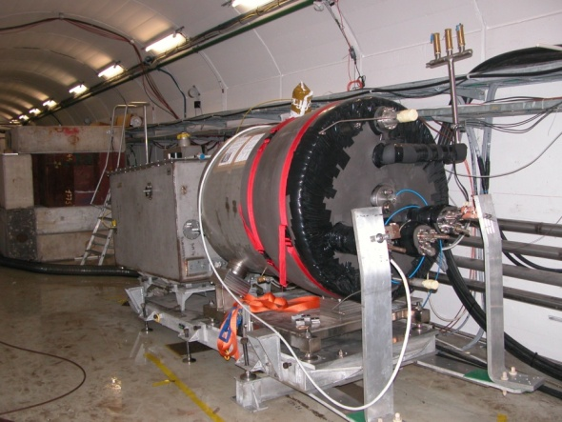

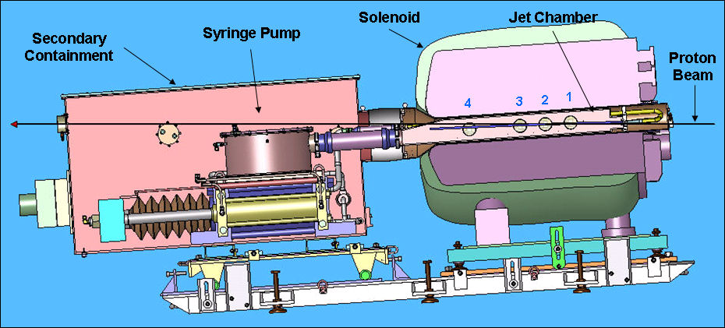
The MERIT Experiment
The MERIT Experiment at the CERN PS
  Proof-of-principle demonstration of a liquid Hg jet target in high-field solenoid in Fall `07
  Demonstrated a 20m/s liquid Hg jet injected into a 15 T solenoid and hit with a 115 KJ/pulse beam!
  a Technology OK for beam powers up to
  8 MW with a repetition rate of 70 Hz!
1 cm
Hg jet in a 15 T solenoid
with measured disruption length ~ 28 cm

Slide 18
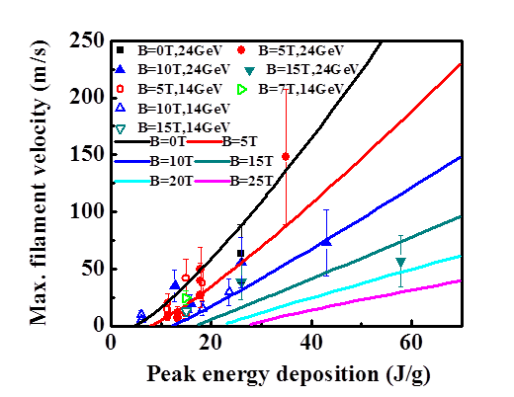
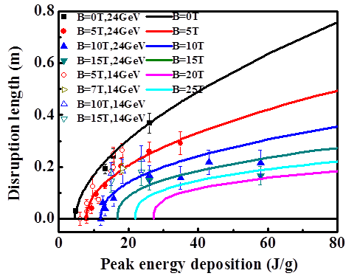
MERIT Results
Jet Disruption Length
Filament Ejection Velocity

Slide 19
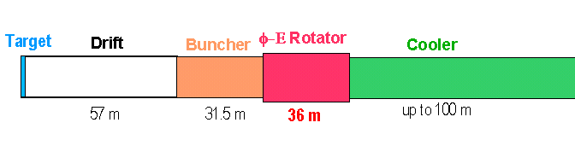
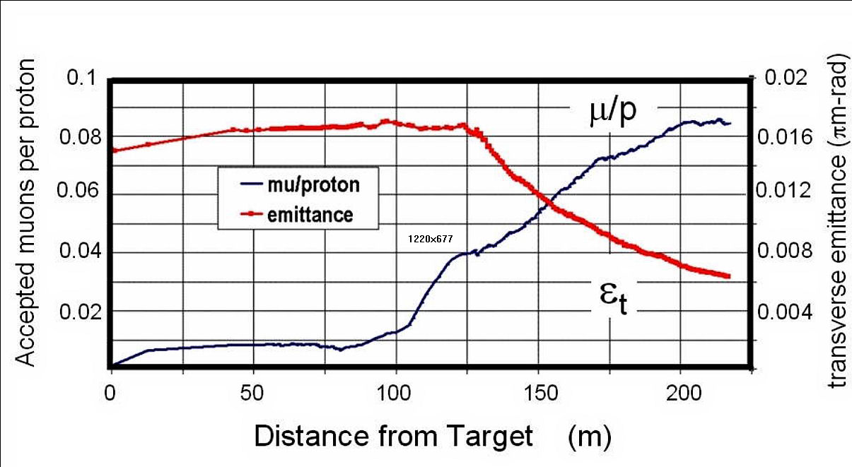
The Front End
Neuffer
A multi-MW proton source will enable O(10²¹) muons/year to be produced, bunched and cooled within the acceptance of a subsequent accelerator.

Slide 20
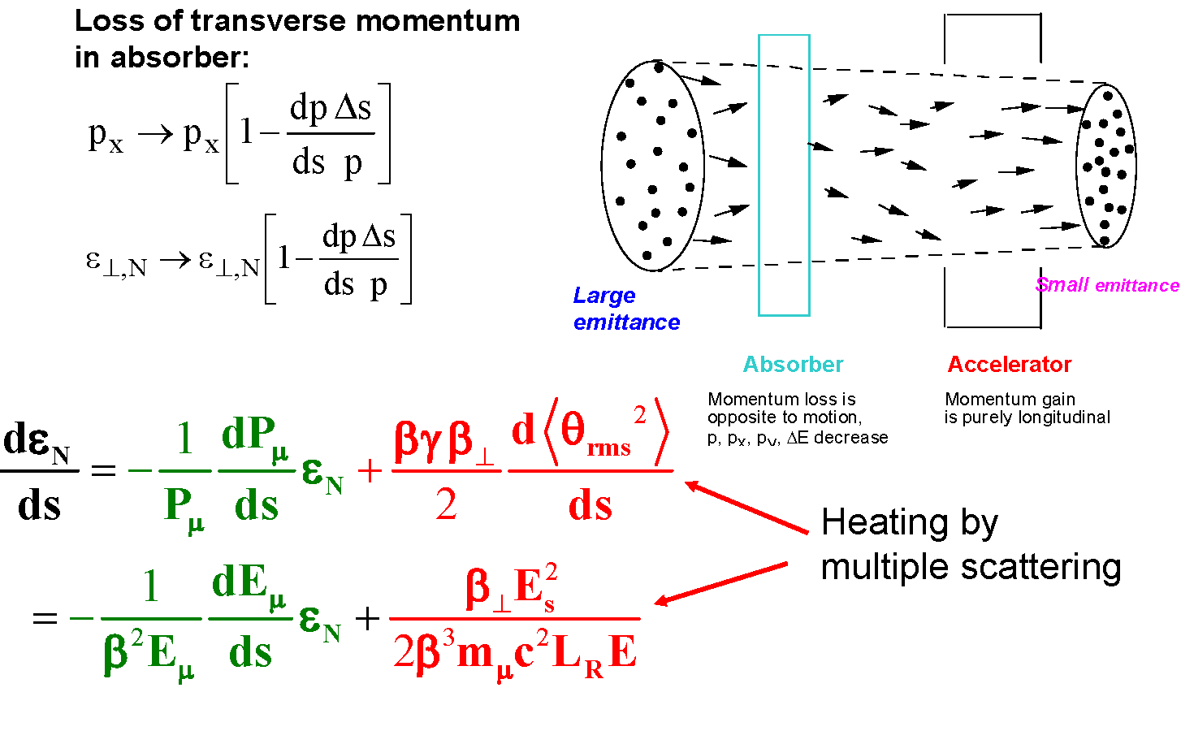
Ionization Cooling (D. Neuffer, FNAL)

Slide 21
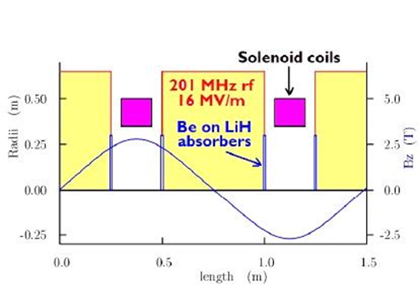
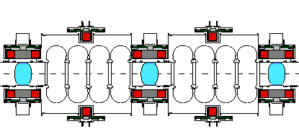
Transverse 4D Cooling
IDS-NF Cooling Cell
Focusing Solenoids
RF
MICE Cooling Cells

Slide 22
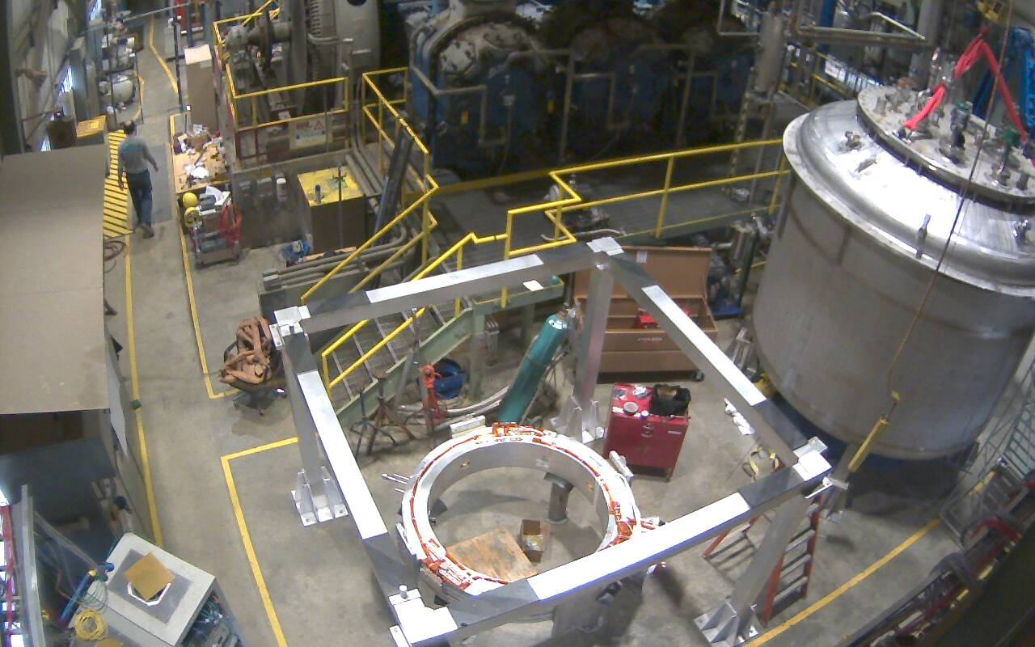
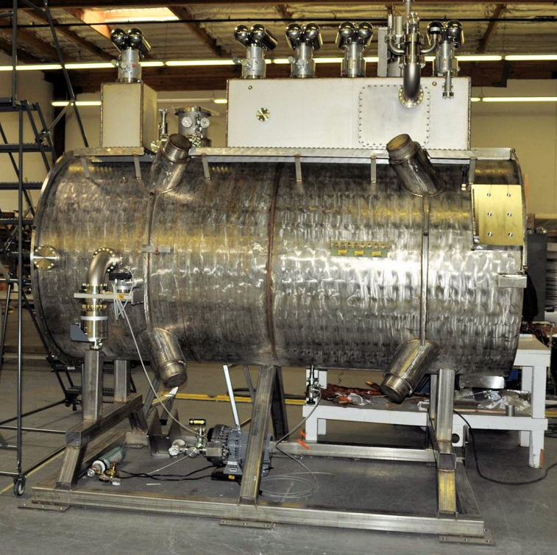
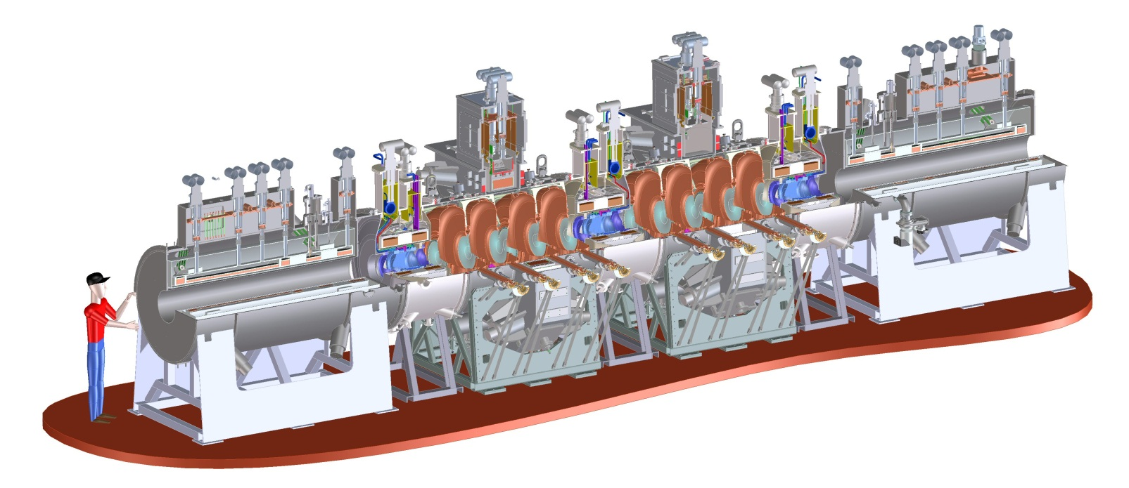
Muon Ionization Cooling Experiment (MICE)
First Coupling Coil Cold Mass
Being Readied for Training
First Spectrometer Solenoid
Now Commissioned!
Fermilab Solenoid Test Facility
  Initial beam emittance intrinsically large
Muon Cooling a Ionization Cooling
    dE/dx energy loss in materials
    RF to replace p_{long}
MICE
RF-Coupling
Coil (RFCC)
Units
Spectrometer
Solenoids

Slide 23
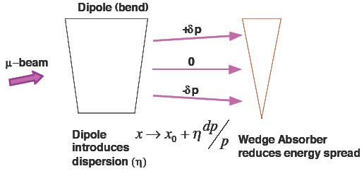
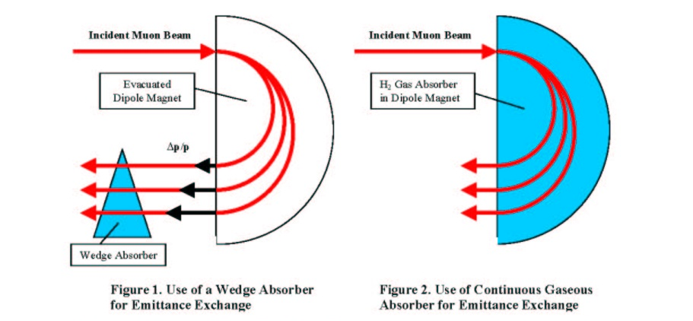

Longitudinal Ionization Cooling

Slide 24
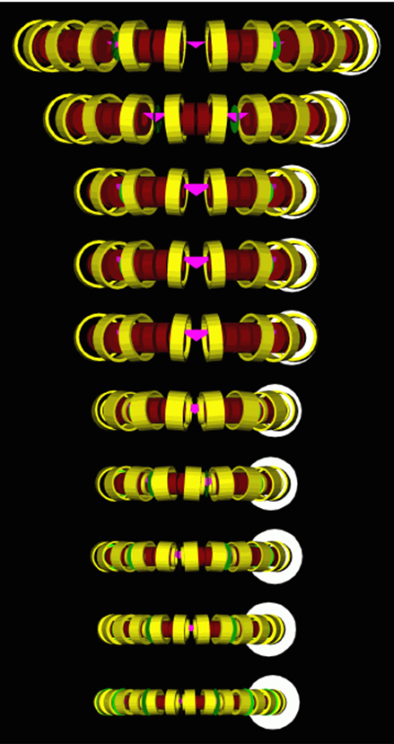
6D Cooling Rings
The “Guggenheim” Approach
Beam dispersion in each ring
Wedge absorbers in each ring
Smaller rings feature higher frequency RF and stronger focusing solenoids
Requires injection and extraction systems for each ring

Slide 25
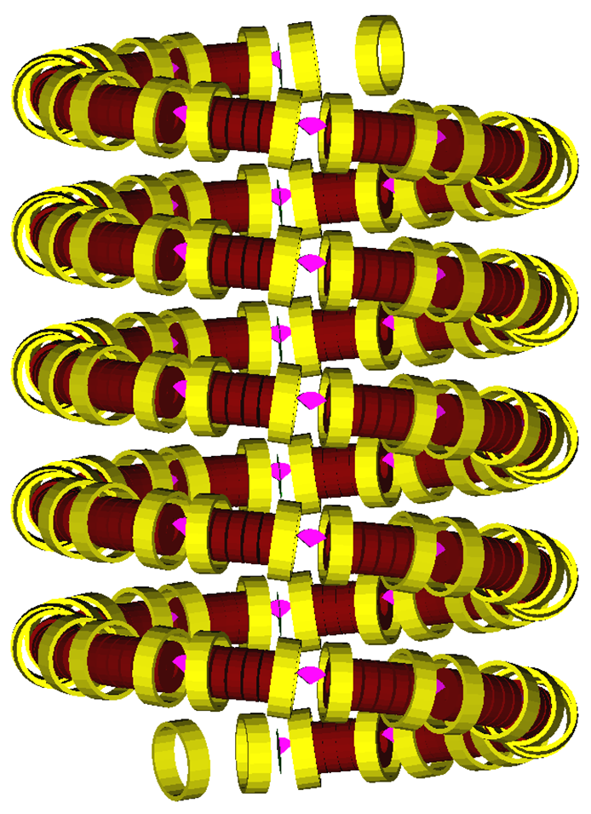
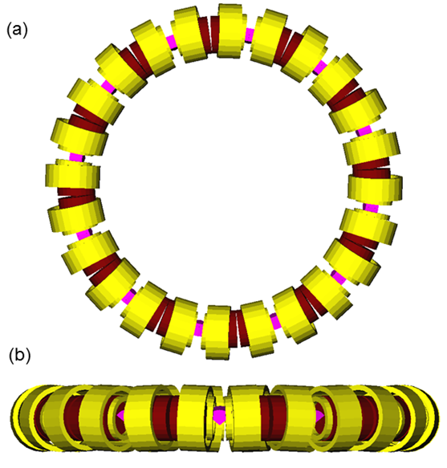
Elimination of Injection/Extraction
Requires Injection/Extraction
Injection/Extraction not Required

Slide 26
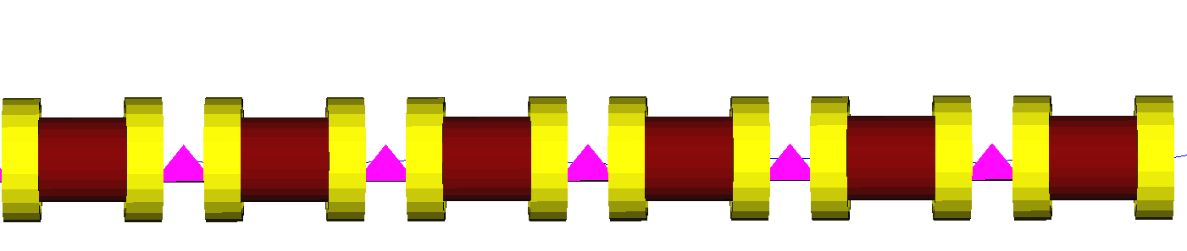
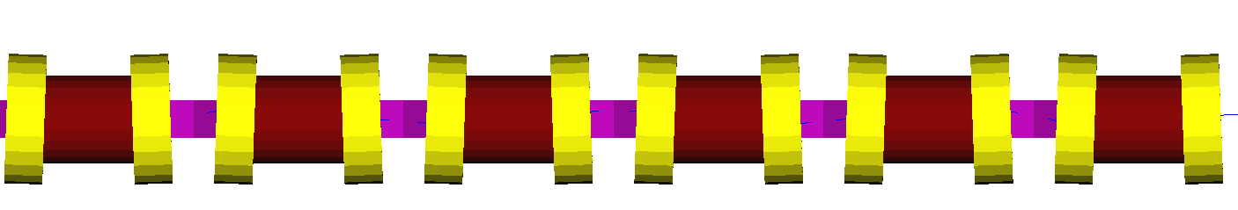
A Rectilinear 6D Cooling Channel
V. Balbekov, FNAL
TOP VIEW
SIDE VIEW
SIDE VIEW
Tilted alternating solenoids with wedge absorbers
26

Slide 27
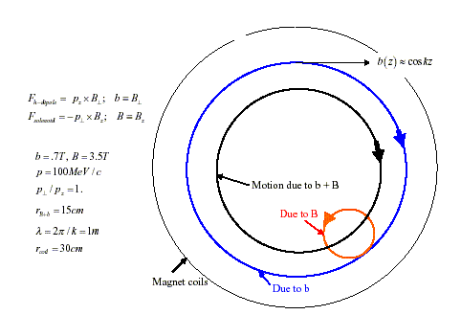
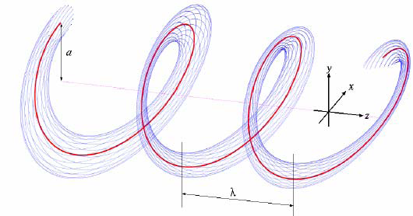
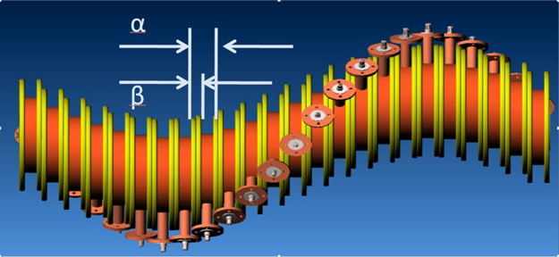
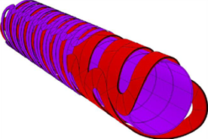
Helical Cooling Channel
High Momentum
Low Momentum
Channels filled
With HP H₂ Gas
Helical Snake Design
Linear Helical Solenoid Design

Slide 28
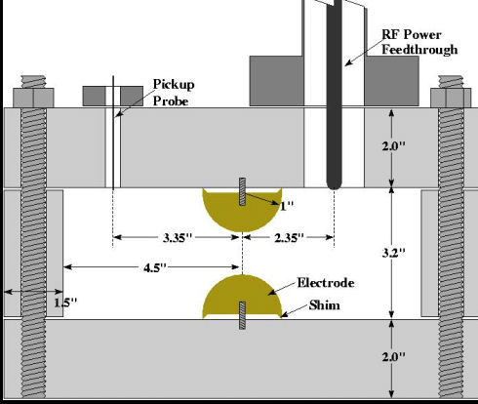
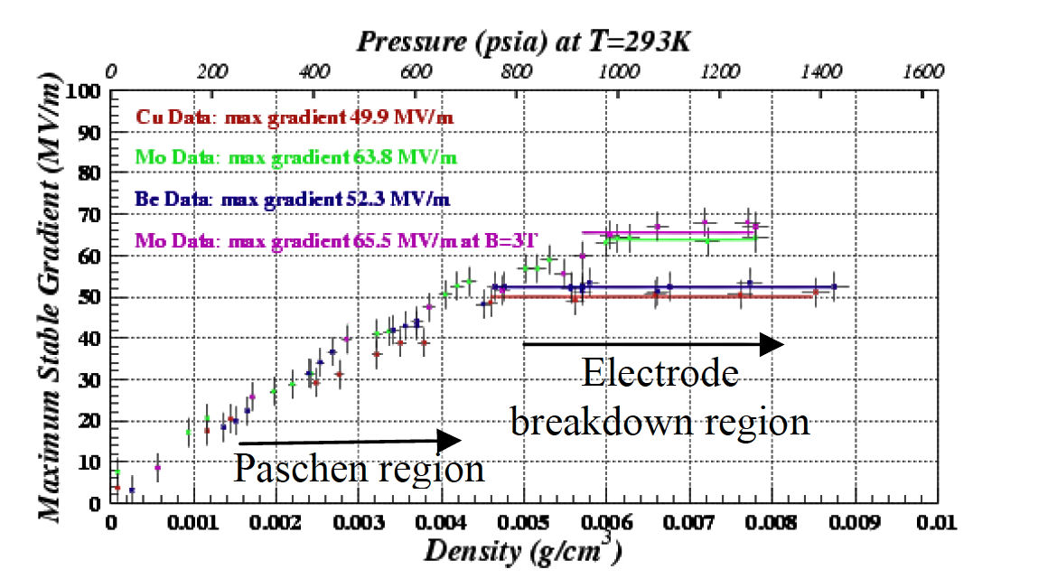
High-Pressure H₂ Filled Cavities
Muons, Inc.
High Pressure Test Cell
Study breakdown properties of materials in H₂ gas
Operation in B field
  No degradation in up to 3T
No Difference
B=0 & B=3T

Slide 29
The MC Cooling Scenario

Slide 30
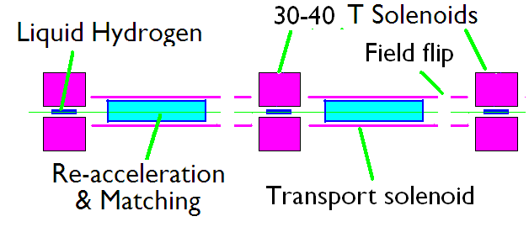
Proposed Final Cooling Lattice
R.B. Palmer

Slide 31
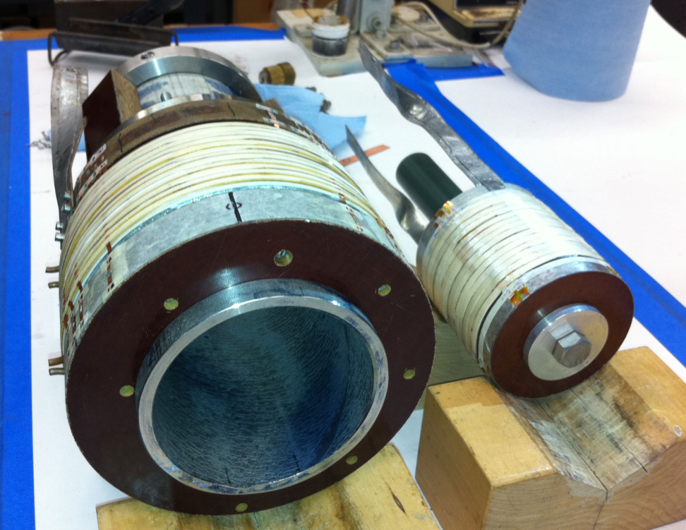
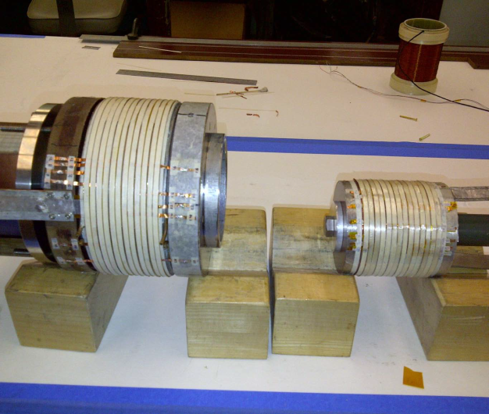
Two Solenoids are being built and tested
Solenoid #1
(Mid-sert)
ID = 10cm
OD=17cm
24 Pancakes
Solenoid #2
(Insert)
ID = 2.5cm
OD=9.1cm
14 Pancakes

Slide 32
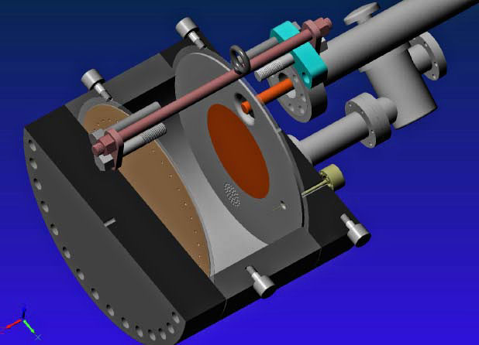
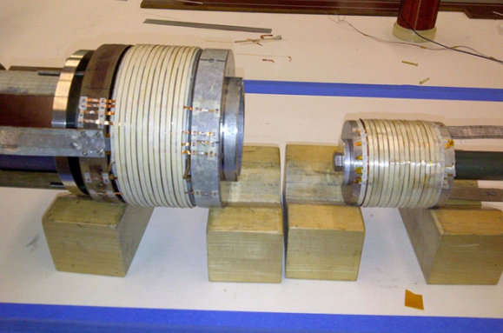
Recent Technology Highlights
Successful Operation of 805 MHz “All Seasons” Cavity in 3T Magnetic Field under Vacuum
MuCool Test Area/Muons Inc
World Record
HTS-only Coil
15T on-axis field
16T on coil
PBL/BNL
Demonstration of High Pressure RF Cavity in 3T Magnetic Field with Beam
Extrapolates to
μ-Collider Parameters
MuCool Test Area
Breakthrough in HTS Cable Performance with Cables Matching Strand Performance
FNAL-Tech Div
T. Shen-Early Career Award
1% Dry Air (0.2% O2) in GH2
Pure GH2
1% Dry Air
(0.2 % O2)
in GH2 at
B = 3T
~50X reduction in
RF power dissipation
E₀ = 25 MV/m

Slide 33
A Staging Scenario
Facility Required New Technology
νSTORM ----
Entry Level νFactory Solenoid Capture; RF in 3-T B Field
High Luminosity νFactory 4D Cooling, Multi-MW Target Station
Higgs Factory 6D Cooling
Muon Collider High-Field Solenoids

Slide 34
The MAP Timeline
Physics program can build on Phase II of Project X

Slide 35
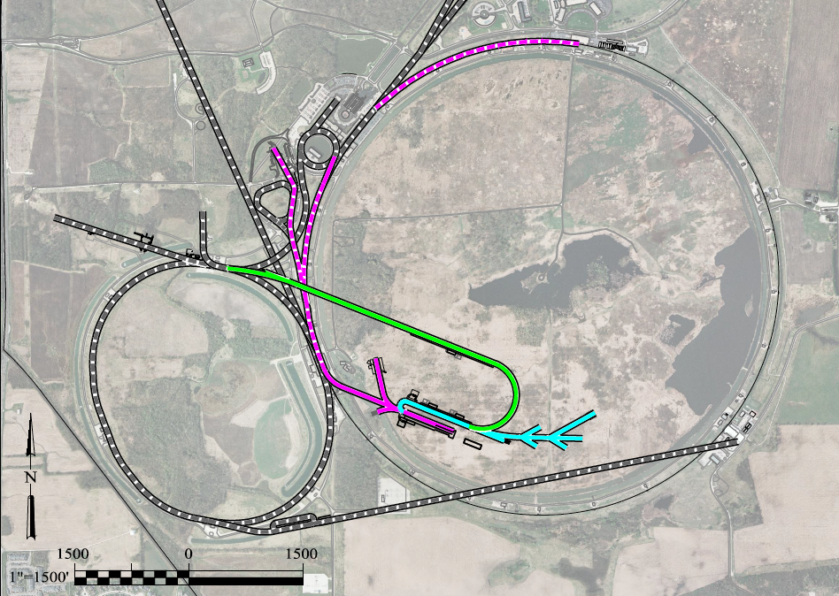
A Staging Scenario
Based on FNAL project X
Very preliminary
work in progress
To Homestake
LBNE
Buncher/
Accumulator
Rings & Target
RLA to 63 GeV +
300m Higgs Factory
NF Decay Ring:
νs to Homestake
Front End+4D+6D
Project X
Stage III
Linac + RLA to ~4 GeV
Project X
Stage II
Project X
Stage I
νSTORM + Muon Beam
R&D Facility

Slide 36
SUMMARY
  Muons provide an attractive option for a future Lepton Collider
  The U.S. Muon Accelerator Program has embarked on a 6-year MC fesaability study
  Key technical issues are being addressed
    Multi-MW Target Stations
    High-gradient RF in strong magnetic fields
    High-field (30-40T) solenoid development
    6D Cooling (Critical for a Muon Collider)

Slide 37
Backup Slides

Slide 38
Muon Collider - Neutrino Factory Comparison
NEUTRINO FACTORY
ν Factory Goal:
O(10²¹) μ/year
within the
accelerator
acceptance
Share same complex
MUON COLLIDER

Slide 39
The Lepton Advantage
Proton are composite particles while leptons are point-like
Proton collisions are richer but more complicated.
Lepton collisions tend to be simpler and easier to decipher.
For colliding leptons, the full energy of the collision is available. The energy reach of a 1.4TeV lepton machine is roughly equivalent to the 14TeV LHC.

