Slide 1
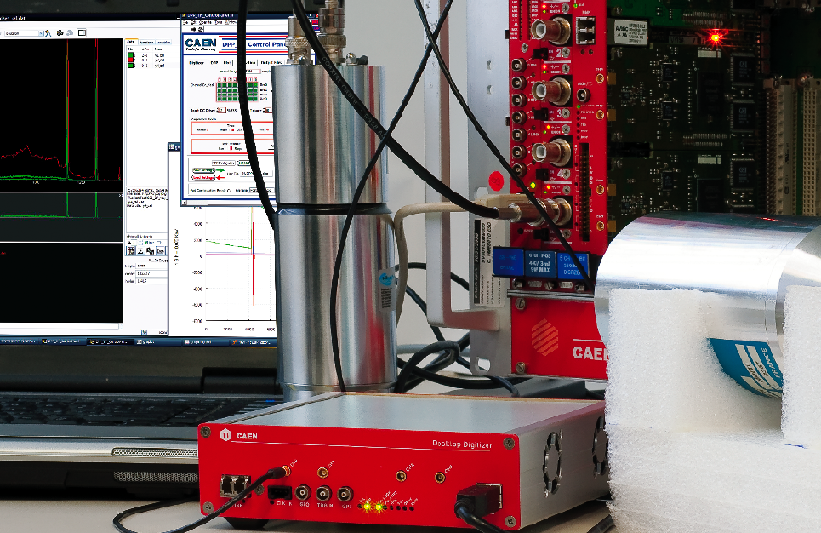
Tools for Discovery
Digital Readout and Advanced Triggering
May 17th 2013, Centro Volta
Marco Locatelli
-CAEN-

Slide 2
The Digital Approach
Digital readout is now a standard in modern physics experiments and applications:
. HEP
. Nuclear
. Astroparticle
. Fusion
. Homeland Security, Environmental, Medical…
On board Digital Pulse Processing (DPP) ensures:
. Flexibility
. Data Reduction
. Trigger Logic
Reproduction, transfer, distribution of part or all of the contents in this document in any form without prior written permission of CAEN S.p.A. is prohibited
Notes:
2

Slide 3
Trigger modalities
Use of an External Global Trigger
. Typically used in accelerator experiment: machine trigger, dedicated trigger electronics
. Synchronized Digitizers triggered on the TRG_IN connector
Example: XMASS Experiment (Kamioka, JPN)
Main Features:
640 Channels
V1751 based (1 GS/s, 10 bit)
No trigger propagation
No on-board trigger logic
Waveform Acquisition
Data Reduction through DPP-ZLE
Reproduction, transfer, distribution of part or all of the contents in this document in any form without prior written permission of CAEN S.p.A. is prohibited
Notes:
3

Slide 4
On Board Trigger Logic
Digitizer running DPP Firmware can:
Propagate local triggers from each channel to the others within the board
TR-TV mode: triggers from other channels (trigger requests) can be used as trigger validation. Coincidence, Neighbor Triggering…
Apply individual trigger masks and simple combinatorial logics on board (AND, OR, Majority)
Reproduction, transfer, distribution of part or all of the contents in this document in any form without prior written permission of CAEN S.p.A. is prohibited
Notes:
4

Slide 5
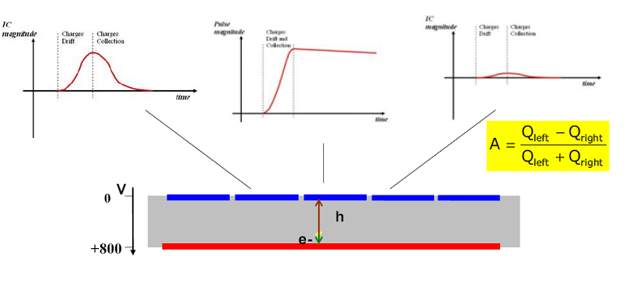
On Board Trigger Logic
Example: ProSPECTus (Liverpool, UK)
Main Features:
32 Channels (Segmented Clover Detector)
V1724 based (100 MS/s, 14 bit)
Waveform Acquisition
Trigger Logic: One channel triggers itself and also neighbour channels
Reproduction, transfer, distribution of part or all of the contents in this document in any form without prior written permission of CAEN S.p.A. is prohibited
Notes:
5

Slide 6
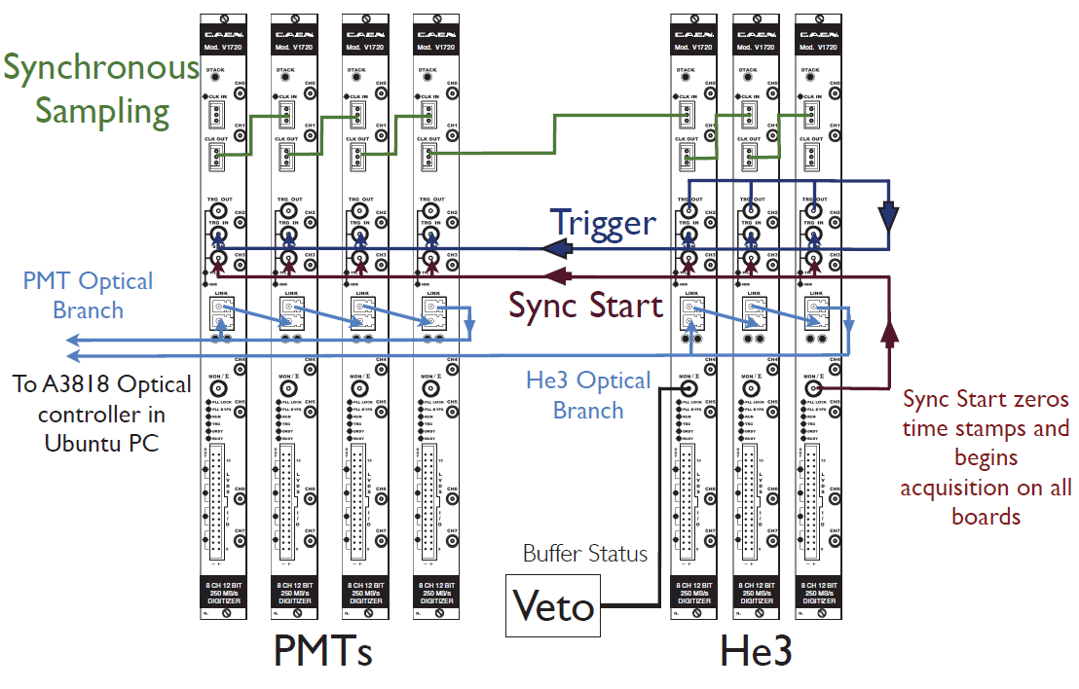
Trigger Propagation
Trigger Propagation:
Result of on-board logic on one board can be propagated to other boards through TRG_OUT - TRG_IN daisy chain
No use of External Logic Units
Example: FaNS array at NIST (Gaithersburg, USA)
Main Features:
56 Channels (Plastics, He3 Tubes)
V1720 based (250 MS/s, 10 bit)
Waveform Acquisition
Trigger propagation
Trigger logic: OR of the He3 channels
Data Reduction through DPP-ZLE
Reproduction, transfer, distribution of part or all of the contents in this document in any form without prior written permission of CAEN S.p.A. is prohibited
Notes:
6

Slide 7
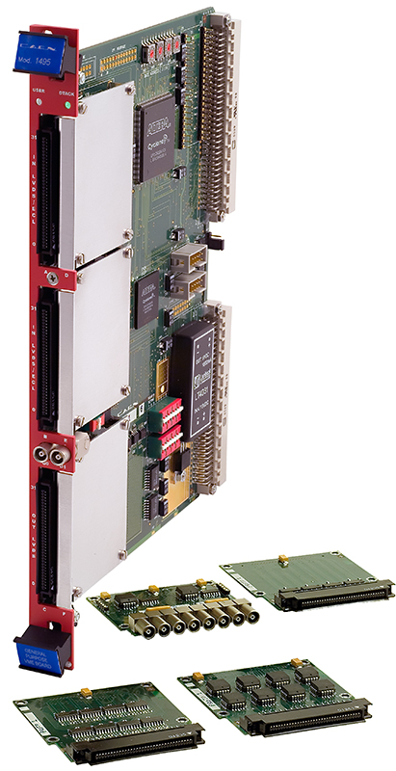
External Trigger Logic
High Level Triggering:
Complex trigger requirements can be achieved through the use of External Logic Units → CAEN V1495
User programmable FPGA for customized logic
High number of I/Os expandable with different piggy backs
Take advantage of digitizers LVDS I/Os:
. Over-thresholds
. Busy
. Veto
. Individual Trigger propagation
Reproduction, transfer, distribution of part or all of the contents in this document in any form without prior written permission of CAEN S.p.A. is prohibited
Notes:
7

Slide 8
External Trigger Logic
CLOCK MASTER
BOARD
CLOCK DISTRIB.
Progr. Phase shift
SLOW CONTROL
VME
V1718
VME-USB
TRIGGER
LOGIC
(V1495)
TRIGGER
SYNC START/STOP
CONET OPTICAL LINK
Readout and/or control
80MB/s, up to 4x8 boards
TRIGGER / SYNC
CONET
A3818
PCIe
DISCRIM
ANALOG OUT
Thr
ANALOG OUTPUT
Linear Sum,
Majority
One PC can read up to 32 boards (256 channels!)
INDIVIDUAL TRIGGER IN/OUT
Reproduction, transfer, distribution of part or all of the contents in this document in any form without prior written permission of CAEN S.p.A. is prohibited
Notes:
8

Slide 9
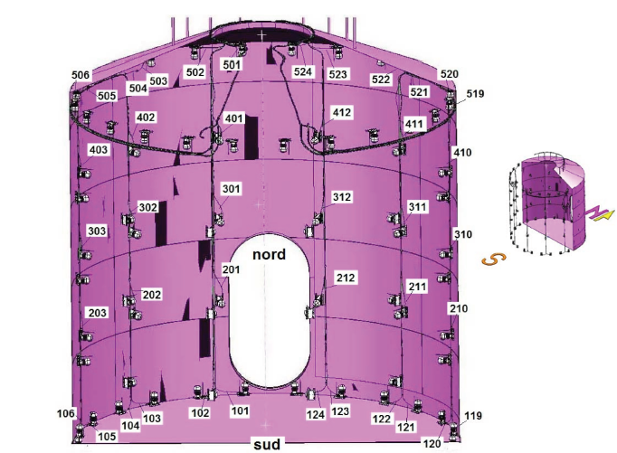
External Trigger Logic
Example: Muon VETO Xenon1T (LNGS, Italy)
Main Features:
88 Channels (PMTs)
V1724 based (100 MS/s, 14 bit)
Waveform Acquisition
Trigger propagation via V1495
Trigger logic:
In the digitizers:
Threshold is set channel by channel
LVDS Output programmed to activate if the threshold
is exceeded
88 bits (1 per channel) sent to V1495
In the V1495:
a time window W and a threshold N on the number of incoming triggers is set.
If the number of incoming signals is > N in the time window W triggers are propagated
Reproduction, transfer, distribution of part or all of the contents in this document in any form without prior written permission of CAEN S.p.A. is prohibited
Notes:
9

Slide 10
Conclusions
Digital Readout is a well established and reliable technique.
Synchronization made it ideal for both small lab applications and big physics experiment.
Digital Pulse Processing is a powerful data reduction tool.
On-board Logic manage easily simple trigger conditions and propagation.
Very complex trigger conditions can be achieved by programming external logic units.
Reproduction, transfer, distribution of part or all of the contents in this document in any form without prior written permission of CAEN S.p.A. is prohibited
Notes:
10

Slide 11
Thank you!
Reproduction, transfer, distribution of part or all of the contents in this document in any form without prior written permission of CAEN S.p.A. is prohibited
Notes:
11

