Slide 1

Recent investigations on rare nuclear processes in the DAMA set-ups and LNGS Ge facility (STELLA)
R. Cerulli
INFN-LNGS
Seminar at LNGS March 27, 2013

Slide 2
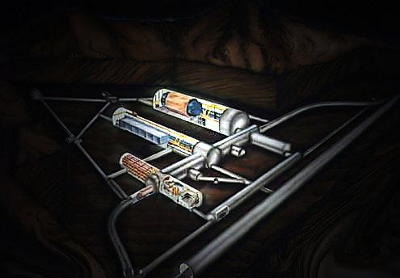
DAMA project
The DAMA project was proposed to develop and to exploit low background scintillator in order to investigate rare processes
DAMA/LIBRA ( DAMA/NaI)
DAMA/LXe
DAMA/R&D
DAMA/Crys
DAMA/Ge and Ge facility
Collaboration:
Roma Tor Vergata, Roma La Sapienza, LNGS, IHEP/Beijing
+ by-products and small scale expts.: INR-Kiev
+ in LNGS: Chemistry Lab and Ge facility (STELLA)
+ some activities: JINR-Dubna Russia, ITEP-Moscow Russia, Nikolaev Institute of Inorganic Chemistry - Novosibirsk Russia, Institute of Physics and Technology- Kharkiv Russia, University of Jyvaskyla Finland, IIT-Ropar India
+ neutron meas.: ENEA-Frascati
Web Site: http://people.roma2.infn.it/dama

Slide 3
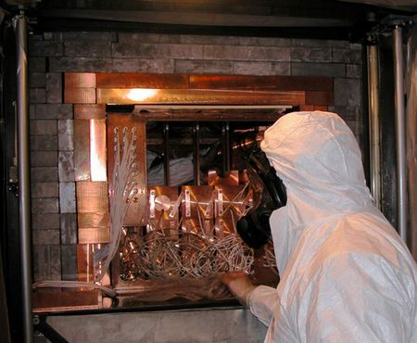
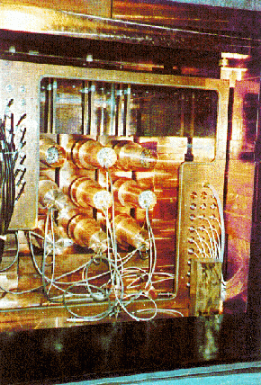
Main results
DAMA/LIBRA
Radiopurity, performances, procedures, etc.
NIMA592(2008)297, JINST 7 (2012) 03009
Results on DM particles, Annual Modulation Signature EPJC56(2008)333, EPJC67(2010)39,PRD84(2011)055014
Results on other rare processes
EPJC62(2009)327, EPJC72(2012)1920
DAMA/NaI
Performances:
N.Cim.A112(1999)545-575, EPJC18(2000)283, Riv.N.Cim.26 n. 1(2003)1-73, IJMPD13(2004)2127
Results on DM particles:
PLB424(1998)195, PLB450(1999)448, PRD61(1999)023512, PLB480(2000)23, EPJC18(2000)283, PLB509(2001)197, EPJC23(2002)61, PRD66(2002)043503, Riv.N.Cim.26 n.1(2003)1, IJMPD13(2004)2127, IJMPA21(2006)1445,
EPJC47(2006)263, IJMPA22(2007)3155, EPJC53(2008)205, PRD77(2008)023506, MPLA23(2008)2125.
Results on rare processes:
PLB408(1997)439, PRC60(1999)065501, PLB460(1999)235, PLB515(2001)6,
EPJdirect C14(2002)1, EPJA23(2005)7, EPJA24(2005)51
DAMA/LXe
Performances
NIMA482(2002)728
Results on DM particles,
PLB436(1998)379, PLB387(1996)222, NJP2(2000)15.1, PLB436(1998)379, EPJdirectC11(2001)1
Results on rare processes
PLB527(2002)182, PLB546(2002)23, A.P.5(1996)217, PRD61(2000)117301, PLB465(1999)315, Beyond the Desert (2003)365, PLB493(2000)12, EPJA27s01(2006)35

Slide 4
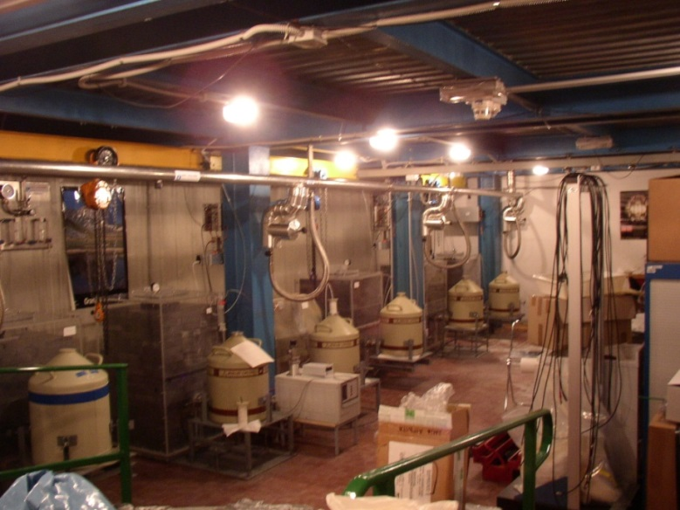
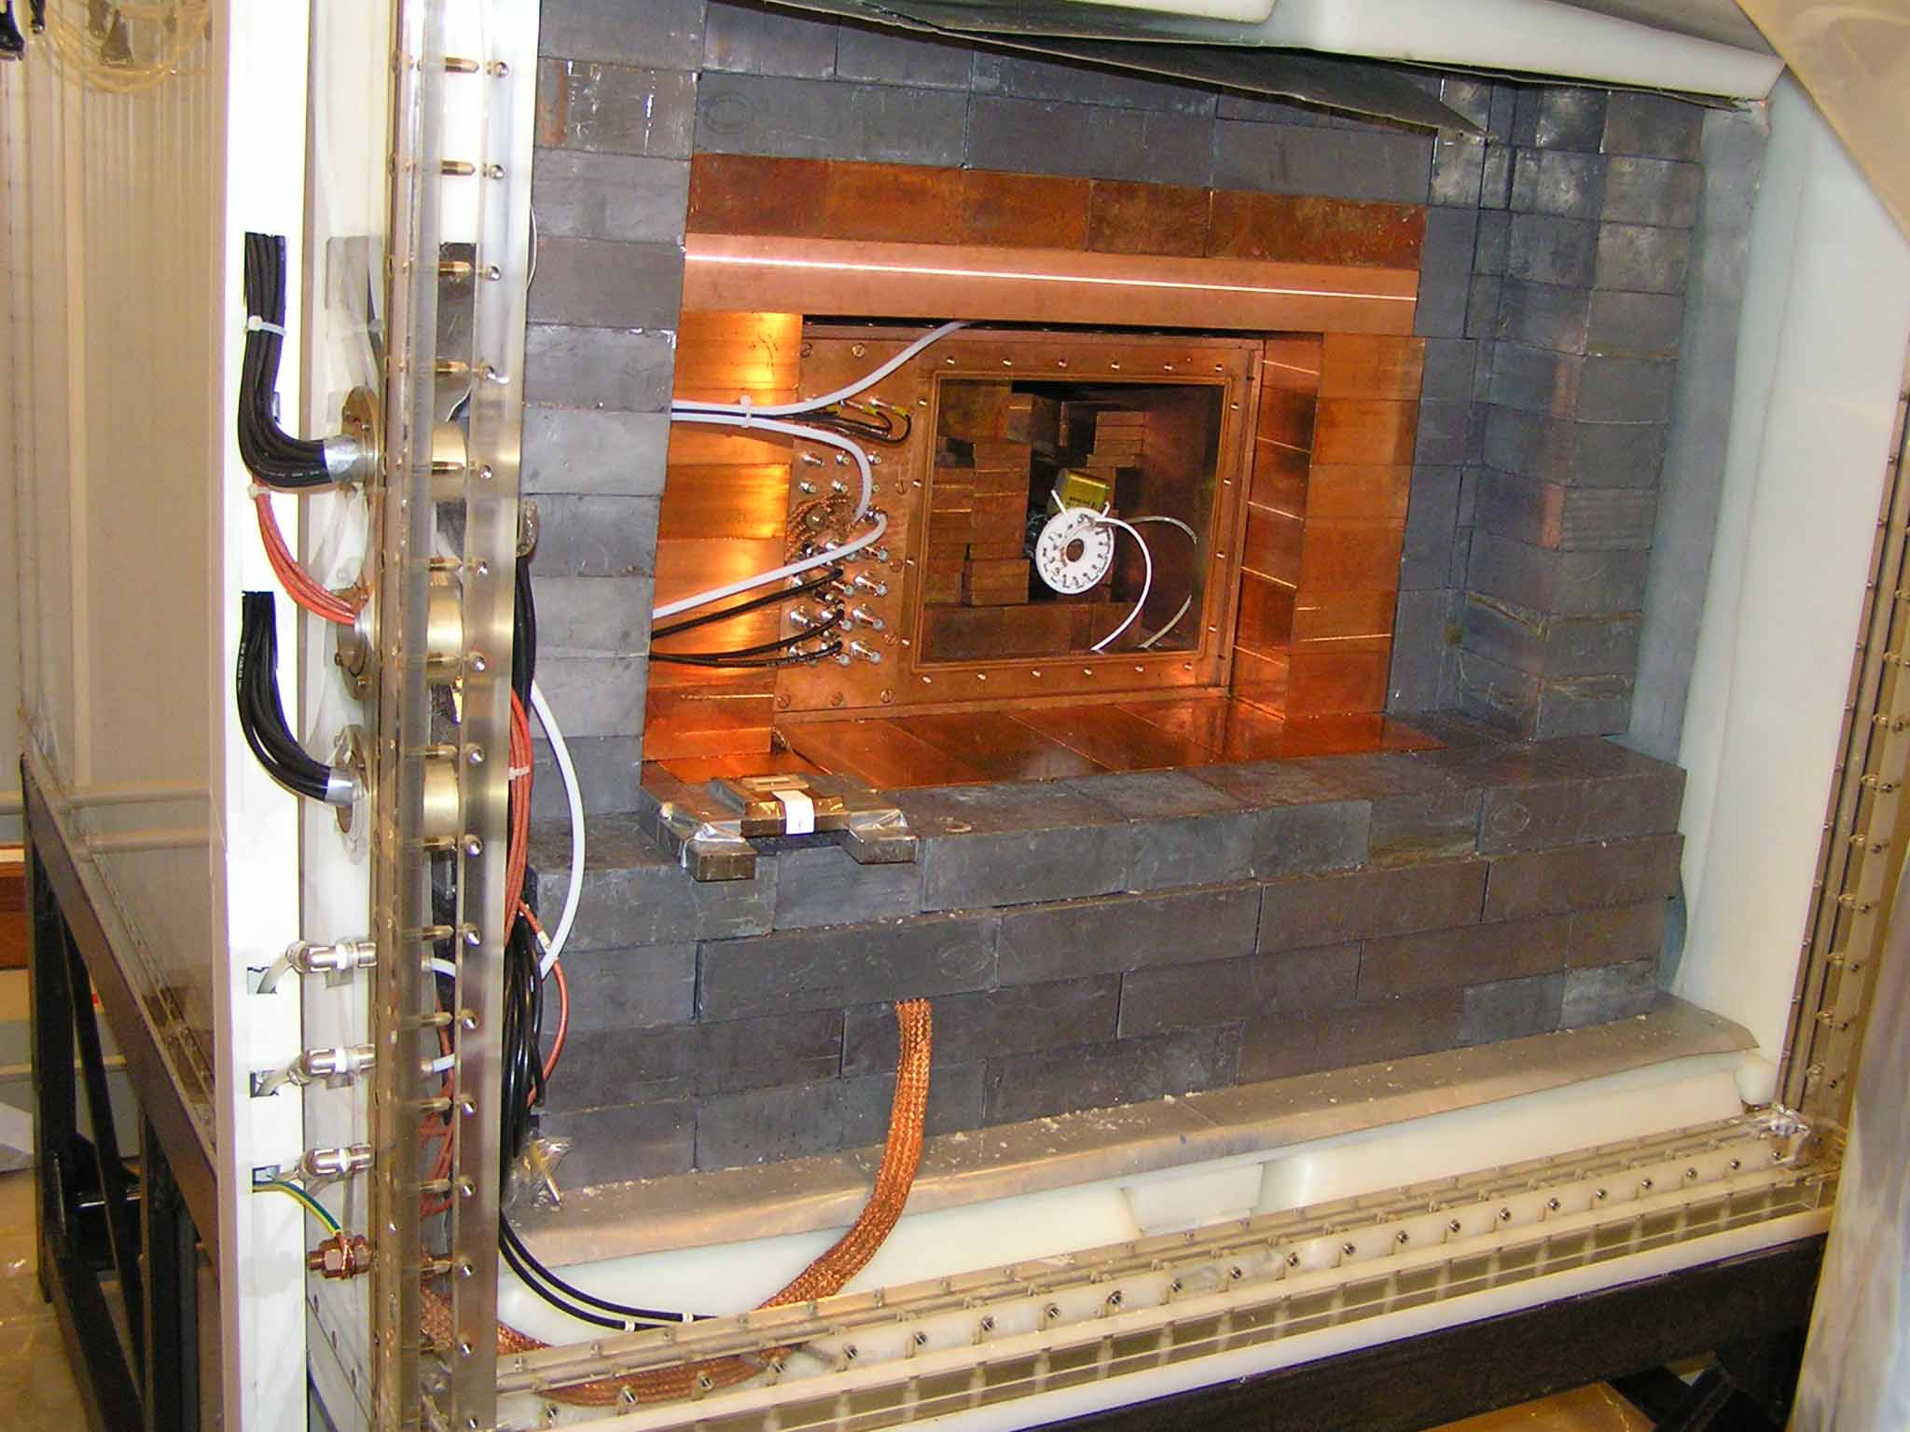
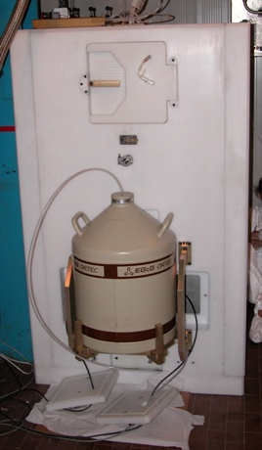
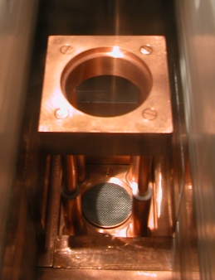
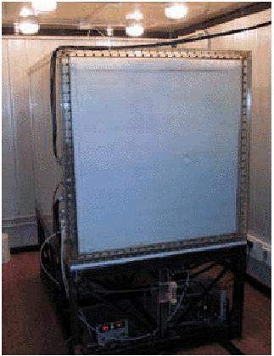
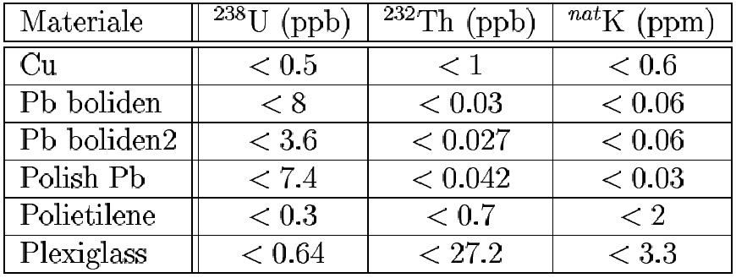
DAMA/R&D
DAMA/Ge and STELLA
Hermetic Copper box
Copper
Detector
Hermetic Plexiglass box maintained in HP Nitrogen atmosphere
Paraffin
Lead
Cadmium

Slide 5
DAMA activity in the R&D set-up and in the LNGS Ge facility
Systematical studies and development of various crystal scintillators for low background physics:
scintillator development: radio-purification, enrichment, optical features, etc.
exploiting the potentiality of the low background scintillation technique
studying various experimental approaches to perform measurements on rare processes with high sensitivity
realization of pilot experiments
  CaF₂(Eu), CeF₃, BaF₂, CdWO₄, ¹⁰⁶CdWO₄, ¹¹⁶CdWO₄, ZnWO₄, LaCl₃(Ce), LiEu(BO₃)₃, LiF(W), CeCl₃, Li₂MoO₄, SrI₂(Eu), etc.
  Samples and powders measurements in HPGe also to investigate several rare processes
  Platinum, Osmium, Dysprosium, Molybdenum, Ruthenium, Lithium, etc.

Slide 6
Physics in DAMA/R&D and LNGS Ge facility
Dark Matter with CaF2(Eu)
Solar Axions
2β decay in various isotopes
Observation of rare α decays
highly forbidden β decay
Cluster decay
CNC decay
2β⁻2v observed for several nuclides
experiments mainly on 2β⁻
(T_{1/2} ∼10²³-10²⁵ yr)
2β⁺ decay:
- 34 candidates for 2ε,
22 also for εβ⁺ , 6 also for 2β⁺
2β⁺2v not observed yet (indication ¹³⁰Ba in geoch. exp.)(T_{1/2} ∼10¹⁸-10²¹ y)
2ε and εβ⁺ important: observation of 0ν mode could help to distinguish between the mechanisms of neutrinoless 2β decay (non-zero neutrino mass or right-handed admixtures in weak interactions)
DAMA focus on search for 2β⁺ decay
AP7(1997)73, N.Cim.A110(1997)189, NPB563(1999)97, AP10(1999)115, NPA705(2002)29, NIMA498(2003)352, NIMA525(2004)535, NIMA555(2005)270, UJP51(2006)1037, NPA789(2007)15, PRC76(2007)064603, PLB658(2008)193, EPJA36(2008)167, NPA824(2009)101, NPA826(2009)256, JPG:NPP38(2011)115107, JPG: NPP38(2011)015103, PRC85(2012)044610, JINST6(2011)P08011, PRC85(2012)044610
NIMA572(2007)734, NPA806(2008)388, EPJA42(2009)171, NPA824(2009)101, NIMA607(2009) 573, NIMA846(2010)143, NIMA615(2010)301, NPA846(2010)143, EPJA47(2011)91, NPA859(2011)126, PRC83(2011)034603, NIMA626-7(2011)31, PLB711(2012)41, NIMA670(2012)10, NIMA704(2013)40, EPJC73(2013)2276, EPJA49(2013)24, PRC87(2013) 034607

Slide 7
Summary of the results presented in this talk
First observation of α decay of ¹⁹⁰Pt to the first excited level of ¹⁸⁶Os
First observation of α decay of ¹⁵¹Eu in ¹⁴⁷Pm
First preliminary hint of α decay of ¹⁸⁴Os to the first excited 2⁺ level of ¹⁸⁰W
New measurement of 2ν2β decay of ¹⁰⁰Mo to the first excited 0+ level of ¹⁰⁰Ru
Development of ¹⁰⁶CdWO₄ crystal scintillators to search for 2β in ¹⁰⁶Cd
Development of ¹¹⁶CdWO₄ crystal scintillators to search for 2β in ¹¹⁶Cd
Development of ZnWO4 crystal scintillators to search for 2β in Zn and W
Other results and future perspectives on various topics

Slide 8
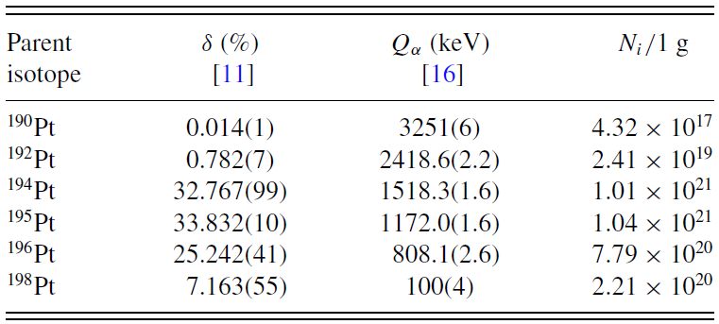
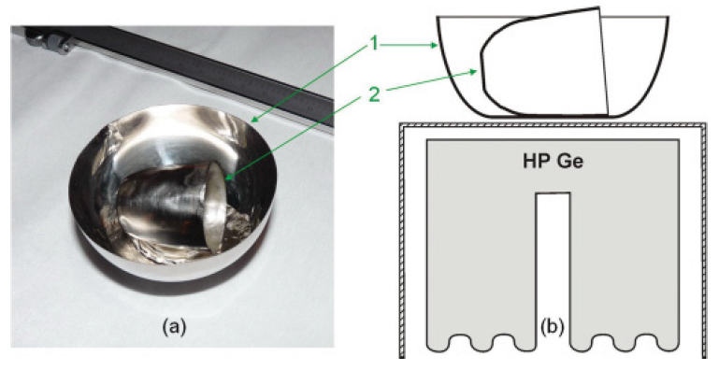
First observation of α decay of ¹⁹⁰Pt to the first excited level of ¹⁸⁶Os
PHYS.REV.C83 (2011)034603
Pt isotopes potentially unstable to α decay
α decay ¹⁹⁰Pt → of ¹⁸⁶Os (g.s.) previously observed:
T_{1/2} = (6.5 ± 0.3) × 10¹¹ yr
Our work: α decay to 1st excited level ¹⁸⁶Os (J^{p}=2⁺)
E_{exc} = 137.2 keV ⇒ Q_{α} = 3114(6) keV
(Theor. half-life ∼10¹³–10¹⁴ yr)
The experimental set-up
Pt crucibles (42.53 g) measured in HPGe (GeCris) (468 cm³, FWHM=2.0 keV@1332 keV )
T (sample) = 1815.4 h
T(bckg) = 1045.6 h
detector shielded by layers of low-radioactive copper (∼10 cm) and lead (∼ 20 cm)
Setup continuously flushed by high-purity boil-off nitrogen

Slide 9
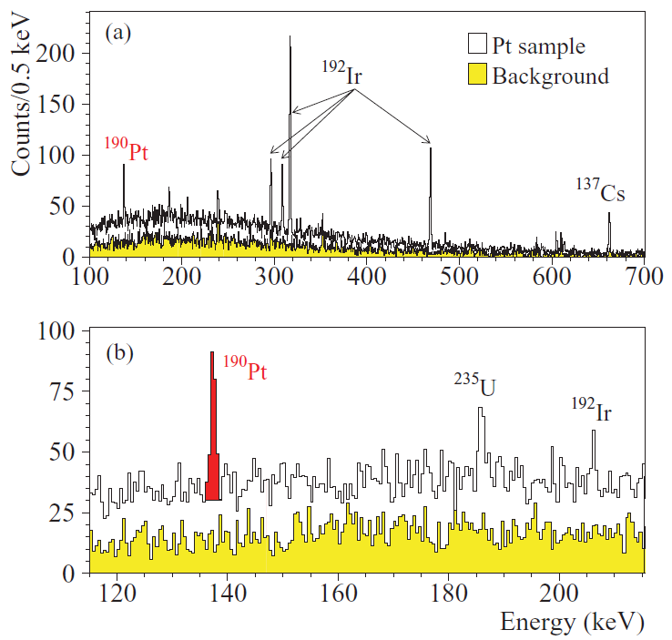
First observation of α decay of ¹⁹⁰Pt to the first excited level of ¹⁸⁶Os
PHYS.REV.C83 (2011)034603
No significant contamination by “usual” radioactive contaminants: U/Th series, ⁴⁰K, ⁶⁰Co
¹⁹²Ir present: 49 ±3 mBq/kg (cosmogenic activation of Pt by cosmic rays at the Earth’s surface)
1815 h
Peak at (137.1 ± 0.1) keV absent in the background spectrum
The presence of an excess around 137 keV is credited at about 8σ
Other processes mimicking the decay excluded
T_{1/2} in relevant agreement with theoretical calculations based on the liquid drop model and the description of the α decay as a very asymmetric fission process

Slide 10
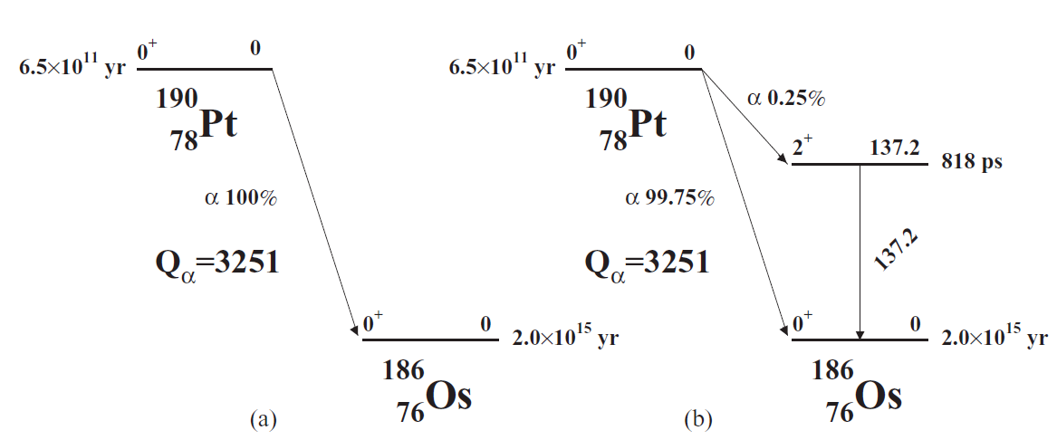
Implication and perspectives
PHYS.REV.C83 (2011)034603
Old scheme of the ¹⁹⁰Pt α decay and the updated scheme after our observation of the ¹⁹⁰Pt→¹⁸⁶Os(2⁺) transition
… and more:
Improved T_{1/2} limits for α decays of other Pt isotopes at level of 10¹⁶–10²⁰ yr
First limits on:
resonant 0ν2ε in ¹⁹⁰Pt: T_{1/2} ∼ 10¹⁴-10¹⁶yr
2β of ¹⁹⁸Pt to the 411.8 keV excited level of ¹⁹⁸Hg: T_{1/2} > 3.5×10¹⁸yr
New measurements with ~200 g Pt sample are foreseen

Slide 11
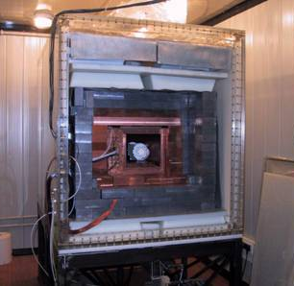
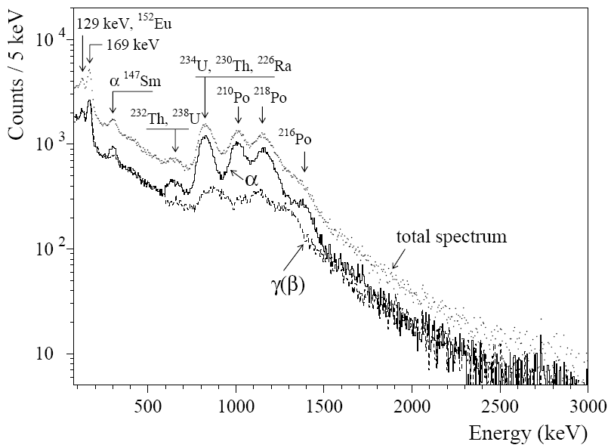
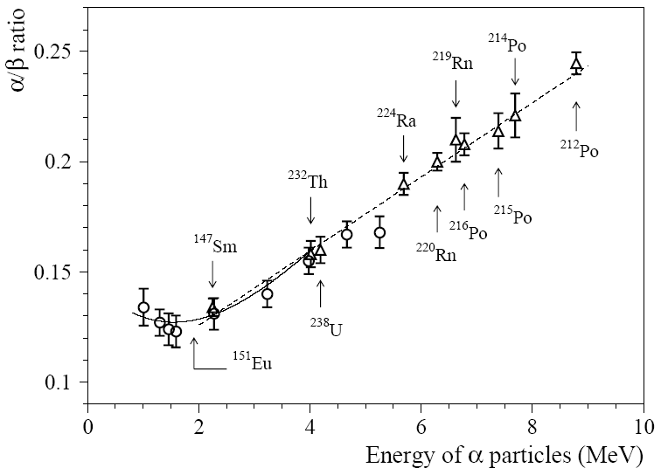
First observation of the α decay of ¹⁵¹Eu in ¹⁴⁷Pm
Nucl. Phys. A 789 (2007) 15
¹⁵¹Eu (δ = 47.81(6)%) and ¹⁵³Eu (δ = 52.19(6)%) positive energy release to α decay.
¹⁵³Eu low Q_{α} , no hope for experimental observation,
Estimations of half-life for ¹⁵¹Eu at level of 10¹⁸ yr.
Low background CaF₂(Eu) scintillator, 370 g mass
Eu concentration measured by ICP-MS
10 cm pure quartz light guide (TETRASIL-B)
Low background PMT
Measured energy spectrum (7426 h)
Energy dependence of the α/β ratio
α activity in CaF₂(Eu) estimated (about 8 mBq/Kg)
Presence of β active isotopes (U/Th families, ⁴⁰K, ⁶⁰Co, ⁹⁰Sr–⁹⁰Y, ¹³⁷Cs, ¹⁵⁴Eu) and external γ rays simulated with GEANT4

Slide 12
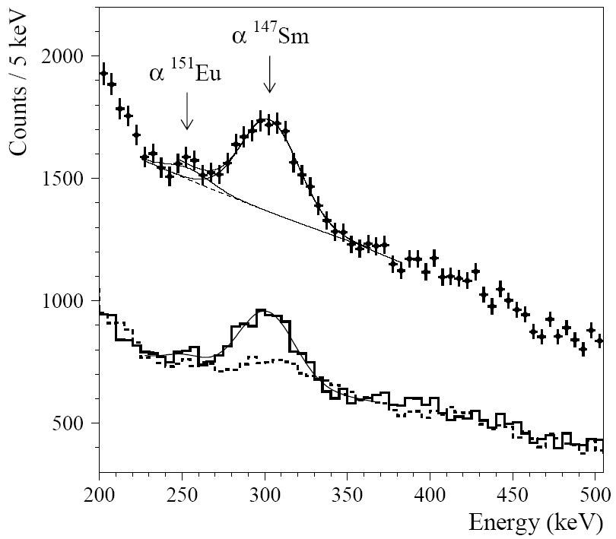
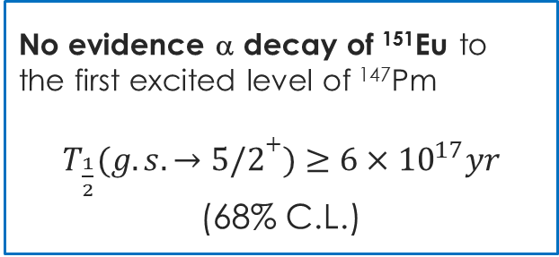
First observation of the α decay of ¹⁵¹Eu in ¹⁴⁷Pm
Nucl. Phys. A 789 (2007) 15
Peculiarity on the left of the ¹⁴⁷Sm peak can be attributed to the α decay of ¹⁵¹Eu
(expected peak at 1.912 MeV⇒245±36 keV)
Low energy part of the spectrum T=7426 h
¹⁵¹Eu α decay:
α
… or in a cautious approach:
γ(β)
T_{1/2} is in agreement with theoretical values based on liquid drop model and α as asymmetric fission process
No evidence α decay of ¹⁵¹Eu to the first excited level of ¹⁴⁷Pm
$T_{\frac{1}{2}}(g.s. →5/2+)≥6×{10}^{17}yr$
(68% C.L.)
Presence of Promethium in the Earth crust:
Taking into account the abundance of Europium in the crust (2×10⁻⁴%) (equilibrium mass of natural Pm in Earth crsut 560 g)
⇒ additional 12⁺¹⁷₋₈ g natural Pm born by ¹⁵¹Eu

Slide 13
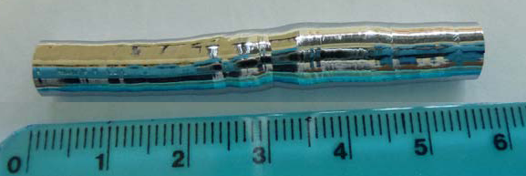
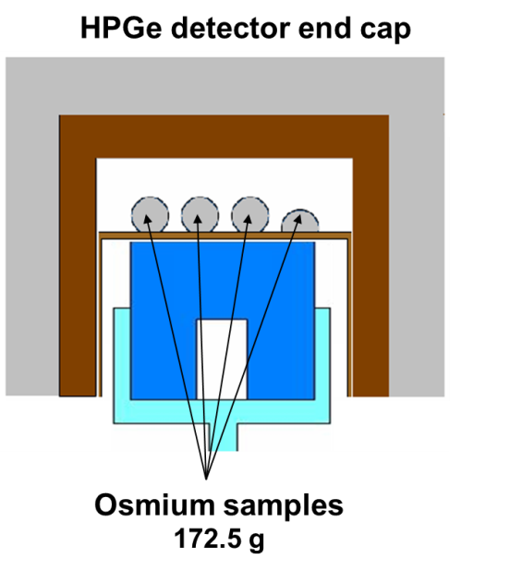
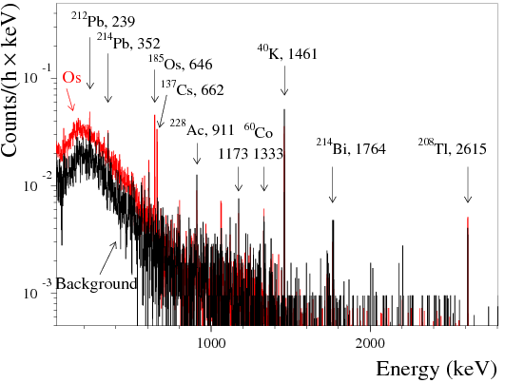
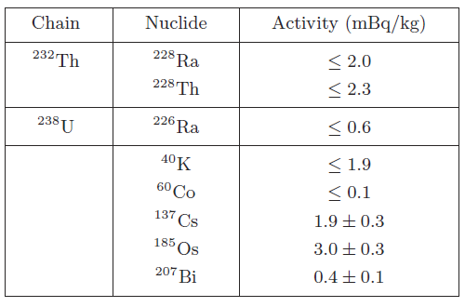
First search for rare decays of Osmium by low background HPGe detector
Eur. Phys. J A 49(2013)24
Osmium rare decays
εβ^{+,} 2ε decay in ¹⁸⁴Os (Q=1454 keV, δ=0.02%)
2β⁻ decay in ¹⁹²Os (Q=412 keV, δ=40.78%)
Possibility of resonant 0ν2ε in ¹⁸⁴Os that can increase probability of decay
¹⁸⁴Os and ¹⁸⁶Os are potentially unstable relatively to α decay to excited levels of daughter nuclei
Energy spectra of background (1046 h) and accumulated with the osmium sample (2741 h)
HPGe detector with volume 465 сm³
FWHM = 2 keV @1332 keV ⁶⁰Co
Radioactive Contaminations

Slide 14
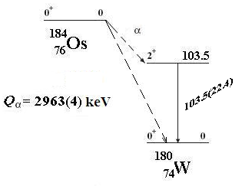
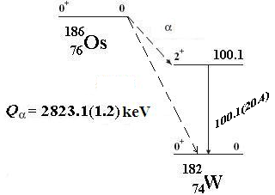
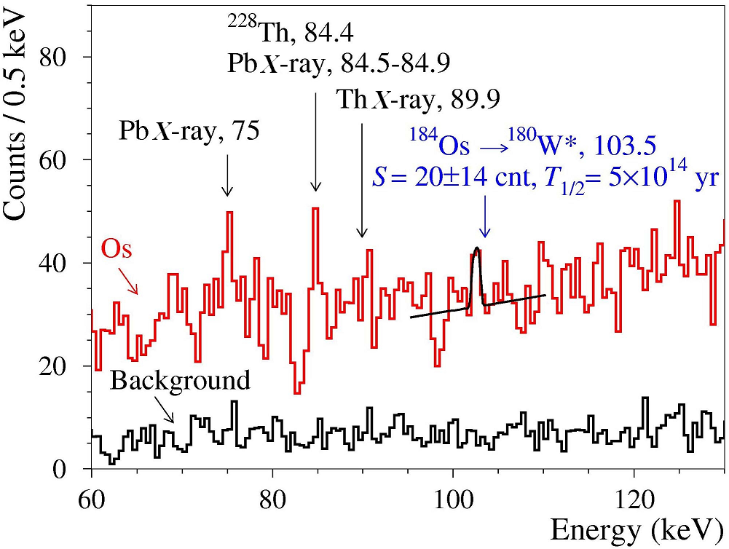
First possible hint of α decay of ¹⁸⁴Os
Proc. NPAE2012, (2013) 357
Very Preliminary
Theoretical estimations:
T_{1/2} ≈ 1.2 × 10¹⁵ yr [1] , T_{1/2} ≈ 2.6 × 10¹⁵ yr [2]
[1] Buck B., Merchant A.C., Perez S.M. // J. Phys. G 17(1991)1223
[2] Poenaru D.N., Ivascu M. // J. Phys. 44(1983)791
δ = 0.02%
δ = 1.58%
  Hint for α decay of ¹⁸⁴Os to the first excited 2⁺ level of ¹⁸⁰W:
  T_{1/2} = 5⁺⁸₋₂ × 10¹⁴ yr
  Limit on α decay of ¹⁸⁶Os to the first excited level of ¹⁸²W:
  T_{1/2} > 4 × 10¹⁶ yr
measurement for confirmation in progress

Slide 15
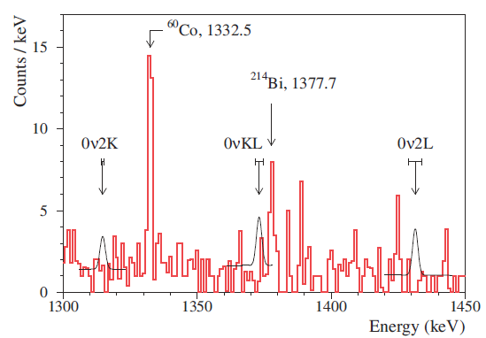
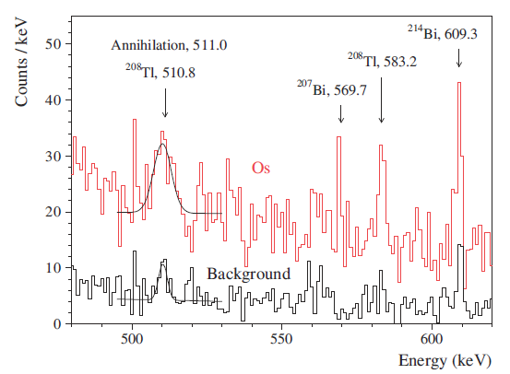
First search for 2β decay of Osmium
Eur. Phys. J A 49(2013)24
0ν2Κ decay in ¹⁸⁴Os
0ν2ε processes
T_{1/2}^{0ν2K} > 1.7 × 10¹⁷ yr
T_{1/2}^{(2ν+0ν)εβ+} > 2.5 × 10¹⁶ yr
  First experiment to search for 2β decay of osmium
  Double β processes in ¹⁸⁴Os have been bounded on the level of
  T_{1/2} > 10^{16–17} yr (90% C.L)
  2β decay of ¹⁹²Os to the 2⁺₁ level of ¹⁹²Pt is restricted as
  T_{1/2} > 5.3 × 10¹⁹ yr (90% C.L)
Measurement in progress (for 2ν2Κ); new measurement with Os powder foreseen, and future enrichment in ¹⁸⁴Os considered

Slide 16
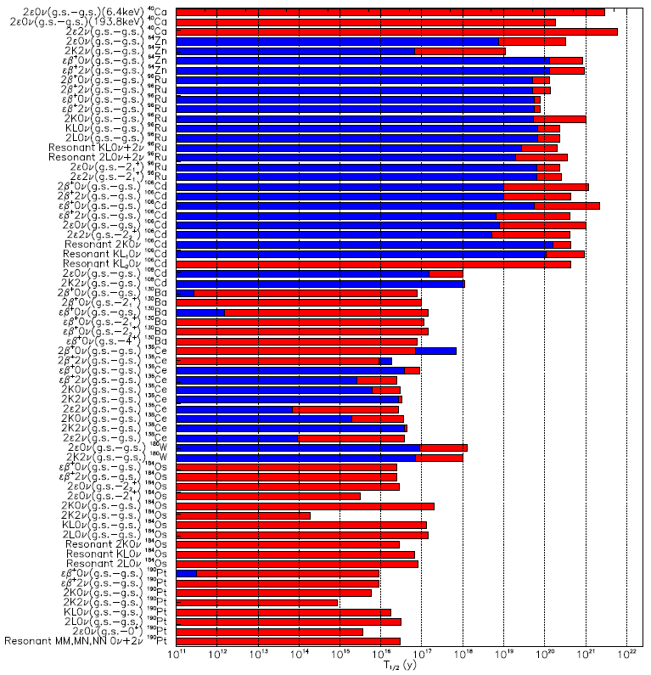
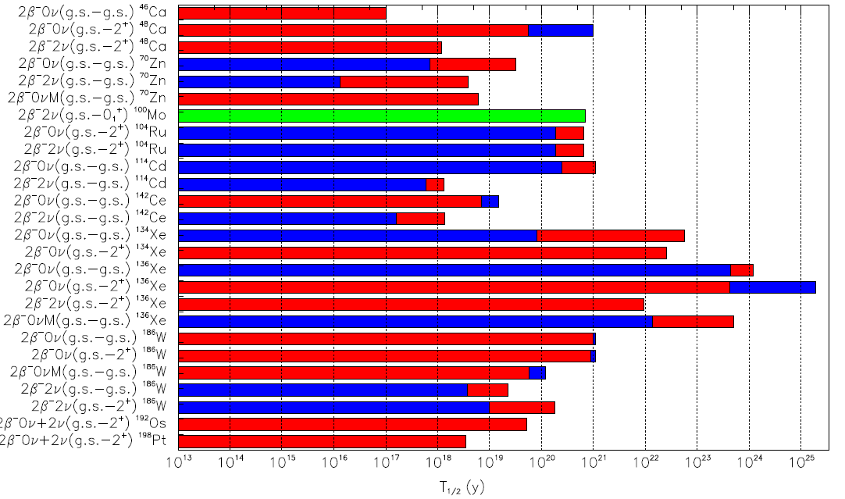
Summary of searches for ββ decay modes (partial list)
ARMONIA: New observation of 2ν2β⁻ ¹⁰⁰Mo→¹⁰⁰Ru (g.s.→0₁⁺) NPA846 (2010)143
Many competitive limits obtained on lifetime of 2β⁺, εβ⁺ and 2ε processes (⁴⁰Ca, ⁶⁴Zn, ⁹⁶Ru, ¹⁰⁶Cd, ¹⁰⁸Cd, ¹³⁰Ba, ¹³⁶Ce, ¹³⁸Ce, ¹⁸⁰W, ¹⁹⁰Pt).
First searches for resonant ββ decays in some isotopes
T_{1/2} experimental limits by DAMA (in red) and previous ones (in blue). All the limits are at 90% C.L. except for 0ν2β⁺ in ¹³⁶Ce and 2β⁻0ν in ¹⁴²Ce at 68% C.L.. In green observed!

Slide 17

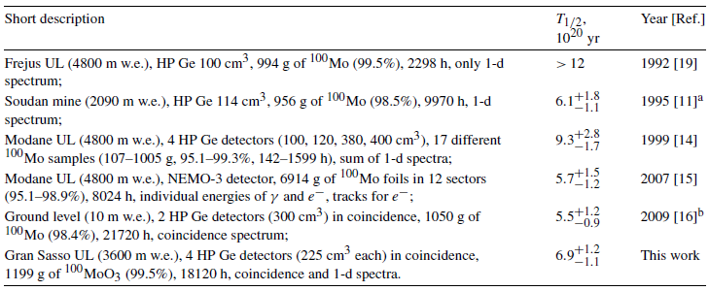
Armonia
(meAsuReMent of twO-NeutrIno ββ decAy of ¹⁰⁰Mo to 0⁺₁ level of ¹⁰⁰Ru )
NPA846(2010)143
Allowed 2β2ν decay to the g.s. of ¹⁰⁰Ru observed in several direct experiments, T_{1/2} ~ (3.3–11.5) × 10¹⁸ yr (from NEMO-3 (7 kg of ¹⁰⁰Mo),
T_{1/2}(2ν; g.s. – g.s.) = (7.1± 0.5) × 10¹⁸ yr
2β2ν decay of ¹⁰⁰Mo to the first excited 0⁺₁ level of ¹⁰⁰Ru registered in contradiction with an early measurement
1 kg of the Molybdenum used to set the limit was re-measured
Strategy
Measurement:
If 0⁺₁ excited level of ¹⁰⁰Ru (E=1130 keV) populated,
⇒ two γ quanta (591 keV + 540 keV) emitted in cascade in deexcitation
Molybdenum sample (mass ≈ 1 kg enriched in ¹⁰⁰Mo at 99.5%) installed in 4 low-background HPGe detectors (~225 cm³ each one)
T_{1/2} measured in several experiments:
Set-up enclosed in a lead and copper passive shielding and with a nitrogen ventilation system in order to avoid radon
2 Stage: 1) first meas.; 2) sample purification performed and new meas. (14 times lower ⁴⁰K)

Slide 18
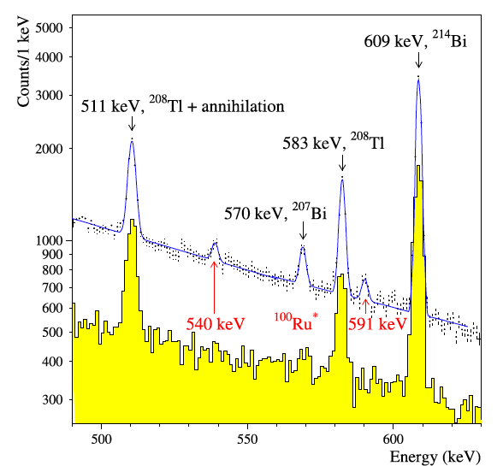
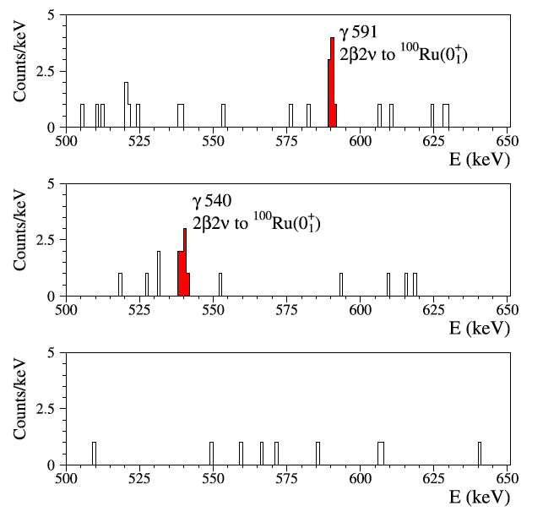
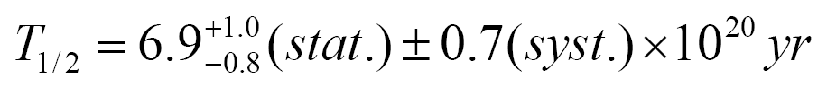
Armonia
(meAsuReMent of twO-NeutrIno ββ decAy of ¹⁰⁰Mo to 0⁺₁ level of ¹⁰⁰Ru )
NPA846(2010)143
Molybdenum sample (mass ≈ 1 kg enriched in ¹⁰⁰Mo at 99.5%) installed in 4 low-background HPGe detectors (~225 cm³ each one), T=18120 h
After sample purification
1-dim spectrum
8 coincidence events in the coincidence spectrum between any two HP Ge
normalized background
The observed ¹⁰⁰Mo →¹⁰⁰Ru* 2β2ν decay is in agreement with previous results, while the old limit T_{1/2} >1.2 x 10²¹ yr is not confirmed

Slide 19
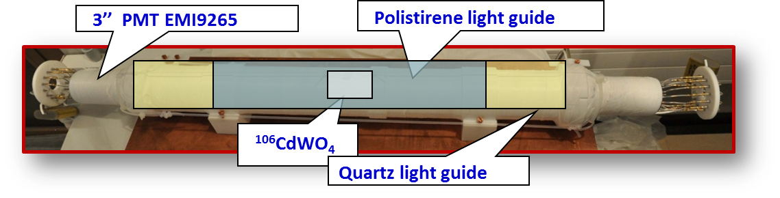
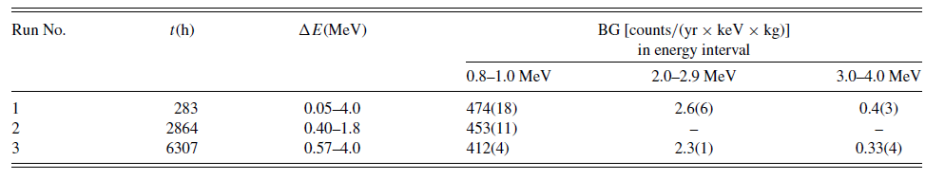
Development of enriched ¹⁰⁶CdWO₄ to search for 2β decay of ¹⁰⁶Cd in DAMA/R&D
NIMA651(2010)301
PRC85(2012)044610
66% enriched ¹⁰⁶CdWO4 crystal scintillator (215 g), 2.66×10²³ nuclei of ¹⁰⁶Cd developed
2nd enriched CdWO₄ crystal ever produced
¹⁰⁶Cd promising for 2β⁺:
δ =(1.25 ± 0.06)%; possibile enrichment up to 100%;
Q_{2β}= (2770±7) keV; 2β⁺, εβ⁺ and 2ε decay modes possible with favourable theoretical mean lives (resonant processes possible)
* – Never reported for CdWO₄
** – FWHM that was reached in 2β experiment
[1] NIMA615(2010)301 [2] JInst6(2011)P08011
Data taking periods

Slide 20
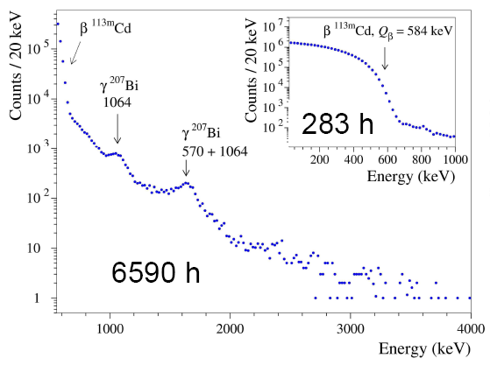
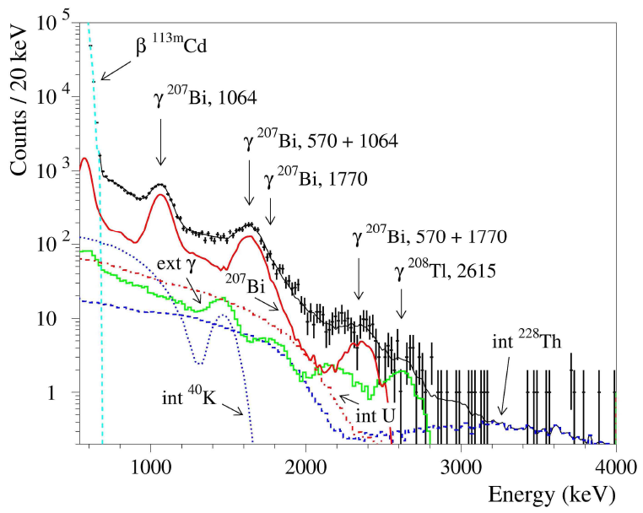
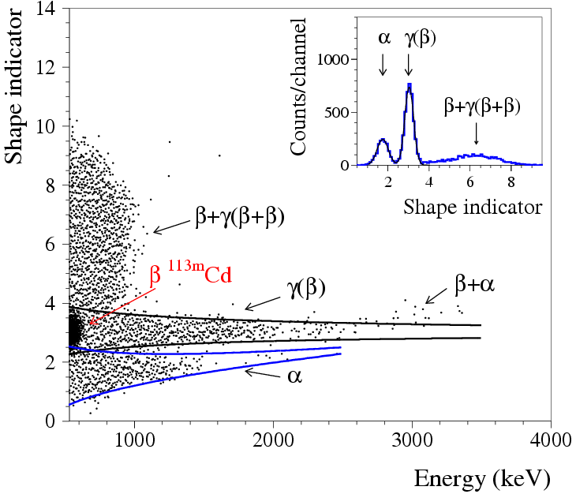
Search for 2β decay in ¹⁰⁶Cd
Experimental data
Distribution of the γ/β events selected by PSD
Main results (preliminary)
Contamination level in ¹⁰⁶CdWO₄ (mBq/Kg)
²⁰⁷Bi <0.7
^{113m}Cd 116 ·10³
²³²Th < 0.07
²²⁸Th 0.042(4)
²³⁸U <0.6
²²⁶Ra 0.012(3)
⁴⁰K <1.4

Slide 21
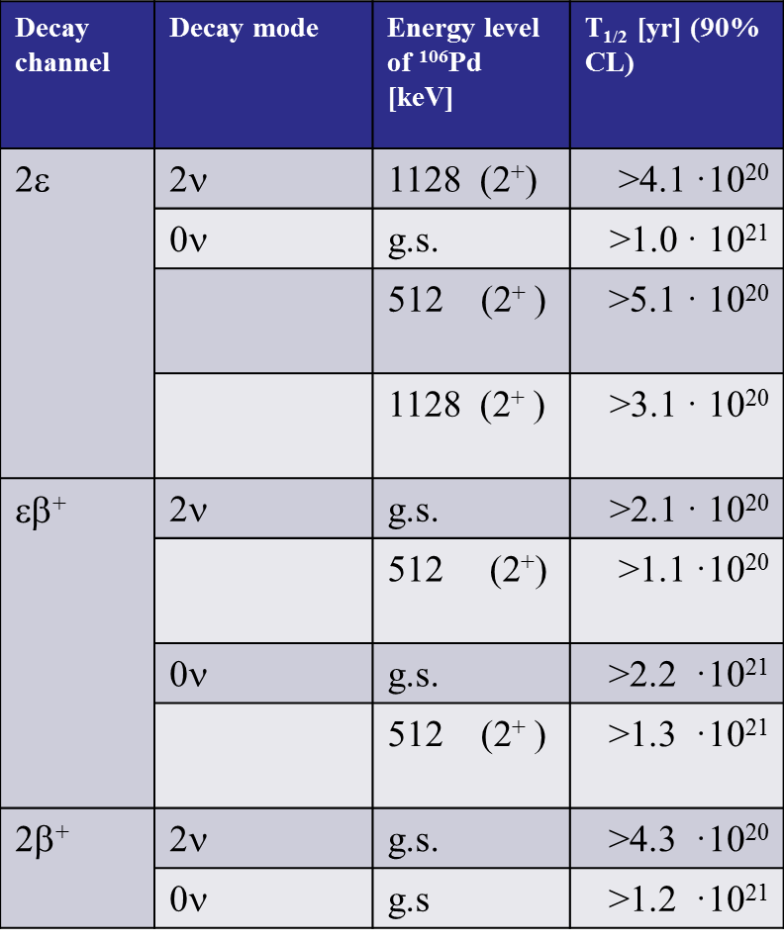
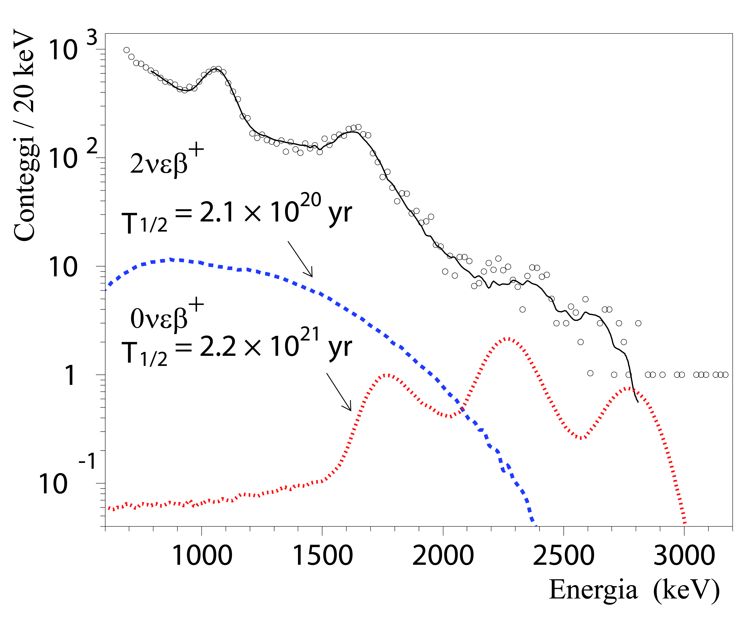
Limits on T_{1/2} of some 2β decay modes in ¹⁰⁶Cd
Phys. Rev. C 85 (2012) 044610
Example of fit to determine the limit on T_{1/2}
T_{1/2} (2β, ¹⁰⁶Cd→ ¹⁰⁶Pd) ≥ 10¹⁹⁻²¹ yr
27 new results for 2β ¹⁰⁶Cd
9 of them – for the first time

Slide 22
New measurement with
¹⁰⁶CdWO₄ in GeMulti
¹⁰⁶CdWO₄ in coincidence / anticoincidence with 4-crystals HPGe detector (GeMulti)
Registration efficiency ~ (3–8)%
Expected background ~ a few counts/yr
511 keV γ
511 keV γ
PbWO₄ light guide (archaeological lead)
Sensitivity to 2ν εβ⁺ and 2β⁺ in ¹⁰⁶Cd:
T_{1/2} ~ 10²⁰ - 10²¹ yr
Theory: 2ν2K: 10²⁰ - 5×10²¹ yr, 2νεβ⁺: 8×10²⁰ - 4×10²² yr
HPGe 225 cm³
PMT
¹⁰⁶CdWO₄
In data taking since December 2012
Further step: production of ¹⁰⁶CdWO₄ from the ¹⁰⁶Cd depleted in ¹¹³Cd to remove ^{113m}Cd
Future and general perspectives:
increase mass, running time, enrichment, ... reasonable goal

Slide 23
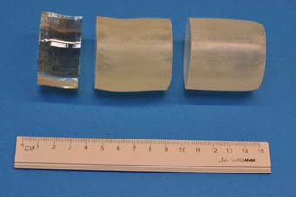
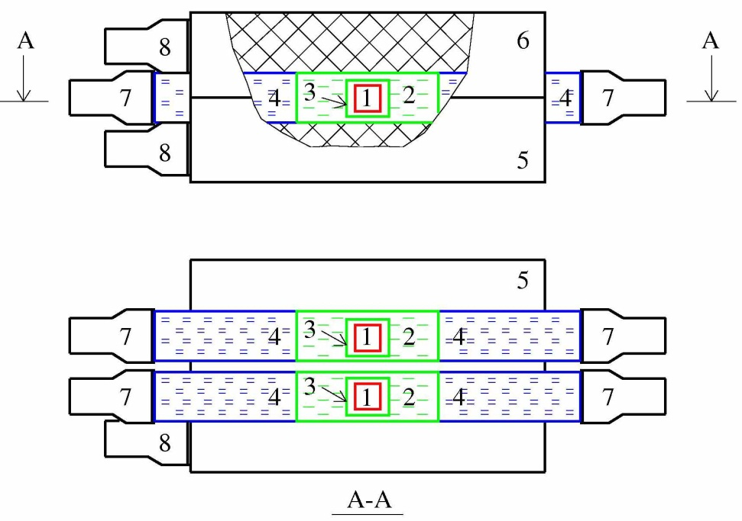
Developments of ¹¹⁶CdWO4 and investigation of 2β decay in ¹¹⁶Cd with DAMA/R&D
Coll. DAMA+INR-Kiev+NIIC+ITEP-Moscow+ JSC NeoChem
JINST 06 (2011)P08011
Proc. NPAE2012, (2013) 353
Rad. Meas., in press
Schema of AURORA set-up (stage 1,2):
2 ¹¹⁶CdWO₄ crystal 4.5 × 5 cm
ultra-low background PMTs
plastic scintillator with cavity (to place ¹¹⁶CdWO₄)194 mm lenght + 200 mm high purity quartz
¹¹⁶CdWO₄ surrounded by active shield made of plastic scintillator of large volume (500 × 300 × 240 mm), viewed by four low background 2'' PMTs.
complete 4π active shield of the main (¹¹⁶CdWO₄) detectors provided
326 g
589 g
586 g
In data taking
In 5 yr of measurements
⇒ The reachable sensitivity on T_{1/2}^{0ν2β} is foreseen to be ≥ 1 × 10²⁴ yr
This measurement will also improve aspects of the low background techniques and can act as a pilot for next larger mass experiment

Slide 24
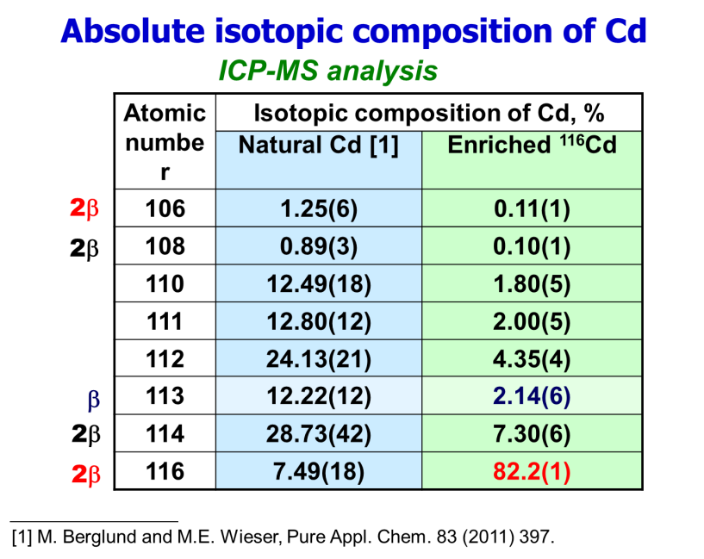
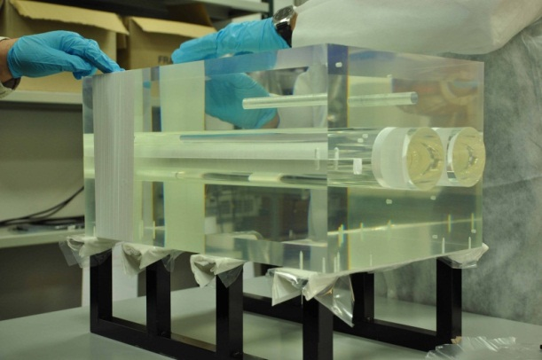
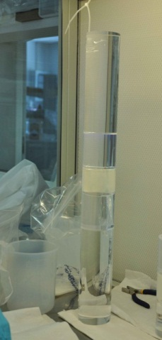
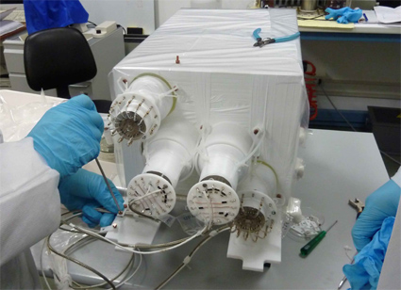
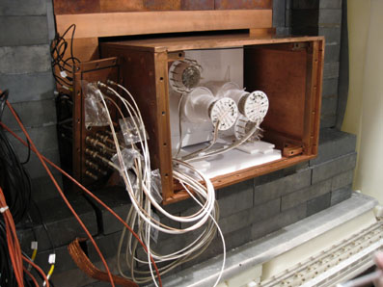
Investigation for 2β decay of ¹¹⁶Cd
JINST 06 (2011)P08011
Stage | Mass(g) | Livetime (h) | Some Features
1 | 586.2 589.3 | 1727 | Detector: Veto covered by PTFE; Light-guides covered by PTFE; LS –”LS-221” (ISMA, Kharkiv). DAQ: Sampling rate 20 MS/s; low level threshold ≈ 50 keV.
2 | 579.8 582.4 | 8552 | Detector: Veto covered by Tyvek; Light-guides covered by Mylar; LS –Ultima gold liquid scintillator. DAQ: Sampling rate 50 MS/s; low level threshold ≈ 300 keV.
3 | 579.8 582.4 | running | Detector: Plastic veto substituted by OFHC low radioactive Cu bricks surrounding each detector
Further improvements in preparation

Slide 25
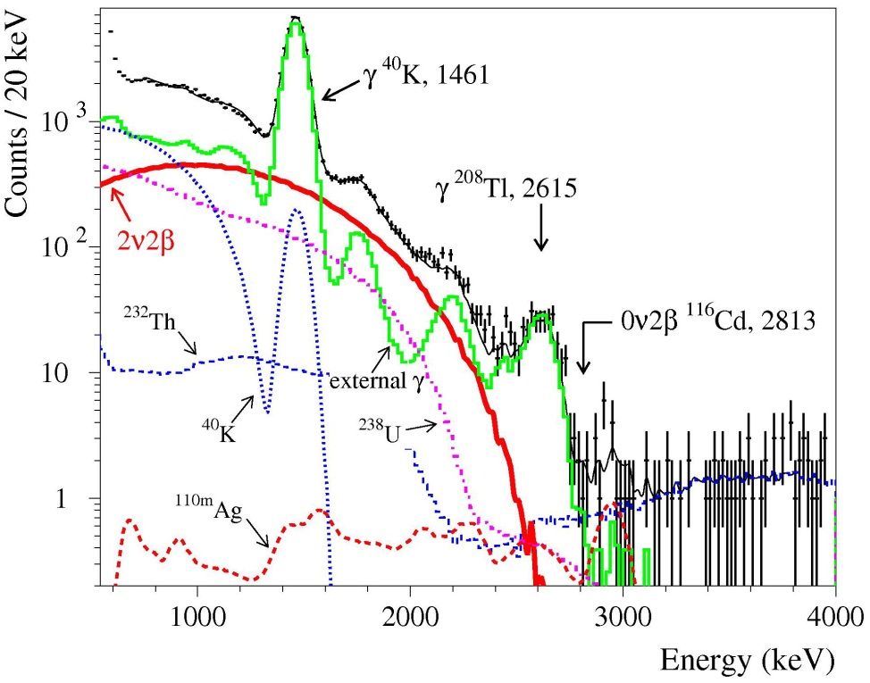
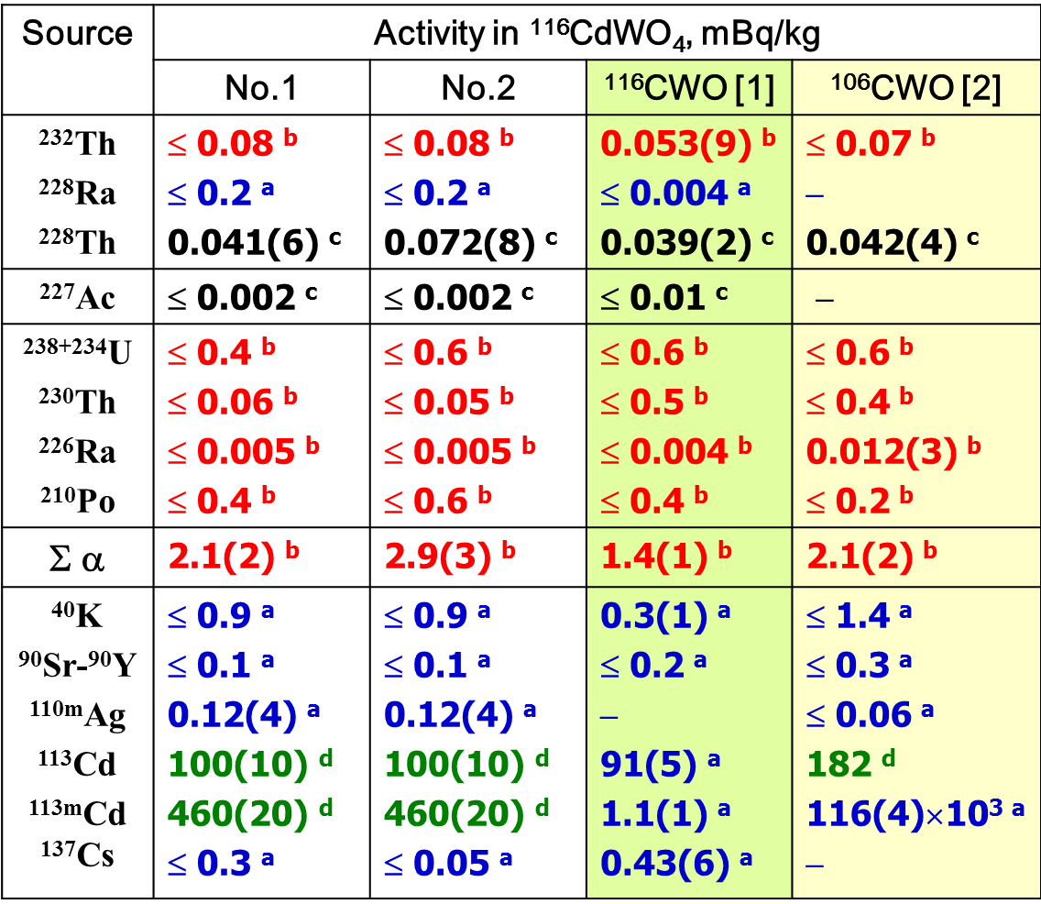
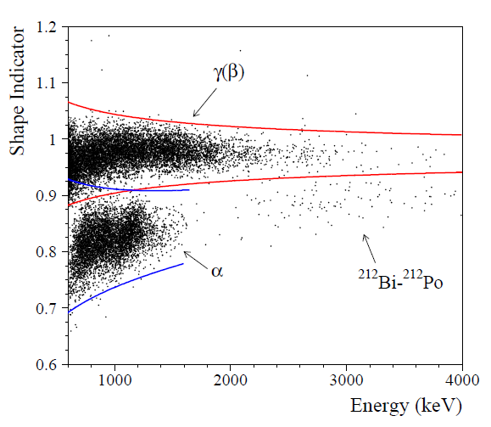
Background ¹¹⁶CdWO₄ (stage 2)
Radioactive contamination of ¹¹⁶CdWO₄ crystals
Preliminary
PSD γ(β), ≈88%
0.032(2)
0.054(3)
PSD γ(β), ≈99%
ª Fit of background spectra; ^{b} Pulse shape discrimination;
^{c} Time-amplitude analysis; ^{d} ICP-MS analysis
[1] F.A. Danevich et al., PRC 68 (2003) 035501.
[2] P. Belli et al., PRC 85 (2012) 044610

Slide 26

Background in 0ν2β region of ¹¹⁶Cd (stage 3)
Preliminary
Anti-coincidences
8825 kg×h
¹¹⁶CWO | Activity, mBq/kg
 | ²²⁸Th | Total α
No.1 No.2 | 0.032(2) 0.054(3) | 2.1(2) 2.9(3)
0ν2β ¹¹⁶Cd, 2813 keV
PSD α & BiPo
Stage 2:
Rate @ 2.7–2.9 MeV:
0.28(4) cnt/(keV×kg×yr)
PSD γ(β)
Stage 3:
Rate @ 2.7–2.9 MeV:
0.11(3) cnt/(keV×kg×yr)
Stage 3:
Rate @ 2.8–3.0 MeV:
0.07(3) cnt/(keV×kg×yr)

Slide 27


Preliminary results (measurement in progress)
MonteCarlo expectation for 2β ¹¹⁶Cd
¹¹⁶CdWO4 1.16 kg, 8552 h
T_{1/2} (2ν2β) = 2.5(5)×10¹⁹ yr
(in agreement with previous determinations)
T_{1/2} (0ν2β) ≥ 6.7×10²¹ yr
6 new results for 2β ¹¹⁶Cd
Further development in preparation (recrystallization, etc)
Future measurement in GeMulti also under study

Slide 28






ZnWO₄ crystal scintillators
Development of low background ZnWO₄ crystal scintillators with large volume and high scintillation properties is important to investigate double beta decay modes in Zn and W isotopes with source=detector approach
Various detectors with mass 0.1-0.7 kg realized by exploiting different materials and techniques
Inside a cavity (filled up with high-pure silicon oil) φ 47 x 59 mm in central part of a polystyrene light-guide 66 mm in diameter and 312 mm in length.
PLB658(2008)193
NPA826(2009)256
NIMA626-627(2011)31
JP38(2011)115107
PMT EMI65-B53/FL
Polystyrene Light-guide
ZnWO₄

Slide 29



Radioactive contamination of ZnWO₄ crystal scintillators
NIMA 626(2011)31
Summary of the measurements
Also ICP-MS analysis
α contamination at level of 0.2 -2 mBq/kg , further improvement under investigation

Slide 30

ββ decay modes in Zn and W isotopes with (0.1 – 0.7 kg) low background ZnWO₄
J. Phys. G: Nucl. Part. Phys. 38 (2011) 115107
Improved (up to 2 orders of magnitude) limits on the ββ decay modes of ⁶⁴Zn, ⁷⁰Zn, ¹⁸⁰W and ¹⁸⁶W:
T_{1/2} ∼10¹⁸ – 10²¹ yr.
up to now only 5 nuclides (⁴⁰Ca, ⁷⁸Kr, ¹¹²Sn, ¹²⁰Te and ¹⁰⁶Cd) over 34 candidates to 2ε, εβ⁺, 2β⁺ processes have been studied at this level of sensitivity in direct search experiments
Total exposure = 0.529 kg x y,
Thershold at 10 keV
A possible positive hint of the (2ν+0ν)ΕCβ⁺ decay in ⁶⁴Zn with T_{1/2} = (1.1 ± 0.9) × 10¹⁹ yr [I. Bikit et al., Appl. Radiat. Isot. 46(1995)455] excluded
the 0ν2ΕC capture in ¹⁸⁰W is of particular interest due to the possibility of the resonant process;
the rare α decay of the ¹⁸⁰W with T_{1/2} = (1.3^{+0.6}_{-0.5} ) × 10¹⁸ yr observed and new limit on the T_{1/2} of the α transition of the ¹⁸³W to the metastable level 1/2⁻ at 375 keV of ¹⁷⁹Hf has been set:
T_{1/2} = 6.7 × 10²⁰ yr.
Further developments, new detectors ... towards suitable mass fragmented set-up

Slide 31


The ADAMO project: Study of the directionality approach with ZnWO4 anisotropic detectors
Eur. Phys. J. C 73 (2013) 2276
Directionality: study of the correlation between the Earth motion in the galactic rest frame and the arrival direction of those Dark Matter (DM) candidates inducing just nuclear recoils
Nuclear recoils would be strongly correlated with the DM impinging direction
This effect can be pointed out through the study of the variation in the response of anisotropic scintillation detectors during sidereal day
σ_{p} = 5×10⁻⁵ pb, m_{DM}= 50 GeV
light output and pulse shape of ZnWO₄ depend on the direction of the impinging particles with respect to the crystal axes
These anisotropic features provide two independent ways to exploit directionality, overcoming the difficulties of TPC detectors due to the very short track of recoils
[2-3] keV
Complementary information to those by DAMA/LIBRA for some aspects
Example (for a given model framework) of the expected counting rate as a function of the detector velocity direction

Slide 32



Search for double-β decays of ⁹⁶Ru and ¹⁰⁴Ru by ultra-low background HP Ge γ spectrometry
EPJA42(2009)171
PRC87(2013) 034607
⁹⁶Ru potentially 2β⁺ active nuclei, δ ∼ 5,54% and
Resonant “0ν2ε-capture” possible (energy-release = energy of exited level daughter’s nuclei), that can arise possibility of decay (up to 10⁶)
Favourable theorethical T_{1/2}:
2ν2ε - (4.7-39)×10²⁰ yr, 2νεβ+ − (2.0−23)×10²¹ yr (g.s.→g.s.), J. Suhonen, PRC 86 (2012) 024301
Possible processes:
2β⁺ – g.s.
εβ⁺ – g.s., 778 keV
2ε – up to 2713 keV
Stage 1
Preliminary results EPJA, 2β⁺/εβ⁺/2ε (0ν+2ν) in ⁹⁶Ru
Further measurements over 2162 h with a 473 g sample
Preliminary limits on 2β in ⁹⁶Ru: T_{1/2} ≈10^{18–19} y
Stage 2
Purification from ⁴⁰К with electron beam melting method (10 times decrease of ⁴⁰K)
Increased mass of Ru sample (720 g)
T=5479 h in Ge-Mult set-up (4 x 225 cm³)
Sensitivity:
T_{1/2} ≈10^{20–21} y for ⁹⁶Ru
T_{1/2} ≈10²⁰ y for ¹⁰⁴Ru (2β⁻)
Previous limits improved
T^{2k0ν}_{1/2} >1.0 ×10²¹ yr (90%C.L.) in ⁹⁶Ru
T^{resKL0ν}_{1/2} >2.0 ×10²⁰ yr (90%C.L.) in ⁹⁶Ru
New measurement with purified sample with higher mass

Slide 33




Example of the study of new kind of scintillator detector:
SrI₂(Eu) crystal scintillator:
NIMA670(2012) 10
High light output (>100000 γ/MeV)
Good energy resolution (~3% at 662 keV)
Absence of natural long-living radioactive isotopes.
A scintillator crystal doped by 1.2% in Eu and with a nearly cylindrical shape (13 x 11 mm; 6.6 g mass) produced by Stockbarger growth technique
Preliminary measurement in the low background set-up installed at sea-level at INR, Kyiv, Ukraine:
  detector performances
  α/β discrimination
Measurement in the Ge facility at LNGS
Measured during 706 h with ULB-HPGe γ ray spectrometer to investigate background and put new limits on 2β decay of ⁸⁴Sr (Q_{2β} . 1787.4. keV )
Potentiality of SrI₂(Eu) to the search for the ⁸⁴Sr 2β decay demonstrated for the first time (crystal mass= 6.6 g; δ_{84Sr}=0.56(1)% ; measuring time = 101.52 h)
New/improved half-life limits on 2ε and εβ⁺ decay modes in ⁸⁴Sr at level T_{1/2} ~ 10¹⁵-10¹⁶ yr
With higher mass crystal and longer meas. time high sensitivity expected
A R&D of SrI₂(Eu) crystal scintillators is in progress

Slide 34
Conclusions
Continue efforts to develop new/improved crystal scintillators for low background physics
Potentiality of the low background scintillation technique for the search of rare processes proved
Many rare processes investigated with high sensitivity in DAMA/R&D and STELLA as e.g.:
  Sensitivity for 2β⁺ decay at level of 10²¹ yr
  First observation of rare α decay of ¹⁹⁰Pt, ¹⁵¹Eu
  First possible indication of α decay of ¹⁸⁴Os
  Improvement foreseen
Experiments on 2β decay of ¹⁰⁶Cd and ¹¹⁶Cd running/under-improvement
Other new measurement in preparation and/or foreseen (Gd, Nd, Ru, SrI, etc.)
Other rare processes investigated also by DAMA/LIBRA and future long dedicated measurements for special topics foreseen
DAMA/LXe running and the activity of DAMA/crys started

