Slide 1
Lar upgrade
F. Tartarelli
Incontro con i referee, 20/03/2012

Slide 2
Lar Phase I upgrade
Purposes:
maintain high efficiency for Level-1 triggering on low P_{T} objects (electrons and photons)
Improve jet, tau, MET triggers
Enable lower thresholds for multi-object triggers
Give more flexibility in trigger menu design and in operations
In the LAr calorimeter this implies changes to the front-end electronics to allow greater granularity to be exploited at Level-1
finer segmentation in eta
depth information
Enable use of more powerful LVL2 /offline-like variables/ techniques in the L1Calo selection:
Shower shapes

Slide 4
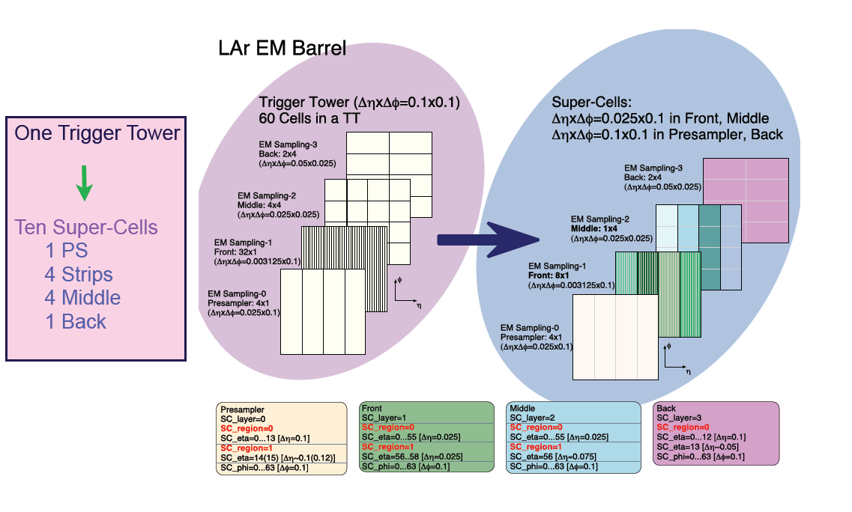

Slide 5
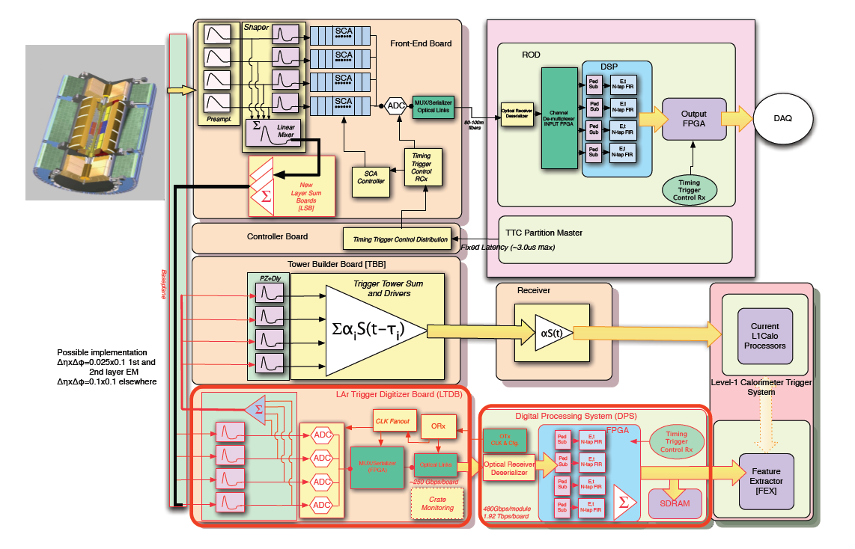

Slide 6
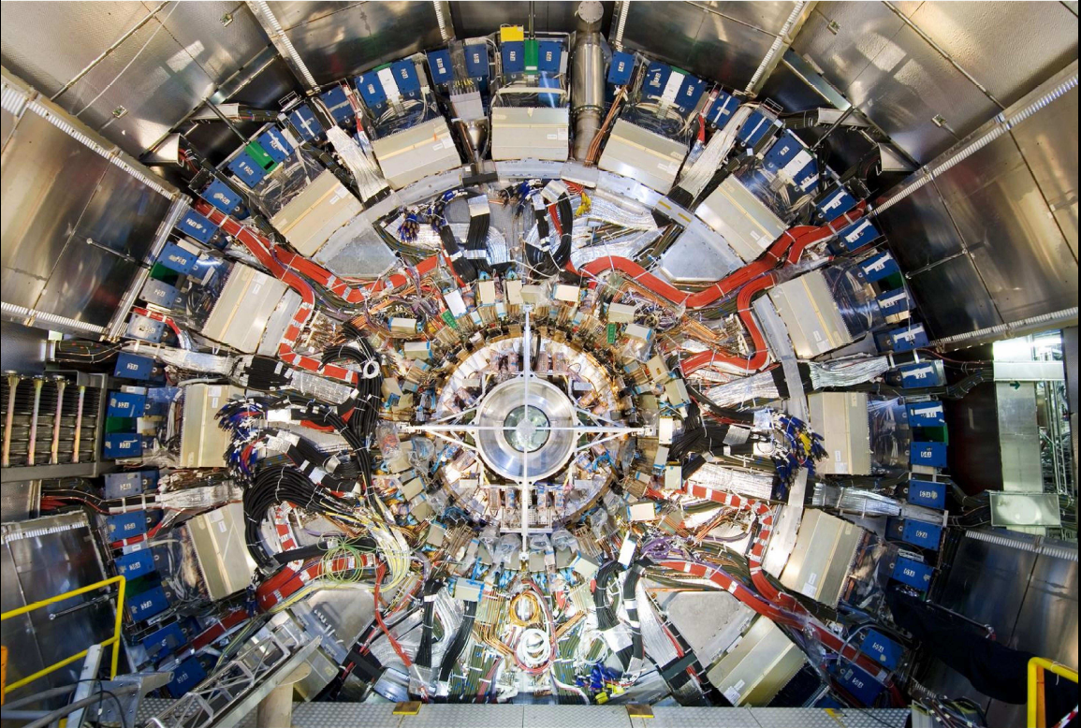

Slide 7
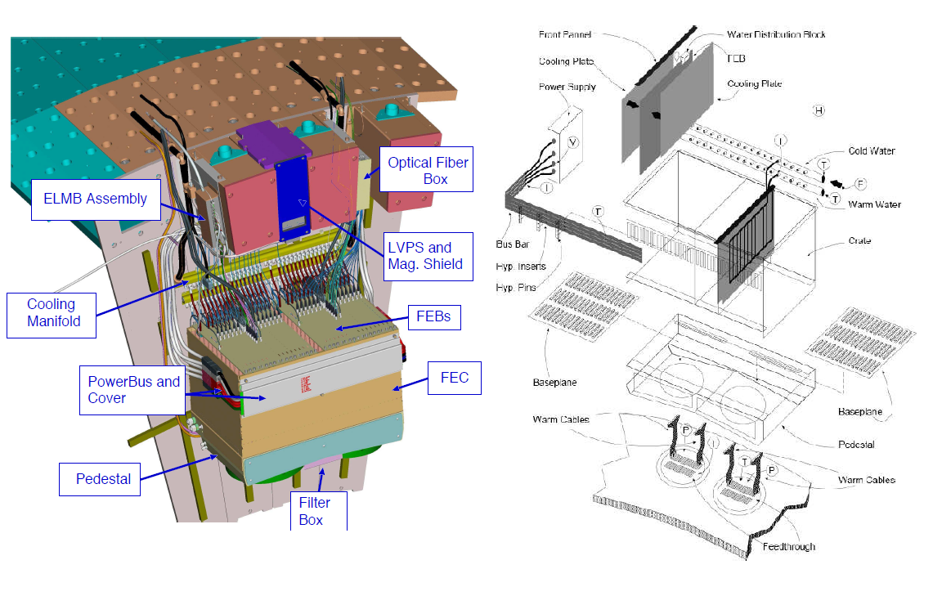

Slide 8
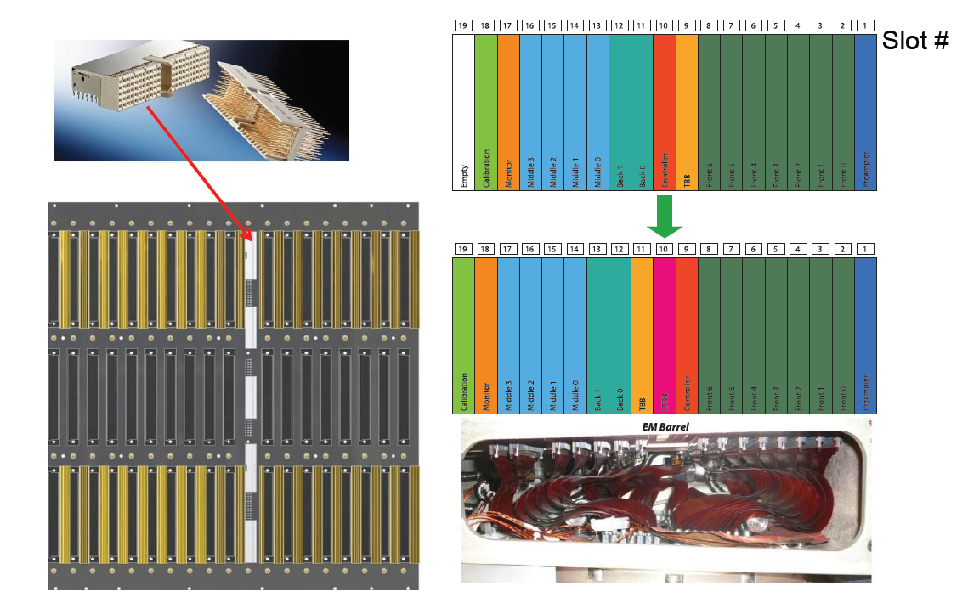

Slide 9
In-situ Demonstrator
In order to test and commission the proposed upgrade for Phase-I before ATLAS operation:
Test of single elements
Full lab system tests at the LAr Electronic Maintenance Facility (EMF)
Installation of in-situ demonstrator during LS1
Test of production components
The in-situ demonstrator plan is to equip one FEC with the read-out for the increased granularity :
Likely one barrel FEC (etaxphi=1.4x0.4, about 2% of trigger acceptance)
2 new baseplanes, all FEBs in the crate equipped with new LSBs, 2 LTDB0s, long fibers up to USA15 counting room, 2 LD
The LTDB0 will not have the components for the full series Phase-I boards, it will have a very similar functionality.

Slide 10
Demonstrator
IDR review requested more details for In-situ demonstrator
They were worried it could be a major “disruption” of ATLAS operation
More info added to the summary document of the review:
Well taken and, finally, very supportive:
Agreed to hold an ATLAS review before the installation of Demonstrator
Show results of system test
Show installation plan with risks
4 months prior to access end -> ~March 2014 (as of now)

Slide 11
LAr electronic upgrade for Phase I
Project is on schedule:
IDR passed on January 9-11, 2013
CB approval on February 8, 2013
Next step is TDR due September 15, 2013
Outcome very positive, a few things to follow towards TDR. MOU soon after TDR:
Discussions on cost sharing just started
✓
✓
✓
✓

Slide 12
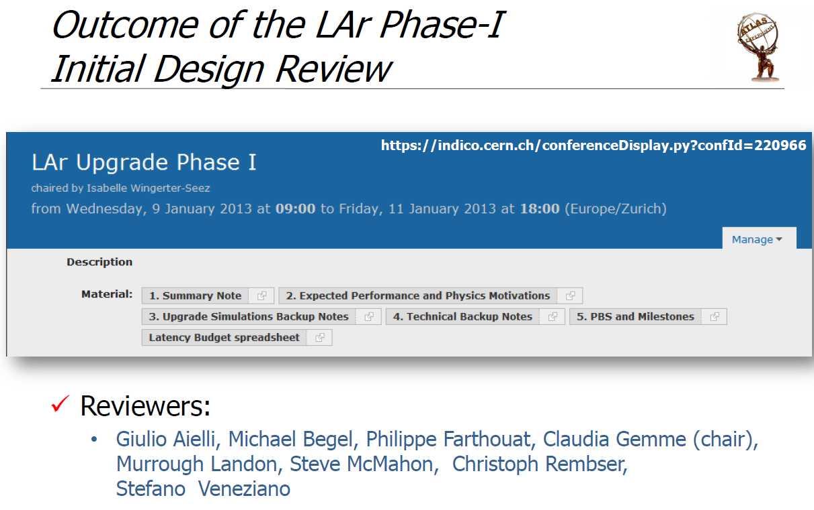

Slide 18
Milano possible contributions
Baseplanes:
redesign
~1/3 of the production in Italy
[collaboration with BNL, Orsay]
Layer Summing Boards:
redesign
~1/3 of the production in Italy
[collaboration with BNL, Saclay]
On-detector new Lar Trigger Digitizer Board (LTDB):
design of power distribution scheme for demonstrator and Phase I LTDB’s, considering also compatibility for Phase II upgrade
POL instead of LVDS, extension of the studies done in the framework of the Gruppo V - APOLLO Project (which used LAr as use case)
[collaboration with BNL]
Data formatting on LTDB:
design of algorithms for data multiplexing/serialization using FPGA as a test bench
Collaboration with BNL on radiation tests
Simulazioni:
Simulazioni: sviluppo di algoritmi che utilizzino le supercelle a L1
Interessi in vari aspetti del progetto con simulazioni, design e prototyping di componenti,…

Slide 19
Costi (kCHF)
Deliverables | Total | 2013 | 2014 | 2015 | 2016
Baseplanes: constr, assembly, conn,... 1/3 produzione in Italia → | 1.076 0.360 | 0.007 0.07 | 0.007 0.07 | 0.531 0.177 | 0.531 0.177
Layer Sum Boards (Barrel, EM Endcap) | 0.689 | 0.014 | 0.000 | 0.000 | 0.675
Total (MCHF): | 1.765 | 0.021 | 0.007 | 0.531 | 1.206
Total (Italy): | 0.600 | 0.014 | 0.007 | 0.177 | 0.402
Rinunciando a design e produzione delle LSB e mantenendo la produzione di circa 1/3 della produzione dei baseplanes, il possibile contributo italiano si riduce di un fattore 2:
360 kCHF (era 600 kCHF)
Abbiamo chiesto ad una ditta italiana una stima piu’ precisa del costo della produzione dei baseplanes e siamo in attesa di una risposta:
Elfes Technology srl, Cinisello Balsamo (MI)

Slide 20
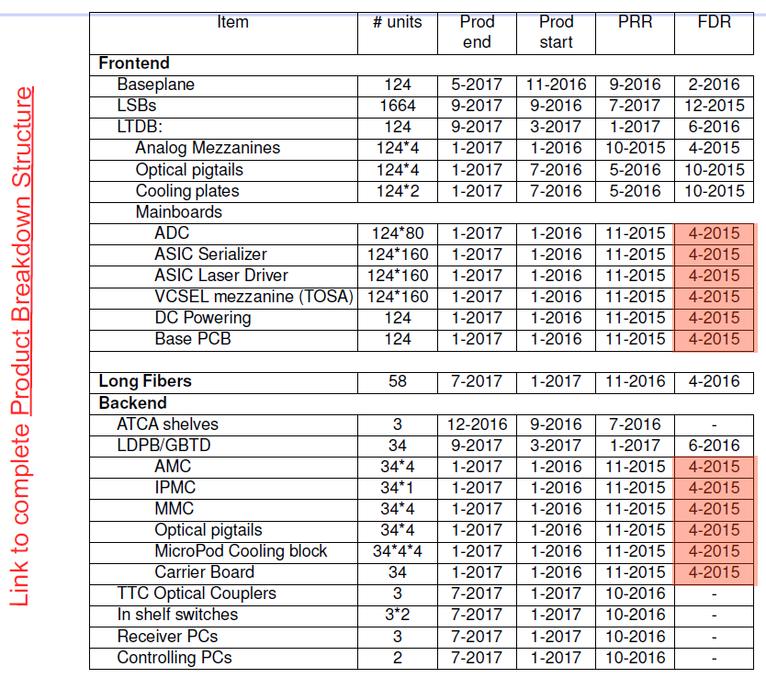

Slide 21
New baseplane design
Status of baseplane design:
EMB (Milano/Orsay): ~finished
EMB (Milano/Orsay): ~finished
EMEC standard (Orsay):~finished
EMEC special (Milano/Orsay): finalizing design
HEC (Milano? Triumph?): not started
FCAL (Canada/Arizona): not started
Finalizing studies on signal extraction at high-Z vs. double driver with respect to signal attenuation and delay
Produzione dei primi prototipi potrebbe cominciare in Aprile:
Per il 2013 ci sono stati assegnati 5 keuro sj per questa produzione

Slide 22
Barrel baseplane
La scheda e’ stata progettata usando:
Solo stripline con impedenza controllata (50 ohm, tracce di 150 μm)
Usando 5 layers, uno in piu’ della scheda esistente, per migliorare il routing
Non introducendo “via” per avere migliore signal integrity.
Per il connettore della LTDB (fila centrale della figura) e’ stato scelto un connettore Hard Metric a 2mm con shielding integrato.
Lo spazio fra le traccie e’ ~300 μm per avere basso crosstalk (< 1 %)
Ulteriori verifiche sul layout:
Simulazione a piena scheda con Hyperlinx dell’integrita’ del segnale
Simulazione dei segnali ottenuta con Spice e generazione dei modelli IBIS
Eventuale ottimizzazione del layout in accordo con il produttore del prototipo della scheda

Slide 23
Milano involvement and responsibilities
People involved (7 persone, ≈3 FTE al momento):
M. Citterio (DT): design nuovi baseplane, nuova distribuzione potenza
F. Tartarelli (PR): simulazione performance, tests
L. Carminati (RU): simulazione performance
M. Fanti (RU): simulazione performance
M. Lazzaroni (PA): nuova distribuzione potenza (in sinergia con APOLLO)
M. Alderighi (Ric. INAF): FPGA redundant code
R. Turra (AR): simulazione performance
+ 1 progettista del servizio elettronica
Attualmente il nostro l’involvement e’ in linea con quanto disponibili presso gli altri istituti della collaborazione LAr

Slide 24
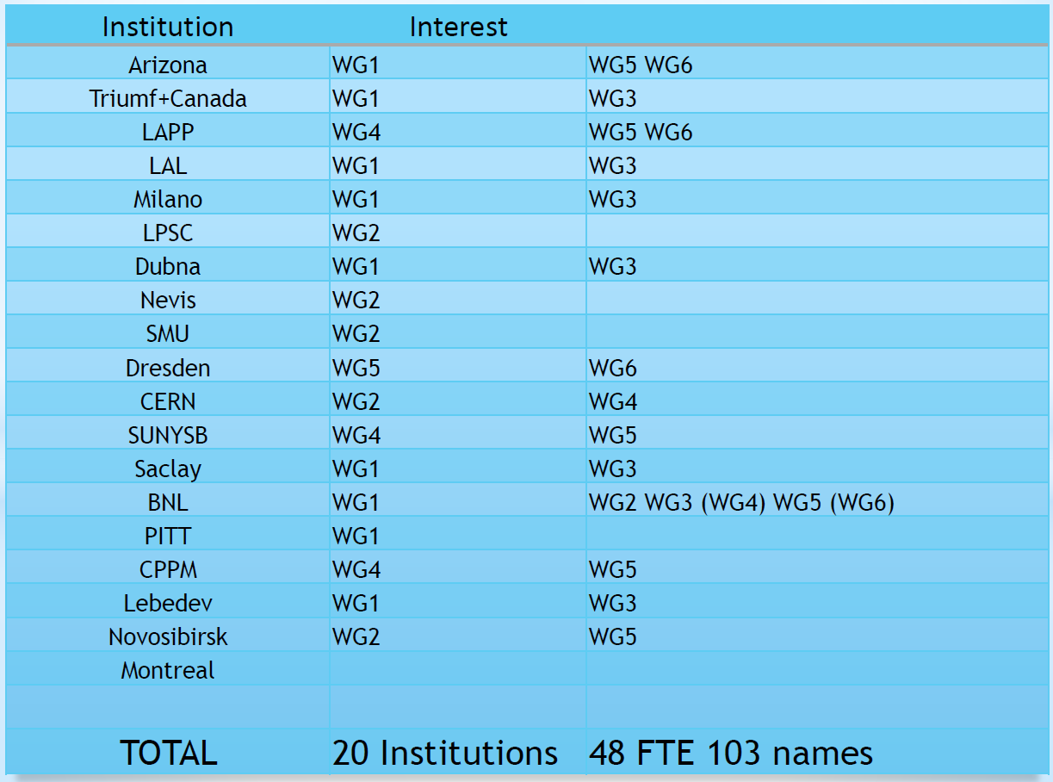

Slide 25
Phase II
Apart of the possibility of replacing FCAL and HEC electronics (still under discussion), the main change to LAr will be the replacement of all the 1524 Front End Boards (FEBs):
the total dose for an integrated luminosity of 3000 fb-1 exceeds the FEB specifications
the Level-1 trigger latency may exceed the depth of the analog pipeline memories installed on the FEBs
natural ageing of electronic components
New FEBs (FEB2s) will be designed with fully digital free running readout, i.e. avoiding trigger signal receivers and data buffering on the FEB
signals from all calorimeter cells are digitized at 40 MHz and sent off-detector

Slide 26
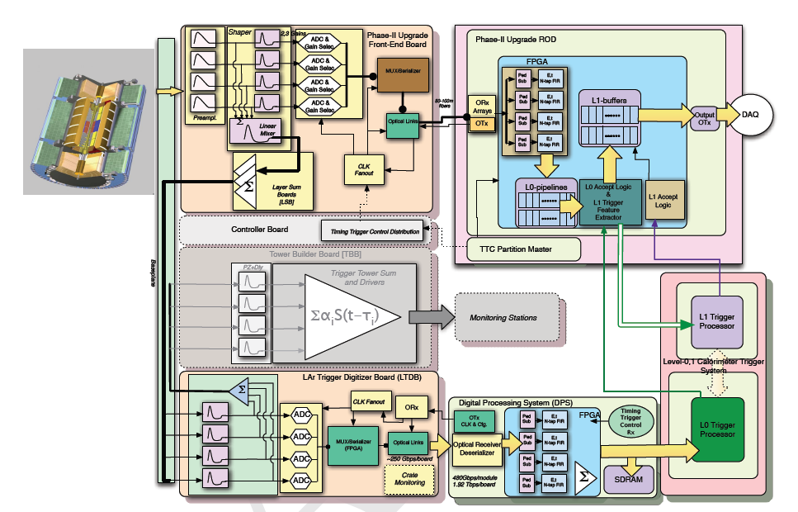
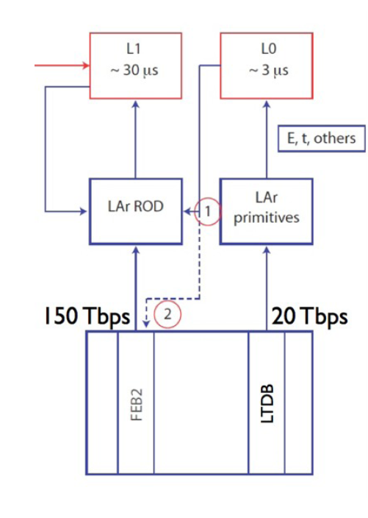
Phase II
The Phase I upgrade is compatible with the Phase II
FEB2s will be fitted in the existing Front End Crates and
will use the same baseplanes built for Phase I
Lar has already acquired all connectors needed for the FEB2s before they disappear from market
LSBs, being FEB daughter cards, will not be kept
Phase I LTDBs will also stay
Can be used to provide a low latency L0 trigger using the supercell granularity
The full LAr calorimeter granularity will be available to the L1 trigger to further refine the trigger decision, possibly based on refined reconstruction in a region-of-interest determined by L0.

Slide 27
Milano interests for Phase II
Continue involvement with:
power distribution architecture
new front-end (for the current calo FE we have realized the preamps)
Powering distribution: power architecture with main converters and point-of-load converters (POL) close to the front-end
New Front-End: analog preamplification and shaping stages will be integrated in a single ASIC: Liquid Argon Preamp and Shaper (LAPAS)
Implementation of a wide dynamic range single ended preamp followed by low power differential shaping stages with multiple gains
SiGe technology (IBM, IHP)

Slide 29
Demonstrator
Demonstrate that we know how to make baseplane, install them and find possible problems on detector
Show that analog signals are still OK and there are no faults in the digital functions
Show waveforms of new super cells (and compare with legacy system)
Front end electronics
How to power: switching regulator? Impact on noise
How to cool
How to reliably transmit data in a real environment
Show the cell mapping is right for the new system and for the existing analog TBB
Full integration:
at Board level and at Crate level
Back end electronics
Demonstrate data processing
Steps
Step 1: use whatever available (COTS ADC, etc.)
Step 2: migrate towards final (ASIC based)

Slide 30
Phase II: detector upgrade options
Option 0: No change neither of the HEC cold electronics nor of the FCal detectors.
Option 1: If the HEC cold electronics have to be replaced, the large cold cryostat cover would have to be opened and the irradiated FCal would have to be removed. A newly built cold FCal (sFCal) would then be inserted before closing the cryostat.
Option 2: If the HEC cold electronics do not have to be replaced, the cold FCal would be replaced by a new one of the sFCal type. It is anticipated that only the small cover of the cold vessel, the FCal bulkhead, would have to be removed.
Option 3: If the HEC cold electronics do not have to be replaced, the cold FCal would stay in place and a new small calorimeter (Mini-FCal) would be placed in front of it. In this case only the cryostat warm vessel would have to be opened.
Draft a document with selection process and tentative selection criteria. Decision process should conclude within LAr by end 2013/beginning 2014. Independent LAr review board

