Slide 1
3D diamond detectors
Felix Bachmair on behalf of 3DD/RD42 collaboration
RD13, Florence, 3. – 5.6.2013
Notes:
3DD:
University of Manchester,
CEA Saclay,
CERN,
ETH Zurich,
Ohio State University

Slide 2
Overview
Motivation
Fabrication
Properties of conducting columns
Test beam results
Conclusion & Outlook

Slide 3
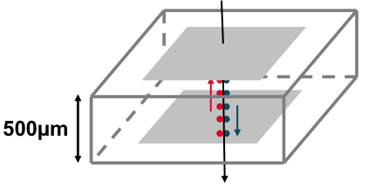
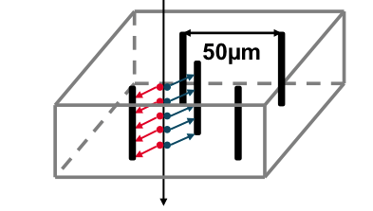
Motivation – Why 3D?
Planar
3D
150 μm
Drift distance shorter than in planar (≈ 100μm vs. 500μm)
Comparable to mean free path of charge carriers in irradiated diamond (few 10¹⁵ p/cm²)
Results in more efficient charge collection

Slide 4
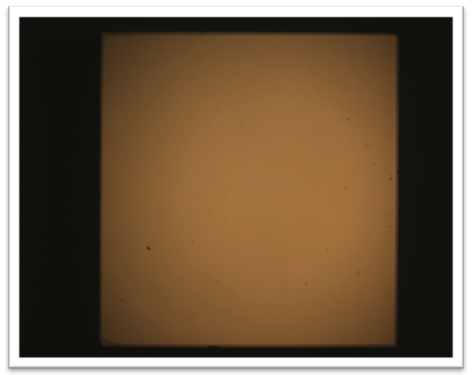
Fabrication – Surface treatment
100µm
Surface
Treatment
Column
Formation
Metallization
Notes:
OHIO: acid boiling -> remove surface dirt
not a hydrogen terminated surface, terminate with oxygen before drilling holes

Slide 5
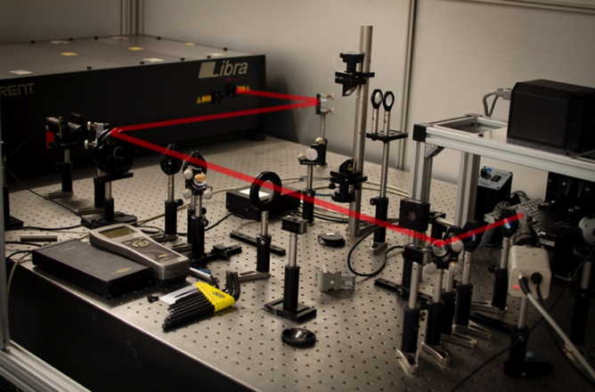
Fabrication – Column formation
Femto second laser
  Wavelength = 800 nm
  Repetition rate = 1kHz
  Pulse duration = 100 fs
  Spot size = 6 μm
  Pulse Energy:
    E = 1 – 23 μJ/pulse
    Φ = 1 – 30 J/cm²
Surface
Treatment
Column
Formation
Metallization
Notes:
In Manchester
run with plexi glas
20 mum per second --> 30 sec/ column
PICTURE LASER Beam goes through the diamond moves upwords

Slide 6
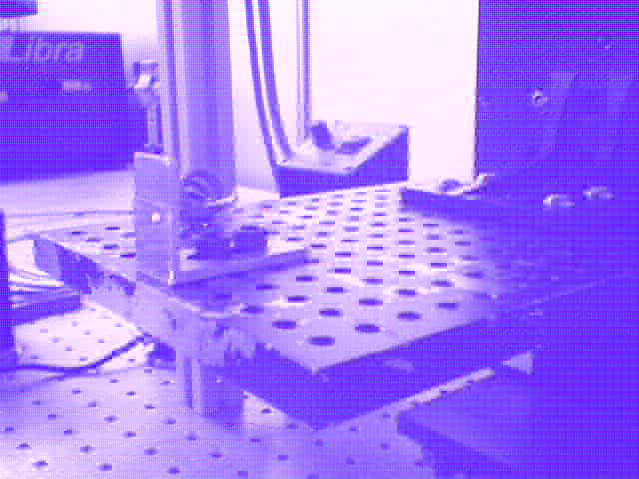
Fabrication – Column formation
Surface
Treatment
Column
Formation
Metallization
Notes:
In Manchester
run with plexi glas
20 mum per second --> 30 sec/ column
Hole is put from buttom to the top
Different connection at bottom and top →

Slide 7
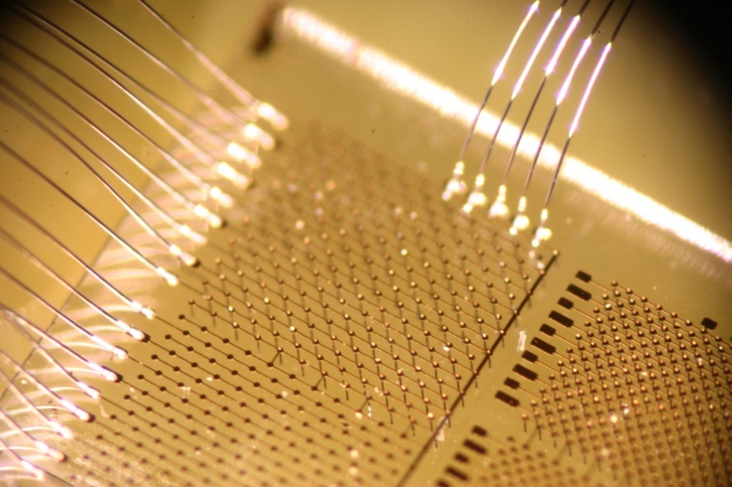
Fabrication
Surface
treatment
Column
Formation
Metallization
Notes:
Ohio: Titanium, platinum, gold

Slide 8
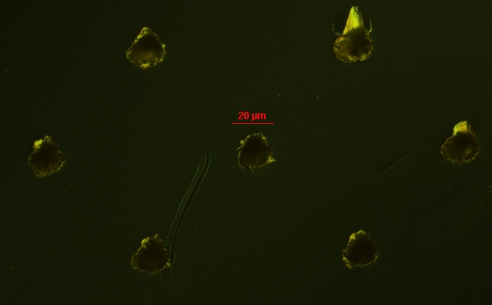
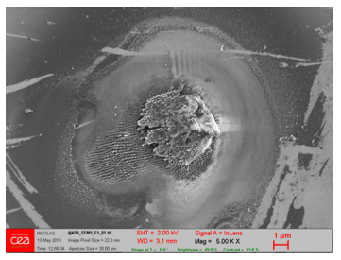
Conducting Columns
Seed Side

Slide 9
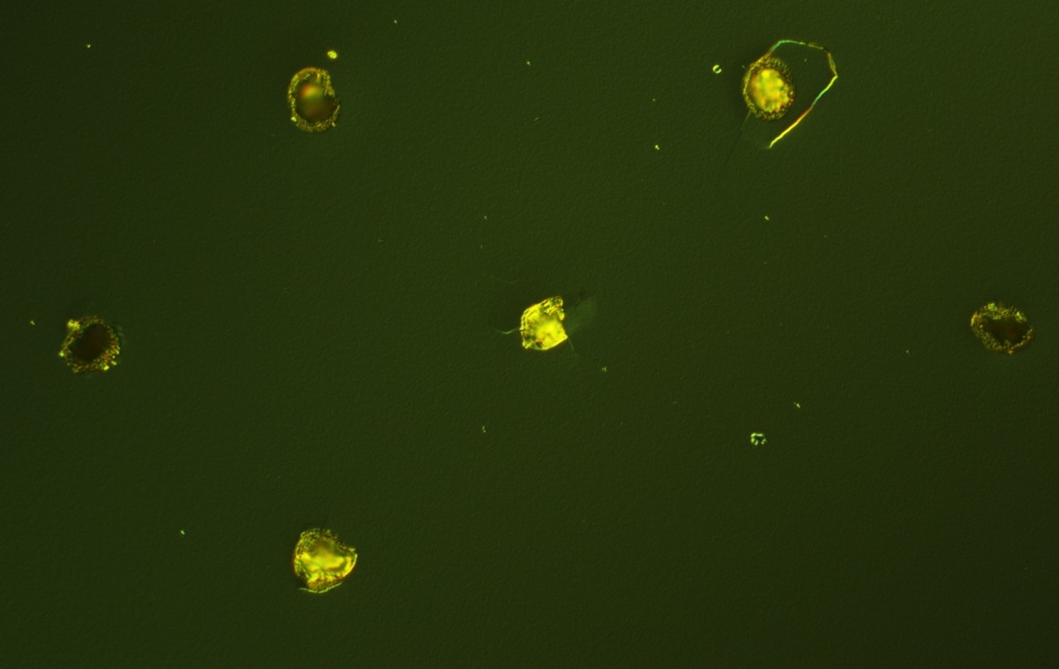

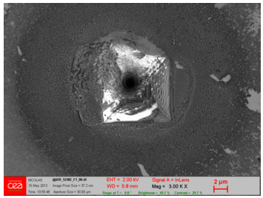
Conducting Columns
Exit Side

Slide 10
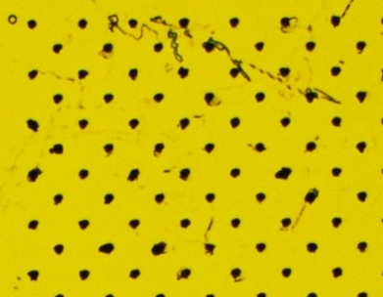
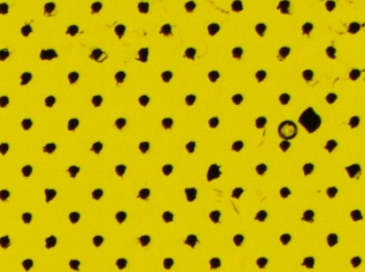
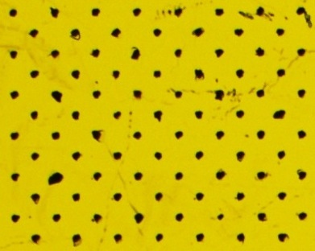
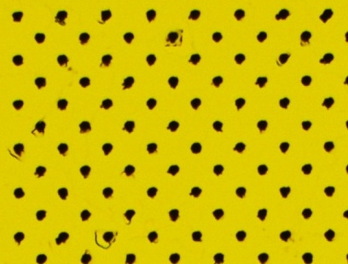
Conducting Columns – micro machining
 | Low Power | High Power
Seed Side
Low Speed
High Speed

Slide 11
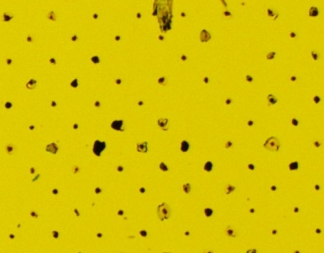
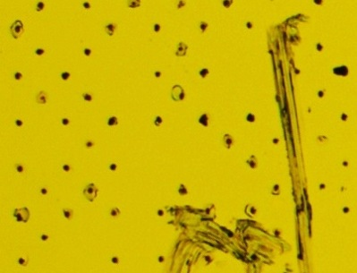
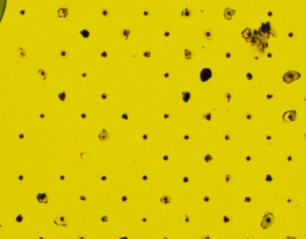
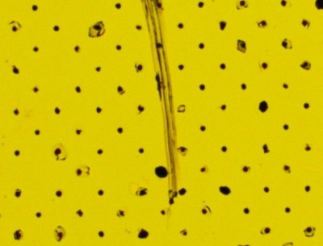
Conducting Columns – micro machining
 | Low Power | High Power
Exit Side
Low Speed
High Speed

Slide 12
Conducting Columns – micro machining
 | Low Power | High Power
 | 92.2 ± 1.4 % | 78.7 ± 2.1%
 | 93.3 ± 1.3 % | 87.6 ± 1.7 %
371 columns for each parameter set
Assuming binominal distribution for error calculation
Low Speed
High Speed
Notes:
Power Speed Fails
Low High 25
Low Low 29
High High 46
High Low 79

Slide 13
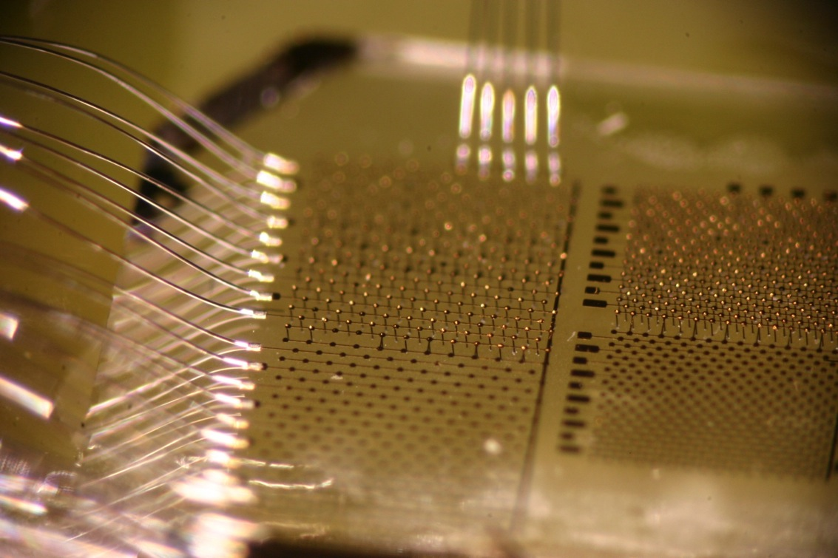
Missing Columns

Slide 14
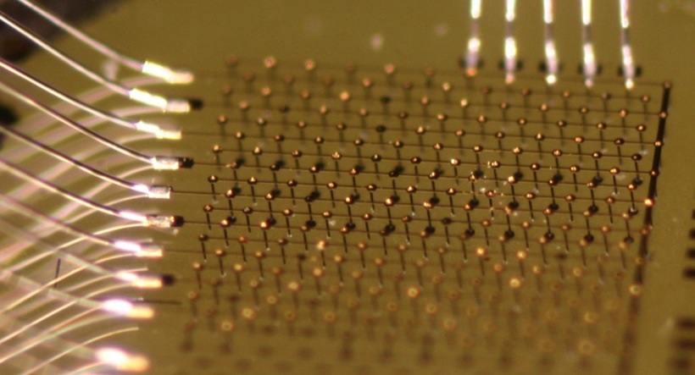
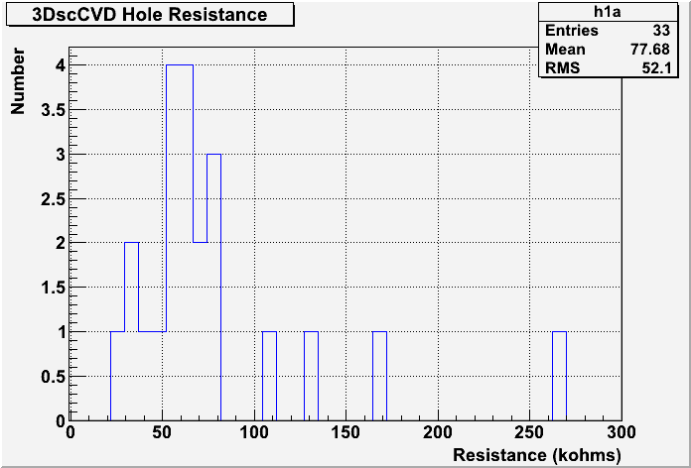
Column Resistance: Contact
Metallization & Column OK: ~ 90 %
Resistivity of columns:
Notes:
How does this measurement work:
Metallization of the columns on back with small pads,
Measure the resistance

Slide 15
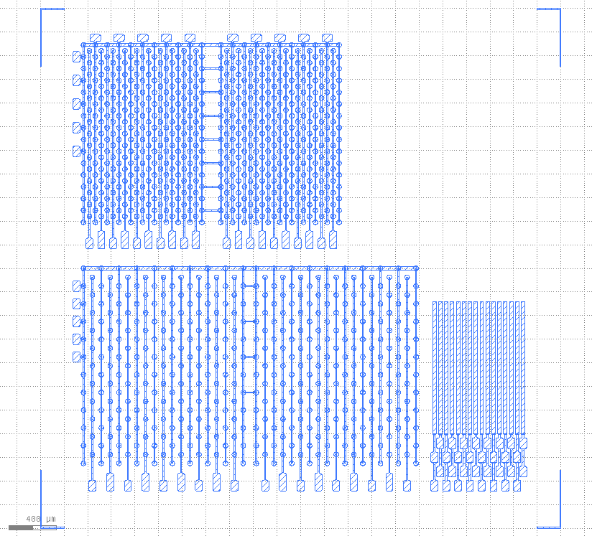
CERN Test beam
3D mask
no columns
3D mask with columns
Strip
Blue: front side
Three structures:
Strip detector as a reference to compare to with backplane (bias voltage)
3D mask layout (bias and readout from the same side)
  Without machined columns to understand the electric field
  With machined columns

Slide 16
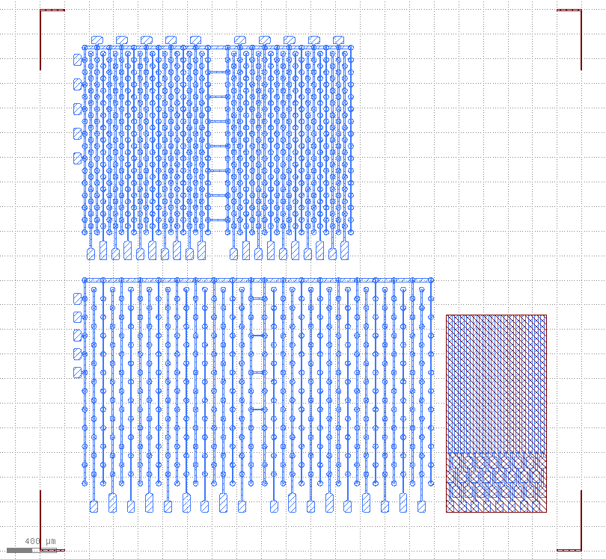
CERN Test beam
3D mask
no columns
3D mask with columns
Strip
Blue: front side
Brown: backside
Three structures:
Strip detector as a reference to compare to with backplane (bias voltage)
3D mask layout (bias and readout from the same side)
  Without machined columns to understand the electric field
  With machined columns

Slide 17
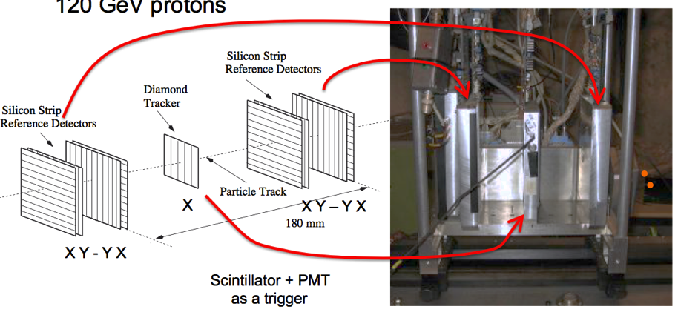
CERN Test beam
Using Strasbourg strip telescope in H6A (NA-SPS) with 120 GeV protons (4X, 4Y planes, Resolution: a few μm)
Triggering on coincidence of 2 scintillators
≈ 20 cm

Slide 18
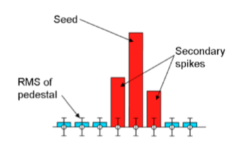
CERN Test beam - Clustering
After pedestal subtraction: Clustering
  Seed → 5 σ
  Hit → 3 σ
  At least one Seed needed to form a cluster
Seed Cut
Hit Cut

Slide 19
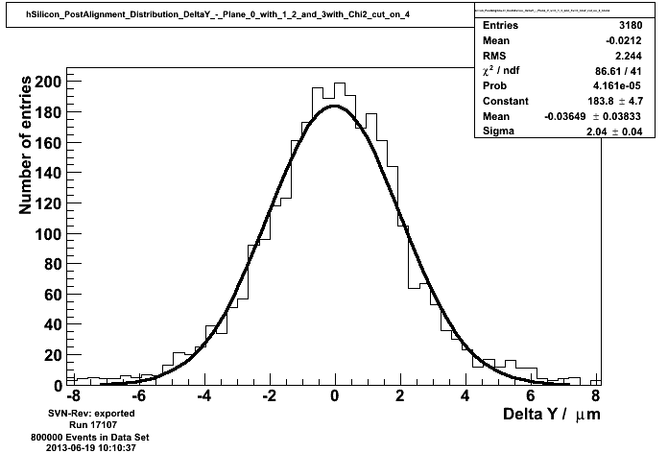
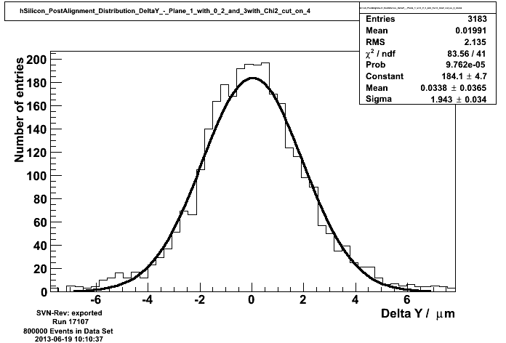
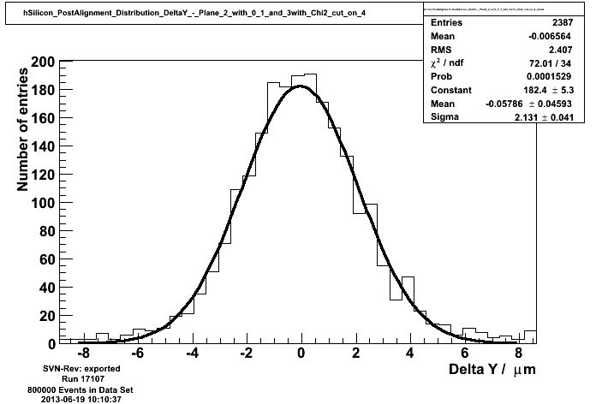
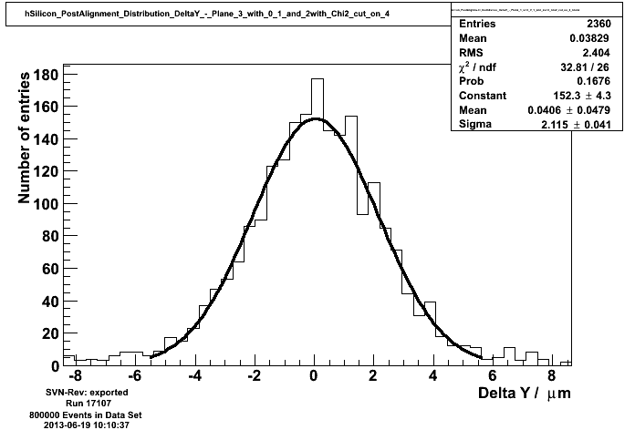
CERN Test beam – Telescope Resolution
Silicon strip detectors
Using eta corrected hit position for each detector
σ =
2.04μm
σ =
1.94μm
σ =
2.13μm
σ =
2.11μm

Slide 20
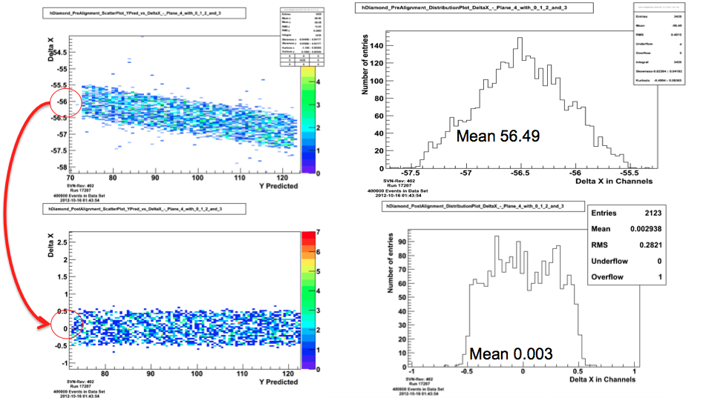
Diamond alignment
Using strip detector for alignment: highest hit position
Before alignment
After alignment

Slide 21
Results
Showing results for 3D single crystal CVD (batch2)
  Strip detector:
    Bias Voltage V_{Bias} = +500 V
  3D detector
    Bias Voltage V_{Bias} = +25 V
  1.1M events collected

Slide 22
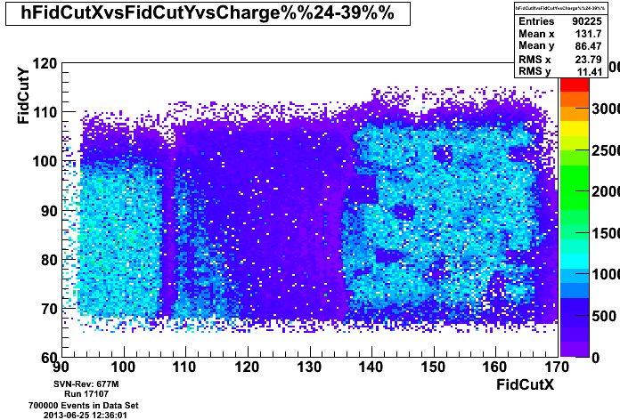
CERN Test beam – Fiducial regions
Requiring one and only one cluster in each telescope plane
Plotting average telescope position for selecting rough fiducial region
Requiring at least one Diamond cluster
Mean charge of first cluster

Slide 23
Fiducial Regions
In diamond detector:
Mean charge of cluster with the highest pulse height

Slide 24
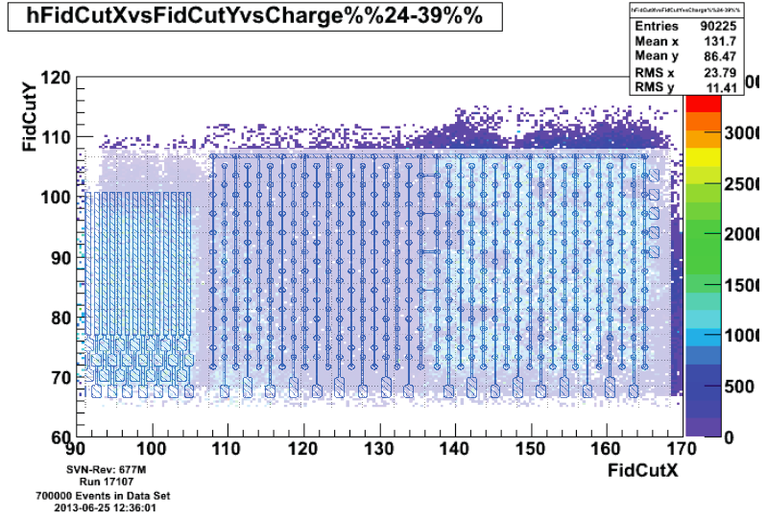
Fiducial Regions
Overlay with pattern of mask
Mean charge of cluster with the highest pulse height

Slide 25
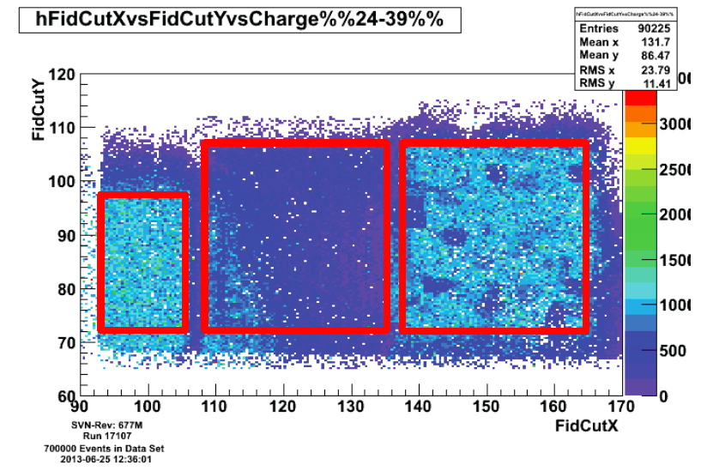
Fiducial Regions
Fiducial regions for the three different patterns
Mean charge of cluster with the highest pulse height

Slide 26
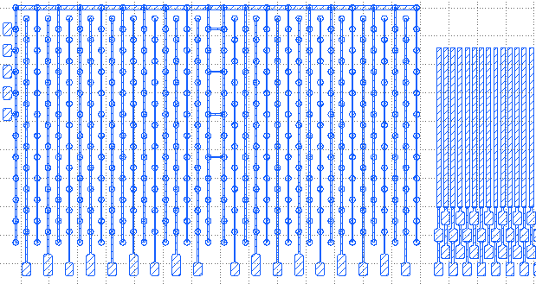
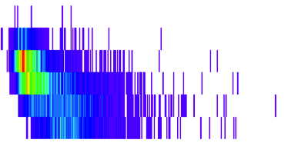
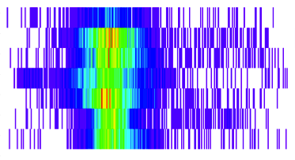
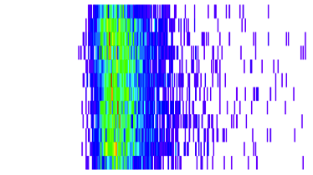
CERN Test beam
Strip
3D
no columns
3D
with columns
Charge of diamond cluster in ADC counts
1500
1000
500
← Strip @ 500V
3D with columns @ 25V →

Slide 27
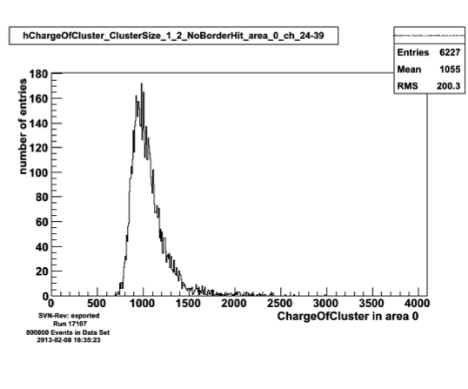
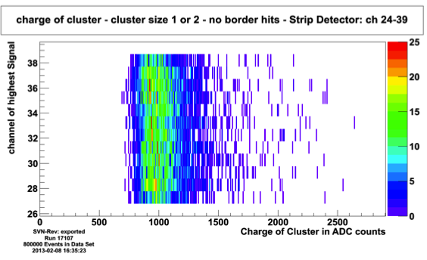
PH in strip detector
Similar pulse height in every channel
Landau distribution, MP @ ~1000

Slide 28
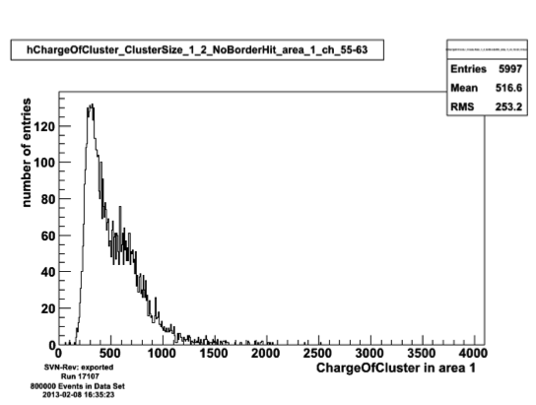
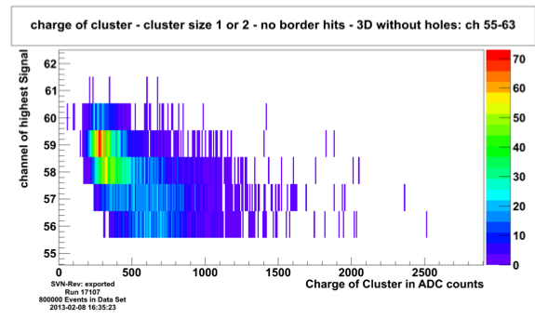
PH in 3D without columns
3D with columns @ 25 V
Effect of Strip
Detector @ 500V
Strip Detector @ 500 V
Influence of strip structure (500V vs. 25V), which is at lower channels

Slide 29
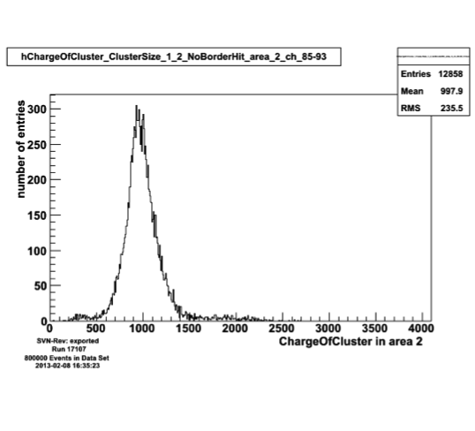
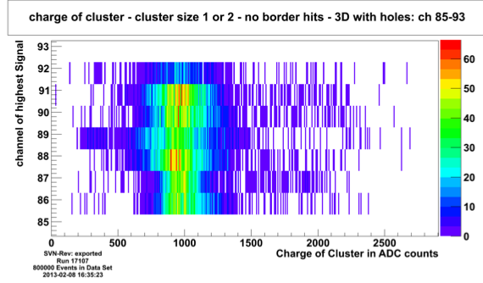
PH in 3D with columns
Gaussian tail to lower pulse heights
Small ‘bump’ at low pulse height ~ 400ADC

Slide 30
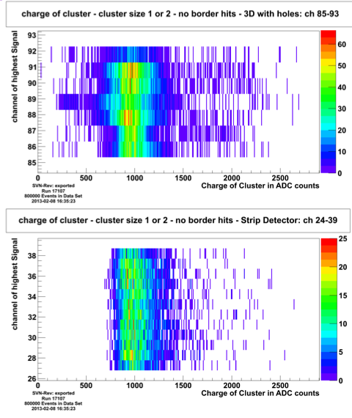
Comparison: 3D with columns vs. Strip detector
3D with
Columns
@ 25 V
Strip
@ 500 V

Slide 31
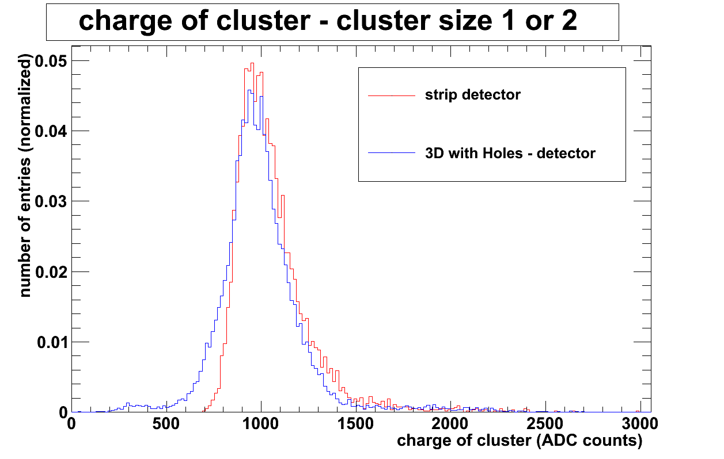
Strip vs. 3D
@ 500 V
@ 25 V
Peaking at the same pulse height

Slide 32
Strip vs. 3D
@ 500 V
@ 25 V
Missing
Readout columns?
Peaking at the same pulse height

Slide 33
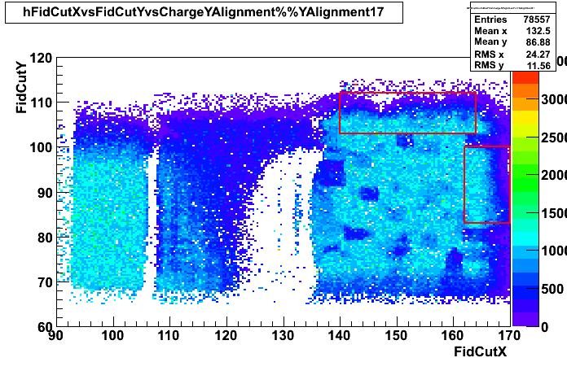
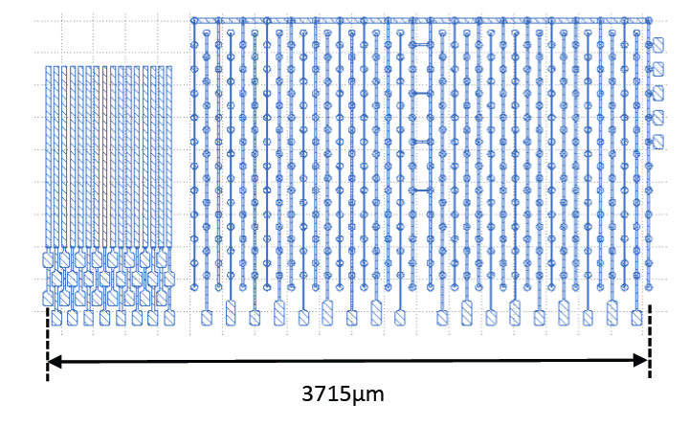

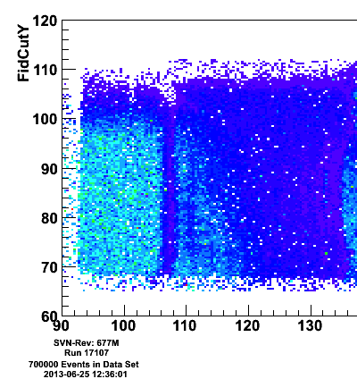
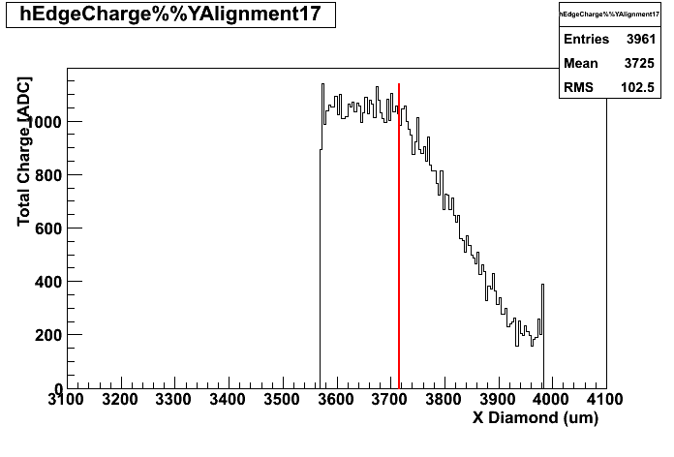
Y Alignment
3715 μm
Predicted from strip detector alignment
3715 um

Slide 34
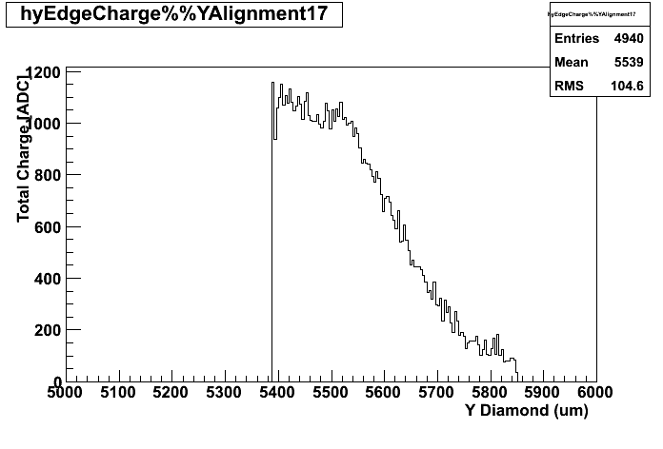
Y Alignment
3715 μm
5530 um
Predicted from strip detector alignment
3715 um

Slide 35

Pulse height distribution with overlaid grid
8 cells which seems to have a broken readout column (predicted 7 [p.12] )

Slide 36

Area without missing readout column
Notes:
Can be increased to a bigger section

Slide 37

Pulse height for this area
good agreement of strip detector and 3D detector

Slide 38
Conclusion
Produced conductive columns within diamond bulk
Achieved ≈ 90 % success rate in column formation
Success in metallization and column contact
Test beam results → columns collects full charge with much lower bias voltage

Slide 39

Outlook
Batch 3: new Layout
  Possibility of better alignment in y
  Better isolation between structures
  Bias voltage from the back
  Cubic and hexagonal cells
  Isolated cells
Radiation tests to be done
More groups to start with 3D diamonds within RD42, e.g. Gottingen

Slide 40
backup

Slide 41
Why diamond?
 | Si | diamond
Band Gap [eV] | 1.12 | 5.45
Electron Mobility [cm²/V s] | 1450 | 2200
Hole Mobility [cm²/V s] | 500 | 1600
Saturation Velocity [cm / s] | 0.8 · 10⁷ | 2 · 10⁷
Breakdown Field [V / m] | 3 · 10⁵ | 2.2 · 10⁷
Resistivity [Ohm] | 2.3 · 10⁵ | > 10¹¹
Dielectric Constant | 11.9 | 5.7
Displacement Energy [eV] | 13-20 | 43
e-h creation energy [eV] | 3.6 | 13
Average e-h pairs per MIP per μm | 89 | 36
Charge Collecting Distance [μm] | ~full | ~ 250-300
Thermal conductivity [W/cm K] | 1.5 | 22
Low leakage current
Low capacitance
Operation at high voltages
Operation without cooling
Radiation tolerant
Low signal
Single crystals small in size
Still quite expensive
Notes:
Once if it is irradiated: Mean free path is longer than the drift distance

Slide 42












TCAD Simulation
150µm
MIP
+40V
(25,25)
Slice @ Z=250μm
42

Slide 43

Side View

Slide 44



Motivation – Single Crystals
Cross polarized image
www.diamondcvd.com
Notes:
Cross polarized image with microscope
Defects are changing polarization
Show up as bright regions
Star == point defect
remove

Slide 45



Motivation – Polycrystalline Diamond
P.W.May, DRM, V19, I5-6,p369-396, 2009
Notes:
remove

Slide 46

Fiducial Regions
Overlay with pattern of mask and Fiducial cuts for each pattern

Slide 47

Mean pulse height for each cell

