Slide 1
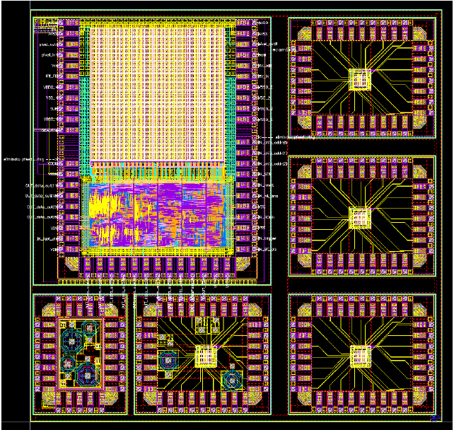
Monolithic Pixel Sensors in a Quadruple Well CMOS Technology
S. Zucca
PRIN-VIPIX-SuperB Collaboration meeting – 27th March, 2013 - Milano

Slide 2
Outline
Motivation: design of high granularity monolithic active pixel sensors (MAPS) for application to the Layer0 of the SuperB SVT
Low material budget (<1% X₀)
Pixel pitch of 50 μm in both x and y directions
High hit rate (100 MHz/cm²) & fast timestamp (< 1μs) - challenging for CMOS MAPS
High radiation hardness (3 Mrad/yr and 5∙10¹² 1 MeV neutron equivalent/cm²/yr) – challenging for CMOS MAPS
Apsel4well front-end readout
Analog FE and charge collection performance
Effects of neutron irradiation on charge collection properties
Monte Carlo charge loss model
Ongoing activities and future plans

Slide 3
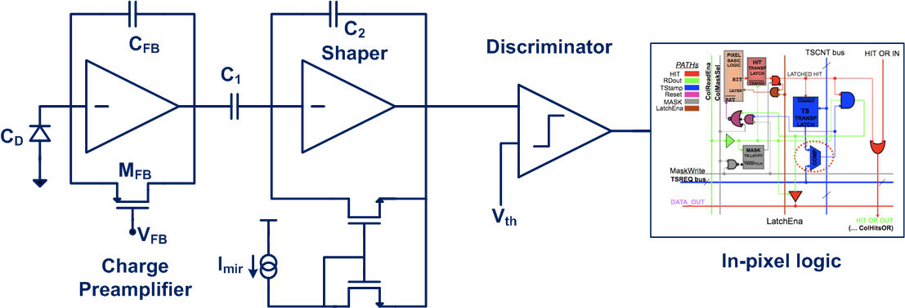
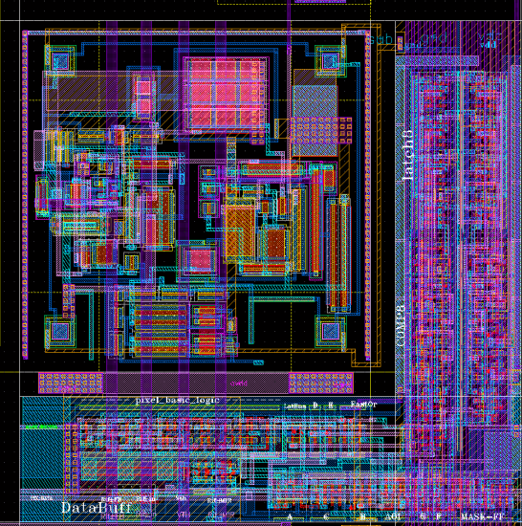
Apsel4well front-end architecture
4 interconnected N-well diffusions as collecting electrode
SENSORS
Charge PA with feedback capacitance C_{FB} continuously discharged by a PMOS operated in deep-subthreshold region
Analog front-end section
Shaping stage with a feedback capacitance C₂ discharged with a constant current proportional to I_{mir}
Active load comparator
In-pixel logic with time stamping capabilities, readout can be data-push or triggered
In-pixel logic

Slide 4
Apsel4well analog FE performance
Three different versions of Apsel4well have been fabricated:
5 μm thick std. res. epi layer
12 μm thick std. res. epi layer
12 μm thick high res. epi layer
Slight differences in Gq
Measured performance | 3x3 matrix
Gq (C_{inj}, std.-high res. epi layer) | 900-1100 mV/fC
Gq (⁵⁵Fe, high res. epi layer) | 850-950 mV/fC
Peaking time | 290 ns
ENC (C_{T} =C_{D}+C_{gg} =42 fF) | 38 e-
INL (@ 2000e-) | 2%
Current consumption* | 10 μA/pixel
Analog power consumption* | 18 μW/pixel
Analog power dissipation* | 0.7 W/cm²
* Data from simulations

Slide 5
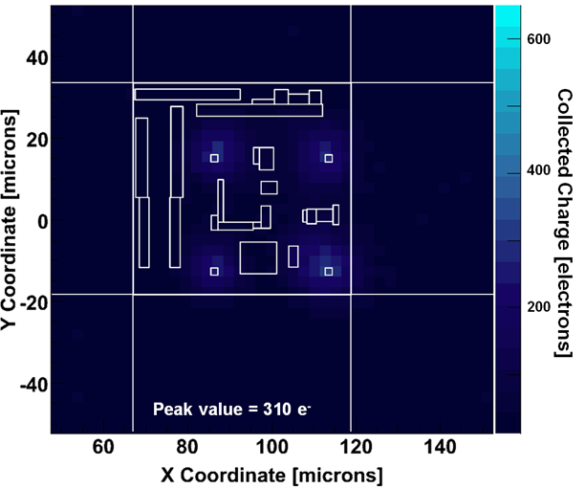
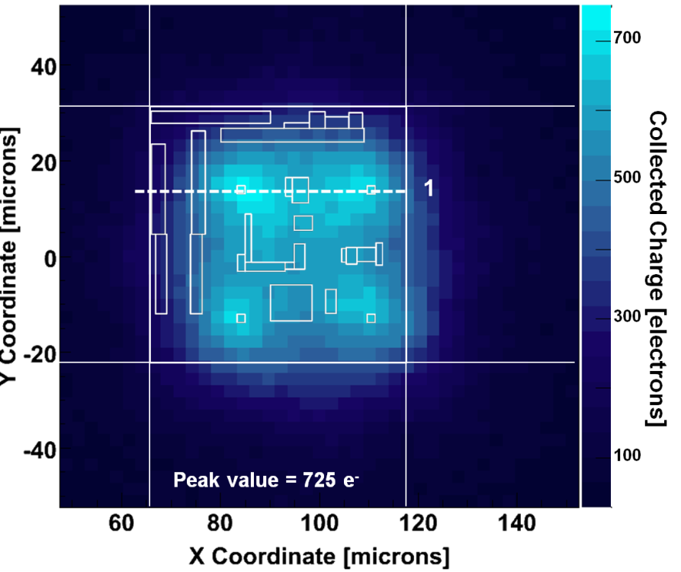
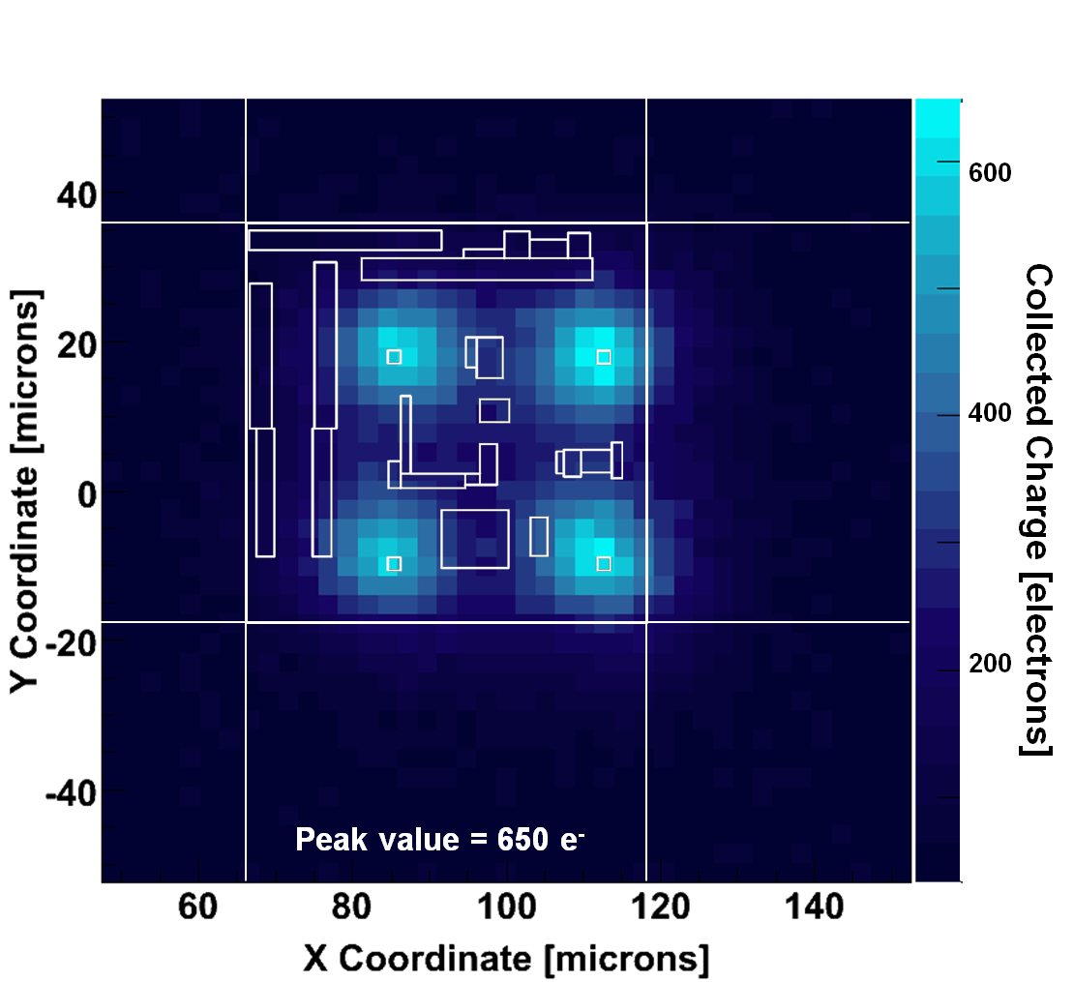
Charge collection measurements
5 um thick std. Res w/o deep Pwell
12 um thick high res with deep Pwell
5 um thick std. Res with deep Pwell
MPV calculated with Gq measured through C_{inj}

Slide 6
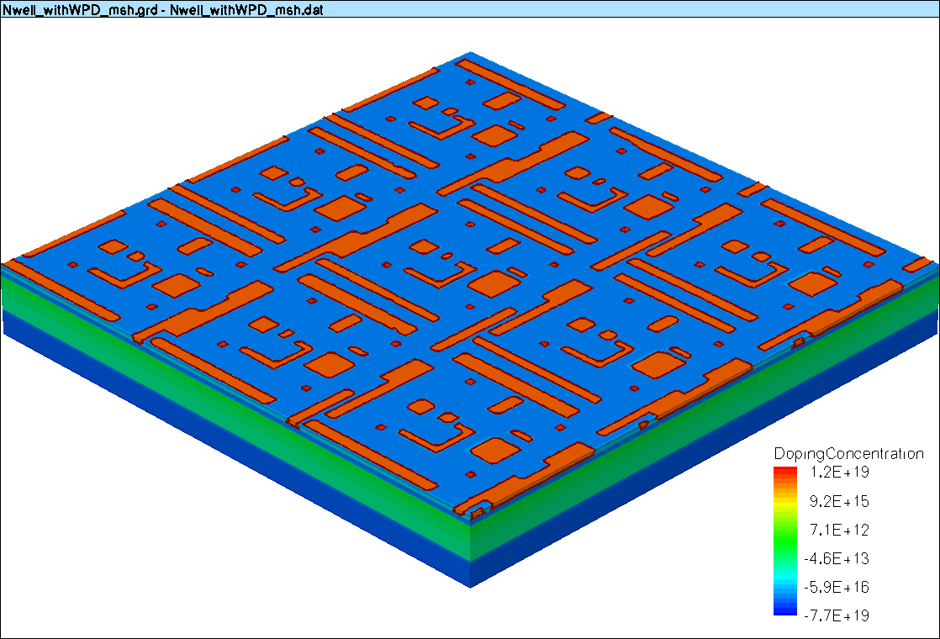
Charge collection: TCAD simulations
12 um std res
12 um high res

Slide 7
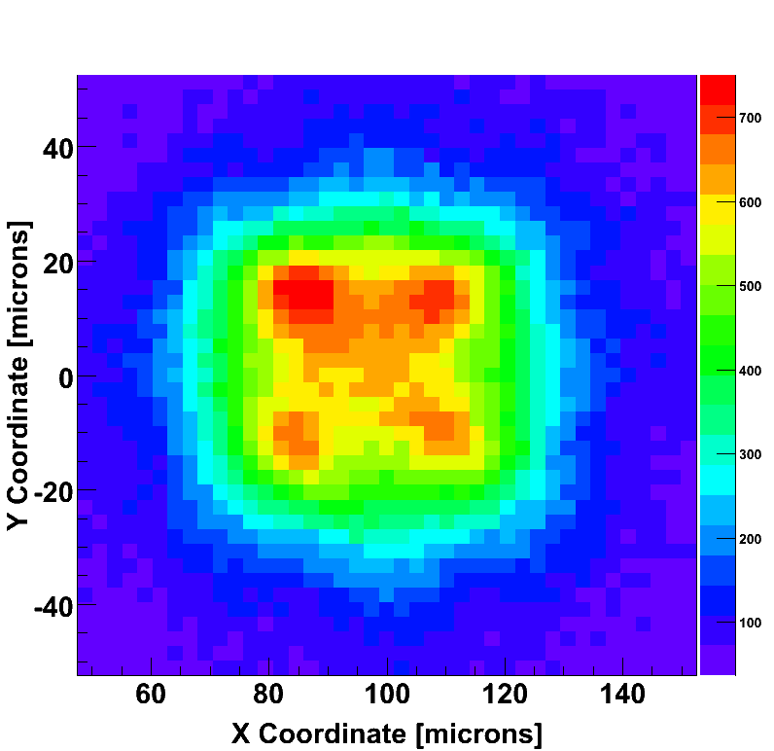
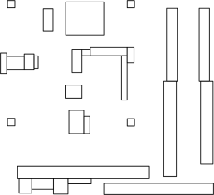
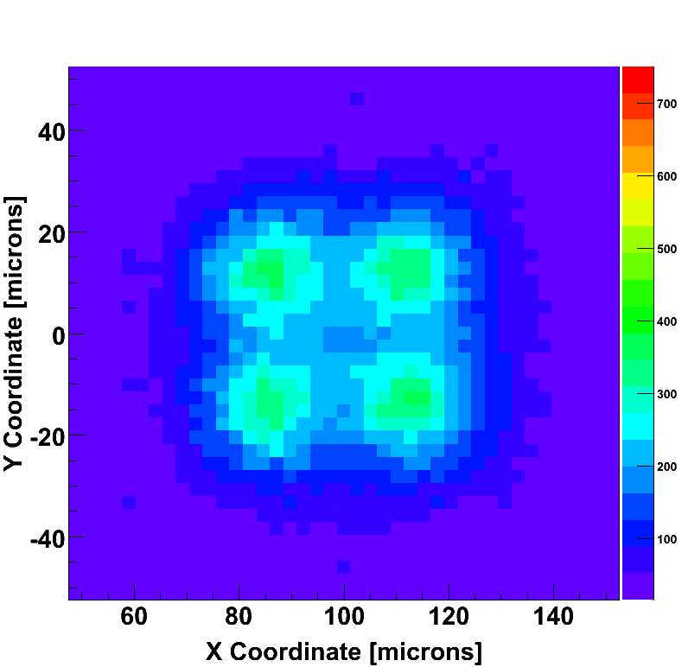
Neutron irradiation effects on charge collection
Apsel4well MAPS (12 um high res)
700
500
Collected Charge (electrons)
300
Before irradiation 725 e-
100
700
500
Measurements performed by means of IR laser source (different samples for each irradiation step)
Collected Charge (electrons)
300
Higher resistance to bulk damage in the case of high res epi layer
After 10¹⁴ n/cm² 355 e-
100
Results quite in good agreement with Monte Carlo charge loss model

Slide 8
Monte Carlo charge loss model
In typical CMOS monolithic sensors, charge released in the substrate mainly moves by thermal diffusion
D=diffusion constant n=carrier concentration
Excess charge in the substrate recombines according to
n’=excess charge τ₀=10 μs concentration N_{ref}=10¹⁶ cm⁻³
To account for bulk damage
The bulk damage tolerance of Apsel4well with high resistivity epitaxial layer can be further improved by increasing the area of the four collecting electrodes
Φ=1-MeV-neutron equivalent fluence K=silicon damage constant

Slide 9
Neutron irradiation effects on Gq and ENC
Normalized charge sensitivity and ENC of pixel 22 at varying fluences (up to 10¹⁴ 1 MeV neutron equivalent/cm²)
12 μm thick std. res. epi. layer
12 μm thick high res. epi. layer
No significant trend in the case of a standard resistivity epitaxial layer (different samples for each irradiation step)
Decrease in charge sensitivity in the case of high resistivity epitaxial layer, probably due to the increase of the leakage current in the collecting electrodes (to be further investigated)

Slide 10
Ongoing activities and future plans
Irradiation with γ-rays has started and devices are under test after the first step (1 Mrad)
Tests of “immunity” to substrate noise phenomena
Optimization of 3D TCAD simulations for:
Improving the precision of the Monte Carlo simulation results by further investigating the dependence of the depleted volume on the collecting electrode area
Evaluating the depleted volume as a function of the inverse biasing voltage
Future plans
Tests on back thinned (down to 50 μm and 25 μm) Apsel4well samples featuring a 12 μm thick high res epi layer

Slide 11
Backup slides

Slide 12
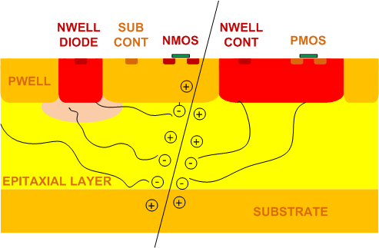
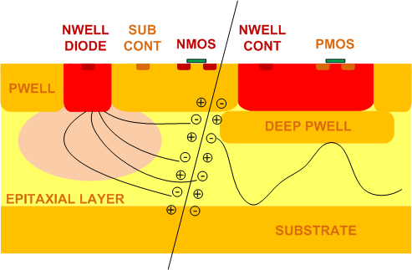
0.18 μm CMOS INMAPS process
Charge diffuses in the almost undepleted substrate of CMOS MAPS. It can be thinned down to few tens of microns with no signal loss
Charge collection efficiency of MAPS structures developed in a standard CMOS process can be affected by the presence of competitive N-wells needed for in-pixel logic suited for a fast readout.
Standard CMOS process
To overcome this issue a planar 0.18 μm CMOS process with quadruple well (INMAPS) has been considered
An additional processing step deposits a deep P-well layer
Different epitaxial layer options for Apsel4well - high resistivity epitaxial layer (1 kΩ∙cm) expected to provide better charge collection properties and higher bulk damage tolerance
INMAPS process

Slide 13
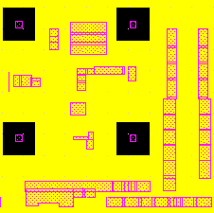
Apsel4well pixel layout
Pixel layout
DPW (yellow) and NW (pink) layers
D
L
SENSORS
W
Analog front-end section
Digital front-end section
50 μm
W=8 μm L=1.5 μm D=27 μm

Slide 14
Apsel4well chip layout
Four 3x3 test analog matrices:
Enclosed layout PA input transistor, 4 collecting electrodes, DPW
Open layout PA input transistor, 4 collecting electrodes, DPW
EL PA input transistor, 2 collecting electrodes, DPW
EL PA input transistor, 4 collecting electrodes, no DPW
5 mm
Test structures:
Octagonal pn diodes
Accumulation capacitors
Single analog channels
32x32 matrix with peripheral readout logic
5 mm

Slide 15
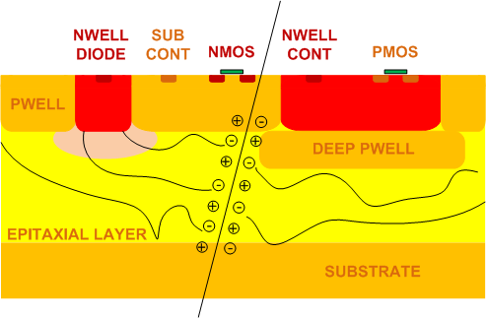
Epitaxial layer
The epitaxial layer, featuring a resistivity higher than both the deep P-well and the substrate, improves the charge collection properties.
The foundry provides different typologies of epitaxial layers. Three different versions of Apsel4well have been fabricated:
5 μm standard resistivity (≈10 Ω∙cm) epitaxial layer
12 μm standard resistivity epitaxial layer
12 μm high resistivity (≈1 kΩ∙cm) epitaxial layer
Advantages of a high resistivity epitaxial layer:
better charge collection properties (higher collected charge, charge collection speed)
higher bulk damage hardness expected

