Slide 1
Prin 2009 Bologna RU - Status
Mauro Villa

Slide 2
Prin 2009 BO Goals
Digital readout architectures for pixel chips
Space resolution 50 um, time resolution 100 ns
Efficiency >98% with 100 Mhit/s rate on 1 cmq
Online tracking system
Continue the study on the AM systems (+PI+MI)
Push the system to its limit (bandwidths)
AM roads processing (tracking/fitting/TSP)

Slide 3
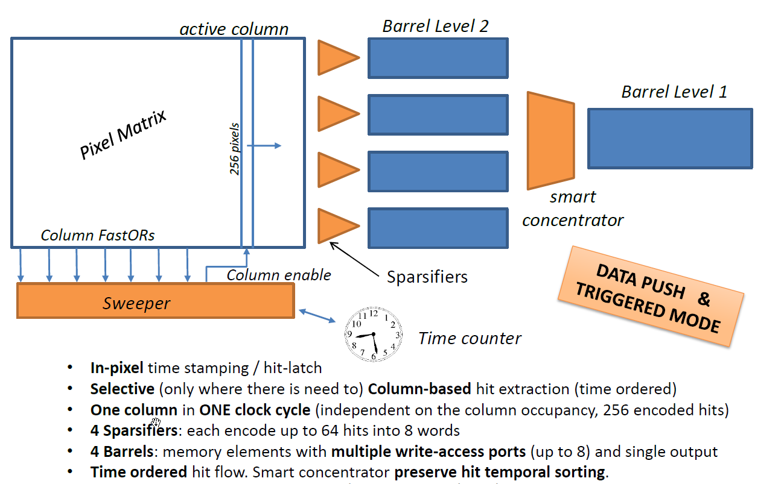
Pixel chip architecture

Slide 5
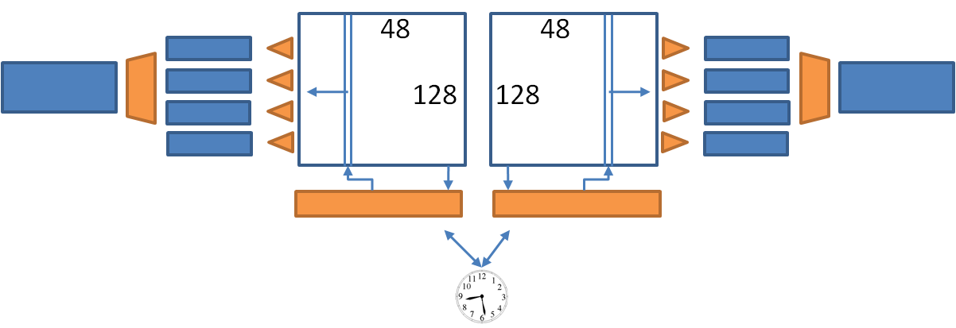
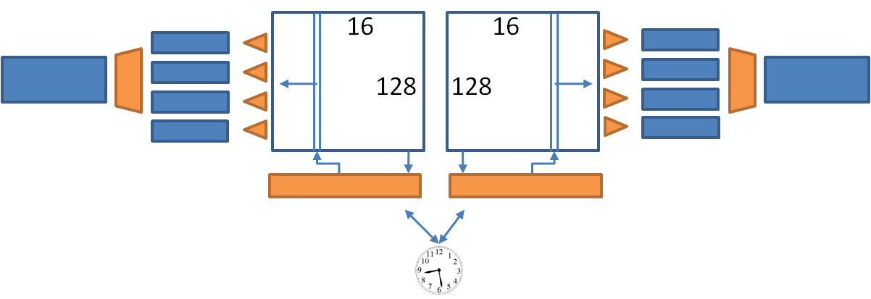
The 3D MAPS projects
Apsel-VI
MATRIX 96x128(2 sub-m. 48 x128)
5.2 x 10 mm (incl. scr. line)
Rows divided in:
4 sparsifiers
32 rows for each sparsifier
8 zones for each sparsifier (Wzone= 4 pixels)
SuperPix1
MATRIX 32x128 (2 sub-m. 16x128)
3.5 x 10 mm (inc. scr. Line)
Rows divided in:
4 sparsifiers
32 rows for each sparsifier
8 zones for each sparsifier (Wzone= 4 pixels)

Slide 8
Stratix Firmware building blocks
Stratix
VME Memory
32 D32
+ EPMCs
Register
File
Main
FSM
Clock
Manager
EPMC
Regs
Data
Processing
Spy
buffer
Spy
buffer
8 Hit streams
6 AM Hit streams
From epmc or simu
L1Accept
Roads
AM
From TTC or simu
Post
Processing
Event
Out
Spy
buffer
S-Link out

Slide 9
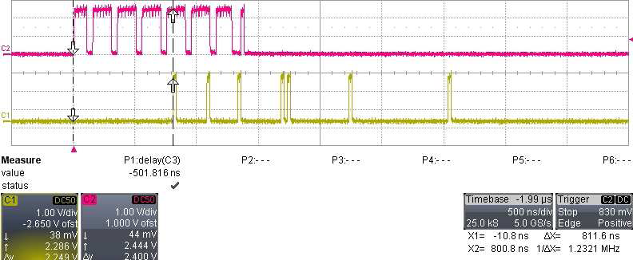
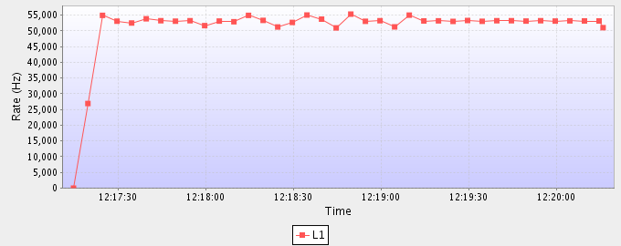
Latenza e Rate
Hit EDRO → AMB
Road AMB → EDRO
Latenza AM ≈ 0.8 μs
Scrittura disabilitata
Configurazione finale

Slide 10
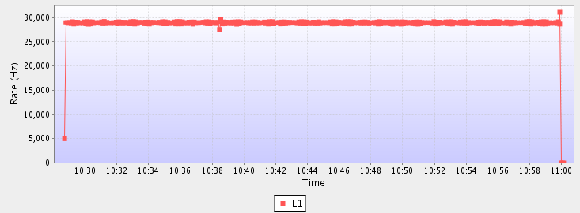
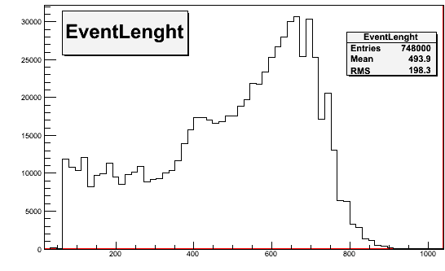
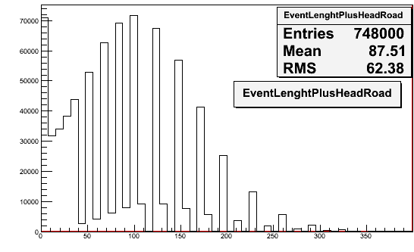
HW Hit generation in EDRO → AM → EDRO → ROS
Test system in Bologna: sample run
TDAQ Rate
HW hit generation to
exercise the system at low and high rates
DAQ rates 1Hz →62 kHz stable
depending on event size
No TDAQ errors
Mean size ≈ 500 words
Mean roads ≈ 90
TDAQ rate: 28 kHz
Online histograms
Evt length
AM roads
Comparison with offline analysis: on 100k events, 9M HW roads, 99% matched in simulation (missing roads due to event mixing, wrong data transfer or cuts), 0.1% missing End-Events.

Slide 11
Firmware e Software
Simulazione
SOFTWARE
HIT
Lettura
Controllo
ATLAS
EDRO
EDRO
AMB
AMB
Gen
Confronto
HIT
Qualità del Run:
Errori
Istogrammi
Grafici
DISCO
ROAD

Slide 12
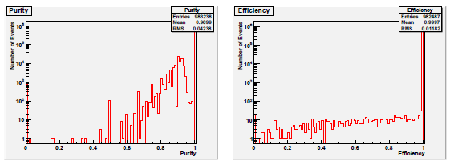
Evoluzione Firmware
Purezza = Road corrette individuate / totali individuate
Efficienza = Road corrette individuate / totali attese
Vecchia Versione
Pur 100%
Eff 100%
Nuova Versione

Slide 13
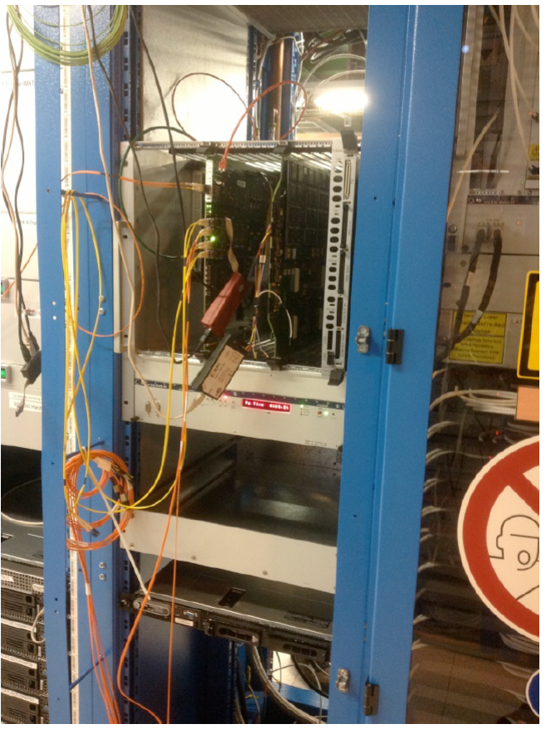
Installazione
Ottobre, CERN:
Installazione in ATLAS
Test dati reali
Banca pattern di prova
Test di trasmissione hit e stabilità
EDRO
AMB

Slide 14
Not implemented
Prin program describes track cleaning by a Data Organizer, a Tree Search Processor and a Track fitter (BO+MI+PI).
No time to develop the data organizer, no track fitting. The TSP has been superseeded by the next generation of AM chips (don’t care bits).

Slide 15
Prin-related papers/presentations
F. Giorgi – The Front-End chip for the SVT detector – Elba 2012
F. Giorgi - A fast digital readout architecture for vertically integrated pixel sensors WIT 2012 (poster np)
A. Gabrielli – Development and simulation results-… IPRD2010
A. Gabrielli – High efficiency readout circuits … (NIM 2011)
A. Annovi – The EDRO Board connected to the Associative Memory … TIPP2011
M. Villa - Online tracking applications of the general purpose EDRO Board ... WIT 2012 (poster np)

Slide 16
Summary
Digital readout architectures for pixel chips
PRIN goals reached; readout architectures fully developed, simulated and ready to be submitted
Online tracking system
2 out of 3 PRIN goals reached;
Last one superseed by new AM chips

Slide 18
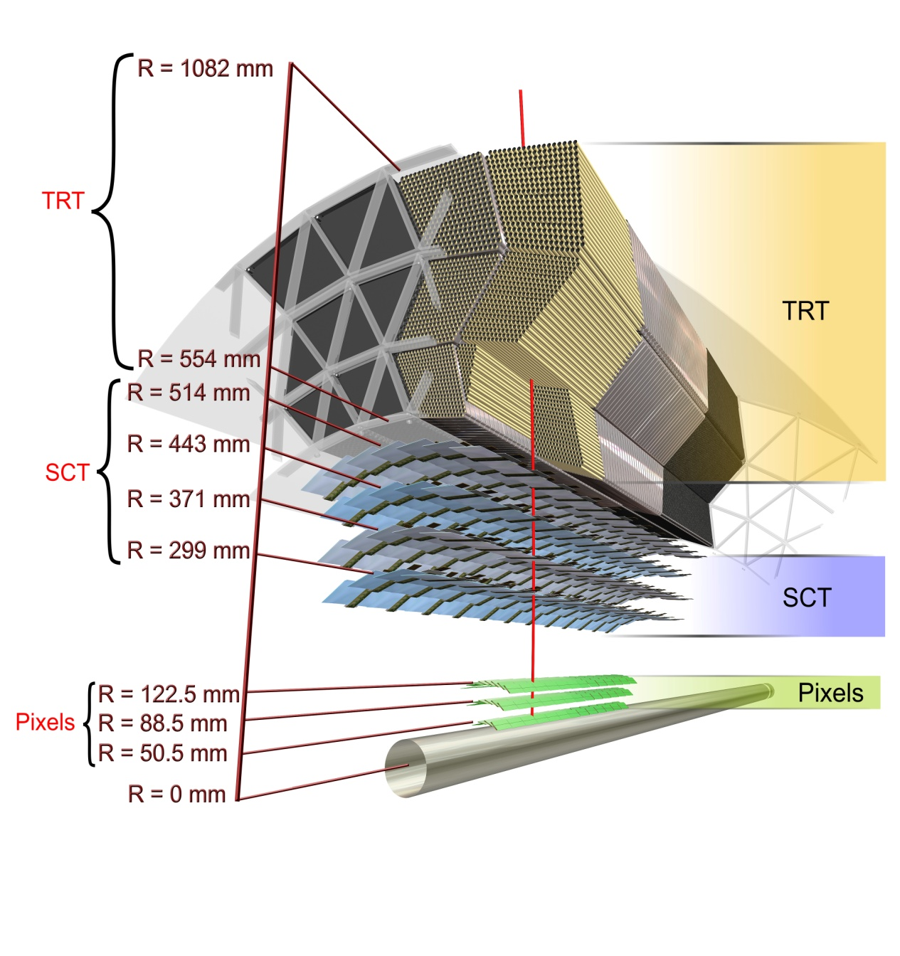
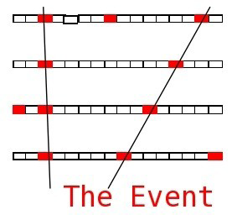
Vertical Slice
Prototipo 2012:
AMB
EDRO
HIT
PATTERN
ROAD = Regione che contiene tutte le tracce di un Pattern
Particella (alto pT)

Slide 19
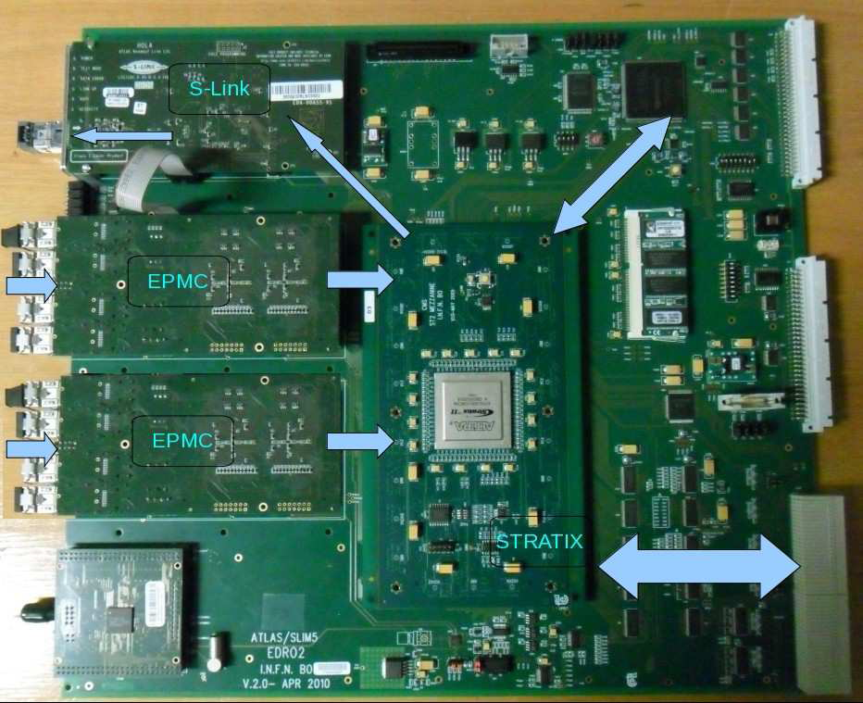
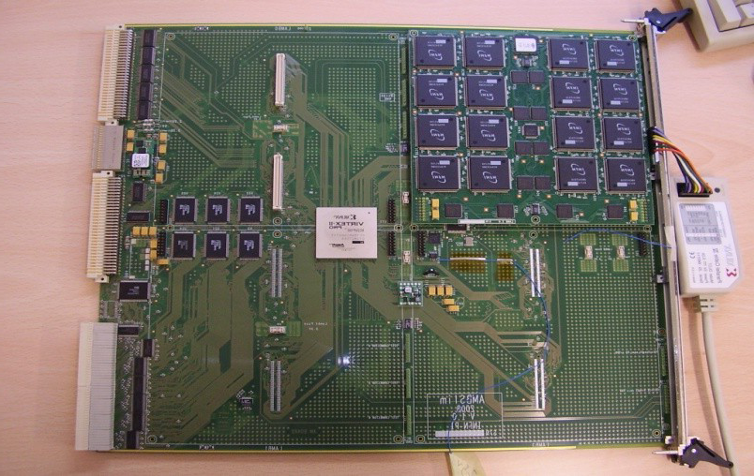
La scheda EDRO
Altera Stratix II FPGA
Riceve/genera e organizza le hit
Strip/pixel colpito → coordinate reali
Comunica con la AMB
DAQ
Road + hit
EDRO
VME
CPU
AMChip
ATLAS
o
Simu
Road
8 hit stream
Stratix
AMB
Gen
6 hit bus

Slide 20
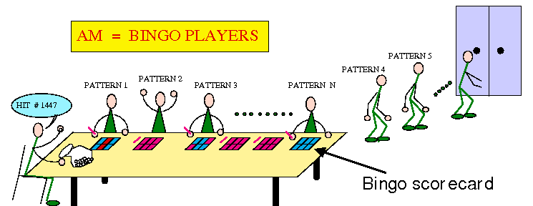
Memorie Associative
AMChip basato sulle CAM
Correlazione tra hit -> pattern a bassa risoluzione in parallelo
Banca (50k - 100k) pattern (6-8 layer) → road

Slide 21
I Primi Test
Scopo: testare passo a passo, scheda per scheda durante lo sviluppo
Bologna, Pisa
Sviluppo firmware EDRO e AM
Hit generate nella EDRO
Hit e road salvate su disco
Simulazione
Confronto dei risultati

Slide 22
Latenza e Rate
Hit EDRO → AMB
Road AMB → EDRO
Latenza AM ≈ μs
Scrittura disabilitata
Configurazione finale

Slide 23
Test Vertical Slice
Bologna, Pisa, CERN
Test prototipo completo
Hit generate da programma e salvate
Inviate da PC
Risultati su disco
Simulazione prende hit e road da file diversi
Confronto risultati

Slide 24
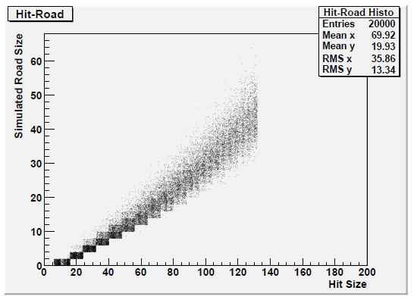
Test Vertical Slice
Corretta trasmissione hit
Match tra road trovate e simulate
Purezza 100%
Efficienza 100%

