Slide 1
Activity on the design and characterization of front-end electronics in the frame of the PRIN09 project
Luigi Gaioniª, Alessia Manazzaª, Massimo Manghisoni^{b,a}, Emanuele Quartieri^{c,a}, Lodovico Ratti^{c,a}, Valerio Re^{b,a}, Gianluca Traversi^{b,a}, Stefano Zuccaª
ª INFN sezione di Pavia
^{b} Università di Bergamo
^{c} Università di Pavia
PRIN09 Collaboration Meeting, Milan, March 27th 2013

Slide 2


What is in the PRIN09 proposal (FE electronics-wise)
Optimization of high granularity detection systems for charged particle tracking according to the SuperB SVT requirements – granularity (40-50 um), detection efficiency, power distribution, threshold dispersion, radiation hardness, material budget
40 um pitch MAPS with DNW collecting electrode in a vertically integrated, two-tier, 130 nm CMOS technology
50 um pitch mixed-signal front-end circuits in a vertically integrated, two-tier, 130 nm CMOS technology for hybrid pixel detectors
also DNW MAPS (Apsel family) and front-end chips for hybrid pixels in 130 nm planar CMOS technology and MAPS in the INMAPS, 180 nm process were mentioned
Feasibility study of particle detectors for high precision event timing, using diamond or 3D detectors
planar 65 nm and vertically integrated 130 nm CMOS technologies proposed for front-end electronics design
jitter and time walk minimization, implementation of timing methods (fractional triggering, time to digital conversion, time to analog conversion, TAC-based TDC, time vernier)

Slide 3
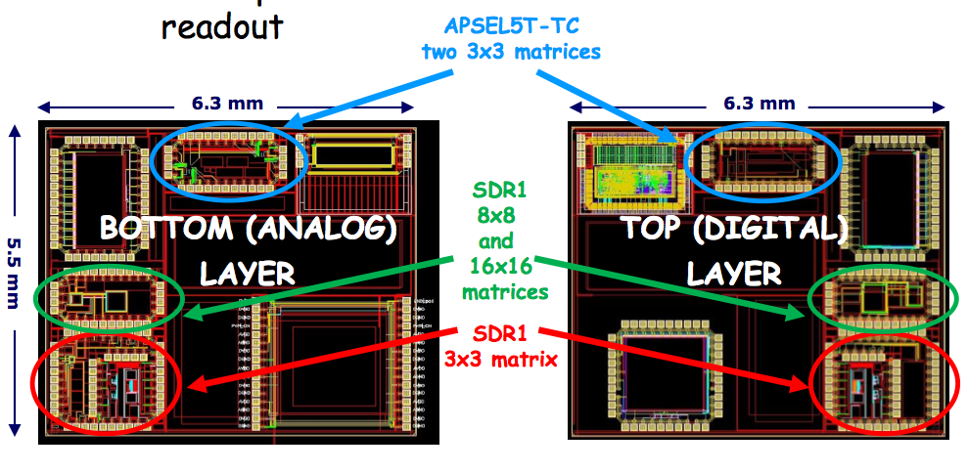
Vertically integrated MAPS (Tezzaron/Chartered)
Fully functional samples available since last summer, more available in the coming weeks
Apsel3DTC samples tested on the SPS beam at CERN
Radiation tolerance tests on SDR1 chips are in progress
Characterization of the SDR1 and Apsel test structures already covered by Giulia and Alessia this morning

Slide 4
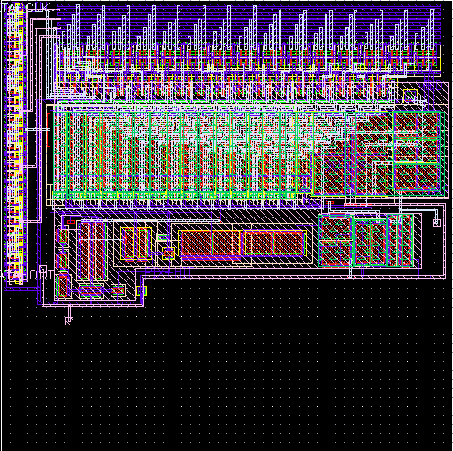
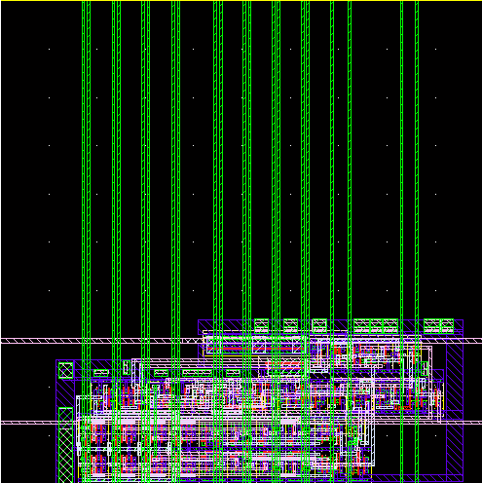
APSELVI and Superpix1 (Tezzaron/Globalfoundries)
Design of the APSELVI 3D MAPS and of the Superpix1 chip for hybrid pixels is in progress - to be submitted hopefully at the beginning of next Summer
some solutions implemented to improve power distribution (voltage drop minimization circuit) and threshold dispersion (threshold correction circuit)
on chip pulser for charge sensitivity calibration and general functional tests
polarity selection available for signal readout from different kinds of detectors
device simulation for best trade-off between noise and charge collection efficiency
Design of the APSELVI and Superpix1 chips already covered by Luigi and Alessia this morning

Slide 5
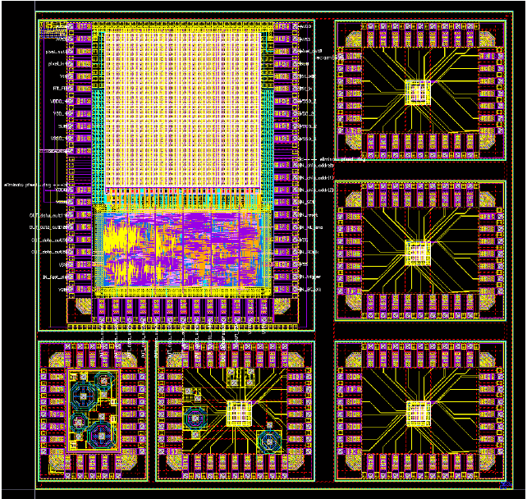
Apsel4well – MAPS in INMAPS technology
Monolithic sensors in a 180 nm CMOS technology with deep P-well implant
different technology solutions tested – 5 and 12 um epi-layer thickness, standard and high resistivity epi-layer (10¹³ and 10¹⁵ cm⁻³)
extensive radiation tolerance characterization (bulk damage tests up to 10¹⁴ cm⁻², TID characterization is in progress, planned to reach 10 Mrad total dose)
quite bad substrate noise problems under investigation
Characterization of the Apsel4well test structures already covered by Stefano Zucca this morning

Slide 6
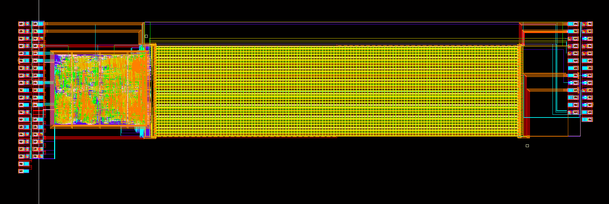
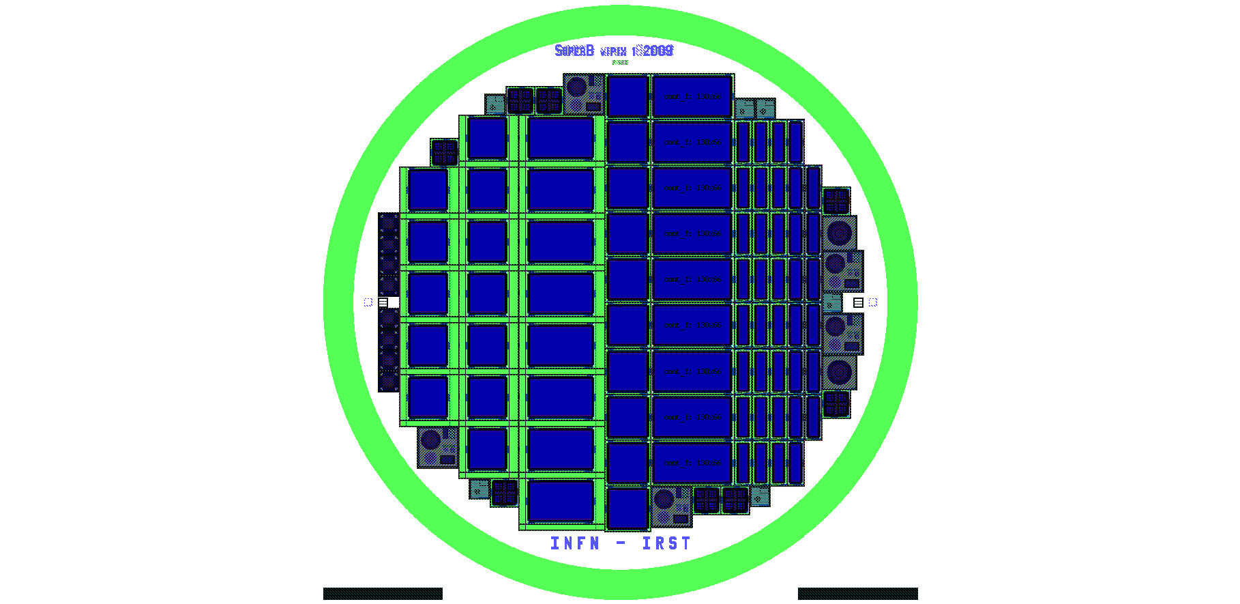
Integration of heterogeneous layers with T-Micro
Very high interconnect density, with small bond pads (squares with a side of 5 or 10 μm, depending on the bump size, 2x2 μm² or 8x8 μm²) both on the sensor and the readout sides ➔ more room for top metal routing, in particular for power and ground lines, smaller capacitive coupling, less material
Preliminary test of the T-Micro integration process performed on pre-existing readout chips (Superpix0) and high resistivity n-on-n pixel sensors (VPix1)
Sensors in the red box have no metal layers under the markers
Superpix0 chip layout
Front-end chips and a pixel sensor wafer shipped to T-Micro in Dec. 2012
5 vertically integrated chips now waiting for customs expenses to be paid

Slide 7
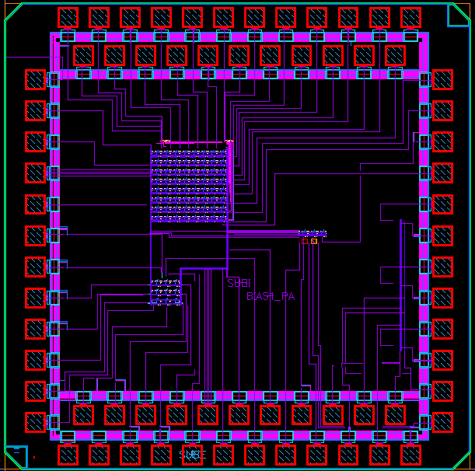
Apsel65 Fast Front-End (FFE) chip
3 fast-channels with Cinj and detector simulating capacitor (50 fF, 100 fF, 150 fF)
Developed in a CMOS 65 nm technology (IBM) for the readout of pixel sensors (C_{D} of the order of 100 fF)
Relatively fast operation (25 ns peaking time)
8x8 DNW MAPS matrix
- digital outputs
- outputs of the shapers can be accessed through row and column decoders and read out one at time
3 standalone channel with Cinj and detector simulating capacitor (250 fF, 350 fF, 450 fF)
3x3 DNW MAPS matrix
9 analog outputs
Digital output of the central pixel
Cinj on central pixel

Slide 8
Fast Front-End standalone channels
Peaking time (at analog buffer out) is close to 25 ns
Charge sensitivity has an average value of 33 mV/fC. Since output buffer gain ≈ 0.89 → G_{Q} @ shaper output is close to 37 mV/fC (42 mV/fC simulated)
Noise: ENC=214 e⁻ rms (204 e⁻ rms simulated)

Slide 9
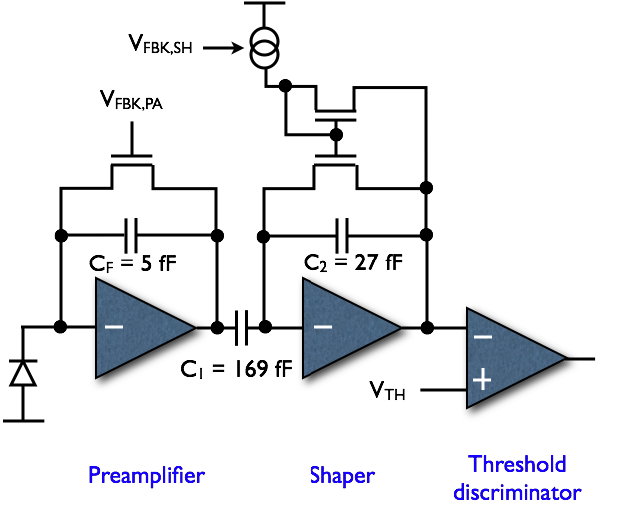
Apsel65 DNW MAPS
Main design features
W/L PA input device: 28/0.25
Power consumption: 20 μW/cell
Equivalent noise charge: 38 e⁻
Threshold dispersion: 38 e⁻ (main contributions from shaper input device and NMOS and PMOS pair in the discriminator)
Charge sensitivity: 725 mV/fC
Peaking time: 300 ns
Same readout scheme (except for components value) for the fast front-end channels which were designed according to the typical specifications associated with the readout of fully-depleted pixel sensors (tp = 25 ns)

Slide 10
Standalone DNW MAPS
Peaking time (at analog buffer out) is close to 530 ns (for Qin=800 e⁻) - Simulation data: tp=300 ns at shaper out, tp=400 ns at buffer out
Recovery time increases linearly with the signal amplitude (C2 discharged by a constant current source)
Charge sensitivity has an average value of 760 mV/fC (725 mv/fC simulated)
Measured ENC is about 10% higher with respect to simulated values

Slide 11
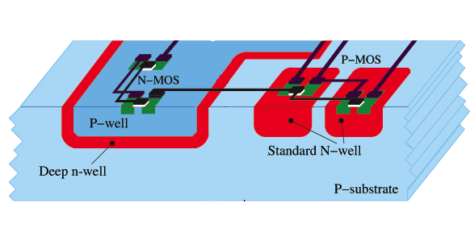
⁵⁵Fe measurements
Soft X-ray from ⁵⁵Fe source (5.9 keV) used to calibrate pixel gain in channels with no injection capacitance
INCIDENT PHOTONS
5.9 keV line  1640 e/h pairs
With charge entirely collected clear peak @ 200 mV → G_{Q} = 760 mV/fC
Using ⁵⁵Fe gain calibration: pixel noise 4.6 mV → ENC=38e⁻ rms
8/11
2011 IEEE Nuclear Science Symposium and Medical Imaging Conference - Oct 23-29 – Valencia, Spain

Slide 12
Low power, high speed threshold discriminators
Discriminators compatible with applications in high granularity pixel detectors
CMOS 65 nm TSMC technology
low power (< 10 uW), high speed (no more than a few ns delay), small area (fitting in a 50 um pitch pixel, of course together with the other analog and digital blocks), low threshold dispersion (not larger than the noise)
Twofold purpose
minimize the impact of the discriminator delay on hit time resolution in tracking detectors
avoid non-linearity at small input charge values in the channel response as seen by the digital section
Two architectures have been evaluated (classical preampli+shaper analog front-end is assumed)
differential stage with mirror load (directly driven by the shaper output)
transimpedance amplifier (driven by the shaper output through a transconductor)
Best trade-off among the above mentioned specifications can be reached by including a 5-bit threshold correction circuit

Slide 13
Low power, high speed threshold discriminators
Analog front-end specifications:
DC voltage at the shaper output: 200mV
Output dynamic range: 800 mV
Threshold voltage: 240 mV
ENC: 150 electrons
Parameters of interest: delay (Δt, defined as t(Vout exceeds 600 mV)-t(Vin exceeds Vth), threshold dispersion (σ_{th}), power dissipation (P)
A figure of merit M is defined as
Δt x σ_{th} x P

Slide 14
Discriminator architectures
Current discriminator
Voltage discriminator

Slide 15
Some results for the voltage discriminator
Version |  | Delay [ns] | Dispersion [mV] | Current [uA] | FOM
1 uA | HS | 5.04 | 10.09 | 1.00 | 50.87
 | MD | 12.94 | 2.87 | 1.00 | 37.11
 | LD | 18.32 | 1.71 | 1.00 | 31.35
2 uA | HS | 1.26 | 15.27 | 2.00 | 38.41
 | MD | 4.67 | 5.58 | 2.00 | 52.09
 | LD | 13.83 | 1.45 | 2.00 | 40.07
5 uA | HS | 1.53 | 8.97 | 5.00 | 68.54
 | MD | 5.37 | 2.96 | 5.00 | 79.43
 | LD | 11.42 | 1.37 | 5.00 | 78.00
10 uA | HS | 0.69 | 8.21 | 10.00 | 56.54
 | MD | 2.09 | 3.10 | 10.00 | 64.61
 | LD | 7.15 | 1.98 | 10.00 | 141.17

Slide 16
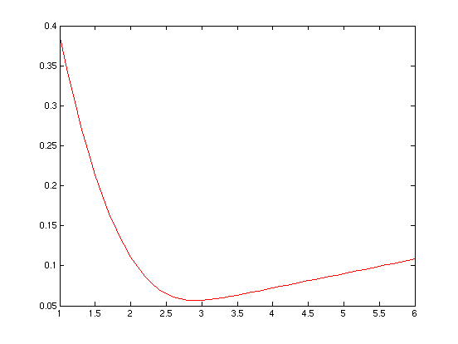
Threshold correction circuit
Vo
Vin
+
Vth*
Vi
Vth+VDAC
-
σ_{corr}/σ_{th}
5 bit DAC
Correction Factor≈0.057@DAC Range≈6σ
DAC Range/2σ

