Slide 1
Vertical integration of heterogeneous layers with T-Micro and INMAPS sensor substrate thinning with Aptek
Massimo Manghisoni, Lodovico Ratti
VIPIX Collaboration Meeting, Milan, March 27th 2013

Slide 2
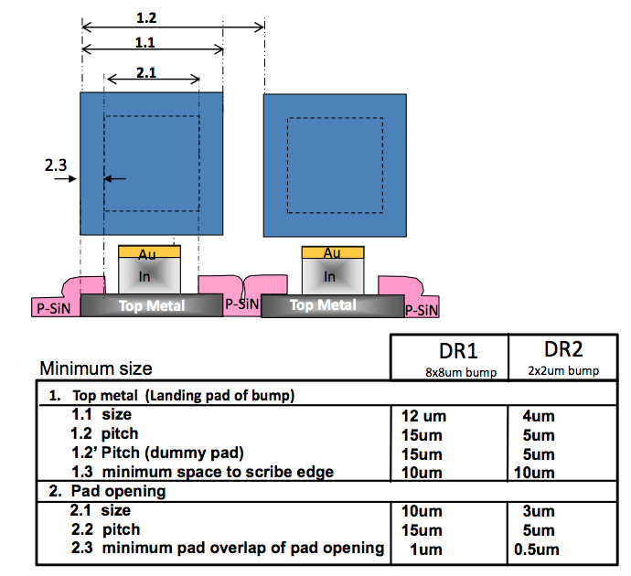

Vertical integration with T-Micro
Very high interconnect density, with small bond pads (squares with a side of 5 or 10 μm, depending on the bump size, 2x2 μm² or 8x8 μm²) both on the sensor and the readout sides ➔ more room for top metal routing, in particular for power and ground lines, smaller capacitive coupling, less material

Slide 3
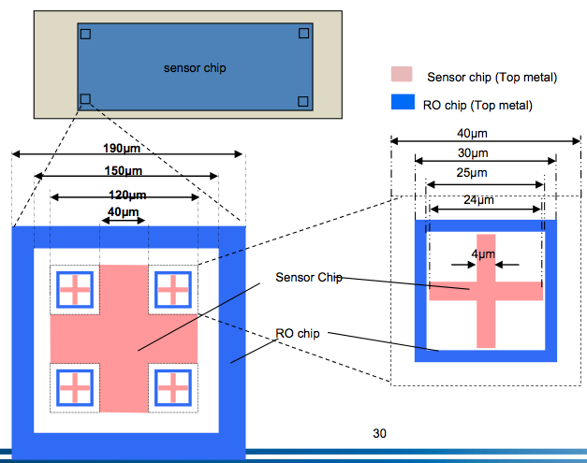
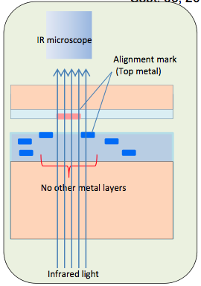
Alignment rules
Markers for rough and fine alignment (through IR imaging), apparently not mandatory

Slide 4
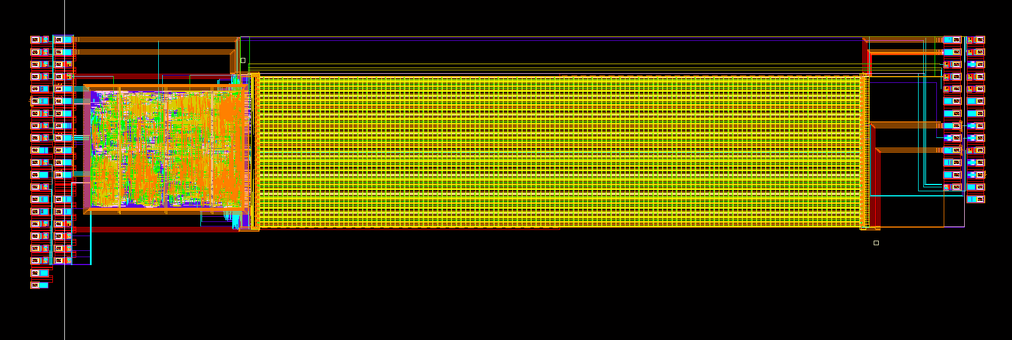
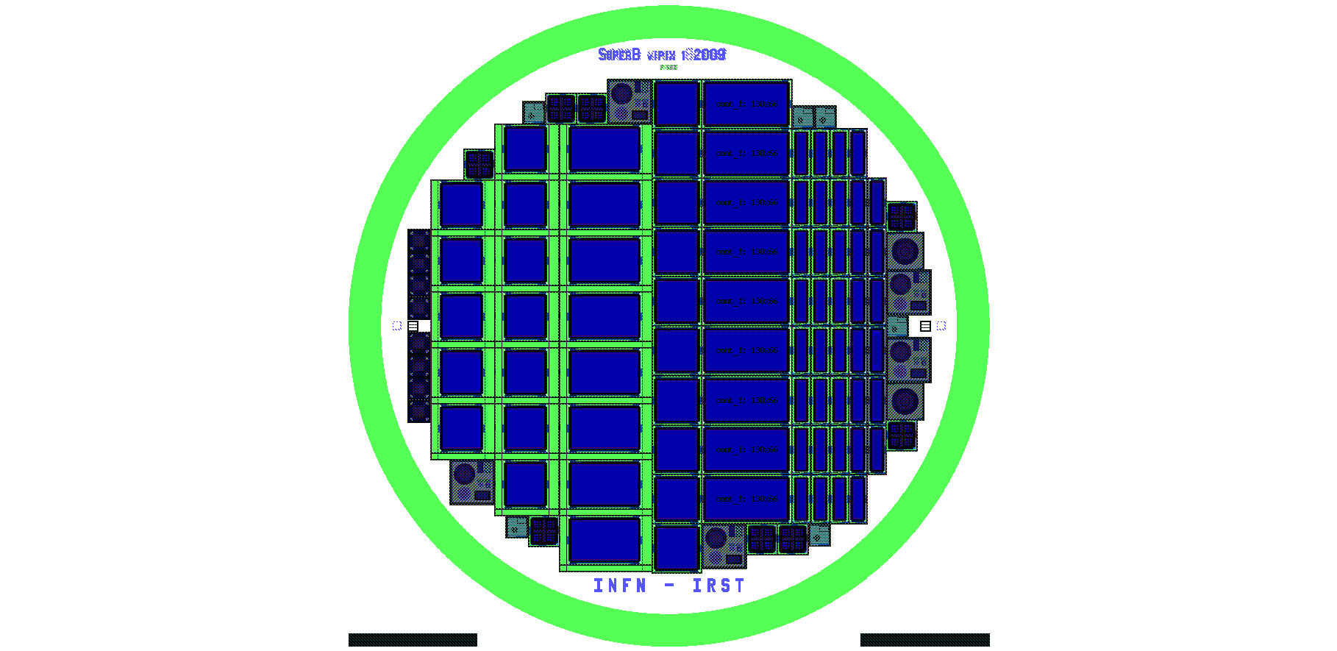
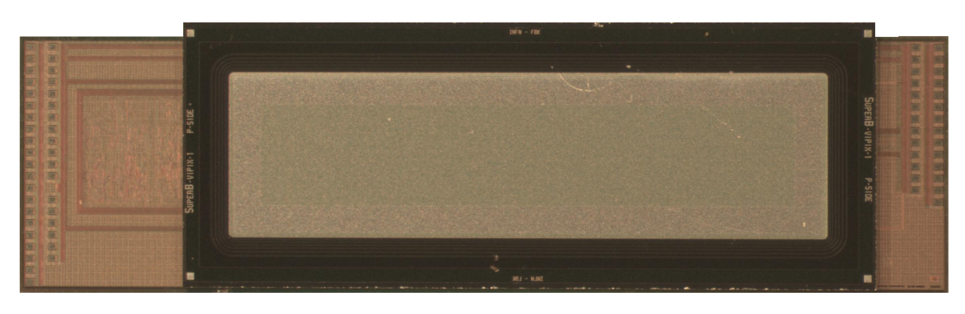
Vertically integrated layers
Preliminary test of the T-Micro integration process performed on pre-existing readout chips (Superpix0) and high resistivity n-on-n pixel sensors (VPix1)
Sensors in the red box have no metal layers under the markers
Superpix0 chip layout
Front-end chips and a pixel sensor wafer shipped to T-Micro in Dec. 2012
5 vertically integrated chips now waiting for customs expenses to be paid
Recall that a few samples of Superpix0 readout chips and VPix1 sensors have already been bump bonded with IZM

Slide 5
Surface inspection and alignment

Slide 6
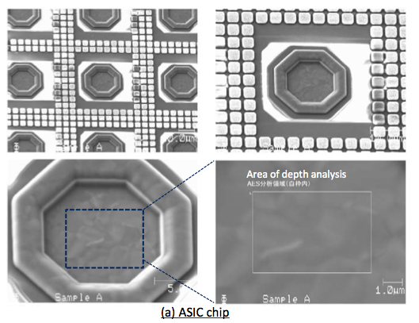
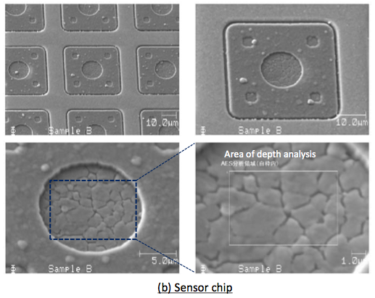
Auger electron spectroscopy (AES analysis)
Sensor chip
ASIC chip

Slide 7
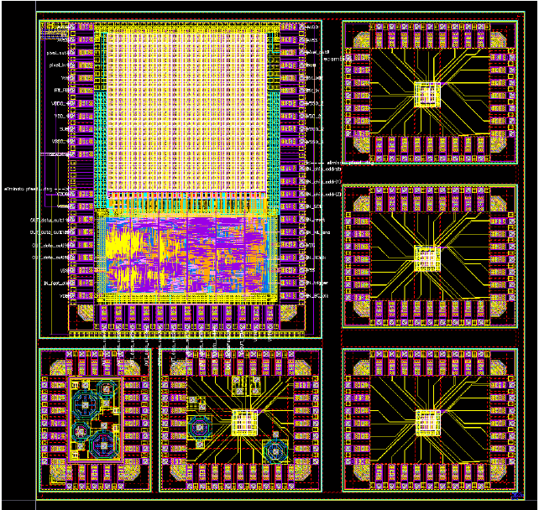
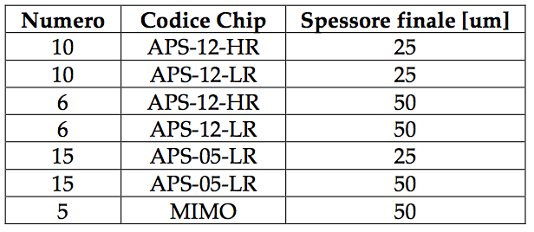
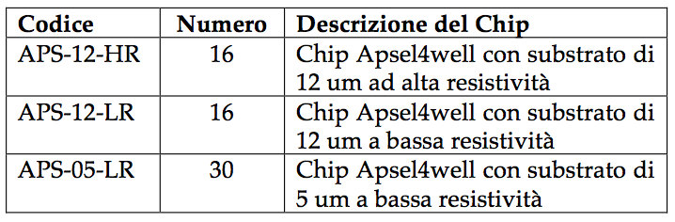
INMAPS chip thinning
The aim is to understand whether and how the collection properties of quadruple well MAPS are changed by thinning the substrate (low material budget)
Metallize (if needed) the chip backside after processing, try and increase depleted volume by uniformly applying a negative voltage to the backside
Chip thickness after processing
Processed chips

