Slide 1
SuperKEKB/Belle II schedule
Calendar
2010
2011
2012
2013
2014
2015
2016
2017
・・・
Japan FY
2010
2011
2012
2013
2014
2015
2016
2017
・・
Feb. 2013
Jan. 2015
SuperKEKB construction
Detector upgrade to Belle II
SuperKEKB operation
Belle II roll in
QCS install
VXD install
Belle roll out
KEKB
operation
Dismantling KEKB
Accelerator tuning
BEAST
Fabrication and tests of ring components
Physics run
Install and set up
Electricity and cooling facility
MR & DR buildings
DR tunnel
Upgraded Linac operation
for SuperKEKB, PF, PF-AR
Linac
Linac upgrade / operation for PF&PF-AR

Slide 2
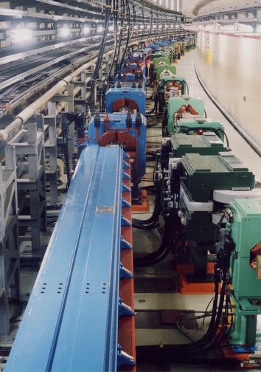
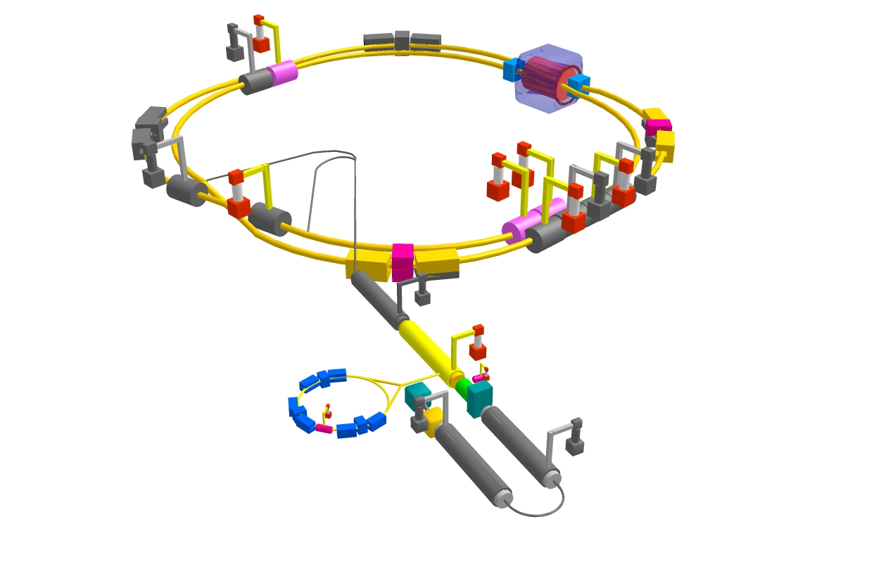


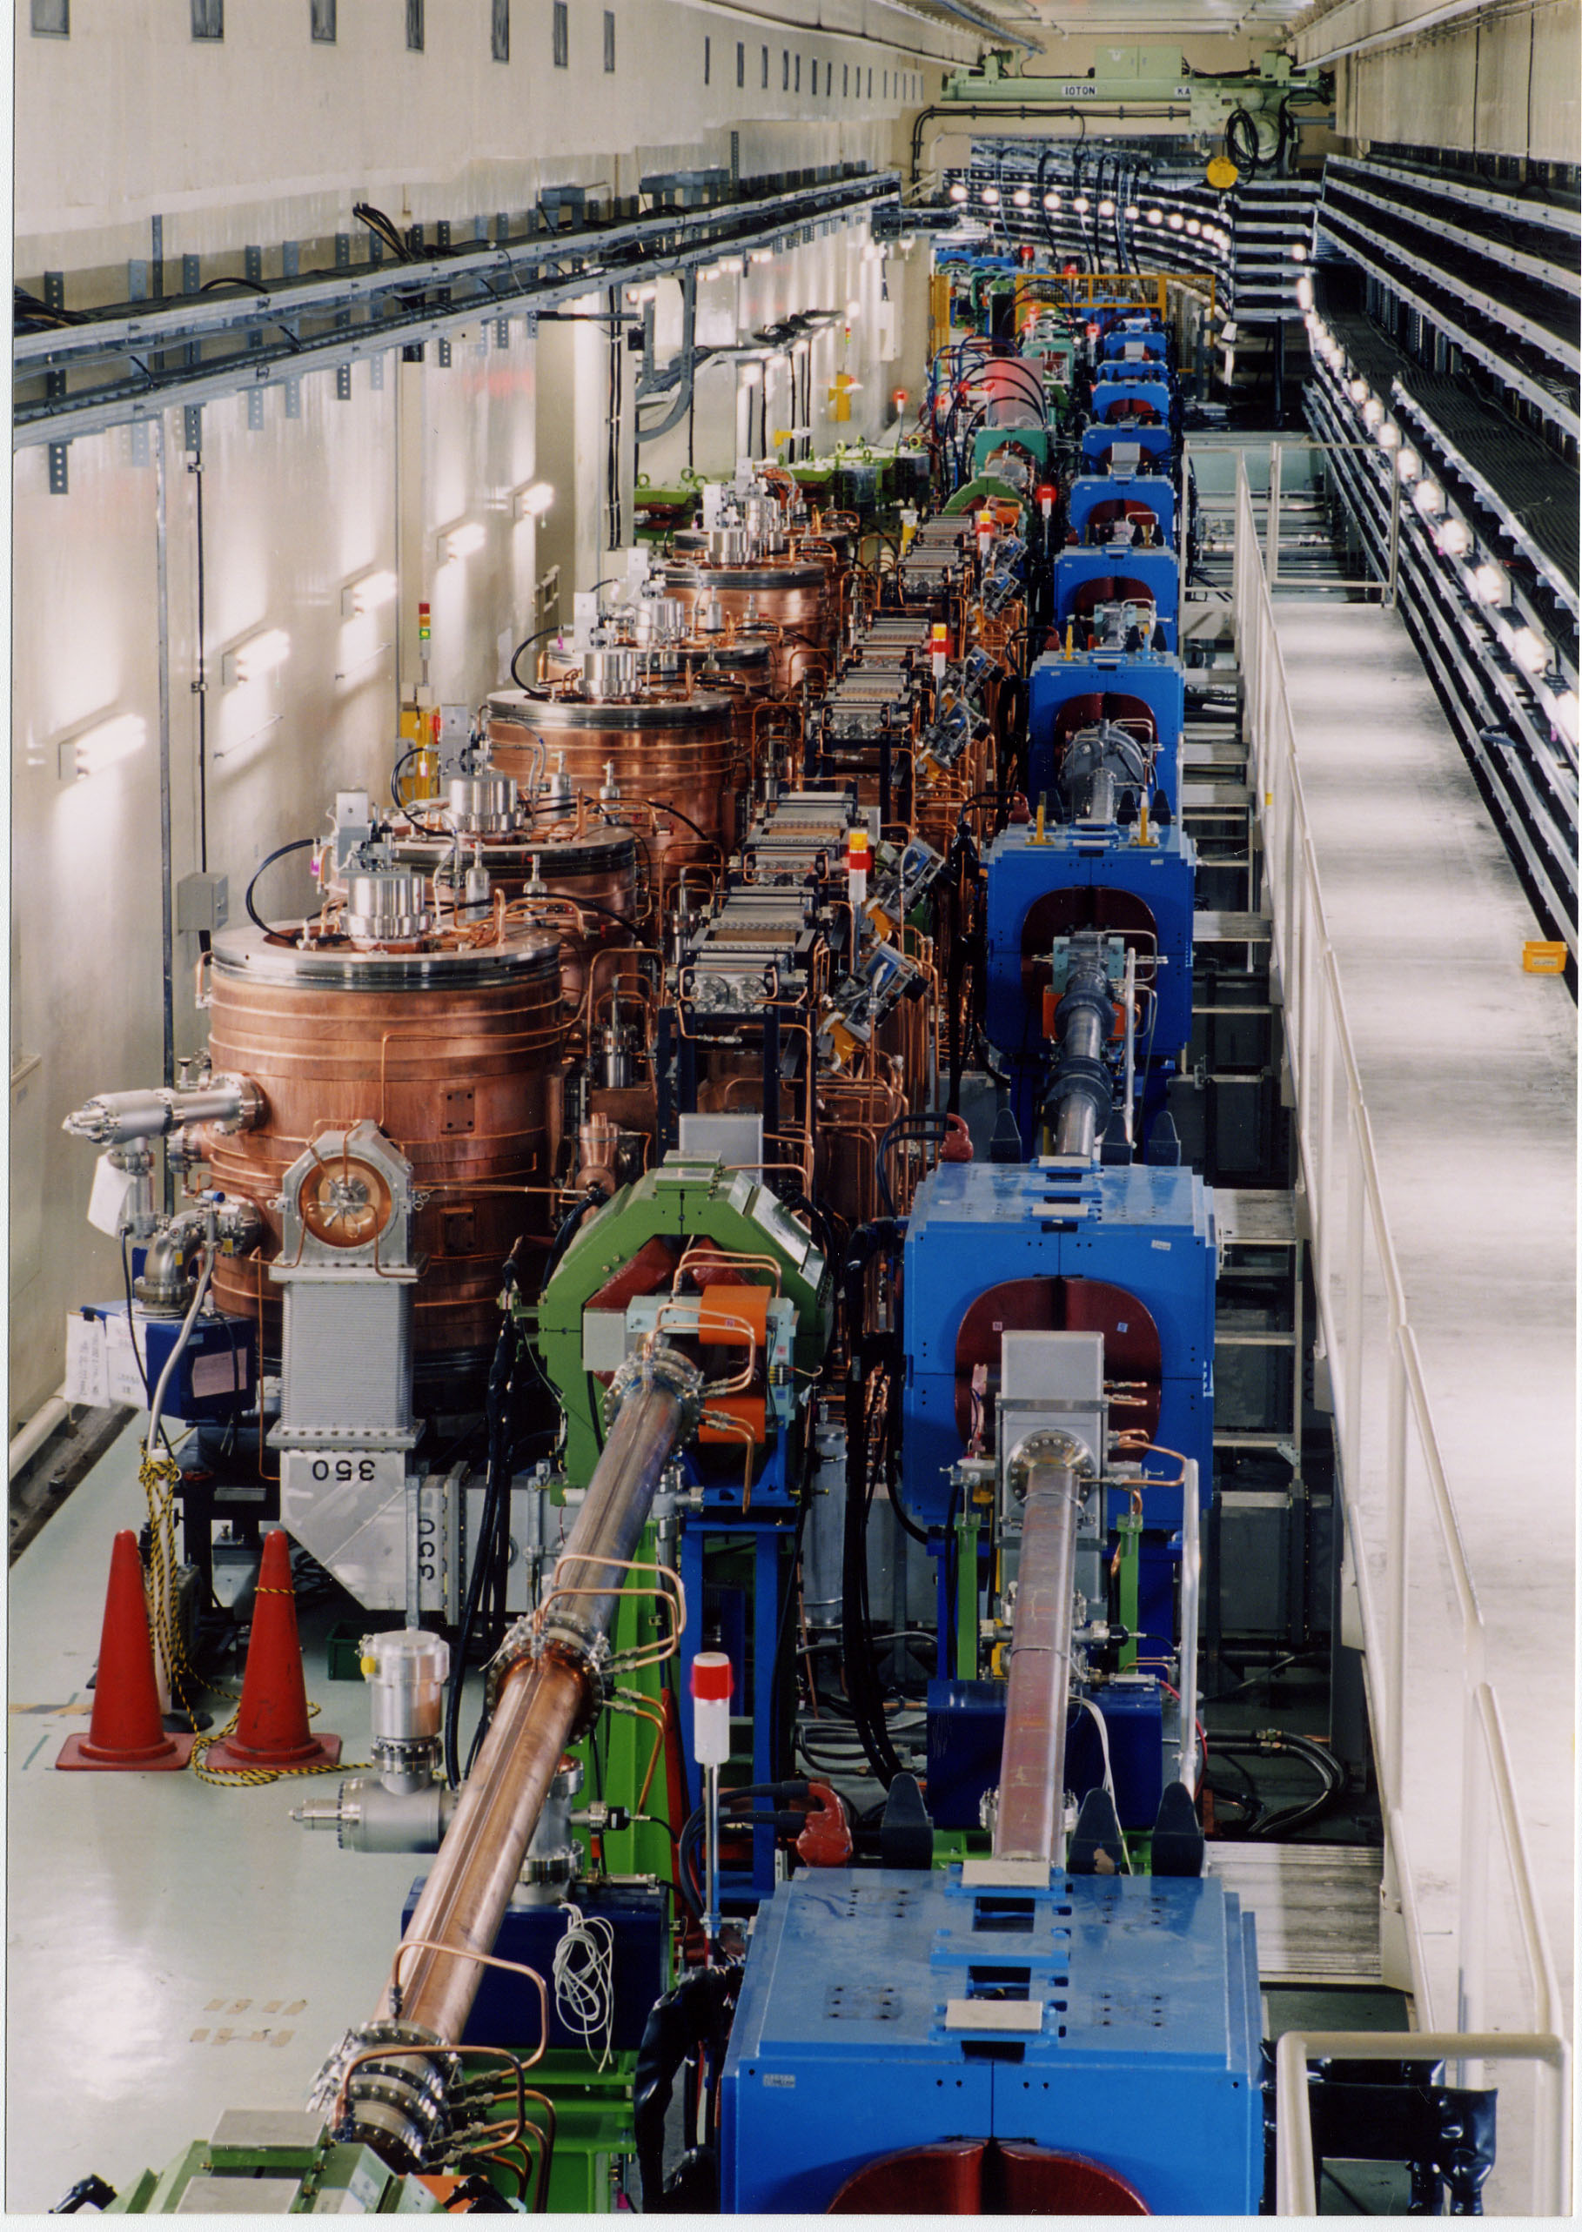

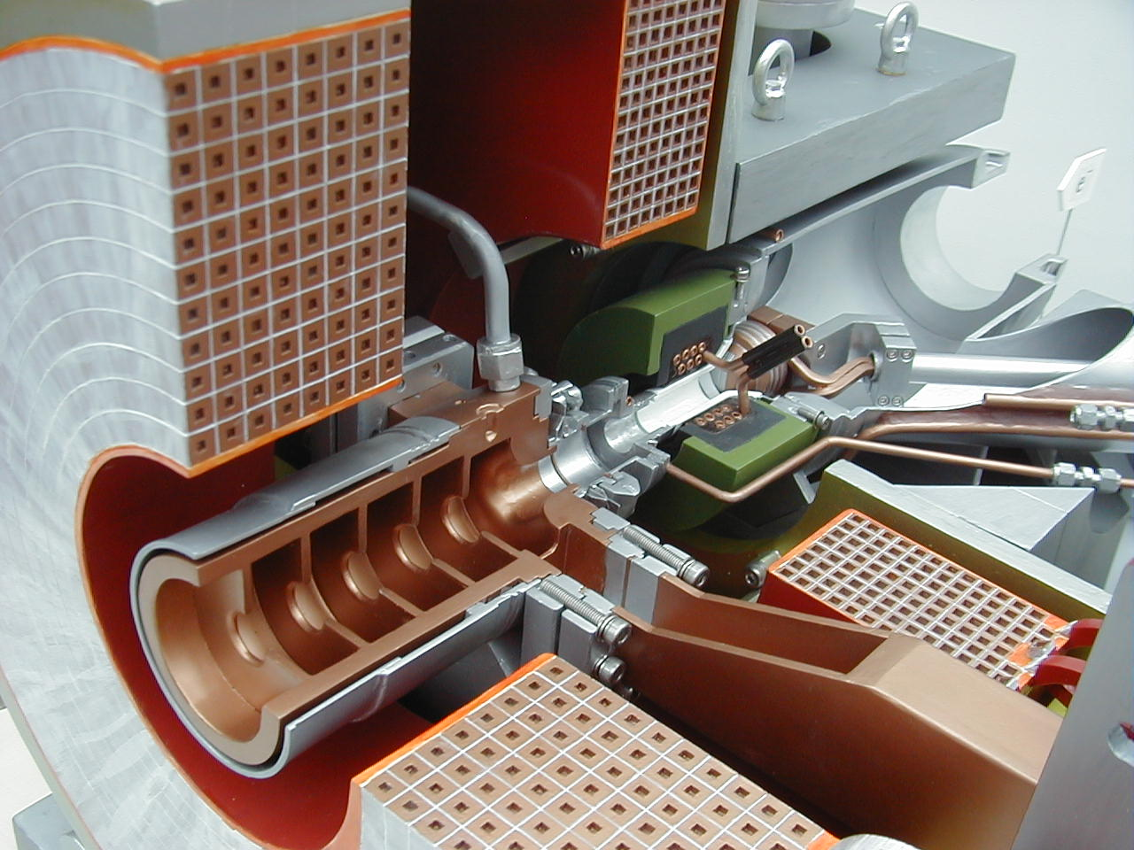
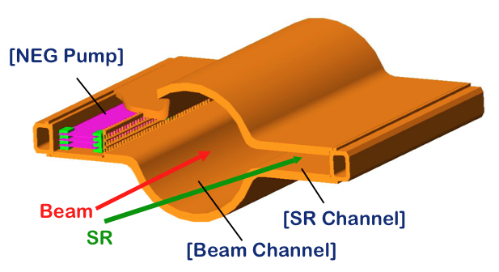
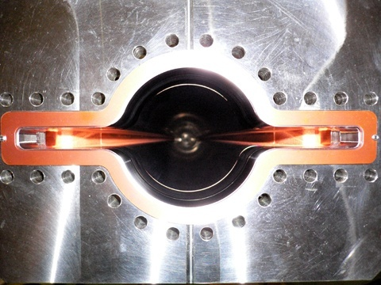

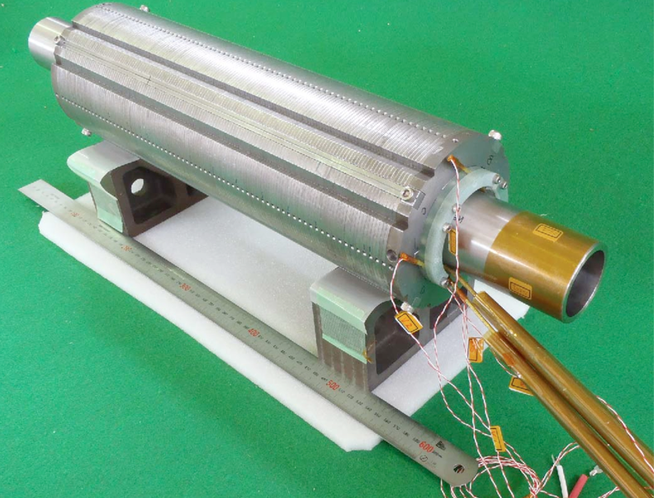
Positron beam 3.6 A
Colliding bunches
Belle II
Electron beam 2.6 A
New IR
SuperKEKB
Superconducting final focus Q-magnets
New beam pipe
& bellows
Reinforcement of RF system
Fast and precise beam diagnostics and control system
Long bending magnets for LER, rearrangement of optics to keep low emittance
Damping ring
Positron source
Low emittance gun
Ante-chamber, TiN coating to suppress electron cloud
x40 more luminosity

Slide 3
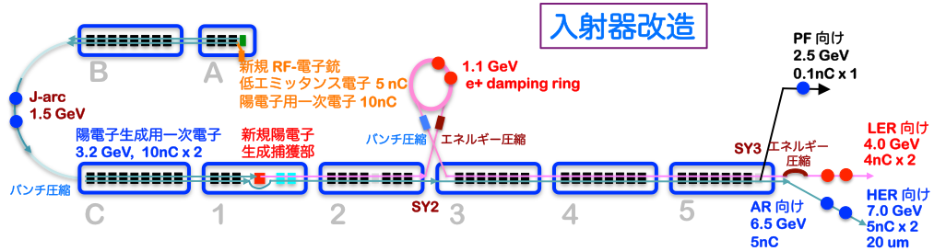
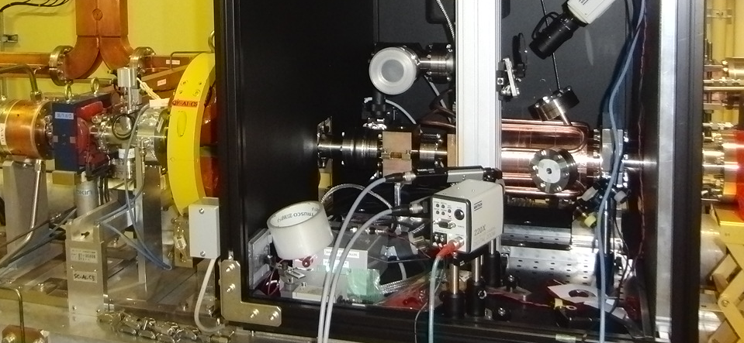
Injector LINAC
Photo RF gun @A-1
  Low emittance e-
    with high-charge RF-gun
  Low emittance e+
    with damping ring
  Higher e+ beam current
    with new capture section
  Emittance preservation
    with precise beam control
  4+1 ring simultaneous injection
・高電荷対応の電界収束の構造
・イリジウムセリウムフォトカソードで長寿命・それなりの量子効率
・イッテルビウム媒質のレーザーにより高効率・時間構造の制御

Slide 4
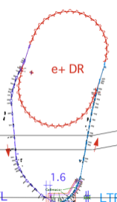
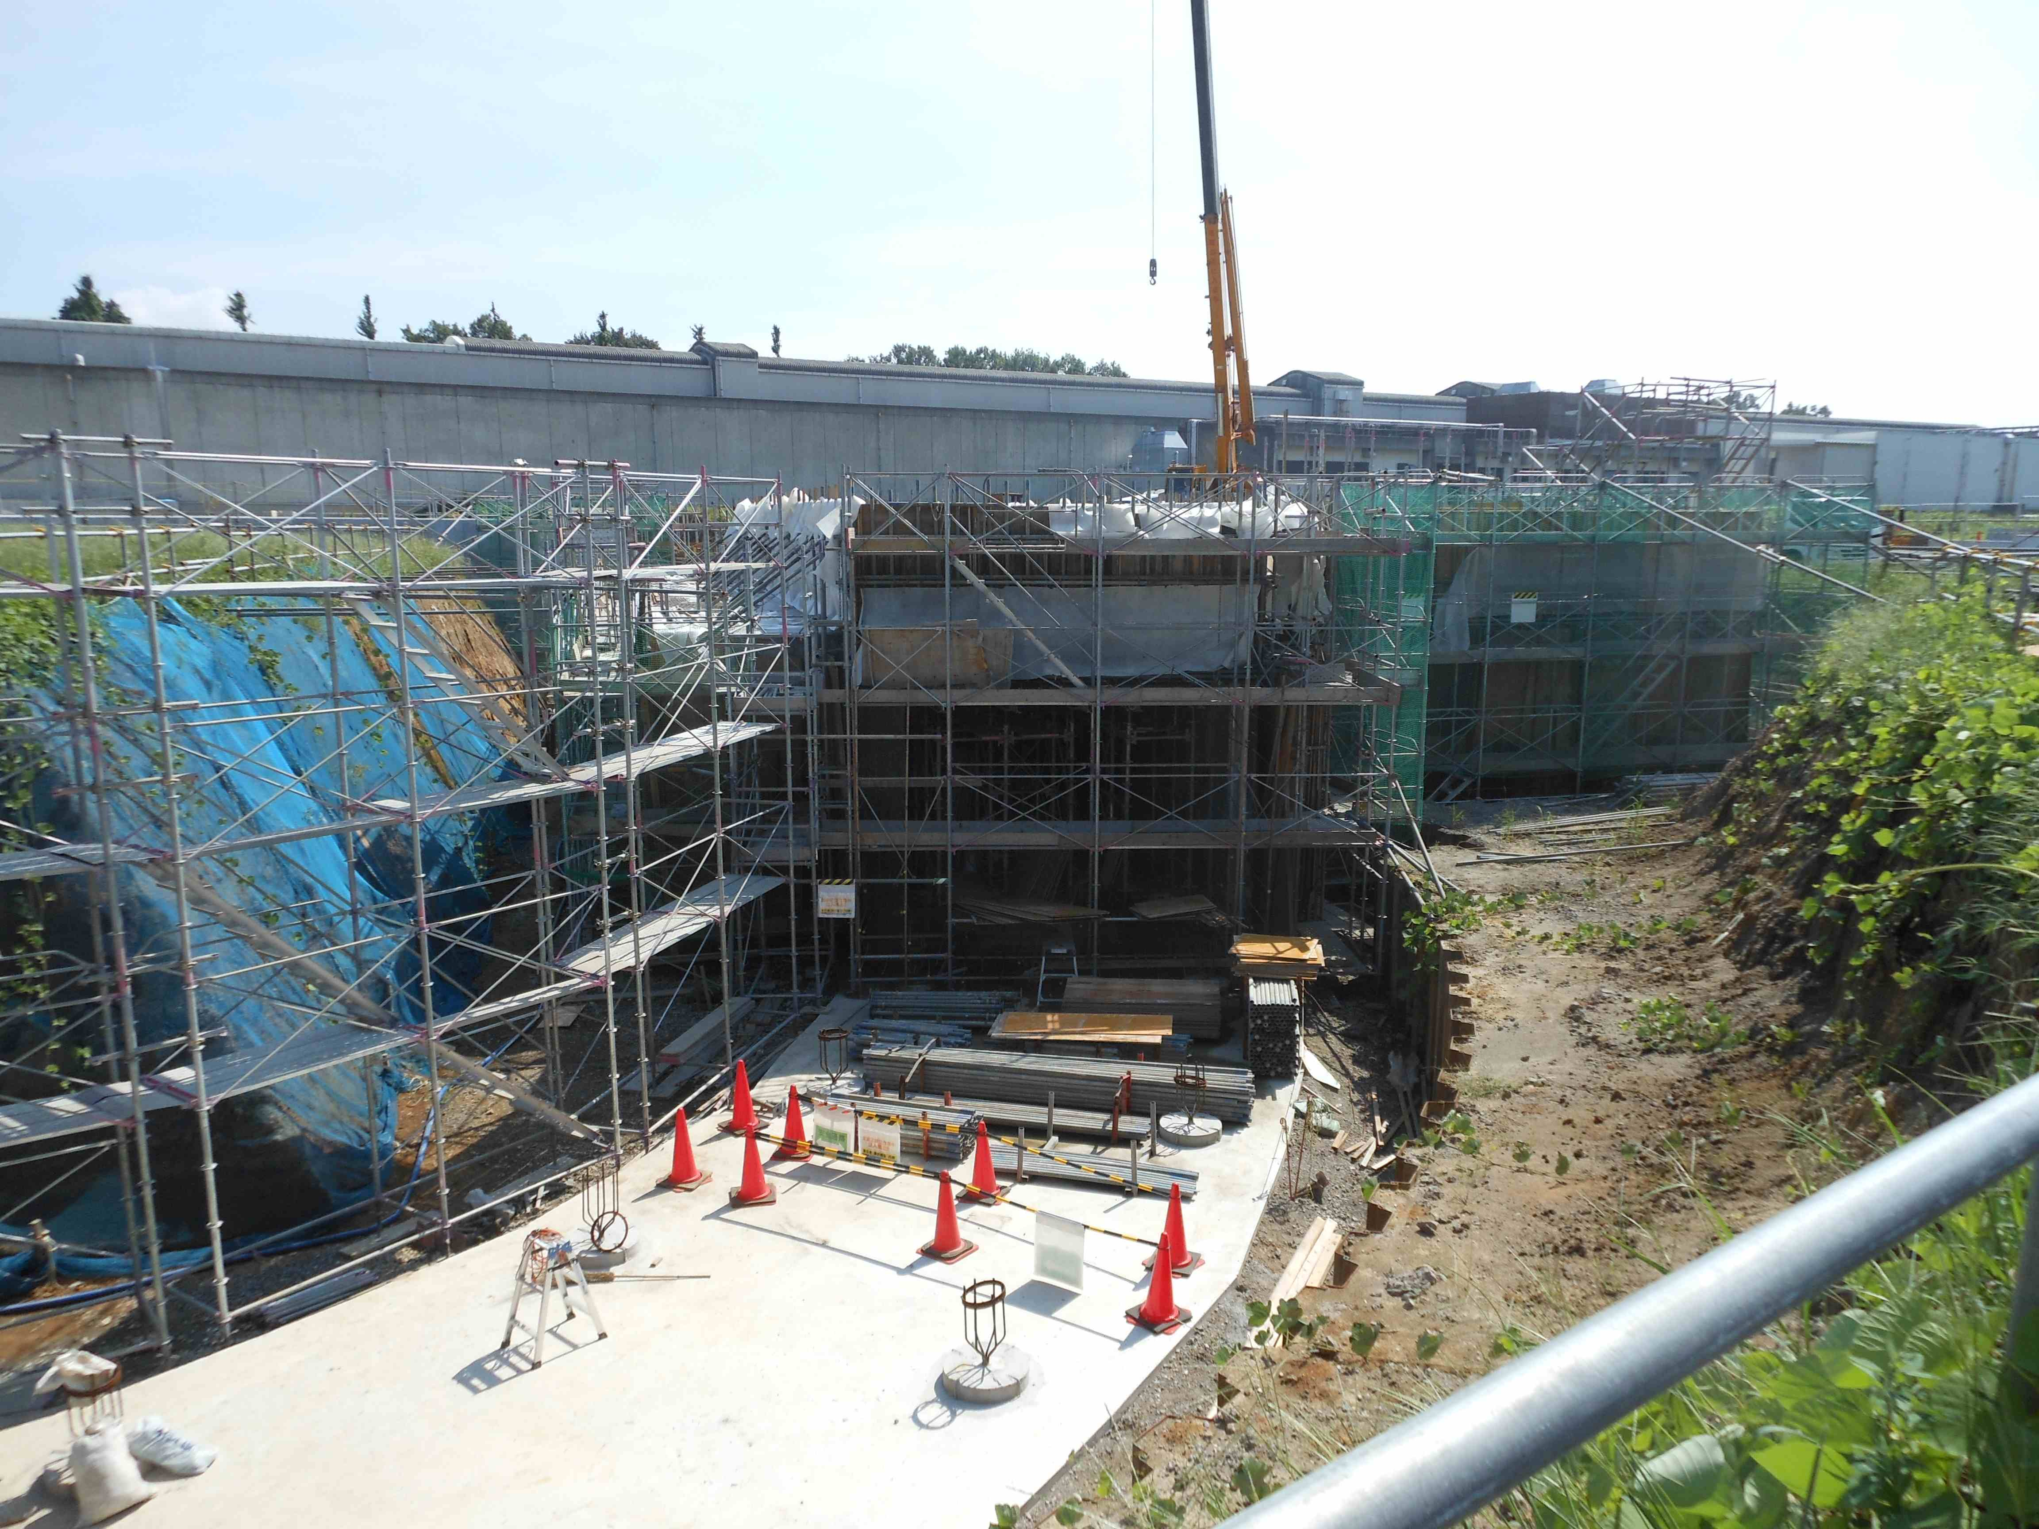
Damping Ring for positron
入射器
陽電子ダンピングリング
エネルギー：１．１GeV
周長 136m
DR tunnel
Tunnel construction close to finish
Construction of buildings starts soon, completed in JFY2013
Operation starts in 2015

Slide 5
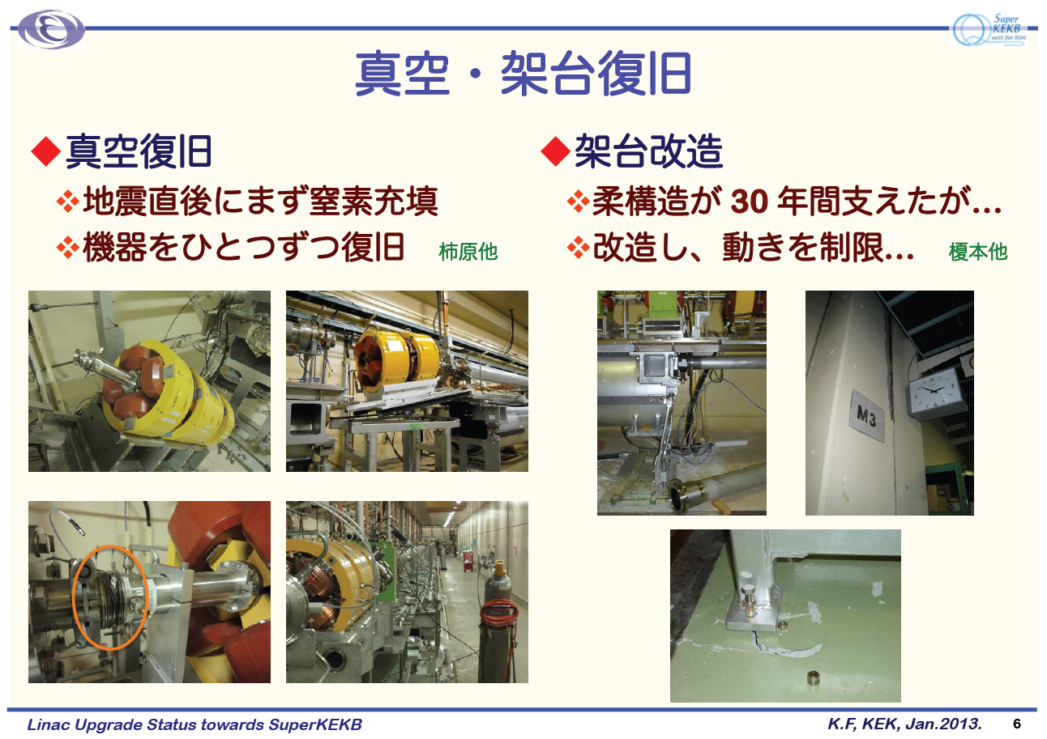
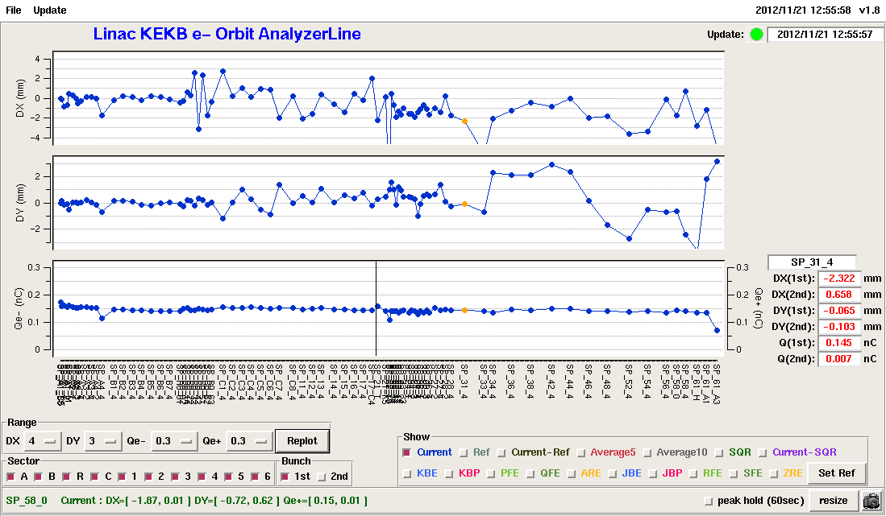
First beam through 600m LINAC
X
Y
Charge
2012.11
Very preliminary (including tuning of monitor system)
600-m linac
Notes:
約 28 万 5 千 Shot

Slide 6
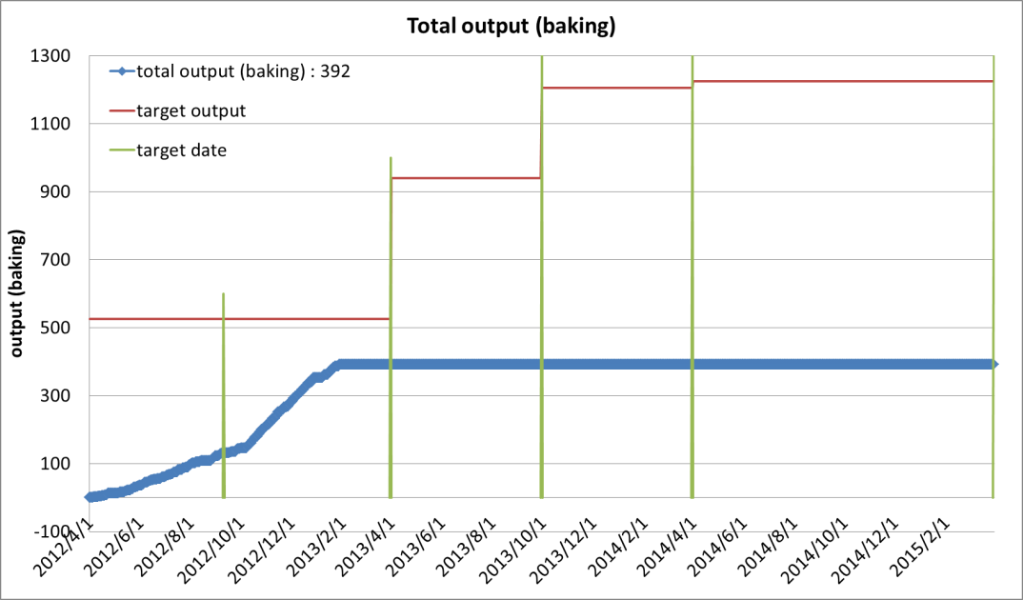
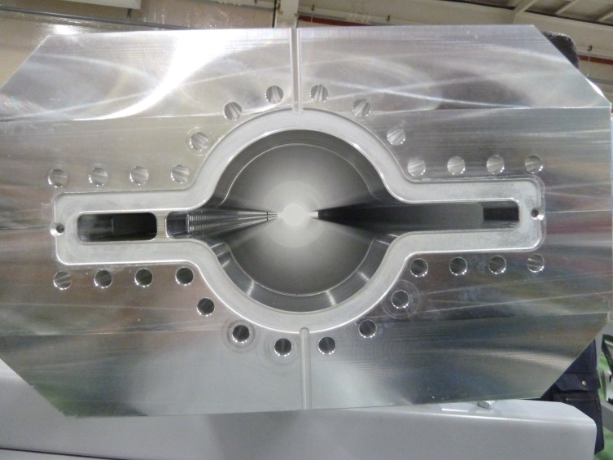
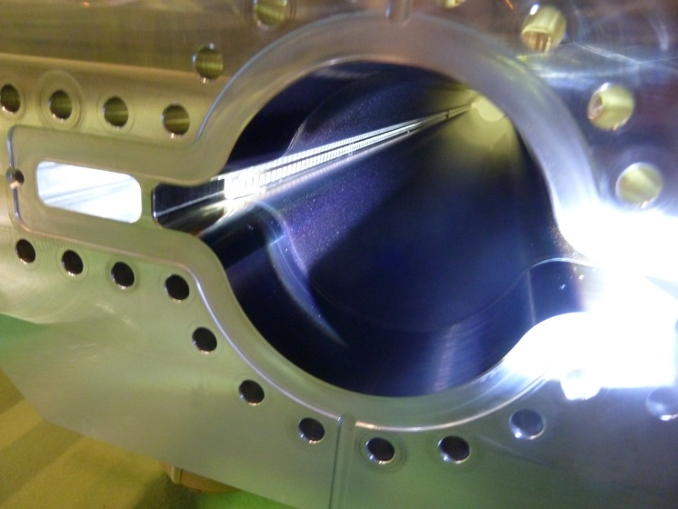
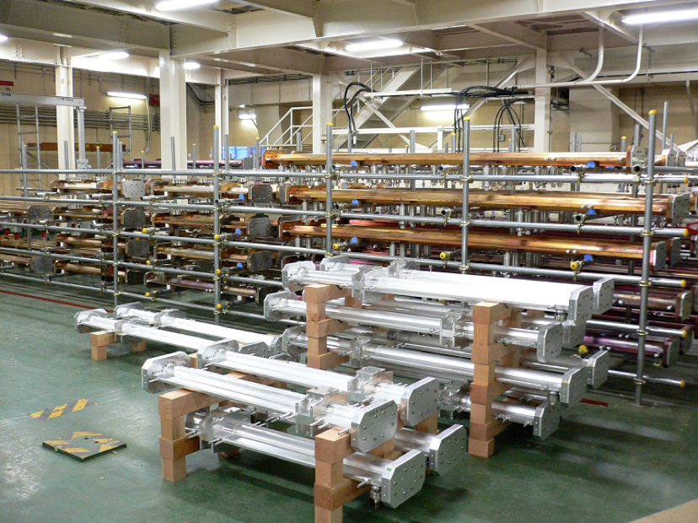
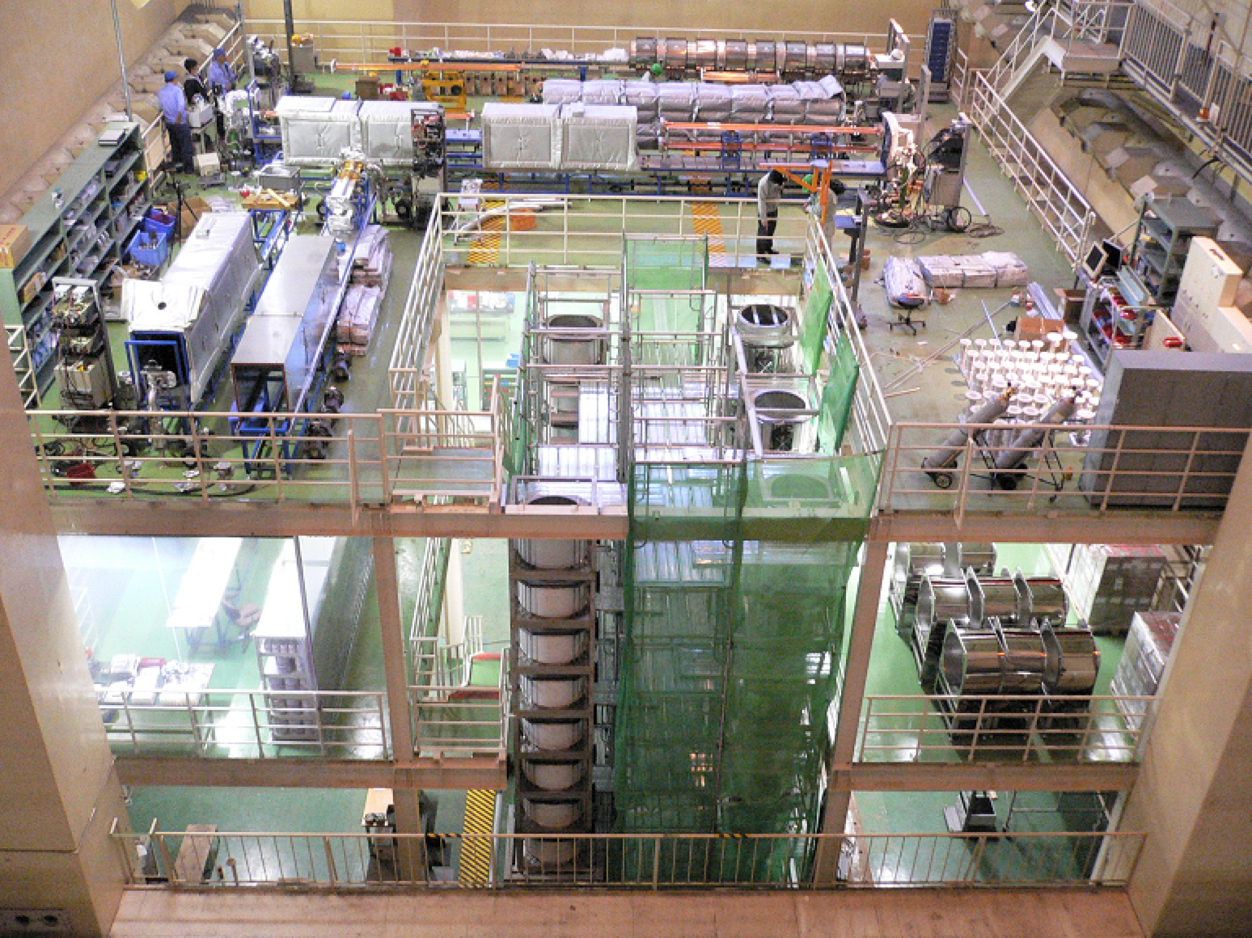
Vacuum chambers
(1200 pipes/2years）
TiN coating and baking in KEK (OHO)
Al BP before coating
After TiN coating
before baking
After baking
B2
B3
B4

Slide 7
Reinforcement of RF system
KEKB-RF
D4
OHO
D5
D7
FUJI
D8
D10
NIKKO
D11
1
2
2
2
1
2
2
2
2
1
2
2
2
2
1
C
B
A
A
B
C
E
E
D
C
B
A
A
B
C
D
E
D
C
B
A
A
B
C
D
E
F
HER
LER
SuperKEKB-RF
(ultimate)
add 5 klystrons, HP&LL
add 3 power supplies
add 2 more klystrons, HP&LL,
add 1 more power supply
add 2 klystrons, HP&LL
add 2 power supplies
D4
D5
D7
D8
D10
D11
2
2
2
2
2
2
2
2
2
2
2
2
2
2
2
2
2
2
H
G
F
E
D
C
B
A
A
B
C
D
E
F
F
E
D
C
B
A
A
B
C
D
E
F
D
C
B
A
A
B
C
D
E
F
add 2 ARES
add 2 SC (option)
convert to LER
remove 4 ARES
Klystron, HP&LLRF system
2
Type “A” power supply (for two klystrons)
ARES cavity
SC cavity
Crab cavity
1
Type “B” power supply (for one klystron)
1 cavity driven by 1 klystron (as much as possible)
5 more stations by day 1, extra 4 stations as beam current increases
Notes:
ビーム電流増加（～２倍）、ビームパワー増大（～３倍）のため、地上部RFステーション（クライストロン、クライストロン用電源、ハイパワー機器、冷却システム、制御系等で構成）の増設およびARES空洞の再配置を行ない、なるべく1 Klystronで1 cavityをドライブするようにする。
T=0までに５ステーションを増強。
T=0以後のビーム電流増強に合わせてさらに４ステーションを増強。
（進捗）：
・地上部RFは５ステーションの増強整備が進行中：
・増設分のクライストロン電源は設置済み
・クライストロンおよびハイパワー機器の増強は進行中
・冷却システム増強整備は来年度実施予定
・制御系の整備は進行中
・ARES空洞の再配置は、メインの作業を終えた。

Slide 8
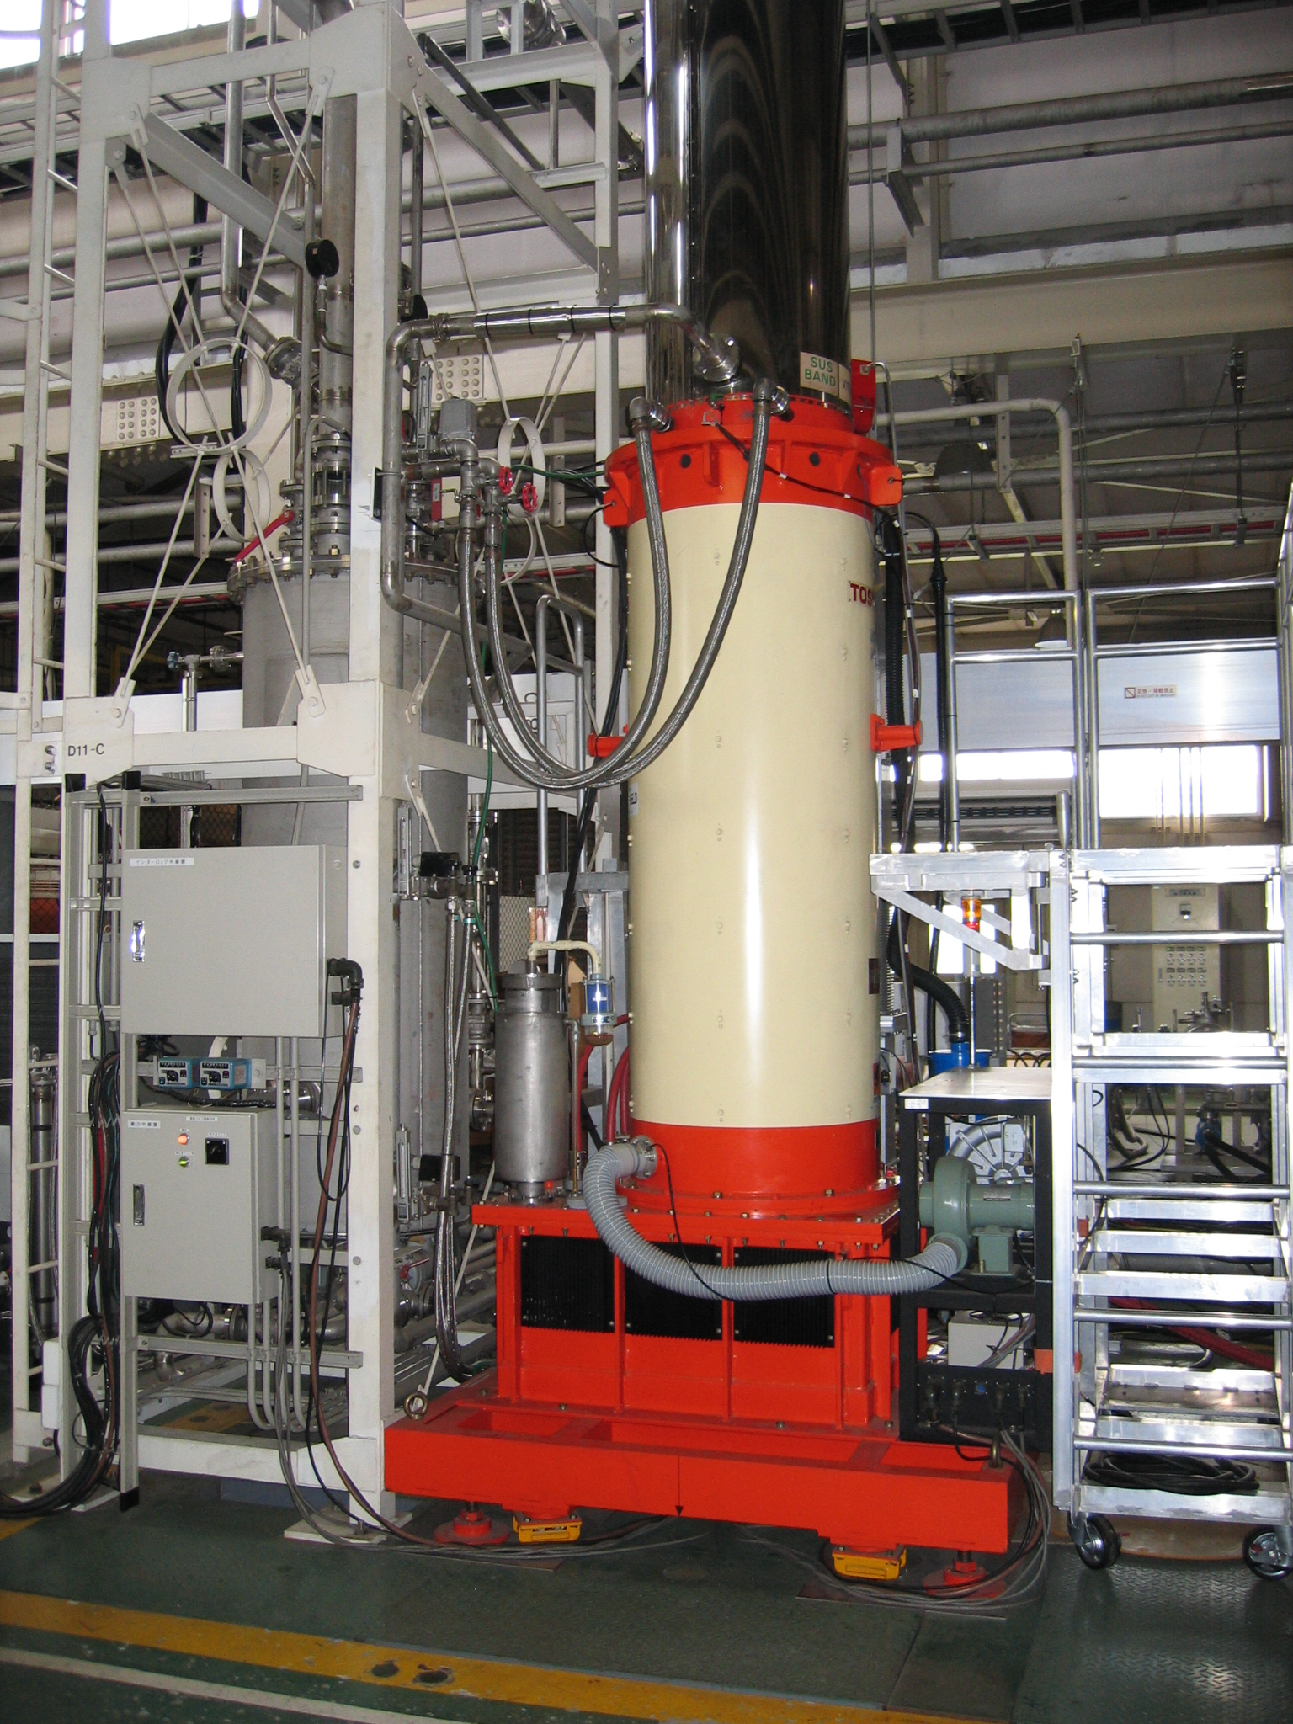
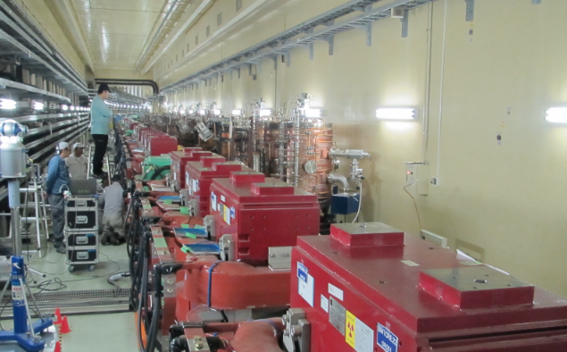
RF
5 stations on ground level being build:
・Power supplies all in place
・Klystrons and related high power equipment being build
・Cooling system to be build in JFY2013
・Control system being prepared
6 ARES cavities moved from HER to LER (at OHO)
1.2MW CW klystron

Slide 9
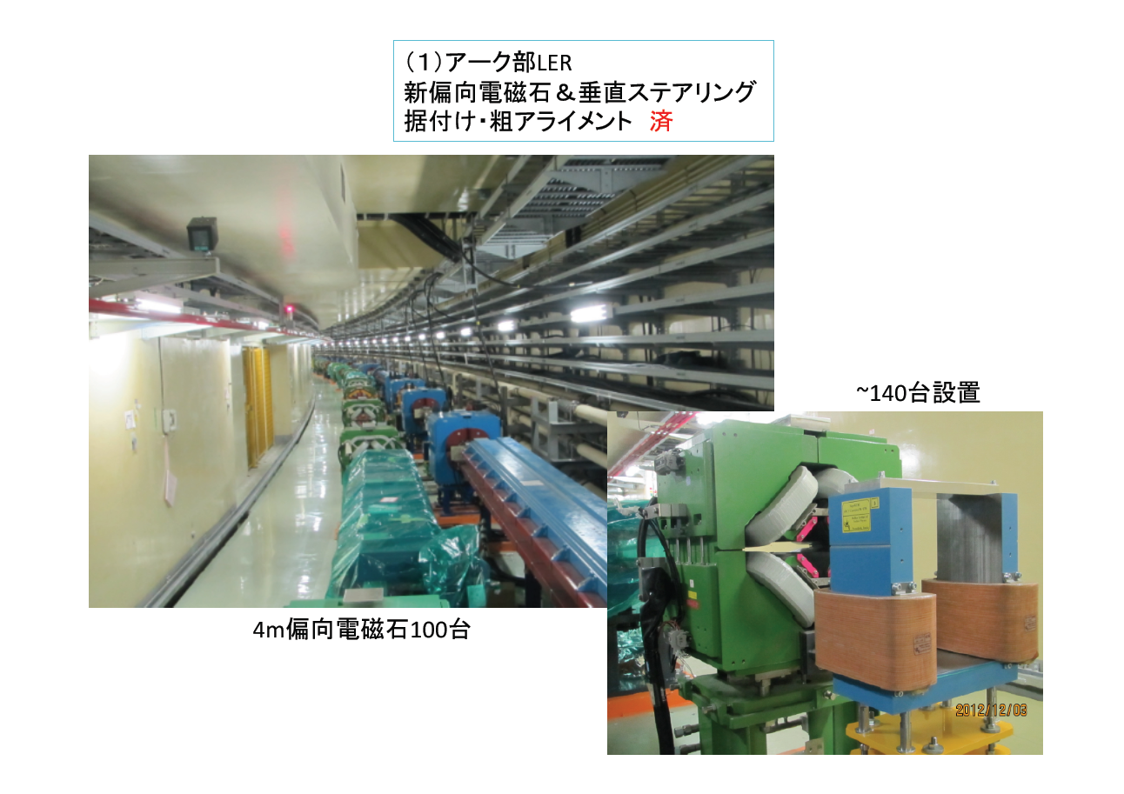
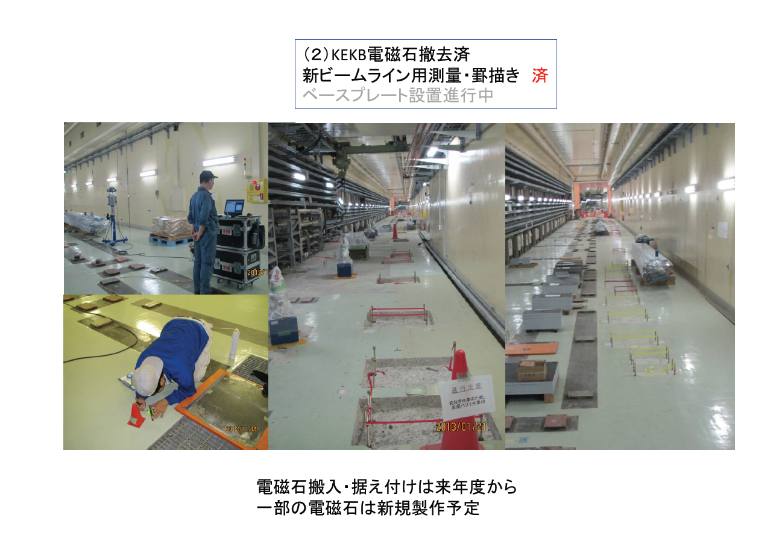
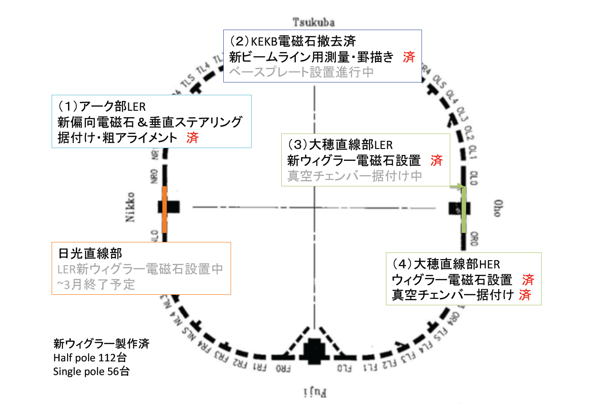
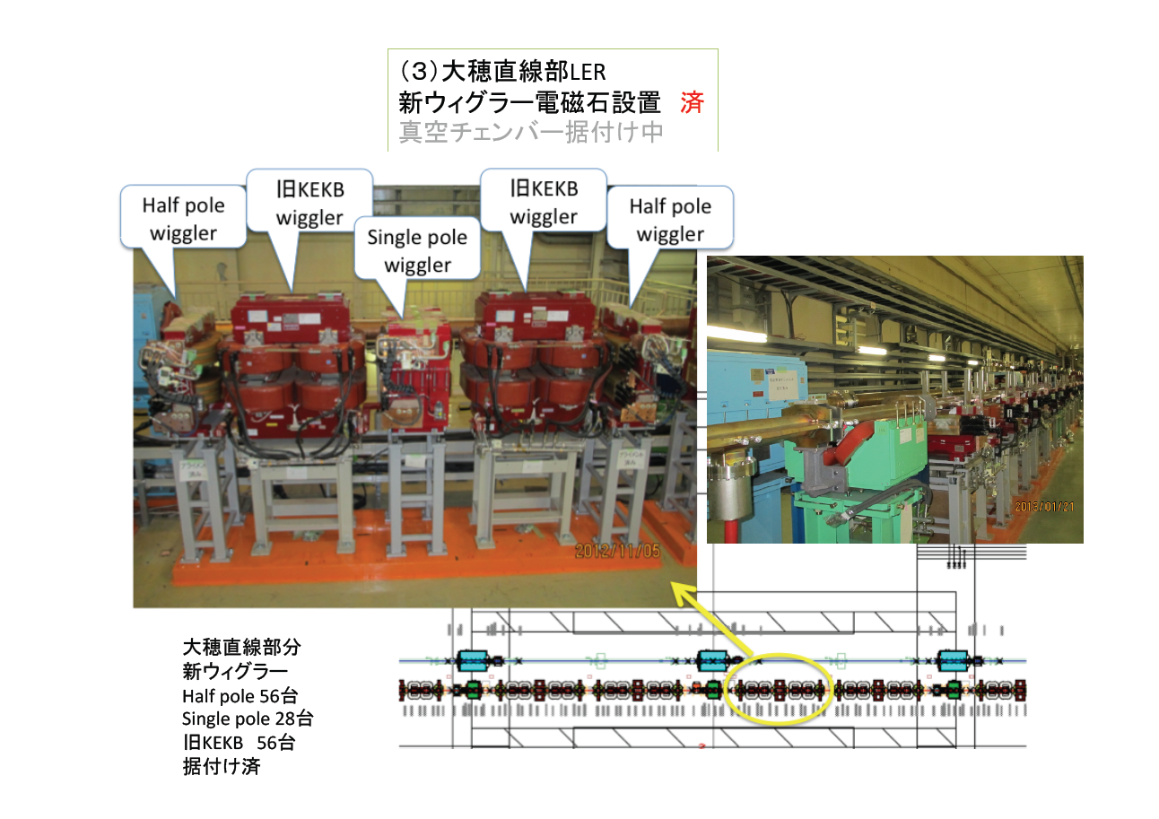
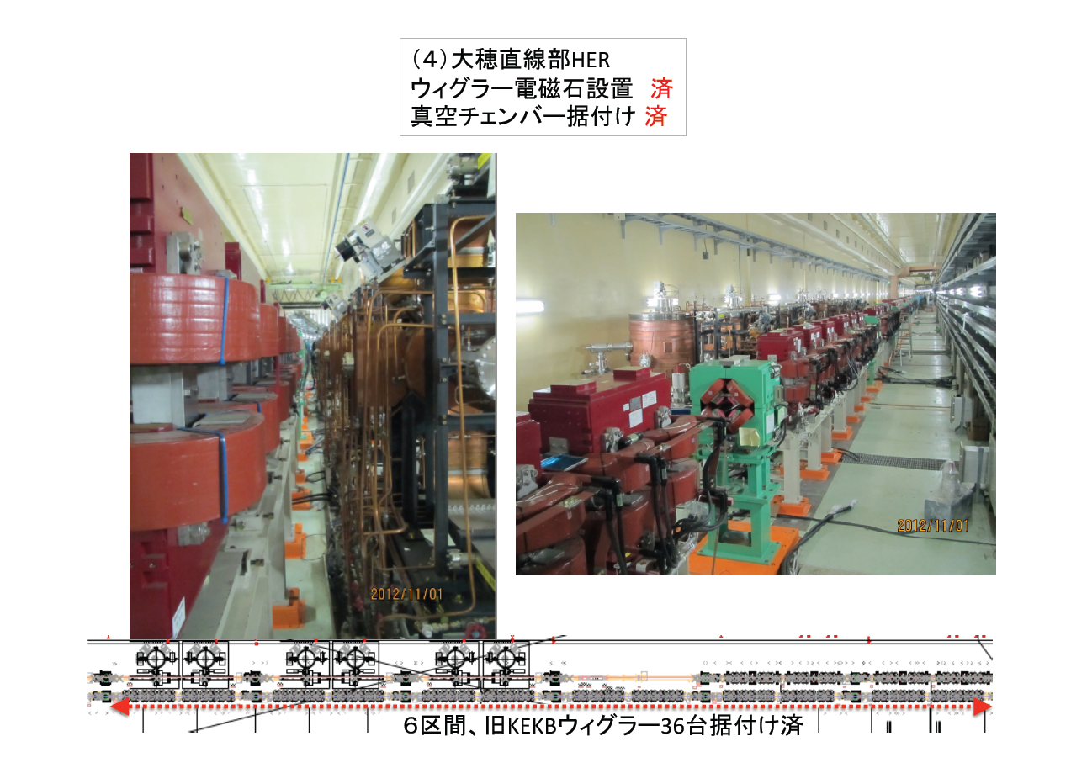
Main Ring設置状況

Slide 10
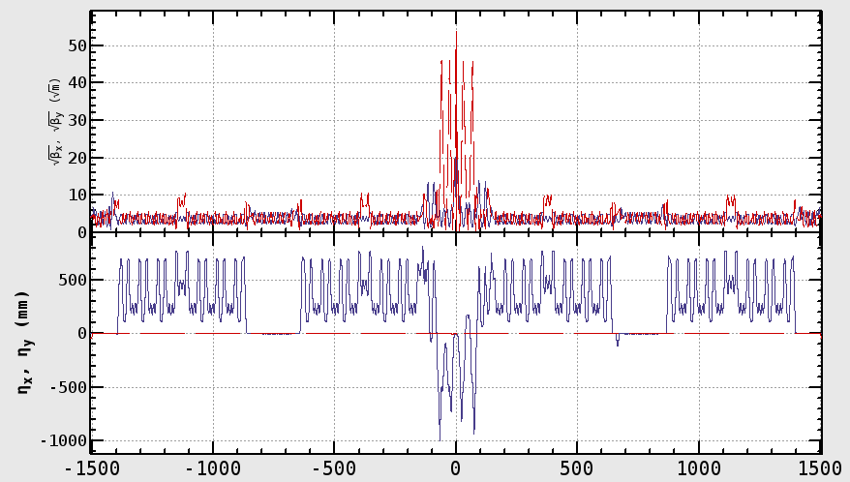
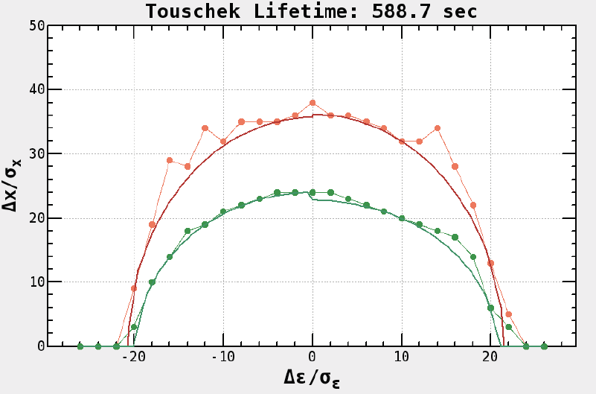
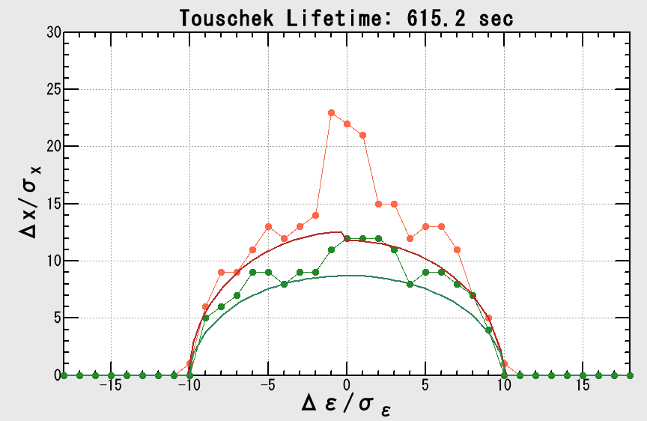
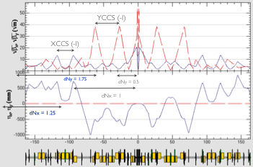
Beam Optics
IR optics for LER
Local Chromaticity Correction
衝突点領域 (〜300 m) を全面的に更新し、両リングに水平垂直両方向の局所色収差補正セクションを設置する。
Precision calculation of optics
超伝導4極磁石に付随する非線形磁場
鉄ヨークを持たない LER 超伝導4極磁石がHERビーム軌道上につくる漏れ磁場
ソレノイドのフリンジ磁場
等も、44極 ＆ 歪44極成分までとり入れて、 ビーム光学系の設計・評価を行う。
IP
LER optics for entire ring
Dynamic aperture→
Estimated Touschek lifetime ～600 sec.
β
LER
HER
dispersion
IP

Slide 11
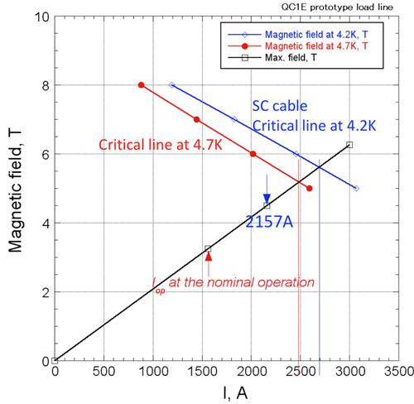
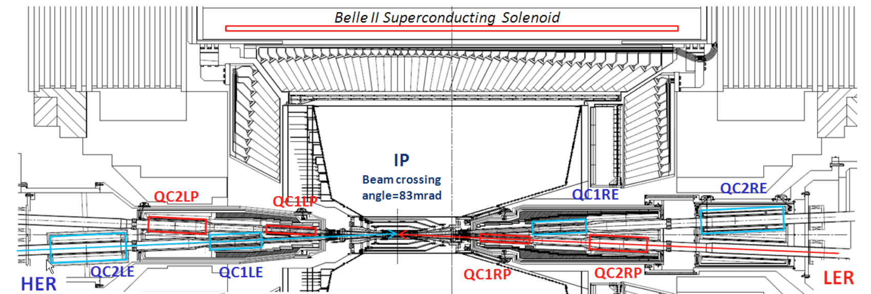
Superconducting magnets at IR
8 main Q magnets (KEK) + 40 correction coils (KEK/BNL collaboration)
Magnets and cryostat for L-side being done (JFY2012-2013)
R-side (JFY2013-2014)
Prototype main Q (QC1LE)
No quench up to 2157A (1558.5A for nominal operaiton)
I_{4S}/I_{c@4.7K} = 62.8%
I_{12GeV}/I_{c@4.7K} = 87.0%
margin good enough for operation

Slide 12
Belle II Detector
K_{L} and muon detector:
Resistive Plate Counter (barrel outer layers)
Scintillator + WLSF + MPPC (end-caps, inner 2 barrel layers)
EM Calorimeter:
CsI(Tl), waveform sampling (barrel)
Pure CsI + waveform sampling (end-caps)
Particle Identification
Time-of-Propagation counter (barrel)
Prox. focusing Aerogel RICH (fwd)
electron (7GeV)
Beryllium beam pipe
2cm diameter
Vertex Detector
2 layers DEPFET + 4 layers DSSD
positron (4GeV)
Central Drift Chamber
He(50%):C2H6(50%), Small cells, long lever arm, fast electronics

Slide 13
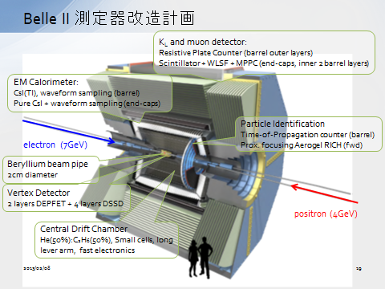
Construction schedule
JFY2012
Rotation (～Mar. 2013)
JFY2013
KLM installation
(Test insertion in Apr,
completed by Mar. 2014)
JFY2015
ARICH installation (May)
Endcap ready for installation (Jun.)
TOP installation (Apr.)
CDC installation (May)
Barrel part ready for machine commissioning
SVD, PXD ready at KEK (Aug.)
VXD (=SVD+PXD) integration (autumn)
(after integration, calibration and commissioning)
Belle II ready for physics run
JFY2014
ECL readout electronics
barrel installation (～Jun.）
endcap installation (by Mar. 2015)

Slide 14
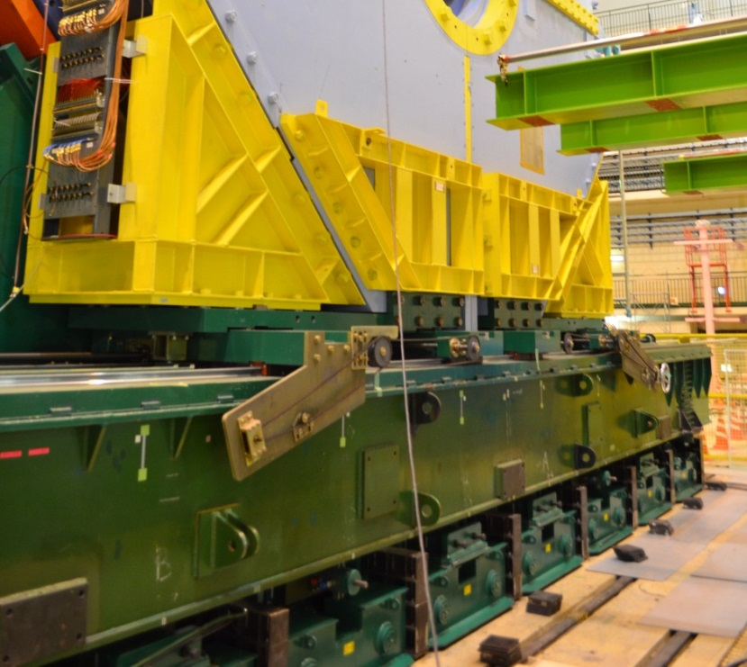
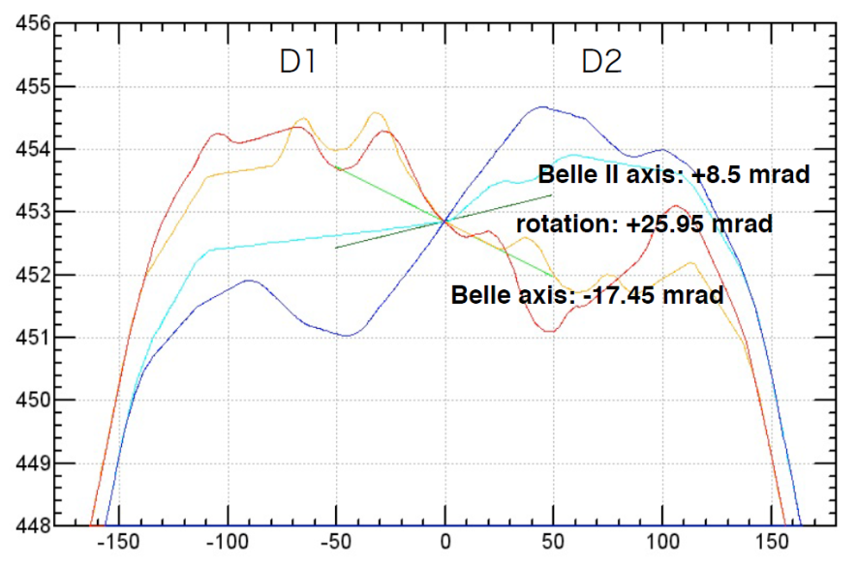
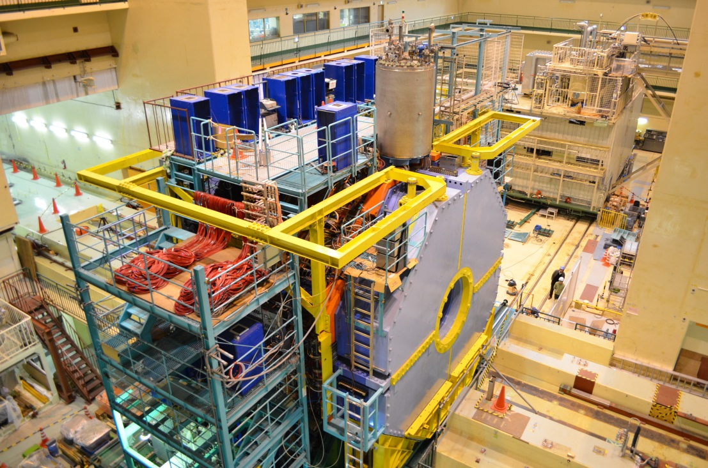
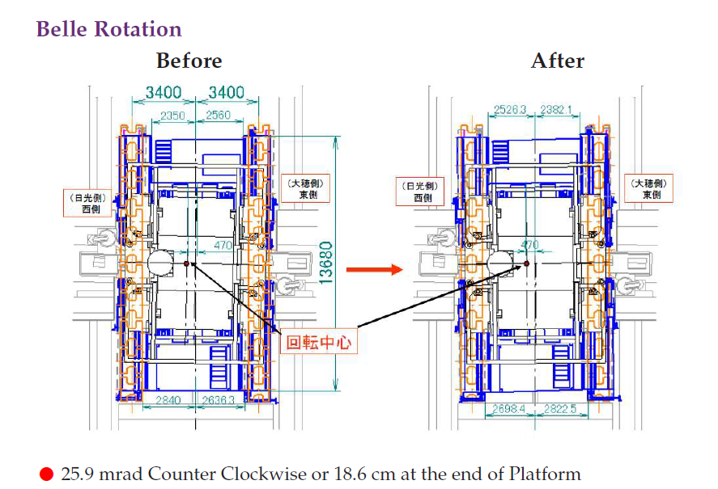
Belle Rotation
Rotate solenoid axis by 25.95mrad
Modified “bogies”
Roll-in on 7 Feb. 1/3 rotated by 16 Feb.

Slide 15
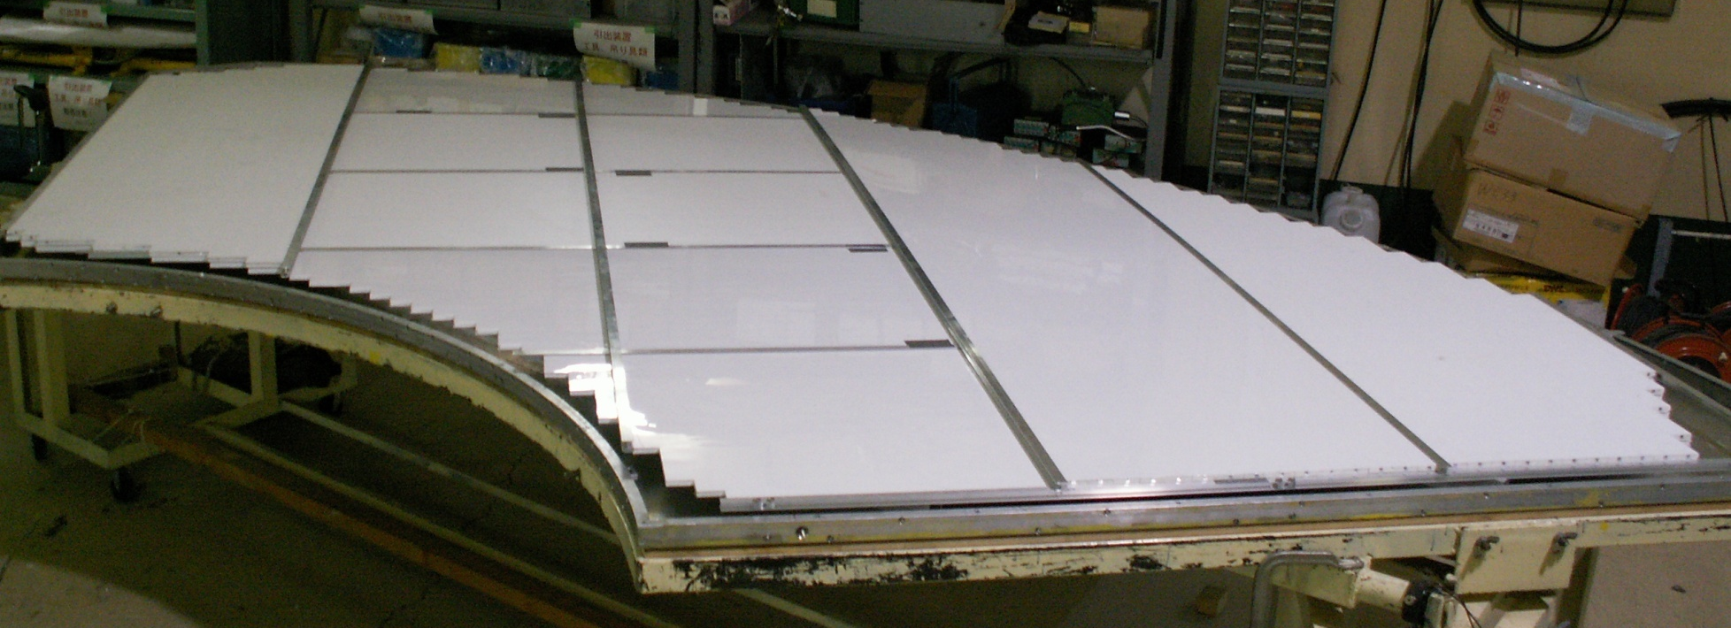
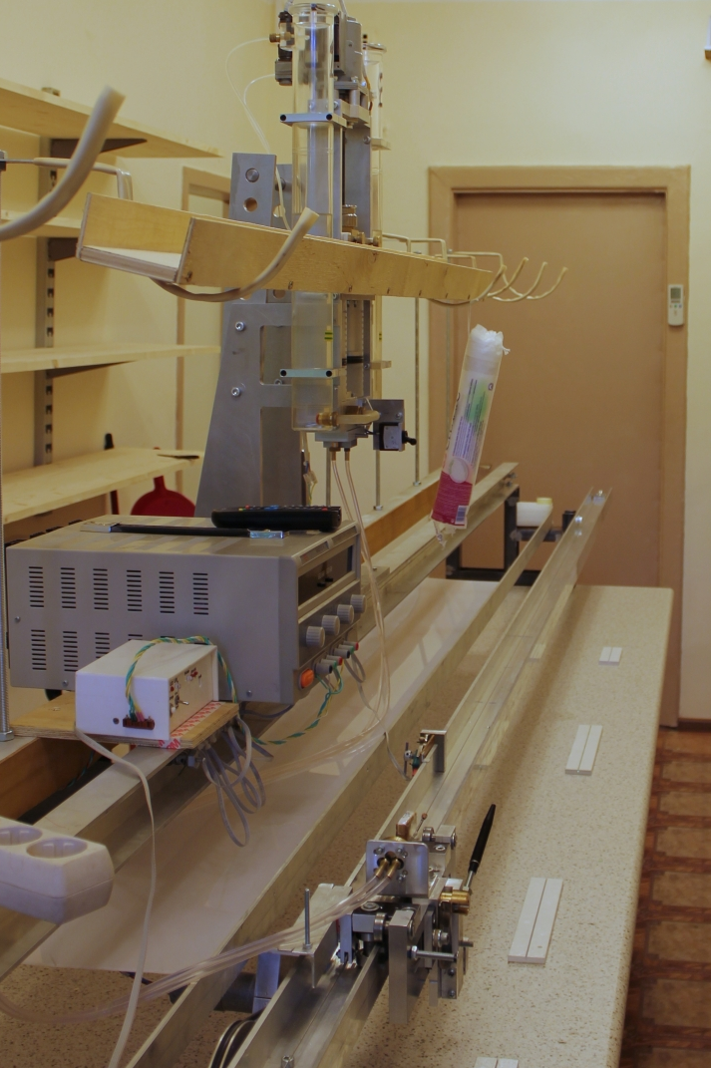
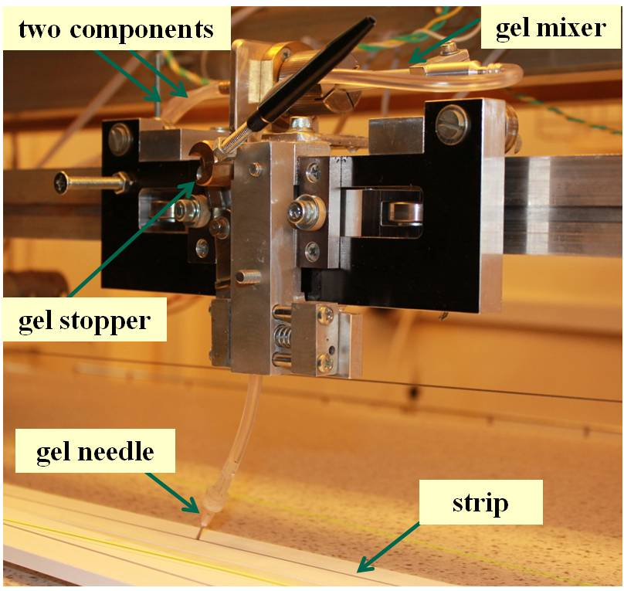
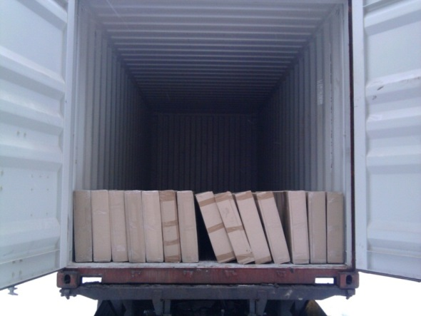
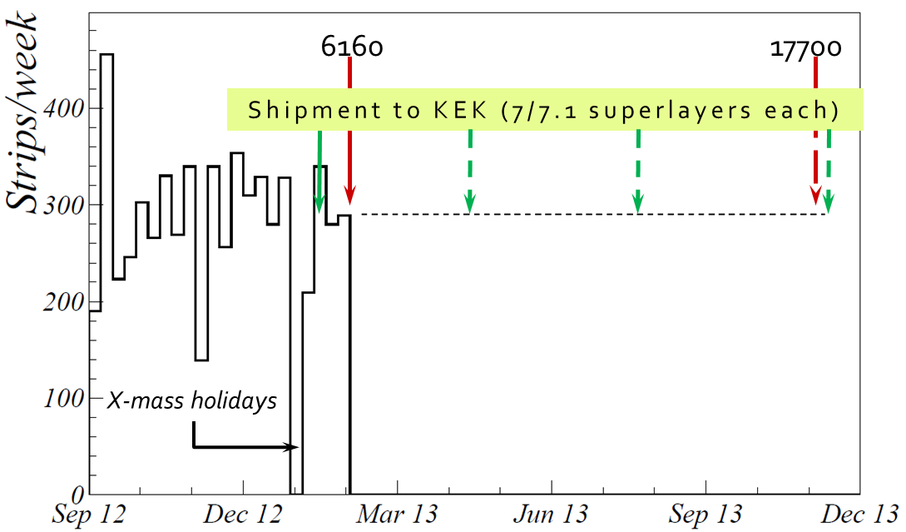
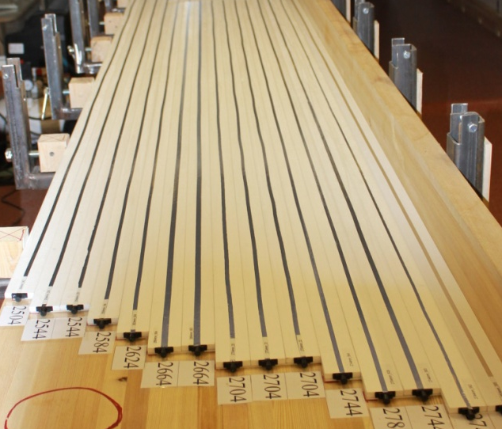
K_{L}, μ detector (KLM)
gel pump
290 x 14 x 62 cm³
First 28 boxes (120kg each; ~1/4 of total) left Russia on Jan. 24
moving carriage
Another 30 boxes to be shipped in Apr. Jul. Oct.
Assembled, tested, and inserted at KEK by Mar. 2014

Slide 16
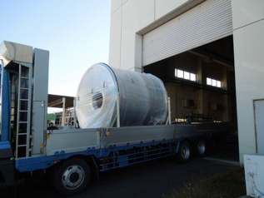
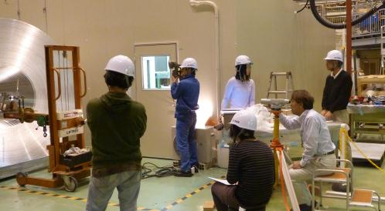
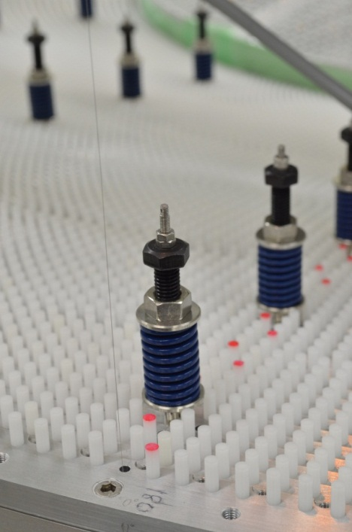
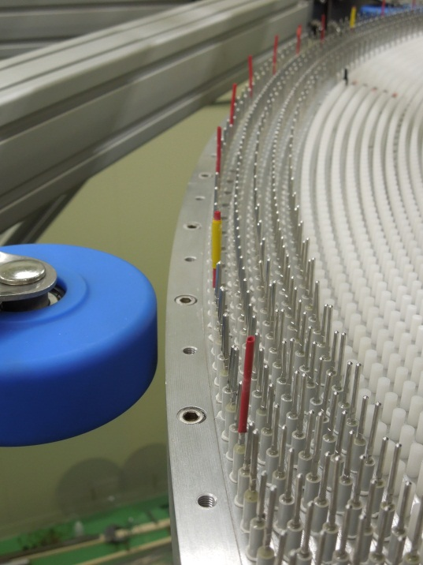
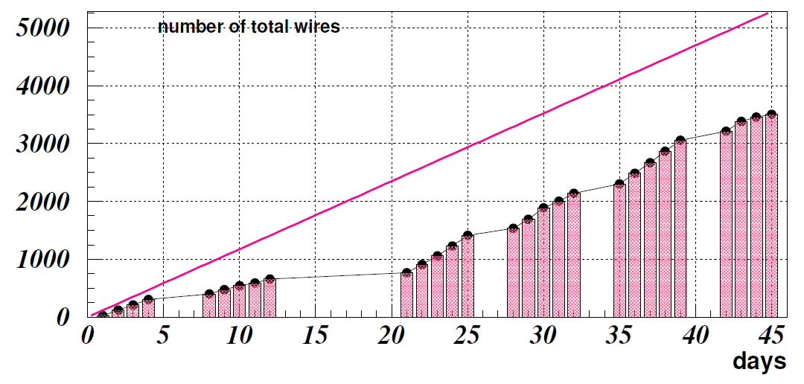
Central Drift Chamber (CDC)
Nov. 21, 2012
Nov. 30 VXD dummy loading test
3508 wires (~7%) completed by Jan. 31, 2013
All 56k wires to be completed in ~1 year
Dec. 18 1st wire
Jan. 31, 2013
Improving methods
New Year holidays

Slide 17
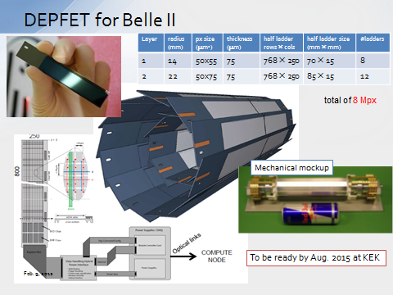
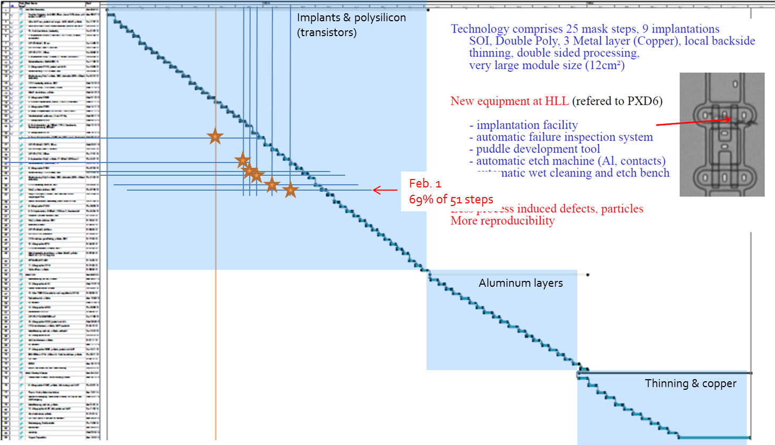
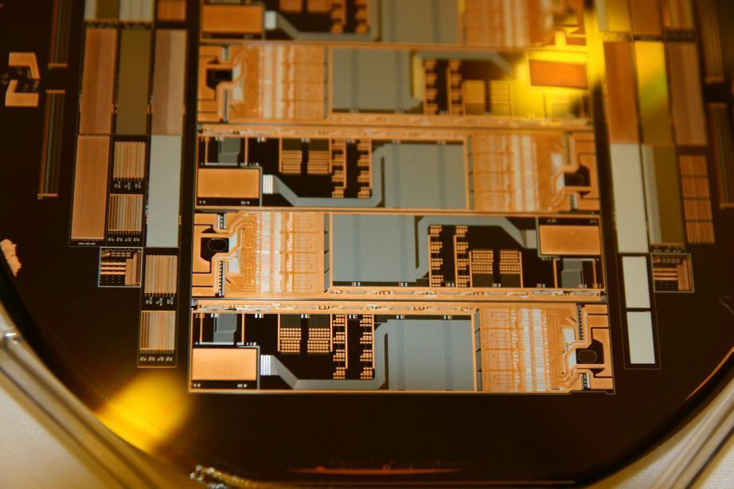
Vertex Detectors (VXD=PXD+SVD)
Belle II Belle
Beam Pipe r = 10mm 15mm
DEPFET
Layer 1 r = 14mm
Layer 2 r = 22mm
DSSD
Layer 3 r = 38mm 20mm
Layer 4 r = 80mm 43.5mm
Layer 5 r = 105mm 70mm
Layer 6 r = 135mm 88mm
Advanced test for metal layers
69% of Poly-silicon layer processing has completed by Feb. 1 (earlier than scheduled)
Electric test module
Total 2- years of processing

Slide 18


Belle II Collaboration
US
Russia
Korea
Japan
20 countries/regions, 70 institutions
~450 collaborators
Germany

Slide 19



Slide 20
Groups for baseline upgrades
Group | Country, Inst.
IR | KEK
STR | KEK
PXD | DEPFET collab. (Germany, Czech, Spain…)
SVD | Vienna, KEK, Tokyo, Krakow, India, Tohoku, Melbourne, …
CDC | KEK, NTU, Osaka-CU, NPC, Viet Nam, …
ARICH | KEK, Ljubljana, Tokyo MU, Niigata, …
TOP | US, Nagoya, Ljubljana
ECL | BINP, Hanyang, Nara-WU, NTU, …
B-KLM | US
E-KLM | ITEP, US (readout)
DAQ | KEK, IHEP
TRG | KEK, Korea, …
SOFT
COMP | KEK, PNNL, Karlsruhe, …
Luminosity monitor | KEK, BINP
Bkg monitor | <- BEAST

Slide 22


Slide 23


Slide 24



Slide 25
List of potential contributions within the Belle II SVD group for new collaborators
A new assembly site
Option 1: Sharing layer 5 or 6 ladder assembly with Vienna group.
Option 2: Assembly of forward and backward sensor (DSSD) modules(*), common to layer 4 to 6.
  Needs clean room with wire bonding, coordinate measurement machine and (preferably) climate chamber
  Prepare assembly jigs
  Perform assembly of ladders from its parts (involves several steps of gluing and bonding)
  Prepare of transfer jigs
  Introduction/Training can be done by either IPMU or Vienna people.
(*) Note: SVD ladders consist of ORIGAMI sensor modules and forward and backward sensor modules. Origami modules are for the chip-on-sensor readout in the central part of ladders. In the forward and backward modules, signal from sensors is read out with conventional structure: sensor/flex/hybrid. The Belle2 SVD ladders are designed to use common Origami, forward and backward modules.

Slide 26
Electronics
Power supplies:
  Produce and test rad-hard DC/DC converter modules with CERN ASIC
  Prepare power distribution with existing Kenwood power supplies
  Procure new/additional supplies for sensor biasing (up to ±100V)
  Procure low voltage power supply system and replace the 10-year old power supply system that was built for the Belle SVD.
  Finer power supply segmentation will be beneficial to adjust bias voltages for different sensor direction and position.
FADC system:
  Development of certain firmware blocks (e.g. GbE interface) for the FADC system
  Production and testing of FADC system components ((part of) FPGA daughter boards and/or FADC mother boards)
Environmental monitoring:
  Development and production of rad-hard sensors for
    Temperature
    Humidity
    Instantaneous radiation
    Integrated radiation (dose)
    Pressure
    Gas flow (in, out)
  to be applied in several locations in the PXD/SVD volume (and/or externally)

Slide 27
Software
Monitoring software (run parameters, event display, online analysis)
Slow- and run control software (based on EPICS and NSM2)
Run parameter database (APV25 settings, bias voltages, bad strips, etc.)
Details should be discussed with the SVD software coordinator.

Slide 28
Future Options
Pure CsI
CDC cluster counting (?)
2nd version of PXD

Slide 29
[Crystals]
ISMA can fabricate ~2000 crystals in 4 years: 1 year for preparation + 3 years for production. The first endcap will be ready in year 3, the second in year 4. This assumption is based on utilizing 3 furnaces that are currently allocated for non-doped crystal production. It could be reinforced, but of course, with certain investment.
[Photo sensor]
So far, APD hasn’t been successful. It is still too noisy to be used for pure CsI.
Firm candidate is photo pentode (PP). Discussion with HPK has to be restarted. According to an old communication with them in >2 years ago, we need 2 years for production. Situation might have changed since then.
If we go for PP, we need significant redesigning of endcap container. After the start of crystal production, mechanical design must be done within 1-2 years. We have significant shortage of manpower in mechanical design.

Slide 30
[Readout electronics]
Shaper DSP for pure CsI has no progress in these 1.5 years. (Some small progress very recently)
A prototype is ready, but nothing has been examined because of limited manpower.
People (BINP) are more concentrated on shaper for CsI(Tl).
In principle, only analog part has to be studied separately, digital part and the rest of data acquisition chain must be common. We need electronics experts to do this.
To check the entire system, there must be at least one more beam test (at BINP for example) for pure CsI.
<Crystal by crystal acceptance test>
If we use PP, we probably can use radiation source to measure uniformity, otherwise we need a cosmic ray test stand. We keep 15 years old stand for Belle 1, but not sure if wire chambers still work or not. We need manpower to design new stand, or repair old stand.

Slide 31

Machine/Detector commissioning scenario
First target luminosity
1 x 10³⁴ cm⁻²s⁻¹
Scenario 1
First target luminosity
1 x 10³⁴ cm⁻²s⁻¹
Scenario 2

