Slide 1
A case for a hadron photo-production source at IRIDE
R. Faccini^{1,2}, F. Grazzi³, A. Pietropaolo⁴, L. Quintieri⁵, P. Valente¹
¹ INFN Sezione Roma
² Univ. La Sapienza
³ CNR-ISC Firenze
⁴ ENEA Centro Ricerche Frascati
⁵ ENEA Centro Ricerche Casaccia

Slide 2
Production (γ,n)
Frenamento dell’elettrone in targhetta
Emissione di radiazione di frenamento
Reazioni (γ,n) + evaporazione del nucleo
Lo yield neutronico (n per primario, Y) dipende principalmente dal materiale della targhetta e dalla sua geometria:
  Y < 0.1 n/e per E_{e} < 200 MeV (W,Ta)
  Y ~ 0.2 n/e per E_{e} = 500 MeV (W,Ta)
  Y ~ 0.7 per E_{e}=500 MeV (U)
  Y ~ 0.7 per E_{e} > 1 GeV (W,Ta)
Per E_{e}>150 MeV processi adronici dovuta a produzione di pioni: cascate intra- e inter-nucleari (fotofissione nel caso dell’Uranio)
Simulazioni e calcoli stimolati dallo studio di fattibilità per la facility n@BTF
Lo yield dipende dallo spessore della targhetta ma c’è il problema di potenza dissipata → targhetta segmentata o rotante per migliore raffreddamento.
γ
e⁻
n
A,Z

Slide 3
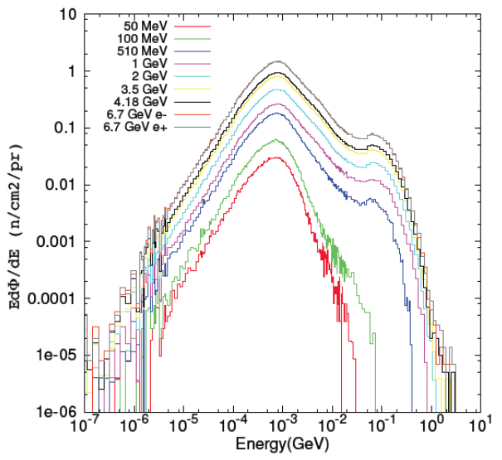
Neutron spectra@ target
Picco di evaporazione, che dipende dal tipo di target (in questo caso, W)
1 GeV

Slide 4
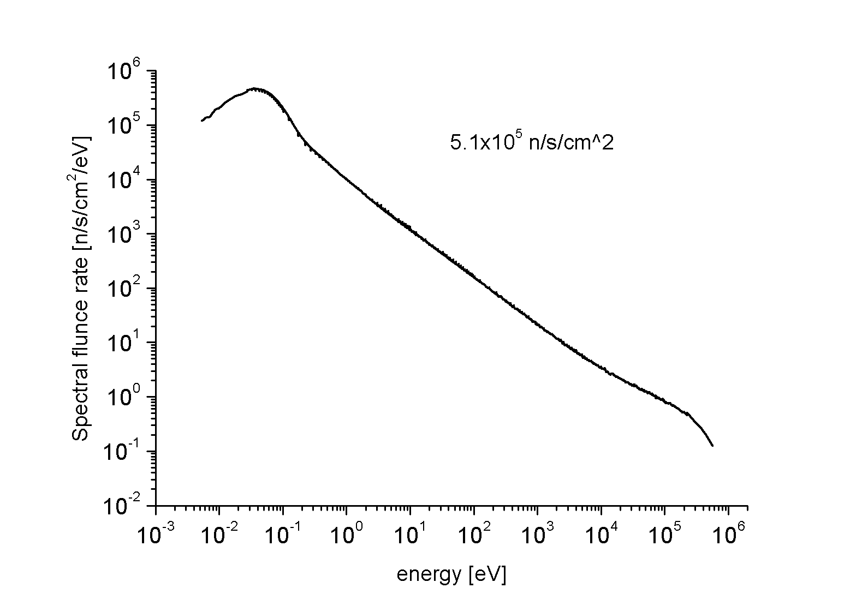
A typical moderated spectrum
Source: GELINA
Moderator: water
Flight path: 10 m

Slide 5
An outlook on some accelerator-driven neutron facilities worldwide

Slide 6
Existing (Japan)
Name | Type | Primary Particles | Reaction | Intensity | Moderator | Application
HUNS （Hokkaido University Neutron Source) | Linac | Electrons energy: 35MeV, current 30 μA single-100 Hz (Usually up to 50Hz) | Photoproduction | 1.6x10¹² n/sec @ 35 MeV and 1kW | Water thermal moderator and coupled methane moderator | Imaging, SANS, device development, nuclear data
RIKEN Accelerator-driven Neutron Source (RANS) | proton Linac | Protons peak current:10mA average current: 100uA Pulse width:30-200μsec frequency 20–200 Hz duty 1% | Be(p,n) | 10¹²n/s (100uA, 7MeV by simulated) | thermal, polyethylene (1st phase) | thermal: imaging, detector development
 |  |  |  |  | cold, mesitylene (2nd phase) | cold: SANS, pulse imaging
Kyoto Univ. Accelerator-driven Neutron Source (KUANS) | proton Linac | Proton peak current: 10mA , average current: 101μA Pulse width: 30-200μsec repetition 20 - 200Hz duty 1% | Be(p,n) | 10¹¹n/s (100uA, 3.5MeV by simulated) | thermal, polyethylene | imaging, detector development, education
J-PARC | Proton synchrotron | Protons Energy: 3 GeV 333 μA Repetition 25 Hz | spallation | 3-5x10¹⁶ n/s | Liquid hydrogen | Diffraction, spectroscopy, spin-echo, imaging.
Y.K. Kyanagi

Slide 7
Existing（out of Japan)
Name | Type | Primary Particles | Reaction | Intensity | Moderator | Application
Compact Pulsed Hadron Source (CPHS) China | proton Linac | Protons energy: 3 MeV (stage 1 ) / 13MeV(stage 2), peak current: 50 mA, average current: 1.25mA pulse duration: 500µs, frequency: 50Hz, | Be(p, n) | ~5×10¹³n/s (1.25mA, 13MeV, by simulated) | Thermal, Polythene (stage 1); Cold, solid methane (stage 2) | SANS(BL1), neutron instrument development (BL2), imaging(BL3), detector development(BL4)
PKUNIFTY (Peking University Neutron Imaging Facility) China | RFQ linac | Deuteron, Energy: 2 MeV, Peak current: 40 mA Average current: 400 μA Pulse width: 0.2-1 ms Frequency:100 Hz | Be(d, n) | 3×10¹² n/s @ average current of 4 mA (simulation) | polyethylene and light water | imaging, education
 |  |  |  | 3×10¹¹ n/s @ average current of 0.4 mA (current experiments)
GELINA (Belgium) | Van Der Graaf | protons, alpha and lithium. ΔV: 7 MV max cw current: 30 μA pulse width < 1 ns frequency: multiple of 330 ns | Li7(p,n)Be7 | 3´10e8 n/s @ 2 MeV and 30 μA | none. the neutron spectra is shaped by shaping the proton energy spectra | nuclear astrophysics, neutron activation, validation of nuclear data, next generation reactors data
LENS (Low Energy Neutron Source) USA | RFQ + 2 LINAC Sections | Protons, Energy: 13 MeV, Peak current: 25 mA (peak) (current) pulse width 0.015–0.6 ms frequency 20 Hz Planned parameters Energy: 18 MeV Peak current: 100 mA Pulse width: 0.015-2.0 ms Frequency: 20 Hz | Be(p, n) | Target station 1 – 3 x10¹¹ n//s current. 5 x 10¹² n/s (planned) Target station 2 – ~10¹³ n/s (current), ~5x10¹³ n/s (planned) | Target Station 1 User selectable – None, water, poly without light water reflector. Target Station 2 Solid methane at 4K with light water reflector | Target Station 1 Radiation effects – commercial and military electronics testing Neutron imaging (radiography and tomography) – geology, antropology, art Target Station 2 SANS – geology, materials science, biophysics Spin polarized reflectometer – biophysics, polymers Test Beam Line – detector and optics development, moderator research
Y.K. Kyanagi

Slide 8
Main (accelerator driven) neutron sources in Europe
Name | Type | Primary Particles | Reaction | Intensity | Moderator | Application
ISIS Spallation Neutron Source UK http://www.isis.stfc.ac.uk/ | proton Synchrotron | proton, energy: 800 MeV Average current: 200μA, pulse duration: two bunches 100 ns width and 200 ns apart frequency: 40Hz for TS-I and 10 hz for TS-II Target: W/Ta | spallation | ~10¹⁶n/s (estimated) | Water Methane (solid) Liquid hydrogen | Diffraction Quasi Elastic scatterjng spectroscopy Small Angle reflectometry
SINQ @ PSI Swizterland http://www.psi.ch/sinq/ | cyclotron | proton energy: 590 MeV Current: 1 mA frequency;. Continuous Target: lead rods Envisaged rotating euthectic lead-bismuth (MEGAPIE project, successful test in 2006) to improve by 80% the neutron flux | spallation | 3x10¹⁶ n/s | Heavy water Liquid deuterium | Diffraction Small Angle Scattering Spectroscopy Raadiography Imaging reflectometry
Frascati Neutron Generator ENEA-Frascati | Deuteron Linear Accelerator | Deuterons Deuteron energy: 260 keV Current: 1 mA Target: deuterium or tritium Frequency: continuous | D(d,n)³He or T(d,n)α | D-D reaction 10⁹ n/s @ 2.5 MeV D-T reaction 10¹¹ n/s @ 14 MeV | The monochromatic beams at 2.5 and 14 MeV can be moderated by movable moderation systems to obtain thermal neutrons fpr specific measurements | Benchmark experiments Activation cross sections measurements, fast neutron activation analysis, detector development
GELINA Belgium http://irmm.jrc.ec.europa.eu/about_IRMM/laboratories/Pages/gelina_neutron_time_of_flight_facility.aspx | Electron LINAC | Electron energy: 100 MeV Average current: 100 μA Frequency: 800 Hz Pulse width: 1 ns Target: uranium | Photoproduction | 3.4 x 10¹³ n/s | Both moderated and non moderated beams | NRCA Neutron data Nuclear structure

Slide 9
The Spallation Neutron Source in US
Name | Type | Primary Particles | Reaction | Intensity | Moderator | Application
Spallation Neutron Source* USA http://www.bnl.gov/cad/sns/ | proton Synchrotron | proton, energy: 1 GeV Average current: 2 mA, pulse duration: 695 ns frequency: 60Hz, Target: rotating liquid Hg | spallation | ~10¹⁷n/s (estimated) | Water Methane (solid) Liquid hydrogen | Diffraction spectroscopy Small Angle reflectometry
* Parameters from SNS design: present performances possibly reduced due to target problems

Slide 10
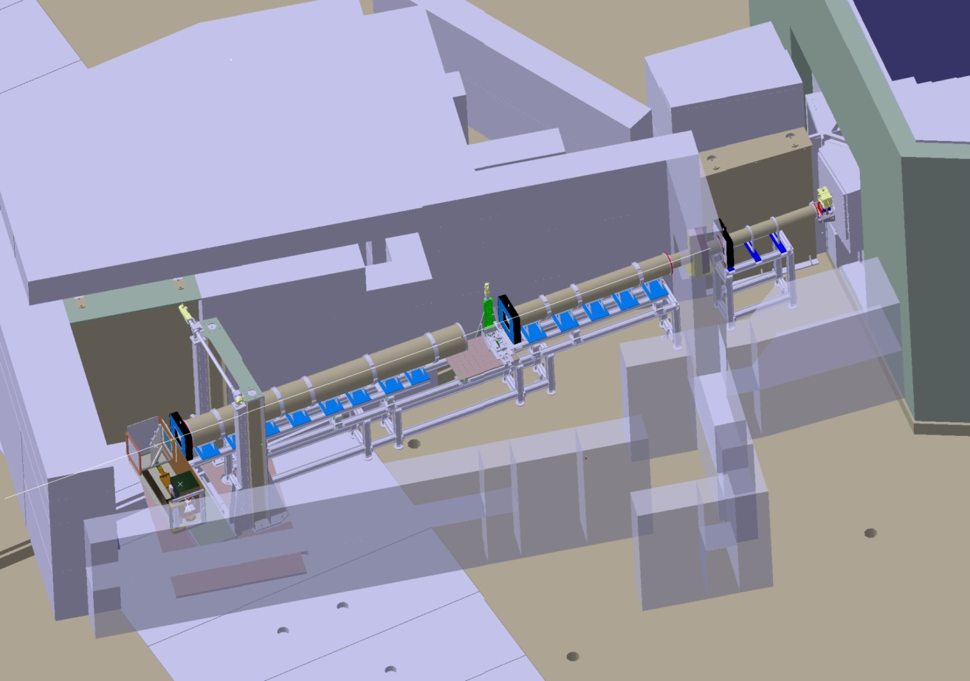
Neutron imaging
Neutron Imaging (radiography and tomography) is a technique able to perform spatial and volumetric maps of samples in order to study their morphology
5 beamlines in Europe + 1 in construction
requested beam time / available beam time = 3 / 1 ≈ 500 users per year
source
Small field of view,
high res.
measuring position
large field of view,
high res.
meas. position
The ICON beam-line at the SINQ continuous spallation neutron source
http://www.psi.ch/sinq/icon/icon

Slide 11
Neutron tomography scheme
Andor DV 436 16-bit CCD Detector
2048×2048 pixels
nominal pixel size of 13.5 μm (CCD chip size: 2.76 cm x 2.76 cm)
Lens optic system
(1:1 optic)
Sample
Pin hole
diameters: 4 cm
L/D achieved: 178
Rotating table
step angle of 0.96 ° (over 360°)
exposure time for projection: range from 5 s to 60 s
⁶Li based Scintillator
Thickness: 100 μm

Slide 12
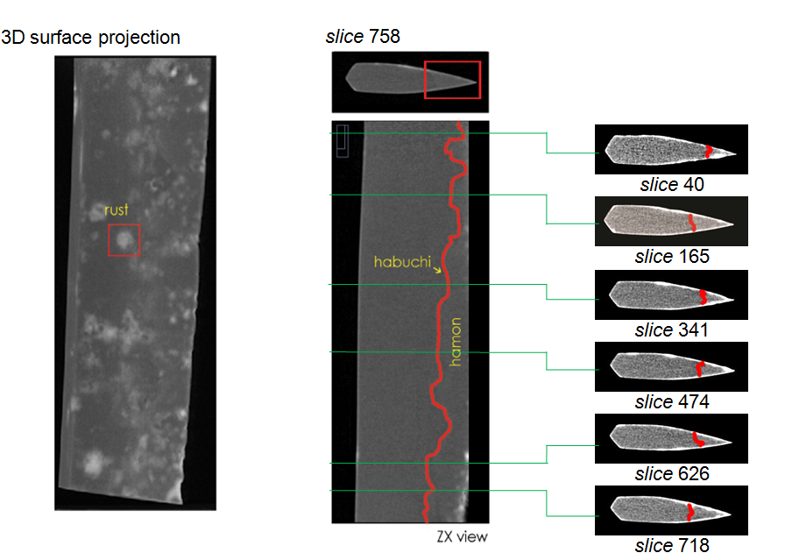
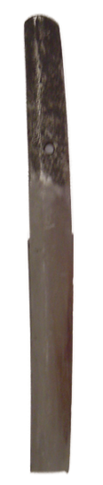
Neutron tomography results, an example:
Japanese swords characterization
(F. Salvemini et al. J. Anal. At. Spectrom. 2012)

Slide 13
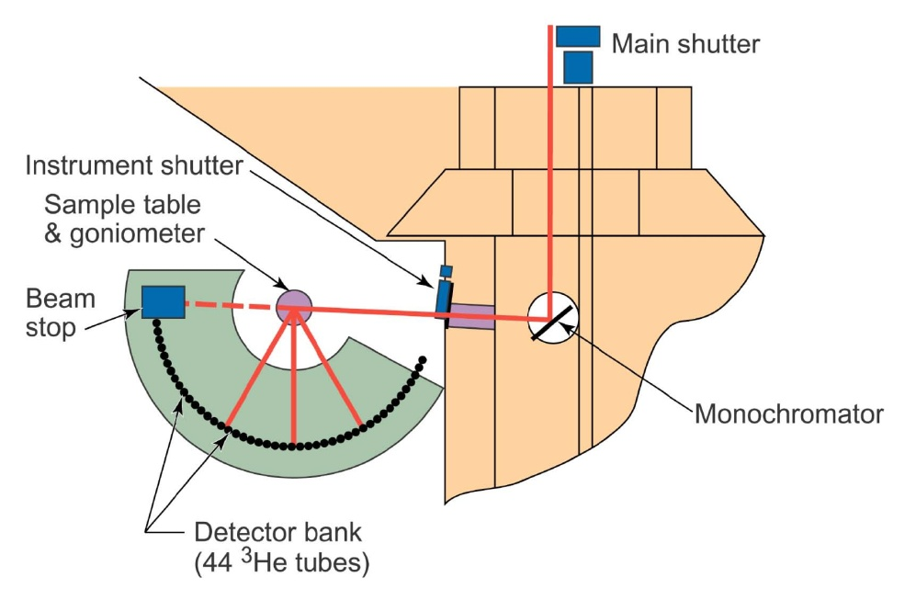
Neutron Scattering
Elastic, quasi-elastic and inelastic scattering
A wide range of techniques able to determine:
lattice structure (diffraction),
macrostructure (small angle scattering),
interface morphology (reflectometry)
diffusion processes (quasi elastic scattering),
collective and vibrational states of matter (inelastic scattering)
More than 100 beamlines in Europe
requested beam time/available beam time = 2 / 1 ≈ 6000 users per year
≈ 2000 Italian users
More info:Società Italiana di Spettroscopia Neutronica (www.sisn.it)
An example: HB-2A neutron powder diffractometer (ORNL, USA)

Slide 14
Neutron irradiation
Single event effects (SEE) are defined as disturbance of an active electronic device caused by a single energetic particle:
  Upset (SEU): change in logic state, simplest example is a memory cell in RAM
  Latchup (SEL): sharp increase in current resulting from turning on parasitic pnpn
  Damage or burnout (SEB) of power transistor or other high voltage device
  Functional interrupt (SEFI): malfunctions in more complex parts sometimes as lockup, hard error, etc

Slide 15
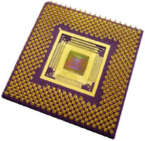
An Industry Wide Problem
High energy neutron
Gate
Drain
Source
-
-
+
-
+
+
Neutron collides with silicon atom causing ejection of heavy ion
+
-
Trail of ionisation and current pulse
+
-
+
-
Notes:
15

Slide 16
Avionics
In 2001, the NASA Altair, Unmanned Air Vehicle (UAV) flew its first flight at an altitude of 100,000 feet. Designed by NASA-Dryden engineers and scientists, it is designed to fly for up to 48 hours to complete a variety of science research studies of Earth.
Because of the complexity of the computer systems (called avionics) onboard, and the very high altitudes being flown, special attention had to be paid to cosmic ray showers. These particles, mostly neutrons, pass through the walls of the aircraft and can affect computer circuitry.
About 80 upsets in about 600 hours of flight

Slide 17
Neutron Radiation from primary cosmic rays
Incident Primary Cosmic Ray
25 km
25km
π⁰
P
N
Electromagnetic
‘Soft’ Component
π^{+/-}
π⁻
γ
γ
π
μ^{+/-}
p
p
n
N
n
n
n
μ⁻
p
10 km
e⁺
p
n
P
SEE
Neutrons
e⁻
n
e⁺
n
n
p
n
n
p
n
p
n
P
Mesonic
‘Hard’ Component
n
n
N
p
n
Nucleonic Component
Sea Level
n
p

Slide 18
Neutron Radiation from primary cosmic rays

Slide 19
Long lasting measurements!
Due to the low neutron flux in the atmosphere, the characterization of the behaviour of electronics in the atmospheric neutron field requires very long data taking to achieve statistically significant results.
That’s why neutron sources are useful to accelerate tests that can be carried out in a few minutes to simulated one year of data taking. This is very important as industries produce new devices in rapid times and need to speed up, using effective protocols, robustness tests.

Slide 20
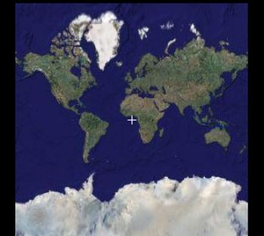
World-wide irradiation facilities
UPPSALA
TRIUMF
ISIS
LANSCE
RCNP
IRIDE

Slide 21
A neutron source for IRIDE
A neutron source in the IRIDE complex would be interesting for different communities of users if capable of providing:
  An “intense” neutron flux in the interesting energy region
  User-friendly beam-lines
    Instruments, access, etc.
Even though not competitive with spallation sources and reactors in terms of absolute flux, a photo-production facility with a significant neutron yield would help to:
  Increase the available beam-time and enlarge the community
  Develop new technologies and detectors
  Provide training for beam-line scientists, accelerator experts, computing, electronics, detectors
Essentially two scenarios
    Continuous
    Pulsed

Slide 22
a. Continuous source
Charge in one bunch: Q = 1 nC
Bunch rate: R = 1 MHz
Average current: <I> = Q*R = 10⁻⁹*10⁶= 1 mA
# of electrons/second: N_{e}=Q*R/e= 10⁻³C s⁻¹/e=0.625×10¹⁶ s⁻¹
T = Q*R*Y/e= 1.25×10¹⁵ n/s @target for Y=0.2
T = Q*R*Y/e= 5.0×10¹⁵ n/s @target for Y=0.8
Techniques:
Very interesting for imaging (tomography and radiography)
Using monochromators, it would be possible to perform measurements with diffraction, SANS, reflectrometry
Cons and Pros:
Of course no time-of-flight technique can be used in continous mode…
…The neutron source can be the beam-dump of other IRIDE applications/experiments/facilities

Slide 23
b. Pulsed source
Charge in one bunch: Q = 1 nC
Bunch rate: R = 1.3 GHz
Burst width: W = 500 ns
Repetition (burst) rate: r = 50 Hz
Beam loading: 20%
Average current: <I> = Q*R*W*r = 32.5 μA
# of electrons/second: N_{e}=Q*R*W*r/e= 2.03×10¹⁴ s⁻¹
T = #e*Y = 1.625×10¹⁴ n/s @target for Y=0.8
Techniques:
Diffraction with time of flight, 20× better wrt scenario a.
Similar performance for SANS and reflectometry
Energy resolved imaging
Cons and Pros:
Time structure is important: probably difficult to run in “parasitic” mode with other experiments/facilities
Lower yield wrt continous mode…
…but time-of-flight can be used

Slide 24
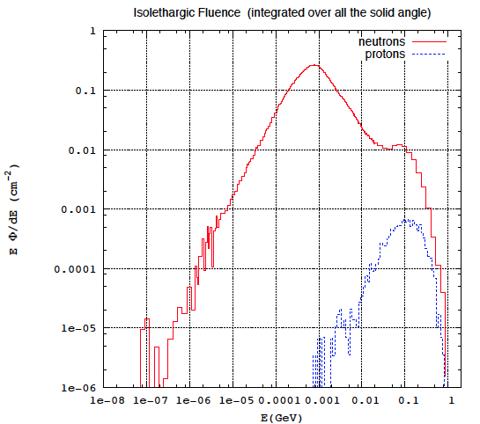
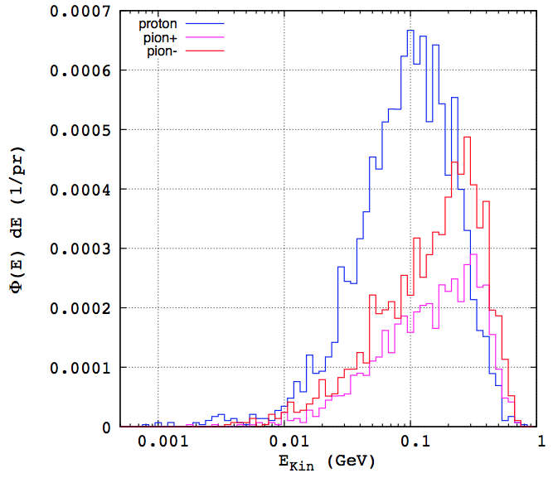
More than neutrons

