Slide 1

Regularized delta interactions
for nuclear structure calculations
Karim Bennaceur, Jacek Dobaczewski, Francesco Raimondi
International Nuclear Physics Conference (INPC 2013)
Florence, Italy, 3-7 June 2013
Notes:
1

Slide 2
Outline
Standard effective interactions in nuclear physics
Regularized pseudopotentials
Three-body forces vs. density-dependent terms
Interactions without density dependence
Conclusions

Slide 3
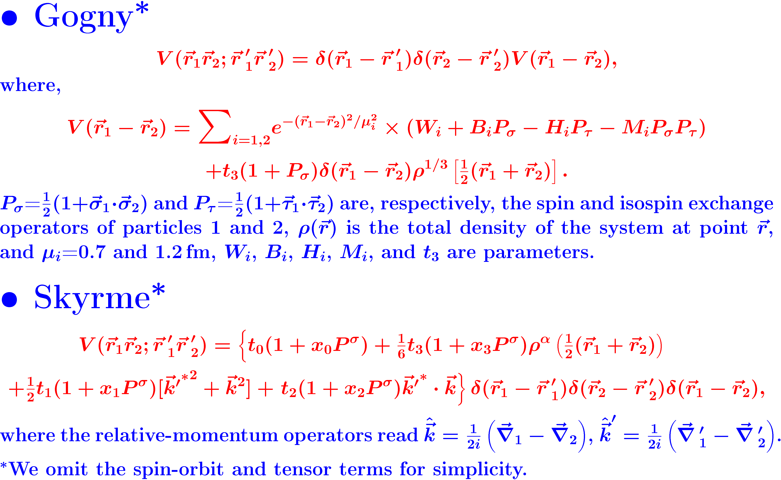
Standard effective interactions

Slide 4
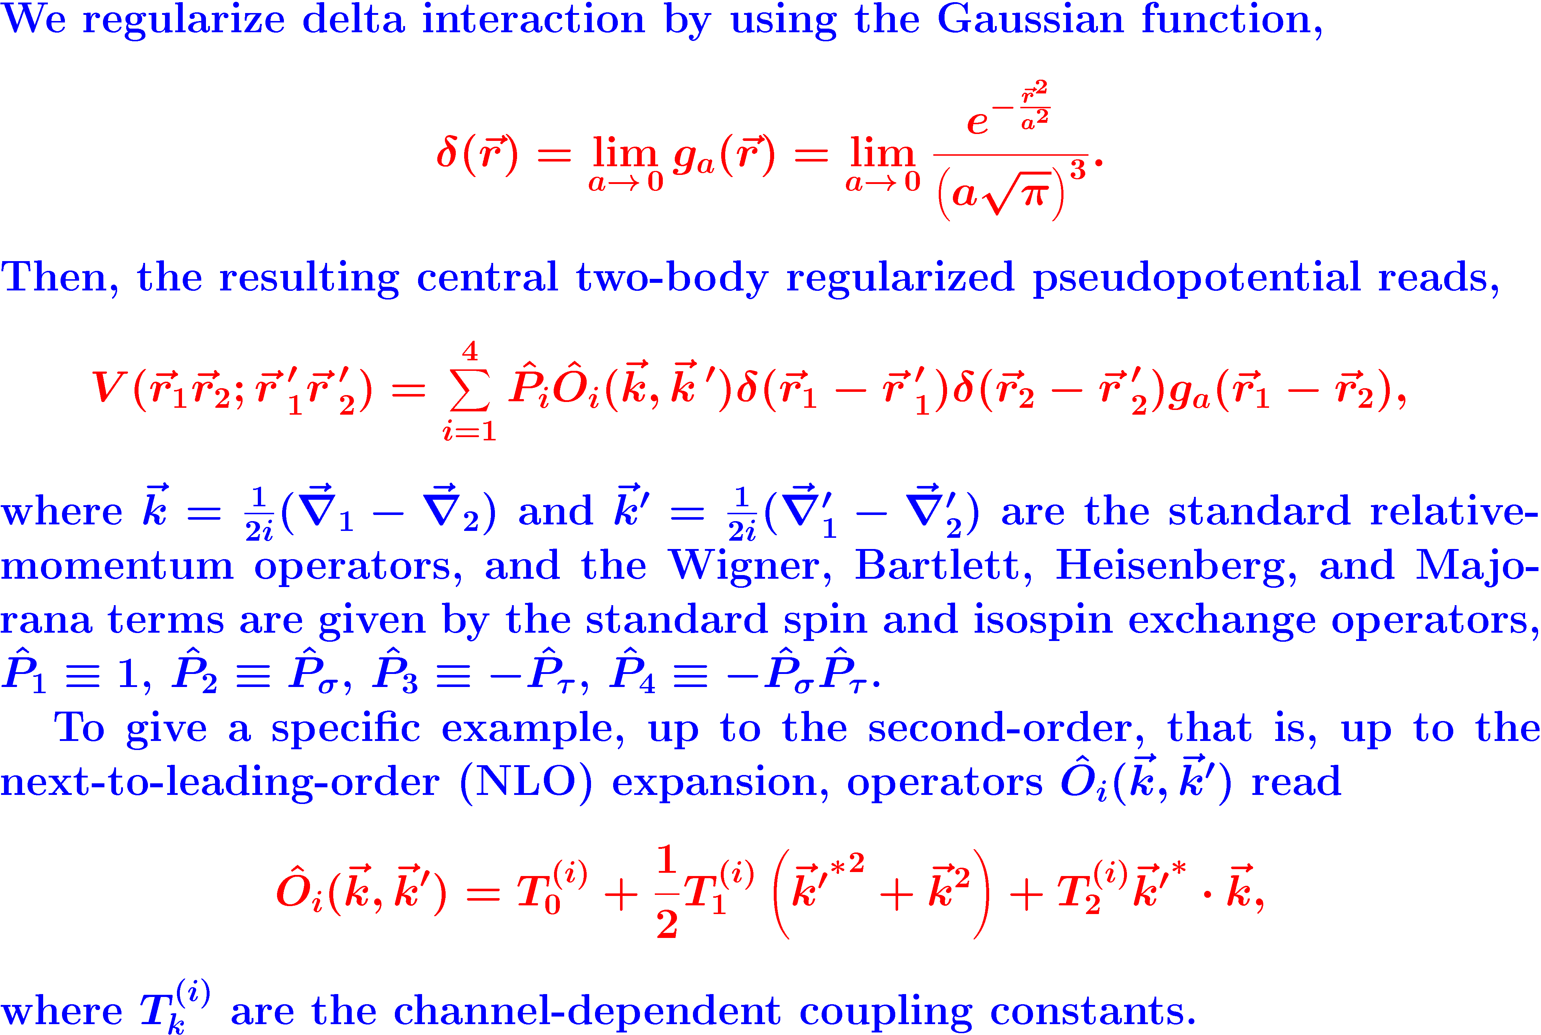
Regularized pseudopotentials
J.D, K. Bennaceur, F. Raimondi, J. Phys. G. 39, 125103 (2012)

Slide 5
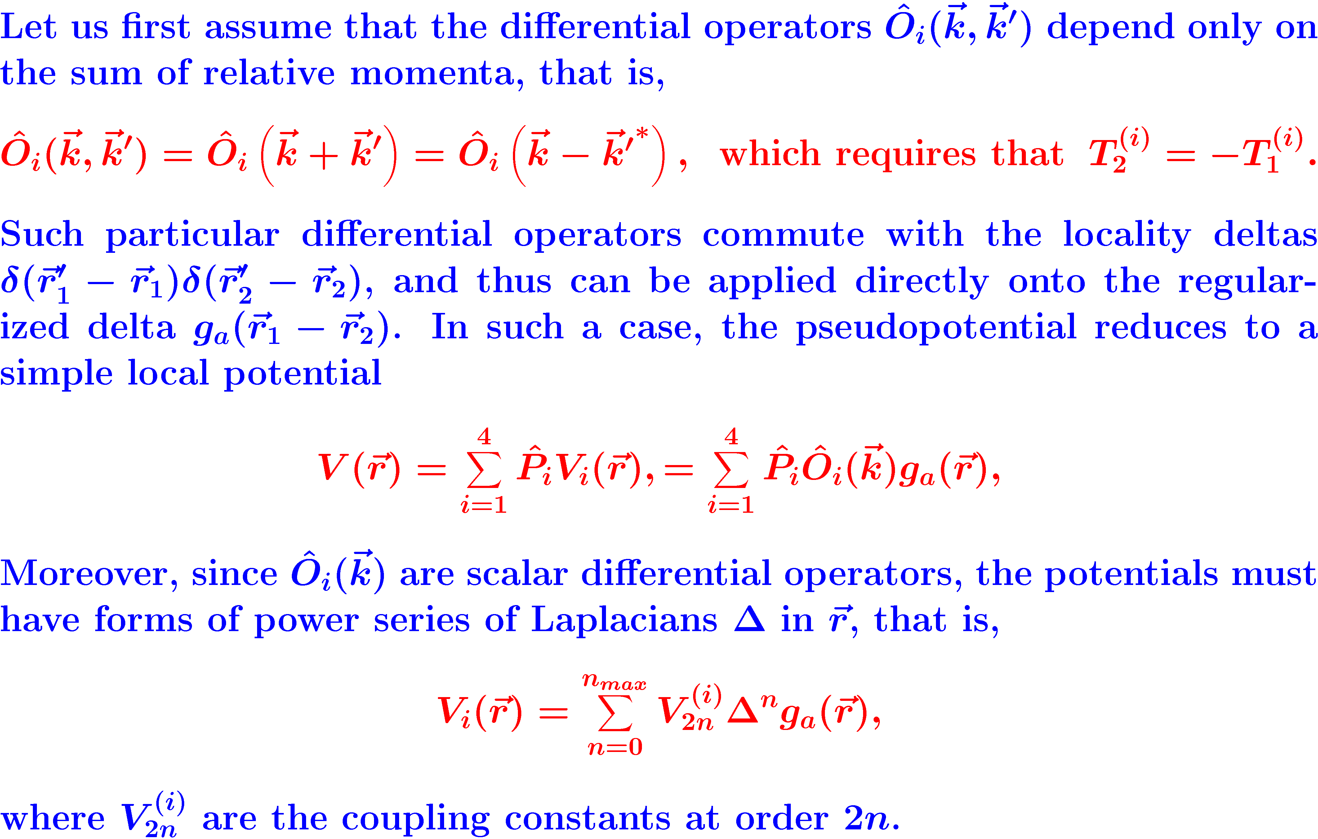
Regularized pseudopotentials
J.D, K. Bennaceur, F. Raimondi, J. Phys. G. 39, 125103 (2012)

Slide 6
Regularized pseudopotentials vs. Gogny
J.D, K. Bennaceur, F. Raimondi, J. Phys. G. 39, 125103 (2012)

Slide 7
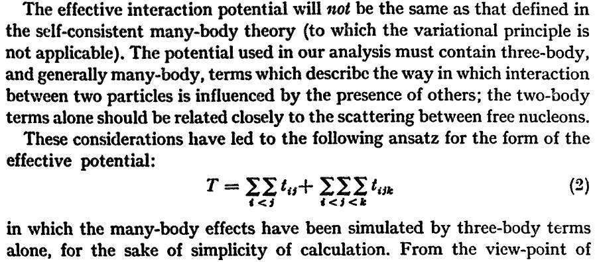
Skyrme’s three-body interaction

Slide 8



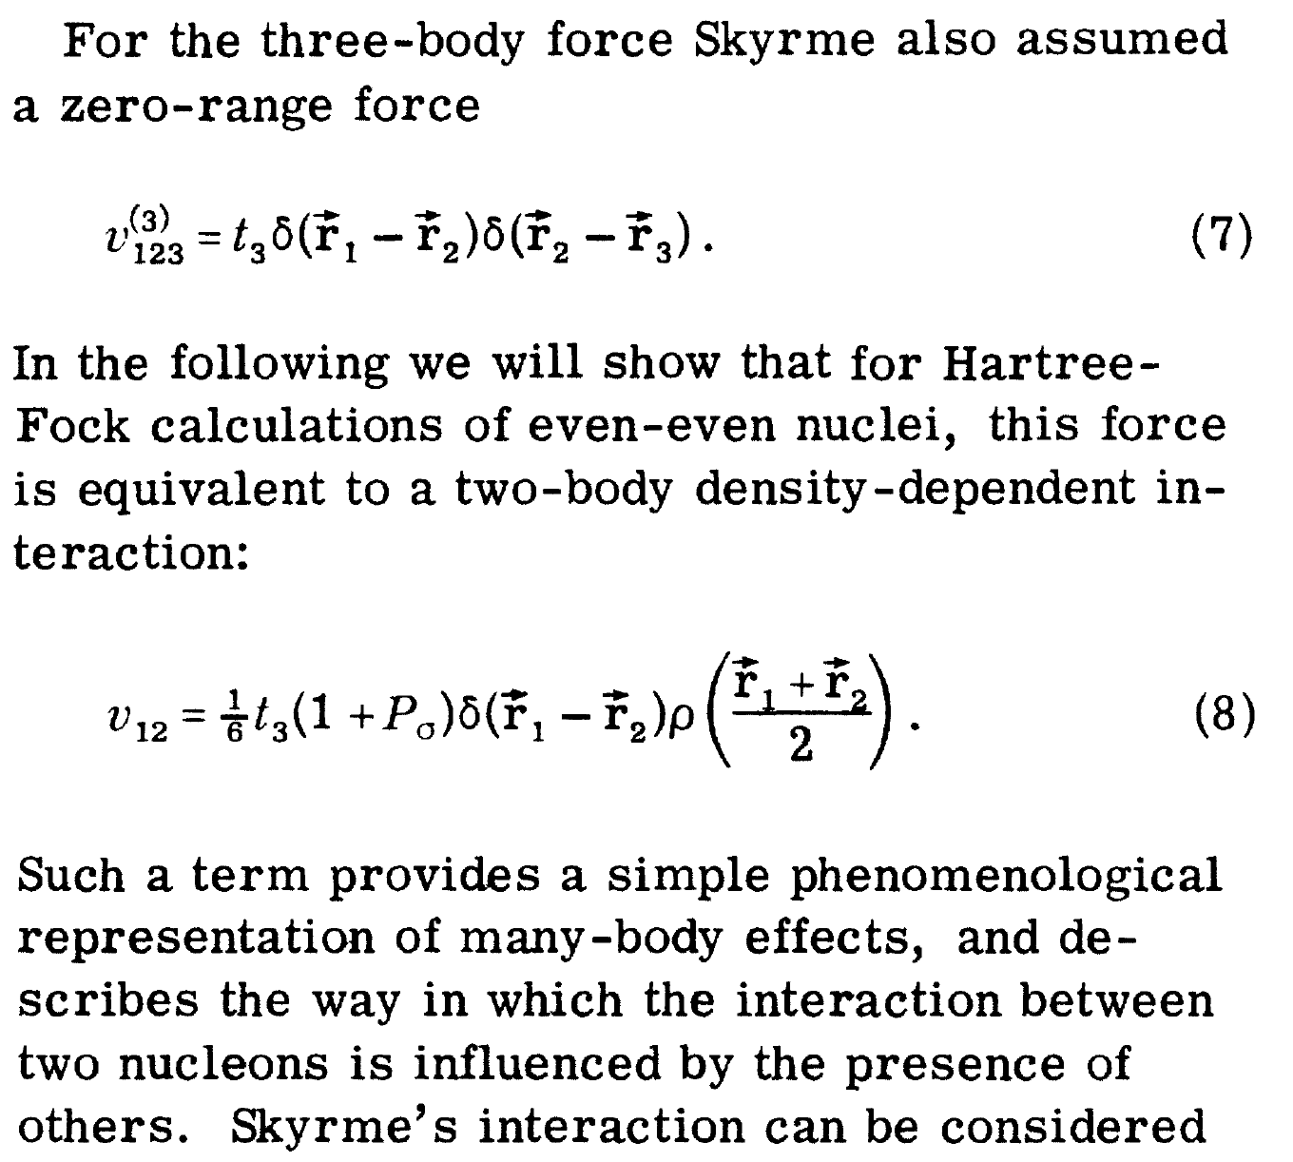
The density dependence is born

Slide 9
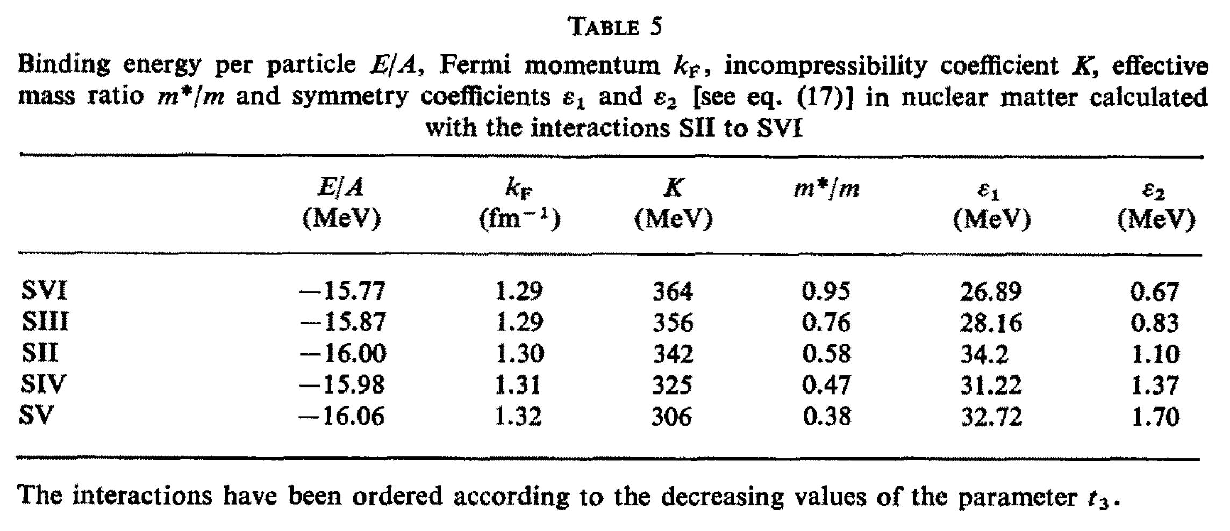
The density dependence is exploited
t₃
(MeV fm⁶)
17000
14000
9331
5000
0

Slide 10
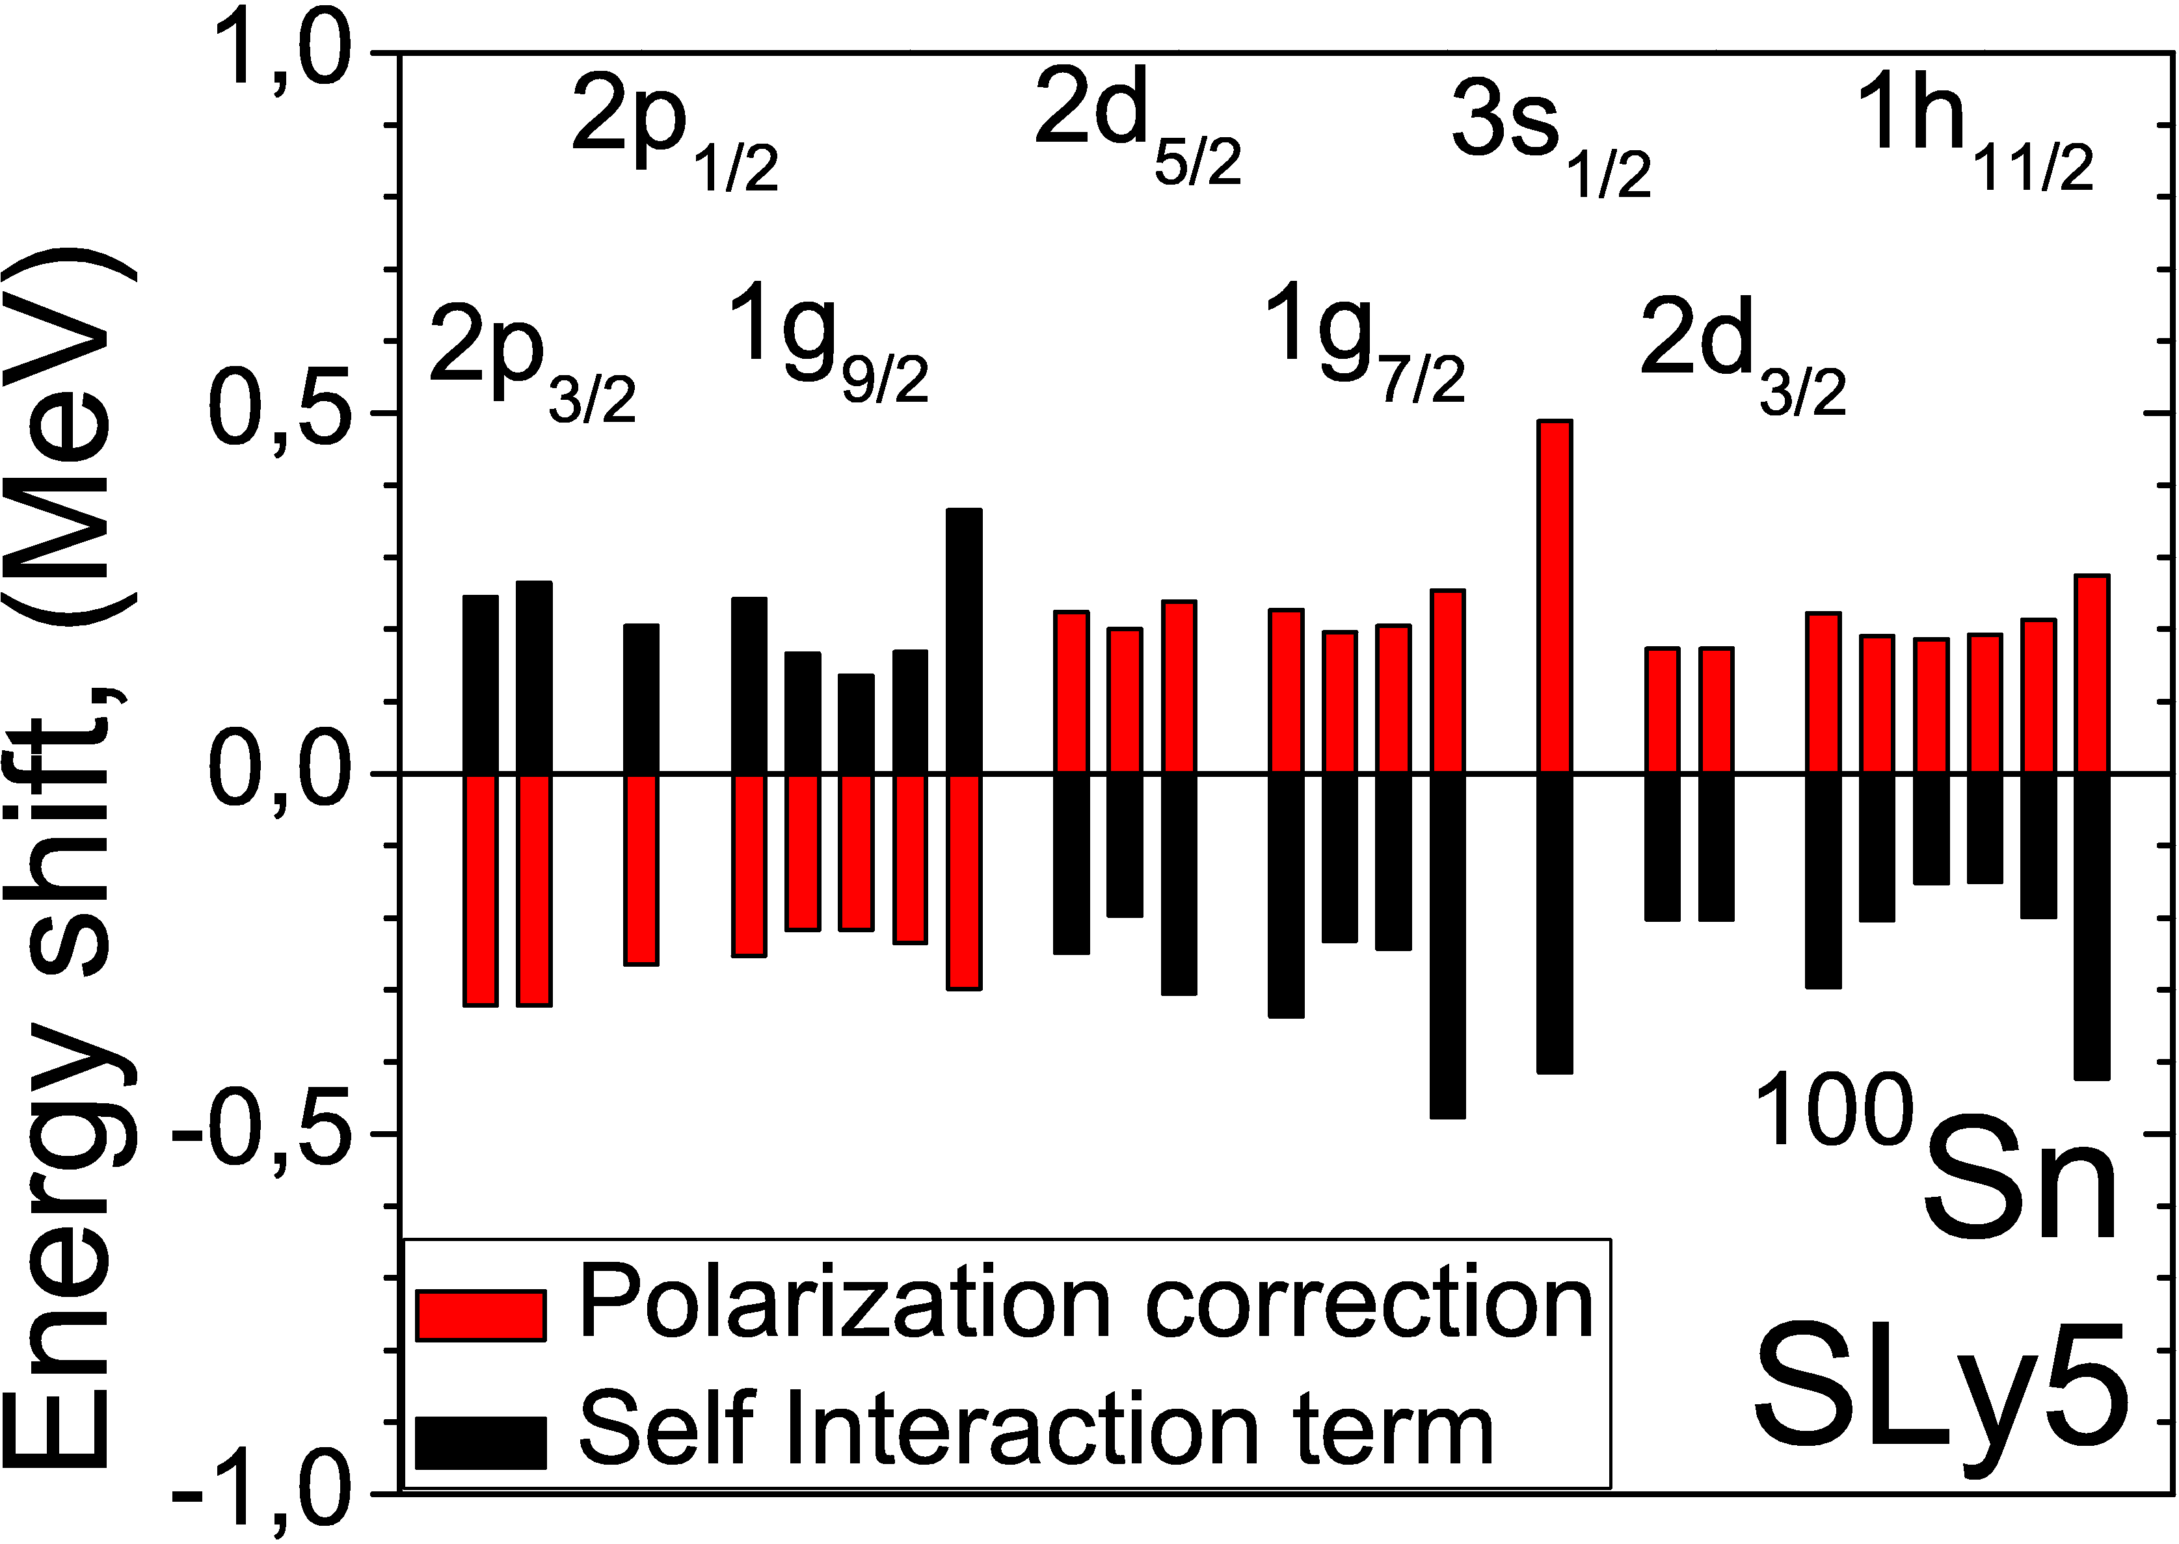
The density dependence causes havoc
Particle-number projection impossible
Strong self interaction present
J.D. et al., Phys. Rev. C 76, 054315 (2007)
D. Tarpanov. et al., to be published

Slide 11
The density dependence causes havoc
Particle-number projection impossible
Strong self interaction present
Poster NS232
J.D. et al., Phys. Rev. C 76, 054315 (2007)
D. Tarpanov. et al., to be published

Slide 12
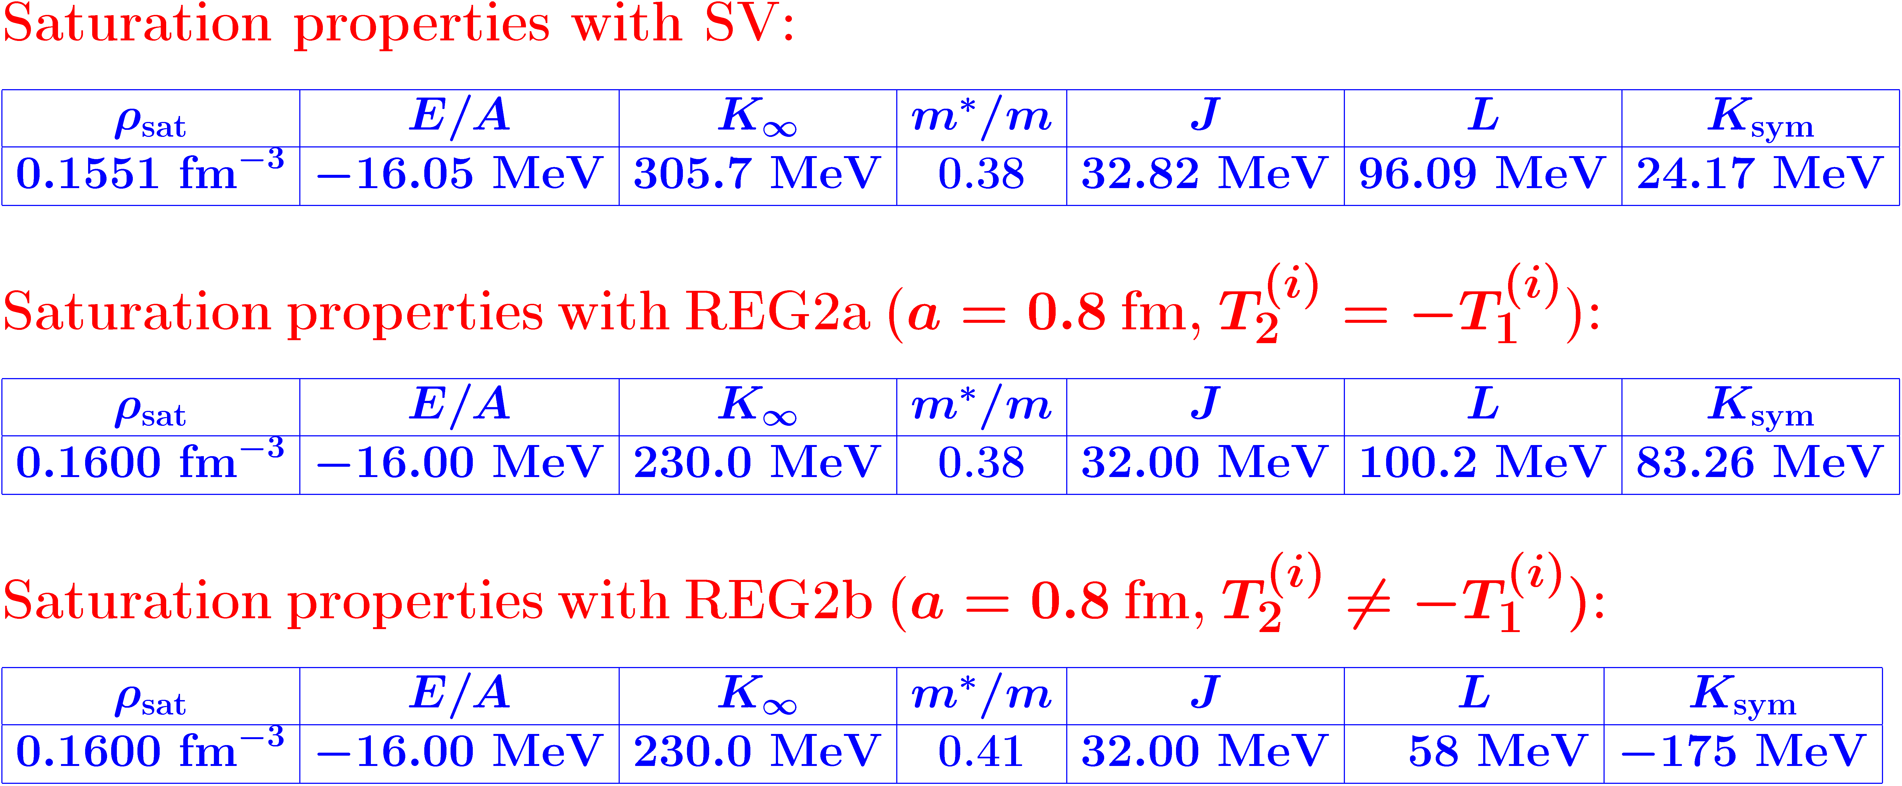
First density-independent finite-range interactions based on regularized pseudopotentials
K. Bennaceur, J.D, F. Raimondi, arXiv:1305.7210

Slide 13
Equations of state
zero range
SLy4
SV
K. Bennaceur, J.D, F. Raimondi, arXiv:1305.7210
density-dependent
density-independent
D1N
REG2b
finite range

Slide 14
Masses of doubly magic nuclei
K. Bennaceur, J.D, F. Raimondi, arXiv:1305.7210

Slide 15
Conclusions
We introduced a new class of energy density functionals that are based on regularized pseudopotentials. They allow for constructing density-independent finite-range interactions.
In our opinion, future prospects for using the proposed regularized pseudopotentials are high.
  They may present better convergence properties than similar expansions based on the zero-range interactions.
  They allow for convergent summations of contributions from high single-particle momenta,
  They allow for formulating a consistent expansion in terms of the orders of derivatives, with the convergence properties gauged against the regularization scale.
  They allow for consistent beyond-mean field calculations.
The regularized pseudopotentials give us a possibility of building an order-by-order correctible theory.

Slide 16
Thank you

Slide 17
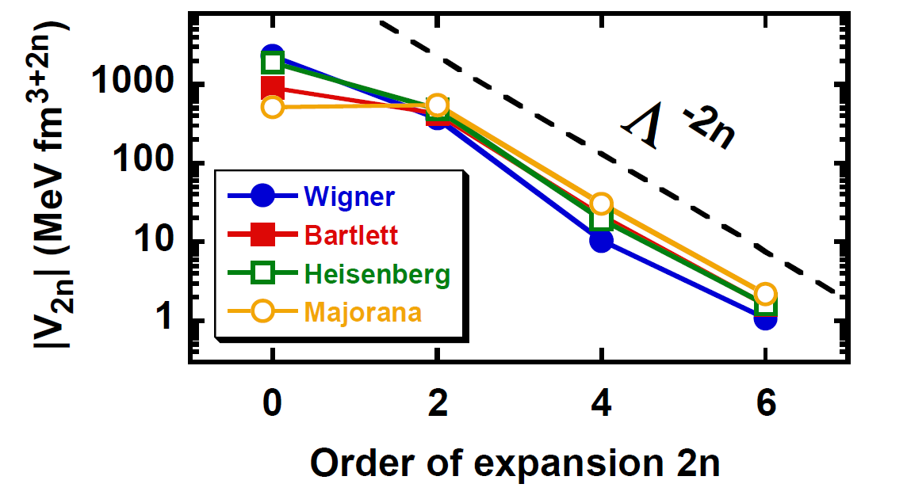
Coupling constants of the regularized pseudopotentials
Λ ≈ 700 MeV/c ≈ 3.8 fm⁻¹
J.D, K. Bennaceur, F. Raimondi, J. Phys. G. 39, 125103 (2012)

Slide 18
Coupling constants of the regularized pseudopotentials in natural units
v_{2n} =f² Λ^{2n} V_{2n} for f=35 MeV/(c)^{3/2}
J.D, K. Bennaceur, F. Raimondi, J. Phys. G. 39, 125103 (2012)

Slide 19
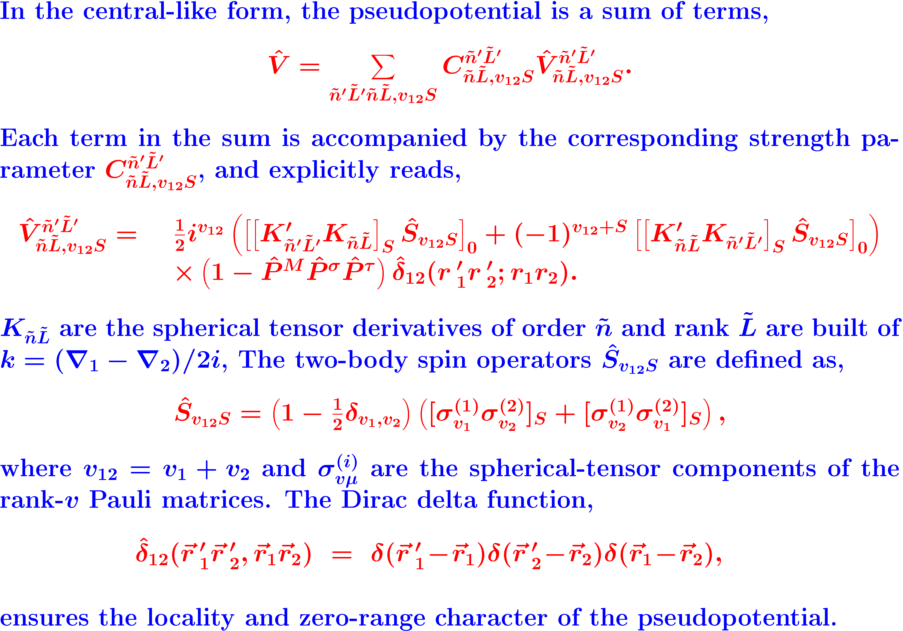
Pseudopotentials
F. Raimondi et al., Phys. Rev. C 83, 054311 (2011)

Slide 20
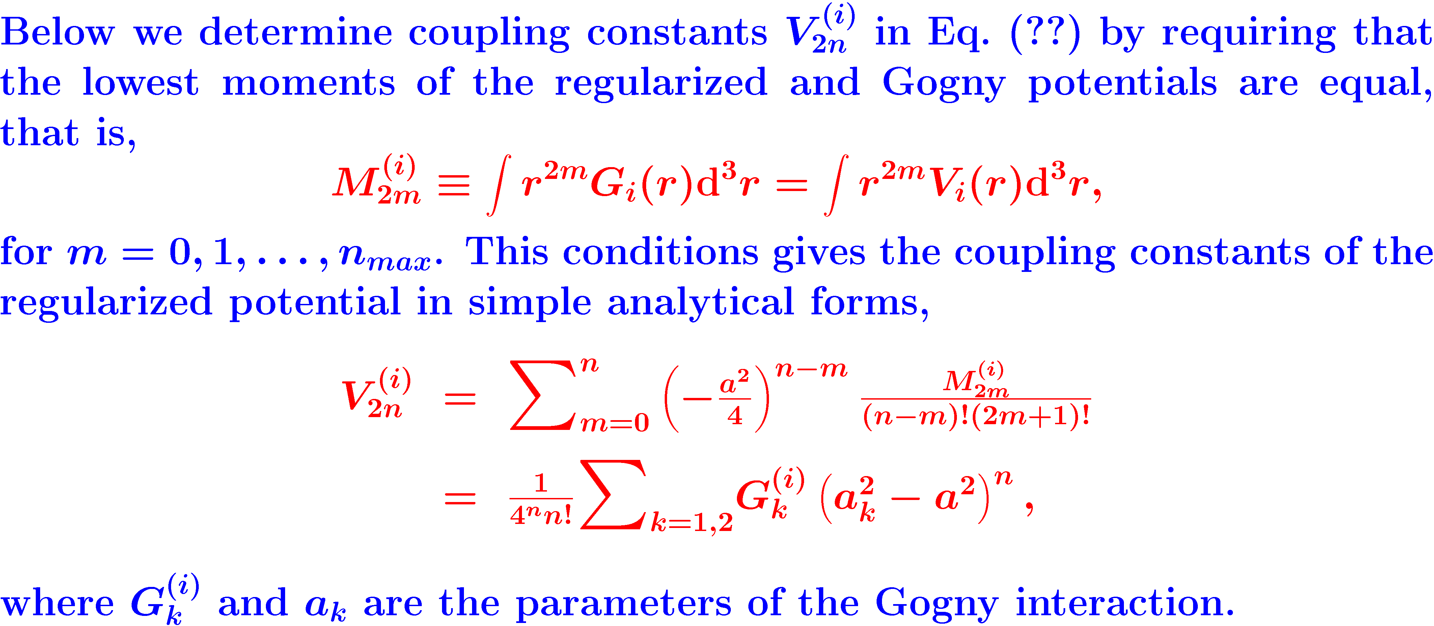
Regularized pseudopotentials
J.D, K. Bennaceur, F. Raimondi, J. Phys. G. 39, 125103 (2012)

Slide 21
Regularized pseudopotentials vs. Gogny
J.D, K. Bennaceur, F. Raimondi, J. Phys. G. 39, 125103 (2012)

