Slide 1





Level Lifetimes in ⁹⁴Zr from DSAM Measurements Following Inelastic Neutron Scattering
Steven W. Yates
3 June 2013

Slide 2




Previous ⁹⁴Zr(n,n′γ) Results
Recent studies [1] of ⁹⁴Zr with the (n,n′γ) reaction and an enriched ⁹⁴ZrO₂ scattering sample revealed an interesting and unique result — i.e.,
1671.5
[1] Elhami et al., Phys. Rev. C 75, 011301(R)(2007); Phys. Rev. C 78,
064303 (2008).
4⁺
0⁺
919
7.8(7) W.u.
4.9(11) W.u.
“Anomalous behavior”
⁹⁴Zr

Slide 3

New Measurements
Recent preliminary studies of ⁹⁴Zr with electron scattering indicate a conflicting result.
N. Pietralla et al., Technical University of Darmstadt

Slide 4

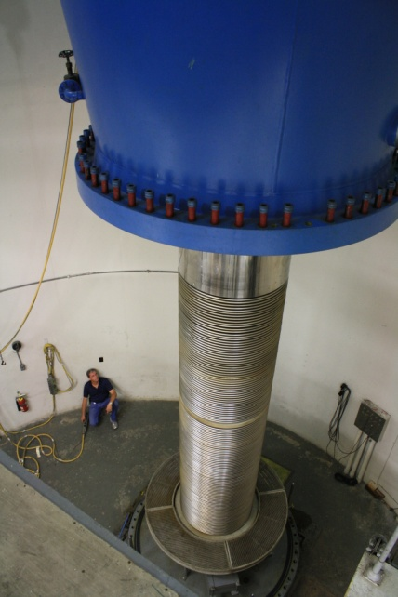
Inelastic Neutron Scattering (INS)
(n,n'γ) reaction
Monoenergetic neutrons created by:
  Target cell of ³H₂ gas and accelerator produced protons – 7-MV Van de Graaff accelerator
Q = -0.764 MeV
Scattering sample
³H₂ (g)
p
n
Mo foil

Slide 5
Inelastic Neutron Scattering
n’
n
γ
E**
Populate levels up to the neutron energy (E_{n})
E*
Notes:
Populate levels up to the neutron energy

Slide 6
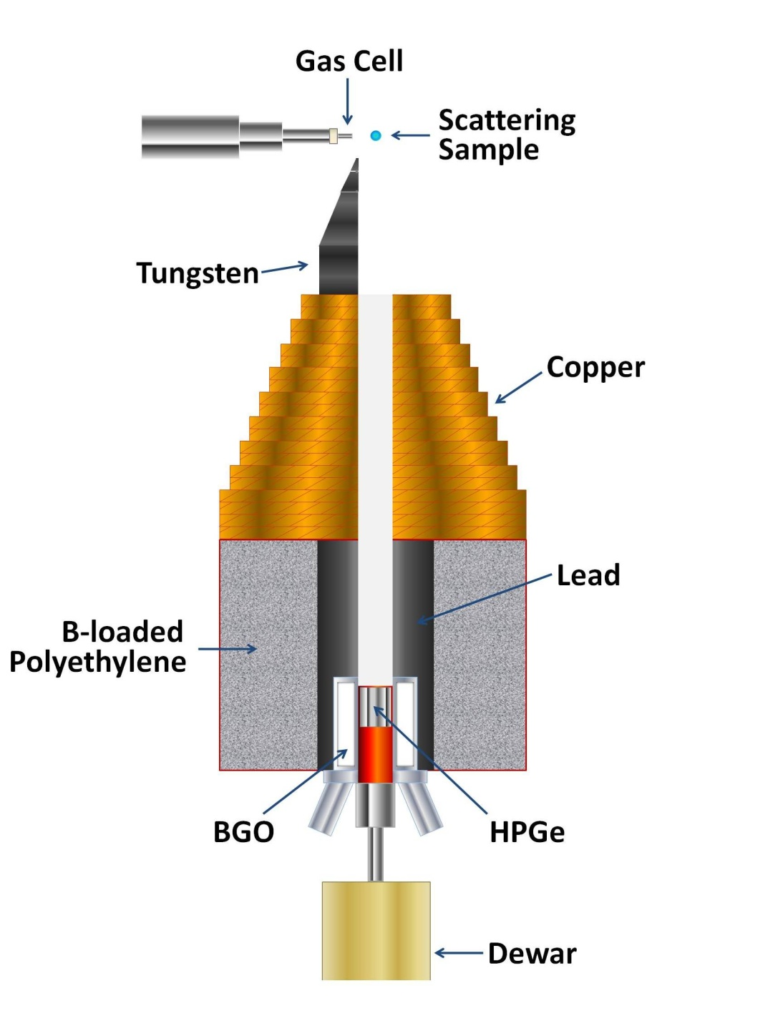
Experimental Setup
Excitation functions
  Vary neutron energy
  Detection angle constant
  Levels populated as a function of neutron energy
Angular distributions
  Constant neutron energy
  Detection angle varied from 40°-150°
  Level lifetimes, transition probabilities

Slide 7
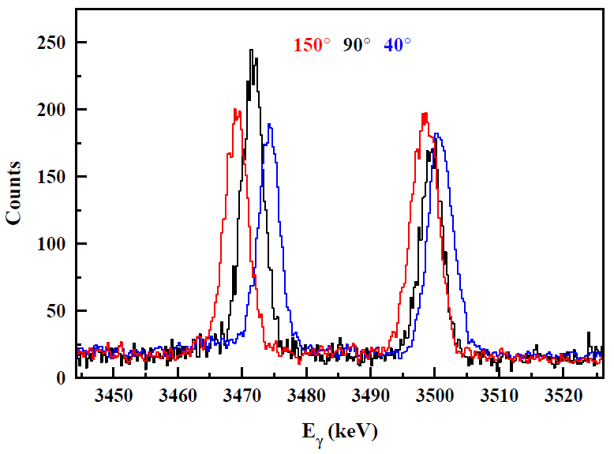
Level Lifetimes: Doppler-Shift Attenuation Method (DSAM)
180°
0°
γ
γ
Scattered neutron causes the nucleus to recoil.
Emitted γ rays experience a Doppler shift.
Level lifetimes in the femtosecond region can be determined.
τ = 7.6(9) fs
τ = 76(7) fs
T. Belgya, G. Molnár, and S. W. Yates, Nucl. Phys. A607, 43 (1996)

Slide 8
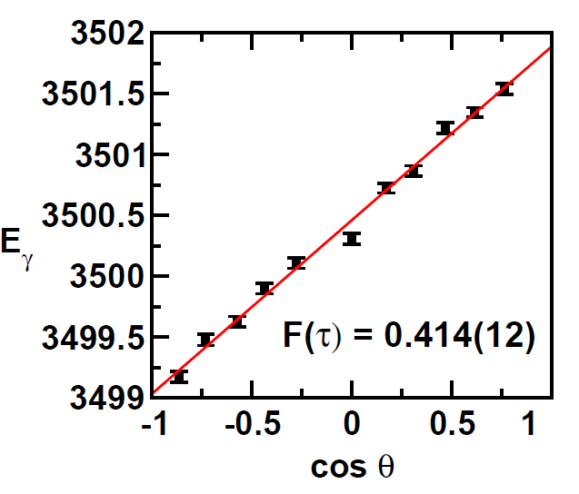
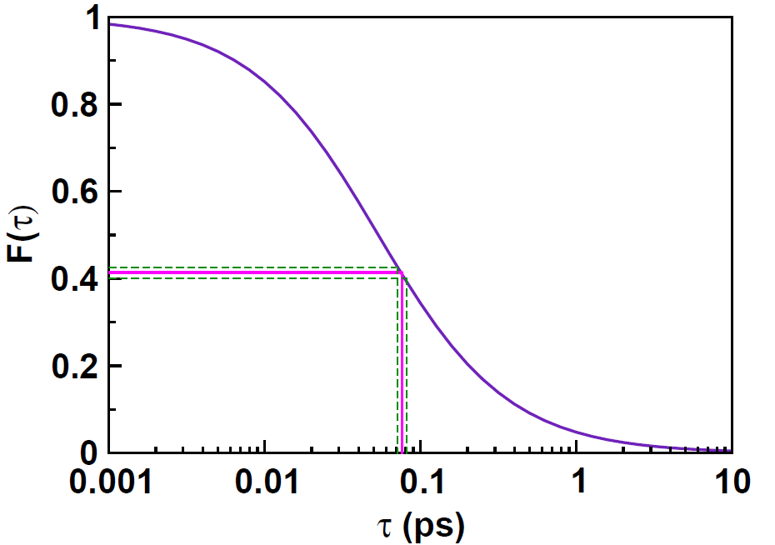
DSAM
Calculated curve
Completely
Doppler-
shifted
Not Doppler-
shifted
F(τ)_{exp}
τ
τ = 76(7) fs
K.B. Winterbon, Nucl. Phys. A246, 293 (1975).

Slide 9


Is there a problem with the lifetime?
Return to the analysis of Elhami’s data:
  Revealed a minor error in the density used
  Corrected result:
Re-analyze starting from the spectra:
  Result:
Re-measure with a metallic Zr scattering sample of natural abundance:
  Elhami et al. used an enriched (98.6%) ⁹⁴ZrO₂ sample.
  Any problems which may arise due to sample composition should be eliminated.
  Stopping powers are better understood for metal.
    Validity of Bragg’s Rule – additivity of stopping powers
  Natural sample allows comparison with other isotopes.

Slide 10
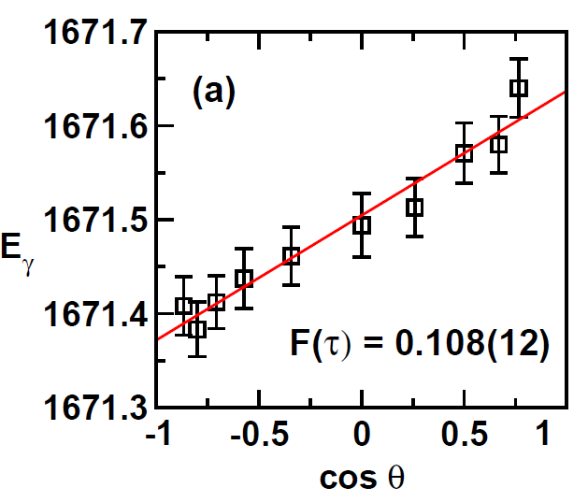


^{nat}Zr_{metal}(n,n′γ)
E_{n} = 2.0 MeV
Previous result:
Is this difference due to the oxide scattering sample?

Slide 11
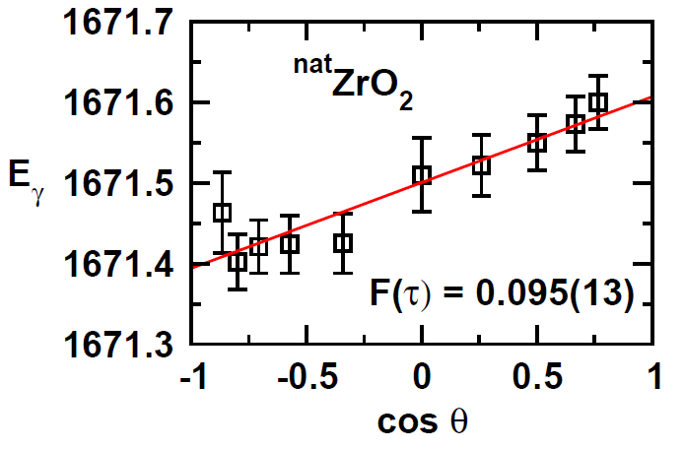

^{nat}ZrO₂(n,n′γ)
^{nat}Zr metal:
E_{n} = 2.0 MeV

Slide 12
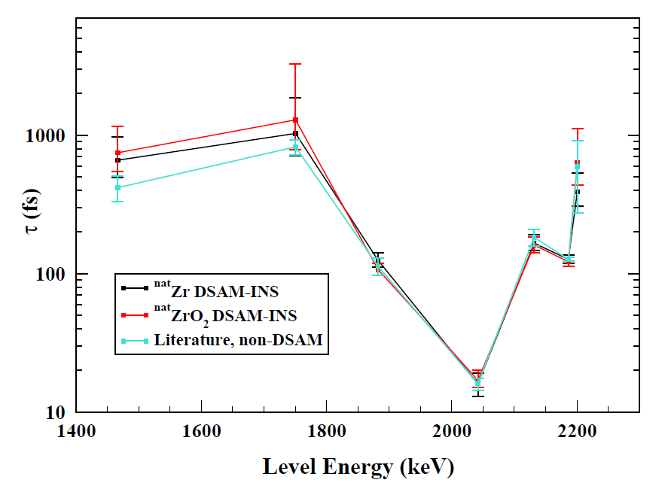
Literature/Metal/Oxide Comparison
E_{n} = 2.5 MeV
⁹¹Zr
⁹⁶Zr
⁹¹Zr
⁹¹Zr
⁹¹Zr
⁹⁰Zr
⁹¹Zr

Slide 13
What is the source of the discrepancy?
Stopping powers?
  No! The lifetimes from the metallic and oxide samples of natural abundance agree well.
Enriched ⁹⁴ZrO₂ sample composition?
  Is it really ZrO₂?
  Is it crystalline material?

Slide 14
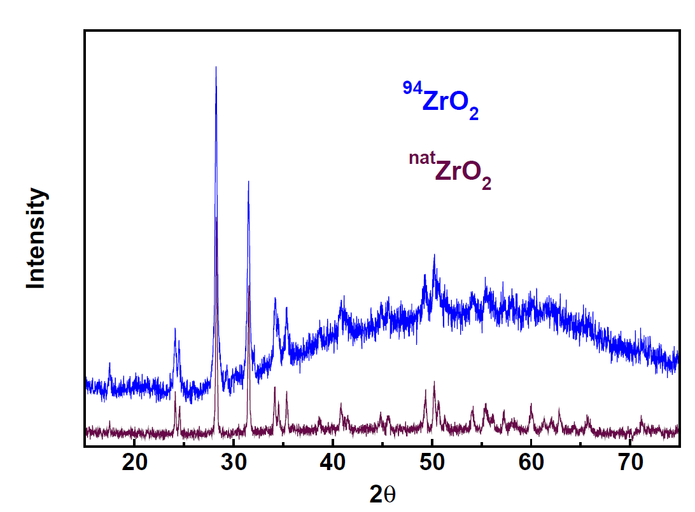
Powder X-ray Diffraction
Scherrer Equation
37 nm
gives size of crystalline domains.
55 nm
Monoclinic ZrO₂
Amorphous component?

Slide 15
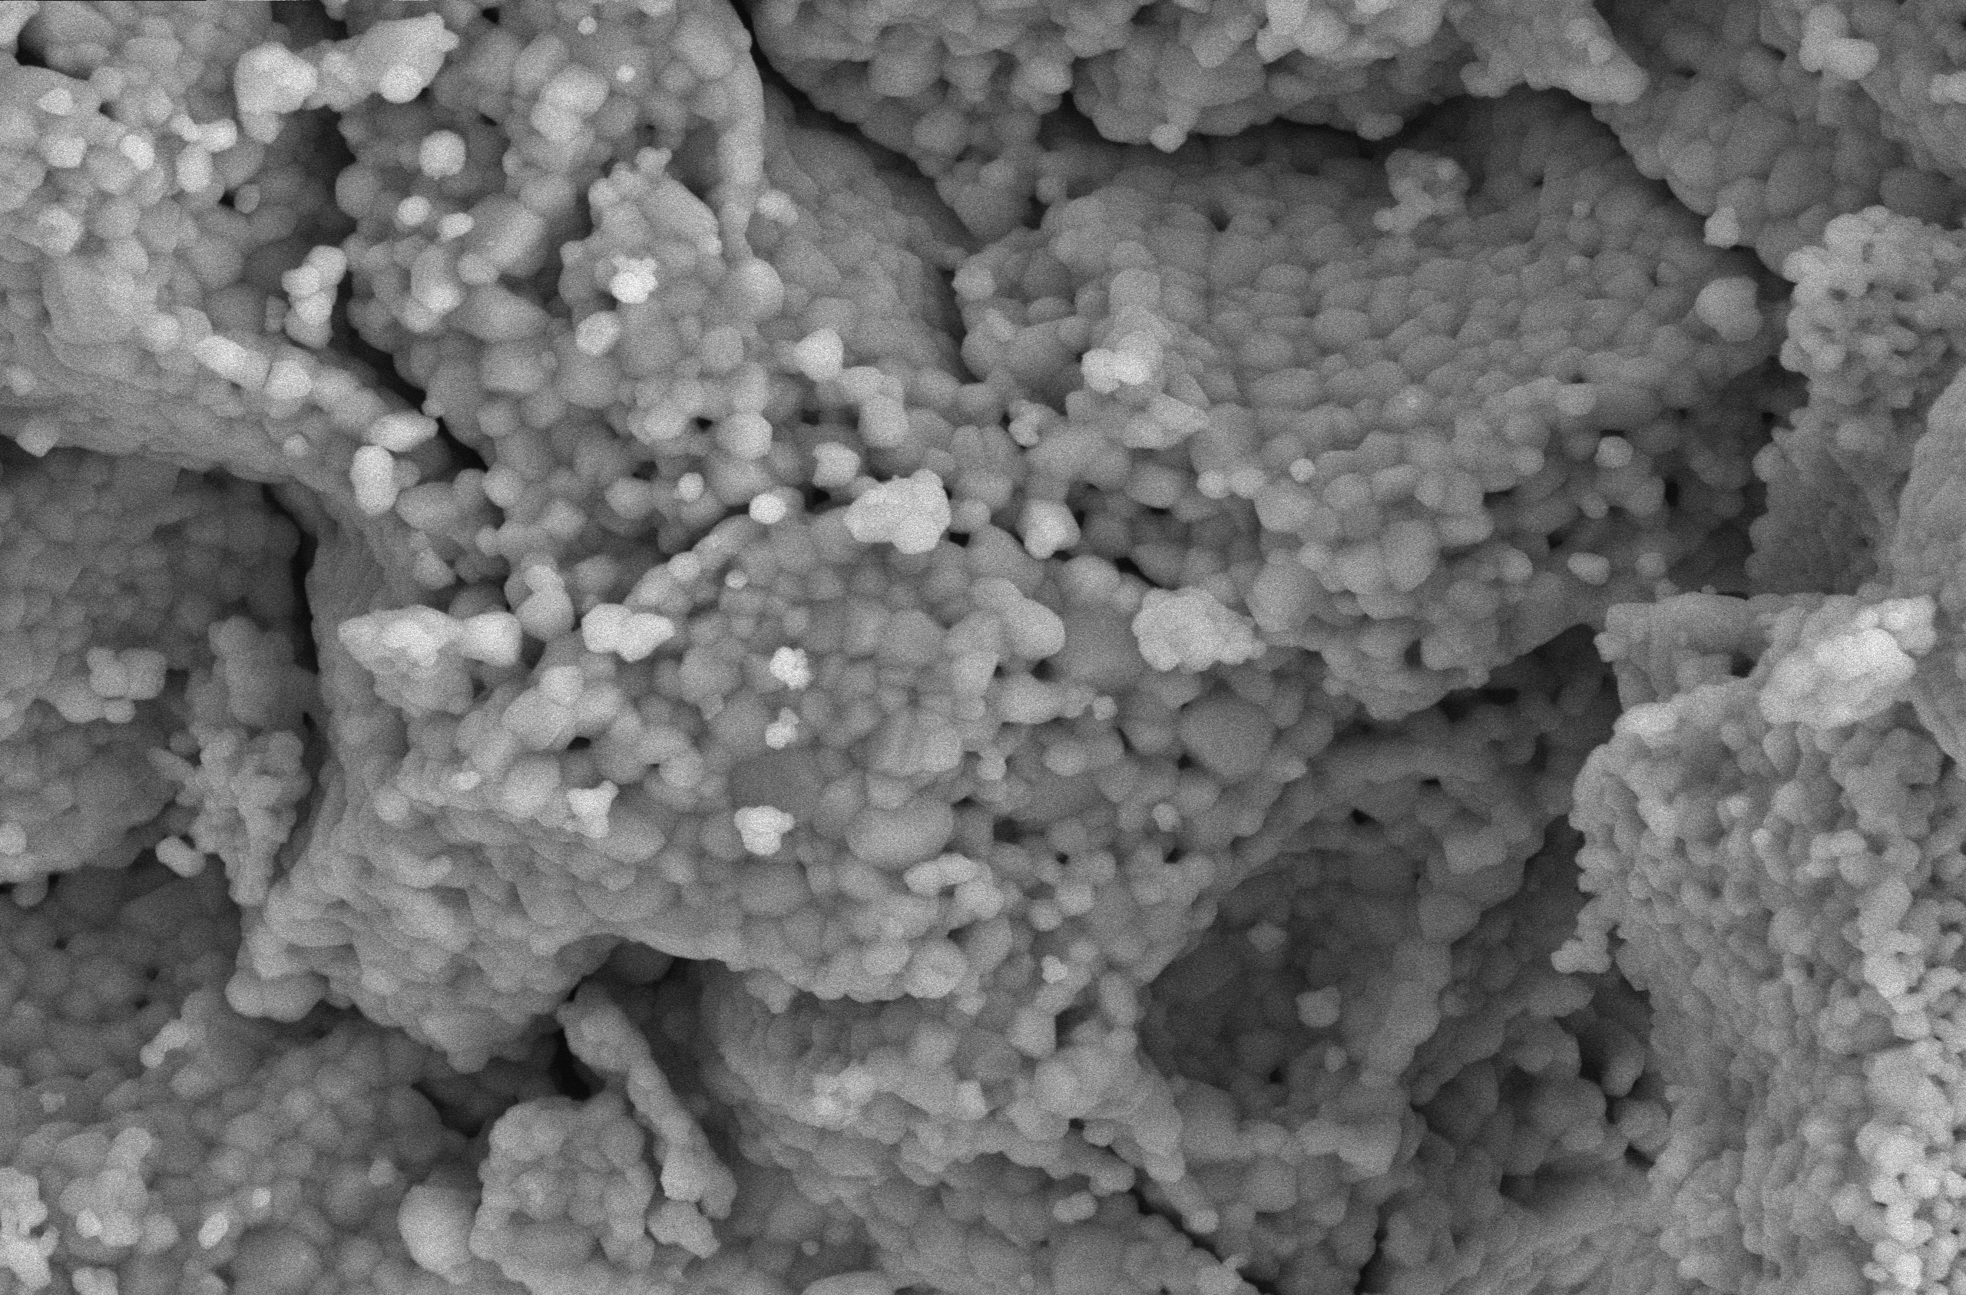
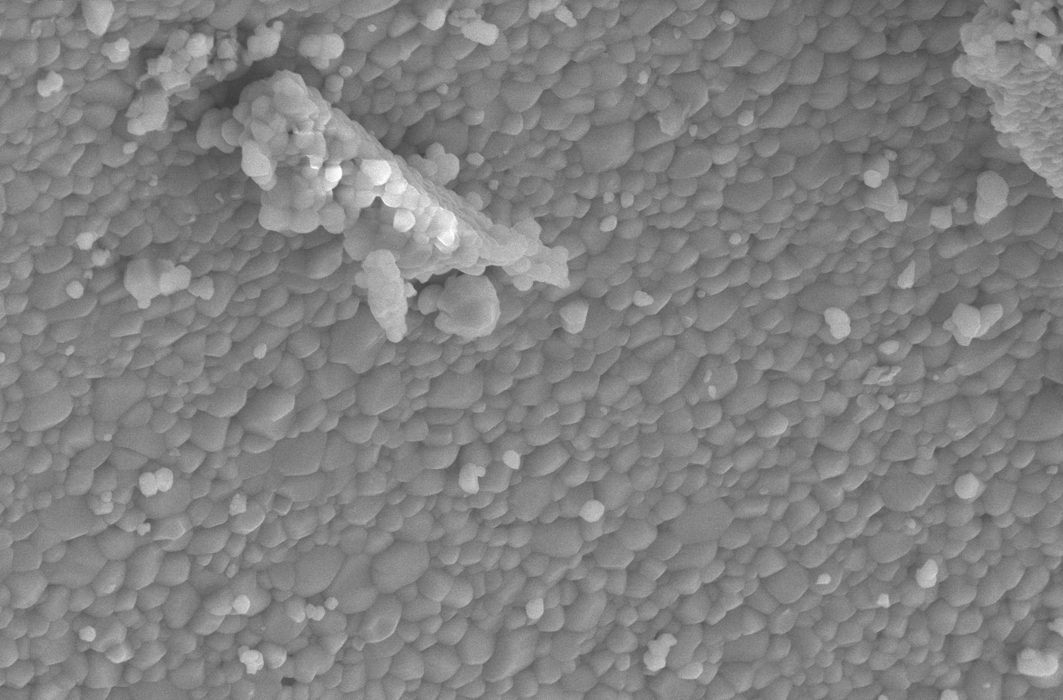
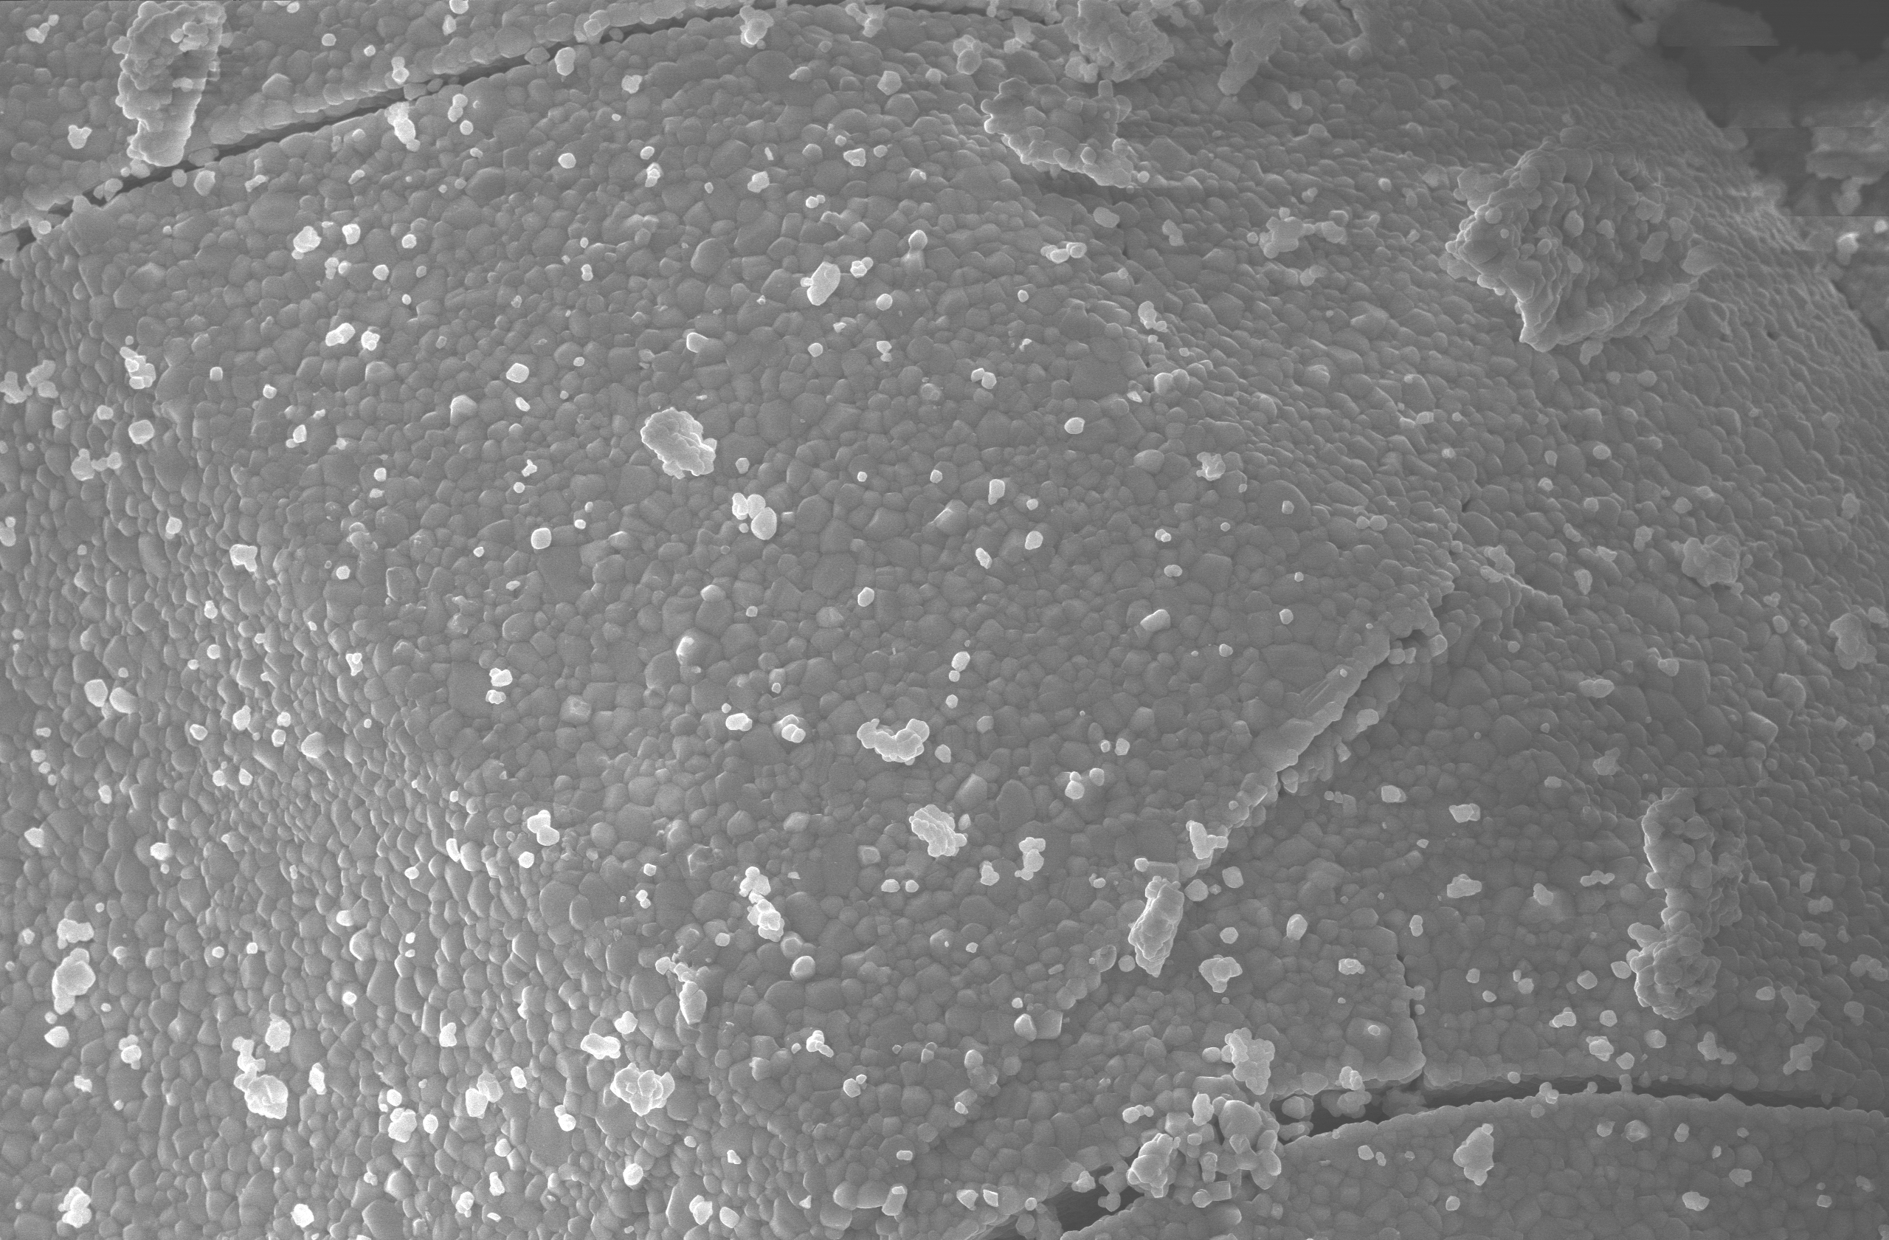
SEM ^{nat}ZrO₂
5 μm
5 μm
10 μm

Slide 16
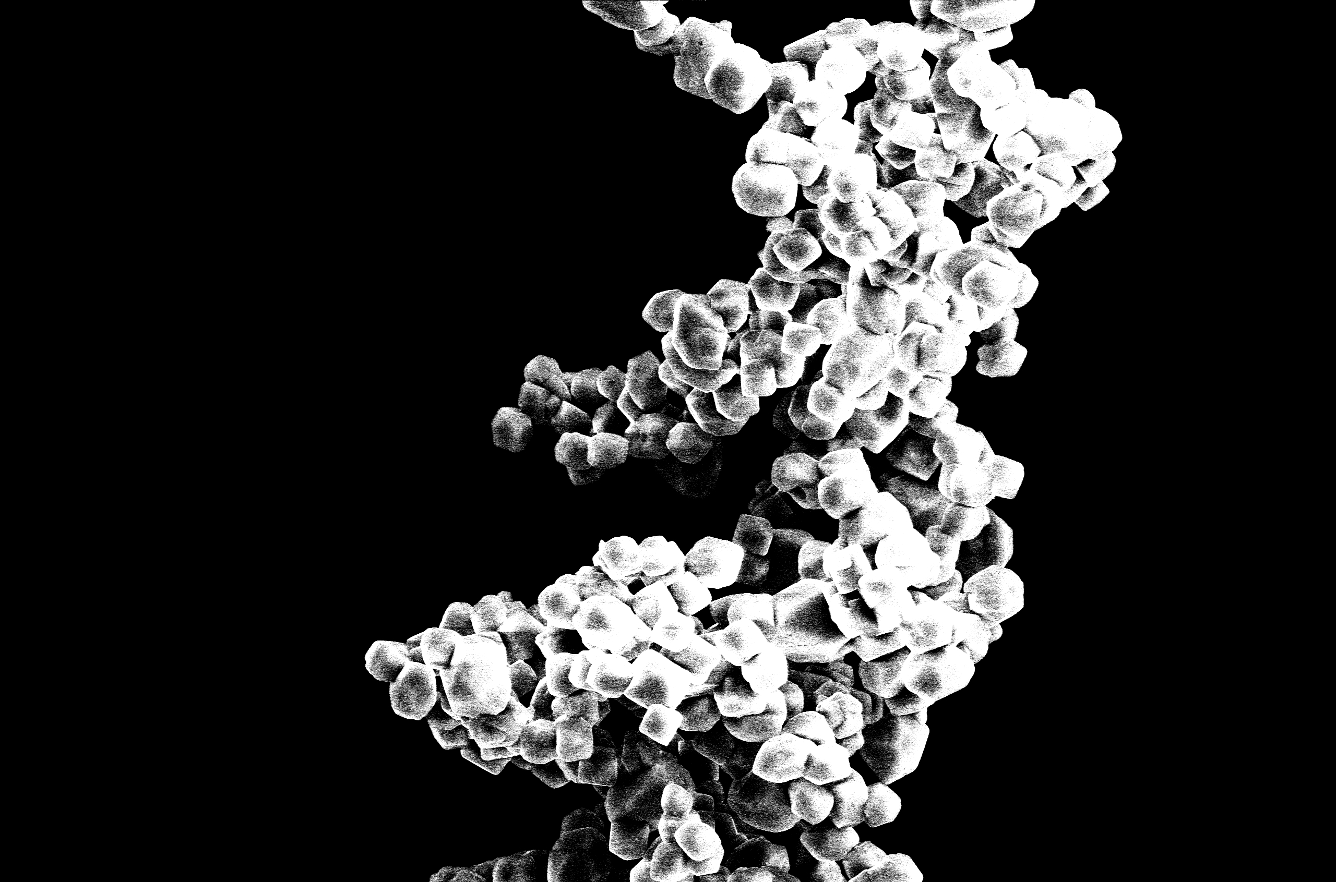
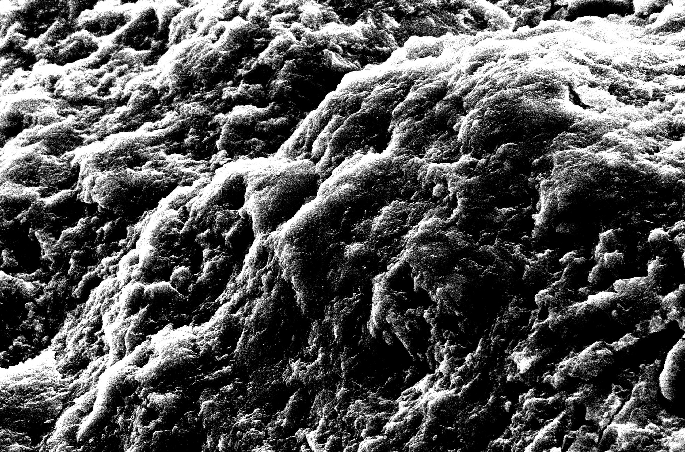
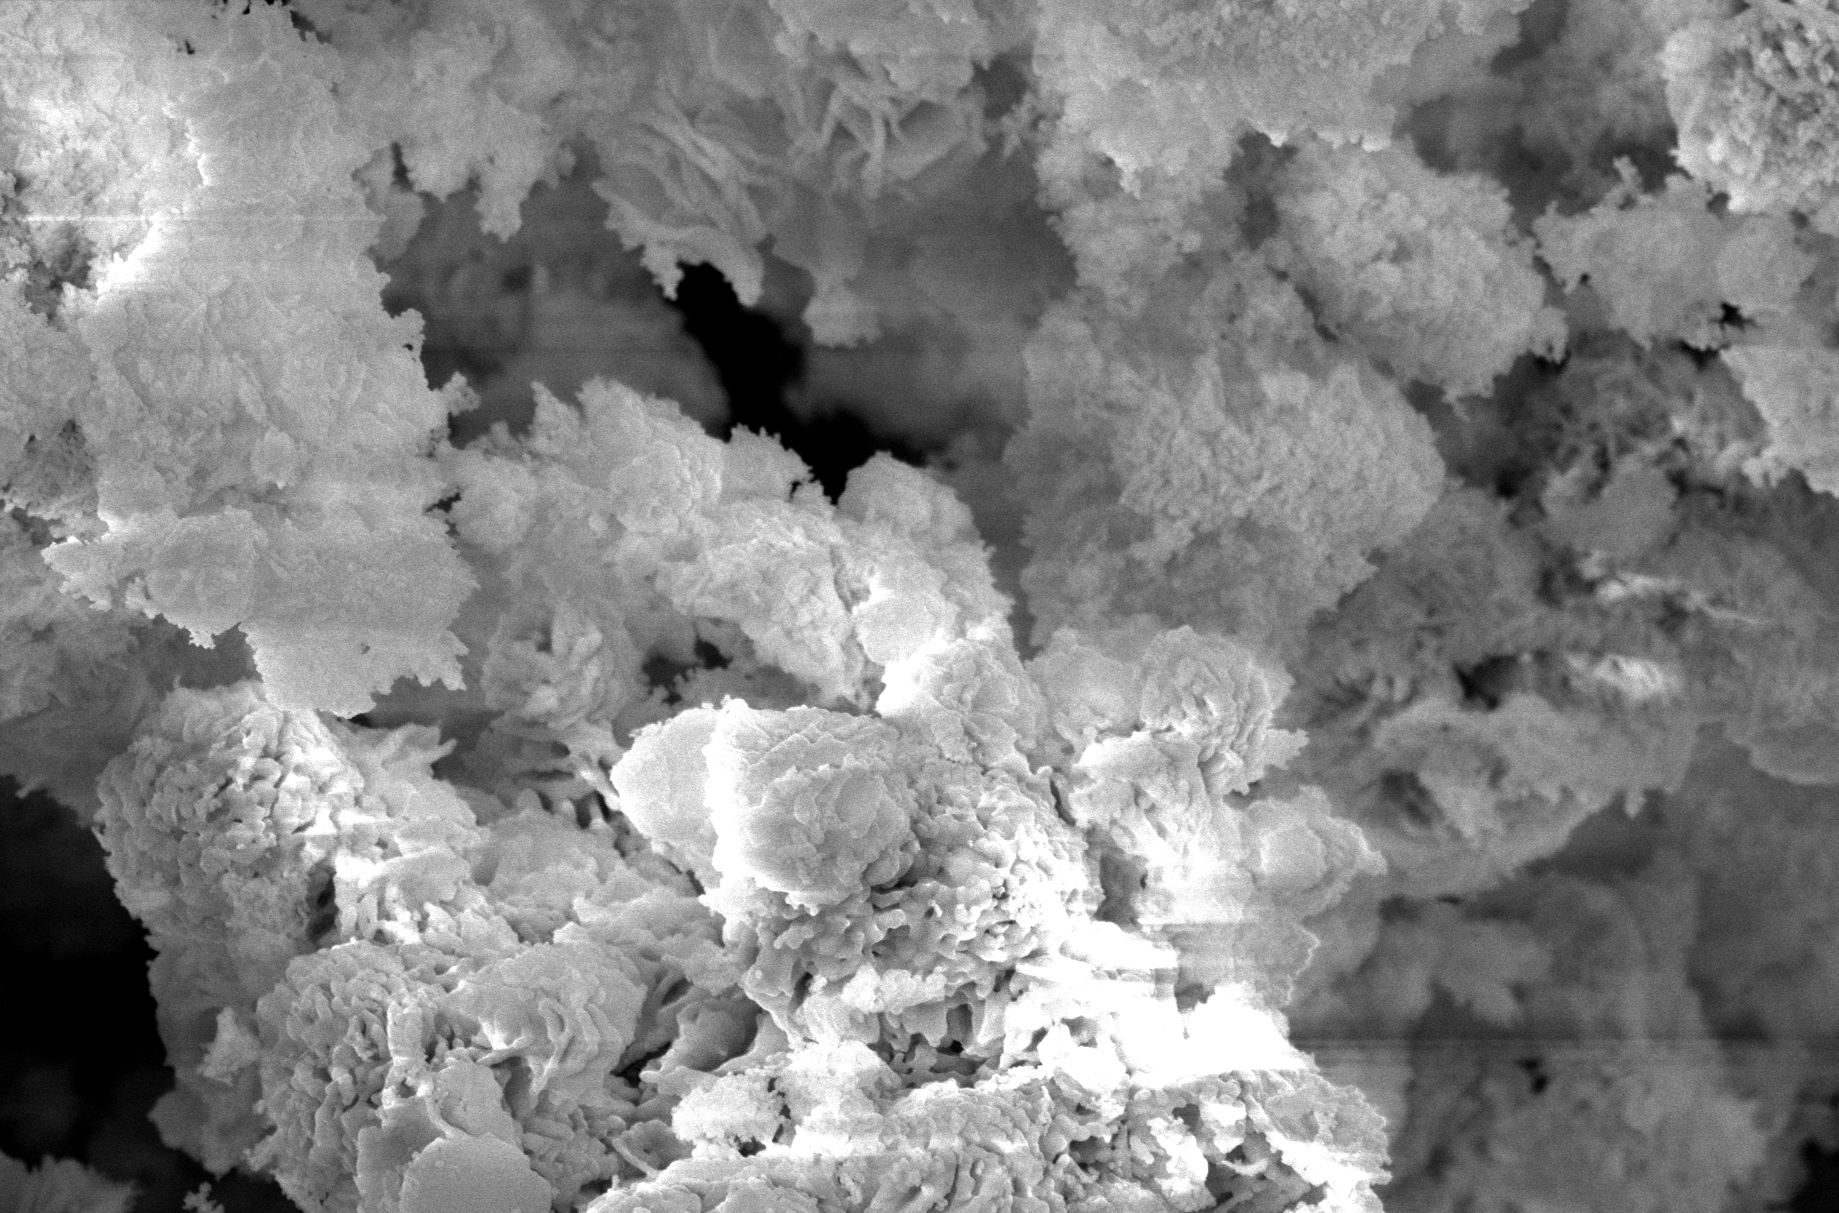
SEM ⁹⁴ZrO₂
10 μm
5 μm
Is the difference in lifetimes due to the amorphous component?
5 μm

Slide 17
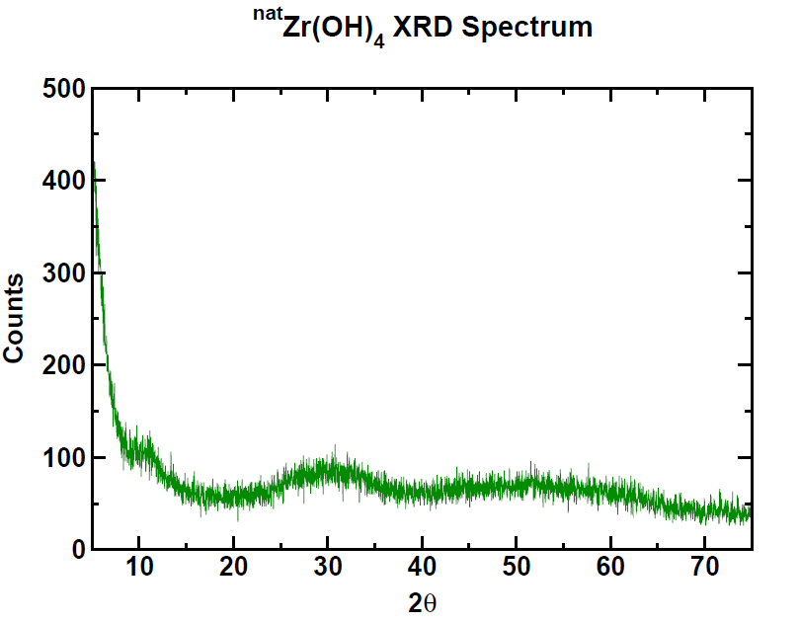
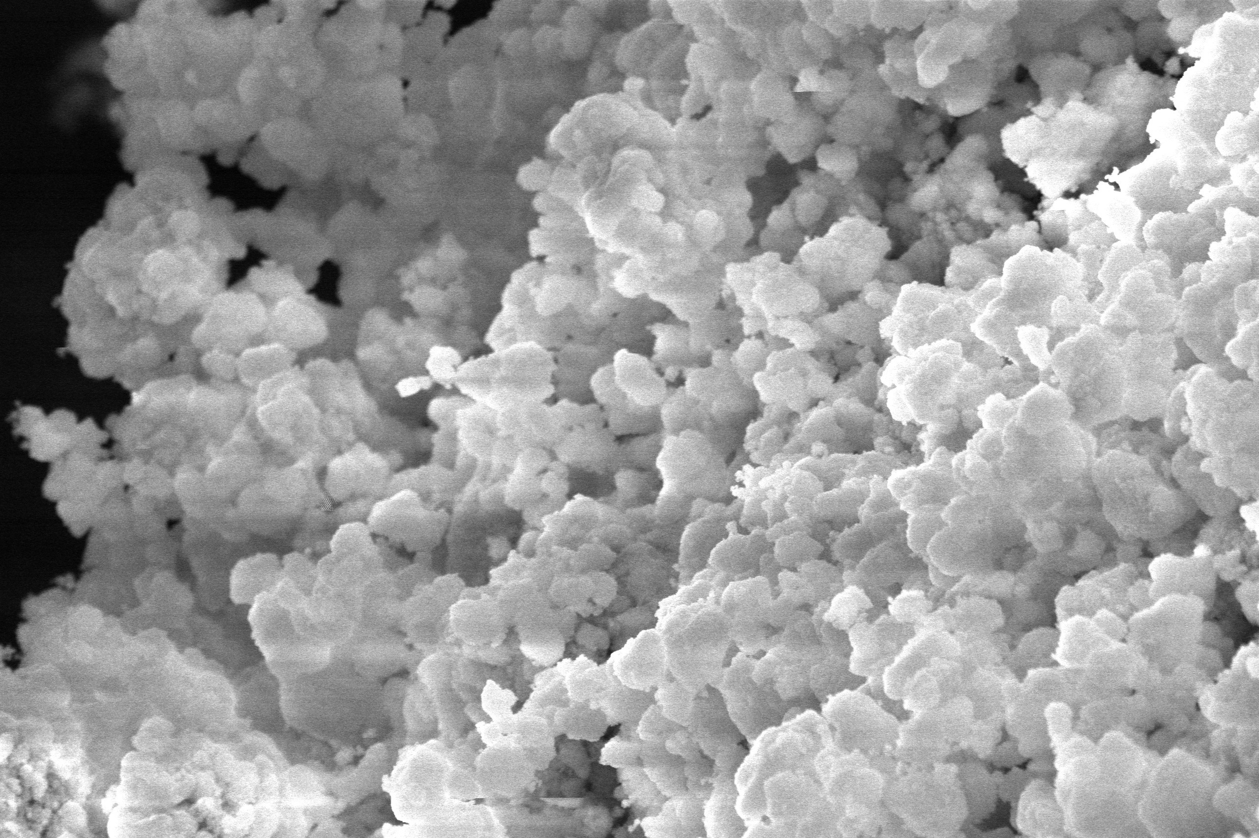
Effect of Amorphous Material: ^{nat}Zr(OH)₄
Powder X-ray Diffraction Spectrum
5 μm
5 μm

Slide 18
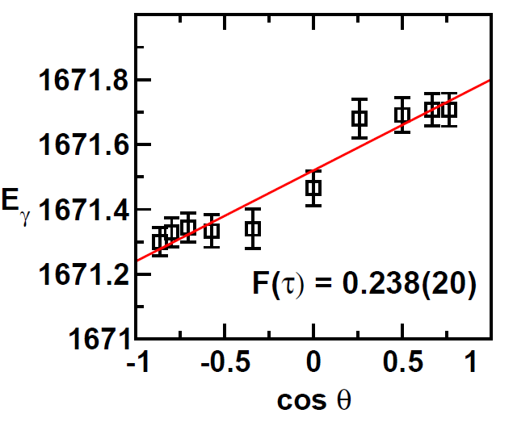
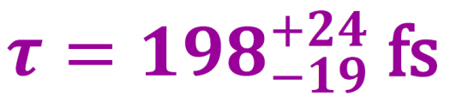
Effect of Amorphous Material: ^{nat}Zr(OH)₄
Previous result:
^{nat}Zr metal:
^{nat}ZrO₂:
E_{n} = 2.0 MeV
Why???

Slide 19
Effect of Particle Size
velocity
velocity
v(τ)
v(τ)
time
τ
time
τ
Large Particle Size
Recoil within single particle
Uniform stopping
Small Particle Size
Recoiling through multiple particles
Non-uniform stopping

Slide 20
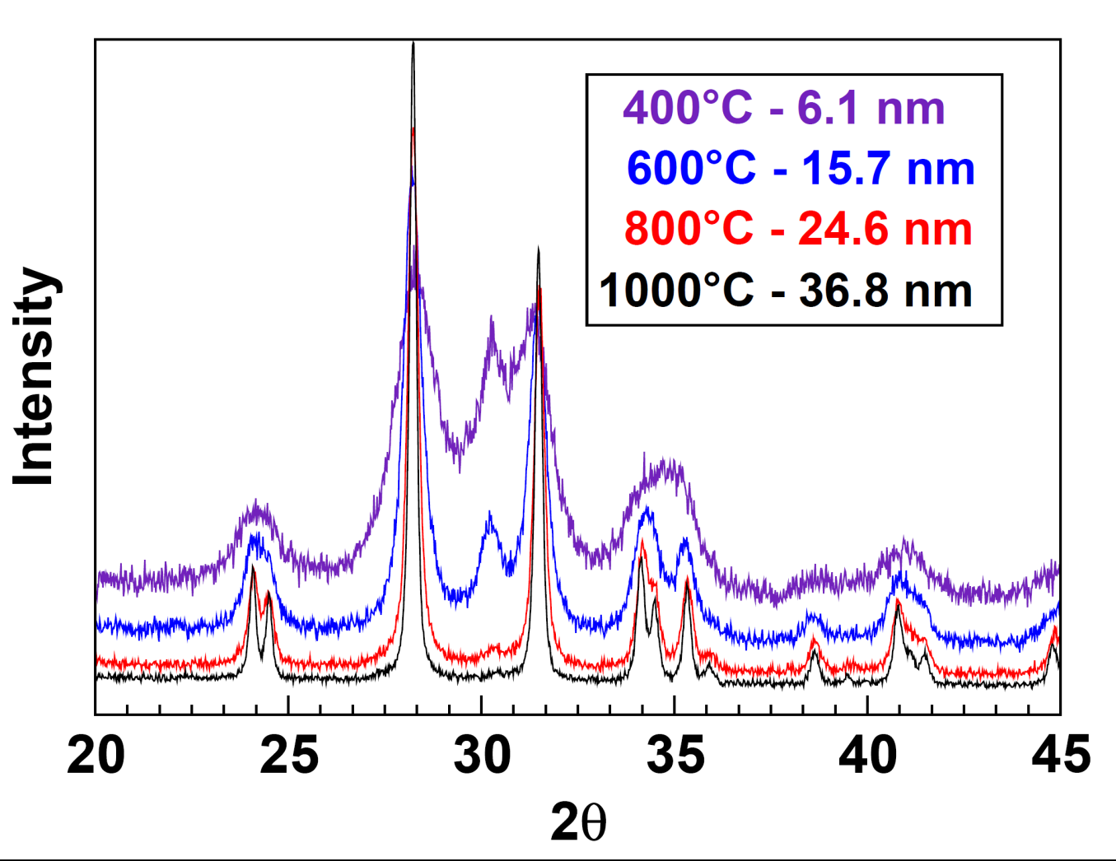
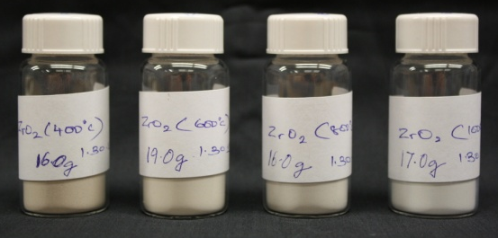
Preparation of ^{nat}ZrO₂ of Different Sizes
Heat
with B. H. Davis
of the UK Center for Applied Energy Research

Slide 21
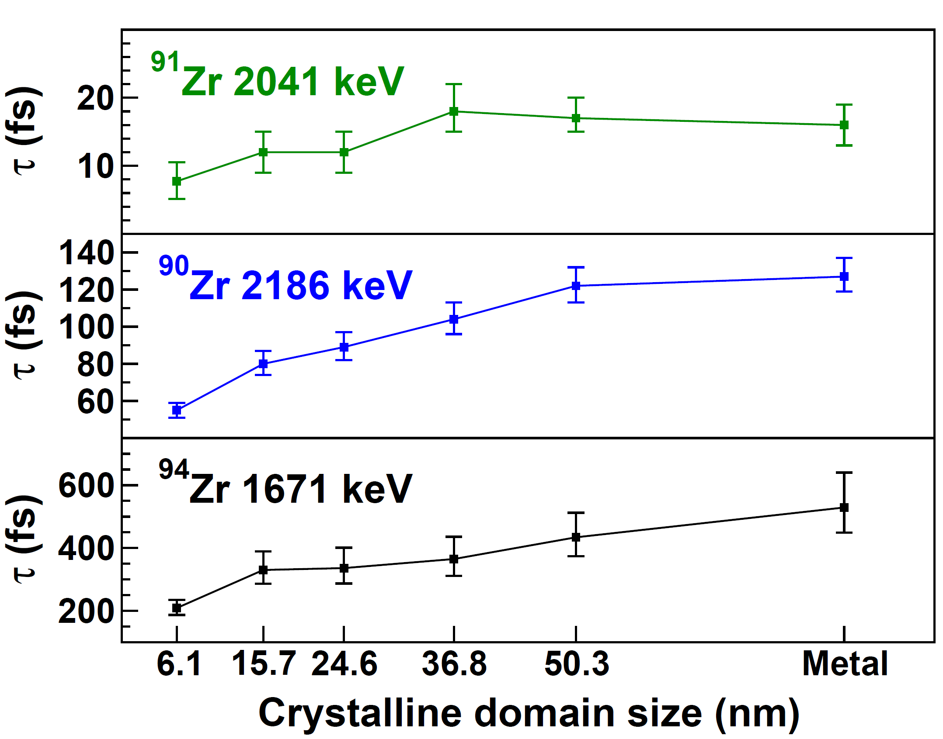
Lifetime as a Function of Domain Size
Average Recoil Distance ≈ 12 nm

Slide 22

New Results
(Metal/Oxide Average)
1671.5
4⁺
0⁺
919
3.9(3) W.u.
4.9(11) W.u.
S. Raman et al.
ORNL
⁹⁴Zr
?

Slide 23
New Results
(Metal/Oxide Average)
1671.5
4⁺
0⁺
919
3.9(3) W.u.
4.4(2) W.u.
V. Werner, et al.
Yale University
(preliminary)
⁹⁴Zr
?

Slide 24

What is the 1671.5-keV 2⁺ state?
Elhami et al., Phys. Rev. C 75, 011301(R) (2007)
mixed-symmetry state
1671.5
2
M1
0.17
$$μ_{N}^{}$$
4⁺
0⁺
919
3.9 W.u.
⁹⁴Zr

Slide 25
What is the 1671.5-keV 2⁺ state?
4⁺
2330
Chakraborty et al.,
Phys. Rev. Lett.
110, 022504 (2013)
34 W.u.
shape coexistence
1671.5
19 W.u.
4⁺
0⁺
919
⁹⁴Zr

Slide 26
Acknowledgments
UK Collaborators:
E. E. Peters
A. Chakraborty
B. P. Crider
A. Kumar
M. T. McEllistrem
F. M. Prados-Estévez
J. R. Vanhoy
Special Thanks to:
B. H. Davis – ZrO₂ preparation
M. K. Gnanamani – ZrO₂ preparation
L. Ji – XRD
M. Scheck – private communication
V. Werner – private communication
J. Ye – SEM
Funding:
Thank You!
This material is based upon work supported by the U.S. National Science Foundation under Grant No. PHY-0956310.

Slide 27
What is the 1671.5-keV 2⁺ state?
4⁺
2330
Chakraborty et al.,
Phys. Rev. Lett.
110, 022504 (2007)
34 W.u.
1671.5
2
19 W.u.
0.17
$$μ_{N}^{}$$
4⁺
Elhami et al.,
Phys. Rev. C
75, 011301(R)
(2007)
0⁺
919
3.9 W.u.
⁹⁴Zr

Slide 28
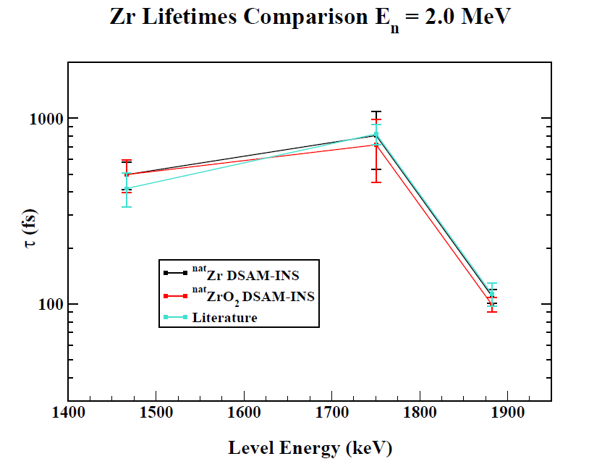

Slide 29
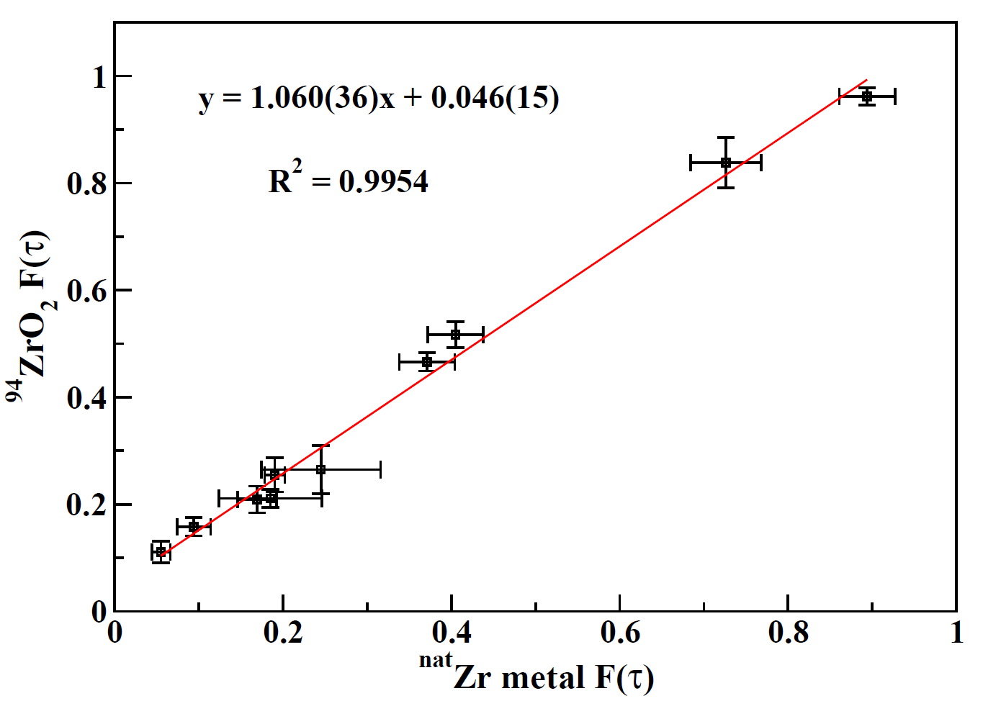
Correcting the Previous Measurement
E_{n} = 3.5 MeV

