Slide 1
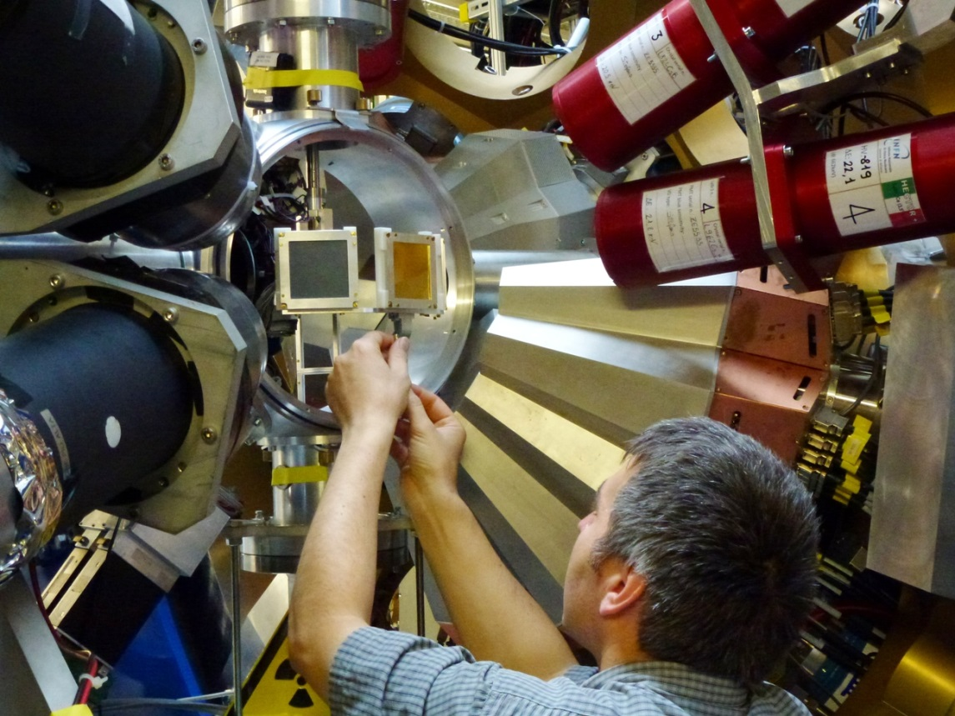



On the Road to FAIR:
First Operation of AGATA in PreSPEC at GSI
Norbert Pietralla, TU-Darmstadt, & academic leader of GSI γ-spectroscopy group
on behalf of the PreSPEC-AGATA collaboration
DAAD
DAAD
BMBF
Thanks to M. Reese, TU Darmstadt,
for help on preparing this presentation

Slide 2
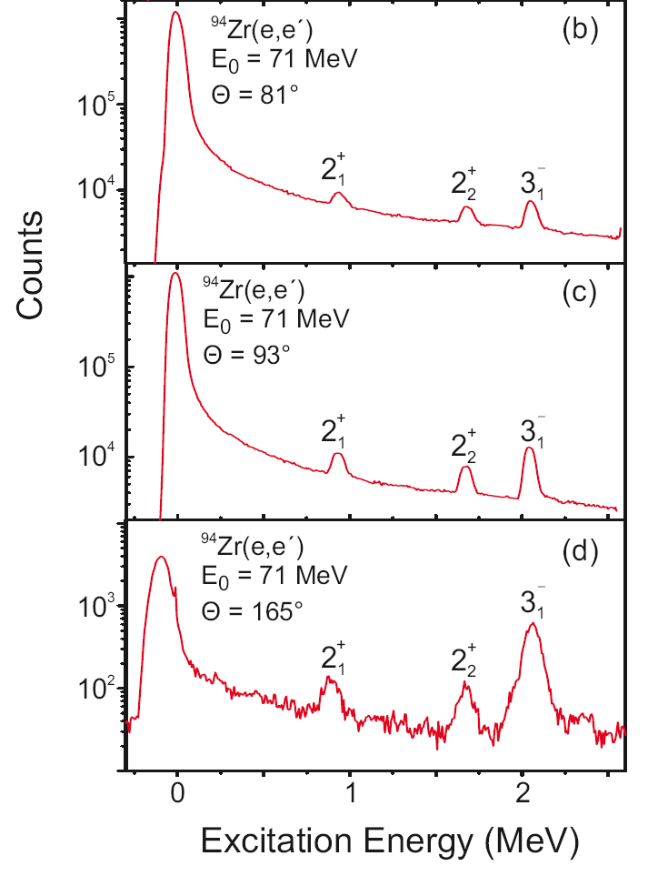
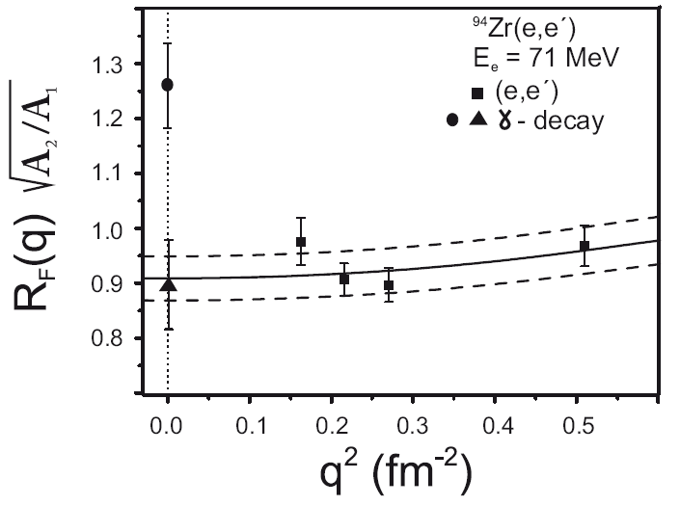

A word to Steve on ⁹⁴Zr!
Recent electron scattering at S-DALINAC
A. Scheikh Obeid, thesis, TU Darmstadt 2013
Our B(E2)-ratio from (e,e’) at S-DALINAC
Steve’s new value

Slide 3
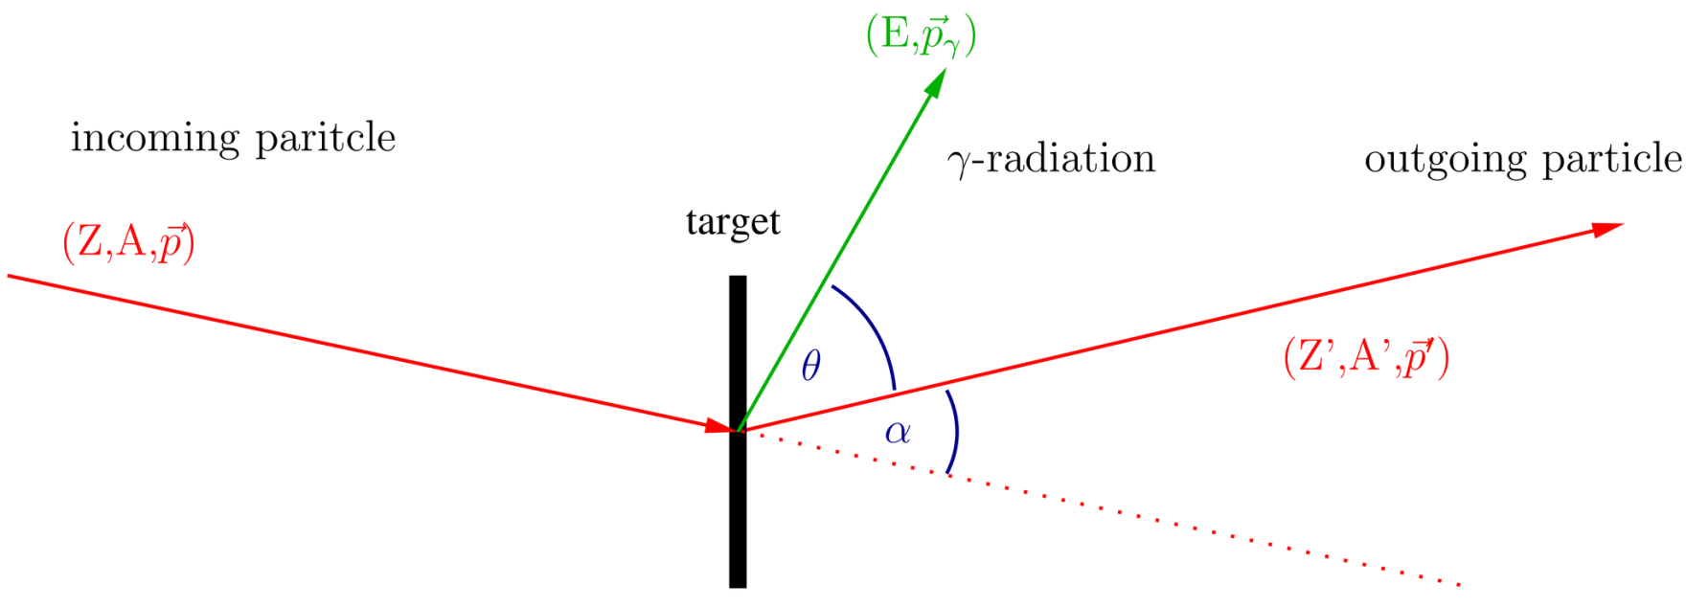
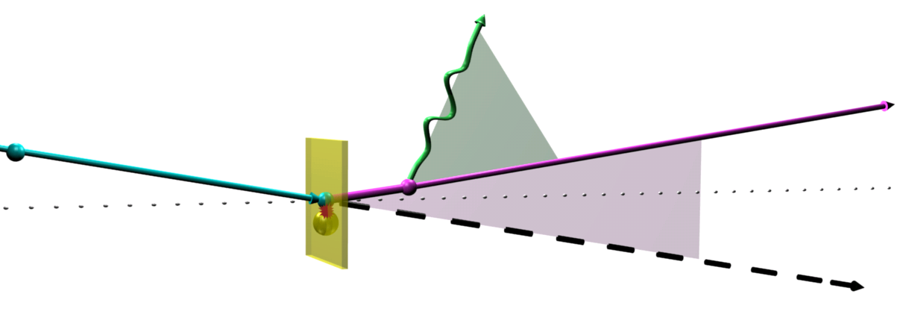
In-beam ejectile γ-spectroscopy the generic challenge at RIBs
Doppler shifted
γ-radiation
incoming particle
(Z, A, v)
Outgoing particle
(Z’, A’, v’)
θ
α
optical axis
reaction
target nucleus
Challenges
Incoming particle selection and identification: here FRS @ GSI
v/c ≈ 0.5: large Doppler-shift of γ-radiation
High accuracy in α and θ → granular detectors
Outgoing particle identification: LYCCA
Detection of γ-radiation: AGATA

Slide 4
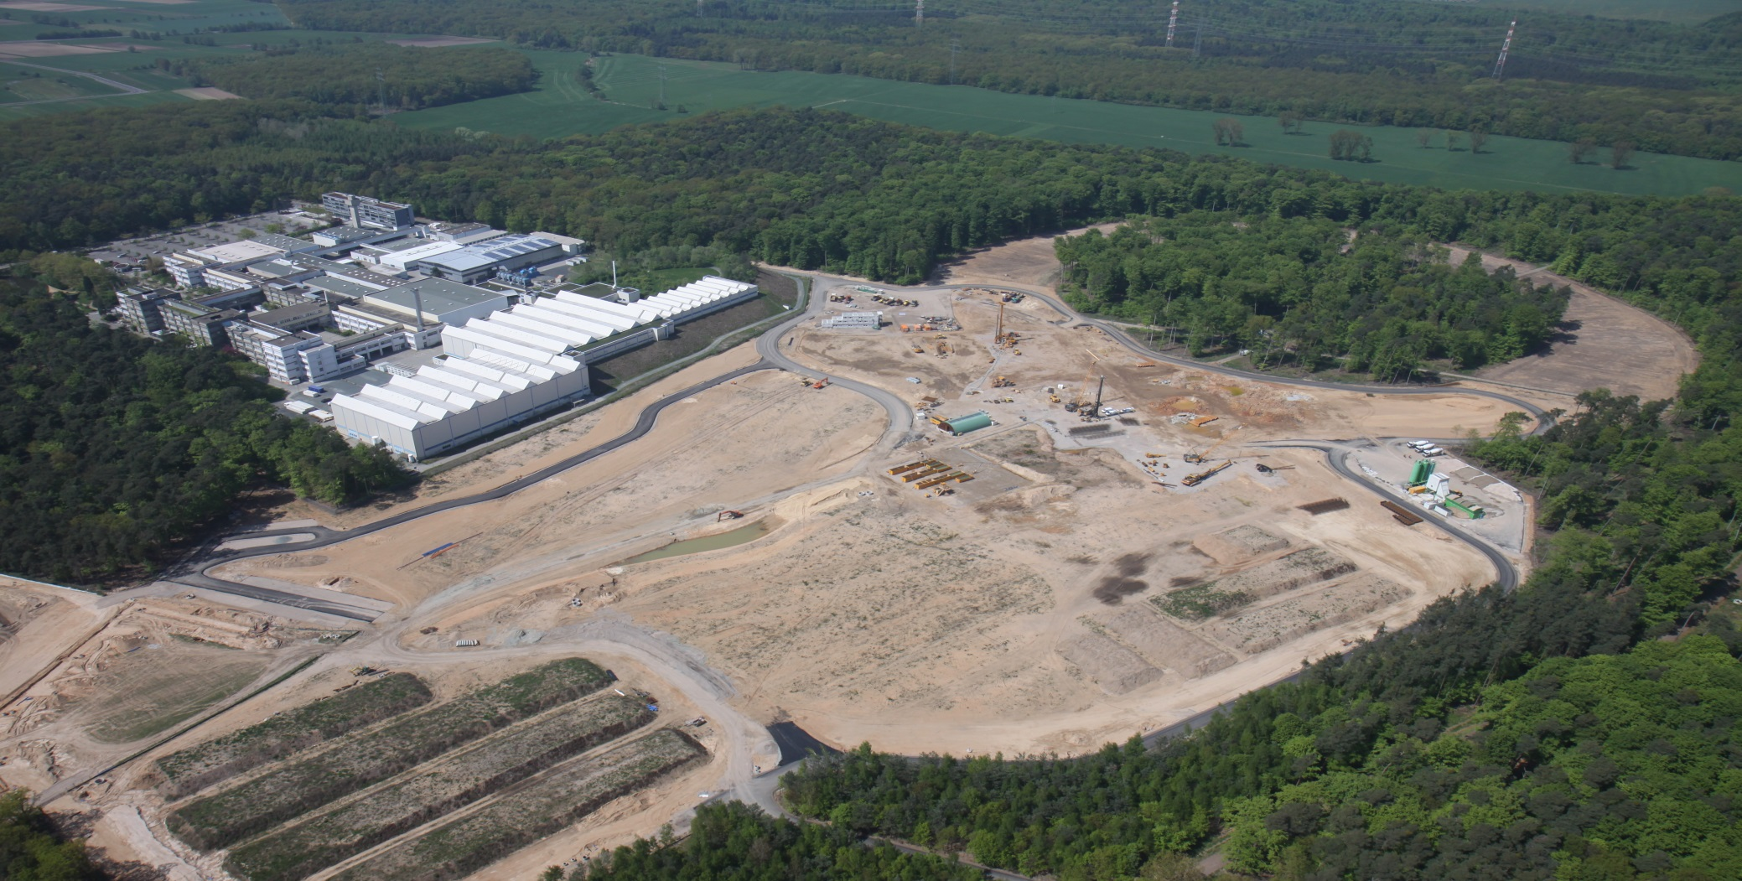
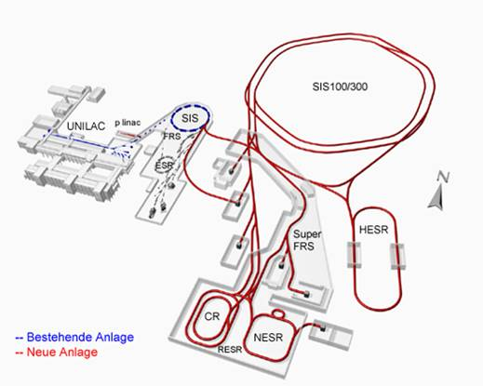
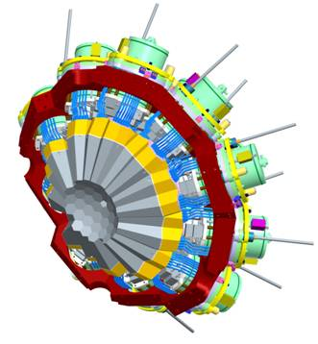

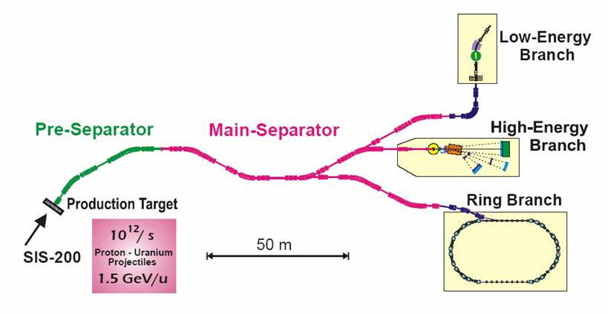

Now: Towards HISPEC @ FAIR
Dino Bazzacco, tomorrow 9 am
RIBs at relativistic energies:
High-Energy Branch: 300-1500 MeV/u
Low-Energy Branch: 0-150 MeV/u
Ring Branch: cooling and storing in ESR
Gamma Spectroscopy:
HISPEC / DESPEC
NuSTAR ExperimentsNuSTAR (Nuclear Structure, astrophysics and Reactions) encompasses all experiments that will be benefiting from the unique possibilities opened up through the Super-FRS, which will deliver an unprecedented range of radioactive ion beams (RIBs). The experiments will exploit beams of different energies and characteristics at three branches; the high-energy branch utilizes the RIBs at relativistic energies (300-1500 MeV/u) as created in the production process, the low-energy branch aims at using beams in the range of 0-150 MeV/u whereas the ring branch will exploit cooled and stored beams in the storage ring NESR. These projects are gathered within the NuSTAR collaboration and shares development and other synergies across the projects.
Picture from 5. Apr 2013 (http://www.fair-center.de)

Slide 5
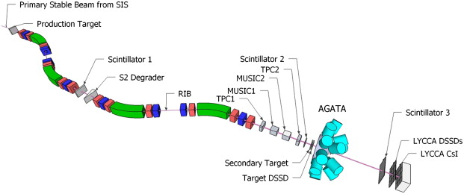
While waiting for FAIR - HISPEC:
PreSPEC @ GSI
Gamma-ray detection
2011: 105 HPGe detectors (Euroball)
BaF Scintillators (HECTOR)
2012: HPGe array using pulse-
shape analysis and γ-ray
tracking techniques (AGATA)
BaF&LaBr scintillators (HECTOR+)
FRS
particle selection: Bρ-ΔE-Bρ
Particle identification:
TPC tracking detectors
ToF measurement
Energy-loss measurement
LYCCA
Outgoing particle tracking and identification:
Z identification via E-ΔE
Mass identification via E-ToF

Slide 6
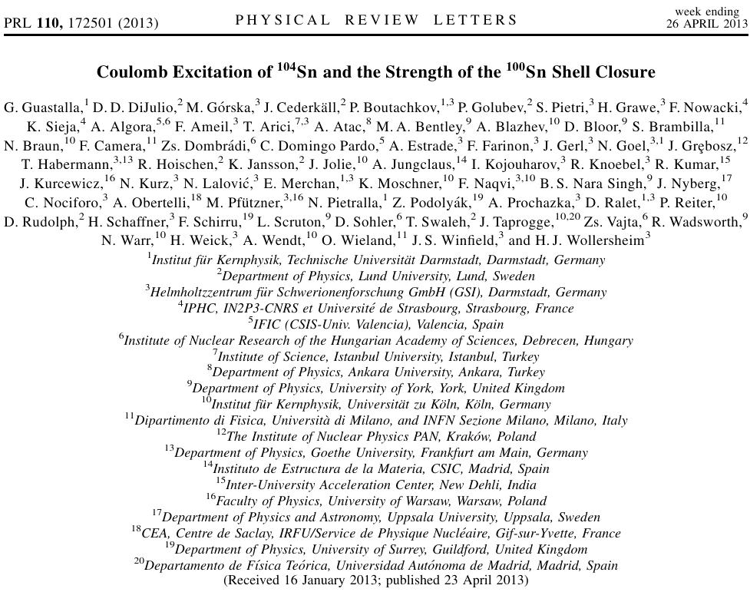
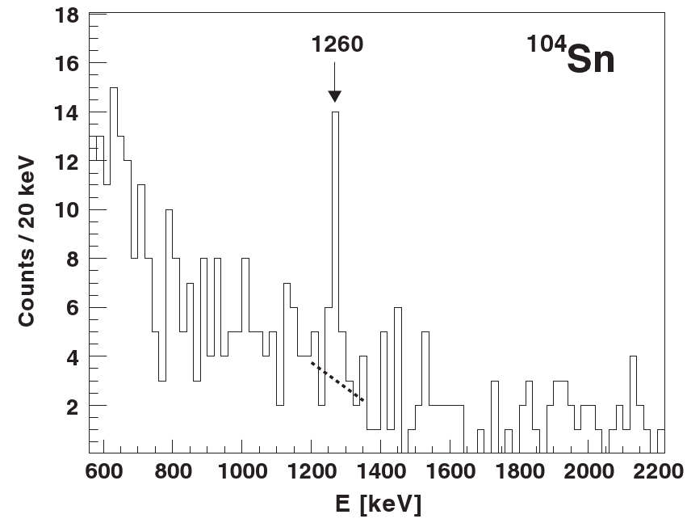
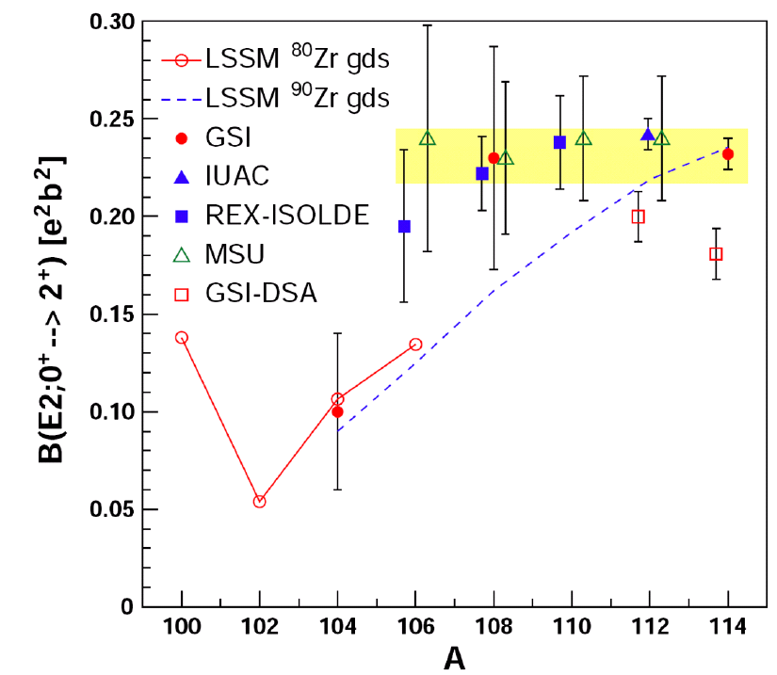
One of first PreSPEC results
Coulomb excitation of ¹⁰⁴Sn
G.Guastalla et al., PRL 110, 172501 (2013)

Slide 7
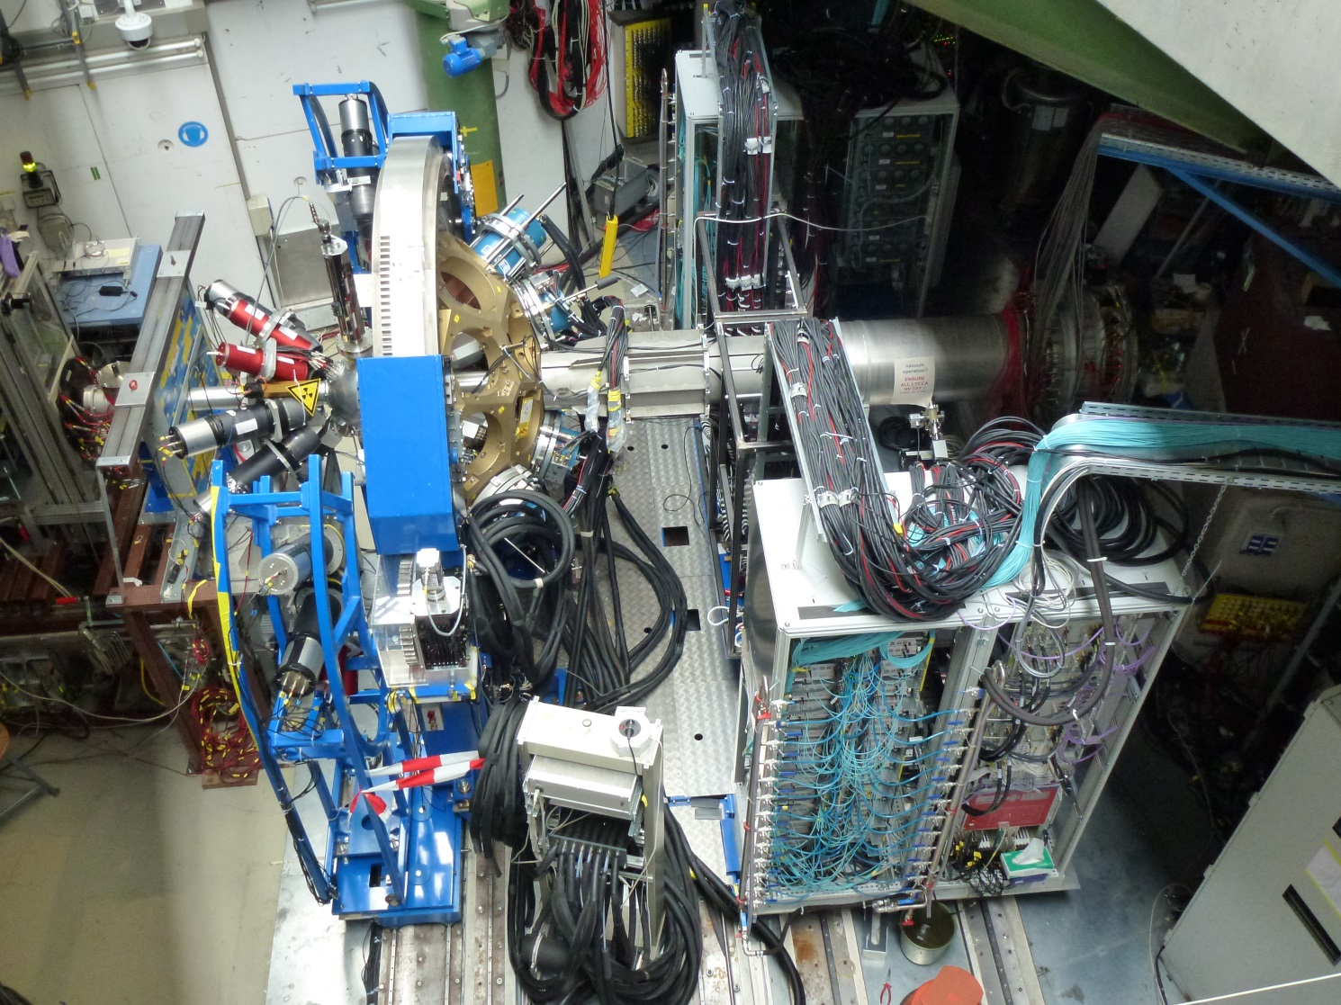
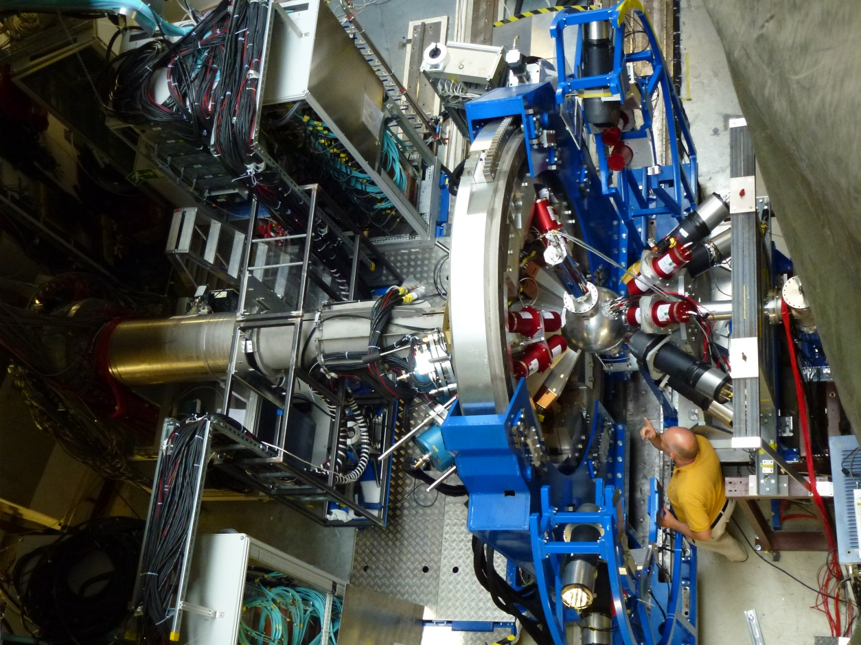
PreSPEC-AGATA in 2012
AGATA
LYCCA
RIB from FRS
HECTOR+
Set-up:
AGATA collaboration
GSI γ-group

Slide 8
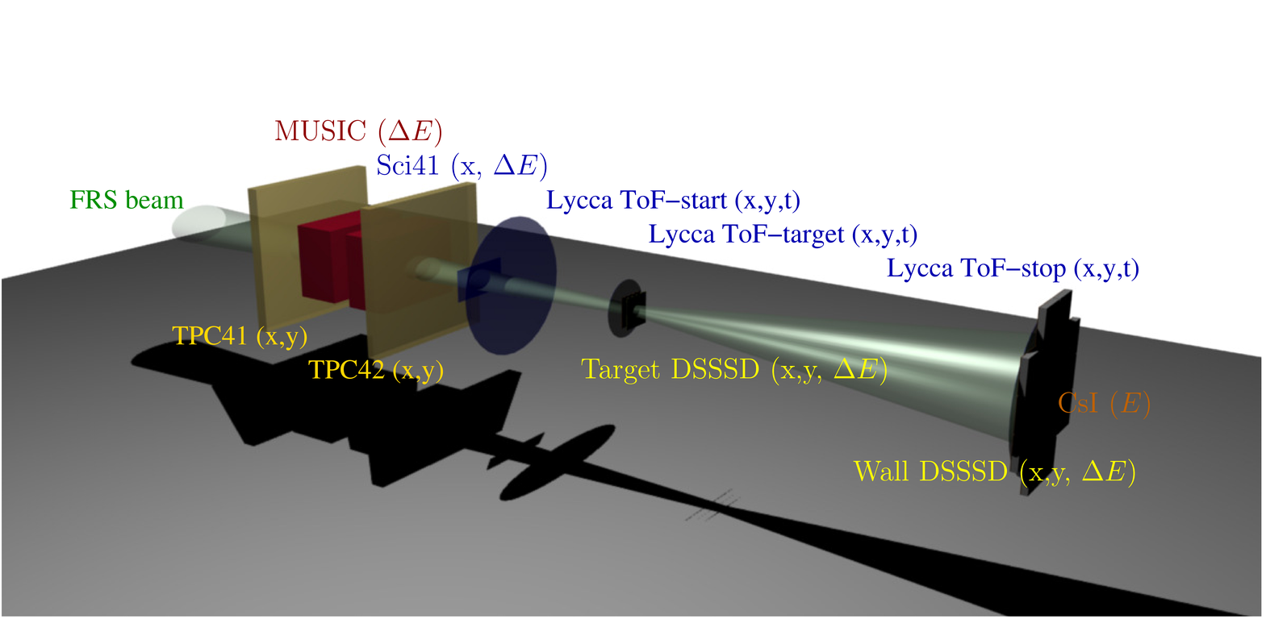
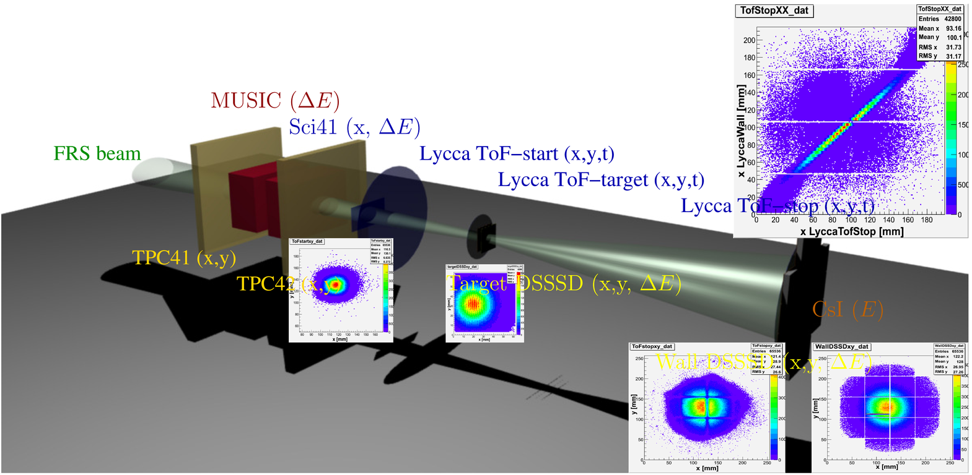
LYCCA
Lund-York-Cologne CAlorimeter
17 silicon DSSSD detectors for tracking and energy loss
144 CsI scintillators for particle energy
3 fast plastic scintillators for time of flight and tracking

Slide 9
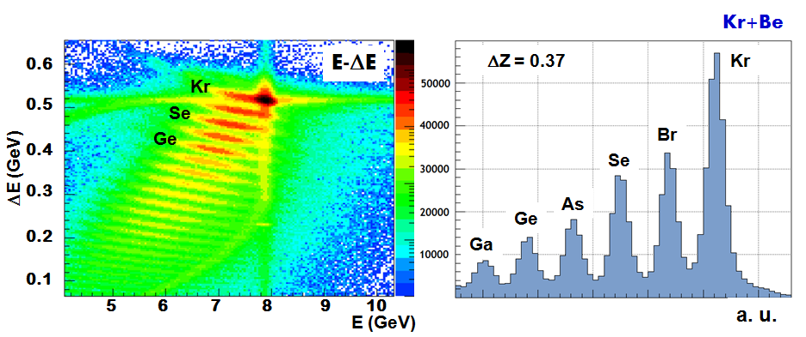
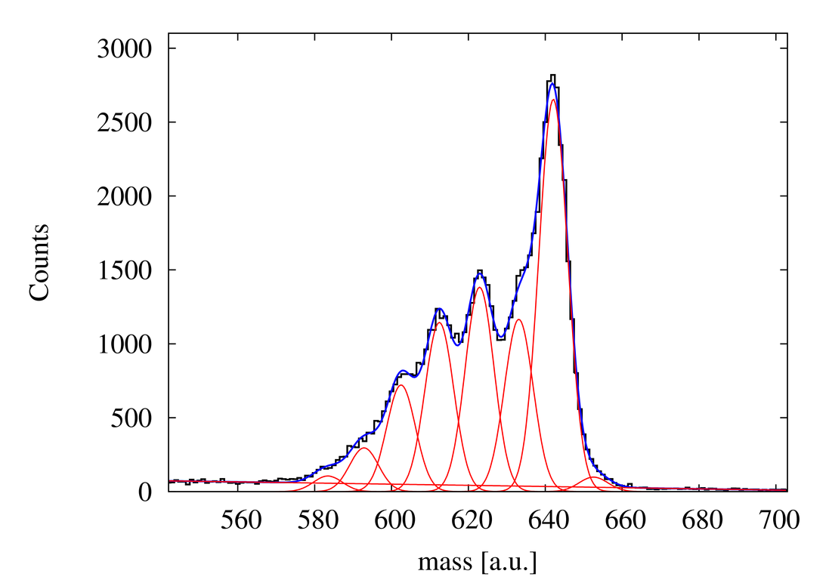
LYCCA Performance
E-ΔE charge identification: ΔZ / Z ≈ 1%
E-Tof mass identification: ΔA / A ≈ 1%
Primary beam
contaminant
different A with equal Z
ΔA/A = 0.8
A ≈ 80
D.Rudolph, M.Bentley,
P.Reiter & groups

Slide 10
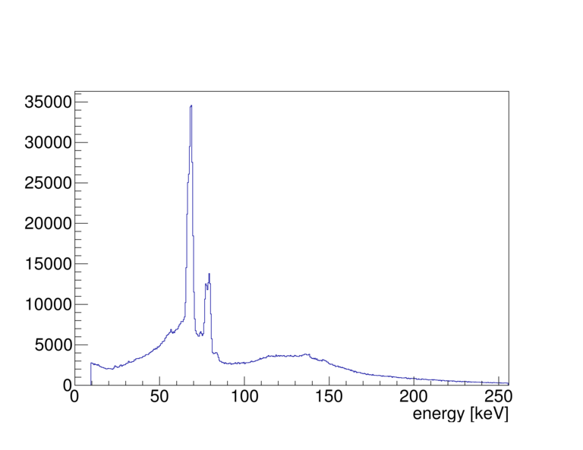
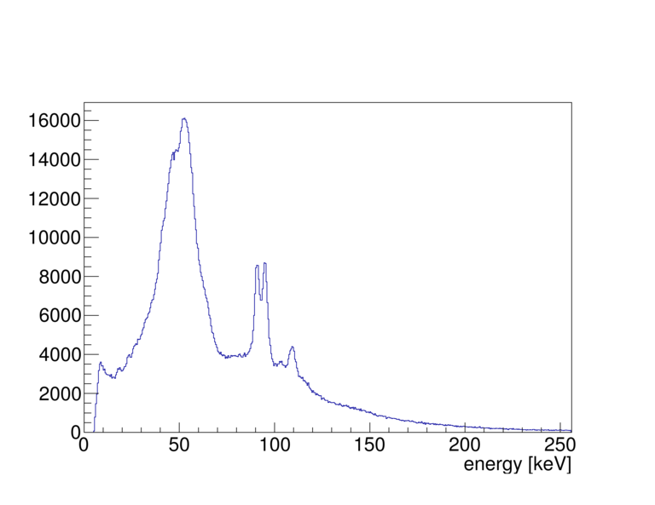
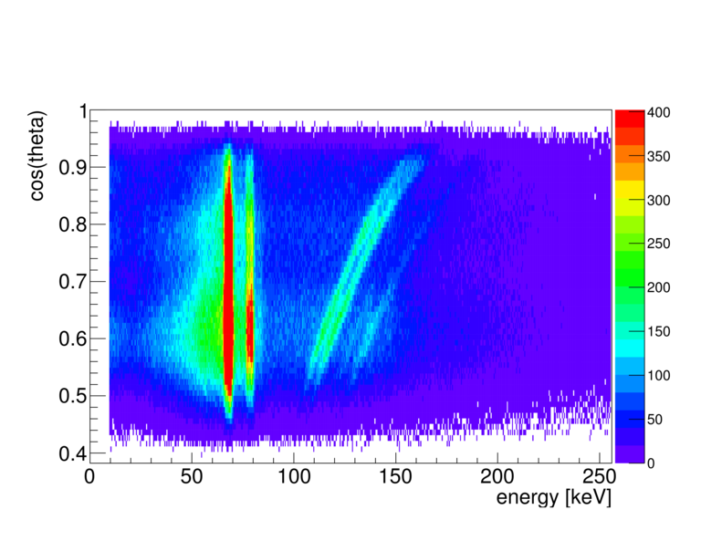
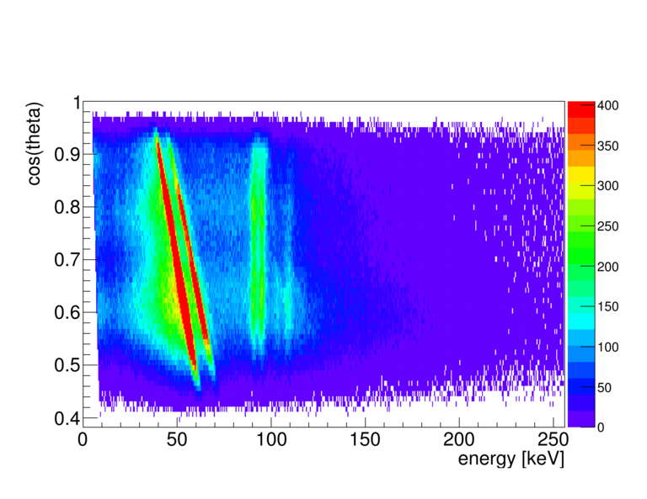
Doppler-Correction of Uranium X-Rays
Technical Commissioning
Au target
X-rays
Au target
X-rays
U beam on Gold Target:
thickness 400 mg/cm²
U velocity at Target position:
v/c ≈ 0.5
U-atoms have x-rays around 100 keV
Doppler shift to 100 – 150 keV
U beam
X-rays
U beam
X-rays
AGATA
Position
Information
+
LYCCA
particle tracking
Doppler-
shift
correction

Slide 11
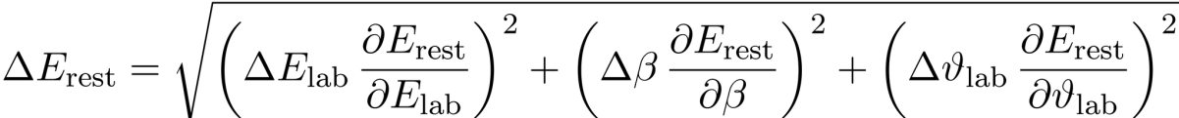
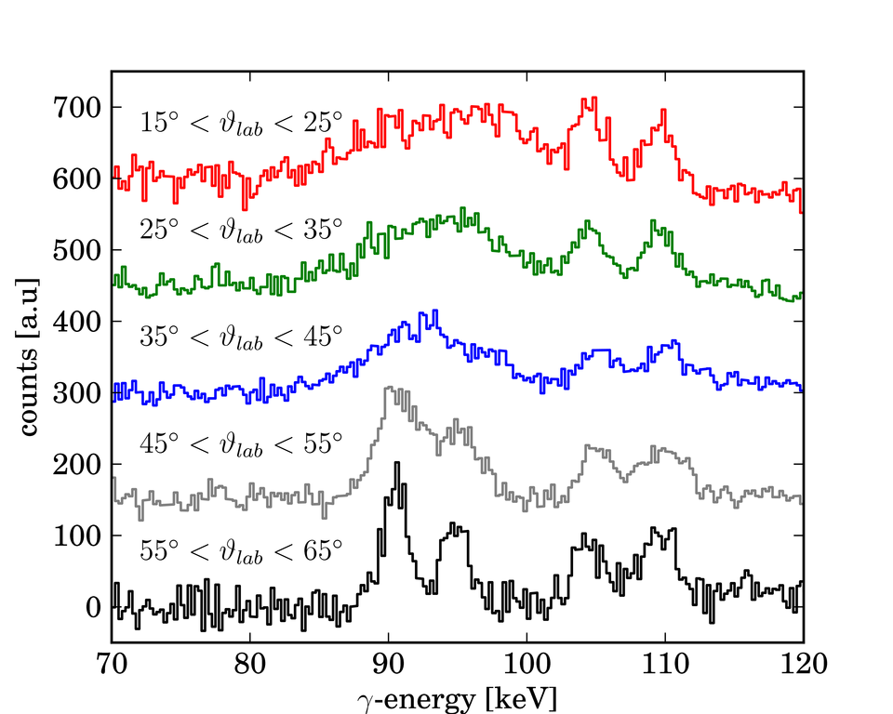
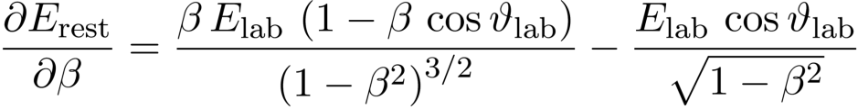
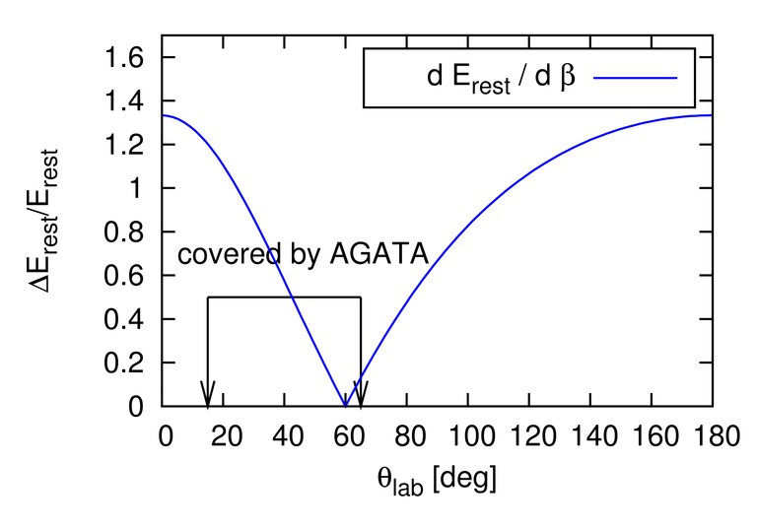
Doppler-Shift Correction
Energy Resolution
Observation of X-ray radiation
Short decay time
Decay inside target
Δβ is large
Velocity-uncertainty dominates
U on Be

Slide 12
Performance Commissioning
Coulex and Fragmentation of ⁸⁰Kr
Goals
⁸⁰Kr
Demonstrate performance of AGATA at relativistic beam energies
determine typical background and detection sensitivity
Obtain first data for the optimization of Pulse-Shape Analysis and Gamma-Ray Tracking algorithms in (S-)FRS conditions
Large Coulex cross section
Reasonably long lifetime
(no decay inside the target)
Physics Runs
0.4 mg/cm² Au target in central position (22h, Coulex)
0.4 mg/cm² Au target 12cm downstream of center (51h, Coulex)
0.7 mg/cm² Be target in central position (29h, Fragmentation)

Slide 13
Complex Data Analysis
AGATA
NARVAL acquisition
FRS/LYCCA/HECTOR
MBS acquisition
Experiment
(simplified)
Preamplifier traces
(on disk)
Raw Data
(on disk)
Particle tracking
and identification
Pulse shape analysis
Analysis
(simplified)
Gamma-Ray tracking
and Doppler correction
Interaction Points
(on disk)
Make sure everything is
correct
Lots of parameters to
understand / optimize
Gamma Spectrum

Slide 14
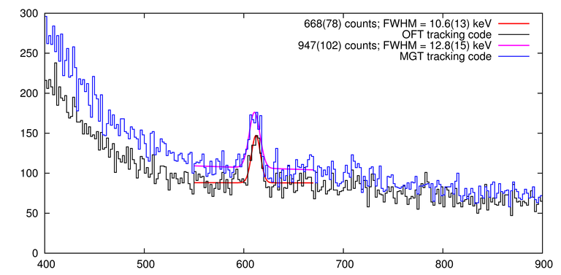
⁸⁰Kr gamma rays
(preliminary)
One shift:
duration ≈ 8h
intensity ≈ 35k part. per spill
Difference between the OFT and MGT gamma
tracking algorithms
Trigger:
particle-AGATA-LYCCA
particle-HECTOR-LYCCA
⁸⁰Kr 2₁⁺ 0₁⁺
616.6 keV
MGT tracking
950 counts
2.2% resolution
Gates:
particle-gamma time
LYCCA E-ΔE
LYCCA E-ToF
gamma multiplicity <= 2
OFT tracking
670 counts
1.7% resolution
Statistics:
incident particles ≈ 92·10⁶
part.-AGATA triggers ≈ 1.3·10⁶
energy [keV]

Slide 15
Preliminary Summary of PreSPEC-AGATA performance for Coulex
Particle rate 35·10³ per spill
Dead time 130 μs
LYCCA efficiency (ε_{LYCCA}) ≈ ε_{pγ} / ε_{AGATA}
AGATA efficiency (ε_{AGATA}) (work in progress)
LYCCA mass resolution 1%
LYCCA Z resolution 1%
AGATA energy resolution
after Doppler correction 1.7 % @ 616 keV
(very preliminary: results around 1.2 % have been achieved but with fewer counts in the peak)
Peak/Background Ratio ≈ 1 @ 616 keV
(very preliminary: results around ≈ 2.5 have been achieved loosing counts in the peak)
Total efficiency with
14 AGATA crystals (ε_{pγ}) ≈ 1.6 %
(detected / emitted gammas in 616 keV line of ⁸⁰Kr, demonstrated, improvement on-going)
typical spill structure
rate
12 sec
10 sec
time

Slide 16
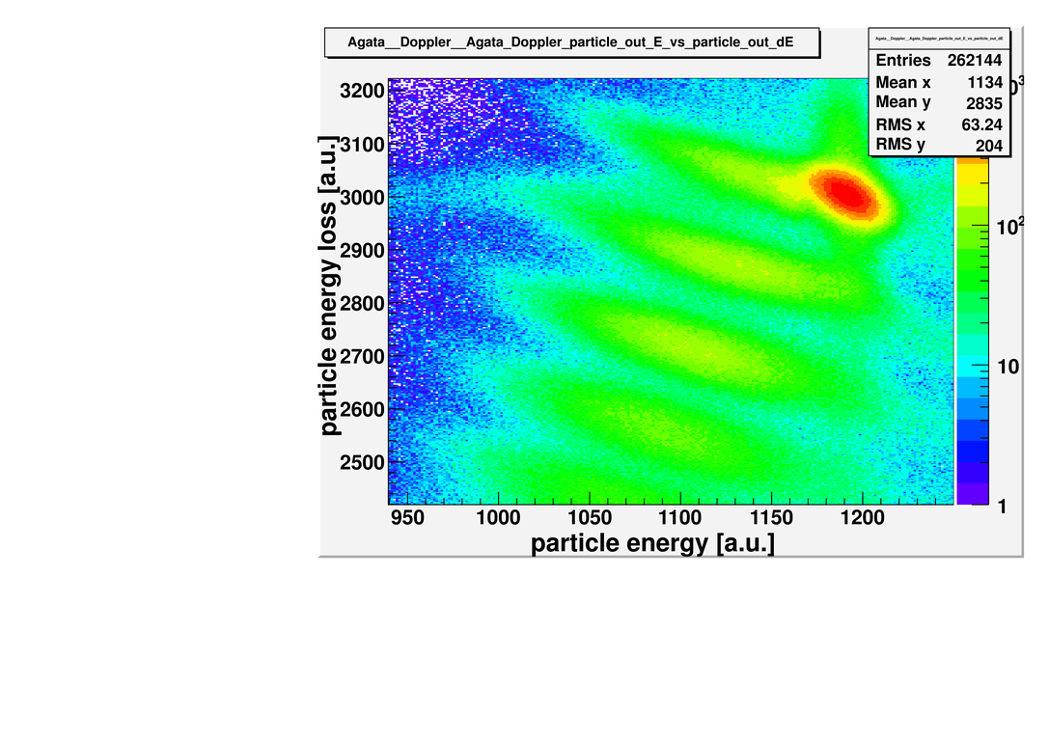
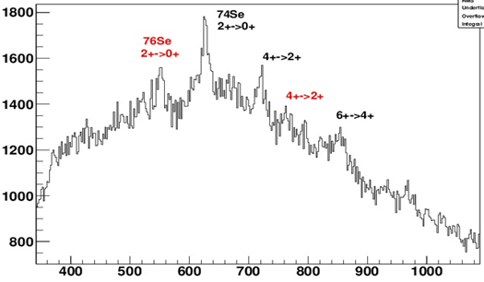
Secondary Fragmentation
Se-Isotopes
Gamma spectrum:
gated on Se isotopes
no LYCCA mass identification
Se isotopes

Slide 17
Experimental Campaign 2012
S424 Performance Commissioning
S429 Pb-region Coulex
      → Poster NS 209: L.G.Sarmiento et al.)
S426 Br M1-Coulex (FRS setup + 1 shift)
S430 ⁶⁴Fe Pygmy
S433 ⁵²Fe Coulex
S428 n-rich Zr-region (lifetimes)
S431 ¹³²Sn 1p-knockout
S427 ⁷⁰Kr, T_{z}=-1, isospin symmetry, 2n-knockout
S434 A=46 isospin-triplet, Coulex / differential plunger

Slide 18

People
T. Arici, P. Boutachkov, M. L. Cortes, A. Givechev, N. Goel, E. Gregor,
G. Guastalla, T. Habermann, N. Lalovic, E. Merchan, S. Pietri, D. Ralet,
M. Reese, P. P. Singh,
J. Gerl, M. Gorska, I. Koujoharov, H. Schaffner, H. J. Wollersheim,
D. Bazzaco, W. Korten, D. Rudolph, O. Wieland,
and many more from AGATA collaboration…
Blue = TU Darmstadt-members of GSI γ-group
DAAD
BMBF

Slide 19
Summary
PreSPEC @ GSI: “first feeling for FAIR” (HISPEC)
→ The ultimate need for gamma-tracking
AGATA set up at GSI-FRS S4
performance commissioning done, analysis on-going
→ development of tools and experience for HISPEC
4 “production experiments” done, analyses started
… looking forward to FAIR / NUSTAR …

