Slide 1
Direct probe to the ground state configuration of ‘ISLAND OF INVERSION’ nuclei through Coulomb Breakup
Ushasi Datta Pramanik
Ushasi.dattapramanik@saha
SAHA INSTITUTE OF NUCLEAR PHYSICS KOLKATA,
Alexander Von Humboldt fellowship & project grants
INPC 2013, Florence, 3rd June,

Slide 2
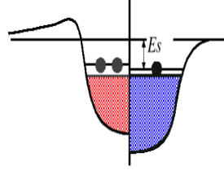
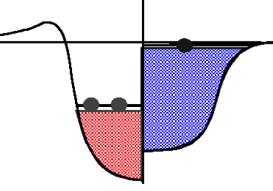
Nucleus---many body system
Single particle levels
averaging
Residual interaction
Two body interaction
Mean field
Reduction of spin-orbit inter.
Spin-isospin dep. central part
Tensor part of interaction
Coupling to continuum
Three body force
……………
Individual particle
Neutron skin
Diffuse surface
Decoupling of proton, neutron
Mixing of the states
Final single particle structure
Occup. Prob. of particular state
Spectroscopic factor
Shell evaluation !!!!!!
New magic number!!!!!

Slide 3
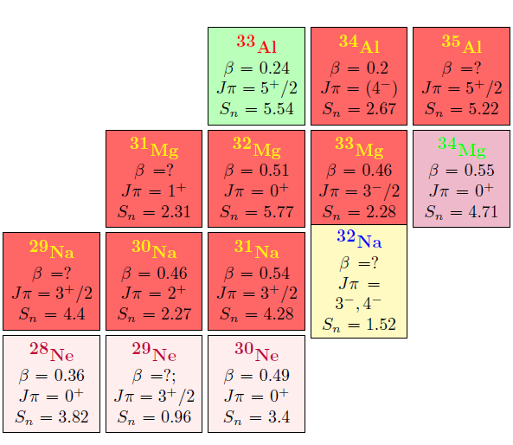
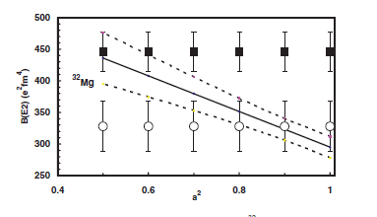
ISLAND OF INVERSION
^{31,32}Na mass measurement
C.Thibault et al., PRC12 (1975) 644
³²Mg large deformation
T. Motobayashi et al., Phys. Lett. B 346, 9
³²Mg H. T. Fortune,
PRC85, 2012
³²Mg (shape co-existence)
K.Wimmer et al.PRL 105, 252501 (2010)
Shell gap breaking ~ N~20 (sd-----pf)
Coulomb Breakup of ‘Island of Inversion Nuclei’ !!!!!!!!!!!!!!!!!!

Slide 4
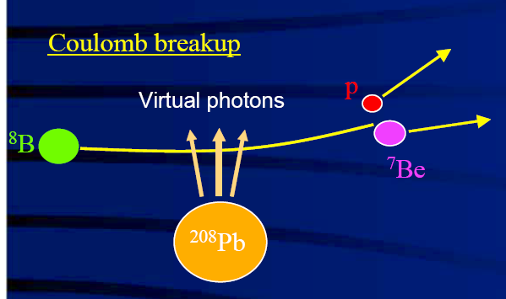
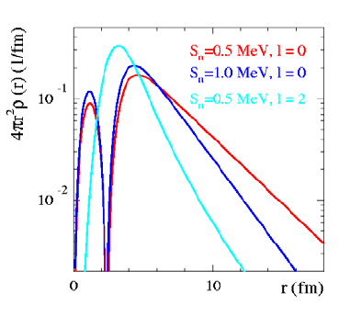
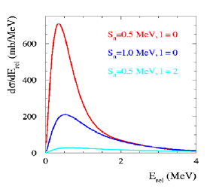
Coulomb breakup (400-450 A MeV)
Fermi, 1924
G.Baur, C.A.Bertulani, NPA458, 188
n
³³Mg
³²Mg
Transversal el mag. field
E1 predominant
High Fourier components
η (=b/λ) >1, st. line approx.
ξ (t col /tnucl) <1 , sudden
Highly sensitive to the quantum numbers of valence nucleon !!!
Shape of differential cross section ⇒ angular momentum l
Cross section ⇒ spectroscopic factor C²S (T. Nakamura et al., PLB 331, 296 (1994)
γ-ray coincidence ⇒ identification of core state I_{c}
U.Datta Pramanik et al., PLB553, 63 (2003)

Slide 5
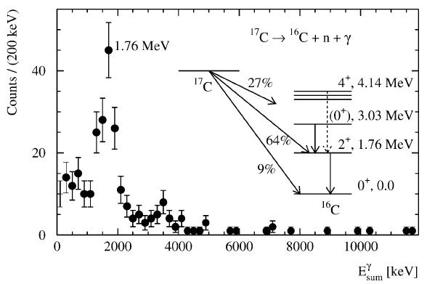
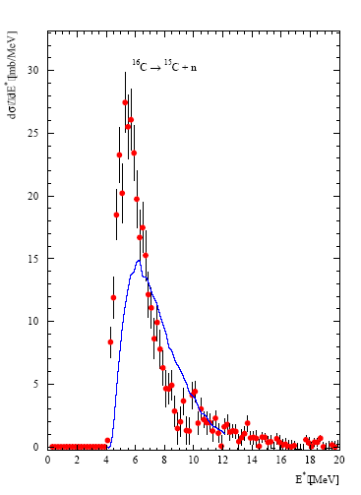
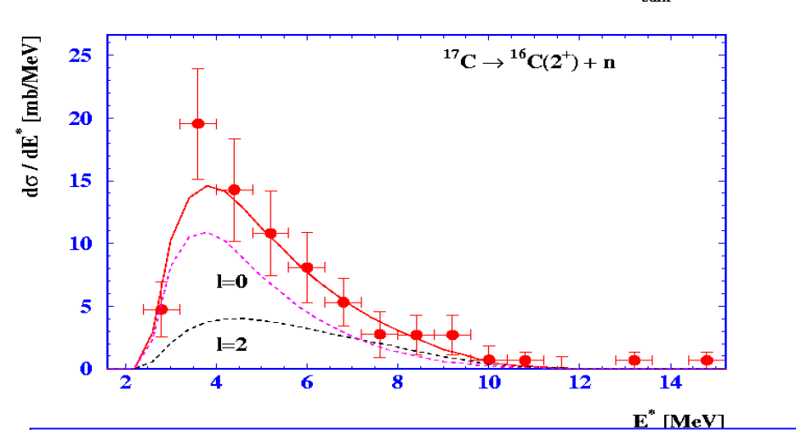
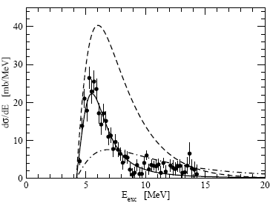
¹⁶C (gr.) ¹⁵C(1/2⁺) ⊗ ν_{s ,d.}
.
¹⁷C (gr.) ¹⁶C(2⁺) ⊗ ν_{s ,d.}
.
U.Datta Pramanik, Prog. Part. and
Nucl. Phys., vol. 59, 183-192, 2007
U.Datta Pramanik et al. PLB 551, 53(2003),

Slide 6
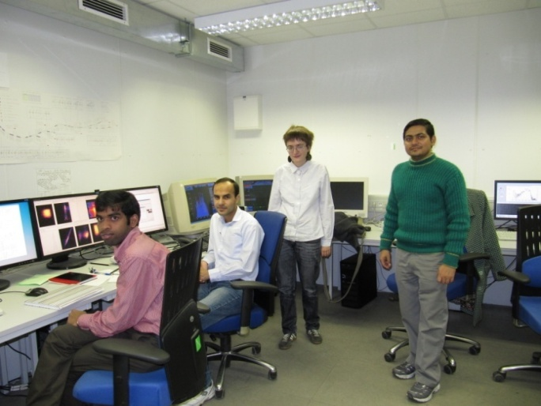
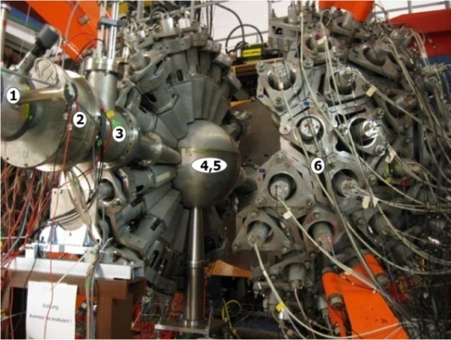
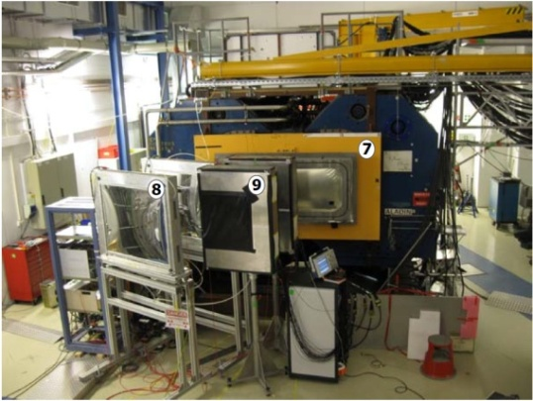
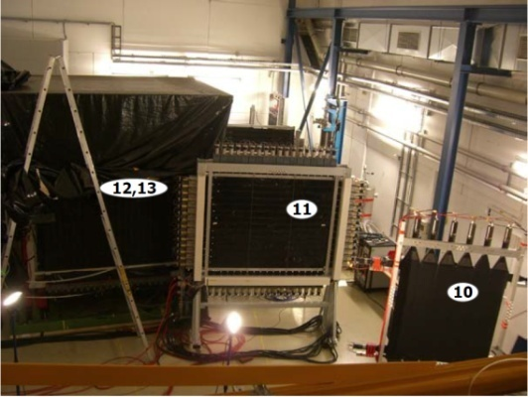
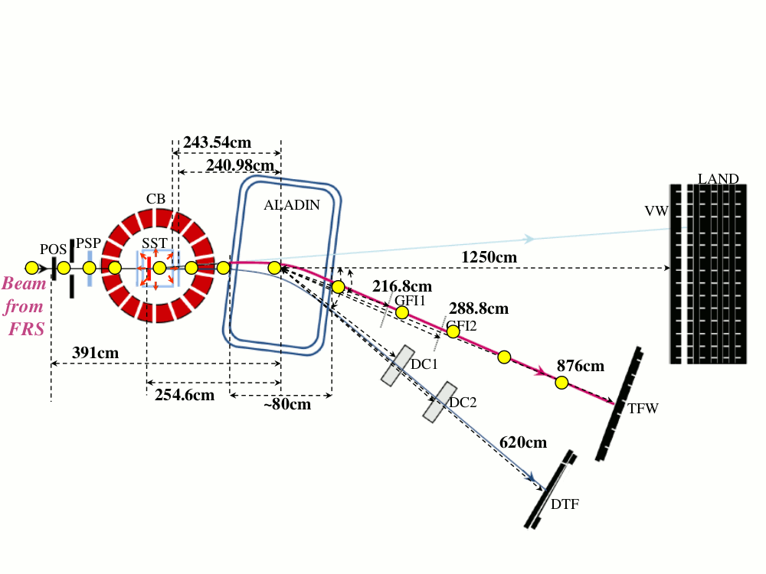
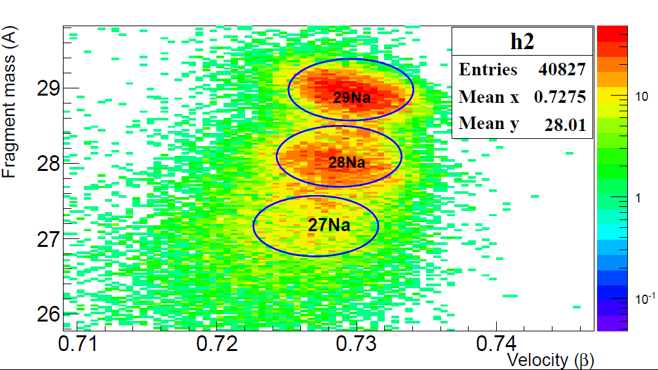
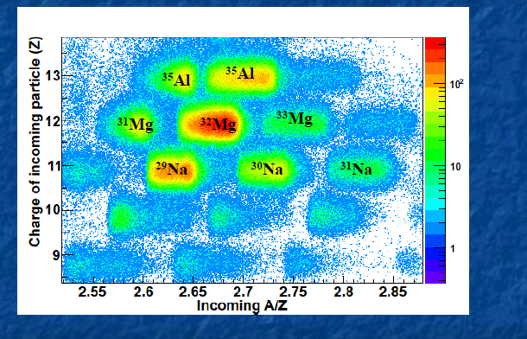
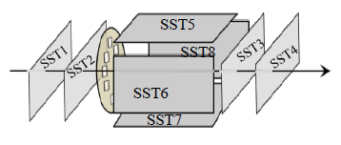
Experimental setup for kinematically complete measurements “LAND-ALADIN setup”

Slide 7
Slide deleted by speaker request

Slide 8
Slide deleted by speaker request

Slide 9
Slide deleted by speaker request

Slide 10
Slide deleted by speaker request

Slide 11
Coulomb dissociation is a useful tool to probe gr. state configuration
of loosely bound sd-pf shell nuclei
³⁵Al(N=22)
³⁰Na(N=19)
³⁴Al(N=21)
³³Mg(N=21)
³⁴Al(gr) ⊗ν p3/2
²⁹Na(gr) ⊗ν s1/2
Both ³⁴Al, ³³Mg , ground state configuration
Is fragmented ,
CD cross-section is in favour of
s-wave valence nucleon
Nilsson model with large deformation(0.48)
1/2 [200] 60-70% j_{1/2}

Slide 12
SINP, Kolkata, India : S. Chakraborty, A. Rahaman, P Basu, S.Bhattacharya , S.Chatterjee , J.Ray,
GSI, Darmstadt, : T. Aumann, K. Boretzky, C. Caesar, D. Gonzalez-Diaz, H. Emling, O. Ershova, H. Geissel, M. Heil, A. Kelic, C. Langer, Y. Leiffel, G. Munzenberg, C. Nociforo, V. Panin, R. Plag, R. Reifarth, D. Rossi, H. Simon, C. Scheidenberger, S. Typel, V. Volkov, H. Weick, F. Wamers, J. Winfield, M. Zoric;
Univ. of Santiago de Compostela, : S. Beceiro, D. Cotrina-Gil, P. Diaz-Fernandez, H. A. Pol; TU, Dramstadt :, T. Kroll; University of Liverpool, : M. Chariter, J. Taylor; University of Surrey, W. N. Catford; HZDR Rossendorf : A. Wagner; INFN, legnaro, Italy : G. De Angelis; Chalmers University of Technology, Sweden : B. Jonson, H. T. Johansson; TU, Munich, Germany : R. Krucken; T. Le Bleis KVI Groningen, Netherland : M. A. Najafi; LBNL, Berkeley, USA : , S. Paschalis;RIKEN, Japan : Y. Togano; EMMI, GSI, Darmstadt : J. Marganiec;Instituto Tecnol´ogico de Aeron´autica-CTA, S˜ao Jos´e dos Campos, Brazil : B. V. Carlson;
Alexander Von Humboldt fellowship & project grants

Slide 13
What we can learn from the study of ‘single particle properties’ ?
Nucleus---many body system
Single particle levels
averaging
Residual interaction
Two body interaction
Mean field
Reduction of spin-orbit inter.
Spin-isospin dep. central part
Tensor part of interaction
Coupling to continuum
Three body force
……………
Individual particle
Neutron skin
Diffuse surface
Decoupling of proton, neutron
Mixing of the states
Final single particle structure
Occup. Prob. of particular state
Spectroscopic factor
Shell evaluation !!!!!!
New magic number!!!!!
Impact of Single particle prop. of nuclei on Astro. scenario, r-process, DC

