Slide 1
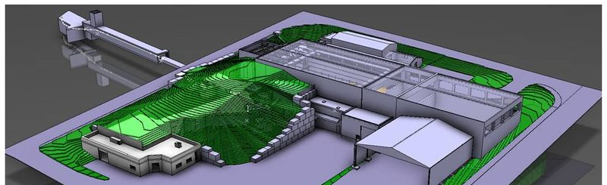

Mass measurements at ISOLDE
Magdalena Kowalska for the ISOLTRAP collaboration
CERN, PH-Dept
ISOLTRAP setup
Technical developments
Recent mass measurements

Slide 2
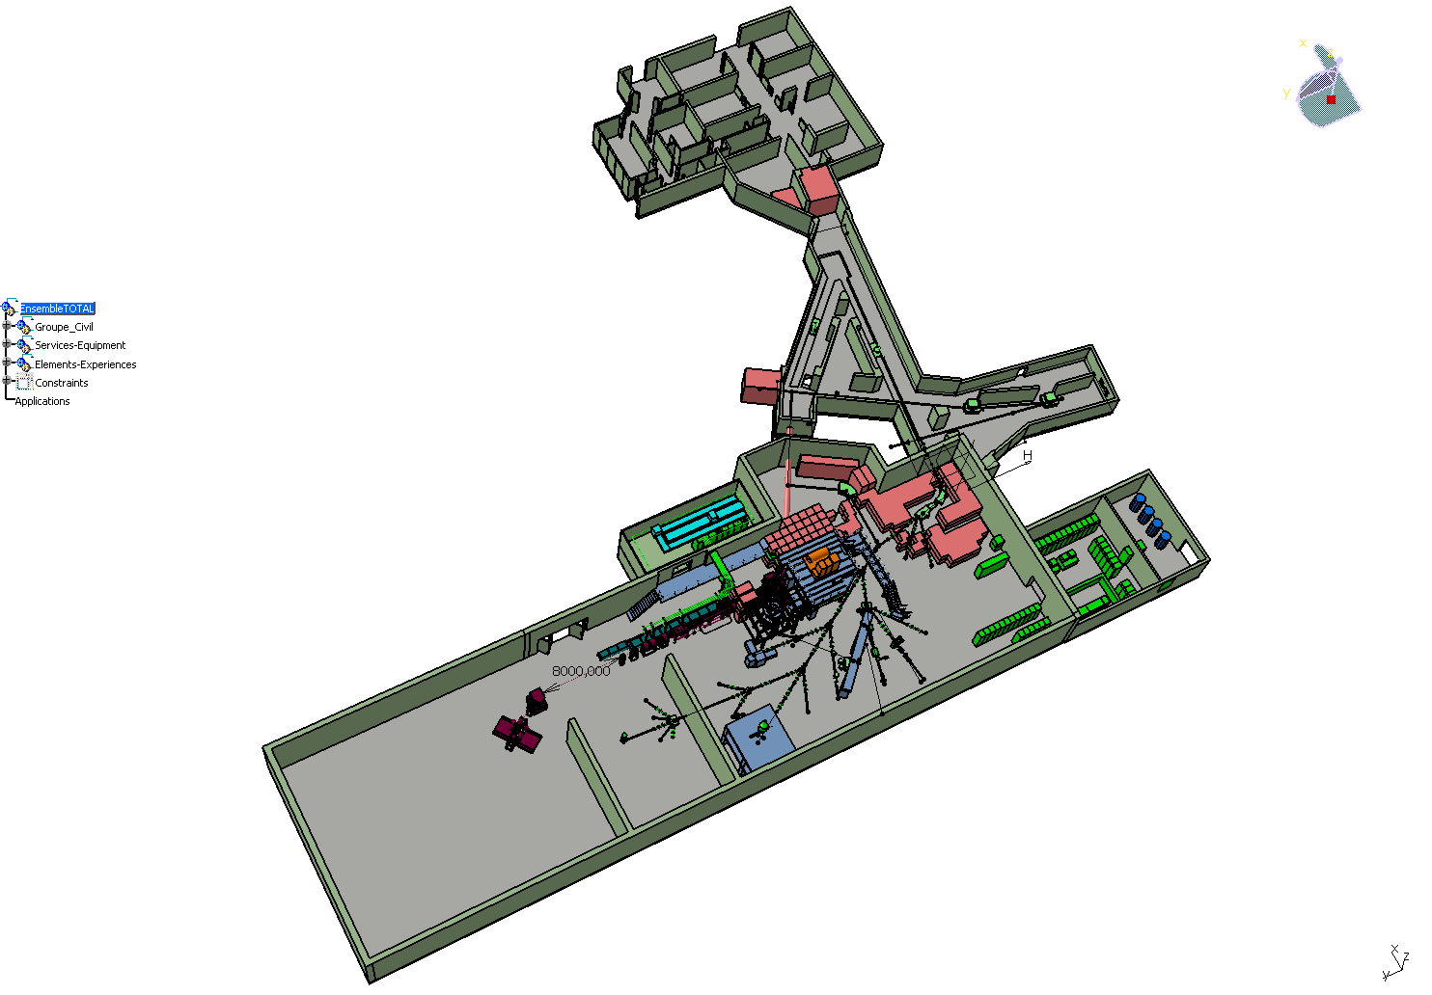
Mass measurements at ISOLDE
Target stations
HRS & GPS
PS-Booster
1.4 GeV protons
3×10¹³ ppp
Mass-sep.
HRS
WINDMILL
ISOLTRAP
MISTRAL
(until 2010)

Slide 3
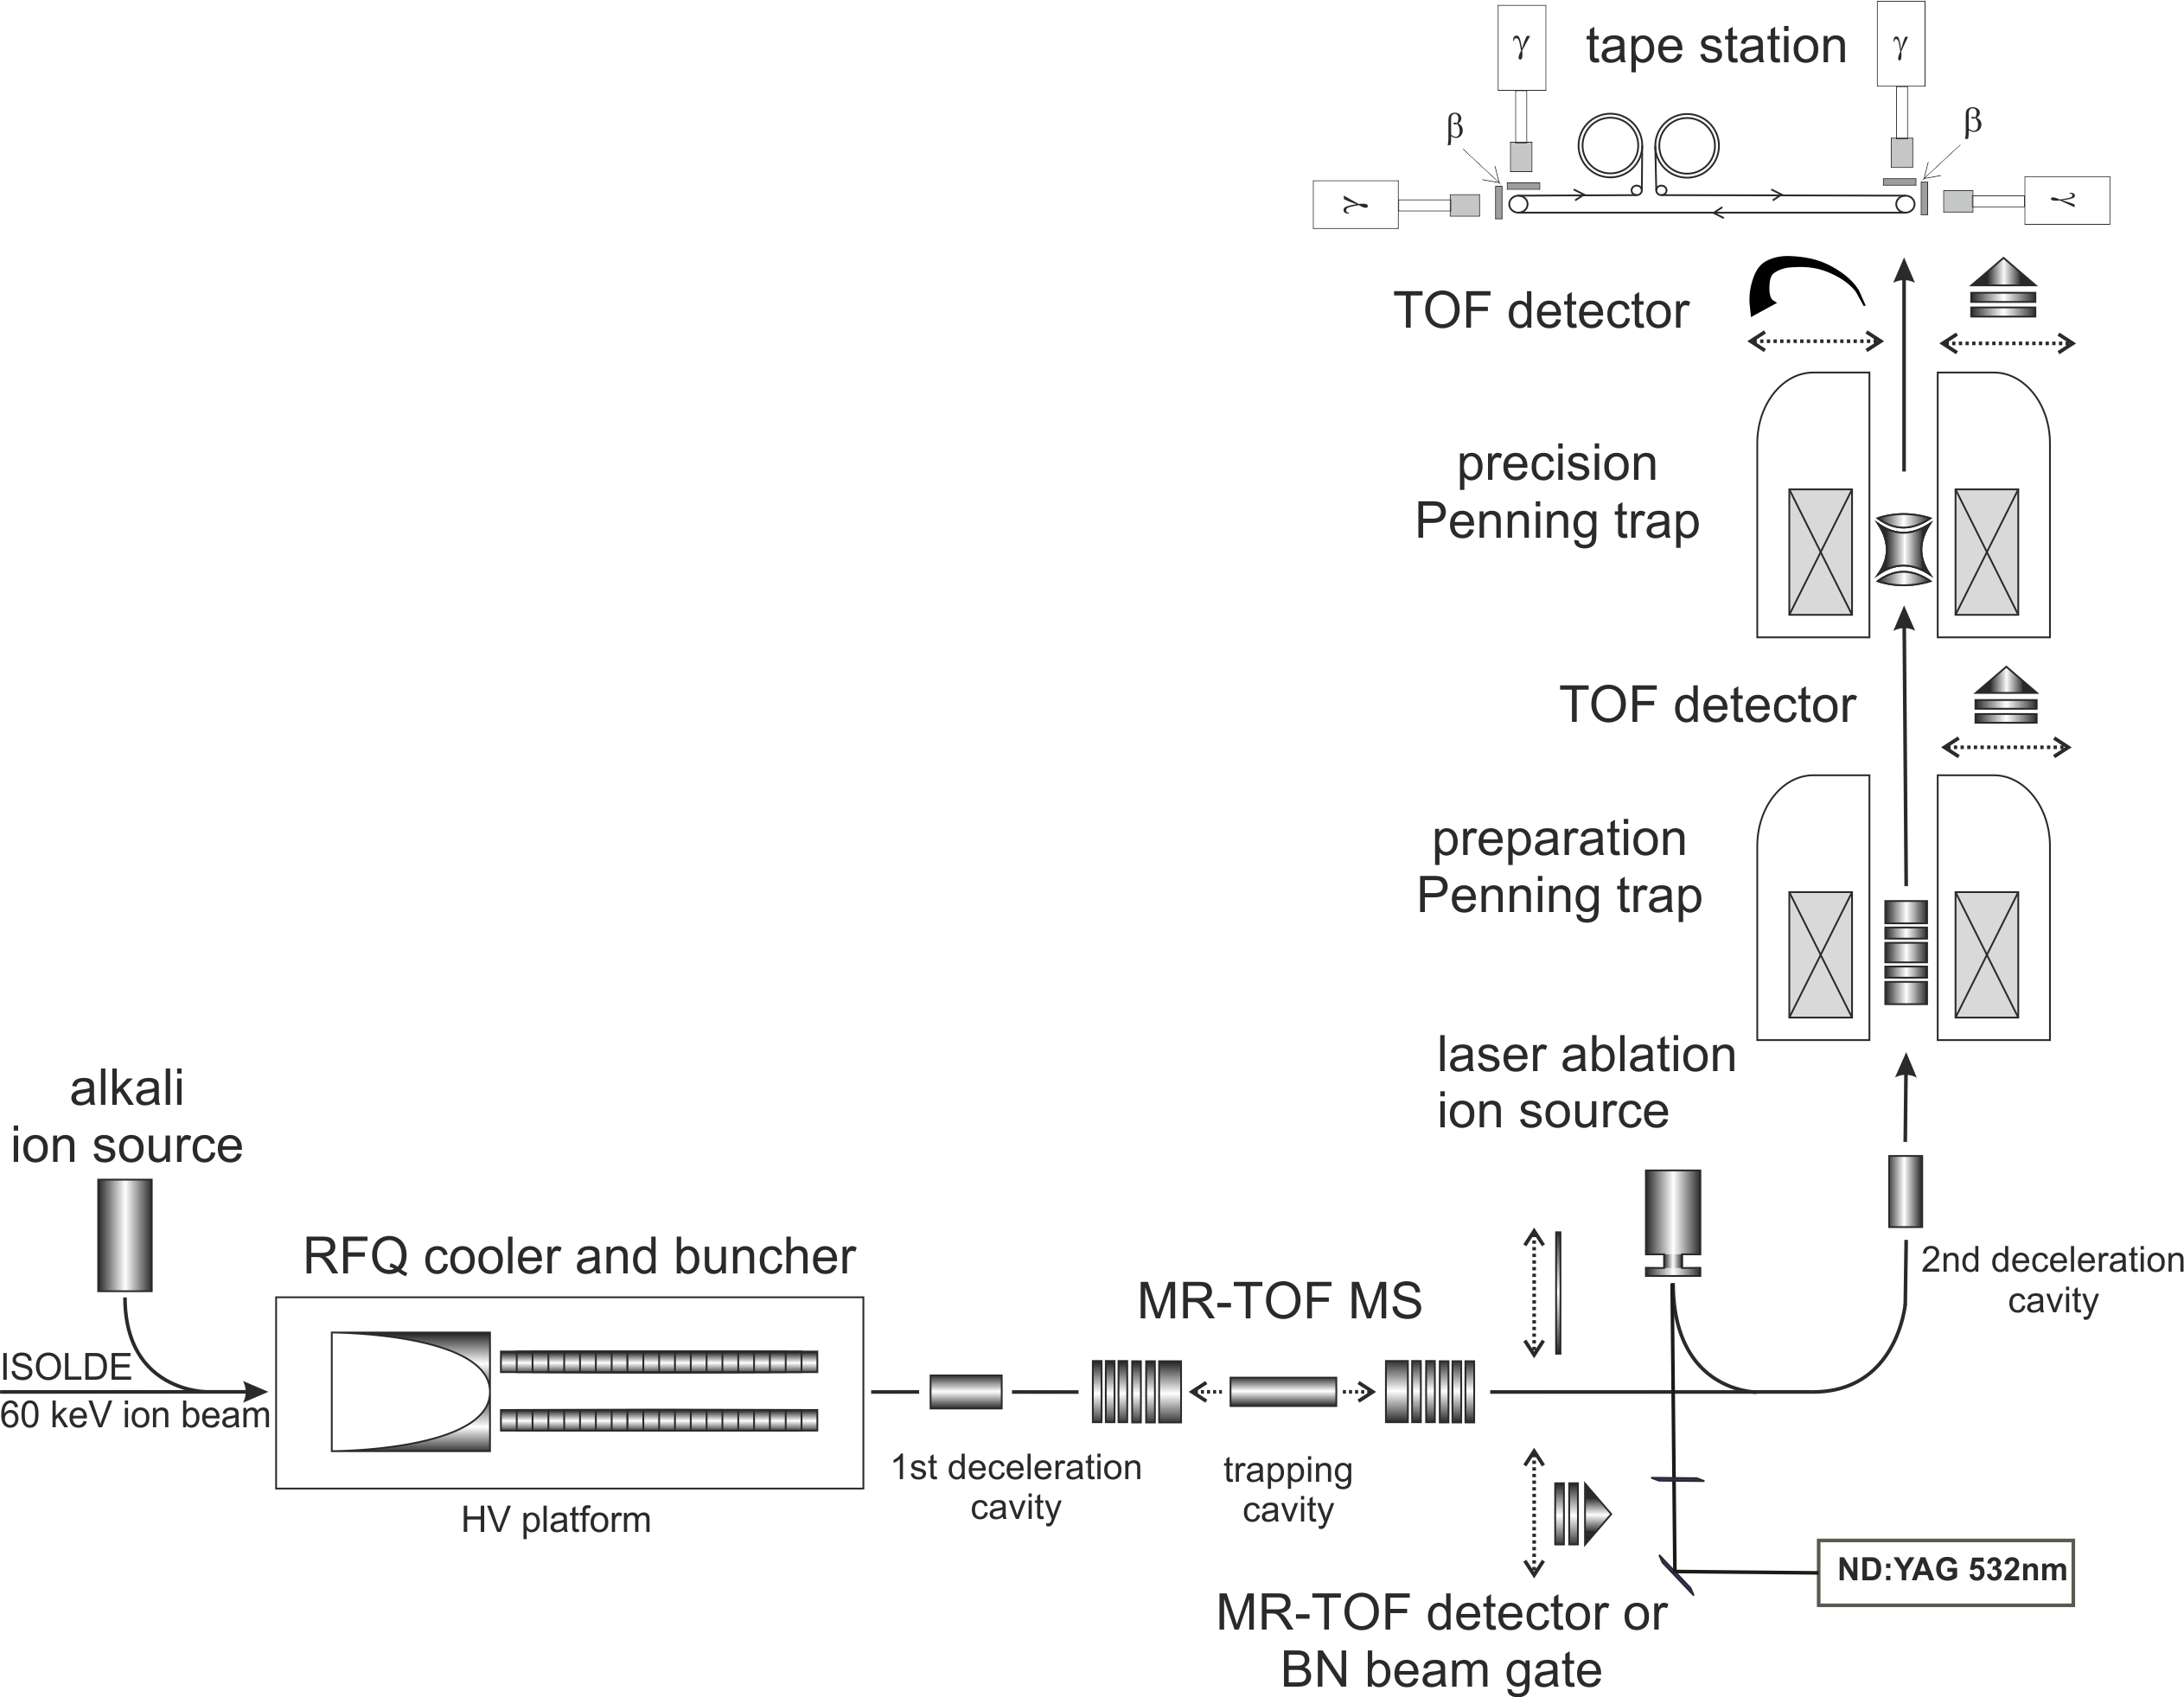
ISOLTRAP
Beta- and gamma decay studies
From cyclotron frequency to mass
determination of cyclotron frequency
(R = 10⁷)
50 ms - 10 s,
100%
removal of
contaminant ions
(R = 10⁵)
50 ms - 1 s,
100%
Bunching of the
continuous beam
10-100 ms, >50%
10 ms, 1-10%

Slide 4
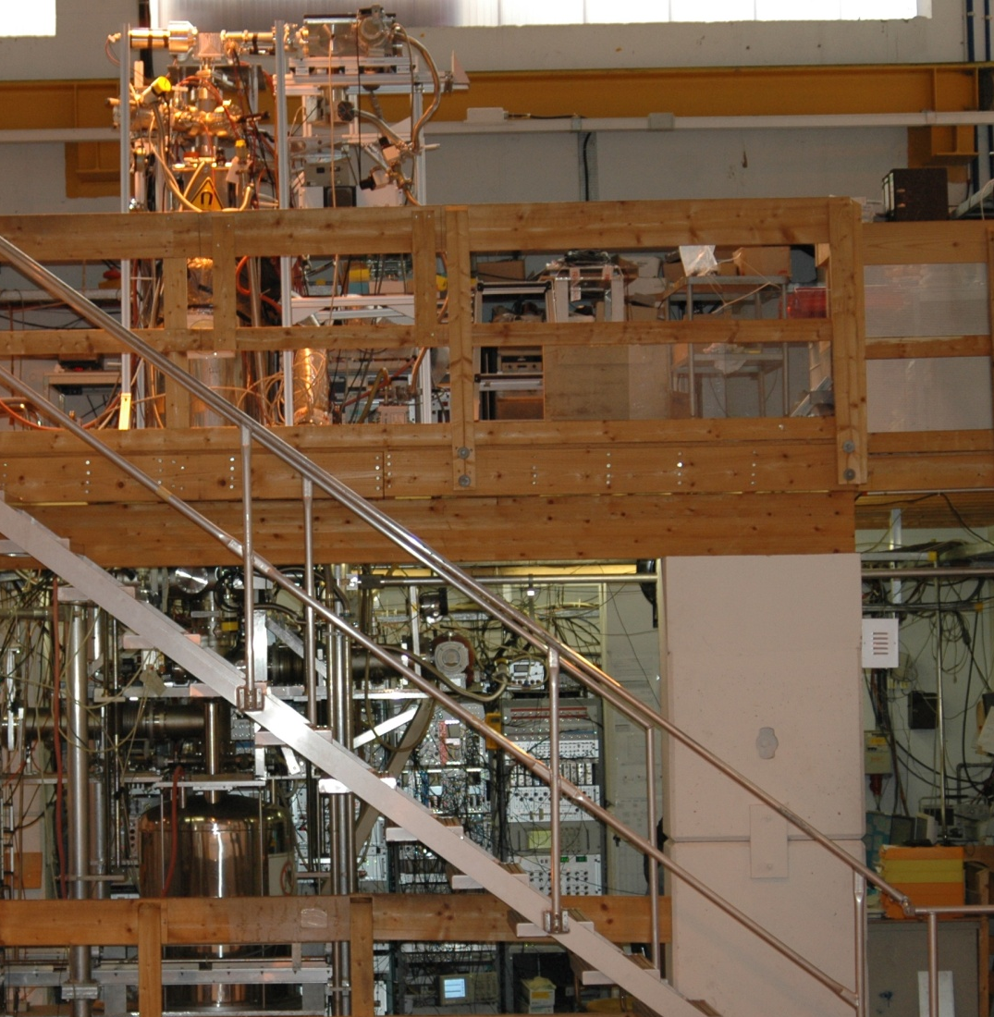
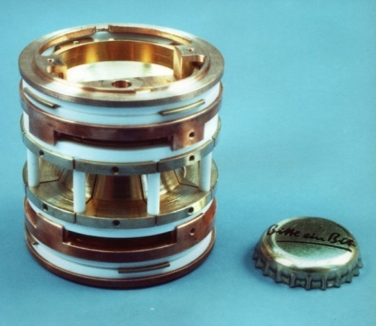
ISOLTRAP

Slide 5
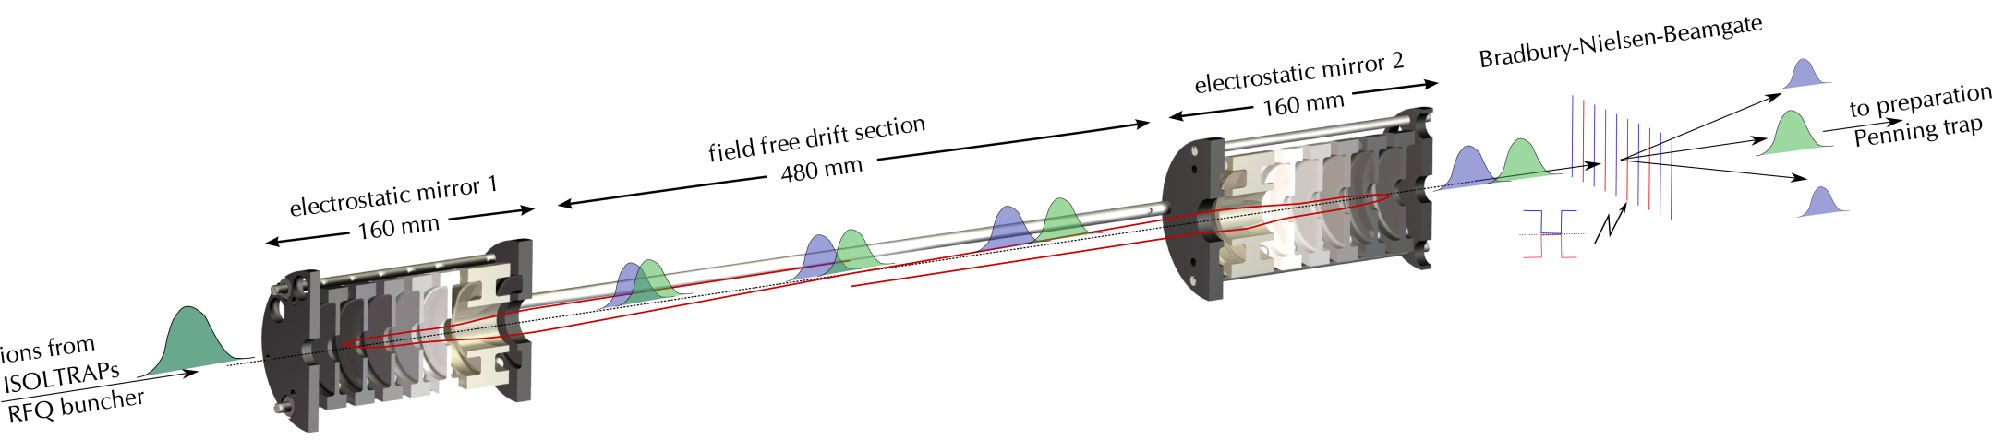
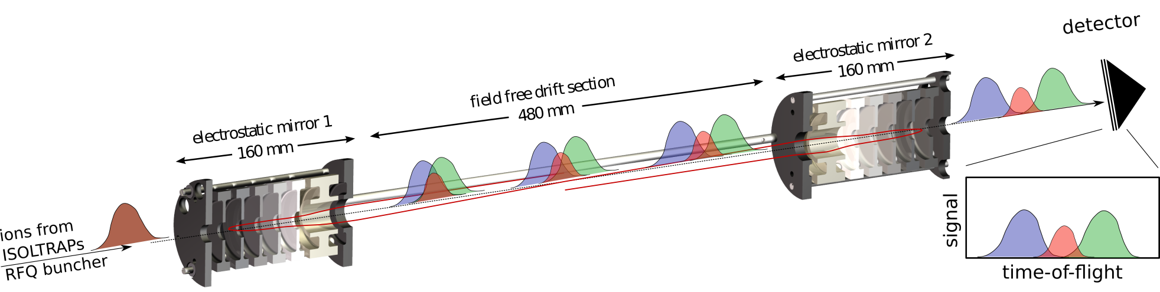
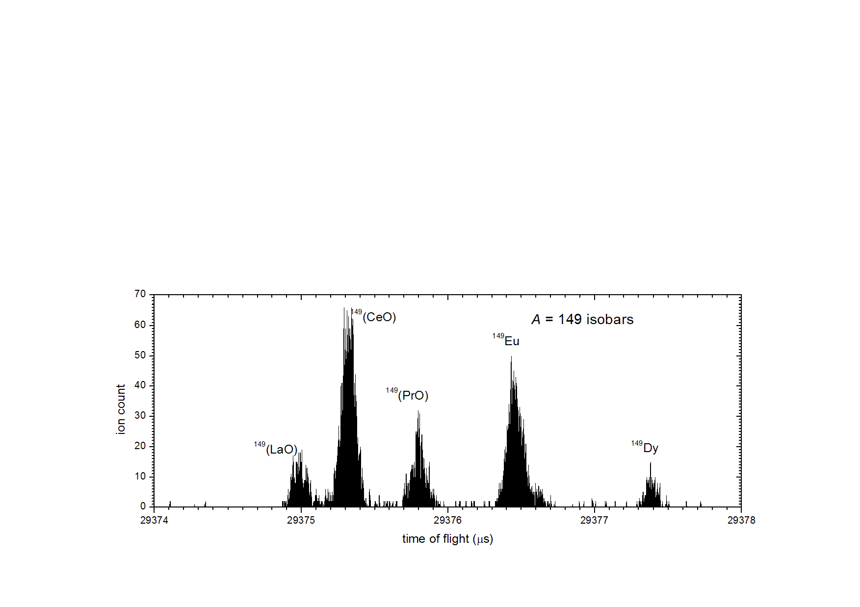
Multi-Reflection Time-of-Flight Mass Separator
TOF for ions of the same energy but different mass differs
Beam purifier
Mass
analyzer
Electrostatic potentials
Typical trapping time: 25-75 ms
m/Δm (FW) > 10⁵
Suppression factor 10⁴
Mass uncertainty < 50 keV
ions
R.N. Wolf et al., Nucl. Instr. and Meth. A 686, 82-90 (2012)
TOF (μs)

Slide 6
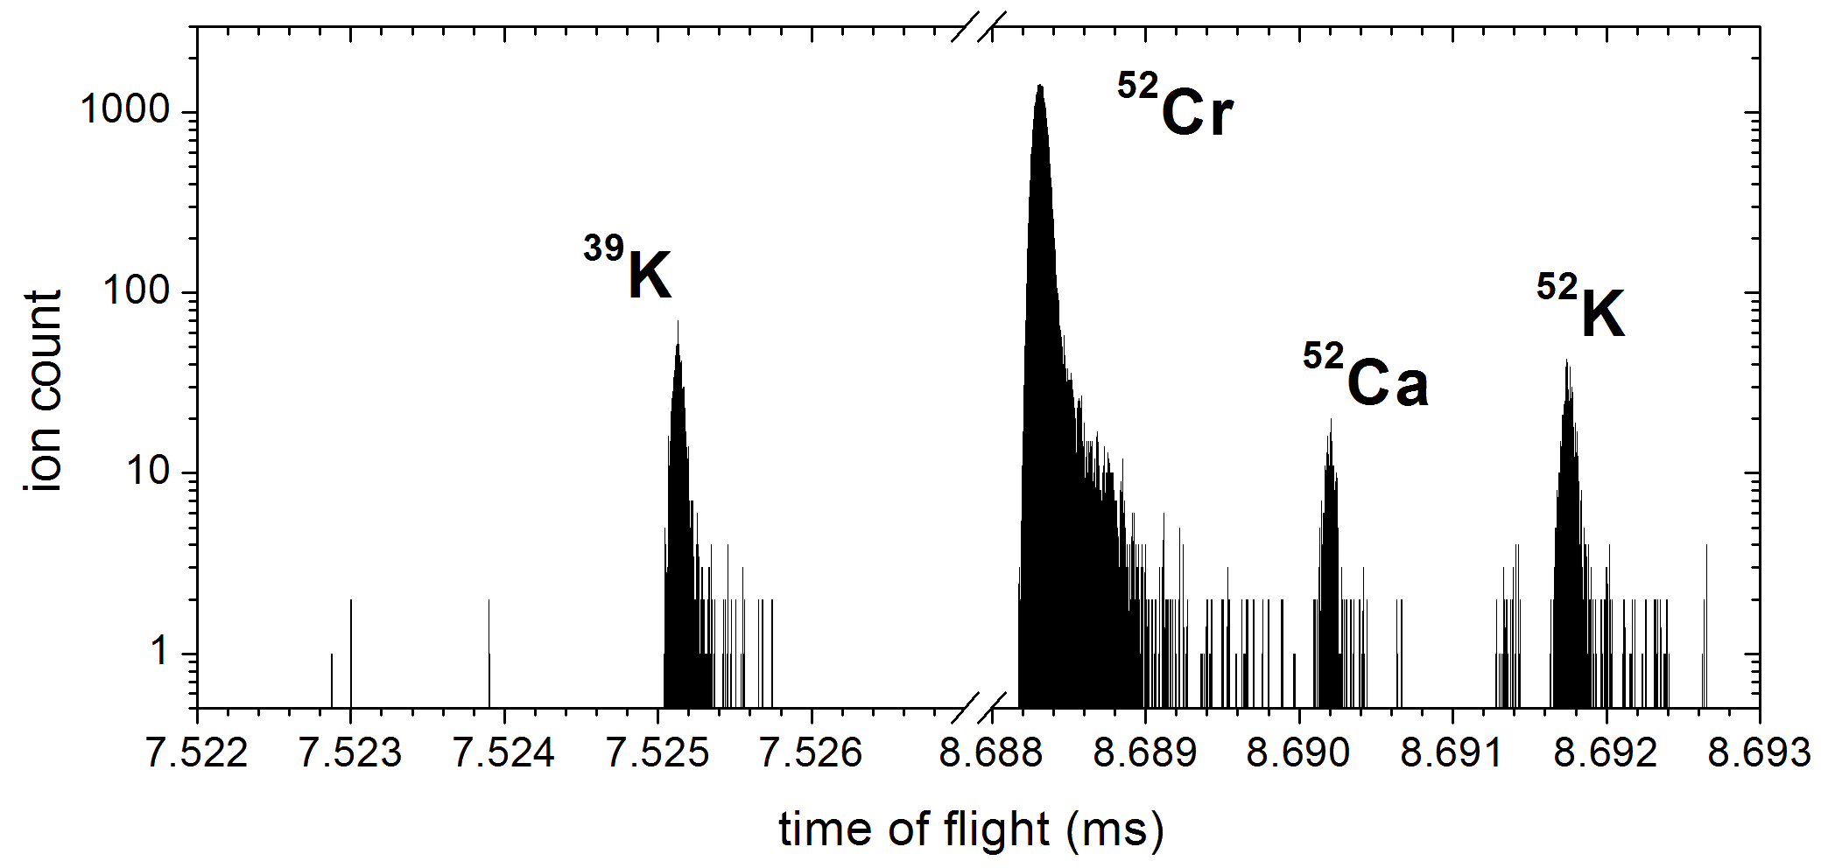
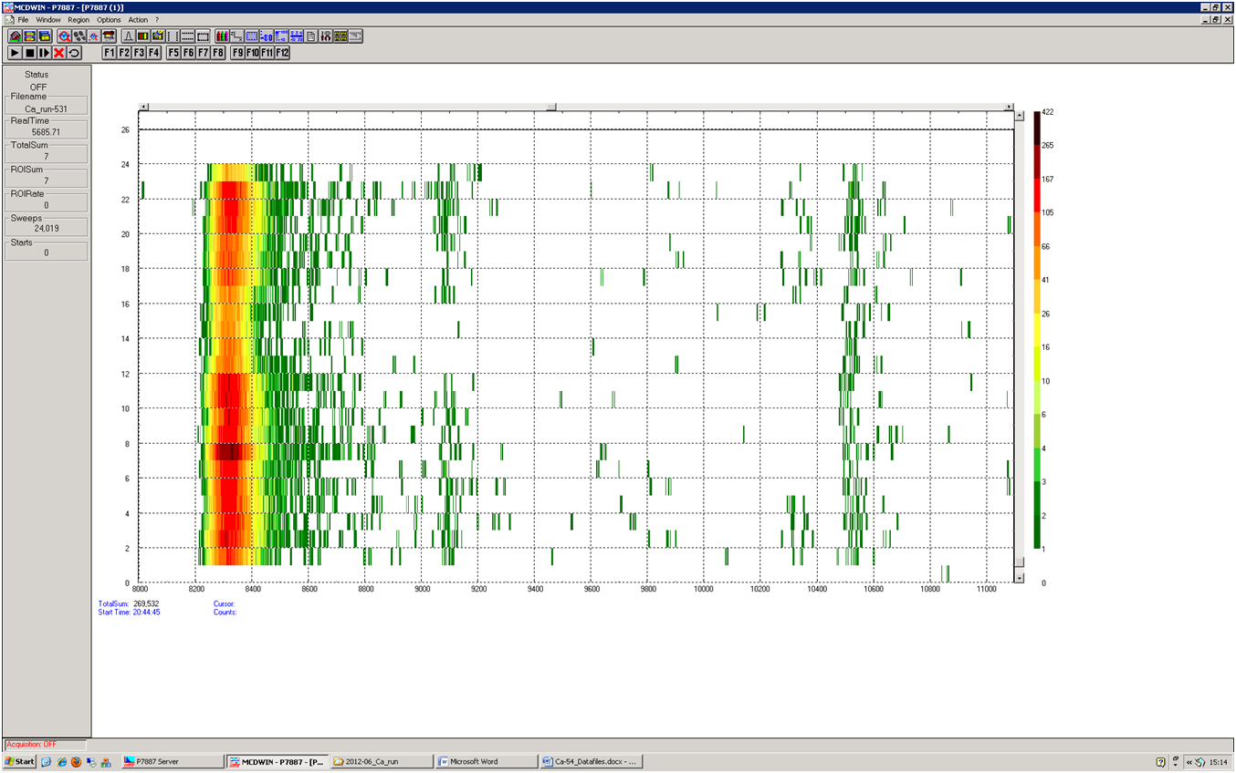

Mass measurements with MR-TOF MR
Monday talk by S. Kreim
Performance: 50 keV statistical uncertainty for ~ 2000 counts
Maximum rate: ~ 50 ions per cycle (detection limitation)
Time: 10 ms buncher + 5 ms trapping in MR-TOF MS (+ accumulation in buncher
protons off
Measurement time /a.u.
lasers off
⁵⁴Cr
Time of flight / arb. units
Expected
TOF ⁵⁴Ca
S. Kreim et al., INTC-P-317, IS 532 (2011)
F. Wienholtz et al., accepted for publication

Slide 7
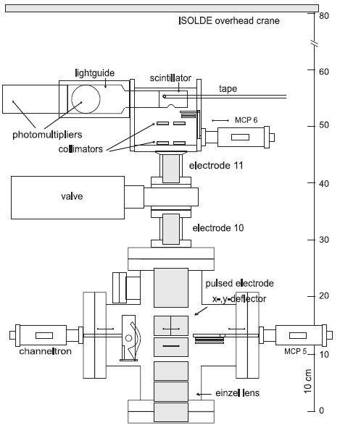
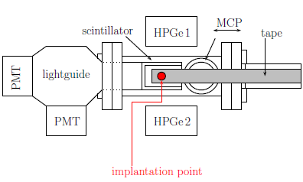
Decay station behind traps
Trap-assisted decay studies
  Use ISOLTRAP to purify the beam
Decay-assisted mass measurements
  Use decay station to identify trapped nuclei
Quasi-simultaneous mass and decay measurements possible
M. Kowalska, S. Naimi et al., Nucl. Instr. and Meth. A 689, 102-107 (2012)
Ions from traps

Slide 8
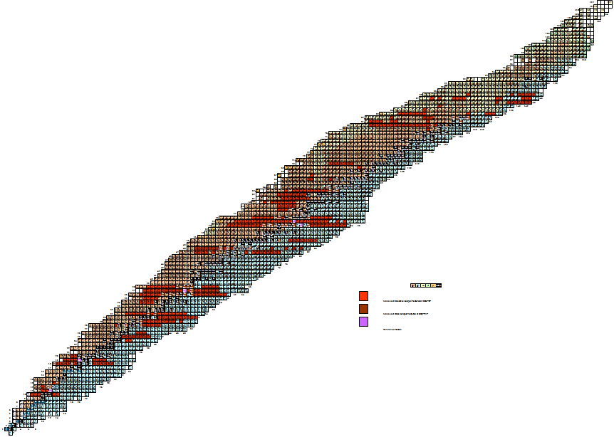
ISOLTRAP harvest since INPC2010
ISOLTRAP:
600 masses, down to 10 ions/s and 50 ms half-life
Since last INPC
  Around 50 masses measured
  1 new nucleus identified
  Several isomer excitation energies
  New: spin-state assignments
  New: HFS scans
^{197,198,205,207,209,211}At
^{190,194,198}Tl
^{223,224}Ra
Z=82
^{178gs,m,180,188,190}Au
N=126
^{222,224-233}Fr
¹⁴⁴⁻¹⁴⁹Cs
Z=50
magic numbers
nucleosynthesis
residual interaction
N=82
^{99,100}Rb
Z=28
⁸²Zn
N=50
Z=20
⁵¹⁻⁵⁴Ca
N=28
⁵¹⁻⁵³K
N=20

Slide 9
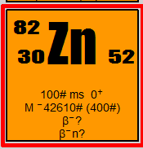
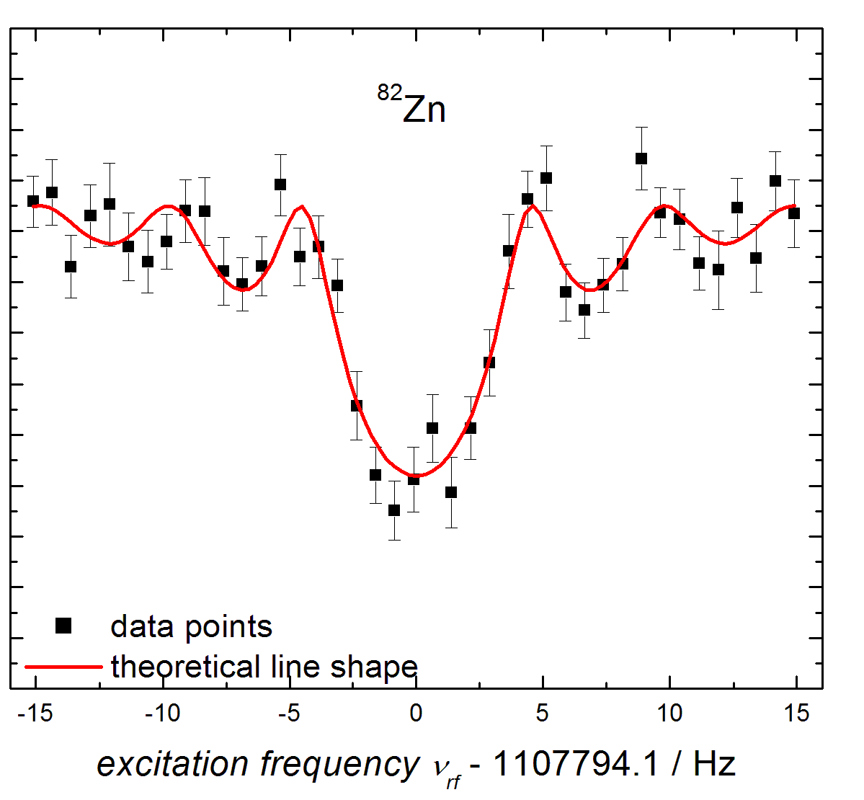
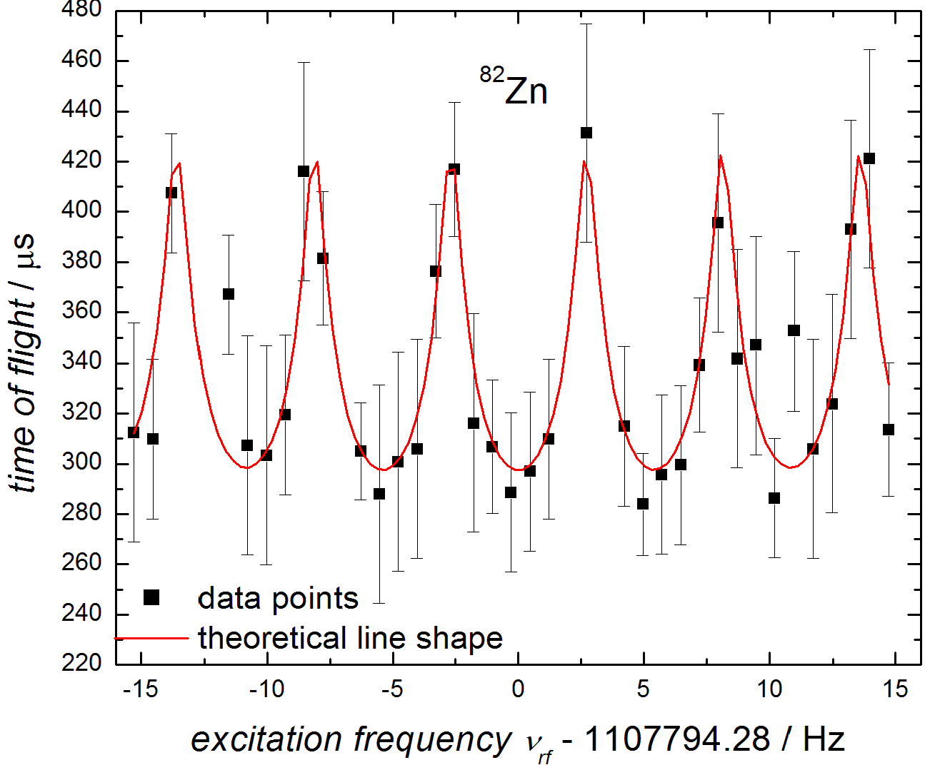
82Zn
High-precision mass of 82Zn: after several attempts at ISOLTRAP and elsewhere
Combined ISOLDE technical know-how:
  neutron-converter and quartz transfer line (contaminant suppression)
  laser ionisation (beam enhancement)
Combined ISOLTRAP know-how:
  MR-TOF MS (contaminant suppression)
  Ramsey excitation (gain in measurement time and/or precision)
Excitation | TOF | Ramsey
duration | 195 min | 35 min
Ion count | 580 | 75
m/δm | 1*10⁻⁷ | 8*10⁻⁸
200 ms
20-160-20 ms
R.N. Wolf et al, Phys. Rev. Lett. 110, 041101 (2013)

Slide 10
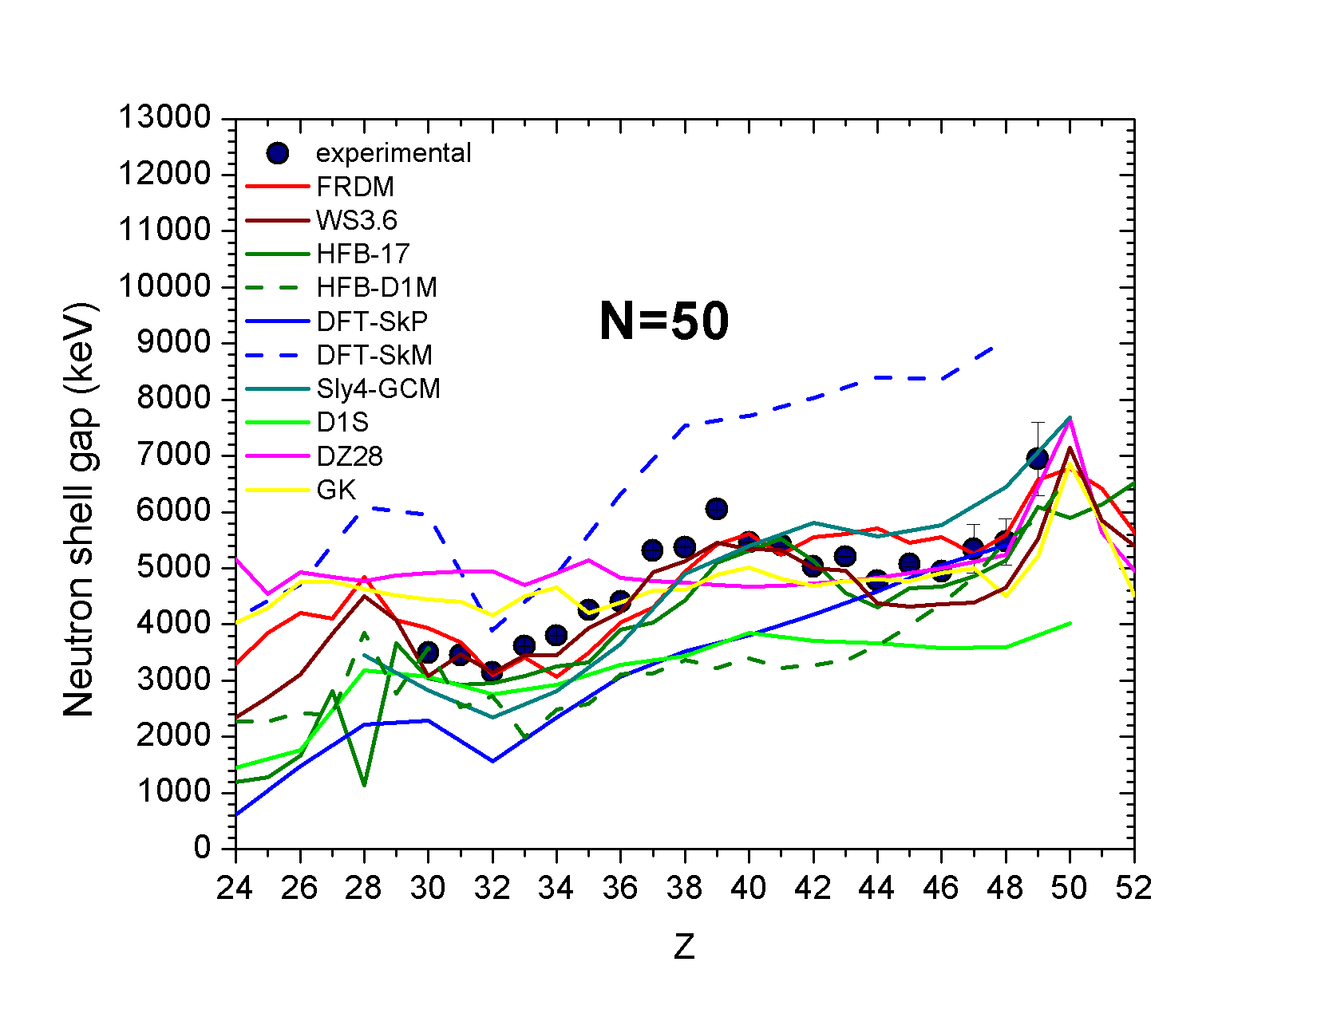
82Zn
Nuclear structure:
  N=50 shell closure
Zn
Shell enhancement towards 78Ni

Slide 11
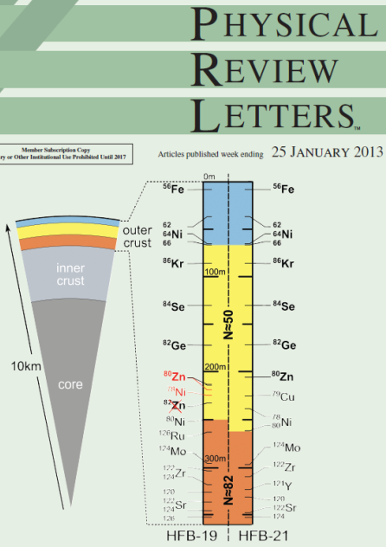
82Zn
Astrophysics – neutron-star composition
  Relevant data: nuclear binding energy (+well-known electron and lattice energy)
Test for mass models (e.g. HFB)
  HFB-19 to 21: constrained to reproduce different realistic neutron-matter EOS
  Mass agreement best for HFS-21
  Measured value of 1.97(4) solar masses excludes many models for dense-matter EOS, in particular HFB-19
Outer crust probed to higher depths
  82Zn not present
Canonical neutron star: 1.4 solar mass and 10 km radius
R.N. Wolf et al, Phys. Rev. Lett. 110, 041101 (2013)

Slide 12
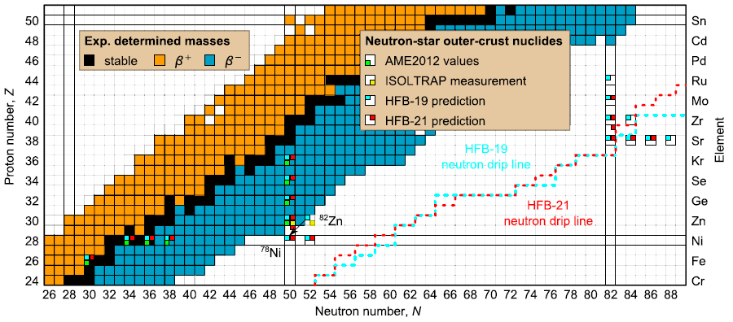
82Zn
Astrophysics – r-process path
R.N. Wolf et al, Phys. Rev. Lett. 110, 041101 (2013)

Slide 13
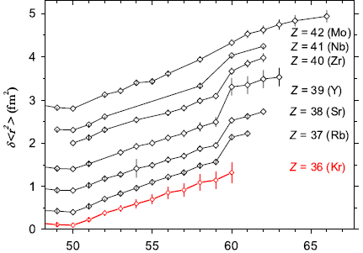
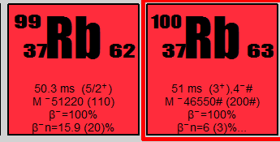
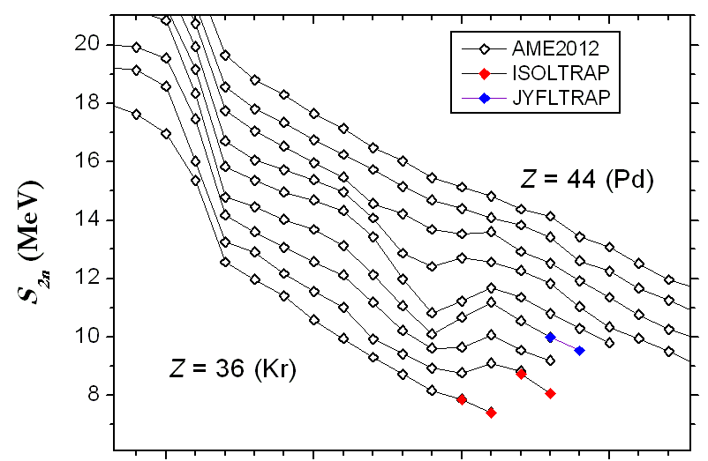
99,100Rb
Nuclear structure around A=100 – quantum phase transitions
  Sudden onset of deformation around n-rich Zr isotopes
  ISOLTRAP 2010: Kr at the border of the region
  Rb: 98,99Rb – deformed, how about 100Rb?
  Kr – S_{2n} consistent with radii, 100Rb – radius missing (see TRIUMF poster for radii up to 99Rb)
Data under analysis – stay tuned
N
Rb?
Kr: S. Naimi et al. PRL 105, 032502 (2010)

Slide 14
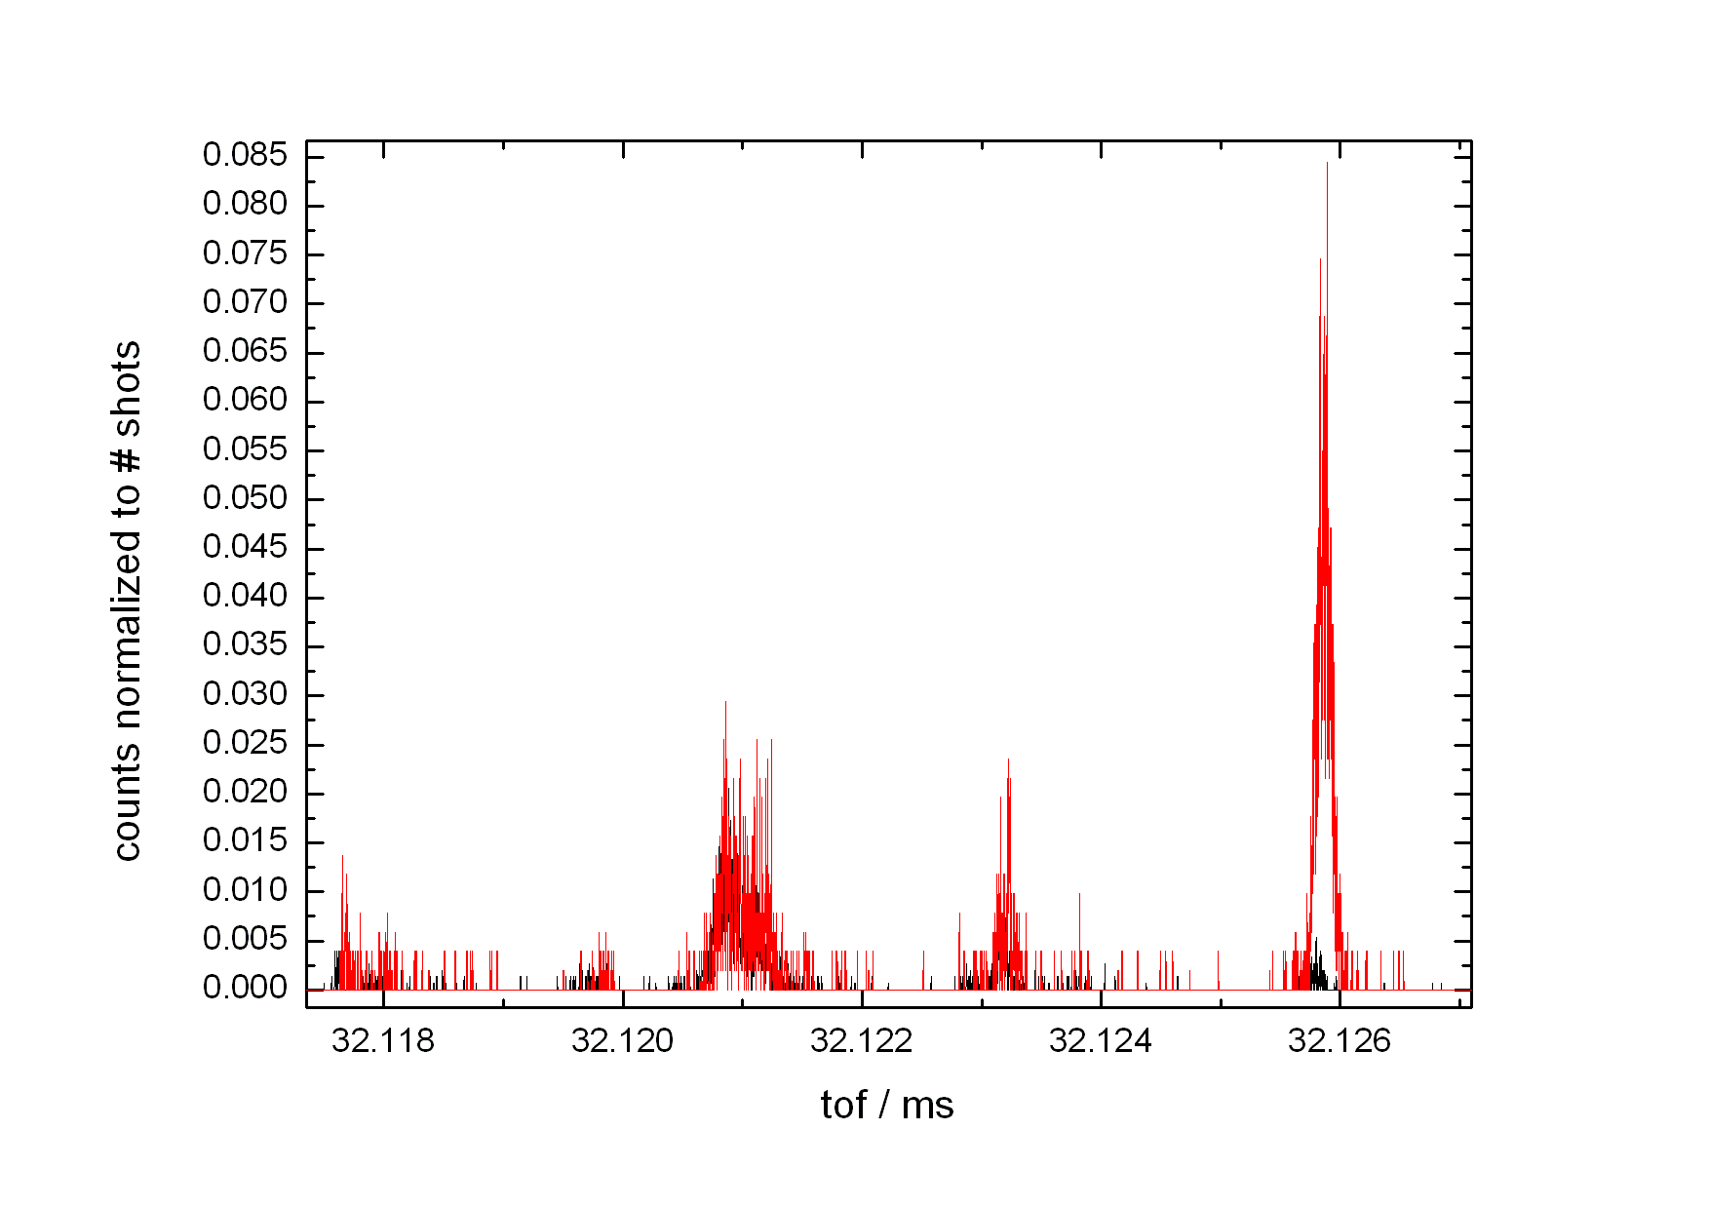
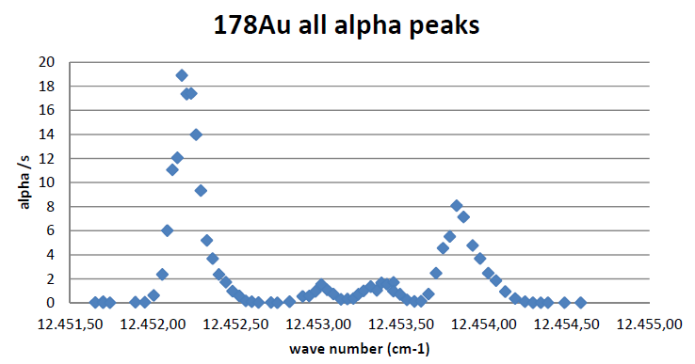
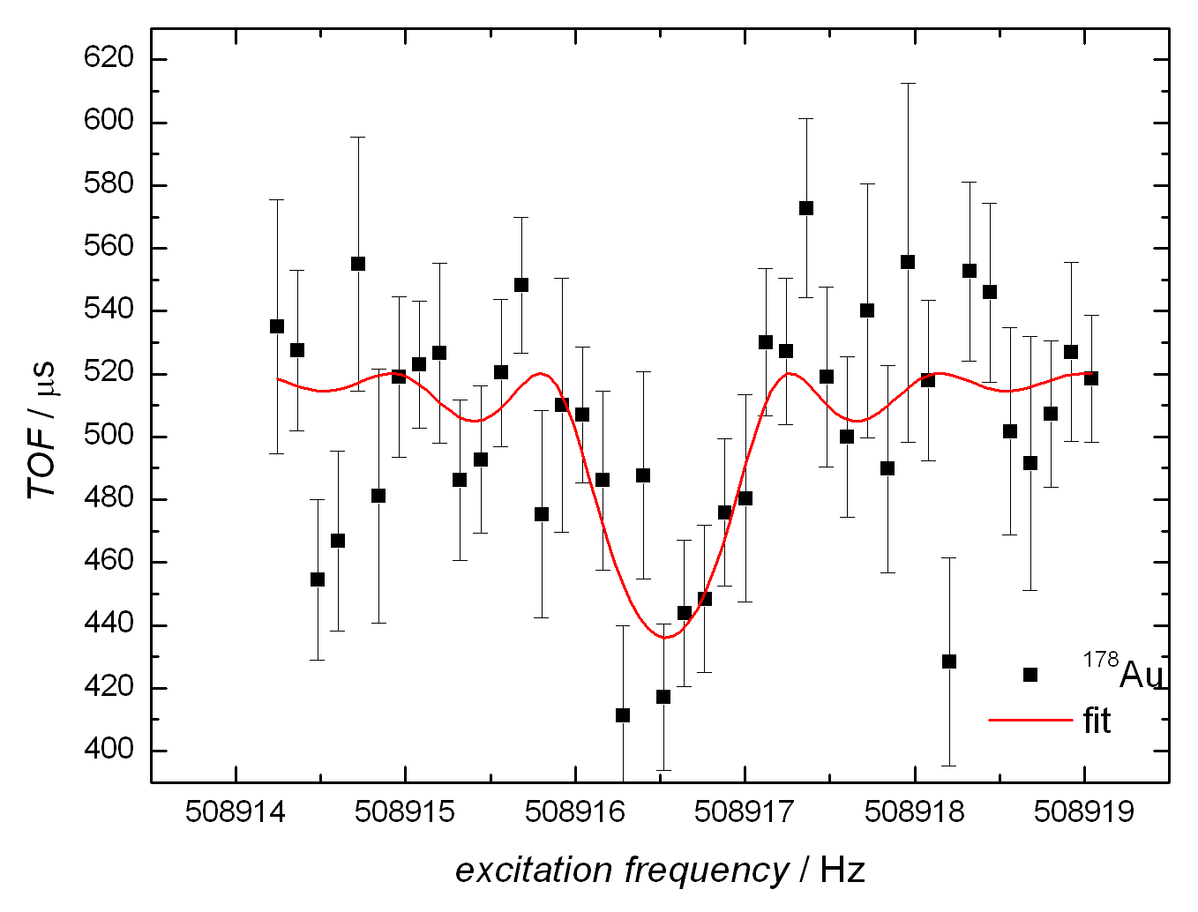
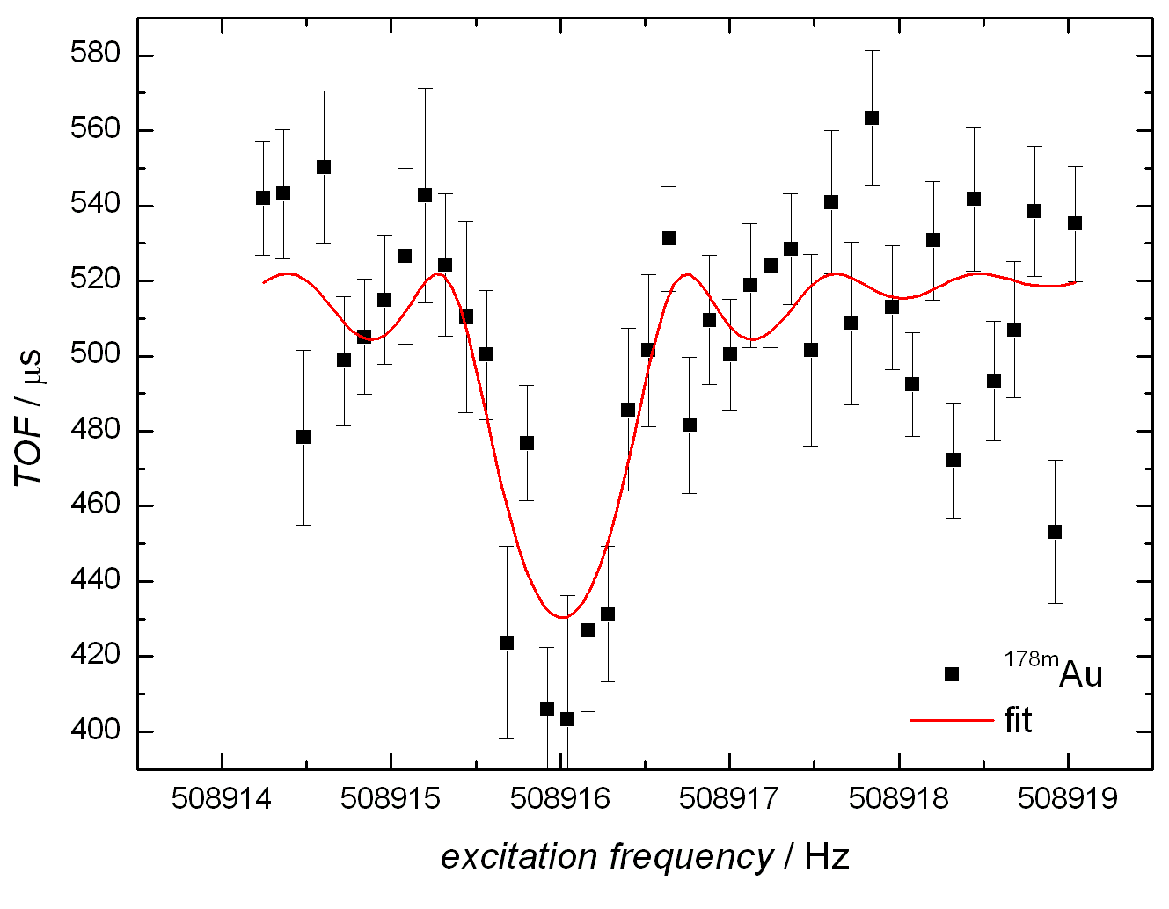
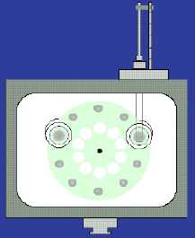
gs and isomer masses of n-def Au
Synergy with Windmill Experiment and laser ionisation
MR-TOF used for fast beam purification and HFS scans
MR-TOF MS spectra
ν_{laser} resonant on ¹⁷⁸Au
ν_{laser} resonant on ^{178m}Au
^{178m}Au
oxides
atomic
isobars
¹⁷⁸Au
Different setting of RILIS lasers
Windmill

Slide 15
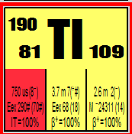
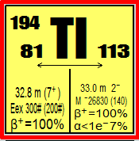
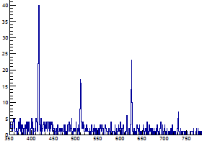
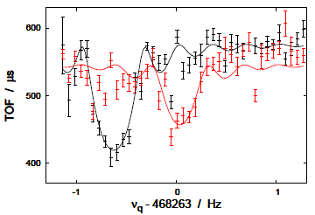
190,194Tl
Nuclear structure
  Vicinity of Z=82, wealth of isomers
ISOLTRAP decay station assisting mass studies
190Tl
  Mass of high-spin isomer
  Masses in alpha-chain
194Tl
  Confirmation of spin-state assignment
  gs and isomer masses
  Isomer excitation energy determined
²⁰⁶Ac (10-)
²⁰⁶Ac (3+)
²⁰²Fr (10-)
²⁰²Fr (3+)
counts
¹⁹⁸At (10-)
¹⁹⁸At (3+)
γ−γ coincidence spectrum
¹⁹⁴Bi (10-)
¹⁹⁴Bi (3+)
¹⁹⁰Tl (7+)
¹⁹⁰Tl (2-)
ISOLTRAP
E / keV
From α Q-values
TOF / us
E(7+) = 260 (15) keV
M. Kowalska, S. Naimi et al., Nucl. Instr. and Meth. A 689, 102 (2012)
J. Stanja, Ch. Borgmann et al., in prepatation

Slide 16
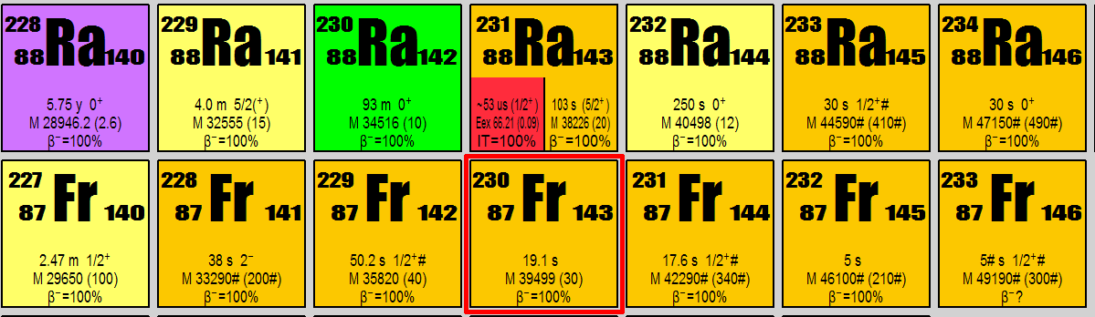
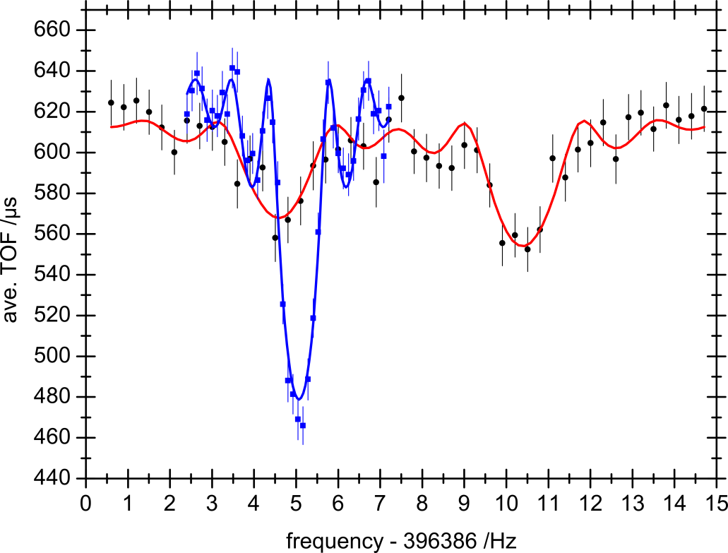
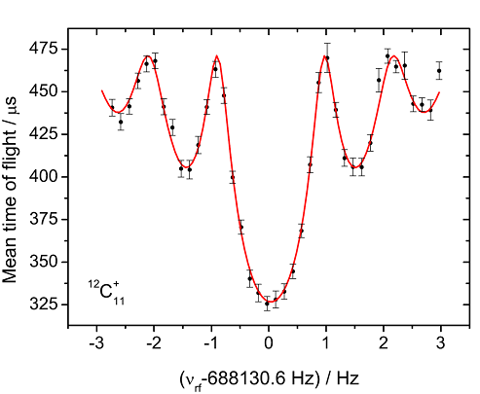
N-rich Fr and Ra
Poster by M. Rosenbusch
Astrophysics
  close to r-process path
Nuclear structure
  Complementary to Rn data (Rn, Ra – octupole correlations)
  Test of mass-model predictions in heavy, n-rich mass region
with cleaning
without cleaning
Cleaning in MR-TOF MS
Additional dipolar cleaning in precision trap
First identification
²²⁹Fr⁺
²²⁹Ra⁺
T_{ex}=600ms
∆f=0.5Hz !!
T_{ex}=1200ms
S. Kreim et al., INTC-P-299, IS 518 (2011)
M. Rosenbusch, PhD thesis

Slide 17
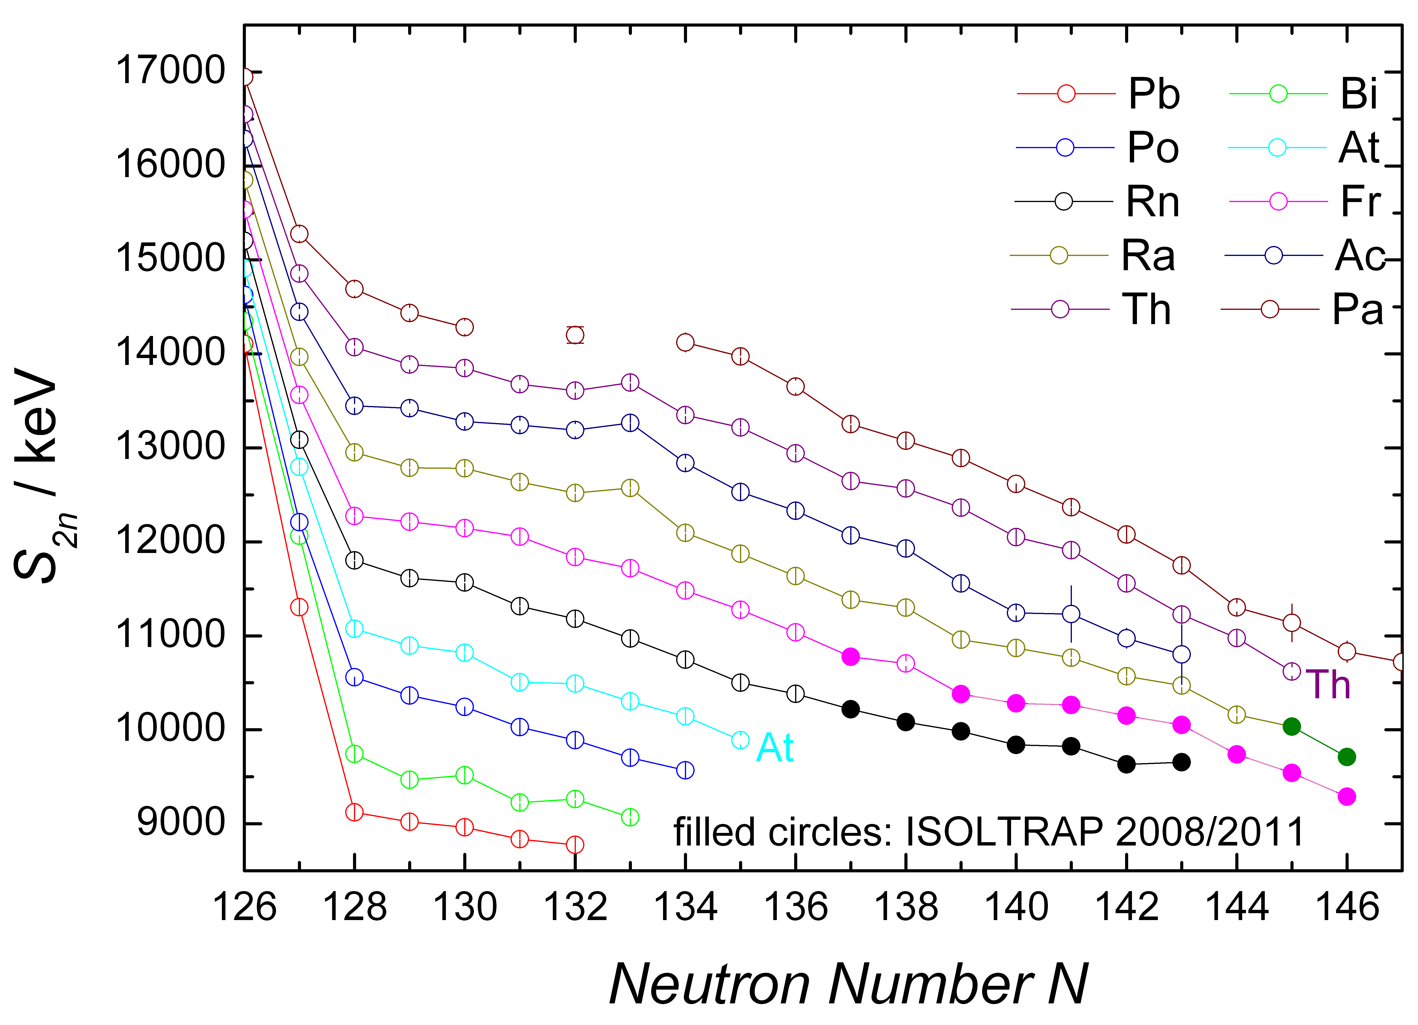
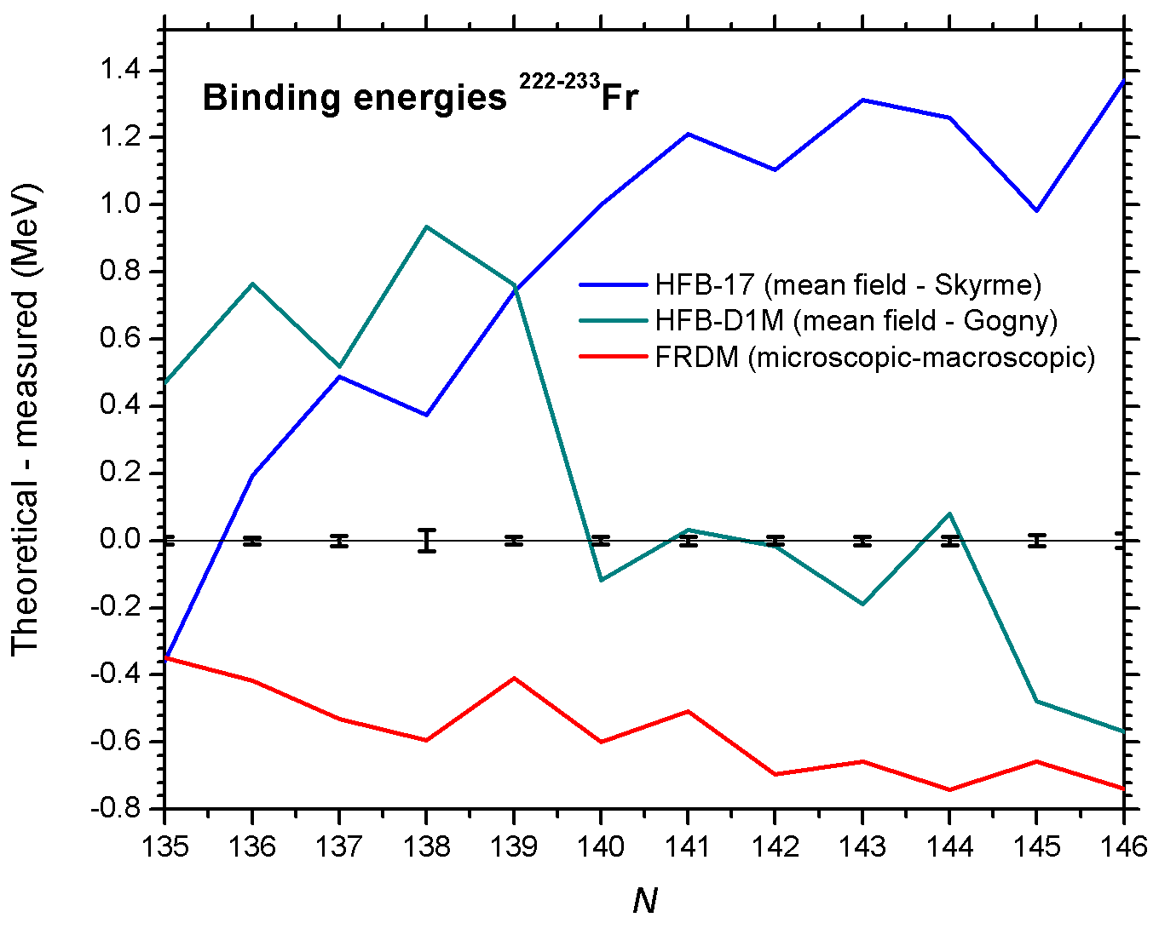
N-rich Fr and Ra
Comparison to mass models
  Not many models
2-neutron separation energy
  Hint for deformation effects
Preliminary
Fr
Ra
S. Kreim et al., INTC-P-299, IS 518 (2011)
D. Neiherr et al., PRL 102, 112501 (2009)
M. Rosenbusch, PhD thesis

Slide 18
Summary and outlook
Mass measurements at ISOLDE performed with ISOLTRAP setup
Recent technical upgrades
Physics cases all over nuclear chart
Results relevant for nuclear structure and astrophysics
New types of studies
The future looks bright

Slide 19
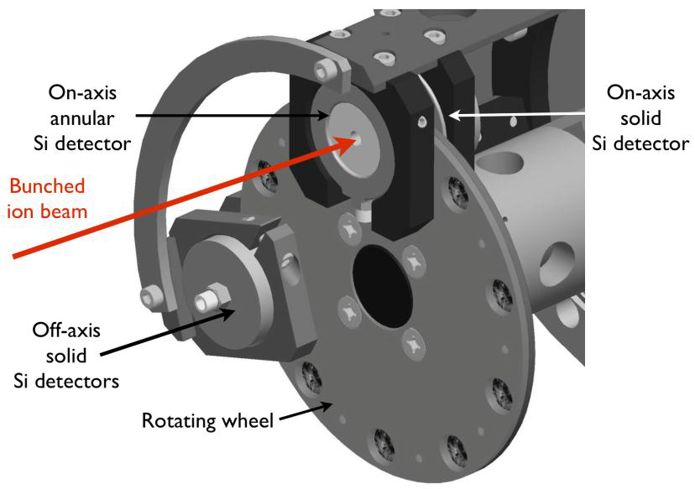
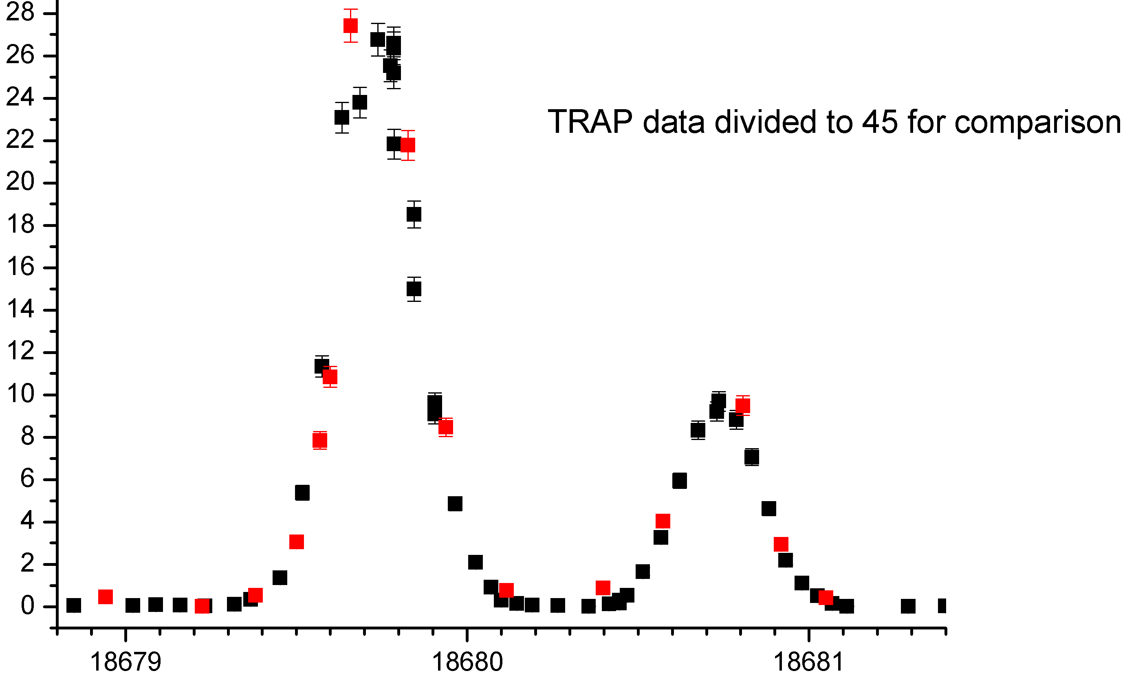
Synergies: lasers and traps
Laser Spectroscopy of n-deficient Au
Wind mill – decay spectrometer ( )
¹⁷⁹Au
counts
preliminary!
wave number / cm⁻¹
ISOLTRAP – detector for single ions ( )
HFS studies: all isotopes are accessible due to complementarity (decay vs. counting)
  Region of deformed nuclei in neutron-rich gold isotopes
State-selective spectroscopy (isomer selectivity at RILIS + isobar selectivity at ISOLTRAP)
  Determination of excitation energies

Slide 20
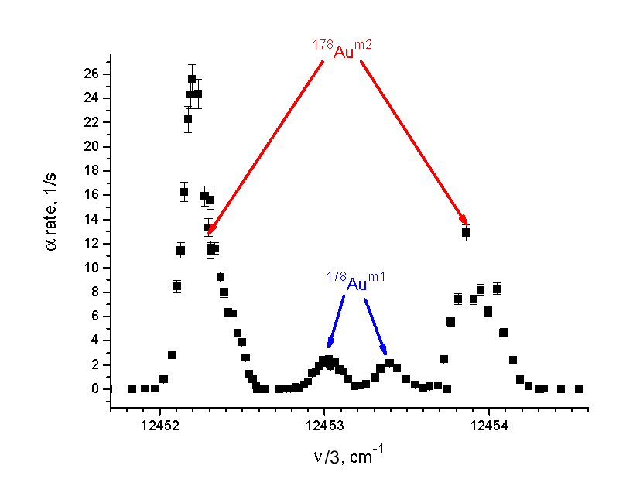
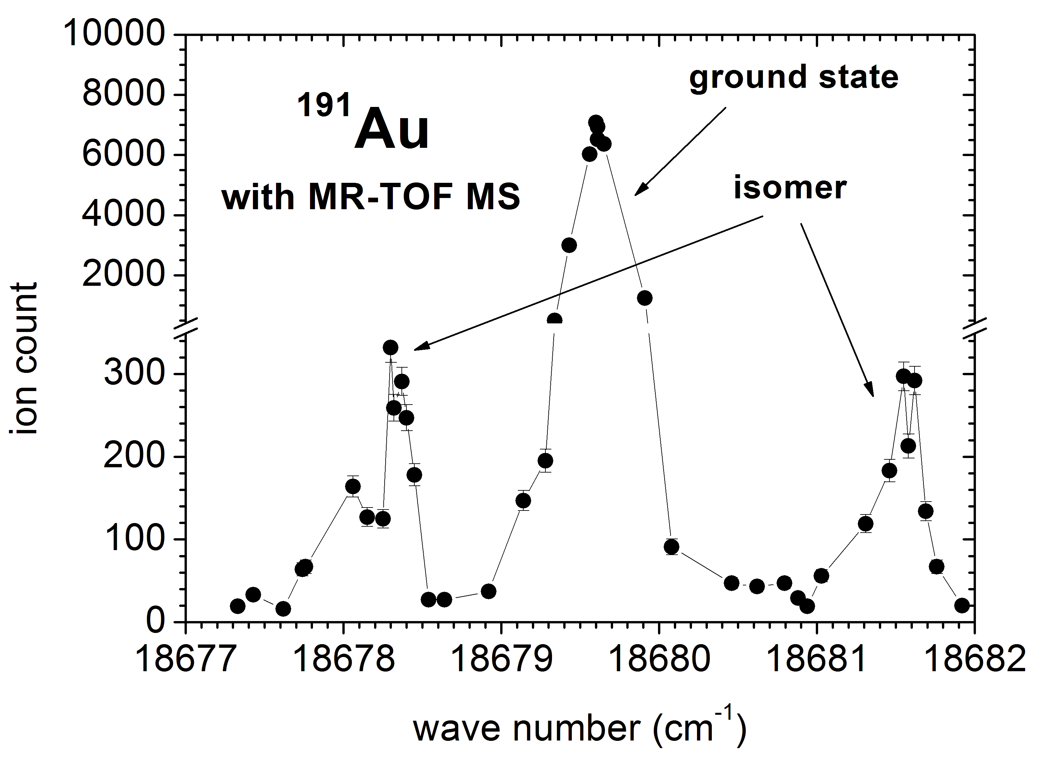



MR-TOF MS: Au HFS structure
Windmill spectrum
Proof of principle of resonance ionization laser spectroscopy with the MR-TOF MS.
Excitation energy of isomer in ¹⁷⁸Au.
S. Kreim et al., INTC-P-299, IS 518 (2011)
S. Kreim et al., Nucl. Instr. Meth. B, submitted (2013)

Slide 21




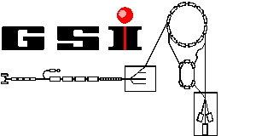
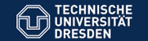
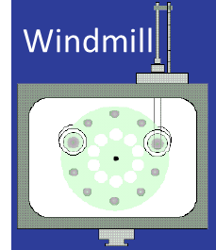







P. Ascher, D. Atanasov, K. Blaum, Ch. Böhm, Ch. Borgmann, R. B. Cakirli,
S. Eliseev, S. Naimi
S. George, M. Rosenbusch, R. Wolf, L. Schweikhard, F. Wienholtz
G. Audi, D. Lunney, V. Manea, M. Wang
D. Beck, F. Herfurth, J. Kluge, Y. Litvinov, E. Minaya-Ramirez, D. Neidherr
J. Stanja, K. Zuber
S. Kreim
S. Schwarz, G. Bollen
M. Breitenfeldt
T. E. Cocolios
http://isoltrap.web.cern.ch
contact at CERN: skreim@cern.ch

Slide 22
Thank you for your attention

Slide 23
N-rich Ca isotopes
protons off
Measurement time / arb. units
lasers off
⁵⁴Cr
Time of flight / arb. units
Expected
TOF ⁵⁴Ca
Data from summer 2012
Masses of ^{51,52}Ca measured with conventional TOF resonances in ISOLTRAP‘s precision trap.
Direct mass-measurement using the MR-TOF on ⁵²⁻⁵⁴Ca

Slide 24
82Zn
100 ms, 200 ms
15 ms
100 ms + 5 ms
2.5 ms, 100 turns,
R = 6000

Slide 25
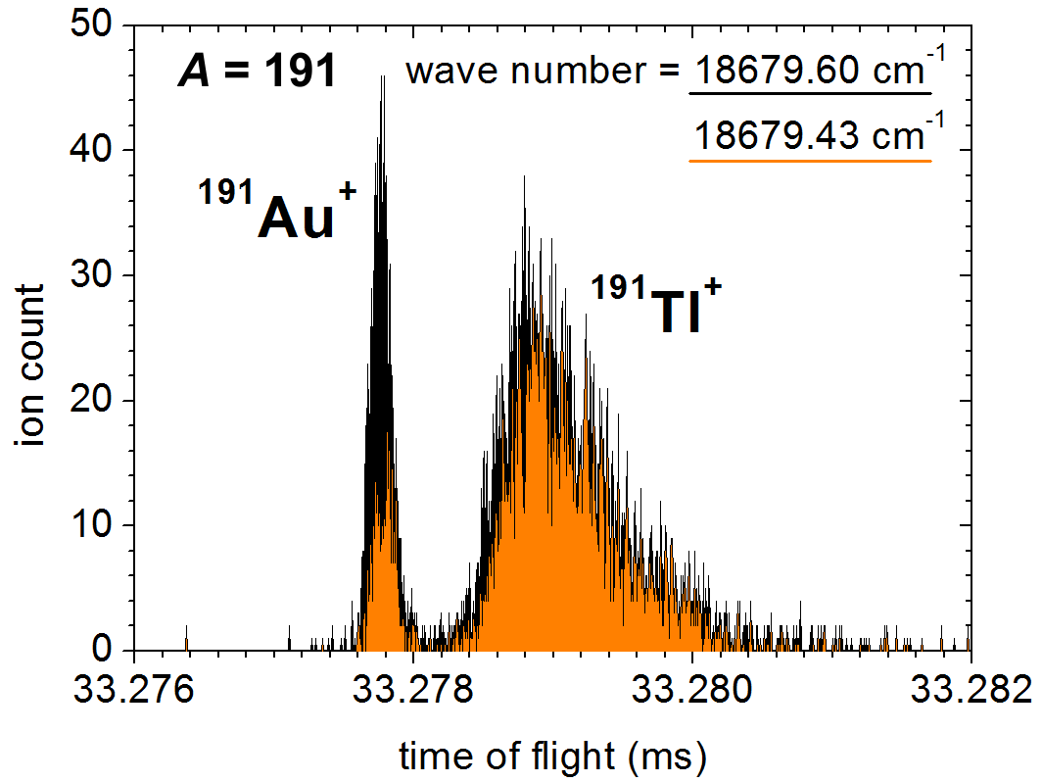
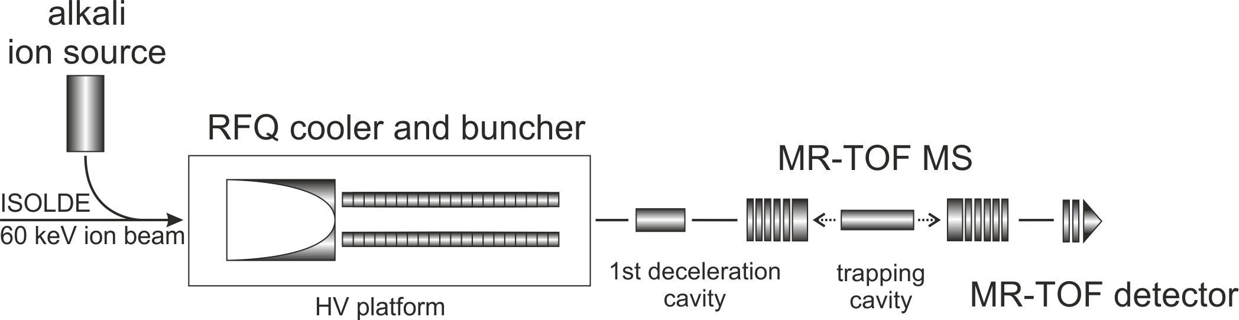
Resonance-ionization laser spectroscopy with MR-TOF MS
Resonant-ionization laser spectroscopy with:
direct-ion detection
reduced or suppressed background
normalization using isobaric contaminants
no dependence on decay mode
using the laser-ion source @ ISOLDE: RILIS
S. Kreim et al, submitted to Nucl. Instr. Meth. B (2013)
B. Marsh et al., submitted to Nucl. Instr. Meth. B (2013

Slide 26
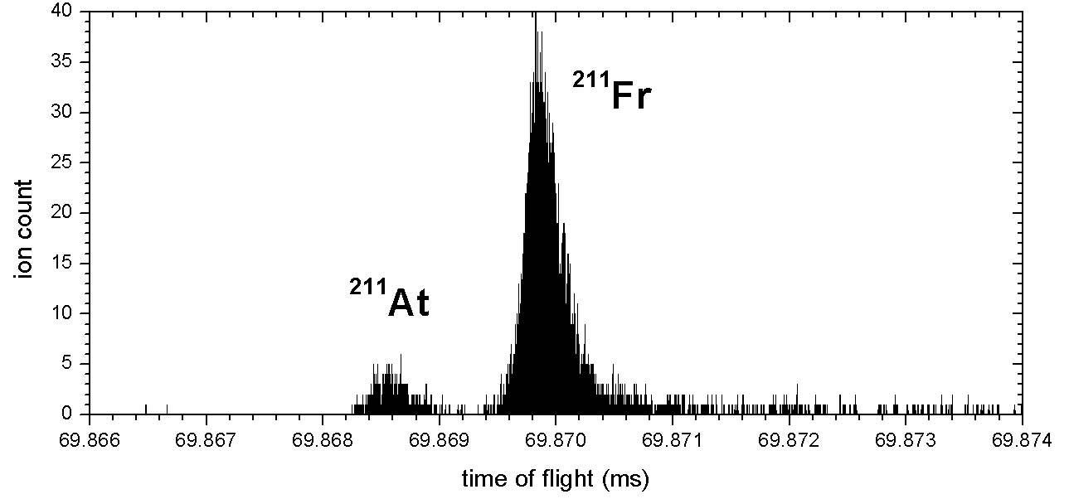
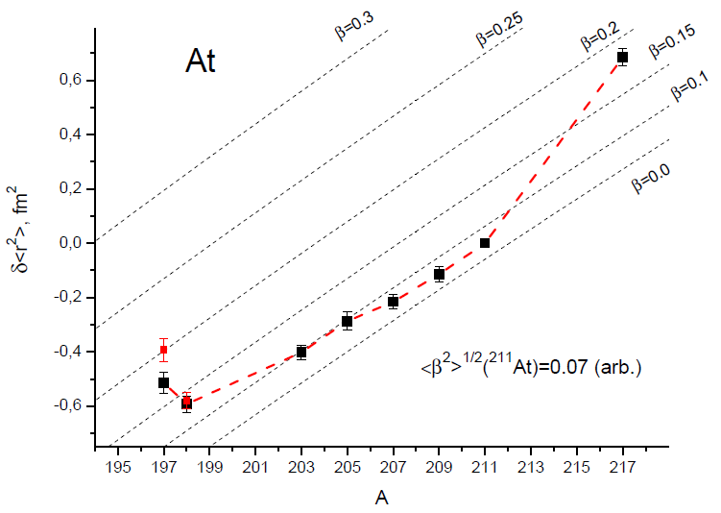
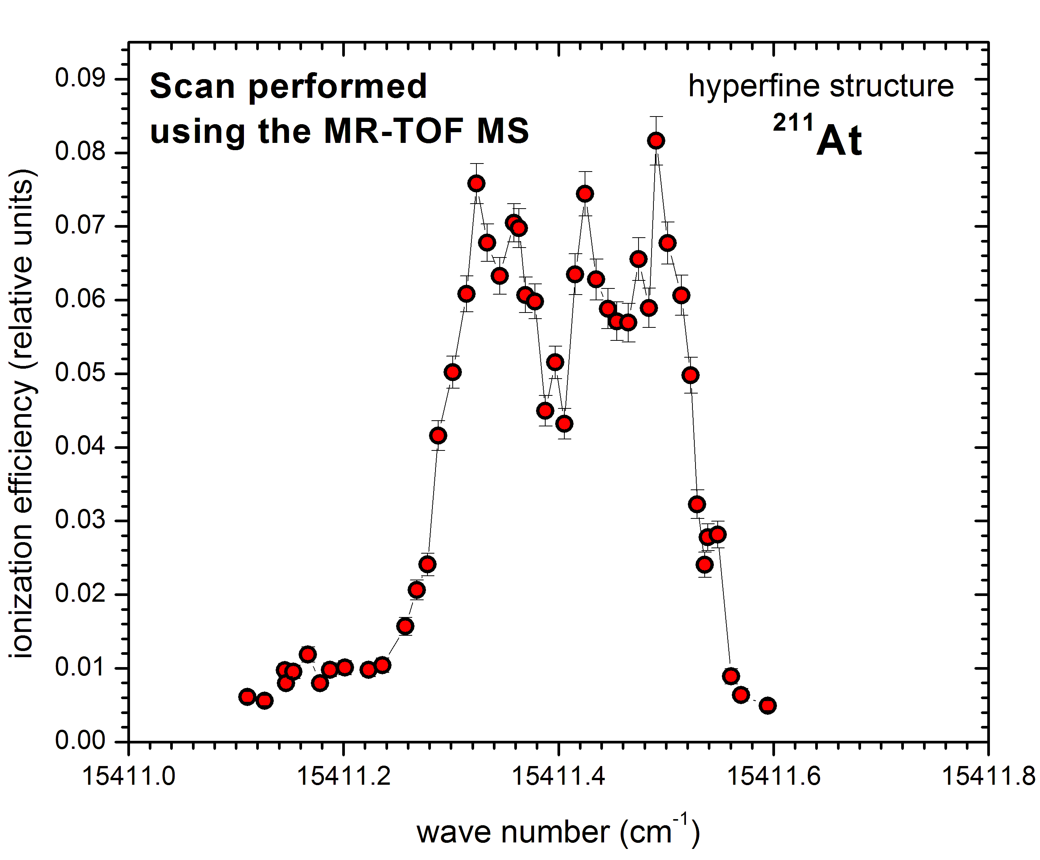
At HFS
Preliminary
Joint experimental campaign with the Windmill experiment and RILIS.
S. Kreim et al., INTC-P-299, IS 518 (2011)
A. Andreyev et al., INTC-P-319 (2012)

Slide 27
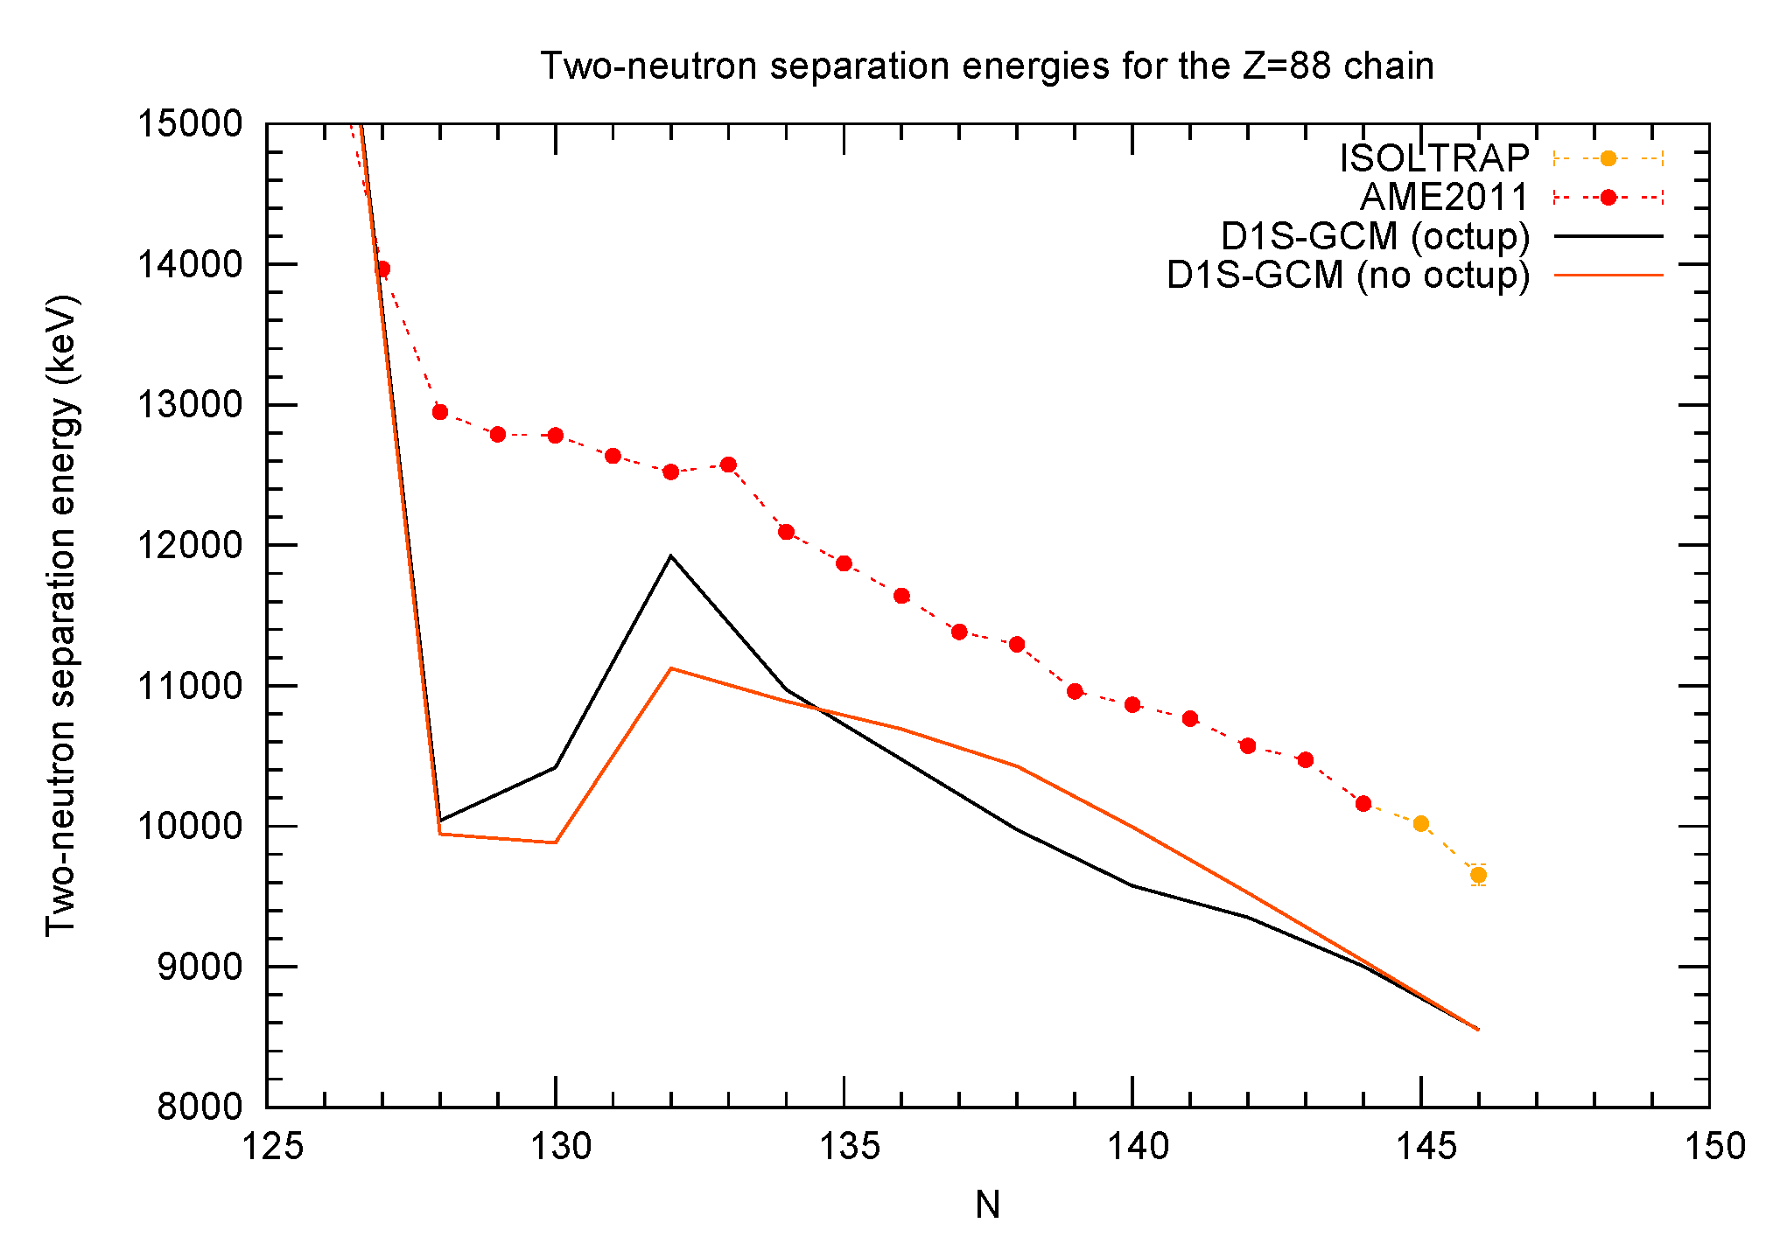
Not many models to compare to in the neutron-rich, heavy-mass region
Models have difficulties to describe these nuclei
How well can observables from ground-state properties describe subtle structural effects?
Investigate odd-even staggering in 3-point indicator (neutron empirical pairing gap)
S. Goriely et al., PRL 102, 152503 and 242501 (2009)
P. Moller, et al., Data and Nucl. Data Tables 59, 185 (1995)
G. Bertsch, Private Communication
W. Satula et al., PRL 81, 3599 (1998)

Slide 28
Neutron stars
Outer crust of neutron stars is a possible birthplace of the heavy elements due to neutronization of matter
Depth profile of a neutron star by using experimental masses and mass models as input for equation of state
Two groups of nuclides constitue outer crust: N=50 and N=82
The most exotic nuclide yet measured for modelling the elemental composition of the outer crust

Slide 29
82Zn
Tolman - Oppenheimer - Volkoff equations: relating pressure and mass-energy density with neutron-star mass and radius
HFB-19 to 21: constrained to reproduce 3 different representative realistic neutron-matter EOS (as obtained from many-body calculations using realistic 2- and 3-body forces) up to the highest densities prevailing in neutron stars
  restricted comparisons to these models because also use their predictions of the equation of state of neutron-star matter for consistency
  82Zn is considerably less bound than predicted by HFB-19 and HFB-20 ME_{HFB-19,20} = 42.96 MeV)
  prediction of HFB-21 close (ME_{HFB-21} = 42.70 MeV) -> predicted neutron-star profile unchanged
Measured value of 1.97(4) solar masses excludes many theoretical models for the dense-matter EOS, in particular HFB-19, which predicts a lower maximum neutron-star mass
Mass model | Mass difference to ISOLTRAP /MeV
HFB-19 | -42.96-(-42.314)=0.646
HFB-20 | -42.96-(-42.314)=0.646
HFB-21 | -42.70-(-42.314)=0.386

Slide 30
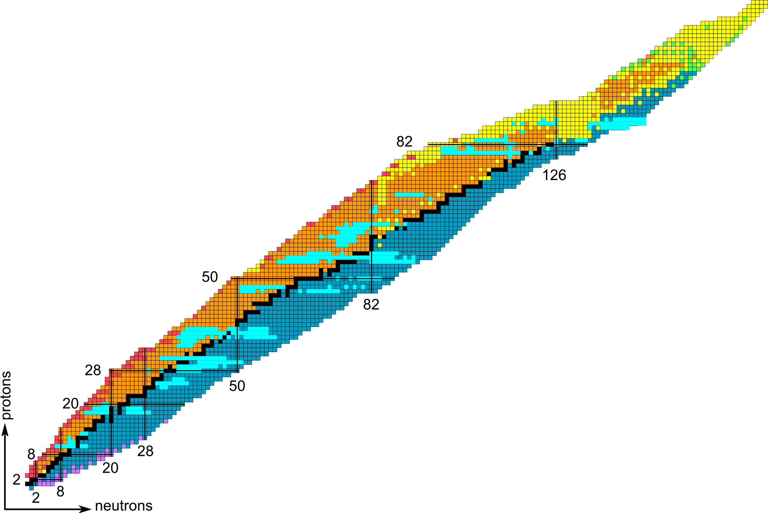
residual interaction
magic numbers
weak interaction
nucleosynthesis
Nuclear structure
halo nuclei
^{190,193}Tl
⁹⁹⁻¹¹⁰Cd
²²⁴⁻²³³Fr
⁶¹⁻⁶³Fe
¹³⁶⁻¹⁴⁶Xe
²²³⁻²²⁹Rn
⁸²Zn
Examples:
discovery of new nuclides, ²²⁹Radon, ²³³Francium
critical-point boundary for NQPT near A=100 from ^{96,97}Kr
provide experimental data for shell structure investigation
⁸²Zn is important for modelling of the crust of neutron stars
Neidherr et al., Phys. Rev. Lett. 102, 112501 (2009)
Naimi et al., Phys. Rev. Lett. 105, 032502 (2010)
Dworschak et al., Phys. Rev. Lett. 100, 072501 (2008)
R. N. Wolf et al., PRL submitted (2012)
30

Slide 31

194Tl

Slide 32

90
91
Pa
212
Pa
213
Pa
214
Pa
215
Pa
216
Pa
217
Pa
218
Pa
219
Pa
220
Pa
221
Pa
222
Pa
223
Pa
224
Pa
225
Pa
226
Pa
227
Pa
228
Pa
229
Pa
230
Pa
231
Pa
232
Pa
233
Pa
234
Pa
235
Pa
236
Pa
237
Pa
238
89
Ac
207
Ac
208
Th
210
Th
211
Th
212
Th
213
Th
214
Th
215
Th
216
Th
217
Th
218
Th
219
Th
220
Th
221
Th
222
Th
223
Th
224
Th
225
Th
226
Th
227
Th
228
Th
229
Th
230
Th
231
Th
232
Th
233
Th
234
Th
235
Th
236
Th
237
88
Ra
202
Ra
203
Ra
204
Ra
205
Ra
206
Ra
207
Ac
209
Ac
210
Ac
211
Ac
212
Ac
213
Ac
214
Ac
215
Ac
216
Ac
217
Ac
218
Ac
219
Ac
220
Ac
221
Ac
222
Ac
223
Ac
224
Ac
225
Ac
226
Ac
227
Ac
228
Ac
229
Ac
230
Ac
231
Ac
232
Ac
233
Ac
234
87
Fr
200
Fr
201
Fr
202
Fr
203
Fr
204
Fr
205
Fr
206
Ra
208
Ra
209
Ra
210
Ra
211
Ra
212
Ra
213
Ra
214
Ra
215
Ra
216
Ra
217
Ra
218
Ra
219
Ra
220
Ra
221
Ra
222
Ra
223
Ra
224
Ra
225
Ra
226
Ra
227
Ra
228
Ra
229
Ra
230
86
Rn
196
Rn
197
Rn
198
Rn
199
Rn
200
Rn
201
Rn
202
Rn
203
Rn
204
Rn
205
Fr
207
Fr
208
Fr
209
Fr
210
Fr
211
Fr
212
Fr
213
Fr
214
Fr
215
Fr
216
Fr
217
Fr
218
Fr
219
Fr
220
Fr
221
Fr
222
Fr
223
Fr
224
Fr
225
Fr
226
Fr
227
Fr
228
Fr
229
85
At
194
At
195
At
196
At
197
At
198
At
199
At
200
At
201
At
202
At
203
At
204
Rn
206
Rn
207
Rn
208
Rn
209
Rn
210
Rn
211
Rn
212
Rn
213
Rn
214
Rn
215
Rn
216
Rn
217
Rn
218
Rn
219
Rn
220
Rn
221
Rn
222
Rn
223
Rn
224
Rn
225
Rn
226
Rn
227
Rn
228
84
Po
190
Po
191
Po
192
Po
193
Po
194
Po
195
Po
196
Po
197
Po
198
Po
199
Po
200
Po
201
Po
202
Po
203
At
205
At
206
At
207
At
208
At
209
At
210
At
211
At
212
At
213
At
214
At
215
At
216
At
217
At
218
At
219
At
220
At
221
At
222
At
223
140
142
83
Bi
185
Bi
186
Bi
187
Bi
188
Bi
189
Bi
190
Bi
191
Bi
192
Bi
193
Bi
194
Bi
195
Bi
196
Bi
197
Bi
198
Bi
199
Bi
200
Bi
201
Bi
202
Po
204
Po
205
Po
206
Po
207
Po
208
Po
209
Po
210
Po
211
Po
212
Po
213
Po
214
Po
215
Po
216
Po
217
Po
218
Po
219
Po
220
138
82
Pb
180
Pb
181
Pb
182
Pb
183
Pb
184
Pb
185
Pb
186
Pb
187
Pb
188
Pb
189
Pb
190
Pb
191
Pb
192
Pb
193
Pb
194
Pb
195
Pb
196
Pb
197
Pb
198
Pb
199
Pb
200
Pb
201
Bi
203
Bi
204
Bi
205
Bi
206
Bi
207
Bi
208
Bi
210
Bi
211
Bi
212
Bi
213
Bi
214
Bi
215
Bi
216
Bi
217
Bi
218
136
81
Tl
179
Tl
180
Tl
181
Tl
182
Tl
183
Tl
184
Tl
185
Tl
186
Tl
187
Tl
188
Tl
189
Tl
190
Tl
191
Tl
192
Tl
193
Tl
194
Tl
195
Tl
196
Tl
197
Tl
198
Tl
199
Tl
200
Pb
202
Pb
203
Pb
204
Pb
205
Pb
206
Pb
207
Pb
208
Pb
209
Pb
210
Pb
211
Pb
212
Pb
213
Pb
214
134
80
Hg
174
Hg
175
Hg
176
Hg
177
Hg
178
Hg
179
Hg
180
Hg
181
Hg
182
Hg
183
Hg
184
Hg
185
Hg
186
Hg
187
Hg
188
Hg
189
Hg
190
Hg
191
Hg
192
Hg
193
Hg
194
Hg
195
Hg
196
Hg
197
Hg
198
Hg
199
Tl
201
Tl
202
Tl
203
Tl
204
Tl
205
Tl
206
Tl
207
Tl
208
Tl
209
Tl
210
Tl
211
Tl
212
132
79
Au
171
Au
172
Au
173
Au
174
Au
175
Au
176
Au
177
Au
178
Au
179
Au
180
Au
181
Au
182
Au
183
Au
184
Au
185
Au
186
Au
187
Au
188
Au
189
Au
190
Au
191
Au
192
Au
193
Au
194
Au
195
Au
196
Au
197
Au
198
Hg
200
Hg
201
Hg
202
Hg
203
Hg
204
Hg
205
Hg
206
Hg
207
Hg
208
Hg
209
Hg
210
78
Pt
166
Pt
167
Pt
168
Pt
169
Pt
170
Pt
171
Pt
172
Pt
173
Pt
174
Pt
175
Pt
176
Pt
177
Pt
178
Pt
179
Pt
180
Pt
181
Pt
182
Pt
183
Pt
184
Pt
185
Pt
186
Pt
187
Pt
188
Pt
189
Pt
190
Au
199
Au
200
Au
201
Au
202
Au
203
Au
204
Au
205
128
130
56
Ba
114
Ba
115
Ba
116
Ba
117
57
La
120
La
121
La
122
La
123
La
124
La
125
La
126
La
127
La
128
La
129
La
130
La
131
La
132
La
133
La
134
La
135
La
136
La
137
La
138
La
139
La
140
La
141
La
142
La
143
La
144
La
145
La
146
La
147
La
148
La
149
La
150
La
151
La
152
La
153
La
154
55
Cs
112
Cs
113
Cs
114
Cs
115
Cs
116
Ba
118
Ba
119
Ba
120
Ba
121
Ba
122
Ba
123
Ba
124
Ba
125
Ba
126
Ba
127
Ba
128
Ba
129
Ba
130
Ba
131
Ba
132
Ba
133
Ba
134
Ba
135
Ba
136
Ba
137
Ba
138
Ba
139
Ba
140
Ba
141
Ba
142
Ba
143
Ba
144
Ba
145
Ba
146
Ba
147
Ba
148
Ba
149
Ba
150
Ba
151
Ba
152
Ba
153
54
Xe
110
Xe
111
Xe
112
Xe
113
Xe
114
Xe
115
Cs
117
Cs
118
Cs
119
Cs
120
Cs
121
Cs
122
Cs
123
Cs
124
Cs
125
Cs
126
Cs
127
Cs
128
Cs
129
Cs
130
Cs
131
Cs
132
Cs
133
Cs
134
Cs
135
Cs
136
Cs
137
Cs
138
Cs
139
Cs
140
Cs
141
Cs
142
Cs
143
Cs
144
Cs
145
Cs
146
Cs
147
Cs
148
Cs
149
Cs
150
Cs
151
Cs
152
53
I
108
I
109
I
110
I
111
I
112
I
113
I
114
Xe
116
Xe
117
Xe
118
Xe
119
Xe
120
Xe
121
Xe
122
Xe
123
Xe
124
Xe
125
Xe
126
Xe
127
Xe
128
Xe
129
Xe
130
Xe
131
Xe
132
Xe
133
Xe
134
Xe
135
Xe
136
Xe
137
Xe
138
Xe
139
Xe
140
Xe
141
Xe
142
Xe
143
Xe
144
Xe
145
Xe
146
Xe
147
94
96
52
Te
106
Te
107
Te
108
Te
109
Te
110
Te
111
Te
112
Te
113
I
115
I
116
I
117
I
118
I
119
I
120
I
121
I
122
I
123
I
124
I
125
I
126
I
127
I
128
I
129
I
130
I
131
I
132
I
133
I
134
I
135
I
136
I
137
I
138
I
139
I
140
I
141
I
142
I
143
I
144
92
51
Sb
103
Sb
104
Sb
105
Sb
106
Sb
107
Sb
108
Sb
109
Sb
110
Sb
111
Sb
112
Te
114
Te
115
Te
116
Te
117
Te
118
Te
119
Te
120
Te
121
Te
122
Te
123
Te
124
Te
125
Te
126
Te
127
Te
128
Te
129
Te
130
Te
131
Te
132
Te
133
Te
134
Te
135
Te
136
Te
137
Te
138
Te
139
Te
140
Te
141
Te
142
50
Sn
100
Sn
101
Sn
102
Sn
103
Sn
104
Sn
105
Sn
106
Sn
107
Sn
108
Sn
109
Sn
110
Sn
111
Sb
113
Sb
114
Sb
115
Sb
116
Sb
117
Sb
118
Sb
119
Sb
120
Sb
121
Sb
122
Sb
123
Sb
124
Sb
125
Sb
126
Sb
127
Sb
128
Sb
129
Sb
130
Sb
131
Sb
132
Sb
133
Sb
134
Sb
135
Sb
136
Sb
137
Sb
138
Sb
139
90
49
In
98
In
99
In
100
In
101
In
102
In
103
In
104
In
105
In
106
In
107
In
108
In
109
In
110
Sn
112
Sn
113
Sn
114
Sn
115
Sn
116
Sn
117
Sn
118
Sn
119
Sn
120
Sn
121
Sn
122
Sn
123
Sn
124
Sn
125
Sn
126
Sn
127
Sn
128
Sn
129
Sn
130
Sn
131
Sn
132
Sn
133
Sn
134
Sn
135
Sn
136
Sn
137
88
48
Cd
97
Cd
98
Cd
99
Cd
100
Cd
101
Cd
102
Cd
103
Cd
104
Cd
105
Cd
106
Cd
107
Cd
108
Cd
109
In
111
In
112
In
113
In
114
In
115
In
116
In
117
In
118
In
119
In
120
In
121
In
122
In
123
In
124
In
125
In
126
In
127
In
128
In
129
In
130
In
131
In
132
In
133
In
134
86
47
Ag
94
Ag
95
Ag
96
Ag
97
Ag
98
Ag
99
Ag
100
Ag
101
Ag
102
Ag
103
Ag
104
Ag
105
Ag
106
Ag
107
Ag
108
Cd
110
Cd
111
Cd
112
Cd
113
Cd
114
Cd
115
Cd
116
Cd
117
Cd
118
Cd
119
Cd
120
Cd
121
Cd
122
Cd
123
Cd
124
Cd
125
Cd
126
Cd
127
Cd
128
Cd
129
Cd
130
84
46
Pd
91
Pd
92
Pd
93
Pd
94
Pd
95
Pd
96
Pd
97
Pd
98
Pd
99
Pd
100
Pd
101
Pd
102
Pd
103
Pd
104
Pd
105
Pd
106
Pd
107
Ag
109
Ag
110
Ag
111
Ag
112
Ag
113
Ag
114
Ag
115
Ag
116
Ag
117
Ag
118
Ag
119
Ag
120
Ag
121
Ag
122
Ag
123
Ag
124
Ag
125
Ag
126
Ag
127
82
45
Ru
89
Ru
90
Ru
91
Ru
92
Ru
93
Rh
94
Rh
95
Rh
96
Rh
97
Rh
98
Rh
99
Rh
100
Rh
101
Rh
102
Rh
103
Rh
104
Rh
105
Rh
106
Pd
108
Pd
109
Pd
110
Pd
111
Pd
112
Pd
113
Pd
114
Pd
115
Pd
116
Pd
117
Pd
118
Pd
119
Pd
120
Pd
121
Pd
122
Pd
123
78
80
44
Ru
87
Ru
88
Ru
89
Ru
90
Ru
91
Ru
92
Ru
93
Ru
94
Ru
95
Ru
96
Ru
97
Ru
98
Ru
99
Ru
100
Ru
101
Ru
102
Ru
103
Ru
104
Ru
105
Rh
107
Rh
108
Rh
109
Rh
110
Rh
111
Rh
112
Rh
113
Rh
114
Rh
115
Rh
116
Rh
117
Rh
118
Rh
119
Rh
120
Rh
121
43
Tc
86
Tc
87
Tc
88
Tc
89
Tc
90
Tc
91
Tc
92
Tc
93
Tc
94
Tc
95
Tc
96
Tc
97
Tc
98
Tc
99
Tc
100
Tc
101
Tc
102
Tc
103
Tc
104
Ru
106
Ru
107
Ru
108
Ru
109
Ru
110
Ru
111
Ru
112
Ru
113
Ru
114
Ru
115
Ru
116
Ru
117
Ru
118
76
42
Mo
84
Mo
85
Mo
86
Mo
87
Mo
88
Mo
89
Mo
90
Mo
91
Mo
92
Mo
93
Mo
94
Mo
95
Mo
96
Mo
97
Mo
98
Mo
99
Mo
100
Mo
101
Mo
102
Mo
103
Tc
105
Tc
106
Tc
107
Tc
108
Tc
109
Tc
110
Tc
111
Tc
112
Tc
113
Tc
114
Tc
115
74
41
Nb
82
Nb
83
Nb
84
Nb
85
Nb
86
Nb
87
Nb
88
Nb
89
Nb
90
Nb
91
Nb
92
Nb
93
Nb
94
Nb
95
Nb
96
Nb
97
Nb
98
Nb
99
Nb
100
Nb
101
Nb
102
Mo
104
Mo
105
Mo
106
Mo
107
Mo
108
Mo
109
Mo
110
Mo
111
Mo
112
Mo
113
72
40
Zr
80
Zr
81
Zr
82
Zr
83
Zr
84
Zr
85
Zr
86
Zr
87
Zr
88
Zr
89
Zr
90
Zr
91
Zr
92
Zr
93
Zr
94
Zr
95
Zr
96
Zr
97
Zr
98
Zr
99
Zr
100
Zr
101
Nb
103
Nb
104
Nb
105
Nb
106
Nb
107
Nb
108
Nb
109
Nb
110
70
39
Y
78
Y
79
Y
80
Y
81
Y
82
Y
83
Y
84
Y
85
Y
86
Y
87
Y
88
Y
89
Y
90
Y
91
Y
92
Y
93
Y
94
Y
95
Y
96
Y
97
Y
98
Y
99
Y
100
Zr
102
Zr
103
Zr
104
Zr
105
Zr
106
Zr
107
68
38
Sr
73
Sr
74
Sr
75
Sr
76
Sr
77
Sr
78
Sr
79
Sr
80
Sr
81
Sr
82
Sr
83
Sr
84
Sr
85
Sr
86
Sr
87
Sr
88
Sr
89
Sr
90
Sr
91
Sr
92
Sr
93
Sr
94
Sr
95
Sr
96
Sr
97
Sr
98
Sr
99
Y
101
Y
102
Y
103
Y
104
Y
105
β⁺
β⁻
α
sf
p
stable
37
Rb
74
Rb
75
Rb
76
Rb
77
Rb
78
Rb
79
Rb
80
Rb
81
Rb
82
Rb
83
Rb
84
Rb
85
Rb
86
Rb
87
Rb
88
Rb
89
Rb
90
Rb
91
Rb
92
Rb
93
Rb
94
Rb
95
Rb
96
Rb
97
Rb
98
Sr
100
Sr
101
Sr
102
66
36
Kr
69
Kr
70
Kr
71
Kr
72
Kr
73
Kr
74
Kr
75
Kr
76
Kr
77
Kr
78
Kr
79
Kr
80
Kr
81
Kr
82
Kr
83
Kr
84
Kr
85
Kr
86
Kr
87
Kr
88
Kr
89
Kr
90
Kr
91
Kr
92
Kr
93
Kr
94
Kr
95
Kr
96
Rb
99
Rb
100
Rb
101
Rb
102
34
Se
65
35
Br
69
Br
70
Br
71
Br
72
Br
73
Br
74
Br
75
Br
76
Br
77
Br
78
Br
79
Br
80
Br
81
Br
82
Br
83
Br
84
Br
85
Br
86
Br
87
Br
88
Br
89
Br
90
Br
91
Br
92
Br
93
Br
94
60
62
64
Masses of radioactive isotopes measured at ISOLTRAP
33
As
64
Se
66
Se
67
Se
68
Se
69
Se
70
Se
71
Se
72
Se
73
Se
74
Se
75
Se
76
Se
77
Se
78
Se
79
Se
80
Se
81
Se
82
Se
83
Se
84
Se
85
Se
86
Se
87
Se
88
Se
89
Se
90
Se
91
58
32
Ge
61
Ge
62
Ge
63
As
65
As
66
As
67
As
68
As
69
As
70
As
71
As
72
As
73
As
74
As
75
As
76
As
77
As
78
As
79
As
80
As
81
As
82
As
83
As
84
As
85
As
86
As
87
As
88
As
89
31
Ga
60
Ga
61
Ga
62
Ge
64
Ge
65
Ge
66
Ge
67
Ge
68
Ge
69
Ge
70
Ge
71
Ge
72
Ge
73
Ge
74
Ge
75
Ge
76
Ge
77
Ge
78
Ge
79
Ge
80
Ge
81
Ge
82
Ge
83
Ge
84
Ge
85
Ge
86
56
Masses of stable isotopes measured at ISOLTRAP
30
Zn
57
Zn
58
Zn
59
Zn
60
Zn
61
Ga
63
Ga
64
Ga
65
Ga
66
Ga
67
Ga
68
Ga
69
Ga
70
Ga
71
Ga
72
Ga
73
Ga
74
Ga
75
Ga
76
Ga
77
Ga
78
Ga
79
Ga
80
Ga
81
Ga
82
Ga
83
Ga
84
54
29
Cu
55
Cu
56
Cu
57
Cu
58
Cu
59
Cu
60
Zn
62
Zn
63
Zn
64
Zn
65
Zn
66
Zn
67
Zn
68
Zn
69
Zn
70
Zn
71
Zn
72
Zn
73
Zn
74
Zn
75
Zn
76
Zn
77
Zn
78
Zn
79
Zn
80
Zn
81
52
28
Ni
50
Ni
51
Ni
52
Ni
53
Ni
54
Ni
55
Ni
56
Ni
57
Ni
58
Ni
59
Cu
61
Cu
62
Cu
63
Cu
64
Cu
65
Cu
66
Cu
67
Cu
68
Cu
69
Cu
70
Cu
71
Cu
72
Cu
73
Cu
74
Cu
75
Cu
76
Cu
77
Cu
78
Cu
79
Cu
80
27
Co
50
Co
51
Co
52
Co
53
Co
54
Co
55
Co
56
Co
57
Co
58
Ni
60
Ni
61
Ni
62
Ni
63
Ni
64
Ni
65
Ni
66
Ni
67
Ni
68
Ni
69
Ni
70
Ni
71
Ni
72
Ni
73
Ni
74
Ni
75
Ni
76
Ni
77
Ni
78
Reference masses
26
Fe
46
Fe
47
Fe
48
Fe
49
Fe
50
Fe
51
Fe
52
Fe
53
Fe
54
Fe
55
Fe
56
Fe
57
Co
59
Co
60
Co
61
Co
62
Co
63
Co
64
Co
65
Co
66
Co
67
Co
68
Co
69
Co
70
Co
71
Co
72
Co
73
Co
74
Co
75
50
25
Mn
46
Mn
47
Mn
48
Mn
49
Mn
50
Mn
51
Mn
52
Mn
53
Mn
54
Mn
55
Mn
56
Fe
58
Fe
59
Fe
60
Fe
61
Fe
62
Fe
63
Fe
64
Fe
65
Fe
66
Fe
67
Fe
68
Fe
69
44
46
48
24
Cr
43
Cr
44
Cr
45
Cr
46
Cr
47
Cr
48
Cr
49
Cr
50
Cr
51
Cr
52
Cr
53
Cr
54
Cr
55
Mn
57
Mn
58
Mn
59
Mn
60
Mn
61
Mn
62
Mn
63
Mn
64
Mn
65
Mn
66
42
23
V
43
V
44
V
45
V
46
V
47
V
48
V
49
V
50
V
51
V
52
V
53
V
54
Cr
56
Cr
57
Cr
58
Cr
59
Cr
60
Cr
61
Cr
62
Cr
63
Cr
64
22
Ti
39
Ti
40
Ti
41
Ti
42
Ti
43
Ti
44
Ti
45
Ti
46
Ti
47
Ti
48
Ti
49
Ti
50
Ti
51
Ti
52
Ti
53
V
55
V
56
V
57
V
58
V
59
V
60
V
61
40
21
Sc
40
Sc
41
Sc
42
Sc
43
Sc
44
Sc
45
Sc
46
Sc
47
Sc
48
Sc
49
Sc
50
Sc
51
Sc
52
Ti
54
Ti
55
Ti
56
Ti
57
Ti
58
38
Ca
44
Ca
45
Ca
46
Ca
47
Ca
48
Ca
49
Ca
50
Ca
51
Ca
52
Sc
53
Sc
54
Sc
55
36
20
Ca
35
Ca
36
Ca
37
Ca
38
Ca
39
Ca
40
Ca
41
Ca
42
Ca
43
K
43
K
44
K
45
K
46
K
47
K
48
K
49
K
50
K
51
Ca
53
19
K
35
K
36
K
37
K
38
K
39
K
40
K
41
K
42
Ar
42
Ar
43
Ar
44
Ar
45
Ar
46
Ar
47
Ar
48
Ar
49
Ar
50
K
52
K
53
K
54
18
Ar
31
Ar
32
Ar
33
Ar
34
Ar
35
Ar
36
Ar
37
Ar
38
Ar
39
Ar
40
Ar
41
Cl
41
Cl
42
Cl
43
Cl
44
Cl
45
Cl
46
Cl
47
Cl
48
Cl
49
Ar
51
Cl
51
16
S
27
17
Cl
31
Cl
32
Cl
33
Cl
34
Cl
35
Cl
36
Cl
37
Cl
38
Cl
39
Cl
40
S
40
S
41
S
42
S
43
S
44
S
45
S
46
S
47
S
48
34
15
P
26
S
28
S
29
S
30
S
31
S
32
S
33
S
34
S
35
S
36
S
37
S
38
S
39
P
39
P
40
P
41
P
42
P
43
P
44
P
45
P
46
32
14
Si
22
Si
23
Si
24
Si
25
P
27
P
28
P
29
P
30
P
31
P
32
P
33
P
34
P
35
P
36
P
37
P
38
Si
38
Si
39
Si
40
Si
41
Si
42
30
13
Al
22
Al
23
Al
24
Si
26
Si
27
Si
28
Si
29
Si
30
Si
31
Si
32
Si
33
Si
34
Si
35
Si
36
Si
37
Al
37
Al
38
Al
39
28
12
Mg
20
Mg
21
Mg
22
Mg
23
Al
25
Al
26
Al
27
Al
28
Al
29
Al
30
Al
31
Al
32
Al
33
Al
34
Al
35
Al
36
Mg
36
26
11
Na
19
Na
20
Na
21
Na
22
Mg
24
Mg
25
Mg
26
Mg
27
Mg
28
Mg
29
Mg
30
Mg
31
Mg
32
Mg
33
Mg
34
Mg
35
Na
35
10
Ne
16
Ne
17
Ne
18
Ne
19
Ne
20
Ne
21
Na
23
Na
24
Na
25
Na
26
Na
27
Na
28
Na
29
Na
30
Na
31
Na
32
Na
33
Na
34
9
F
15
F
16
F
17
F
18
F
19
F
20
Ne
22
Ne
23
Ne
24
Ne
25
Ne
26
Ne
27
Ne
28
Ne
29
Ne
30
Ne
32
8
O
12
O
13
O
14
O
15
O
16
O
17
O
18
O
19
F
21
F
22
F
23
F
24
F
25
F
26
F
27
F
29
22
7
N
11
N
12
N
13
N
14
N
15
N
16
N
17
N
18
O
20
O
21
O
22
O
23
O
24
18
20
6
C
8
C
9
C
10
C
11
C
12
C
13
C
14
C
15
C
16
C
17
N
19
N
20
N
21
N
22
N
23
5
B
7
B
8
B
9
B
10
B
11
B
12
B
13
B
14
B
15
C
18
C
19
C
20
C
22
4
Be
6
Be
7
Be
8
Be
9
Be
10
Be
11
Be
12
Be
14
B
17
B
19
16
2
3
Li
5
Li
6
Li
7
Li
8
Li
9
Li
10
Li
11
10
12
14
1
H
1
He
3
He
4
He
5
He
6
He
7
He
8
He
9
H
2
H
3
4
6
8
n
1
2

Slide 33

Penning-trap mass measurements
Mass determined from ion cyclotron frequency in magnetic field
Penning trap used to confine ions during measurement
ωc = ω+ + ω-
A=100, B=6T
ν₊ ≈ 1 MHz
ν₋ ≈ 1 kHz
ν_{z} ≈ 44 kHz

