Slide 1
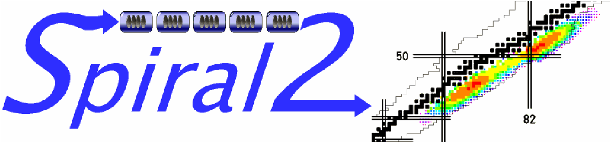










Status of SPIRAL2 facility
Hervé Savajols
on behalf of the SPIRAL2 Project Group
&
Physics Collaborations
www.ganil-spiral2.eu

Slide 2
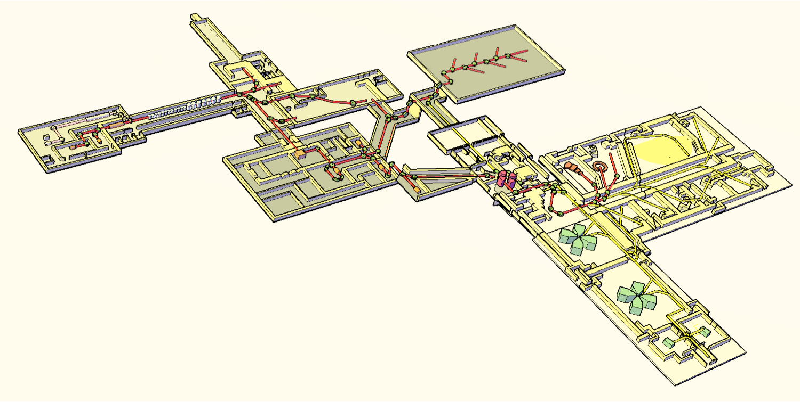

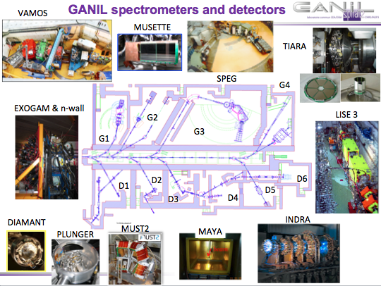
SPIRAL2 a national priority
TGIR roadmap (rapport ministère 2012)
Phase1:
Increase the intensity of stable beams by a factor 10 to 100 – High intense neutron source
10pμA (6.10¹³pps) A<50
DESIR (low energy facility)
DESIR
NFS
S³
GANIL
LINAC driver
33 MeV p, 40 MeV d (5mA)
14.5 A.MeV HI (1mA)
Production
up to 10¹⁴ FF/s
CIME : 1-20 AMeV
(9 AMeV pour FF)
Phase2:
Produce exotic nuclei in abondance (factor 10 to 1000 higher than present facility)
Expand the range of exotic nuclei to Z>40 A>80
Investment :
Cost: 151,7 M€ & >23 M€ detectors
Post-acceleration of high intensity RIB through the CIME cyclotron to the curent GANIL facility
SPIRAL2 is on the list of the European Strategy Forum on Research Infrastructures (ESFRI)
Notes:
For those who don’t know what SPIRAL2 is, Let me start by a brief description of the project. Here you have the layout of this facility which will be constructed in two phases. The first phase which is presently in construction is based …
Attached to this fisrt phase, two new experimental are also under construction : one dedicated to NFS and the other which will host the new S3 spectrometer, I will describe later.
The second phase which in the detail design phase, will concern the production building …. New DESIR facility recentky funded …
This facility will deliver in a near future, both high intensity stable beams and and intensity of radioactive beams.
Here you have the layout of the facility
SPIRAL2 est une priorite nationale tel que decrit dans la Feuille de route TGIR en France (rapport ministère 2012)
Incluses dans la liste ESFRI des grandes infrastructures européennes et NuPECC Road-map 2010 et
sections efficaces extrêmement faibles
• production majoritaire d’espèces indésirables
• très courte durée de vie des noyaux d’intérêt
DEUX installations complémentaires en EUROPE
Desir : (faisceaux radioactifs de basse énergie très loin de la stabilité).
Nouveau pour GANIL

Slide 3
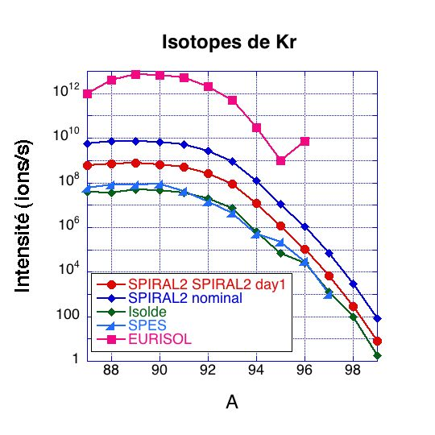
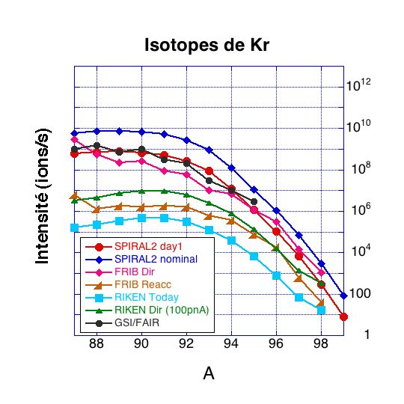
SPIRAL 2: Advanced ISOL RIB facility
SPIRAL 2: Experiments with RIB at low cross sections
and very exotic nuclei at few MeV/nucleon
SPIRAL2 – ISOL facilities
SPIRAL2 – ISOL facilities
SPIRAL2 – In flight facilities
EURISOL
Heavy Nuclei
Kr
Kr
SPIRAL2
Fusion- evap., DIC
1nb
x
Coulex, Direct reac
Yield, pps
1mb
+
1mb
Nominal
Day 1
ISOL RIB beams:
- high intensity, optical quality & purity
Versatility:
- light & HI, high-intensity stable-ion & RIB
- Multi-beam capabilities,
- Months of beam-time
- World-class arrays & detectors
Notes:
State-of-the-art RIB facility
Comparison of the expected yields for ISOL facilities.
SP2 and HIE-ISOLDE truly intermediate state ISOL facilities allowing for a very important increase (more than factor of 100) in the beam intensity with respect to the presently available intensities.
Ce transparent illustre le fait que pour certain isotopes les intensités des faisceaux exotiques produits seront proches aux intensités de faisceaux stables.
Ici nous avons une compaison des intensités pour les faisceaux riches en neutron de Kr entre diverses installations.
A gauche les Installations de type ISOL et à droite les installations dites en vol.
Les courbes rouge et bleu représentent les intensités attendues pour SPIRAL2 dans la première phase de son exploiation
et en régime nominal.
On voit clairement qu’elles sont bien supérieure à celle de ISOLDE ou bien celle du projet SPES (pas encore financés). Et biensur elles
Sont bien inférieure à celle produit par EURISOL.
Comparer aux installations dites en-vol, elles sont aussi les plus importantes.
Ceux ci est d’autant plus vrai, si on prend leur branche dite isol qui est directement comparable à SP2.
State-of-the-art RIB facility
Comparison of the expected yields for ISOL facilities.
SP2 and HIE-ISOLDE truly intermediate state ISOL facilities allowing for a very important increase (more than factor of 100) in the beam intensity with respect to the presently available intensities.

Slide 4
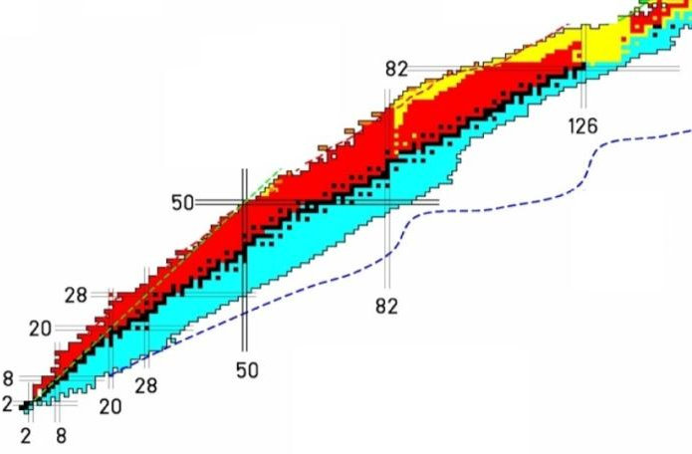
SPIRAL2 area of excellence
The primary beam intensities of the LINAC open new opportunity in the race for super-heavy nuclei
With the fusion-evaporation of medium mass nuclei proton-rich nuclei like ¹⁰⁰Sn will be accessible
Z=120 (1/m)
¹⁰⁰Sn (1/s)
¹³²Sn (10⁹/s)
High intense neutron rich beams, in the intermediate masses, will be available for the first time
⁹²Kr (10⁹/s)
⁶He (10¹²/s)
With the stable light ions induced reactions :
light exotic nuclei will be produced with intensities
comparable to current stable beam
High intense white neutron source covering the 1–40 MeV energy range will be available
Notes:
This slide somehow show a summary of the area of excellence open by the new SPIRAL2 beams @ GANIL

Slide 5
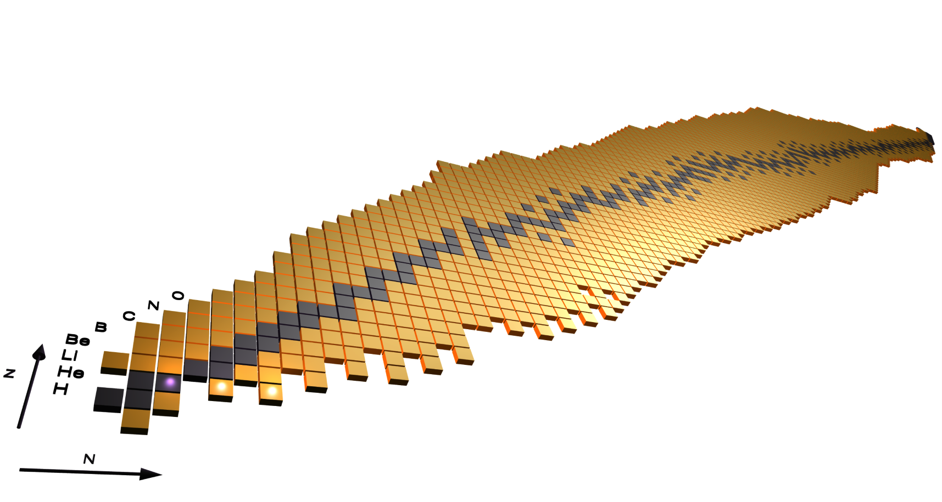
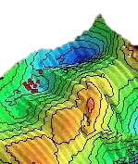
82 Letters of Intend (>1000 authors)
for the Day 1 experiments at SPIRAL2
Probing nuclei at the extreme
Equation of State,
Role of Isospin in nuclear reaction
5 LoIs
Heavy and Super
Heavy Elements
4 LoIs
Shell structure
very far from stability in
p-rich nuclei
24 LoIs
p, 2p, α decay
3 LoIs
Extreme Excitation
Extreme mass
Astrophysics
CNO, rp-process
11 LoIs
Astrophysics
r-process path
2 LoIs
Extreme N/Z
isospin
Stable nuclei
Shell structure
very far from stability in
n-rich nuclei
22 LoIs
Spins & Shapes, Collective modes, SD, HD
8 LoIs
Neutrons for science
13 LoIs
06/11/2012
Fundamental Interactions – 2 LoIs
29 LoIs Phase 1 (16 for S3, 13 for NFS)
53 LoIs Phase 2 (21 for DESIR)
Atomic physics 1 LoI
Notes:
Le noyau comme il a été rapelé est un système complexe ET quantique
Avec pour objectif au long cours : aider au développement de modèles prédictifs
L’outil actuel pour progresser consiste en l’etude des comportements aux extrêmes qui révèlent de nouveaux phénomènes:
Avec par exemple l’etude de la structure en couche qui est au fondement de construction du noyau, mais qui s’avère beaucoup plus riche qu’initialiement entrevue:
apparation et disparition des nombres magiques en fonction du nombre de neutron/proton
dilution de la notion de “nombre” magique et apparition d’un îlot étendu de stabilité dans les noyaux superlourds
évolution de la structure en couche avec la déformation et apparition de phénomènes nouveaux comme la coexistence de forme
Pour progresser dans cette compréhension du noyau atomique, de sa structure, de ses propriétes qui sont aussi indispensables à d’autres domaines
comme par exemple l’astrophysique nucléaire, les interaction fodamentales, il est essentiel d’identifier la meilleure démarche
Quels sont le noyaux clefs, Comment les produire et les etudier
Et je vais, j’espère vous demontrer dans cet exposé, que GANIL SPIRAL2 est une installation majeure dans cette quete.
avec deux problèmes fondamentaux qui sont
- l’interaction nucléon-nucléon dans le noyau
- le traitement du problème à N corps.
-

Slide 6
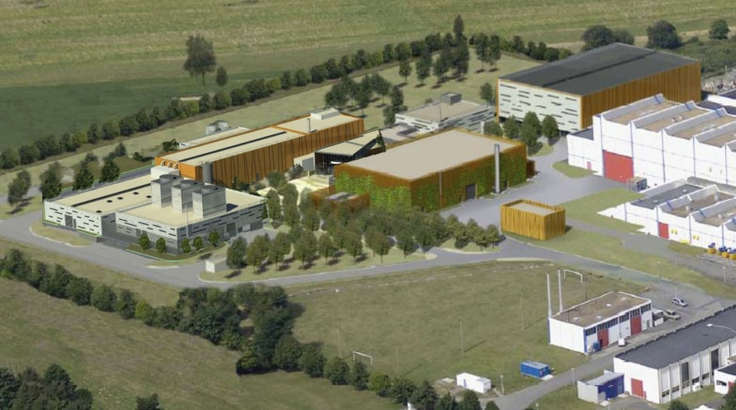
Phase 1
Phase 1
Phase 2
Notes:
Few slides about the status of the Project
For Phase 1 as you know the civil construction is well advanced

Slide 7
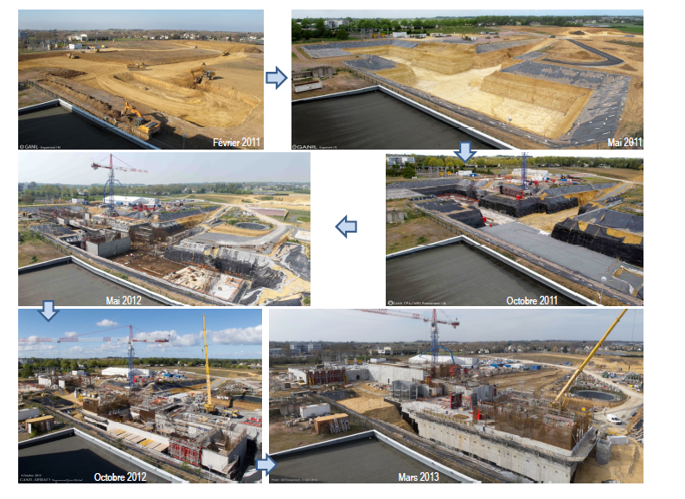
Civil Construction
98 % of the concrete done (14000m³)
Feb 2011
May 2011
May 2012
Oct 2011
Oct 2012
March 2013
Notes:
Tower crane will be disassemble this summer

Slide 8
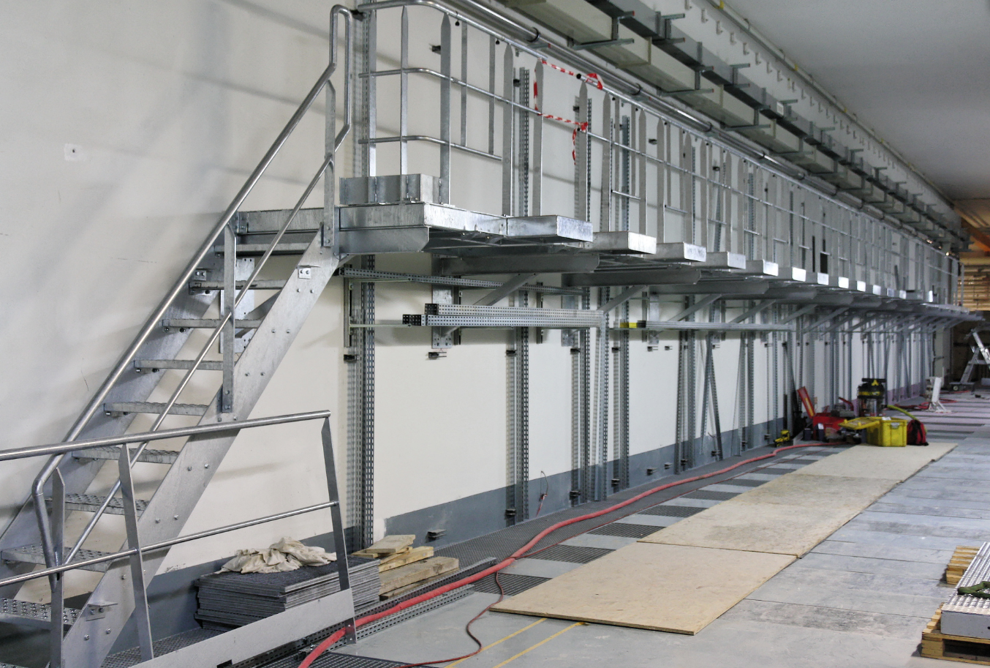
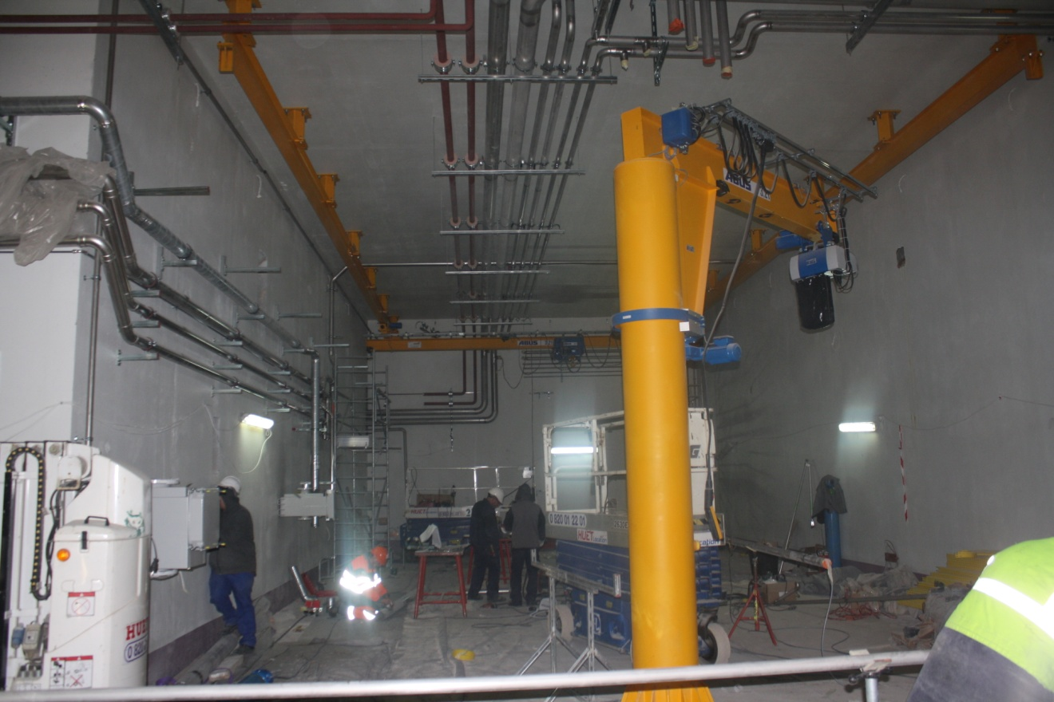
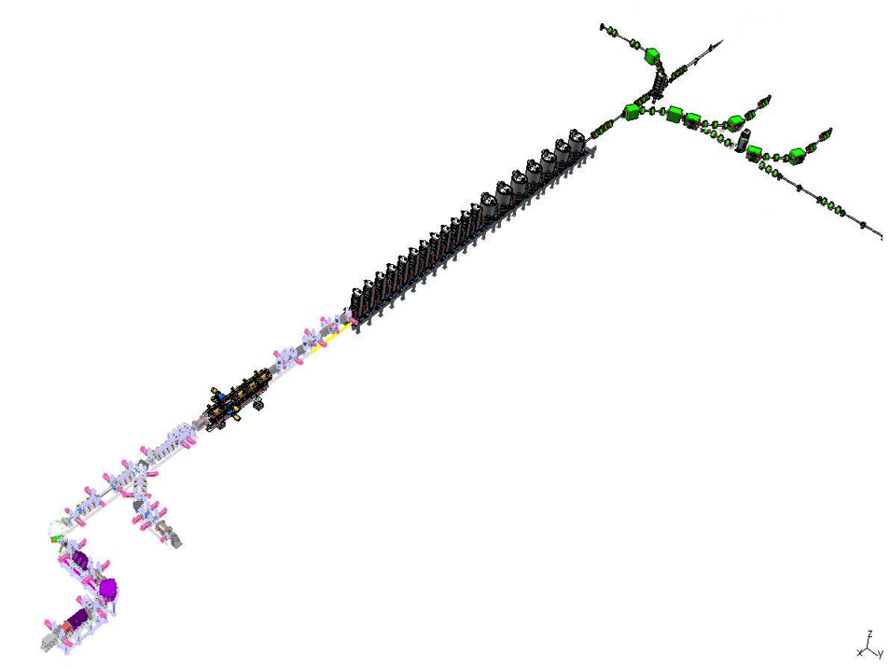
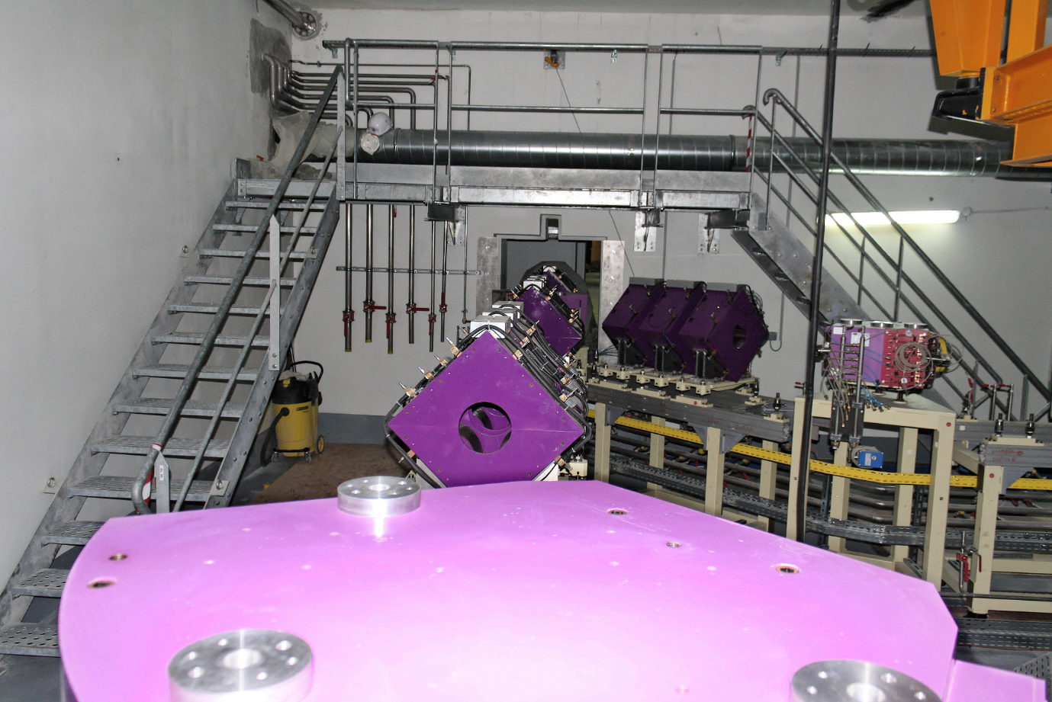
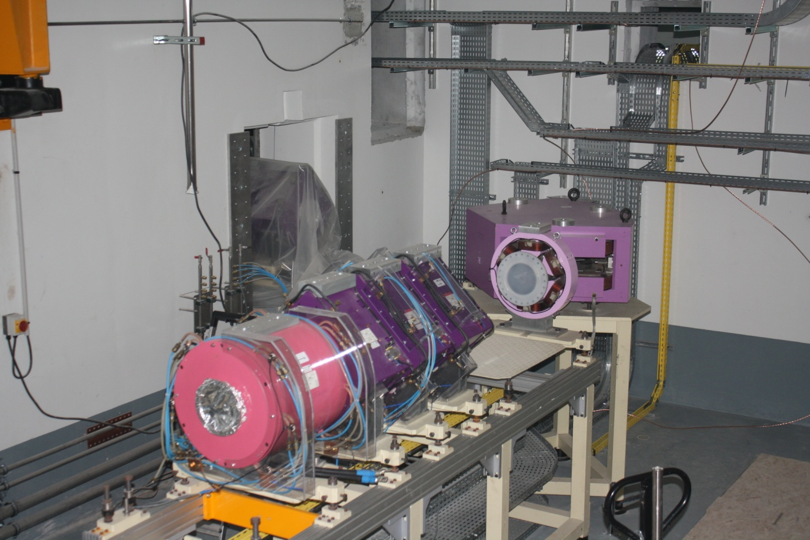
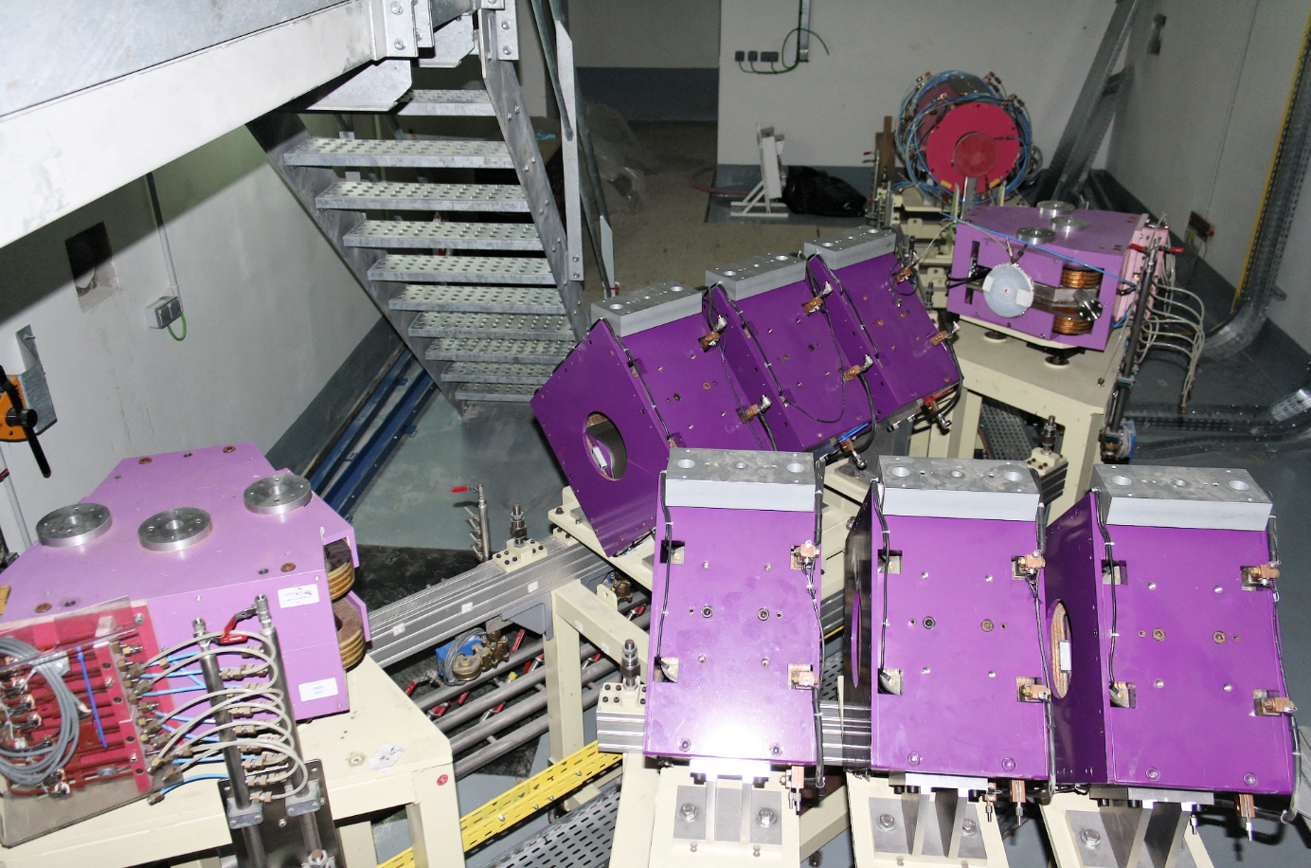
Installation is
ongoing
March 2013
Notes:
While the construction is progressing, As soon as we have for one cave the infrastructure done we start to install some equipments even if the concrete is not finish at the end of the accelerator

Slide 9
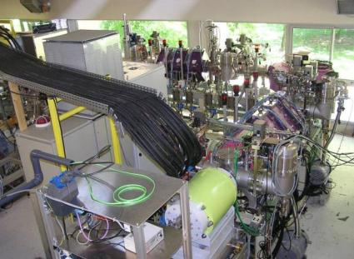
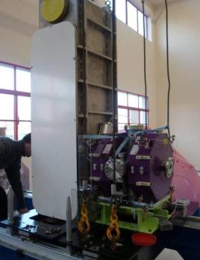
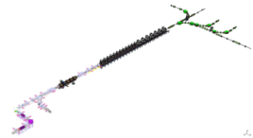


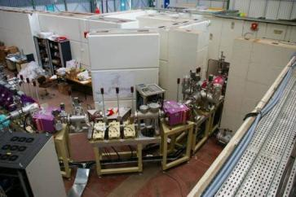
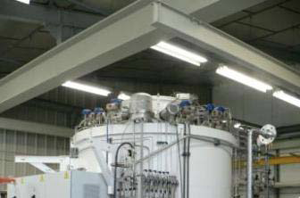
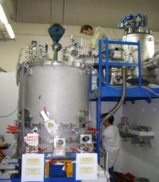
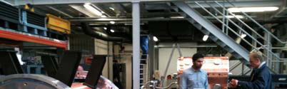
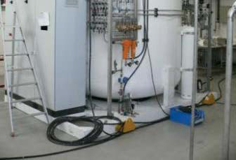
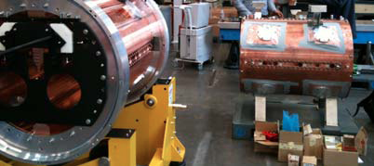

HI beam line
Phase 1
Move to GANIL
All cavities qualified
4 cryomodules tested
All delivered before
May 2014
Decree of SPIRAL2 Phase 1 signed by Prime Minister on May 8th 2012
Operation permit expected by Mid 2014
SPIRAL2 Phase1 schedule :
Installation of the first equipment ➔December 2012
Start of the RFQ installation ➔ September 2013
Start of the Cryomodule installation ➔ November 2013
RFQ/BTI first beams ➔ June 2014
LINAC cool down ➔ July 2014
First Linac beams ➔ December 2014
Move to GANIL
A share construction
Cryomodule A
Cold Box
Acceptance testing
From the manufacter
d & p beam line
Cryomodule B
T4+T5 assembled
@ Saclay June 2013
4 cavities qualified
2 cryomodules tested
All delivered before
March 2014
RFQ
Notes:
All pieces of the phase 1 are either siiting at GANIL ready to be installed or in tests or still under construction.
Here are some exemple :
Here you have the latest schedule of the Phase 1 based on the final civil construction schedule and the installation of all equipments
Cryo A
6 cavités qualifiées sur 6 testées (en cryostat vertical)
• 1 cryomodule sans coupleur testé : système validé
Cryo B
Test en Cryostat Vertical de toutes les cavités B avec leur plongeur
RFQ
Module T5
- Assemblé,
- Joints à remplacer fin juin (fuites).
Modules T1 à T4
RFQ
(IRFU)
Existence solution de repli
- Tubes achevés,
- Lames usinées avec surépaisseurs
de 0,5 mm,
- Pré-assemblés pour mesures 3D :
permettre de procéder à l’usinage
final des lames.

Slide 10
Phase 2
Phase 2
Phase 1

Slide 11
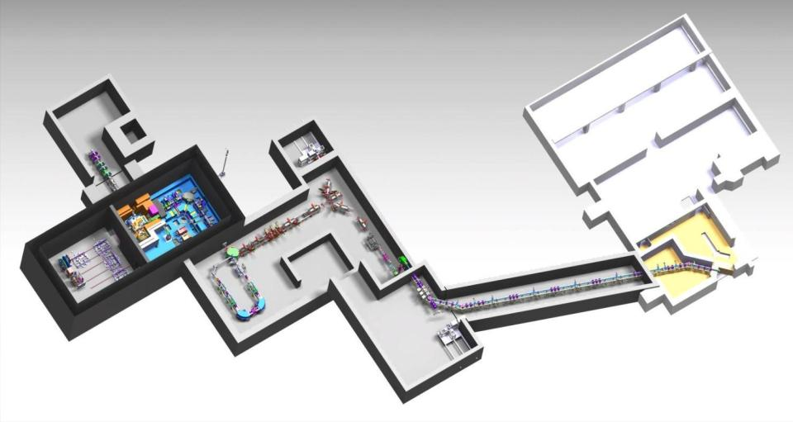
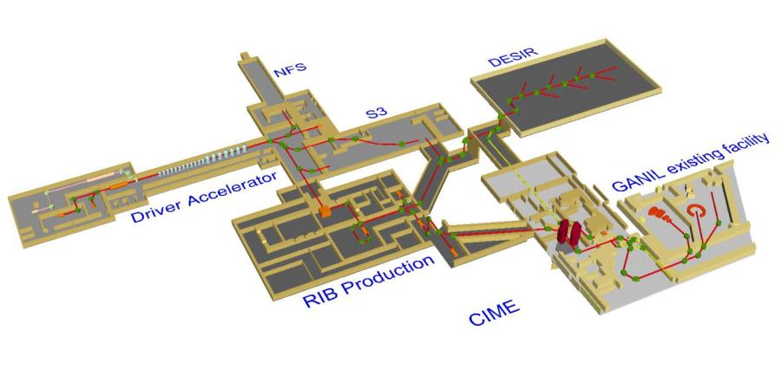
RIB Production & transport
Phase 2
Intensive design work is ongoing
LINAC
beam
Identification Station
Production hall
1+ RIB to DESIR Hall
1+ beam tranfer lines
ECR Charge booster
Maintenance and waste management area
N+ beam tranfer lines to CIME existing cyclotron
CIME
RFQ Cooler & High Resolution Separator
End design study: Sept. 2013
Notes:
Concerning the phase 2, intensive design work is ongoing.
Here you have the layout of the facility
The design of buildings like sp2 requires the integration of many kinds of information into a synthetic whole.
As for the phase 1, a dedicated company assists us for integration of the process in the building
Integration and synthesis : process + building (3D…)
Enginery of cabling : collect of needs, allocation of reservations…
Effective integration : planning to integrate the process into the building

Slide 12
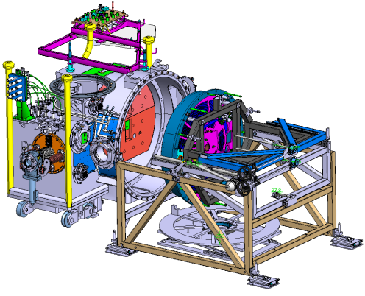

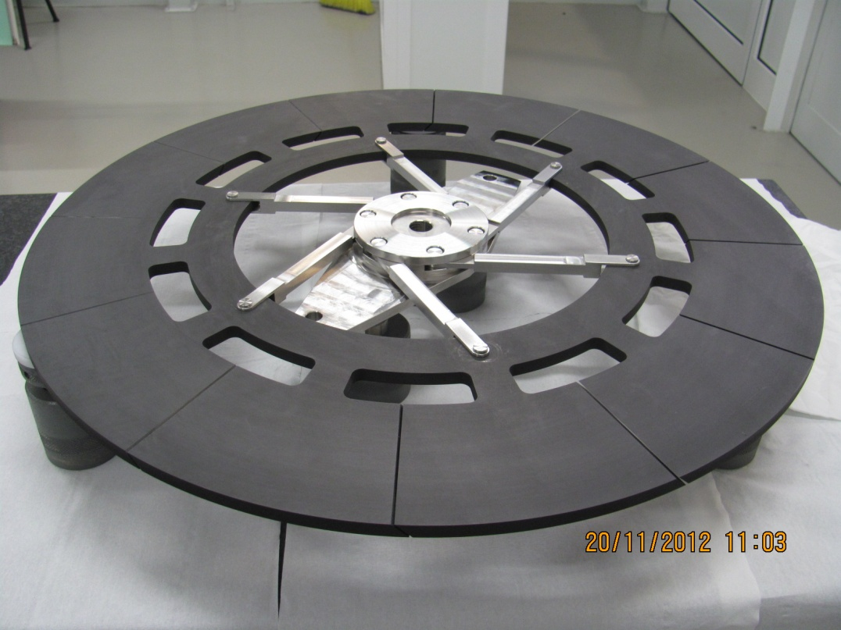
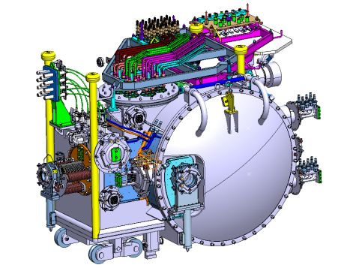
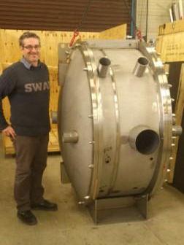
RIB Production module
Target and ion source
50-200 kW Graphite Converter
MoU with LNL Legnaro
50 kW Converter Production
& testing
Converter remote handling
GANIL & ESS Bilbao
Extraction
This equipment is very ambitious :
  - Dimensions : 3,1x2,2x2 m and 9 T,
  - Mounting and dismounting by robot every 3 month,
  - HV : 60 KV,
  - High neutron and gamma integrate dose,
  - Positioning in all directions at +/-0,5 mm,
  - Vacuum at 10⁻⁶ mbar,
  - Many servitudes
MoU signed with ESS Bilbao
manufacturing design study
chamber construction
Source inspection
Testing and validation
Notes:
The key part is the RiB production module
It contains the graphique converter wheel for producing neutron, connected to the different type of target ion source.

Slide 13

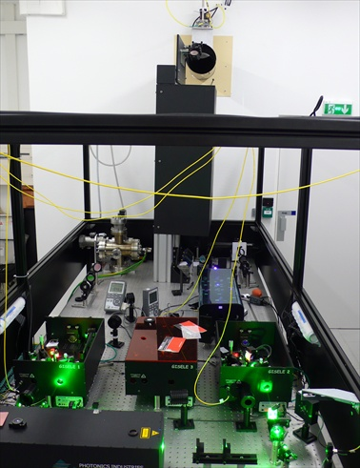
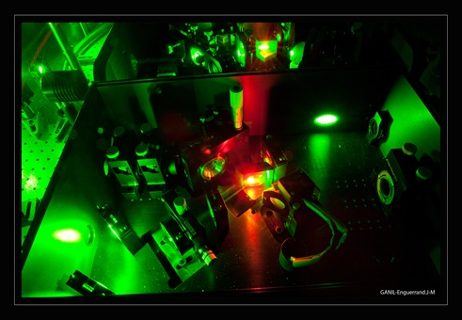
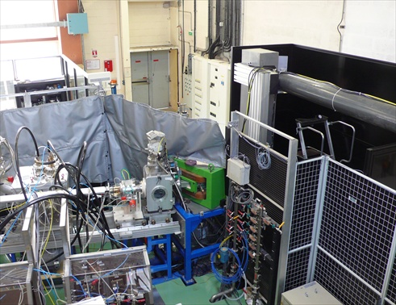
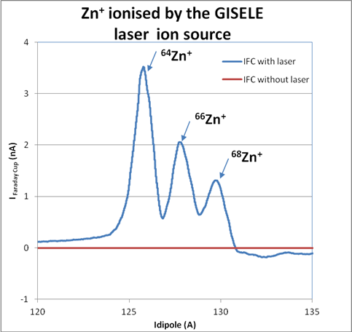
Laser Ion Source GISELE
Off line RILIS prototype for SPIRAL2
TiSa laser, 20m transport path and hot cavity: June 2010-July 2011
First Ga beam (July 2011)
First Zn beam (June - November 2012)
Next beams: Sn, Y, In
Bench 2 & Laser transport system
Laser system GISELE
TRIUMF-Mainz collaborations
Zn⁺ 2012
Lecesne et al, RSI 81 (2008) 02A910
Notes:
Let me flash the laser ion source wich is a new activity at Ganil.
Here you have pictures of the gisele setup funded by the french anr.
Gisele mean :
This is the off … It’s based on TiSa lasers
the first stable ion beam produced by GISELE at GANIL using resonant laser ionization. That’s one small step for the RILIS community, but a big step for me and for the future SPIRAL2 facility in France!
3 TiSa cavities
from TRIUMF
2 Tripler cavities
from Mainz U

Slide 14
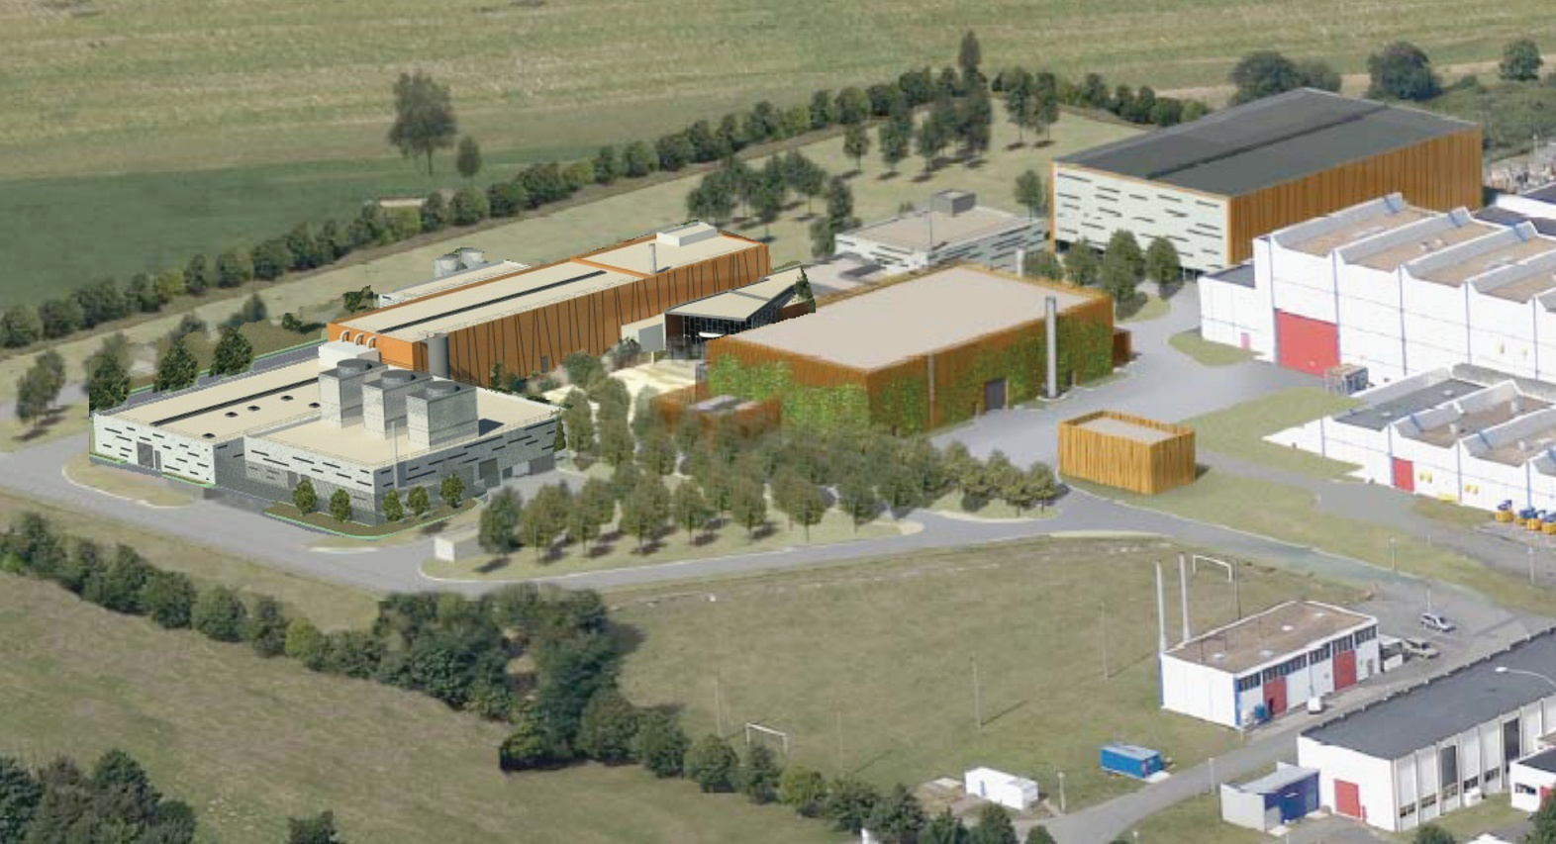
SPIRAL2 New Experimental Facilities

Slide 15
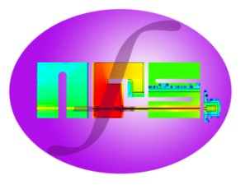
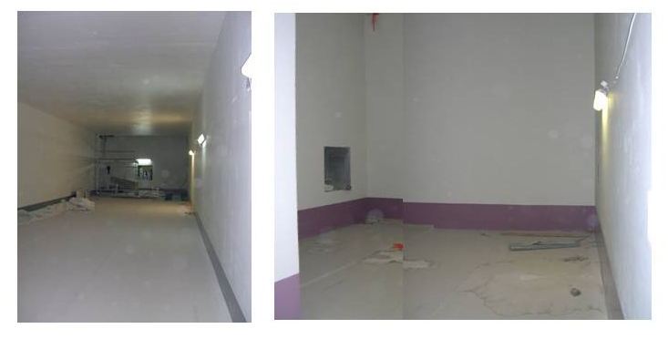
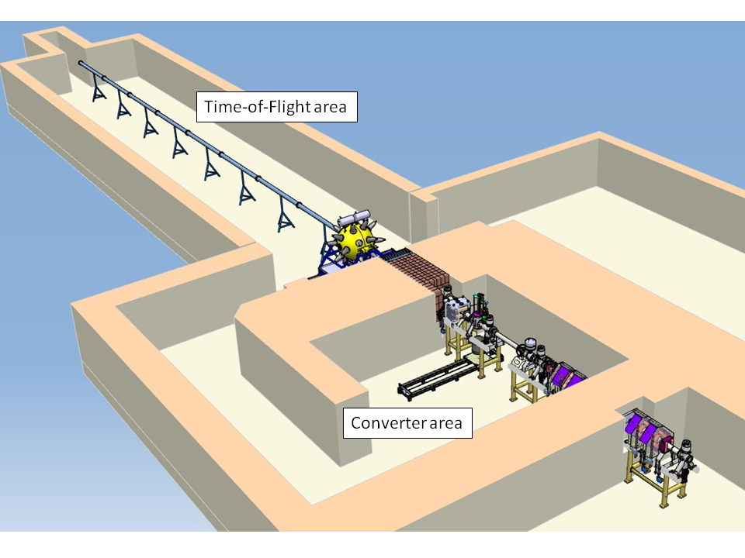
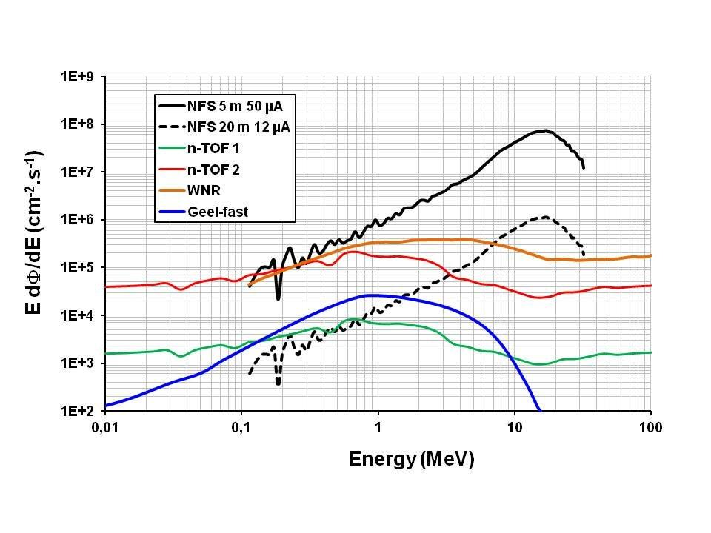





Neutrons For Science
NFS Physics case (11 LoIs)
- Fission reactors of new generation
- Fusion technology
- Studies related to hybrid reactors (ADS)
- Basic data for evaluated data bases
- Nuclear medicine and biology
- Development of new detectors
I < 50 µA
P < 2 kW
● Beam at 0°
● Collimator ↔ beam quality
● Size (Lⅹl) ≃ (28m ⅹ 6m)
- TOF measurements
- free flight path
Use of radioactive samples
A< 1 GBq for thin layers
A< 10 GBq for thick samples
ToF area
● Beam line extension
● Converter
● Magnet and beam dump
● Irradiation station (n, p, d)
Converter room
High intense neutron flux :
Φ >1,5.10¹³ n/s in 4π
Continuous or mono energetic spectra
Well collimated neutron beam
First experiment in 2014
Notes:
With NFS, GANIL will benefit for the first time of a high energy neutrons beam
In range of 1 to 40 MeV we will be very competitive …
It presents a real interest in nuclear physics and the applications.
For NFS, most of the workpackage are under contruction as the clearing magnet and the converter.
Avec NFS, le GANIL/SPIRAL2 va bénificier d’une source de neutrons rapide. Suivant le type de convertisseurs, nous pourrons avoir un spectre
soit Continu ou monoénergétique entre 1 et 40 MeV
De plus des cibles d’actines vont pouvoir etre utilisées.
Des faisceaux légers vont aussi pourvoir etre utlisés pour des mesures d’activation …
On est plutot dans le domaine de la physique appliquée dans le domaine de l’énergie
Avec un champ tres vaste tel que

Slide 16
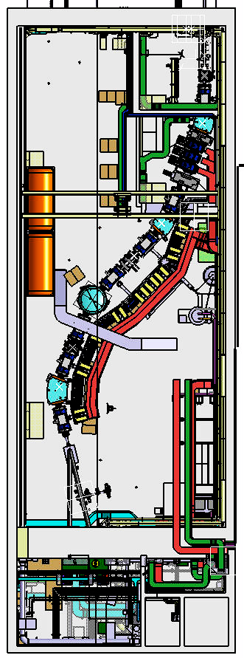

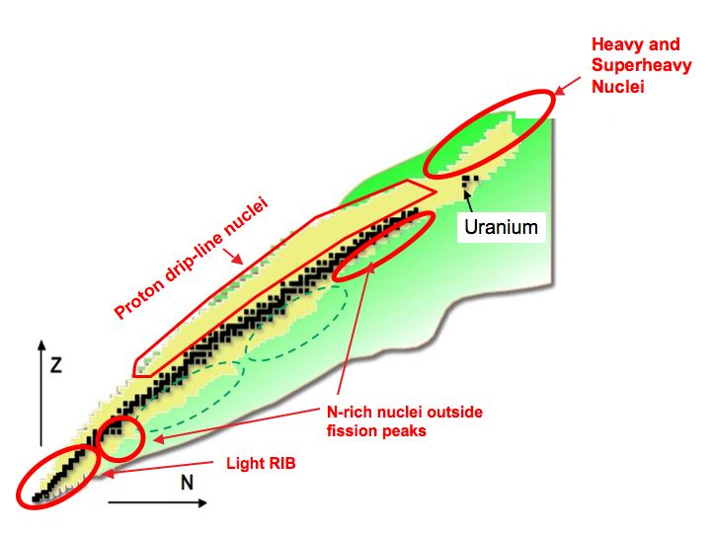

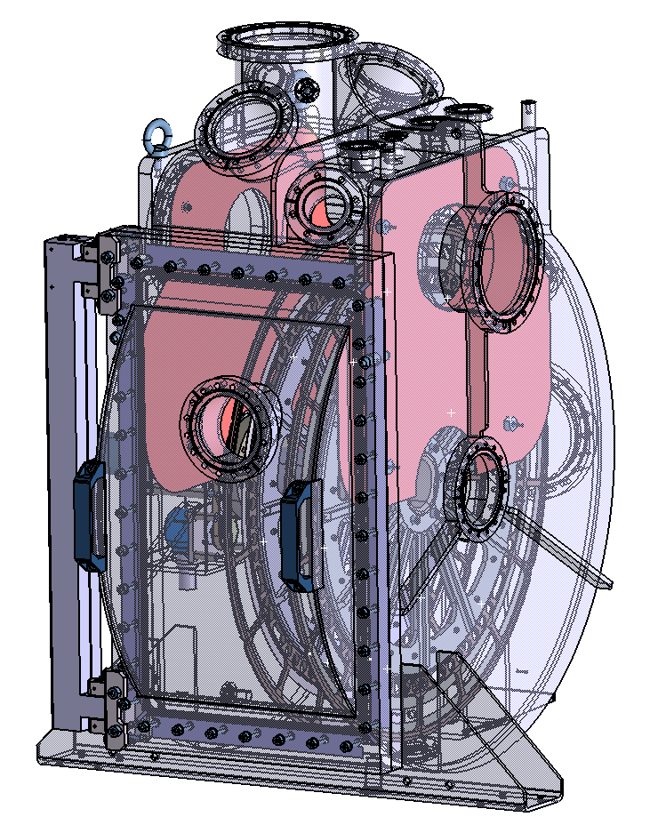
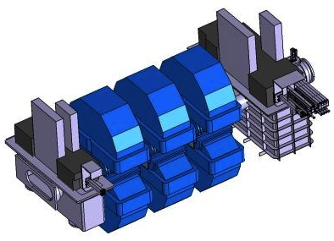
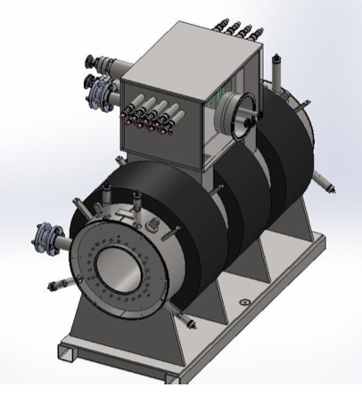
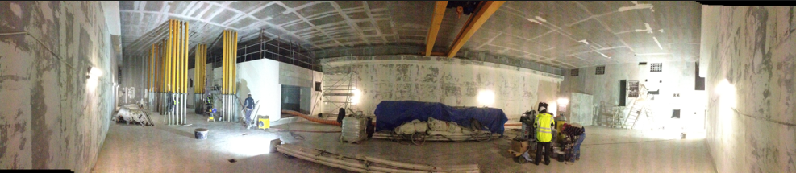
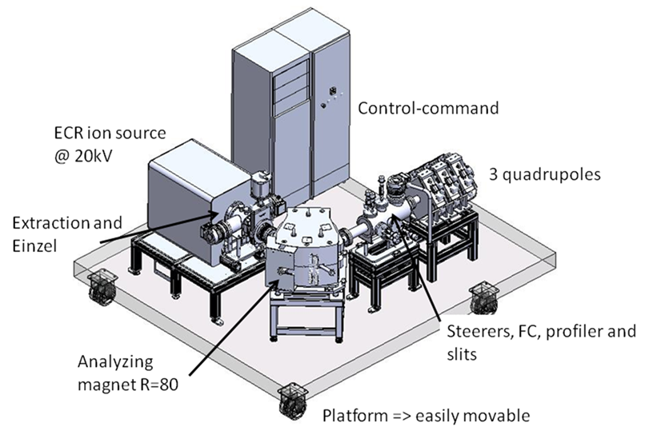
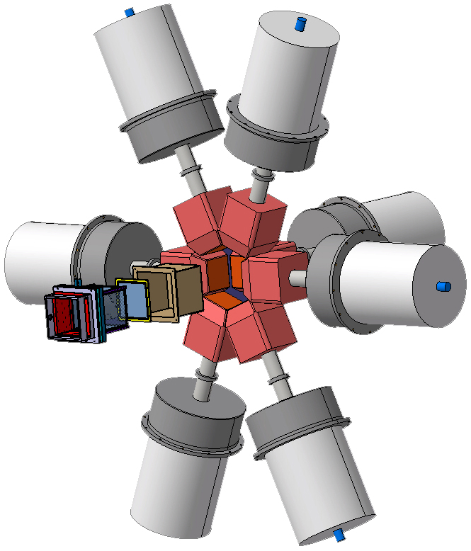
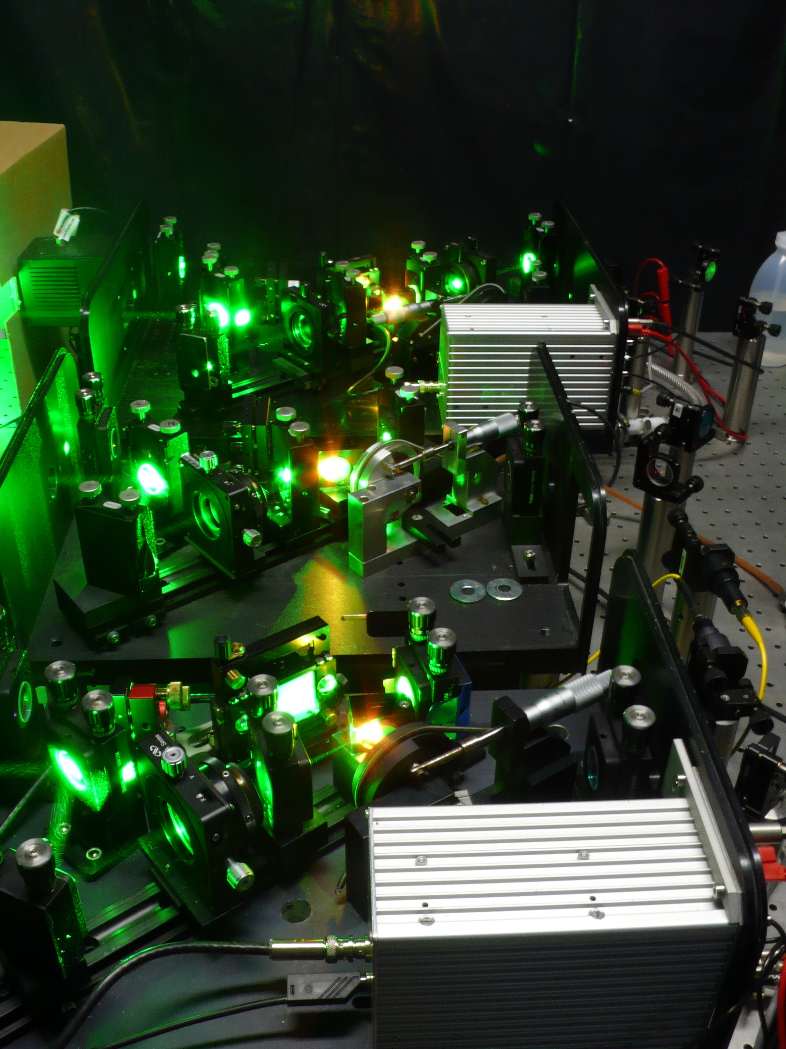





S3 Physics case (16 LoIs)
- VHE – SHE elements
- Proton drip-line and N=Z
- Nuclear astrophysics
- Atomic physics
First experiment in 2015
High power
Rotating targets
including actinides
Beam dump
& Movable
fingers
Large
acceptance
SC Multipoles
Beam
FISIC setup
Fast Ion Slow
Ion Collisions
Implantation-decay
station at the mass
dispersive plan
Low
Energy
Branch
DESIR
Notes:
This slide show the latest layout of S3

Slide 17
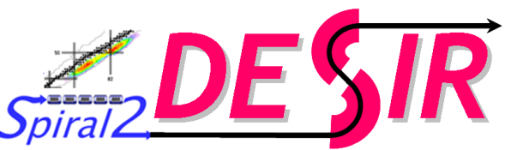







The DESIR facility at SPIRAL2
EQUIPEX 2011 9M€
120 physicists, 35 institutions, 15 countries
Bertram Blank – CENBG France (Project leader)
Jean Charles Thomas – GANIL France (EQUIPEX)
High quality 1+ RIB of 10 to 60 kV from:
SPIRAL1 (light n-deficient nuclei from beam/target fragmentation)
SPIRAL2 (n-rich fission fragments, transfer and fusion-evaporation products)
S3 (fusion-evaporation products, refractory elements)
First experiment mid 2018

Slide 18








DESIR experimental hall & associated detectors
DECA Agreement
DECA collaboration
14 owners of equipments
Commitment: ~5 M€
50% from EU partners
MLLTrap
N -TOF detector
PIPERADE+TAGS
LPCTrap
BEDO
TETRA
BELEN
Silicon Cube
LUMIERE
TONNERRE
Identification
station
Notes:
The DESIR hall will host state of the art detection system to study nucllei at the rest and perform GS property measurement.
Mass measurent
Laser spectroscopy
Decay property
Fundamantal interaction
Recently an agreement has been signed beetween the 14 owners …
Il faut rappeler que les equipements experimentaux associés à DESIR existes ou sont en cours de construction par la
collaboration, à hauteur de 5 M€ et 520 h.mois d’investissement. Un accord de collaboration a ete signé par les parties
Lors e la derniere SP2 week.

Slide 19








GANIL/SPIRAL 2 facility: status & outlook
Phase 1
Commissioning/
experiments
in 2014
NFS MoU
EQUIPEX CONVENTION ANR-10-EQPX-46-01
DESIR EQUIPEX – DECA
EXOGAM 2
Coll. Agreement
PARIS
MoU
gamma
Phase 2 (RIB)
Detailed Design finished by 2013
Civil construction
from 2015
GASPARD
Charged
particle
Nominal operation of GANIL/SPIRAL2:
up to 79 weeks/y of stable-ion beams
up to 53 weeks/y of RIB
up to 5 beams (2 RIB) simultaneously
800-900 users
NEDA
MoU
ACTAR-TPC
Coll. Agreement
FAZIA
MoU
neutron
Notes:
19
Associé a cette nouvelle installation, nous allons avoir 3 nouvelles aires experimentales :
Ce trasnparent résume l’ensemble des nouvelles installations et détecteurs associés à SP2.
Concerning the SPIRAL 2 new experimental halls & detectors
Important milestone was achieve beginning of this year, with the signature of MoU of collaboration agreement for all of these detectors except
Gaspard.
This represents the promise of partner donation to finance the first stages or all of these projects.
All thoses detectors are represented in the ICC
La quasi totalité des MoU ou accord de collaborations sont maintenant signé….
Ceci represente des promesse de donts desp artenaires pour les financement pour les premières phases ou la totalité de ces projets.

Slide 20
Conclusions
SPIRAL2 Phase 1 (LINAC, S3, NFS) under construction; civil construction to be finished by beginning of 2014
First SPIRAL2 Phase 1 beam by end 2014
NFS & S3 phase 0 (8 M€ from EQUIPEX) fully funded and under construction
  Fisrt NFS beam end 2014
  First S³ beam end 2015
SPIRAL 2 Phase 2 (RIB, DESIR) design study finished by 2013, final decision on the construction expected by end 2013, Civil construction from 2015
DESIR: building and partially beam lines funded (9 M€ from EQUIPEX)
Next generation of detectors under construction (ACTAR-TPC, FAZIA, NEDA, EXOGAM2, PARIS)
GANIL/SPIRAL will continue to run (5-6 months/year)
New RIBs with the upgrade of SPIRAL1 in 2016

Slide 21

GANIL/SPIRAL2 by 2015
Notes:
Fisrt I would like to start with this picture that shows how GANIL will look like in 2015

Slide 22

RIB with SPIRAL1 & SPIRAL2
Energy range of SPIRAL1 & 2 ISOL RIB :
≤ 60keV and 1-15 MeV/nucl.
SHE
In-flight S3
N=Z Isol+In-flight
In-flight S3
+ SPIRAL1 with new RIB !
GANIL/SPIRAL1/SPIRAL2 Beams
New Web interface
ISOL RIB Fission
Products
ISOL & in-flight RIB from transfer and
deep inelastic Reactions
Nominal operation of GANIL/SPIRAL2:
up to 79 weeks/y of stable-ion beams
up to 53 weeks/y of RIB
up to 5 beams (2 RIBs) simultaneously
800-900 users
pro.ganil-spiral2.eu/users-guide/accelerators/chart-beams
Notes:
RIB available GANIL will cover the following regions.
Very promising RIB will be available in the next future at GANIL, and if you want to get more precise beam intensity as well as the energy, please
Use the new interactive web interface has been put online
where any users can estimated the currently available and future beams at the GANIL/SPIRAL1/SPIRAL2 facility.
Regions produced with light beams (ISOL), HI beams ISOL and in-flight completed by nuclei produced with high intensity RIB of ff.
Pour ce qui concerne les faisceaux radioactifs, les énergies disponibles vont de quelques dixaine de keV et 15 MeV/u (postaccélartion de CIME),
Qui est très bien adapté pour la compréhension détaillé de la structure du noyau
Une grande partie de la carte des radionucléides va etre accessibles …
Une interface web est main,tenant disponible pour les utilisateurs qui leur permet d’estimés les intensités et énergies disponibles avec GANIL/SPIRAL2
Il faut aussi souligner, que dans un régime d’exploitation dit nominal, jusqu’à … 79 semaines de faisceaux stables /an

Slide 23




Atomic Physics of ion-ion collisions
FitFISIC

Slide 24




NFS Experimental Techniques
Differential XS (n,n’γ)
High Energy resolution measurement
GAIN setup (Ge array)
(Nuclear Data)
Differential XS: (n,Xn), (n,LCP) (n,fission) measurement
Medley
Carmen
(Reaction models, Nuclear Data)
Time-of-flight area
Collimateur
Salle
convertisseur
XS measurement by activation
p,d,n,HI
(Fusion & Fission technologies)
Additional topics :
Irradiation of electronic components, cells, …
- Detector characterization
Notes:
Concernant NFS,, Ici nous avons un descriptif de l’installation avec les differentes techniques expérimentales envisagées.
Tout d’abord, il est possible de realiser des mesures de XS par activation au niveau du convertisseur. Ceux sont des mesures simples.
Ensuite au tout debut de la salle de temps de vol, des mesures de sections efficaces differentielles avec les sispositifs Medley et Carmen sont prevues.
Les experiences au bout de la salle de temps de vol sont reservées à des mesures necessitant une tres bonne resolution en NRJ. Ici le detecteur Gain
Est prevue d’etre implanté.
Enfin des mesures additionelles d’irradiation de composents electroniques ou bien de cellules ansi que la caracterisation de detecteur sera possible.
Qui ont un accent mis sur les lots qui sont à la charge des laboratoires francais.
For NFS, most of the workpackage are under contruction as the clearing magnet and the converter.
Concernant NFS, la plupart des lots comme par le convertisseur et le dipole de déflection sont en cours de construction. Le budget estimé est de 485 k€
Et l’ensemble du setup peut etre prêt en 2013 pour commissionning.

Slide 25




Production Module Cave
Beam line area
Production area (cocon)
Maintenance area
Vacuum system
Servitude supplies
Laser transport
Manutention (robot)
Module for maintenance
Notes:
High level of radiation : red cave
Of the component shotld be totaly remote handling with robot and wit a high level of reliability (3 months of running period)

Slide 26


ISOL Rare Isotope Beams at SPIRAL 2
Up to 2.3 kg HD UC₂
C
Decoupling the power of the driver beam from the RIB production target
Up to 10¹⁴ fiss./s
5mA
200kW
Few kW
Converter
J. Benlliure
²H,
n
1+
UCx
IS
Fission fragments
2 step Target
²H
Converter
n
1+
Target
IS
e.g. ⁹Be(n,α) ⁶He 10¹²pps
p, d
1+
UCx
IS
Fission fragments
Direct Target
HI
1+
Target
IS
e.g. ^{14,15}O, ¹¹C, ¹⁰²⁻¹⁰⁶Sn
Notes:
Spiral2 main production mehanism is based on
2 step high power target (n induced reactions)
Decoupling the power of the driver beam from the RIB production target
Direct target
Light ions induced reactions or HI induced reactions
Multiplier par plusieurs ordres de grandeur (de 100 à 1000) la production de noyaux exotiques et élargir considérablement la gamme des éléments éphémères
Le mode privilégié de production des ions radioactifs consiste en la fission d’une cible de carbure d’U induite par des neutrons rapides. Les neutrons provienne de
La cassure des deutons dans un convertisseur en Carbonne.
Cette technique à l’avantage de decouplé la puissance du faisceau primaire de la cible de production
Un taux de fission de 5.1013 FF/s sera atteint à la puissance max de 200 kW du faisceau de deutons.
Comme on le verra par la suite cette technique produits des faisceaux tres intenses de noyaux riches en neutrons situes dans les deux bosses de fissions :
Jusqu’à des intensité de 1à10 ppps pour des Kr ou Sn.
Les neutrons produits par le convertisseur pour aussi engendrer des reactions de transferts sur des cibles légères comme N + 9Be pour des faisceaux tres intenses de 6Hé
On pourra utilsé d’autres modes de prod comme le faisceau direct de p ou d dans la cible d’U
Ou des ions lourds pour des reactions de transferts et de fusion evap dans des cibles adaptées ..
Grace à ces modes de prod on va pouvoir couvrir une grande partie de la charte des noyaux :
Le convertisseur utilisé est une roue de carbone dans laquelle les deutons sont cassés, libérant protons et neutrons.en l'utilisation d'un faisceau de deutons qui apres
Spiral2 main production mehanism is based on
2 step high power target (n induced reactions)
Decoupling the power of the driver beam from the RIB production target
Direct target
Light ions induced reactions or HI induced reactions

Slide 27

Accelerator Configuration
Total length: 65 m (without HE lines)
Slow (LEBT) and Fast Chopper (MEBT) RFQ (1/1, 1/2, 1/3) & 3 re-bunchers
12 QWR beta 0.07 (12 cryomodules) 14 (+2) QWR beta 0.12 (7+1 cryomodules) 1.1 kW Helium Liquifier (4.5 K) Room Temperature Quadrupoles Solid State RF amplifiers (10 & 20 KW) 6.5 MV/m max E_{acc} = V_{acc}/(β_{opt}λ) with V_{acc}=∫ E_{z}(z)e^{iωz/c}dz.
Particles | H⁺ | ³He²⁺ | D⁺ | Ions
Q/A | 1 | 2/3 | 1/2 | 1/3 | 1/6
I (mA) max. | 5 | 5 | 5 | 1 | 1
W_{O} max. (Mev/A) | 33 | 24 | 20 | 15 | 9
CW max. beam power (KW) | 165 | 180 | 200 | 44 | 48
Based on the EURISOL post-accelerator design

Slide 28
I 2013 I 2014 I 2015 I 2016 I 2017 I
Civil Construction
Assembly and implementation of equipment's
Stage approach commissioning
Full
Facility
Com.
Stable ion beams for Experiments
PAC NFS
NFS Experiments
Com.
PAC S³
S³ Experiments
Com.
Design, R&D, Prototyping
Civil Construction and assembly of equipment's Phase 2
RIB, DESIR
End APS
Final Building cost
Equip. cost
LoI Day 1
SPIRAL2 Phase 2
Update
PAC
Phase 2
Construction Décision
Building Permit

Slide 29

Stable beams SPIRAL2 – Phase1
Energy HI = 0.75-15 A.MeV
I < 50 µA P < 2 kW
En: 1MeV – 40 MeV
High HI beam intensities :
up to 10pμA (6.10¹³pps) A<50
DC or pulsed beam
Next step : new A/q=6 injector
Heavy nuclei A>50
High intense neutron flux :
- Φ >1,5.10¹³ n/s in 4π
- Φ >6.10¹¹ n/cm²/s at 5 cm
Continuous or mono energetic spectra
Well collimated neutron beam
Notes:
One of the main feature of this new facility come from the intensity that will be available
First unique Intensity of stable HI beams :
The bleu curve shows the nominal intensity as function of the mass expected from noble gases delivered by the LINAC
As compare to the red curve available today at GANIL. We might expect a factor 10 higher and 10 pmicro A up to
Mass 50.
Sofar the starting ion source phenix V2 for the commissioning and the first experiments will delivered :
V3 – we might pay attention and push to keep momentum in the development of such source :
The green curve is the ultimate intensities with a new injector, option of the project but with the buildings already exist
We will also have access with NFS to unique flux of neutron beam in the range of 1-40 MeV.
Here is a comparison with other facilities :
Cleary wwe will be competitive in this energy domain
En fonctionnement nominal, l’intensité effective des ions lourds stables gazeux accélérés par le
LINAC de SPIRAL2 correspondra à la courbe bleu. La courbe en rouge représente les intensités
actuellement disponibles au GANIL. La courbe verte montre les intensités atteignables avec un RFQ
A/q = 6, qui est une option du projet SPIRAL2, mais dont l’intégration a été anticipée lors de la
construction des bâtiments de la Phase 1.
Ces intensité sonneront un avantage decisif pour la synthèse et l’etude des noyaux lourds et SL aisni que les noyaux deficients en neutrons.
Ces intensités offriront aussi des perspectives uniques en phys atomique
SPIRAL 2 avec son accélérateur linéaire de deutons de très haute intensité combiné avec un
convertisseur dans la salle NFS va permettre de produire des flux de neutrons de haute
intensité (jusqu’à 1013 n/s) et d’énergie élevée. Comme le montre la figure ci-dessous NFS
concurrence favorablement plusieurs installations, du même type dans la gamme d’énergie de
0.1 MeV à 40 MeV.
Comparaison des flux de neutrons en fonction de l’énergie entre les installations NFS, Gelina (Geel,
Belgique), WNR (Los Alamos, US) et n-TOF (CERN).
FAISCEAU DISPONIBLE LORS DE LA PHASE 1
Concernant les ions lourds l’accélérateur lineaire supra de SPIRAL2, en fonctionnement nominal pourra delivré des intensités pour les gaz rares correspondants à la courbe bleu
Si on regarde maintenant les intensités des faisceaux demandés pour les premières experiences avec le LINAC. Aujourd’hui les résulats montrent que
pour NFS, p et d, on remplis le cahier des charges, alors que pour les faisceaux de S3, on atteint les spécifications pour les faisceaux legers, mais pas pour les faisceaux métalliques de S, Ca à l’exception du Ni.
Nous avons aussi decidé pour augmenter l’intensité des faisceaux d’augmenter le volume de la chambre à plasma de la source (doubler)
Et enfin pour atteindre les inbtensités requises, il faudra une source totalement supra …
Ici je voudrais aussi ajouter la necessite pour NFS d’un hacheur de faisceau rapide pour selectionner des paquets unique de faisceau qui doit etre
Operationel pour les premières experiences.
Voir avec Marco … tjrs en dehors du projet????
Prototype ???
One of the unique opprtunity of this new facility comes from the intensity that will be in the case of the HI about 1 order of magnitude higher than present facilities. Of course it will strongly depend on the front end, Ions source and the injector of the LINAC driver.
Here are shown different expected intensity curves for noble gas ions depending on the Ion source various scenari.
Here are the results obtain with phoenix V2 at Grenoble … Unfotunately I will not be able to show some results from the A-phoenix source as they had many technical problems and the test are postpones.
We therefore decided to start the commissioning and first experiments with the Phoenix V2 (Not SC), as this source gave descent intensities in a stable operation mode. O, Ar, Ni
If you compare the performances of this source with the expected intensites for day 1 experiment, we cover 65% of the proposed beams.
A short term strategy is to Upgrate of Phoenix V2 with a Larger plasma chamber and new oven Ø20 mm, to improve it performances
In future there is no doubt that we will need to go for a full SC higly charge state ions. This decision will be taken next year
Single bunch selector is needed for the NFS experiments and would have to be installed at the early operation stage of the facility

