Slide 1



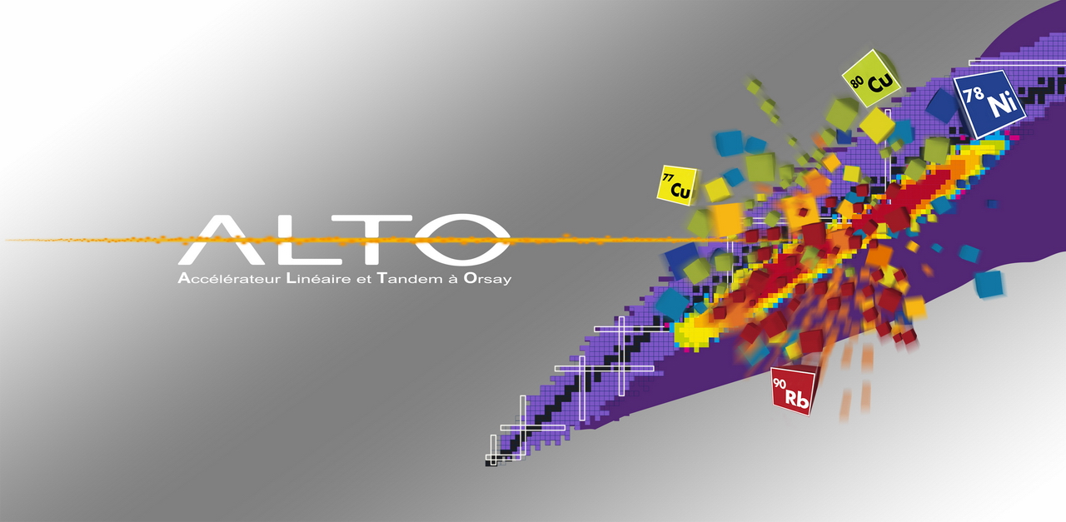
ALTO, the electron-driven ISOL facility in Orsay
past, present and future
David Verney – IPN Orsay
On behalf of the ALTO teams
►history and description of the ISOL facility
►RIB developments at ALTO
and contribution to R&D in ISOL science
from ALTO
►Progress in the instrumentation
of the secondary beam lines

Slide 2
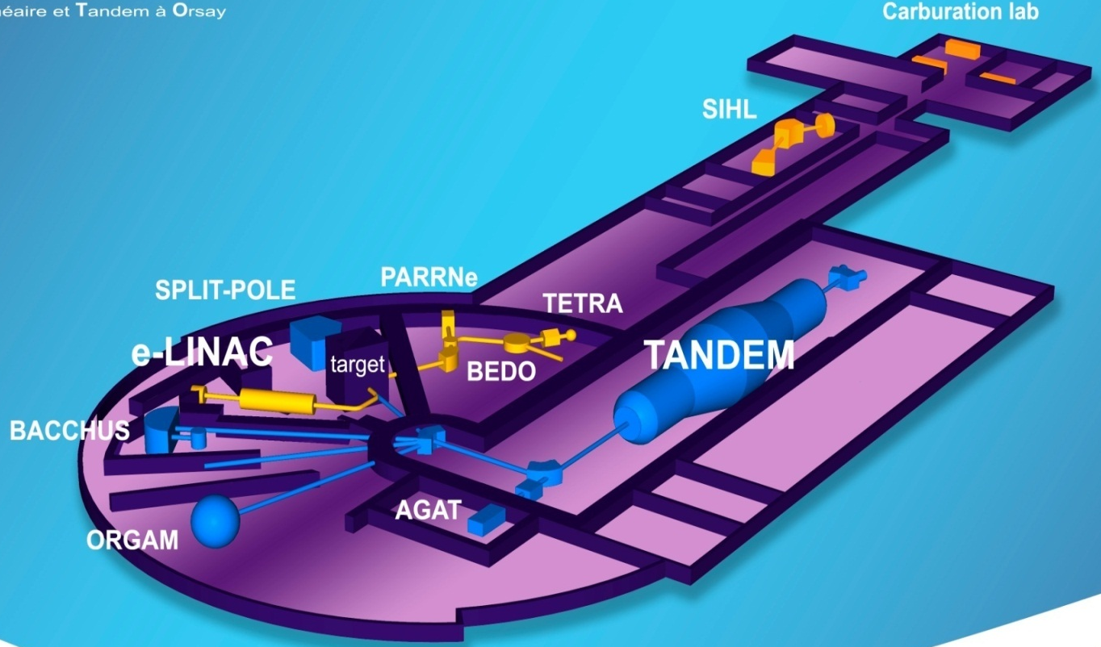
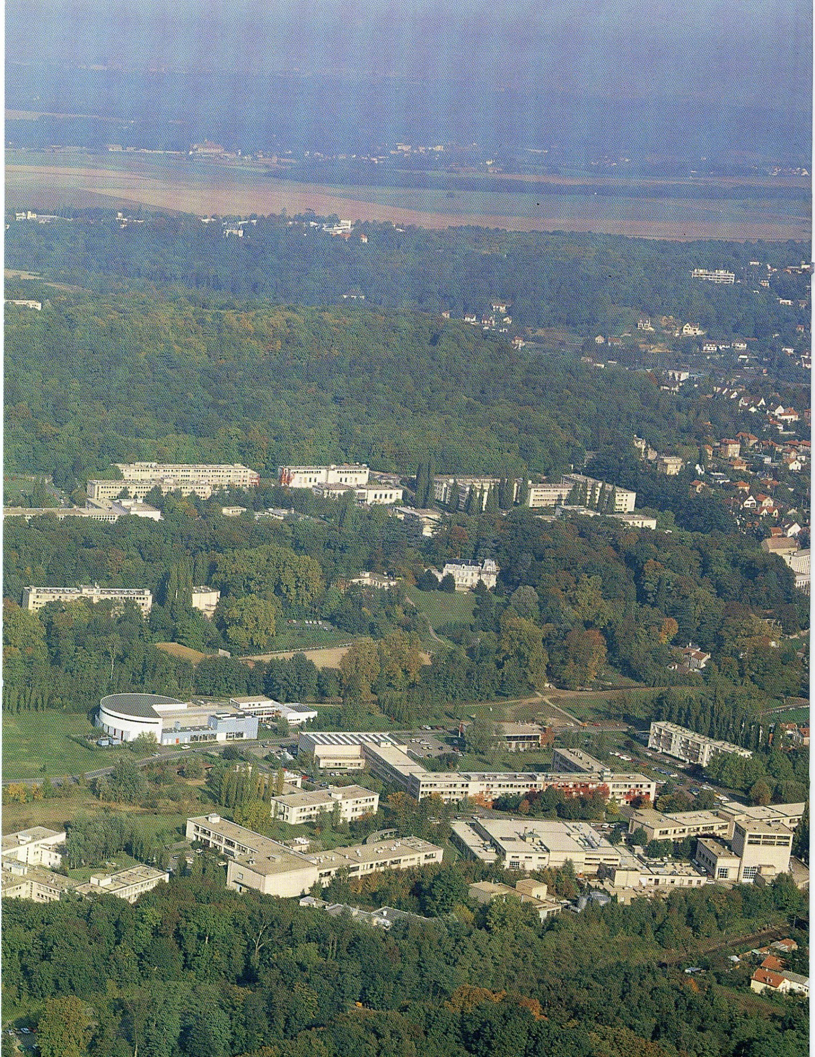

Tandem building
Institut de Physique Nucléaire
Campus of the Paris Sud University Orsay (France)
Verney – IPN Orsay INPC 2013 – Firenze – 2-7 May 2013
Page 2/

Slide 3

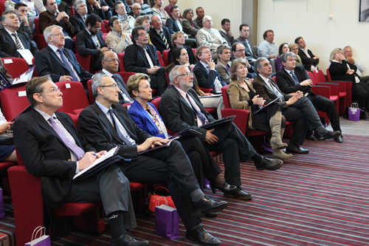
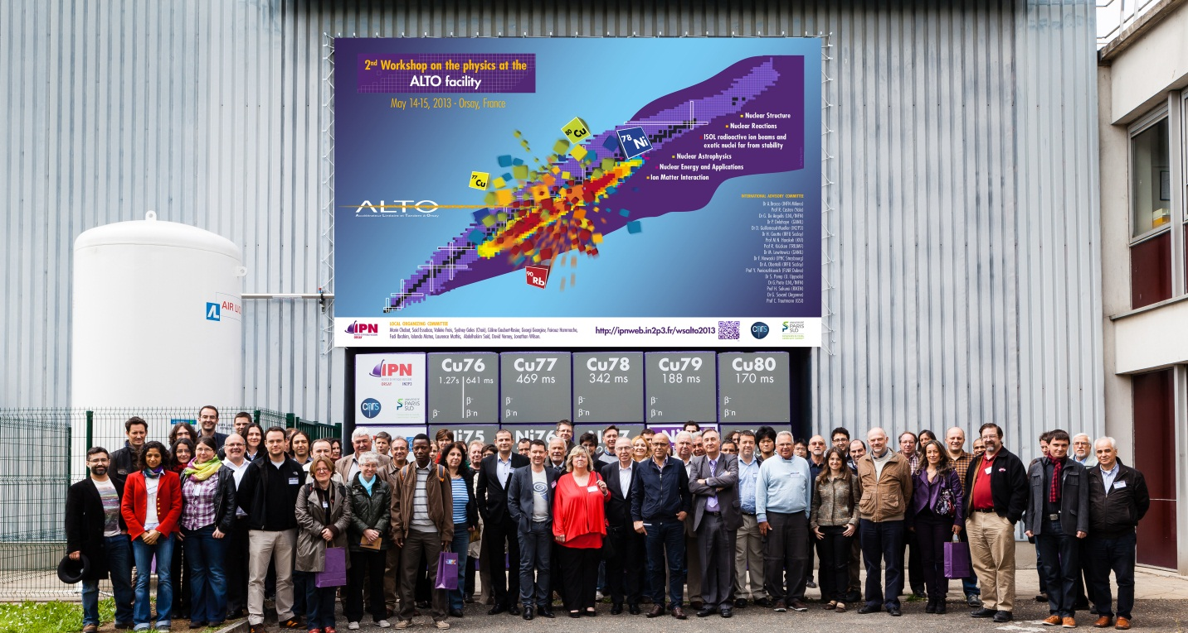
March 2012
green light from French nuclear safety authorities
May 13th 2013 – formal inauguration
May 14-15th 2013 – 2nd Workshop on the Physics at ALTO
Verney – IPN Orsay INPC 2013 – Firenze – 2-7 May 2013
Page 3/

Slide 4
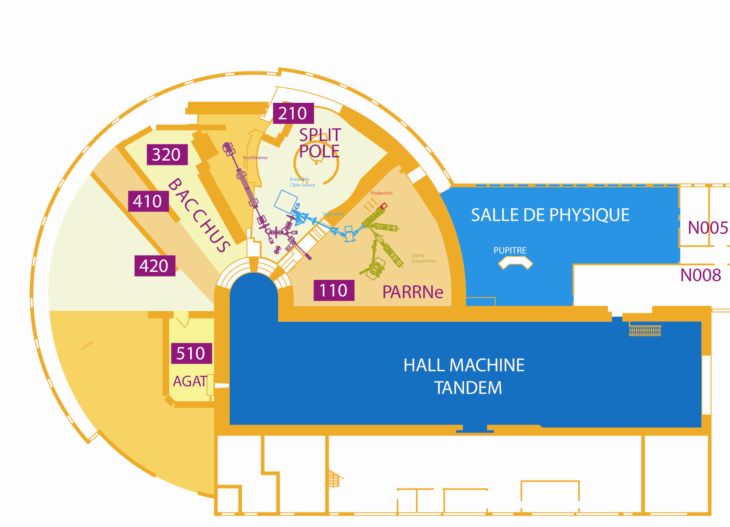
Tandem/ALTO general layout
Stable beams
Line 210 SPLIT POLE
ISOL
Production cave
line 320 BACCHUS
ISOL
Driver
ISOL
Mass separator and
Low energy RIB lines
line 410
ISOL installation
line 420
ORGAM
cluster/
molecular/
droplets beams
Radioactive beam lines
Stable beam without spectrometer
Stable beam with spectrometer
Verney – IPN Orsay INPC 2013 – Firenze – 2-7 May 2013
Page 4/

Slide 5
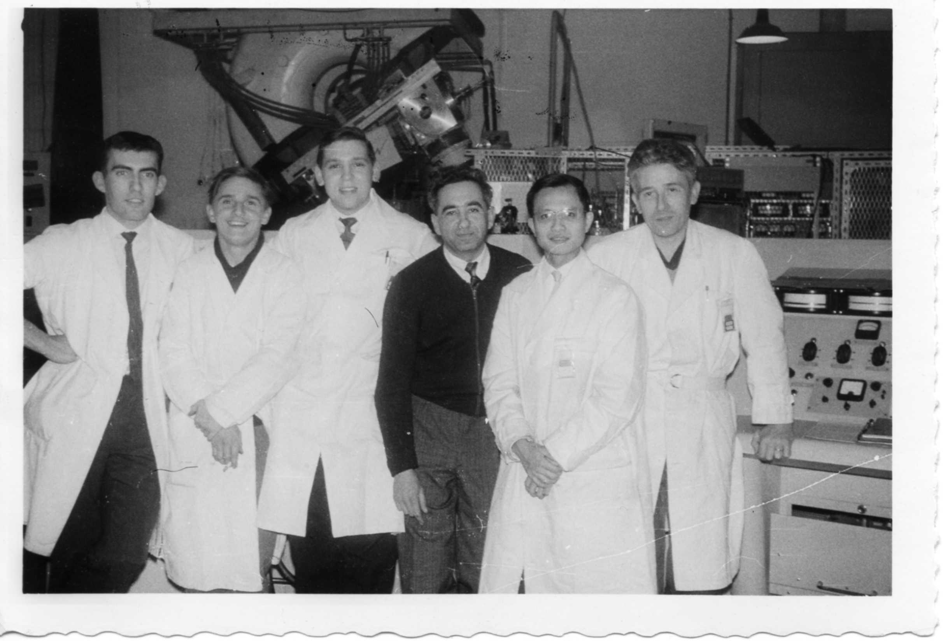
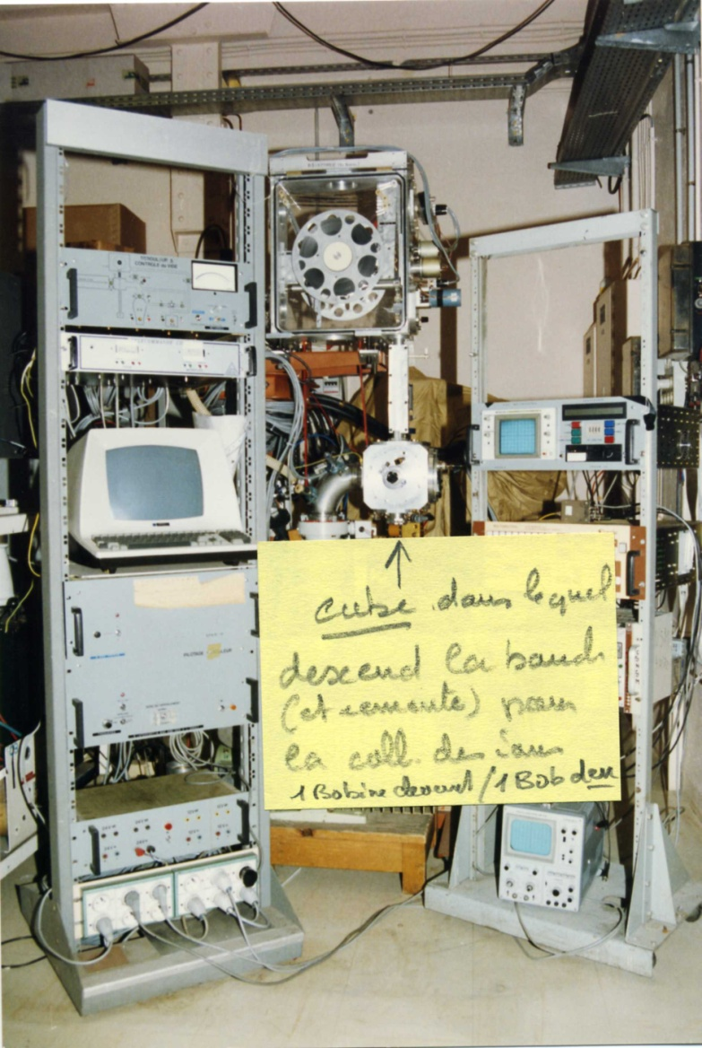
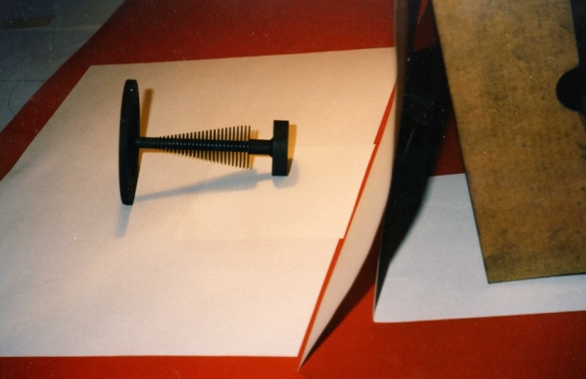
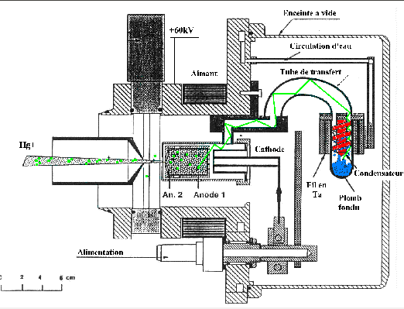
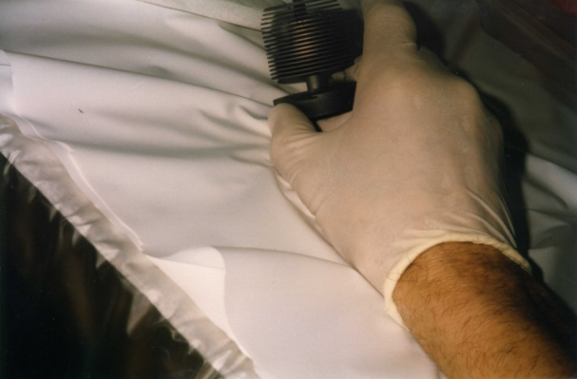
ISOL TECHNIQUE IS AN OLD TRADITION AT IPN ORSAY !
Introduction of the ISOL technique at GANIL
1992
J. Obert
1964
1997
SPIRAL1 target
Contribution to the improvement of the liquid Pb target
ISOLDE 90’s
SPIRAL/Louvain target
Verney – IPN Orsay INPC 2013 – Firenze – 2-7 May 2013
Page 5/

Slide 6
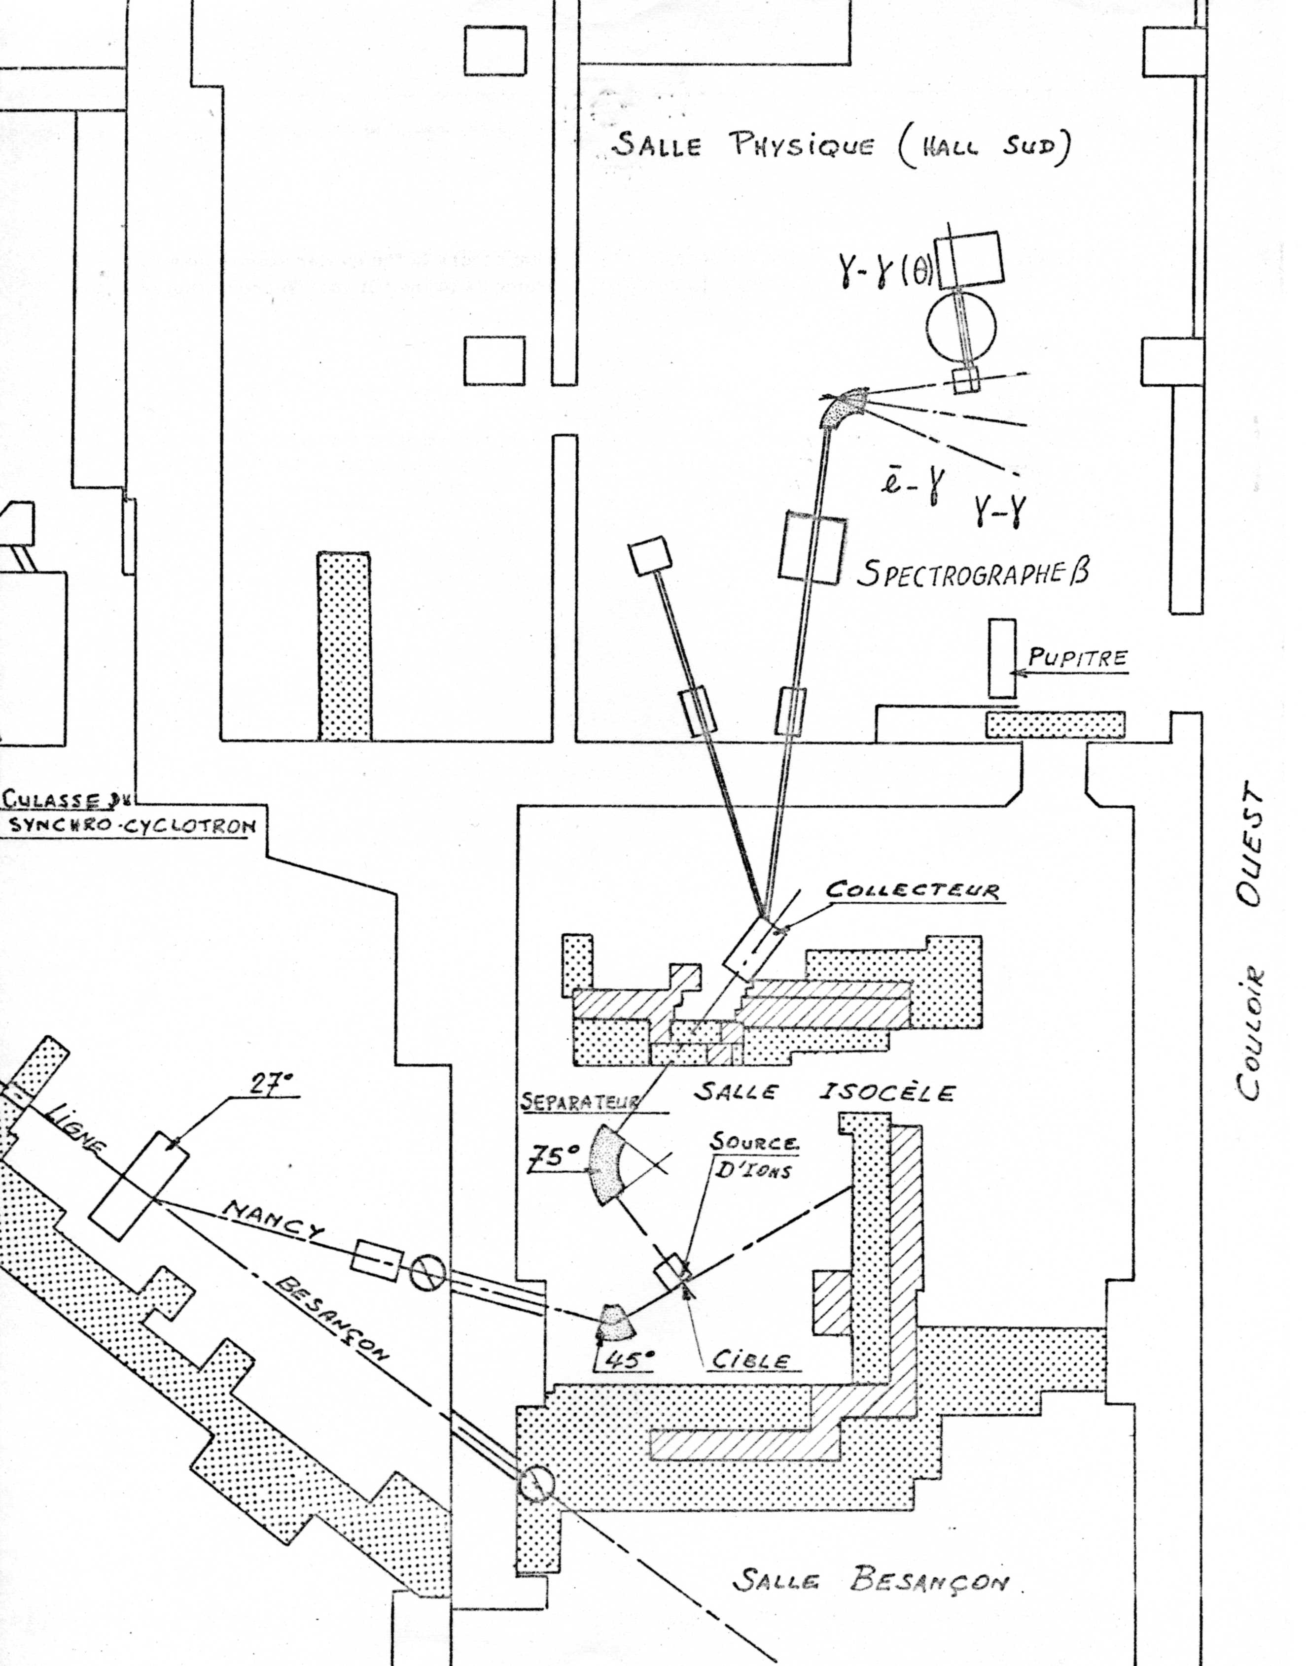
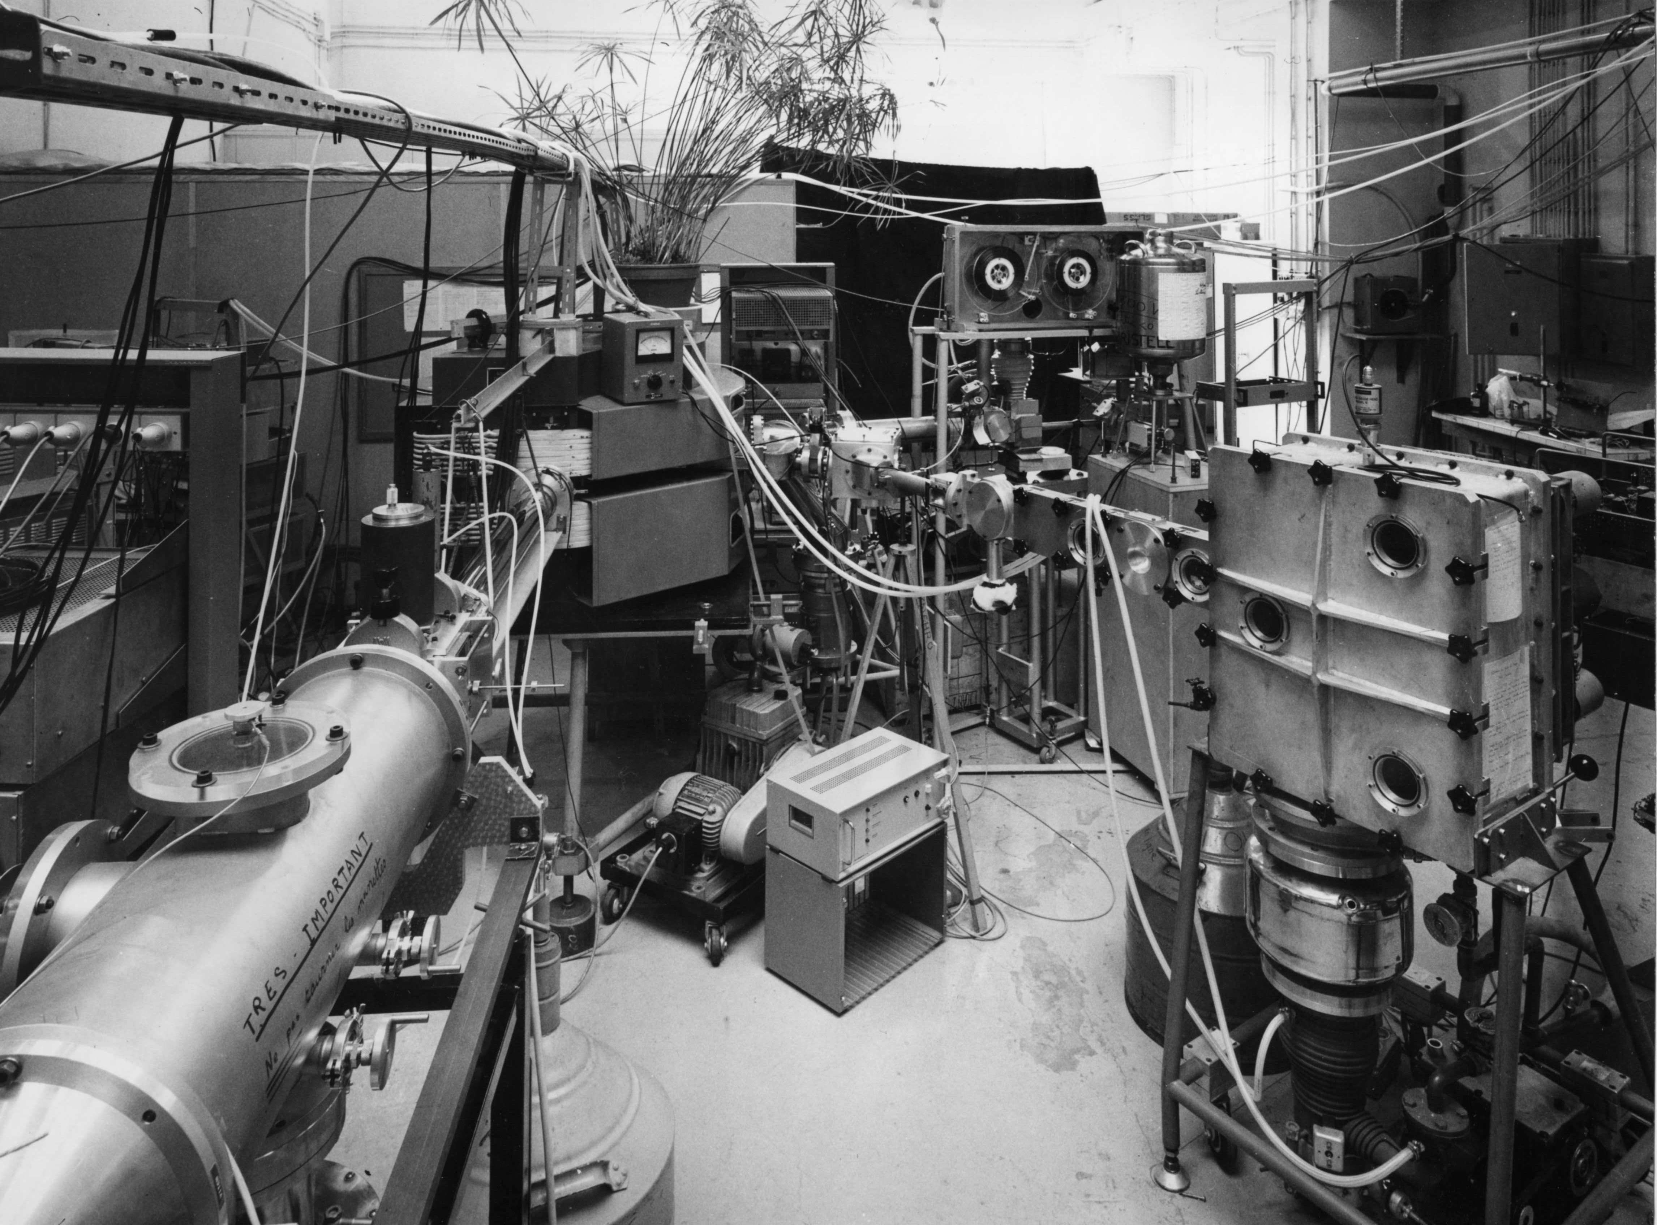
beginning of the 70’s : the ISOCELE ISOL setup at the Orsay SC (now proton therapy center)
Verney – IPN Orsay INPC 2013 – Firenze – 2-7 May 2013
Page 6/

Slide 7
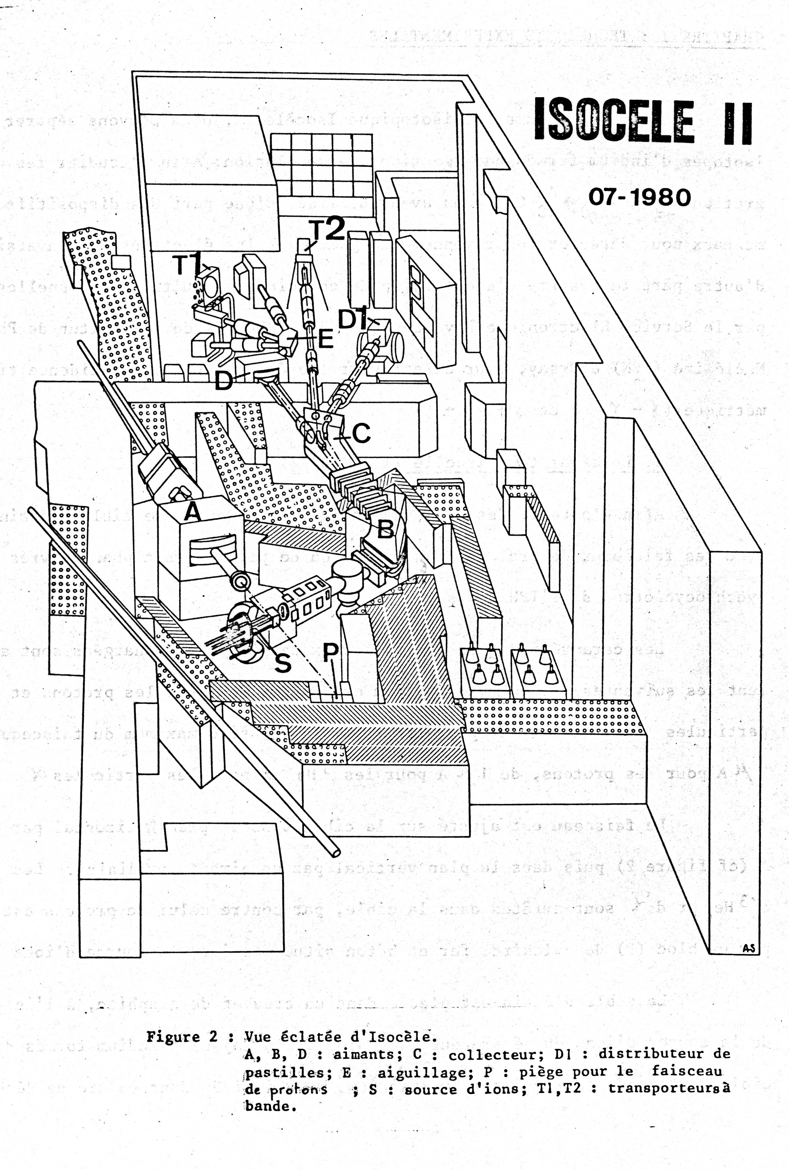
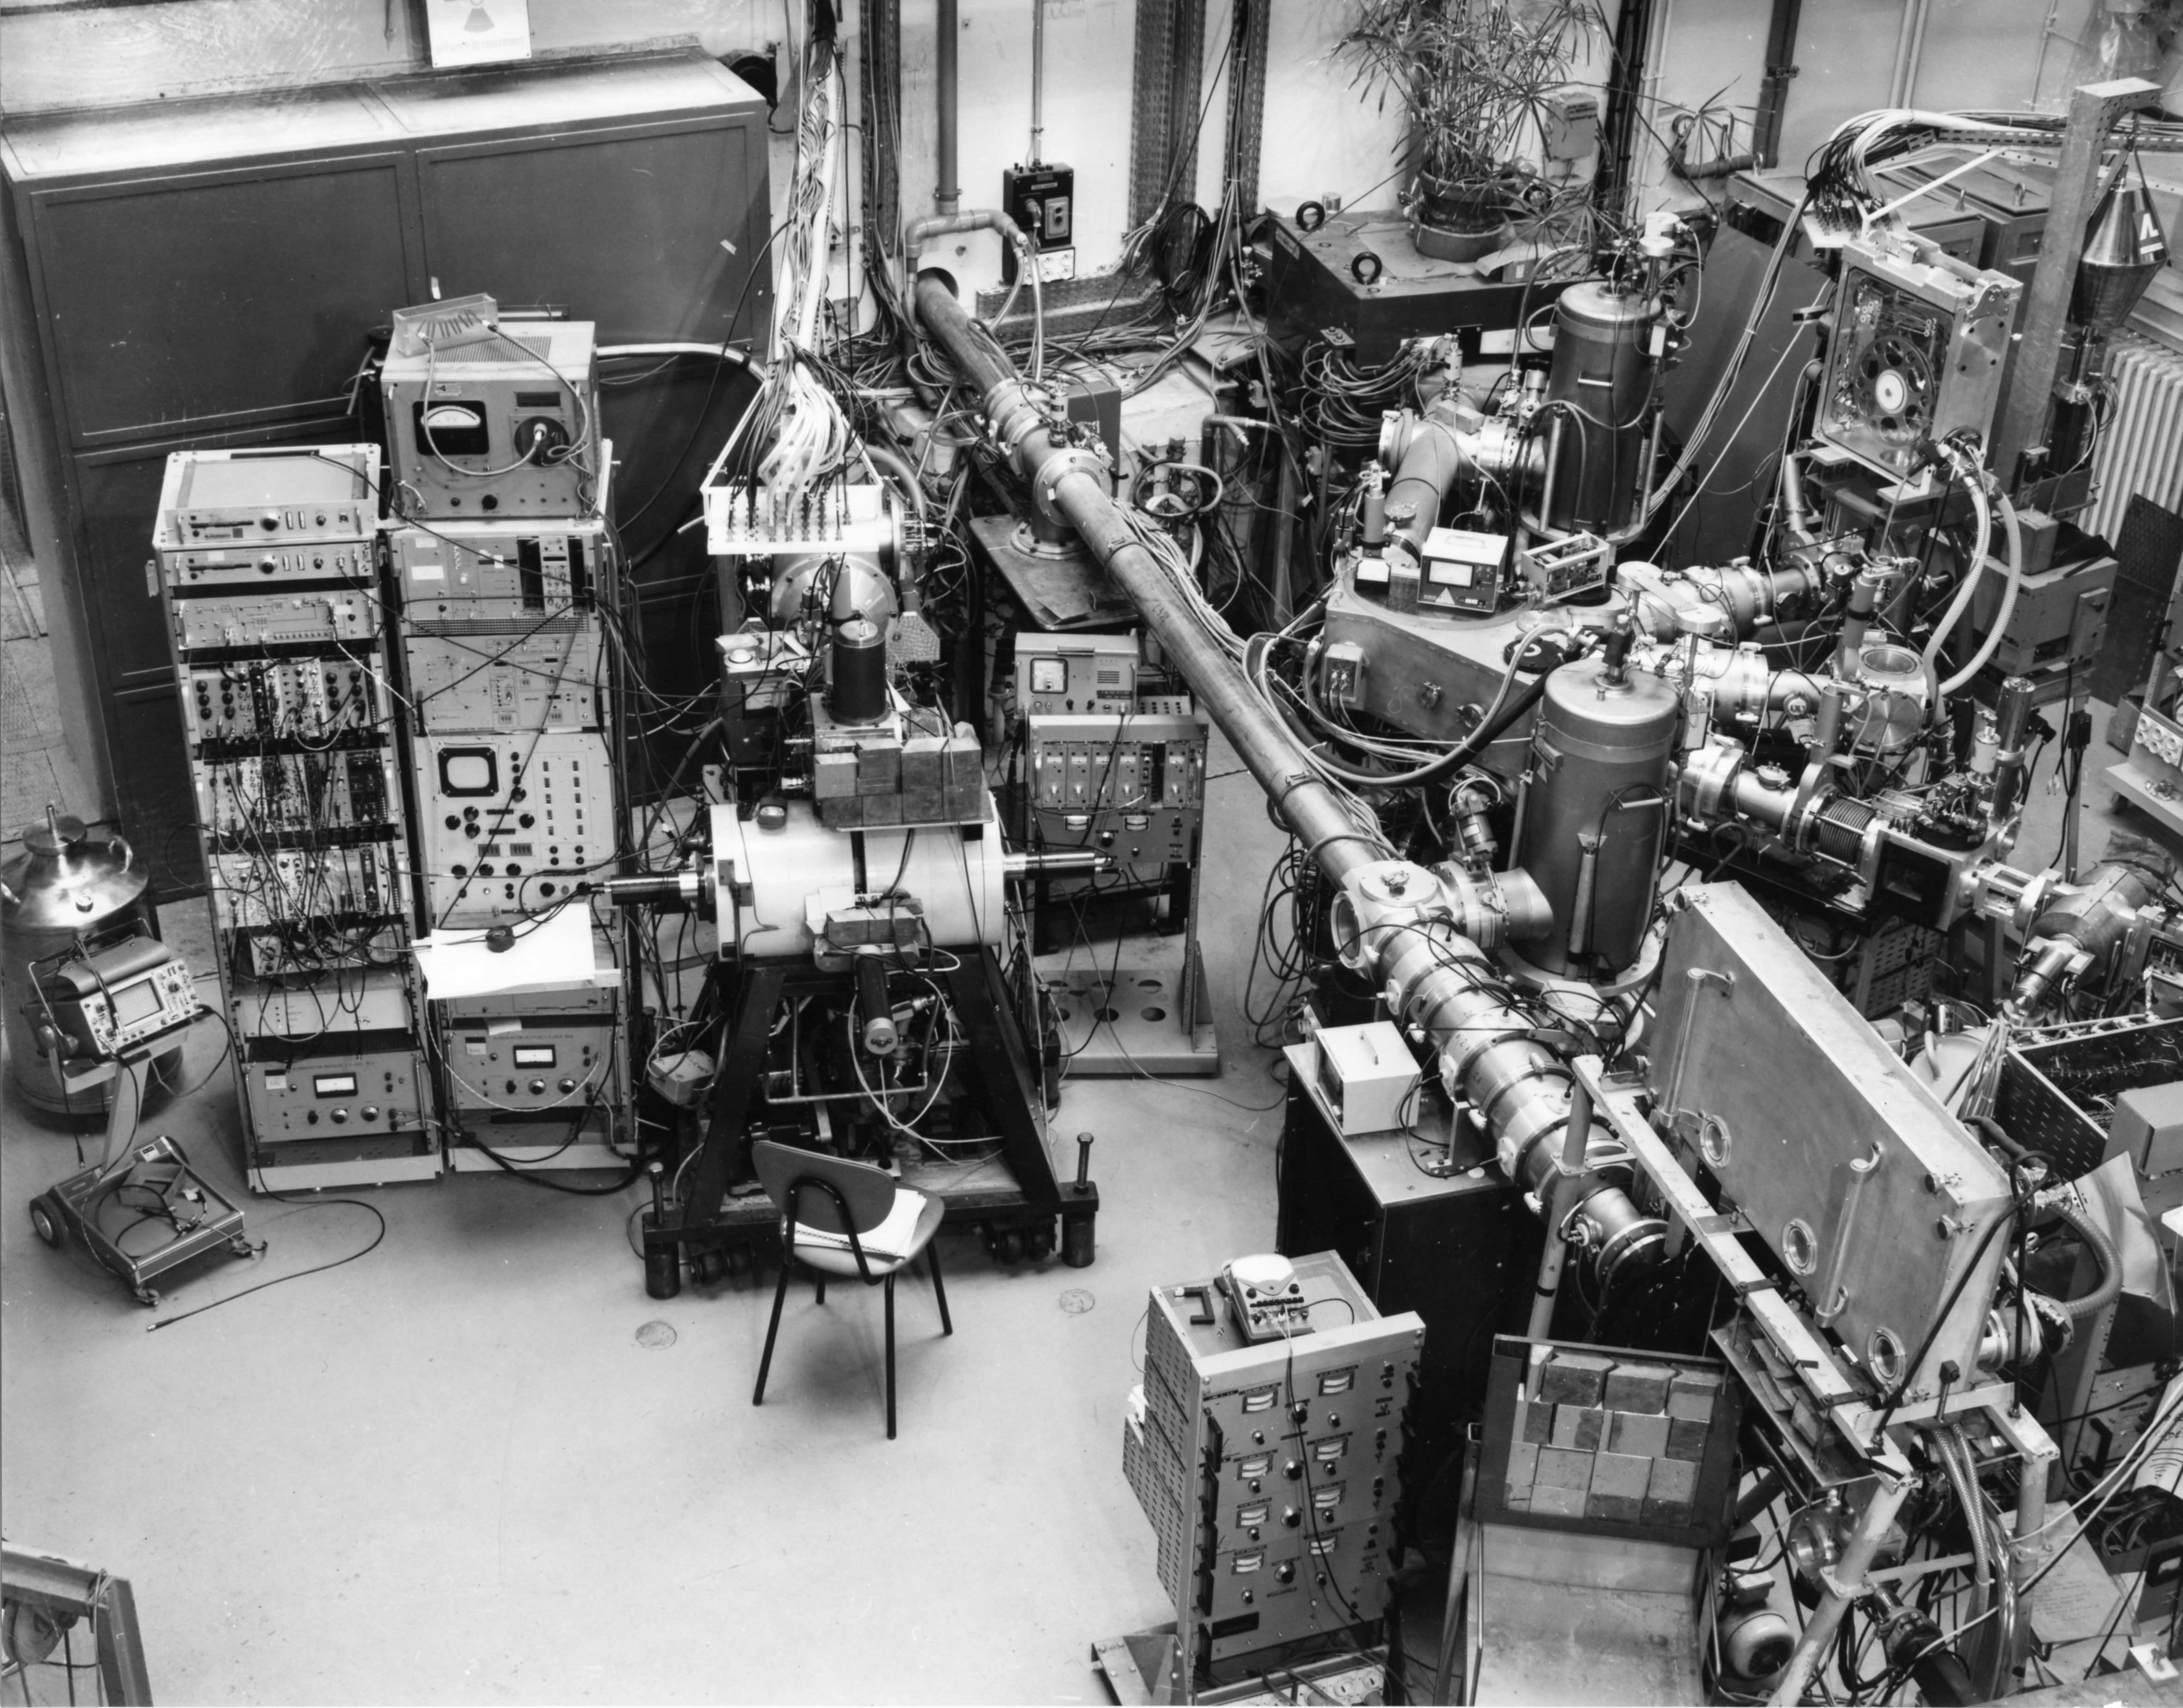
ending 70’s/beginning 80’s, upgrade of the SC ⇒ ISOCELE2
(exactly at the same time for the same reasons, at CERN : ISOLDE3)
Verney – IPN Orsay INPC 2013 – Firenze – 2-7 May 2013
Page 7/

Slide 8
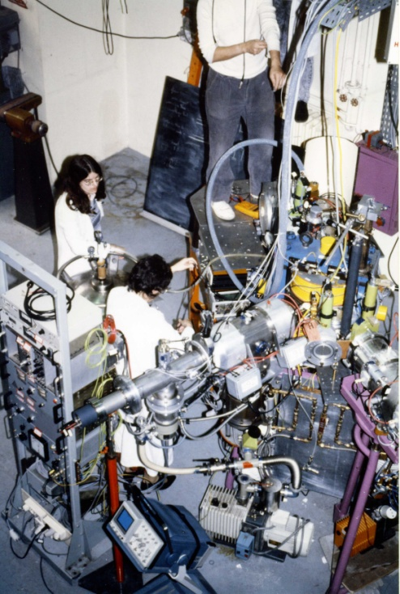
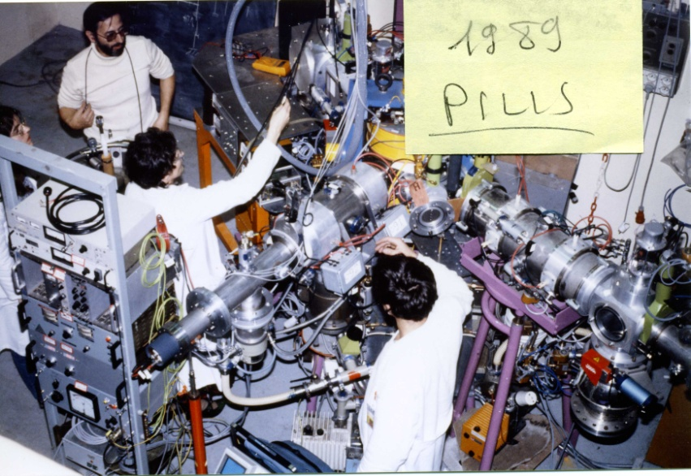
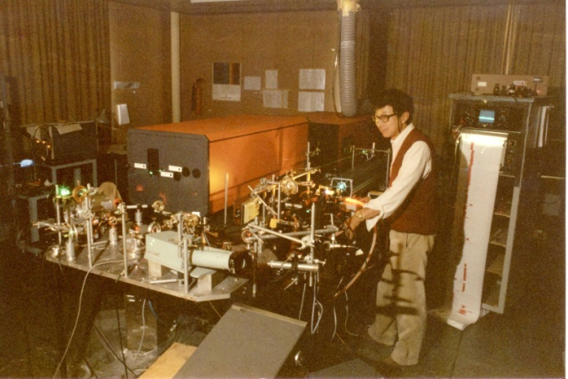
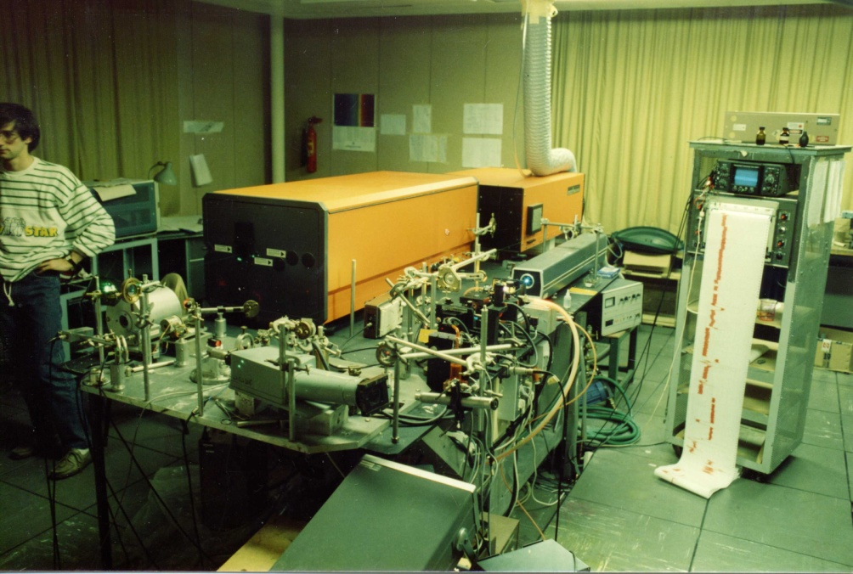
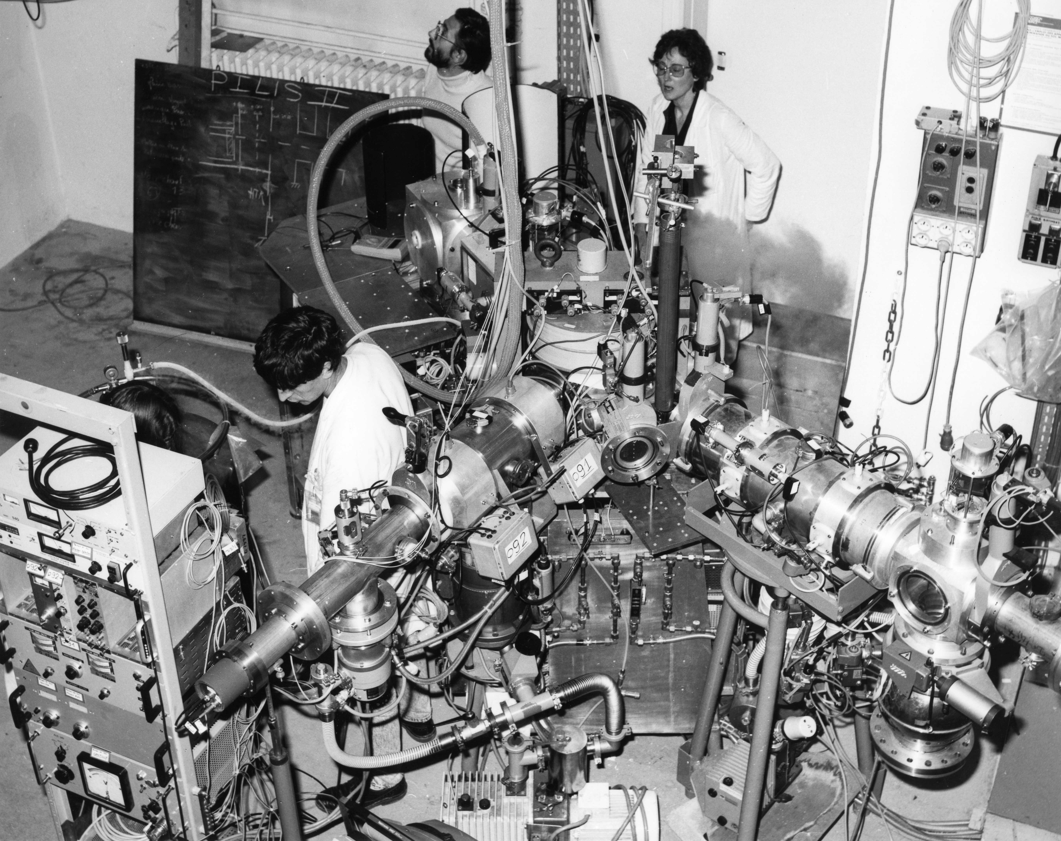
end 80’s, first online laser ion source at IPN: PILIS
beginning 90’s the medicine (proton therapy) takes
possession of the SC
the PILIS activity moves to ISOLDE/CERN → COMPLIS setup
Verney – IPN Orsay INPC 2013 – Firenze – 2-7 May 2013
Page 8/

Slide 9
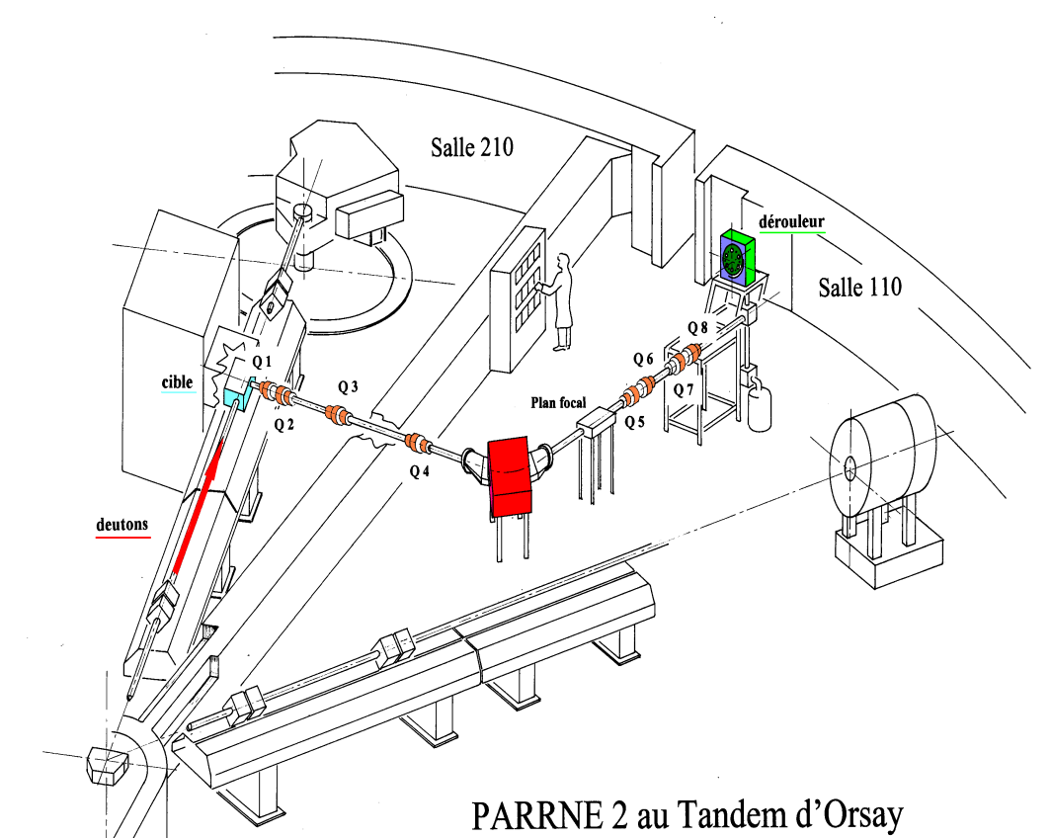
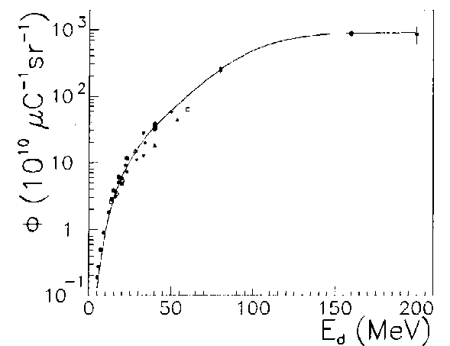
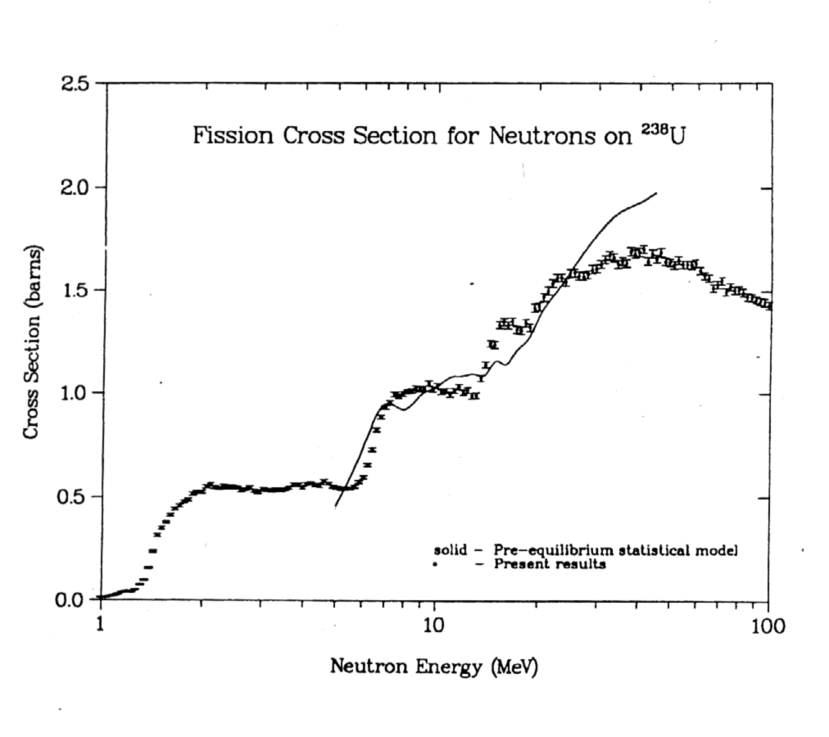
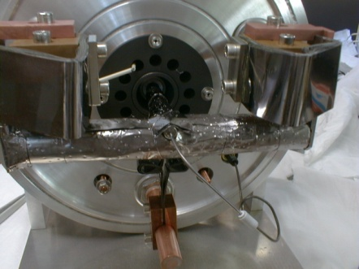
90’s ending, beginning 2000’s, ISOL activity back at IPN: PARRNe
initially a R&D test bench for the SPIRAL2 project
« Production d’Atomes Radioactifs Riches en Neutrons »
from P.W.Lisowski et al, OECD/NEA Report
NEANDC-305 'U' 1991 p.177
Thesis Nicolas Pauwels
IPN Orsay
detection
ion
source
mass separator
fast
neutrons
target
(10^9 fissions/s)
deuteron beam
(1µA 26 MeV)
²³⁸U
Fission
Fragments
fission
1+
converter
(C)
Verney – IPN Orsay INPC 2013 – Firenze – 2-7 May 2013
Page 9/

Slide 10
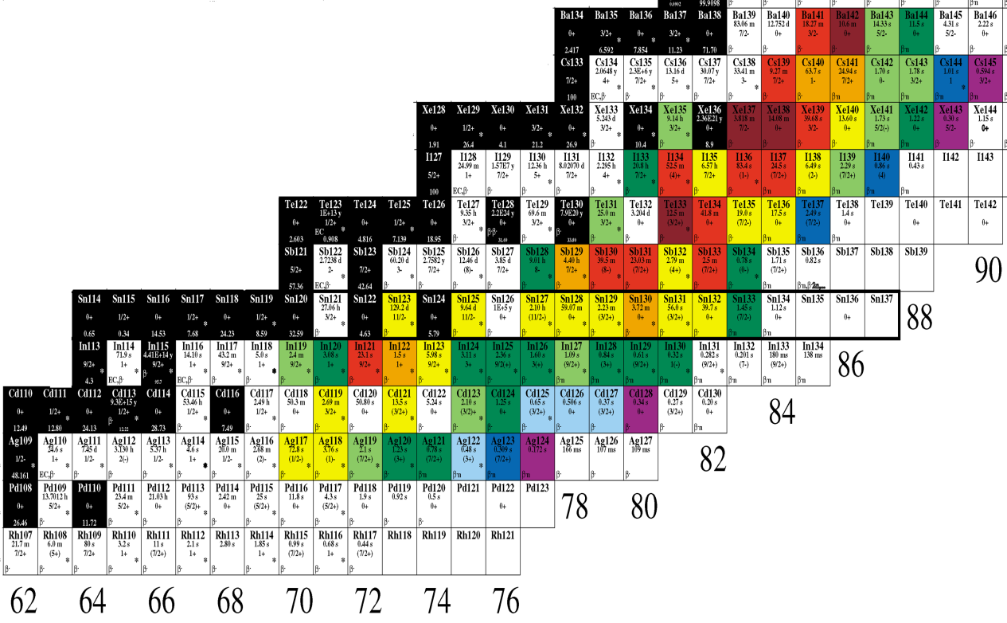


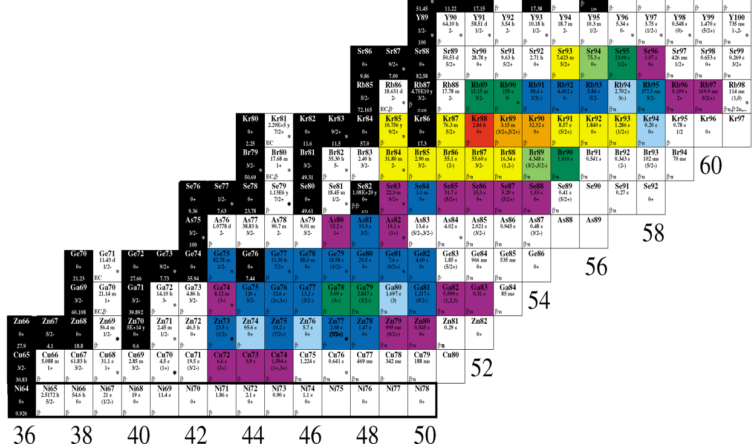
2000 :
production yields with a hot plasma ion source (Febiad)
56
54
Measured productions yields at the detection point at PARRNe
52
Production /s/µA
measured in dec 2000
5 10⁶ – 5 10⁷
50
10⁶ – 5 10⁶
5 10⁵ – 10⁶
48
10⁵ – 5 10⁵
5 10⁴ – 10⁵
46
10⁴ – 5 10⁴
5 10³ – 10⁴
10³ – 5 10³
10² – 10³
Stable
38
Hot plasma ion source
1µA deuterons from the Tandem
26 MeV
10⁹ fissons/s
inside the target
36
34
Z
32
30
28
N
Verney – IPN Orsay INPC 2013 – Firenze – 2-7 May 2013
Page 10/

Slide 11
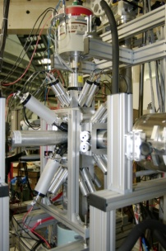
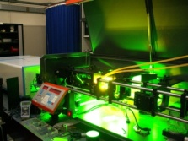
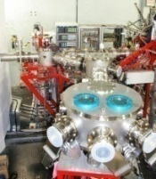
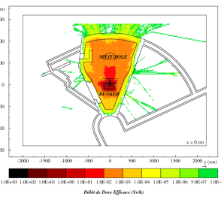
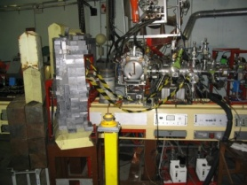
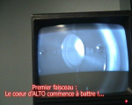
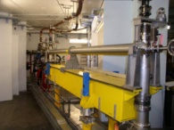
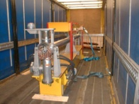
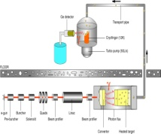
INAUGURATION
2013
BEDO commissioning
green light from French nuclear safety authorities
2012
2011
first laser ionized RIB
2010
building of the low energy beam lines + laser ion source
2009
Commissioning : tests
and radiation safety measurements
TIS vault
2008
84Ga -> 84Ge β-decay
2007
UCx target on line with e-beam
– production yields measurements
2006
First e-beam extracted
2005
RF system
2004
construction of the LINAC bunker
2003
arrival of the LINAC cavity from decommissioned LEP injector
2002
81Zn -> 81Ga β-decay
2001
83Ga -> 83Ge β-decay
exploratory photofission experiment at CERN
2000
1999
ISOL available at TANDEM
PARRNe mass-separator on line
1998
initial idea of a R&D test bench for the SPIRAL2 project at the Orsay Tandem
Verney – IPN Orsay INPC 2013 – Firenze – 2-7 May 2013
Page 11/

Slide 12
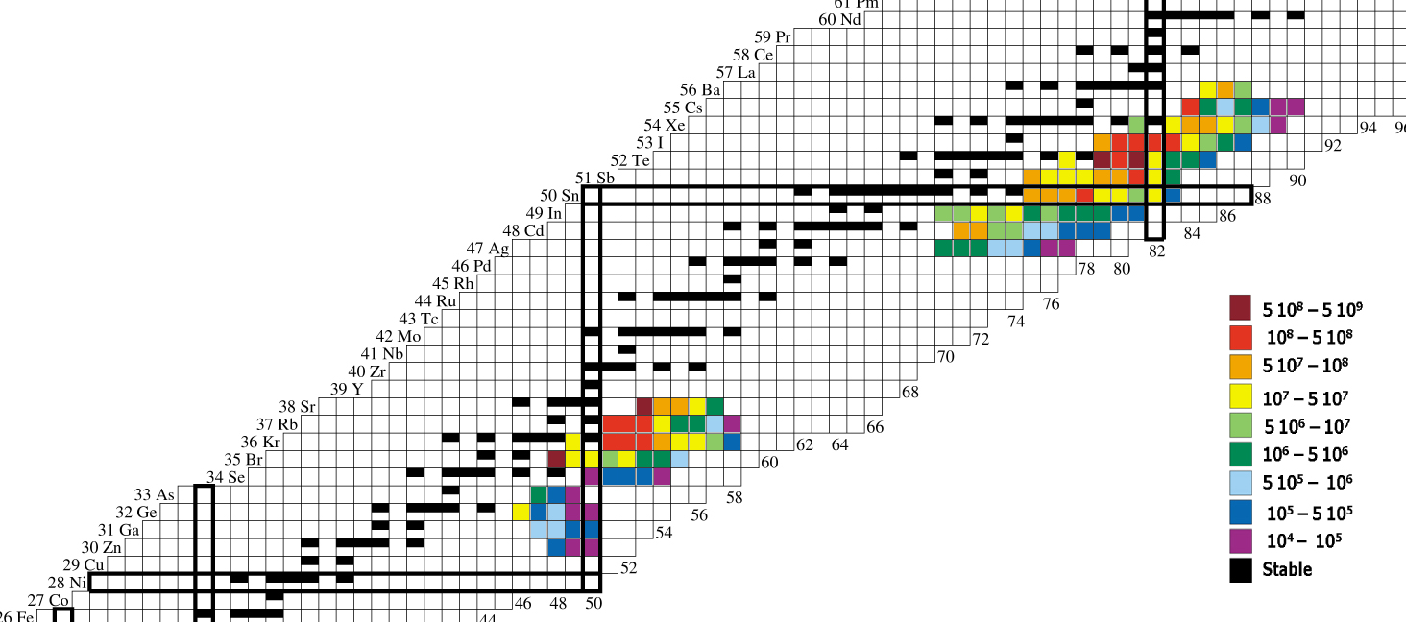
ALTO=ISOL installation based on photo-fission: the first of its kind in the world
Measured productions yields at the detection point
on line with the PARRNe mass separator
electrons -> gamma induced fission
Production /s/100nA
5 10⁶ – 5 10⁷
green light from French nuclear safety authorities
officially granted Spring 2012
10⁶ – 5 10⁶
5 10⁵ – 10⁶
10⁵ – 5 10⁵
5 10⁴ – 10⁵
×100
10⁴ – 5 10⁴
5 10³ – 10⁴
10³ – 5 10³
10² – 10³
measured in June 2006
Stable
Hot plasma ion source
100nA electrons
50 MeV
10⁹ fissons/s inside the target
nominal intensity:
10 μA ⇒~ 10¹¹ fissions/s
Verney – IPN Orsay INPC 2013 – Firenze – 2-7 May 2013
Page 12/

Slide 13

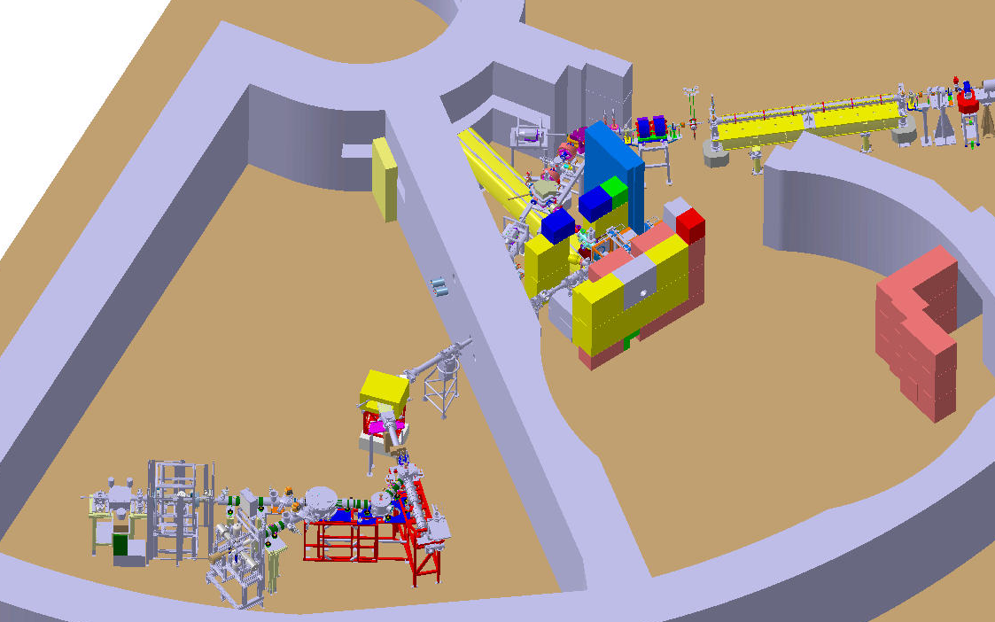
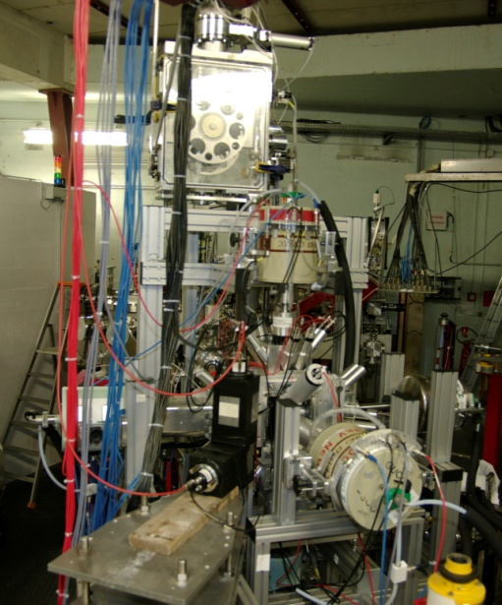
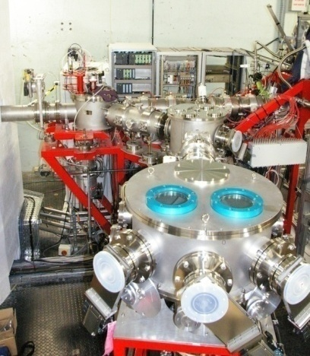
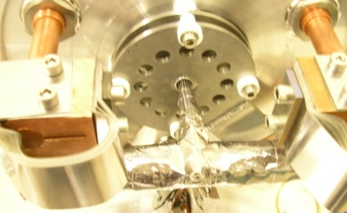
ALTO=ISOL installation based on photo-fission: the first of its kind in the world
e-LINAC
10 µA 50MeV
(former 1st section of the LEP injector)
BEDO
beta decay spectroscopy
secondary
beam lines
TIS vault
~5.10^11 fissions/s
POLAREX
nuclear orientation on line
PARRNe
mass separator
Target Ion-source ensemble
kicker - bender
identification station
Verney – IPN Orsay INPC 2013 – Firenze – 2-7 May 2013
Page 13/

Slide 14

RIB developments at ALTO
and contribution to R&D in ISOL science
from ALTO

Slide 15
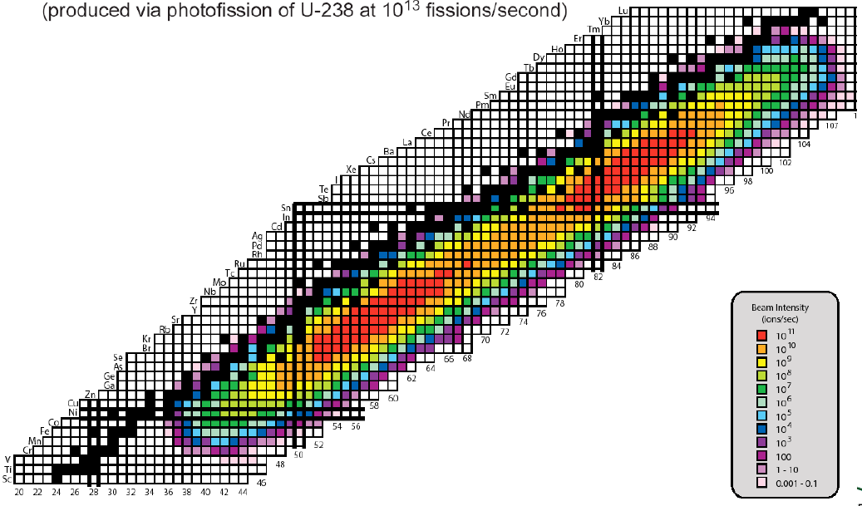
RIB developments and R&D in ISOL science
R&D program on the fluorination of Lanthanides
Lanthanide Region
Semi refractory
(slow release from UCx)
Strong physics motivation:
study of mid-shell effects
⇨ B(E2) measurements
fast timing
Program led by B. Roussière (IPN Orsay), collaboration CSNSM (France), Tandar (Argentina) and INRNE (Bulgaria)
first fast-timing experiment at ALTO with low-intensity e⁻ beam on ^{137,139}Cs
Eur. Phys. J. A (2011) 47: 106
Verney – IPN Orsay INPC 2013 – Firenze – 2-7 May 2013
Page 15/

Slide 16
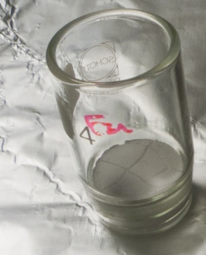


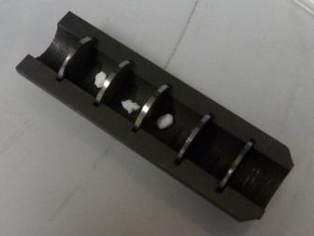



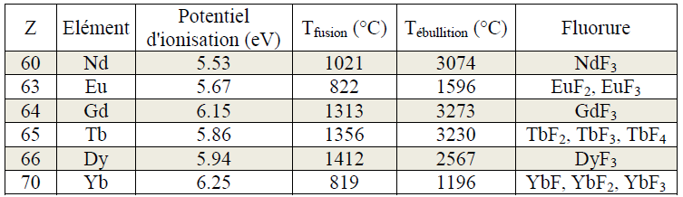
RIB developments and R&D in ISOL science
R&D program on the fluorination of Lanthanides
SIHL off-line mass separator
Strategy :
Fasten the release of Ln by formation of LnF_{n}⁺ molecular beams
Tests :
the different parameters:
●injected fluoride gas
●target temperature
●source type
Target made of Lanthanide oxides mixed in graphite powder

Slide 17
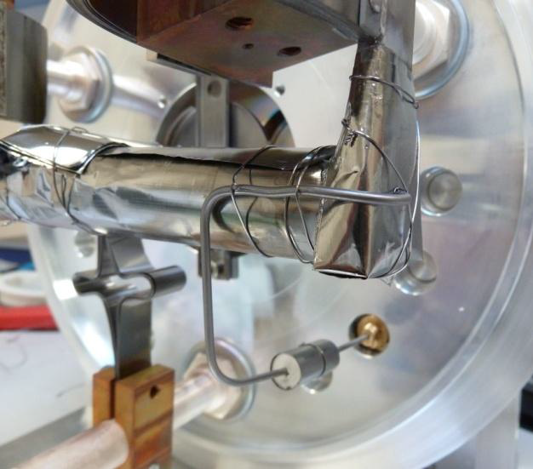
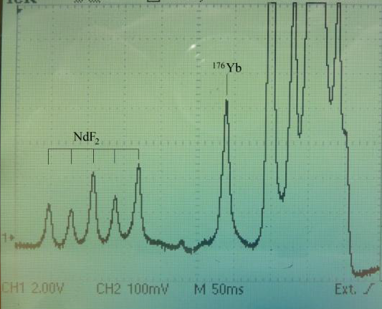
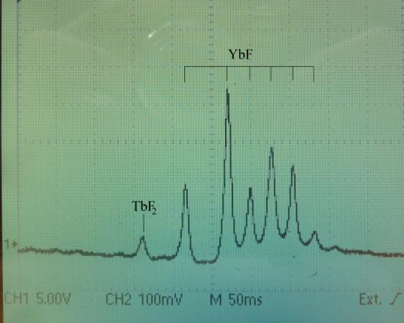
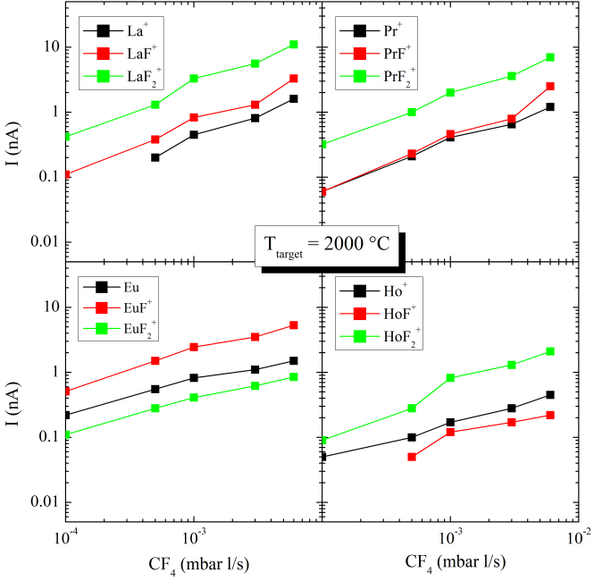
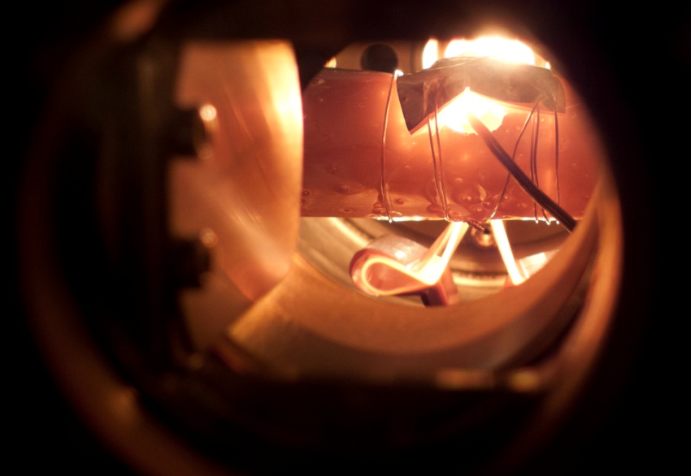
RIB developments and R&D in ISOL science
R&D program on the fluorination of Lanthanides
Mass scan
Measurements performesd with hot plasma (Febiad) and surface (W) ion sources
CF4 inlet tube
flow max compatible with good running conditions:~6 x 10⁻³ bar.l/s
High correlation between the valence of the Ln and the observed ions (Ln⁺, LnF⁺ or LnF₂⁺).
Reliable T° control
Verney – IPN Orsay INPC 2013 – Firenze – 2-7 May 2013
Page 17/

Slide 18
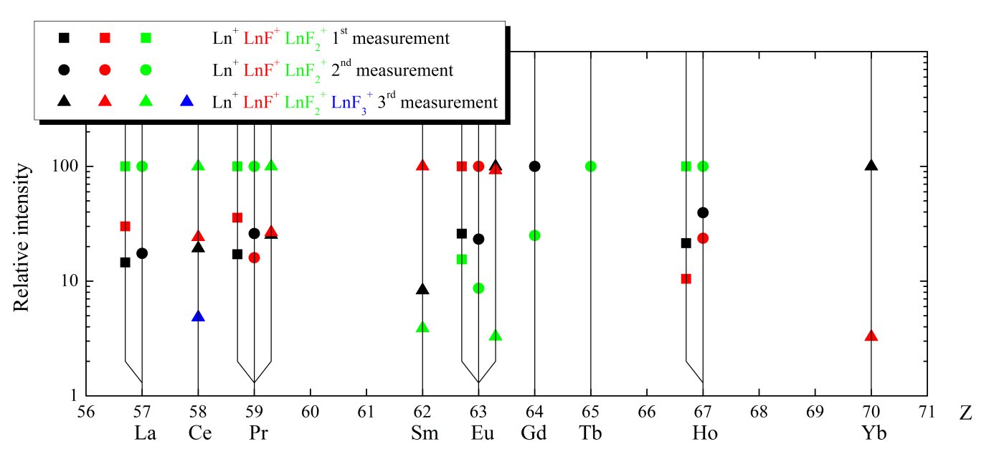

RIB developments and R&D in ISOL science
R&D program on the fluorination of Lanthanides
● 1st systematic study on the fluorination for Lanthanides beams
● Dependence on the valence of the Lanthanide
● Process sensitive to heating conditions
● Reproducible results
● No chemical corrosion observed in the front-end (after more than 3 weeks of operation)
● Further tests are scheduled for optimizing the operation conditions before going to online experiments
Towards a more general R&D program
on molecular beams
IPN Chemists, engineers and physicists
N. Barré-Boscher, M. Cheikh Mhamed, S. Essabaa, C. Lau,
B. Roussière, A. Said, S. Tusseau-Nenez
R&D of interest for all current ISOL facilities and extendable to develop new radioactive molecular beams.
Powerful technique to produce chemically reactive nuclei.
In the framework of ENSAR2: a proposal submitted, involving CERN, GANIL, GSI and INFN: to be discussed…
Verney – IPN Orsay INPC 2013 – Firenze – 2-7 May 2013
Page 18/

Slide 19
RIB developments and R&D in ISOL science
UCx developments at IPN - ALTO
ENSAR JRA02, ActILab:
Actinide ISOL Target R&D Laboratory
● CERN-ISOLDE
● GANIL-SPIRAL2
● INFN- SPES
● IPN- ALTO
● Laboratory of Chemical Sciences, Univ. of Rennes (France)
for the synthesis of samples and microstructural characterizations (SEM)
● ICMMO-Orsay
for SEM observations and XRD measurements on non-radioactive samples
Objectives:
Today : ALTO, 10¹¹ fissions / sec
Tomorrow : SPIRAL2 >10¹³ fissions / sec
Future : EURISOL, 10¹⁵ fissions / sec
Nowadays
The most widely used ISOL targets = uranium carbide + graphite (UCX), mostly UC2
Concentration of ²³⁸U ~ 3 g/cm3
Operate at temperatures ranging from 2 000 °C to 2 200 °C
How to increase the RIB intensities ?
Increasing the primary beam
Increasing uranium density → higher production rate of FPs
IPN Chemists, engineers and physicists
N. Barré-Boscher, M. Cheikh Mhamed, S. Essabaa, C. Lau,
B. Roussière, A. Said, S. Tusseau-Nenez
BUT that cannot be the end of the story:
favor the FPs releases, particularly crucial for the short-lived species
Controlling the porosity
Reducing the thickness of pellets
Verney – IPN Orsay INPC 2013 – Firenze – 2-7 May 2013
Page 19/

Slide 20

RIB developments and R&D in ISOL science
UCx developments at IPN - ALTO
Carburation lab
SIHL off-line mass separator
15 MV MP Tandem
Strategy :
Measure the release properties of pellets after irradiation
Control and characterize :
the different parameters:
● UCx synthesis method
● porosity
● microstructure
● physicochemical properties
● …
Densest samples
Porous samples
Verney – IPN Orsay INPC 2013 – Firenze – 2-7 May 2013
Page 20/

Slide 21





RIB developments and R&D in ISOL science
UCx developments at IPN - ALTO
Heating 1700°C during 30 min
Secondary vacuum
Cooling to 70°C in 10 min
Deuteron Tandem beam
Irradiation time 20 min
Cooling time 30 min
The furnace for heating test is home made. Calibration by melting of Pt
Verney – IPN Orsay INPC 2013 – Firenze – 2-7 May 2013
Page 21/

Slide 22



RIB developments and R&D in ISOL science
UCx developments at IPN - ALTO
Results from gamma spectrometry
Clearly, diffusion and effusion are correlated with the porosity / pore size distribution of the sample
More on the method in:
B. Hy et al., NIM B 288 (2012) 34
Verney – IPN Orsay INPC 2013 – Firenze – 2-7 May 2013
Page 22/

Slide 23


RIB developments and R&D in ISOL science
Laser ionized RIBs at ALTO
The ALTO laser ion source RIALTO (Resonant Ionization at ALTO)
Installation supervised by S. Franchoo
with the collaboration of
ISOLDE:
V. Fedosseev, B. Marsh, T. Goodacre
Univ. Manchester:
K. Flanagan
Univ. Mainz:
T. Kron, K. Wendt
Mezzanine of the mass separator/RIB zone
The on-line laser installation validated in 2011
with the production of Ga beams.
2012: Upgrade 2 new lasers (Radiant Dyes).
2013: Reference cell (in progress...)
Laser beams are driven some 17 m away down to the TIS
Verney – IPN Orsay INPC 2013 – Firenze – 2-7 May 2013
Page 23/

Slide 24

RIB developments and R&D in ISOL science
Laser ionized RIBs at ALTO
Verney – IPN Orsay INPC 2013 – Firenze – 2-7 May 2013
Page 24/

Slide 25


RIB developments and R&D in ISOL science
Laser ionized RIBs at ALTO
Upgrades 2012 - 2013
● Validated with Ga beams: 287/297 nm + 532 nm
● Next run with Zn beams: 214 nm + 636 nm + 532 nm (f tripling) – starting June 17th 2013
● Laser schemes and optics settled with the support of ISOLDE-CERN
● EdgeWave pump laser
(532 nm, 100 W, 10 KHz, 10 ns)
● 2 Radiant Dyes Narrowscan lasers
(540 – 900 nm)
BBO doubling units (270 – 450 nm)
Verney – IPN Orsay INPC 2013 – Firenze – 2-7 May 2013
Page 25/

Slide 26

RIB developments and R&D in ISOL science
Laser ionized RIBs at ALTO
Reference cell in progress…
Design: engineering office of the “Accelerators” Division of IPN
Tests: R&D group of ALTO
Collaboration with Mainz University: T. Kron and K. Wendt
Verney – IPN Orsay INPC 2013 – Firenze – 2-7 May 2013
Page 26/

Slide 27
Progress in the instrumentation
of the secondary beam lines

Slide 28

Progress in the instrumentation of the secondary beam lines
beta-decay spectroscopy in the N=50 region
more than 10 years of experiments in the ⁷⁸Ni region
at the PARRNe mass separator (Tandem/ALTO)
Present limit of structure knowledge
(at least few excited states are known)
hot plasma ionization
(1 µA deuteron primary beam)
O. Perru PhD – def. 10th December 2004
Eur. Phys. J. A 28, 307 (2006)
surface ionization
(2-4 µA electron primary beam)
M. Lebois PhD – def. 23th September 2008
PRC 80, 044308 (2009)
B. Tastet PhD – def. 13th May 2011
PRC 87, 054307 (2013)
D. Testov PhD – def. November 2013
laser ionization
(10 µA electron primary beam)
K. Kolos PhD – def. September 2012
As82
Ge79
Ge80
Ge81
Ge85
Ge86
Ga79
Ga80
Ga82
Ga83
Ga84
Ga85
Zn81
hot plasma ionization
(1 µA deuteron primary beam)
PRC 76 (2007) 054312
laser ionization
To be done in June 2013 PhD A. Etile
Verney – IPN Orsay INPC 2013 – Firenze – 2-7 May 2013
Page 28/

Slide 29


Progress in the instrumentation of the secondary beam lines
beta-decay spectroscopy in the N=50 region
new tape station : BEDO
kicker-bender
PARRNe mass separator
PARRNe mass separator focal plane
build up
ion collection
decay
ion beam deviated
central beam line
“historical” measurement position
time
Mylar tape
beam
Large volume Ge detector
(EUROGAM-1 French-UK loan pool)
T1/2 measurement: tape motion cycling
Triggerless DAQ 400ps resolution time stamping
plastic scintilator
Ge CLOVER
(proto EXOGAM )
εtotal_{(photo-peak 1.3MeV)}~2%
Verney – IPN Orsay INPC 2013 – Firenze – 2-7 May 2013
Page 29/

Slide 30


Progress in the instrumentation of the secondary beam lines
BEDO : BEta Decay studies at Orsay
ancilary
plastic
BGO
Compact geometry (max γ efficiency)
γ background suppression
BGO crystals
4π-β
Ge
4π beta
Ge
β energy loss
Ge
Ge
Compton
plastic scintillator
collection point
Verney – IPN Orsay INPC 2013 – Firenze – 2-7 May 2013
Page 30/

Slide 31


Progress in the instrumentation of the secondary beam lines
BEDO : BEta Decay studies at Orsay
4 EXOGAM small prototypes
Source-cap distance = 5 cm
measured ε_{γ (1 MeV)} = 5-6 % (previous system 1-2%)
sensitivity 0.1 pps
beam entrance
up to 5 Ge detectors
6 plastic detectors
Anti-Compton belt
Verney – IPN Orsay INPC 2013 – Firenze – 2-7 May 2013
Page 31/

Slide 32


Progress in the instrumentation of the secondary beam lines
BEDO : BEta Decay studies at Orsay
BEDO setup
in gamma mode
4 small EXOGAM clovers
BEDO setup
in neutron mode
Dubna neutron detector TETRA
(1st physics exp. last year)
gamma
neutron
1
2
3
fast timing mode
LaBr3
LaBr3
Ge
BaF2
LaBr3
Distances / source :
Ge = 40 mm
LaBr3 = 25 mm
BaF2 et LaBr3 = 40 mm
Plastique = 25 mm
~90 ³He tubes
borated polyethylene shielding
Ge detectors
BGO shields
Verney – IPN Orsay INPC 2013 – Firenze – 2-7 May 2013
Page 32/

Slide 33



Direct β-delayed neutron emission measurement of ⁸⁴Ga with TETRA
⁸³As
T_{1/2}=13.4 s
⁸⁴As
T_{1/2}=4.2 s
D. Testov PhD work and Orsay-Dubna collaboration
Yu Penionzhkevich, V. Smirnov and E. Sokol
Pn(⁸⁴Ge)=10.2(9) B.Pfeiffer et al. Prog. Nucl. Energy 41, 39 (2002)
others: 10.8(6) , 9.5(20) , 9(3)
β-n
β
β
⁸³Ge
T_{1/2}= 1.85 s
⁸⁴Ge
T_{1/2}=0.954 s
β-n
β
⁸⁴Ga
T_{1/2}=0.085s
Pn
γ
γ
n
n
γ
Pn=70(15) K.-L.Kratz et al. Z.Phys. A340, 419 (1991) and B.Pfeiffer et al. Prog. Nucl. Energy 41, 39 (2002)
Pn=80(15) C.J.Gross et al. Acta Phys.Pol. B40, 447 (2009)
Pn=47(10) J.A.Winger et al Proc.4th. Intern. Conf. Fission and Properties of Neutron-Rich Nuclei, Sanibel Island, Florida (2007);
Pn=74(14) J.A.Winger PRC 81, 044303 (2010)
TETRA detector at BEDO setup:
- 4Pi neutron detector 90 counters ³He 7 atm
[measured eff. 63±5% (on line)]
- 4π beta detector
- 1 Ge detector
- movable tape
Verney – IPN Orsay INPC 2013 – Firenze – 2-7 May 2013
Page 33/

Slide 34



Direct β-delayed neutron emission measurement of ⁸⁴Ga with TETRA
⁸³As
T_{1/2}=13.4 s
⁸⁴As
T_{1/2}=4.2 s
T1/2=0.085s
Pn(⁸⁴Ga)=49.8%
Pn(⁸⁴Ge)=10.2(9) B.Pfeiffer et al. Prog. Nucl. Energy 41, 39 (2002)
others: 10.8(6) , 9.5(20) , 9(3)
β-n
β
β
⁸³Ge
T_{1/2}= 1.85 s
⁸⁴Ge
T_{1/2}=0.954 s
β-n
β
⁸⁴Ga
T_{1/2}=0.085s
Pn
preliminary
T1/2=0.085s
Pn(⁸⁴Ga)=14%
Testov et al. in preparation
γ
γ
n
n
T1/2=0.085s
Pn(⁸⁴Ge)>>10%
γ
evidence for a longer lived neutron emitter in the beam which cannot be ⁸⁴Ge: ⁸⁴Ga isomer ????
We already proposed the existence of an isomer in 84Ga
Lebois et al PRC 80 (2009)

Slide 35



Progress in the instrumentation of the secondary beam lines
TETRA and BEDO in sequential mode
dipole ON -> towards BEDO
TETRA
dipole OFF -> towards TETRA
BEDO
BEDO
RIB on tape
decay
tape motion
RIB on tape
decay
Collaboration IPN-FLNR Orsay-Dubna
TETRA
Expected on line March-April 2014
Verney – IPN Orsay INPC 2013 – Firenze – 2-7 May 2013
Page 35/

Slide 36
Progress in the instrumentation of the secondary beam lines
Nuclear orientation on line: the POLAREX project at ALTO
Physics at the right arm of the kicker-bender
TETRA
POLAREX
TAS
BEDO
SPECOLOR
(project)
Verney – IPN Orsay INPC 2013 – Firenze – 2-7 May 2013
Page 36/

Slide 37


Progress in the instrumentation of the secondary beam lines
POLAREX
Low Temperature Nuclear Orientation
Ge Detector
Courtesy S. Roccia
The detail of the shape of the angular distribution depends on the particular transition: spins of the nuclear states involved, transition multipolarities, and also on the environment of the nuclei like the total magnetic field and the temperature.
AND Nuclear Magnetic Resonance
The good frequency -> the magnetic moment
Provided the magnetic field and the temperature are known
Hyperfine information
Nuclear thermometer
Verney – IPN Orsay INPC 2013 – Firenze – 2-7 May 2013
Page 37/

Slide 38

Progress in the instrumentation of the secondary beam lines
POLAREX
Possible and/or interesting measurements at ALTO
N=50
Z=50
¹³²Sn
N=82
⁷⁸Ni
Z=28
Verney – IPN Orsay INPC 2013 – Firenze – 2-7 May 2013
Page 38/

Slide 39



Progress in the instrumentation of the secondary beam lines
POLAREX
Dilution
Refrigerator
POLAREX
Vertical beam line
ALTO beam
Verney – IPN Orsay INPC 2013 – Firenze – 2-7 May 2013
Page 39/

Slide 40


Progress in the instrumentation of the secondary beam lines
POLAREX
PolarEx
Rejuvenation of the dilution cryostat
Thermometry
Electronics
Acquisition control
Preparation on the ALTO site
Structure and platforms
Faisceaulogie and beam line design
Collaboration
● CSNSM Orsay:
A. Astier, G. Audi, S. Cabaret, A. Etilé, C. Gaulard, G. Georgiev, S. Roccia
● LPSC Grenoble:
G. Simpson
● IPN Orsay:
F. Ibrahim, D. Verney
● INM :
L. Risegari
● University of Tennessee, University of Oxford
N.J. Stone
● University of Maryland,University of Oxford
J.R. Stone
● University of Novi Sad :
M. Veskovic J. Nikolov
● letters of intent received
● OFF line measurements at CSNSM √
● OFF line measurements at ALTO ×
● ON line measurements at ALTO ×
More on POLAREX: see poster by A. Etile
Verney – IPN Orsay INPC 2013 – Firenze – 2-7 May 2013
Page 40/

Slide 41
Progress in the instrumentation of the secondary beam lines
TAS: Total Absorption Spectroscopy program
Physics at the right arm of the kicker-bender
TETRA
POLAREX
TAS
BEDO
SPECOLOR
(project)
Verney – IPN Orsay INPC 2013 – Firenze – 2-7 May 2013
Page 41/

Slide 42


Progress in the instrumentation of the secondary beam lines
TAS: Total Absorption Spectroscopy program
The TAS Collaboration

Slide 43

Progress in the instrumentation of the secondary beam lines
TAS: Total Absorption Spectroscopy program
Courtesy M. Fallot
Verney – IPN Orsay INPC 2013 – Firenze – 2-7 May 2013
Page 43/

Slide 44

Progress in the instrumentation of the secondary beam lines
TAS: Total Absorption Spectroscopy program
Courtesy M. Fallot
Verney – IPN Orsay INPC 2013 – Firenze – 2-7 May 2013
Page 44/

Slide 45
►IPN Orsay has long been an important player in the european ISOL-landscape, and continues to be so through ALTO and SPIRAL2
►R&D and physics at ALTO paves the way towards SPIRAL2 phase 2 and DESIR
(initiate some parts of the physics program, train the next generation of nuclear physicists to the ISOL technique, prepare the instruments and methodolies etc)

Slide 46



Tandem+ISOL = 4000 h per year
Possibility to run in the future
ISOL and Tandem simultaneously
28 engineers and technicians for
Technical support
250 outside users (30 countries)/an
PAC: One/year
- R. F. CASTEN , Chair (Yale University)
- E. BALANZAT (CIMAP – Caen)
- D. BALABANSKI (Sofia – Bulgarie)
- S. GREVY (CENBG)
- E. KHAN (IPNO)
- W. KORTEN (SPhN-IRFU-CEA)
- B. RUBIO (IFIC Valencia)
C. TRAUTMANN (GSI)
A. TUMINO (LNS -Catania)
J. C. THOMAS (GANIL)
ALTO:
TNA within ENSAR
and
Candidate for TNA within ENSAR2

