Slide 1
Investigation of the Dynamical Dipole Mode in the ^{40,48}Ca+^{152,144}Sm fusion- evaporation and fission reactions at 11 MeV/nucleon
Concetta Parascandolo
Università degli Studi di Padova & INFN - Padova

Slide 2
The physics case
Giant Dipole Resonance (GDR) → out of phase collective oscillation of protons and neutrons of the nucleus: emission of dipole γ-rays
Dynamical Dipole (DD) → excitation of a pre-equilibrium GDR in charge-asymmetric heavy-ion collisions: emission of prompt dipole γ-rays
The intensity of the DD emission is expected to depend on the :
Initial dipole moment
Reaction dynamics (centrality, mass asymmetry, E_{lab})
Symmetry term of the EoS below saturation acting as a restoring force
What we can learn by studying the DD emission :
Reaction dynamics: charge equilibration
density dependence of the nuclear matter EOS at ρ < ρ₀
→ to probe the isovector part of the in-medium effective interaction at low densities

Slide 3
Dynamical Dipole in fusion reactions
Experimental method:
Comparison of the energy spectra and the angular distributions of the γ-rays emitted in two reactions with different charge asymmetry that populate the same CN with identical excitation energy and identical spin distribution
Evidence of the dynamical dipole mode:
1) Extra yield γ (prompt dipole radiation) for the charge asymmetric system at E_{DD}<E_{GDR}
2) anisotropic γ-ray excess angular distribution

Slide 4
Dynamical Dipole
Heavier Systems
As a fast cooling mechanism of the composite system the prompt dipole radiation could be used to favour the super heavy element formation through hot fusion reactions.
V. Baran et al., PRL 87(2001) 182501, C. Simenel et al., PRC 76(2007) 024609
Cold Fusion Reactions
Hot Fusion Reactions
Larger CN survival probability
Larger CN formation probability
Does the dynamical dipole yield decrease with the increasing of the mass of the reaction partners as TDHF calculations predict ?
C. Simenel et al., PRL 86(2001) 2971
Interesting:
To investigate the existence of the dynamical dipole mode in heavier composite systems !

Slide 5
Dynamical Dipole : ¹⁹²Pb
⁴⁰Ca + ¹⁵²Sm
E_{lab} = 440 MeV
D(t=0) = 30.6 fm
∆_{m} = 0.22
⁴⁸Ca + ¹⁴⁴Sm
E_{lab} = 485 MeV
D(t=0) = 5.3 fm
∆_{m} = 0.18
¹⁹²Pb
E*= 236 MeV
L_{fus} =74ћ
L_{fus,evap}=36ћ
B_{f}(l=0) = 10.4 MeV
Charge Asymmetric
Charge Symmetric
Fusion - Evaporation
Fission
Detection of evaporation residues in singles and in coincidence with γ-rays and charged particles
Detection of the two fission fragments in singles and in coincidence with γ-rays and charged particles
γ-ray (particles) multiplicity spectra and angular distribution/correlation

Slide 6
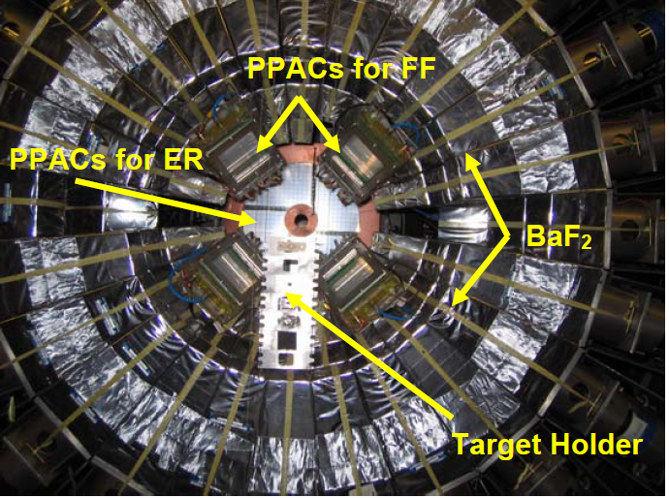
Experimental Setup
– rays and light particles detectors
MEDEA :
Multi Element DEtector Array
180 BaF₂ (48 at θ =90°)
d=22 cm (ΔΩ = 3.37π sr)
Position sensitive PPACs
θ = 7° ± 3.75° at 70 cm from the target (ΔΩ_{total}= 0.089 sr) for evaporation residues
θ = 53° ± 11° (Δφ =22°) at 16 cm from the target (ΔΩ_{total}= 0.16 sr) for fission fragments

Slide 7
Excitation Energy
E_{lab} increases → preequilibrium particle emission
Experimental evaluation of E* and A of the CN detecting light charged particles in fusion reactions
The energy spectra at different angles are reproduced by two (three) moving sources:
slow source: CN (fission fragment) evaporation
intermediate velocity source: preequilibrium particles emitted before thermalization of the composite system
In the system of the emitting source :
In the laboratory:
1. Maxwell distribution (surface-type)
M : multiplicity T : source temperature
E_{c} : Coulomb barrier
E’: particle energy in the source
reference frame
E_{s} : energy of a particle moving with the source velocity
E_{lab}, θ : particle energy and angle
2. Maxwell distribution (volume-type)
** The neutron multiplicity can be obtained from our proton data and from systematics**

Slide 8
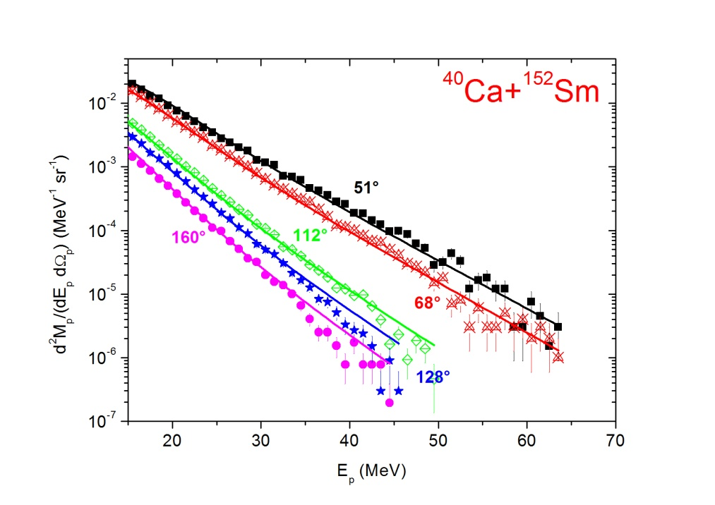
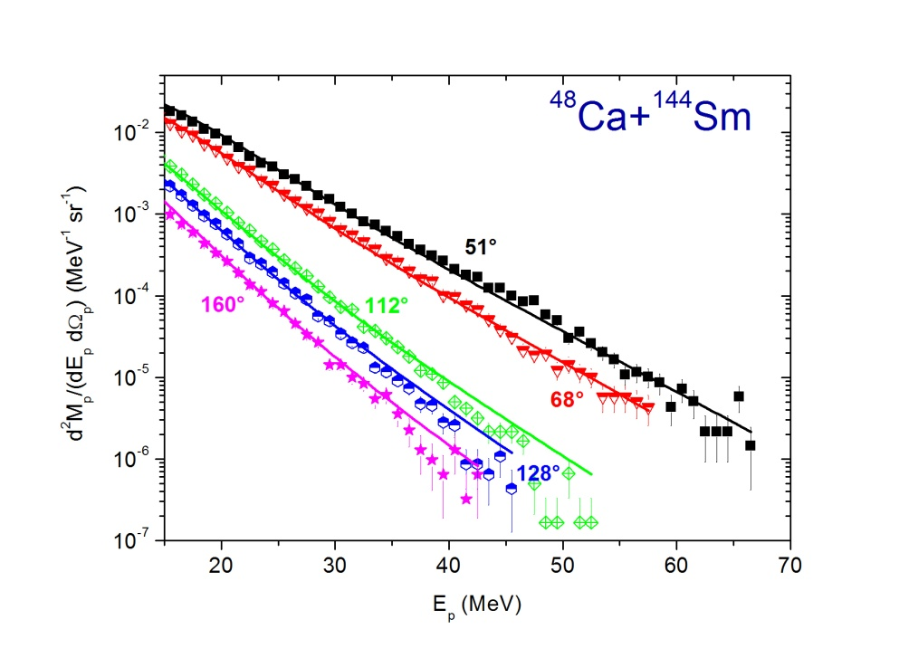
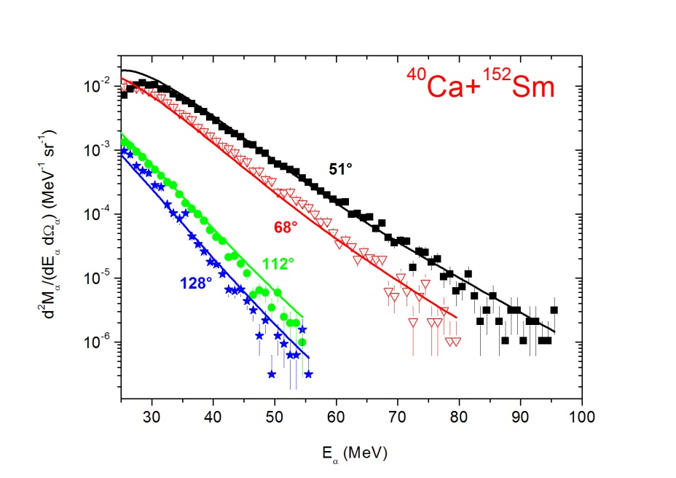
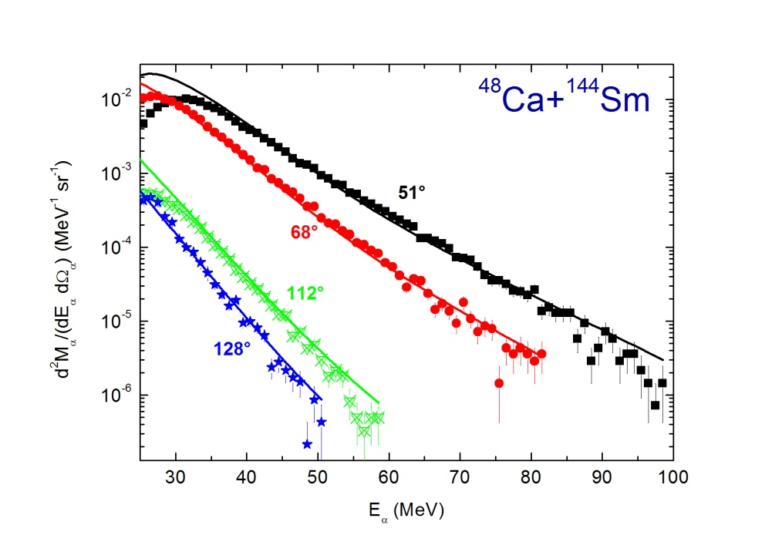
Excitation Energy : Evaporation
PRELIMINARY !!!
Proton spectra
α spectra

Slide 9
Excitation Energy : Evaporation
Protons
PRELIMINARY !!!
Reaction | v_{CN} (cm/ns) | E_{c} (MeV) | M_{CN} | T_{CN} (MeV) | M_{pre} | T_{pre} (MeV) | v_{pre} (cm/ns)
⁴⁰Ca + ¹⁵²Sm | 0.956 | 6 | 2.17 ± 0.08 | 2.78 ± 0.03 | 0.77 ± 0.09 | 4.96 ± 0.13 | 1.56 ± 0.06
⁴⁸Ca + ¹⁴⁴Sm | 1.1 | 6 | 1.94± 0.06 | 2.82 ± 0.04 | 0.69 ± 0.08 | 4.98 ± 0.12 | 1.74 ± 0.07
⁴⁰Ca + ¹⁵²Sm E*= 222± 3 MeV ⁴⁸Ca + ¹⁴⁴Sm E*= 223 ± 3 MeV
α particles
Reaction | v_{CN} (cm/ns) | E_{c} (MeV) | M_{CN} | T_{CN} (MeV) | M_{pre} | T_{pre} (MeV) | v_{pre} (cm/ns)
⁴⁰Ca + ¹⁵²Sm | 0.956 | 15 | 1.81 ± 0.10 | 3.80± 0.08 | 0.21 ± 0.06 | 6.61 ± 0.32 | 1.56 ± 0.15
⁴⁸Ca + ¹⁴⁴Sm | 1.1 | 15 | 2.24± 0.06 | 3.67 ± 0.05 | 0.21 ± 0.04 | 7.10 ± 0.21 | 1.94 ± 0.11
The compound nucleus formed in the ^{40,48}Ca + ^{152,144}Sm fusion reactions at ~11 MeV/nucleon has the same average excitation energy and the same mass A = 189

Slide 10
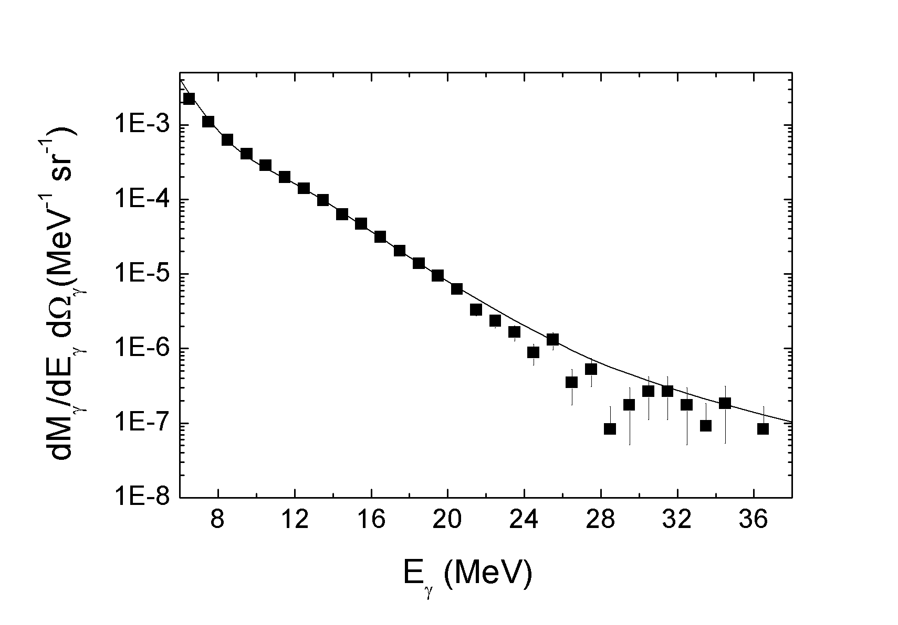
Fusion-evaporation γ-ray spectra
Charge symmetric reaction γ-ray spectrum
well reproduced by statistical model calculations and nn bremsstrahlung emission
CN: ¹⁹²Pb, E*= 223 MeV, a=A/11 MeV⁻¹ , E_{GDR}=13 MeV, Γ_{GDR}= 12 MeV, F_{GDR}= 1 TRKSR
E_{GDR} = 13 MeV E* deduced from the experimental particle angular distributions

Slide 11
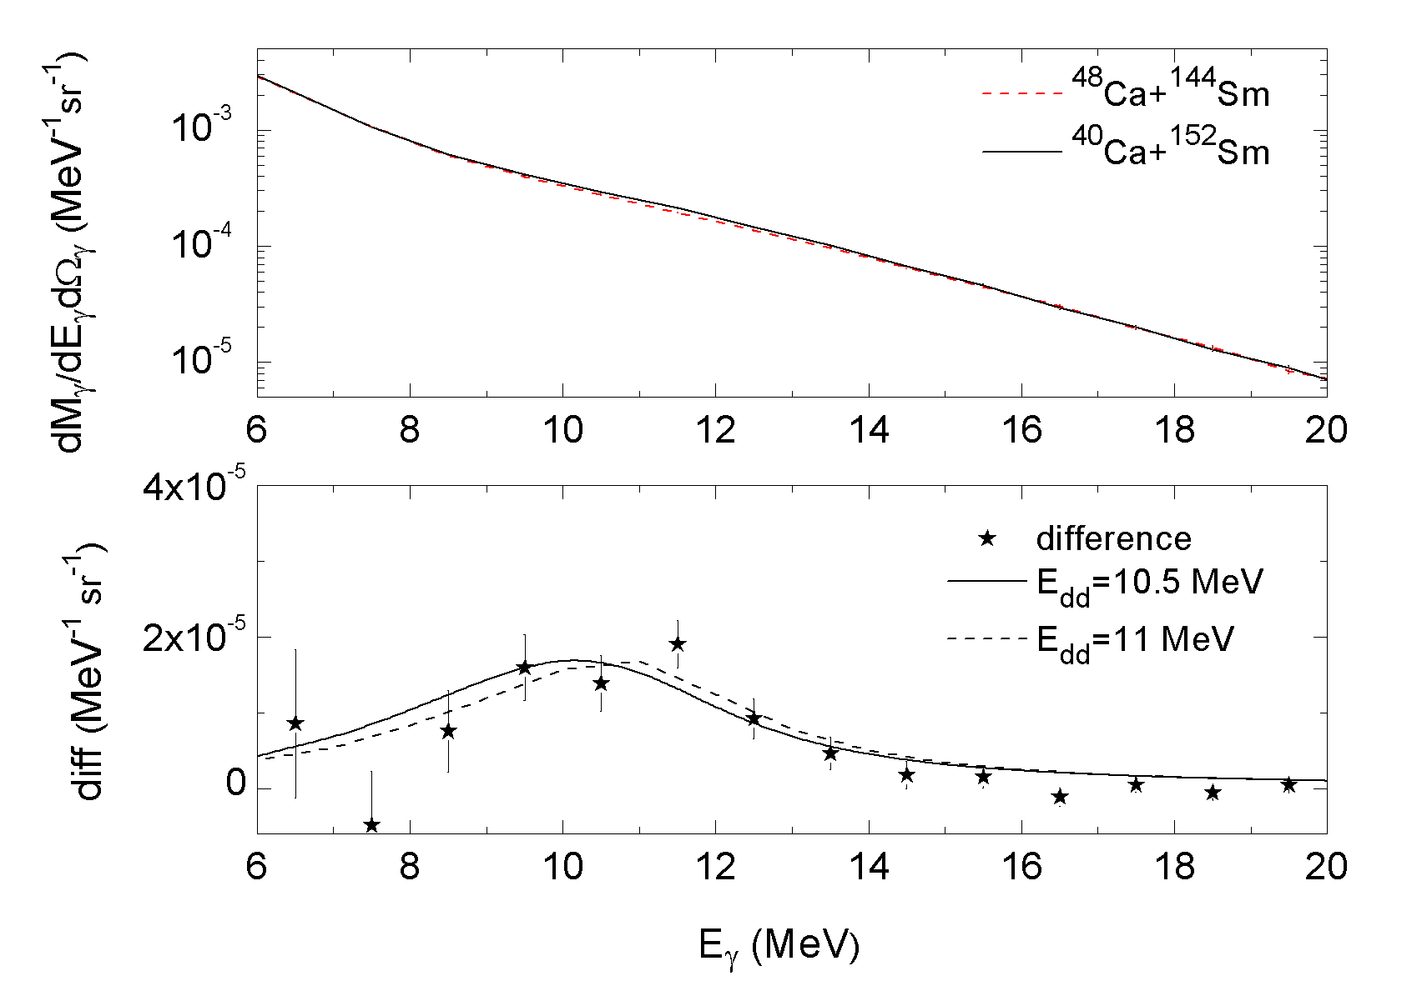
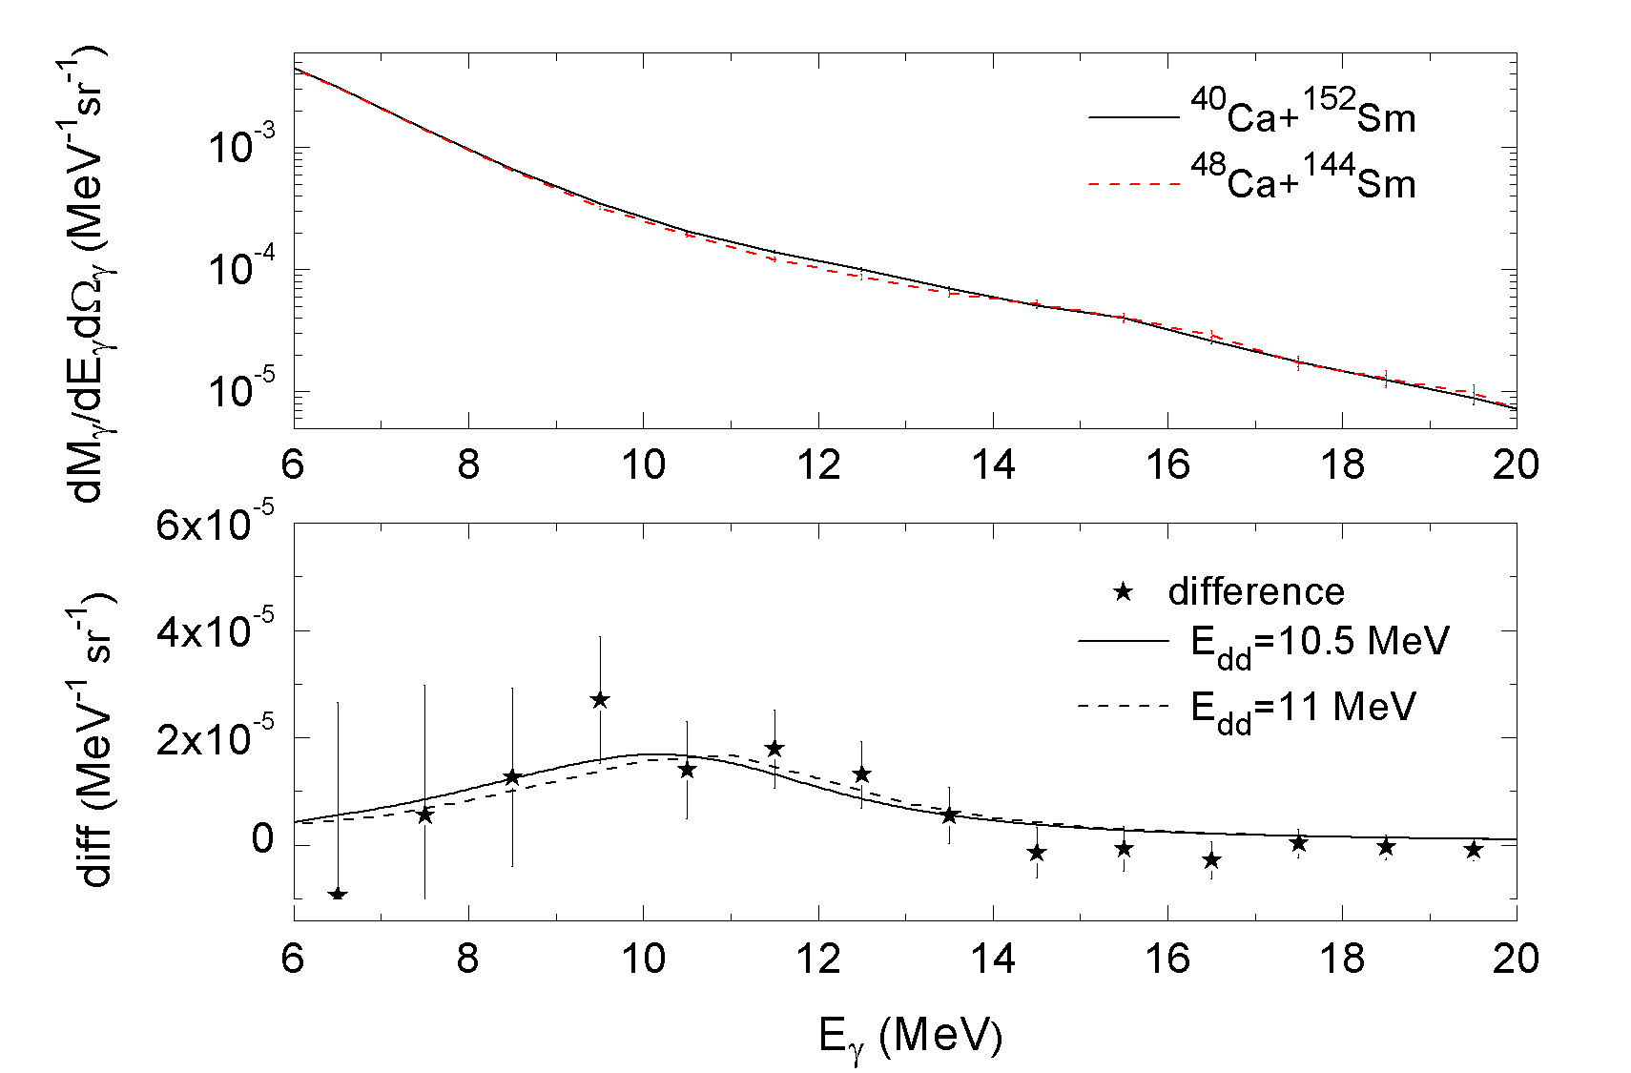
γ−ray spectra
Experimental evidence of an extra γ yield in the charge asymmetric reaction
Fusion - Evaporation
Fission
E_{dd} = 10.5 MeV, Γ_{dd}=3.5 MeV E_{GDR} = 13 MeV
8 MeV≤E_{γ}≤16 MeV
M_{γ}(θ_{γ}) = (8.0 ± 1.3) 10⁻⁵ γ/ sr M_{γ}(θ_{γ}) = (10.0 ± 3.0) 10⁻⁵ γ/ sr
D. Pierroutsakou, AIP Conf. Proc 1423, 59 (2012) C. Parascandolo, Act. Phys. Pol. B 44, 605 (2013)

Slide 12
γ−ray Angular Distribution
The angular distribution of the DD γ-rays is a sensitive probe of the fusion dynamics and of the DD excitation mechanism and lifetime because it depends:
1) on the rotation angular velocity of the dinuclear system during the DD emission
2) on the timescale of this emission
Fusion-evaporation
Integration of the center-of-mass charge asymmetric and charge symmetric reaction bremsstrahlung-subtracted γ-ray yield and of their difference for 9≤E_{γ} ≤16 MeV for the rings: θ = 51°, 68°, 83°, 97°, 112° and 128° with respect to the beam direction
The angular distribution of the γ-rays was fitted by using the equation:

Slide 13
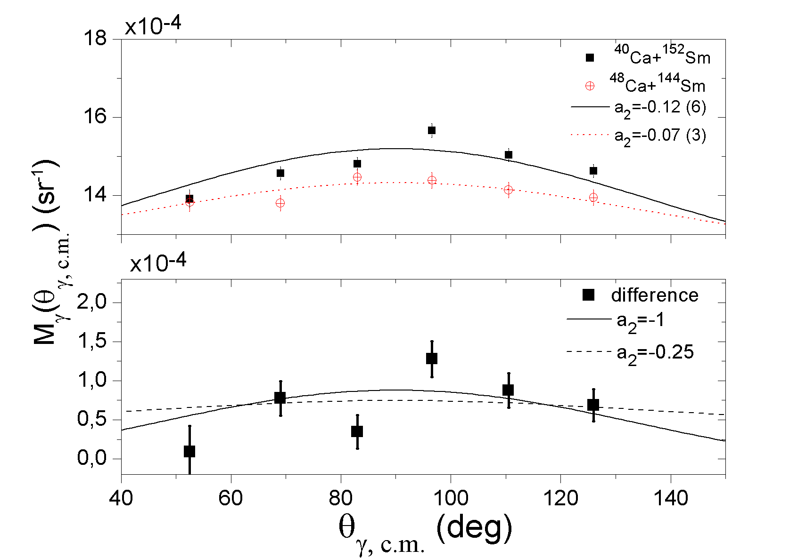
Angular distribution of DD γ-rays in fusion-evaporation events
Asymmetric angular distribution of the DD γ-rays with respect to the beam direction: compatible with DD γ-ray emission from the early moments of the dinucleus formation when the DD axis that has not rotated much with respect to the beam axis (in agreement with our previous results in the Ar+Zr system)

Slide 14
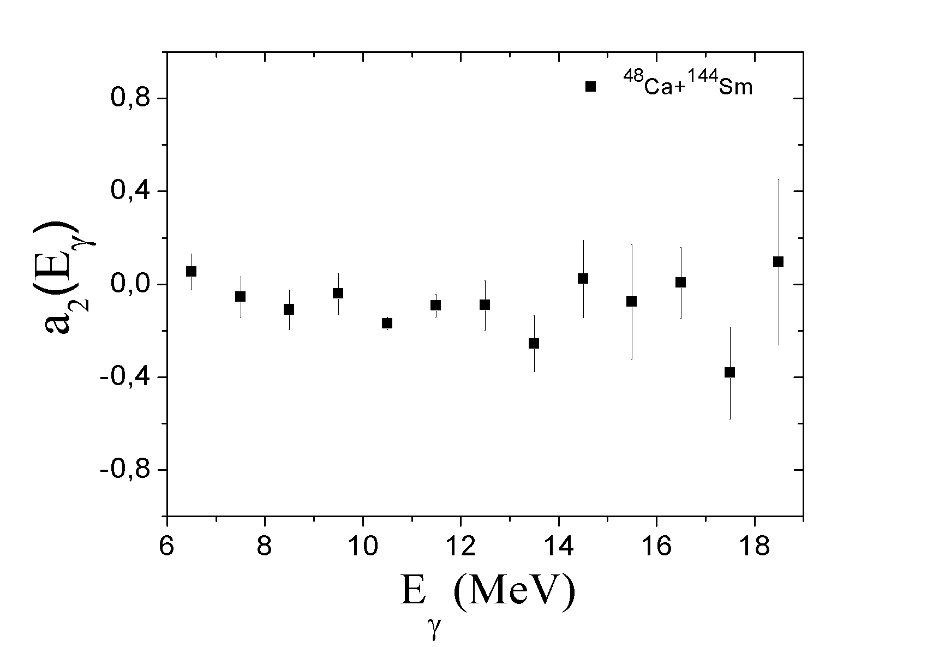
Angular distribution of DD γ-rays :
⁴⁸Ca + ¹⁴⁴Sm
a₂(E_{γ}) of the charge symmetric reaction γ-rays in agreement with emission from the statistical GDR

Slide 15
Fission : γ−ray – fragment Angular Correlation with respect to the spin directon
1) Integration of γ-ray yield of the difference between the two reactions for 8≤E_{γ} ≤13 MeV with respect to the spin direction
2) The angular distribution of the γ-rays was fitted by using the equation:

Slide 16
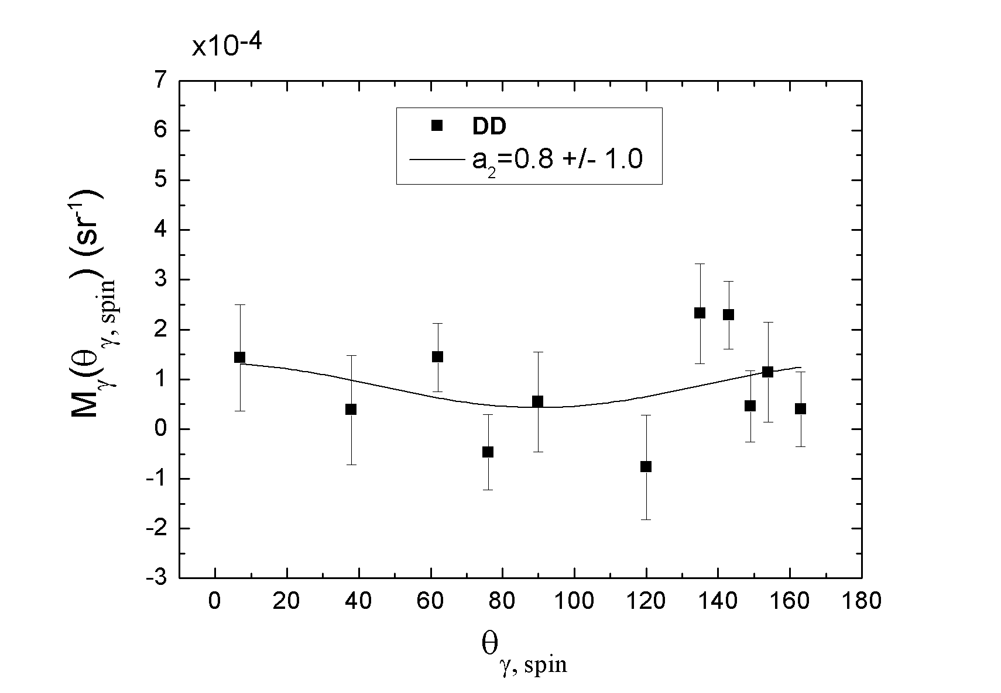
Fission : γ−ray – fragment Angular Correlation with respect to the spin directon
8 MeV≤E_{γ}≤13 MeV
PRELIMINARY !!!
The DD angular distribution integrated from 8 to 13 MeV can be reproduced with a₂=0.8

Slide 17
Dynamical Dipole : Theory
BNV transport model: the reaction dynamics is described in a microscopic approach based on semiclassical transport equations where mean field and two body collisions are treated in a self-consistent way
EoS dependent on ρ + nuclear medium reduced n-n cross sections
Evolution of the dipole moment D(t)=(NZ/A) * X(t)
Dynamical Dipole γ-ray emission obtained from the Bremsstrahlung formula:
V. Baran, D.M. Brink, M. Colonna and M. Di Toro, PRL 87 (2001) 182501

Slide 18
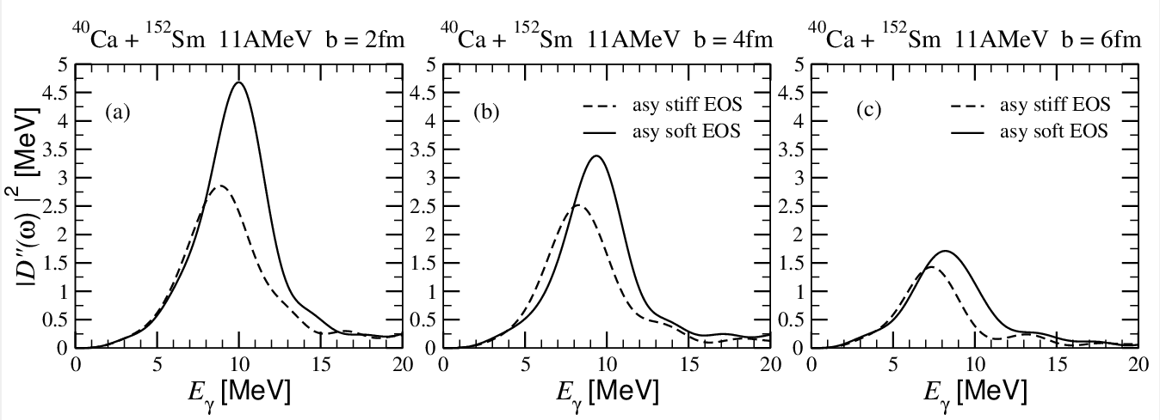
BNV Calculations : DD in Ca+Sm
M. Colonna, V. Baran , M. Di Toro, C. Rizzo private communication
Reduced centroid energy and total yield with the Asy-stiff choice because of a smaller restoring force and a less robust collective dipole response in the dilute neck region where the symmetry energy is smaller. Slightly wider distributions with the Asy-soft choice because of a larger number of fast neutron emission that damps the dipole oscillation
For low impact parameters E_{DD}= 10 MeV and Γ_{DD}= 4 MeV (asy-soft choice) is in reasonable agreement with the data

Slide 19
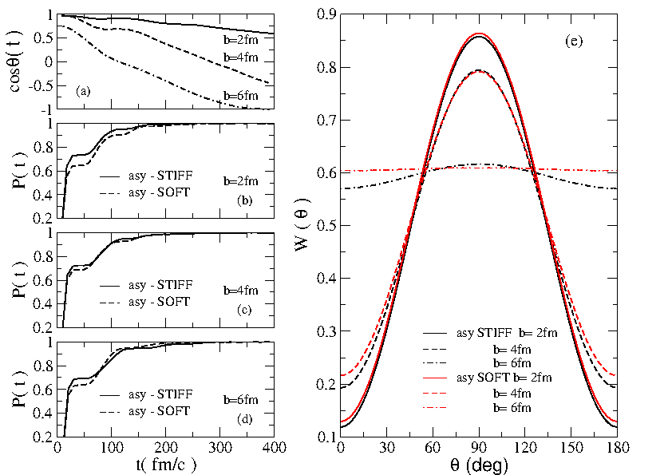
BNV Calculations
Angular Distribution
M. Colonna, V. Baran, M. Di Toro, C. Rizzo private communication
The DD emission occurs mainly from 50 to 150 fm/c while the dinuclear system rotates from 25° to 40 ° (2 fm) and from 25 ° to 55 ° (4 fm).
Very anisotropic angular distribution for central collisions and less anisotropic for larger b. Results compatible with our data.
The angular distributions are sensitive to the EoS choice only for large b

Slide 20
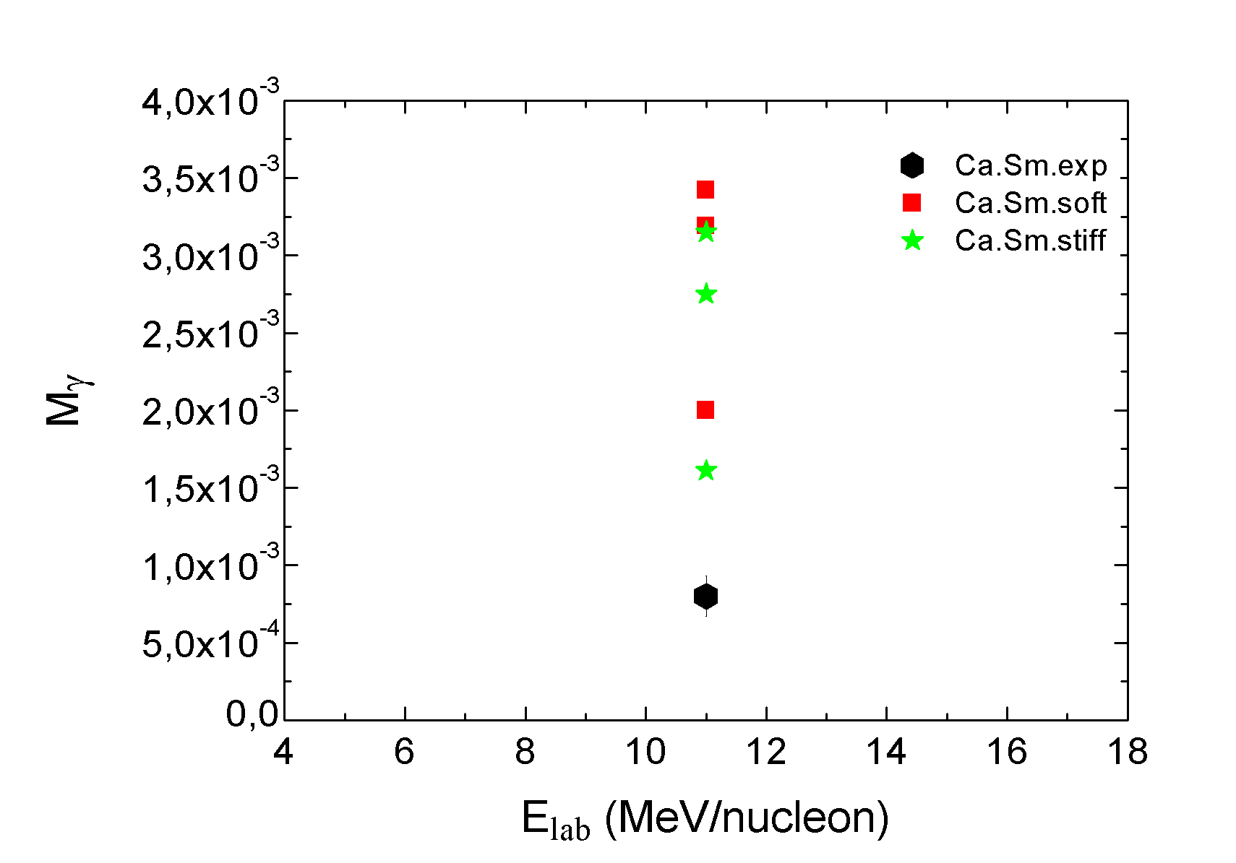
DD : ^{40,48}Ca+^{152,144}Sm Yield
Theoretical DD yield calculated at b = 2, 4, 6 fm and compared with data for evaporation
(b_{max}=1.5 fm)
Experimental yield obtained by integrating over energy from 8 to 16 MeV.
Evaporation exp
The theoretical DD yield increases with decreasing b for both Asy-Soft and Asy-Stiff choice.
The theoretical yield is larger than the experimental one for central reactions: further investigation is needed to understand the discrepancy

Slide 21
Summary and Conclusions
The DD survives in heavy composite systems, centered at an energy E_{DD} ~10.5 MeV lower than that of the statistical GDR, E_{GDR}= 13 MeV, with a width Γ_{DD} = 3.5 MeV in both fusion-evaporation and mass-symmetric fission events.
The DD γ-ray angular distribution with respect to the beam axis in evaporation events shows a large anisotropy compatible with a dipole axis which has not rotated much with respect to the beam direction and with a dipole emission occurring in the early stages of the reaction.
In fission events, the preliminary analysis of the DD γ-ray - fragment angular correlation with respect to the spin axis is compatible with a dipole emission from a deformed dinucleus.
BNV transport calculations predict centroid, width and angular distributions of the DD in reasonable agreement with the data but they largely overpredict the yield → Need to better understand the interplay between the different parameters influencing the DD features
Future
The DD yield is not sensitive to the density dependence of the EOS by using stable beams, however RIB-induced reactions could allow us to probe the symmetry energy dependence on the nuclear densities at sub-saturation values.
Could the DD γ decay be useful for superheavy elements ??? → Need for realistic theoretical models to predict the evaporation residue cross section by including properly the DD γ-ray emission.

Slide 22
Collaboration
EXPERIMENTS
C. Parascandolo (PhD thesis), D. Pierroutsakou, C. Agodi, R. Alba, A. Boiano, R. Coniglione, E. De Filippo, A. Del Zoppo, E. Emanuele, F. Farinon, A. Guglielmetti, M. La Commara, C. Maiolino, B. Martin, C. Mazzocchi, M. Mazzocco, M. Romoli, M. Sandoli, D. Santonocito, C. Signorini, R. Silvestri, F. Soramel, E. Strano, D. Torresi, A. Trifirò, M. Trimarchi
THEORY
V. Baran, M. Colonna, M. Di Toro, C. Rizzo

Slide 23
Grazie !

