Slide 1
Extreme Light Infrastructure - Nuclear Physics ELI – NP
European Research Center
Nicolae-Victor Zamfir
National Institute for Physics and Nuclear Engineering (IFIN-HH)
Bucharest-Magurele, Romania

Slide 2

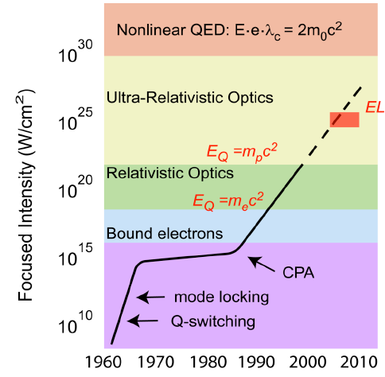
Extreme Light Infrastructure (ELI)
Gerard Mourou 1985: Chirped Pulse Amplification (CPA)

Slide 3

Extreme Light Infrastructure
2005: ELI on ESFRI list
2007-2010: ELI-PP
December 2009: EC Decision
3 Pillars:
CZECH REP: Secondary Sources
HUNGARY: Short Pulses
ROMANIA: Nuclear Physics
(www.eli-np.ro)
3

Slide 4
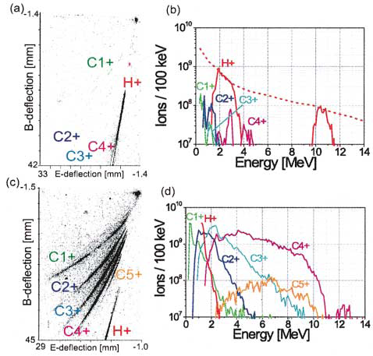
Protons, Heavy Ions
Heavy ion beams at LULI (France)
Laser pulses:
30 J, 300 fs, 1.05 μm => 5x10¹⁹ W/cm².
Target: 1 μm C
on rear side of 50 μm W foils
Detection: Thomson parabola spectrometers
+ CR-39 track detectors
Protons come from surface contamination
Heating the target the protons are
removed and heavy ions are better
accelerated

Slide 5
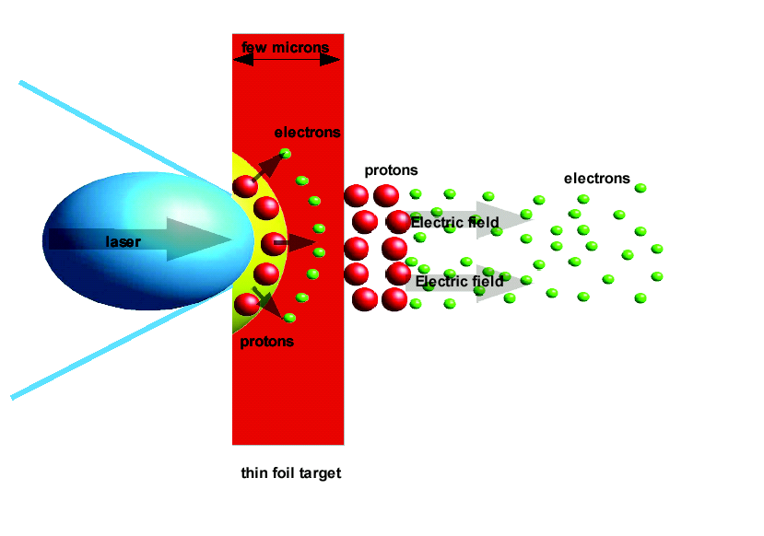
Target Normal Sheath Acceleration (TNSA)
Secondary
target
Secondary radiations
- electrons bremssstrahlung
- gamma rays, neutrons
Primary radiations
Electrons are expelled from the target due to the ponderomotive force
Heavy ions are accelerated in the field created by the electrons
E~I_{laser}^{1/2}
S.C. Wilks et al., Phys. Plasmas 8, 542 (2001).

Slide 6
DLC foils

Slide 7
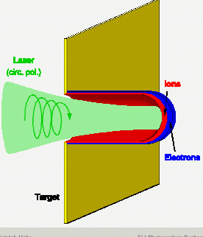
Radiation Pressure Acceleration RPA
Electrons and ions accelerated
at solid state densities 10²⁴e cm⁻³
(Classical beam densities 10⁸e cm⁻³ )
E~ I _{laser}

Slide 8
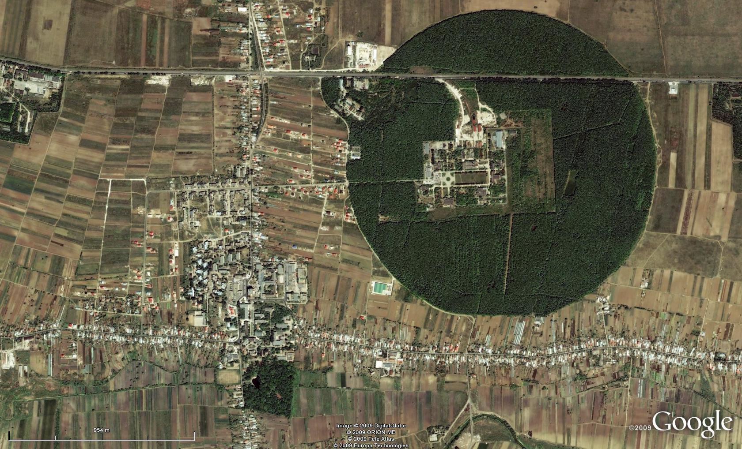
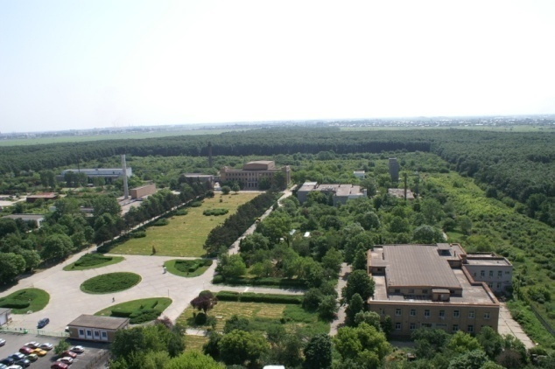
Bucharest-Magurele
National Physics Institutes
NUCLEAR
Tandem accelerators Cyclotrons
γ – Irradiator
Advanced Detectors
Biophysics
Environmental Phys.
Radioisotopes
BUCHAREST
ring rail/road
ELI-NP
Lasers
Plasma
Optoelectronics
Material Physics
Theoretical Physics
Particle Physics
ELI-NP

Slide 9
ELI-Nuclear Physics
Large equipments:
Ultra-short pulse high power laser system, 2 x 10PW maximum power
Gamma beam, high intensity, tunable energy up to 20MeV,
produced by Compton scattering of a laser beam
on a 700 MeV electron beam produced by a warm LINAC
Experiments:
8 experimental areas
- laser
- gamma
- laser+gamma
Total cost 293 M€ w/o VAT
  Duration/phasing: 2 phases (2012-2015/2014-2017)
9

Slide 10
ELI – Nuclear Physics Research
Nuclear Physics experiments to characterize laser – target interaction
Photonuclear reactions
Exotic Nuclear Physics and astrophysics
complementary to other NP large facilities (FAIR, SPIRAL2)
Applied Research based on high intensity laser and very brilliant γ beams
10

Slide 11

ELI – NP Experiments (1)
Stand-alone High Power Laser Experiments
Nuclear Techniques for Characterization of Laser-Induced Radiations
Modelling of High-Intensity Laser Interaction with Matter
Stopping Power of Charge Particles Bunches with Ultra-High Density
Laser Acceleration of very dense Electrons, Protons and Heavy Ions Beams
Laser-Accelerated Th Beam to produce Neutron-Rich Nuclei around the N = 126 Waiting Point of the r-Process via the Fission-Fusion Reaction
A Relativistic Ultra-thin Electron Sheet used as a Relativistic Mirror for the Production of Brilliant, Intense Coherent γ-Rays
Studies of enhanced decay of ²⁶Al in hot plasma environments
11

Slide 12
ELI – NP Experiments (2)
Laser + γ /e− Beam
Probing the Pair Creation from the Vacuum in the Focus of Strong Electrical Fields with a High Energy γ Beam
The Real Part of the Index of Refraction of the Vacuum in High Fields: Vacuum Birefringence
Cascades of e+e− Pairs and γ -Rays triggered by a Single Slow Electron in Strong Fields
Compton Scattering and Radiation Reaction of a Single Electron at High Intensities
Nuclear Lifetime Measurements by Streaking Conversion Electrons with a Laser Field.
12

Slide 13
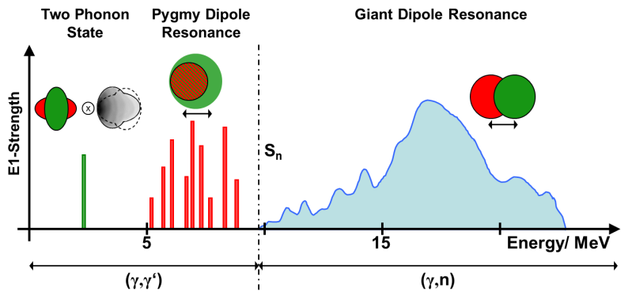
ELI – NP Experiments (3)
Nuclear photonics
Pure EM-interaction (nuclear-) model independent
“small“ cross sections, penetrating (thick targets)
Minimum projectile mass, minimum ang. mom. transfer, spin-selective: dipole-modes
Polarisation “Parity physics“
13
N. Pietralla

Slide 14
ELI – NP Experiments (4)
Standalone γ /e experiments for nuclear spectroscopy and astrophysics
Measuring Narrow Doorway States, embedded in Regions of High Level Density in the First Nuclear Minimum, which are identified by specific (γ, f), (γ, p), (γ, n) Reactions
Dipole polarizability with high intensity, monoenergetic MeV γ-radiation for the evaluation of neutron skin
Nuclear Transitions and Parity-violating Meson-Nucleon Coupling
Study of pygmy and giant dipole resonances
Gamma scattering on nuclei
Fine-structure of Photo-response above the Particle Threshold: the (γ ,α), (γ,p) and (γ ,n)
Nuclear Resonance Fluorescence on Rare Isotopes and Isomers
Neutron Capture Cross Section of s-Process Branching Nuclei with Inverse Reactions
Measurements of (γ, p) and (γ, α) Reaction Cross Sections for p-Process Nucleosynthesis
High Resolution Inelastic Electron Scattering (e,e’)
14

Slide 15
Applied Research at ELI – NP
Laser-produced charged particle beams may become an attractive alternative for large scale conventional facilities (10¹⁵ more intense)
High Resolution, high Intensity electron, positron, X-Ray and γ Beams
- Radioscopy and Tomography
- Materials research in high intensity radiation fields
Applications of Nuclear Resonance Fluorescence
- Management of sensitive nuclear materials
- New production techniques for radioisotopes for medical use
15

Slide 16
Project implementation
2010 2011 2012 2013 2014 2015
White Book (Scientific Case)
Feasibility Study
Preparation of the Application
E.C. Evaluation & Approval
Building - Preparation
Building - Construction
Major Eqp. - Tender
Major Eqp.– Constr, Install
Experimental set-ups
Recruitment
2017
16

Slide 17
Human Resources
Technical Staff (18)
Eng. Staff (18)
PhD students (50)
Jr. researchers (107)
Senior researchers (20)
Head of Res. Activities (5)
2013
2014
2015
2016
2017
2018
2019

Slide 18





