Slide 1


Study of Heavy-ion Induced Fission
for Heavy Element Synthesis
Katsuhisa Nishio
Advanced Science Research Center,
Japan Atomic Energy Agency,
Tokai, JAPAN
INPC2013

Slide 2
Contents
Motivation
In-beam fission experiment at JAEA tandem facility
Theoretical model
Evaporation residue measurement
Conclusions

Slide 3
Super-heavy Nuclei
Heavier Element
⁴⁸Ca + Actinide Target Nuclei
(FLNR)
120
Cold Fusion (GSI,RIKEN)
Pb, Bi Targets
Spherical Shell
162
Missing Region
114
Using Radioactive Nuclei
108
184
Proton Number
Deformed Shell
α
sf
EC
β⁻
Neutron Number
Understanding for fusion using actinide target nuclei are
important to explore SHN

Slide 4

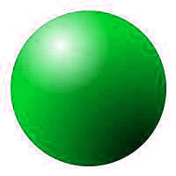
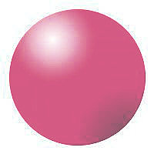

Three steps for hｅａｖｙ-element synthesis
³⁴S + ²³⁸U ²⁷²Hs* ²⁶⁸Hs + 4 ¹n
14 92 108 ¹⁰⁸ ⁰
(1) Contact
(2) Fusion
CN
(3) Evaporation
6.6×10¹²
3.0×10¹¹
1 atom
Fusion-
Fission
Quasifission
6.3×10¹²
~ 3×10¹¹
Fusion probability

Slide 5
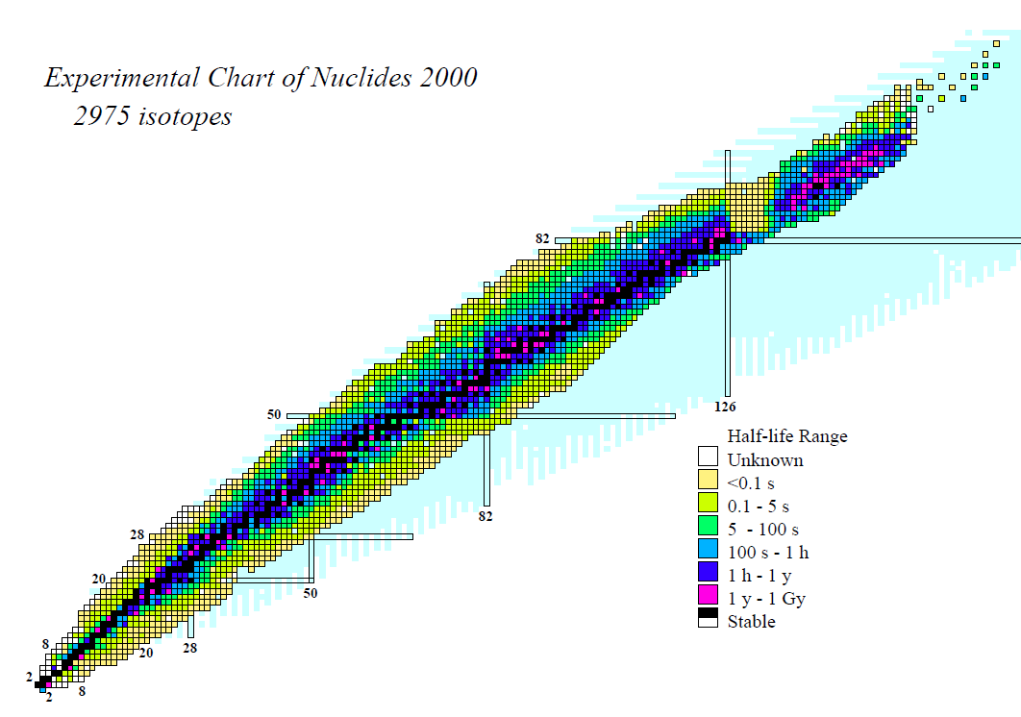
Orientation effects in fusion and quasi-fission
²⁷⁴Hs (Z=108)
Compund
Nucleus
²³⁸U
³⁶S
Proton
²³⁸U
Fusion
²⁰⁸Pb
Potential Energy
¹³²Sn
Quasi-fission
⁷⁸Ni
Neutron
+
Elongation
0
Mass Asymmetry
-
Potential by Y. Aritomo

Slide 6
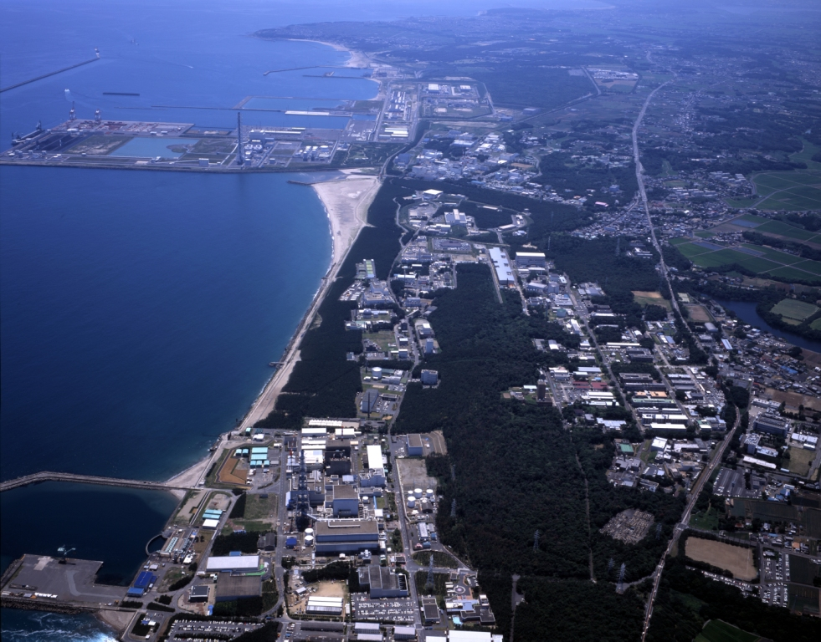
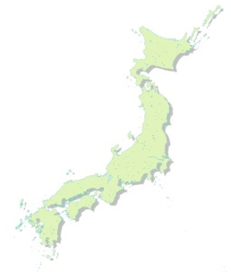
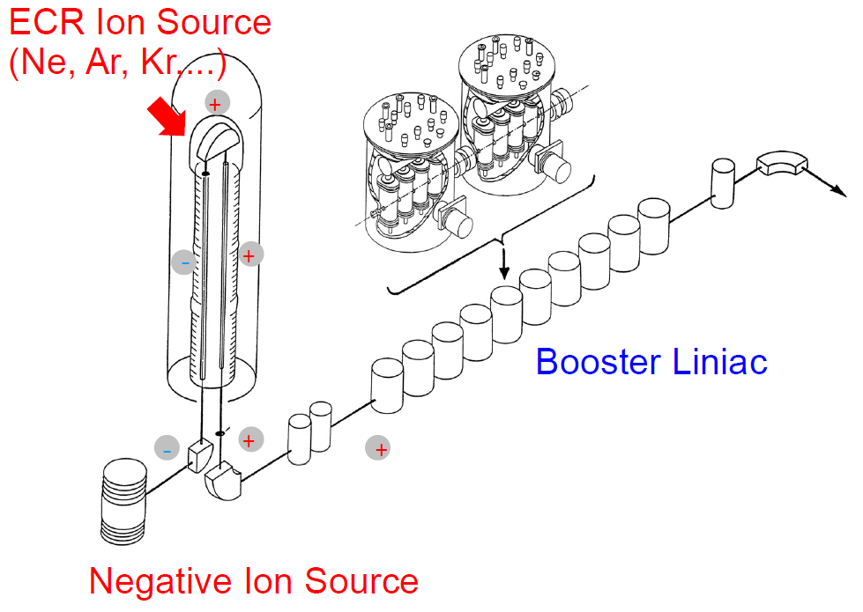
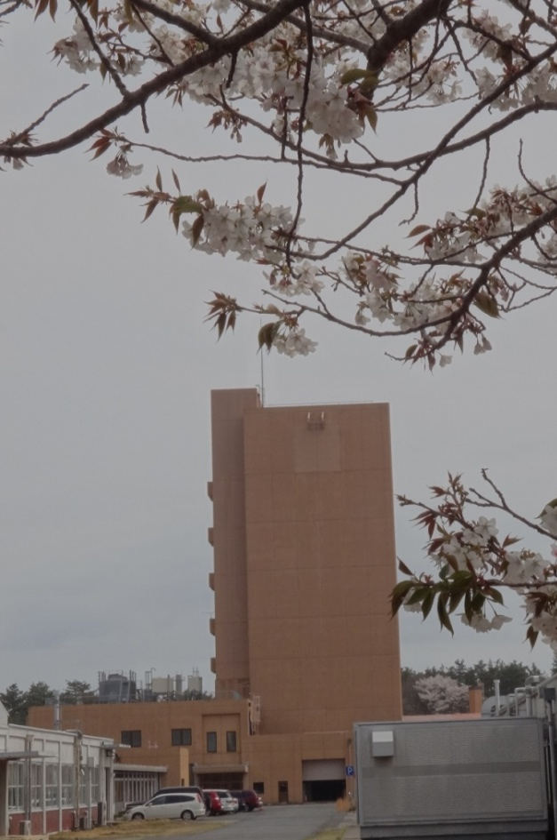
JAEA Tandem facility at Tokai
JAEA Tokai Campus
20 MV Tandem (20UR)
Super-conducting Booster Liniac
ECR Ion Source on the terminal
Negative Ion Source

Slide 7
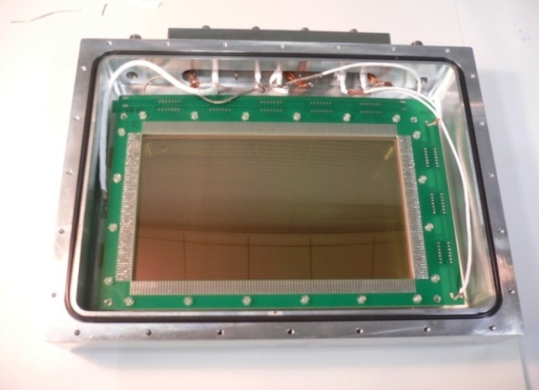
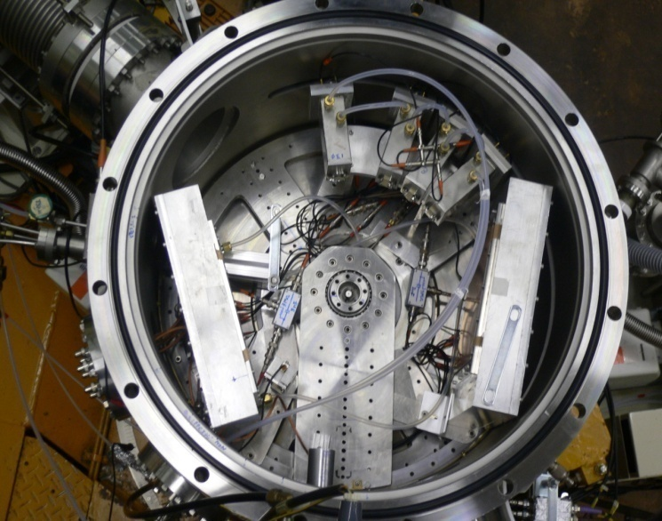
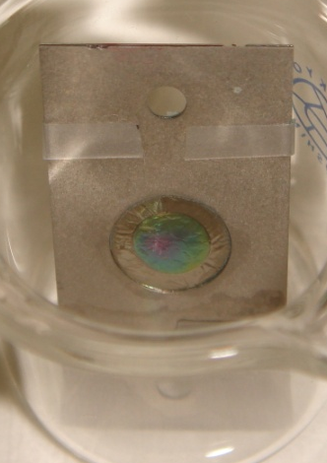
In-beam fission measurement
200 mm
³⁰Si, ³¹P, ^{36,34}S, ⁴⁰Ar, ^{40,48}Ca Beams
120 mm
Fission
Fragment 1
Fission
Fragment 2
Multi-Wire Proportional Counter
²³⁸U
²³⁸U target
MWPC1
MWPC2
5 mm

Slide 8
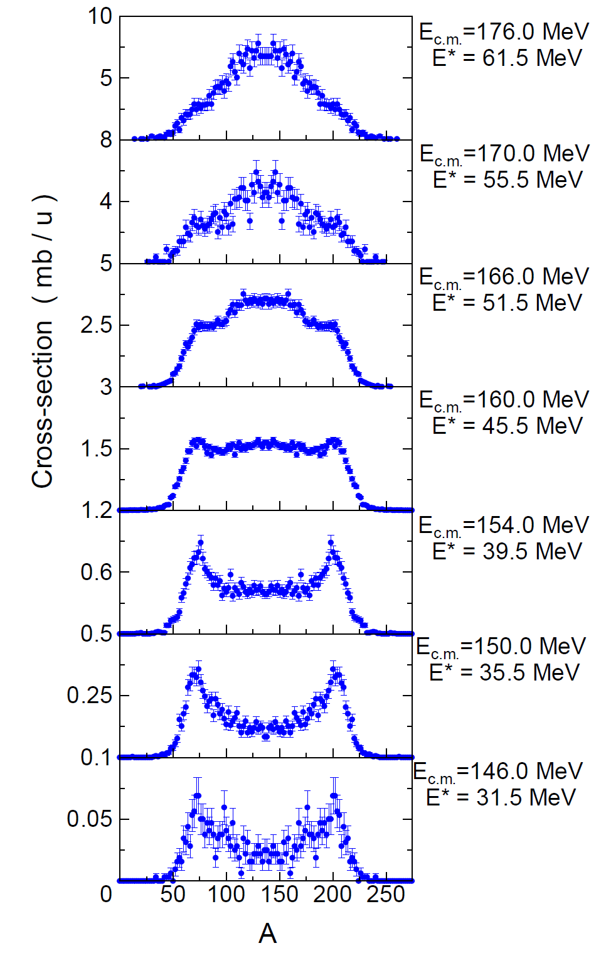
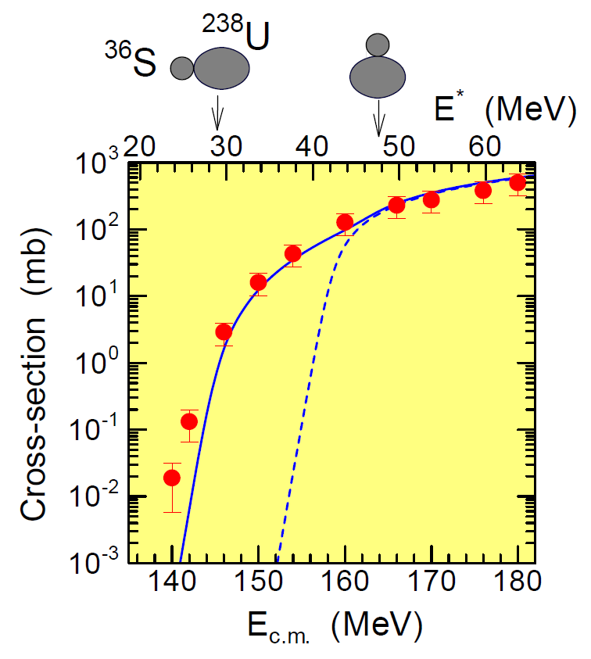
Orientation effects in ³⁶S + ²³⁸U
Fission cross section (mb)
One-dimensional
Model
Quasifission
Deformation of ²³⁸U
K. Nishio et al., Phys. Rev. C, 77 (2008) 064607.

Slide 9
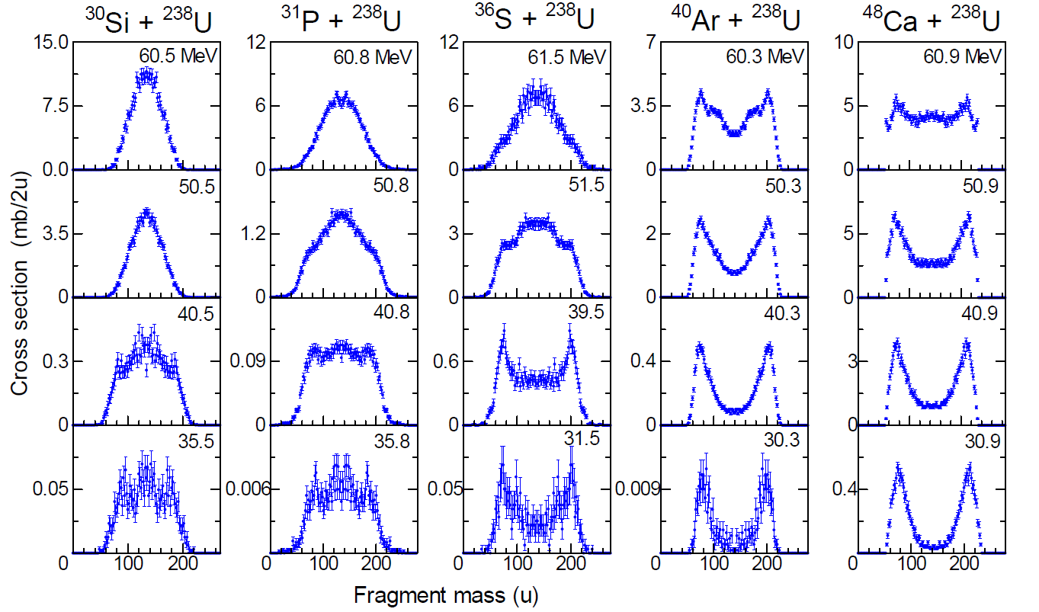
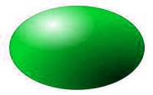


Fission fragment mass distributions
High Incident Energy
²³⁸U
Cross section to produce fragments (mb)
Low Incident Energy
Fragment Mass
Excitation Energy of CN
Quasifission
K. Nishio et al., Phys. Rev. C, 77, 064607 (2008).
K. Nishio et al., Phys. Rev. C, 82, 044604 (2010).

Slide 10
Dynamical calculation of nuclear shape
– Fluctuation dissipation model －
²⁷²Hs
Langevin Equation
CN
Fusion
²³⁸U
³⁴S
Potential Energy (MeV)
Quasifission
Fission
Two center shell model
( 3 dimension )
Charge Center
Distance
Mass Asymmetry
V. Zagreabev, J. Phys. G, 31, 825 (2005).
Y. Aritomo et al., Nucl.Phys. A753, 152 (2005).
Y. Aritomo, Phys.Rev.C, 80, 064604 (2009).

Slide 11
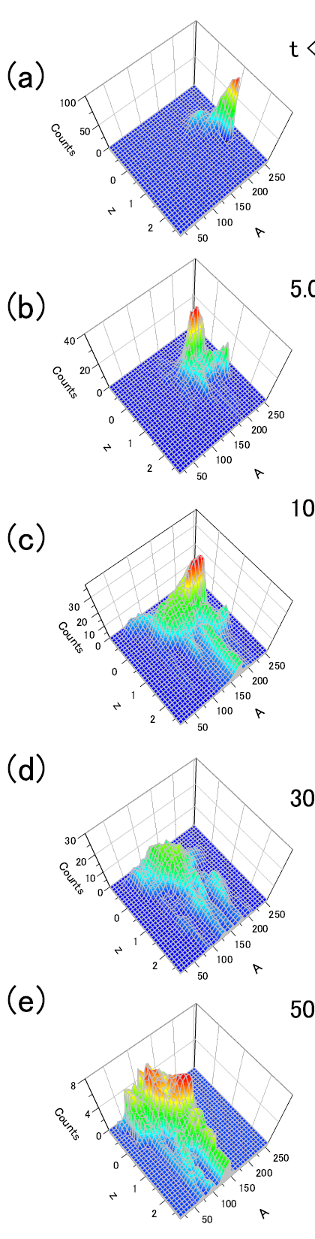
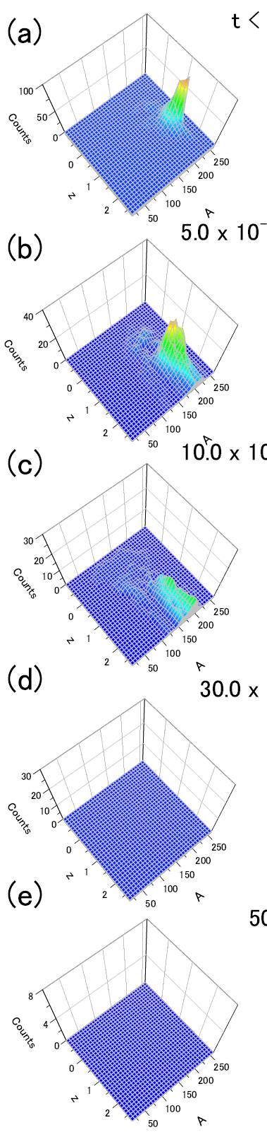
Shape evolution ( Polar collisions)
Y. Aritomo et al., Phys. Rev. C 85, 044614 (2012).
³⁰Si + ²³⁸U
CN
³⁶S + ²³⁸U
Quasi-
Fission
m =178
Fusion-
Fission
m =134
CN
Mass Asymmetry
Quasi-
Fission
m =200
Charge Center
Distance
0 – 5
5 –10
10 –30
30 –50
> 50
Time (×10⁻²¹ s )

Slide 12
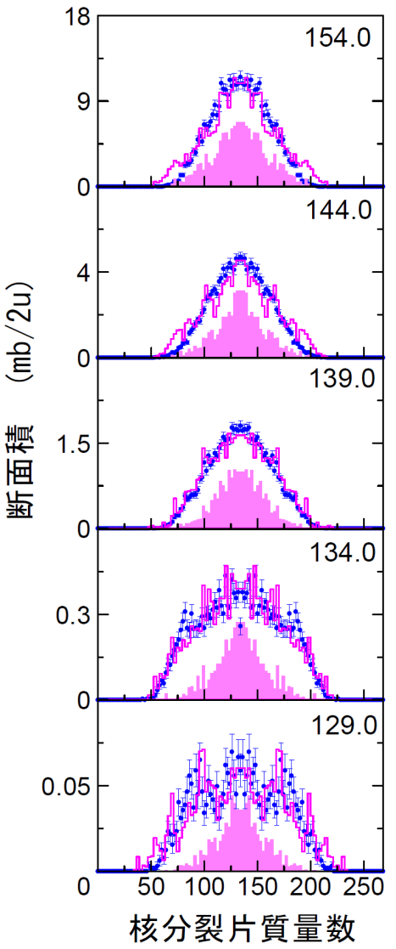
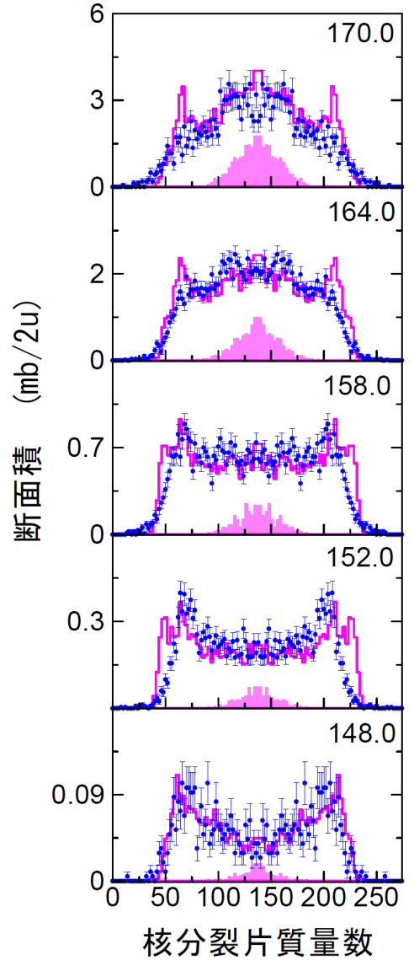




Fusion probability
³⁰Si + ²³⁸U
³⁴S + ²³⁸U
c.m. Energy
(MeV)
46 %
15 %
Fusion Probability
41 %
11 %
²⁶³Sg
²⁶⁷Hs
37 %
7.5 %
Cross section (mb/2u)
33 %
4.9 %
²⁶⁴Sg
²⁶⁸Hs
Histogram
All Fission Fragments
29 %
3.6 %
Filled Area
Fusion-Fission
Mass
Mass
Experimental Data

Slide 13
Measurement of evaporation residue cross sections
at GSI-SHIP
³⁰Si + ²³⁸U = ²⁶⁸Sg*
Silicon strip detector
³⁰Si beams (1.0 pμA) in 2006
³⁴S + ²³⁸U = ²⁷²Hs*
³⁴S beams (2.0 – 2.5 pμA) in 2009
Timing detector
²³⁸U Targets
SHIP
S. Hofmann and G.Münzenberg,
Rev. Mod. Phys. 72, 733 (2000).

Slide 14
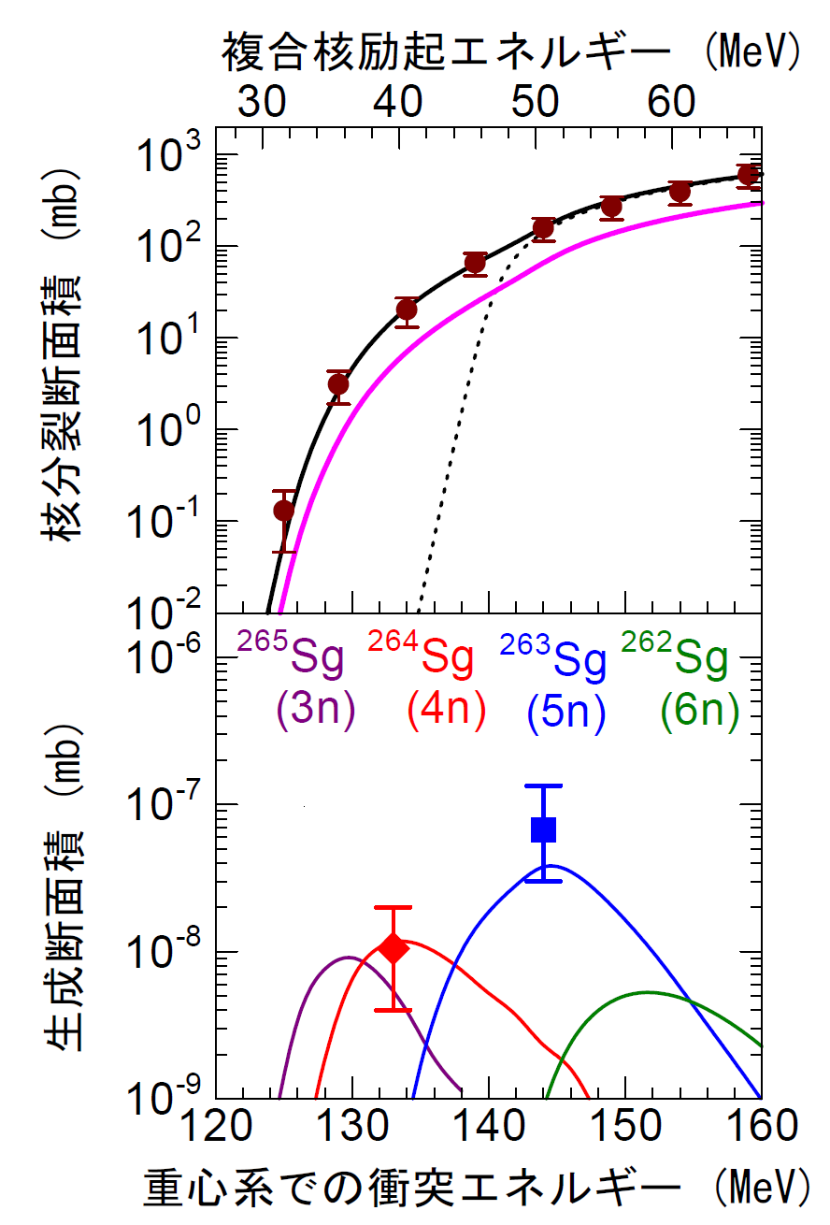
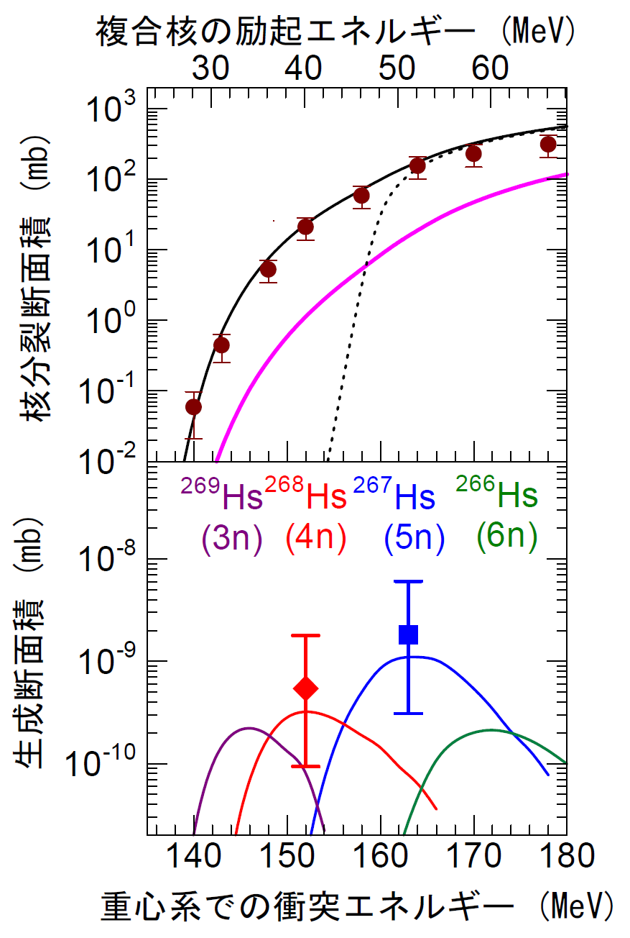
Fusion and evaporation residue cross sections
³⁰Si + ²³⁸U
³⁴S + ²³⁸U
Capture Cross Section
Excitation energy
Excitation energy
E
Qasifission
Quasifission
×Fusion Probability
Fission
Cross section (mb)
Fission
cross section (mb)
Fusion Cross Section
×Survival Probability
(Statistical Model )
67 pb
0.54 pb
1.8 pb
10 pb
Evaporation Residue
Cross section (mb)
Evaporation Residue
Cross section (mb)
Cross sections for SHN
Energy in c.m. (MeV)
Energy in c.m. (MeV)
K. Nishio et al., PRC 82, 044604 (2010).
K. Nishio et al., PRC 82, 024611 (2010).

Slide 15
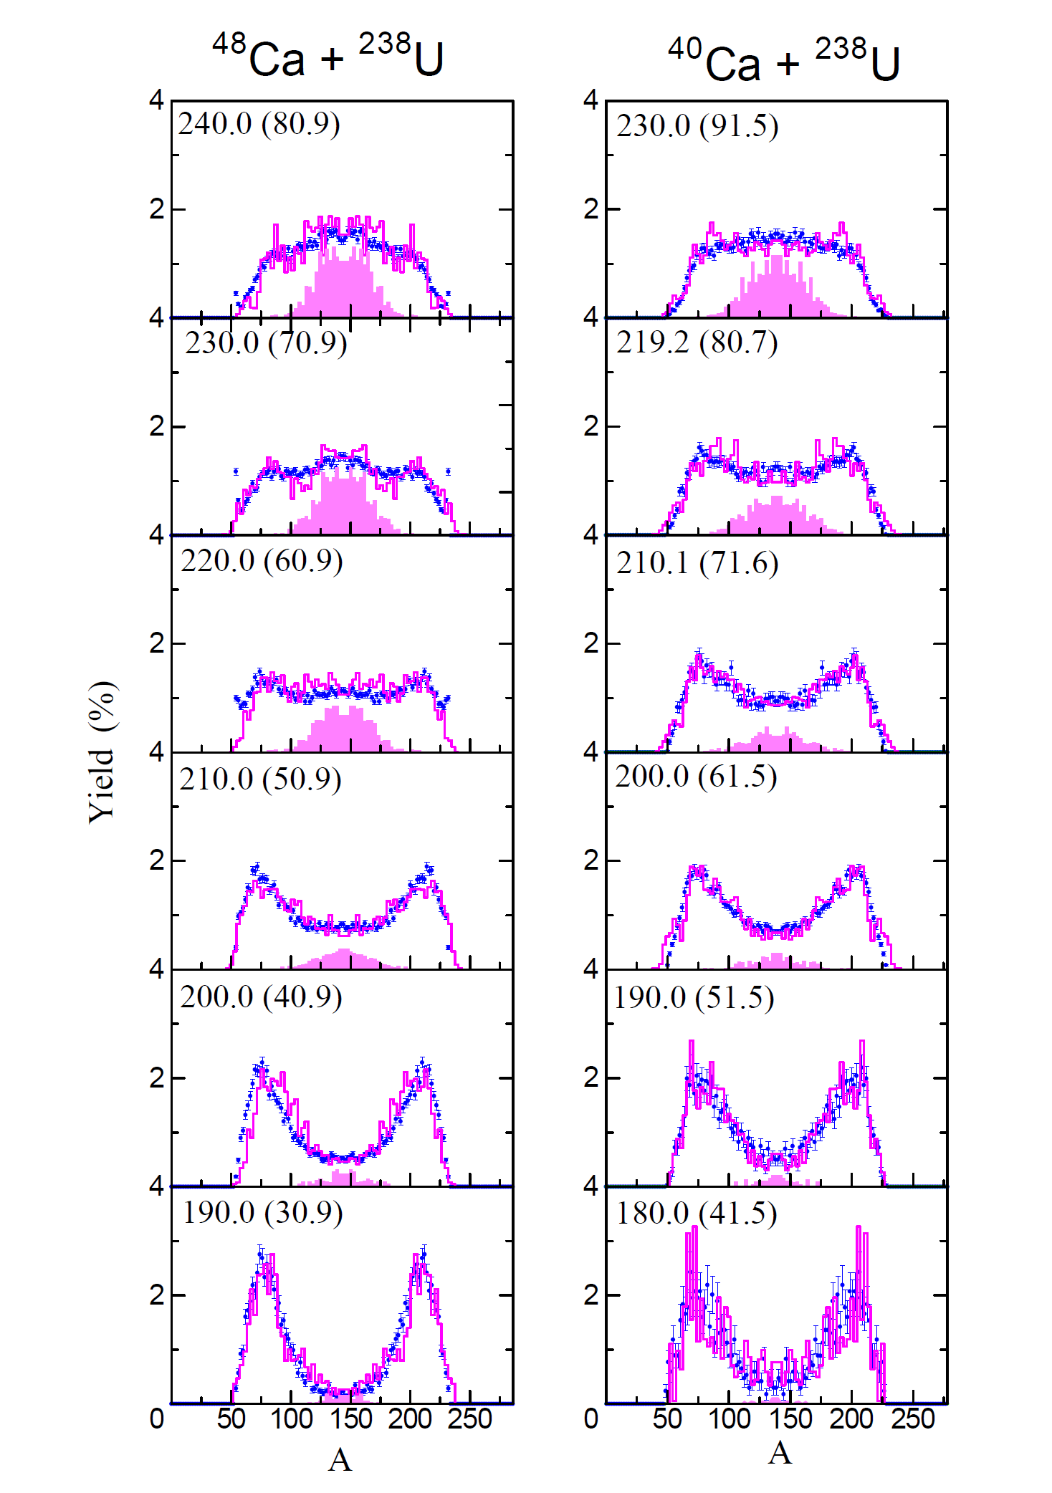
Fusion probabilities for ^{40,48}Ca + ²³⁸U
Q ( ⁴⁰Ca + ²³⁸U ) = - 138.6 MeV
Q ( ⁴⁸Ca + ²³⁸U ) = - 159.1 MeV
Fusion Probability
^{282,283}Cn
E_{c.m.}
K.Nishio et al., Phys. Rev. C, 86, 034608 (2012)

Slide 16
Summary
Orientation effects on fusion probability are observed
Fusion probabilities determined by the in-beam fission experiment can explain evaporation residue cross sections
for ³⁰Si,³⁴S + ²³⁸U
Measurement of evaporation residue cross section at the deep sub-barrier energies is desired to draw comprehensive picture of orientation effects.

Slide 17
K. Nishio, H. Ikezoe, S. Mitsuoka, I. Nishinaka, H. Makii, Y. Wakabayashi, Y. Nagame
Japan Atomic Energy Agency, Tokai, Japan
A. Andreyev
University of York, York, UK
S. Hofmann, D. Ackermann, F.P. Heßberger, S. Heinz, J. Khuyagbaatar, B. Kindler, V.F.Comas J.A. Heredia, I. Kojouharov, B. Lommel, R. Mann, B. Sulignano, Ch.E. Düllmann, M.Schädel
GSI, Darmstadt, Germany
S. Chiba
Tokyo Institute of Technology, Japan
S. Antalic, S. Saro
Comenius University, Bratislava, Slovakia
A.G. Popeko, A.V. Yeremin, A. Svirikhin
Flerov Laboratory of Nuclear Reactions, Dubna, Russia
A. Yakushev, A. Gorshkov, R. Graeger, A. Türler
Technical University Munchen, Garching, Germany
P. Kuusiniemi
University of Oulu, Pyhayarvi, Finland
T. Ohtsuki, K. Hirose
Institute for Nuclear Physics, Tohoku University, Sendai, Japan
Y. Watanabe
High Energy Accelerator Research Organization, Tsukuba, Japan
Y. Aritomo
Flelov Laboratory of Nuclear Reactions, Dubna, Russia
Japan Atomic Energy Agency, Tokai, Japan

Slide 18
Thank you.

