Slide 1
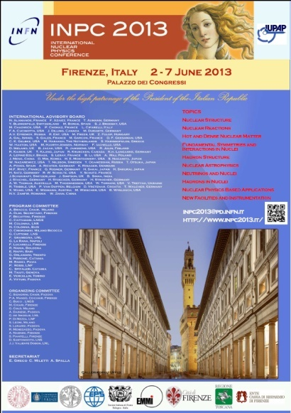


COLLECTIVE FEATURES OF NUCLEAR DYNAMICS WITH EXOTIC NUCLEI WITHIN MICROSCOPIC TRANSPORT MODELS
Virgil Baran
University of Bucharest
ROMANIA

Slide 2
CO-WORKERS
Maria COLONNA, Massimo DI TORO, Carmelo RIZZO
UNIVERSITY OF CATANIA AND LABORATORI NAZIONALI DEL SUD,
CATANIA, ITALY
Andreea CROITORU, Bogdan FRECUS, Daniel DUMITRU, Roxana ZUS
UNIVERSITY OF BUCHAREST, ROMANIA

Slide 3
An important issue in modern nuclear physics:
PROVIDE AN APPROPRIATE DENSITY DEPENDENCE OF THE SYMMETRY ENERGY WHICH IS ABLE TO EXPLAIN IN A UNIFIED MANNER PHENOMENA AT DENSITIES BELOW SATURATION AS WELL AS AT LARGE COMPRESSIONS OF NUCLEAR MATTER

Slide 4
THE ROLES OF SYMMETRY ENERGY
PYGMY DIPOLE
RESONANCE
NEUTRONS SKIN
DIPOLE POLARIZABILITIES
SYMMETRY ENERGY
ISOSPIN DYNAMICS
PARTICLE PRODUCTION
NEUTRON STARS

Slide 5
COLLECTIVE DYNAMICS WITH EXOTIC NUCLEI
OUTLINE
PYGMY DIPOLE RESONANCE WITHIN LANDAU-VLASOV APPROACH
II. DYNAMICAL DIPOLE MODE IN DISSIPATIVE REACTIONS
III. COLLECTIVE FLOWS OF INTERMEDIATE MASS FRAGMENTS IN FRAGMENTATION AT FERMI ENERGIES

Slide 6
DYNAMICS OF MANY-BODY SYSTEMS
Classical
Many-body
Eq.
Many-body
Schrodinger
Eq.
Green’s function
One-body distribution
function
Slater
determinants
Time-Dependent
Hartree-Fock
Wigner
function
Vlasov
Eq.
Landau
Kinetic Eq.
Boltzmann
Eq.
small
oscillations
moment
expansion
coherent
state
RPA
Elasticity
Hydrodynamics
Zero sound
First sound

Slide 7
LANDAU THEORY OF FERMI LIQUIDS
FOR NUCLEAR MATTER
FERMI LIQUID
(FREE) ENERGY
FUNCTIONAL
EFFECTIVE
INTERACTIONS
(mean-field)
NUCLEON-NUCLEON
CROSS-SECTION
LANDAU
PARAMETERS
LANDAU KINETIC
EQUATION
COLLISION
INTEGRAL
COLLECTIVE
MODES
sounds
unstable modes
TRANSPORT
PROPERTIES
viscosity
thermal
conductivity
diffusion
coefficient
STATIC
PROPERTIES
specific heat
incompressibility
magnetic susceptibility

Slide 8



ENERGY DENSITY FUNCTIONAL APPROACH TO NUCLEAR
DYNAMICS

Slide 9

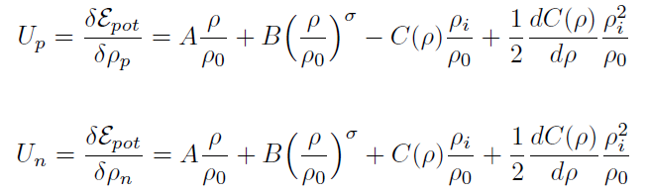
FROM ENERGY DENSITY FUNCTIONAL TO NUCLEAR MEAN FIELD TO TRANSPORT APROACH

Slide 10
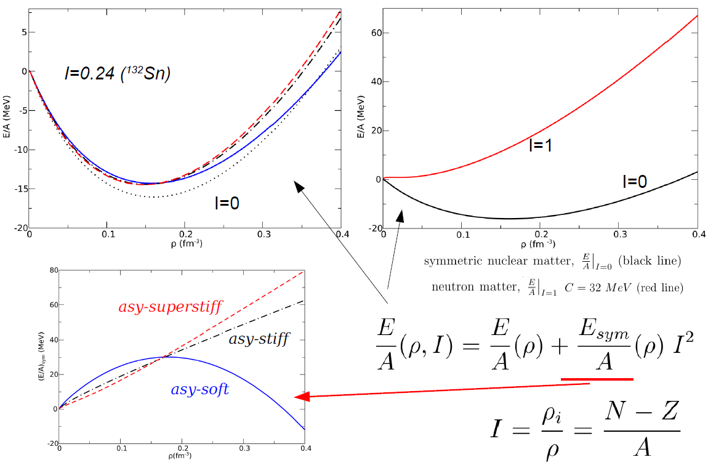
NUCLEAR EQUATION OF STATE (T=0 MEV)

Slide 11
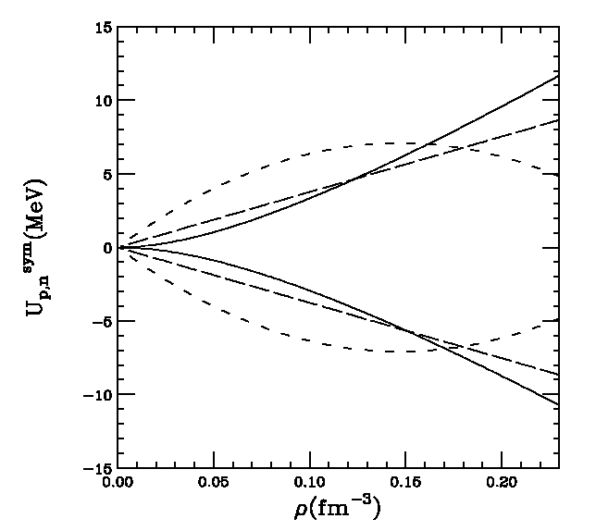
ISOVECTOR MEAN FIELD: THE SLOPE PARAMETER L
neutron
L=14MeV
proton
L=72 MeV
Asy-stiff
Asy-soft
Asy-superstiff
L=96 MeV

Slide 12
STATIC PROPERTIES: NUCLEAR SKIN
DENSITY
MEAN SQUARE RADIUS
NEUTRON SKIN
THICKNESS

Slide 13
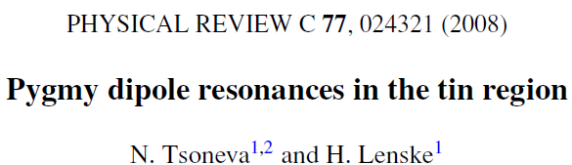
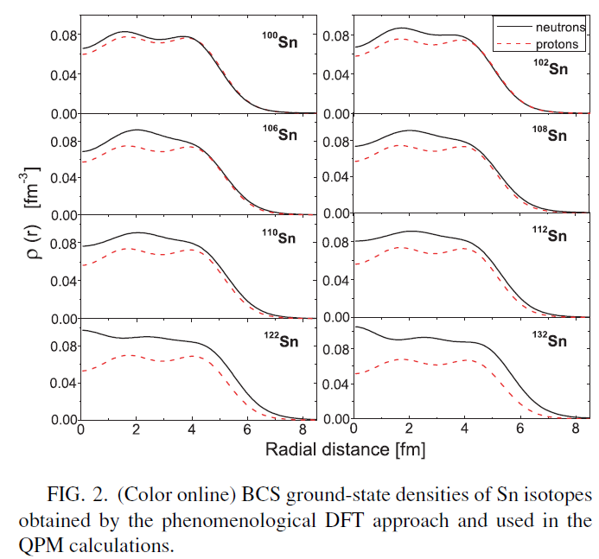
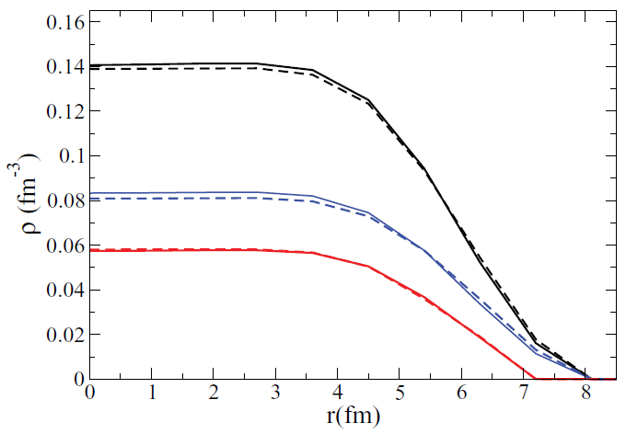
STATIC PROPERTIES: DENSITY PROFILES

Slide 14
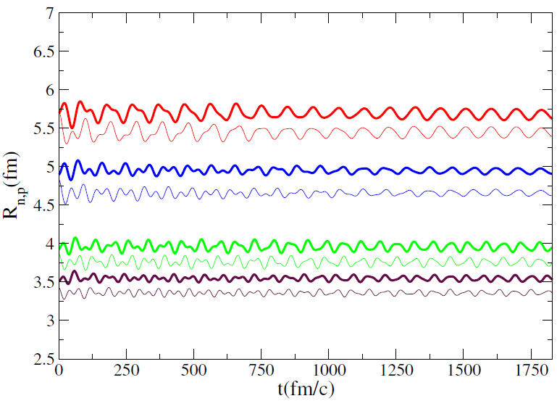
SMALL OSCILLATIONS AROUND EQUILIBRIUM VALUE OF NEUTRONS AND PROTONS MEAN-SQUARE RADII

Slide 15
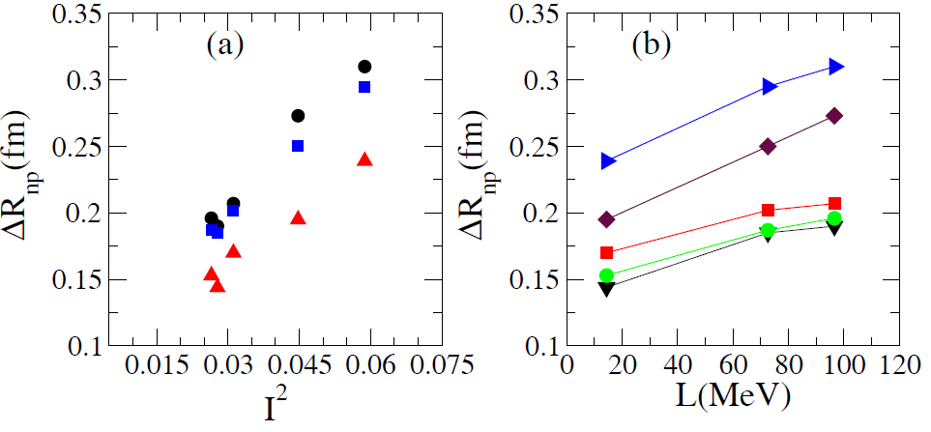
NEUTRON SKIN THICKNESS: ISOSPIN AND SLOPE PARAMETER DEPENDENCE

Slide 16
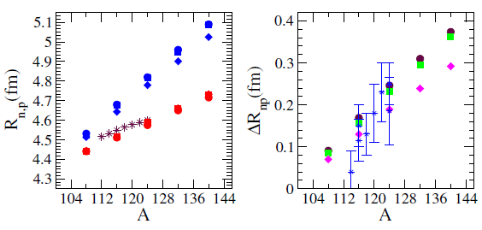
Sn ISOTOPES
THE NEUTRONS AND PROTONS MEAN SQUARE RADII
NEUTRON SKIN THICKNESS

Slide 17
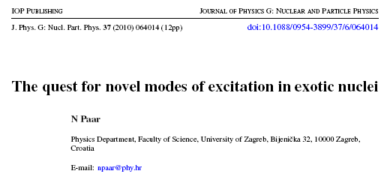
CRITICAL QUESTIONS

Slide 18
THEORETICAL APPROACHES TO PYGMY DIPOLE
PHENOMENOLOGICAL APPROACHES BASED ON HYDRODYNAMICS OR
FLUID DYNAMICS EQUATIONS
R. Mohan, M. Danos, L. C. Biedenharn, Phys. Rev. C 3, 1740 (1971)
Y. Suzuki, K. Ikeda, H. Sato, Prog. Theor. Phys. 83, 180 (1990)
S. I. Bastrukov et al., Phys. Lett. B 664, 258 (2008)
2. NONRELATIVISTIC MICROSCOPIC APPROACHES USING RANDOM PHASE
APPROXIMATION (RPA) WITH VARIOUS EFFECTIVE INTERACTIONS
N.Tsoneva, H. Lenske, Phys. Rev. C 77, 024321 (2008)
G. Co’ et al., Phys. Rev. C 80, 014308 (2009)
K. Yoshida, Phys. Rev. C 80, 044324 (2009)
X.Roca-Maza et al., Phys. Rev. C 85, 024601 (2012)
3. RELATIVISTIC QUASIPARTICLE RPA
D. Vretenar et al., NPA 692, 496 (2001); D. Vretenar et al., NPA 731, 281 (2004)
E. Litvinova et al, PRC 78, 014312 (2008) ; D Pena Artega et al., PRC 79, 034311 (2009)
J. Endres et al., Phys. Rev. Lett. 105, 212503 (2010)
4. TRANSPORT APPROCHES BASED ON LANDAU-VLASOV EQUATION OR QMD
V.I. Abrosimov, O.I. Davydovs’ka, Ukr. J. Phys. 54 (11), 1068 (2009)
M. Urban, Phys. Rev. C 85, 034322 (2012)
V. Baran, B. Frecus, M. Colonna, M. Di Toro, Rom.J. Phys 57, 36-48 (2012)
V. Baran, B. Frecus, M. Colonna, M. Di Toro, Phys. Rev. C 85, 051601(R) (2012)
C. Tao et al., Phys. Rev. C 87, 014621 (2013) (QMD)

Slide 19
OBSERVABLES OF INTEREST FOR COLLECTIVE PYGMY DIPOLE
THE CENTROID ENERGY OF THE PDR COLLECTIVE RESPONSE
THE EXHAUSTED ENERGY WEIGHTED SUM RULE (EWSR)
3) MASS DEPENDENCE OF PDR ENERGY CENTROID
4) THE ROLE OF SYMMETRY ENERGY

Slide 20
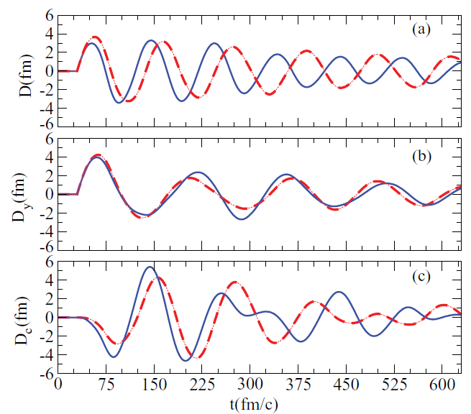
PYGMY-LIKE INITIAL CONDITIONS: THE TIME DEPENDENCE OF
DIPOLE MOMENTS
THE TOTAL DIPOLE IS
STRONGLY INFLUENCED
BY THE CORE MODE
PYGMY DIPOLE MODE
EXCITATION OF THE
CORE DIPOLE MODE

Slide 21
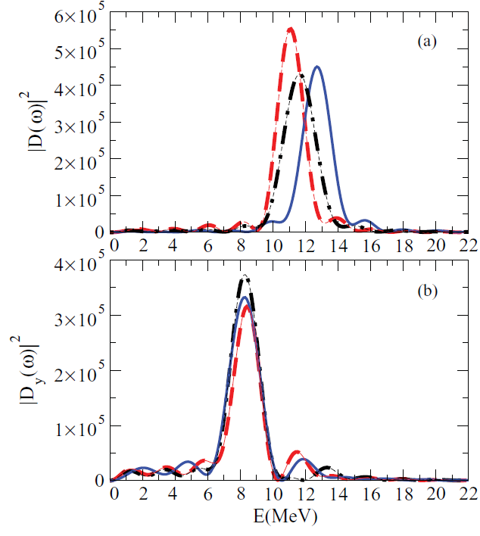
PYGMY-LIKE INITIAL CONDITIONS: POWER SPECTRUM

Slide 22
GDR-LIKE INITIAL CONDITIONS

Slide 23
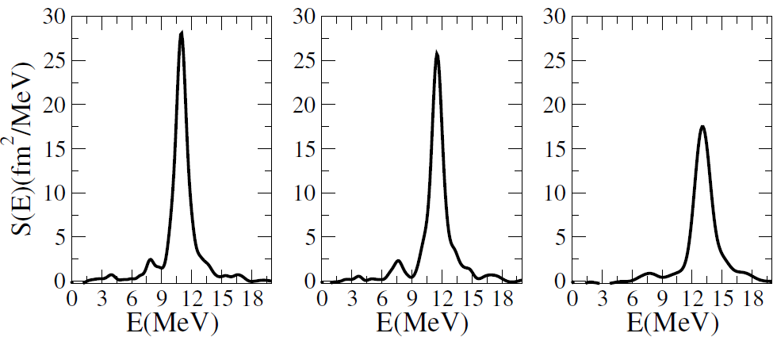
THE DIPOLE STRENGTH FUNCTION

Slide 24
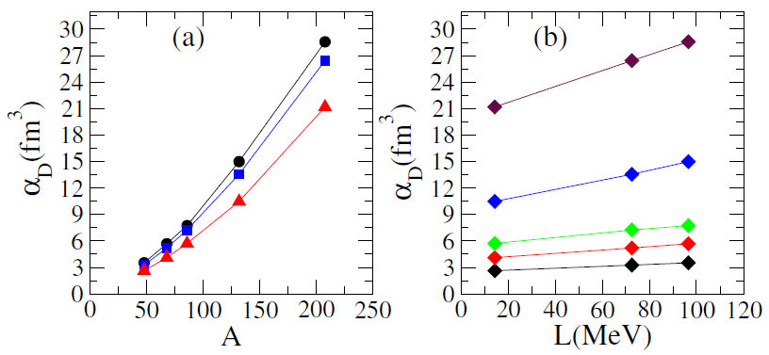
THE NUCLEAR DIPOLE POLARIZABILITY:
MASS AND SYMMETRY ENERGY EFFECTS

Slide 25
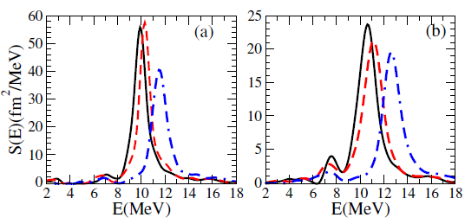
THE DIPOLE STRENGTH FUNCTION

Slide 26
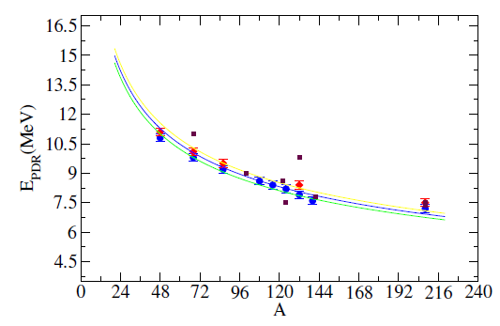
MASS DEPENDENCE OF PYGMY DIPOLE RESONANCE:
CENTROID ENERGY
Squares (maroon)
Experimental data

Slide 27
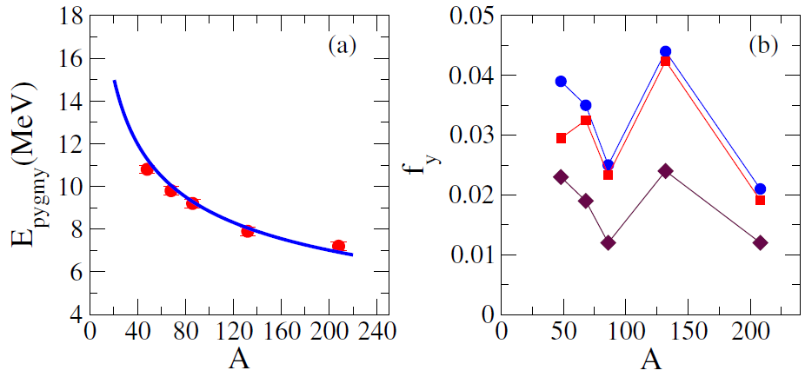

THE EWSR EXHAUSTED BY PDR: MASS DEPENDENCE

Slide 28
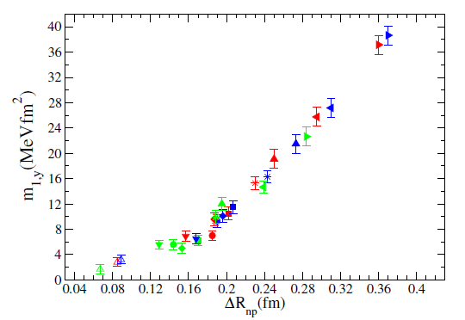
EWSR EXHAUSTED BY PDR: NEUTRON SKIN DEPENDENCE
CONNECTING PYGMY DIPOLE RESONANCE TO NEUTRON SKIN

Slide 29
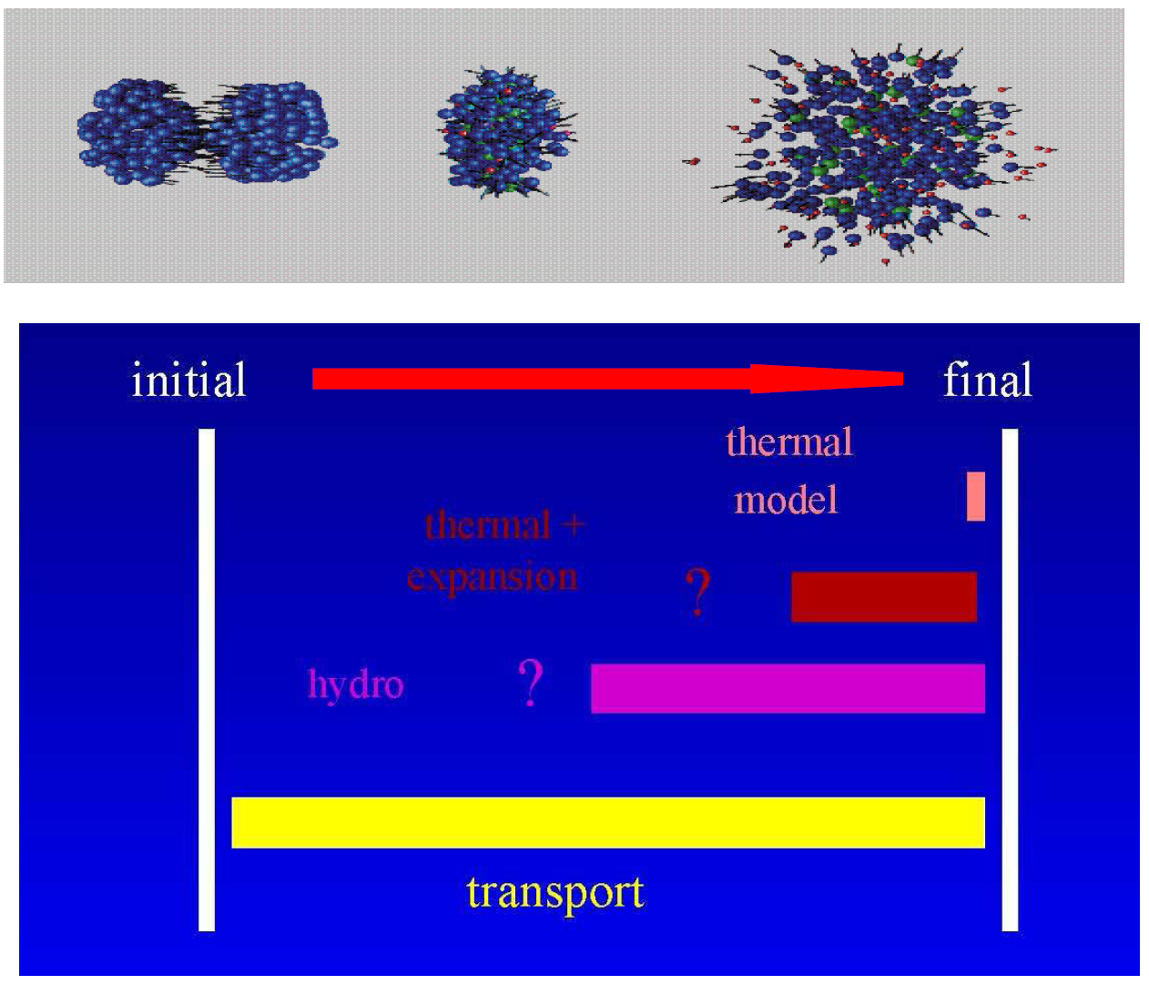
LEVELS OF DESCRIPTION OF EVOLUTION FROM INITIAL TO FINAL STATE IN NUCLEAR DYNAMICS
Statistical Models(global equilibrium)
Statistical emission in expanding
System
Hydrodynamical models
(local equilibrium)
Transport models (BUU,BNV, QMD,
AMD)

Slide 30
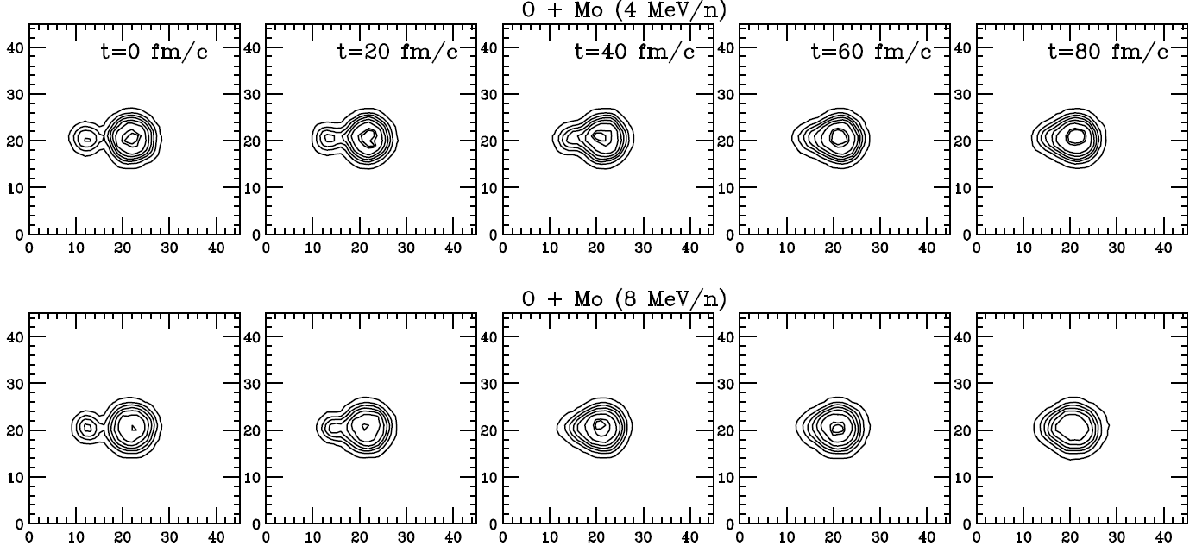
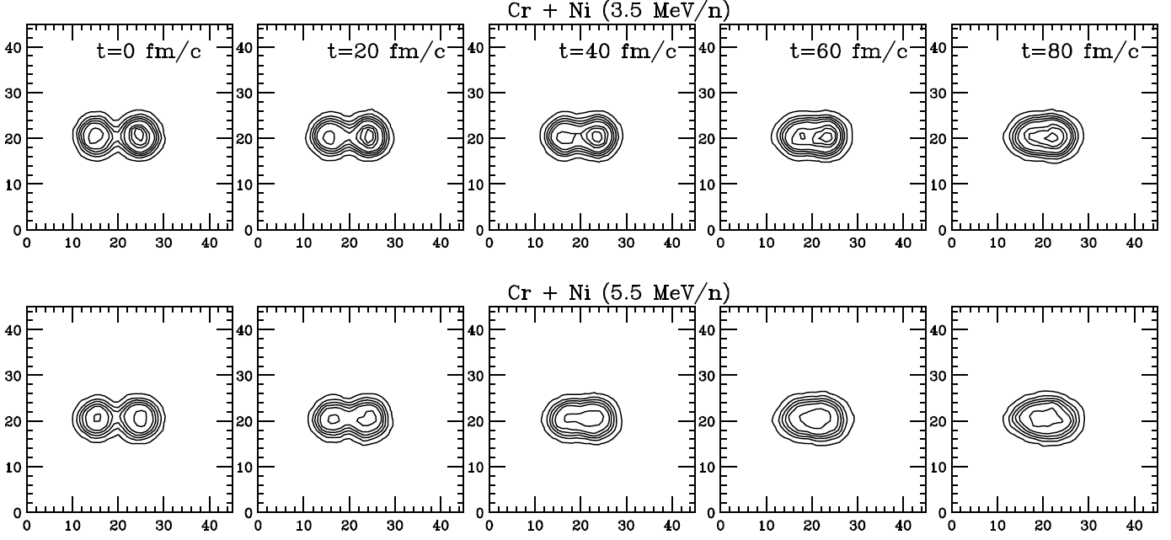
FUSION DYNAMICS ABOVE COULOMB BARRIER
fm
fm

Slide 31
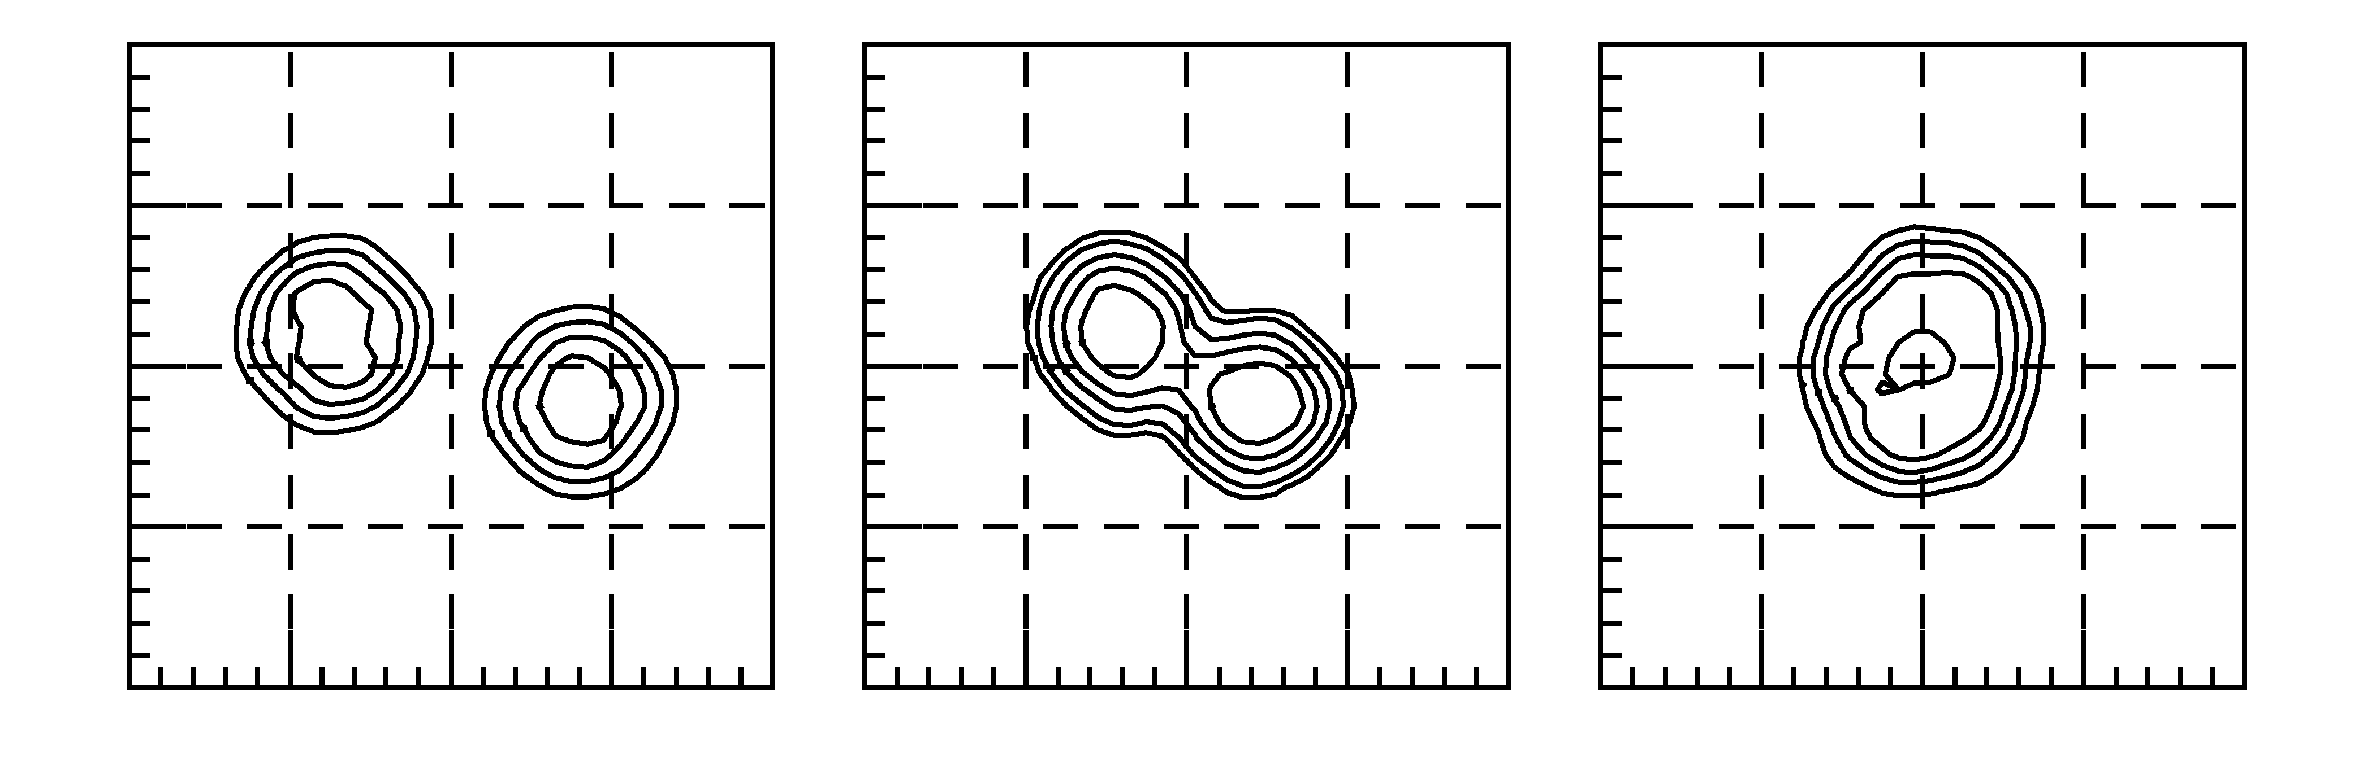
PRE-EQUILIBRIUM DIPOLE RADIATION
Charge Equilibration Dynamics:
Stochastic → Diffusion
vs.
Collective → Dipole Oscillations of the Di-nuclear System
Along Fusion Dynamics
D(t) : bremss. dipole radiation CN: stat. GDR
Initial Dipole
Isovector Restoring Force
Neck Dynamics (Mass Asymmetry)
Anisotropy
Cooling on the way to Fusion
Symmetry energy below saturation

Slide 32
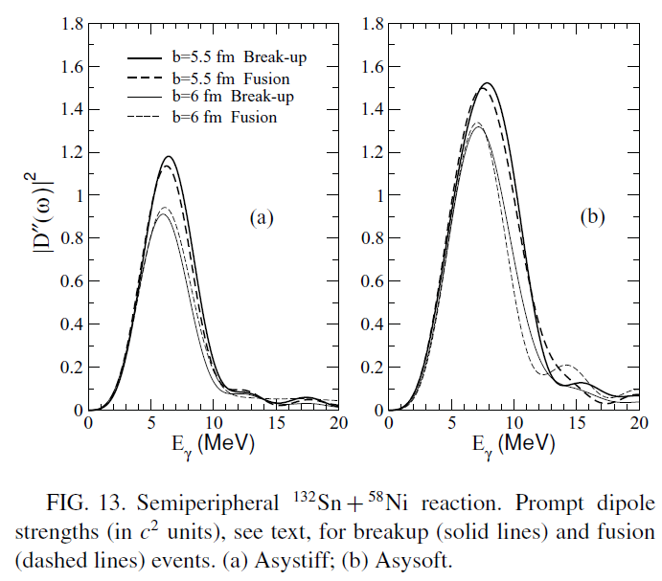

PRE-EQUILIBRIUM DIPOLE EMISSION

Slide 33
ISOSPIN IN NUCLEAR DYNAMICS
FERMI ENERGY DOMAIN
mean field:
scalar + isovector
nucleon – nucleon
collisions
Isospin
dynamics
ENHANCED IMF
PRODUCTION
DENSITY DEPENDENCE
OF SYMMETRY ENERGY
STOCHASTIC BNV TRANSPORT MODEL
- asysoft
-asystiff
- superasystiff
Asy-EOS

Slide 34
STOCHASTIC MEAN FIELD TRANSPORT EQUATION:
VLASOV + NN-COLLISIONS and PAULI CORRELATIONS
Fluctuations
gain
loss
Self-Consistent Mean Field
Equation of State
SMF model : fluctuations projected onto ordinary space density fluctuations δρ
V. Baran, M. Colonna, M. Di Toro, V. Greco
Phys.Rep. 410 (2005) 335

Slide 35
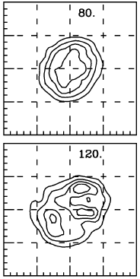
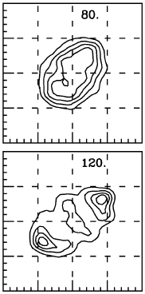
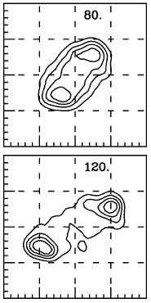
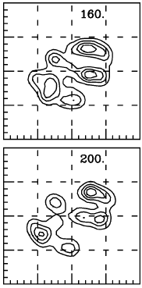
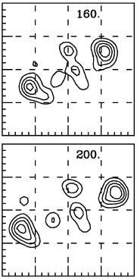
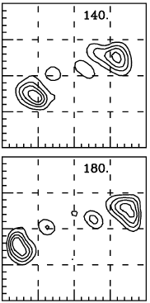
TRANSITION IN FRAGMENTATION MECHANISM
MULTIFRAGMENTATION
NECK FRAGMENTATION
b=2fm
b=4fm
b=6fm

Slide 36
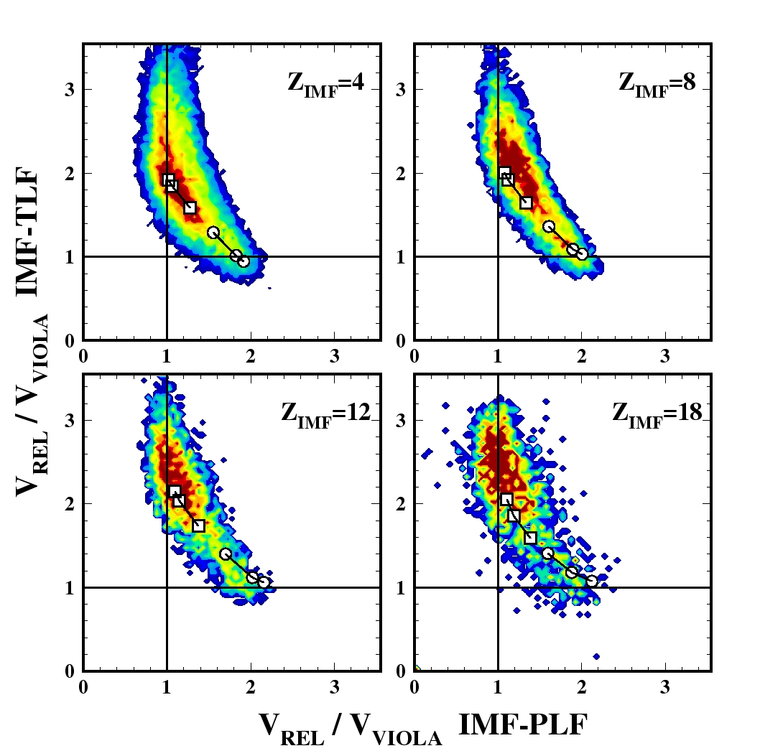
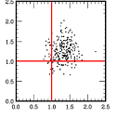
REDUCED VELOCITY PLOTS:
DEVIATIONS FROM VIOLA SYSTEMATICS
Chimera 124Sn+64Ni 35AMeV data, same E_loss selections
Note: BNV model accounts only for the “prompt” component of IMF’s
BNV
V. Baran,M.Colonna, M.Di Toro Nucl. Phys A730 (2004) 329
E.De Filippo et al. (Chimera Coll.) PRC71(2005)044602 and 064604

Slide 37
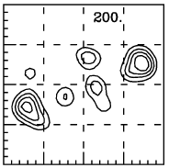
ANALYSIS METHOD OF KINEMATIC PROPERTIES
Coulomb propagation of the trajectories
H1
Entrance channel memory (PLF and TLF like fragments)
x
H2
v_{H1-} v_{H2}
IMF1
v_{H1}
Define the
intrinsic axis
of the event
IMF2
IMF3
IMF4
v_{H2}
0
40fm
z
V_{par} – the component of the fragment velocity along intrinsic axis
V_{tra} – the component of the fragment velocity perpendicular
to intrinsic axis

Slide 38
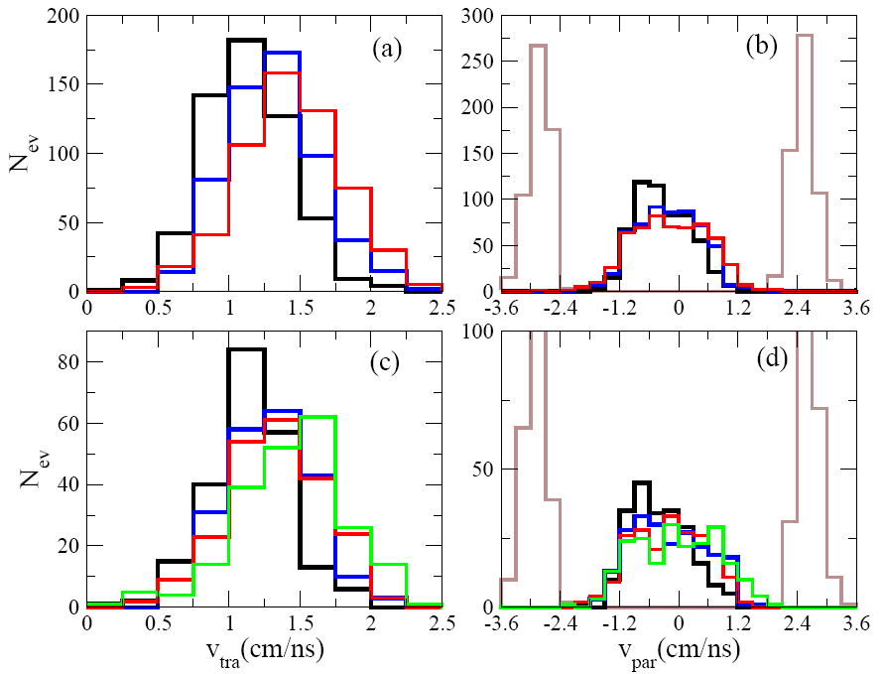
HIERARCHY IN TRANSVERSE VELOCITY DISTRIBUTION
¹²⁴Sn+¹²⁴Sn
b=4fm
Transverse velocity
distributions
Parallel velocity
distributions
Velocity distribution
of the heaviest fragment
in reaction
ASYSOFT
3 IMF
4 IMF
The lightest IMF’s acquires
the greatest transverse
velocities
The IMF’s velocity distributions along intrinsic
axis are centred around mid-velocity region

Slide 39
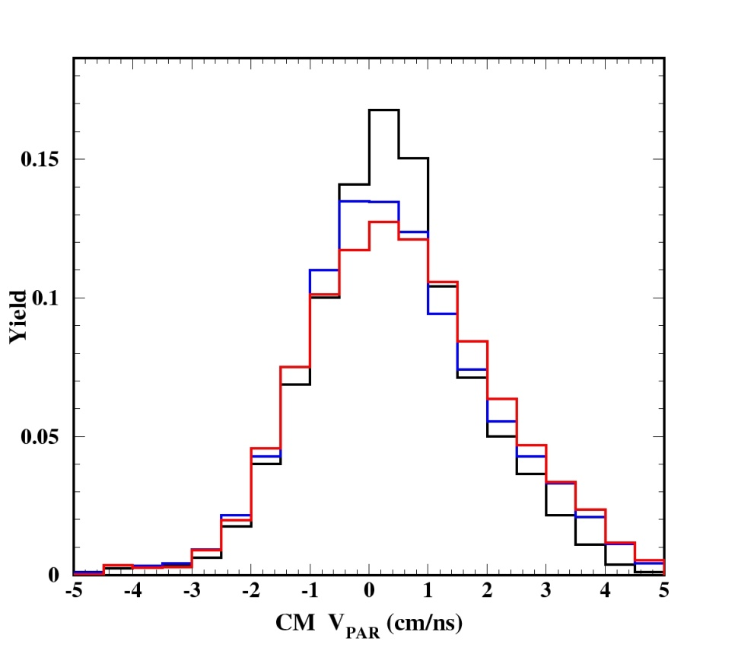
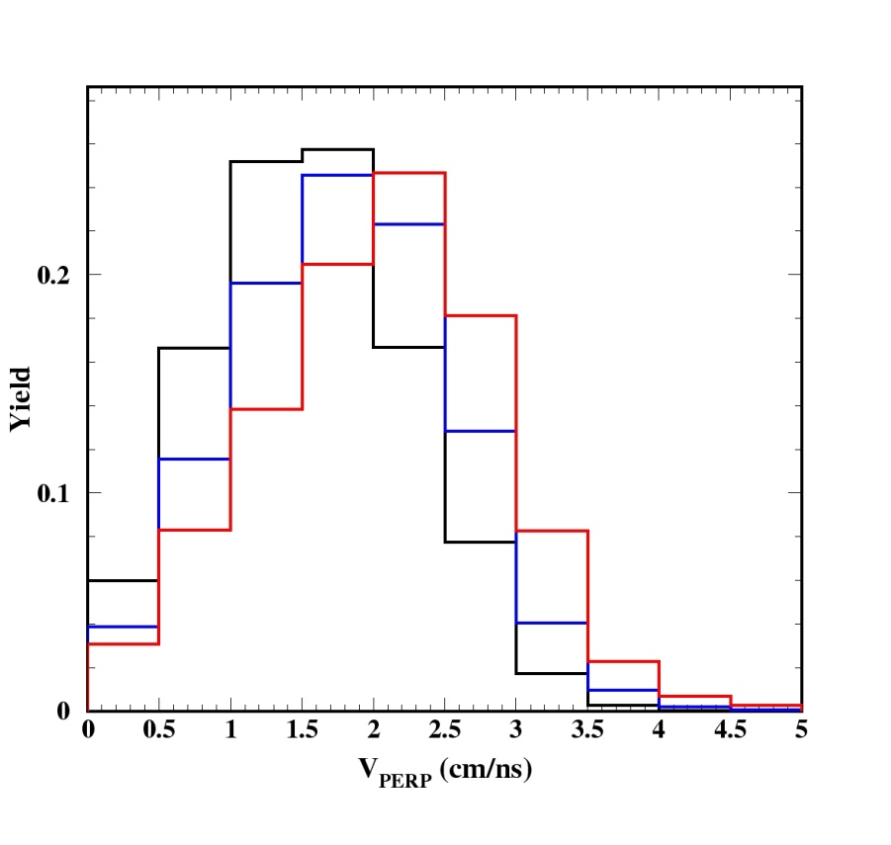
HIERARCHY IN VELOCITY DISTRIBUTION: CHIMERA RESULTS
Exp ¹²⁴Sn+⁶⁴Ni: velocities components calculated respect to the
PLF – TLF separation axis
Fast
Mid1
θ
The lightest fragment is shifted toward higher values of trasversal velocity
CM
Mid2
Beam axis
Slow
Mid3

Slide 40
COLLECTIVE FLOWS OF INTERMEDIATE MASS FRAGMENTS
transverse (direct) flow parameter:
elliptic flow anisotropy parameter:
¹²⁴Sn + ¹²⁴Sn, 50AMeV, b=4fm
- the in-reaction plane component of the momentum perpendicular to the beam axis
- the momentum component orthogonal to the reaction plane

Slide 41
DIRECT FLOW PARAMETER FOR IMF’S
asysoft
asysuperstiff

Slide 42
ELLIPTIC FLOW PARAMETER FOR IMF’S
asysoft
asysuperstiff

Slide 43
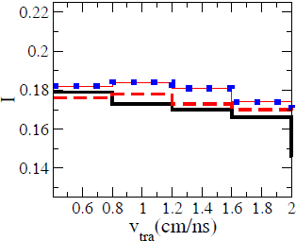
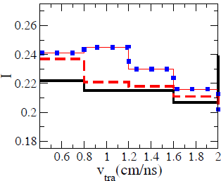
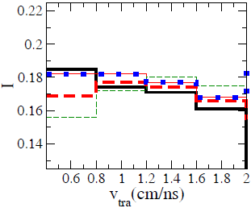
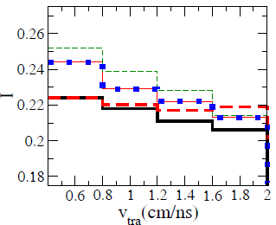
ISOSPIN-TRANSVERSE VELOCITY CORRELATION
IN IMF’S HIERARCHY

Slide 44
SUMMARY AND PERSPECTIVES
WE INVESTIGATED THE SENSITIVITY OF SEVERAL OBSERVABLES AND OF
THE COLLECTIVE DYNAMICS OF EXOTIC NUCLEI TO SYMMETRY ENERGY
IN A TRANSPORT APPROACH BASED ON LANDAU-VLASOV EQUATION
CORRELATIONS BETWEEN THE NEUTRON SKIN THICKNESS, THE DIPOLE
POLARIZABILITY,THE EWSR EXHAUSTED BY PYGMY RESONANCE AND THE
SYMMETRY ENERGY SLOPE PARAMETER L
PROVIDED A PARAMETRIZATION OF PDR ENERGY CENTROID WITH MASS
IN QUITE GOOD AGREEMENT WITH SEVERAL EXPERIMENTAL DATA
A LINEAR CORRELATION BETWEEN THE TOTAL EWSR EXHAUSTED BY PDR
AND THE NEUTRON SKIN THICKNESS
SENSITIVITY OF THE PRE-EQUILIBRIUM DIPOLE EMISSION IN FUSION
REACTIONS TO THE DENSITY DEPENDENCE BELOW SATURATION
MORE STRINGENT CONSTRAINTS FROM EXCLUSIVE ANALYSIS OF IMF’S
KINEMATIC PROPERTIES IN CORRELATION WITH THE ISOSPIN CONTENT

