Slide 1

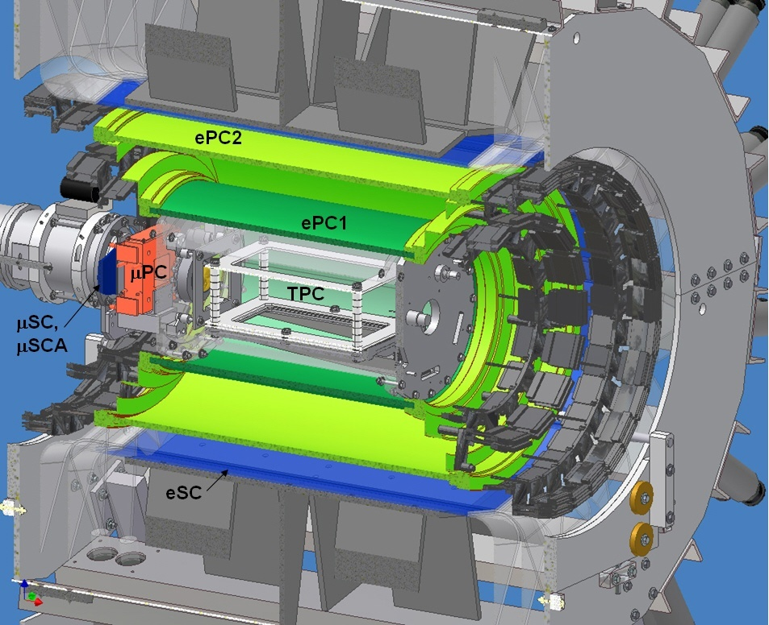
the MuCap experiment – final results on
μp capture rate Λ_{S} and pseudoscalar coupling g_{P}
INPC 2013
Firence Italia
June 2 - 7, 2013
Claude Petitjean
on behalf of the
MuCap-collaboration
cut out view of MuCap detector
http://muon.npl.washington.edu/exp/MuCap/
Petitjean INPC 2013 Firence June 2-7

Slide 2
outline
- goal of MuCap - experimental strategy
lifetime method – TPC – exp. setup
systematics:
- impurities
- pμp molecules – the ortho-para problem
- systematic corrections
final results:
- singlet capture rate Λ_{S}
- induced pseudoscalar coupling constant g_{P}
Petitjean INPC 2013 Firence June 2-7

Slide 3
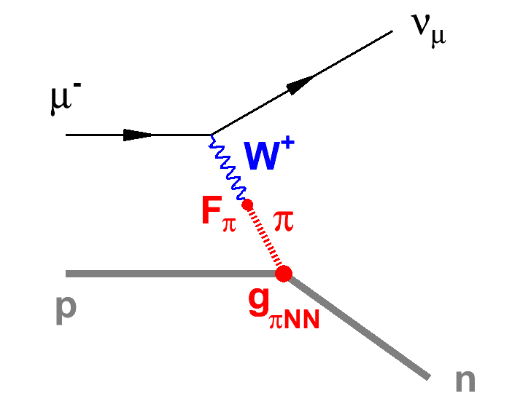
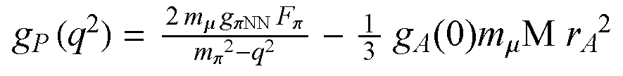
MuCap’s scientific goal
precision measurement of singlet μp capture
μ⁻ + p → ν_{μ} + n rate Λ_{s}
tests basic QCD symmetries: formfactors g_{A,} g_{P}
of these g_{P} is of particular interest
because only μp capture is sensitive to it
while g_{A} can be determined from neutron decay
solid prediction by chiral perturbation theory (V. Bernard et al. 1994):
g_{P}^{theory} = 8.26 ± 0.23
a 1% measurement of Λ_{S} determines g_{P}^{exp} to 6%
Petitjean INPC 2013 Firence June 2-7

Slide 4
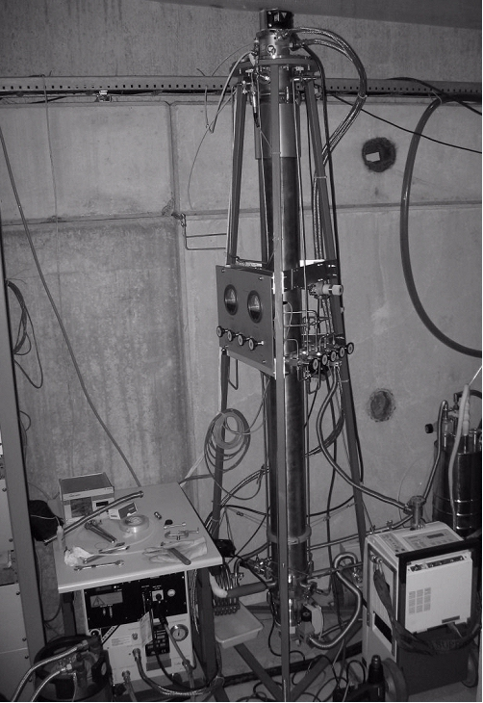
strategy of MuCap experiment
requirements solutions
_________________________________________
precision technique lifetime method
clear interpretation low density H₂ gas (Φ ~ 1%)
ortho-para problem of ppμ
clean μ stops time projection chamber TPC
high purity H₂ gas UHV materials & continuous
c_{Z} < 10⁻⁸ gas circulation + cleaning
isotopically clean H₂ isotope separation
„protium“ with c_{D} < 10⁻⁸ column →
high statistics muon kicker
≥ 10¹⁰ single events
Petitjean INPC 2013 Firence June 2-7
4

Slide 5
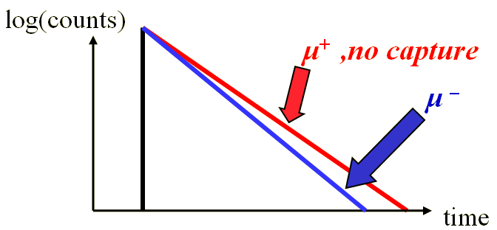
lifetime method
  μp → nν_{μ} rare process
  0.16% of μ → eν_{μ}ν_{e}
  direct neutron detection
  not precise enough
  → lifetime method:
  μp capture rate
  Λ_{S} = difference of μ slopes
  for a 1% result
measure λ(μ⁻p) to 10⁻⁵
[λ(μ⁺) to 10⁻⁶ from MuLan-exp]
  Λ_{S} = λ(μ⁻p) – λ(μ⁺)
we have collected 1.2 10¹⁰ single μ⁻ decays
Petitjean INPC 2013 Firence June 2-7

Slide 6
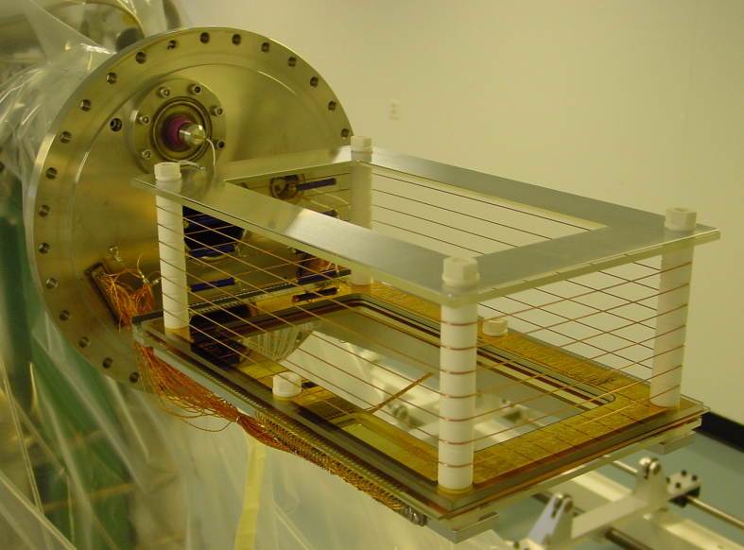
the Hydrogen TPC as active μ stop target
~ 5 liters sensitive volume filled with 10 bar protium
gas is continuously cycled and cleaned
2 kV/cm vertical drift field (v_{d} ~ 5.5 mm/μs)
2-D horizontal readout on 75 anode and 140 cathode wires (5-6 kV)
UHV technique using metals/glass frames/ ceramic materials bakeable to 130 C
full 3-D reconstruction of every μ-stop event
Petitjean SPS June 21 2012 at ETHZ

Slide 7
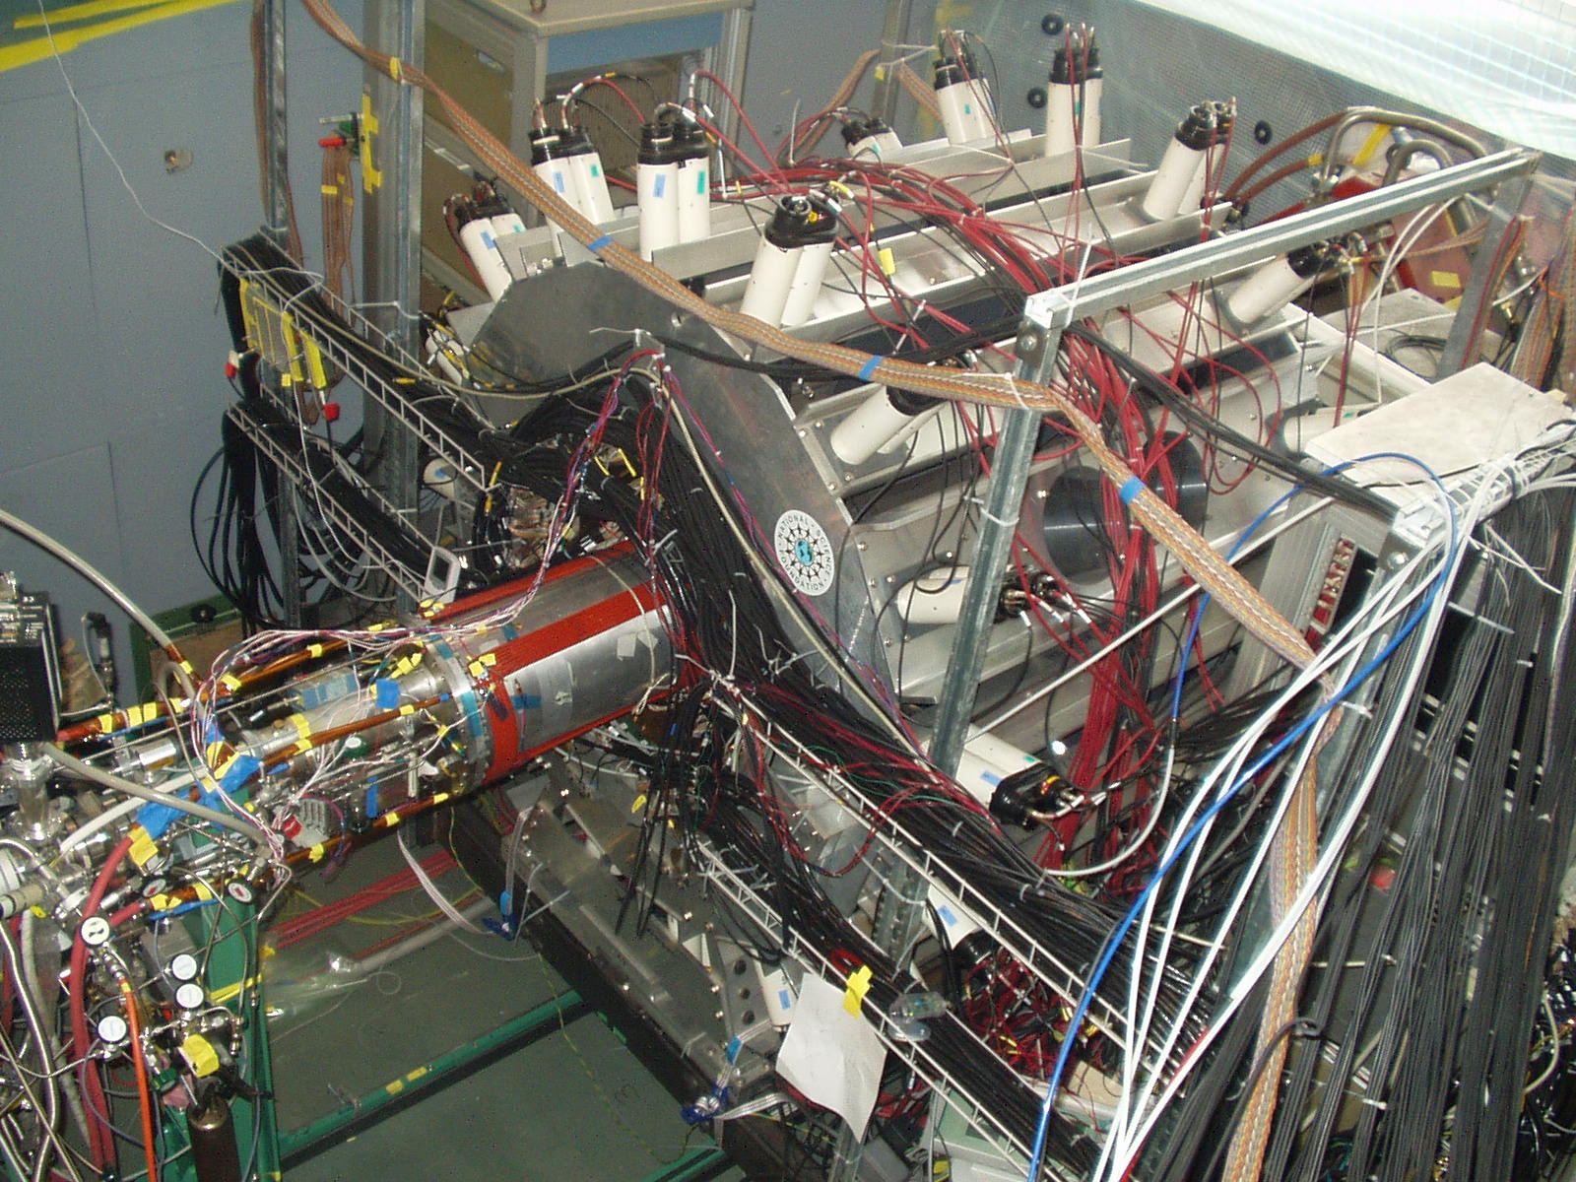
the MuCap detector with TPC vessel out
Petitjean INPC 2013 Firence June 2-7

Slide 8
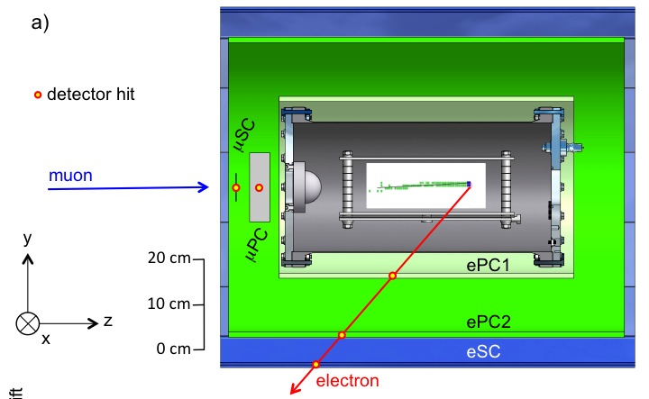
MuCap event μ⁻ → e ν_{μ} ν_{e}
Petitjean INPC 2013 Firence June 2-7

Slide 9
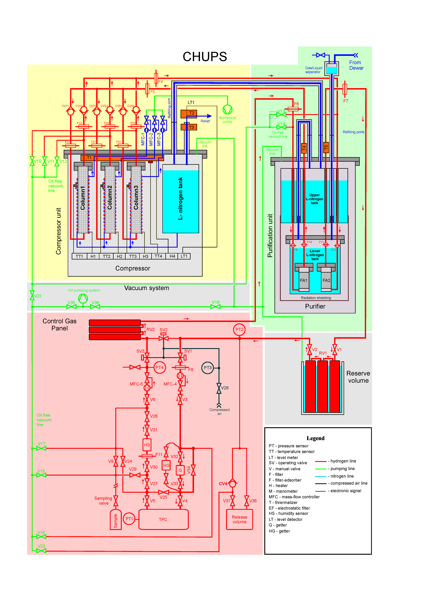
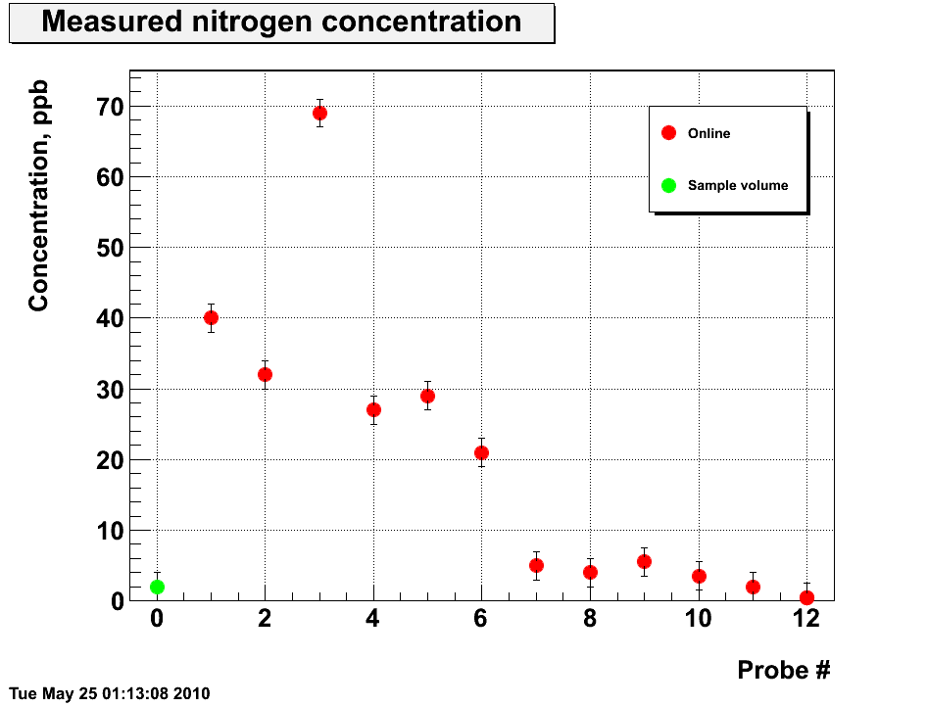
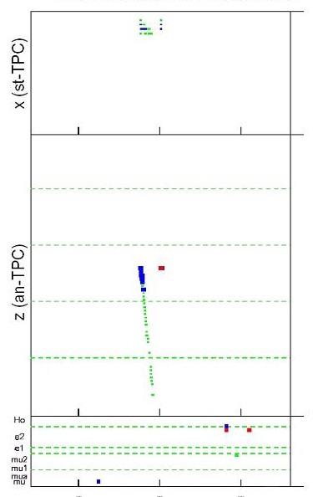
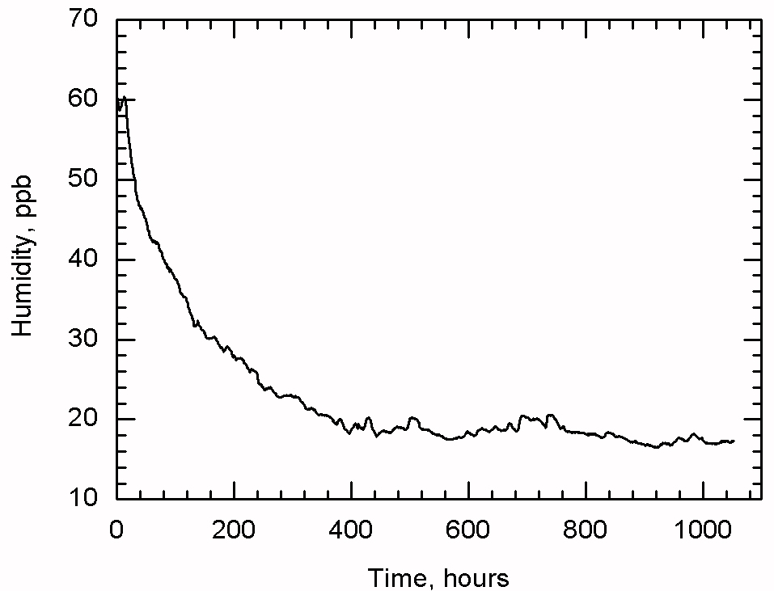
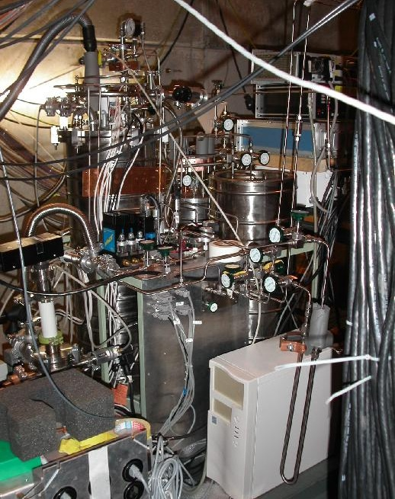
impurities removed with continuous gas cycling
- cryogenic adsorption/desorption cycles using active Carbon
- Zeolite at 80K absorbs all Z>2 impurities
N₂ c ~5ppb
gas chromatography
H₂O c~17ppb
event display showing recoil after μ-capture by impurity
humidity sensor
purification system
we achieved c_{Z} < 2 x 10⁻⁸ impurities in the H₂ gas
Petitjean INPC 2013 Firenze June 2-7

Slide 10
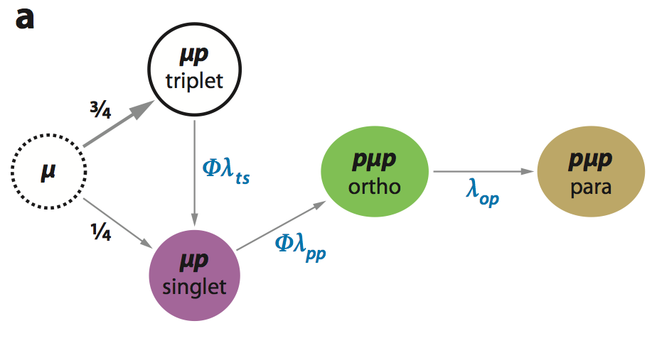
systematics: the ortho – para problem pμp formation makes interpretation of λ^{observed} difficult
Λ_{T} = 12 s⁻¹
Λ_{ortho}= 543 s⁻¹
Λ_{para}= 215 s⁻¹
the problem:
- strong sensitivity to H₂ density Φ
in lq. H₂ (Φ=1) fast pμp formation
but λ_{op} is largely unknown
Λ_{S}= 715 s⁻¹
solution: use low H₂ density Φ ~ 0.01 (→ only 2.5% correction to Λ_{S})
we have remeasured the pμp formation rate: λ_{pp} = 1.94(6) 10⁶s⁻¹
Petitjean INPC 2013 Firence June 2-7
10

Slide 11
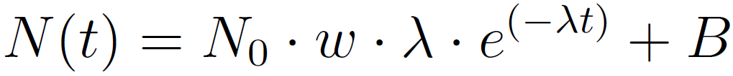
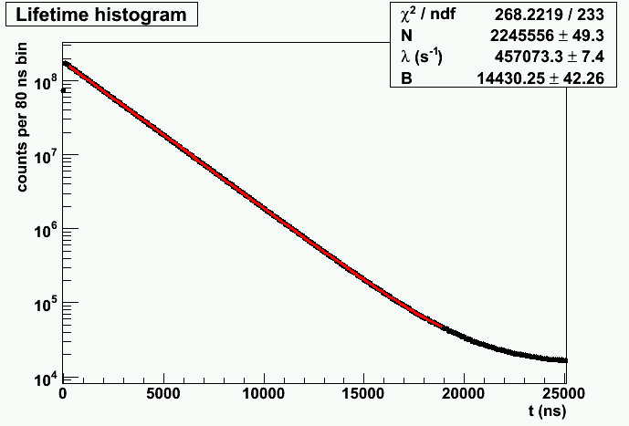
lifetime fit of full statistics (run11)
Petitjean INPC 2013 Firence June 2-7
thesis B. Kiburg
Notes:
11

Slide 12
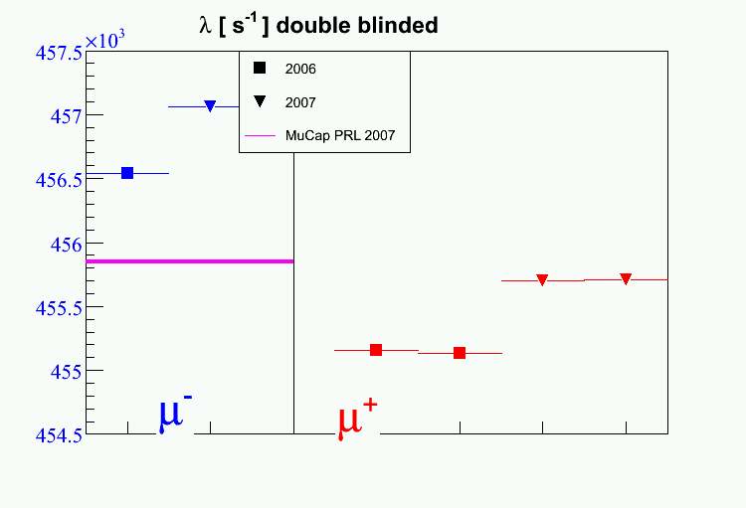
MuCap‘s lifetime results
rates with secret offset
Petitjean INPC 2013 Firence June 2-7
12

Slide 13
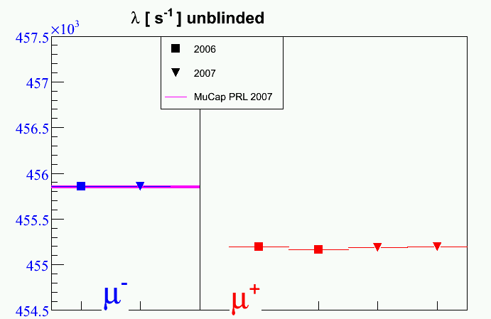
lifetime results after unblinding
analysis of each
run was done „blind“
Petitjean INPC 2013 Firence June 2-7

Slide 14
μp lifetimes λ_{μ} & final capture rate Λ_{S}
 | (old) run-2004 PR Lett. 99, 032002 (2007) | run-2006 | run-2007 | remarks
statistics | 1.6 x 10⁹ | 5.5 x 10⁹ | 5.0 x 10⁹ | events after cuts
λ_{μ-} fit | 455‘883.5 ± 12.5 | 456‘538.00 ± 7.05 ± 7.73 | 457‘071.35 ± 7.58 ± 8.34 | stat errors inflated due to Χ²
sys corr | -32.1 ± 8.4 | -23.30 ± 5.20 | -14.74 ± 3.88 | systematic errors
λ_{μ-} corr | 455‘851.4 ± 15.1 | 455‘857.3 ± 9.3 | 455‘853.1 ± 9.1 | unblinded, full errors
λ_{μ+} |  | 455‘170.05 ± 0.46 | PR Lett. 106, 041803 (2011) | MuLan result
ΔΛ_{pμp} | +19.80 ± 1.87 | +17.73 ± 1.87 | +17.72 ± 1.87 | pμp formation
Δλ_{μp} |  | +12.3 | PR 119(1), 365 (1960) | bound state effect
Λ_{S} | 713.45 ± 15.2 s⁻¹ | 717.3 ± 9.5 s⁻¹ | 713.1 ± 9.4 s⁻¹
Λ_{S}^{MuCap} | = λ_{μ-} - λ_{μ+} +Δλ_{μp} +ΔΛ_{pμp} | 714.9 ± 7.4 s⁻¹ | (±5.4_{stat}±5.0_{sys}) | our final result see PR Lett 110, 012504 (2013)
 |  | 712.7 ± 4.3 s⁻¹ |  | theory
Petitjean INPC 2013 Firence June 2-7

Slide 15
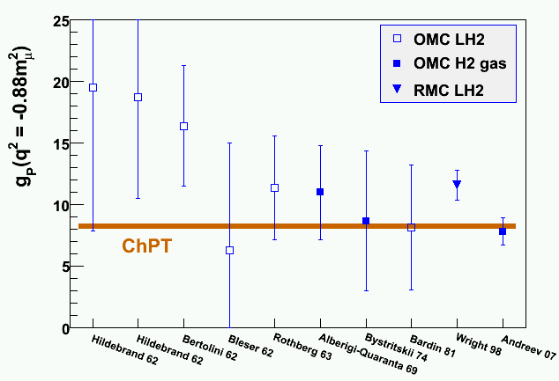
the induced pseudoscalar coupling constant g_{P}
from Λ_{S}^{th}(g_{A},g_{P}) = (712.7 ± 4.3) x [1 + 0.6265 (g_{A}-g_{A}^{PDG}) - 0.0108 (g_{P}-g_{P}^{PDG})]
A. Czarnecki, W.J. Marciano, A. Shirlin, PRL 99, 032003 (2007)
we deduce g_{P}^{MuCap} = 8.06 ± 0.48^{exp} ± 0.28th
excellent
agreement
with chiral
perturbation
theory!
←
Petitjean INPC 2013 Firence June 2-7

Slide 16
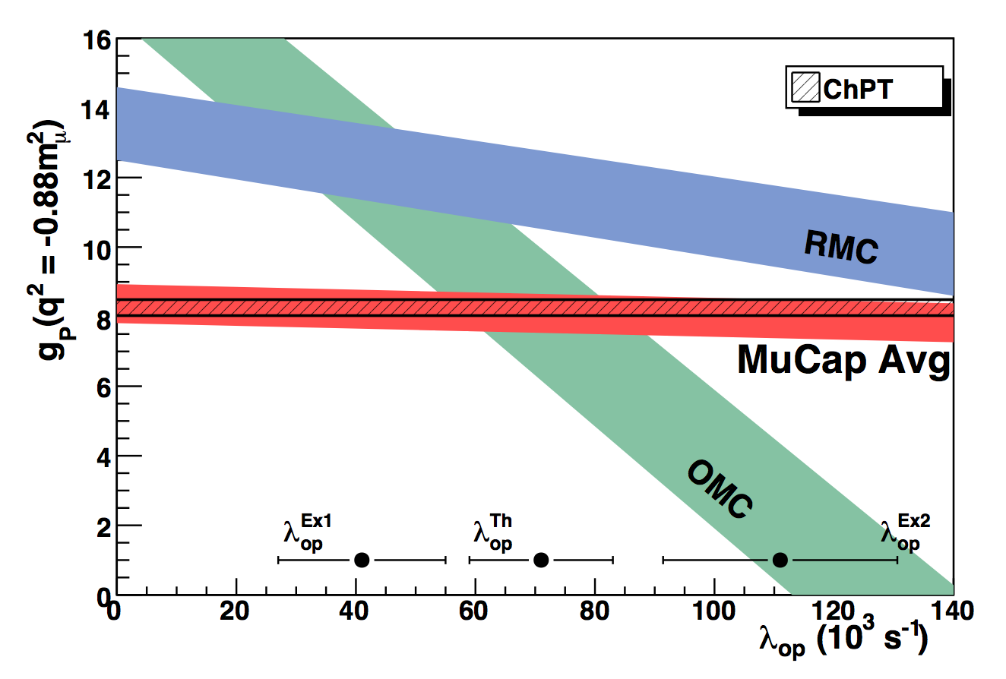
our precise & unambiguous result
solves longstanding puzzle!
g_{P} (MuCap) = 8.04 ± 0.48
g_{P} (theory) = 8.26 ± 0.23
Petitjean INPC 2013 Firence June 2-7

Slide 17
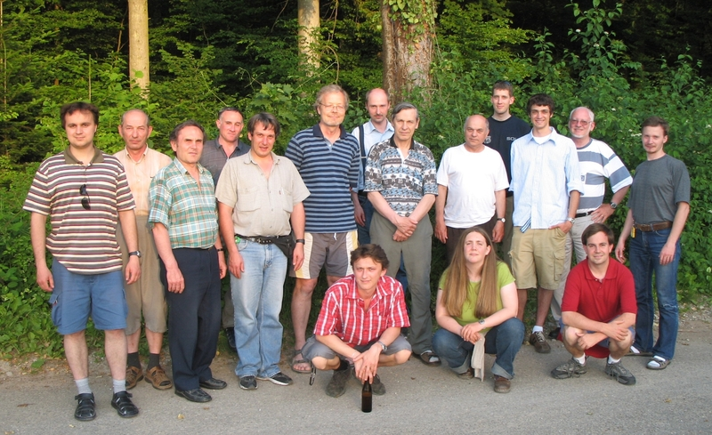
the MuCap collaboration & authors of
Phys. Rev. Lett. 110, 012504 (2013)
V.A. Andreev, T.I. Banks, R.M. Carey, T.A. Case, S.M. Clayton, K.M. Crowe,
J. Deutsch, J. Egger, S.J. Freedman, V.A. Ganzha, T. Gorringe, F.E. Gray,
D.W. Hertzog, M. Hildebrandt, P. Kammel, B. Kiburg, S. Knaak, P.A. Kravtsov,
A.G. Krivshich, B. Lauss, K.R. Lynch, E.M. Maev, O.E. Maev, F. Mulhauser,
C. Petitjean, G.E. Petrov, R. Prieels, G.N. Schapkin, G.G. Semenchuk, M.A. Soroka,
V. Tishchenko, A.A. Vasilyev, A.A. Vorobyov, M.E. Vznuzdaev, P. Winter
(graduate students in red)
Petersburg Nuclear Physics Institute (PNPI), Gatchina, Russia
Paul Scherrer Institute (PSI), Villigen, Switzerland
University of California, Berkeley CA (UCB) and LBNL, USA
University of Illinois at Urbana-Champaign IL (UIUC), USA
University of Washington (UW), Seattle WA, USA
Université Catholique de Louvain, Louvain-la-Neuve, Belgium
University of Kentucky, Lexington KY, USA
Boston University, Boston MA,USA
parts of the collaboration
after one of the main runs at PSI
Petitjean INPC 2013 Firence June 2-7

Slide 18
MuCap systematic error budget
Systematic errors | Run 2006 |  | Run 2007
 | λ (s⁻¹) | δλ (s⁻¹) | λ (s⁻¹) | δλ (s⁻¹)
high-Z impurities | -7.8 | 1.87 | -4.54 | 0.93
μp scatter | -12.4 | 3.22 | -7.20 | 1.25
μp diffusion | -3.1 | 0.1 | -3.0 | 0.1
fiducial volume cut |  | 3.0 |  | 3.0
entrance counter inefficiencies |  | 0.5 |  | 0.5
choice of electron detector definitions |  | 1.8 |  | 1.8
total | -23.3 | 5.1 | -14.7 | 3.9
Petitjean INPC 2013 Firence June 2-7

