Slide 1
Broad resonances in light nuclei studied with β- and γ-spectroscopy
INPC, Firenze, 3/6/2013
Notes:
I am an experimental physicist working on subatomic physics

Slide 2
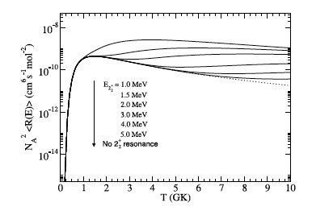
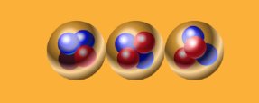
INTEGRAL ⁴⁴Ti
(for rate at low-T,
remember Ed Brown’s talk)
Rotations of the Hoyle state
10.84 1⁻
2⁺ ?
≈10.3 (0⁺)
9.64 3⁻
Haruhiko Morinaga (TUM)
7.65 0⁺
7.27
4.44 2⁺
g.s. 0⁺
¹²C
J^{π}=2⁺ E≈9.7 MeV

Slide 3
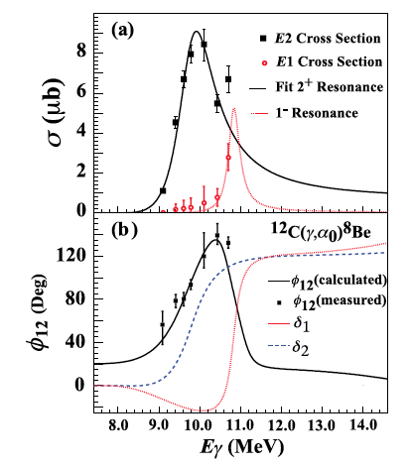
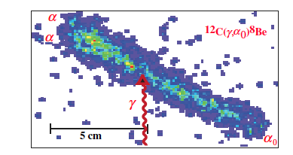
Evidence from the HIγS facility
E(2⁺)=10.03(11) MeV
Γ(2⁺)=0.80(13) MeV

Slide 4
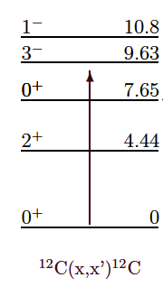
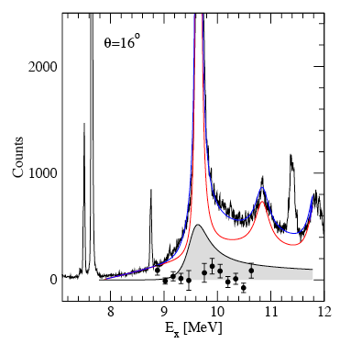
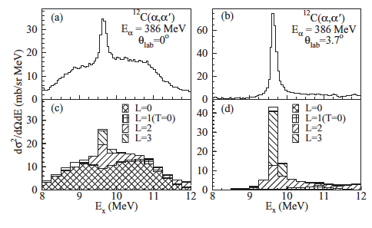
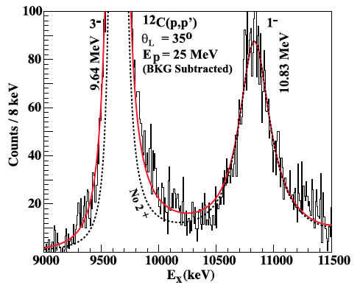
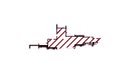
Stellenbosch: Freer et al. (2009): ¹²C(p,p´)¹²C
Lowest 2⁺ resonance in ¹²C?
3⁻
3α
1⁻
Fynbo & Freer, Physics, 4 (2011) 94.
E(2⁺)=9.8(2) MeV
Γ(2⁺)=0.8(2)MeV
Osaka: Itoh et al. (2011): ¹²C(α,α´)¹²C
Yale : Zimmerman et al. (2011): ¹²C(p,p´)¹²C
3⁻
3⁻
3⁻
1⁻

Slide 5
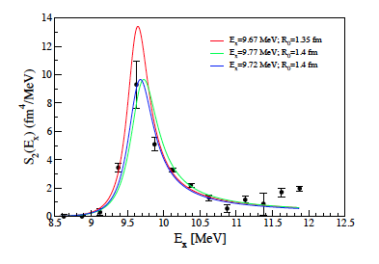
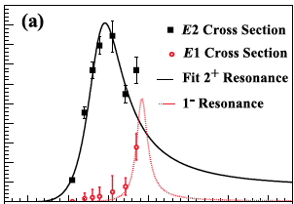
Comparing recent evidence for 2⁺ state
See also:
T. Kokalowa
T.K. Rana
session D3, NR
Tomorrow
Freer and Itoh et al. PR C86 (2012) 034320.

Slide 6
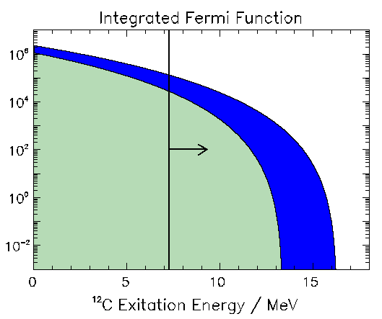
Search for 2⁺ with β-decay
¹²N/¹²B
1⁺
β-decay
(0⁺, 1⁺ or 2⁺)
1⁺
0⁺ or 2⁺ ?
3α
1-3%
3α
0⁺
97-99%
0⁺
¹²C
Notes:
-Selection rules
-N12
-Difficulty : produce + 3a measurement.
-Method – setup
-Data
-Conclusions 0+ 2+
-Problem with 0+ - key idea.

Slide 7
Direct Kinematics+ISOL
target
beam
¹²N/¹²B+X
¹²N/¹²B
Magnet
~100keV
Inverse Kinematics+Separator
¹²N/¹²B
¹²N/¹²B+X
~50MeV
Magnets
target
beam
Notes:
In the top half of the slide I show the ISOL approach, where the produced short-lived isotopes are extracted from the target and ionised, mass separated and stopped in a thin collection foil. This foil can then be surrounded by effective detector arrays. The advantage is that this allows to measure all the three alpha-particles in coincidence with reasonable detection efficiency. The disadvantage is that there still energy loss effects in the collection foil, although much less than in the old “in beam” method. Also, the detection efficiency is dependent on the kinematics and needs to be calculated from Monte-Carlo simulations.
We have used the ISOL method at experiments at ISOLDE facility at CERN and the IGISOL beam-line in Jyvaskyla in Finland. Today I will only talk about our results from Jyvaskyla, whereas our earlier results are published in these references.
The alternative method is to use inverse kinematics shooting the heavy beam on a thin gas target and extract the produced short lived isotopes as beams of 10-20MeV/u and separate and direct them onto an implantation detector. Then the subsequent decays happen in the detector and the summed energy of the three particles is measured directly. If the detector is thin enough the energy deposition of the beta-particles is not a problem.
The advantage is that there are no energy-loss effects and that the sum energy is measured without kinematics dependent detection efficiencies, and that one can count the number of implanted ions and compare to the number of subsequent decays to extract branching ratios. The disadvantage is that the individual alpha-particle energies are not measured and that there is a small energy deposition of the beta-particles.
We have recently used the fragment method at the TRIuP facility at KVI in the Netherlands.

Slide 8
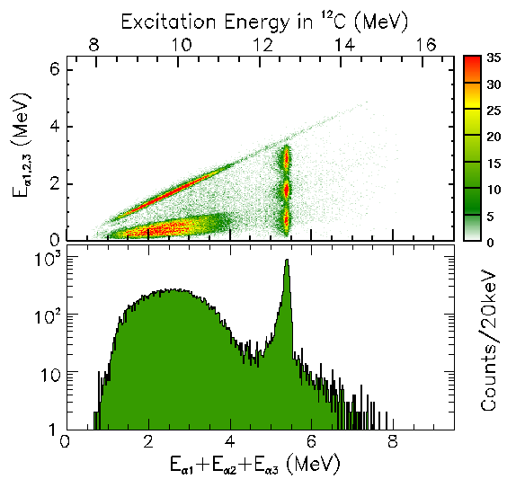
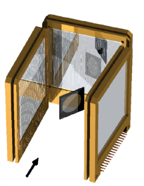
CERN, IGISOL
β-decay approach
¹²N/¹²B
1⁺
β-decay
(0⁺, 1⁺ or 2⁺)
1⁺
0⁺ or 2⁺ ?
3α
¹²N/¹²B
3α
0⁺
0⁺
¹²C
Nature2005 PRC2009,2010, PLB2009
Notes:
-Selection rules
-N12
-Difficulty : produce + 3a measurement.
-Method – setup
-Data
-Conclusions 0+ 2+
-Problem with 0+ - key idea.

Slide 9
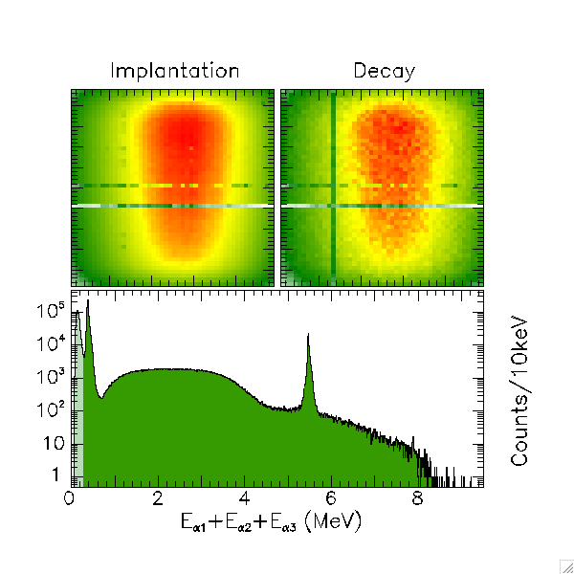
KVI
β-decay approach
¹²N/¹²B
H₂
1⁺
β-decay
(0⁺, 1⁺ or 2⁺)
1⁺
✗ Concern :
Branching ratio ×2 LESS than prev. measurements
- Focus of next talk
0⁺ or 2⁺ ?
3α
3α
0⁺
0⁺
¹²C
Notes:
-Selection rules
-N12
-Difficulty : produce + 3a measurement.
-Method – setup
-Data
-Conclusions 0+ 2+
-Problem with 0+ - key idea.

Slide 10
Interpretation
¹²N/¹²B
1⁺
0⁺
β-decay
(0⁺, 1⁺ or 2⁺)
0⁺
2⁺
1⁺
0⁺
2⁺
3α
Both
0⁺ and 2⁺
R-matrix analysis (multi-channel, multi-level):
3α
0⁺
Beta-decay Scattering:
E(0⁺) = 11.2(3) MeV 9.93(3) MeV
Γ(0⁺)= 1.5(6) MeV 2.71(8) MeV
Beta-decay Scattering: HIgS
E(2⁺) = 11.1(3) MeV 9.8(2) MeV 10.03(11) MeV
Γ(2⁺)= 1.4(4) MeV 0.8(2) MeV 0.80(13) MeV
2⁺
0⁺
¹²C
Notes:
-Selection rules
-N12
-Difficulty : produce + 3a measurement.
-Method – setup
-Data
-Conclusions 0+ 2+
-Problem with 0+ - key idea.

Slide 11
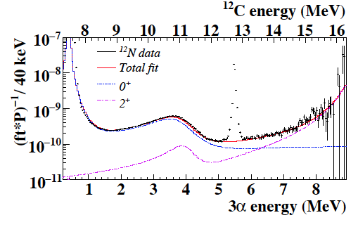
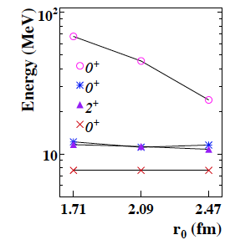
¹²C : understanding the “spectrum”
¹²N
1⁺
0⁺ or 2⁺ ?
3α
3α
0⁺
0⁺
See also:
K.Riisager
Session C2, NS
¹²C

Slide 12
How to get selectivity between 0⁺ and 2⁺ ?
¹²N
2⁺
1⁺
β-decay
1⁺
Both
0⁺ and 2⁺
3α
Only 2⁺
3α
0⁺
0⁺
¹²C
Only 1⁺, 2⁺, and 3⁺ states
Only 0⁺, 1⁺, and 2⁺ states

Slide 13
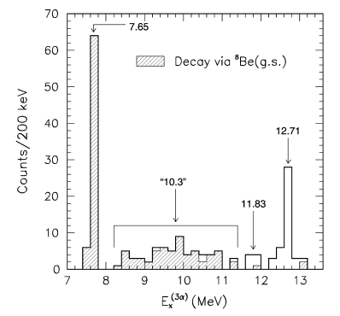
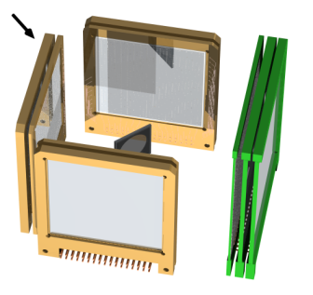
1st case : γ-decay of 1⁺ states (proof-of-principle)
Reaction➔
J^{π}
γ-decay
1⁺
3α
³He 8MeV
3α
0⁺
¹⁰B(³He,π)3α
0⁺
¹²C
IDOG indirect detection of gamma-rays

Slide 14
How to get selectivity between 0⁺ and 2⁺ ?
Reaction➔
2⁺
γ-decay
1⁺
3α
3α
0⁺
0⁺
¹²C
+ M1 >> E2 ➔ 1⁺, 2⁺, 3⁺ no 0⁺ !
− E1 decay populates negative parity ➔ 1⁻, 2⁻, 3⁻

Slide 15
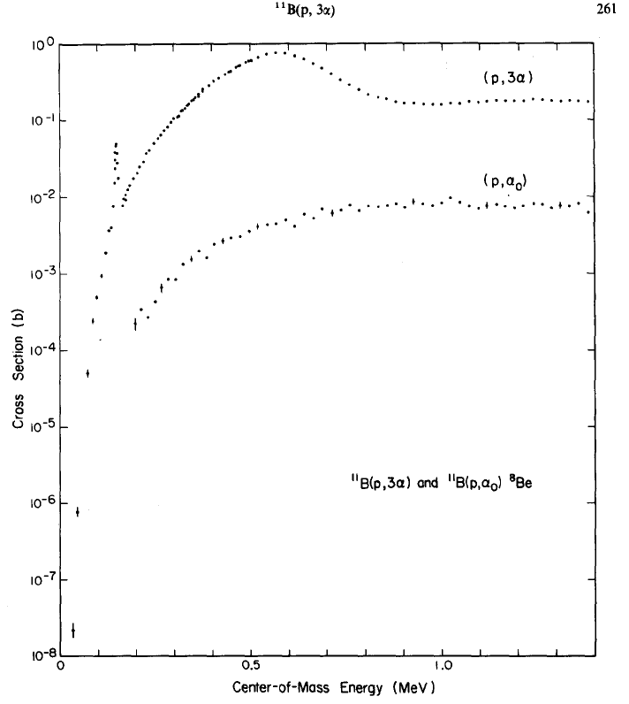
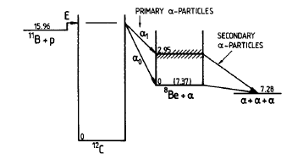
2⁻
¹¹B(p,α)αα
2⁺
1⁻
1⁻
2⁻
2⁺

Slide 16
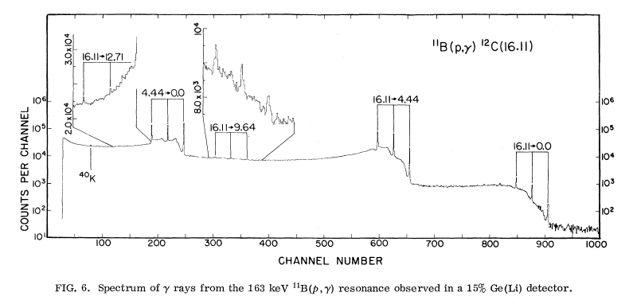
16.1 2⁺
15.11 1⁺
14.08 4⁺
13.35 (2⁻)
12.71 1⁺
¹¹B(p,γ)
11.83 2⁻
10.84 1⁻
≈10 0,2⁺
9.64 3⁻
7.65 0⁺
7.27
4.44 2⁺
g.s. 0⁺
¹²C

Slide 17
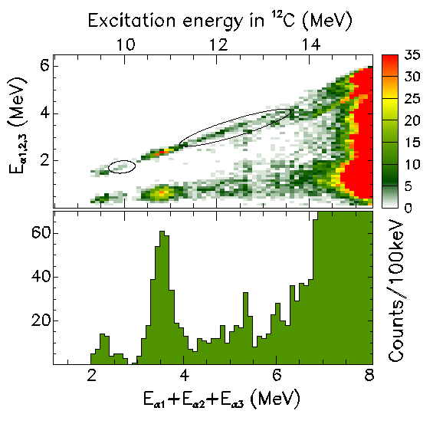
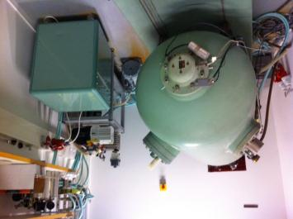
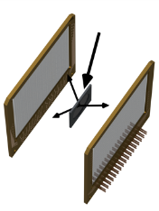
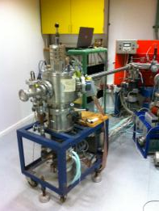
Test experiment 2⁺
Reaction➔
J^{π}=2⁺
2⁻, 1⁻, 0⁺, 3⁻
¹¹B(p,γ)3α
β-decay
p
1⁺
0⁺ or 2⁺ ?
3α
1⁻
¹¹B
1⁺
3α
0⁺
3⁻
2⁺
2⁺
0⁺
¹²C
IDOG indirect detection of gamma-rays
Notes:
-Gamma instead of beta.
-Data from B11 + p. Accelerator in Aarhus. Setup.
-2+. Alpha-decay. Rare gamma-decays seen from less energy.
-Broad structures. Must be 2+. Confirms beta-decay results. No 0+.
-Validates key idea. Lots to do. Difficulties.

Slide 18
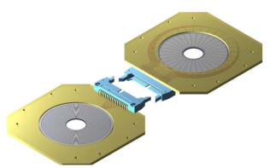
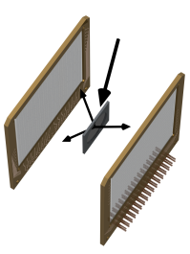
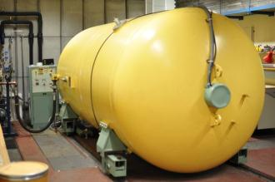
Recent developments
5MV VdG
400kV VdG
18
Notes:
-Upgrade of Detection setup
-More powerful accelerator - 5MeV

Slide 19
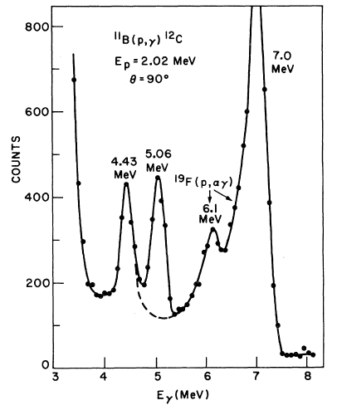
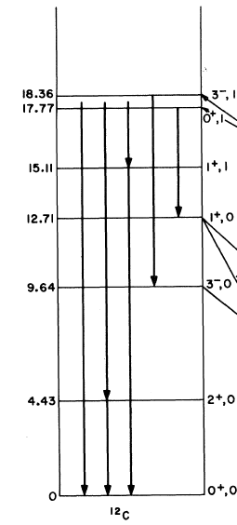
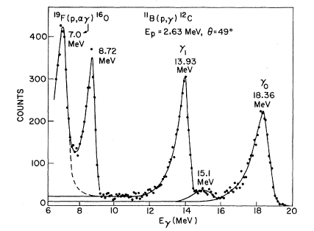
Hanna, Kurath,..
PR C25 (1982) 1179
Recent data
1⁺
17events
Reaction➔
J^{π}=2⁺
0⁺ ,3⁻
¹¹B(p,γ)3α
γ-decay
1⁺
0⁺ or 2⁺ ?
3α
3α
0⁺
0⁺
¹²C
IDOG indirect detection of gamma-rays
Notes:
-Gamma instead of beta.
-Data from B11 + p. Accelerator in Aarhus. Setup.
-2+. Alpha-decay. Rare gamma-decays seen from less energy.
-Broad structures. Must be 2+. Confirms beta-decay results. No 0+.
-Validates key idea. Lots to do. Difficulties.

Slide 20
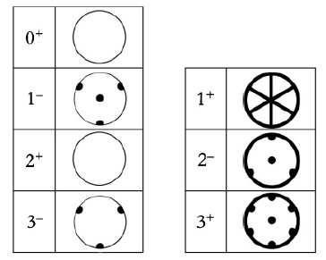
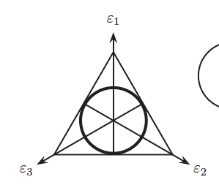
C. Zemach, PR. 133 (1964) 1201 : Decay to 3π
Fynbo et al. PR C79 (2009) 054009 : Decay to 3α

Slide 21
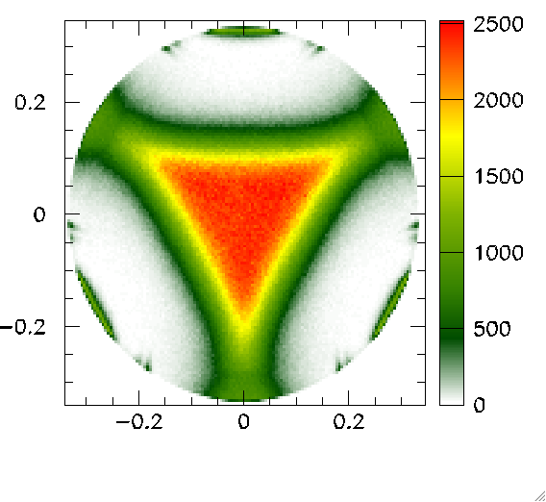
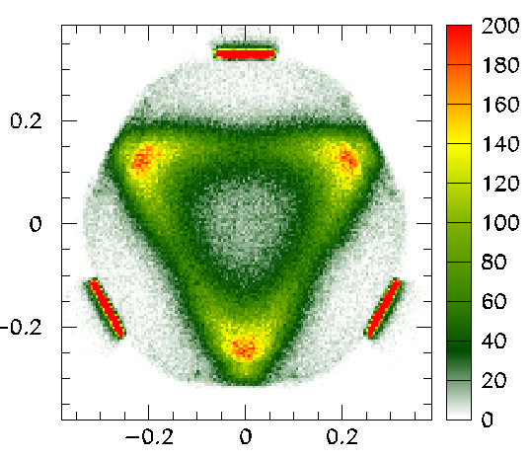
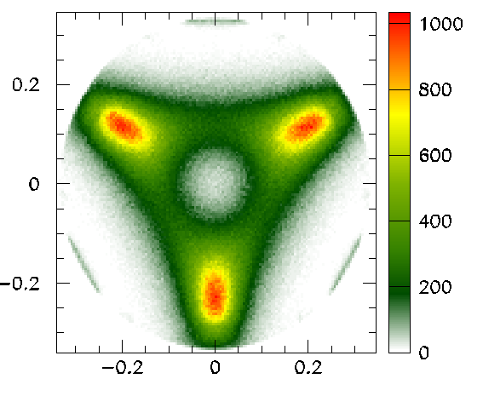
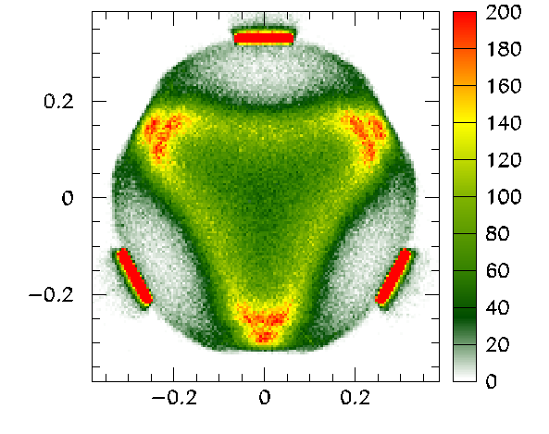
¹¹B(p,α)αα
2⁺ 16.11MeV
0⁺ 17.8MeV
400kV vdG
2⁻ 16.57MeV
3⁻ 18.4MeV
5MV vdG

Slide 22
Develop IDOG method
Common analysis for IDOG & β-decay data
Fully elucidate broad resonances in ⁸Be, ¹²C & ¹⁶O
Future
objectives
β-decay
1⁺
β-decay
2⁻
¹²N
¹⁶N
β-decay
2⁺
0⁺, 1⁺, 2⁺⁻, 3⁻
0⁻, 1⁻, 2⁻, 3⁻
⁸B
2⁺
γ-decay
γ-decay
γ-decay
2⁺
¹²C+α
3α
1⁻
12C+α
1⁻
2⁺
3α
0⁺
2α
2⁺
¹²C
0⁺
¹⁶O
0⁺
2α
0⁺
⁸Be
Notes:
-C-12. gamma+beta
-O-16. gamma+beta
-Be-8. gamma+beta
-Potential contribution
-Required resources

Slide 23
Summary
Properties of broad resonances in¹²C are studied by a mixture of β- and γ- spectroscopy
We use complete kinematics measurement of the 3α to characterize the final state
Will hopefully bring a breakthrough in understanding of broad resonances in these nuclei – and their role in the cosmos
Thanks for your attention !

Slide 24
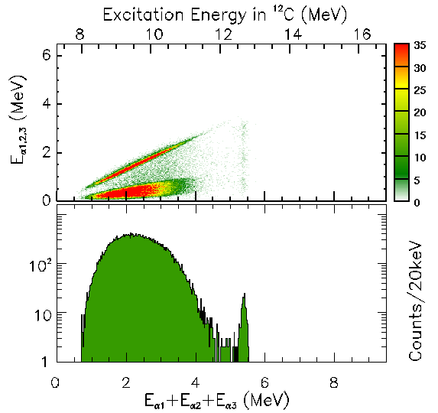
CERN, IGISOL
β-decay approach
¹²N/¹²B
1⁺
β-decay
(0⁺, 1⁺ or 2⁺)
1⁺
0⁺ or 2⁺ ?
3α
¹²N/¹²B
3α
0⁺
0⁺
¹²C
Nature2005 PRC2009,2010, PLB2009
Notes:
-Selection rules
-N12
-Difficulty : produce + 3a measurement.
-Method – setup
-Data
-Conclusions 0+ 2+
-Problem with 0+ - key idea.

Slide 25
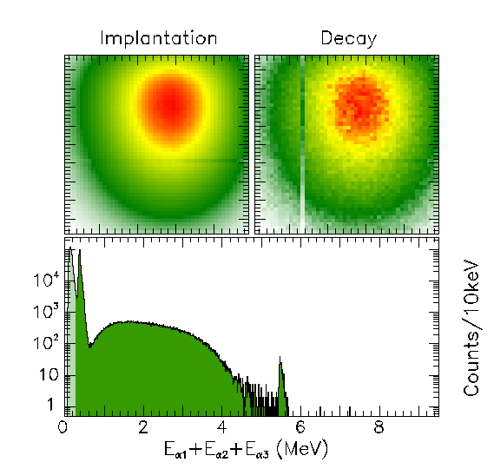
KVI
β-decay approach
¹²N/¹²B
H₂
1⁺
β-decay
(0⁺, 1⁺ or 2⁺)
1⁺
✗ Concern :
Branching ratio ALSO ×2 less than previous measurements
0⁺ or 2⁺ ?
3α
3α
0⁺
0⁺
¹²C
Notes:
-Selection rules
-N12
-Difficulty : produce + 3a measurement.
-Method – setup
-Data
-Conclusions 0+ 2+
-Problem with 0+ - key idea.

Slide 26
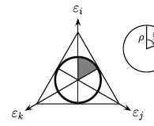
Dalitz plot for 3α
¹²C* α₁+ ⁸Be α₁+α₂+α₃
E₁
Momentum conservation
Energy conservation
¹²C
Q_{I}
α_{i}
⁸Be
Q_{II}
2/3Q_{I}
α₂ + α₃
E₃
E₂
E₁ = m₂₃/(m₁+m₂₃) x Q_{I} = 2/3 xQ_{I}
R.H. Dalitz, Philos. Mag. 44, 1068 (1953).
Notes:
Dalitz det. By two things. INDEPENDENT
Since density of final states proportional to dE1dE2, intensity of dalitz plot (decay amplitude) proportional to matrix element squared
First is final state interactions (eg 2 body resonance). If sequential decay, then 1st particle gets 2/3 energy. This gives bands as shown in Figure.
2nd is symmetry constraints…

Slide 27
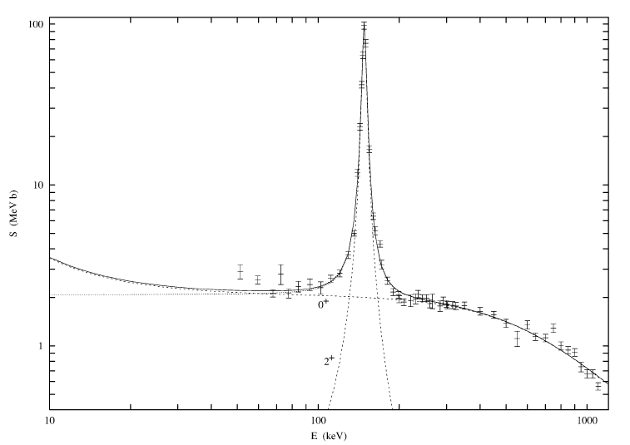
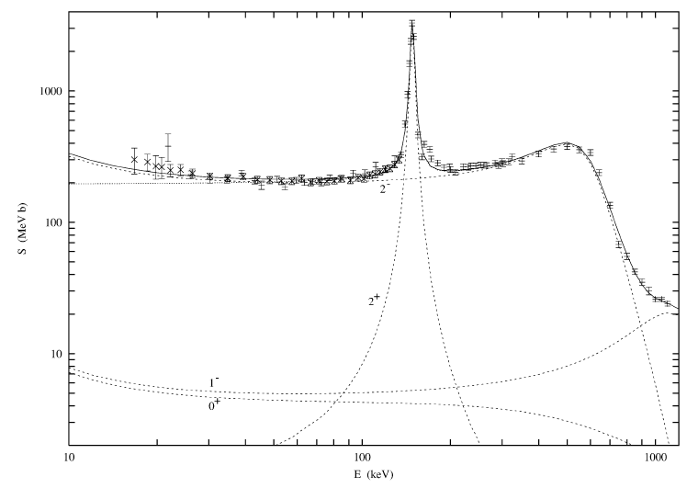
¹¹B(p,α)αα
Resonance at 15.4MeV 0⁺ or 2⁺ ?
Fit in F.C.Barker NP A707 (2002) 277
Data from Davidson1979 and Becker1987
Notes:
-Gamma instead of beta.
-Data from B11 + p. Accelerator in Aarhus. Setup.
-2+. Alpha-decay. Rare gamma-decays seen from less energy.
-Broad structures. Must be 2+. Confirms beta-decay results. No 0+.
-Validates key idea. Lots to do. Difficulties.

