Slide 1
Virtual Neutron Method applied to the study of ¹⁷O(n,α)¹⁴C reaction
Marisa Gulino
LNS - INFN, Catania
&
Università di Enna “Kore”

Slide 2
SUMMARY
Why studying ¹⁷O(n,α)¹⁴C reaction
From Trojan Horse Method to Virtual Neutron Method
The experiments
data analysis and results
INPC 2013 Firenze, Italy 2-7 JUNE 2013

Slide 3
THE ¹⁷O(n,α) REACTION: status of art
NUCLEAR REACTORS
the neutron induced reaction on ¹⁴N and ¹⁷O are the dominant sources of the radioactive isotope ¹⁴C (T_{1/2}= 5730 yr).
NUCLEAR ASTROPHYSICS
In the inhomogeneous big-bang model the ¹⁴C may act as a bottleneck in the production of elements heavier than A=17
anomalies in ¹⁸O/¹⁶O and ¹⁷O/¹⁶O ratios found in asymptotic giant branch stars and in circumstellar Al₂O₃ meteorite grains
neutron poison in the nucleosynthesis of the s-process elements
The cross section of this reaction is characterized by the presence of several narrow resonant states in the ¹⁸O compound nucleus.
8.282 ± 3
8.213 ± 4
8.125 ± 2
8.0378 ± 0.7
8.0443
¹⁷O+n
¹⁸O
INPC 2013 Firenze, Italy 2-7 JUNE 2013

Slide 4
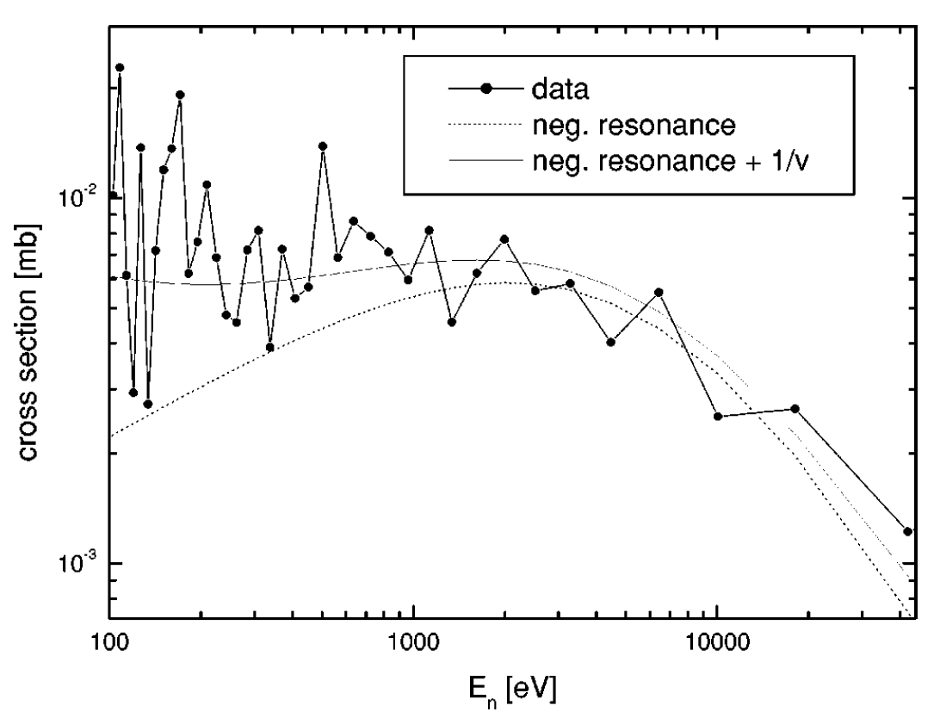
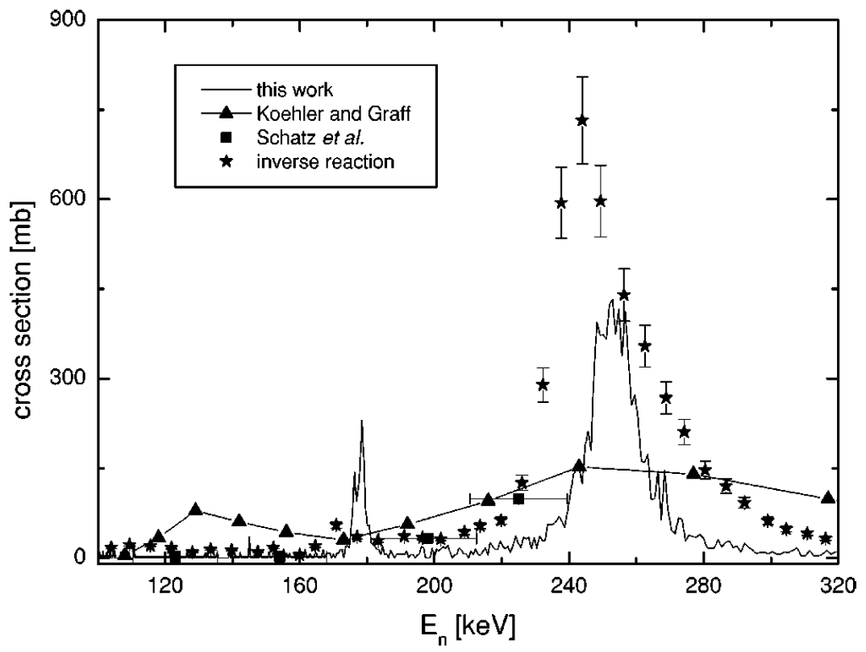
THE ¹⁷O(n,α) REACTION: status of art
8.213
8.282
from J. WAGEMANS et al. PHYSICAL REVIEW C 65 034614 (2002)
INFLUENCE OF SUBTRESHOLD RESONANCE
DIFFERENCES IN EXPERIMENTAL DATA
Data from:
P. E. Koehler and S. M. Graff, Phys. Rev. C 44, 2788 (1991).
H. Schatz, F. Kaeppeler, P. E. Koehler, M. Wiescher, and H. P. Trautvetter, Astrophys. J. 413, 750 (1993).
R. M. Sanders, Phys. Rev. 104, 1434 (1956)
“The reaction rate at the astrophysical relevant temperatures was calculated and found to be a factor of 2–2.5 lower than previously adopted.“
“The significant impact of the presence
of the negative-energy p-wave resonance on the reaction rate was shown.”
INPC 2013 Firenze, Italy 2-7 JUNE 2013

Slide 5
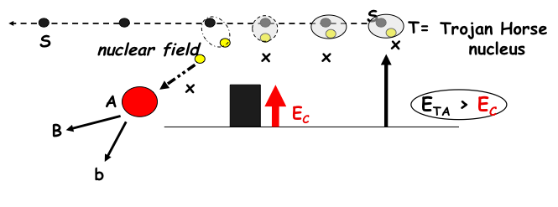
INDIRECT METHODS: Trojan Horse Method reminder
IDEA (C. Spitaleri, 1990):
Extract the cross section σ ^{2Body} for A + x → B + b
from Quasi-free reaction channel data of a
three body reaction
T + A → B + b + s
where T shows a strong clusterization in x+s
B
A
b
x
T
s
E_{TA} = T-A relative energy
E_{C} =T-A Coulomb barrier
E_{Ax}= E_{Bb} – Q_{2body} (pcp)
INPC 2013 Firenze, Italy 2-7 JUNE 2013

Slide 6
From TROJAN HORSE to VIRTUAL NEUTRON METHOD
TROJAN HORSE METHOD extended to → VIRTUAL NEUTRON METHOD
BASIC IDEA: USE OF THE QUASI-FREE BREAK-UP OF DEUTERON
TO GET A VIRTUAL NEUTRON SOURCE
If the Quasi-free mechanism is selected in PWIA the cross section of the reaction n+A→B+b can be deduced
A
B
Detected
particles
b
n
participant
spectator
d
p
N
INPC 2013 Firenze, Italy 2-7 JUNE 2013

Slide 7
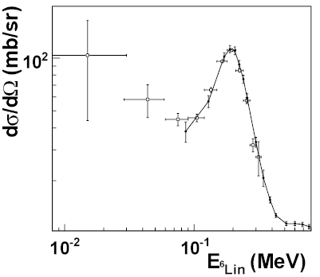
FIRST APPLICATION: THE ⁶Li(n,α) REACTION
⁶Li(n,α)³H
⁶Li(n,α)t cross section
___ direct data
O TH data
d(⁶Li,α ³H)p
³H
⁶Li
Detected
particles
α
n
participant
spectator
d
p
J. of Phys. G, Nucl. Part.Phys. 37, 125105 (2010)
INPC 2013 Firenze, Italy 2-7 JUNE 2013

Slide 8
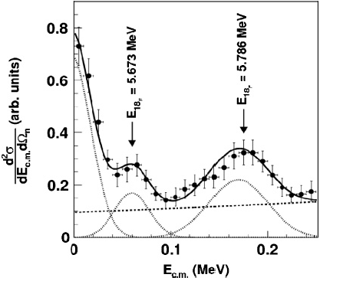
THE ¹⁷O(n,α) REACTION: the ¹⁷O+d experiments
Two experiments have been performed
@LNS - Catania, Italy
@NSL – Notre Dame, IN, USA
¹⁷O+p→¹⁴N+α
¹⁴N+α+n
¹⁷O+d
¹⁴C+α+p
¹⁷O+n→¹⁴C+α
30°
EXPERIMENTAL SET-UP
PSD
17 O @ 40 MeV
5°
IC
CD₂
INPC 2013 Firenze, Italy 2-7 JUNE 2013

Slide 9
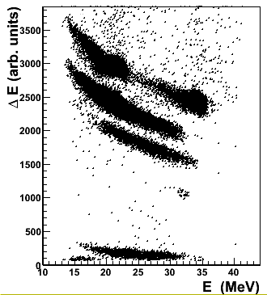
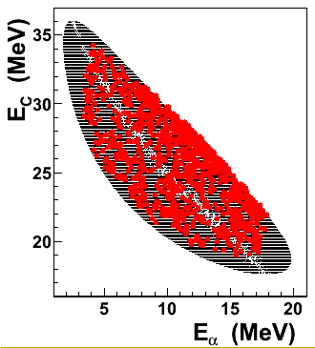
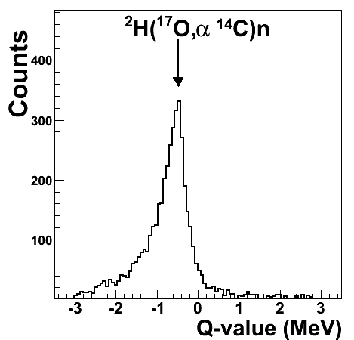
THE ¹⁷O(n,α) REACTION: Identification of reaction channel
← Carbon selection by ΔE-E spectra
ONC
← Coincidence between kinematical calculations and experimental data
P
Q- value of the ¹⁷O+d→¹⁴C+α+p reaction →
INPC 2013 Firenze, Italy 2-7 JUNE 2013

Slide 10
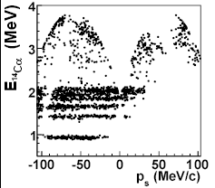
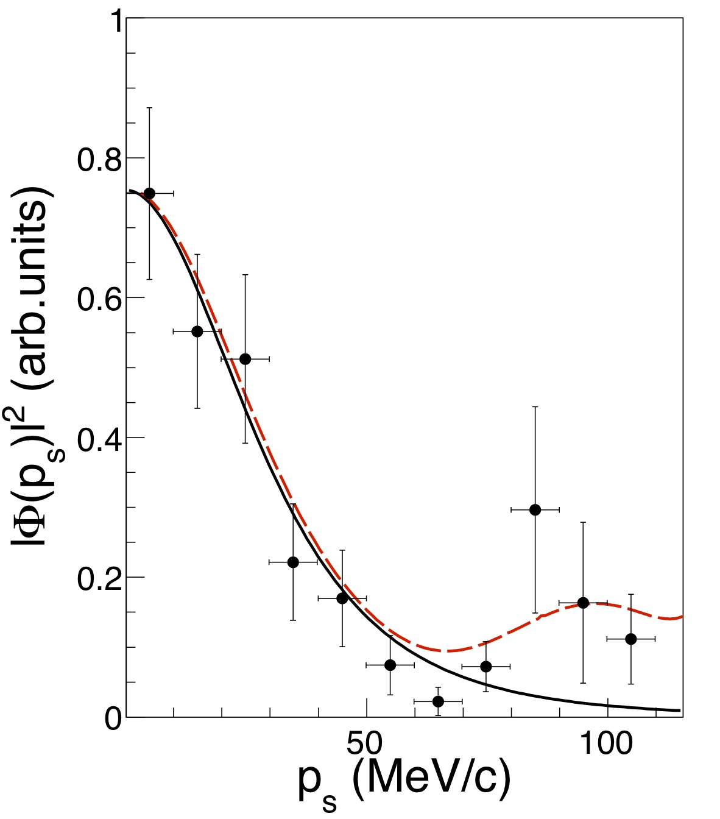
THE ¹⁷O(n,α) REACTION: Evidences of QF mechanism
A more sensitive check of the predominance of the QF reaction mechanism is achieved by investigating the shape of the
experimental momentum distribution of the n and p inside deuteron.
DWBA
INPC 2013 Firenze, Italy 2-7 JUNE 2013

Slide 11
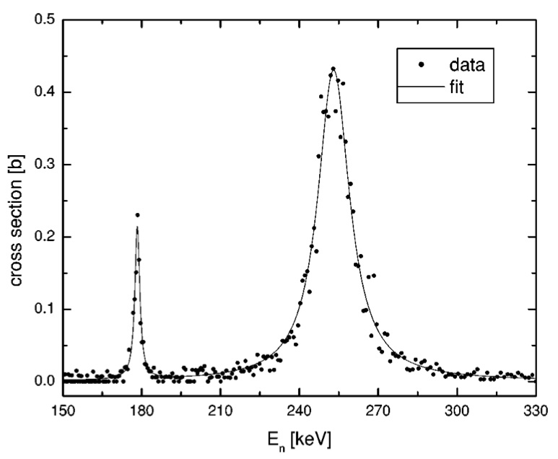
THE ¹⁷O(n,α) REACTION: cross section
PHYSICAL REVIEW C 87, 012801(R) (2013)
LNS
Experiment
III IV
I II III IV
I) subtreshold level
II) resonance populated in l=3 missing in the direct data
III) corresponding to the direct data
IV) corresponding to the direct data
ND
Experiment
I II III IV
INPC 2013 Firenze, Italy 2-7 JUNE 2013

Slide 12
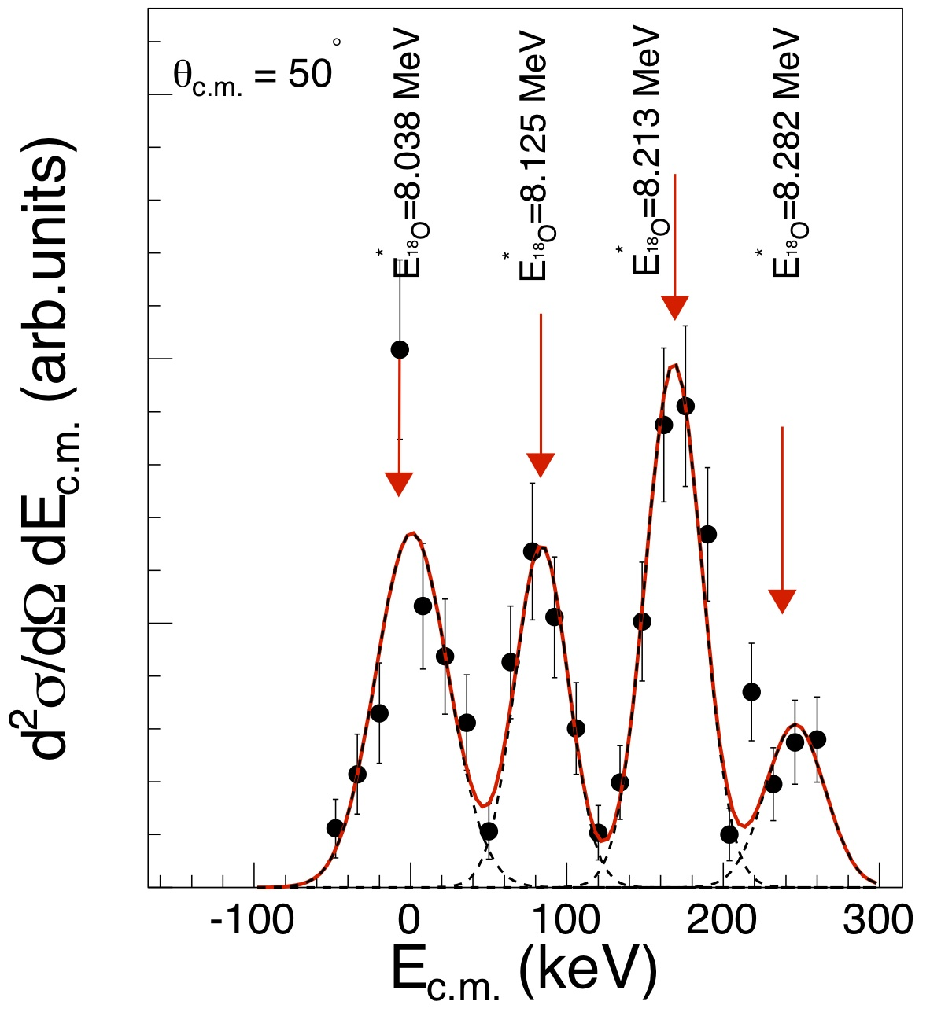
THE ¹⁷O(n,α) REACTION: angular distribution
PHYSICAL REVIEW C 87, 012801(R) (2013)
angular distributions have been measured for the first time
I II
l_{i}=1 l_{i}=3
III IV
l_{i}=2 l_{i}=1
l_{i}=0
l_{i}=0, l_{i}=2
l_{i}=1
l_{i}=3
l_{i}=1
dσ / d cosθ_{cm} (arb. units)
I II III IV
cosθ_{cm}
INPC 2013 Firenze, Italy 2-7 JUNE 2013

Slide 13
THE ¹⁷O(n,α) REACTION: Comparison with direct data
PHYSICAL REVIEW C 87, 012801(R) (2013)
N
Data correction for the penetrability
of the centrifugal barrier
N
INPC 2013 Firenze, Italy 2-7 JUNE 2013

Slide 14
CONCLUSIONS
The results unambiguously indicate the ability of the method to overcome the centrifugal barrier suppression effect and to pick out the contribution of the bare nuclear interaction.
The experiments demonstrated the possibility to measure a neutron induced reaction using the DEUTERON AS SOURCE OF A VIRTUAL NEUTRON BEAM
The quasi-free mechanism can be used in the future to explore other neutron induced reactions of astrophysical interest, i.e. 14N+n →14C+p
The Method offers the unique possibility to study neutron induced reactions on radioactive nuclei having short life times (minutes or less!)
INPC 2013 Firenze, Italy 2-7 JUNE 2013

Slide 15
Thanks to the COLLABORATION
M Gulino^{1,2}, C. Spitaleri^{1,3}, X.D. Tang⁴, G.L. Guardo^{1,3}, L. Lamia³, S. Cherubini^{1,3}, B. Bucher4, V. Burjan⁵, M. Couder⁴, P. Davies⁴, R. deBoer⁴, X. Fang⁴, V.Z. Goldberg⁶, Z. Hons⁵, V. Kroha⁵, L. Lamm^{4,†}, M. La Cognata¹, C. Li⁷, C. Ma⁴, J. Mrazek⁵, A.M. Mukhamedzhanov⁶, M. Notani⁴, S. OBrien4, R.G. Pizzone¹, G.G. Rapisarda^{1,3}, D. Roberson⁴, M.L. Sergi¹, W. Tan⁴, I.J. Thompson⁸, M. Wiescher⁴
1 INFN Laboratori Nazionali del Sud, Catania, Italy
2 Università degli Studi di Enna “KORE”, Enna, Italy
3 Dipartimento di Fisica ed Astronomia, Università degli Studi di Catania, Catania, Italy
4 Department of Physics and Joint Institute for Nuclear Astrophysics, University of Notre Dame, IN, USA
5 Nuclear Physics Institute of ASCR, Rez, Czech Republic
6 Cyclotron Institute,Texas A&M University,College Station, TX, USA
7 China Institute of Atomic Energy, Beijing, China
8 Lawrence Livermore National Laboratory, Livermore, CA, USA
Contact email: gulino@lns.infn.it
INPC 2013 Firenze, Italy 2-7 JUNE 2013

