Slide 1
The ⁶Li(²²Ne, ²⁶Mg)d alpha-Transfer Experiment For the Study of Low Energy Resonances in ²²Ne (α, γ) ²⁶Mg
International Nuclear Physics Conference 2013, Florence, Italy
(06/03/2013)
Shuya Ota: Japan Atomic Energy Agency, Rutgers University
H. Makii, T. Ishii, K. Nishio, S. Mitsuoka, I. Nishinaka :
Japan Atomic Energy Agency
M. Matos, D. Bardayan: Oak Ridge National Laboratory
S. Chiba : Tokyo Institute of Technology

Slide 2
Introduction
S-process in massive stars (> 8 M)
Weak s-process: produces nuclei (A = 60 – 90)
²²Ne(α, n)²⁵Mg in He burning phase: a possible neutron source
²²Ne(α, γ)²⁶Mg: a competing reaction
A variety of experimental techniques have been taken for studying the Low Energy (E_{α} = 0.4 - 1 MeV) Resonances :
Direct measurement (α + ²²Ne) (Jaeger, PRL 2001)
n + ²⁵Mg (Massimi, PRC 2012)
γ + ²⁶Mg (Longland, PRC 2009)
Inelastic scattering (p, p’) (Moss, NPA 1976)
⁶Li + ²²Ne (Giessen, NPA 1993; Ugalde, PRC 2007)
Ambiguities in resonance parameters (E_{r}, J^{π}, Г, Г_{α}, Г_{γ}, Г_{n})

Slide 3
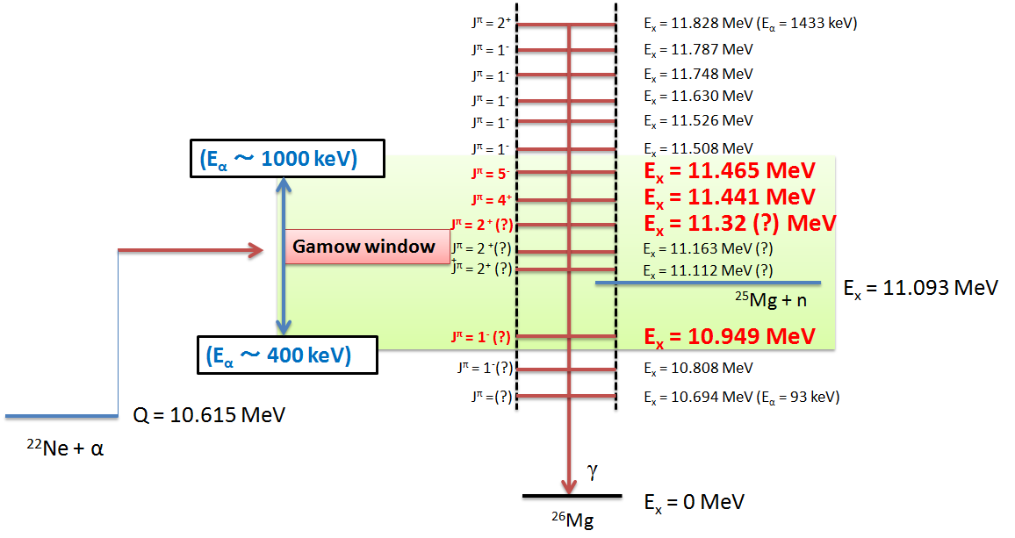
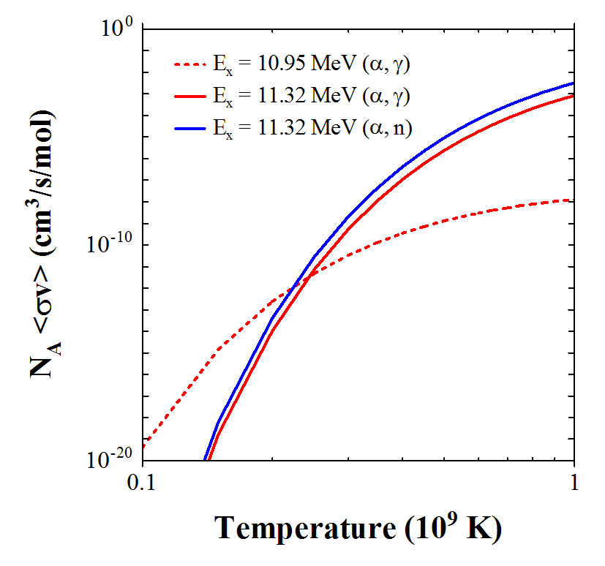
Low energy resonances in α + ²²Ne
For both figures;
cf. Longland, PRC, 2011, Massimi, PRC, 2012
Contributions from
E_{x} = 11.12 & 11.16 MeV(?)
Gamow window (E_{α,lab} = 0.4 – 1 MeV) (T₉ = 0.2-0.3)
²⁶Mg E_{x} = 10.9 – 11.5 MeV (S_{n}: 11.1 MeV)
Observed by many measurements, but not precise
E_{x} ~ 10.9 and 11.3 MeV: dominant resonance
Our goals are:
Branching ratio of n and γ channels (= Г_{n} / Г_{γ} )
Measurement of resonance energies
Contributions from other resonances
He-burning

Slide 4
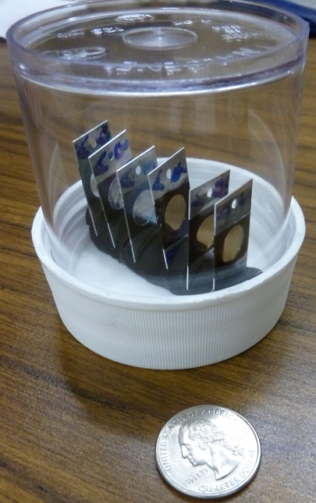
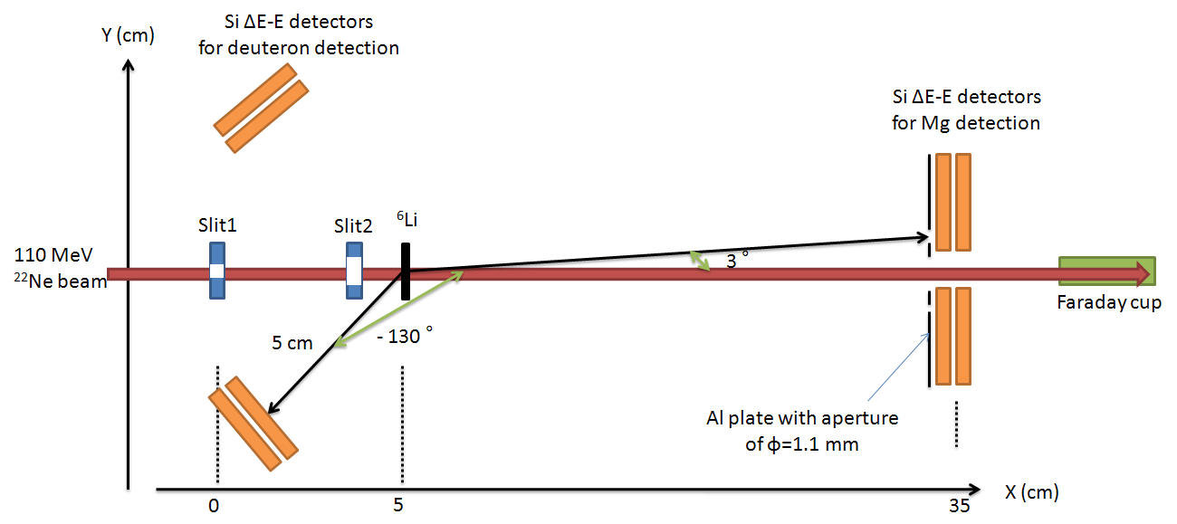
Experimental scheme of ⁶Li(²²Ne, ²⁶Mg) d
Our approach: ⁶Li (²²Ne, ²⁶Mg) d ←(alpha-transfer)
Produces natural parity state (as well as α+²²Ne direct measurement)
Г_{n} / Г_{γ} from production ratio of ^{25, 26}Mg
110 MeV ²²Ne beam from JAEA 20 MV tandem
⁶Li₂CO₃ target on C backing foil
Measurements of beam-like Mg and recoil deuteron with Si △E-E
20°in CM system (covering ~ 40% of solid angle)

Slide 5
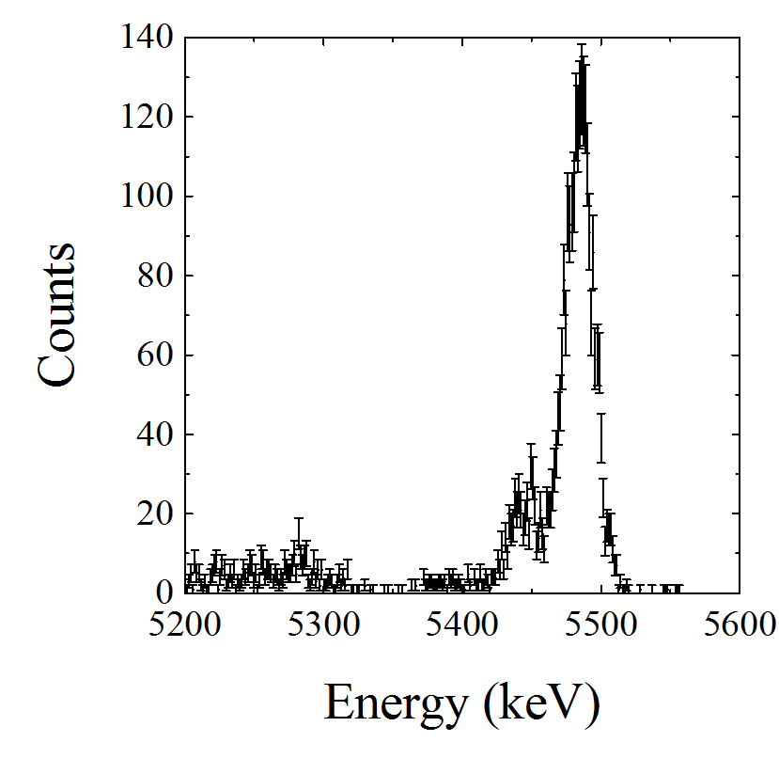
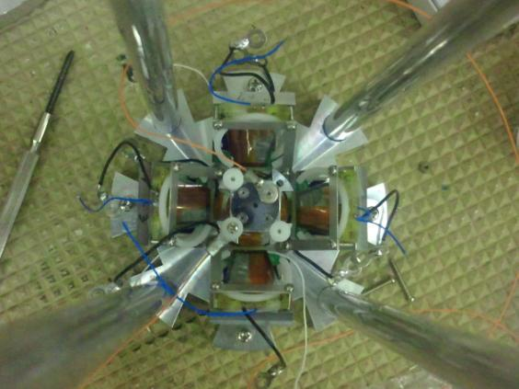
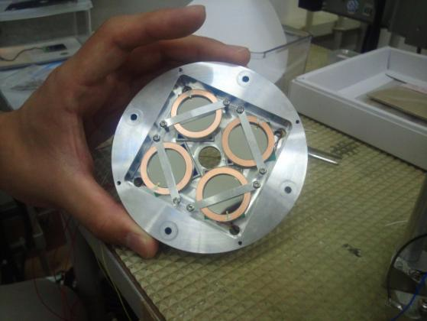
Si △E-E Detectors
Upstream (for deuteron detection) → 8 channels
dE: surface barrier (2×2 cm, thickness: 65 um)
E: PIN photodiode (2×2 cm, thickness = 300 um)
High E-resolution: ~30 keV for dE, ~20 keV for E
using a ²⁴¹Am test source
Downstream (for Mg detection) → 8 channels
dE: surface barrier (φ = 2cm, thickness = 20 um)
E: PIN photodiode (2×2 cm, thickness = 300 um)
E detector ²⁴¹Am spectrum
E-res: 20 keV
Upstream for deuteron
(E-detector is unseen behind △E)
Downstream for Mg
(E-detector is unseen behind △E)

Slide 6
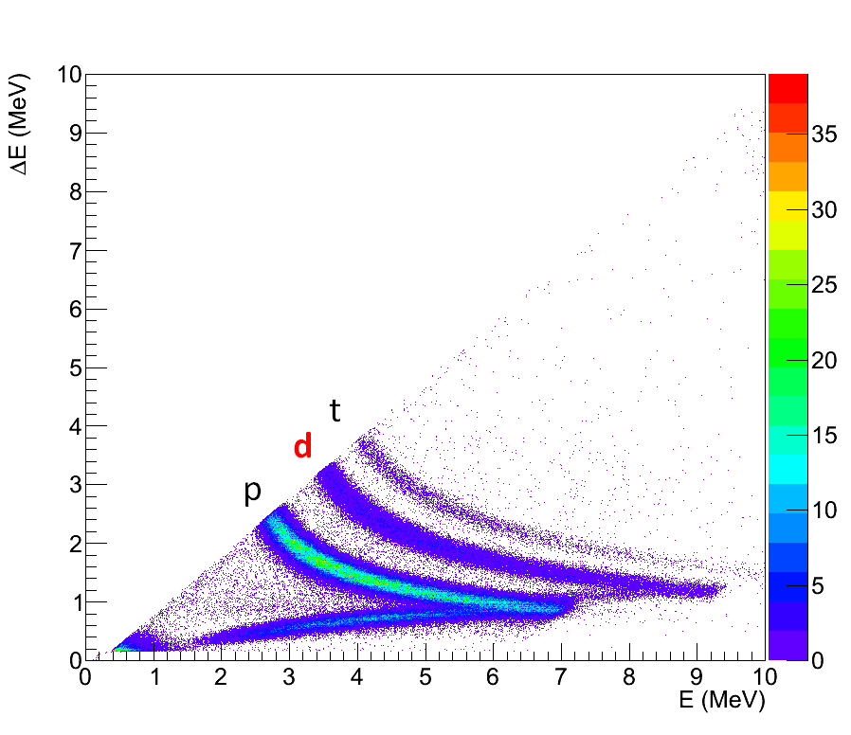
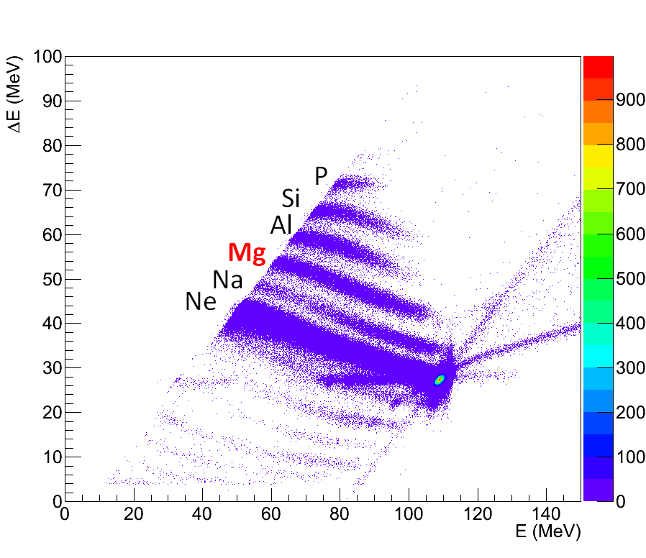
Particle Identification
Upstream
Downstream
Ed = 5.5 – 7 MeV
(ROI)
E-△E Spectra from upstream and downstream detectors
Calibration:
upstream→²⁴¹Am source, downstream→elastic scattering of ²²Ne beam
Good particle identification, but not enough for ^{26, 25}Mg separation
E-resolution for deuteron: FWHM ~ 80 keV (△E+E) in Lab Sys.
Worse than expected (~ 40 keV) due to high noise levels at experiment
- Ed = 5.5 – 7.0 MeV: region of interest for the weak s-process

Slide 7
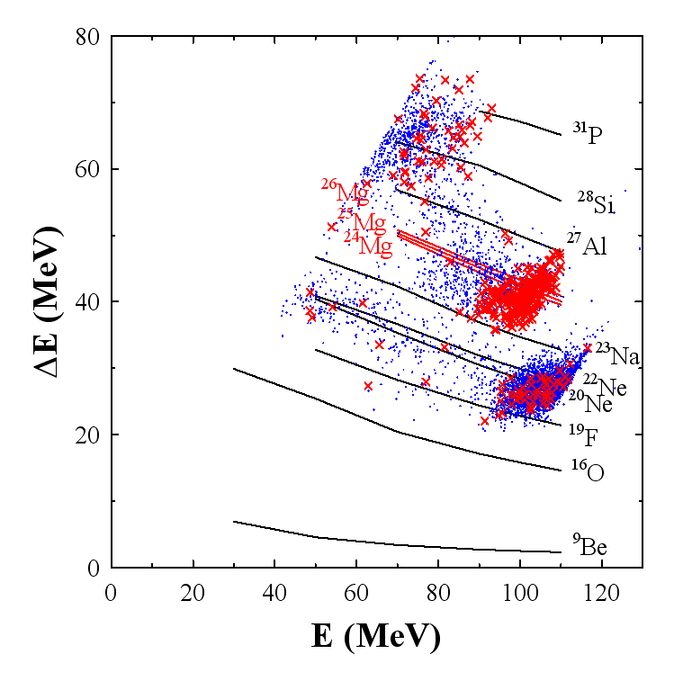
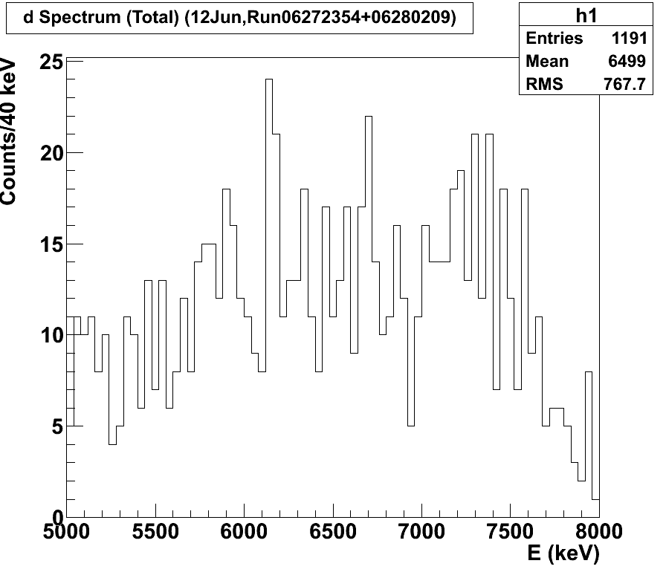
Coincidence Measurement
×: upstream-downstream
×: gated on deuteron
E_{x}=11.31 MeV(?)
E_{x}=11.83 MeV(?)
E_{x}=9.38 MeV(?)
Deuteron spectrum
(gated on Mg coincidence)
Successful coincidence measurements of Mg & d
²⁶Mg resonance peaks were not identified clearly.
Need more statistics and better E-resolution
Production yields roughly agreed with the previous measurement using ⁶Li + ²²Ne reaction

Slide 8
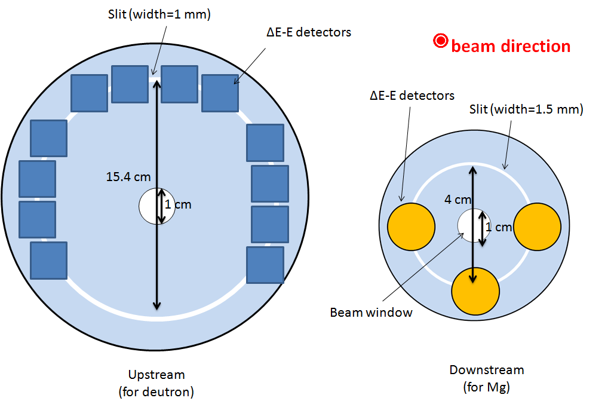
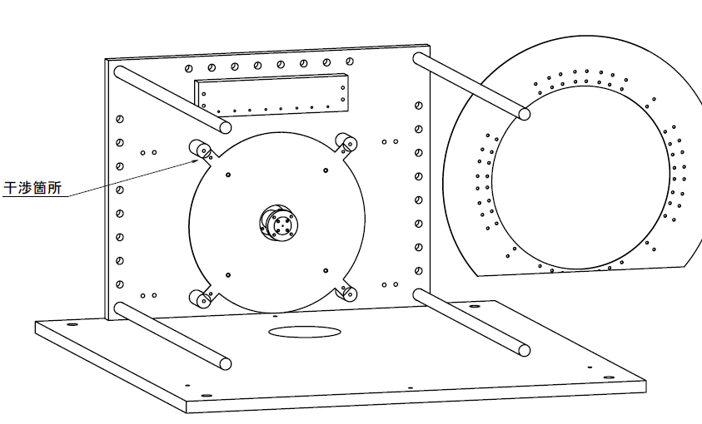
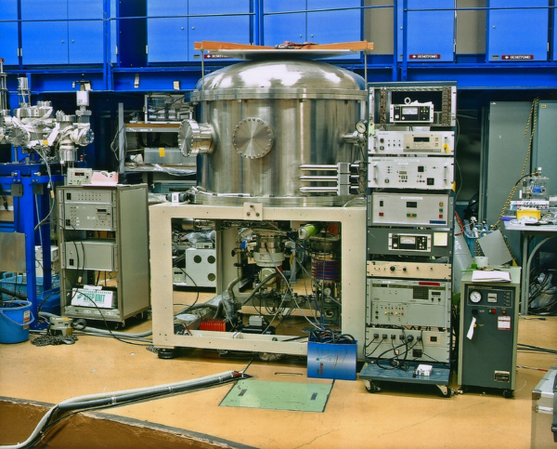
Preparation For Next Beam Time
Improvement
E-resolution for deuteron
- Geometry
Noise cancelling
Statistics
- Upstream detectors: 8 → 24 ch
30 cm
Detectors
New chamber has been developed and installed in a vacuum chamber
30 cm
Upstream (downstream is similar)

Slide 9
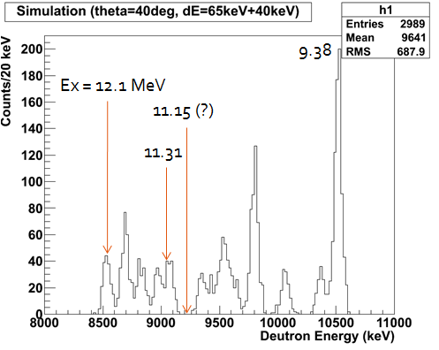
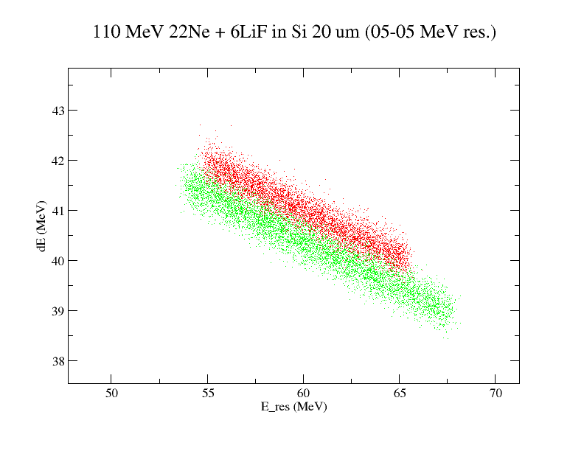
Prospects of Next Experiment
Expected beam time at JAEA tandem on this summer
Improved statistics (~ 5 times)
Resonance spectrum of ²⁶Mg with uncertainties ± 10~20 keV
^{25, 26}Mg branching ratio (Г_{n} / Г_{γ}) : E-resolution of downstream detectors (~0.7% (~ 700 keV ) should be achieved)
Simulated spectrum
Simulated spectrum
²⁶Mg
²⁵Mg

Slide 10
Summary
We are studyingα + ²²Ne reaction for weak s-process by way of ⁶Li (²²Ne, ²⁶Mg) d alpha-transfer reaction
Branching ratio of γ, n channels.
Resonance energies in Gamow window
(E_{x} = 11.31, 11.15, 10.94 MeV)
Test result showed successful coincidences of beam-like Mg and deuteron
Next beam time on summer in 2013

Slide 11
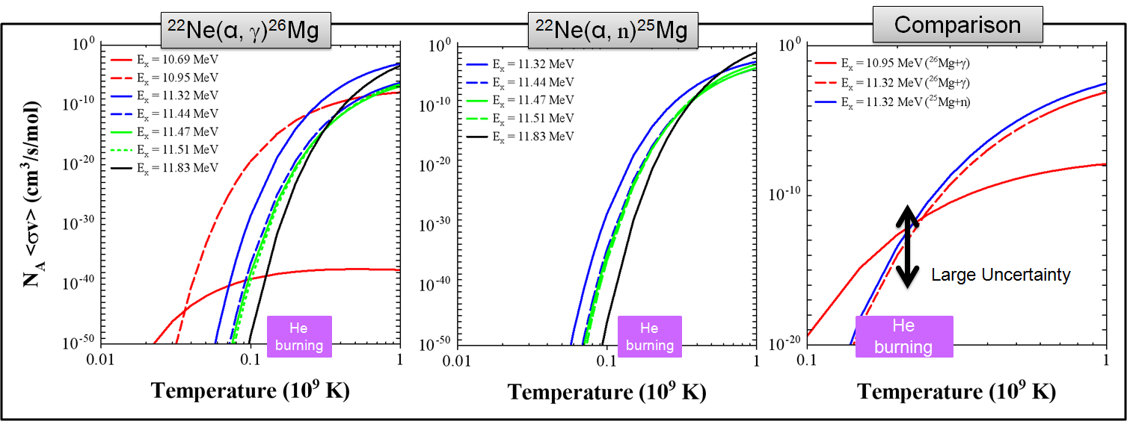

Slide 12
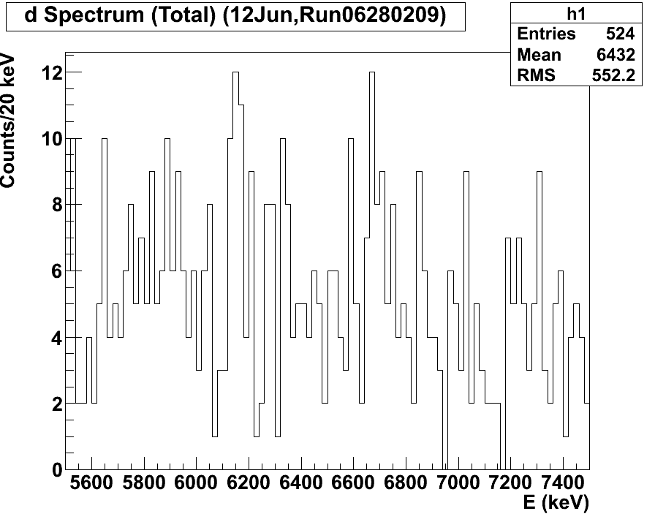
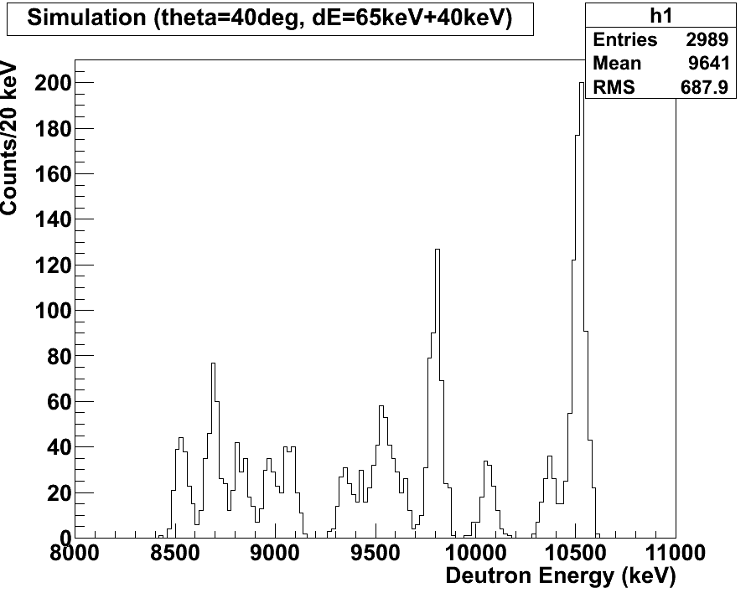
9.38
Ex = 12.1 MeV
11.15 (?)
11.31

