Slide 1



RECENT RESULTS FROM FRS EXPERIMENTS WITH
EXOTIC NUCLEI PRODUCED WITH URANIUM PROJECTILES
Hans Geissel
GSI and Justus Liebig University Giessen
The Challenge of High-Resolution Experiments with Exotic Nuclei
Discovery of New Neutron-Rich Isotopes
Mass and Lifetime Measurements
New Experimental Developments towards the NUSTAR Facility
Super-FRS at FAIR

Slide 2
Scientific Results possible via High-Resolution Spectrometer Experiments
Discovery of New Nuclides and Decay Modes
Reaction and Nuclear Structure Studies with High-Resolution Momentum Measurements (incl. Masses & Lifetimes)
Cross Section Measurements, (total interaction x-section, knockout x-section, charge-exchange x-section)
Angular Distribution (Scattering Experiments)

Slide 3
Phase-Space and Resolving Power
Momentum Resolving Power
Phase Space
Ion-Optical
Properties

Slide 4
Kinematics of Projectile Fragmentation and Fission

Slide 5
High-Resolution Measurements of Rare Isotope Beams with large Emittance
Solutions:
1. Coincidence Measurements
(in front and behind the reaction target, event-by-event)
2. Special ion optical systems
(Energy-loss spectrometer, Isochronous mode)
3. Phase-Space Reduction via Cooling
(Stochastic & Electron Cooling in a Storage Ring, Buffer-Gas Cooling)

Slide 6
Secondary Nuclear Beam Facility
FRS: In-flight Separator & High-Resolution Spectrometer
3
1
SIS
2
Decay Spectroscopy,
High-resolution momentum measurements
Masses, Lifetimes, Direct Reactions,
Isomeric Beams
Reactions Studies (Complete Kinematics)
Notes:
Inflight facility with 3 experimental branches
Different tasks: FRS is primarily an in-flight separator access to all nuclei with lifetimes > 200ns
but also the high-resolution spectrometer, both features will be demonstrated in examples
Fragmentation and fission of 238U at 1GeV/u present unique opportunities for nuclear structure research

Slide 7
Bρ-ΔE-Bρ Separation Method

Slide 8
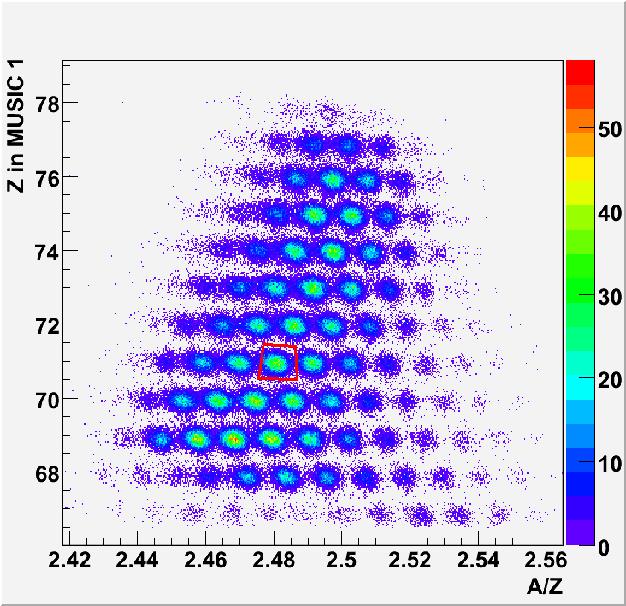
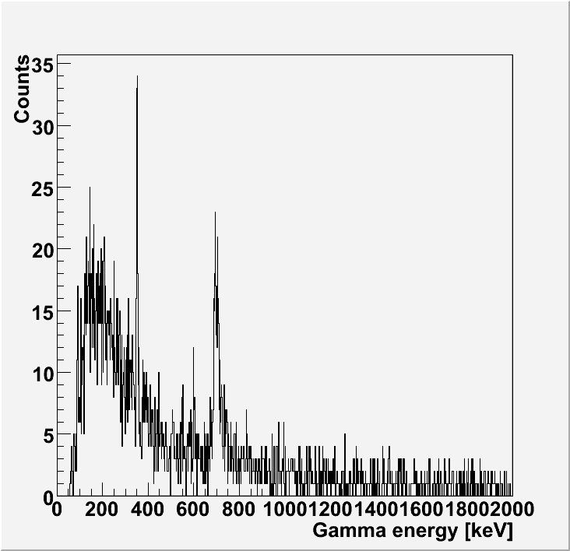
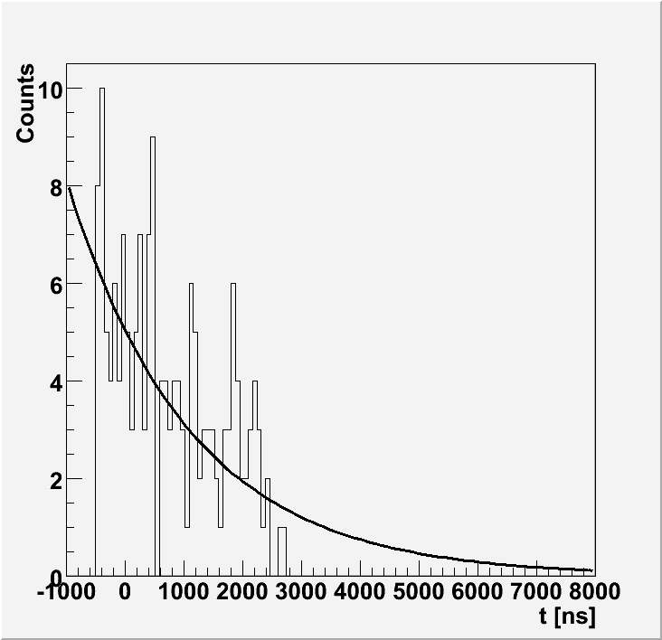
Isomer Tagging Technique – ¹⁷⁵Lu
Verification of Particle Identification
E_{γ}=353 keV
^{175m}Lu
T_{1/2}=1.45(30) μs
^{175m}Lu: E_{γ}=353.3 keV (5/2⁻ →7/2⁺), T_{1/2}=1.49(7) μs
8
F. Farinon

Slide 9
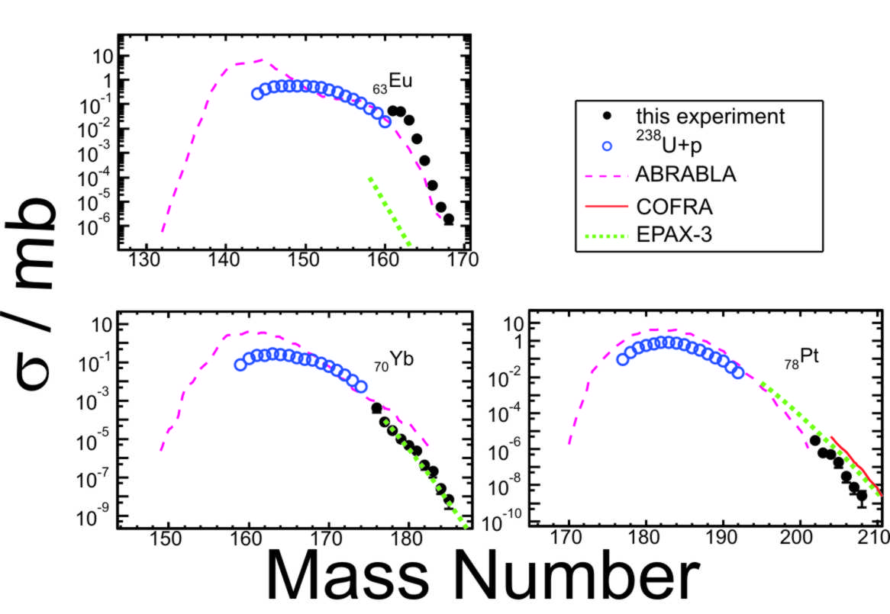
New Neutron-Rich Isotopes
F. Farinon, J. Kucewicz
EPAX 3.0: K. Sümmerer to be published in Phys. Rev. C (2012), arXiv id 1205.5436.
COFRA: J. Taieb et al., Nucl. Phys. A 724 (2003) 413-430.

Slide 10
Reaction Mechanism
¹⁵⁷Nd
T_{frag} = 0.10
T_{fiss} = 0.016
¹⁷⁸Er
T_{frag} = 0.23
T_{fiss} = 0.045
¹⁹¹Re
T_{frag} = 0.41
T_{fiss} = 0.12
ABRABLA:
J.-J. Gaimard, K.-H. Schmidt Nucl. Phys. A 531 (1991) 709.
A. Kelic et al., Proceedings of the Joint ICTP- IAEA, IAEA INDC(NDS)-530 (2008).

Slide 11
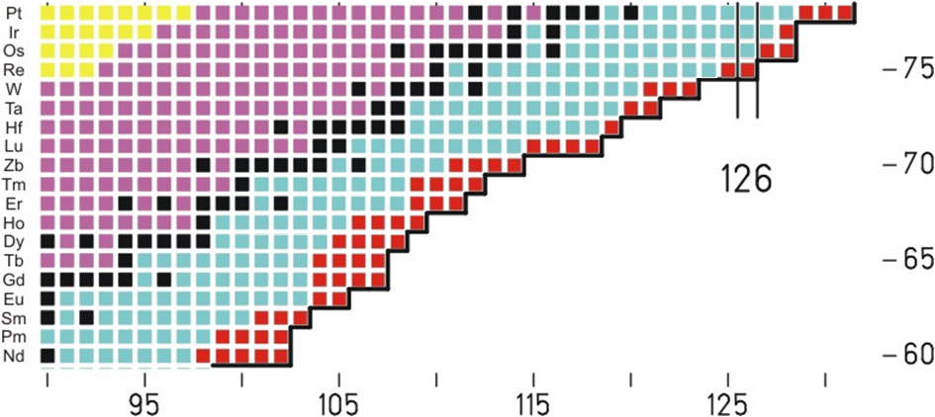
Discovery of 60 New Isotopes
Z
New Isotopes
N
J. Kurcewicz, F. Farinon

Slide 12
Precision Mass Measurements in the ESR
SMS IMS
Schottky Mass Spectrometry
Isochronous Mass Spectrometry
B. Franzke, H. Geissel, G. Münzenberg, H. Wollnik
Notes:
Precision experiments with frequency measurements
2 experimental methods to perform high resolution spectrometry independent of the velocity spread of the fragments
Nuclei in the halflife range > 1s SMS, electron cooling
nuclei appr 10micro s → IMS, faster particle are sent on detours

Slide 13
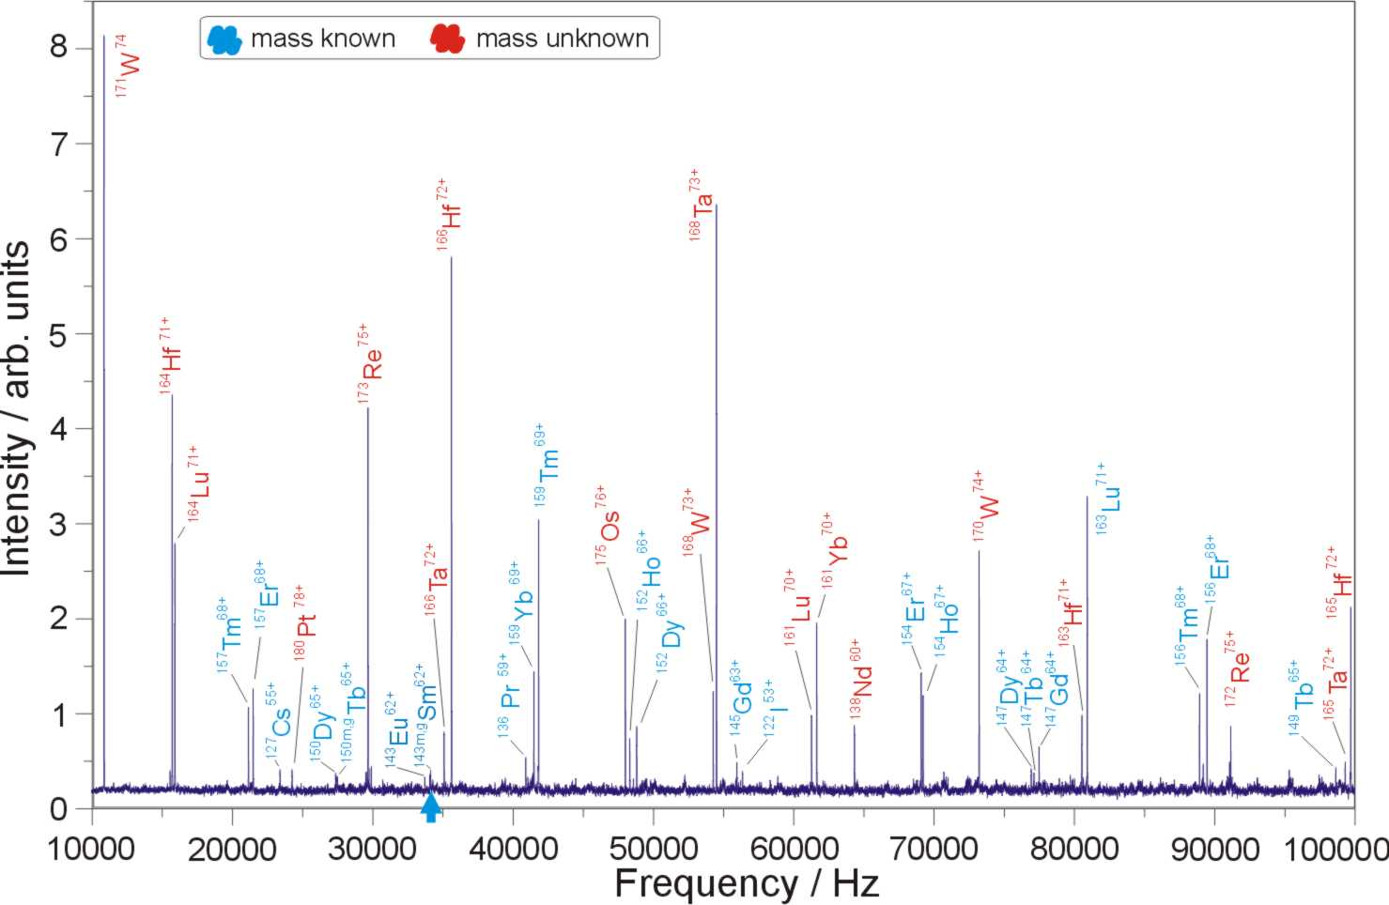
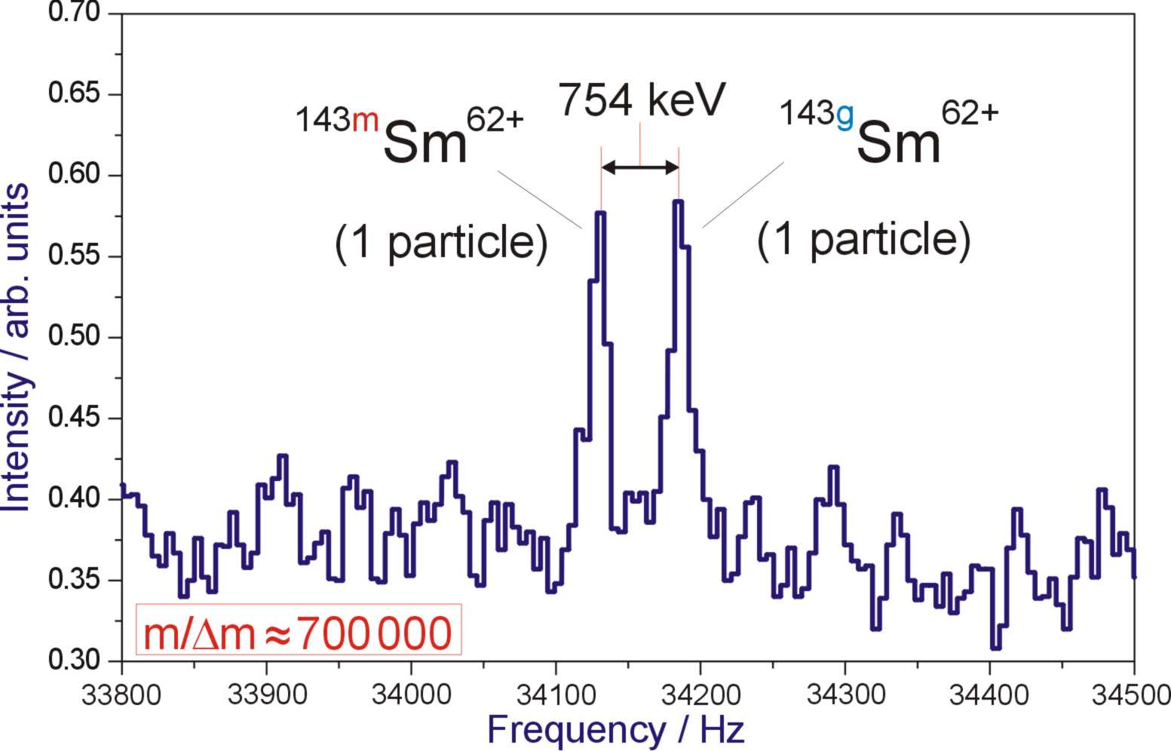
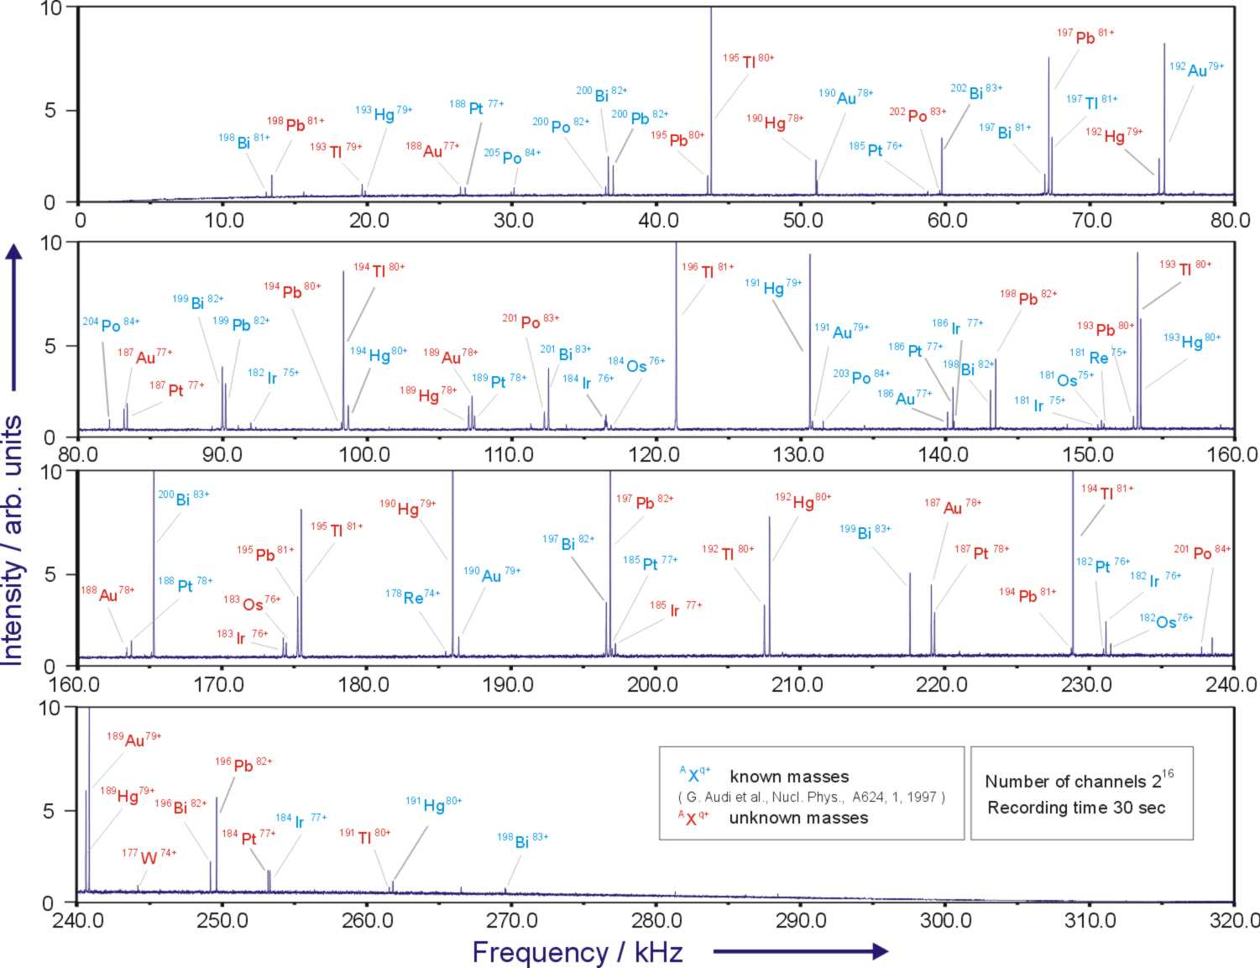
Schottky Frequency Spectra
Sensitivity to Single Ions

Slide 14
Schottky Mass Spectrometry (SMS)
BNL-NNDC April 2011
L. Chen et al. NP 2012

Slide 15
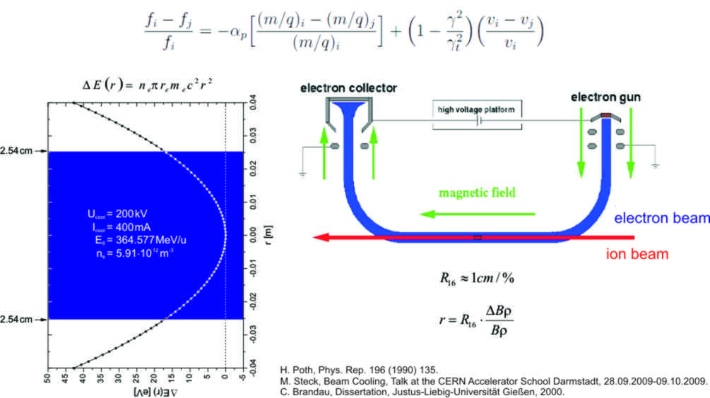
Velocity Profile of the Electron Beam
Influence on the Mass Measurements
L. Chen et al., Nucl. Phys. A 882 (2012) 71.
Systematic Error reduced
σ^{syst} ≈10 keV

Slide 16
Comparison with ISOLTRAP
Z. Patyk, R. Knöbel
ISOLTRAP – data:
F. Herfurth et al., Eur. Phys. J. A 25 (2005) 17-21.
D. Neidherr et al., Phys. Rev. Lett. 102 (2009) 112501.
C. Weber et al., Nucl. Phys. A 803 (2008) 1.
With ²²⁹Fr:
Without ²²⁹Fr:
L. Chen et al., Nucl. Phys. A 882 (2012) 71.

Slide 17
Comparison with Mass Models
L. Chen et al., Nucl. Phys. A 882 (2012) 71.
FRDM: P. Möller et al., At. Data Nucl. Data Tables 59 (1995) 185.
HFB – 14: http://www-astro.ulb.ac.be/Nucdata/Masses/hfb14-plain,
S. Goriely, M. Samyn, and J.M. Pearson, Phys. Rev. C 75 (2007) 064312 and references therein.
HFB – 17: S. Goriely, N. Chamel, and J.M. Pearson, Eur. Phys. J. A 42 (2009) 547-552.
Duflo & Zuker: J. Duflo, A.P. Zuker, Phys. Rev. C 52 (1995) R23.

Slide 18
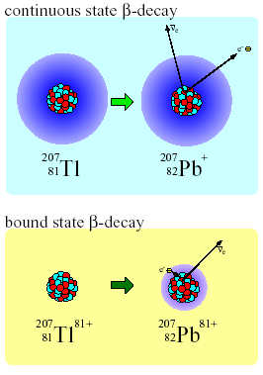
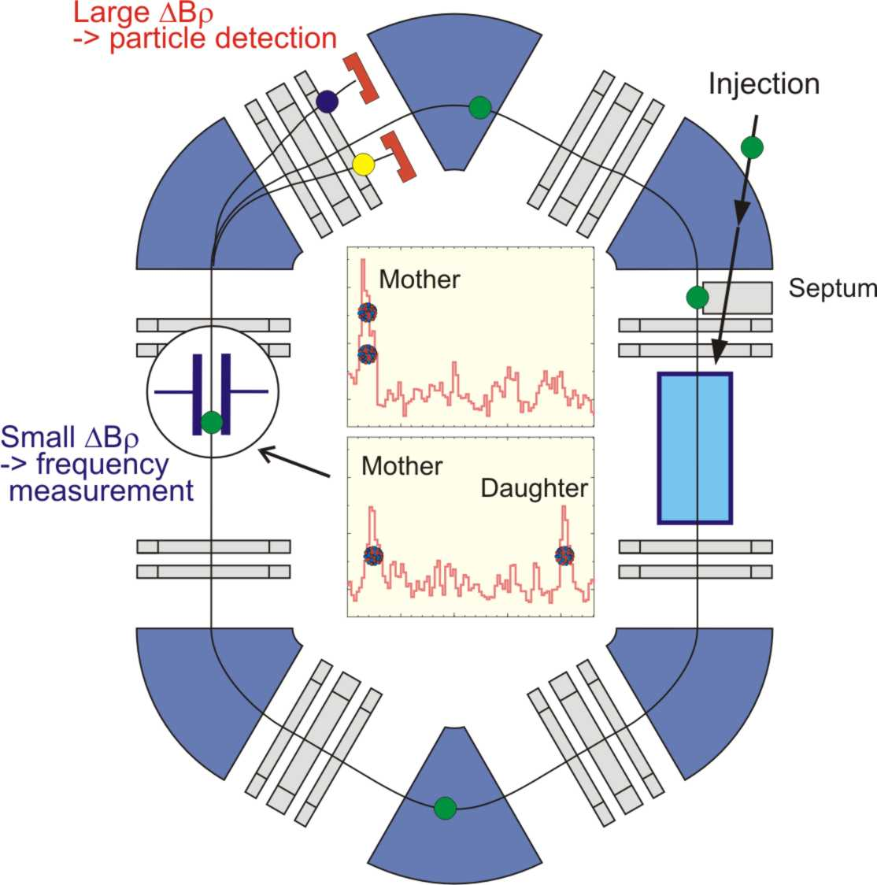
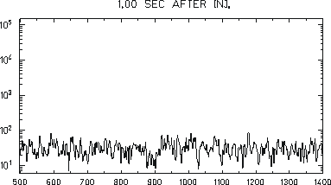
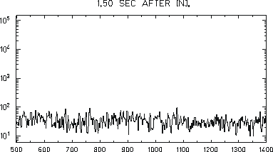
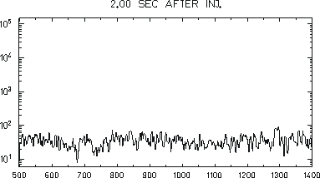
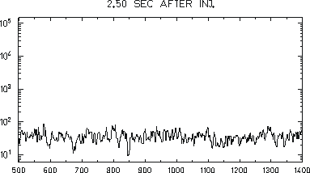
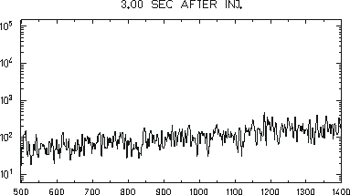
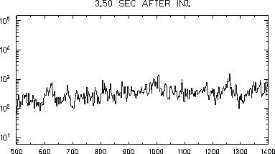
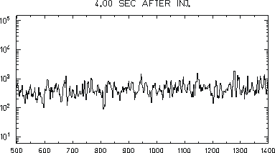
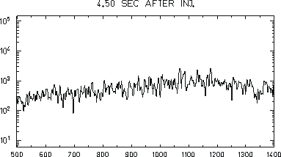
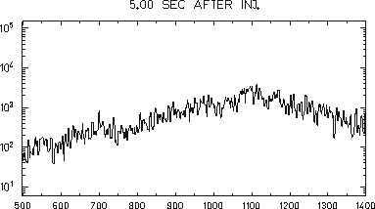
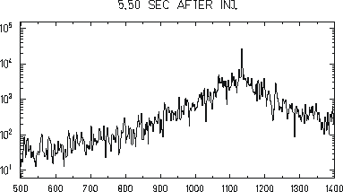
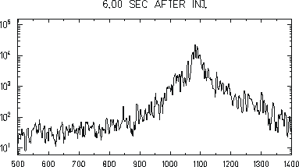
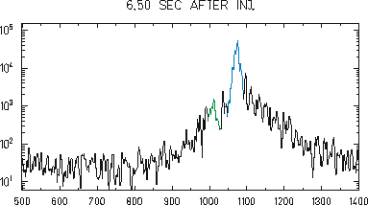
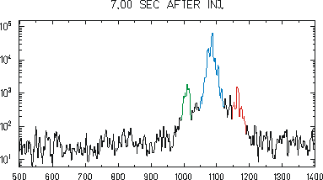
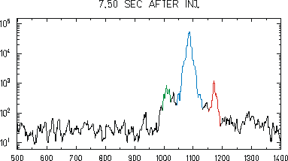
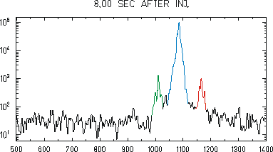
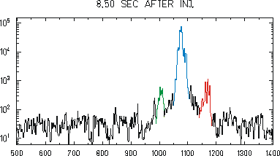
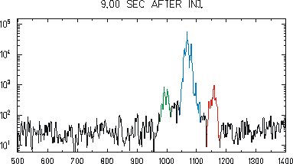
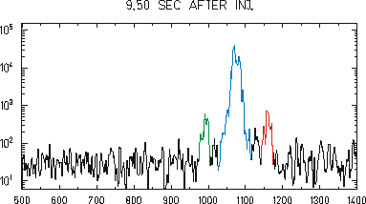
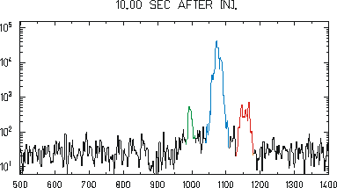
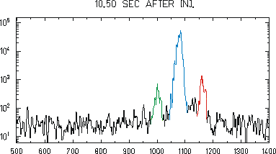
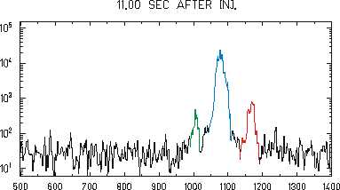
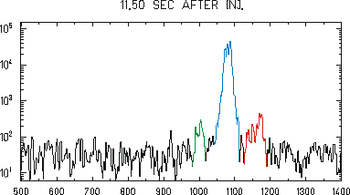
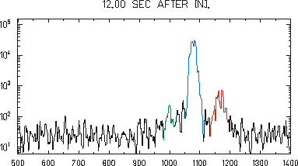
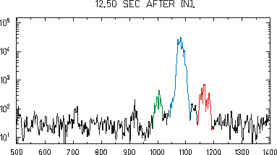
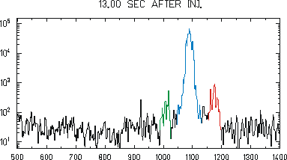
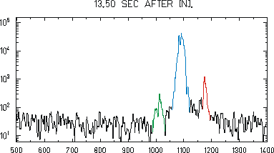
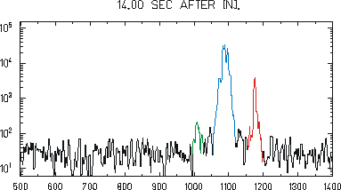
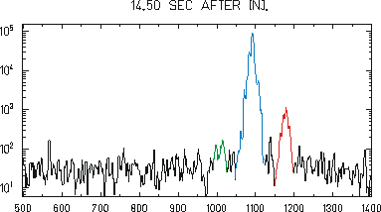
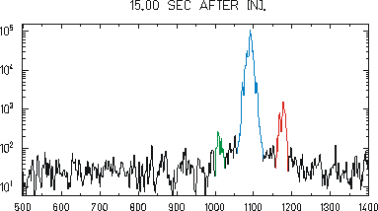
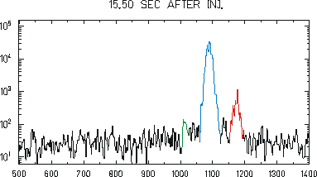
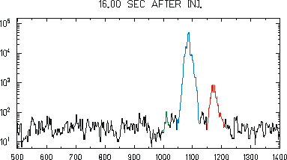
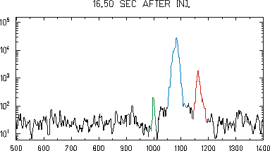
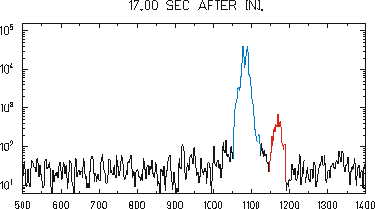
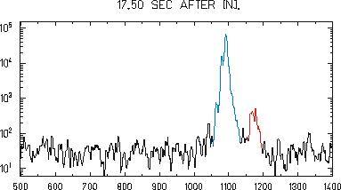
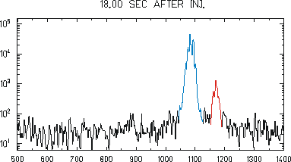
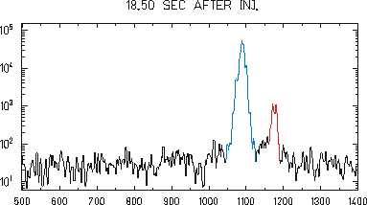
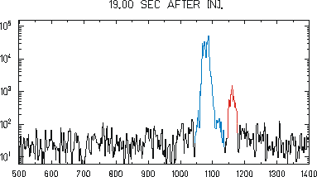
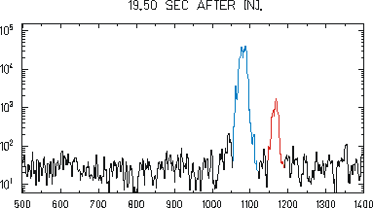
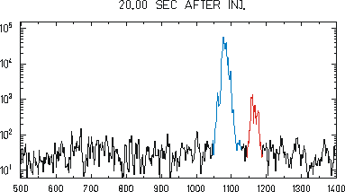
Lifetime Measurements of Short-lived Nuclei
Applying Stochastic and Electronic Cooling
Bound-state Beta-Decay of ²⁰⁷Tl⁸¹⁺
²⁰⁷Tl⁸¹⁺
²⁰⁷Tl⁸¹⁺
^{207m}Tl⁸¹⁺
²⁰⁷Pb⁸¹⁺
^{207m}Tl⁸¹⁺
²⁰⁷Pb⁸¹⁺
T. Otsubo, Phys. Rev. Lett. 100, 164801 (2008)
Notes:
In principle mass and lifetime measurements can be done simultanously
2 Methods depending on the Brho change
unique possibility to measure bare nuclei

Slide 19

Measured Nuclear Electron-Capture of
H-like & He-like ¹⁴⁰Pr and ¹⁴²Pm Ions
Yu.A. Litvinov et al., Phys. Rev. Lett. 99 (2007) 262501
Results for ¹⁴⁰Pr
Experiment
Theory
Relative probability
of EC Decay
Neutral ¹⁴⁰Pr:
P = 2.381
N. Winckler et al., Phys. Lett. B679 (2009) 36
He-like ¹⁴⁰Pr:
P = 2
H-like ¹⁴⁰Pr:
P = 3
Experiment
Experiment: N. Winckler (PhD)
Theory: Z. Patyk et al.PR C77 (2008) 014306

Slide 20





Half-life of neutral ²¹³Fr and ²¹⁴Ra
Fabio Farinon PhD
²¹³Fr
²¹⁴Ra

Slide 21

Half-life of H-like and Neutral ²¹³Fr
(GSI)
(ITALY)
(GSI)
(GSI)
Clear evidence against the predictions of the theoretical paper from Erma
(∆λ / λ ~ 34 %). (A. Erma, Phys. Rev. 105, 1957).

Slide 22

MR-TOF-MS at the FRS Ion Catcher
W.R. Plaß et al., GSI Scientific Report 2010, p. 137 (2011)

Slide 23



MR-TOF-MS: High Resolution Mode
W.R. Plass, T. Dickel, J. Ebert
I
TOF
Ion capacity up to 10⁶/s
Intensity / a.u.
¹³³Cs⁺
10
Detector Signal /mV
5
0
44.9
45.0
45.1
45.2
45.3
45.4
45.5
μ
TOF-49ms /
s
T. Dickel, PhD, 2010

Slide 24






First 1 GeV/u ²³⁸U Run at the FRS with a Cryogenic Stopping Cell & MR-TOF-MS
Collaboration
CSC
MR-ToF-MS
100 mbar, 85K
CSC and MR-ToF-MS online at the final focal plane at the FRS

Slide 25

Stopping Cell Performance
Range distribution of ²²³Th
Range distribution:
  = 15 mg/cm² (Al)
  σ = 7.5 mg/cm² (He)
Stopping cell: 100 mbar, 100 K
  Areal weight: 5 mg/cm² (He)
  corresponds to ~300 mbar room temperature
Preliminary
  almost 2 times higher gas density compared to other stopping cells using an RF structure
Efficiencies
 | ²²³Th
Stopping efficiency | (27 ± 3)%
Survival and extraction efficiency | (43 ± 9)%
Total efficiency | (12 ± 2)%
Preliminary
P. M. Reiter, S. Purushothaman
Notes:
25

Slide 26


MR-TOF-MS: Results
Cleanliness of stopping cell
(Broadband measurement)
Mass measurement
(High resolution mode)
²¹⁹Rn
²¹¹Pb, ²¹¹Bi, ²¹¹Po
Counts
²⁰⁷Pb, ²⁰⁷Tl
Mass [u]
First time, direct mass measurement of short-lived nuclei with an MR-TOF-MS:
Isobars ²¹¹Ra, ²¹¹Po and ²¹¹Fr
²¹³Rn with half-life of 19.5 ms
T. Dickel, W. Plass
Notes:
masse 213!! wichitg
broadband: wie sauber ist einen cryogene stopp zelle!
26

Slide 27

The NUSTAR Facility Super-FRS

Slide 28


Slide 29

E-Loss Spectrometer
Dispersion-Matched
Energy-Loss Spectrometer (dispersion matched)
H. Geissel et al. NIM B in print 2013

Slide 30

Unique Experiments with the Super-FRS
High-Resolution, High-Energy Experiments
Experiments with the heaviest projectile
fragments (q=Z), new decay modes,
in-flight decay, momentum measurements
High-energy experiments:
Hyper-nuclei (T. Saito),
Exotic atoms (mesonic atoms)
[K. Itahashi, R. Hayano]
In-medium effects of mesons, mass of
eta-prime, delta-excitation with exotic
nuclei
M. Pfützner
see contribution C. Scheidenberger

Slide 31

Summary
The discovery of 60 new neutron-rich isotopes have opened up a new field for nuclear structure physics and astrophysics.
Mass-, lifetime measurements of stored exotic nuclei have contributed significantly to the basic knowledge of matter. The gas stopping cell and the MR-ToF open a new field.
The next–generation facilities (Super-FRS, Cryogenic Gas Cell, MR-ToF) will present unique conditions for research and education.

Slide 32



Tribute in Memory of Prof. Dr. Paul Kienle
Strong support to build the combination of
an in-flight separator (FRS) and a storage-
cooler ring (ESR)
Personal involvement in FRS experiments:
Discovery of ¹⁰⁰Sn
Mass and lifetime experiments of stored
exotic nuclei
Discovery of deeply-bound pionic heavy atoms
In-medium mass modification of pions

