Slide 1


From microscopic interactions to the dynamics of the fireball
C. Greiner,
INPC 2013, Firenze, 6th june 2013
in collaboration with:
I.Bouras, A. El, O. Fochler, M. Greif, F. Reining,
F. Senzel, J. Uphoff, C. Wesp and Zhe Xu
Boltzmann parton transport including radiation
observables at RHIC and LHC (elliptic flow, jets, heavy quarks)
- testing and improving the interaction and transport coefficients

Slide 2
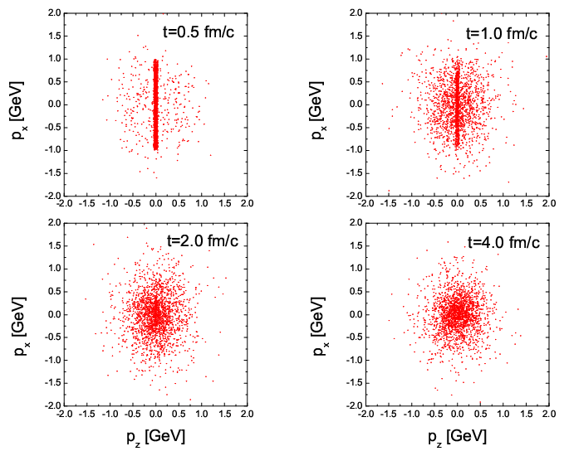
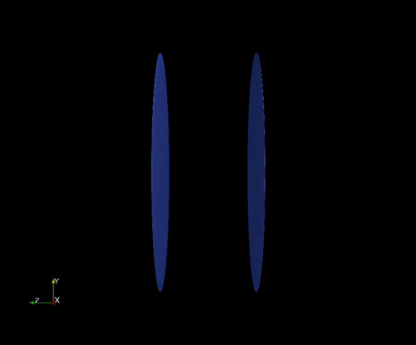
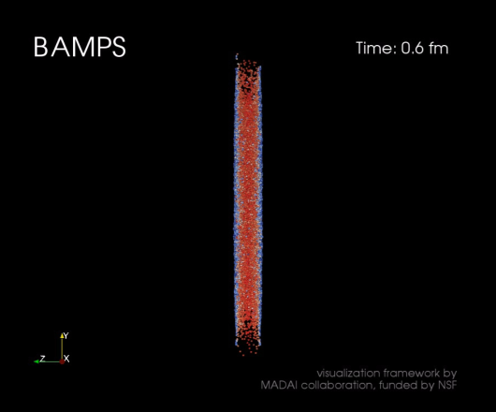
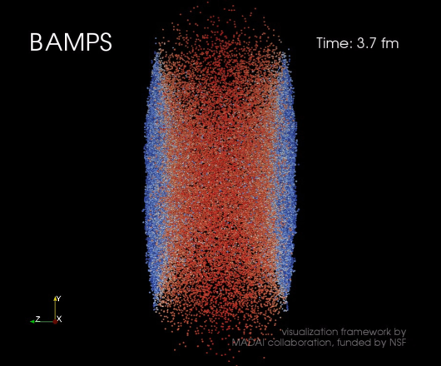
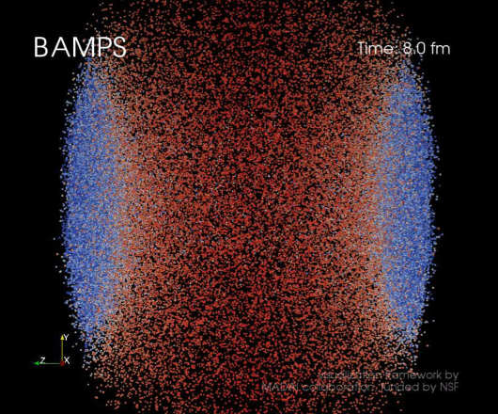
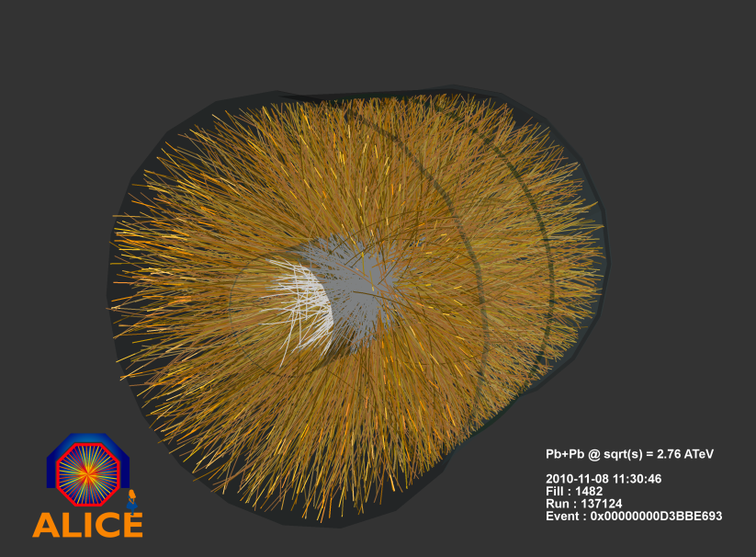
QCD thermalization using parton cascade
No model can describe all (most) aspects of the medium evolution.

Slide 3
BAMPS: Boltzmann Approach of MultiParton Scatterings
A transport algorithm solving the Boltzmann-Equations for on-shell partons with pQCD interactions
(Z)MPC, VNI/BMS, AMPT
collision probability:
Xiong, Shuryak, PRC 49, 2203 (1994)
Dumitru, Gyulassy, PLB 494, 215 (2000)
Serreau, Schiff, JHEP 0111, 039 (2001)
Baier, Mueller, Schiff, Son, PLB 502, 51 (2001)
BAMPS:
Z. Xu and C. Greiner, PRC 71, 064901 (2005);
Z. Xu and C. Greiner, PRC 76, 024911 (2007)

Slide 4
screened partonic interactions in leading order pQCD
elastic part
radiative part
J.F.Gunion, G.F.Bertsch, PRD 25, 746(1982)
T.S.Biro at el., PRC 48, 1275 (1993)
S.M.Wong, NPA 607, 442 (1996)
screening mass:
LPM suppression: the formation time
Λ_{g}: mean free path
suppressed!

Slide 5
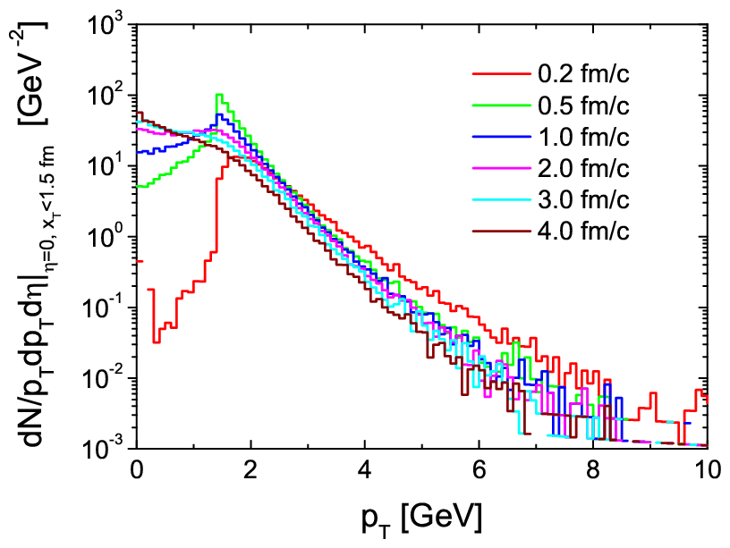
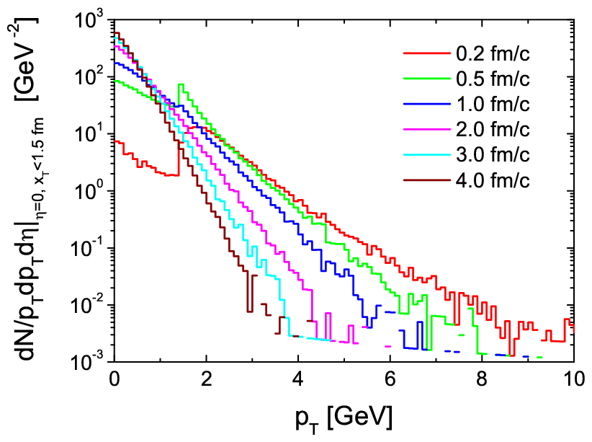
p_{T} spectra
at collision center: x_{T}<1.5 fm, Δz < 0.4 t fm of a central Au+Au at s^{1/2}=200 GeV
Initial conditions: minijets p_{T}>1.4 GeV; coupling α_{s}=0.3
simulation pQCD, only 2-2
simulation pQCD 2-2 + 2-3 + 3-2
3-2 + 2-3: thermalization!
Hydrodynamic behavior!
2-2: NO thermalization

Slide 6
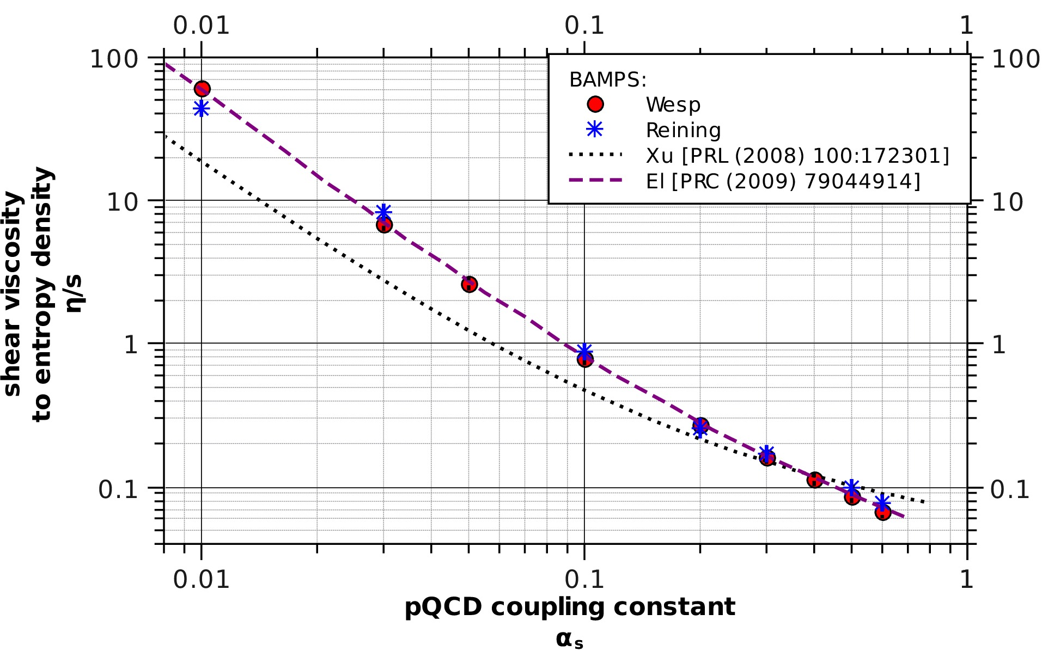
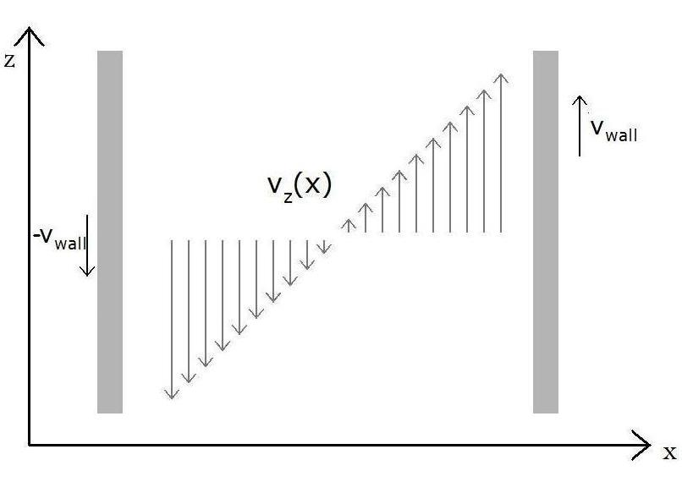
numerical extraction of viscosity
Green-Kubo relation:
C. Wesp
Christian Wesp et al, Phys. Rev. C 84(2011)
F. Reining
Felix Reining et al,
Phys. Rev. E 85 (2012)
Notes:
6

Slide 7
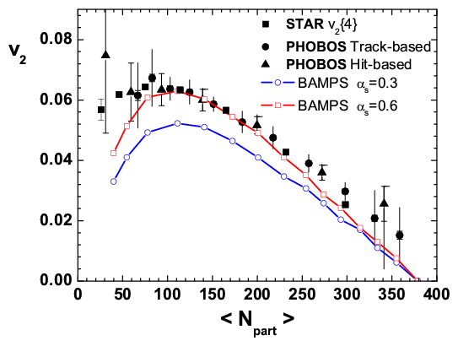
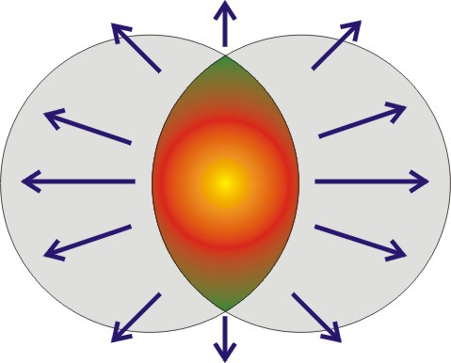
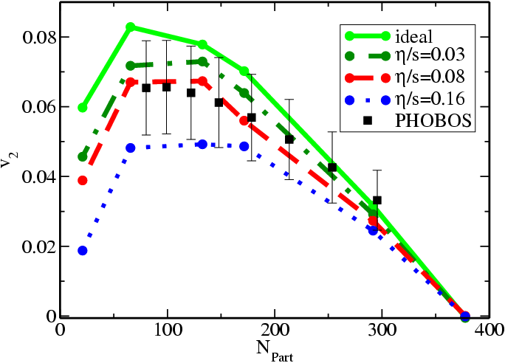
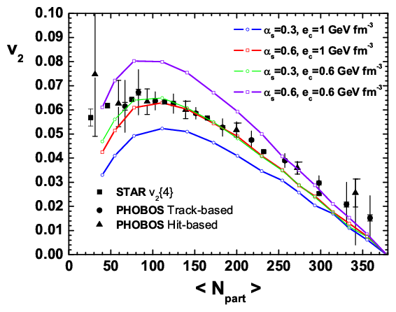
Elliptic Flow and Shear Viscosity in 2-3 at RHIC
2-3 Parton cascade BAMPS
Z. Xu, CG, H. Stöcker, PRL 101:082302,2008
y
z
viscous hydro.
Romatschke, PRL 99, 172301,2007
x
η/s at RHIC: 0.08-0.2

Slide 8
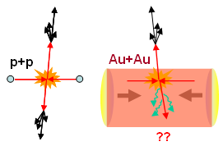
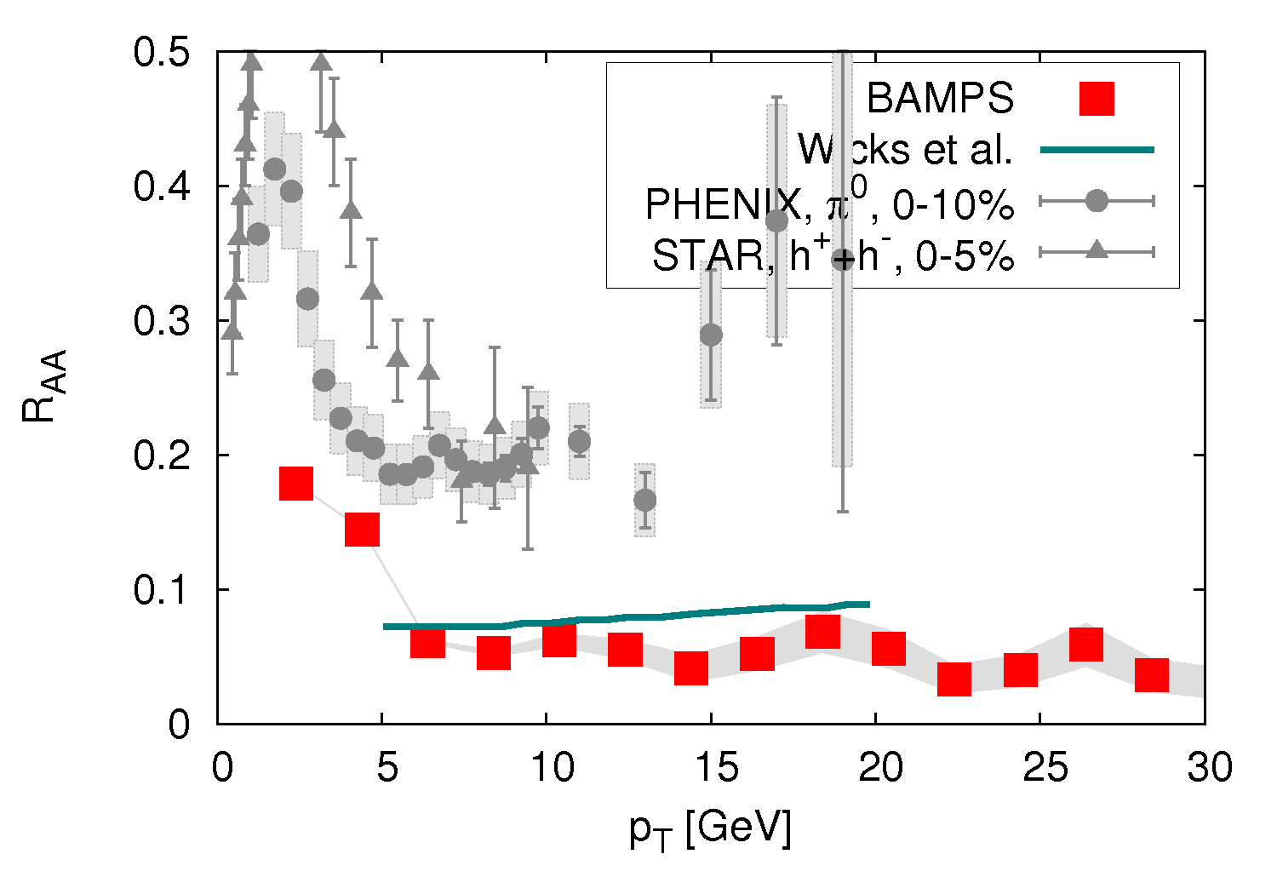
Quenching of jets
first realistic 3d results with BAMPS
R_{AA} ~ 0.052
cf. S. Wicks et al.
Nucl.Phys.A784, 426
nuclear modification factor
central (b=0 fm) Au-Au
at 200 AGeV
O. Fochler et al
PRL102:202301:2009

Slide 9
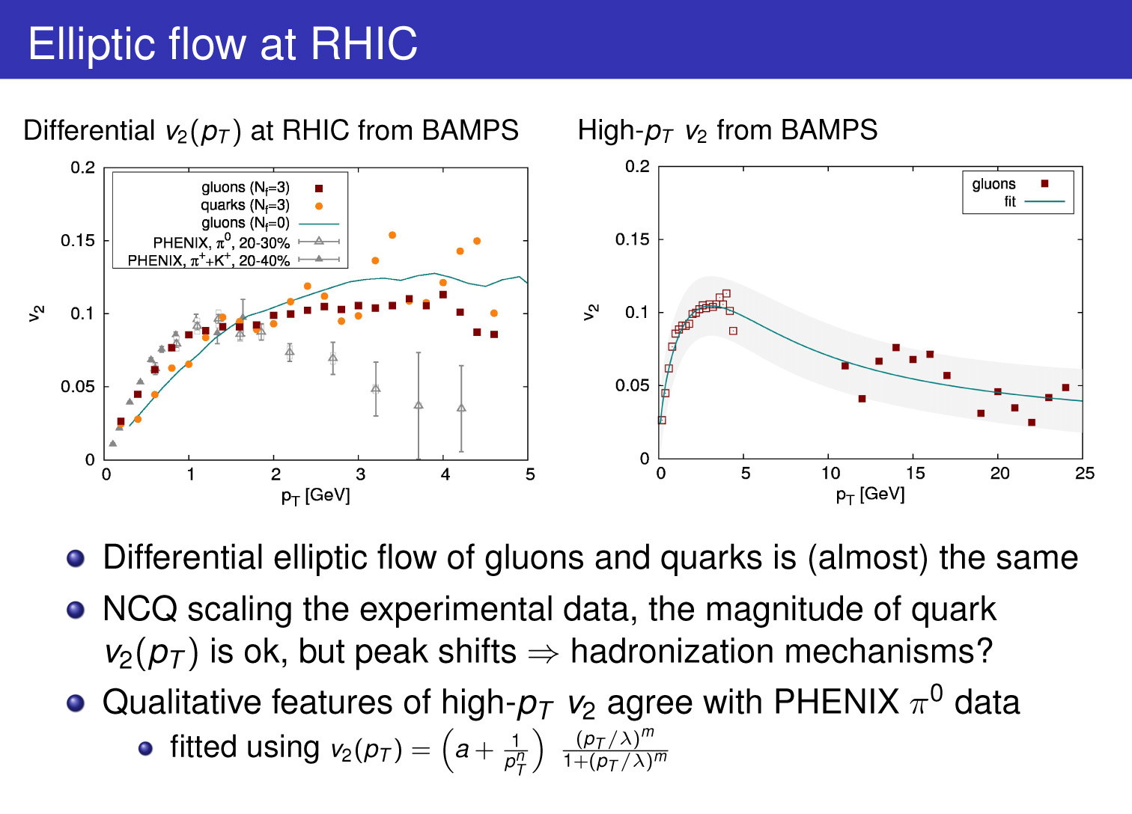

Slide 10
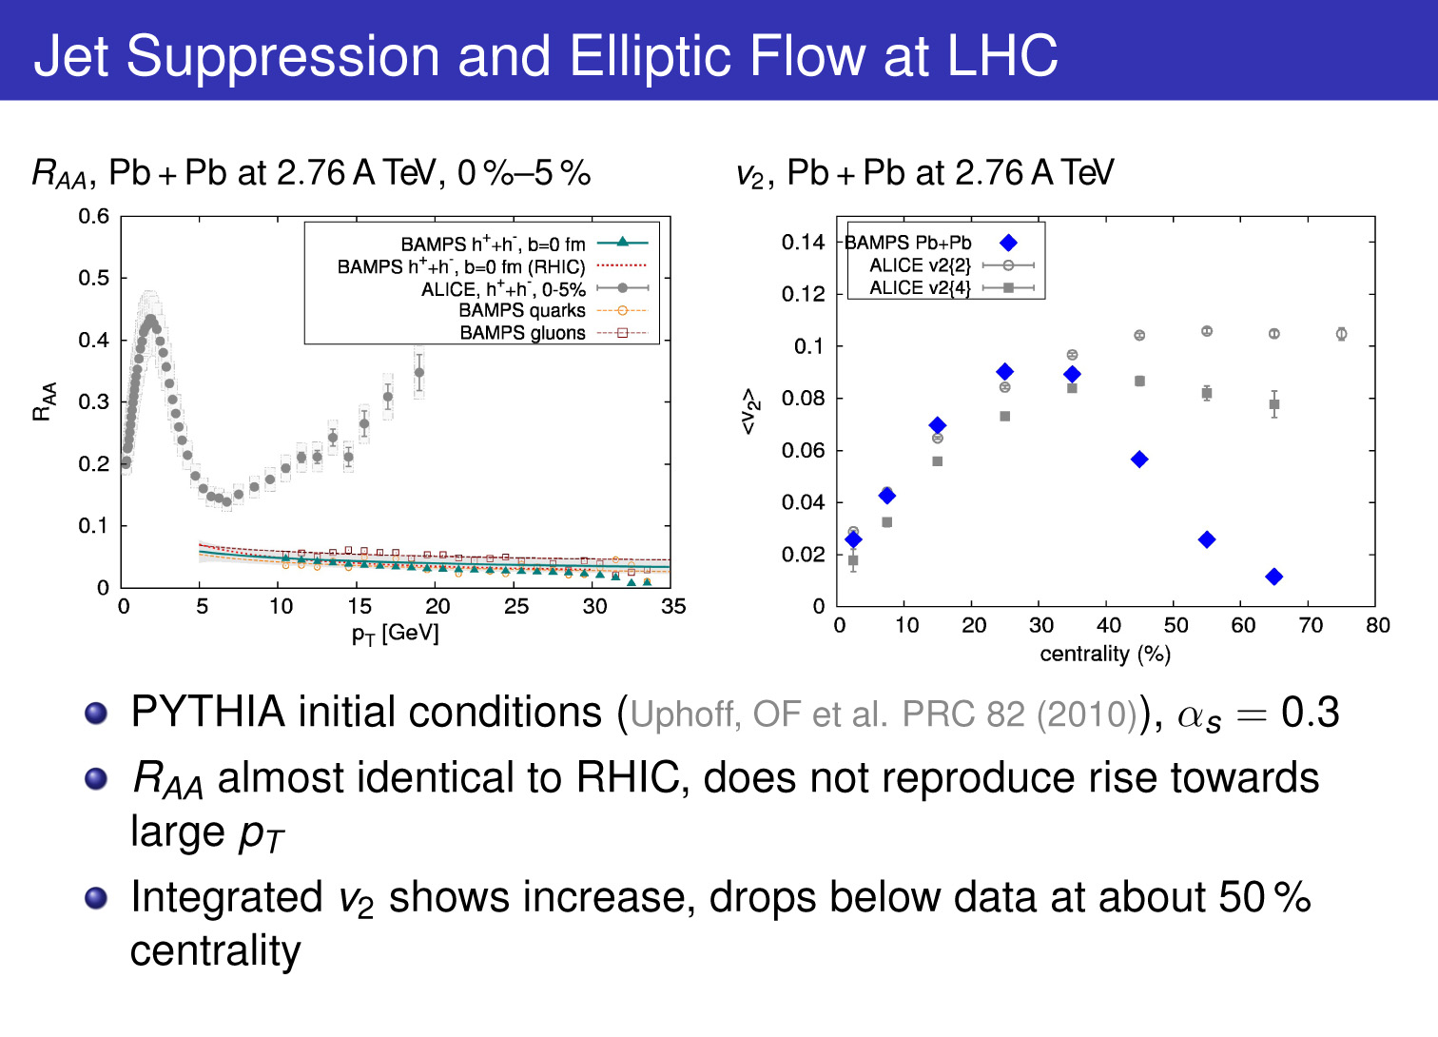
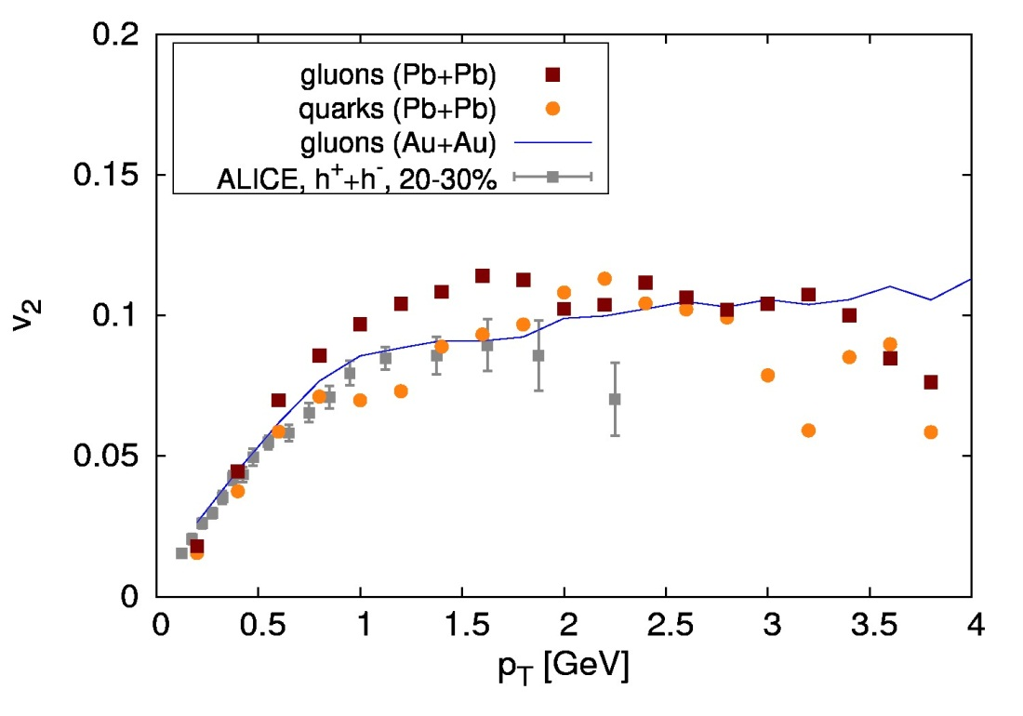
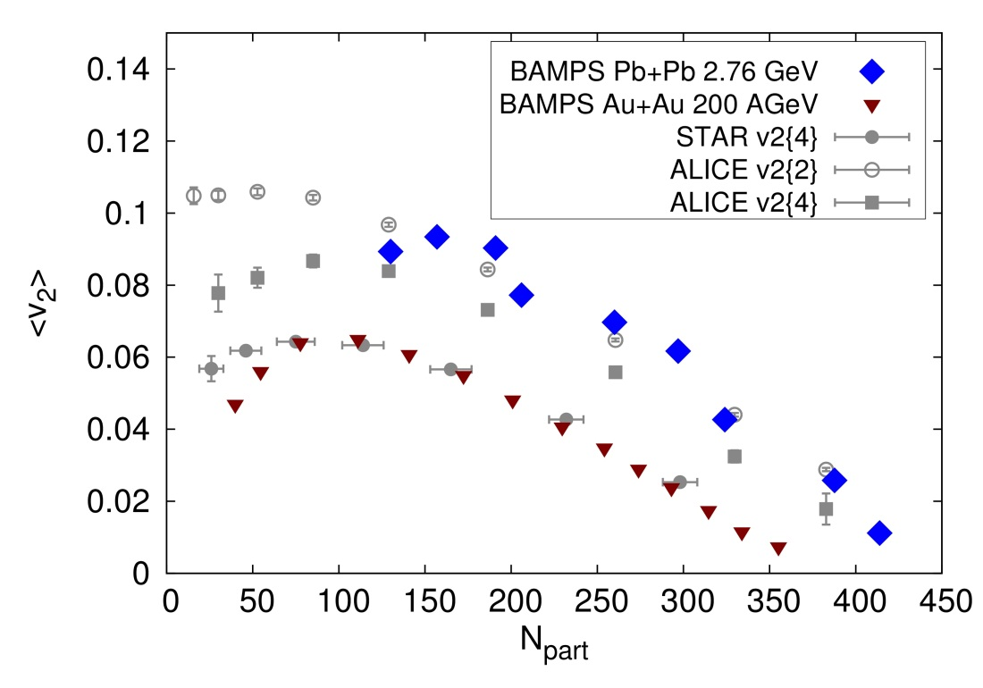
O. Fochler et al,
J. Phys. G 38 (2011)

Slide 11
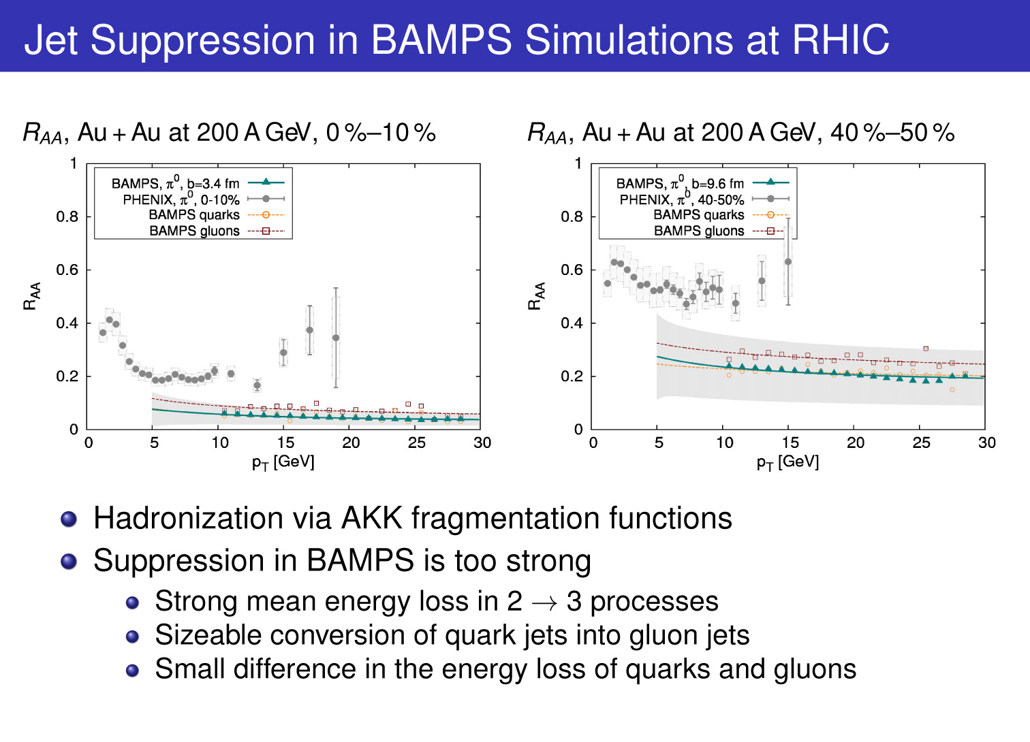
O. Fochler et al,
Phys. Rev. C 82 (2010)

Slide 12
O. Fochler et al,
J. Phys. G 38 (2011)

Slide 13
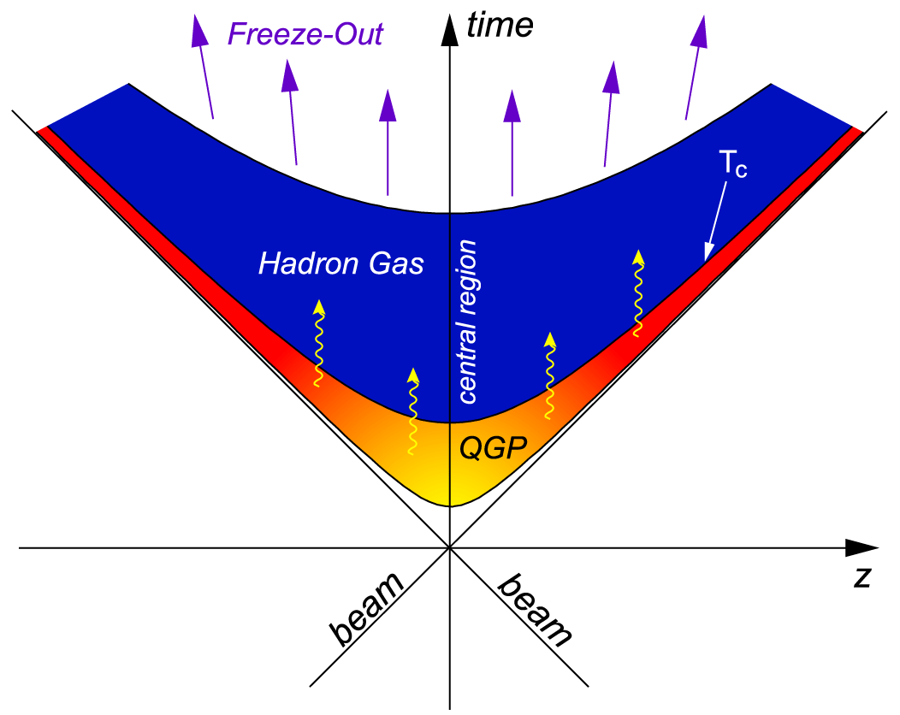
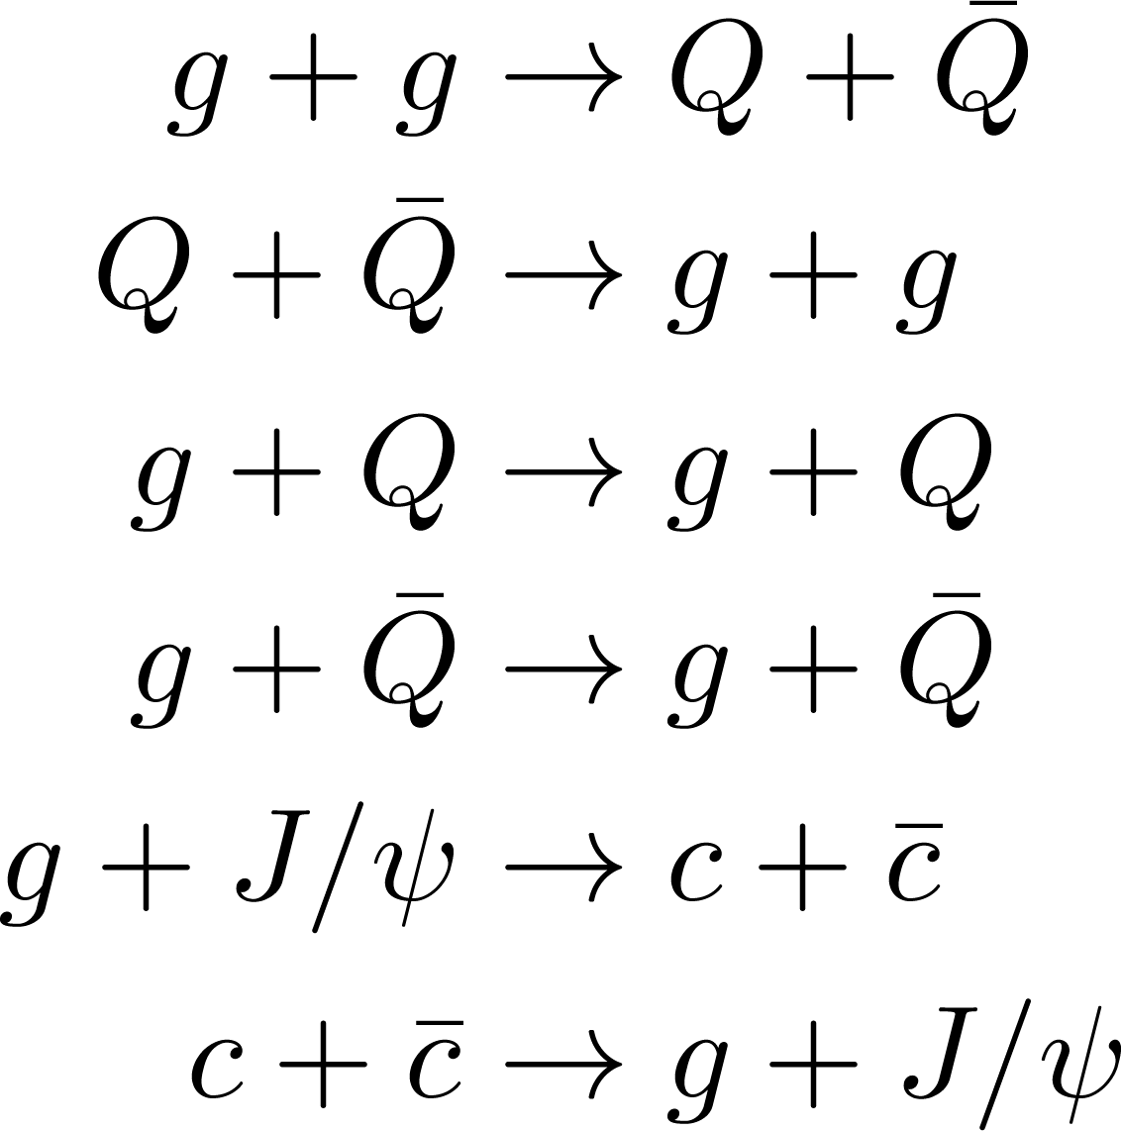
charming probes
_
D
D
Jan Uphoff, Fochler, Xu, CG,
Phys. Rev. C 82 (2010)
Uphoff, Fochler, Xu, CG
Phys. Rev. C84 (2011)
_
c
c
Uphoff, Fochler, Xu,CG,
Phys. Lett. B 717 (2012)
Pre-equil. phase
B
e
B
_
D
Heavy Flavor
b
_
Energy loss
b
c
D
c
D
Charm production
c
c
D
_
Initial hard parton scatterings
c
J/ψ dissociation
J/ψ
_
_
c
J/ψ regeneration
D
c
c
QGP
e
J/ψ
D
Hadronic phase
Notes:
Pythia image: English: Aegeus consults the Pythia, who sits on a tripod. Tondo from an Attic red-figured kylix by the Kodros painter, ca. 440-430 BCE. Antikensammlung Berlin, 2538.
This image (or other media file) is in the public domain because its copyright has expired.
This applies to the United States, Canada, the European Union and those countries with a copyright term of life of the author plus 70 years.
http://en.wikipedia.org/wiki/File:Pythia1.jpg
13

Slide 14
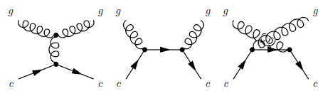
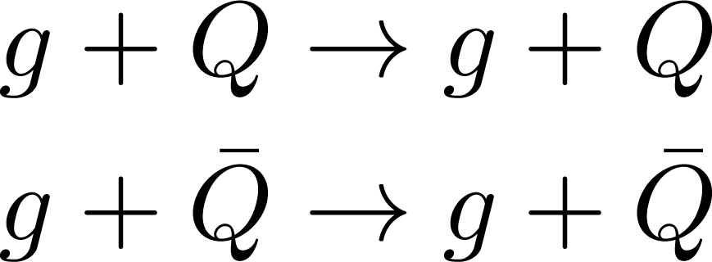

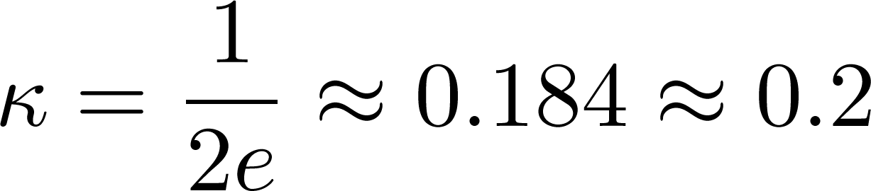
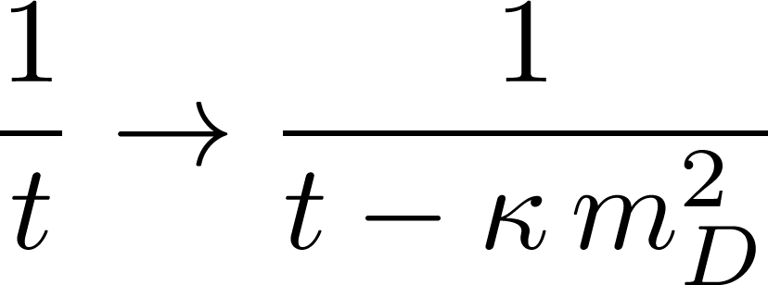
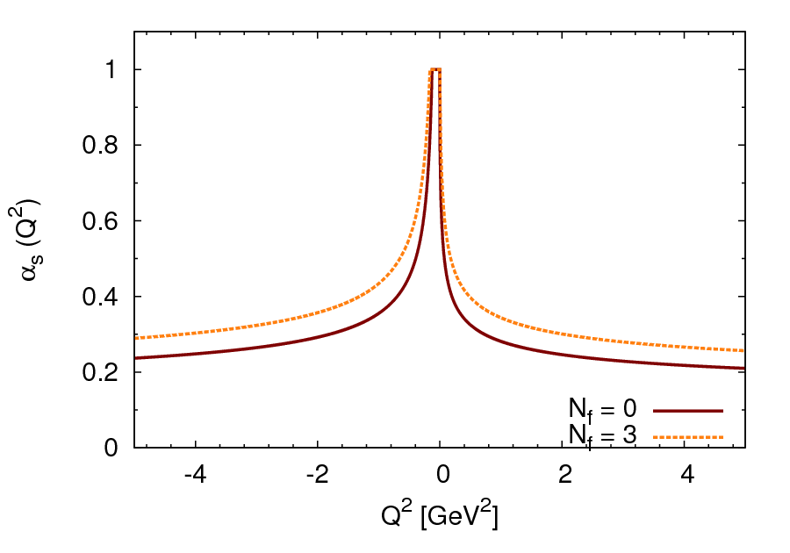
Heavy quark scattering
Leading order perturbative QCD:
t channel is divergent for small t
can be fixed to
A. Peshier, arXiv:0801.0595
[hep-ph]
P.B. Gossiaux,
J. Aichelin,
Phys.Rev.C78 (2008)
by comparing dE/dx to HTL result beyond logarithmic accuracy
Introduce a running coupling constant for all channels

Slide 15
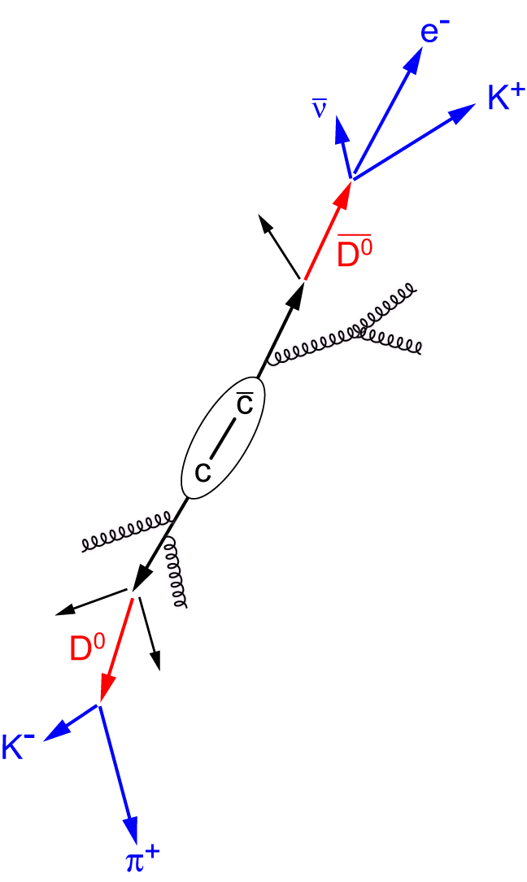
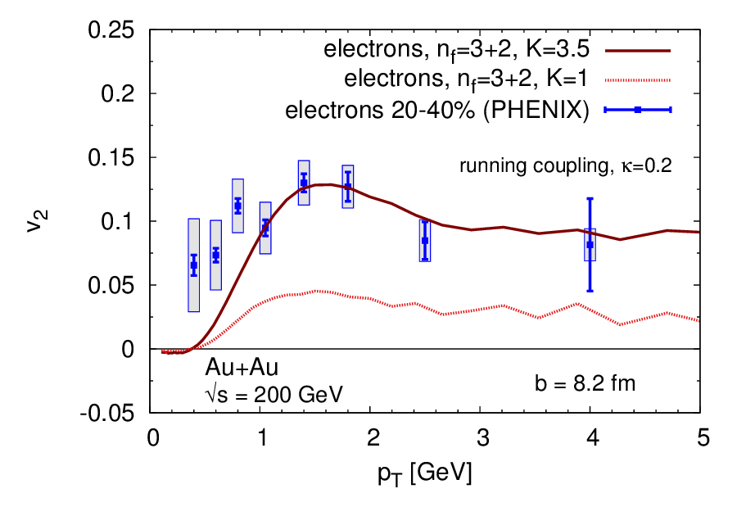
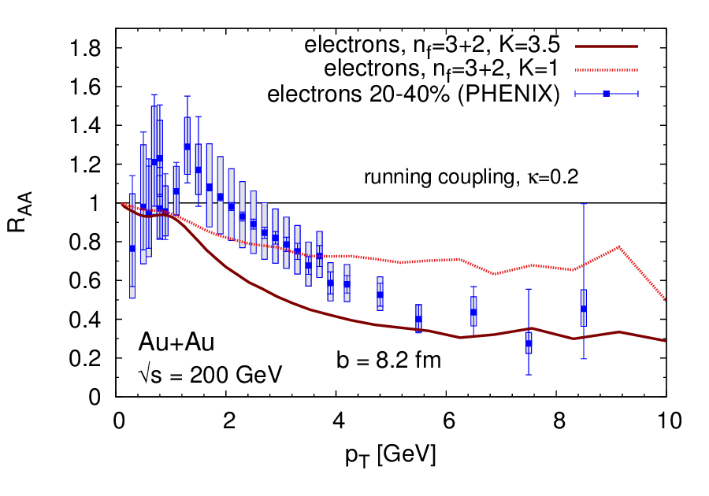
Heavy quark v₂ and R_{AA} at RHIC
Peterson fragmentation
Uphoff, Fochler, Xu, CG
Phys. Rev. C84 (2011)
PHENIX data,
Phys.Rev. C84 (2011)
Notes:
Wicks, Horowitz, Djordjevic, Gyulassy, Nucl.Phys.A784, 426 (2007) and Mustafa, Phys.Rev.C72, 014905 (2005),
15

Slide 16
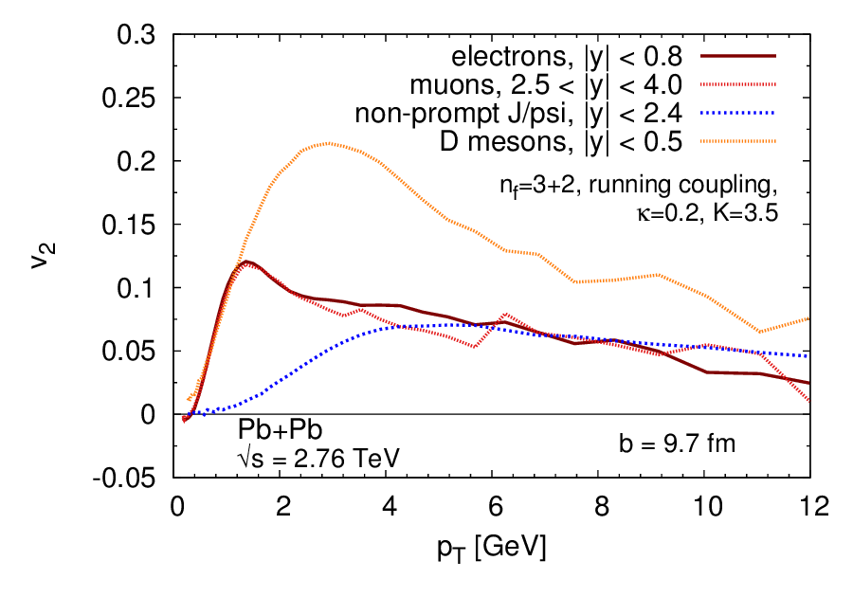
v₂ predictions for the LHC
LHC
only elastic heavy quark processes
Notes:
14,19 20,27
1,73
3,67
16

Slide 17
v₂ predictions for the LHC
LHC
only elastic heavy quark processes
Notes:
14,19 20,27
1,73
3,67
17

Slide 18
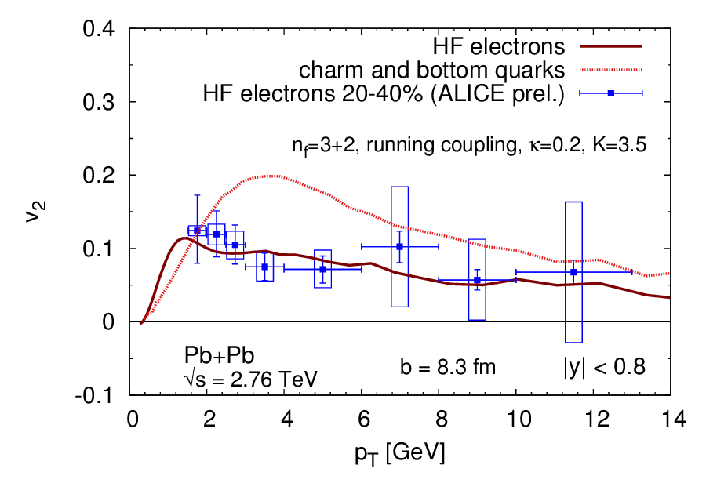
Electron v₂ at LHC
LHC
only elastic heavy quark processes
ALICE data, QM12
Notes:
14,19 20,27
1,73
3,67
18

Slide 19
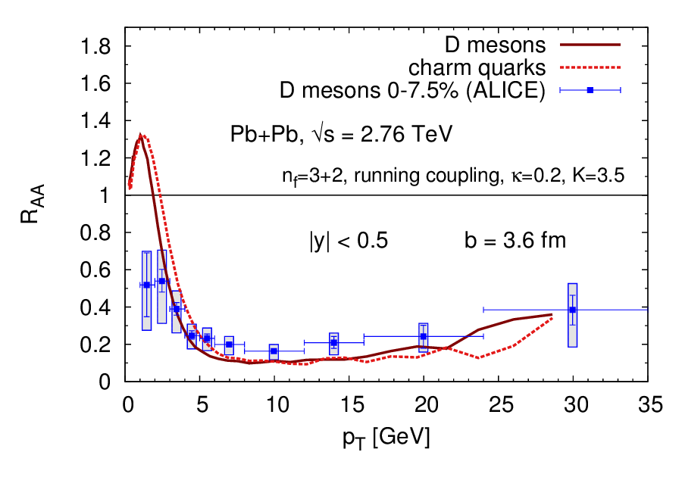
D meson R_{AA} at LHC – 0-7.5% central
LHC
only elastic heavy quark processes
ALICE data, QM12
Notes:
14,19 20,27
1,73
3,67
19

Slide 20
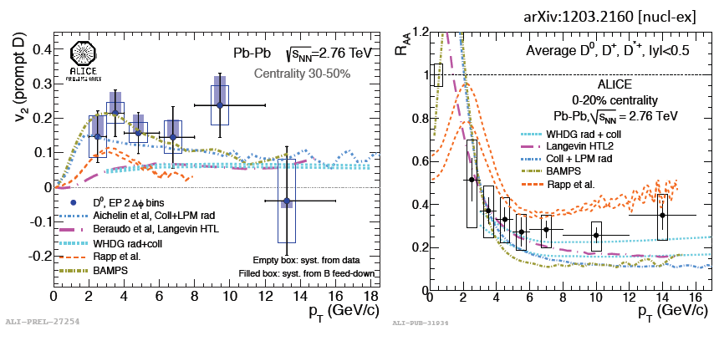
What can we learn?
What can we learn from the models?
  No big surprises in going from RHIC to LHC
  Too early to rule models out (beside AdS/CFT)
  Describing v₂ and R_{AA} simultaneously is challenging
    good v₂ description:
    Rad.+ improved el. pQCD (Gossiaux et al.),
    scaled improved el. pQCD (Uphoff et al.), …
    good R_{AA} description:
    Rad.+el. pQCD (Vitev, WHDG, ASW, Cao, …),
    resonance scattering (Hees et al.) …

Slide 21
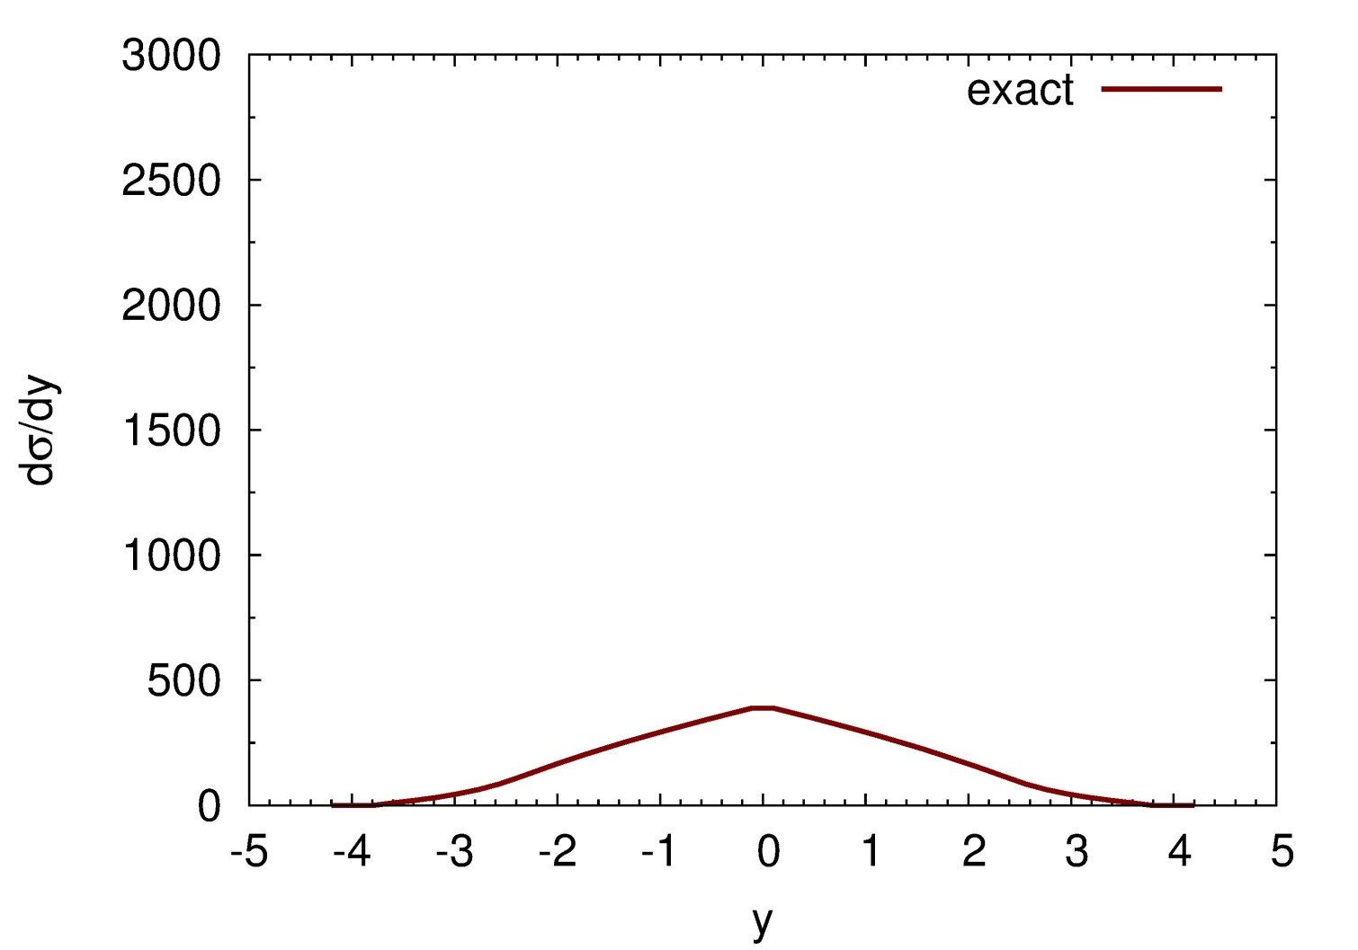
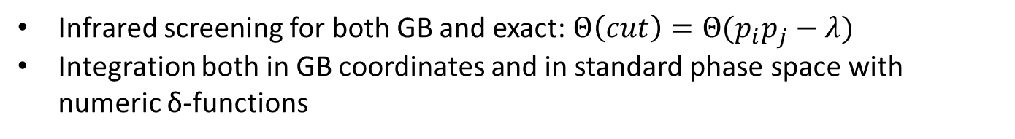
A Closer Look on the Gunion-Bertsch Approximation

Slide 22
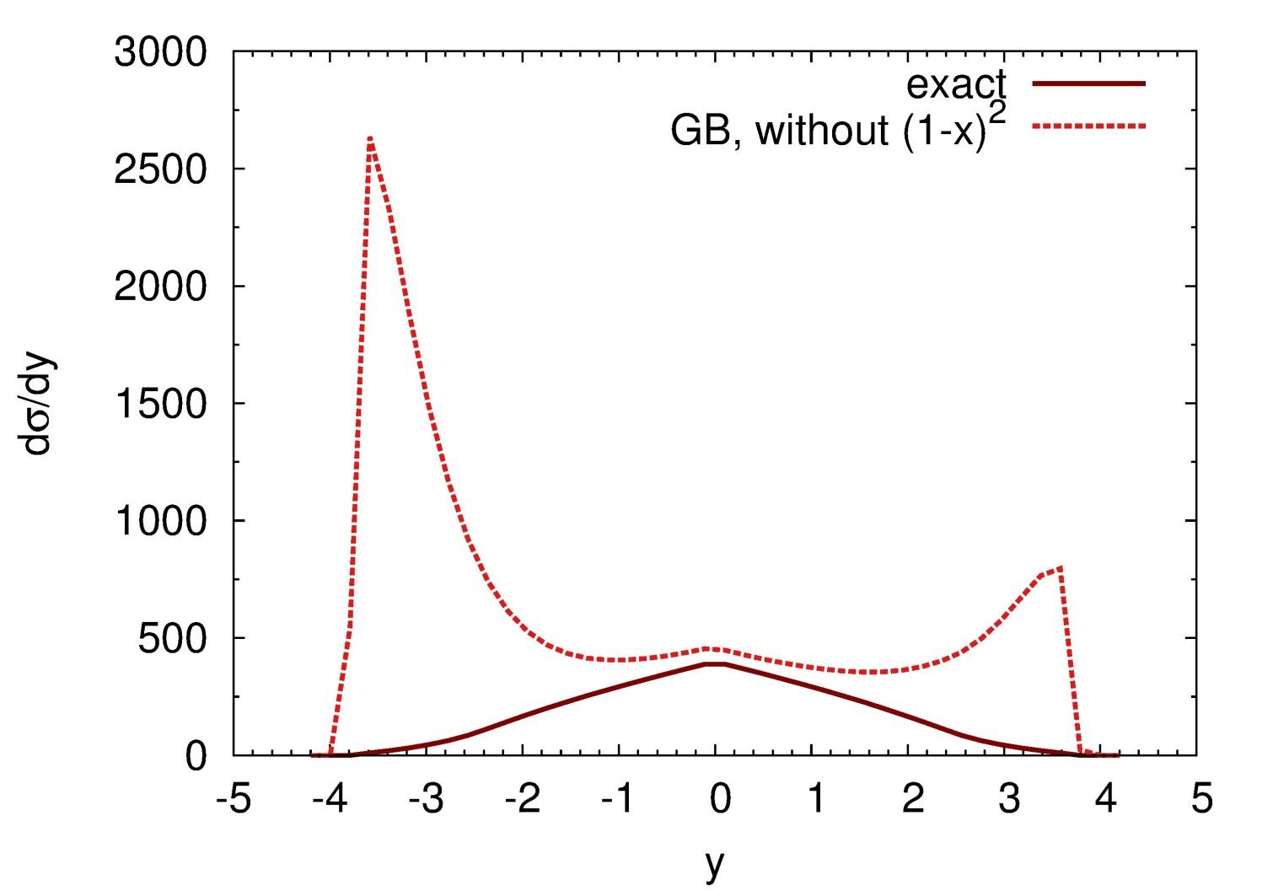
The Problems with Gunion-Bertsch

Slide 23
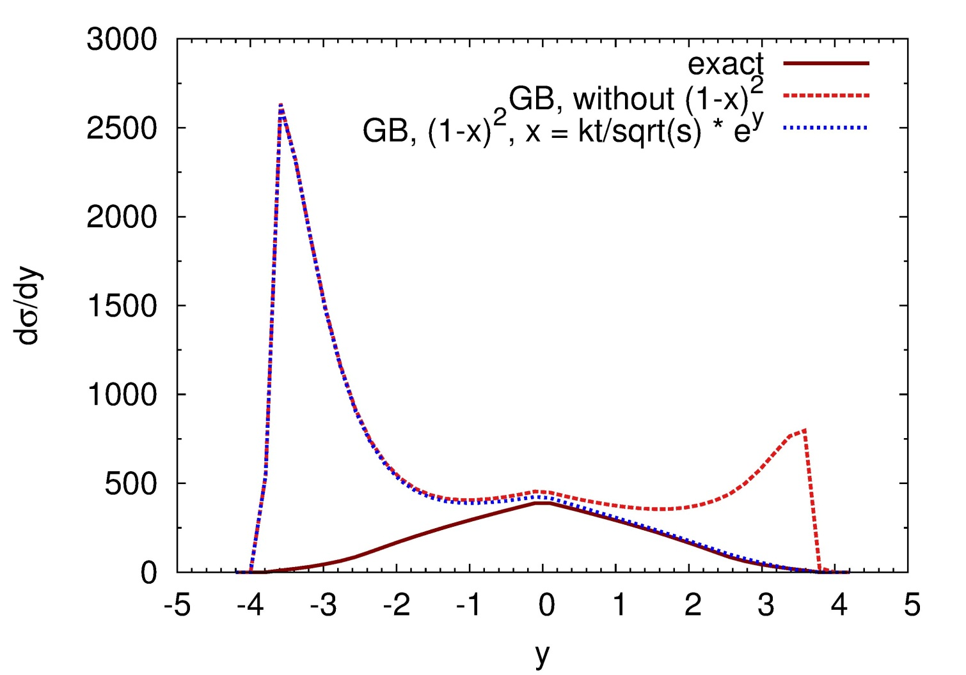
The Problems with Gunion-Bertsch

Slide 24
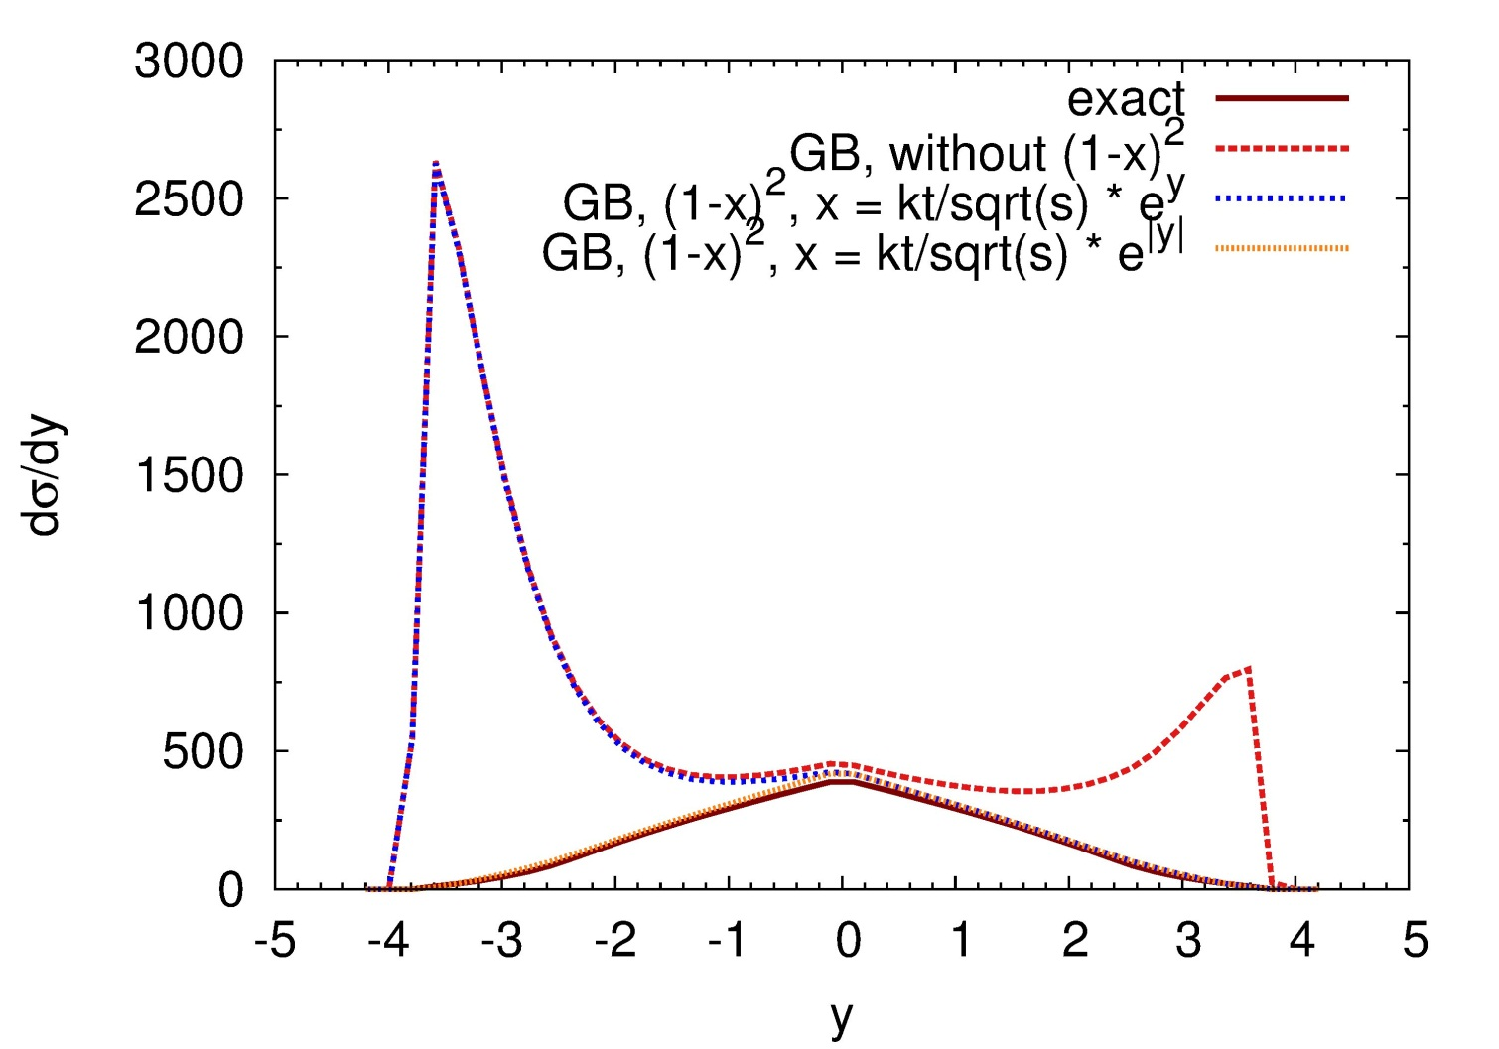
The Problems with Gunion-Bertsch
color glass condensate
see eg
Kovchegov, Rischke,
Phys.Rev. C56 (1997)

Slide 25
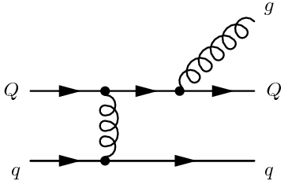
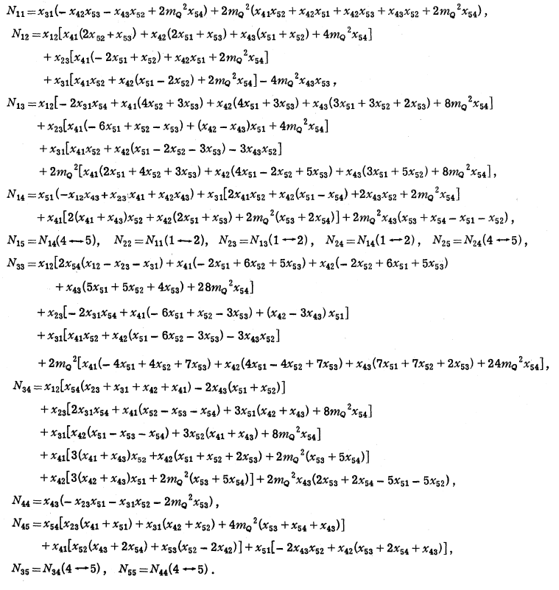
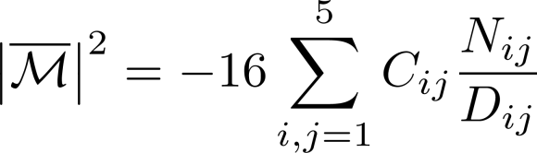
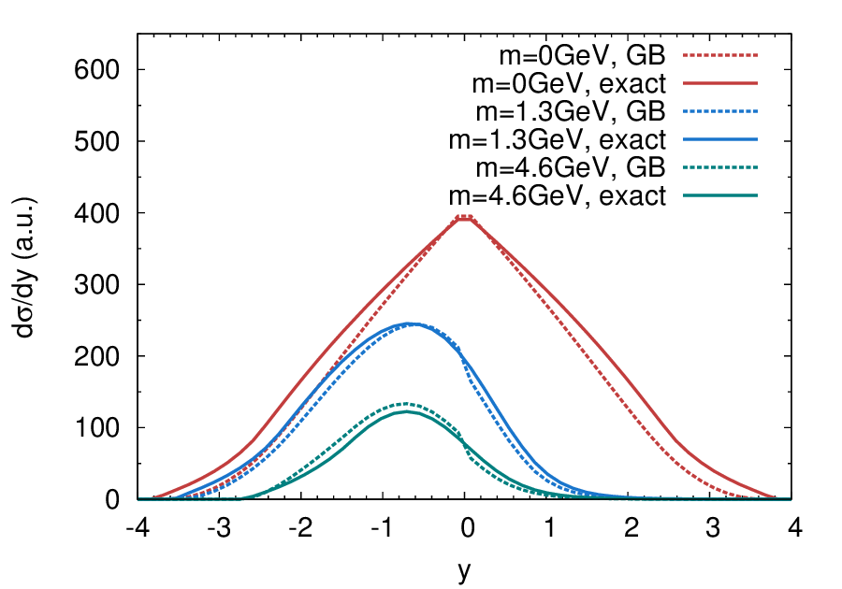
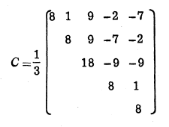
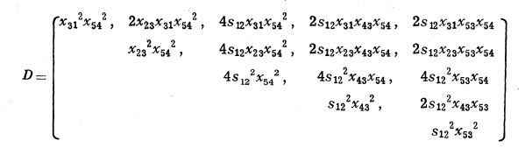
Radiative pQCD processes
Exact matrix element
Kunszt, Pietarinen, Reya, Phys.Rev. D21 (1980)
improved Gunion Bertsch (GB) approximation
Q
q
Fochler, JU, Xu, Greiner, arXiv:1302.5250

Slide 26
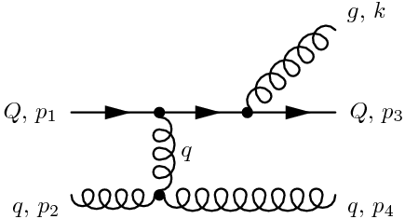


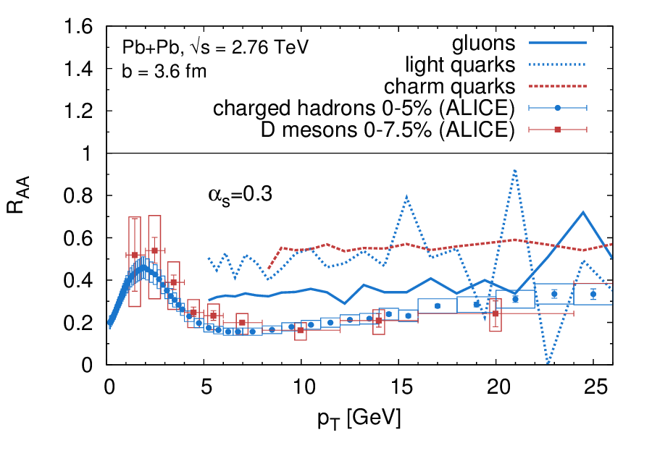
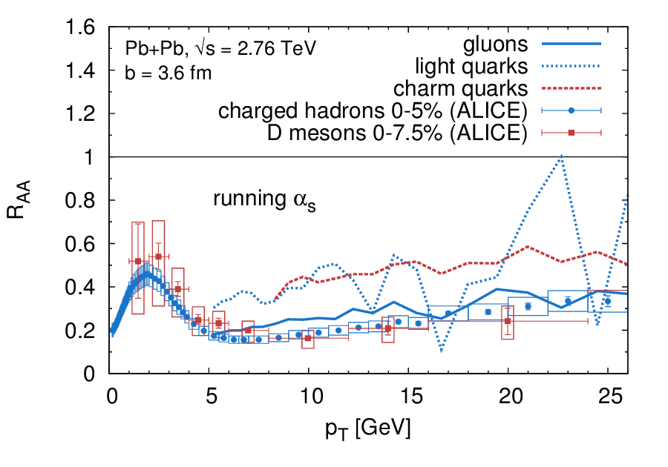
R_{AA} with improved Gunion-Bertsch
Improved Gunion-Bertsch matrix element
Fochler, JU, Xu, Greiner, arXiv:1302.5250

Slide 27
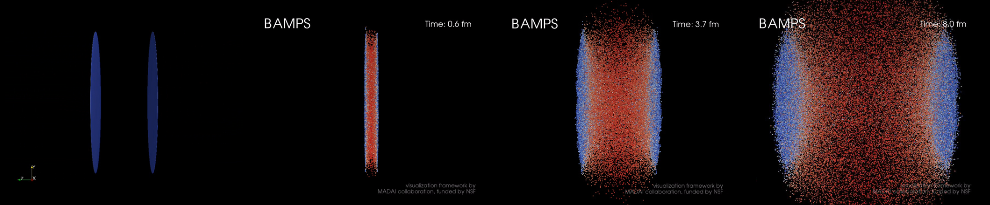
Summary
Inelastic/radiative pQCD interactions (23 + 32) explain:
fast thermalization
large collective flow, also of heavy quarks
small shear viscosity of QCD
semirealistic jet-quenching , also of heavy quarks
Future/ongoing analysis and developments:
Gunion-Bertsch approximation needs corrections
jet-quenching (Mach Cones, ridge, fluctuations)
momentum dijet asymmetry
hadronisation and afterburning (UrQMD)

Slide 28


Riemann problem at finite viscosity
I. Bouras et al, PRL 103:032301 (2009)
Tleft = 400 MeV
Tright = 200 MeV
t = 1.0 fm/c
Development of a shock plateau
η/s less than 0.1-0.2

Slide 29

VISCOUS Solutions
I. Bouras et al,
arXiv:1201.5005 (2012)
… the death of Mach Cones ?

Slide 30



Mach cones at relativistic HIC
Central collisions and
Smooth initial conditions
at RHIC energies
E_jet = 20 GeV
Notes:
30

Slide 31


Mach cones at relativistic HIC
At fixed angle 180
Random position on the semi circle
Notes:
31

Slide 32










LPM-effect
O. Fochler
transport model: incoherent treatment of gg→ggg processes
parent gluon must not scatter during formation time of emitted gluon
  discard all possible interference effects (Bethe-Heitler regime)
p₁
p₂
k_{t}
k_{t}
lab frame
CM frame
τ = 1 / k_{t}
total boost

Slide 33



Impact on observables – R_{AA} and v₂
α_{s} = 0.3
Simulations of R_{AA} and v₂ at 2.76 ATeV
Elliptic flow is decreased, jet quenching is decreased
Effect on R_{AA} is stronger than on v₂
Determined by complex self-screening of rates and relative contributions of different processes to the observables
Room for e.g. running coupling, improvement of results possible

