Slide 1
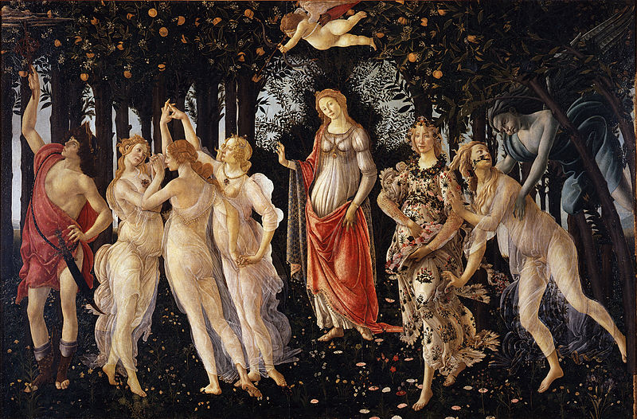
INPC 2013
Firenze, Italy 2 -7 June 2013
Strange hadrons and resonances at LHC energies with the ALICE detector
A. Badalà (INFN Sezione di Catania) for the ALICE Collaboration

Slide 2
Contents
Motivation to study strange hadron and resonance production
Strange hadron and resonance reconstruction in ALICE
K⁰_{S}, Λ, Ξ⁻ and Ω⁻ (+anti-particles), φ(1020), K*(892)⁰ (+anti-particle)
Resonance characteristics (mass and width)
Results:
Strangeness enhancement
Mean p_{T} and resonance to non-resonance yield ratios
Baryon to Meson ratios (Λ /K⁰_{S} ratio and Ω/φ ratio)
Nuclear modification factor (φ)
Summary
2

Slide 3
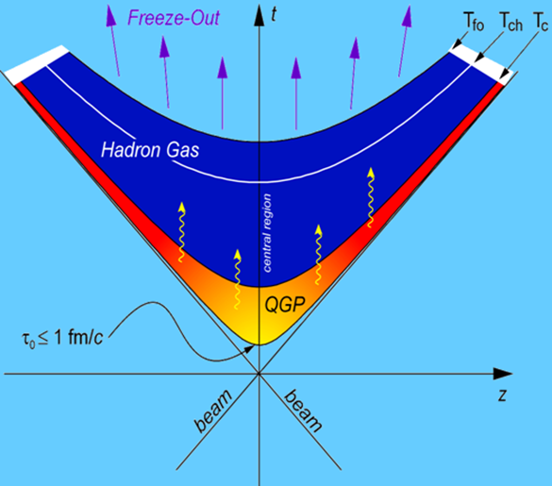
Motivation
The study of (multi)strange particle and resonance production allows information from the early partonic phase of the fireball and its evolution to be extracted
s-quarks are produced in the collisions
multi-strange hadrons have small hadronic interaction cross section (H. van Hecke et al. PRL 81(1998)5764)
resonances have lifetime of few fm/c i.e. ≈ lifetime of fireball. Regeneration and rescattering effects→ Timescale between chemical and kinetic freeze-out (C. Markert, J. Phys. G 31(2005)s897)
π
K
π
K
Modification of width, mass and branching ratio of resonances has been indicated as a probe of chiral symmetry restoration.
Kinetic freeze out
Re-scattering
π
K
Re-generation
time
Chemical freeze-out
3

Slide 4
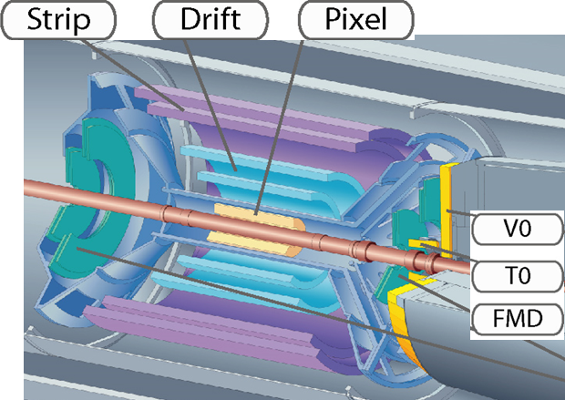
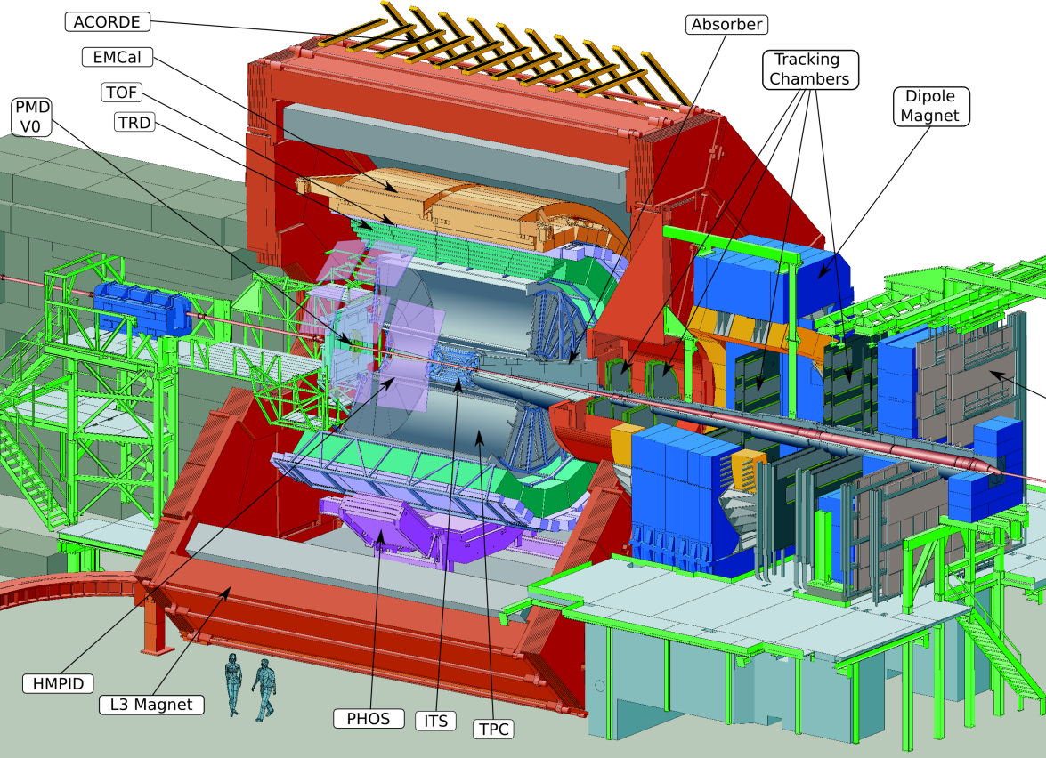
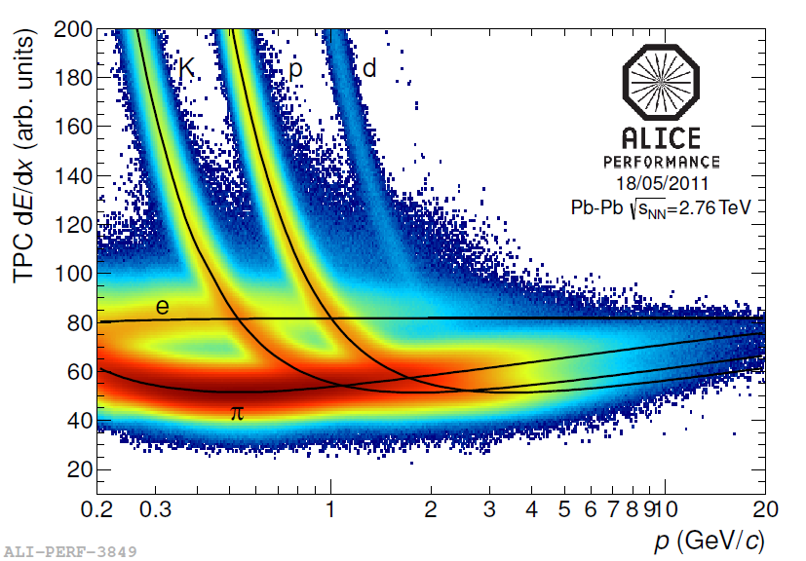
ALICE detector
ITS
TPC σ_{dE/dx} ≈5-6%
ITS,TPC tracking detectors
TPC: particle identification by dE/dx
ITS, VZERO triggering and centrality definition
4

Slide 5
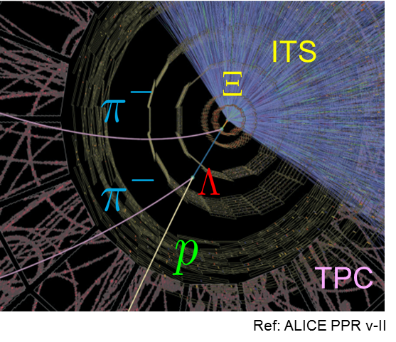
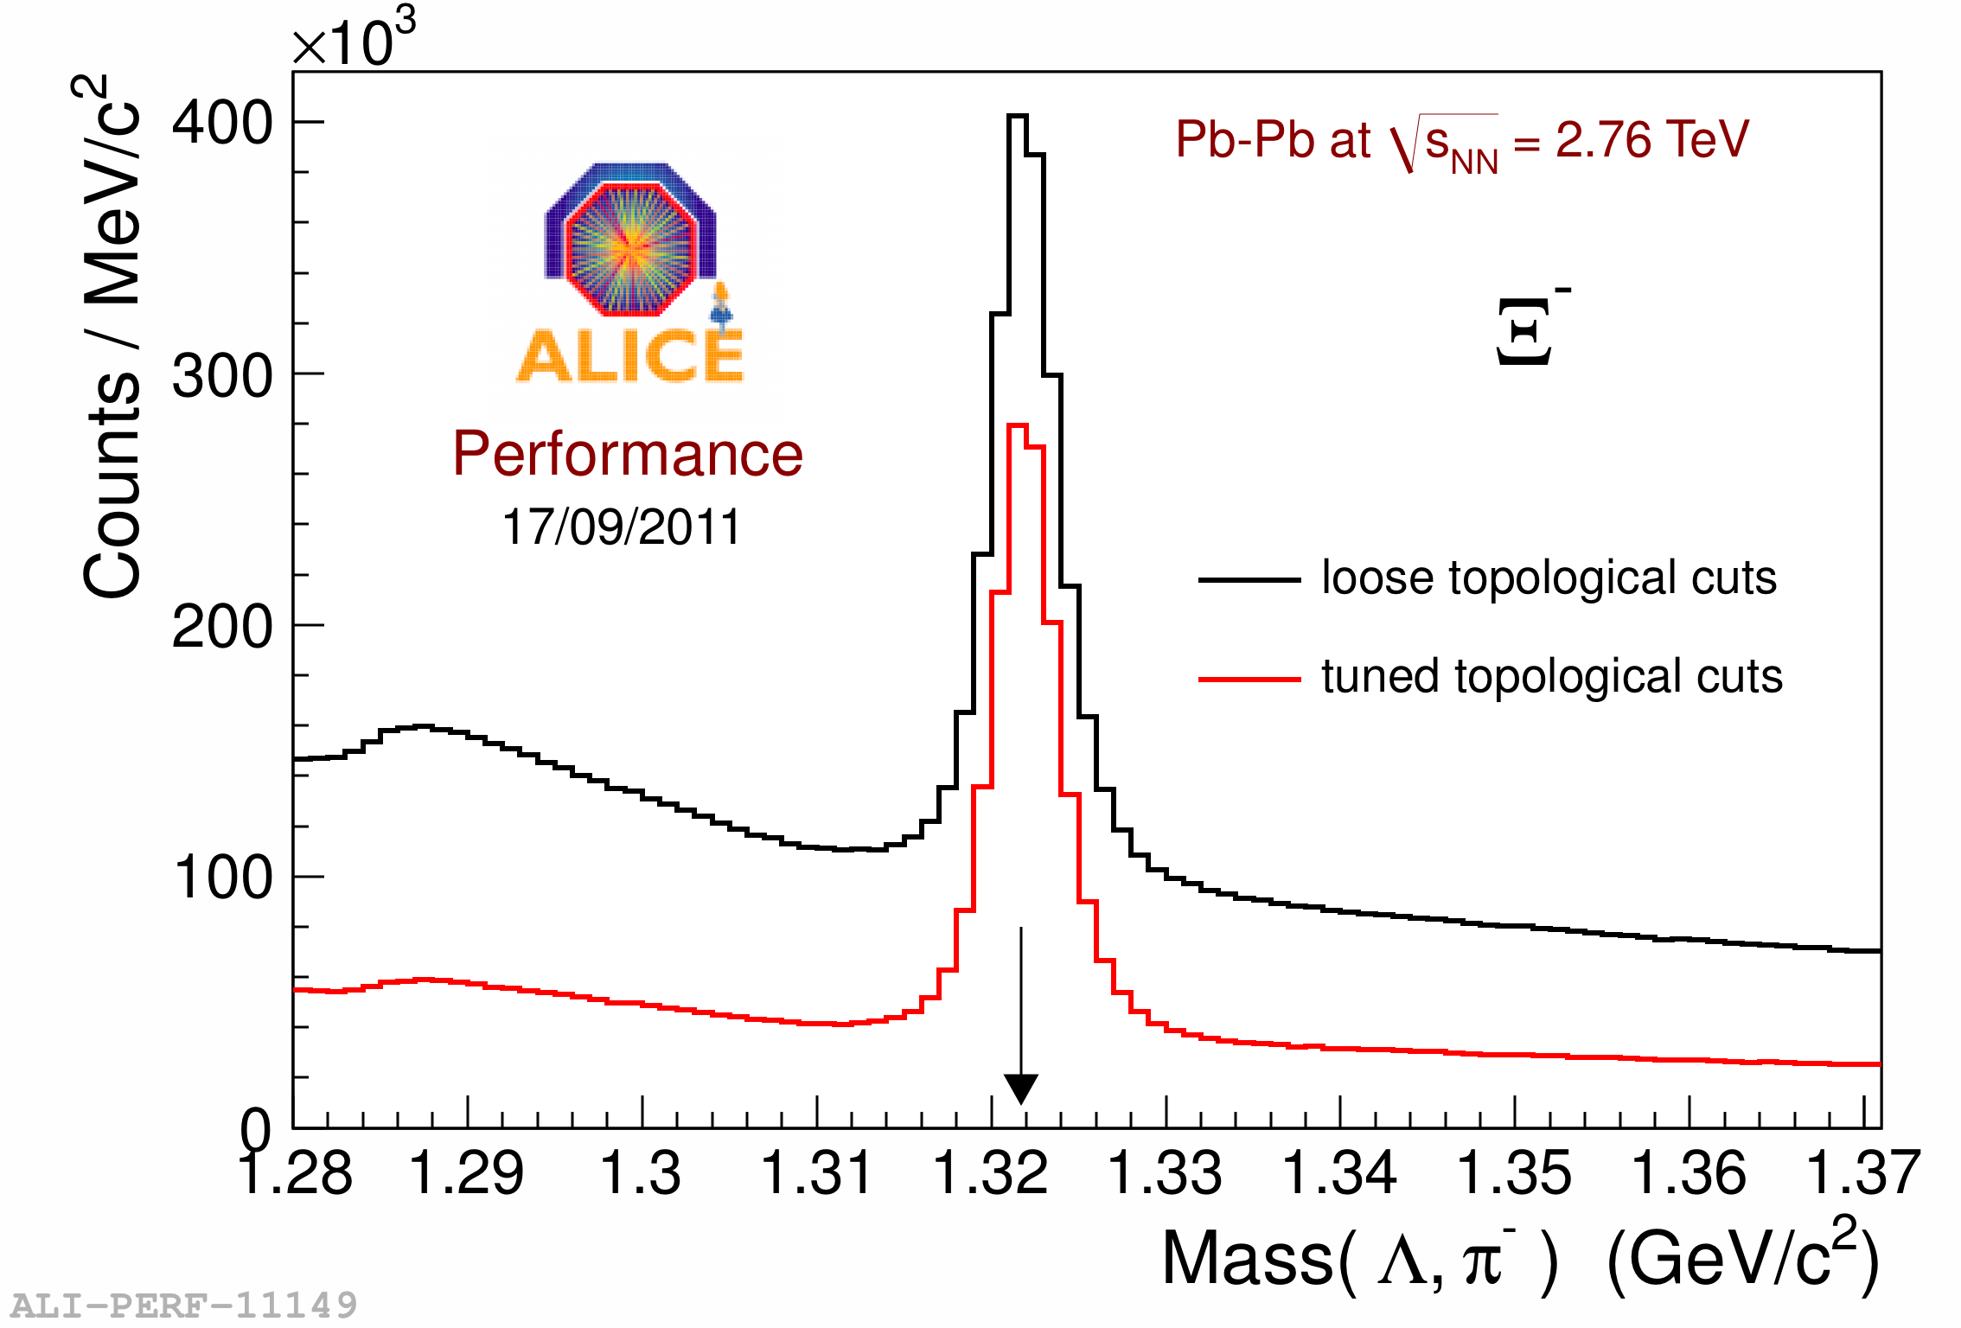
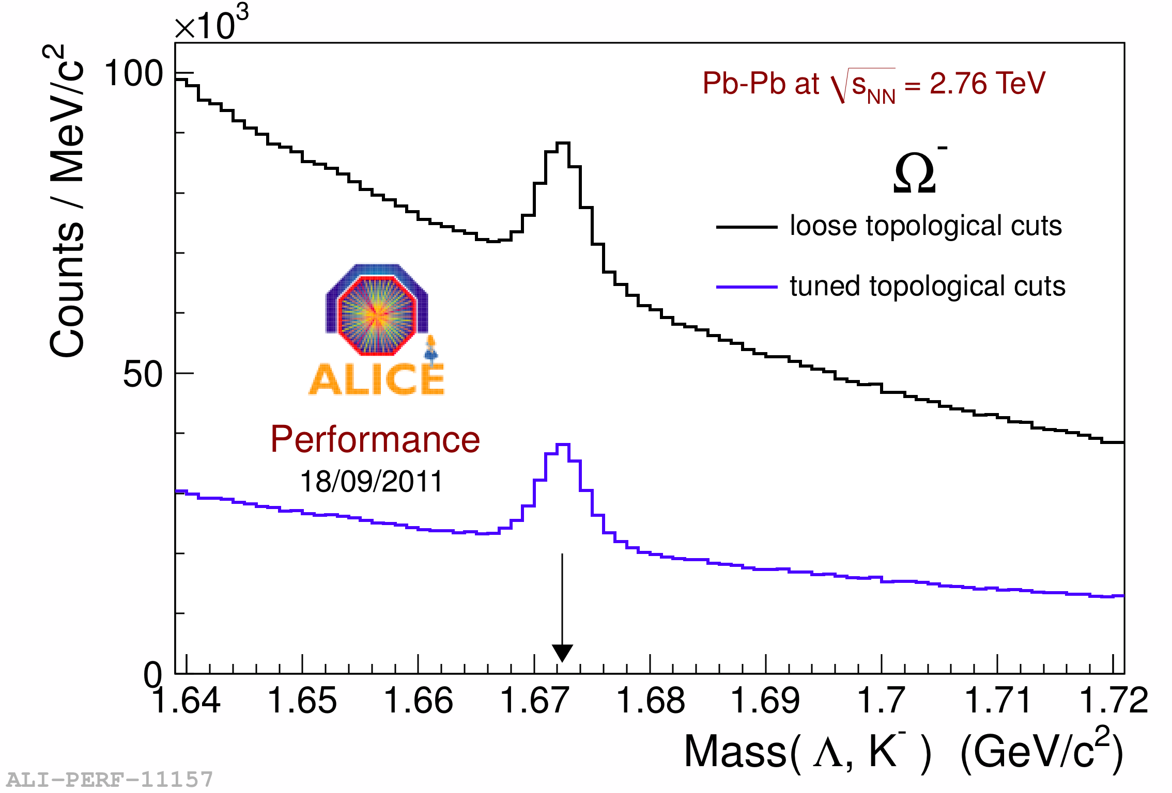
Strange particle detection
Reconstruction of weak decay to charged particles
Single-strange
Multi-strange
V-shaped topology for K⁰_{S} and Λ
Cascade-topology for Ξ and Ω
TPC for particle identification of daughter tracks
5

Slide 6
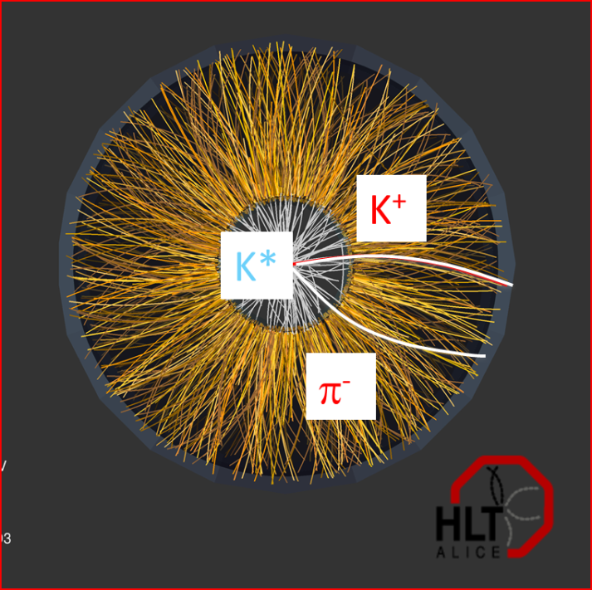
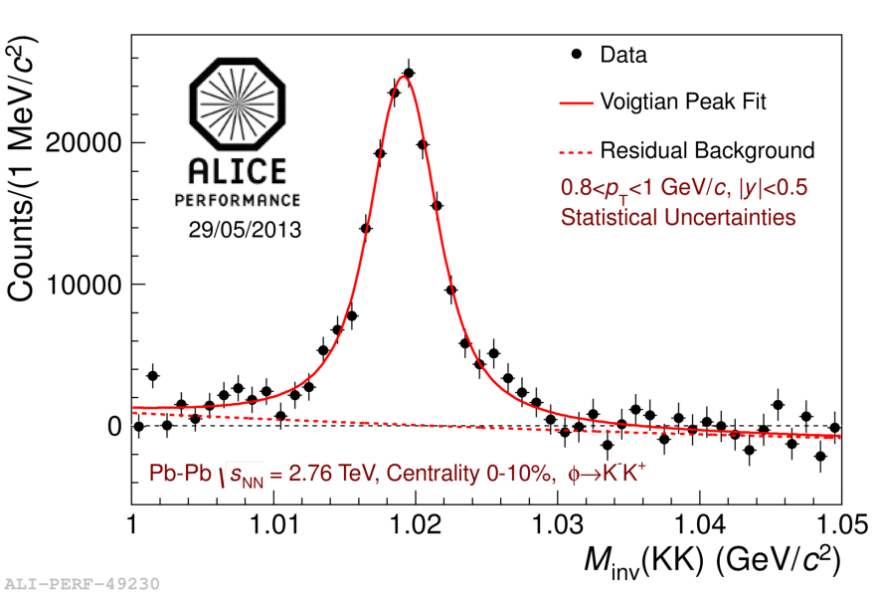
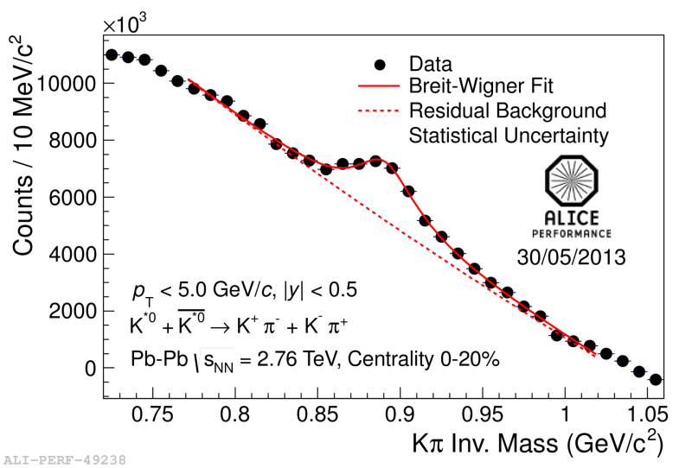
Resonance reconstruction
Reconstructed via their hadronic decay channels:
K^{*0} → K⁺ π⁻
ϕ → K⁺K⁻
K^{*0} → K⁻ π⁺
TPC for particle identification of daughter tracks
Combinatorial background estimated:
Mixed event technique.
Like Sign technique.
Fit:
K*: relativistic Breit-Wigner+polynomial
φ: Voigtian + polynomial
ϕ
K*
6

Slide 7
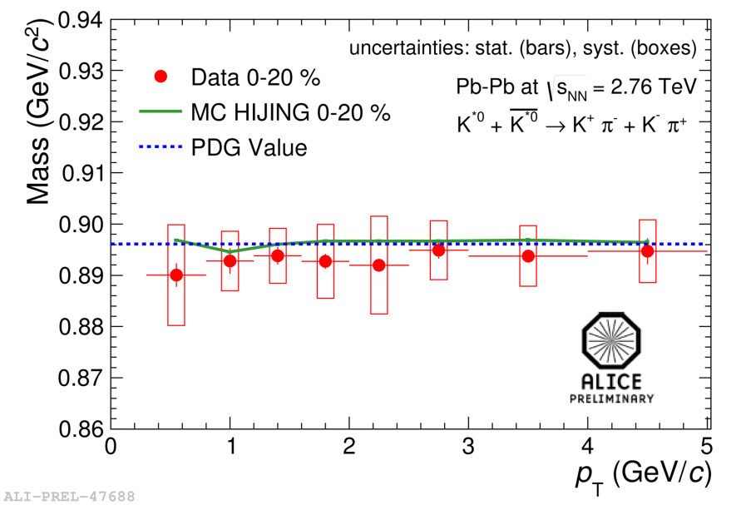
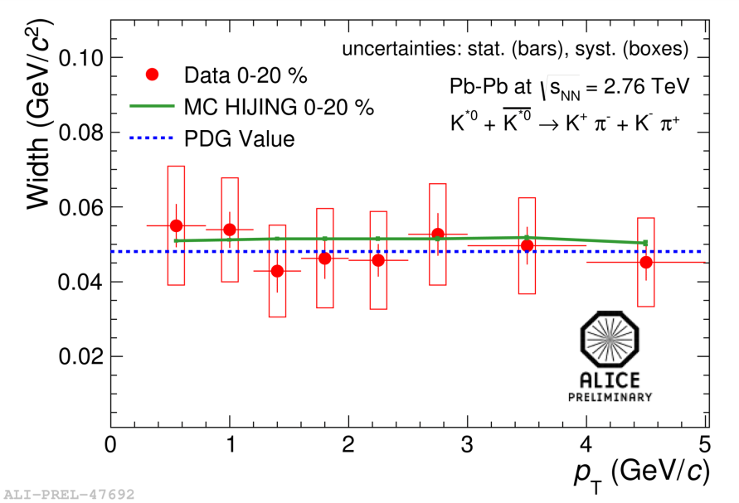
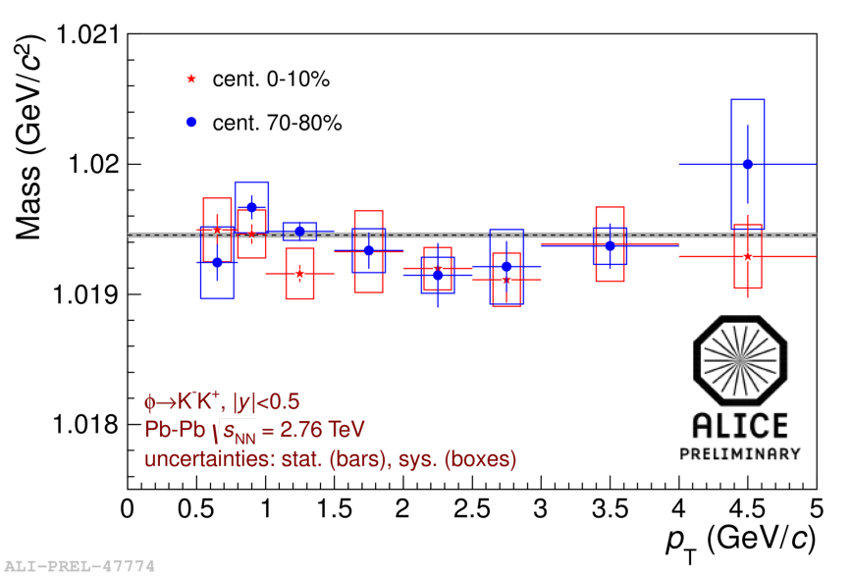
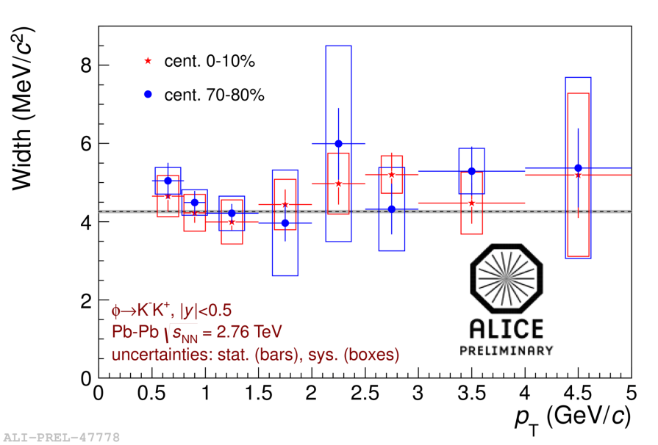
K* and φ mass and width
For K* (892)⁰ and φ(1020) no mass shift or width broadening in Pb-Pb collisions
7

Slide 8
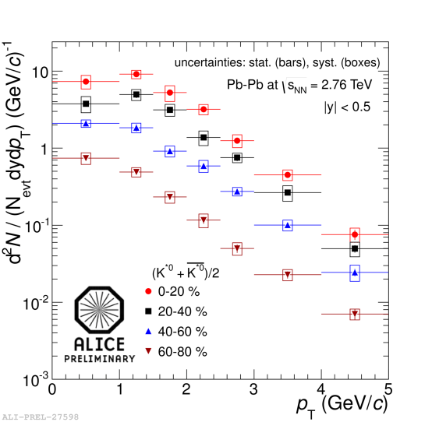
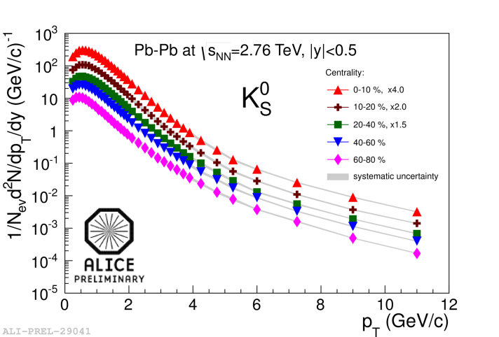
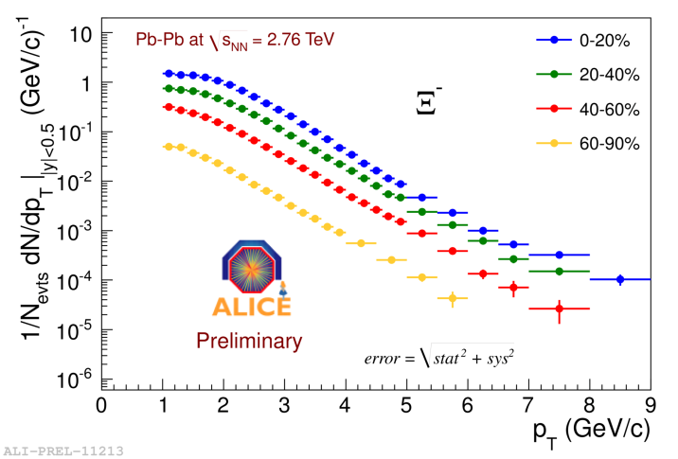
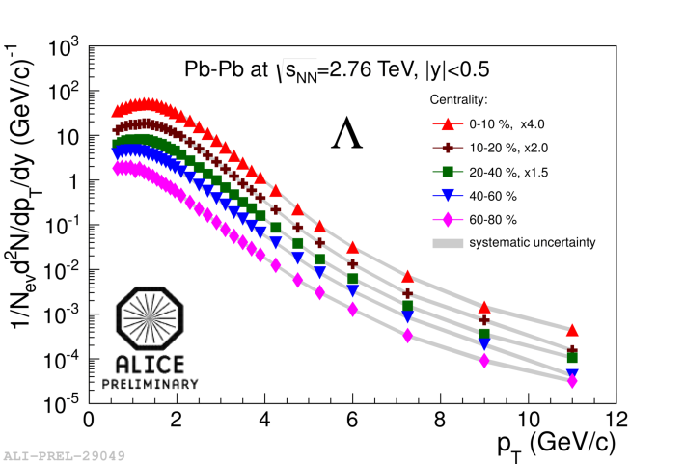
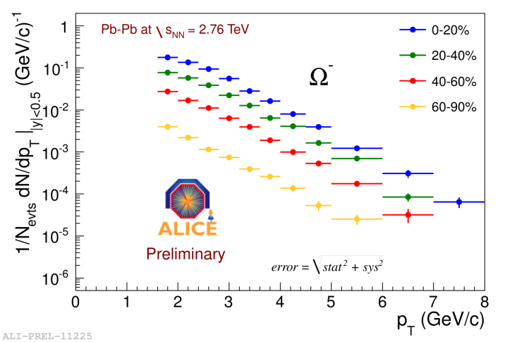
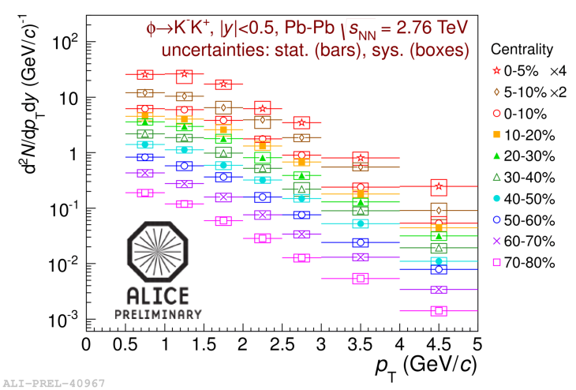
Transverse momentum spectra
Ξ⁻
K*
Ω⁻
φ
Λ
8

Slide 9
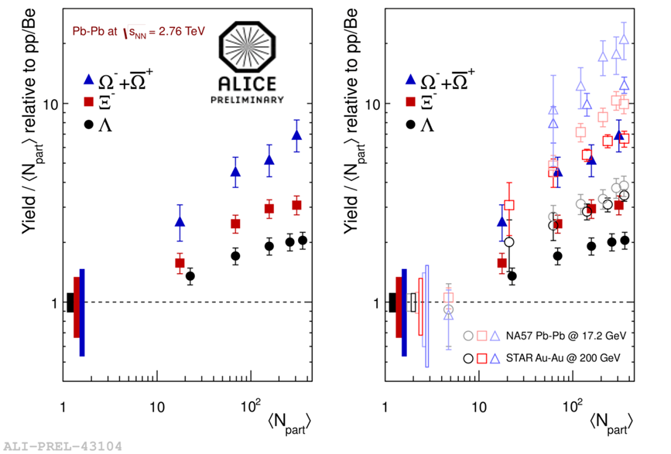
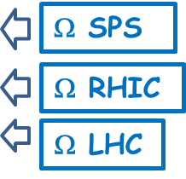
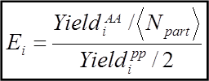
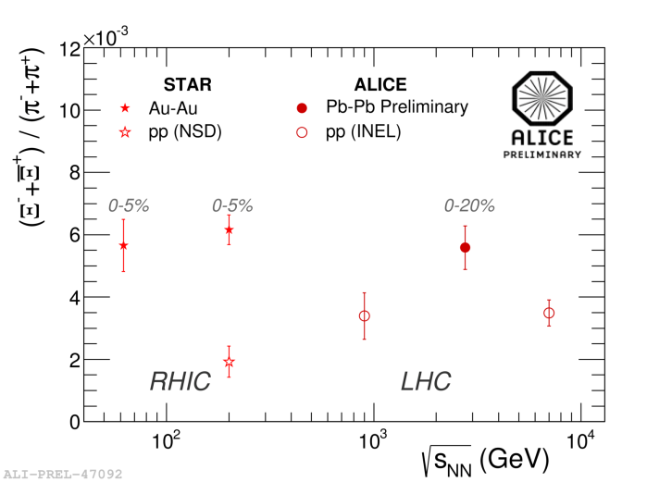
Strangeness enhancement?
Signature: J. Rafelski et al., PRL 48(1982)1066, P. Koch et al., Phys. Rep. 142(1986)167
Hierarchy based on strangeness content
Decreasing trend with energy from SPS→RHIC→LHC
Canonical suppression qualitatelively describes the trend of strangeness yield with centrality and energy.
(S. Hamieh et al., PL B486(2000)61, A. Tounsi et al., arXiv. 011159v1)
9

Slide 10
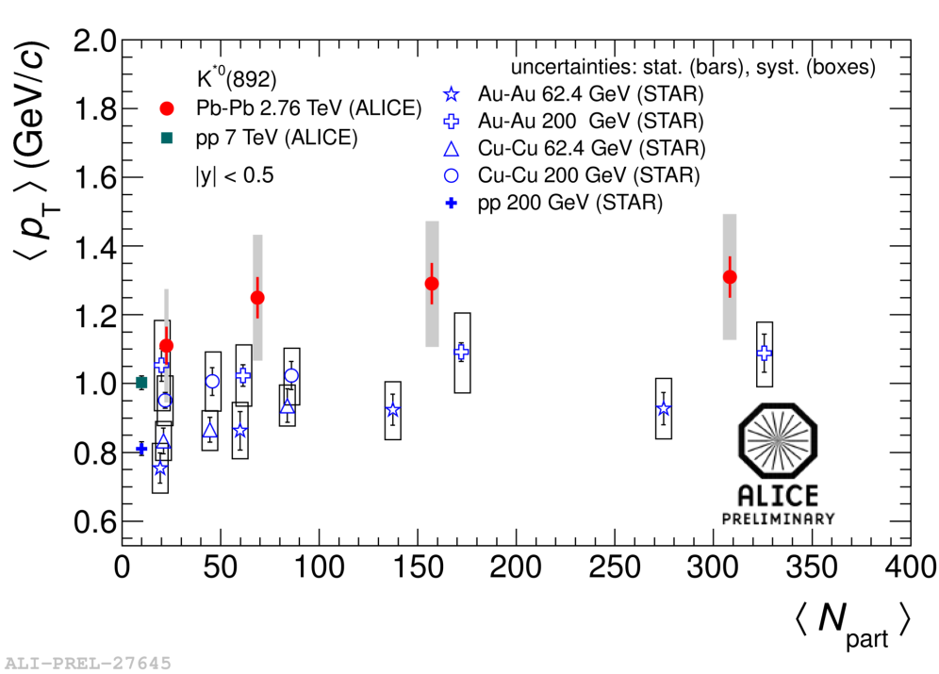
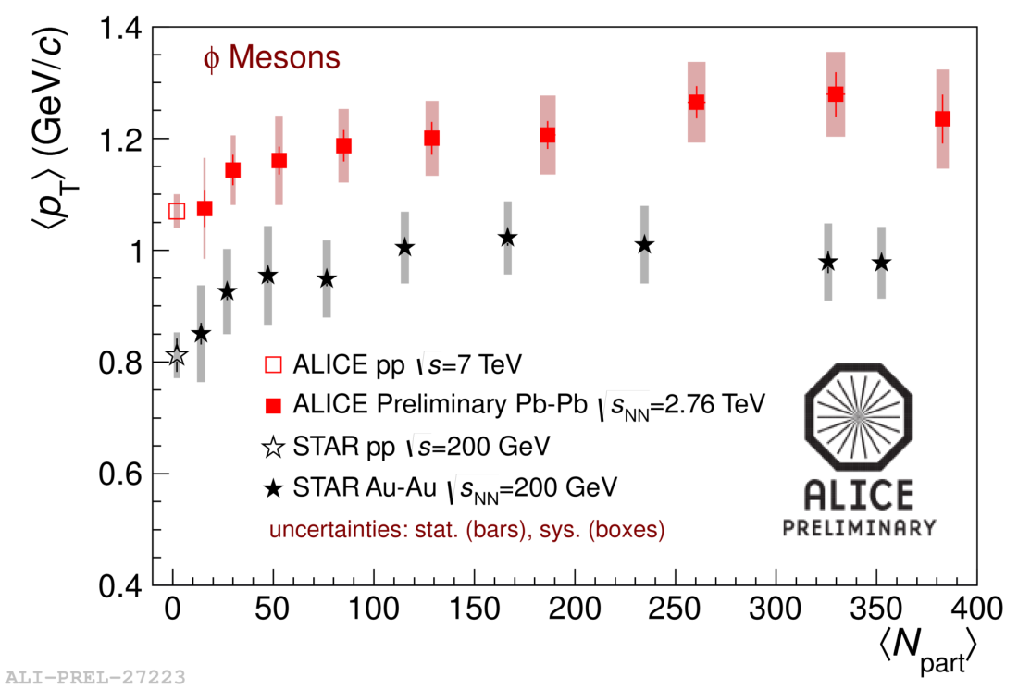
Resonance mean p_{T}
<p_{T}> in pp @√s=7 TeV consistent with peripheral Pb-Pb collisions
<p_{T}>_{LHC} higher than <p_{T}>_{RHIC} →Consistent with a stronger radial flow at LHC than RHIC. Global Blast-wave fit on π, K, p shows ∼10% increase in <β_{T}> over RHIC (ALICE Phys. Rev. Lett. 109, 252301 (2012))
10

Slide 11
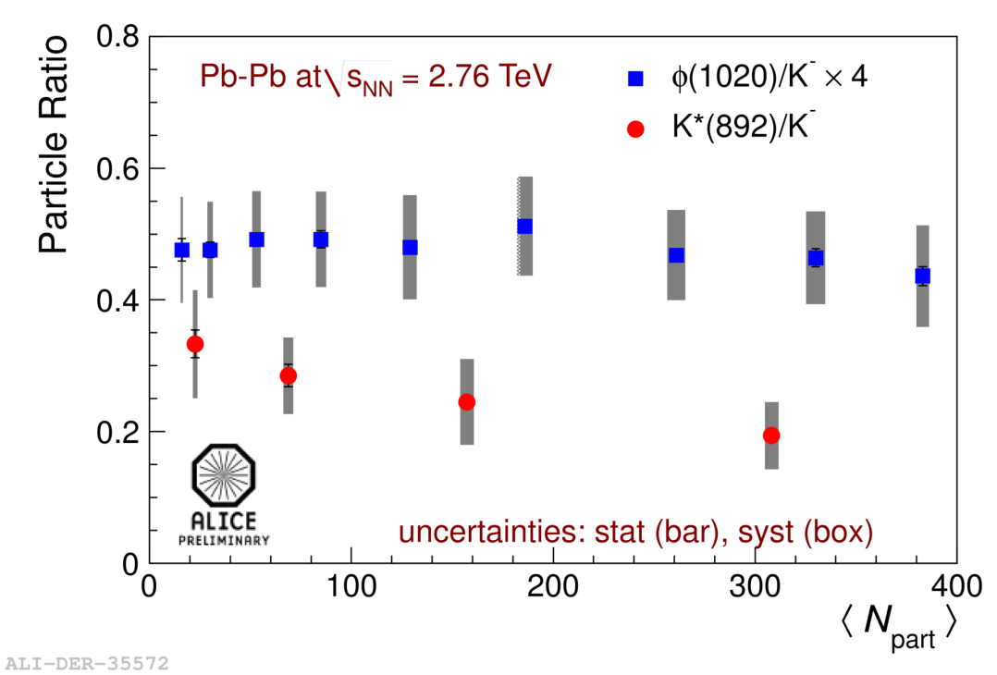
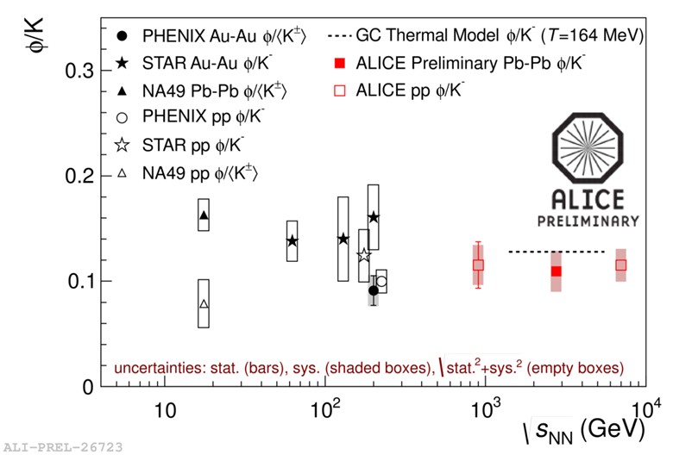
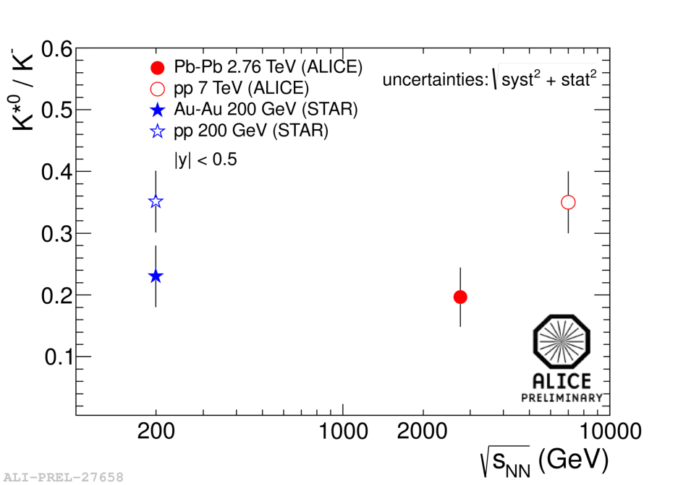
K*/K vs. <N_{part}> and √s_{NN}
φ/K: independent of collision centrality, energy and collision system
K*/K : hint of decrease with increasing centrality
K* suppression due to interaction in hadronic medium? φ not affected due to long lifetime?
 | τ (fm/c)
K^{*0} | 4
φ | 45
pp
HI
11

Slide 12
K*/K vs. radial extension of the fireball
Decrease of the K*/K depends on the radial extension of the fireball?
STAR Coll. , Phys. Rev. C 84, 34909 (2010)
12

Slide 13
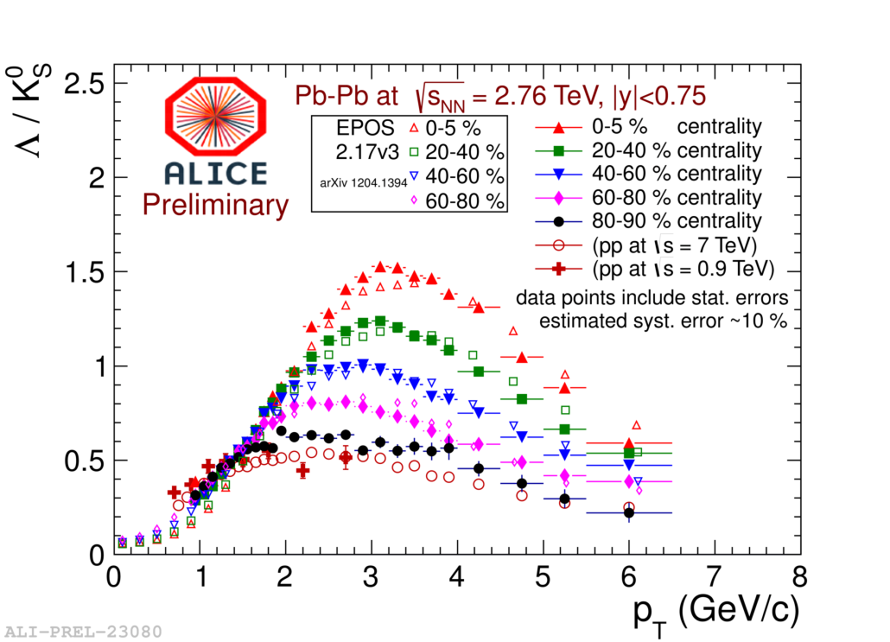
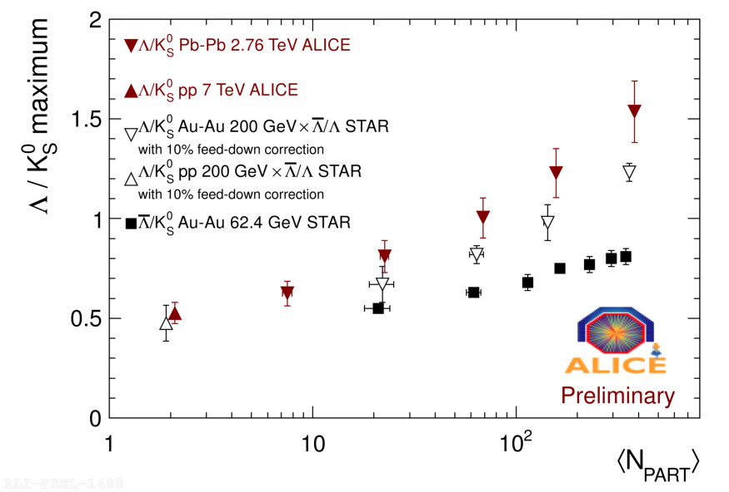
Baryon-to –meson ratio
«Baryon anomaly» already observed at RHIC energy is an important test of the models for the medium evolution. Main ingredients: flow, recombination and fragmentation.
Slightly larger at the LHC than at RHI C
Baryon/meson ratio strongly enhanced at intermediate p_{T}
Increase with centrality
Ratio in pp similar to peripheral Pb-Pb collisions
Enhancement still present at 6 GeV/c
Reproduced by EPOS (also centrality dependence) (K. Werner, PRL 109(2012)102301)
13

Slide 14
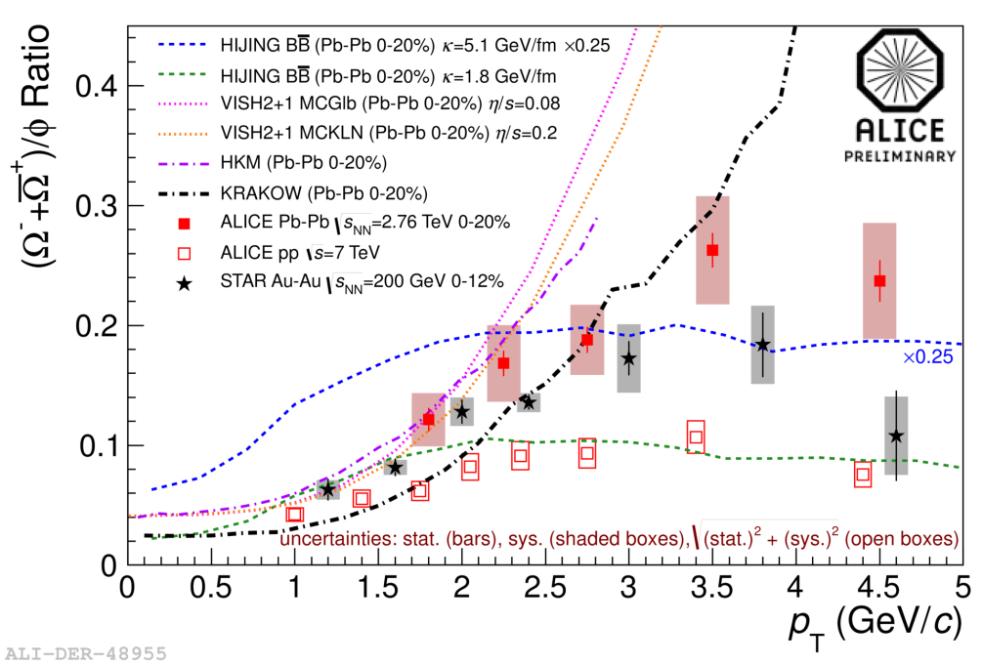
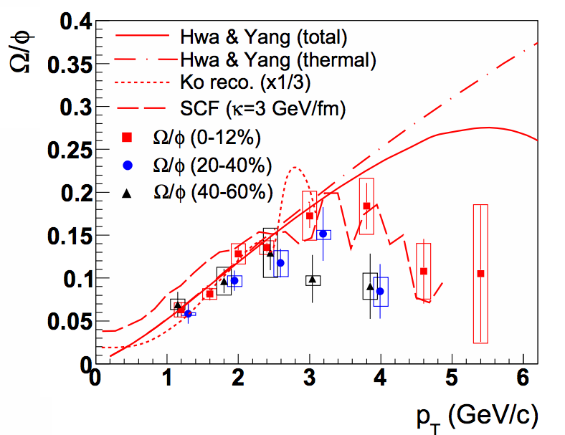
Ω/φ ratio
Low p_{T} data are well reproduced by hydrodynamical models (VISH2+1 and HKM). (C. Shen et al. PR C84(2011)044903, Z. Qiu et la. PL B707(2012)151, I. Karpenko et al. PR C87(2013)024914)
KRAKOW model, which has a non-equilibrium corrections due to viscosity, largely underpredicts the ratio. (P. Bozek et al. PR C85(2012)064915)
HIJING BB (V. Topor Pop et al. PR C84(2011)044909), which models particle production by a Strong Color Field, reproduces Ω/ϕ in:
Au-Au collisions at √s_{NN} =200 GeV (k=3 GeV fm)
pp collisions at √s=7 TeV (k=2 GeV fm).
The expected large string value (k= 5 GeV fm) at LHC energies largely overpredicts the experimental value .
B.I. Abelev et al. (STAR Coll. ) Phys. Rev. C79(2009)064903
14

Slide 15
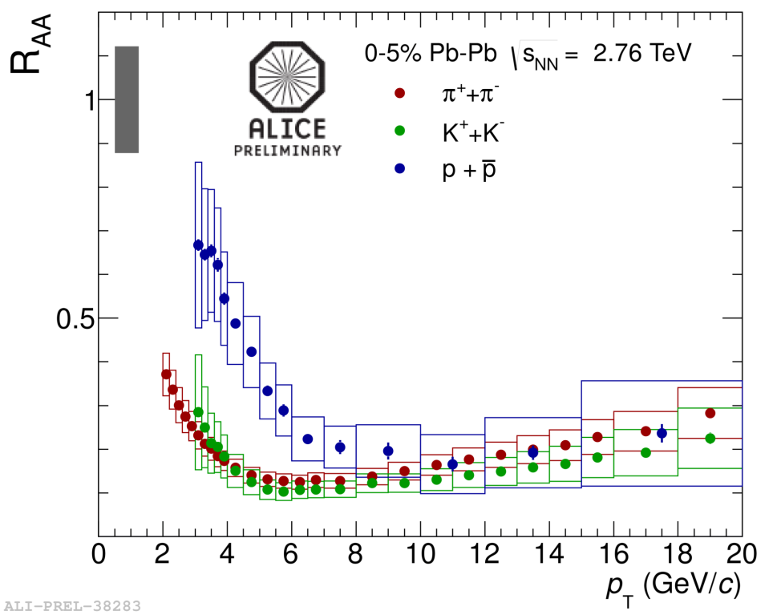
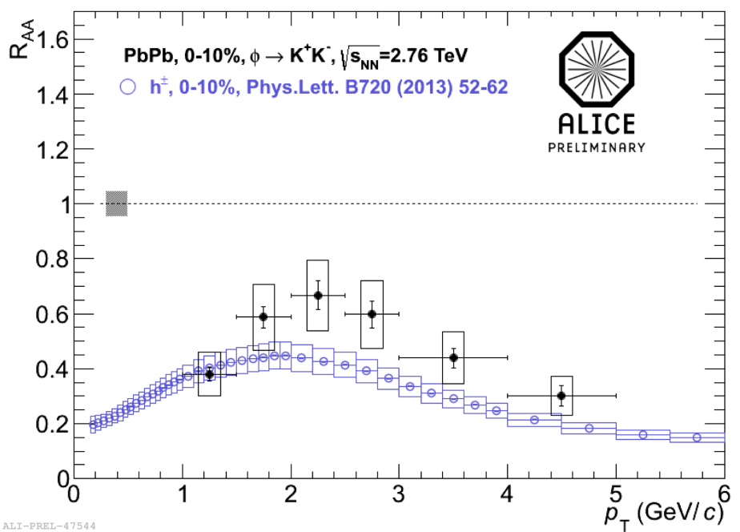
Nuclear modification R_{AA}
Suppression of π, K and p production in central collisions
For p_{T}> 8 GeV/c R_{AA} similar for all particles → no strong flavour or meson/baryon dependence
For low p_{T} large meson/baryon dependence.
R_{AA} (K) similar R_{AA} (π)
R_{AA} (p) > R_{AA} (π)
For p_{T} < 5 GeV/c R_{AA}(φ(1020)) slightly larger than R_{AA}(charged). Similar behaviour at RHIC energy.
15

Slide 16
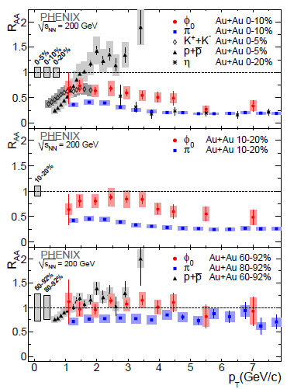
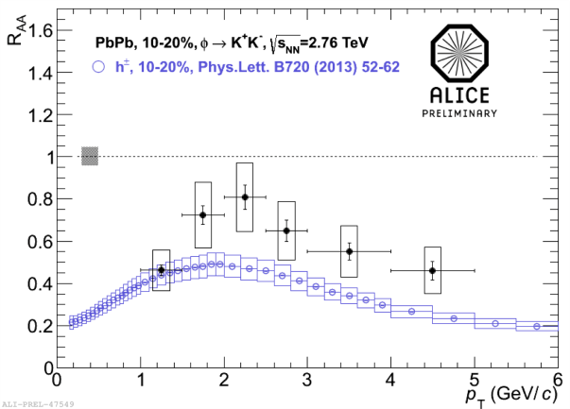
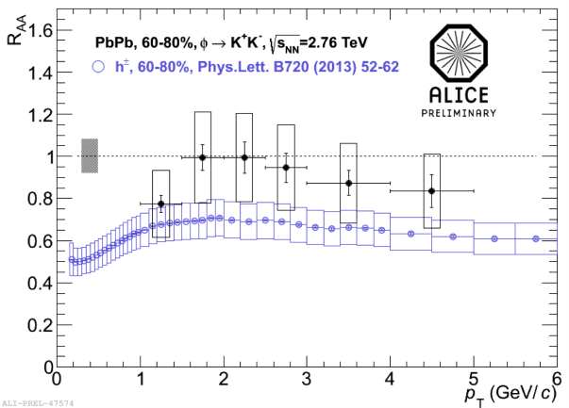
Comparison R_{AA} ALICE-PHENIX
0-10%
10-20%
60-80%
A. Adare et al., Phys. Rev. C83(2011)024909
A. Badalà – INPC 2013 – 2-7 June 2013 – Firenze (Italy)
16

Slide 17
Summary
Strangeness enhancement
Pattern observed at lower energies (SPS/RHIC) still present at LHC
Enhancement increases as energy decreases
Baryon to meson ratios (Λ/K⁰_{S} and Ω/φ) show same trend as at RHIC.
Λ/K⁰_{S} increases from pp above unity in central Pb-Pb collisions at LHC.
These ratios are reproduced by hydrodynamical models at low p_{T}.
Resonances:
Measured mass and width agree with PDG values.
The ratio φ/K rather flat respect to centrality, energy and collision system.
A decrease of the ratio K*/K with increasing the centrality (and radial extension of the fireball) seems present (rescattering effects?)
For p_{T}<5 GeV/c R_{AA}(φ) >R_{AA}(h⁻) and R_{AA}(φ)<R_{AA}(p)
THANK YOU
17

Slide 18
Back-up slides

Slide 19
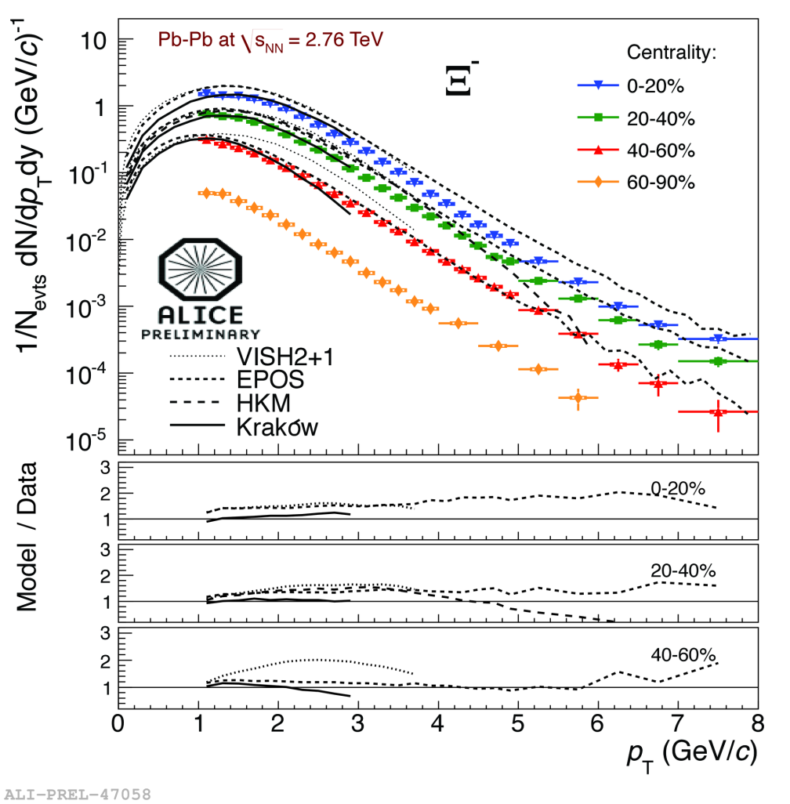
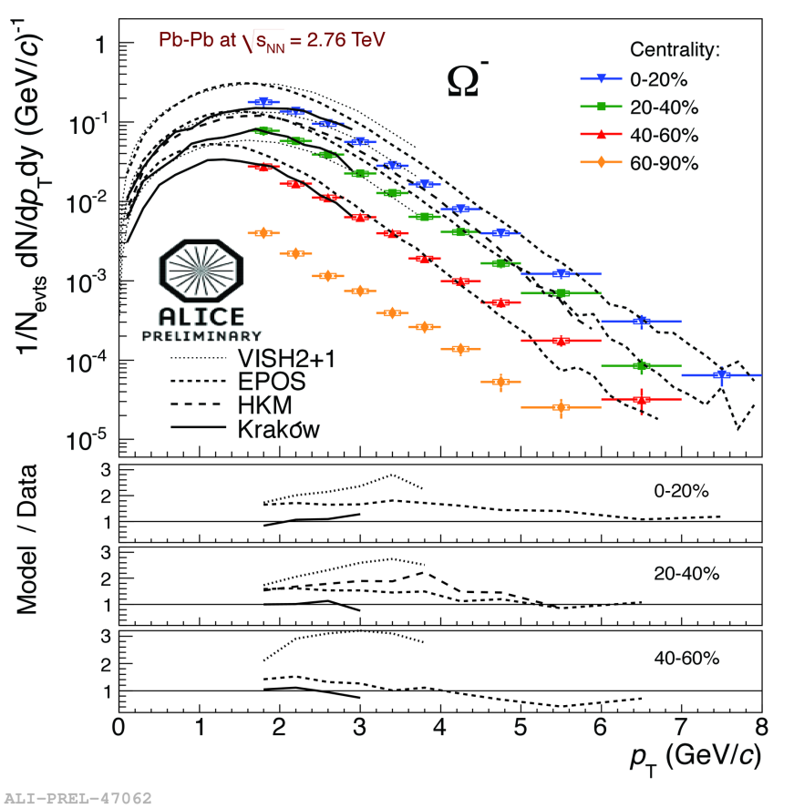

Slide 20
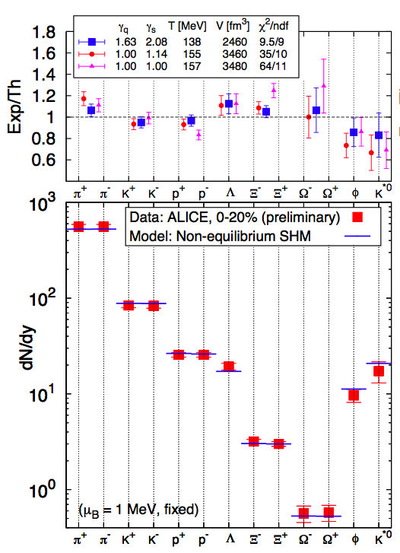
Extrapolation and fits with statistical hadronization model
statistical model (γ_{s}=1) fits data at lower energies
extrapolation from RHIC → T_{fo}=164 MeV
does not fit p and Λ
fitting data → T_{fo}=152 MeV (resonances not included)
but multi-strange deviate
Non-equilibrium?
γ_{s,q}>1

Slide 22
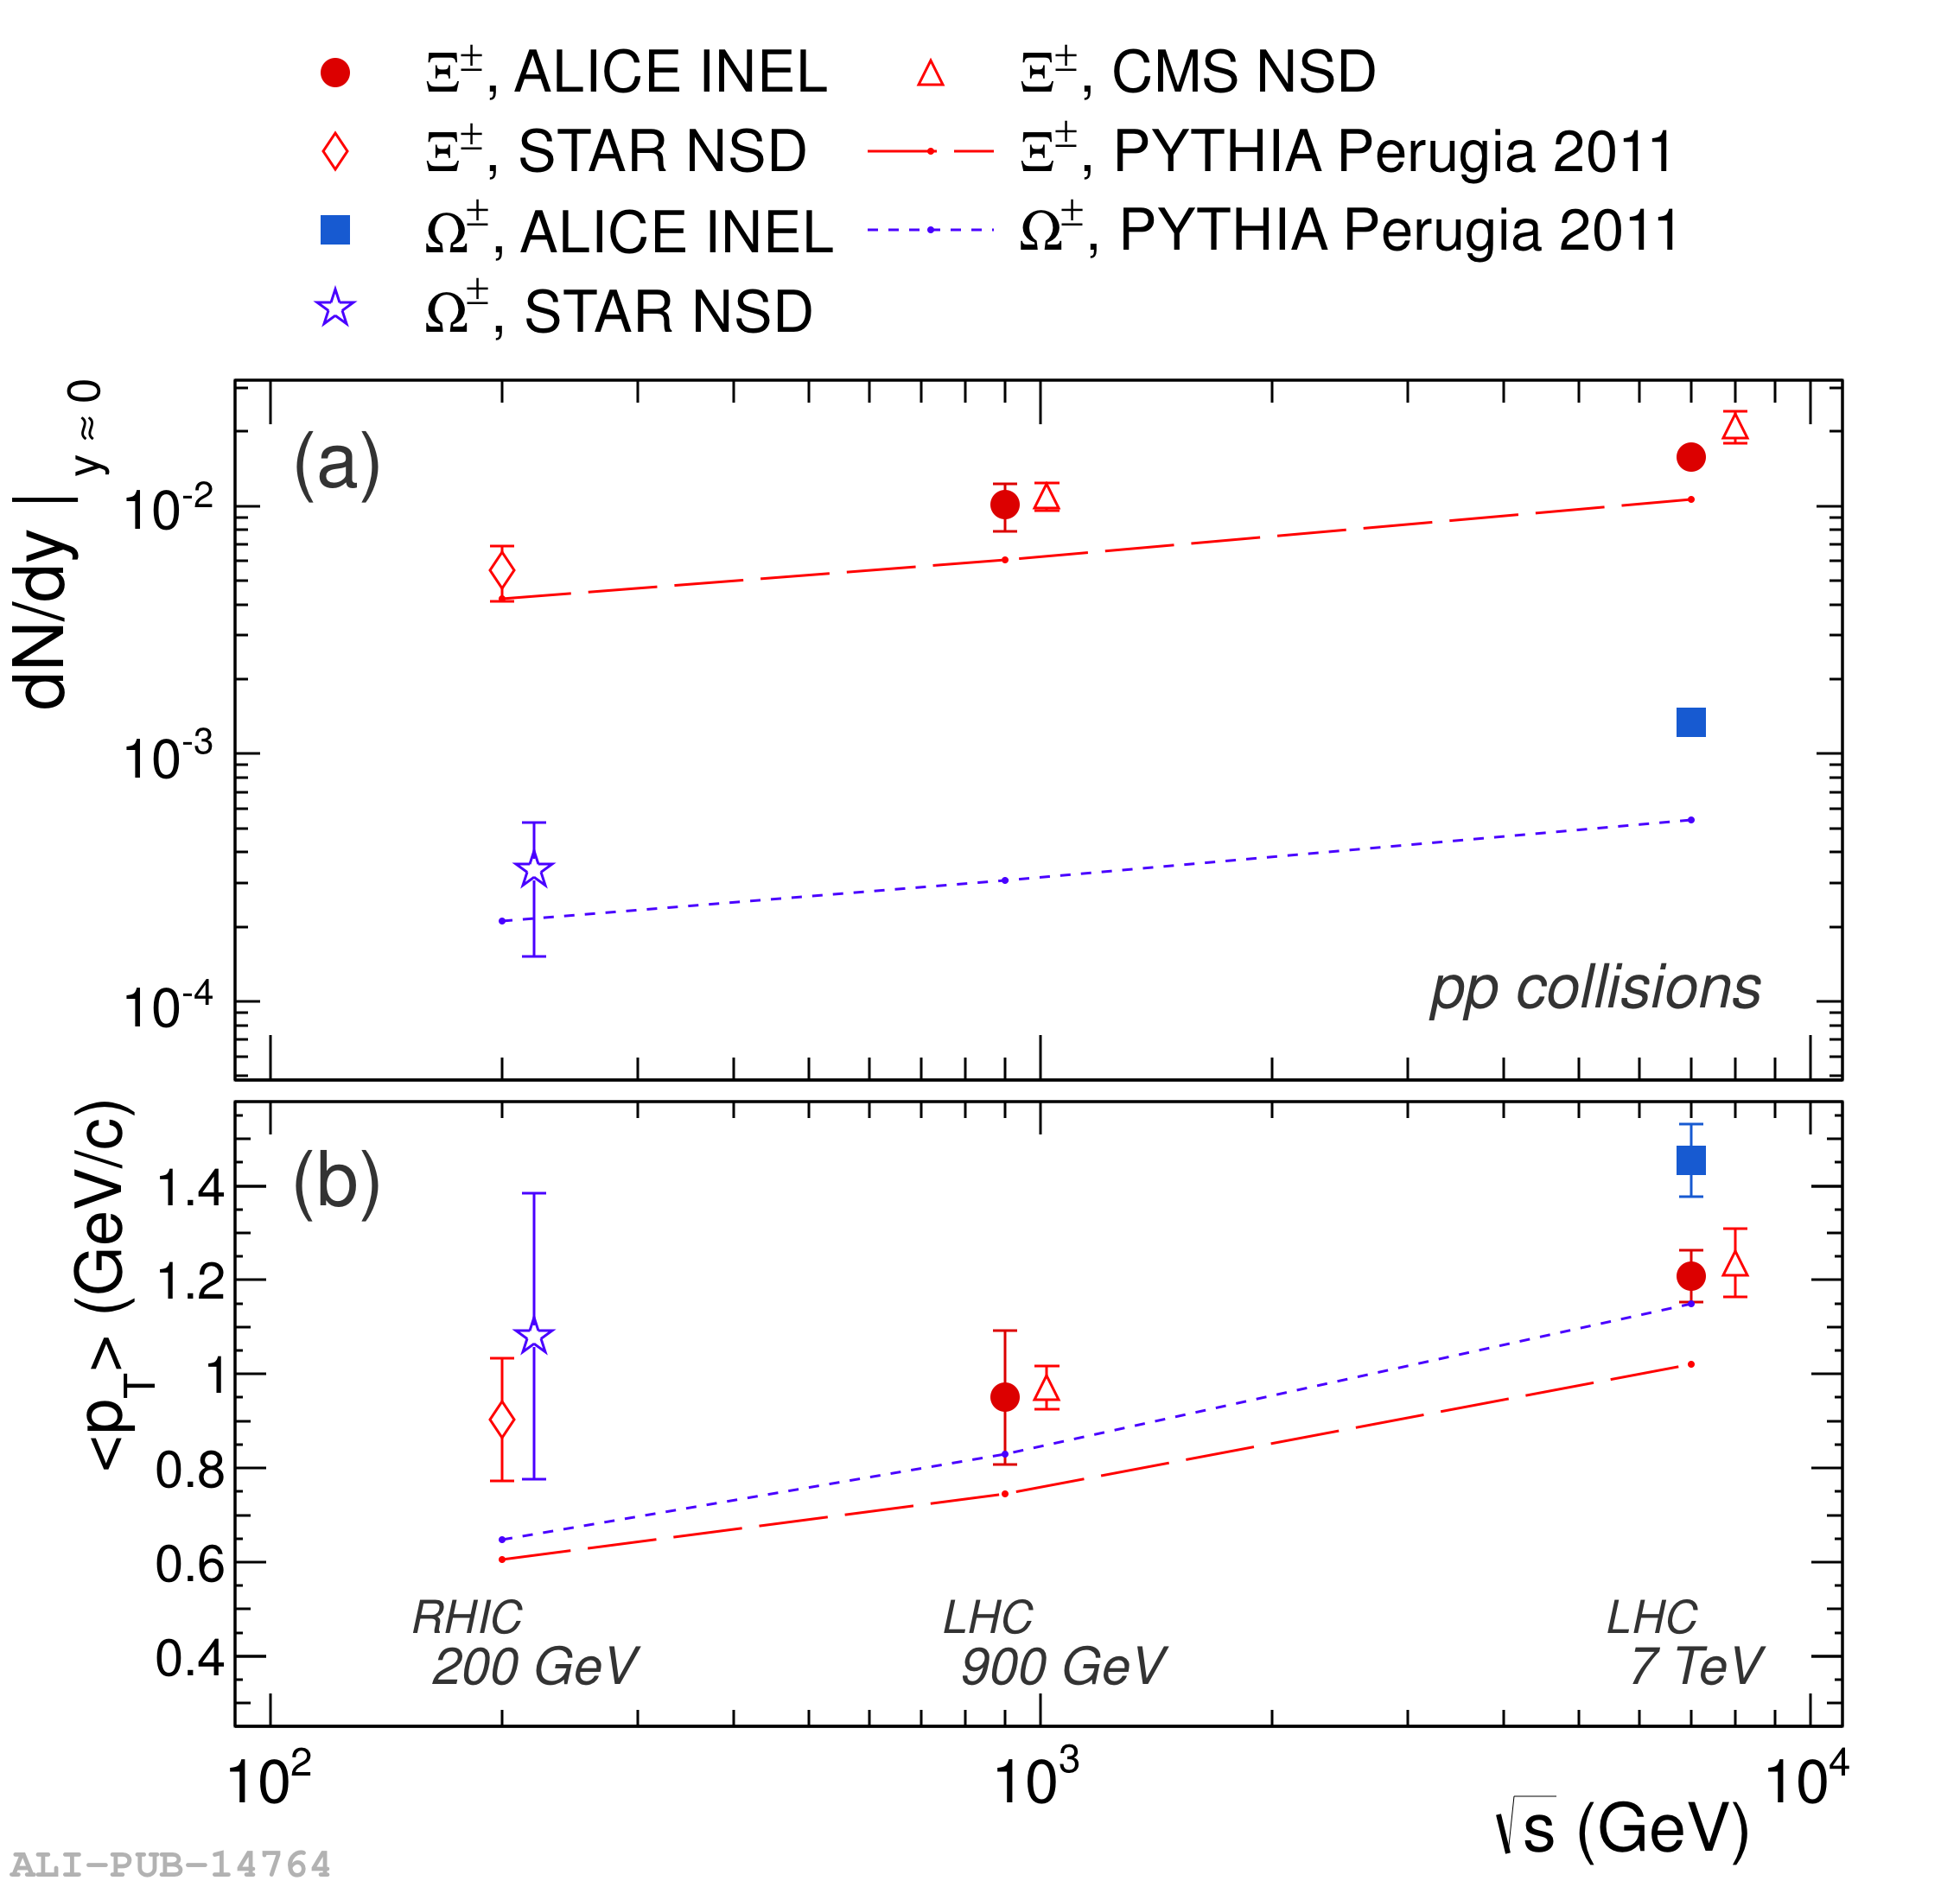
Strangeness enhancement
Defined as
Ω SPS
Ω RHIC
Ω LHC
Yield^{pp} estimation
(Λ,Ξ) Interpolate 0.9 and 7 TeV pp data
(Ω) interpolate 0.2 TeV (STAR) and 7 TeV pp data
Use excitation function from PYTHIA Perugia-2011
Hierarchy based on strangeness content
Decreasing trend with energy from SPS→RHIC→LHC
ALICE Coll., PLB 712 (2012)309

