Slide 1


Searching for new physics
in
beta-neutrino correlations
INPC-2013
Florence, June 3-7, 2013
β⁺
Nathal Severijns
Kath. Universiteit Leuven, Belgium
ν_{e}

Slide 2
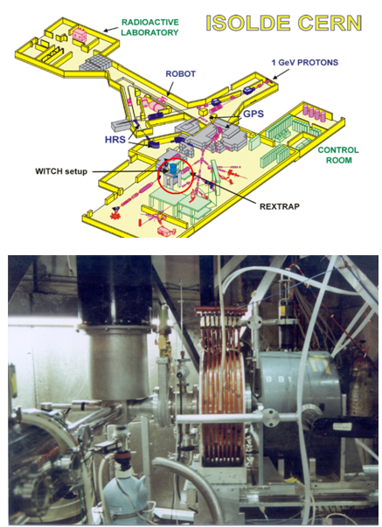
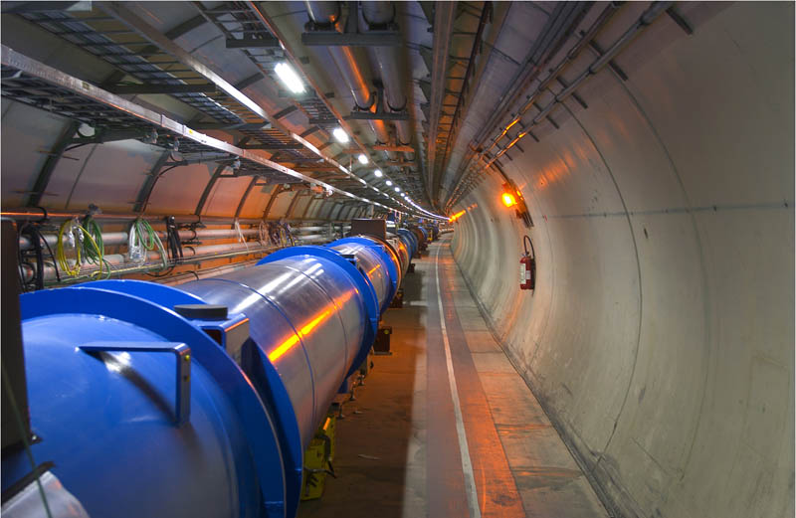
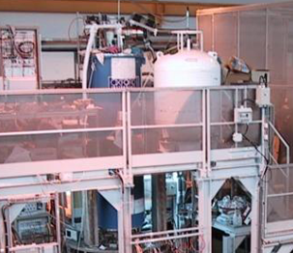
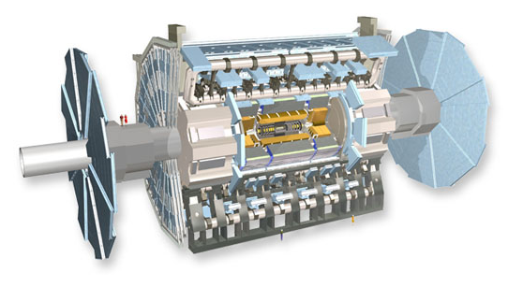
Context and motivation
Evidence for ”new physics” can show up both at the
high energy frontier high precision frontier
(direct production of new particles – e.g. LHC) (indirect search for small deviations)
⇔
New effects are actually being looked for everywhere where improvements in experimental sensitivities are possible (atoms, nuclei, particles).

Slide 3
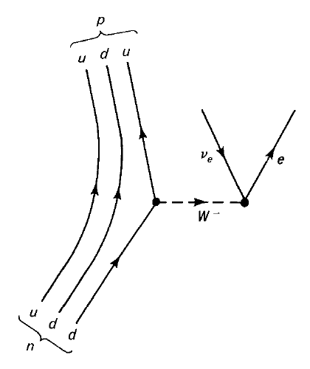
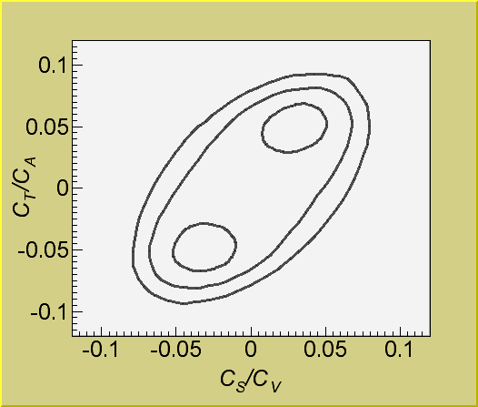
the Standard Model and beyond:
* C_{V} = 1 (CVC)
* C_{A} = -1.27 ( g_{A}/g_{V} = -1.2699(7) from n-decay )
* C_{V}’ = C_{V} & C_{A}’ = C_{A} (maximal P-violation)
* C_{S} = C_{S}’ = C_{T} = C_{T}’ = C_{P} = C_{P}’ ≡ 0
(only V- and A-currents)
experimental upper limits:
(neutron and nuclear β-decay)
* no time reversal violation
(except for the CP-violation described by the phase in the CKM matrix)
for right-handed exotic couplings
from: N. Severijns, M. Beck, O. Naviliat-Cuncic,
Rev. Mod. Phys. 78 (2006) 991
(1σ, 2σ and 3σ contours of equal χ²)
Nathal Severijns – INPC-2013, Florence, June 3-7, 2013

Slide 4
1. β-ν correlation to probe scalar/tensor weak currents
e⁺
nucleus
θ
ν_{e}
(assuming maximal P-violation and T-invariance for V and A interactions)
!!! for pure transitions weak interaction info independent of nuclear matrix elements !!!
recoil corr. (induced form factors) ≈ 10⁻³ ; radiative corrections ≈ 10⁻⁴
Nathal Severijns – INPC-2013, Florence, June 3-7, 2013

Slide 5


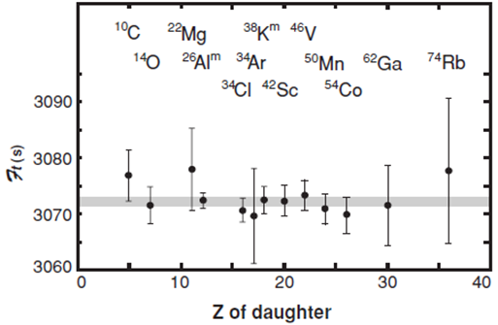
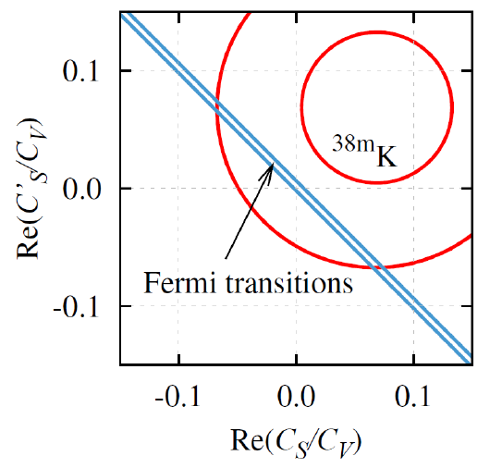
2. β-ν correlation and the Ft values of the Fermi transitions
corrected Ft value of 0+ → 0+ superallowed pure Fermi transitions :
with
Towner & Hardy, Rep. Prog Phys. 73 (2010) 046301
see also talk by A. Laffoley – SY028
^{38m}K: Gorelov, Behr et al.,
PRL 94 (2005) 142501
Nathal Severijns – INPC-2013, Florence, June 3-7, 2013

Slide 6


β decay correlations and Ft values of the mirror β transitions
- correlation coefficients depend on GT/F mixing ratio
e.g. and
β
θ
J
A
- correcting Ft values of mirror β transitions for GT/F mixing ratio :
¹⁹Ne, ²¹Na, ²⁹P, ³⁵Ar and ³⁷K
|V_{ud}| = 0.9719(17)
O. Naviliat-Cuncic & N.S. ,
PRL 102 (2009) 142302
- ΔV_{ud} for relative precision of 0.5 % on a_{βν} or A_{β} : a(¹⁹Ne) → ΔV_{ud} = 0.0010
                A(¹⁹Ne) → ΔV_{ud} = 0.0010
                A(³⁵Ar) → ΔV_{ud} = 0.0004
N.S. & O.Naviliat-Cuncic,
Physica Scripta T152 (2013) 014018
Nathal Severijns – INPC-2013, Florence, June 3-7, 2013

Slide 7
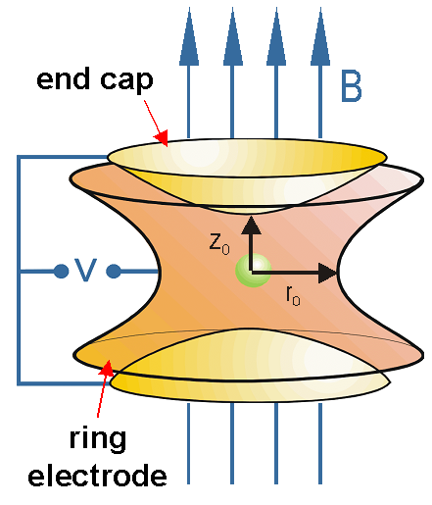
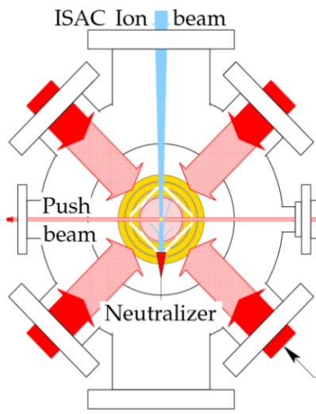
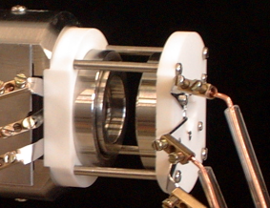
Ion/atom traps for β-ν correlation measurements
Most precise βν correlation measurements
Particle traps: ideal sources
- sample is isotopically pure
- localized in a small volume
- atoms decay at rest
- detection of recoil ion
- negligible source scattering
- potential for polarized sample
Penning
Paul
MOT
Nathal Severijns – INPC-2013, Florence, June 3-7, 2013

Slide 8
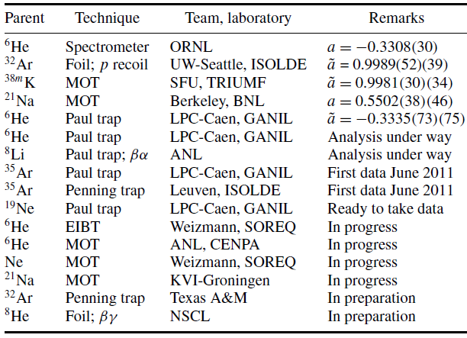
Recent and present βν correlation projects
N.S. & O.Naviliat-Cuncic, Physica Scripta T152 (2013) 014018
Nathal Severijns – INPC-2013, Florence, June 3-7, 2013

Slide 9
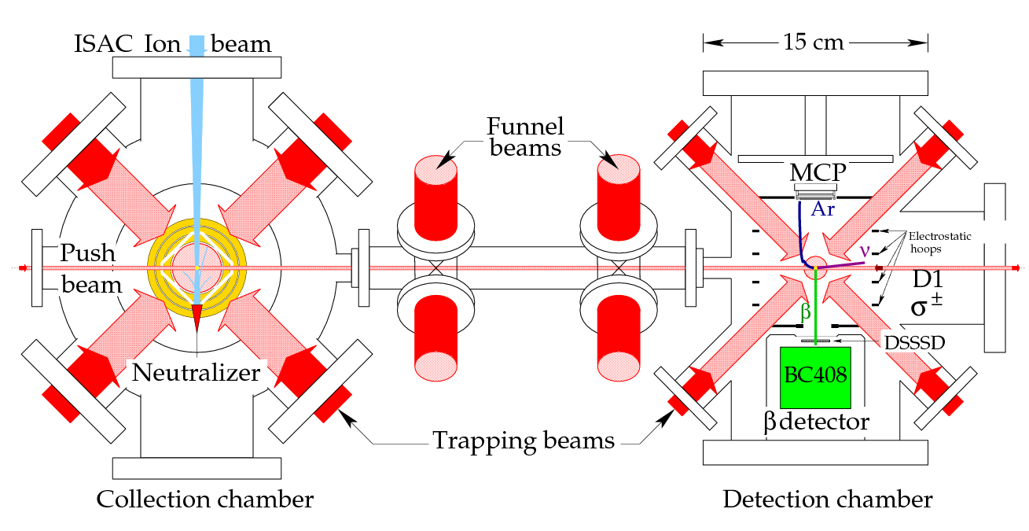
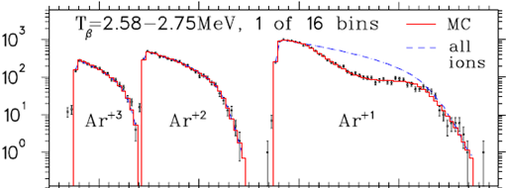
TRINAT MOT trap at TRIUMF-ISAC – ^{38m}K - scalar
search for scalar couplings
superallowed 0⁺ → 0⁺
pure Fermi transition
(t_{1/2} = 0.95 s)
A. Gorelov, J. Behr et al.,
Phys. Rev. Lett. 94 (2005) 142501
TOF
Nathal Severijns – INPC-2013, Florence, June 3-7, 2013

Slide 10
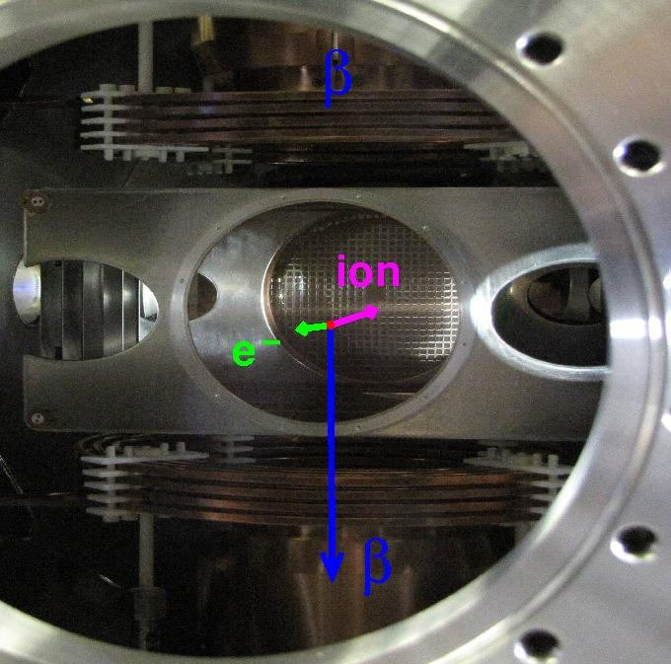
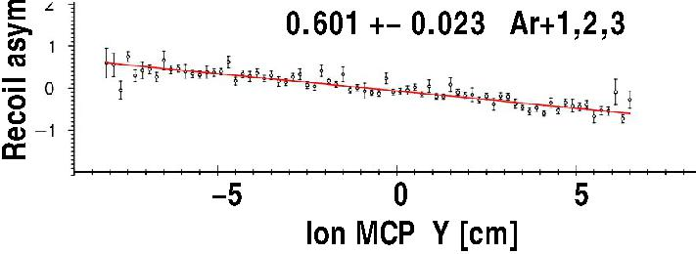
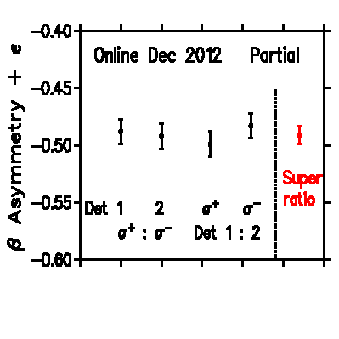
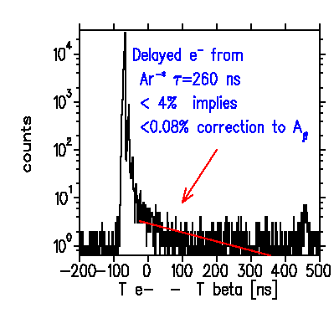
New TRINAT apparatus at ISAC-TRIUMF - J. Behr et al.
³⁷K beta and recoil asymmetries w.r.t. nuclear spin
1 to 2% stat. errors; syst. under analysis; goal: ~ 0.2 % to test standard model
Dec. 2012
beam time

Slide 11
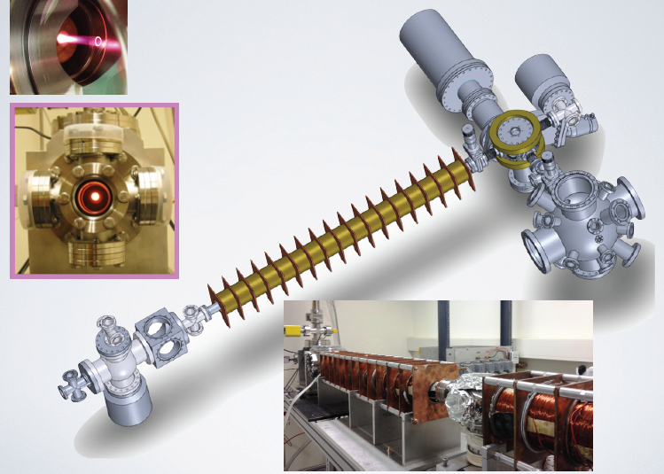
MOT trap for radioactive Ne isotopes
G. Ron et al. (Weizmann Inst. and SOREQ – Israel)
^{17,18,19,23,24}Ne
double-trap MOT concept
(similar to TRINAT)
- p/d accelerator
(5mA/up to 40MeV)
- neutron generator
Zeeman slower

Slide 12
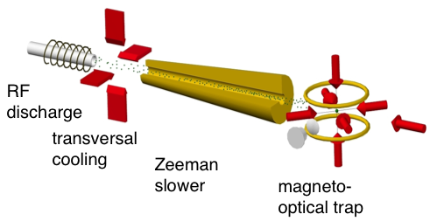
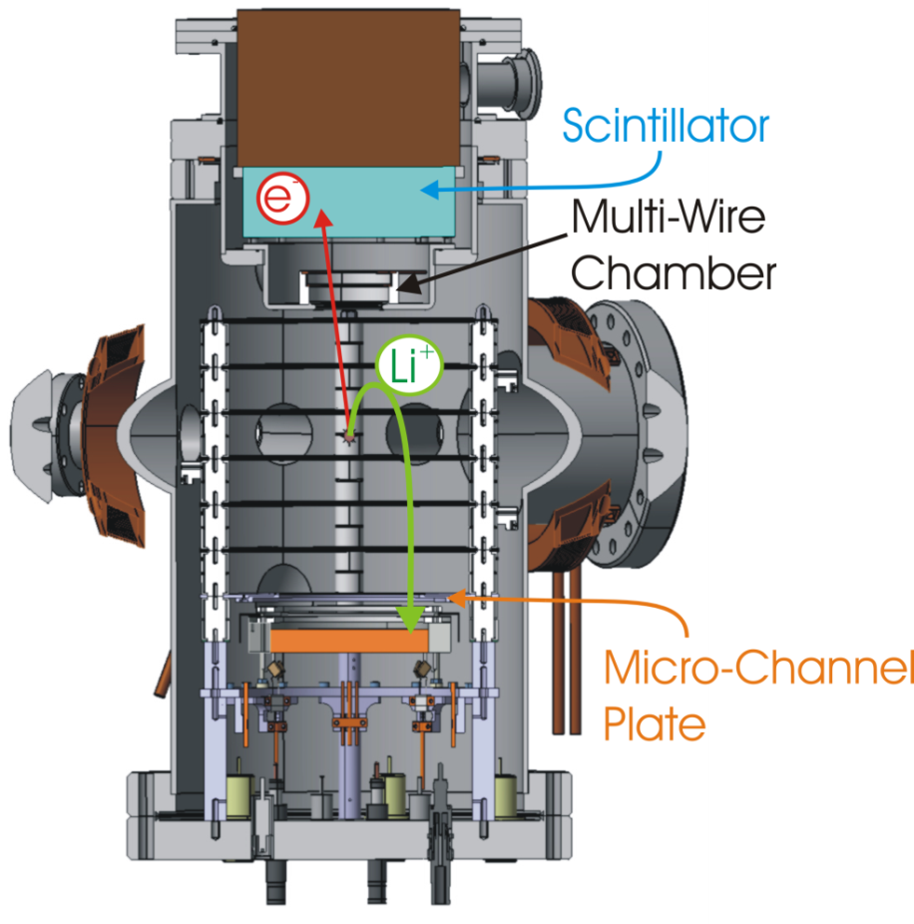
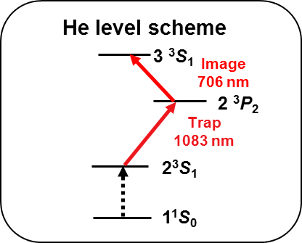
⁶He MOT Trap setup @ CENPA – Univ. Washington, Seattle
P. Mueller, A. Garcia, et al.
Argonne Natl. Lab., Univ. Washington, LPC-CAEN, CERN, NSCL, Michigan State Univ.
1083 nm
⁶He Trap/Detector Chamber
(two-trap concept)
RF discharge -> metastable He*
Laser cooling @ 1083 nm
Timeline:
⁻ ⁶He produced and trapped at CENPA in 2011/2012
  - first data run in summer 2013 --> 1 % measurement
  - 0.1 % measurement by 2015
⁶He Trapping Rates @ CENPA: @ source: 5x10⁹ s⁻¹ ; capt. efficiency = 2x10⁻⁷; @ trap: 1000 s⁻¹
Trap-to-trap transfer: > 60% efficiency, ~15 ms

Slide 13
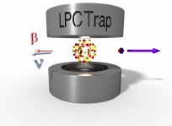
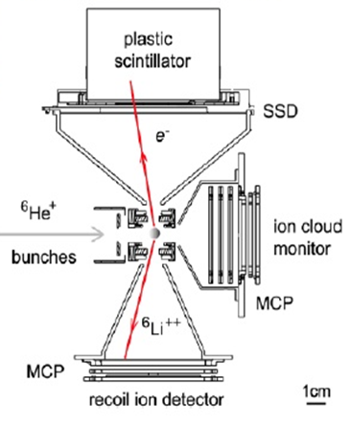
LPCTrap @ GANIL - ⁶He / ³⁵Ar - tensor / scalar
2006 (⁶He): a_{βν} = −0.3335(73)_{stat}(75)_{syst}
X. Fléchard et al., J. Phys. G 38 (2011) 055101
⁶He
2010
Li²⁺
Δa/a ~ 0.5 %
Li³⁺
(analysis in progress)
Δa/a ~ 0.3%
(analysis in progress)
³⁵Ar
2011-2012
Nathal Severijns – INPC-2013, Florence, June 3-7, 2013

Slide 14
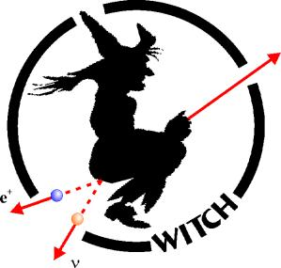
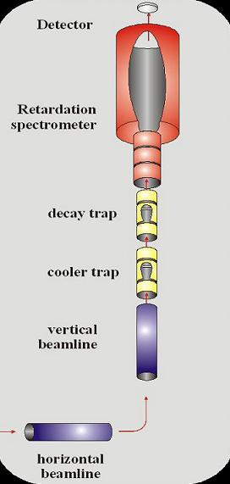
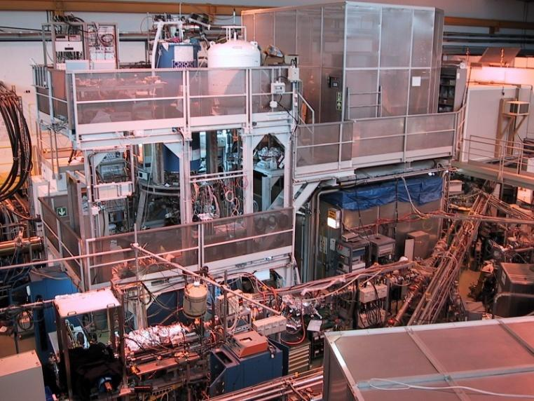
WITCH @ ISOLDE - ³⁵Ar - scalar
(KU Leuven, Univ. Munster, ISOLDE, NPI Rez-Prague, LPC-Caen)
Goal : determine βν correlation for ³⁵Ar with (Δa/a)_{stat} ≤ 0.5 %
→ measure energy spectrum of recoiling ions with a retardation spectrometer
M. Beck et al., Eur. Phys. J. A47 (2011) 45
M. Tandecki et al., NIM A629 (2011) 396
S. Van Gorp et al., NIM A638 (2011) 192
6/3/2013
Nathal Severijns – INPC-2013, Florence, June 3-7, 2013

Slide 15
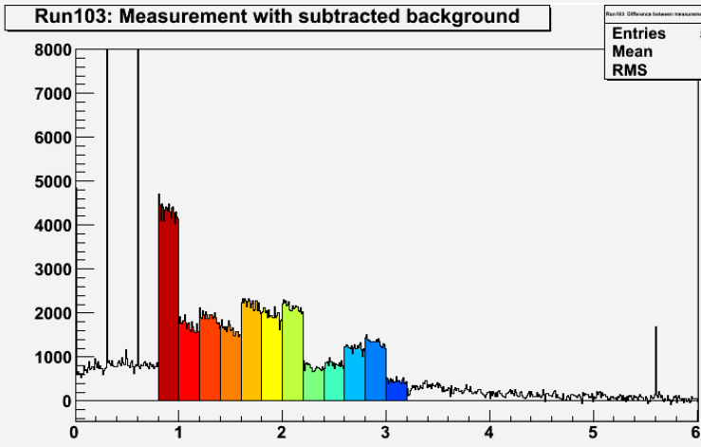
WITCH @ ISOLDE - ³⁵Ar
Nov. 2012 run → Δa /a ~ few % (analysis in progress)
N
ion count rate vs. time for
different retardation voltages
(50 V → 600 V)
see also poster by P. Finlay – NN008
time (s)
Nathal Severijns – INPC-2013, Florence, June 3-7, 2013

Slide 16
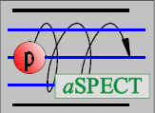
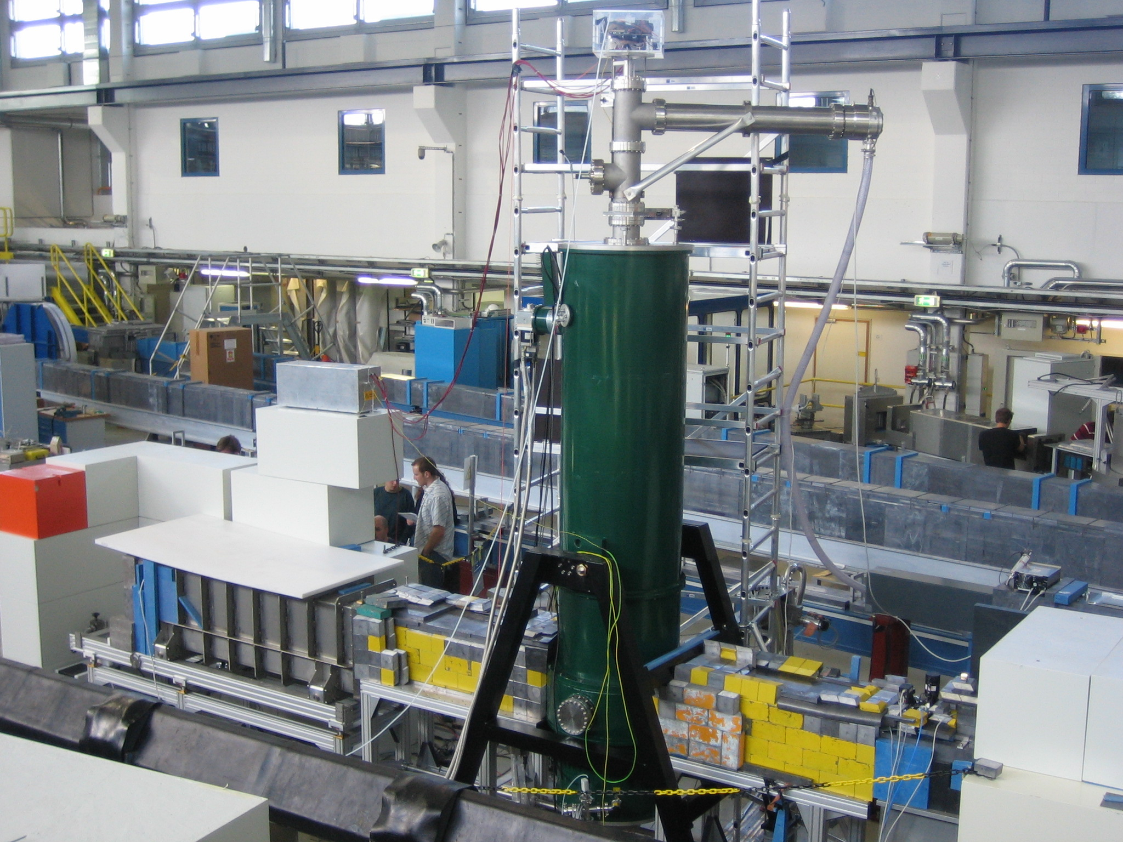
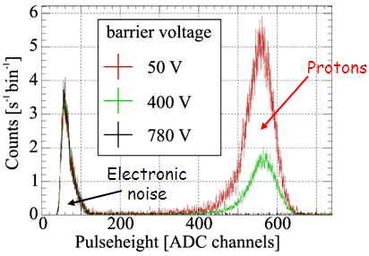
aSPECT retardation spectrometer for n-decay
(Mainz, Virginia, TU-Wien, ILL - W. Heil et al.)
Neutron decay retardation spectrometer (Mainz, Budapest, Virginia)
Status:
Retardation spectrometer commissioned 2008-2012
Problems of detector saturation & discharge-related bg solved
Production run for Δa/a ~ 1%
ongoing at the ILL-Grenoble
Final goal: Δa/a ~ 0.3 %
Detector
Analyzing Plane
0 to 800 V
see also talk by H. Abele – SY001
Protons
Neutrons
Beam Line
M. Simson, NIM A611 (2009) 203
Decay volume
Cold n-source
from reactor

Slide 17
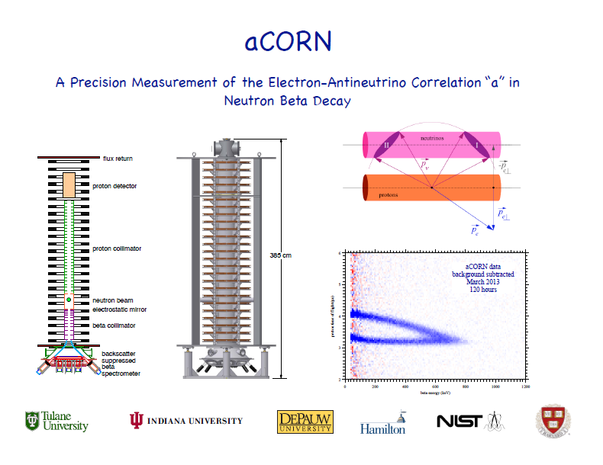

Slide 18
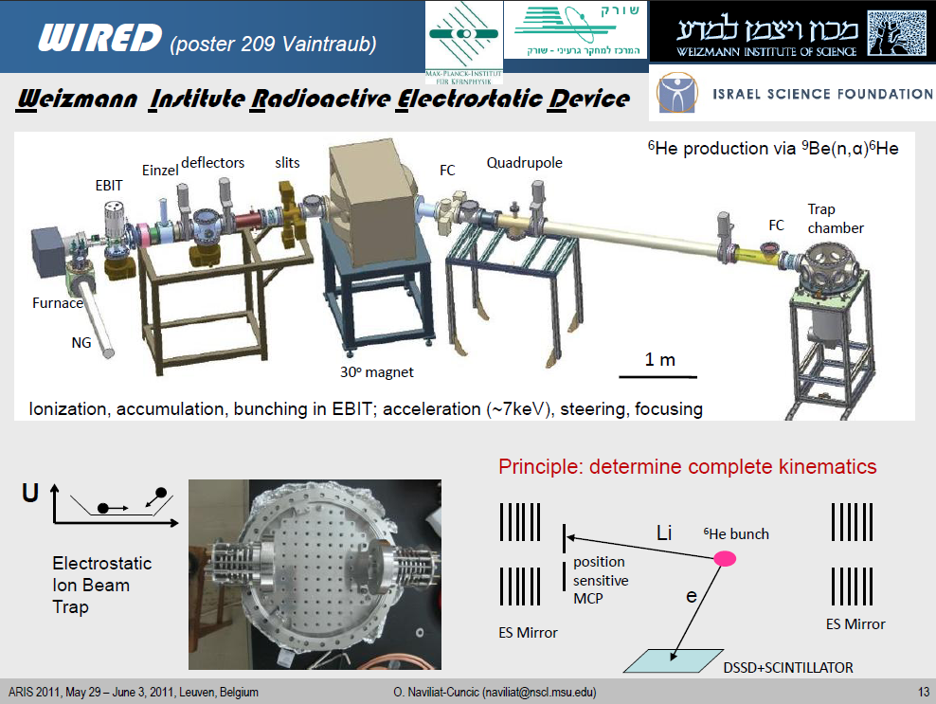
Nathal Severijns – INPC-2013, Florence, June 3-7, 2013

Slide 19
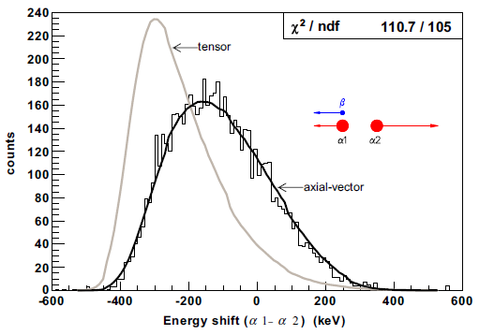
α-β-ν Correlation in Paul trapped 8Li Ions
G. Savard et al. (ANL, Mc. Gill, LLNL, Univ. Chicago, … )
a_{βν} = −0.3307(60)_{stat}(67)_{sys}
G.Li, G.Savard et al., PRL 110 (2013) 082502

Slide 20
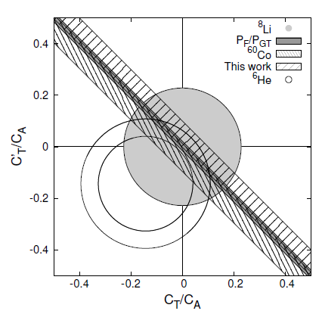
Constraints on tensor type weak couplings
A(⁶⁷Cu)
a(⁶He)
Johnston et al., PR 132 (1063) 1149
A(⁶⁰Co)
F. Wauters, N.S. et al.,
PR C 82 (2010) 055502
α-β-ν(⁸Li)
G.Li, G.Savard et al.,
PRL 110 (2013) 082502
A(⁶⁷Cu)
G. Soti, N.S. et al., submitted
A(⁶⁰Co)
α-β-ν(⁸Li)
a(⁶He)
Nathal Severijns – INPC-2013, Florence, June 3-7, 2013

Slide 21
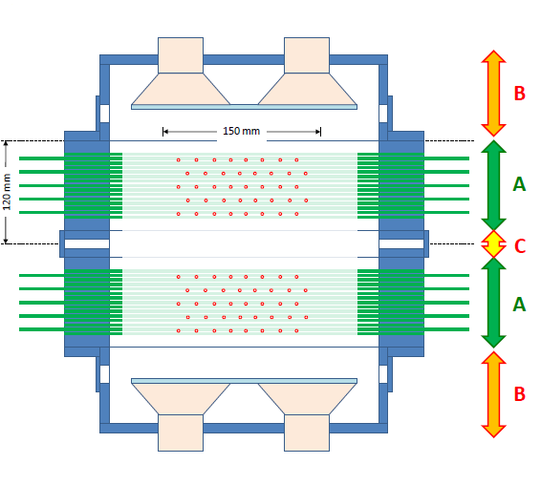
miniBETA spectrometer for β spectrum shape measurements
Univ. Leuven – Univ. Krakow
1. low β-endpoint energies
( ³²P, ⁴⁵Ca, … ) :
→ scalar / tensor type
weak interactions
2. high β-endpoint energies
(⁶⁸Cu, ¹¹⁴In, … ) :
weak magnetism induced term
(most important recoil term)
3. improve current knowledge
on electron scattering
→ improve precision of Geant4
multi-wire drift chamber
scintillator
Nathal Severijns – INPC-2013, Florence, June 3-7, 2013

Slide 22
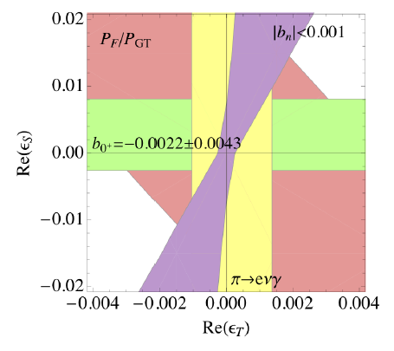
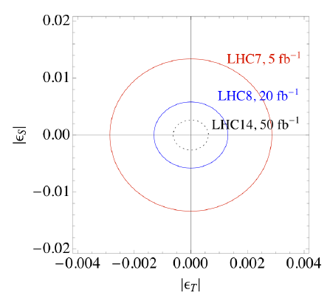
Precision measurements in nuclear/neutron β decay in the LHC era
90 % CL
90 % CL
nuclear and neutron decay, pion decay
limits on scalar/tensor couplings
obtained by CMS collaboration in
pp → e + MET + X channel
S. Chatrchyan et al. (CMS Collab.)
J. High. Energ. Phys. 1208 (2012) 023;
CERN Rep. nr. CMS-PAS-EXO-12-060 (2013)
N. Naviliat-Cuncic and M. Gonzalez-Alonso
Annalen der Physik (2013) in print.
V. Cirigliano, et al.,
J. High. Energ. Phys. 1302 (2013) 046
Nathal Severijns – INPC-2013, Florence, June 3-7, 2013

Slide 23
Summary
Recent and ongoing/planned β-ν correlation measurements
in nuclear β decays and neutron decay → improved limits on scalar and tensor charged weak currents;
Combination of correlation measurements and Ft-values of mirror β transitions can contribute to further improving the precision of the V_{ud} quark mixing matrix element;
Searches for new physics at low energies remain competitive with direct searches at LHC when concentrating on Fierz term and V_{ud}.
Many experiments ongoing using very different methods
→ different systematics and cross-check on values obtained
→ many new results to be expected in the coming years
Nathal Severijns – INPC-2013, Florence, June 3-7, 2013

