Slide 1

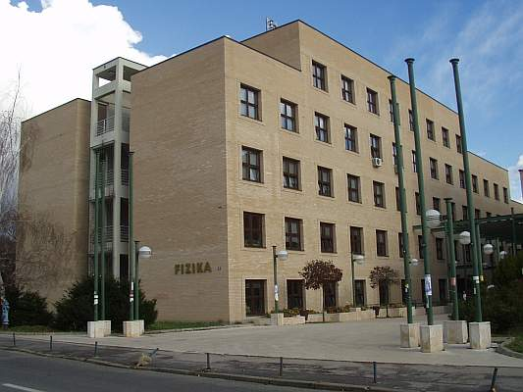
International Nuclear Physics Conference (INPC), Firenze, Italy, June 2-7, 2013
Probing the neutron skin thickness in
collective modes of excitation
N. Paar
Physics Department
Faculty of Science
University of Zagreb
Croatia

Slide 2
CONTENTS
Constraining the neutron-skin thickness in nuclei based on nuclear energy density functionals (EDFs) and experimental data on collective excitations
Search for relationships between the properties of collective modes of excitation and neutron skin thickness (relation to the properties of the symmetry energy).
Which dynamic observables constrain the neutron skin thickness in finite nuclei?
Assessing statistical correlations by means of covariance analysis based on EDFs.Theoretical uncertainties in modeling various observables.
Applications of dipole excitations and antianalog giant dipole resonance, based on recent experimental data and EDFs, in constraining the neutron-skin thickness in nuclei, nuclear matter symmetry energy at saturation density and slope of the symmetry energy

Slide 3
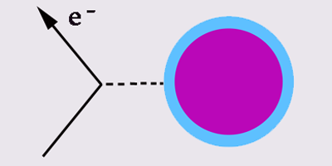

CONSTRAINING THE NEUTRON-SKIN THICKNESS IN NUCLEI
Various approaches to determine the distribution of neutrons in nuclei, e.g.,
using protons, antiprotons, and pions (strong interaction)
parity violating electron scattering (weak interaction)
Lead Radius Experiment (PREx) @ JLab
S. Abrahamyan et al. (PREX Collaboration)
Phys. Rev. Lett. 108, 112502 (2012)
nuclear excitations (giant resonances, charge-exchange modes,
pygmy modes) and energy density functionals in constraining the
neutron-skin thickness
Pygmy dipole resonances: A. Carbone et al., Phys. Rev. C 81, 041301(R) (2010)
Dipole polarizability: J. Piekarewicz et al., Phys. Rev. C 85, 041302(R) (2012)
Anti-analog GDR: A. Krasznahorkay et al., Phys. Lett. B 720, 428 (2013)
Quadrupole resonances: X. Roca-Maza et al., Phys. Rev. C 87, 034301 (2013)
Neutron-skin thickness provides important constraint on theoretical models
- isovector sector of the nuclear energy density functional

Slide 4
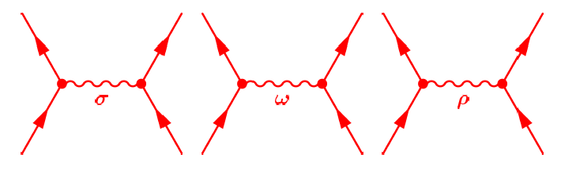

THEORY FRAMEWORK
RELATIVISTIC NUCLEAR ENERGY DENSITY FUNCTIONAL
System of Dirac nucleons coupled
by the exchange mesons and the
photon field
Functional valid through the entire nuclear chart – ground-state
properties. Nuclear matter properties.
In the small amplitude limit, fully self-consistent relativistic
quasiparticle RPA (RQRPA) allows analysis of giant resonances,
low-energy excitations, exotic modes of excitation,...
The model parameters are constrained directly by many-body
observables (e.g. masses, charge radii,...)
D. Vretenar, A. V. Afanasjev, G. A. Lalazissis, and P. Ring, Phys. Rep. 409, 101(2005).
N.P., D. Vretenar, E. Khan, G. Colò, Rep. Prog. Phys. 70, 1 (2007).

Slide 5
CONSTRAINTS ON THE SYMMETRY ENERGY AND NEUTRON SKIN
In order to explore the evolution of the excitation spectra as a function of the
density dependence of the symmetry energy, a set of interactions is used, that
span a broad range of values for the symmetry energy at saturation density (J)
and the slope parameter (L).
ISOVECTOR DIPOLE TRANSITION STRENGTH
Nuclear matter energy per part.:
DD-ME
Symmetry energy term:
E1

Slide 6
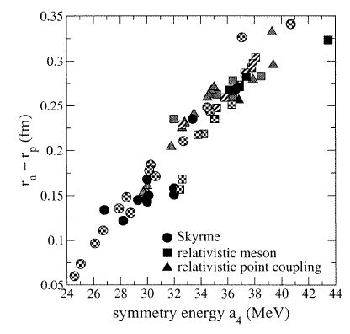
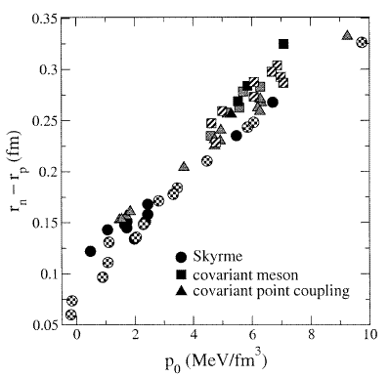
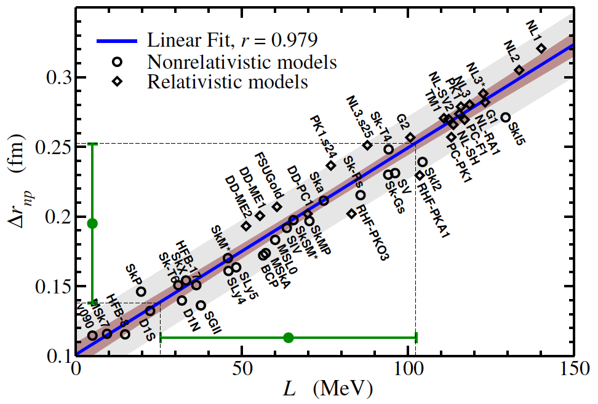
CONSTRAINTS ON THE SYMMETRY ENERGY AND NEUTRON SKIN
R.J.Furnstahl
Nucl. Phys. A 706, 85 (2002)
strong linear correlation between neutron skin thickness and parameters a₄, p₀ (L)
X. Roca-Maza et al.,
Phys. Rev. Lett. 106, 252501 (2011)

Slide 7
COVARIANCE ANALYSIS AND CORRELATIONS
P.-G. Reinhard, W. Nazarewicz, Phys. Rev. C 81, 051303 (2010)
Assume two variables A and B, smoothly varying with the model parameters p.
The covariance between the observables A and B:
Variance and define uncertainties of each observable.
Pearson product-moment correlation coefficient
provides a measure of the correlation (linear dependence) between two variables A and B.
Application to the relativistic functionals:
  Relativistic point coupling model (PC-min1)
  Relativistic model with density dependent meson-nucleon couplings (DDME-min1)
  The model parameters (9) of both interactions are constrained by the same set of (17) nuclei and their properties: binding energies, charge radii, diffraction radii, surface thickness

Slide 8
COVARIANCE ANALYSIS IN CONNECTION TO EDFs
Covariance analysis allows calculation of theoretical uncertainty of any
physical quantity of interest
E.g., proton and neutron distribution radii (r_{p},r_{n}), neutron skin thickness (r_{np}) in ²⁰⁸Pb
 | r_{p}(fm) | r_{n}(fm) | r_{np} (fm)
SV-min | 5.444 ± 0.005 | 5.614 ± 0.039 | 0.170 ± 0.036
FSUGold | 5.469 ± 0.035 | 5.676 ± 0.041 | 0.207 ± 0.037
DDME-min1 | 5.512 ± 0.007 | 5.663 ± 0.034 | 0.201 ± 0.036
(P.G.Reinhard)
(J. Piekarewicz)
(N.P.)
 | r_{np} (fm) (EXP.)
PREX | 0.33 ± 0.17
(p,p) | 0.156 ± 0.025
(α,α’) | 0.12 ± 0.07
Antiproton abs. | 0.18 ± 0.03
S. Abrahamyan et al., PRL. 108, 112502 (2012).
A. Tamii et al., PRL 107, 062502 (2011).
A. Krasznahorkay et al., NPA 731, 224 (2004).
A. Trzinska et al., PRL 87, 082501 (1991).

Slide 9
CORRELATIONS BETWEEN VARIOUS NUCLEAR PROPERTIES
Relativistic functionals: DDME-min1, PC-min1 (N.P.)
Nonrelativistic functionals: - SLy5 (X. Roca-Maza, G. Colò);
- SV-min (P.-G. Reinhard, W. Nazarewicz)

Slide 10
Which quantity correlates with the neutron skin thickness?
Pierson product-moment correlation coefficient for various dynamic quantities
of dipole excitations versus neutron skin thickness (r_{np}):
Both the PDR and IVGDR
properties are correlated
with the neutron skin
thickness.

Slide 11
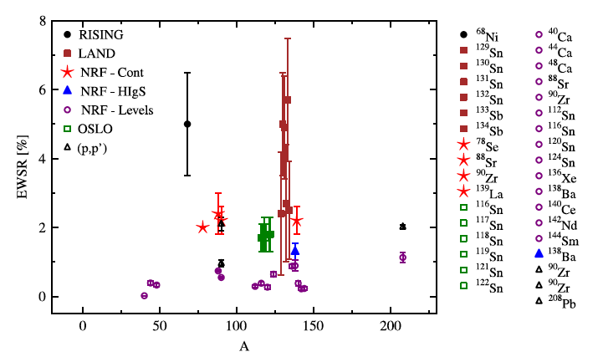
LOW-ENERGY PYGMY DIPOLE TRANSITIONS
Progress in measurements of low-energy electric dipole strength (PDR)
D. Savran, T. Aumann, A. Zilges, Progress in Particle and Nuclear Physics 70, 210 (2013)
Fraction of the E1 EWSR exhausted by the PDR as reported by various experiments:
Are these data useful to constrain the symmetry energy
and neutron-skin thickness?

Slide 12
MOMENTS OF DIPOLE EXCITATIONS vs. NEUTRON SKIN THICKNESS
Various quantities related to E1 transitions vs. the size of the neutron skin in ¹³²Sn using a set of DD-ME effective interactions spanning J=30-38 MeV.
Inverse energy-
weighted strength
~ dipole polarizability α_{D}
Low-energy transitions
display strong sensitivity
on the neutron-skin
thickness compared to
the overall contributions
Transition
strength
Energy-
weighted
strength
Thomas-Reiche-Kuhn
sum rule is conserved
(all relative to
the first point)

Slide 13
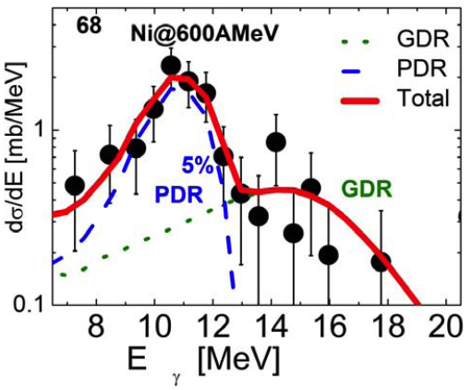
PYGMY DIPOLE STRENGTH IN ⁶⁸Ni
The pygmy dipole strength for ⁶⁸Ni and comparison to experimental data
➔ γ decay from Coulomb excitation of ⁶⁸Ni at 600 MeV/nucleon (INFN,GSI,…)
DD-ME2
 | S_{EW}(E1) [e²fm²MeV] | % EWSR (TRK) | B(E1) [e²fm²]
RNEDF (DD-ME2) | 14.59 | 5.9 % | 1.59
Exp. | 12.2 ± 3.7 | (5±1.5) % | 1.2
9.05 MeV: coherent contributions from
neutron transitions:
2p3/2➔ 3s1/2
2p1/2➔ 2d3/2
1f5/2➔2d3/2
1f5/2➔2d5/2
2p3/2, 2p1/2,1f5/2:
12 excess neutrons
above N=Z core
O. Wieland et al., PRL 102, 092502 (2009)

Slide 14
Application of the PDR : constraints on the symmetry energy
Theoretical dependences of the pygmy EWSR on J and L are determined using
relativistic energy density functionals spanning the range of J and L values.
Available experimental data provide constraints on theoretical models.
DD-ME
Similar approach but different theory ➔ A. Carbone et al, PRC 81, 041301(R) (2010)
Exp. Data: ⁶⁸Ni : O. Wieland et al, PRL 102, 092502 (2009)
^{132,130}Sn: A. Klimkiewicz et al., PRC 76, 051603 (R) (2007)
²⁰⁸Pb: I. Poltoratska et al., PRC 85, 041304 (R) (2012)

Slide 15
Constraining the symmetry energy and R_{np} from dipole polarizability
Dipole polarizability (α_{D}) calculated using relativistic energy density functionals
covering the range of values for the symmetry energy at saturation density (J)
and slope of the symmetry energy (L)
Exp. data from polarized proton inelastic scattering, α_{D}=18.9(13)fm³/e²
A. Tamii et al., PRL. 107, 062502 (2011)
DD-ME
J=(32.6±1.4) MeV
L=(50.9±12.6) MeV

Slide 16
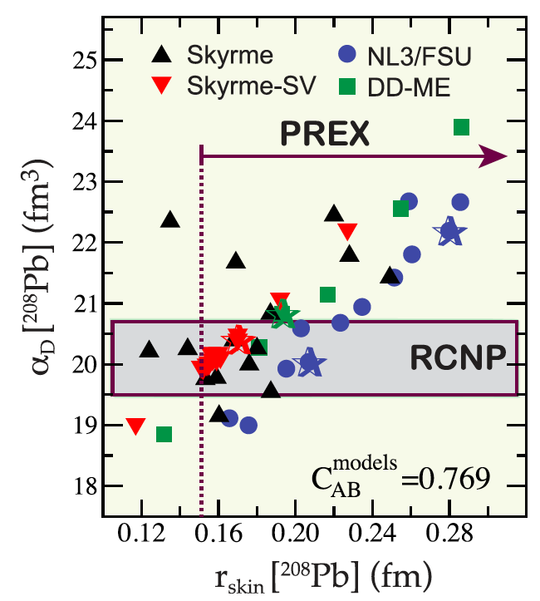
Electric dipole polarizability and neutron skins
Correlation between α_{D} and neutron skin thickness (r_{skin}) based on on the
nuclear density functional theory using both nonrelativistic and relativistic energy
density functionals.
Model averaged values:
r_{skin}(²⁰⁸Pb) = (0.168 ± 0.022) fm
r_{skin}(¹³²Sn) = (0.232 ± 0.022) fm
r_{skin}(⁴⁸Ca) = (0.176 ± 0.018) fm
Experimental data on α_{D} discriminate
between various functionals
J. Piekarewicz, B. K. Agrawal, G. Colò, W. Nazarewicz, N. P., P.-G. Reinhard,
X. Roca-Maza, and D. Vretenar, PRC 85, 041302 (R) (2012)

Slide 17
ANTI-ANALOG GDR AND NEUTRON-SKIN THICKNESS
Charge-exchange modes of excitation
probe neutrons in τ₋ channel:
(proton particle – neutron hole excitations)
-
-
-
-
-
-
-
-
-

Slide 18
ANTI-ANALOG GDR AND NEUTRON-SKIN THICKNESS
TEST CASE: ¹²⁴Sn
METHOD | ΔR_{pn} (fm)
(p,p) 0.8 GeV | 0.25 ± 0.05
(α,α’) IVGDR 120 MeV | 0.21 ± 0.11
Antiproton absorption | 0.19 ± 0.09
(³He,t) IVSGDR | 0.27 ± 0.07
Pygmy dipole resonance | 0.19 ± 0.05
(p,p) 295 MeV | 0.185 ± 0.05
AGDR - present result | 0.21 ± 0.05
E(AGDR)-E(IAS) [MeV]
neutron skin thickness
A. Krasznahorkay, N. P., D. Vretenar,
M.N. Harakeh, Phys. Lett. B 720, 428 (2013).

Slide 19
Constraining the symmetry energy in the RNEDF framework
Summary: constraints from the excitations on the slope of the symmetry energy
(L) and symmetry energy at saturation density (J):
Dipole polarizability
(²⁰⁸Pb)
AGDR excitation energy
(¹²⁴Sn)
Energy weighted pygmy
dipole strength (⁶⁸Ni,¹³²Sn)
DD-ME
Results indicate that some of the PDR strength may be missing ( ~1% TRK)?
⁶⁸Ni : O. Wieland et al, PRL. 102, 092502 (2009)
¹²⁴Sn: A. Krasznahorkay, et al., Phys. Lett. B 720, 428 (2013).
¹³²Sn: P.Adrich et al., Phys. Rev. Lett. 95, 132501(2005).
²⁰⁸Pb (α_{D}): A. Tamii et al., PRL 107, 062502 (2011)
Based on exp.
data :

Slide 20
Constraining the symmetry energy
Constraining the symmetry energy at saturation density and slope of the symmetry energy from various approaches:
Also see M. B. Tsang et al., PRC 86, 015803 (2012)

Slide 21
FINAL REMARKS
Dipole excitations and charge exchange excitations provide valuable constraints on the neutron skin thickness and nuclear matter symmetry energy
Statistical covariance analysis based on various energy density functionals (EDFs) identifies important correlations between various quantities and observables
Possible extensions and improvements of the isovector sector of the EDFs? Awaiting new and revised experimental data (AGDR, α_{D}, PDR, ...)
Thanks to: T. Nikšić, T. Marketin, D. Vretenar, P.-G. Reinhard, W. Nazarewicz,
X. Roca-Maza, G. Colò, J. Piekarewicz, A. Krasznahorkay, M. Harakeh

Slide 22
THEORY FRAMEWORK
1. Relativistic point coupling model
T. Buervenich et al., PRC 65, 044308 (2002)

Slide 23
THEORY FRAMEWORK
2. Relativistic model with density-dependent meson-nucleon couplings
The density dependence of the vertex functions

Slide 24
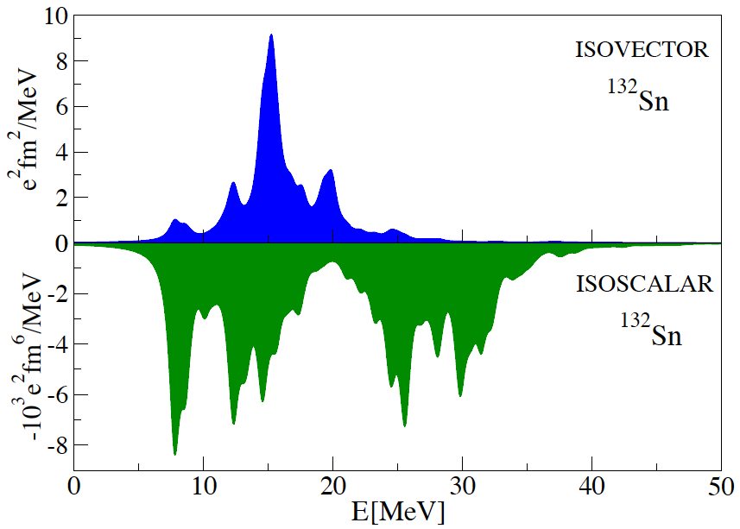
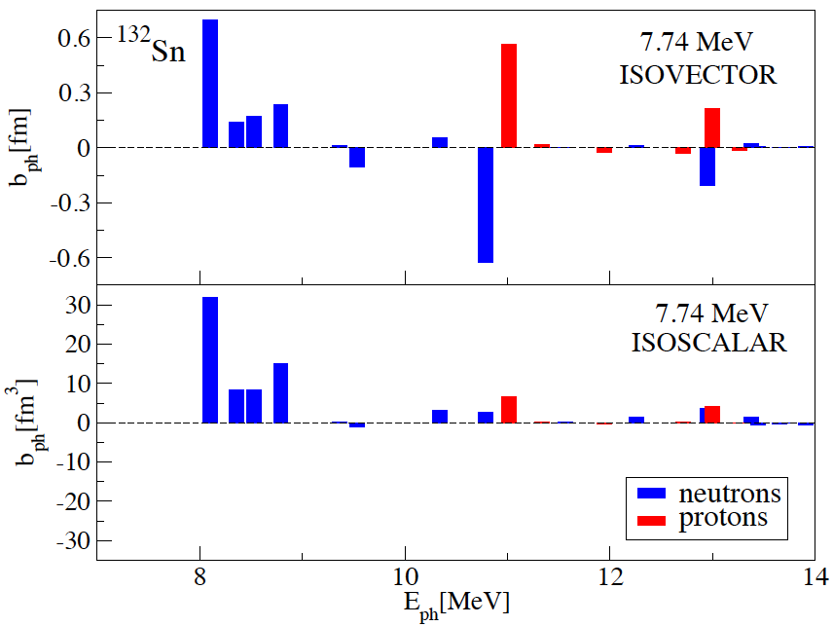
ISOVECTOR AND ISOSCALAR DIPOLE EXCITATIONS
What can we learn from comparison between the isovector and isoscalar
dipole transition strength in neutron rich nuclei ?
DD-ME2
Both in the isoscalar and isovector channel, pronounced low-energy dipole transition strengths are peaked at exactly the same energy. Their structure is dominated by identical neutron transitions with similar relative contributions in the transition strength (apart from the decoherence in the isovector channel).

Slide 25
ON THE NATURE OF THE PYGMY DIPOLE MODE
The pygmy dipole mode represents unique excitation phenomena in nuclei. It is different than GDR, less collective, its strength is determined by coherent neutron contributions, and quantum decoherence of proton and neutron transitions which on the other hand have relevant contribution to the IVGDR.
Partial cancellation of contributions from two large ph (or 2qp) proton and neutron configurations represent the mechanism which is responsible for small “pygmy” strength in the isovector channel.
The same mechanism applies to other nuclei (e.g. ¹³²Sn, ²⁰⁸Pb, etc.)
Both relativistic and nonrelativistic functionals result in similar structure:
D. Vretenar, Y.F. Niu, N.P., J. Meng, PRC 85, 044317 (2012).
X. Roca-Maza, G. Pozzi, M. Brenna, K. Mizuyama, and G. Colò, PRC 85, 024601 (2012)

