Slide 1
Single-particle strength in the odd, neutron-rich Ni isotopes
Francesco Recchia
National Superconducting Cyclotron Laboratory
Dipartimento di Fisica e Astronomia Universita’ degli studi di padova

Slide 2
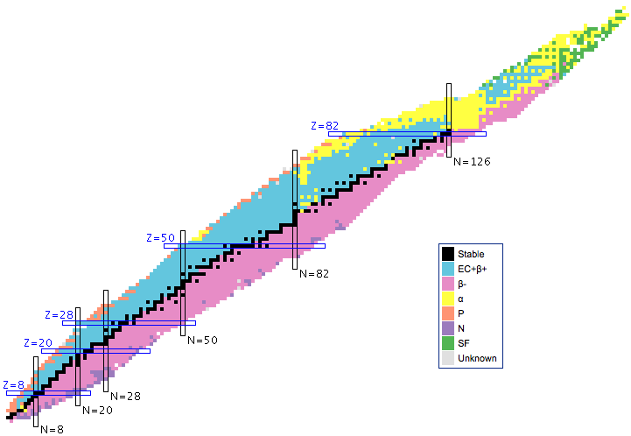
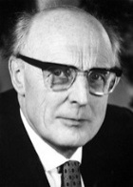
The “spin-orbit” magic numbers
N=4
2d
d_{5/2}
40
1g
50
g_{9/2}
N=3
40
p_{1/2}
2p
f_{5/2}
1f
28
p_{3/2}
20
f_{7/2}
20
20
N=2
2s
d_{3/2}
1d
s_{1/2}
8
d_{5/2}
N=1
8
p_{1/2}
1p
p_{3/2}
H.O
+
L²
+
L.S

Slide 3
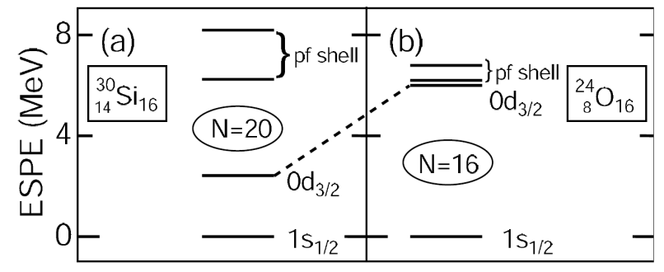
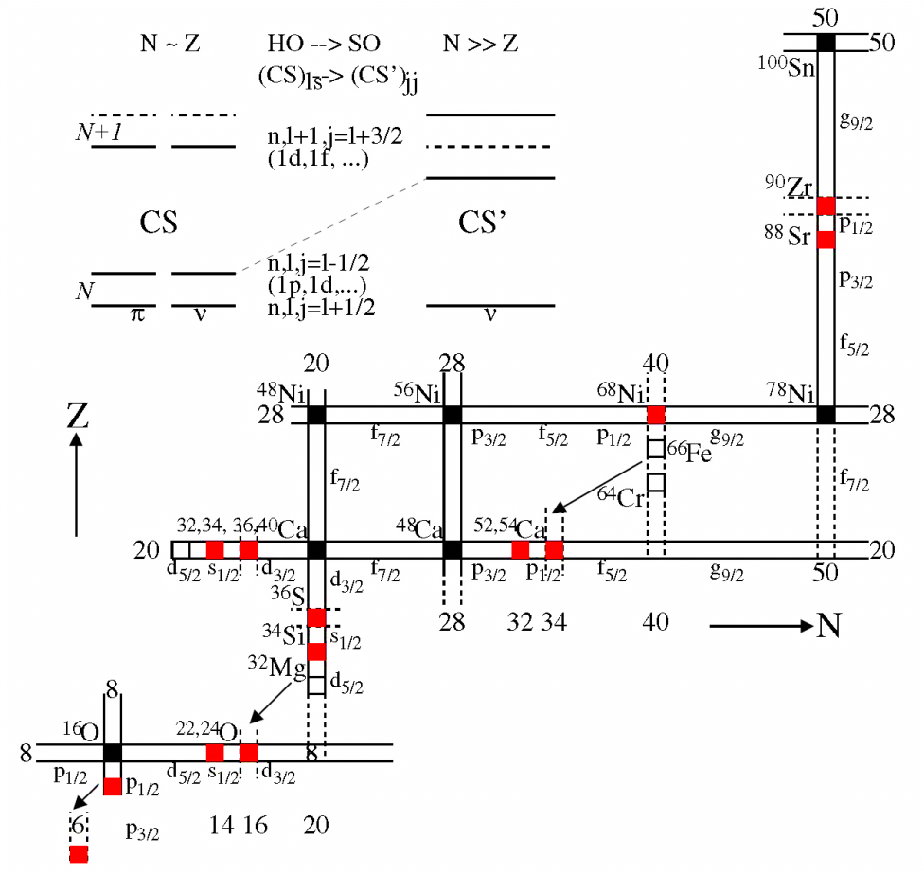
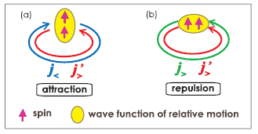
Shell evolution
Disappearance / appearance of magic numbers
P-N attraction between spin-flip partner orbits
Monopole part of the tensor term
Monopole part of the three-body force
m
m’
Δ
m’
m
H. Grawe, EPJ A 25 (2005) 357
T. Otsuka et al. EPJ A 20 (2003) 69-73, PRL 95, 232502 (2005), J.D.Holt et al 2012 J. Phys. G: Nucl. Part. Phys. 39 085111

Slide 4
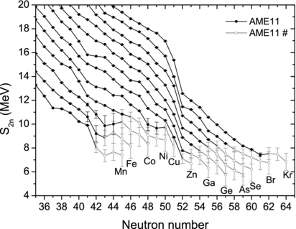
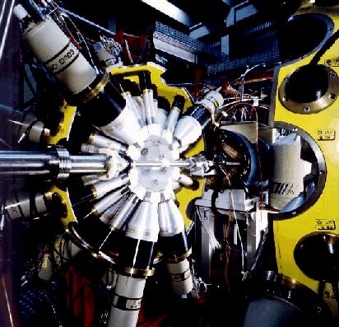
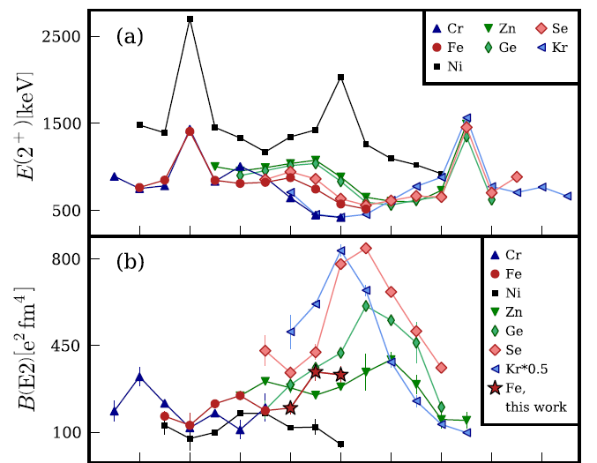
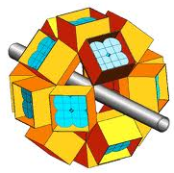
Shell closure at N=40 ??
E(2⁺)
R.Broda et al., PRL 74, 868 (95)
B(E2)
O. Sorlin et al. PRL 88, 092501 (2002)
W. Rother et al. Phys.Rev.Lett. 106, 022502 (2011)
A. Kankainen, et al., J.Phys.G 39, 093101 (2012)

Slide 5
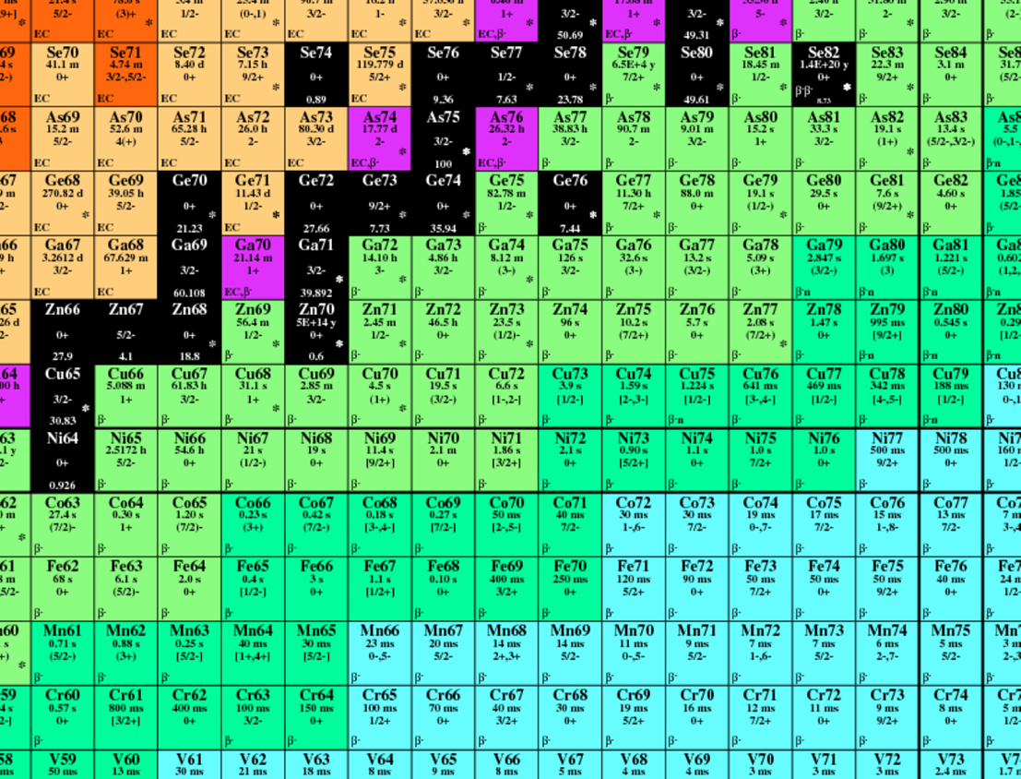
Single Particle Strength in the odd, neutron-rich Ni isotopes
Persistence of customary magic numbers
Spin-isospin part of the nn interaction
Single particle strength in ^{A-1}Ni
components in the g.s. in ^{A}Ni
comparison to shell model calculations
Provide the first gating transitions for GS data
Dec 8 – 12 2012

Slide 6
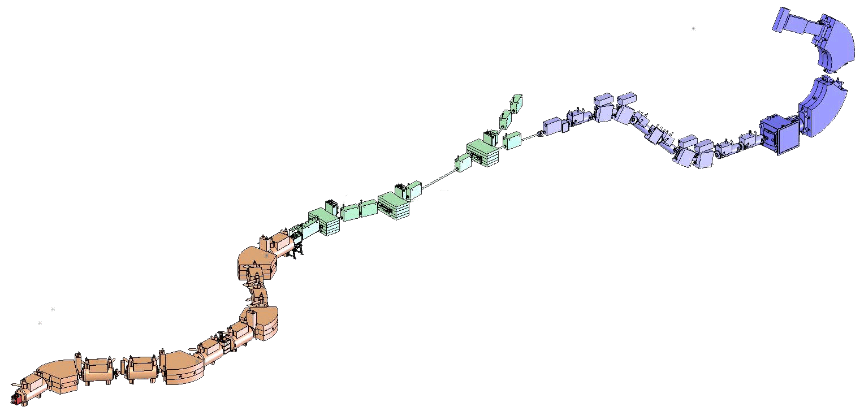
⁷⁵Zn
⁷³Cu
⁷⁴Cu
⁷²Ni
A1900 fragment separator
⁸²Se³⁴⁺,
140 MeV/u

Slide 7
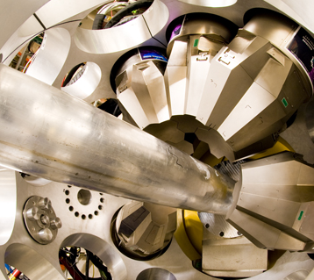
γ
β ̴ 0.4c
⁶⁸Ni
⁶⁷Ni*
⁶⁷Ni
to focal plane S800
Reaction target
100-281mg/cm²
⁹Be
γ
A1900 fragment separator

Slide 8
Gated on ⁶⁸Ni
Reaction product identification S800 spectrograph
⁶⁷Ni
⁶⁶Ni
⁶⁵Co
Reaction target
100-281mg/cm²
Velocity vector
A1900 fragment separator

Slide 9
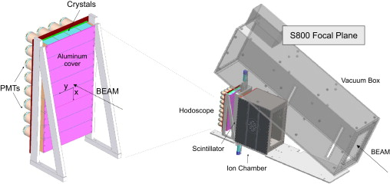
Reaction product identification S800 spectrograph
Reaction target
100-281mg/cm²
K. Meierbachtol et al. NIM A 652 (2011) 668–670
A1900 fragment separator

Slide 10
⁶⁸Ni 1n knock out
5⁻ isomeric content: 39(5)%

Slide 11
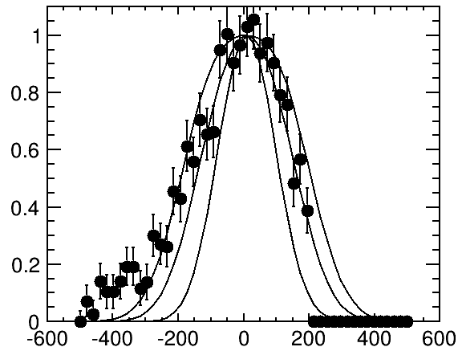
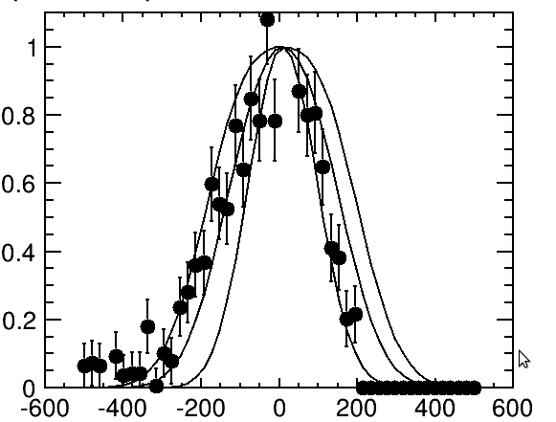
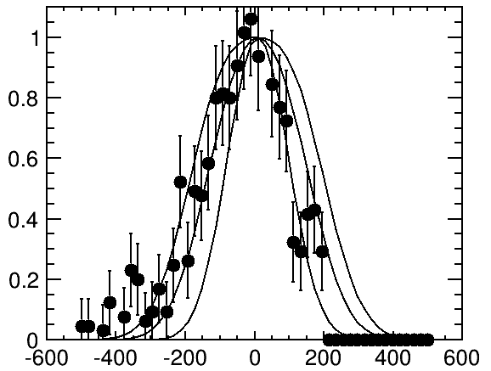
⁷⁰Ni 1n- knock out
jj44
594
1822
1129
Exp
8⁺ isomeric content: 8(1)%
Preliminary
⁶⁹Ni

Slide 12
8⁺ isomeric content: 8(1)%
jj44
EXP

Slide 13
⁶⁸Ni is produced from ⁷⁰Ni

Slide 14
K. Meierbachtol et al. NIM A 652 (2011) 668–670
300(30) ns
A1900 fragment separator
ch

Slide 15
Prompt coincidence
15
<511> in the hodoscope
prompt

Slide 16
GIROD PRC 1988

Slide 17
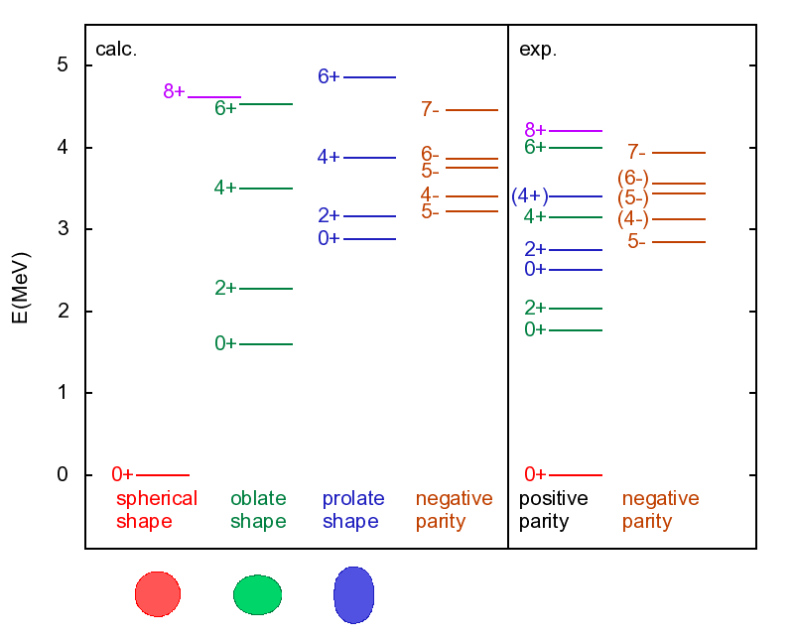
17
⁶⁸Ni
N. Shimuzu, T. Otsuka et al. Prog. Theor. Exp. Phys. (2012) 01A205

Slide 18
Thank you!
Experiment:
A. Gade, R.V.F. Janssens, D. Weisshaar, M. Albers, V. Bader, T. Baugher, D. Bazin, J. Berryman, C.M. Campbell, M.P. Carpenter, J. Chen, C.J. Chiara, H. Crawford, C.R. Hoffman, F.G. Kondev, A. Korichi, C. Langer, T. Lauritsen, E. Lunderberg, S. Noji, R. Stroberg, S. Williams, K. Wimmer, S. Zhu
Theory: B.A. Brown

