Slide 1
Effects of Skyrme Tensor Force on the Spin-Isospin Excitations
C.L.Bai
Department of physics, Sichuan University,
Chengdu, China
bclphy@scu.edu.cn

Slide 2
Collaboratiors
H. Q. Zhang, CIAE, China
X. Z. Zhang, CIAE, China
F.R.Xu, PKU, China
G. Colo, Milano Univ. Italy
H. Sagawa, Aizu Univ. Japan
F. Minato, JAEA. Japan

Slide 3
outline
● Self-consistent HF+RPA based on Skyrme force
● Skyrme parameter sets with tensor force
● Tensor effects on the Spin-Isospin excited states
● GT and SD constraint on the tensor force
● Tensor effect on the β-decay half-life
● Conclusion

Slide 4
Self-consistent HF+RPA based on Skyrme force
Skyrme effective nucleon-nucleon interaction
HF used to study the ground state properties, and get the
single-particle wave functions.
Self-consistent HF+RPA studys the excitation states
We included the Skyrme tensor terms in RPA calculation.
The same interactions as those in HF are used
to calculate A,B so that to keep self-consistency.

Slide 5
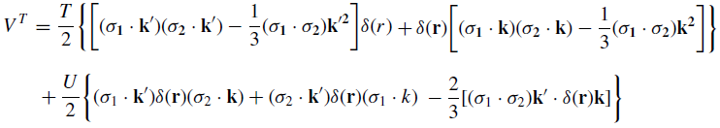
Skyrme parameter sets with tensor force
The tensor terms postulated by Skyrme: Nucl. Phy. 9, 615(1959)
Skyrme parameter sets which include tensor force:
Fl. Stancu et. al, PLB68, 108(1977),
B. A. Brown et. al, PRC74, 061303(R)(2006)
G-Matrix
interaction
T >0,
U>0
G. Colò et. al, PLB646, 227(2007),
D. M. Brink et. al, PRC75, 061311(2007)
Single-particle
energies
T >0,
U<0
Ground state
properties
T ±,
U ±
T. Lesinski et. al. PRC76, 014312(2007)

Slide 6
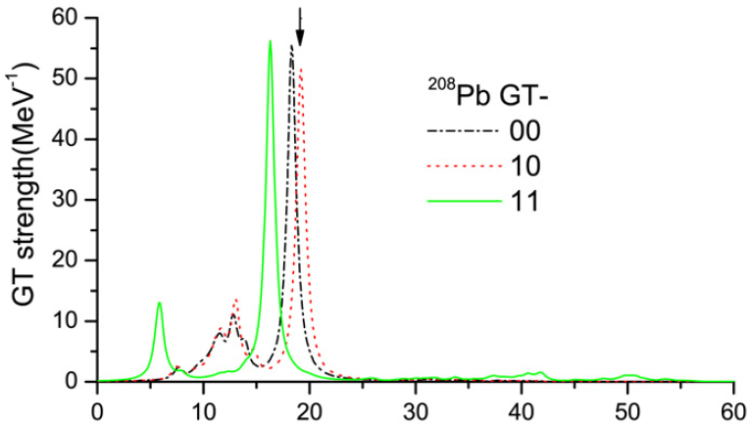
Tensor effects on GT states
Bai , Sagawa, Zhang, Zhang, Colò, Xu, Phys. Lett. B675, 28(2009)
Main peak
Low energy tail
10% strength shifted to 2ħωenergy region

Slide 7
Tensor effects on Charge-exchange SD
Bai, Zhang, Sagawa,
Zhang, Colò, Xu,
PRL 105,072501(2010)
Exp. From
T. Wakasa et. al.,
PRC 84, 014614(2011)
In T43, T >0, U<0
In SLy5+Tw, T>0, U>0
The SD 1⁻ state is shifted
downward dramatically
by the tensor RPA
correlations.

Slide 8
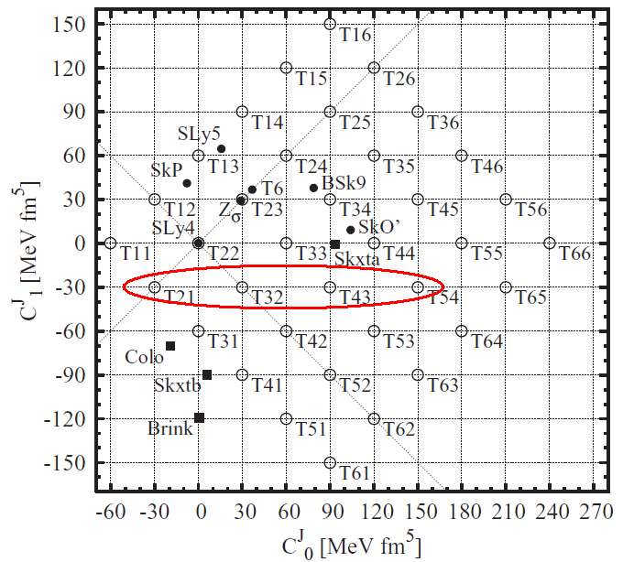
GT and SD constraint on the tensor force
Bai, Zhang, Sagawa, Zhang, Colò, Xu, PRC83,054316(2011);
The exp.main peak energy of SD and GT in ⁹⁰Zr and
²⁰⁸Pb can be the constraints by requiring the condition
● In TIJ family, only T21, T32, T43, and T54 fulfill the condition;
● SD 1- states strongly constrain the value of T;
● Together with SD, GT main peak can be used to constrain value of U.

Slide 9
GT and SD constraint on the tensor force
δ<2.5MeV
δ<2MeV

Slide 10
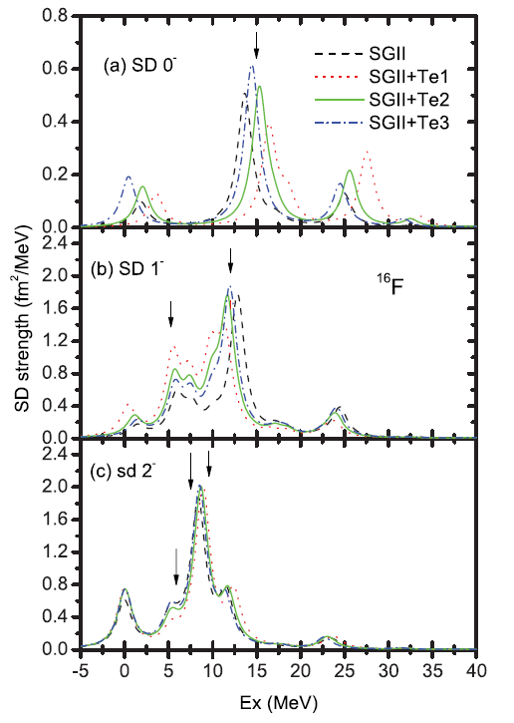

Slide 12
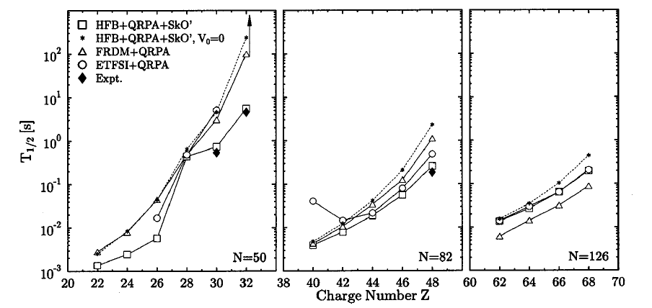
β-decay half-life in open-shell nuclei
T=0 pairing is used
in QRPA Calculation with Skyrme force.
J. Engel, et. Al. Phys. Rev. C 60, 014320(1999)

Slide 13
β-decay half-life in open-shell nuclei
T=0 pairing is used
In relativistic QRPA
Calculations.
T. Niksic, et. al. Phys. Rev. C 71, 014308(2005)

Slide 14
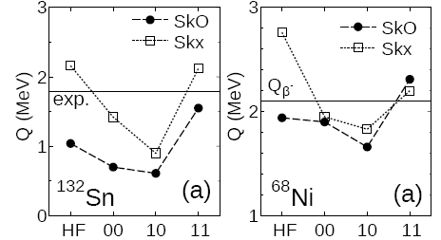
β-decay half-life in closed-shell nuclei
The inclusion of tensor force in self-consistent RPA calculation improve the
Result of Q and logft values.
F. Minato and C. L. Bai, Phys. Rev. Lett 110, 122501(2013)

Slide 15
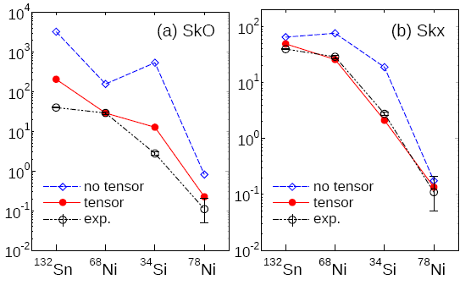
β-decay half-life in closed-shell nuclei
Tensor RPA correlations improve the β-decay half-life calculations in closed-shell nuclei.
F. Minato and C. L. Bai, Phys. Rev. Lett 110, 122501(2013)

Slide 16
Conclusion and outlook
● Tensor force have strong effects on the main peak energy of GT
and charge-exchange SD transitions in closed shell nuclei.
●GT and SD main peak energies can be used to constrain the
strengths of tensor force in a small area;
● In addition to T=0 pairing force, tensor force maybe an
important candidate which play an important role in nuclear
β-decay half-life.
● The effects of tensor force on the spin-isospin excitations of
Open-shell nuclei will be studied soon.

Slide 17
Many Thanks for your attention

