Slide 1
Magnetic and Antimagnetic Rotation in Covariant Density Functional Theory
International Nuclear Physics Conference (INPC 2013) June 2-7, 2013, Firenze, Italy
Pengwei Zhao
School of Physics, Peking University
Collaborators:
H. Z. Liang, Jie Meng, J. Peng, P. Ring, and S. Q. Zhang

Slide 2
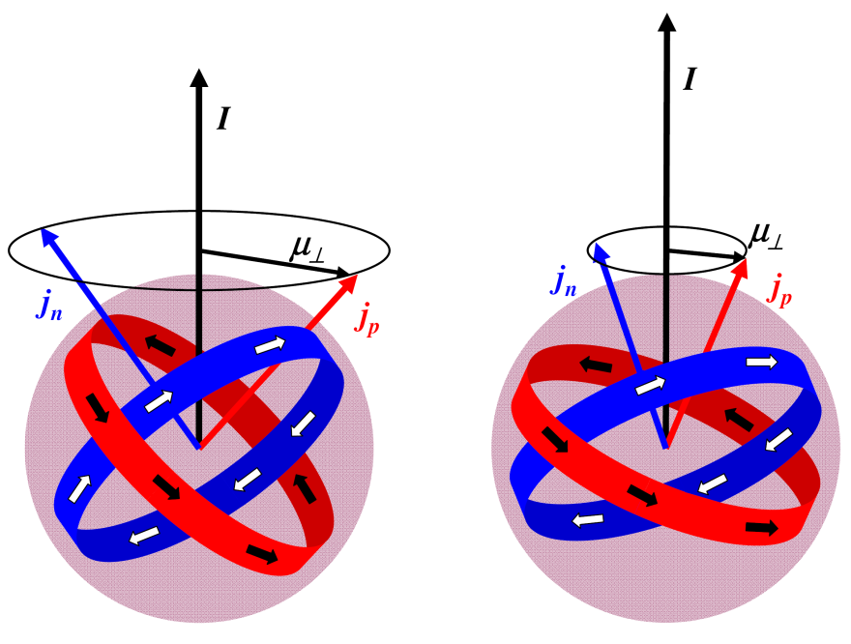
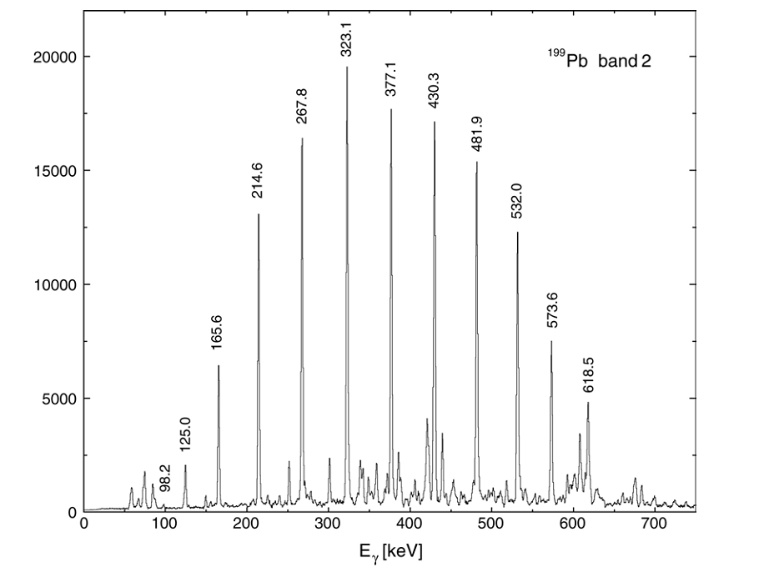
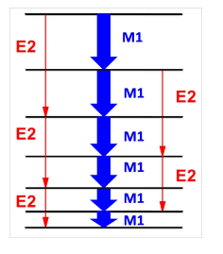
Magnetic Rotation (MR)
near spherical or weakly deformed nuclei
strong M1 and very weak E2 transitions
rotational bands with ΔI = 1
shears mechanism
Frauendorf NPA1993
Hübel PPNP2005
Notes:
The MR has been a hot topic since the end of the last century. Different from the normal deformed band, it is well-known that the MR results from the shears mechanism, i.e., the angular momentum is increased by aligning the valence high-j proton and neutrons.

Slide 3
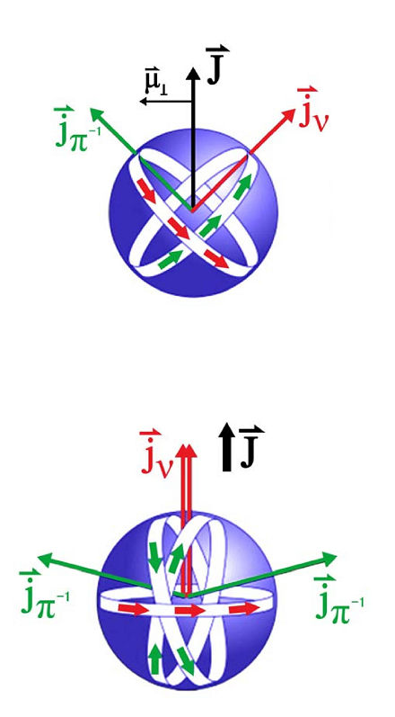
Antimagnetic Rotation (AMR)
Magnetic rotation Ferromagnet
rotational bands with ΔI = 1
near spherical nuclei; weak E2 transitions
strong M1 transitions
B(M1) decrease with spin
shears mechanism
Antimagnetic rotation Antiferromagnet
rotational bands with ΔI = 2
near spherical nuclei; weak E2 transitions
no M1 transitions
B(E2) decrease with spin
two “shears-like” mechanism
Frauendorf 1995
Notes:
The picture of MR is similar to that of a ferrmagnet because in both systems, the magnetic moment is the order parameter breaks the rotational symmetry. Following this idear, the antimagnetic rotation is predicted in a fully analogy to the antiferromagnet. In AMR, the angular momentum is increased by simultaneously aligning the two valence proton towards the neutron angular momentum. This is the so-called “two shears-like” mechanism. Due to this mechanism, there is no M1 transitions and the B(E2) values would decrease with spin.

Slide 4
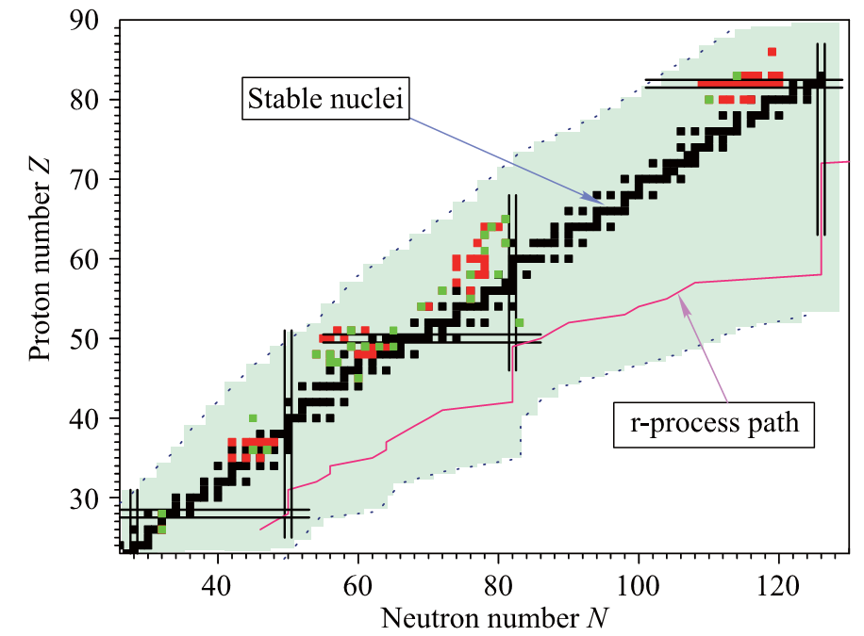
Experiment: MR
Magnetic rotation: 85 nuclei
Meng, Peng, Zhang, PWZ, Front. Phys. 8, 55 (2013)
Notes:
So far, the MR has been investigated extensively in the experiment. In total, about 200 (195) magnetic dipole bands spread over 85 nuclides have been observed, which have been summarized in the nuclear chart in Fig. 3.

Slide 5
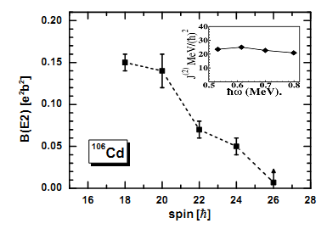
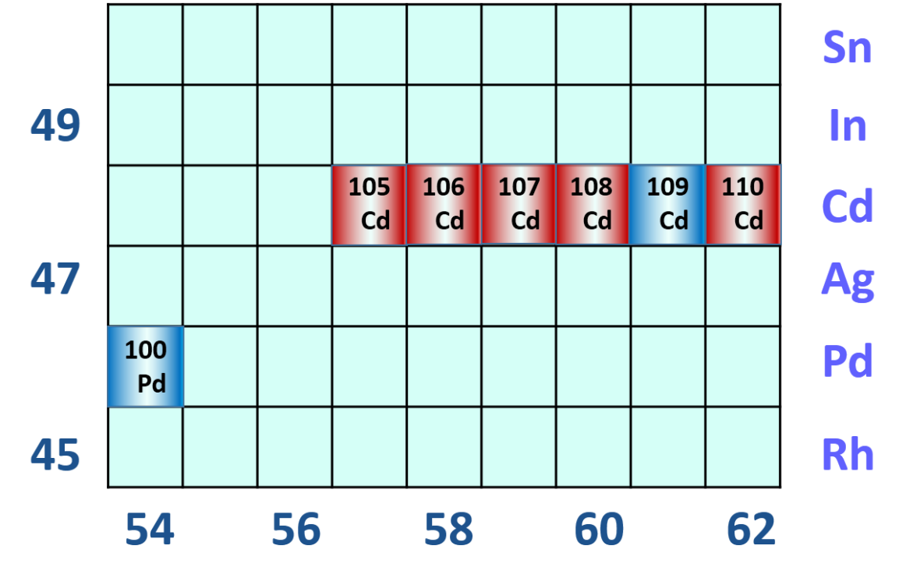
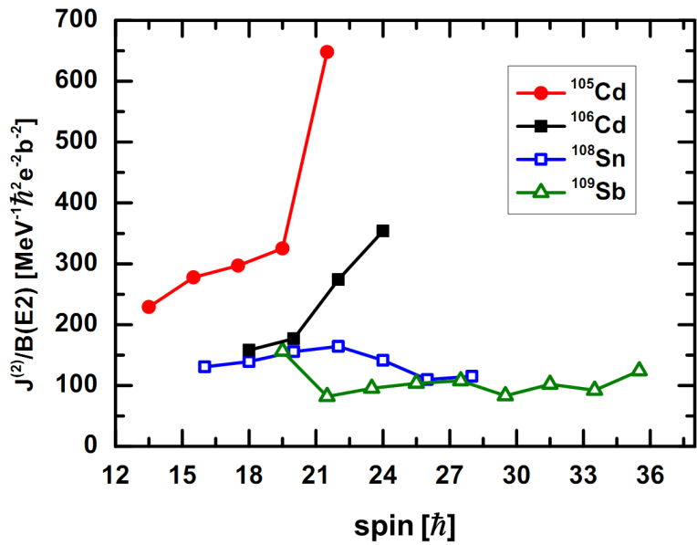
Experiment: AMR
A~100
Small B(E2)
Decrease tendency
Large J⁽²⁾/B(E2)
Increase tendency
Simons PRL2003; Simons PRC2005
Notes:
For the experiment of AMR so far, most investigations focus on this 100 mass region. In particular, clear evidence is give in these cd isotopes. Where small B(E2) values with decrease tendency and large moment of inertia over B(E2) values with increase tendency.

Slide 6
Theory
Semiclassical particle plus rotor model
Clark ARNPS2000
simple geometry for the energies and transition probabilities
Pairing-plus-quadrupole tilted axis cranking (TAC) model Frauendorf NPA1993; Frauendorf NPA2000
schematic Hamiltonian
A fully self-consistent microscopic model?
Density functional theory
Notes:
On the theoretical side, most investigations are based on these two phenomenological models. They have achieved great success in explaining the data. However, theoretically, it involves adjustable parameters for rotational excitations. Therefore, it is necessary to develop a fully self-consistent microscopic model without any free parameters.

Slide 7
DFT: Cranking version
TAC based on Covariant Density Functional Theory
Meson exchange version:
3-D Cranking: Madokoro, Meng, Matsuzaki, Yamaji, PRC 62, 061301 (2000)
2-D Cranking: Peng, Meng, Ring, Zhang, PRC 78, 024313 (2008)
Point-coupling version: Simple and more suitable for systematic investigations
2-D Cranking: PWZ, Zhang, Peng, Liang, Ring, Meng, PLB 699, 181 (2011)
TAC based on Skyrme Density Functional Theory
3-D Cranking: Olbratowski, Dobaczewski, Dudek, Płóciennik, PRL 93, 052501(2004)
2-D Cranking: Olbratowski, Dobaczewski, Dudek, Rzaca-Urban, Marcinkowska, Lieder, APPB 33, 389(2002)
Fully self-consistent microscopic investigations
fully taken into account polarization effects
self-consistently treated the nuclear currents
without any adjustable parameters for rotational excitations
In this presentation
The self-consistent TAC model based on CDFT with PC interaction
Investigation of MR and AMR bands in a fully self-consistent and microscopic way.
Notes:
The TAC based on Covariant Density Functional Theory provides one of the possibilities. The 3D cranking model exists for more than 10 years. However, because of the numerical complexity, 2D is developed to simplify the calculation. Recently, we developed the 2D Cranking model with point-coupling interaction, which is simple and more suitable for systematic investigations. The TAC model based on the non-relativistic Skyrme Functional is also available.

Slide 8
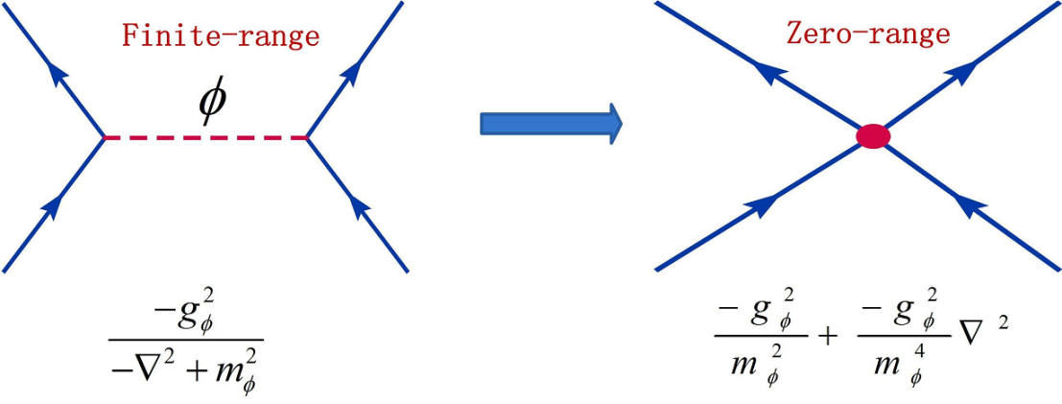
Tilted axis cranking CDFT
General Lagrangian density
Transformed to the frame rotating with the uniform velocity
x
z
Koepf NPA1989; Kaneko PLB1993; Madokoro PRC1997
Notes:
The starting point of the CDFT is this ge

Slide 9
Equations of motion
Dirac Equation
Potential
Spatial components of vector field are involved due to the time-reversal invariance broken

Slide 10
Observables
Binding energy
Angular momentum
Quadrupole moments and magnetic moments
B(M1) and B(E2) transition probabilites
Where

Slide 11
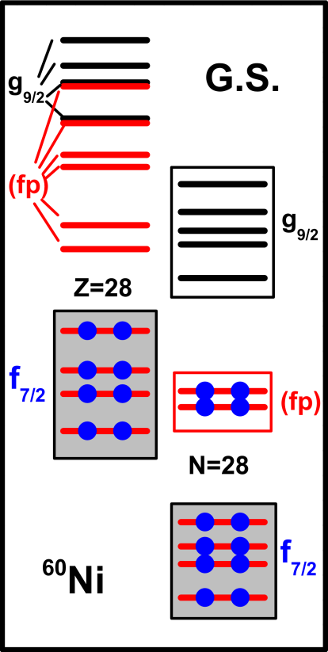
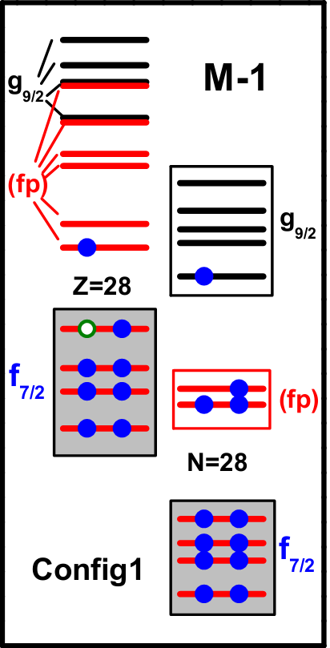
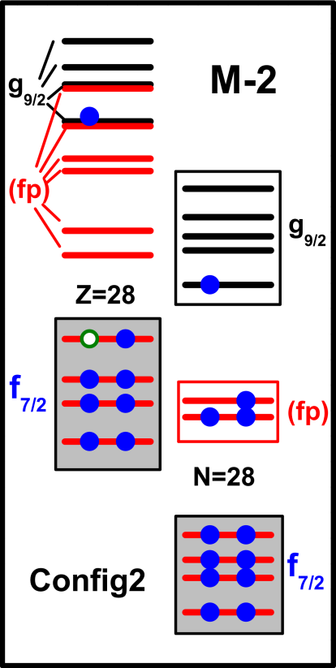
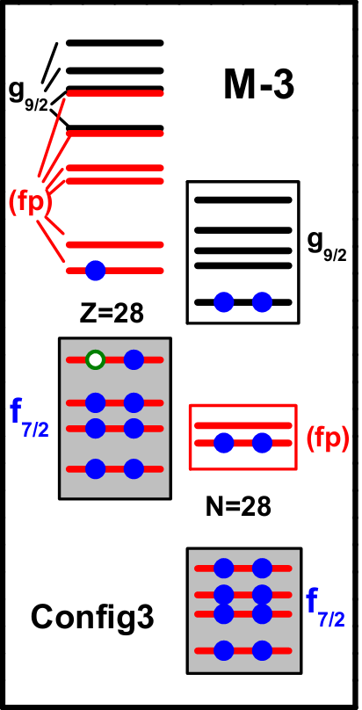
MR: ⁶⁰Ni
Harmonic oscillator shells: Nf = 10
Effective interaction: PC-PK1 PWZ, Li, Yao, Meng, PRC 82, 054317 (2010)
Configurations:
Torres et al, PRC 78, 054318 (2008)
PWZ, Zhang, Peng, Liang, Ring, Meng, PLB 699, 181 (2011)

Slide 12
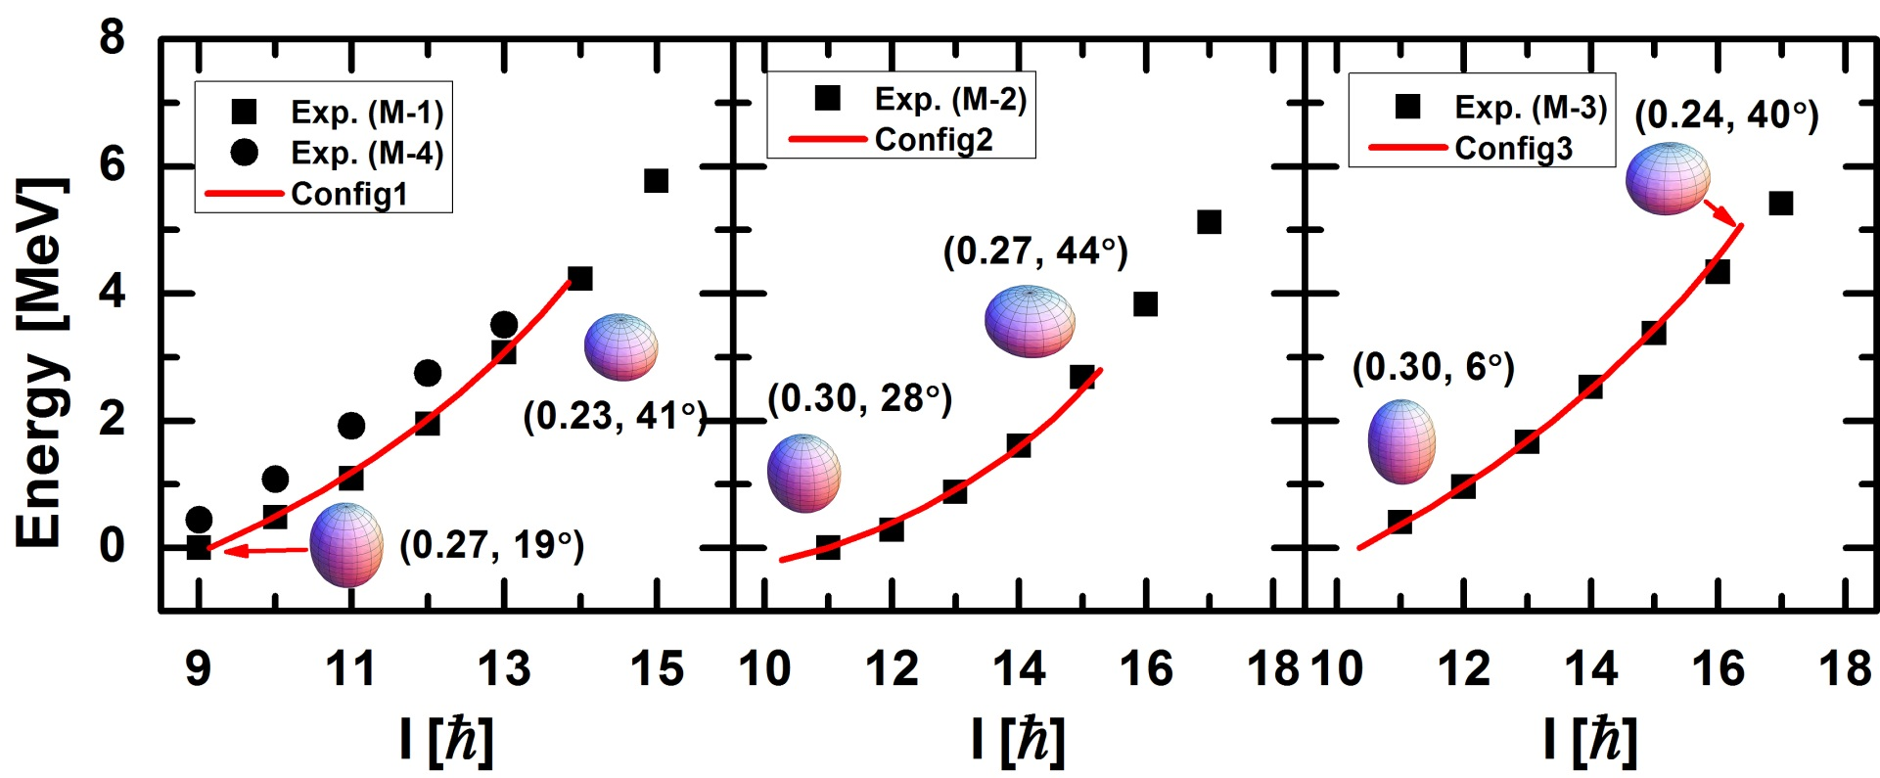
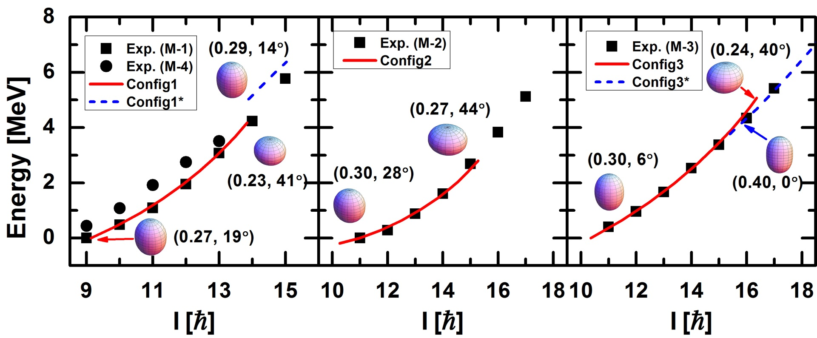
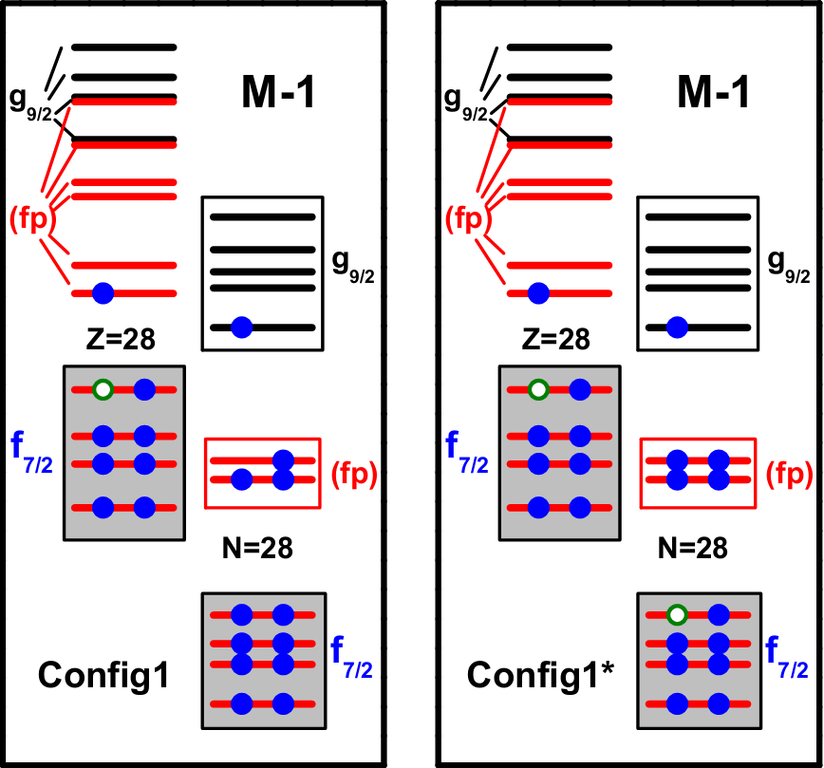
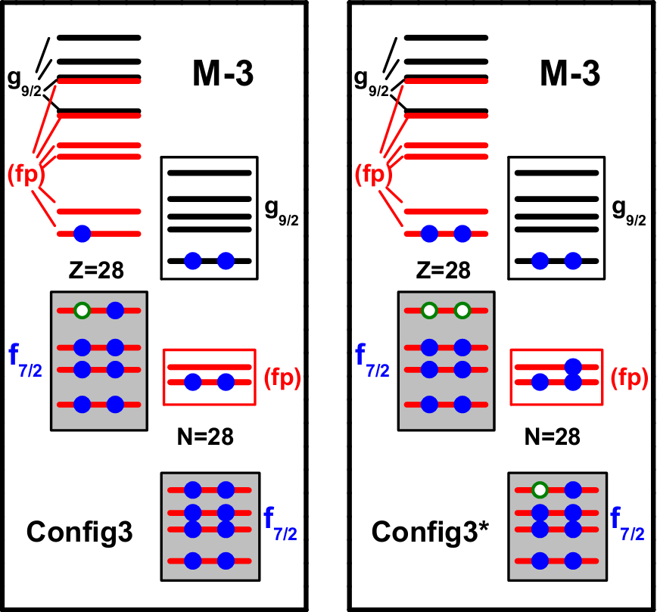
MR: ⁶⁰Ni
PWZ, Zhang, Peng, Liang, Ring, Meng, PLB 699, 181 (2011)
The experimental energies are reproduced quite well (except the larger spin part)
For high-spin states in band M-1 and M-3, Config1* and Config3* are switched in.

Slide 13
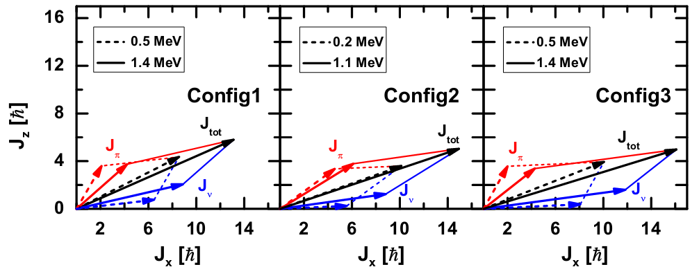
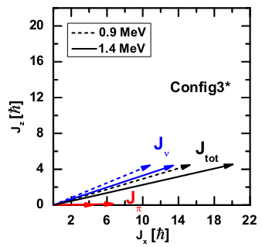
MR: ⁶⁰Ni
Magnetic Rotation
Electric Rotation
PWZ, Zhang, Peng, Liang, Ring, Meng, PLB 699, 181 (2011)

Slide 14
AMR: ¹⁰⁵Cd
Harmonic oscillator shells: Nf = 10
Effective interaction: PC-PK1 PWZ, Li, Yao, Meng, PRC 82, 054317 (2010)
Configurations:
Polarizations:
¹⁰⁷Sn
¹⁰⁷Sn + π[(g_{9/2})⁻²]
¹⁰⁵Cd
Choudhury et al, PRC 82 , 061308 (2010)
PWZ, Peng, Liang, Ring, Meng PRL 107, 122501(2011)

Slide 15
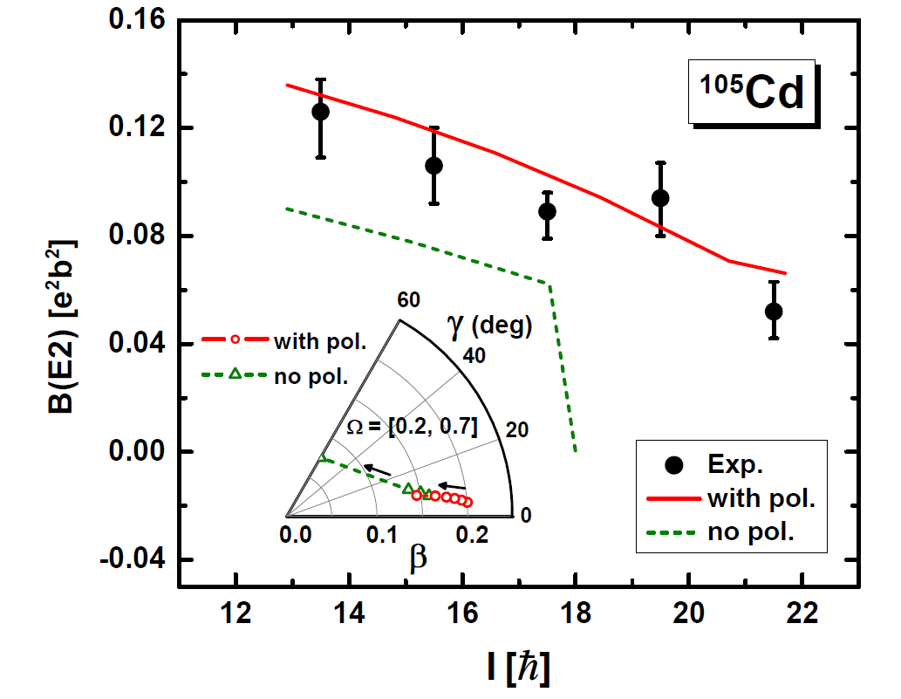
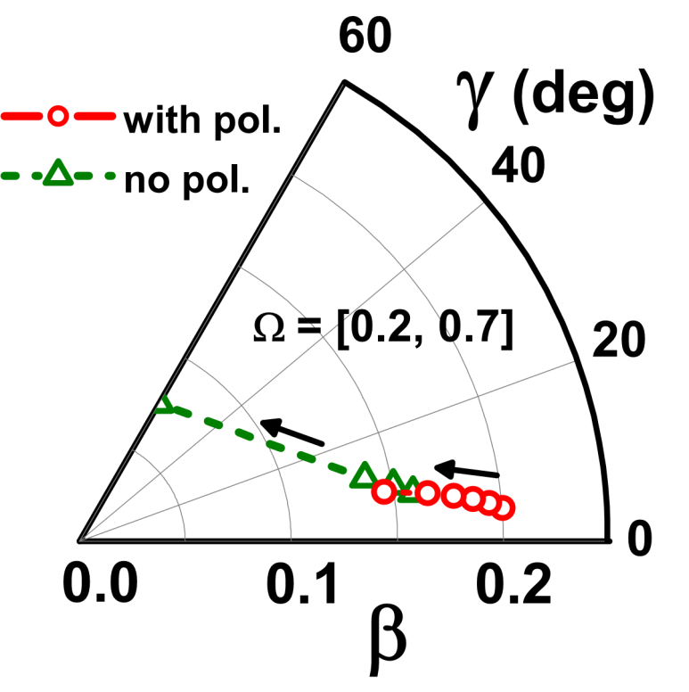
AMR: ¹⁰⁵Cd
PWZ, Peng, Liang, Ring, Meng PRL 107, 122501(2011)
The calculated B(E2) values are in excellent agreement with the data.
The B(E2) values decrease with the increasing spin
Without polarization, the B(E2) values drop to zero when the spin large than 17ħ.
Without polarization, the nucleus changes to be a oblate shape when the spin large than 17ħ.
It is of importance to emphasize that polarization effects play a very important role in the self-consistent microscopic description of AMR bands, especially for the E2 transitions.

Slide 16
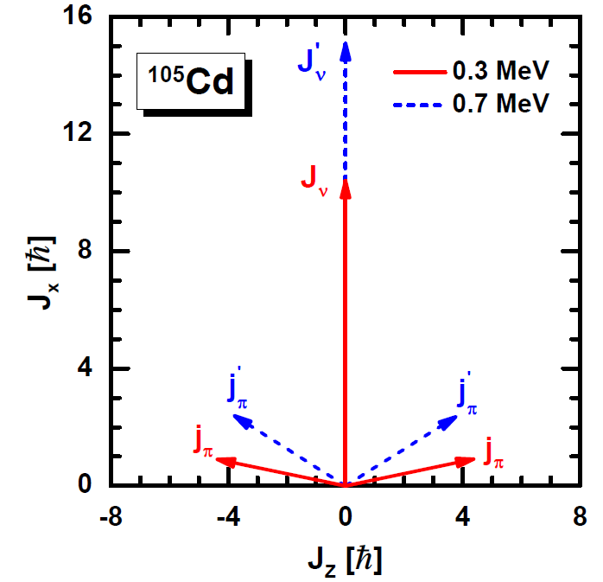
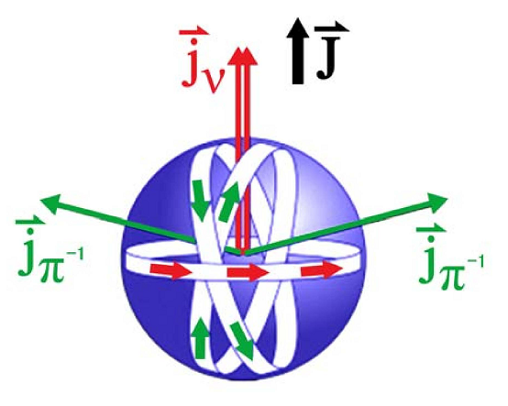
AMR: two “shears-like” mechanism
PWZ, Peng, Liang, Ring, Meng PRL 107, 122501(2011)
The angular momentum is increased due to the alignment of two proton holes
The two “shears-like” mechanism is excellently presented.

Slide 17
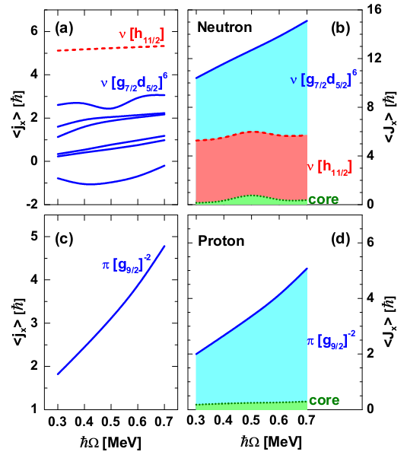
AMR: single particle angular momentum
PWZ, Peng, Liang, Ring, Meng PRC 85, 054310 (2012)
For the protons, only the two holes in the g_{9/2} shell contribute.
For the neutrons, the particles above the N= 50 shell contribute.
Angular momentum increases due to the alignment of proton holes and the mixing within the neutron orbitals.
Due to the strong mixing between neutrons, a core in the phenomenological model cannot be well defined.

Slide 18
Summary
Covariant density functional theory has been extended to describe rotational excitations including MR and AMR.
MR: ⁶⁰Ni PWZ, Zhang, Peng, Liang, Ring, Meng, PLB 699, 181 (2011)
⁵⁸Fe Steppenbeck et al., PRC 85, 044316 (2012)
¹⁹⁸Pb,¹⁹⁹Pb Yu, PWZ, Zhang, Ring, Meng, PRC 85, 024318 (2012)
AMR: ¹⁰⁵Cd PWZ, Peng, Liang, Ring, Meng PRL 107, 122501(2011)
PWZ, Peng, Liang, Ring, Meng PRC 85, 054310 (2012)
¹¹²In Li et al., PRC 86, 057305 (2012).
Thank you very much for your attention!

