Slide 1
High Resolution ¹⁴⁸Nd(³He,nγ) Two Proton Stripping Reaction and the structure of the 0₂⁺ State in ¹⁵⁰Sm
J. F. Sharpey-Schafer¹, P. Papka^{2,3}, S. P. Bvumbi⁴, P. Jones³, P. Vymers², R. A. Bark³, T. D. Bucher ³, T. S. Dinoko¹, J. L. Easton¹, M. S. Herbert¹, P. V. Keshwa², N. Khumalo¹, E. A. Lawrie³, J. J. Lawrie³, S. N. T. Majola^{3,5}, J. Ndayishimye², M. R. Nchodu³, D. Negi³, S. P. Noncolela¹, J. N. Orce¹, O. Shirinda³, P. Sithole¹, M. A. Stankiewicz⁵ and M. Wiedeking³
¹Department of Physics, University of Western Cape, South Africa
²Department of Physics, Stellenbosch University, South Africa
³Department of Nuclear Physics, iThemba LABS, South Africa
⁴Department of Physics, University of Johannesburg, South Africa
⁵Department of Physics, University of Cape Town, South Africa

Slide 2
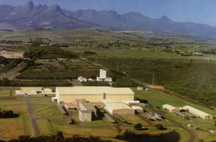
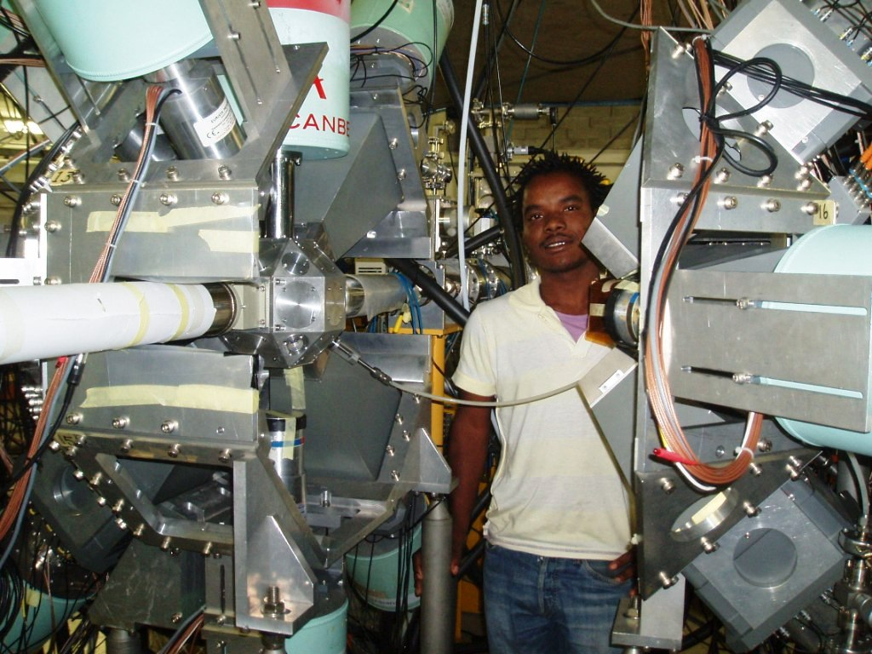
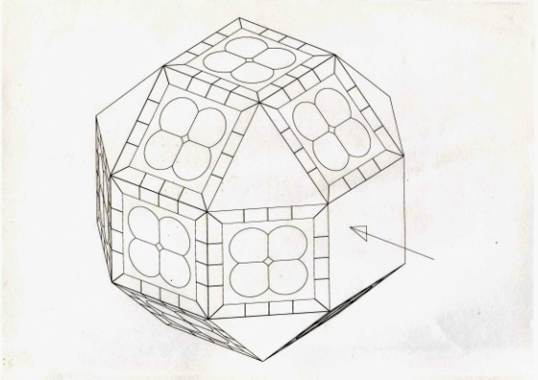
iThemba LABS
Near Cape Town
AFRODITE = AFRican OmnipurposeDetector for InnovativeTechniques and Experiments
9 Clover HPGe in BGO Shields
8 LEPS each with 4 quadrants
DAIMANT
T-o-F Recoil Detector
Frozen ¹³⁶Xe target
Neutron Wall
Solar Cell HI detector checkerboard
High Energy Capture γ-rays
High Resolution (³He,n) two proton stripping

Slide 3
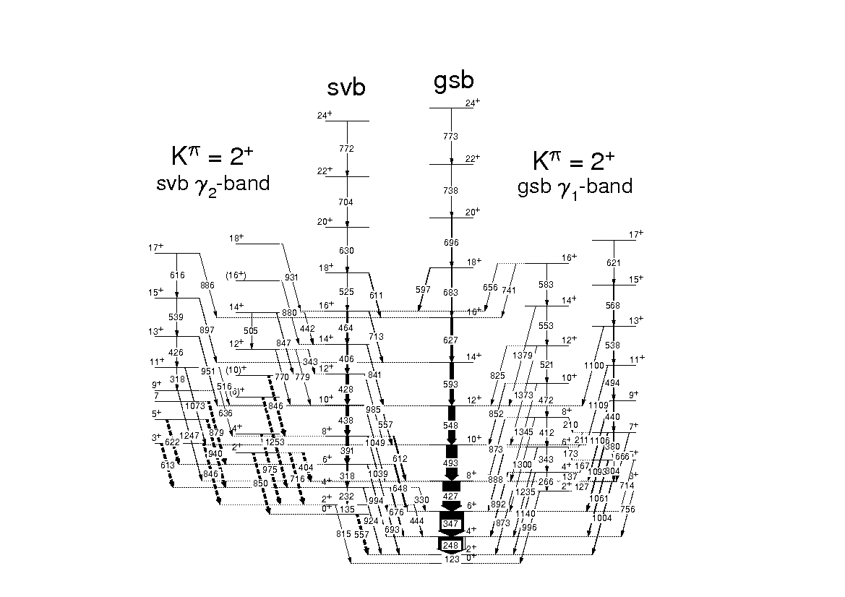
JFS-S et al., Eur. Phys. J. A47 (2011) 5
¹⁵⁴₆₄Gd₉₀

Slide 4
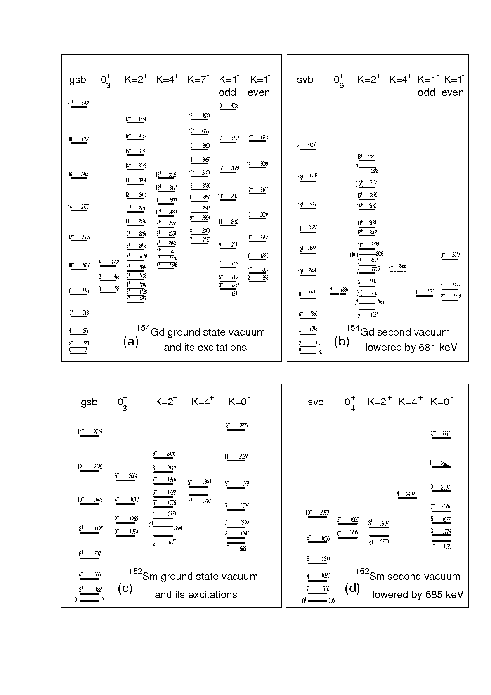
Congruence of first & second Vacuum structures in ¹⁵⁴Gd & ¹⁵²Sm
JFS-S et al., Eur. Phys. J. A47 (2011) 5

Slide 5
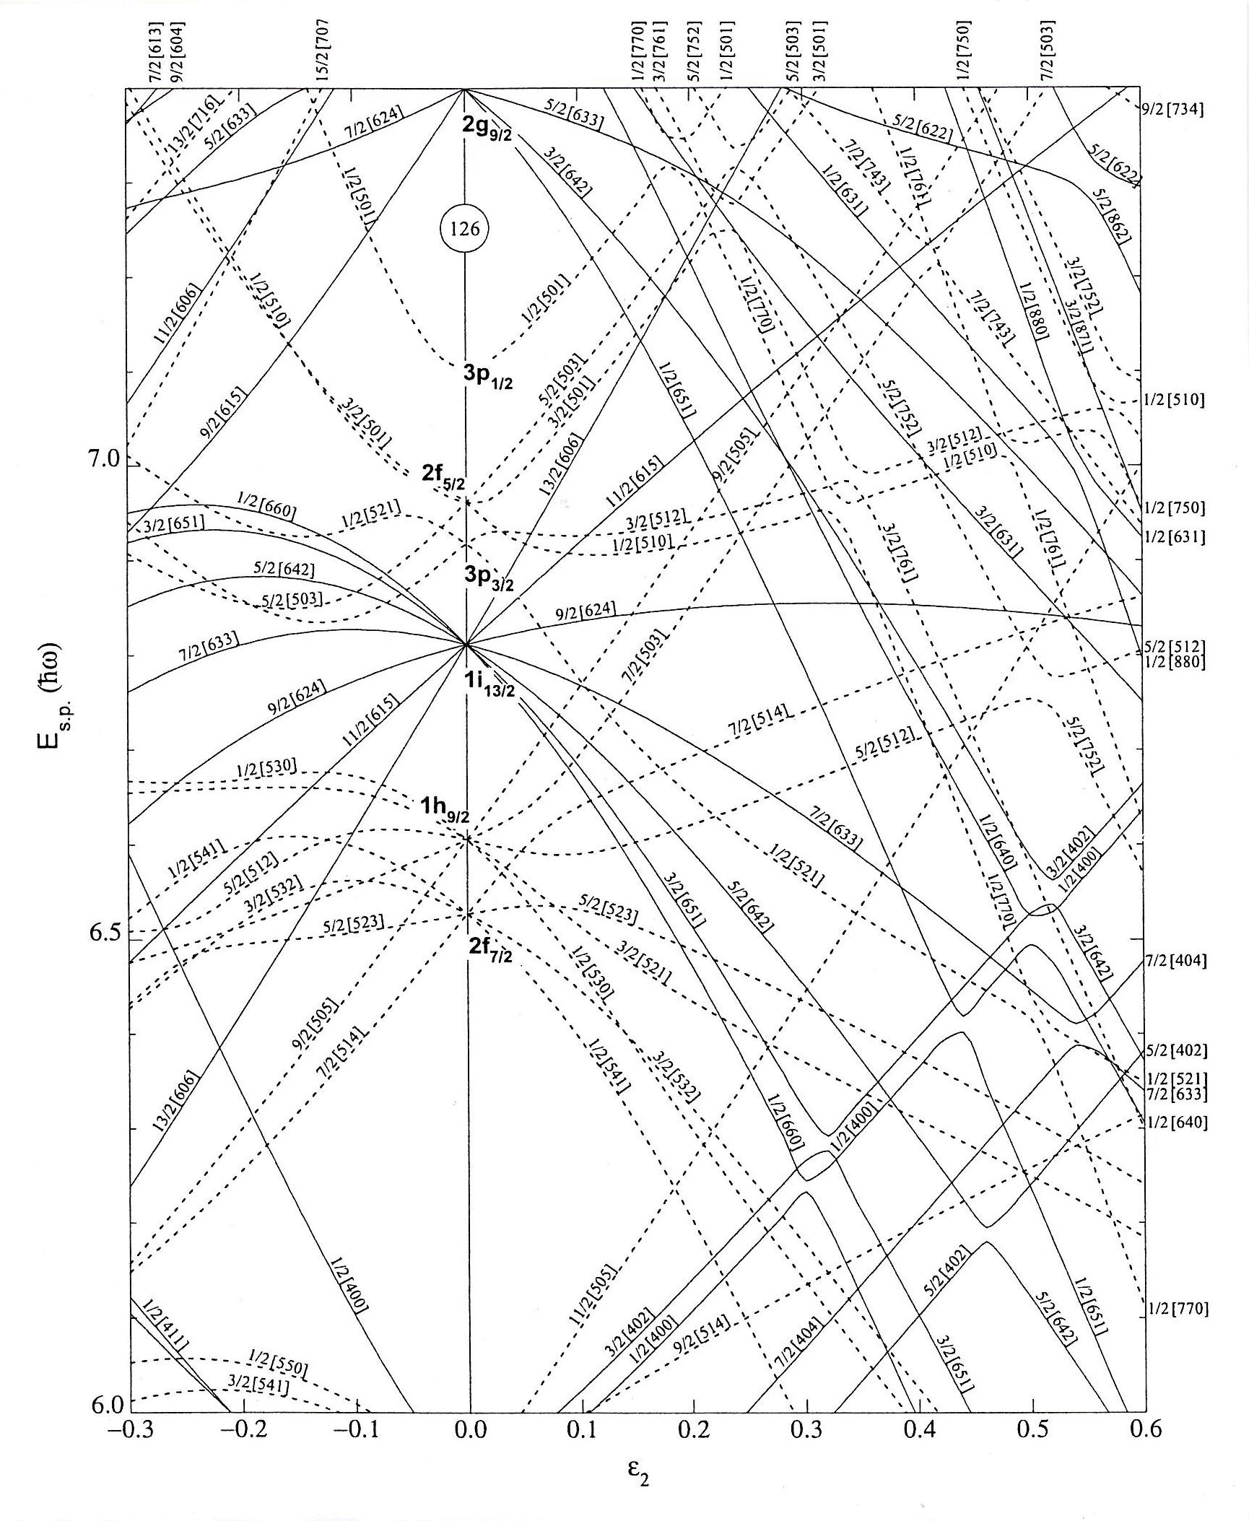
Configuration Dependent or Quadrupole
Pairing;
Assume
Δ_{pp}≈ Δ_{oo}>> Δ_{op}
[660]1/2⁺
“Prolate”
R. E. Griffin, A. D. Jackson and A. B. Volkov, Phys. Lett. 36B, 281 (1971).
W. I. van Rij and S. H. Kahana, Phys. Rev. Lett. 28, 50 (1972).
S. K. Abdulvagabova, S. P. Ivanova and N. I. Pyatov, Phys. Lett. 38B, 251 (1972).
D. R. Bès, R. A. Broglia and B. Nilsson, Phys. Lett. 40B, 338 (1972).
I. Ragnarsson and R. A. Broglia, Nucl. Phys. A263, 315 (1976).
[505]11/2⁻
“Oblate”
82 Neutrons
Prolate Deformation =>

Slide 6
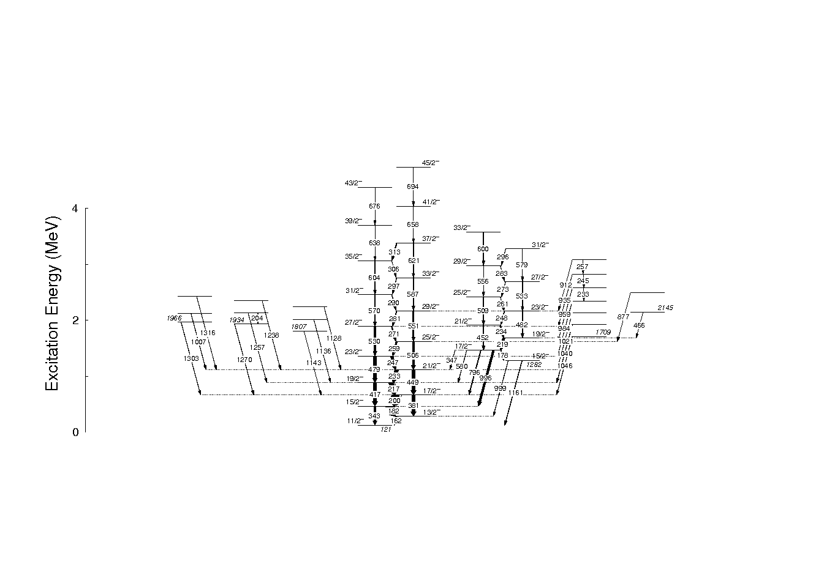
JFS-S et al., Eur. Phys. J. A47 (2011) 6
¹⁵⁵Gd₉₁
High-K Decay Scheme
K^{π}=15/2⁻
=2_{γ}⁺ + [505]11/2⁻
Missing │0₂⁺ >
coupling
[505]11/2⁻

Slide 7

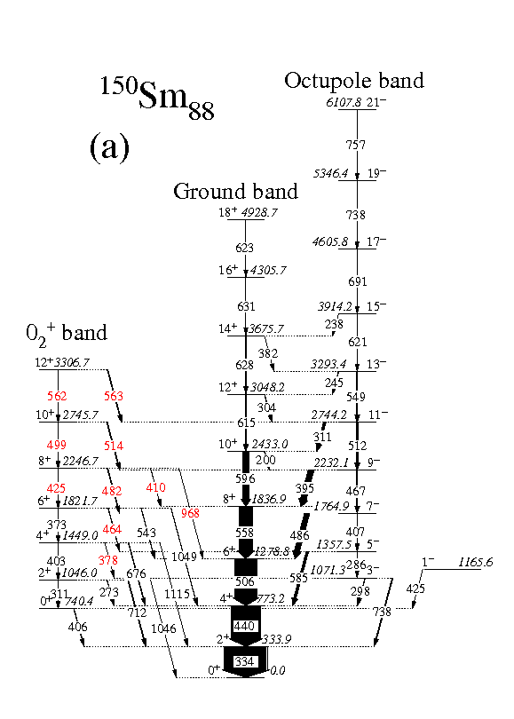
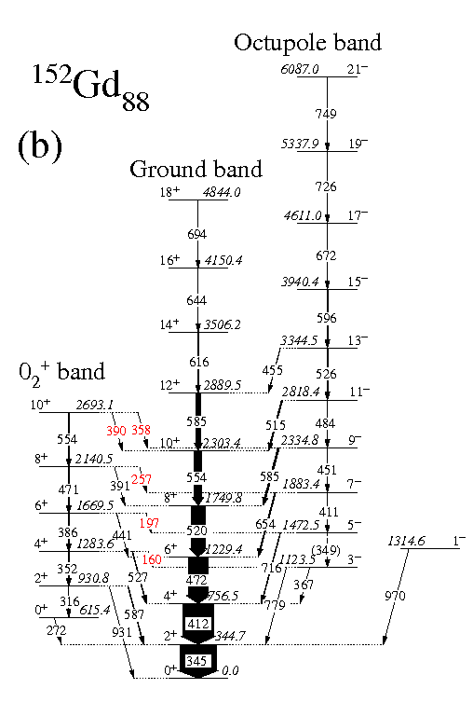
Suzan P. Bvumbi et al., Phys. Rev. C87 (2013) 044333
Partial level schemes of ¹⁵⁰Sm (a) and ¹⁵²Gd (b)
showing the ground state, second vacuum 0₂⁺ and octupole bands.
New transitions and E1 transitions from the second vacuum 0₂⁺ bands to the octupole bands
are shown in red.

Slide 8
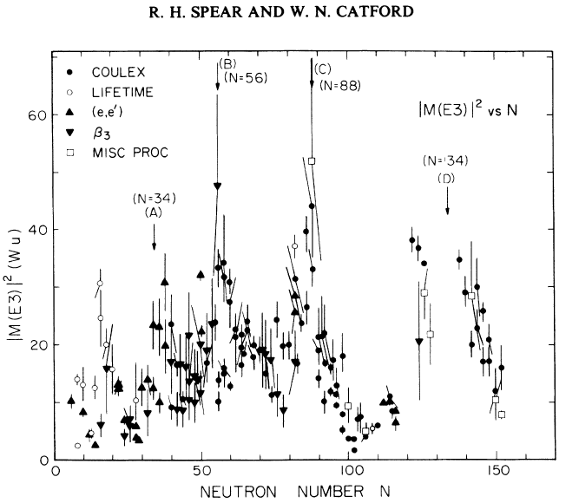
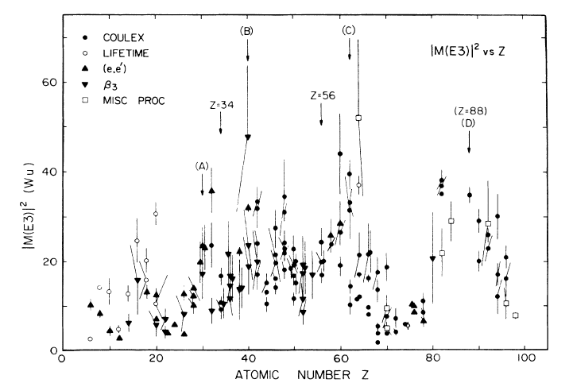
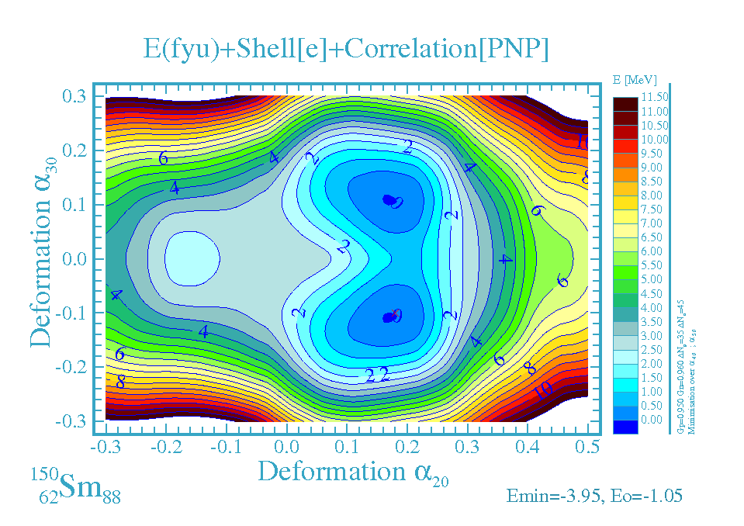
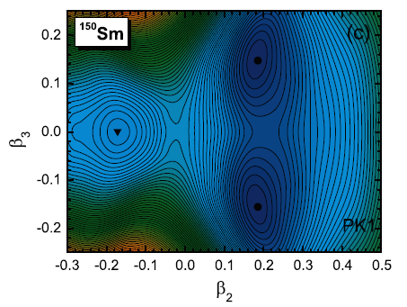
Phys. Rev. C41, (1990) R1351
¹⁵⁰₆₂Sm₈₈
Z=62
Zang et al. Phys. Rev. C81 (2010) 034302; Relativistic mean-field
Jerzy Dudek & Dominque Curian; private communication

Slide 9
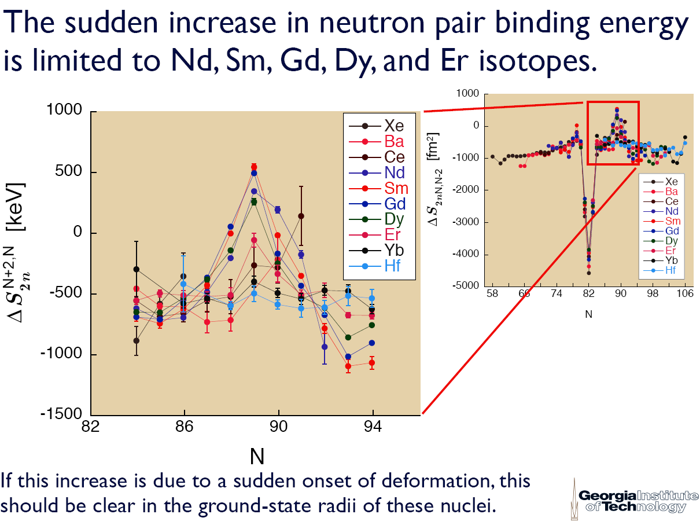
Slide from W. David Kulp

Slide 10
There are only two examples where the double beta 2β2ν decay to excited states in a nucleus has been measured. These are;
¹⁰⁰Mo → ¹⁰⁰Ru first excited 0₂⁺
partial lifetime T_{1/2} = 1.6(~6)x10²⁰yr.
¹⁵⁰Nd → ¹⁵⁰Sm first excited 0₂⁺
partial lifetime T_{1/2} = 1.33(~30)x10²⁰yr.
Frank T. Avignone III, Steven R. Elliott and Jonathan Engle, Rev. Mod. Phys. 80, 481 (2008).

Slide 11
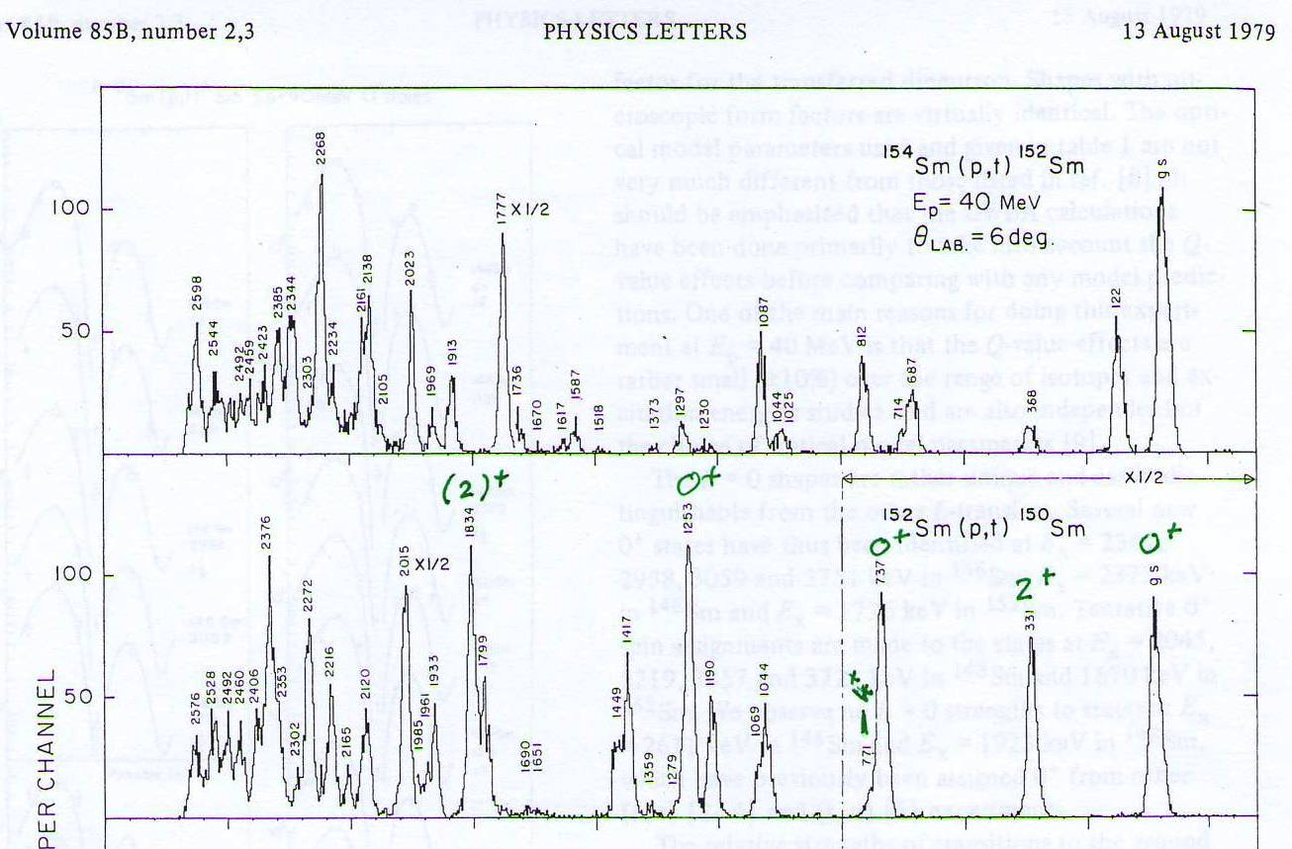
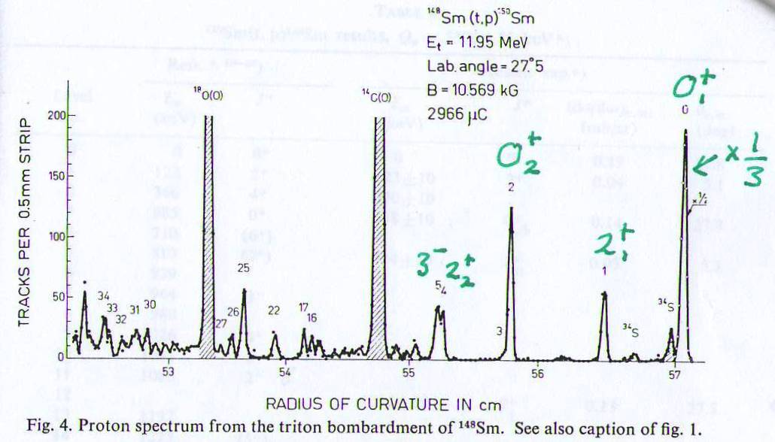
θ = 6°
Two Neutron Pick-up
¹⁵²Sm(p,t)¹⁵⁰Sm
A. Saha et al., Phys. Lett. 85B, 215 (1079).
θ = 27°
Two Neutron Stripping
¹⁴⁸Sm(t,p)¹⁵⁰Sm
J. H. Bjerregaard et al.,
Nucl. Phys. 86, 145 (1966).

Slide 12
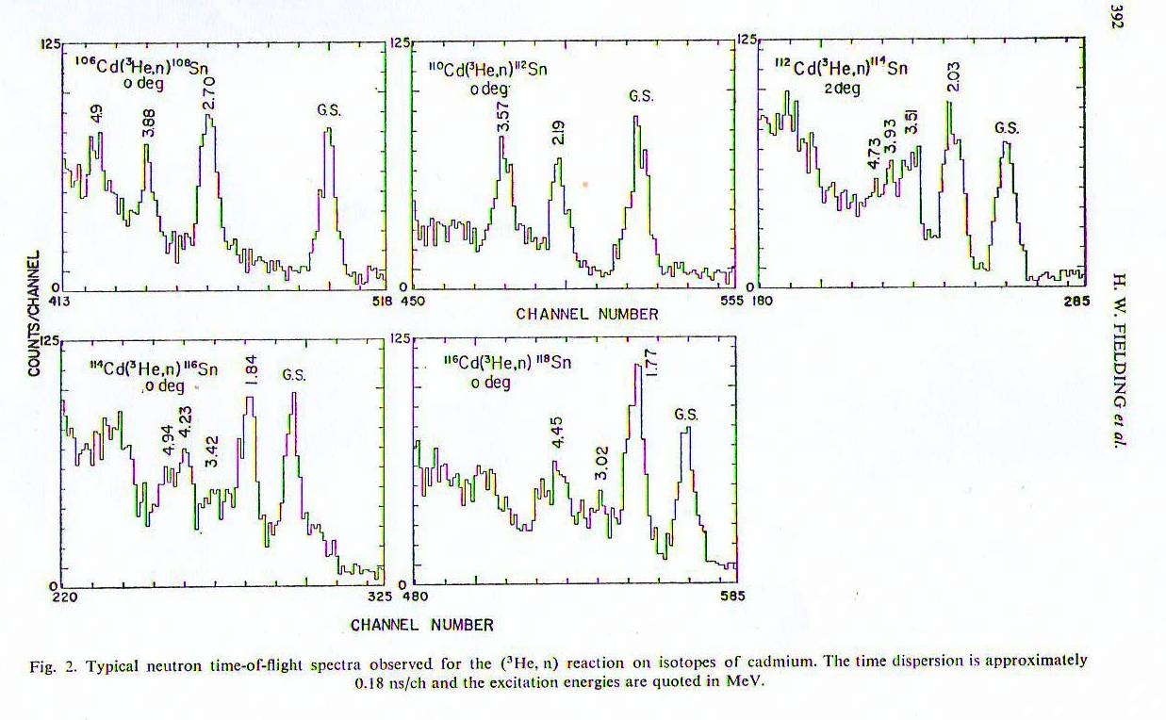

Two Proton Stripping Reactions
₄₈Cd(³He,n)₅₀Sn
ΔE ≈ 500 keV
Time-of-Flight →
$∝$ v_{n} $∝ √E_{n}$
³He beam 25.4 MeV
9 m
Neutron detector
Target
H. W. Fielding et al., Nucl. Phys. A281, 389 (1977)
{W P Alford and friends}

Slide 13
THE PROBLEM for ⁽³He,n) Two Proton Stripping:
1. How to get good resolution ΔE_{n} ≈ 2 keV
2. How to separate the 1 in 1000 (³He,n) direct reaction events from the flood of (³He,xn) fusion-evaporation events ??
THE SOLUTION:
1. Use HPGe detectors having ΔE_{γ} ≈ 2 keV
(i) Note that Q _{(3He,n)} ≈ + 7 MeV E_{n} ≈ 32 MeV Fast
while Q _{(3He,xn)} ≈ - 17 MeV E_{n} < 6 MeV Slow
(ii) To 0⁺ states, the (³He,n) cross-section peaks at 0°
while for (³He,xn) all neutrons are emitted isotropically
ie. the direct reaction L=0 neutrons to 0_{n}⁺ states are focused at 0°
While the evaporation neutrons are emitted in all directions.

Slide 14
AFRODITE = AFRican Omnipurpose Detector for Innovative Technologies and Experiments
AFRODITE
9 HPGe Clovers
in BGO shields
12 Neutron detectors
Each 10x10x60 cm
target
beam stop
25 MeV
³He beam
Pb γ-ray shielding wall
~2.0m
Schematic set-up for (³He,n) experiments

Slide 15
We have measured:
¹⁴⁸Nd(³He,n)¹⁵⁰Sm
and ⁹⁸Mo(³He,n)¹⁰⁰Ru
at 25 MeV
(a) ¹⁴⁸Nd(³He,n)¹⁵⁰Sm
Q-values and fusion-evaporation Cross-sections
1n => + 6.512 MeV ¹⁵⁰Sm <0.1%
2n => - 1.474 MeV
3n => - 7.348 MeV ¹⁴⁸Sm 64% 464 mb (3n)
4n => -15.488 MeV ¹⁴⁷Sm 34% 249 mb (4n)
(b) ⁹⁸Mo(³He,n)¹⁰⁰Ru
Q-values Cross-sections
1n => + 7.971 MeV ¹⁰⁰Ru <0.1%
2n => - 1.702 MeV ⁹⁹Ru 5.8% 51 mb (2n)
3n => - 9.171 MeV ⁹⁸Ru 81.5% 716 mb (3n)
4n => -19.420 MeV

Slide 16
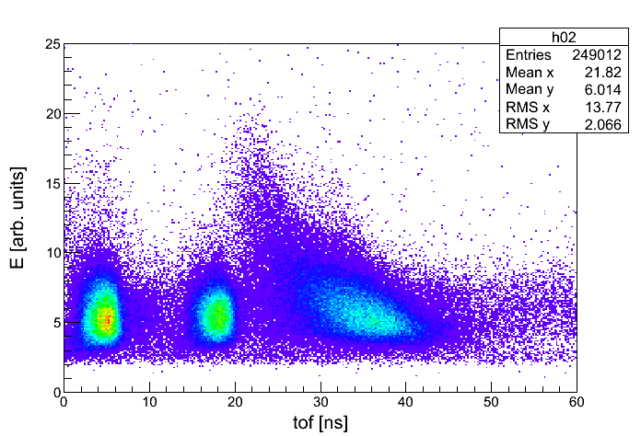
⁵⁹₂₇Co₃₂(³He,n)⁶¹₂₉Cu₃₂
Fast Neutrons
from (³He,n)
γ-rays from target
γ-rays from beam stop
Statistical Neutrons
from (³He,xn)
P. Papka et al., submitted to Phys. Rev. C

Slide 17
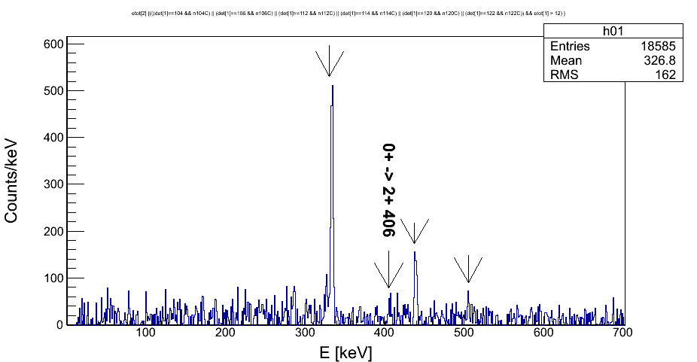
Initial analysis of ¹⁴⁸Nd(³He,n)¹⁵⁰Sm
2₁⁺
4₁⁺
6₁⁺
from Paul Papka

Slide 18
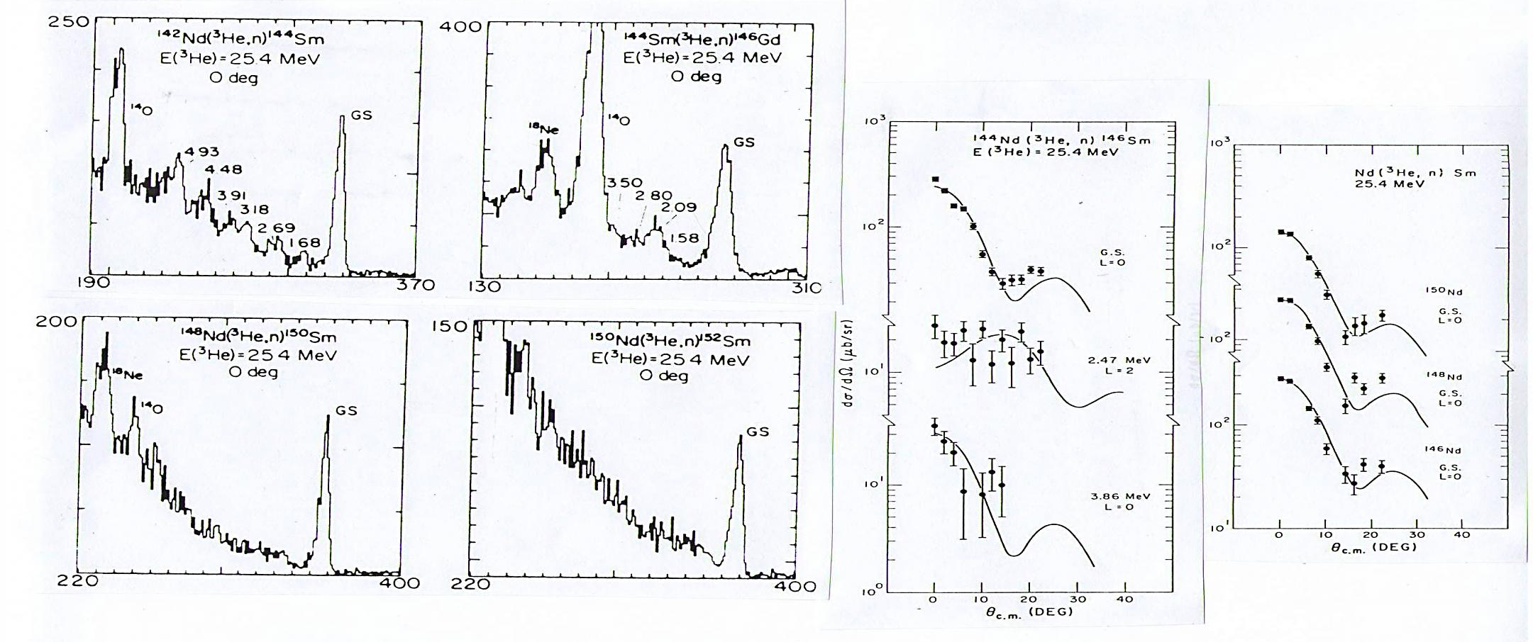
W. P. Alford et al., Nucl. Phys. A321 (1979) 45.
Angular Range of our
Neutron Detectors
θ = 0° to 10°
All Experiments have snags and/or Flaws !!!!
Our Major Snag is that we do
NOT DETECT THE GROUND STATE [no γ-rays !!]
BUT we are rescued by W P Alford, and his mates, by their low resolution measurements !!!! They can see the ground state and little else.
We can then fit their spectra, as an upper limit, as we know the relative strengths of the population of the excited states.

Slide 19
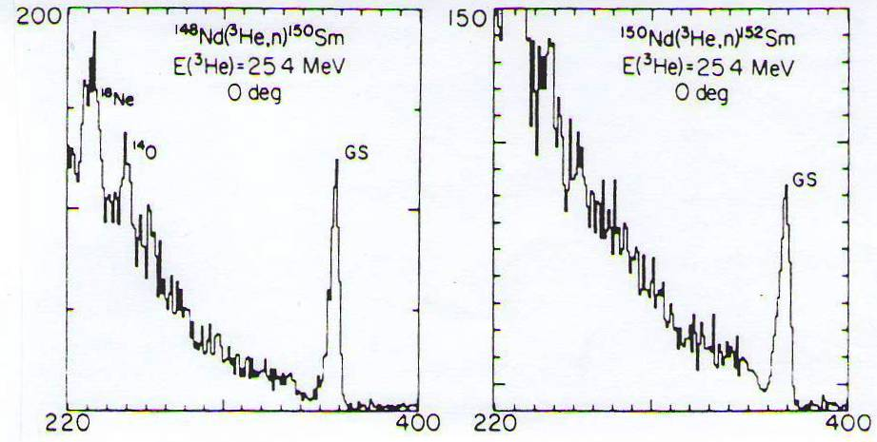
Coulex of Target
by incoming beam
~5 channels = 1 ns
= 550 keV
~7 channels
is wider
Alford et al. NP A321 (1979) 45
6₁⁺ 1279
¹⁵⁰Sm₈₈
0₃⁺ 1082
¹⁵²Sm₉₀
4₁⁺ 773
6₁⁺ 707
Number of Counts
0₂⁺ 740
0₂⁺ 685
2₁⁺ 334
4₁⁺ 366
2₁⁺ 122
Channel number
0₁⁺ 0
0₁⁺ 0

Slide 20
Counts in Peaks 150Sm
Level | E_{x} (keV) | γ-rays | Fit ToF
0⁺ | 0 | -- | 469(25)
2⁺ | 334 | 1728(77) | 173(20)
4⁺ | 439 | 585(56) | 38(10)
6⁺ | 506 | 218(38) | --
Relative Intensities150Sm
Level | E_{x} (keV) | γ-rays | Fit ToF
0⁺ | 0 | -- | 271(19)
2⁺ | 334 | 100(5) | 100
4⁺ | 439 | 34(4) | 22(6)
6⁺ | 506 | 13(2) | --

Slide 21
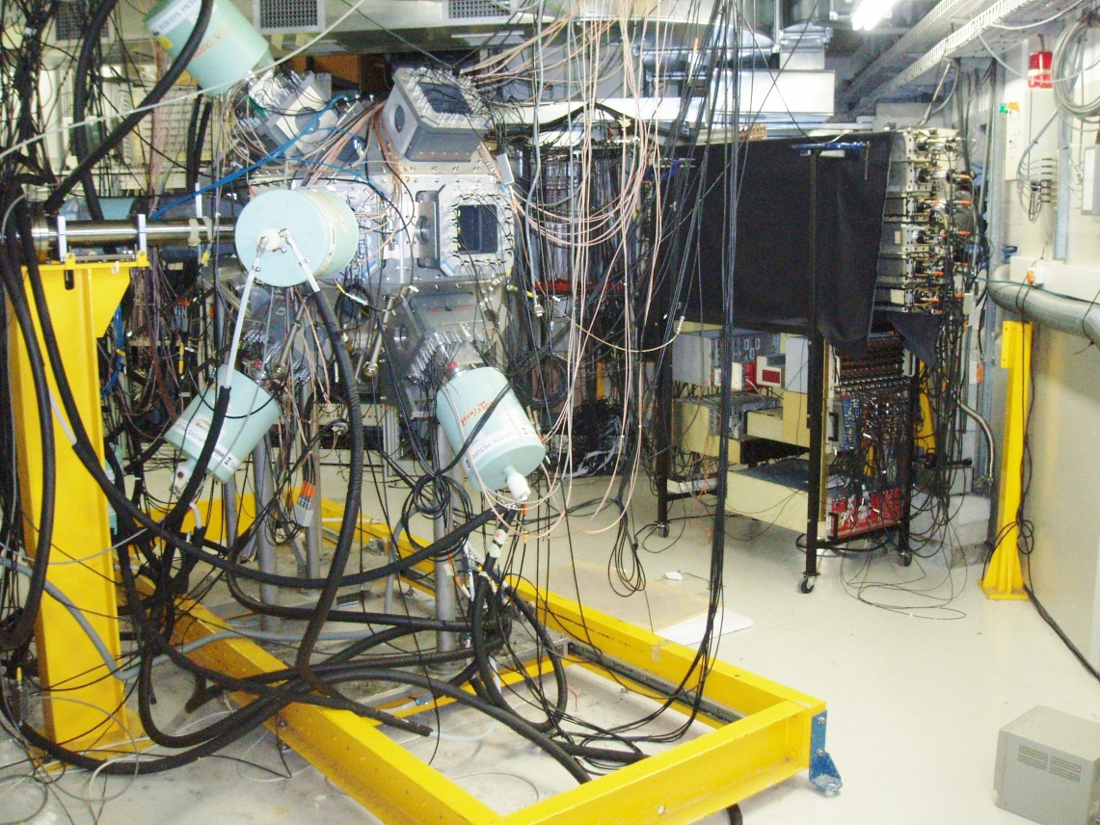
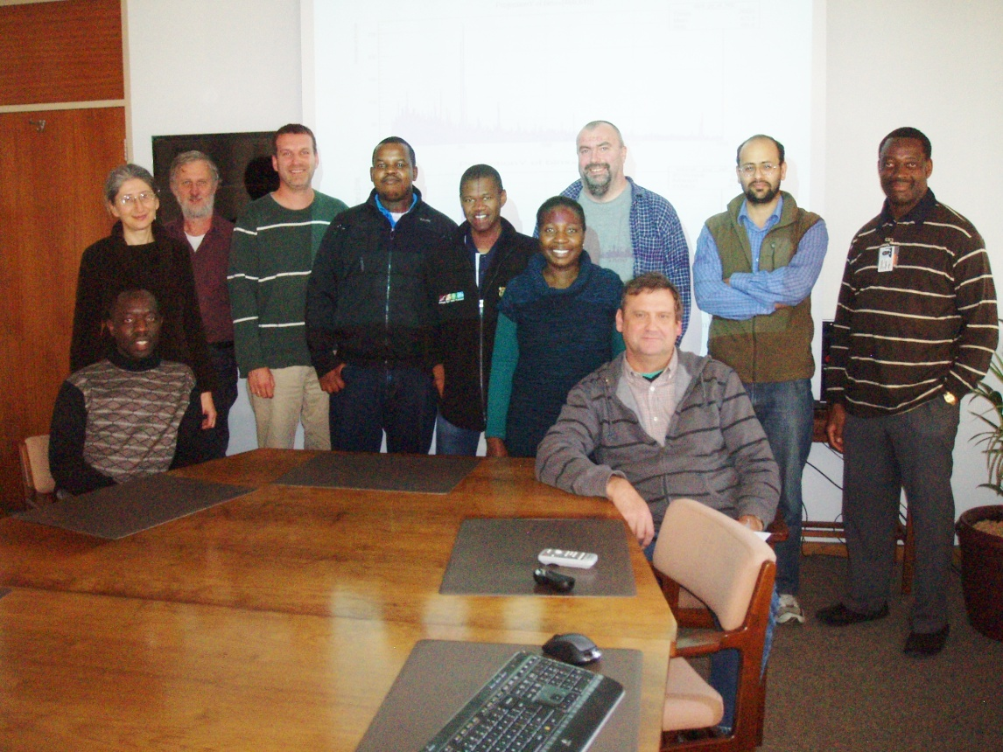
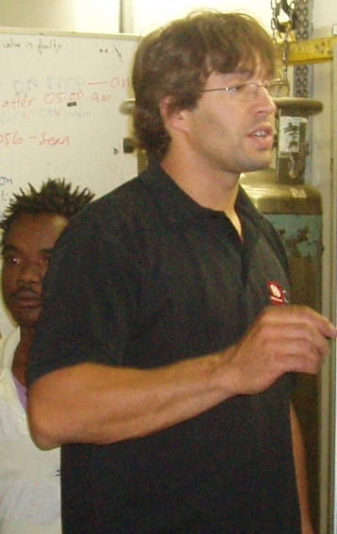
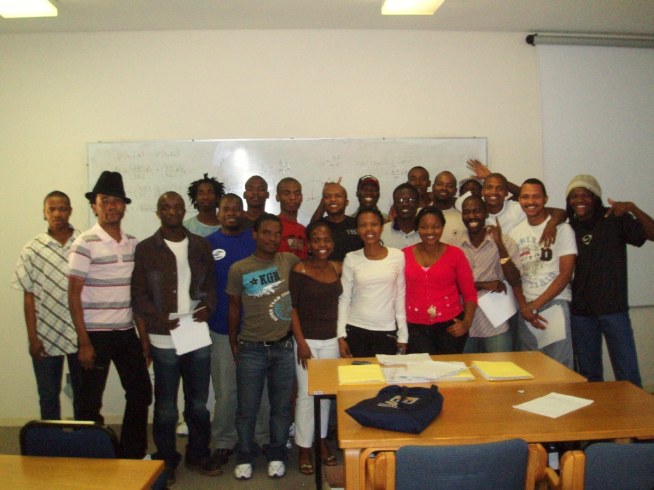

AFRODITE Crew
UWC Graduate School
Paul Papka
R&R

