Slide 1


SEARCH FOR HIGHER LAYING CHARMONIUM AND EXOTICS IN EXPERIMENTS USING HIGH QUALITY ANTIPROTON BEAM
WITH MOMENTUM UP TO 15 GeV/c
Barabanov M.Yu., Vodopyanov A.S.
Veksler-Baldin Laboratory of High Energy Physics
Joint Institute for Nuclear Research
Dubna, Moscow region, Russia 141980
PANDA Collaboration

Slide 2
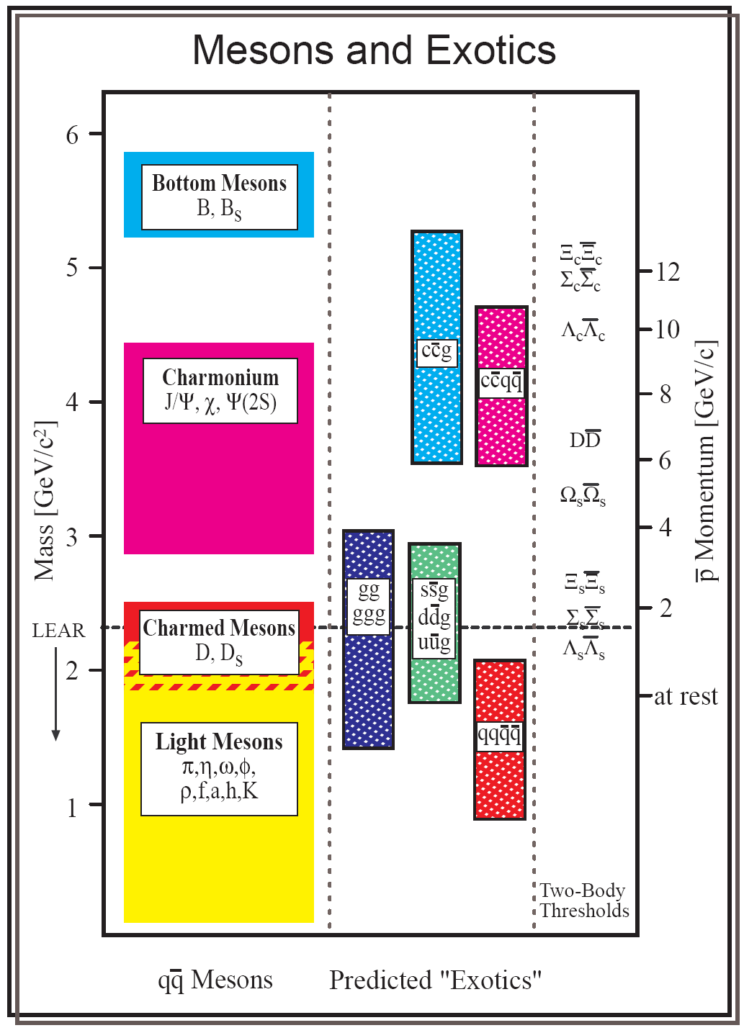
Ulrich Wiedner
Expected masses of qq-mesons, glueballs, hybrids and two-body production thresholds.

Slide 3
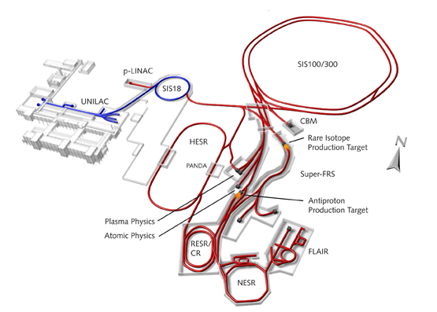
The PANDA experiment will be one of the key experiments at the Facility for Antiproton and Ion Research FAIR. Antiprotons accumulated in the High Energy Storage Ring HESR will collide with the fixed internal hydrogen or nuclear target. A beam luminosity of an order of 2x10³²sm⁻²c⁻¹ and momentum resolution σ(p)/p of an order of 10⁻⁵ are expected. The scientists from different countries intend to do fundamental research on various topics around the weak, electromagnetic and strong forces, exotic states of matter and the structure of hadrons.
Proposed layout of HESR

Slide 4
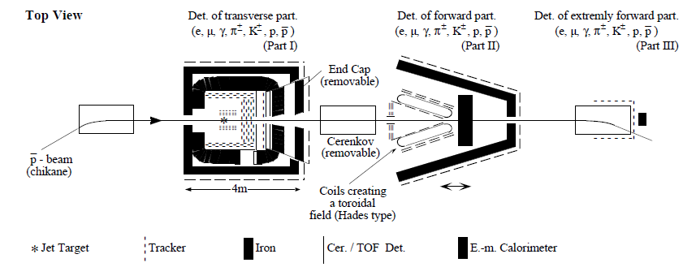
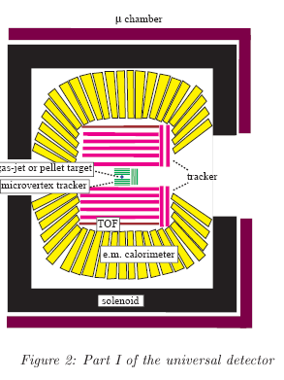
In order to yield the necessary information from the antiproton-proton collisions a versatile PANDA detector will be build being able to provide precise trajectory reconstruction, energy and momentum measurements and very efficient identification of charged particles in full coverage of the solid angle and wide energy range.

Slide 5
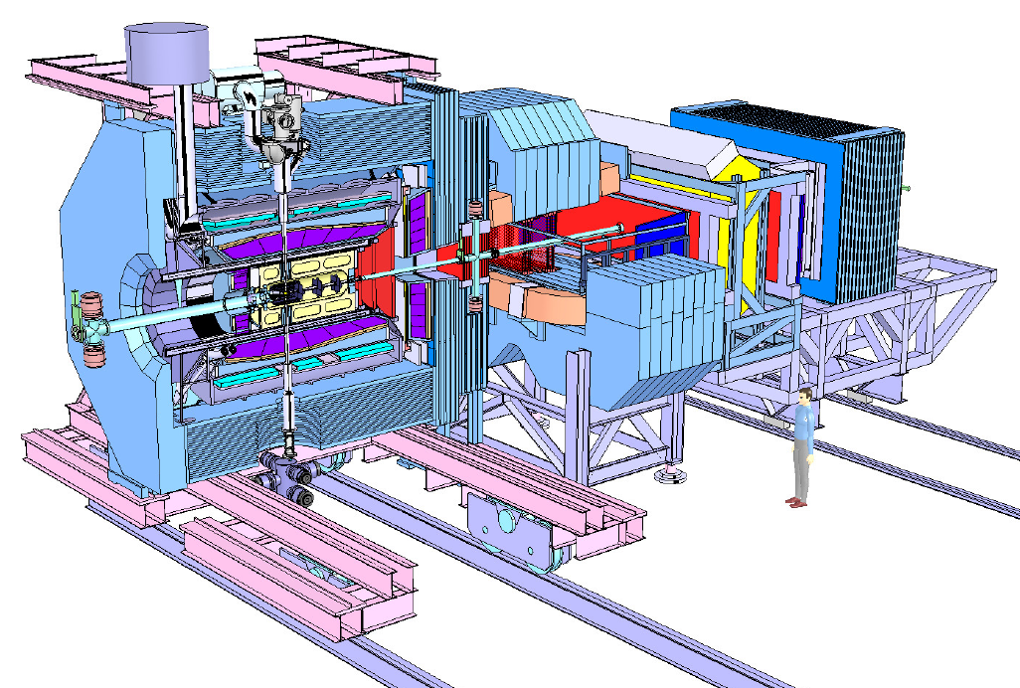
Target spectrometer
Forward spectrometer
To achieve high momentum resolution the detector must consist of two magnetic spectrometers: target spectrometer consisting of a superconducting magnetic solenoid around the interaction region relevant for measurements at large angles and forward spectrometer based on a dipole magnet to momentum-analyze the forward-going particles.

Slide 6
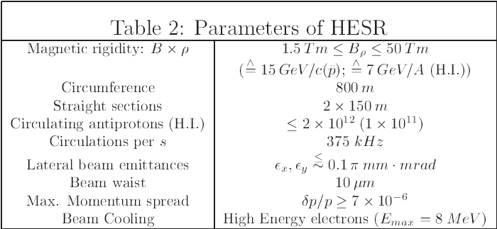
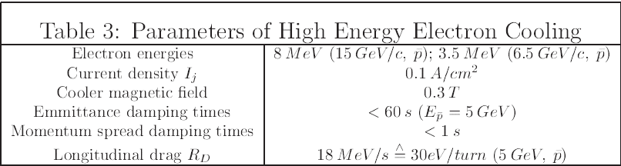

Slide 7
Outline
Conventional & exotic hadrons
Review of recent experimental data
Analysis & results
Summary & perspectives

Slide 8
PREAMBLE
➡ STUDY OF FLAVOUR PARTICLES (S, P, D-WAVE CHARMONIUM STATES, CHARMED HYBRIDS & TETRAQUARKS)
➡ ANALYSIS OF SPECTRUM IN MASS REGION ABOVE DD-THRESHOLD. A REVIEW OF THE NEW XYZ-CHARMONIUMLIKE MESONS AND ATTEMPTS OF THEIR POSSIBLE INTERPRETATION
➡ DISCUSSION OF THE RESULTS OF CULCULATION FOR THE HIGHER LYING CHARMONIUM AND EXOTICS AND THEIR COMPARISON WITH THE RECENTLY REVEALED EXPERIMENTAL DATA ABOVE DD-THRESHOLD
➡ APPLICATION OF THE INTEGRAL FORMALISM FOR DECAY OF HADRON RESONANCES TO CALCULATE THE WIDTHS OF CHARMONIUM AND EXOTICS

Slide 9
Why is charmonium chosen!?
Charmonium possesses some well favored characteristics:
• Charmonium – is the simplest two-particle system consisting of quark & antiquark;
• Charmonium – is a compact bound system with small widths varying from several tens of keV to several tens of MeV compared to the light unflavored mesons and baryons;
Charm quark c has a large mass (1.27 ± 0.07 GeV) compared to the masses of u, d & s (~ 0.1 GeV) quarks, that makes it plausible to attempt a description of the dynamical properties of cc – system in terms of non-relativistic potential models, where the functional form of potential is chosen to reproduce the assymptotic properties of strong interaction;
Quark motion velocities in charmonium are non-relativistic (the coupling constant, α_{s} ≈ 0.3 is not too large, and relativistic effects are manageable ( v²/c² ≈ 0.2));
• The size of charmonium is of the order of less than 1 Fm (R ~ α_{s} · m_{q} ) so that one of the main doctrines of QCD – asymptotic freedom is emerging;
Therefore:
■ charmonium studies are promising for understanding the dynamics of quark interaction at small distances;
■ charmonium spectroscopy is a good testing ground for the theories of strong interactions:
    QCD in both perturbative and nonperturbative regimes
    QCD inspired potential models and phenomenological models

Slide 10
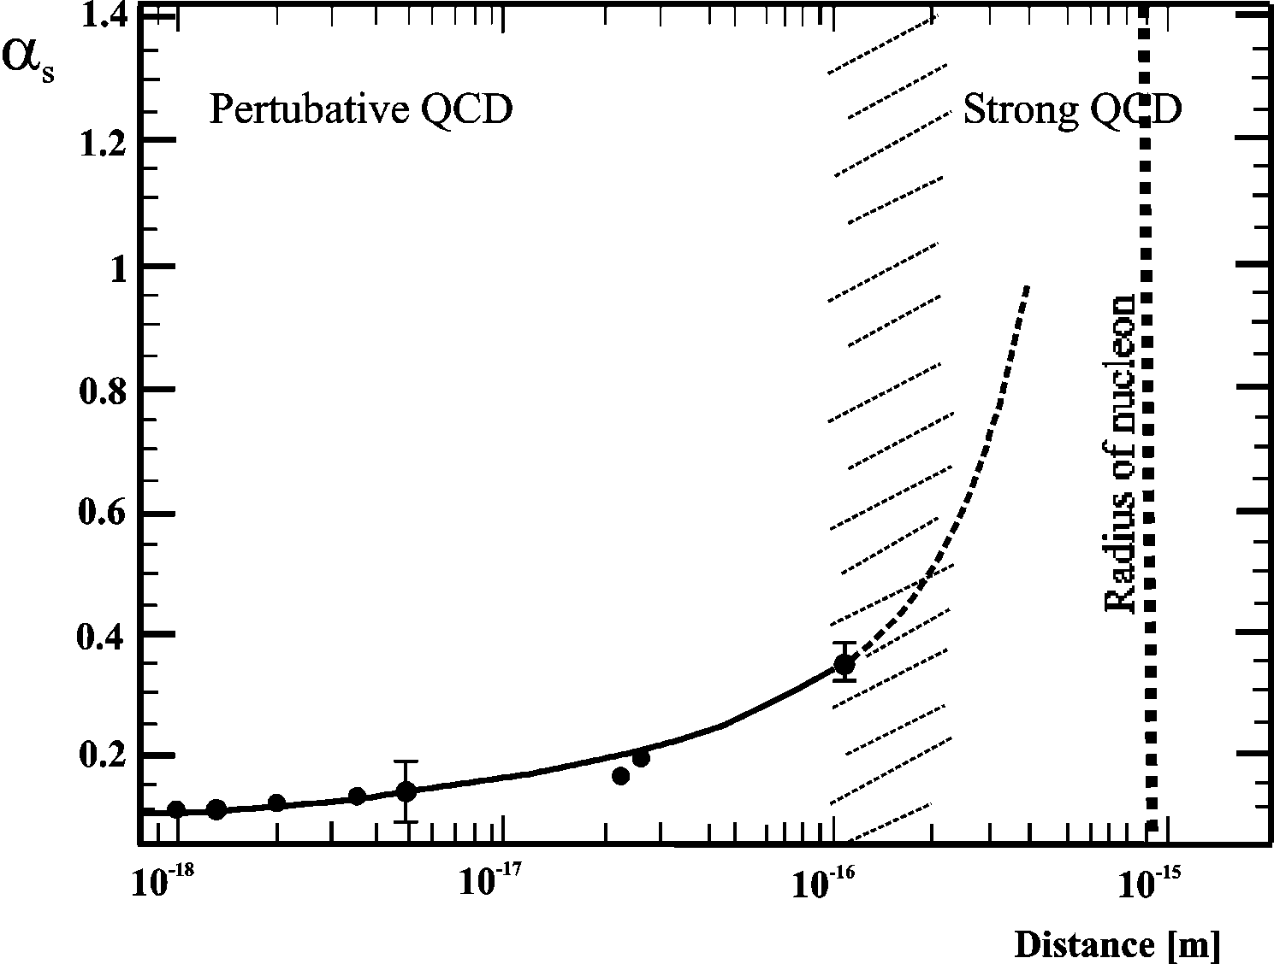
Coupling strength between two quarks as a function of their distance. For small distances (≤ 10⁻¹⁶ m) the strengths α_{s} is ≈ 0.1, allowing a theoretical description by perturbative QCD. For distances comparable to the size of the nucleon, the strength becomes so large (strong QCD) that quarks can not be further separated: they remain confined within the nucleon and another theoretical approaches must be developed and applicable.
For charmonium states α_{s} ≈ 0.3 and <v²/c²> ≈ 0.2.

Slide 11
In QCD-motivated quark potential models, quarkonium states are described as a quark-antiquark pair bound by an inter-quark force (potential) that includes a Coulomb-like one-gluon exchange potential dominates at small separation and a linearly increasing confining potential dominates at large separation.
The energy levels are found by solving a non-relativistic Schrodinger equation:
In central symmetric potential field V(r) the Schrodinger-type equation can be written:
where U(0) = 0 and U' (0) = R(0), and U(r) = rR(r), GeV, R(r) – radial wave function, r – distance between quark and antiquark in quarkonium.
These properties underlie the choice most of potentials: or
The Cornel potential:
a = 0.52 GeV; k = 0.18 GeV.
The orbital levels are labeled by S, P, D,… corresponding to L = 0,1,2,…. The quark and antiquark spins couple to give the total spin S = 0 (singlet) or S = 1 (triplet). Whole momentum of quark-antiquark system J = L+S. Quarkonium states are generally denote by ^{2S+1}L_{J} with quantum numbers J^{PC}, where parity P = (-1)^{L+1} and charge parity C = (-1)^{L+S}.
* A.A. Bykov et al. Physics – Uspekhi, V.143, N1, 1 (1984)

Slide 12




The quark potential models have successfully described the charmonium spectrum, which generally assumes short-range coulomb interaction and long-range linear confining interaction plus spin dependent part coming from one gluon exchange. The zero-order potential is:
where defines a gaussian-smeared hyperfine interaction.
Solution of equation with H₀ = p²/2m_{c} + gives zero order charmonium wavefunctions.
*T. Barnes, S. Godfrey, E. Swangon, Phys. Rev. D 72, 054026 (2005), hep-ph/ 0505002 & Ding G.J. et al., arXiV: 0708.3712 [hep-ph], 2008
The splitting between the multiplets is determined by taking the matrix element of the V_{spin-dep} taken from one-gluon exchange Breit-Fermi-Hamiltonian between zero-order wave functions:
where α_{s} - coupling constant, b - string tension, - hyperfine interaction smear parameter.
Izmestev A. has shown *Nucl. Phys., V.52, N.6 (1990) & *Nucl. Phys., V.53, N.5 (1991) that in the case of curved coordinate space with radius a (confinement radius) and dimension N at the dominant time component of the gluonic potential the quark-antiquark potential defines via Gauss equations. If space of physical system is compact (sphere S³), the harmonic potential assures confinement:
When cotangent argument in V₃(r) is small:
we get:
where R(r), D(r) and G_{N}(r) are scaling factor, gauging and determinant of metric tensor G_{μν}(r).

Slide 13
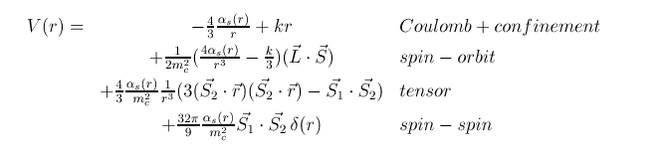
The graphic representation of Bethe –Solpeter equation.
Taking various relativistic spin effects into account, a final potential can be written in a form:

Slide 14
The relativistic corrections can be considered via relativistic Bethe-Solpeter equations:
where a and b – quark and antiquark indexes, J_{ab} – formation amplitude of bound state
by quark a and antiquark b ( and – their propogators), G_{ab} - two particle irreducible
nucleus of Bethe-Solpeter equation describing interaction between quark and antiquark
that reduces to their bound state.
In momentum representation (in the center mass system of quark and antiquark) and
assuming instantaneous interaction Bether-Solpeter equation can be written:
where “~” means transition to the instantaneous interaction, – projective operators
onto the states with positive and negative energy accordingly, γ₀ – Dirac matrix, E –
energy of bound state, E_{a} and E_{b} – quark – antiquark energies. To study quarkonium
spectroscopy one must define the quark - antiquark interaction, i.e. define G or equivalent V(r).

Slide 15
Let us define the set of generators of SO(4) group
where and are coordinate and momentum operators, is angular momentum operator.
Dilatation operator defined on the sphere S³ has the form
The linear combinations of these orthonormal operators
contribute two set of generators of the SU(2) group. Thus the SU(2) group generates the action on a three-dimensional sphere S³. This action consists of the translation with whirling around the direction of translation. We get a Hamiltonian:
where - spin operator, m - mass of the top.
When radius of the sphere:
the Hamiltonian tends to the Pauli operator for the free particle motion:
The spectrum is:
The wave function:
was taken as eigenfunction of total momentum
of the top.
* Advances in Applied Clifford Algebras, V.8, N.2, p.235-254 (1998) & V.8, N.2, p.255-270 (1998) .

Slide 16
In the framework of this approach in the relativistic case the Hamiltonian of a decaying
resonance is defined with the equation ( is a binary decay channel ):
were m_{a} and m_{b} are the masses of resonance decay products (particles a and b).
The spectrum of the Hamiltonian is:
Finally, the formula for resonance mass spectrum can be written in the following form
(we used the system in which ):
where P₀ – is the basic momentum. The momentum of relative motion of decay products P_{n} (particles a and b in the center-of-mass system of decaying resonance) is quantized relatively P_{0.}. R₀ is the parameter with dimension of the length conjugated to P₀.

Slide 17
The cc system has been investigated in great detail first in e⁺e⁻-reactions, and afterwards on a restricted scale (E_{p} ≤ 9 GeV), but with high precision in
pp-annihilation (the experiments R704 at CERN and E760/E835 at Fermilab).
The number of unsolved questions related to charmonium has remained:
• singlet ¹D₂ and triplet ³D_{J} charmonium states are not determined yet;
• higher laying singlet ¹S₀ , ¹P₁ and triplet ³S₁ , ³P_{J} – charmonium states are poorly
investigated;
• only few partial widths of ³P_{J} -states are known (some of the measured decay
widths don’t fit theoretical schemes and additional experimental check
or reconsideration of the corresponding theoretical models is needed, more
data on different decay modes are desirable to clarify the situation);
• almost nothing is known about partial width of ¹D₂ and ³D_{J} charmonium states.
AS RESULT:
• little is known on charmonium states above the the DD – threshold (S, P, D,….);
• many recently discovered states above DD - threshold (XYZ-states) expect their
verification and explanation (their interpretation now is far from being obvious).
IN GENERAL ONE CAN IDENTIFY THREE MAIN CLASSES OF CHARMONIUM DECAYS:
!
decays into particle-antiparticle or DD-pair: pp → (Ψ, η_{c},, χ_{cJ},..) → , , , ;
decays into light hadrons: pp → (Ψ, η_{c},..) → ρπ; pp → Ψ → π⁺π ⁻, pp → Ψ → ωπ⁰, ηπ⁰,… ;
decays with J/Ψ, Ψ' and h_{c} in the final state: pp → J/Ψ + X => pp → J/Ψ π⁺π ⁻, pp → J/Ψ π⁰π⁰;
pp → Ψ' + X => pp → Ψ' π⁺π ⁻, pp → Ψ' π⁰π⁰; pp → h_{c} π⁺π ⁻, pp → h_{c} π⁰π⁰.

Slide 18
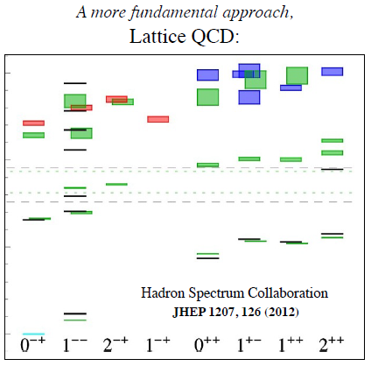
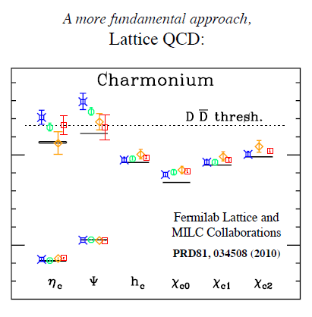

Slide 19
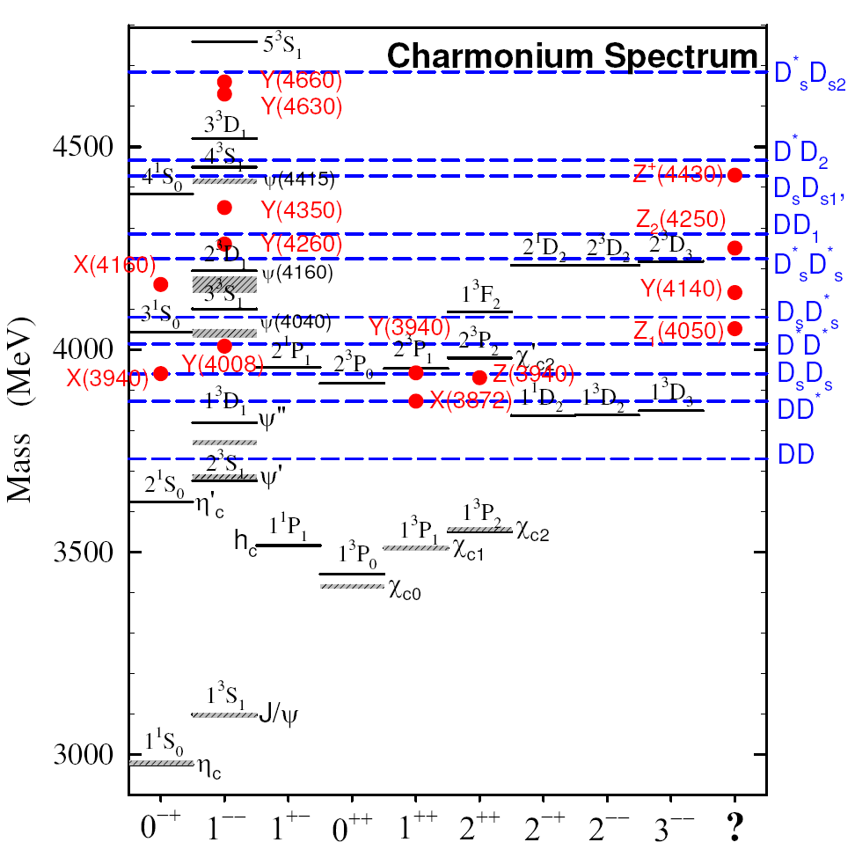
The solid lines are potential model & LQCD predictions; the shaded lines are the observed conventional charmonium states; the blue horizontal dashed lines represent various D_{S}^{(*)}D_{S}^{(*)} thresholds; the red dots are the newly discovered charmonium-like states placed in the column with the most probable spin assignment. The states in the last column don’t fit elsewhere and appear to be truly exotics.

Slide 20
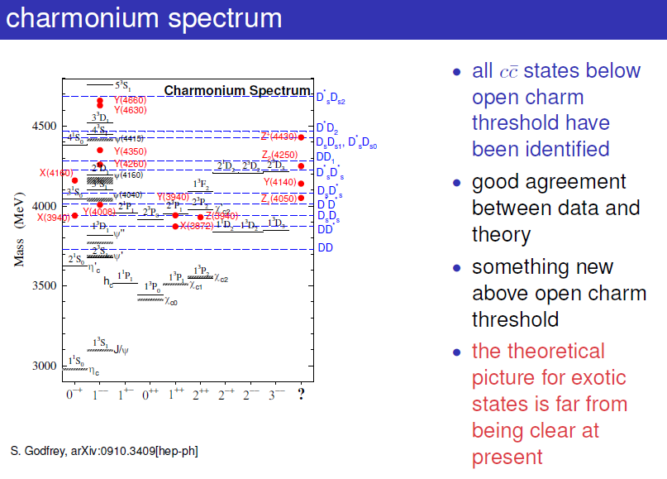

Slide 22
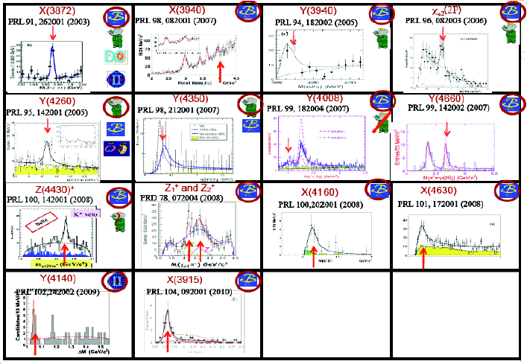
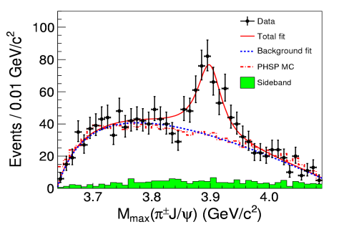
Z_{c}(3900) ⁺
BESIII
?
Many (> 20) new states: above DD – threshold for the recent years were revealed in experiment.
Most of these heavy states are not explained by theory and wait for their verification and explanation.

Slide 23
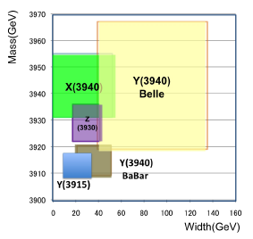

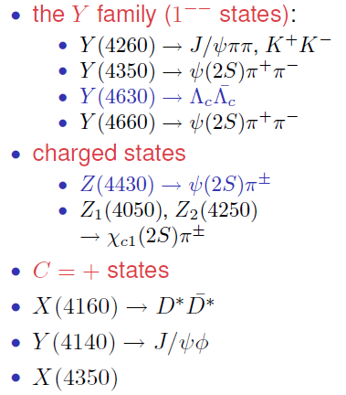
Z_{c}(3900)± → J/Ψπ±
^{new charged} ^{state!}
^{BES III}
WHAT ARE THESE STATES? CHARMONIUM OR WHAT?

Slide 24
Summary of XYZ-particles. Most were observed in one definite channel.

Slide 25

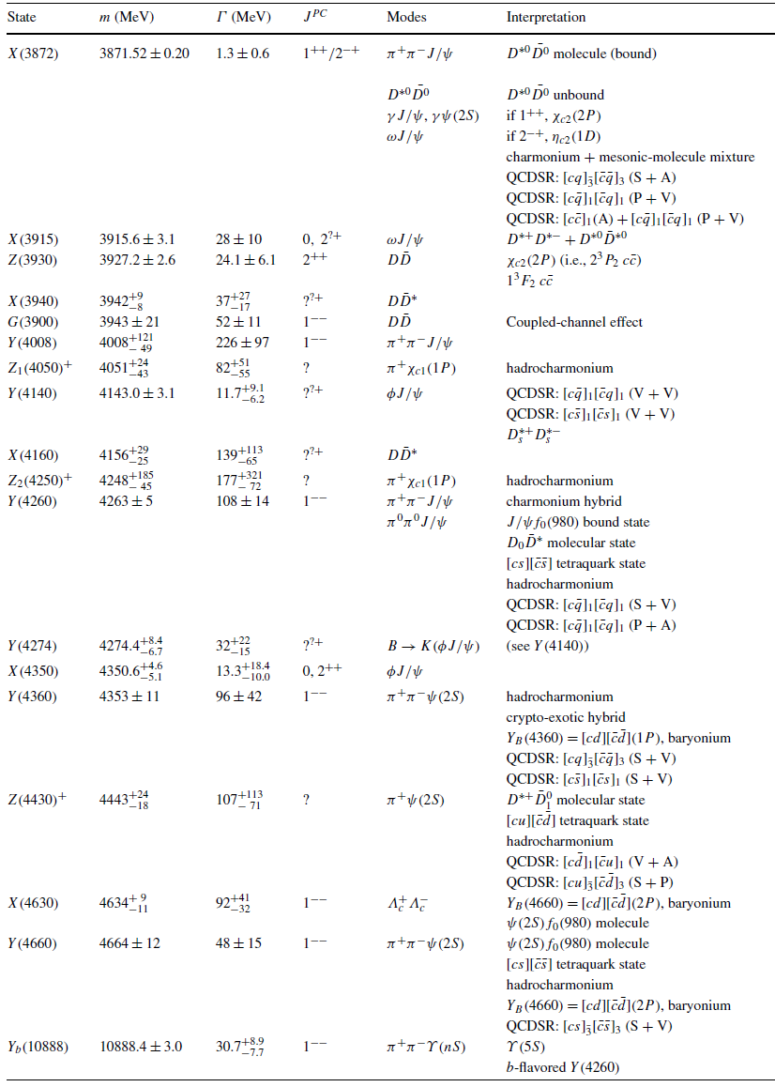

Slide 26
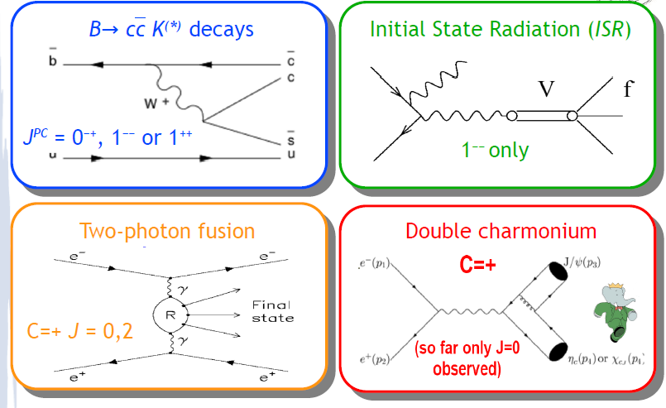
CHARMONIUM PRODUCTION MECHANISMS

Slide 27
CHARMONIUM PRODUCTION MECHANISMS RELEVANT TO THE XYZ – STATES (XYZ - PARTICLES)
■ B → K(cc) => J ^{PC} = 0 ⁻⁺, 1 ⁻ ⁻, 1 ⁺⁺, 2⁻⁺ β ≈ 2 х 10 ⁻³. B⁺ = ub, B⁰ = db, B⁻ = ub.
B-decays to final states containing cc mesons. At the quark level, the dominant decay mechanism is the weak interaction transition of a b quark to c quark accompanied by the emission of a virtual W – boson, the mediator of the weak interaction. Approximately half of the time, the W – boson matirializes as a sc pair. So, almost half of all B-meson decays result in a final state that contains c and c quarks. When these final-state c and c quarks are produced close to each other in phase space, they can coalesce to form a cc meson. The simplest charmonium producing B-meson decays are those where the s quark from the W – combines with the parent B-meson’s u or d quark to form a K-meson (K⁺ = us; K⁰ = ds).
■ Production of J ^{PC} = 1⁻⁻ charmonium states via initial state radiation (ISR). In e⁺e⁻ collisions at a cm energy of 10580 MeV the initial-state e⁺ or e⁻ occasionally radiates a high-energy γ-ray (γ_{ISR} = 4000 MeV – 5000 MeV), and e⁺ and e⁻ subsequently annihilate at a reduced cm energy that correspond to the range of mass values of charmonium mesons. Thus, the ISR process can directly produce charmonium states with J ^{PC} = 1 ⁻ ⁻ .
■ Charmonium associated production with J/Ψ in e⁺e⁻ annihilation. J ^{PC} = 0 ⁻⁺ and 0⁺⁺ . In studies of e⁺e⁻ annihilations at cm energies near 10580 MeV => Belle discovered that in inclusive annihilation process => e⁺e⁻ → J/Ψ + (cc) => J/Ψ + η_{c} or J/Ψ + χ_{c0} (J=0≠1≠2).
■ Two photon collisions. In high energy e⁺e⁻ machines, photon-photon collisions are produced when both an incoming e⁺ and e⁻ radiate photons that subsequently interact with each other. Two photon interactions can directly produce particles with J^{PC}=0 ⁻⁺, 0 ⁺⁺, 2 ⁻⁺, 2⁺⁺.

Slide 28
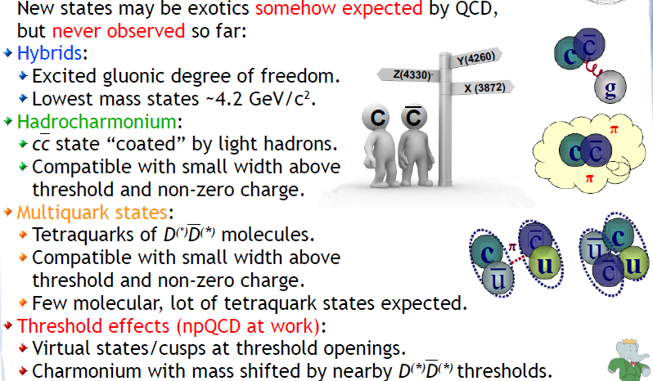

Slide 29
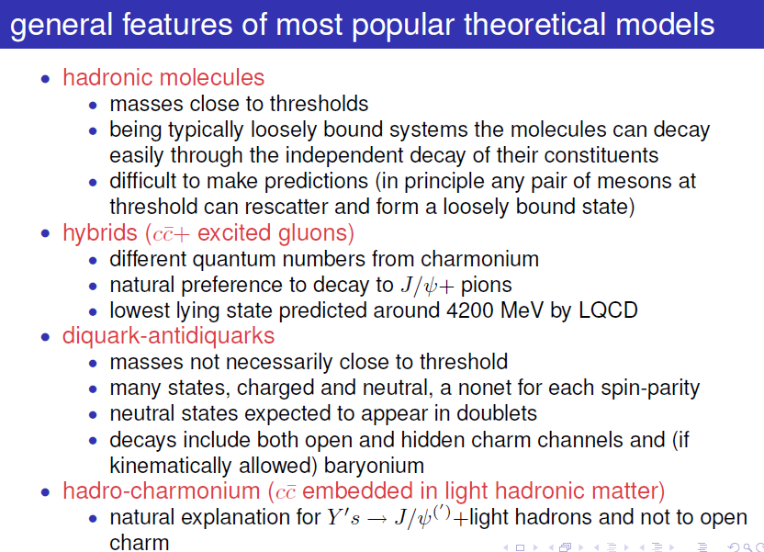

Slide 30
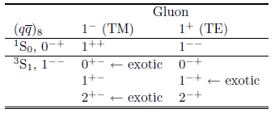
Two different kinds of experiments are foreseen at FAIR :
• production experiment – pp → X + M, where M = π, η, ω,… (conventional states plus states with exotic quantum numbers)
• formation experiment (annihilation process) – pp → X → M₁M₂ (conventional states plus states with non-exotic quantum numbers)
The low laying charmonium hybrid states:
Charmonium hybrids predominantly decay via electromagnetic and hadronic transitions and into the open charm final states:
• ccg→ (Ψ, χ_{cJ}) + light mesons (η, η′, ω, φ) - these modes supply small widths and significant branch fractions;
• ccg→ DD_{J}*. In this case S-wave (L = 0) + P-wave (L = 1) final states should dominate over decays to DD (are forbidden → CP violation) and partial width to should be very small.
The most interesting and promising decay channels of charmed hybrids have been, in particular, analyzed:
• pp → (0⁻⁺, 1⁻⁺ , 2⁻⁺) η → χ_{c0,1,2} (η, ππ;…);
• pp → (0⁺⁻, 1⁺⁻ , 2⁺⁻) η → χ_{c0,1,2} (η, ππ;…);
• pp → (0⁻ ⁻, 1⁻ ⁻ , 2⁻ ⁻) → J/Ψ (η, ω , ππ,…);
• pp → , , (0⁻⁺, 1⁻⁺ , 2⁻⁺, 0⁺⁻, 1⁺⁻ , 2⁺⁻, 1⁺⁺) η → η .
J ^{PC} = 0⁻ ⁻ → exotic!

Slide 31
Мезоны с ароматом
Для мезонов с ароматом схема названий немного проще. Имя дает мезону тяжелейший из двух кварков. Порядок от тяжёлого к легкому следующий: t > b > c > s > d > u. Однако у u- и d-кварков аромата нет, вследствие этого они не влияют на название. Кварк t никогда не встречается в адронах, но символ для мезонов, содержащих t, зарезервирован.
Если второй кварк тоже имеет аромат (любой, кроме u и d), то его наличие обозначается в виде нижнего индекса (s, c или b и, теоретически, t).
Если мезон принадлежит нормальной спин-чётной последовательности, то есть J^{P} = 0⁺, 1⁻, 2⁺, …, то добавляется верхний индекс «*».
Для мезонов, за исключением псевдоскаляров (0⁻) и векторов (1⁻), добавляется в виде нижнего индекса квантовое число полного углового момента J.
кварковый состав | Изоспин | J^{P} = 0⁻, 1⁺, 2⁻… | J^{P} = 0⁺, 1⁻, 2⁺…
 | 1/2
 | 1/2
 | 0
 | 1/2
 | 0
 | 0

Slide 32
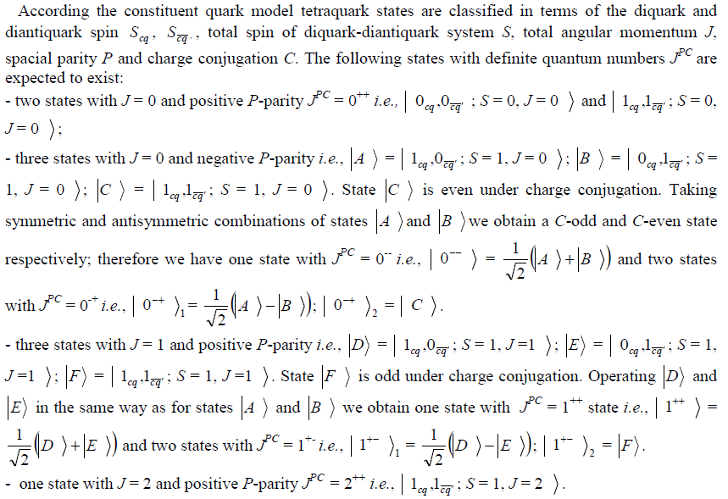
!
!
!
!
!

Slide 33


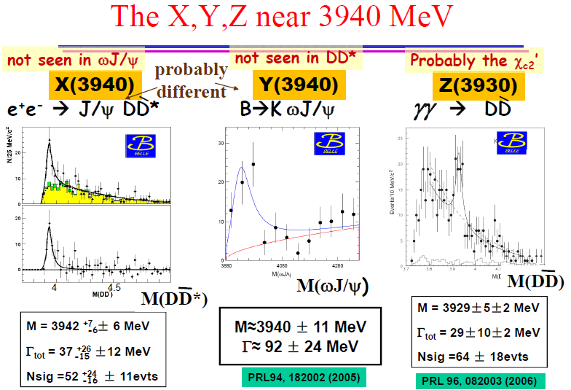


Slide 34
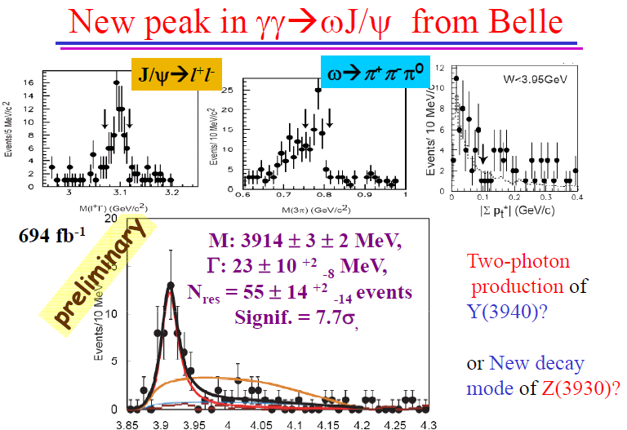

Slide 35
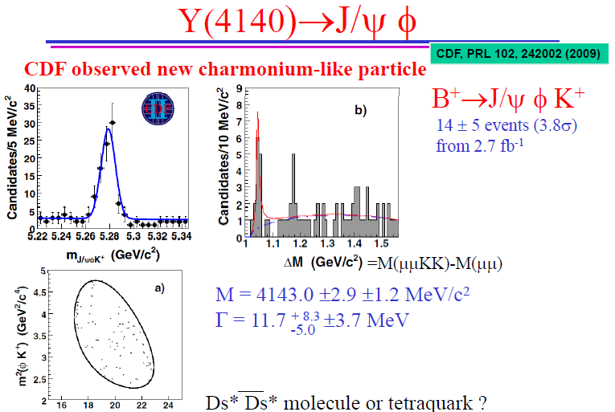

Slide 36
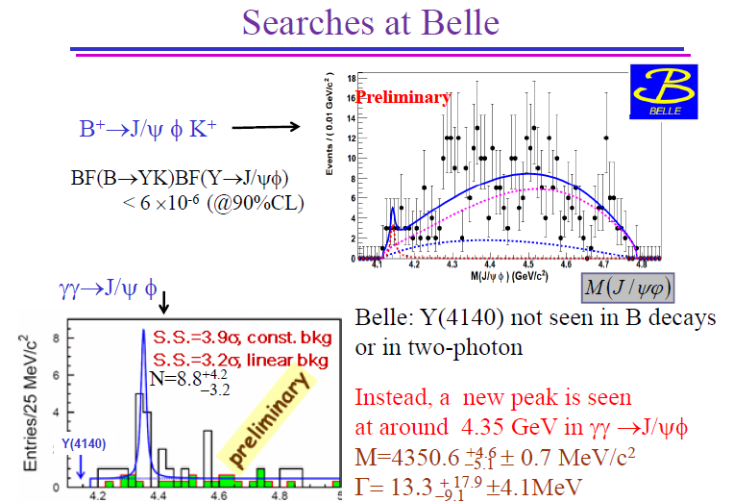


Slide 37
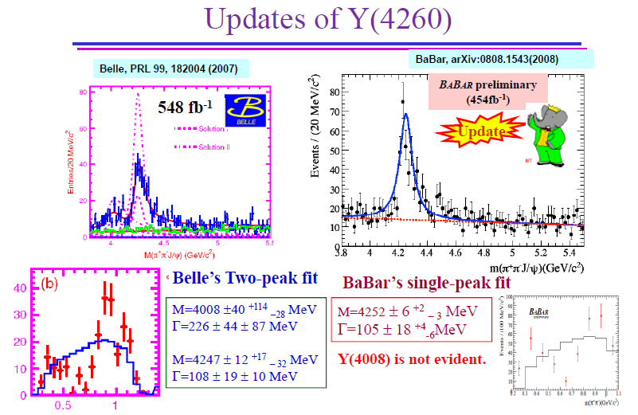

Slide 39
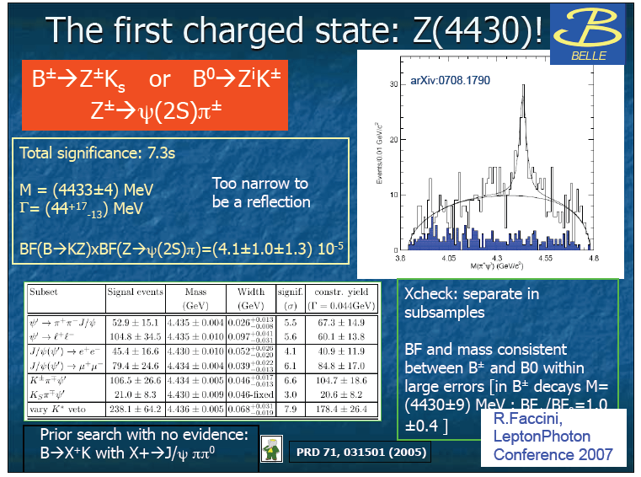

Slide 40

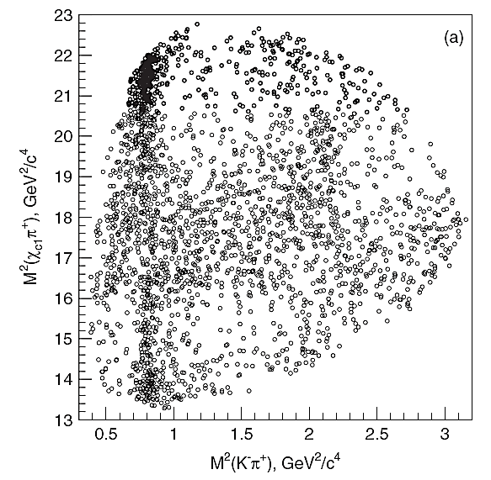
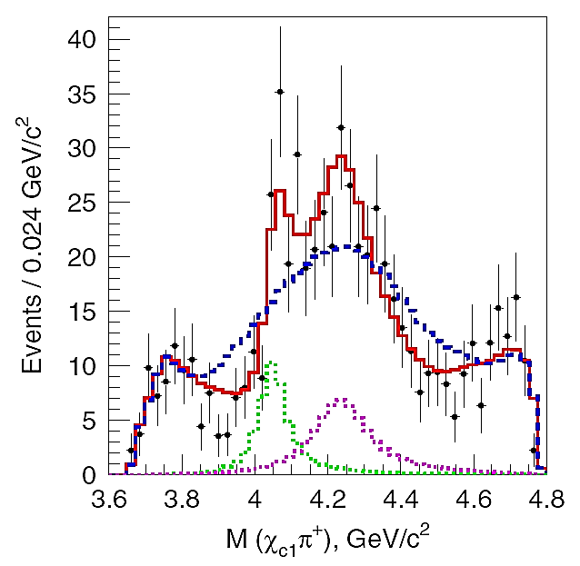
Belle observed Two Z±→χ_{c1}π±
Dalitz-plot analysis of B⁰→χ_{c1}π⁺K⁻ χ_{c1} →J/ψγ with 657M BB
Dalitz plot models: known K*→Kπ only
K*’s + one Z →χ_{c1}π±
K*’s + two Z± states ⇨ favored by data
PRD 78, 072004 (2008)
Significance: 5.7σ
–̶̶̶̶̶̶ –̶̶̶̶̶̶ fit for model with K*’s
–̶̶̶̶̶̶ –̶̶̶̶̶̶ fit for double Z model
–̶̶̶̶̶̶ –̶̶̶̶̶̶ Z₁ contribution
–̶̶̶̶̶̶ –̶̶̶̶̶̶ Z₂ contribution
M(χ_{c1}π⁺)
for 1<M²(K⁻π⁺)<1.75GeV²

Slide 41
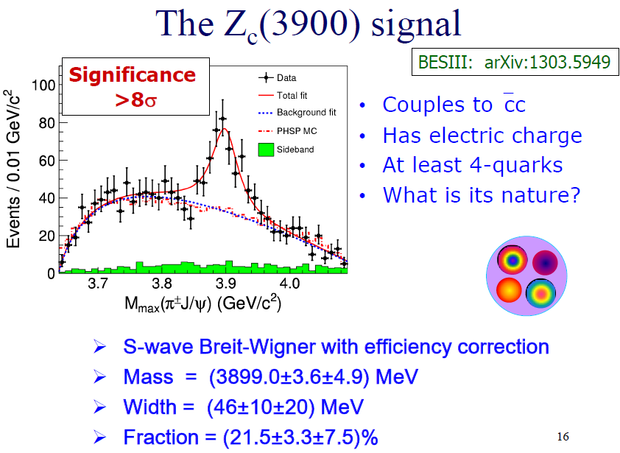

Slide 42
The XYZ particles
• X(3915) – γγ → ωJ/ ψ (J^{PC} = ?⁺⁺ => may be J^{PC} = 0 ⁺⁺)
• Z(3930) – γγ → DD (only J^{PC} = 0⁺⁺ and J^{PC} = 2⁺⁺)
• Y(3940) – B → KωJ/ψ (J^{PC} = 1⁺⁺)
• X(3940) – e⁺e⁻ → J/ψ DD* (J^{PC} = 0⁻⁺, not 0⁺⁺)
• X(4160) – e+e- → J/ ψ D*D* (J^{PC} = 0⁻⁺, not 0⁺⁺)
• Y(4140) – B → KφJ/ ψ (B → KωJ/ ψ )(J^{PC} = ?^{?+})
• X(4350) – γγ → φJ/ ψ (J^{PC} = 0, 2⁺⁺)
• Y(4274) – B → KφJ/ ψ (J^{PC} = ?^{?+})
• Y(4260) – e⁺e⁻ → γ π⁺π⁻J/ψ (no evidence for open charm decay DD, …, D*D*)
• Y(4350) – e⁺e⁻ → γ π⁺π⁻ψ(2S) (no evidence for open charm decay DD, …, D*D*)
• Y(4660) – e⁺e⁻ → γ π⁺ π⁻ ψ(2S)(no evidence for open charm decay DD, …, D*D*)
• Z±(4430) – B → Kπ± ψ(2S); Z±(4050) – B → K π±χ_{c1}; Z±(4250) – B → K π±χ_{c1}
• ISR 1⁻⁻ states => higher laying conventional cc states : Y(4350) <=> 3³D₁ and Y (4660) <=> 5³S₁ respectively: Ding G.J. et al., arXiV: 0708.3712 [hep-ph].
new state
double charmonium decay
new states

Slide 43

Theory referred many years for the lack of new data in hadron spectroscopy especially above DD - threshold.
Now theory does not know where to put the new recently discovered states.
Eleven of the XYZ particles seems possible to interpret as radial excited singlet & triplet states of charmonium in the framework of the combined approach considered above:
  X(3872) – D^{*0}D⁰ molecule or tetraquark [(cq) (cq)]_{S-wave} (q = u, d) ^{*)}
  The interpretation as χ_{c2}(2P) state X(3872) → ωJ/ Ψ seems to be interesting! ^{*)}
  X(3915) – χ_{c0}(2P)
  Y(3940) – χ_{c1}(2P)
  Z(3930) – χ_{c2}(2P)
  X(3940) – η_{c}(3S)
  Y(4140) – tetraquark state [(cq) (cq)] _{S-wave} or [(cs) (cs)] _{S-wave} or D^{*+}_{s}D^{*-}_{s} molecule ^{*)}
  X(4160) – η_{c}(4S)
  Y(4260) – Ψ׳׳ ; charmed hybrid (ccg) or tetraquark [(cs) (cs)]_{S-wave} or D⁰D*, DD₁ molecule^{*)}
  – Y(4350) – Ψ ׳׳׳··, charmed hybrid (ccg) or tetraquark [(cs) (cs)]_{P-wave} ^{*)}
  – Y(4630) – ³D₁; tetraquark state [(cd) (cd)] or baryonium (Λ⁺_{c} Λ⁻_{c} ) ^{*)}
  – Y(4660) – Ψ׳׳׳׳ ···, tetraquark [(cs) (cs)]_{2P-wave} or baryonium ^{*)} Ding G.J. et al., arXiV: 0708.3712
  – Z±(4430) – charged tetraquark state [(cu)][(cd)] or baryonium Λ±_{c}Σ⁰_{c} or D^{*+}D⁰₁ molecule^{*)}
^{*)} N. Brambilla et al., Eur.Phys.J. C 71 (2011) 1534.
HADROCHARMONIUM
Y(4260) Y(4350) Y(4660) Z±(4050) Z±(4250) Z±(4430)
!
by
Y(4140) – 1 ¹D₂
Y(4274) – 2 ¹D₂
Z_{c} (3900) – tetraquark J^{PC} = 1⁺⁺
May be??

Slide 44
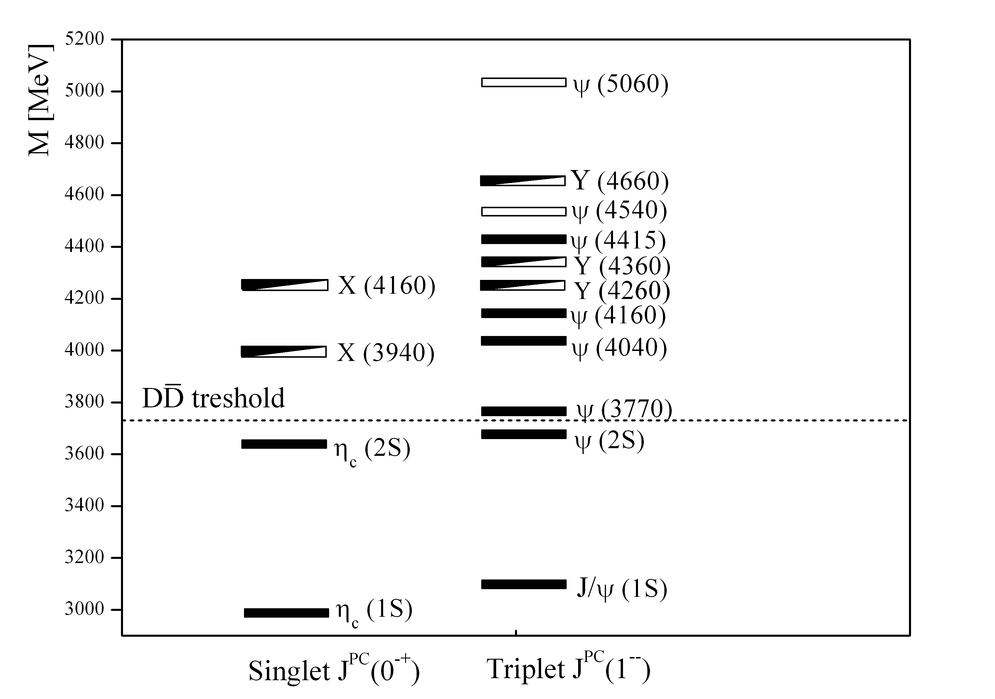


THE SPECTRUM OF SINGLET (¹S₀) AND TRIPLET (³S₁) STATES OF CHARMONIUM
M(6³S₁)=4977MeV
5³S₁
Ding G.J. et al., arXiv: 0708:3712
3³D₁

Slide 45
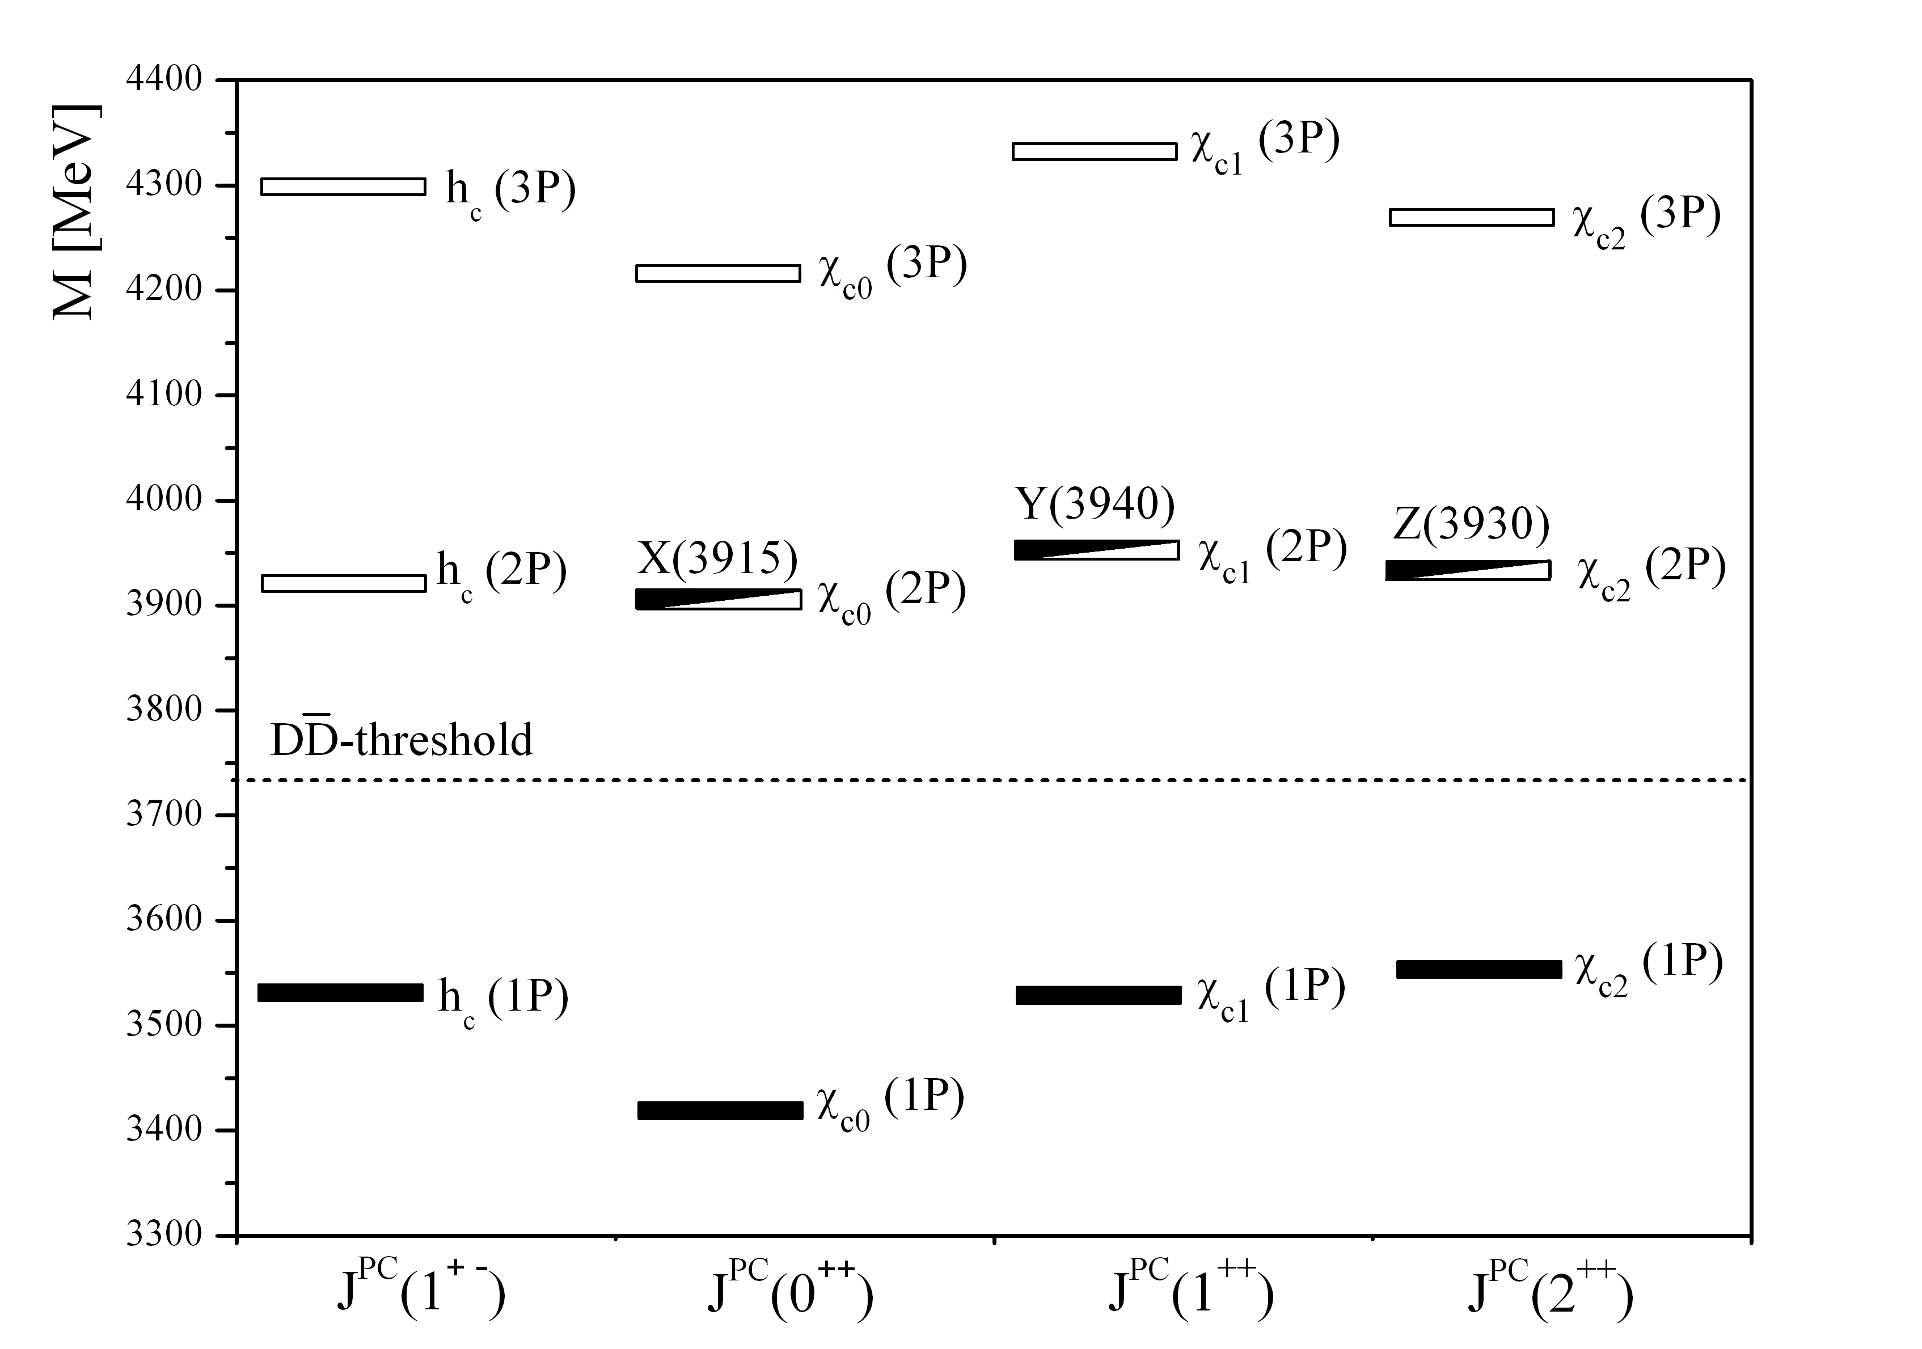
THE SPECTRUM OF SINGLET (¹P₁) AND TRIPLET (³P_{J}) STATES OF CHARMONIUM

Slide 46
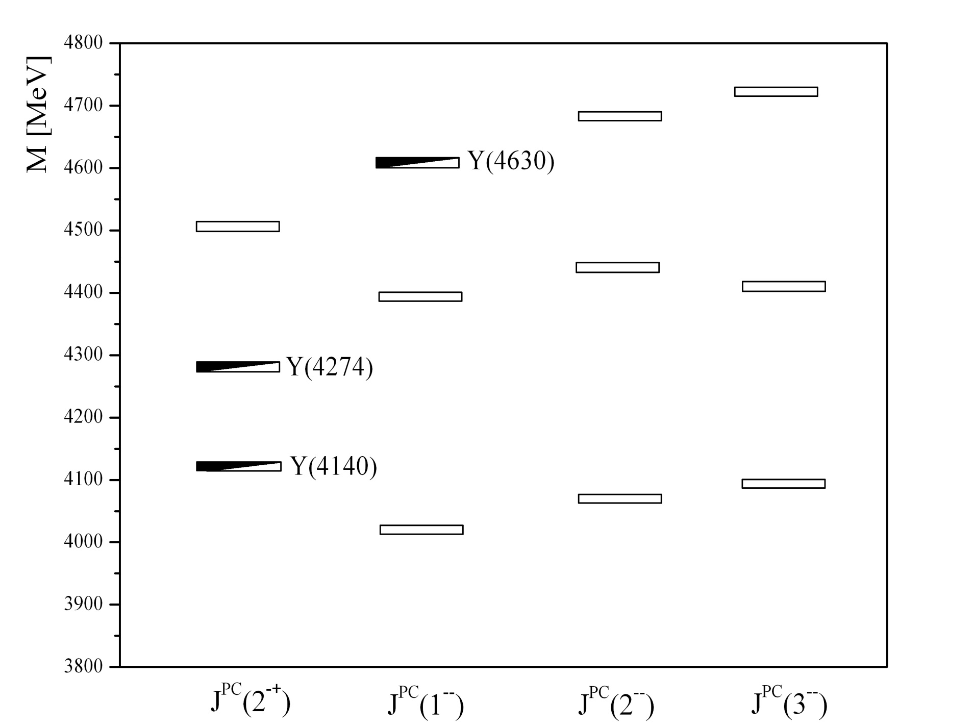
THE SPECTRUM OF SINGLET ¹D₂ AND TRIPLET ³D_{J} STATES OF CHARMONIUM

Slide 47
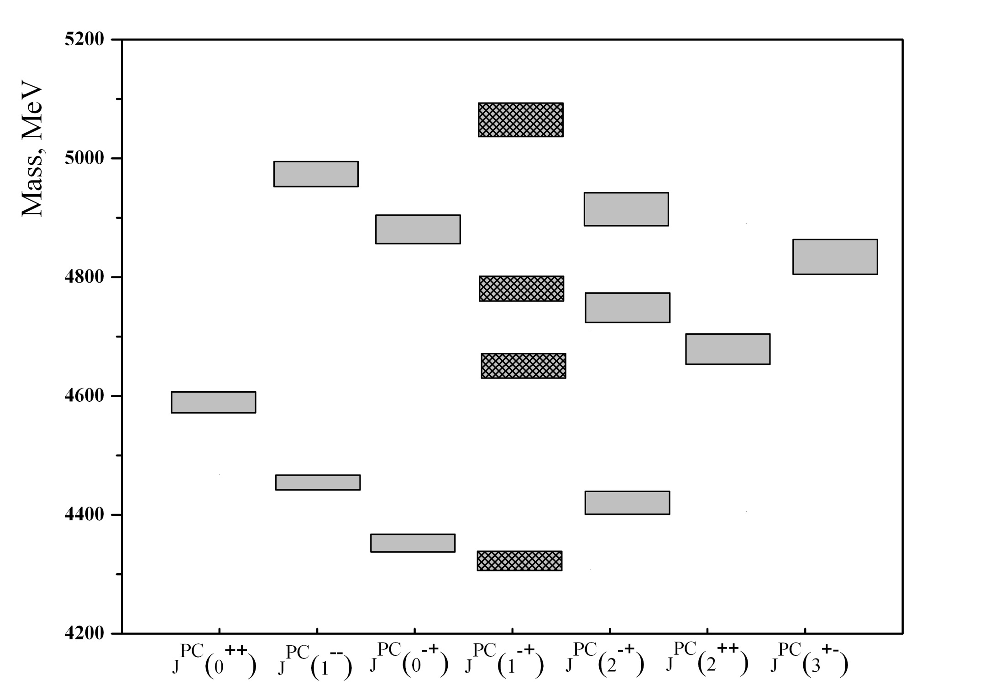
SPECTRUM OF CHARMED HYBRIDS WITH QUANTUM NUMBERS
J^{PC} = 3⁺⁻, 2⁺⁺, 2⁻⁺, 1⁻⁺, 1⁻ ⁻, 0⁻⁺, 0⁺⁺.
J^{PC} exotic
J^{PC} nonexotic
has the lowest mass

Slide 48
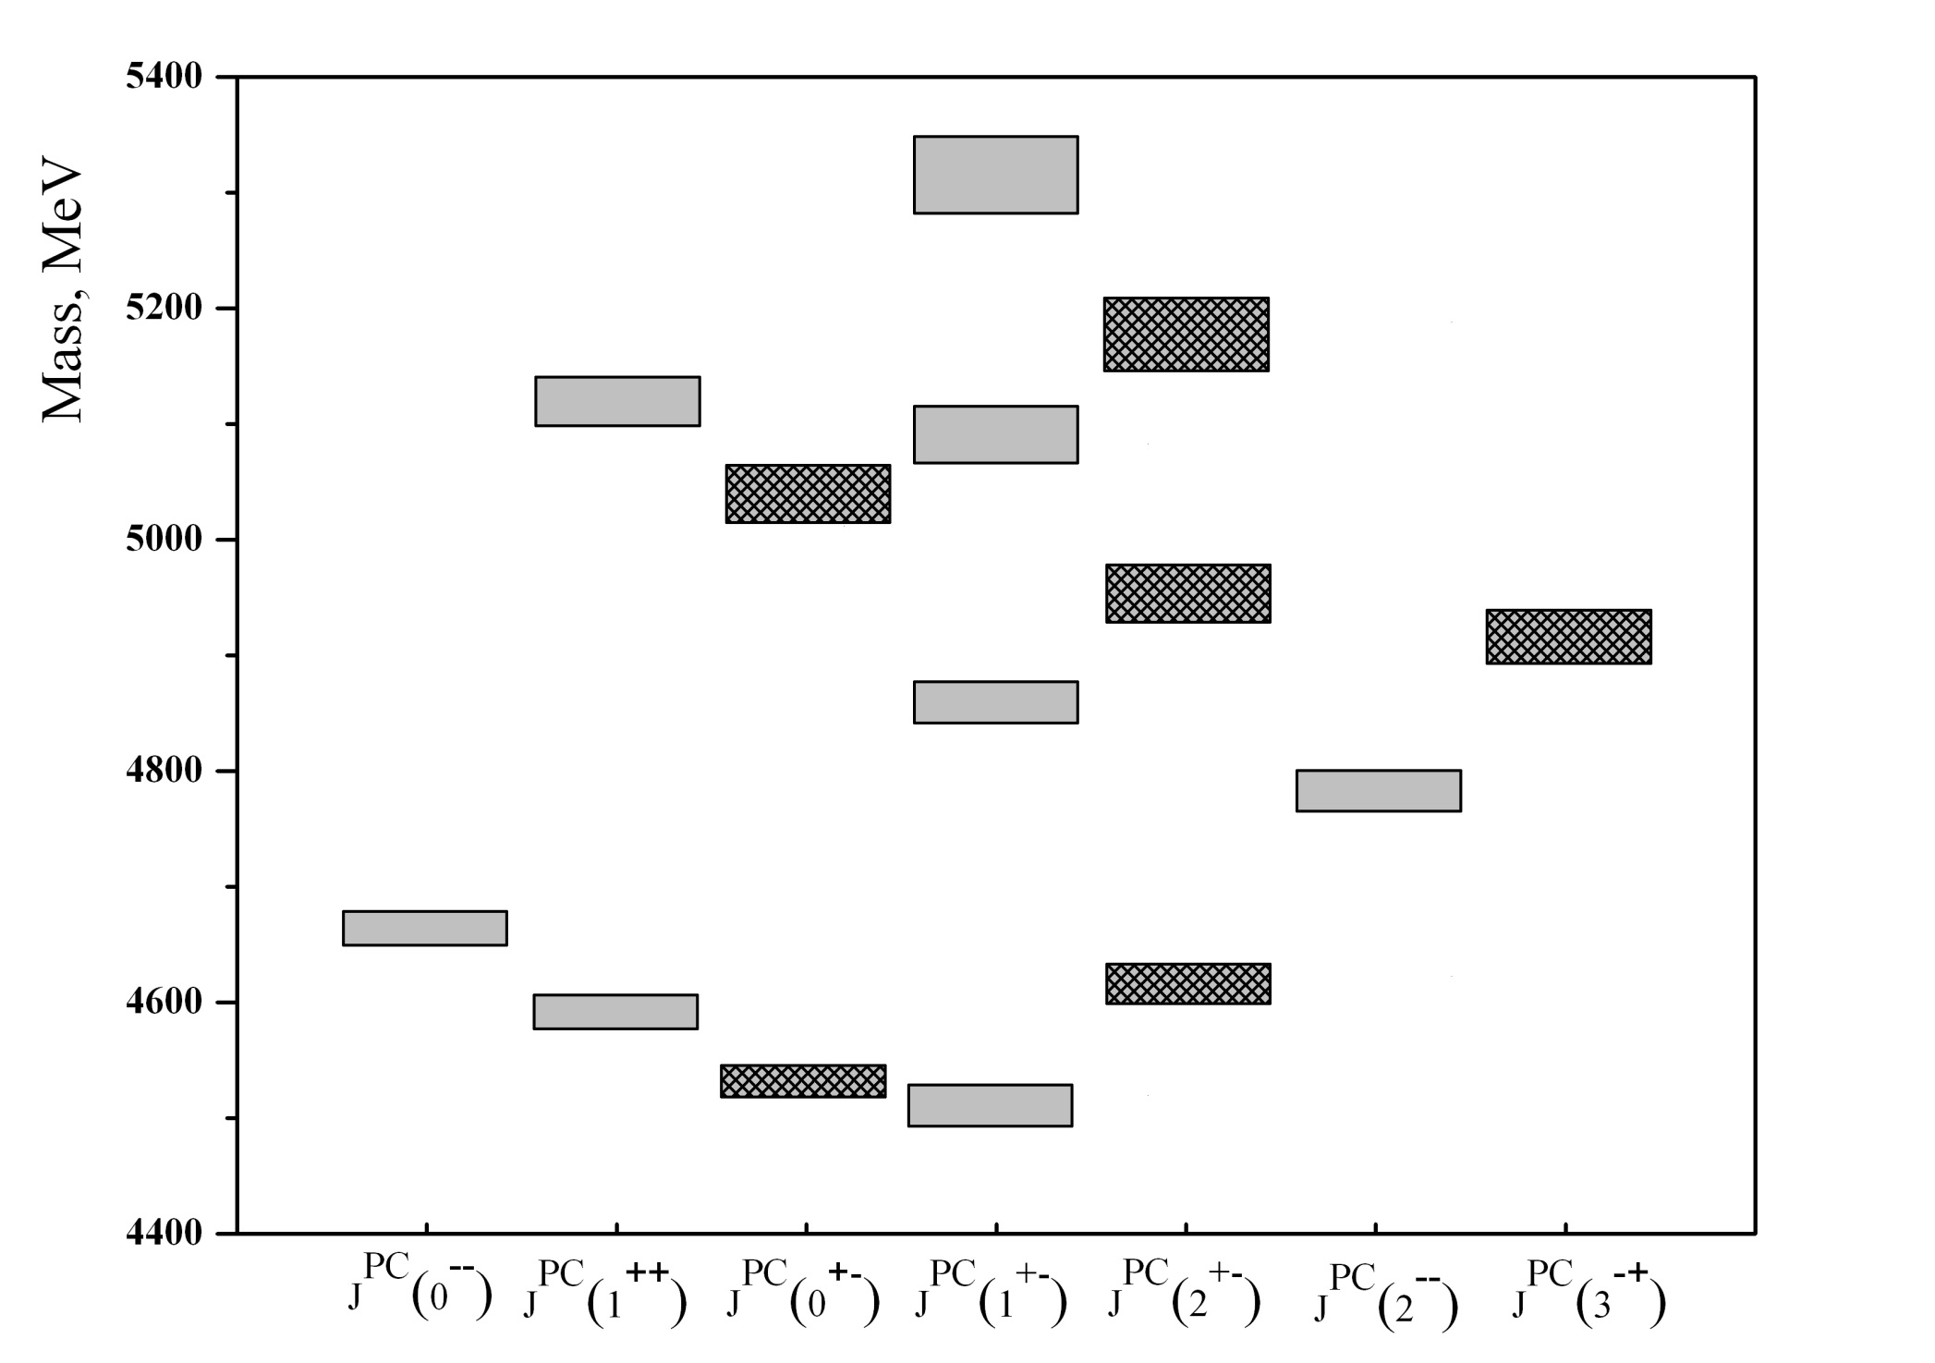
SPECTRUM OF CHARMED HYBRIDS WITH QUANTUM NUMBERS
J^{PC} = 3⁻⁺, 2⁻⁻, 2⁺⁻, 1⁺⁻, 1⁺⁺, 0⁺⁻, 0⁻⁻.
J^{PC} nonexotic
J^{PC} exotic
The well accepted picture is tha the quartet 1⁻⁻,(0,1,2)⁻⁺ is lower in mass than
1⁺⁺,(0,1,2)⁺⁻. The expected splitting is about 100-250 MeV from 1⁻⁺ to 0⁺⁻

Slide 49
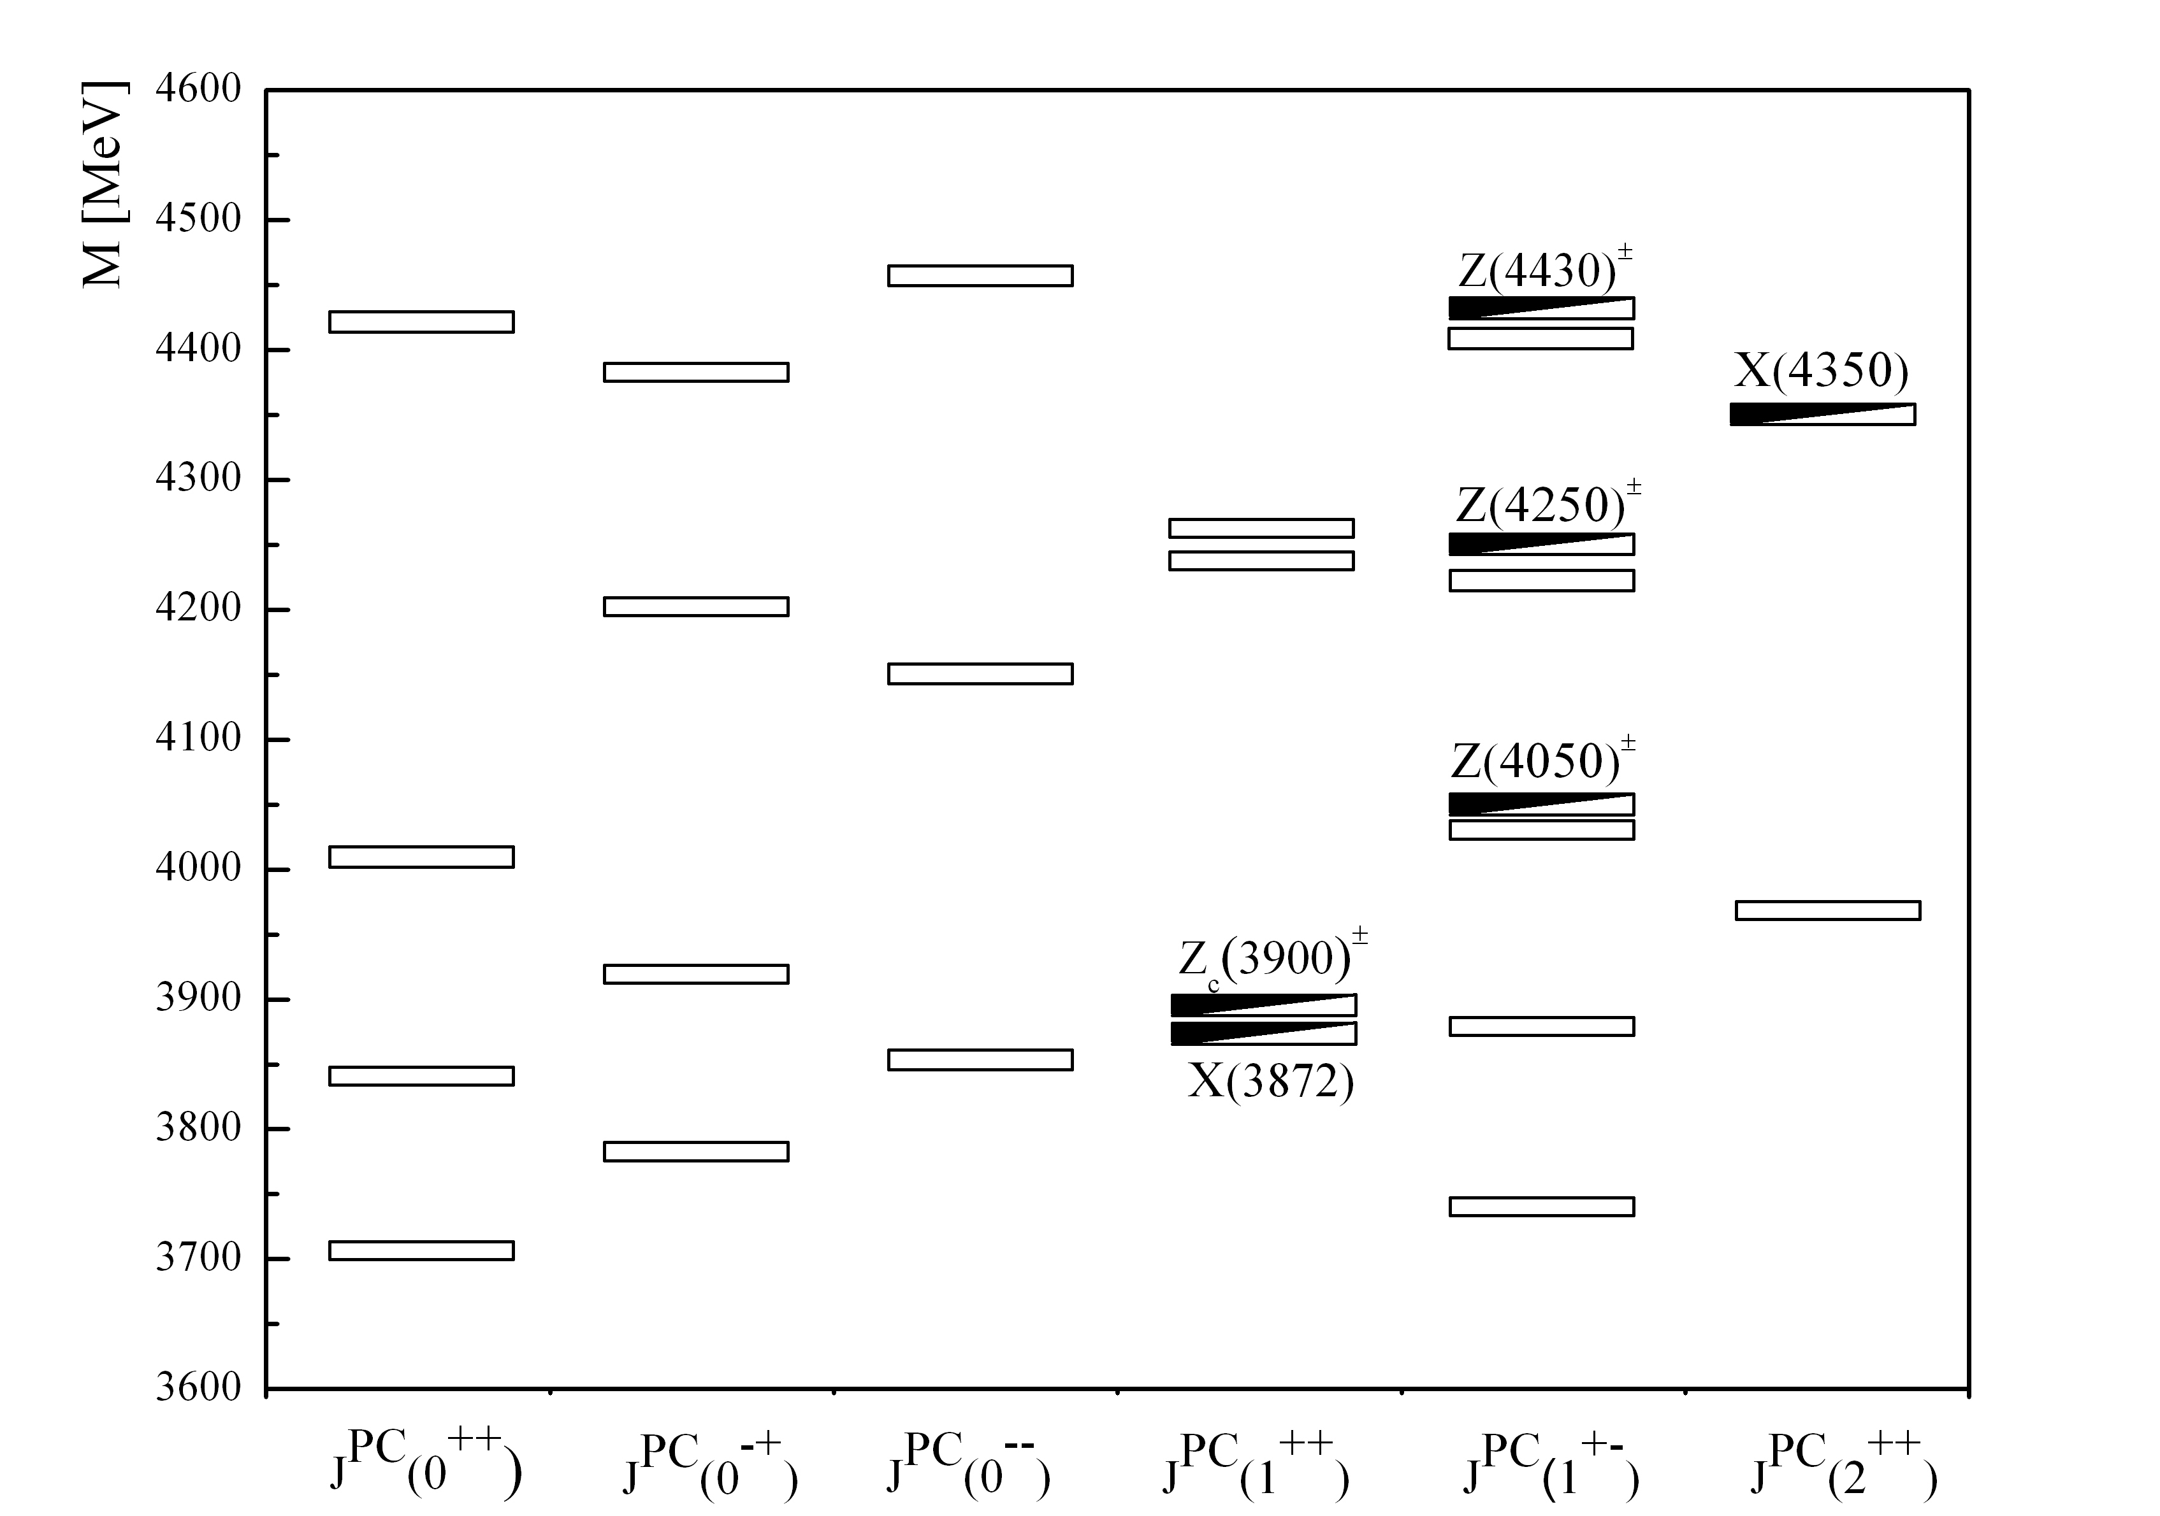
THE SPECTRUM OF TETRAQUARKS WITH THE HIDDEN CHARM.
X(4200-4300)
charge partner of X(3872)
Z(3880)±
J^{PC} = 1⁺⁺ favoured in 2013 by LHCb arXiv: 1302:6269

Slide 50
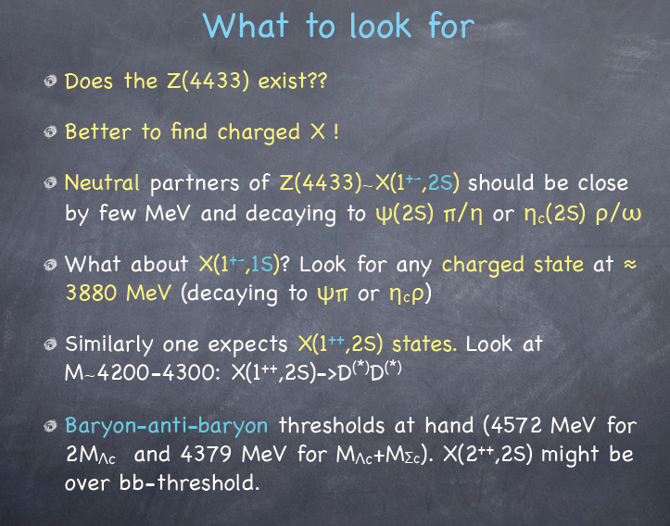


Slide 51
CALCULATION OF WIDTHS
The integral formalism (or in other words integral approach) is based on the possibility of appearance of the discrete quasi stationary states with finite width and positive values of energy in the barrier-type potential. This barrier is formed by the superposition of two type of potentials: short-range attractive potential V₁(r) and long-distance repulsive potential V₂(r).
Thus, the width of a quasi stationary state in the integral approach is defined by the following expression (integral formula):
where
where F_{L}(r) – is the regular decision in the V₂(r) potential, normalized on the energy delta-function; φ_{L(}r) – normalized wave function of the resonance state. This wave function transforms into irregular decision in the V₂(r) potential far away from the internal turning point.
The integral can be estimated with the well known approximately methods:
for example, the saddle-point technique or the other numerical method.

Slide 52
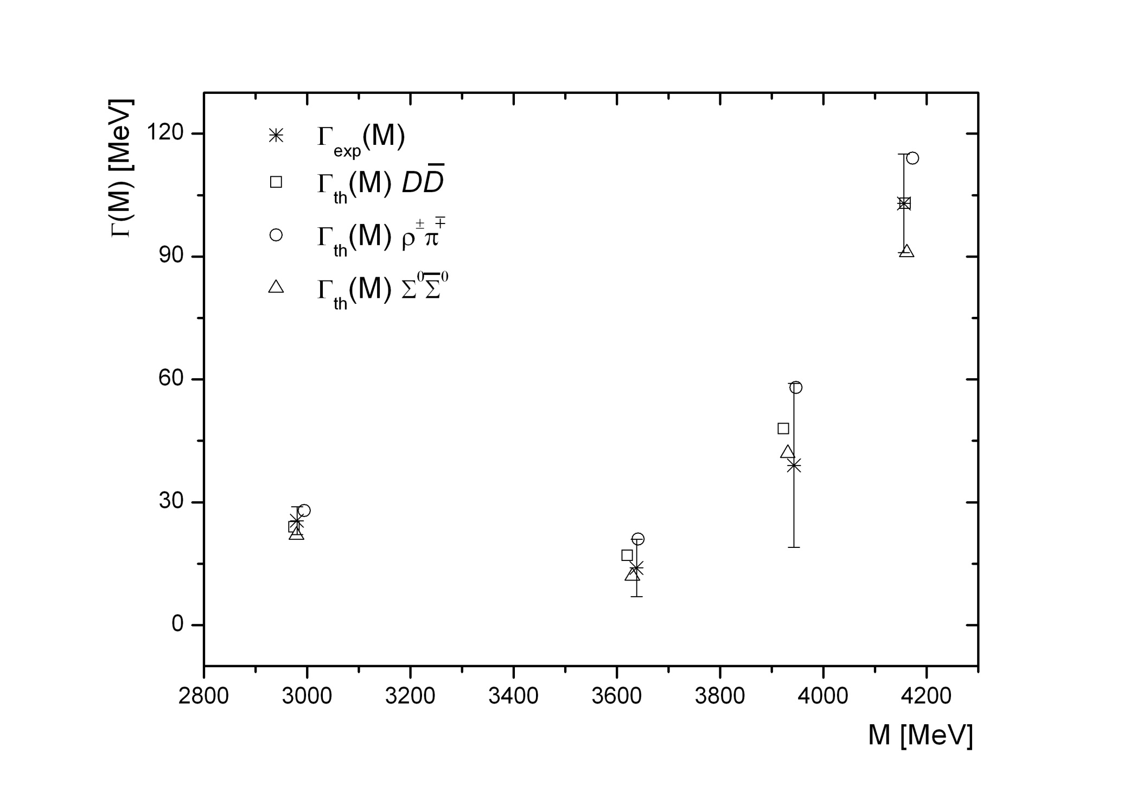
THE WIDTHS OF SINGLET ¹S₀ CHARMONIUM STATES

Slide 53
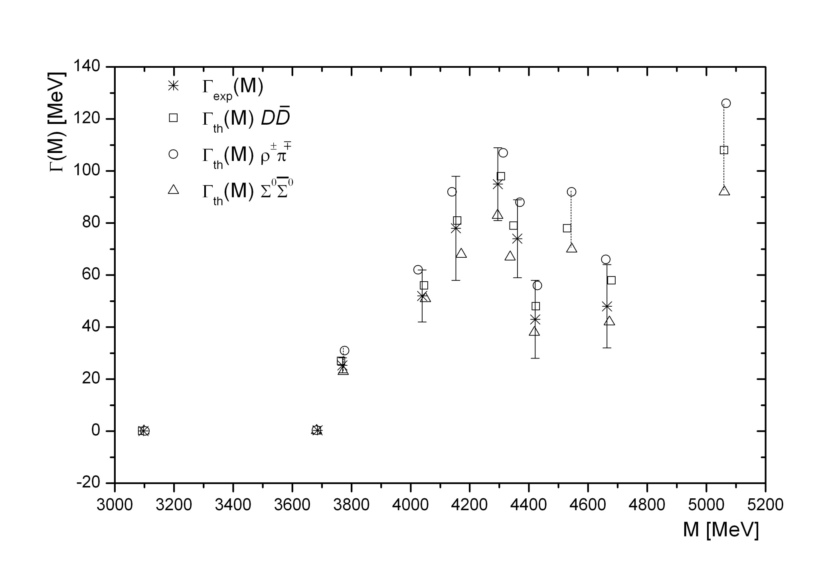
THE WIDTHS OF TRIPLET ³S₁ CHARMONIUM STATES

Slide 54
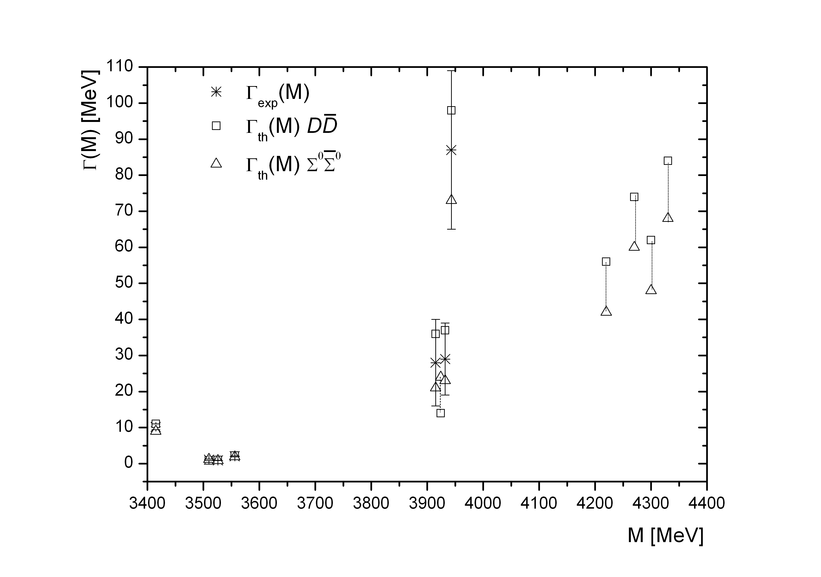
THE WIDTHS OF SINGLET ¹P₁ AND TRIPLET ³P_{J} CHARMONIUM STATES

Slide 55
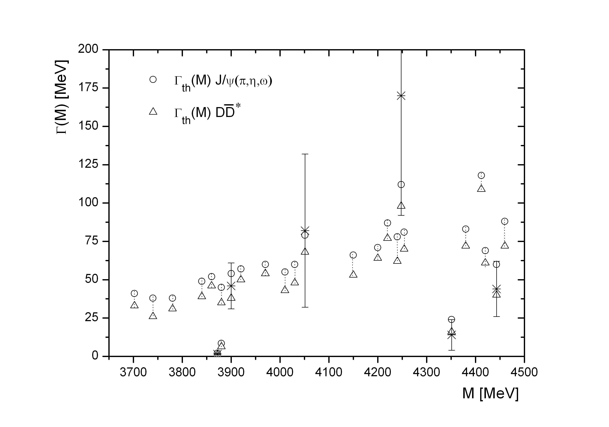
THE WIDTHS OF TETRAQUARKS WITH THE HIDDEN CHARM

Slide 56
Summary
A combined approach has been proposed to study charmonium & exotics.
The most promising decay channels of charmonium (decays into light hadrons, particle-antiparticle, decays with J/Ψ, Ψ' and h_{c} in the final state), charmed hybrids (decays into charmonium & light mesons, decays into DD_{J}* pair) & tetraquarks (decays into charmonium & light mesons, decays into DD* pair) have been elaborately analysed.
Many different charmonium & exotic states are expected to exist in the framework of the combined approach.
The recently discovered XYZ-particles have been analyzed. Eleven of these states can be interpreted as charmonium (two singlet ¹S₀, two singlet ¹D₂, three triplet ³S₁, three triplet ³P_{J} and one triplet ³D_{J}) and six as tetraquarks (two neutral and four charged). It has been shown that charge/neutral tetraquarks must have neutral/charge partners with mass values which differ by few MeV.
Using the integral approach for the hadron resonance decay, the widths of the expected states of charmonium & exotics were calculated; they turn out to be relatively narrow; most of them are of order of several tens of MeV.
The branching ratios of charmonium & exotics were calculated. Their values are of the order of β ≈ 10⁻¹ –10⁻³ dependent of their decay channel.

