Slide 1



Monte Carlo shell model towards ab initio nuclear structure
International Nuclear Physics Conference
INPC 2013
Takashi Abe
Firenze, Italy
June 2-7, 2013

Slide 2
Collaborators
U of Tokyo
  Takaharu Otsuka (Dept of Phys & CNS)
  Noritaka Shimizu (CNS)
  Tooru Yoshida (CNS)
JAEA
  Yutaka Utsuno
Iowa State U
  James P. Vary
  Pieter Maris

Slide 3
Current status of ab inito approaches
Major challenge of nuclear physics
- Understand the nuclear structure from ab-initio calculations in
non-relativistic quantum many-body system w/ realistic nuclear forces (potentials)
- ab-initio approaches: GFMC, NCSM (A ~ 12-14), CC (sub-shell closure +/- 1,2),
SCGF theory, IM-SRG, Lattice EFT, …
demand for extensive computational resources
ab-initio(-like) SM approaches (which attempt to go) beyond standard methods
- IT-NCSM, IT-CI: R. Roth (TU Darmstadt), P. Navratil (TRIUMF), …
- SA-NCSM: T. Dytrych, J.P. Draayer (Louisiana State U), …
- No-Core Monte Carlo Shell Model (MCSM) <- this talk

Slide 4

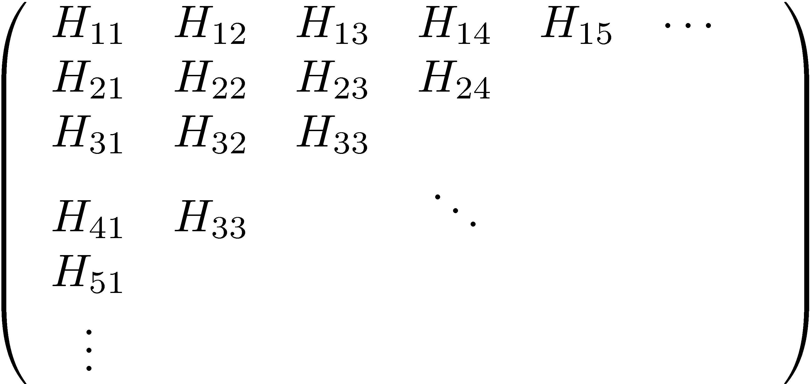
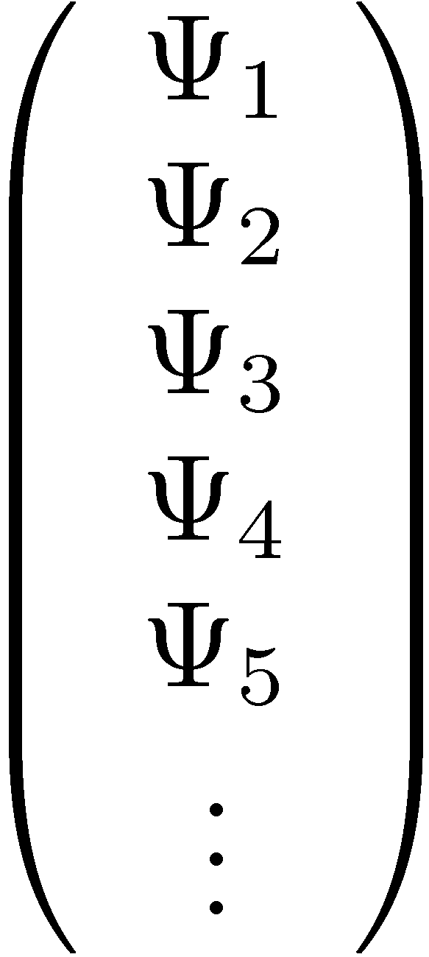
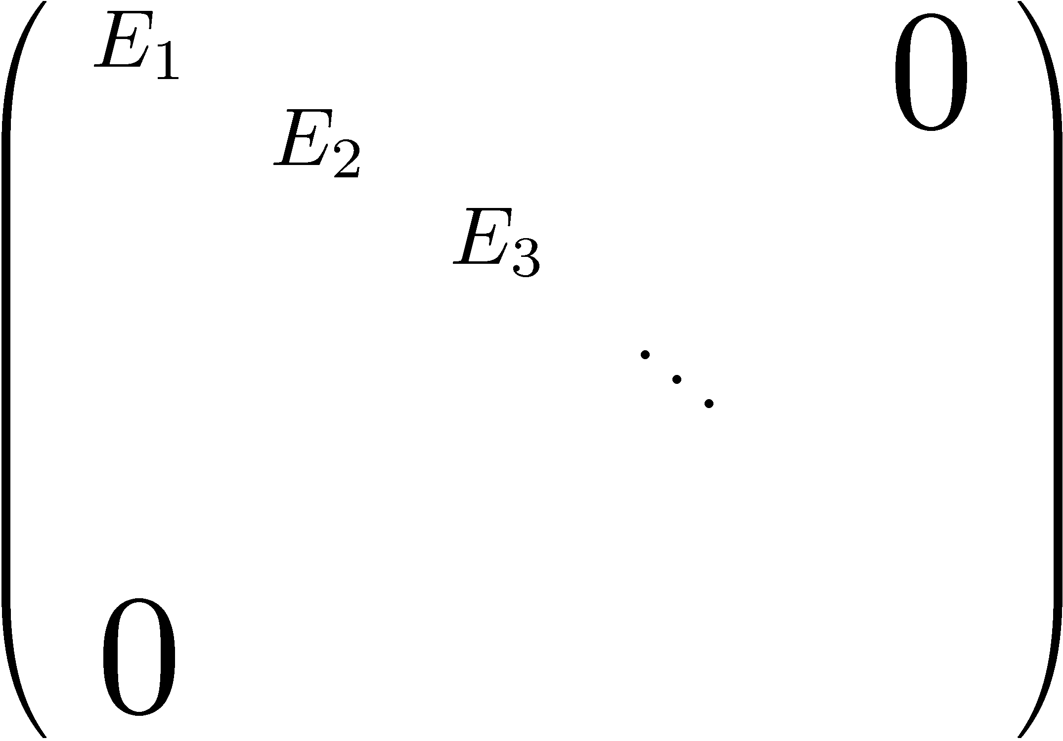

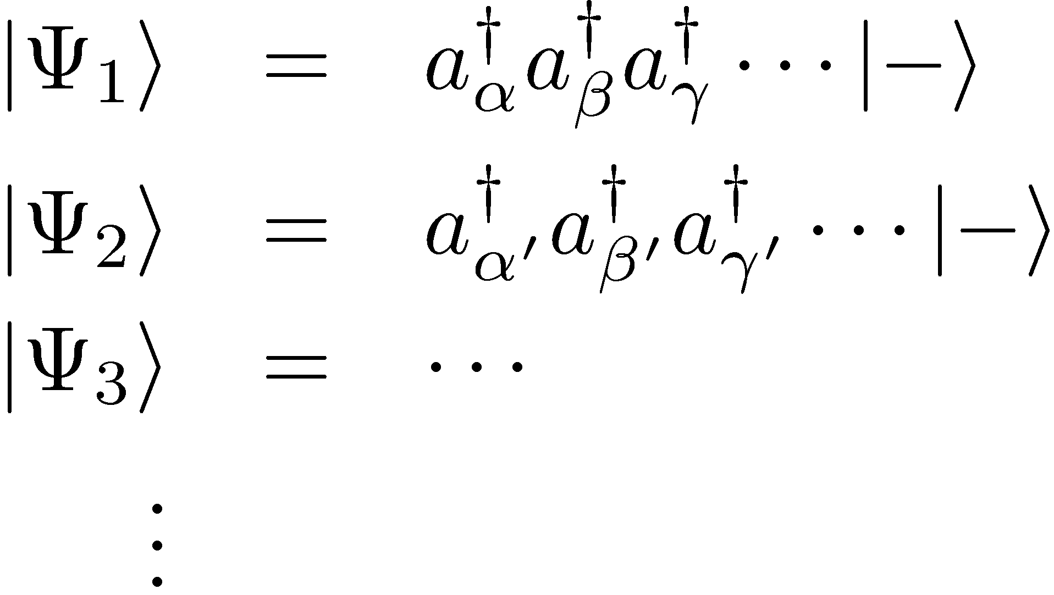
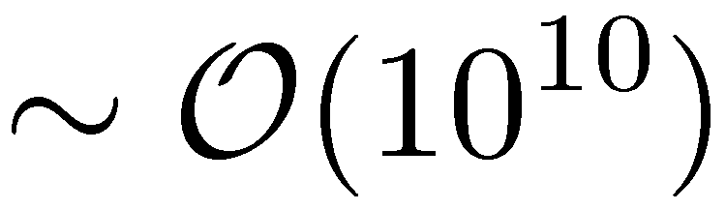
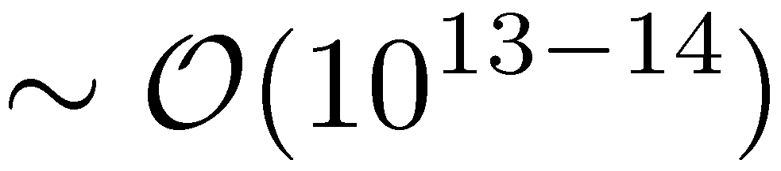
Shell model (Configuration Interaction, CI)
Eigenvalue problem of large sparse Hamiltonian matirx
# non-zero MEs
Large sparse matrix (in M-scheme)

Slide 5
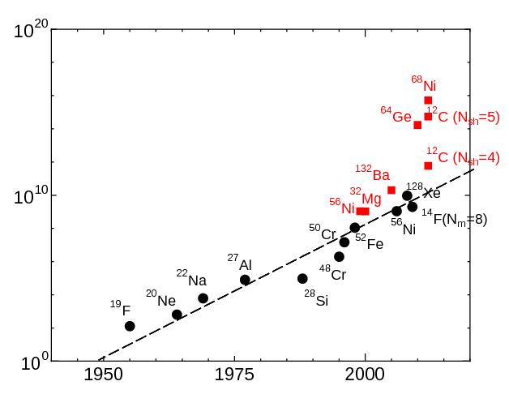
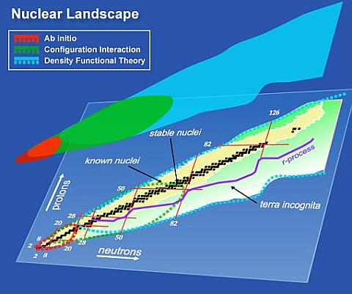
Advantage of the MCSM
Review: T. Otsuka , M. Honma, T. Mizusaki, N. Shimizu, Y. Utsuno, Prog. Part. Nucl. Phys. 47, 319 (2001)
MCSM w/ an assumed inert core is one of the powerful shell model algorithms.
Monte Carlo Shell Model
MCSM
M-scheme dim.
Conventional Shell Model
UNEDF SciDAC Collaboration: http://unedf.org/
Publication Year

Slide 6
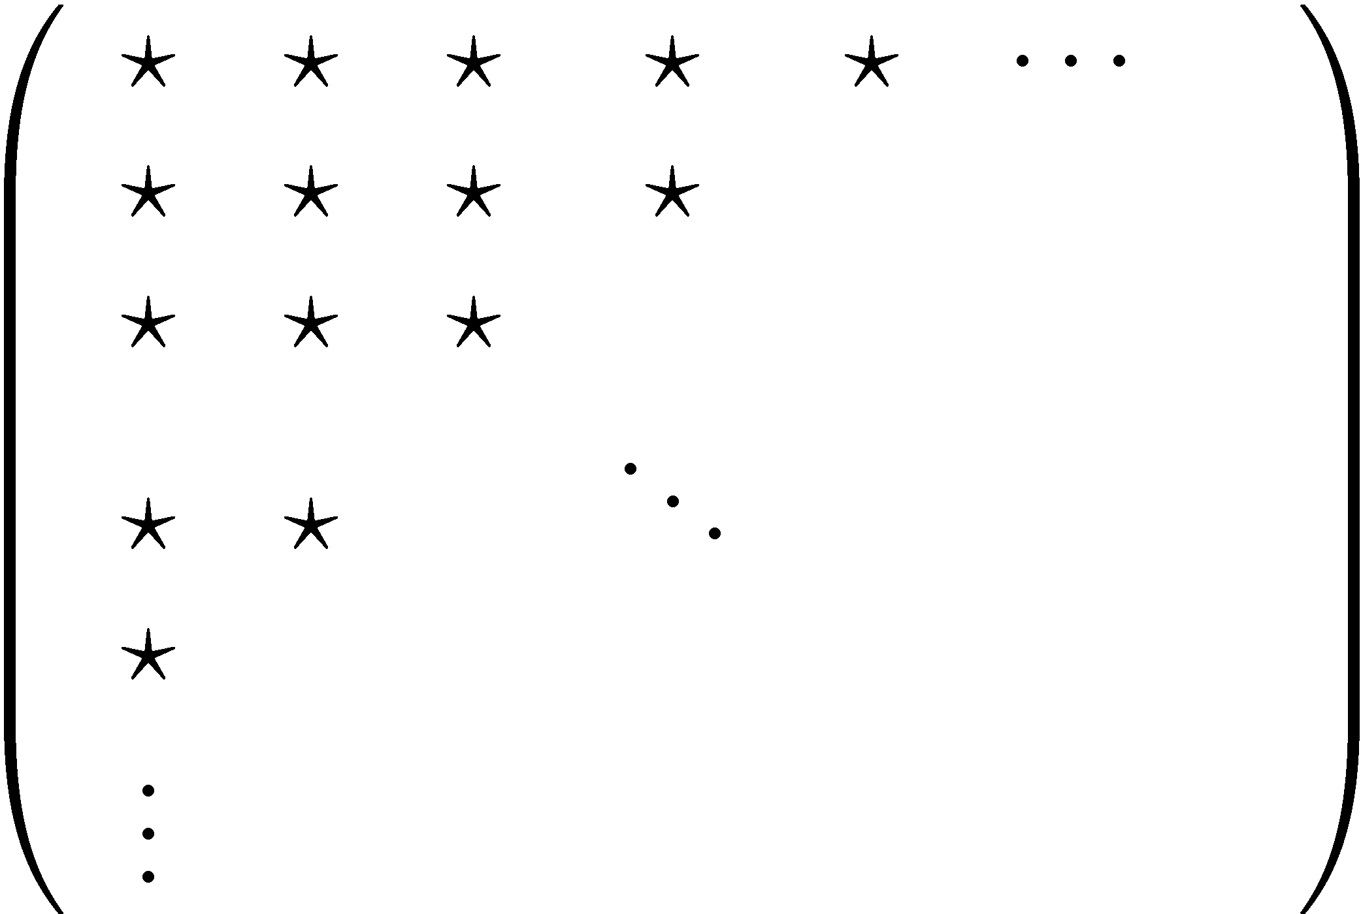

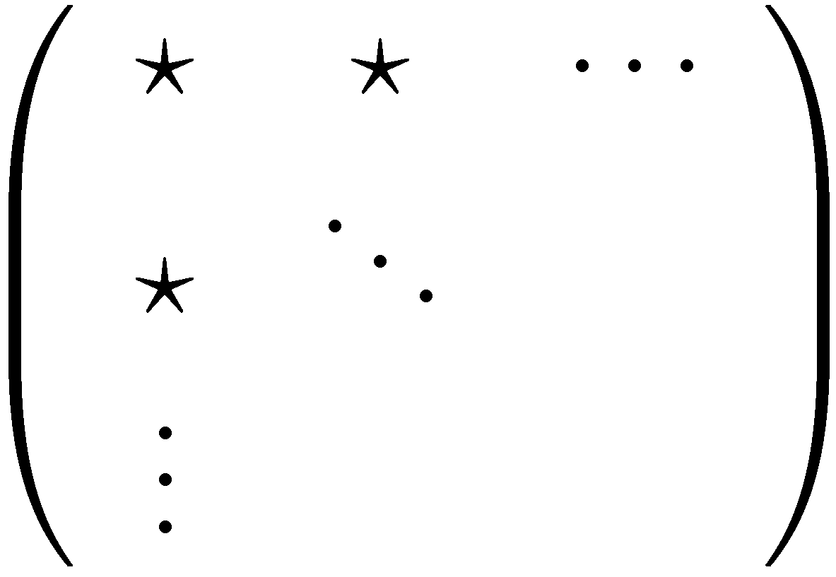
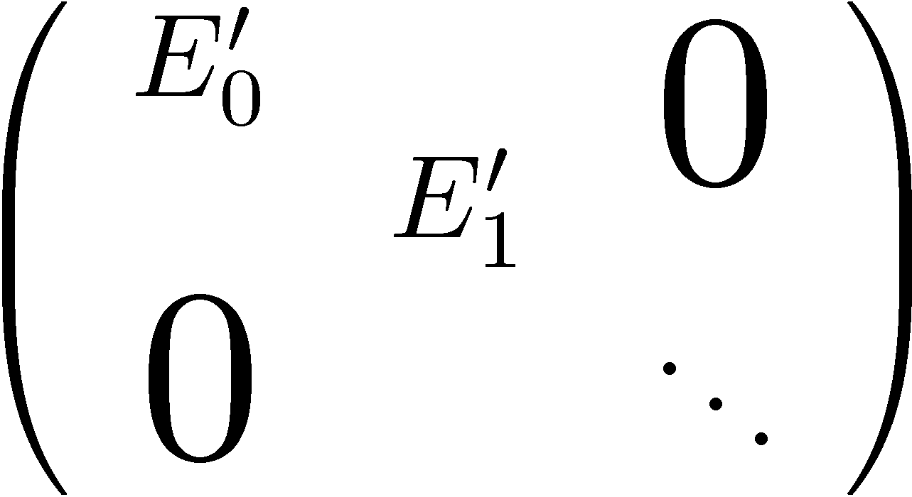
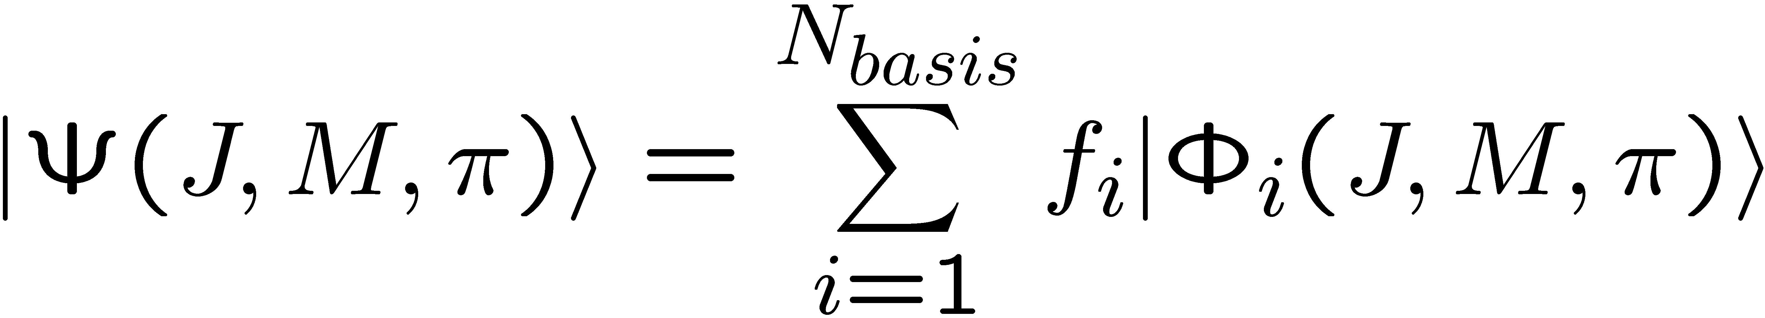
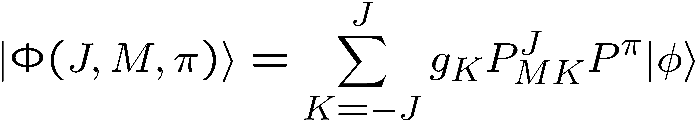
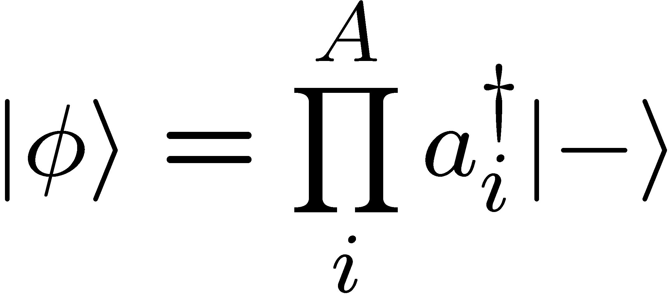
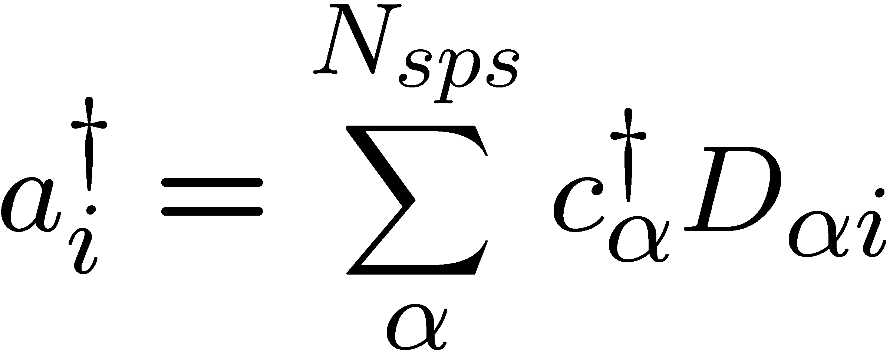
Monte Carlo shell model (MCSM)
Review: T. Otsuka , M. Honma, T. Mizusaki, N. Shimizu, Y. Utsuno, Prog. Part. Nucl. Phys. 47, 319 (2001)
Importance truncation
Standard shell model
Monte Carlo shell model
H =
Diagonalization
All Slater determinants
D_{M} ~ O(10¹⁰)
H ~
Diagonalization
Important bases stochastically selected
D_{MCSM} ~ O(100)
Energy variation
Diagonalization

Slide 7
Recent developments in the MCSM
Energy minimization by the CG method
  N. Shimizu, Y. Utsuno, T. Mizusaki, M. Honma, Y. Tsunoda & T. Otsuka,
  Phys. Rev. C85, 054301 (2012)
Efficient computation of TBMEs
  Y. Utsuno, N. Shimizu, T. Otsuka & T. Abe,
  Compt. Phys. Comm. 184, 102 (2013)
Energy variance extrapolation
  N. Shimizu, Y. Utsuno, T. Mizusaki, T. Otsuka, T. Abe & M. Honma,
  Phys. Rev. C82, 061305 (2010)
Summary of recent MCSM developments
  N. Shimizu, T. Abe, Y. Tsunoda, Y. Utsuno, T. Yoshida, T. Mizusaki,
  M. Honma, T. Otsuka, Prog. Theor. Exp. Phys. 01A205 (2012)
~ 30% reduction of # basis
~ 80% of the peack performance
( ~ 10-20% in the old MCSM )
Evaluation of exact eignvalue w/ error estimate

Slide 8
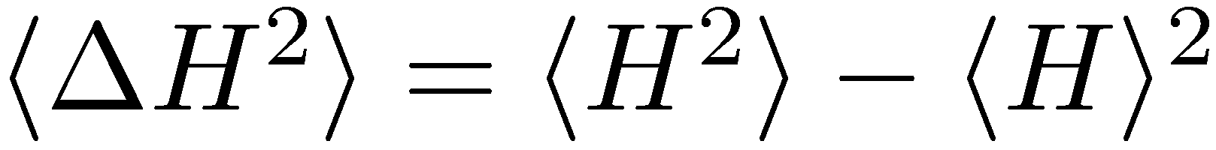
Energies wrt # of basis & energy variance
D_{M} ~ 100
JISP16 NN int.
w/ optimum hw
w/o Coulomb force
w/o spurious CoM treatment
Nshell = 2
D_{M} ~ 3 x 10³
⁴He(0⁺;gs)
Nshell = 3
D_{M} ~ 4 x 10⁴
Nshell = 4
Nshell = 5
D_{M} ~ 3 x 10⁵
Nshell = 2
D_{M} ~ 100
D_{M} ~ 8 x 10⁷
¹²C(0⁺;gs)
Nshell = 3
Exact result is unknown
D_{M} ~ 6 x 10¹¹
Nshell = 4

Slide 9
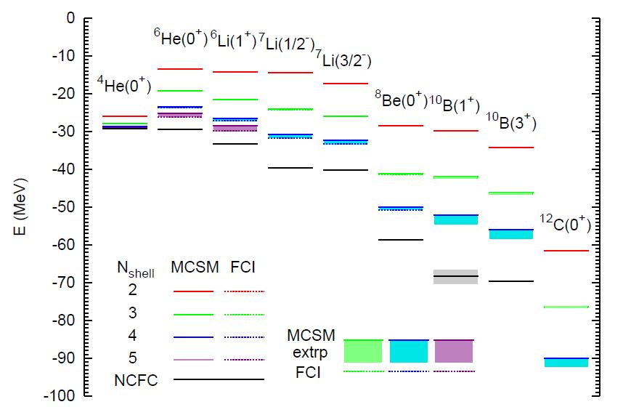
Energies of the Light Nuclei
T. Abe, P. Maris, T. Otsuka, N. Shimizu, Y. Utsuno, J. P. Vary, Phys Rev C86, 054301 (2012)
JISP16 NN int.
w/ optimum hw
w/o Coulomb force
w/o spurious CoM treatment
MCSM results w/ E-var extrp are consistent w/ FCI results

Slide 10
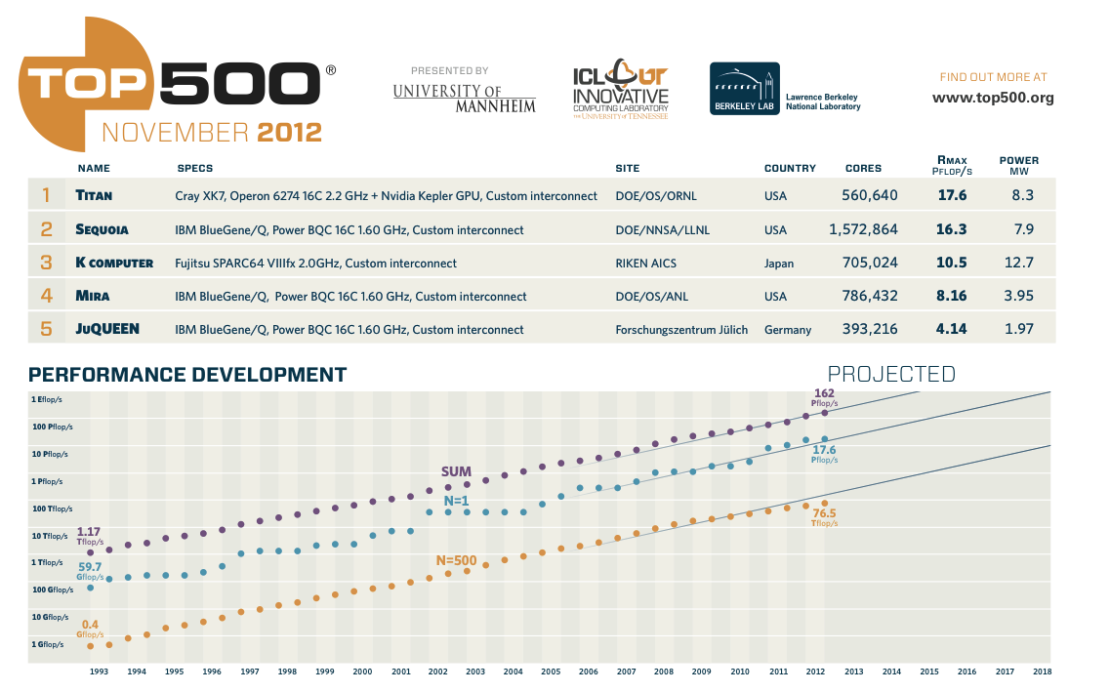
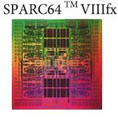
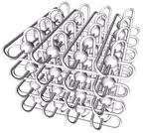


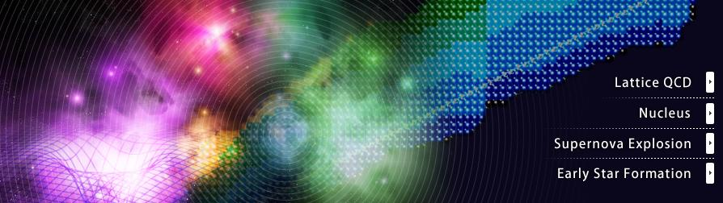
128 GFLOPS/CPU
(8 cores/CPU)
Tofu inter-connection
6D Mesh/Torus
K computer, Japan

Slide 11
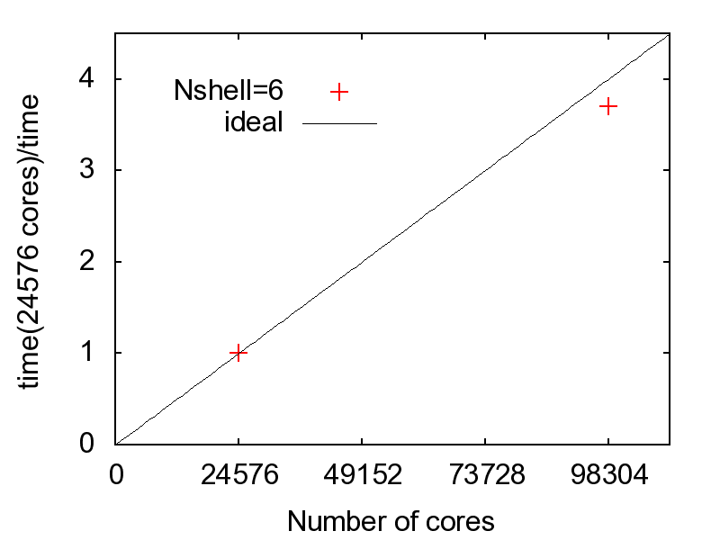
Peak performance & speed-up @ K computer
Optimization of 15th basis dim. of the w.f. in N_{shell}=5 w/ 100 CG iterations (MPI/OpenMP, 8 threads)
Optimization of 48th basis dim. of the 4He (0+) w.f. in N_{shell}=6 w/ 100 CG iterations
Peak performance
Speed-up (strong scaling)
⁴He(0⁺)
⁸Be(0⁺)
¹²C(0⁺)
⁶Li(1⁺)
¹⁰B(3⁺)
15,360 cores
30,720 cores
30 – 40 % thru p-shell nuclei
Scaling up to ~ 100,000 cores
Note: it is a tentative result by early access to the K computer @ AICS, RIKEN.

Slide 12
Energies of the Light Nuclei
T. Abe, P. Maris, T. Otsuka, N. Shimizu, Y. Utsuno, J. P. Vary, Phys Rev C86, 054301 (2012)
JISP16 NN int.
w/ optimum hw
w/o Coulomb force
w/o spurious CoM treatment

Slide 13
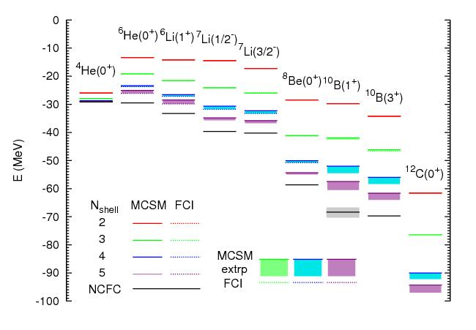
Energies of the Light Nuclei
Preliminary
JISP16 NN int.
w/ optimum hw
w/o Coulomb force
w/o spurious CoM treatment
D_{M} ~ 6 x 10¹⁴
Some MCSM results are not reachable in the current FCI

Slide 14
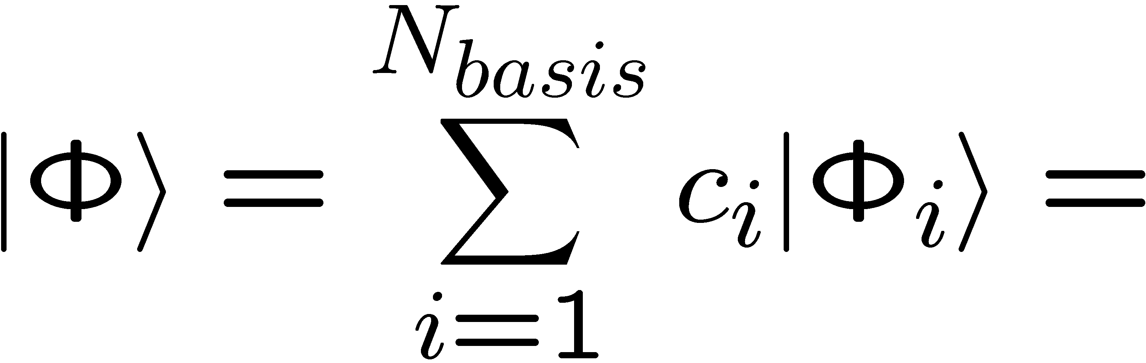
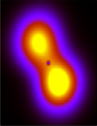
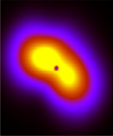
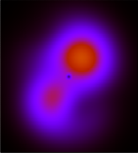
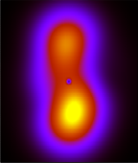
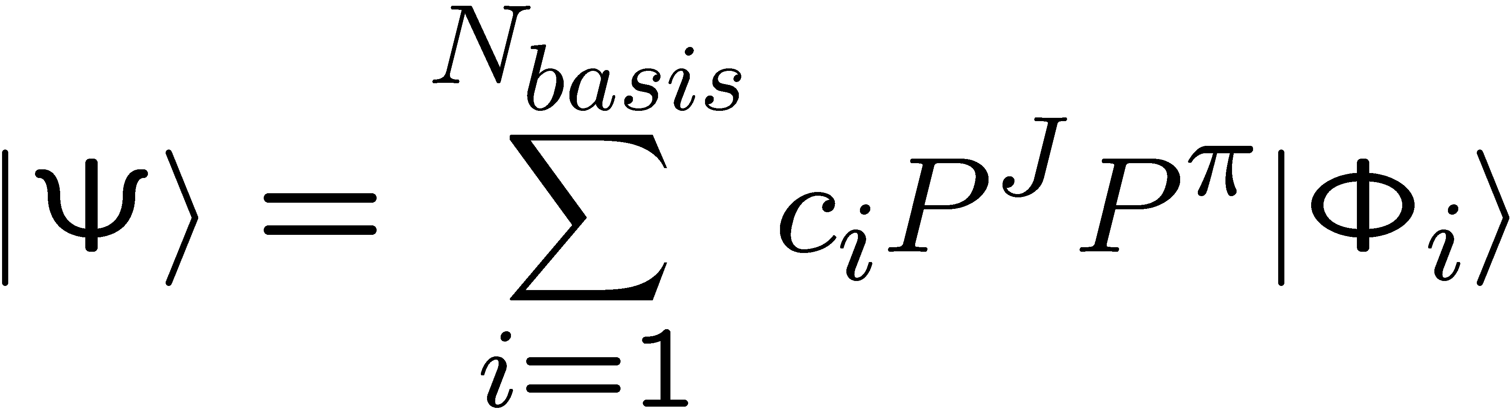
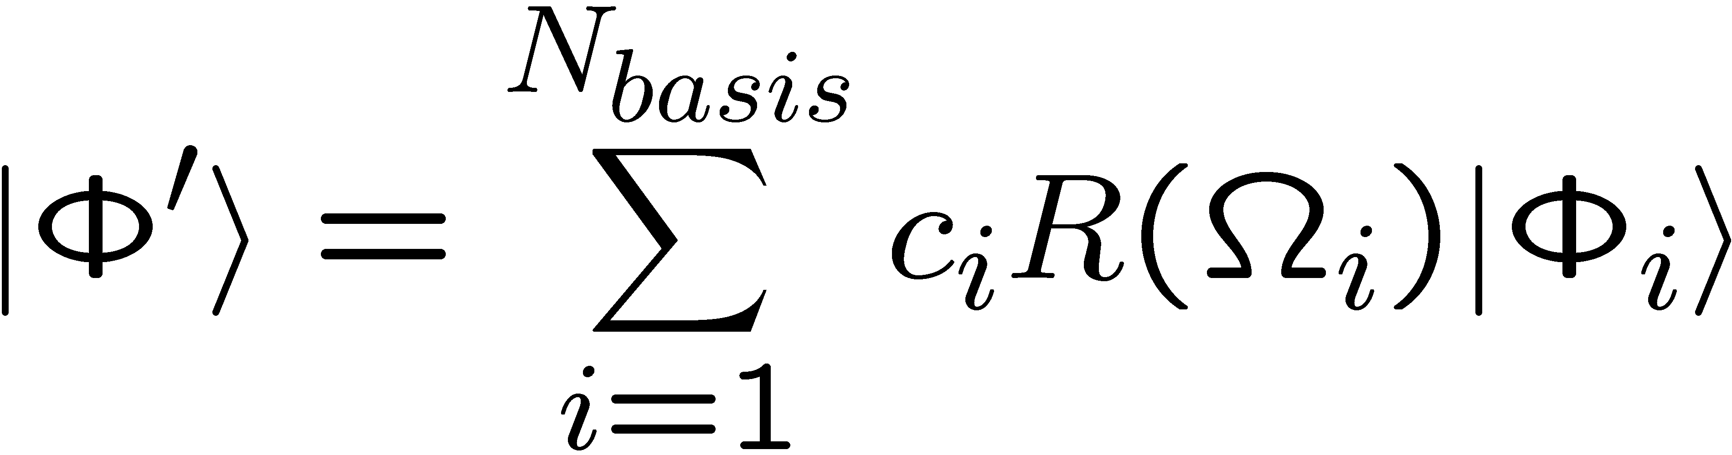
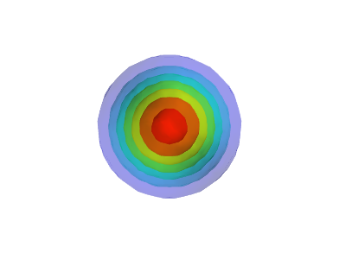
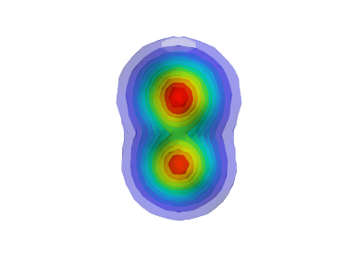
Density plots in MCSM
Poster session (Thursday): T. Yoshida
c₁ + c₂ + c₃ + c₄ + …
Rotation of each basis
by diagonalizing Q-moment
Angular-momentum projection
⁸Be 0⁺ g.s. state
Laboratory frame
“Intrinsic” (body-fixed) frame
Densities in lab. & body-fixed frames can be constructed by MCSM
N. Shimizu, T. Abe, Y. Tsunoda, Y. Utsuno, T. Yoshida, T. Mizusaki, M. Honma, T. Otsuka,
Progress in Theoretical and Experimental Physics, 01A205 (2012)

Slide 15
Summary
MCSM can be applied to no-core calculations of the p-shell nuclei.
- Benchmarks for the p-shell nuclei have been performed and gave good agreements w/ FCI results.
MCSM algorithm/computation
- Extension to larger model spaces (Nshell = 6, 7, …), extrapolation to infinite model space, & comparison with another truncations
- Inclusion of the 3-body force (thru. effective 2-body force)
Physics
- Cluster(-like) states (He & Be isotopes, 12C Hoyle state, …)
- sd-shell nuclei
Perspective

