Slide 1
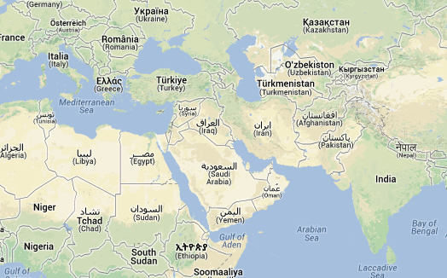
25th International Nuclear
Physics Conference-2013
June 2-7, 2013
Firenze, Italy
Incomplete fusion reactions at low energies in ¹³C+¹⁶⁹Tm system
Vijay R. Sharma¹,
Abhishek Yadav¹, Pushpendra P. Singh², Devendra P. Singh¹, Indu Bala³, Rakesh Kumar³, M. K. Sharma¹, S. Gupta¹, S. Murlithar³, B. P. Singh¹ and R. Prasad¹
¹A. M. University, Aligarh, 202 002, India
²GSI-Helmholtz, Centre for Heavy Ion Research GmbH, D-64291 Darmstadt, Germany
³Inter University Accelerator Centre, New Delhi-67, India
Layout
Prelude
Probes to study incomplete fusion.
Experiment performed
Results
Summary
1

Slide 2
What is ICF ?
Only a part of projectile fuses with target nucleus
Peripheral interactions
How does projectile breaks-up ….. ?
ICF
P
CN’
Repulsive Coulomb + Centrifugal force field dominants over attractive nuclear field
T
T
A_{CN’} = A_{T}+A_{fused}
(to provide sustainable ‘’)
Excited CN de-excites by the emission of light-nuclear-particle(s) and/or γ-radiations .
ICF characteristics ?
Higher production cross-section than statistical code P. Vergani et al., PRC 48, 1815 (1993)
E_{spectator} = E_{projectile} x spectator-projectile mass ratio H. C. Britt et al., PR124, 877 (1961)
Fractional LMT → A_{CN’} < CA_{N} → E_{recoil_CN’} < E_{recoil_CN} P. Vergani et al., PRC 48, 1815 (1993)
Forward peaked PLFs R. I. Badran et al., EPJA 12, 317 (2001)
Spin distributions are different for CF and ICF residues P. P. Singh et al., PLB 671, 20 (2009)
INPC-2013 Vijay R. Sharma 3rd-June-2013

Slide 3
Why do we study ICF… motivation..?
Several Models and studies have been proposed…. The following issues are still not well understood ….
How does the degree of fusion in-completeness depend upon……..?
Mass-asymmetry
Projectile and/or target type
l – values
Sensitiveness of ICF with projectile energy.
ICF follow binding energy systematic or Q-alpha Systematic?
It may be mentioned that no theoretical model is available which can explain ICF experimental data preciously at low energies.
INPC-2013 Vijay R. Sharma 3rd-June-2013

Slide 4
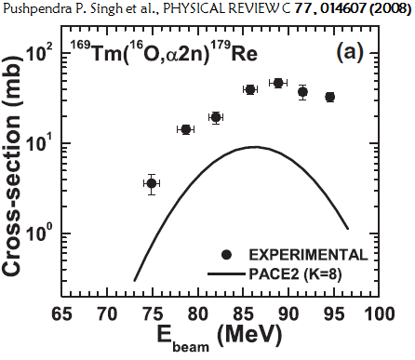
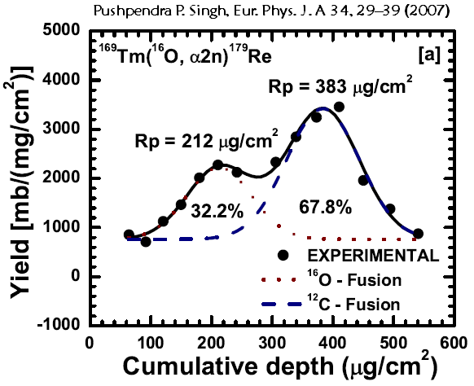
How to study ICF….probes …?
2
EFs
RRDs
1
CF
ICF
ICF
Hint for ICF
Proof for ICF
Enhancement in the production yield of α-emitting channels
Direct measurement of momentum transfer
INPC-2013 Vijay R. Sharma 3rd-June-2013

Slide 5
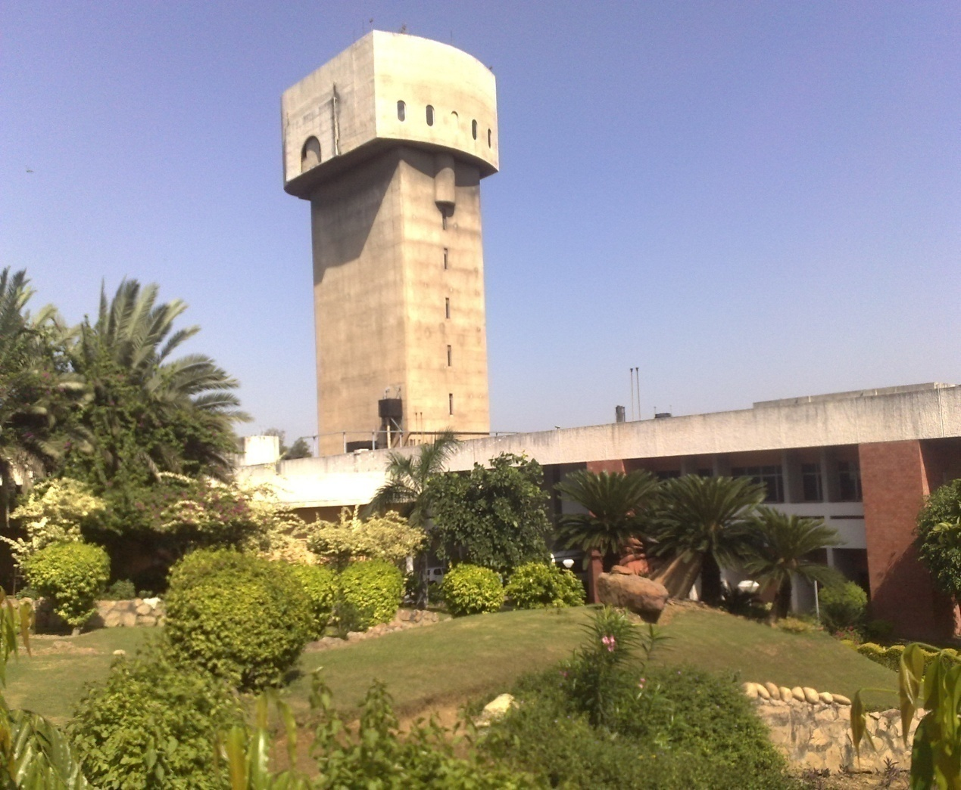
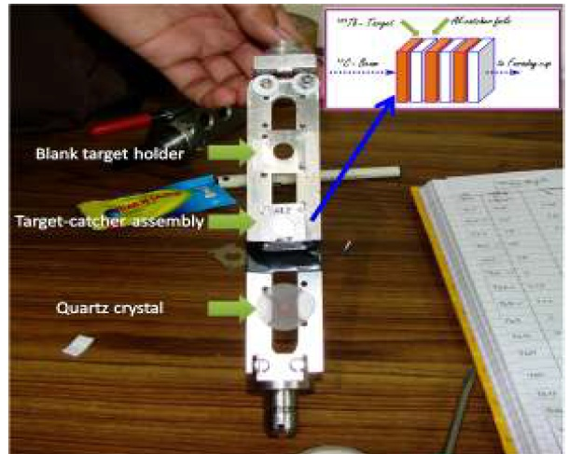
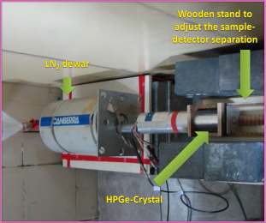
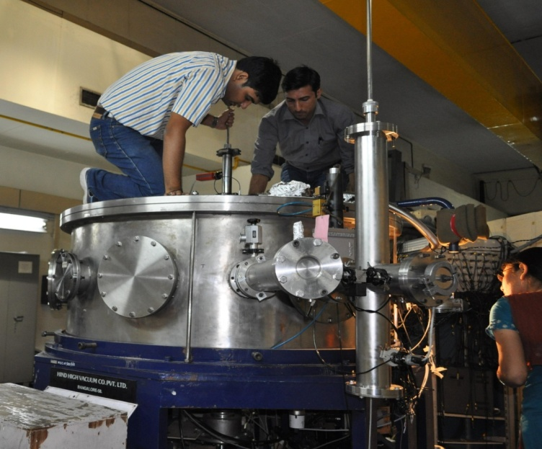
Experiment at IUAC, New Delhi, INDIA
15 UD Pelletron
Beam = ¹³C⁶⁺
Beam Current = 2-4 pnA
Target = ¹⁶⁹Tm
¹³C Beam
General Purpose Scattering Chamber
INTER UNIVERSITY ACCELERATOR CENTRE
INPC-2013 Vijay R. Sharma 3rd-June-2013

Slide 6
Identification of isotopes …Offline method
Spectrum
¹³C+¹⁶⁹Tm @ 82.7 MeV
Channel Selection = Characteristic γ - lines
Half-life
Confirmation = Decay curve analysis
INPC-2013 Vijay R. Sharma 3rd-June-2013

Slide 7
Results… PACE4 (calibration of code)
xn and pxn found to be in good agreement with the theoretical values
Calibration of PACE4 code at PLD=10 has been done.
INPC-2013 Vijay R. Sharma 3rd-June-2013

Slide 8
Alpha Channels …
Enhancement attributed to ICF …
INPC-2013 Vijay R. Sharma 3rd-June-2013

Slide 9
ICF Strength Function… ?
Entrance channel effect
JP Conf. Ser. 282, 012019, (2011)
Present work
V_{rel}/c
B/A of ¹³C (=7.46 MeV) < B/A of ¹²C (=7.68 MeV)
ICF show up
at slightly above barrier, i.e. 17% above V_{B}
at ν_{rel} ≈ 0.039 (3.9 % of c) < Morgenstern values (6% of c)
Smoothly increases upto the studied energies.
Do trends say something …?
(H. Morgenstern et al., Phys. Rev. Lett. 52, 1104 (1984); Phys. Lett. B 113, 463 (1982).)
INPC-2013 Vijay R. Sharma 3rd-June-2013

Slide 10
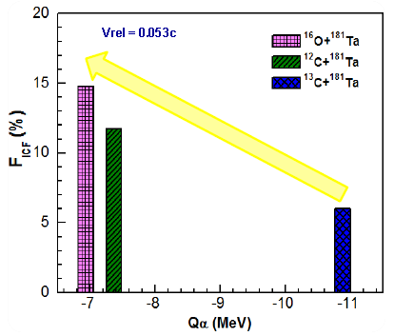
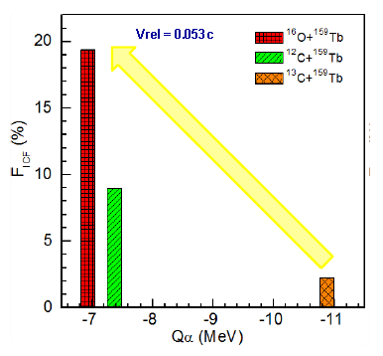
α – Q- Value …
Abhishek Yadav, Vijay R. Sharma et al., Phys. R. C 86, 014603 (2012)
Present work
Projectile | Q_{α}-value
¹⁶O | -7.162
¹²C | -7.3666
¹³C | -10.648
Q_{α} value seems to be an important parameter to explain the incomplete fusion reactions at low energies.
Alpha Q- Value Effect
INPC-2013 Vijay R. Sharma 3rd-June-2013

Slide 11
Summary
The incomplete fusion is a dominant mode of reaction at presently studied energies.
The Incomplete fusion fraction is found to increase with energy.
The onset of ICF has been found just above the 17% of Coulomb barrier.
The alpha Q-Value is an important parameter in order to understand the dependence of ICF on projectile type.
INPC-2013 Vijay R. Sharma 3rd-June-2013

Slide 12
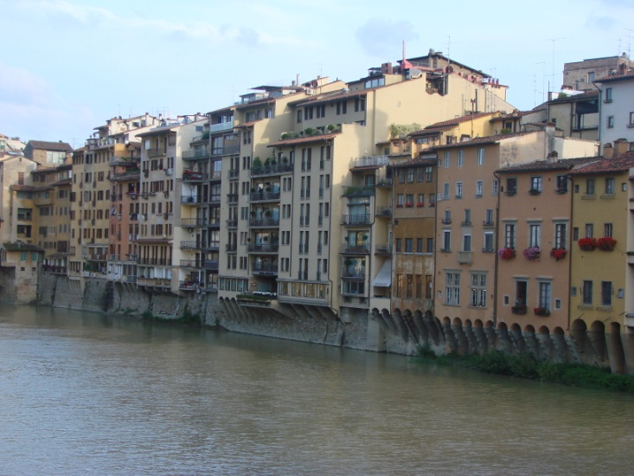
"Let the noble thoughts come to us from every side of the world"- - RigVeda
Thank you for your kind attention
INPC-2013 Vijay R. Sharma 3rd-June-2013

Slide 13
Backup slides

Slide 14
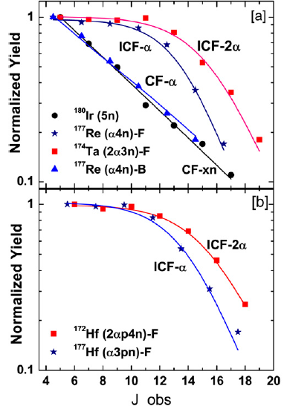
Spin Distributions
SDs
3
Pushpenda P. Singh, Phys. Lett. B 671 (2009) 20-24
l- localization
Entirely different de-excitation patterns.

Slide 15
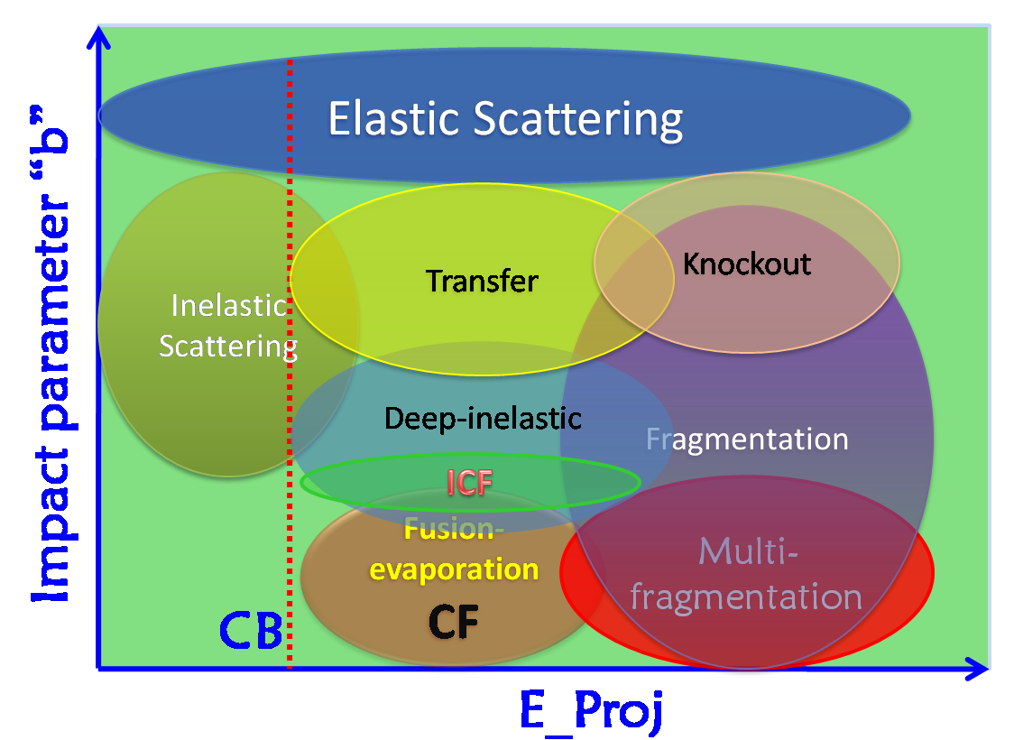
Schematic representation of some nuclear reactions
Different impact parameters correspond to the different ℓ-values and hence different reaction processes at same E_proj.
Large impact parameter causing ICF ..?
INPC-2013 Vijay R. Sharma 3rd-June-2013
Notes:
This is a very interesting picture ……… in this figure the impact parameter have been plotted against the projectile energy ……… as one can see …. As the projectile energy increases .the different reaction processes occurs ……….. However, the interesting point is ….. When we look for a particular projectile energy the different reaction processes occur at different impact-parameters depending upon the different l-windows …… ..like above the coulomb barrier……..… the complete fusion is the dominating mode of reaction….…however, as the impact parameter increases the ICF comes into picture …

Slide 16
Activation Technique
In this technique, a stack of targets backed by Al-catchers may be irradiated by an energetic beam. After the irradiation, the activities induced in the target-catcher foil assembly are recorded off-line for a considerably long time depending on the half-lives of reaction products of interest .

Slide 17
Deformation Values
Nuclides | β₂
¹⁸O | .021
¹⁶O | .021
¹³C | -------
¹²C | .592
¹⁶⁹Tm | .295
¹⁵³Eu | .252
¹⁷⁵Lu | -------

