Slide 1
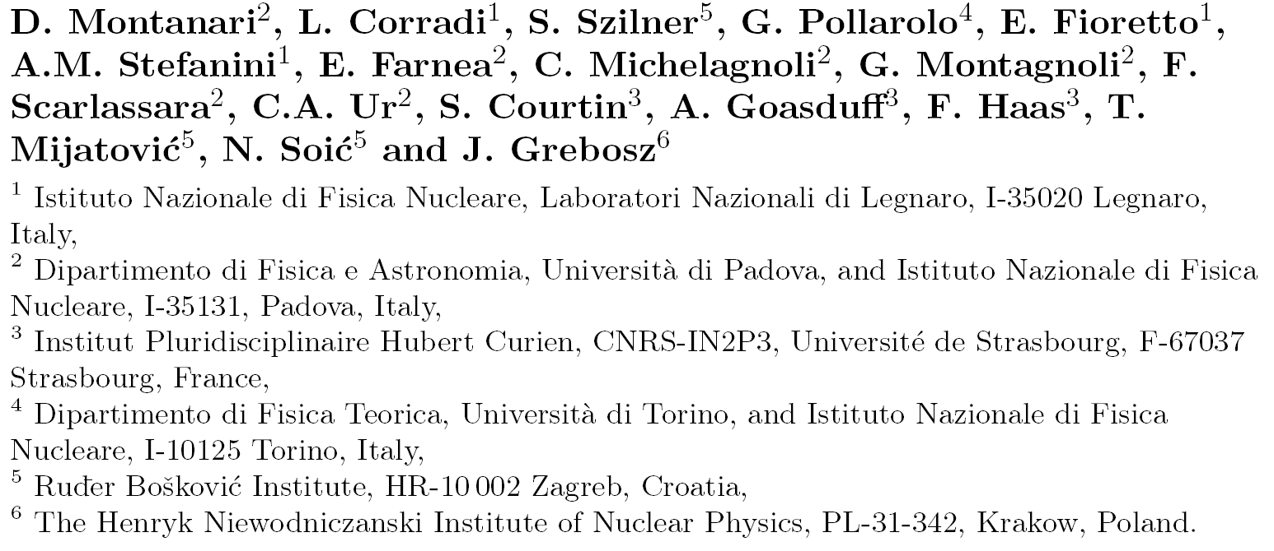
Transfer probability measurements in the superfluid ¹¹⁶Sn+⁶⁰Ni system
International Nuclear Physics Conference- 2013

Slide 2
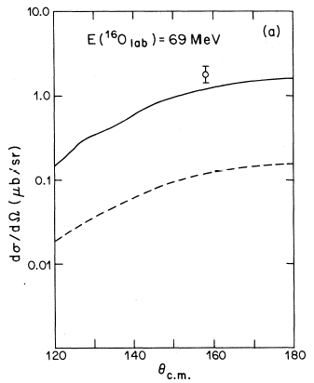
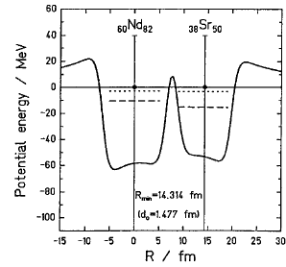
Sub-barrier transfer reactions
Relative role of one- and multi-nucleon transfer channels
Nuclei at large distance
tunneling effects
successive
direct

Slide 3
Sub-barrier transfer reactions
Experimental difficulties
Angular distributions
are backward peaked
in direct kinematics projectile-like
particles have low kinetic energy
Difficult identification of reaction
products in A, Z and Q-values
Cross sections are very small (need for high efficiency)

Slide 4
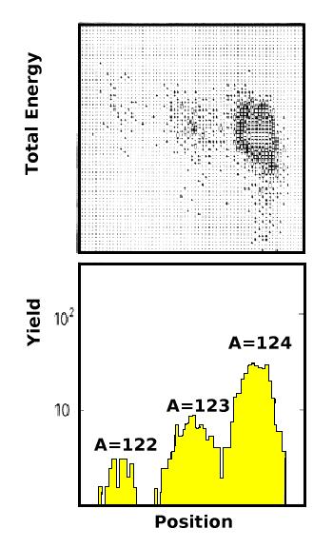
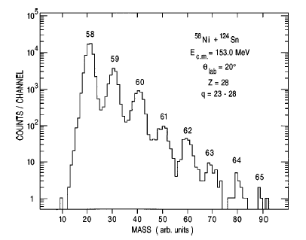
Sub-barrier transfer reactions
⁵⁸Ni
^{x}Sn
RMS
R.Betts et al., PRL59(1987)978
Measurements at subbarrier energies but for only one nucleon transfer and with very poor Q-value resolution
beam direction
Split Pole
> 10º
¹²⁴Sn
⁵⁸Ni
H.Esbensen et al., PRC57(1998)2401
C.L.Jiang et al., PRC57(1998)2393

Slide 5
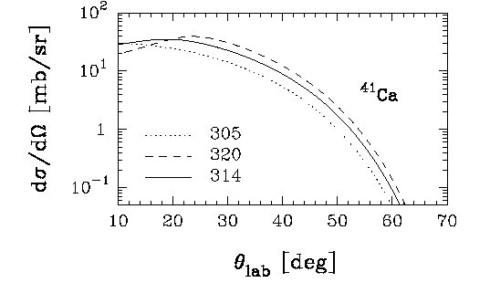
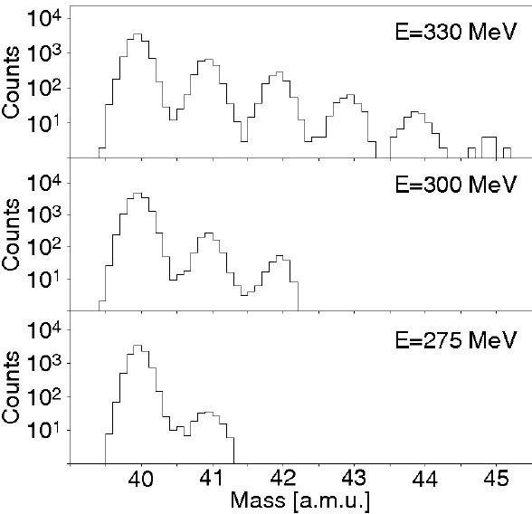
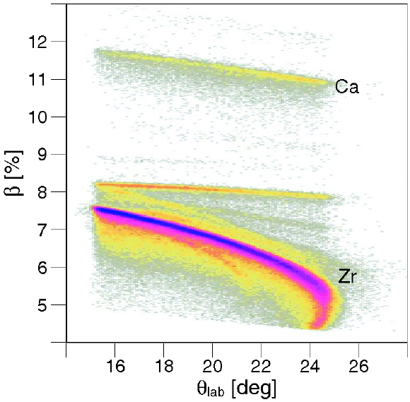
Reaction in inverse kinematics with PRISMA
beam direction
PRISMA
20º
⁹⁶Zr
⁴⁰Ca
Prisma acceptance

Slide 6
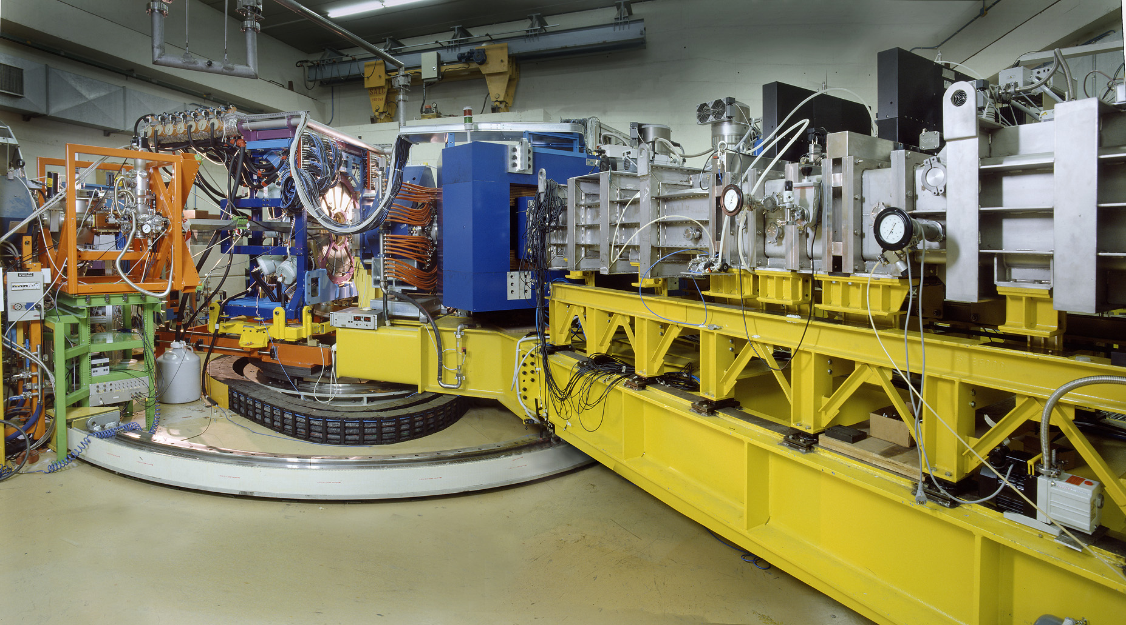
The PRISMA magnetic spectrometer
Laboratori Nazionali di Legnaro – INFN (Italy)
γ-array
PRISMA

Slide 7
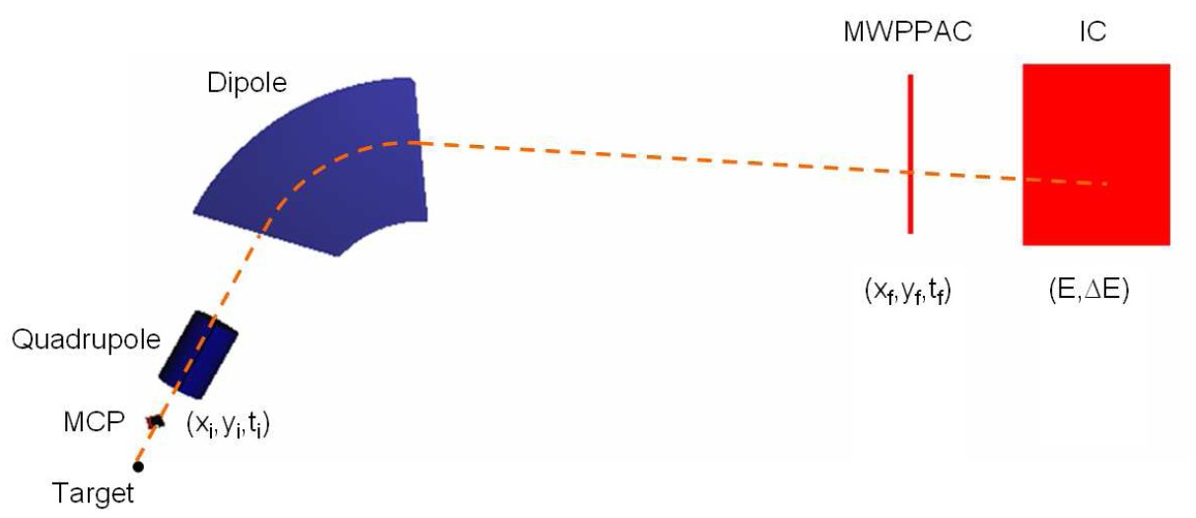
The PRISMA magnetic spectrometer
Total path of the ions ≈ 6 m
D. Montanari et al., Eur. Phys. J. A (2011) 47
Detectors:
entrance detector (MCP)
focal plane detector (MWPPAC)
ionization chamber (IC)
Optics:
quadrupole magnet
dipole magnet

Slide 8


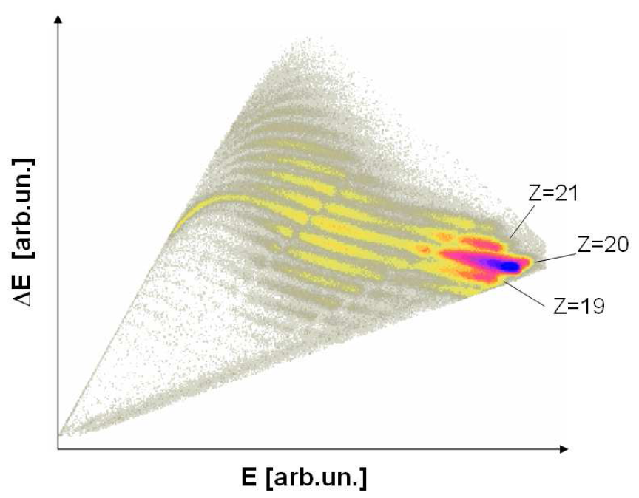
The PRISMA magnetic spectrometer
Ca

Slide 9
The PRISMA magnetic spectrometer
Mass resolution
ΔA/A ≈ 1/150
Imposing a binary reaction and knowing the velocity of the ion
Reconstruction of the reaction Q-value

Slide 10
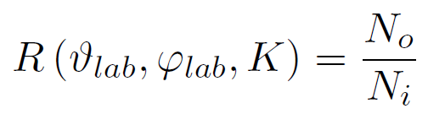
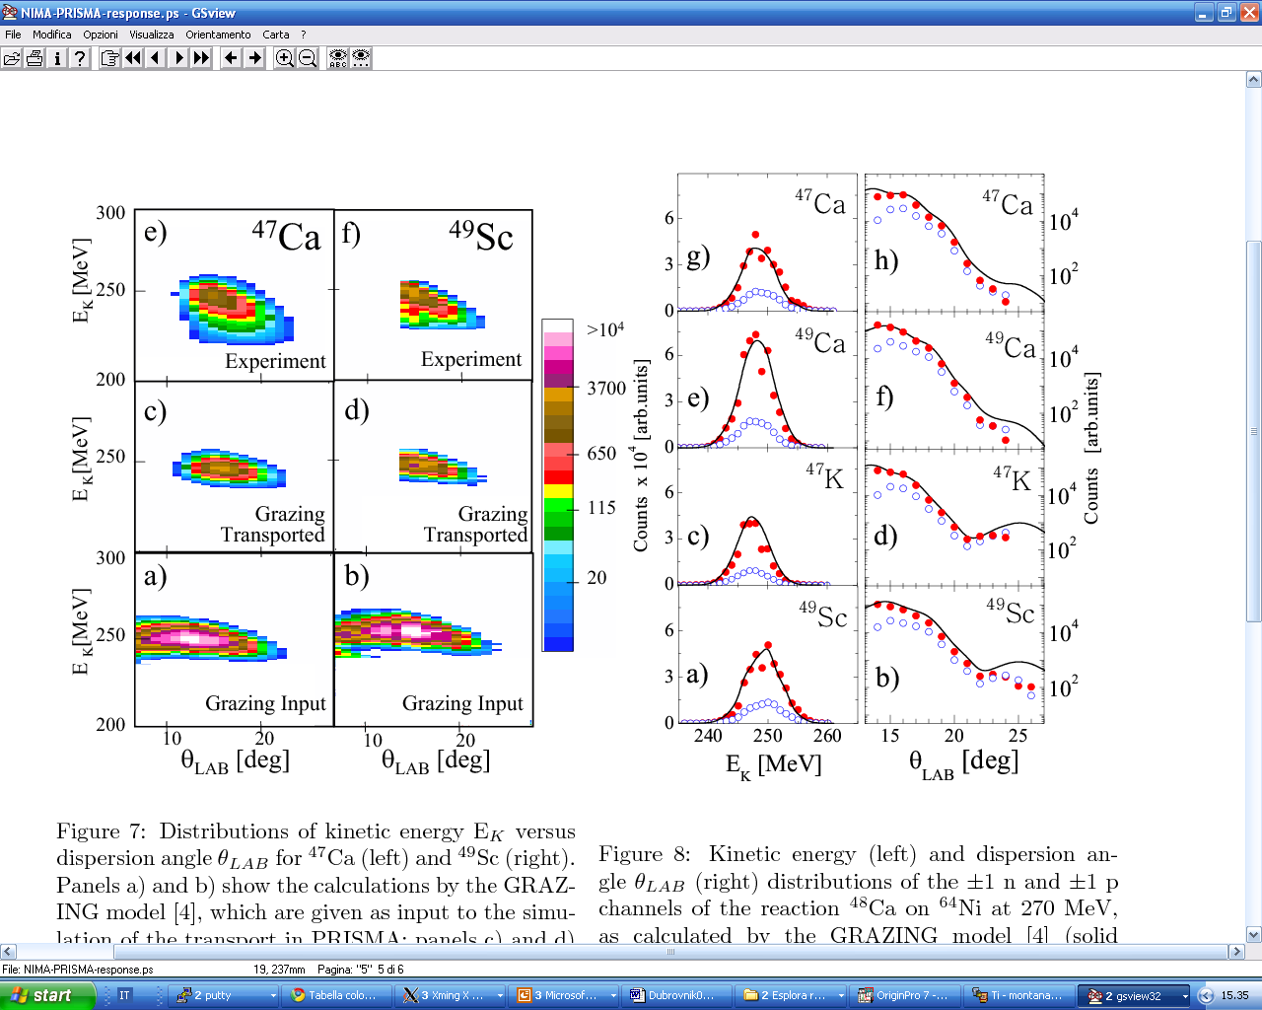
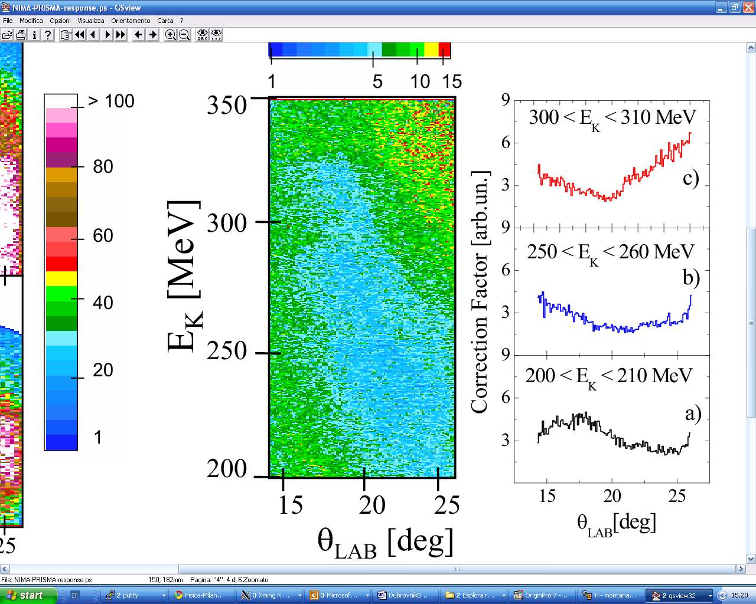
The PRISMA magnetic spectrometer
N₀ = output distribution
N_{i} = input distribution
GRAZING input
GRAZING-Transp
GRAZING-Transp * f(E,θ)

Slide 11
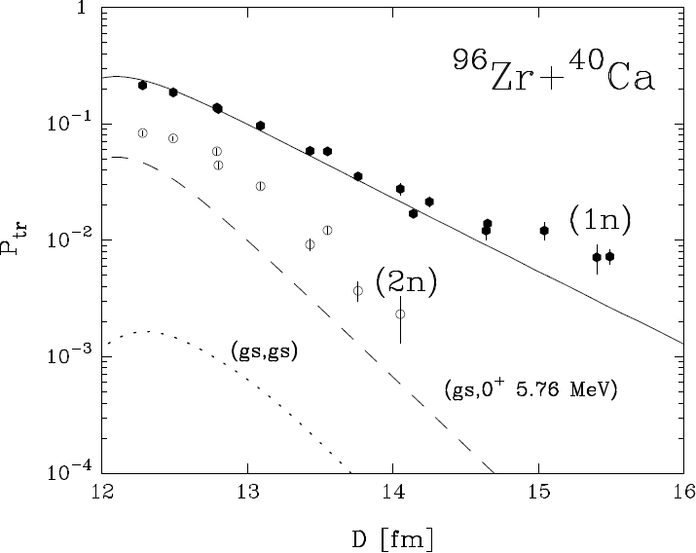


Previous experiment - ⁹⁶Zr+⁴⁰Ca
Experiment
vs
microscopic calculation
+1n well reproduced by theory in slope and absolute value
Same slope of +2n between theory and experiment
+2n enhancement due to the presence of other excited states?
Absorption reproduced by theory
L. Corradi et al., Phys. Rev. C 84, 034603 (2011)

Slide 12
The experiment – ⁶⁰Ni +¹¹⁶Sn
Ground state Q-values
 | +1n | +2n | +3n | +4n
⁹⁶Zr + ⁴⁰Ca | + 0.51 | + 5.53 | + 5.24 | + 9.64
¹¹⁶Sn + ⁶⁰Ni | - 1.74 | + 1.31 | - 2.15 | - 0.24
Closed-shell
Superfluid

Slide 13
The experiment – ⁶⁰Ni +¹¹⁶Sn
Direct kinematics
Inverse kinematics
Angular distributions
θ_{lab} = 50° and 70°
(D ≈ 14.5 fm and 16.7 fm)
Excitation function
E_{beam} ≈ 395 – 500 MeV (θ_{lab} = 20°)
(D ≈ 12.3 to 15.8 fm)
Comparison between angular distributions and excitation functions
Ground state Q-values
 | +1n | +2n | +3n | +4n
⁹⁶Zr + ⁴⁰Ca | + 0.51 | + 5.53 | + 5.24 | + 9.64
¹¹⁶Sn + ⁶⁰Ni | - 1.74 | + 1.31 | - 2.15 | - 0.24
Closed-shell
Superfluid

Slide 14
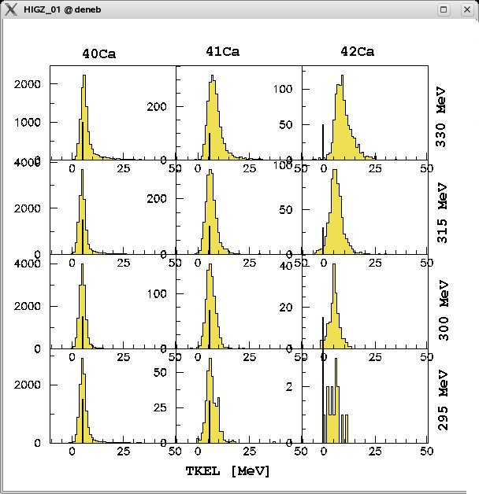
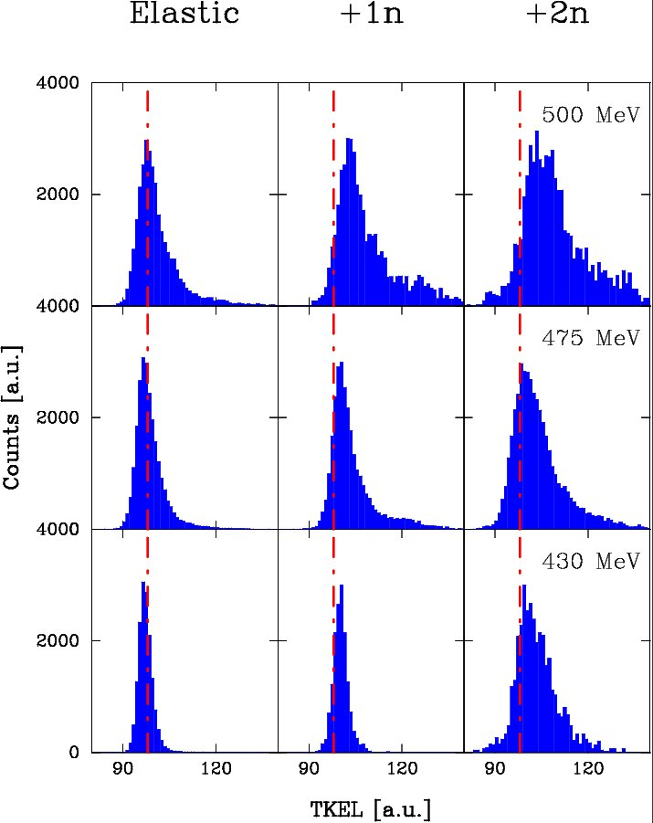
The experiment – ⁶⁰Ni +¹¹⁶Sn
Qvalues for ⁹⁶Zr+ ⁴⁰Ca
Qvalues for ¹¹⁶Sn + ⁶⁰Ni

Slide 15
Experimental results
Ratio σ_{el}/σ_{Ruth}
Monitor detectors:
Check of the beam energy
Absolute normalization of cross sections
Elastic over Rutherford cross section ratio to check parameters of nuclear potential used
Data fits with theoretical calculations of elastic over Rutherford cross section

Slide 16
Transfer probabilities
Neutron transfer channels
+1n and +2n slopes are in agreement with those expected from binding energies

Slide 17
Transfer probabilities
Neutron transfer channels
Good match between excitation function and angular distribution data
Direct kinematics

Slide 18
Transfer probabilities
1 proton transfer channels
Preliminary data
Data under analysis

Slide 19
Conclusions
We performed sub-barrier transfer reactions in direct and inverse kinematics for a superfluid system (previously with closed-shell system)
Comparison between excitation function and angular distribution data
Possibility offered by the γ-array to estimate the population of excited states in reaction products
Next steps
Studying n-p correlations (see S. Szilner’s talk)
[experiment just finished at the LNL – INFN (Italy)]

Slide 20
The end

Slide 21
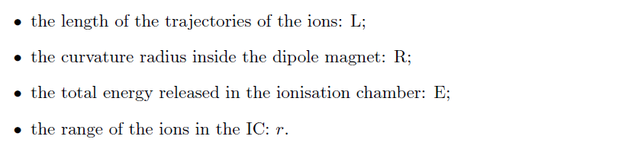
The PRISMA magnetic spectrometer
Measured
Reconstructed

Slide 22
The PRISMA magnetic spectrometer
Total path of the ions ≈ 6 m

Slide 23
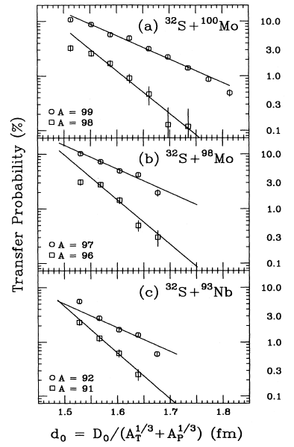
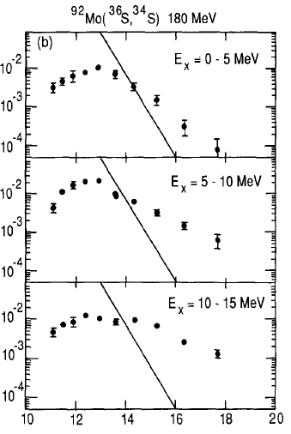

Slope anomaly effects in two nucleon transfer reactions
R.B.Roberts et al. PRC47(1993)R1831
A.H.Wuosmaa et al. PLB255(1991)316

Slide 24
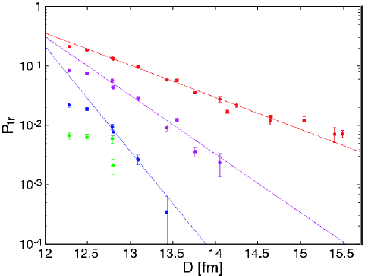
Previous experiment - ⁹⁶Zr+⁴⁰Ca
slopes in nice agreement with those expected from the binding energies
P_{1n}
P_{4n} ~ (P_{2n})²
P_{3n} ~ P_{2n} P_{1n}
P_{2n} ~ 3 (P_{1n})²
L. Corradi, FUSION11, St. Malo – France

Slide 25
Check of scattering energy
Dependence of D on the scattering energy
Peak centroids of monitors
Trajectory reconstruction
(TOF absolute shift)

Slide 26
Beam energy
Crucial in the determination of the distance of closest approach
2 points measured with TANDEM only (precise beam energy determination)
13 points with super-conductive LINAC
1 point of overlap
Monitor detectors → Rutherford cross section of C and Ni ions
Peak centroids determination

Slide 27
Transfer probabilities
2 proton transfer channels
Preliminary data
Data under analysis

Slide 28
Experimental results
Ratio Elastic/Rutherford
Important to check the nuclear potential
Theoretical calculation do not fit the experimental data in the absorption region
Problems in the experiment or in the determination of the beam energy?

Slide 29
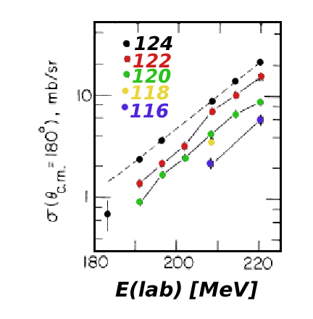

Detection of (heavy) target like ions with recoil mass spectrometers
⁵⁸Ni
^{x}Sn
RMS
measurements have been performed at subbarrier energies but for only one nucleon transfer and with very poor Q-value resolution
slopes consistent with the binding energies for +1n channels
R.Betts et al., PRL59(1987)978

Slide 30
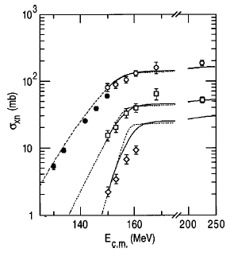

Detection of (light) target like ions in inverse kinematics with spectrographs
beam direction
Split Pole
> 10º
¹²⁴Sn
⁵⁸Ni
+1n
+2n
successive+direct pair transfer
+3n
RMS data
H.Esbensen et al., PRC57(1998)2401
C.L.Jiang et al., PRC57(1998)2393

Slide 31
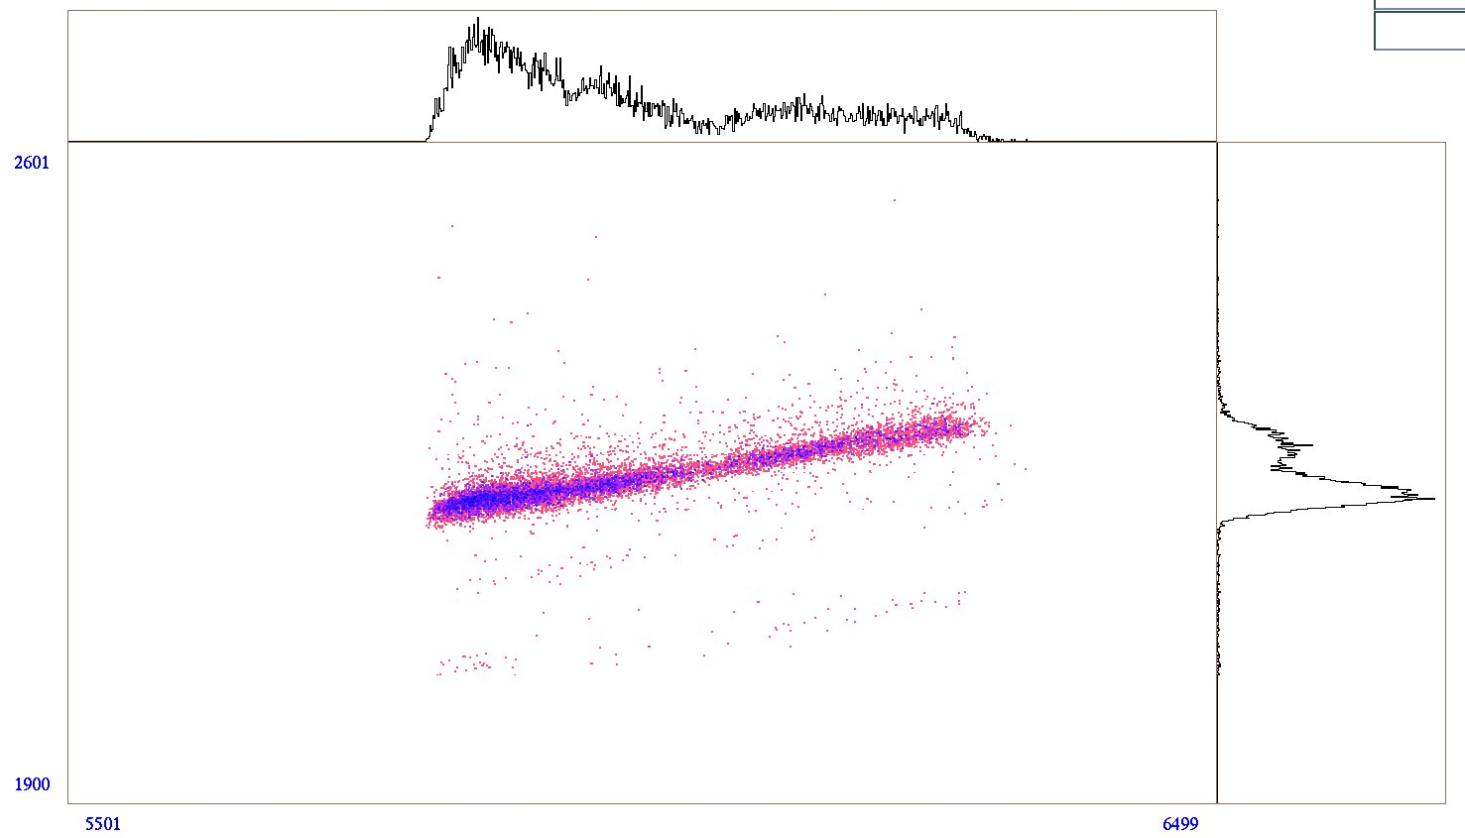
Beam energy
Using TANDEM points for the absolute shift of the TOF
TOF in PRISMA
Length (L) of trajectory independent from TOF
L vs TOF matrix to estimate the velocity of detected ions
Absolute “shift” of TOF spectrum applied to all other cases
TOF [ns]
L [mm]

Slide 32
Beam energy
Determination of scattering energy
We know the absolute TOF
We measure velocity of the elastic channel
We determine the energy of the beam at the scattering point
Energy differs from the nominal one up to a 2%

Slide 33
Transfer probabilities
Less fluctuations of excitation function for transfer probabilities with correct beam energy assignment

Slide 34
Elastic over Rutherford cross section
Data fits with theoretical calculations of elastic/Rutherford cross section

Slide 35
Test of the calculated response
with INPUT theoretical distributions
(dσ/dΩdE)_{GRAZING} ↔ (dσ/dΩdE)_{GRAZING-Transp} * f(E,θ)
⁴⁷Ca
⁴⁹Sc
E_{k}
θ
GRAZING model: (A.Winther, Nucl.Phys.A594 (1995)203)
GRAZING input
GRAZING-Transp
GRAZING-Transp * f(E,θ)

Slide 36
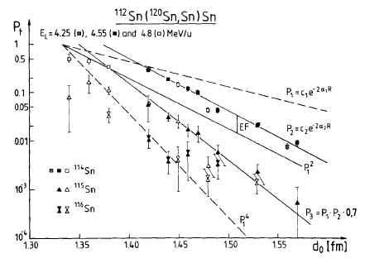
Sub-barrier transfer reactions
Simple empirical model:
(successive transfer):
P⁽²⁾ = P⁽¹⁾*P⁽¹⁾
P⁽³⁾ = P⁽¹⁾*P⁽¹⁾*P⁽¹⁾
Enhancement needed for
two particle transfer probabilities
R. Künkel et al., Z. Phys. 336(1990)336

Slide 37
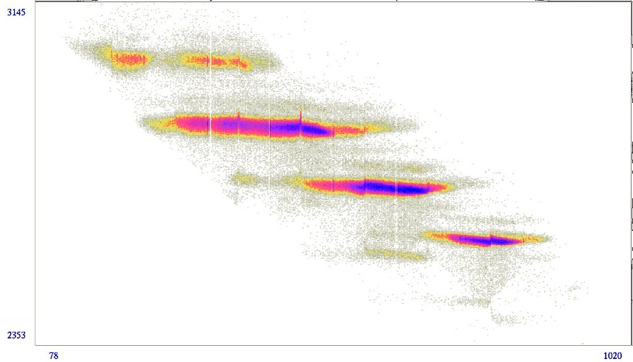
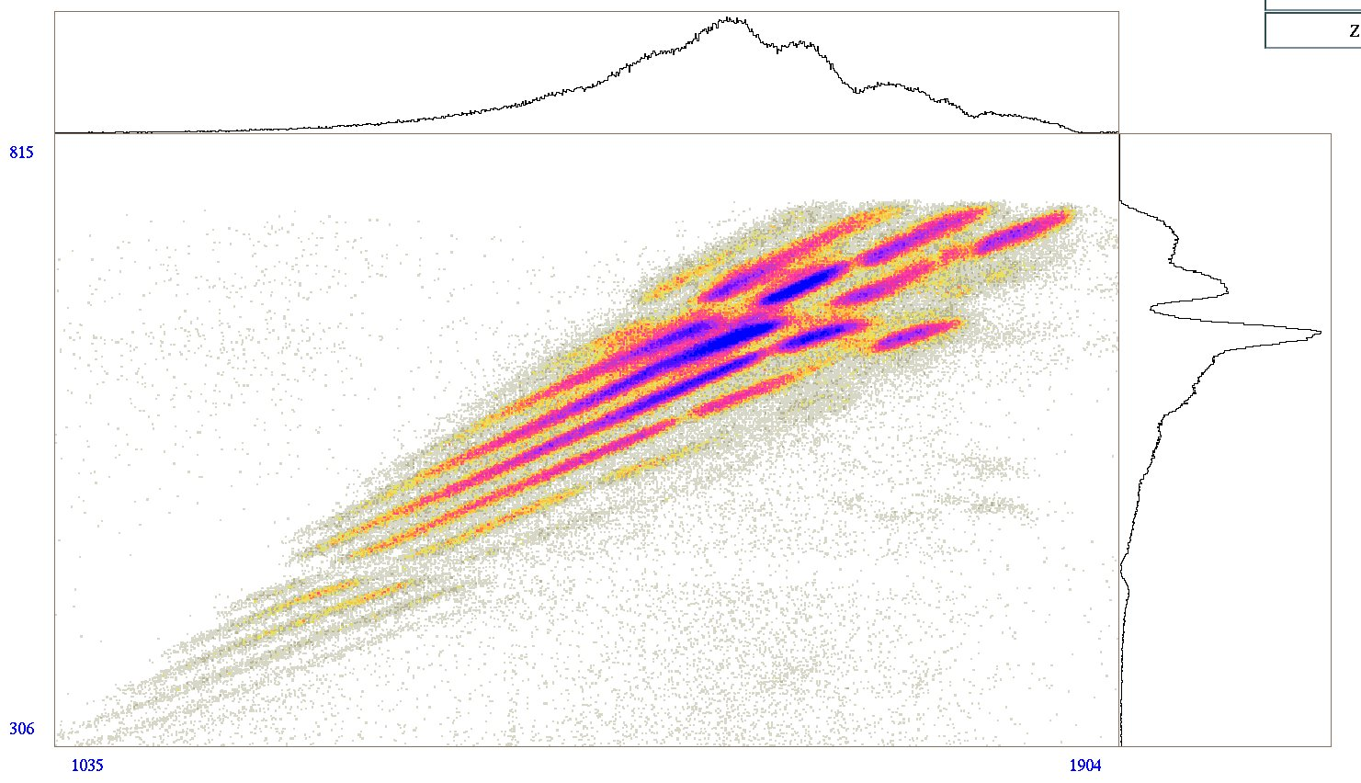
A/q [a.u.]
The experiment – ⁶⁰Ni +¹¹⁶Sn
Direct kinematics
Inverse kinematics
Angular distributions
θ_{lab} = 50° and 70°
(D ≈ 14.5 fm and 16.7 fm)
Excitation function
E_{beam} ≈ 395 – 500 MeV (θ_{lab} = 20°)
(D ≈ 12.3 to 15.8 fm)
RV [a. u.]
X-ppac [a.u.]
Energy [a.u.]

