Slide 1
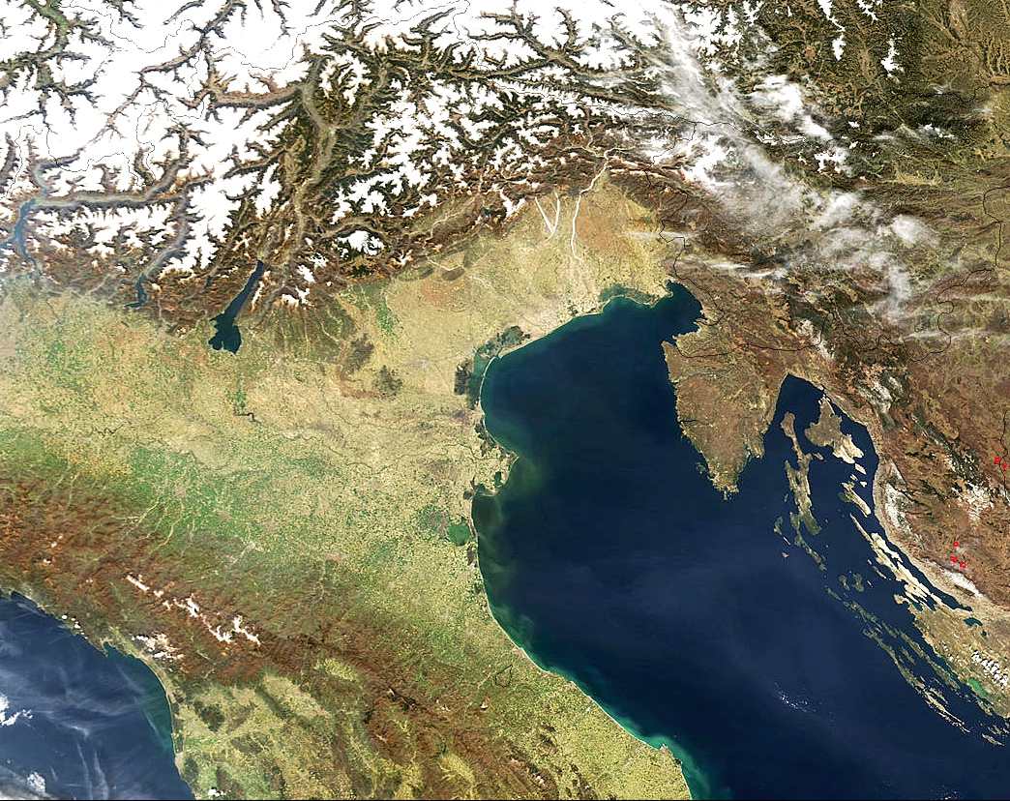

Fusion of ²⁸Si + ²⁸Si: oscillations above the barrier and the behavior down to 1μb
A.M.Stefanini
INFN – Laboratori Naz. di Legnaro, Italy
• Venice
• Florence
Florence, June 3, 2013

Slide 2
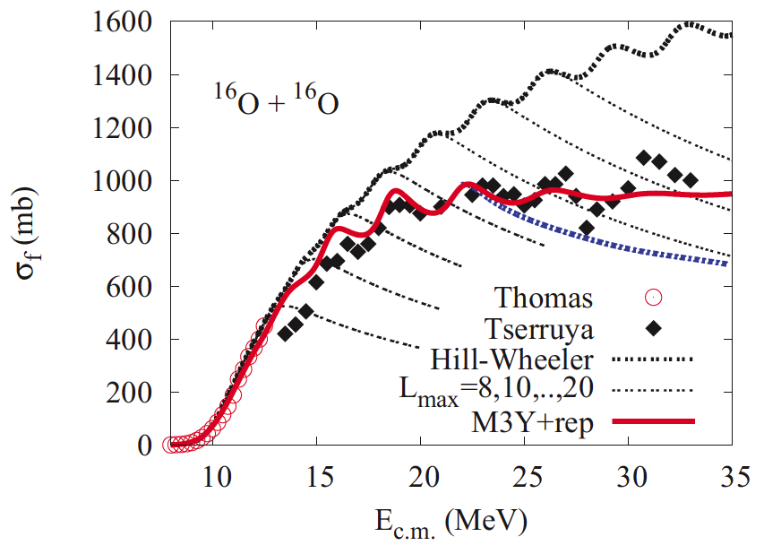
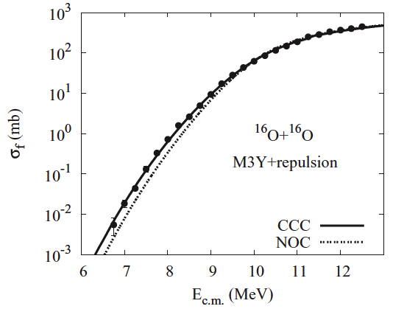
Structures in fusion excitation function of light systems
Oscillatory structures are probably due to the penetration of successive centrifugal barriers
A shallow ion-ion potential is needed to fit the data above (and below) the barrier.
➔➔ Look for above-barrier oscillations in heavier systems, where sub-barrier hindrance is stronger and better established.
Clearly observing such oscillations would provide very useful information on the potential in a wide energy range.
H.Esbensen, PRC77, 054608 (2008); PRC85, 064611 (2012)
C.Y.Wong, PRC86, 064603 (2012)
Notes:
The exc. functions of various light heavy-ion systems indicate that oscillatory structures appear, probably due to the penetration of successive centrifugal barriers:
A shallow potential is needed to fit the data above (as well as below) the barrier.
It would be very interesting to look for above-barrier oscillations in heavier systems, where the sub-barrier hindrance phenomenon is stronger and better established.
A convincing observation of such oscillations would provide useful information on the ion-ion potential in a wide energy range.

Slide 3
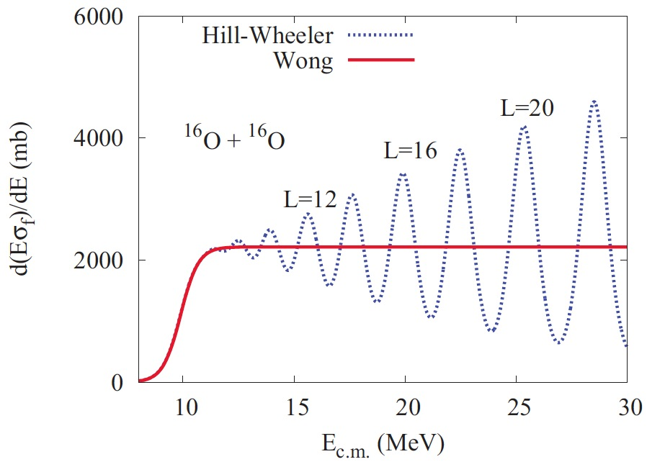
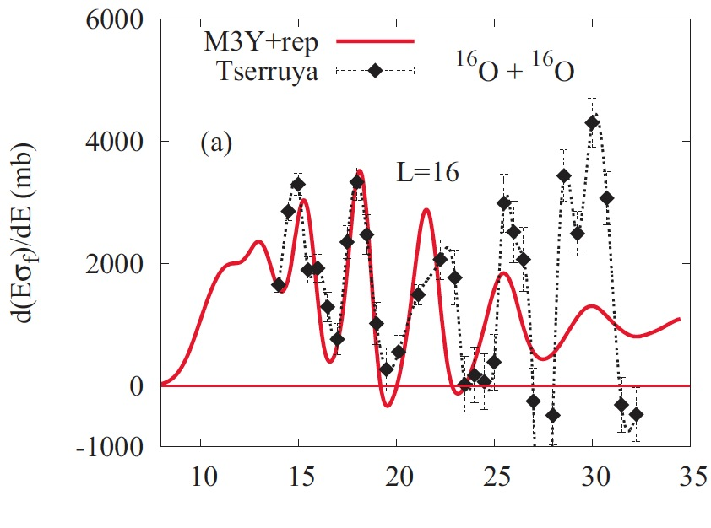
Using the first derivative of the excitation function d(Eσ)/dE makes easier to observe oscillations
The case of ¹⁶O + ¹⁶O
L
D.L.Hill and J.A.Wheeler, PR 89, 1102 (1953)
C.Y.Wong, PRL 31, 766 (1973)
I.Tserruya et al., PRC 18, 1688 (1978)

Slide 4
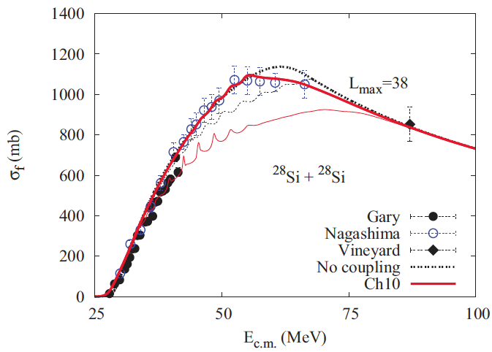
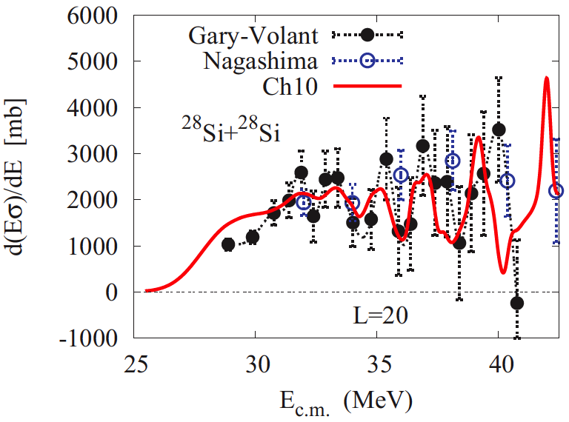
The existing situation for ²⁸Si+²⁸Si before the present experiment
Esbensen
- heavier systems: more difficult
- peaks are closer
- amplitudes smaller
S. Gary and C. Volant, PRC 25, 1877 (1982); Y. Nagashima et al., PRC 33, 176 (1986)

Slide 5
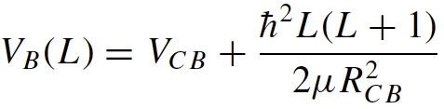
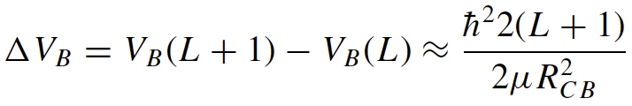
L-dependent fusion barriers can be parametrized as
The energy difference between the heights of successive barriers is
and ≈ twice as that for symmetric systems, i.e. 1.52 MeV for ²⁸Si + ²⁸Si.
The width of the individual barriers is ε₀ = ħω/2π where ħω is the curvature of the Coulomb barrier, in the parabolic approximation
2ε₀ = 1.13 MeV for ²⁸Si + ²⁸Si

Slide 6
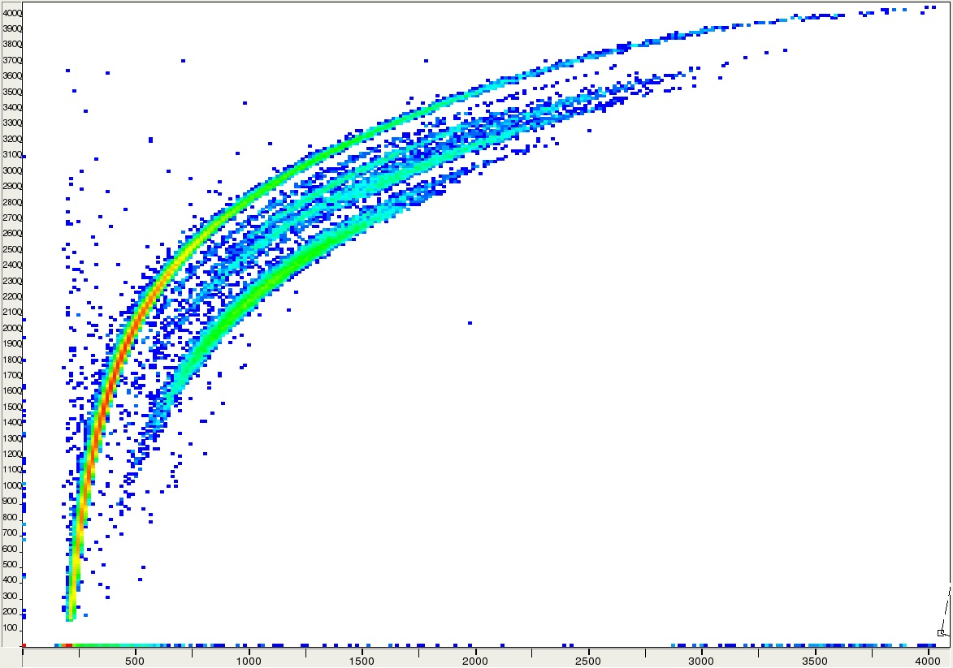
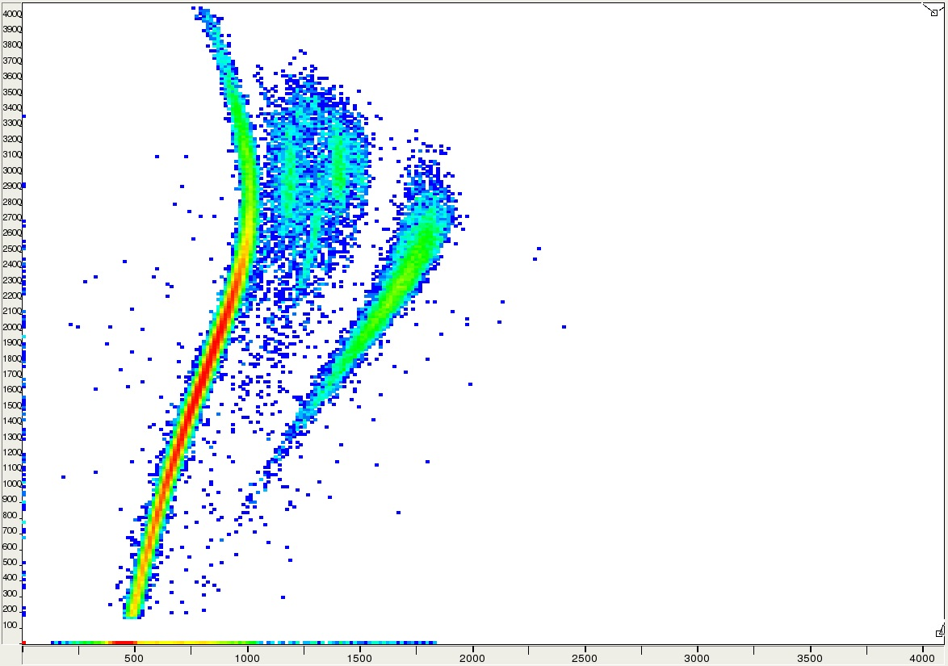
Fusion-evaporation residues ER were detected at forward angles, filtering out the beam by means of an electrostatic deflector
73.5 MeV ²⁸Si + ²⁸Si
(θ_{lab} = 3º)
ER
Fusion on carbon, oxygen
E vs. TOF
degraded
beam
ER
ΔE vs. TOF

Slide 7
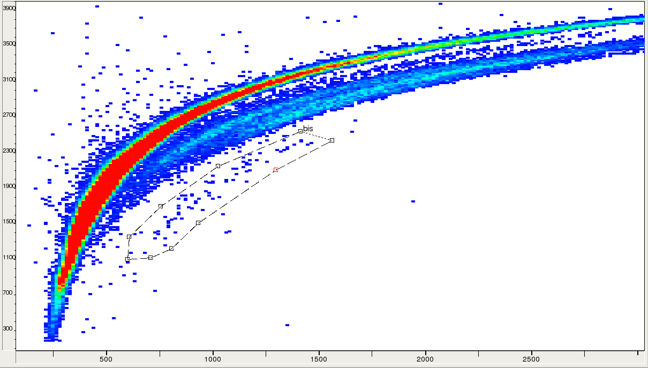
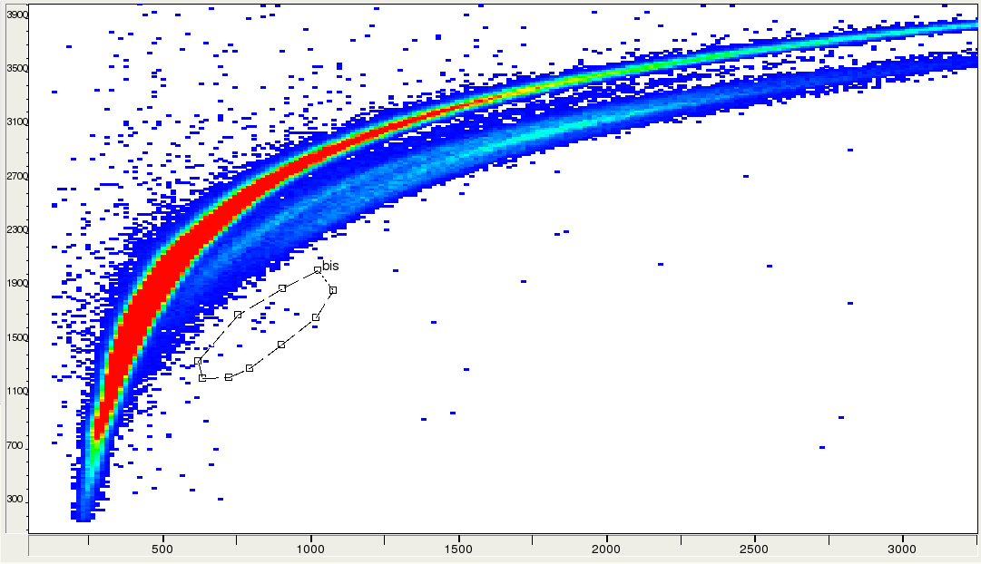
Two-dimensional spectra taken below the barrier
²⁸Si + ²⁸Si
53.0 MeV
453 μb
E vs. TOF
50.0 MeV
27.3 μb
E vs. TOF

Slide 8
The fusion excitation function of ²⁸Si+²⁸Si
(the blue points were measured with ΔE_{lab} = 0.5 MeV, and 1% statistical error)

Slide 9
CC analysis of the sub-barrier excitation function, using a Woods-Saxon potential with a=0.63 fm, r₀=1.04 fm, V₀=73.6 MeV
(adjusted to fit the data in the barrier region)
(the collective 2⁺ state of ²⁸Si has been coupled in)

Slide 10
Fusion cross sections and energy-weighted derivative of the excitation function above the barrier
H.Esbensen, PRC 85, 064611 (2012)

Slide 11
Summary
Fusion cross sections of ²⁸Si + ²⁸Si have been measured in a wide energy range down to ≤ 1 μb
A preliminary CC analysis has been performed for the near- and sub-barrier excitation function, giving a good agreement with data; no indication of fusion hindrance shows up
Above the barrier, oscillations of the excitation function show up, probably due to the penetration of successive centrifugal barriers
The observed oscillations are in remarkable agreement with recent CC calculations, and a consistency appears between their description and the sub-barrier behavior
Further theoretical analyses may provide valuable information on the ion-ion potential in a wide energy range

Slide 12
Our collaboration
A.M.S., L.Corradi, E.Fioretto, H.M.Jia
INFN, Laboratori Nazionali di Legnaro, Legnaro (Padova), Italy
G.Montagnoli, D.Montanari, M.Mazzocco, C.Michelagnoli, C.Parascandolo,
F.Scarlassara, E.Strano, D.Torresi, C.A.Ur
Dept. of Physics, Univ. of Padova and INFN-Padova, Italy
S.Szilner, T.Mijatovic
Ruder Boskovic Institute, Zagreb, Croatia
S.Courtin, F.Haas
IPHC, CNRS-IN2P3, Univ. Louis Pasteur, Strasbourg Cedex 2, France
J.Grebosz
Inst. Of Nucl. Phys., Polish Academy of Sciences, Cracow, Poland
Thank you !

Slide 13
End

Slide 14
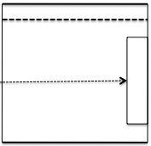
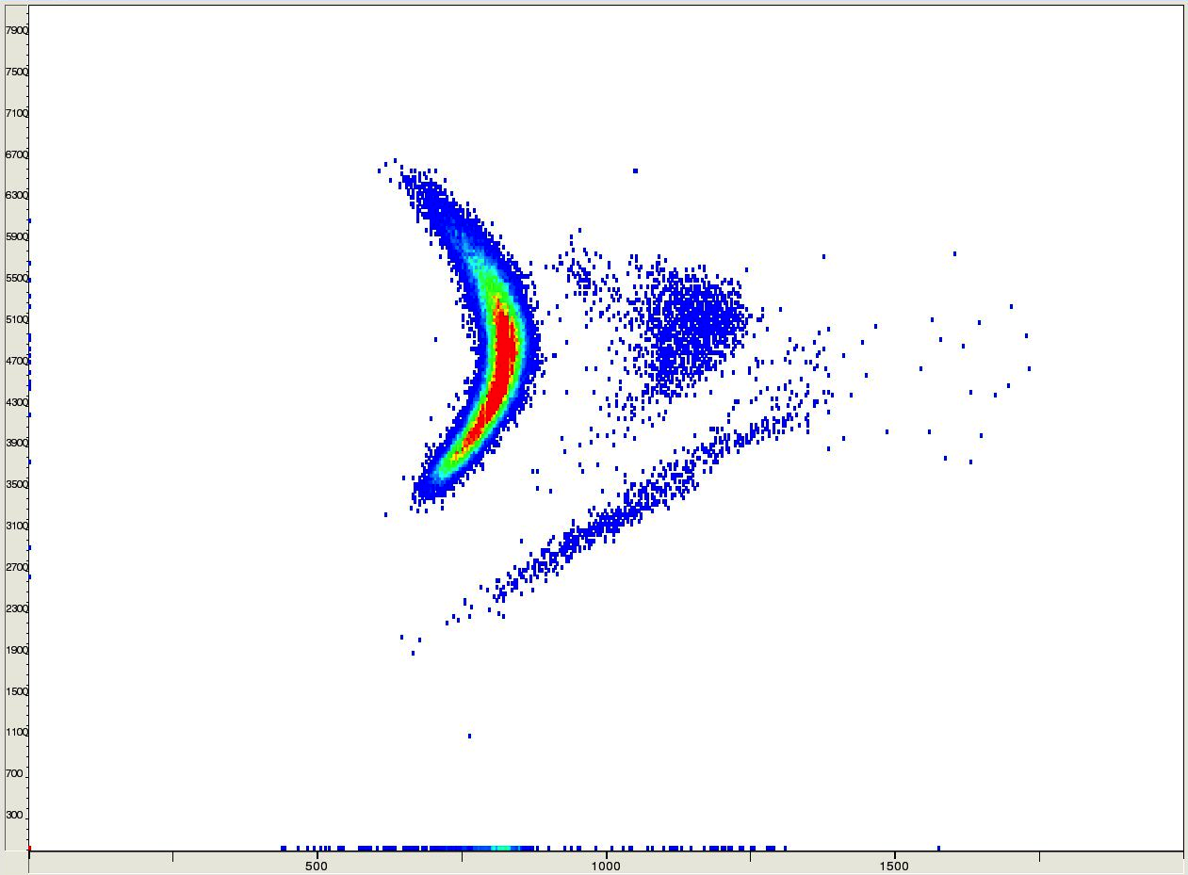
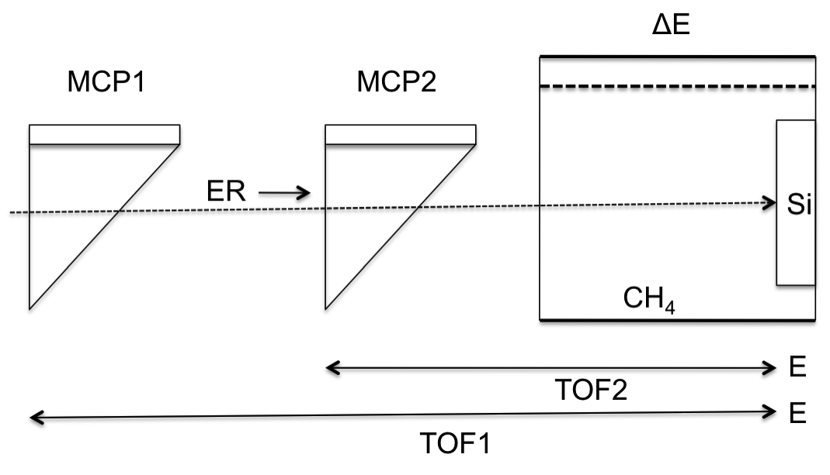
Detector set-up and experimental matrix ΔE-ToF
-HV
beam
target
+HV
degraded beam
fusion on C, F
TOF (cha.)
ER
⁴⁰Ca + ⁴⁰Ca
(lowest measurable cross section ≈ 0.5-1 μb)
ΔE (cha.)

