Slide 1
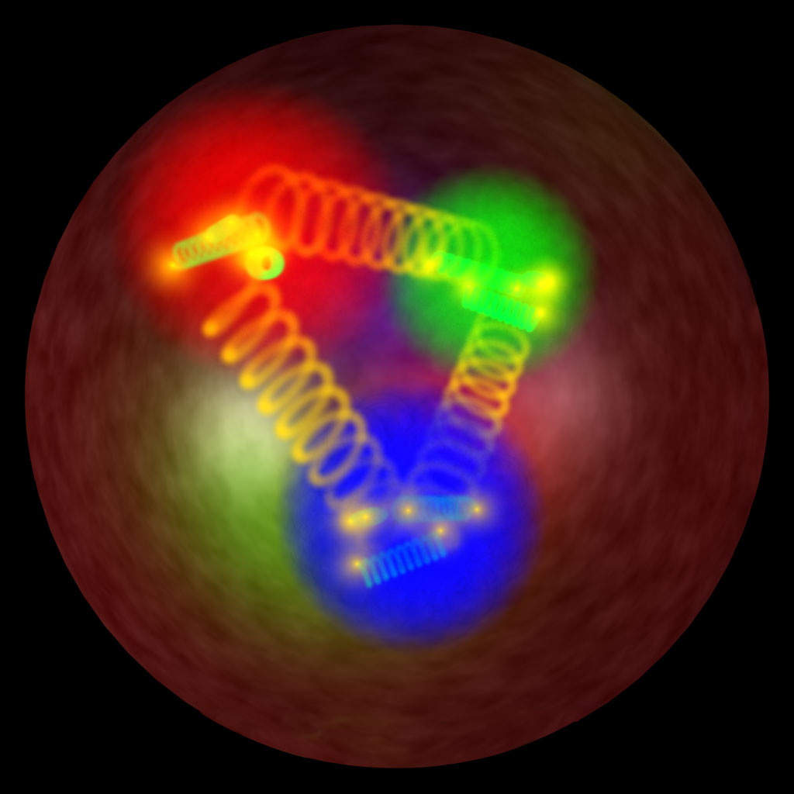
Generalized Parton Distributions:
A general unifying tool
for exploring
the internal structure of hadrons
INPC, 06/06/2013

Slide 2
1/ Introduction to GPDs
2/ From data to CFFs/GPDs
3/ CFFs/GPDs to nucleon imaging

Slide 3
1/ Introduction to GPDs
2/ From data to CFFs/GPDs
3/ CFFs/GPDs to nucleon imaging

Slide 4
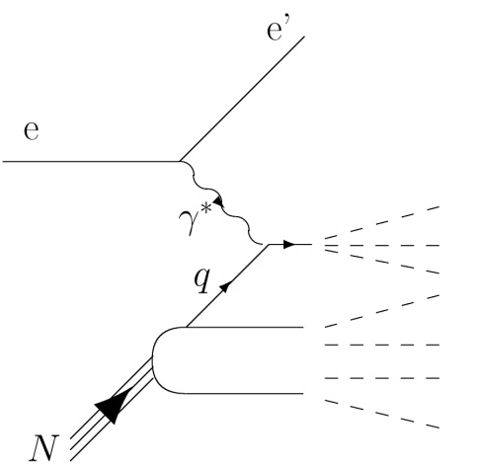
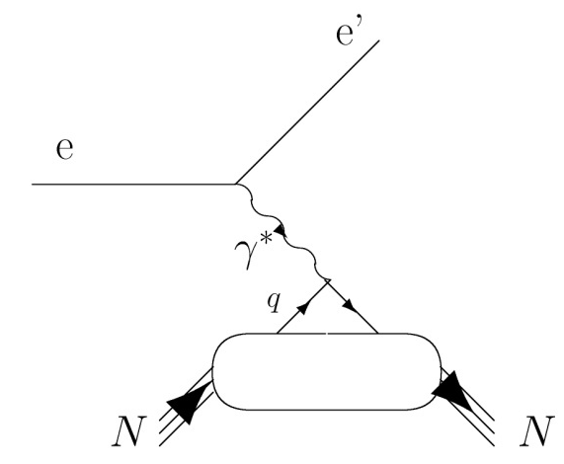
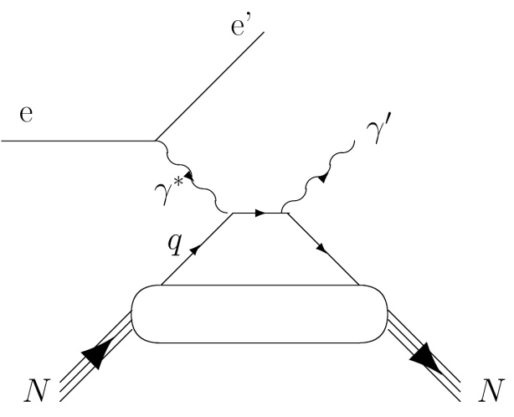
y
ep a eX
z
(DIS)
(Parton Distribution
Functions: PDF)
x
y
ep a ep
z
(elastic)
(Form Factors: FFs)
x
ep a epγ
(DVCS)
z
(Generalized Parton
Distributions: GPDs)
x

Slide 5
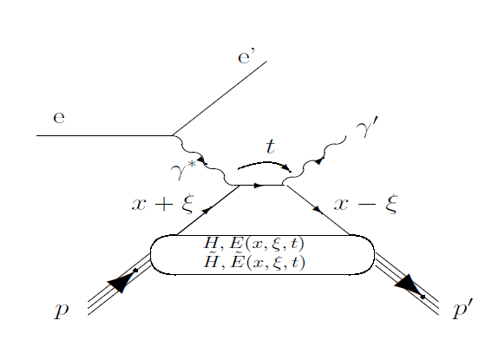



In the light-cone frame:
x+ξ : relative longitudinal momentum of initial quark
x-ξ : relative longitudinal momentum of initial quark
t=Δ² : total squared momentum transfer to the nucleon
(transverse component: )

Slide 6
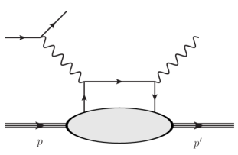
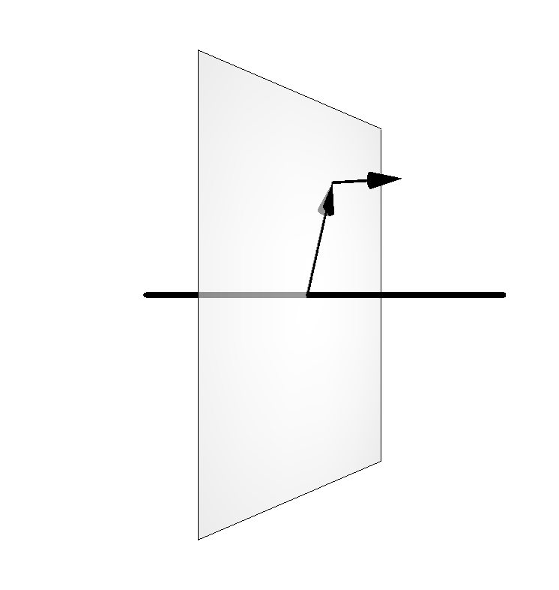


DVCS
GPDs

Slide 7
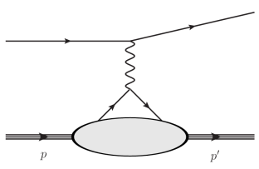
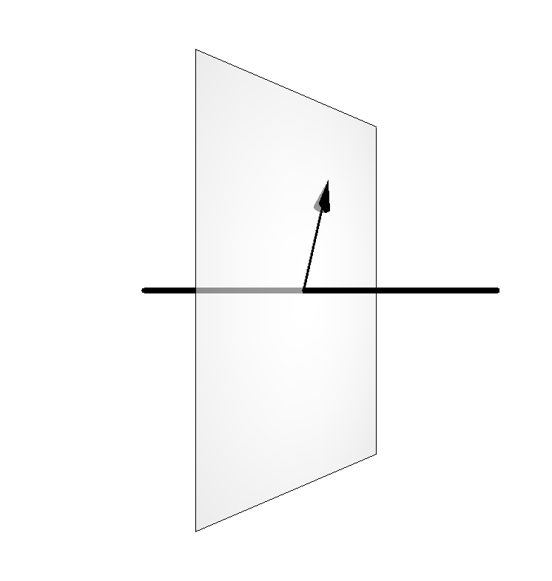
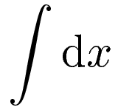
DVCS
ES
GPDs
FFs

Slide 8

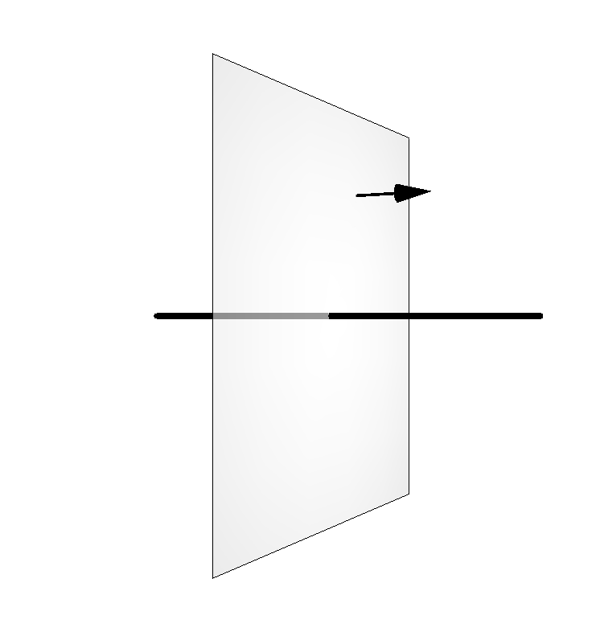
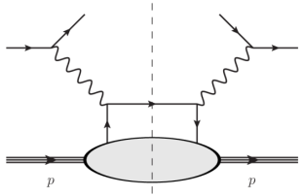
DVCS
ES
GPDs
FFs
PDFs
DIS

Slide 9
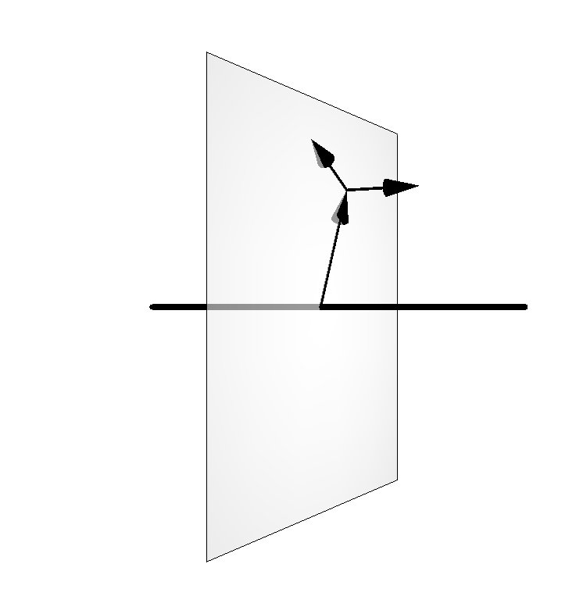

Longitudinal momentum
Transverse momentum
Impact parameter
DVCS
ES
GPDs
FFs
PDFs
DIS

Slide 10
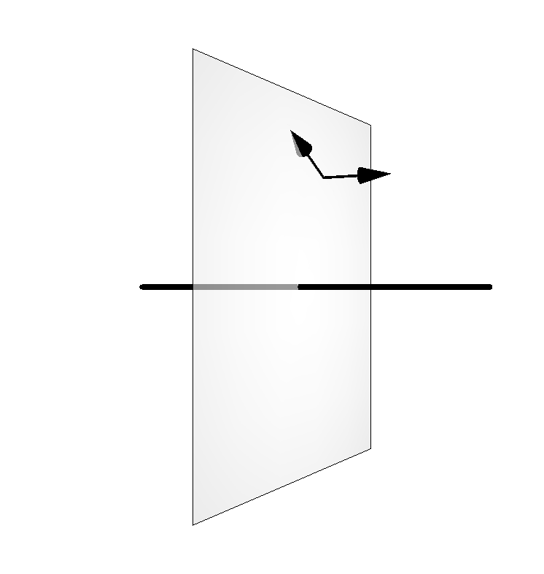

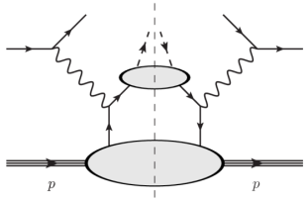
Longitudinal momentum
Transverse momentum
Impact parameter
DVCS
ES
GPDs
FFs
TMDs
PDFs
SIDIS
DIS

Slide 11
Longitudinal momentum
Transverse momentum
Impact parameter
DVCS
ES
GTMDs
GPDs
FFs
TMDs
PDFs
SIDIS
DIS

Slide 12
Longitudinal momentum
Transverse momentum
Impact parameter
DVCS
ES
GTMDs
GPDs
FFs
TMDs
PDFs
(thanks to C. Lorcé
for the graphs)
SIDIS
DIS

Slide 13
Extracting GPDs from DVCS observables
A complex problem:
There are 4 GPDs (H,H,E,E)
~
~

Slide 14
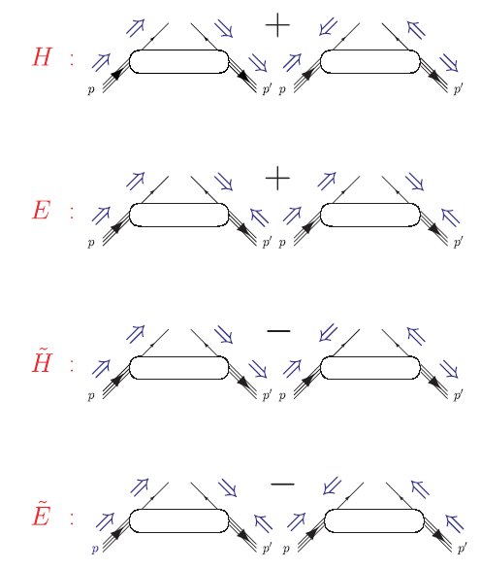

Slide 15
Extracting GPDs from DVCS observables
A complex problem:
There are 4 GPDs (H,H,E,E)
They depend on 4 variables (x,x_{B},t,Q²)
One can access only quantities such as
and (CFFs)
~
~

Slide 16
H^{q}(x,ξ,t) but only ξ and t accessible experimentally

Slide 17




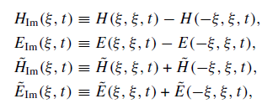

In general, 8 GPD quantities accessible
(Compton Form Factors)
with

Slide 18
Extracting GPDs from DVCS observables
A complex problem:
There are 4 GPDs (H,H,E,E)
They depend on 4 variables (x,x_{B},t,Q²)
One can access only quantities such as
and (CFFs)
~
~

Slide 19
Extracting GPDs from DVCS observables
A complex problem:
There are 4 GPDs (H,H,E,E)
They depend on 4 variables (x,x_{B},t,Q²)
One can access only quantities such as
and (CFFs)
They are defined for each quark flavor (u,d,s)
~
~

Slide 20
Extracting GPDs from DVCS observables
A complex problem:
There are 4 GPDs (H,H,E,E)
They depend on 4 variables (x,x_{B},t,Q²)
One can access only quantities such as
and (CFFs)
They are defined for each quark flavor (u,d,s)
~
~
Measure a series of (DVCS) polarized observables
over a large phase space on the proton and on the neutron

Slide 21
γ
e’
φ
e
leptonic plane
N’
hadronic
plane
ξ= x_{B}/(2-x_{B}) k=-t/4M²
Polarized beam, unpolarized target (BSA) :
~
~
Δσ_{LU} ~ sinφ Im{F₁H + ξ(F₁+F₂)H -kF₂E}dφ
Im{H_{p}, H_{p}, E_{p}}
Unpolarized beam, longitudinal target (lTSA) :
~
~
~
Im{H_{p}, H_{p}}
Δσ_{UL} ~ sinφIm{F₁H+ξ(F₁+F₂)(H + x_{B}/2E) –ξkF₂ E+…}dφ
Polarized beam, longitudinal target (BlTSA) :
~
~
Re{H_{p}, H_{p}}
Δσ_{LL} ~ (A+Bcosφ)Re{F₁H+ξ(F₁+F₂)(H + x_{B}/2E)…}dφ
Unpolarized beam, transverse target (tTSA) :
Δσ_{UT} ~ cosφIm{k(F₂H – F₁E) + ….. }dφ
Im{H_{p}, E_{p}}
Notes:
nDVCS complements pDVCS for the different sensitivity to GPDs of the various observables

Slide 22
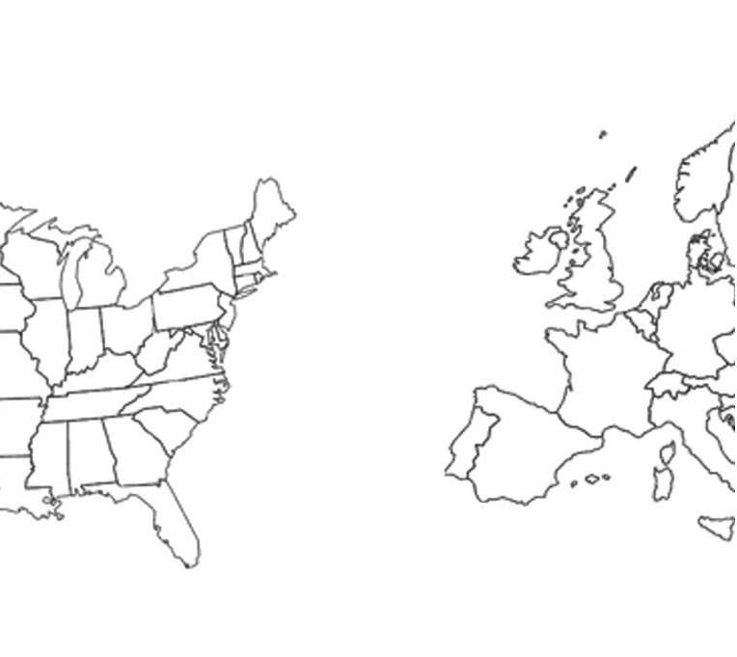
The experimental actors
DESY
HERMES
H1/ZEUS
p-DVCS
BSA,BCA,
tTSA,lTSA,BlTSA
p-DVCS
X-sec,BCA
JLab
CERN
COMPASS
p-DVCS X-sec,BSA,BCA, tTSA,lTSA,BlTSA
Hall A
Hall B
p-DVCS
(Bpol.) X-sec
p-DVCS
BSAs,lTSAs

Slide 23
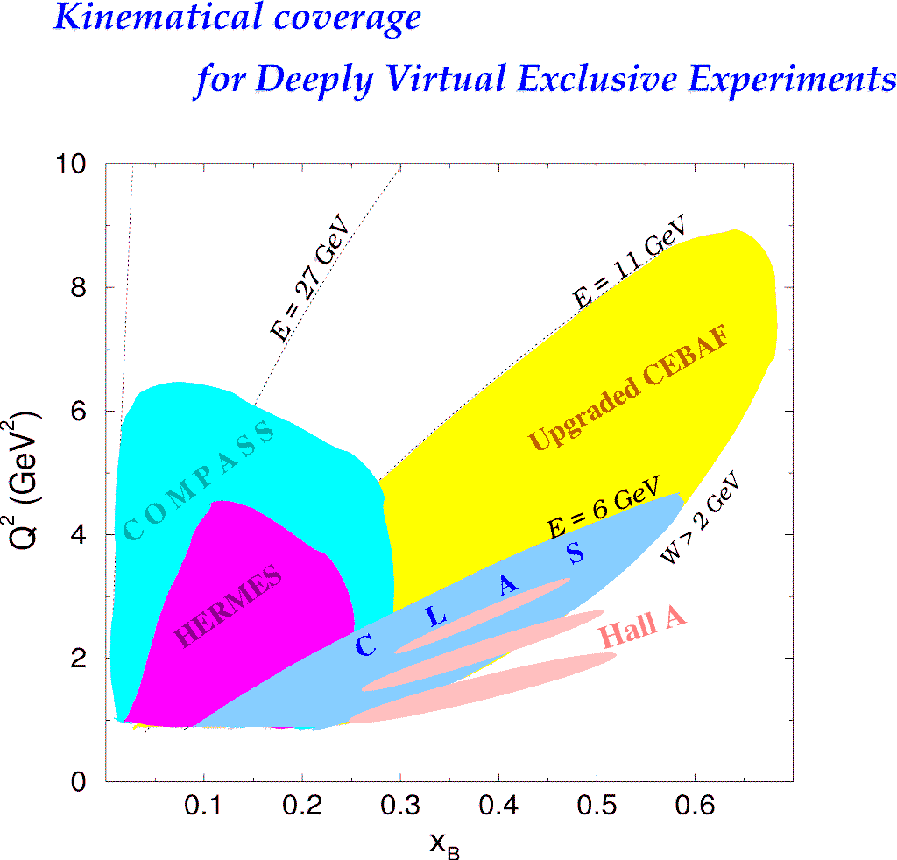

Slide 24
1/ Introduction to GPDs
2/ From data to CFFs/GPDs
3/ CFFs/GPDs to nucleon imaging

Slide 25
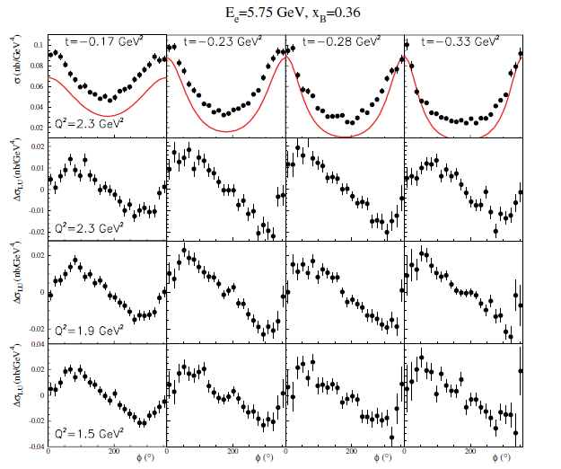
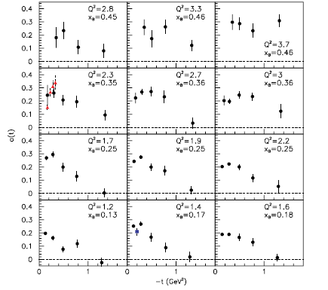
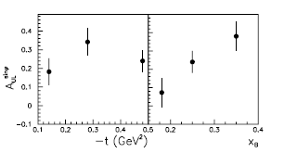
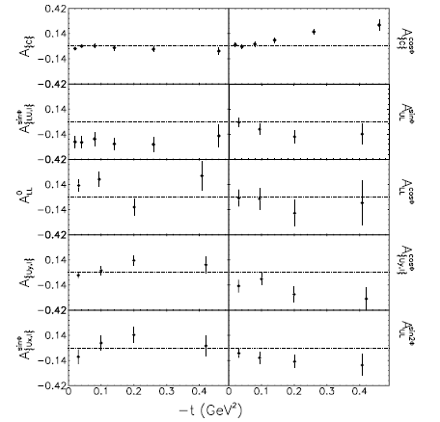
JLab
Hall A
DVCS
B-pol. X-section
DVCS
unpol. X-section
JLab
CLAS
DVCS
BSA
DVCS
lTSA
HERMES
DVCS
BSA,lTSA,tTSA,BCA

Slide 26
Given the well-established LT-LO DVCS+BH amplitude
DVCS
Bethe-Heitler
GPDs
Can one recover the 8 CFFs from the DVCS observables?
Obs= Amp(DVCS+BH) CFFs
Two (quasi-) model-independent approaches
to extract, at fixed x_{B}, t and Q² (« local » fitting),
the CFFs from the DVCS observables

Slide 27
1/ «Brute force » fitting
χ² minimization (with MINUIT + MINOS) of the
available DVCS observables at a given x_{B}, t and Q² point
by varying the CFFs within a limited hyper-space (e.g. 5xVGG)
The problem can be (largely) undersconstrained:
JLab Hall A: pol. and unpol. X-sections
JLab CLAS: BSA + TSA
2 constraints and 8 parameters !
However, as some observables are largely dominated by
a single or a few CFFs, there is a convergence (i.e. a well-defined
minimum χ²) for these latter CFFs.
The contribution of the non-converging CFF entering in
the error bar of the converging ones.
M.G. EPJA 37 (2008) 319
M.G. & H. Moutarde, EPJA 42 (2009) 71
M.G. PLB 689 (2010) 156
M.G. PLB 693 (2010) 17

Slide 28
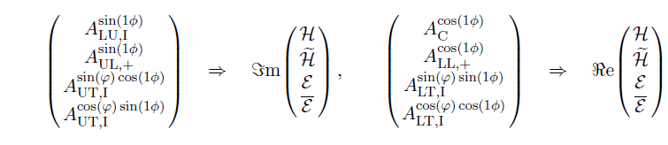
2/ Mapping and linearization
If enough observables measured, one has a system
of 8 equations with 8 unknowns
Given reasonnable approximations (leading-twist dominance,
neglect of some 1/Q² terms,...), the system can be linear
(practical for the error propagation)
~
Δσ_{LU} ~ sinφ Im{F₁H + ξ(F₁+F₂)H -kF₂E}dφ
~
~
Δσ_{UL} ~ sinφIm{F₁H+ξ(F₁+F₂)(H + x_{B}/2E) –ξkF₂ E+…}dφ
K. Kumericki, D. Mueller, M. Murray, arXiv:1301.1230 hep-ph, arXiv:1302.7308 hep-ph

Slide 29
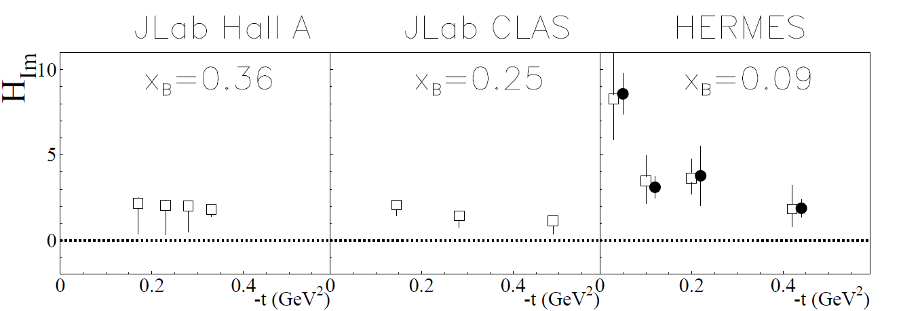
unpol.sec.eff.
+
beam pol.sec.eff.
χ² minimization

Slide 30
unpol.sec.eff.
+
beam pol.sec.eff.
beam spin asym.
+
long. pol. tar. asym
χ² minimization

Slide 31
unpol.sec.eff.
+
beam pol.sec.eff.
beam spin asym.
+
long. pol. tar. asym
beam charge asym.
+
beam spin asym
+
…
χ² minimization
linearization

Slide 32
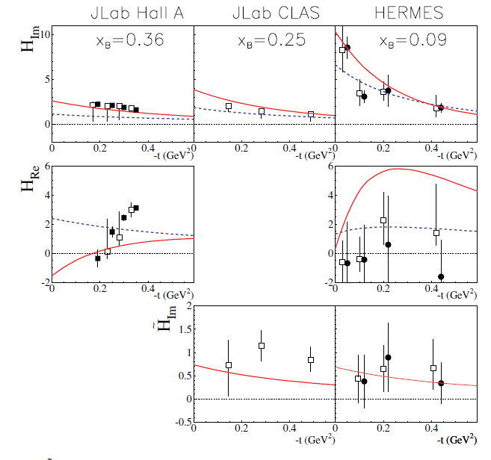
unpol.sec.eff.
+
beam pol.sec.eff.
beam spin asym.
+
long. pol. tar. asym
beam charge asym.
+
beam spin asym
+
…
χ² minimization
linearization
Moutarde 10 model/fit
VGG model
KM10 model/fit

Slide 33
1/ Introduction to GPDs
2/ From data to CFFs/GPDs
3/ CFFs/GPDs to nucleon imaging

Slide 34

From CFFs to spatial densities
How to go from momentum coordinates (t)
to space-time coordinates (b) ?
(with error propagation)
Burkardt (2000)
Applying a (model-dependent) “deskewing” factor:
and, in a first approach, neglecting the sea contribution

Slide 35
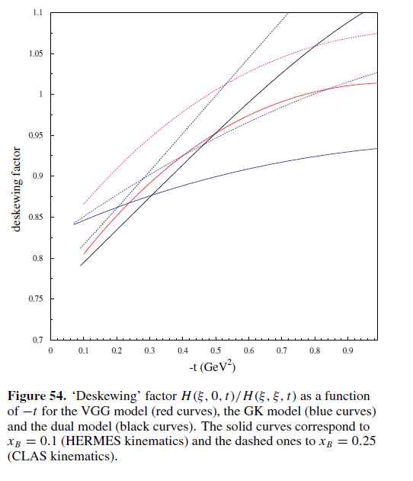

Slide 36
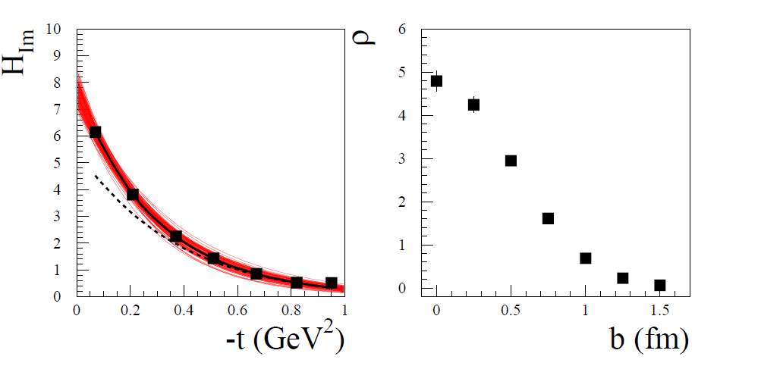
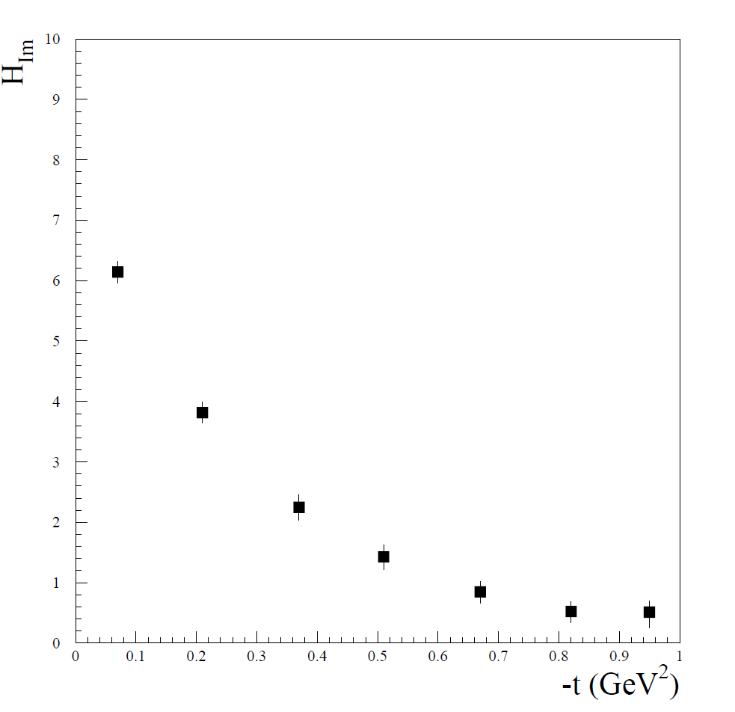
}
1/Smear the data according to their error bar
2/Fit by Ae^{bt}
3/Fourier transform (analytically)
~1000 times

Slide 37
}
1/Smear the data according to their error bar
2/Fit by Ae^{bt}
3/Fourier transform (analytically)
~1000 times

Slide 38
}
1/Smear the data according to their error bar
2/Fit by Ae^{bt}
3/Fourier transform (analytically)
4/Obtain a series of Fourier transform as a function of b
5/For each slice in b, obtain a (Gaussian) distribution which
is fitted so as to extract the mean and the standard deviation
~1000 times
Thanks to J. VandeWiele

Slide 39
}
1/Smear the data according to their error bar
2/Fit by Ae^{bt}
3/Fourier transform (analytically)
4/Obtain a series of Fourier transform as a function of b
5/For each slice in b, obtain a (Gaussian) distribution which
is fitted so as to extract the mean and the standard deviation
~1000 times

Slide 40
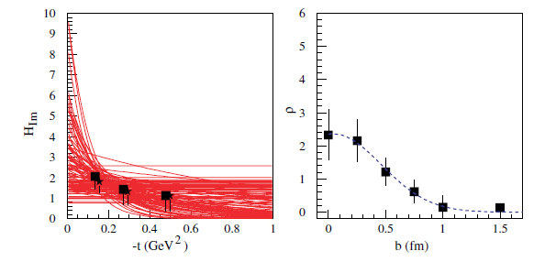
CLAS data (x_{B}=0.25)
“skewed” H_{Im}
(fits applied to « unskewed » data)
“unskewed” H_{Im}

Slide 41
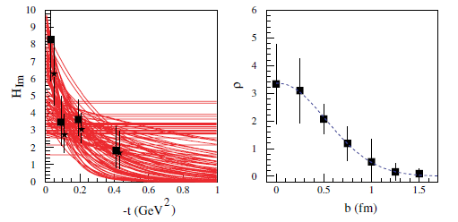
HERMES data (x_{B}=0.09)
“skewed” H_{Im}
(fits applied to « unskewed » data)
“unskewed” H_{Im}

Slide 43
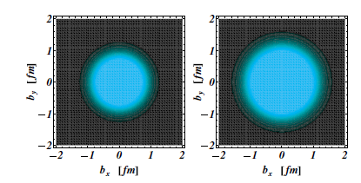
x_{B}=0.25
x_{B}=0.09

Slide 44
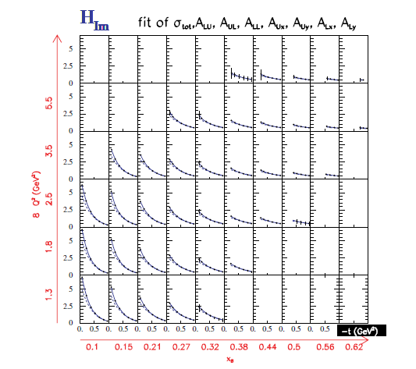
Projections for CLAS12 for H_{Im}

Slide 45
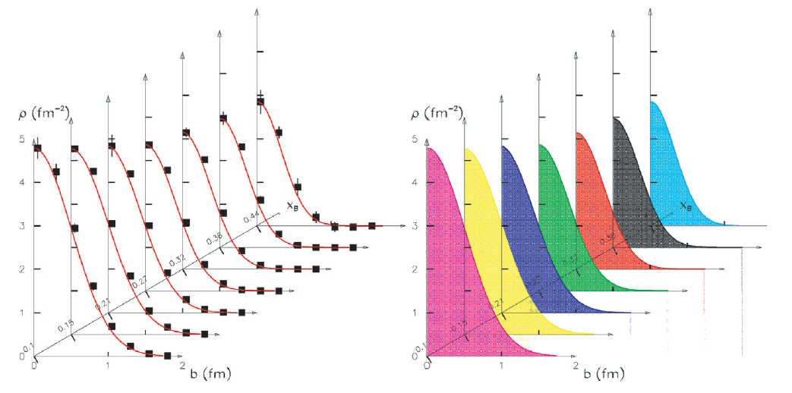
Corresponding spatial densities

Slide 46
GPDs contain a wealth of information on nucleon structure
and dynamics: space-momentum quark correlation, orbital
momentum, pion cloud, pressure forces within the nucleon,…
They are complicated functions of 3 variables x,ξ,t , depend
on quark flavor, correction to leading-twist formalism,…:
extraction of GPDs from precise data and numerous observables,
global fitting, model inputs,…
First new insights on nucleon structure already emerging
from current data with new fitting algorithms
Large flow of new observables and data expected soon
(JLab12,COMPASS) will bring allow a precise nucleon
Tomography in the valence region

Slide 47
1) The HERMES Recoil detector. A. Airapetian et al, e-Print: arXiv:1302.6092
2) Beam-helicity asymmetry arising from deeply virtual Compton scattering measured with kinematically complete event reconstruction A. Airapetian et al, JHEP10(2012)042
3) Beam-helicity and beam-charge asymmetries associated with deeply virtual Compton scattering on the unpolarised proton A. Airapetian et al, JHEP 07 (2012) 032
Many analysis at JLab in progress (CLAS X-sections and lTSA, new Hall A X-sections at different beam
energies, proton and neutron channels,… with publications planned for 2013/2014

Slide 48
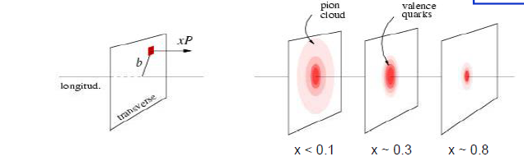
H_{Im}:the t-slope reflects the size of the probed object (Fourier transf.)
The sea quarks (low x) spread to the periphery of the nucleon while the valence quarks (large x) remain in the center

Slide 49
~
The axial charge (~H_{im}) appears to be more « concentrated » than the electromagnetic charge (~H_{im})

