Slide 1
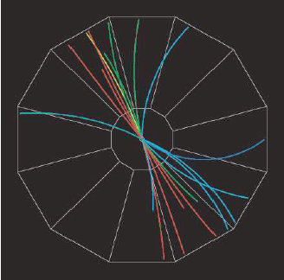


Gluon polarization and jet production at STAR
Pibero Djawotho for the STAR Collaboration
Texas A&M
4 June 2013

Slide 2
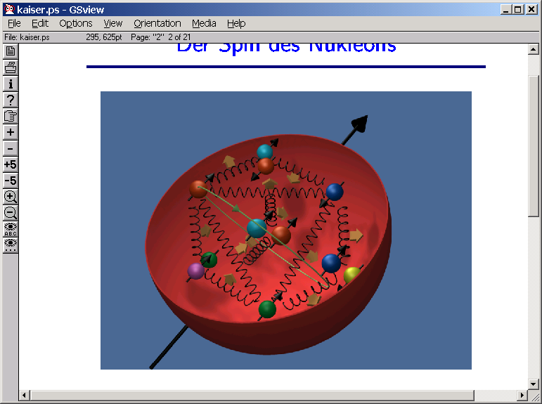
The proton spin sum rule
Quark polarization ΔΣ ≈ 0.3 from polarized deep inelastic scattering
Gluon polarization (ΔG) and orbital angular momentum (L) are poorly constrained
A primary charge of RHIC spin physics ⇒ map Δg(x)

Slide 3
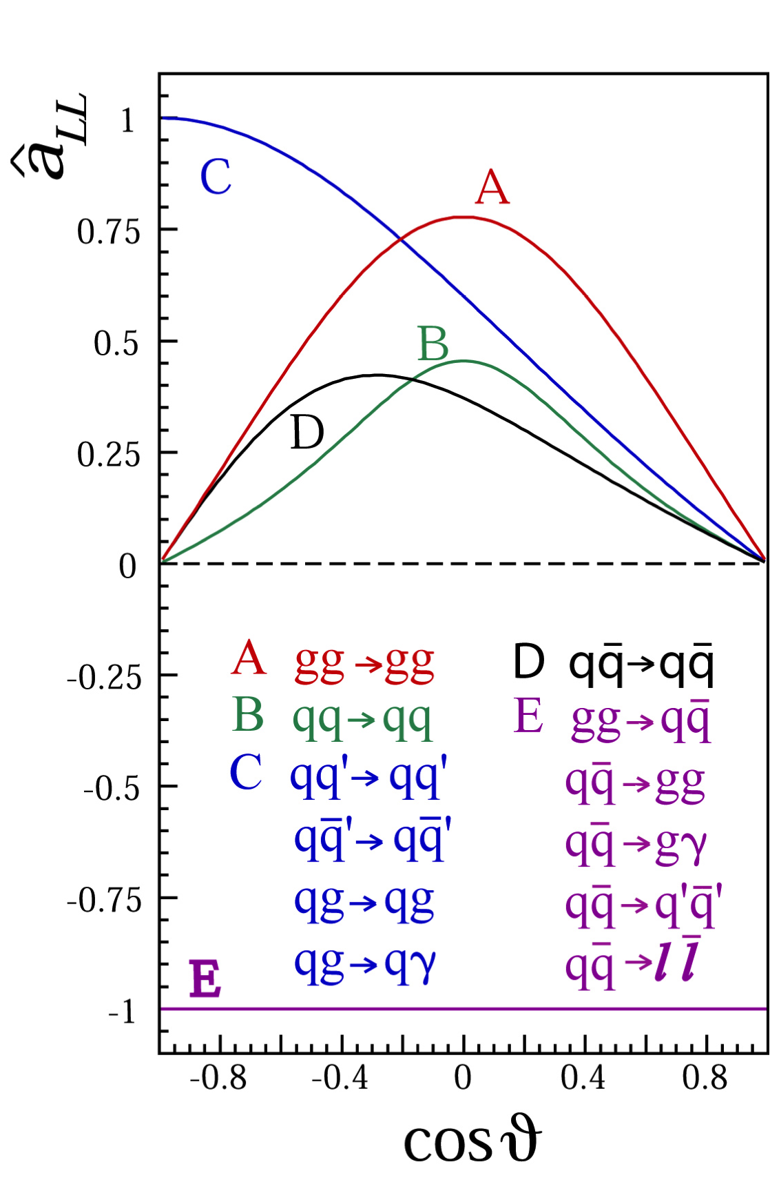



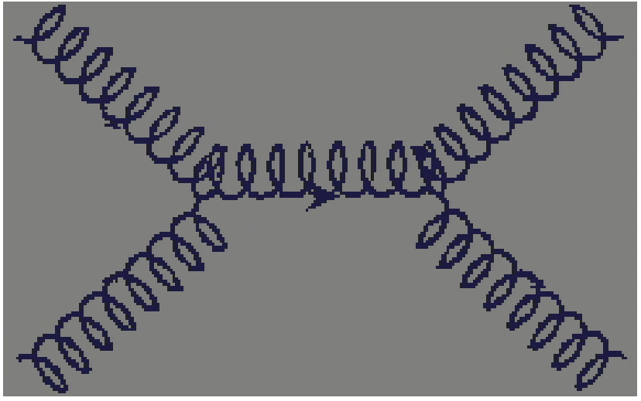
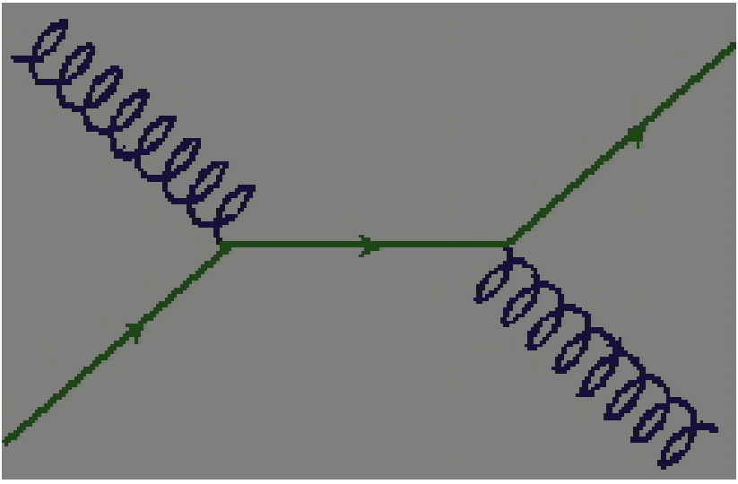
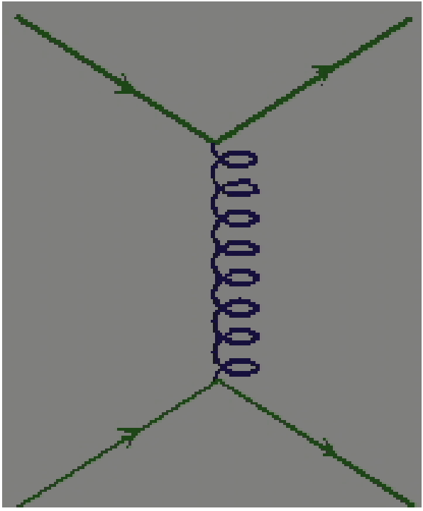
Polarized pp collisions at RHIC
Δf: polarized parton distribution functions
For most RHIC kinematics, gg and qg dominate, making A_{LL} for jets sensitive to gluon polarization.

Slide 4
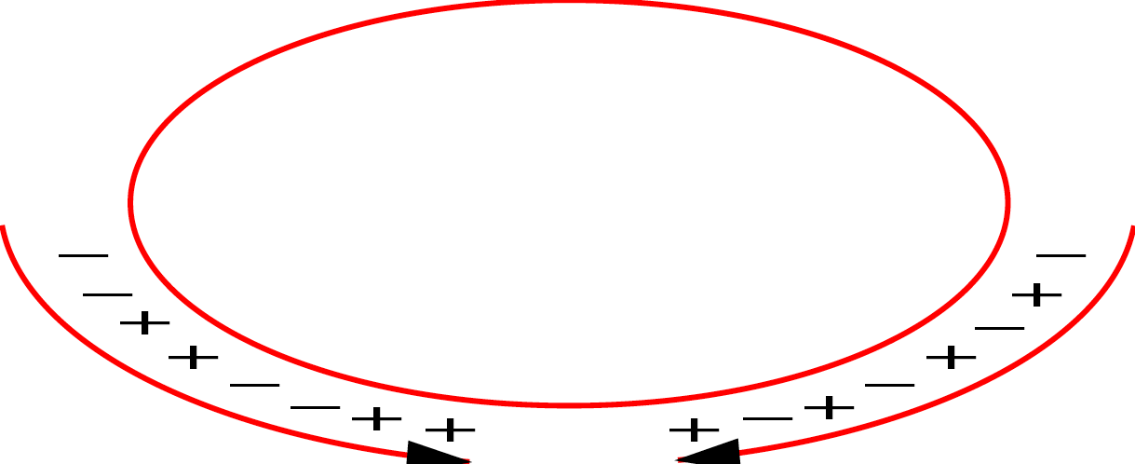
RHIC: The World’s First Polarized Hadron Collider
Absolute Polarimeter (H↑ jet)
RHIC pC Polarimeters
PHOBOS
BRAHMS
Siberian Snakes
Siberian Snakes
PHENIX
STAR
Spin Rotators
(longitudinal polarization)
Spin flipper
Spin Rotators
(longitudinal polarization)
Pol. H⁻ Source
Solenoid Partial Siberian Snake
LINAC
BOOSTER
Helical Partial Siberian Snake
AGS Internal Polarimeter
200 MeV Polarimeter
AGS
AGS pC Polarimeters
Rf Dipole
Strong Helical AGS Snake
Spin varies from rf bucket to rf bucket (9.4 MHz)
Spin pattern changes from fill to fill
Spin rotators provide choice of spin orientation
Billions of spin reversals during a fill with little depolarization

Slide 5
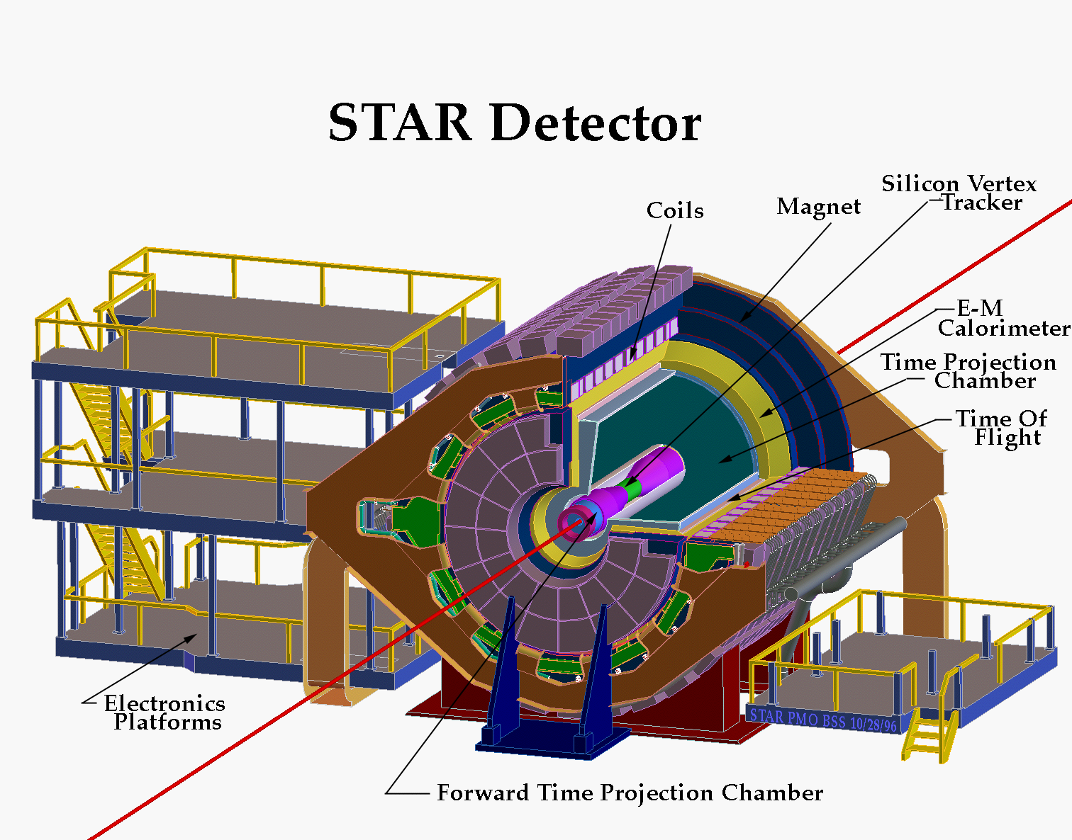
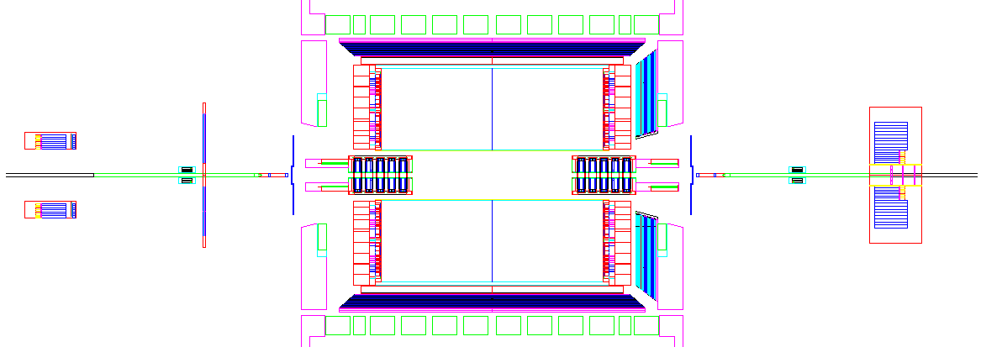
STAR detector in two views
BEMC
EEMC
FMS
FPD
TPC
ZDC
BBC
ZDC
High precision tracking with the TPC
Electromagnetic calorimetry with the BEMC, EEMC, and FMS
Additional detectors for relative luminosity, local polarimetry, and minbias triggering

Slide 6

Jet reconstruction in STAR
Data jets MC jets
Midpoint cone algorithm
(Adapted from Tevatron II - hep-ex/0005012)
Seed energy E_{T}^{seed} = 0.5 GeV
Cone radius R = √Δη²+Δφ² = 0.7
Split/merge fraction f = 0.5
Detector
GEANT
Use PYTHIA + GEANT to quantify detector response
Particle
PYTHIA
PRD 86 032006 (2012)

Slide 7
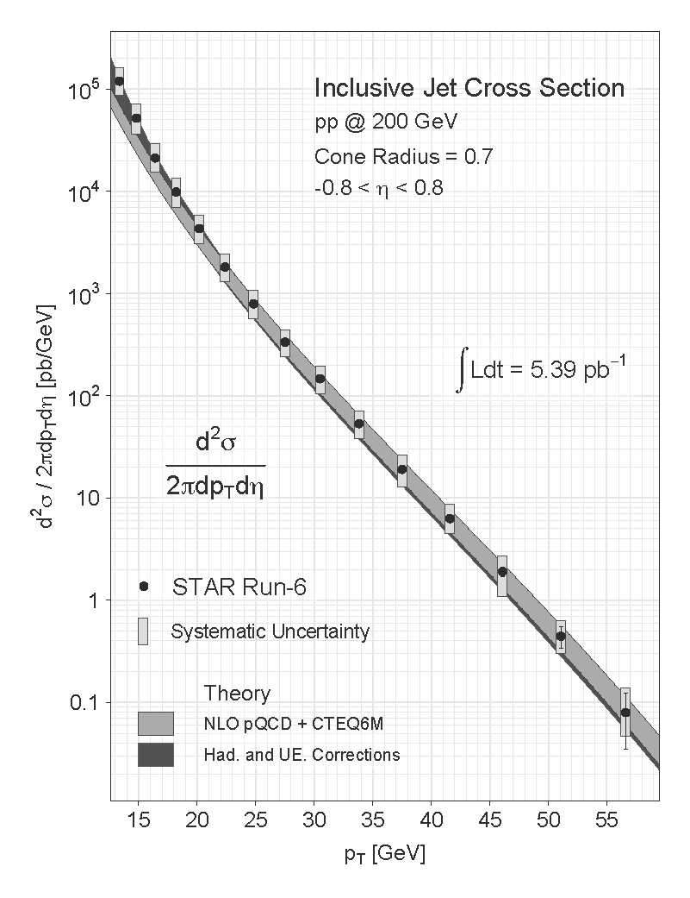
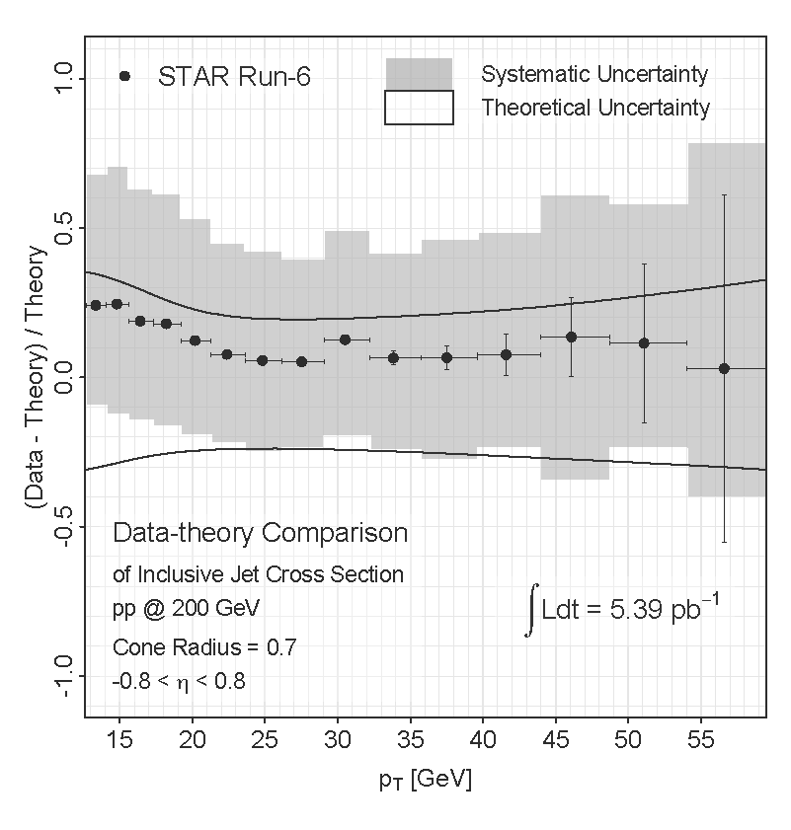
2006 inclusive jet cross section
preliminary
preliminary
Data well described by NLO pQCD+Hadronization+Underlying Event

Slide 8
2006 inclusive jet A_{LL}
STAR
PRD 86 032006 (2012)
Sampled 5.5 pb⁻¹ at ~57% average beam polarization
STAR data rule out several previous models of gluon polarization
Notes:
8

Slide 9
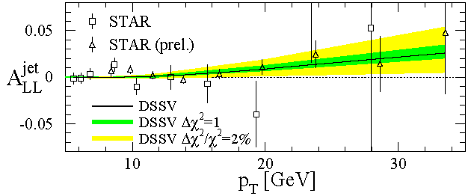
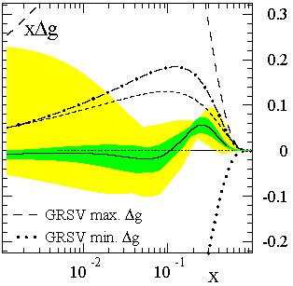
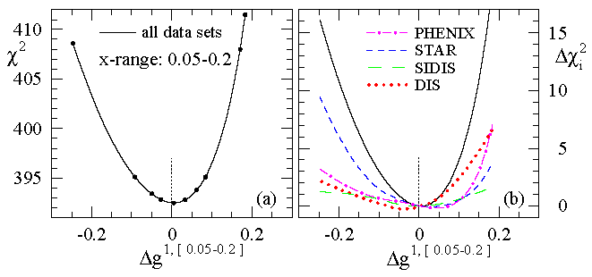
DSSV – First Global Analysis with Polarized Jets
de Florian et al, PRL 101 072001 (2008)
STAR
First global NLO analysis to include DIS, SIDIS, and RHIC pp data on equal footing
Finds node in gluon distribution near x ~ 0.1
Notes:
9

Slide 10
2009 upgrades
2009 jet patch trigger upgrades
  Overlapping jet patches and lower E_{T} threshold improve efficiency and reduce trigger bias
    Net increase of 37% in jet acceptance
  Remove beam-beam counter trigger requirement:
    Trigger more efficiently at high jet p_{T}
    Measure non-collision background
  Increased trigger rate enabled by DAQ1000
Improvements in jet reconstruction
  Subtract 100% of track momentum from struck tower energy (2009) instead of MIP (2006)
  Overall jet energy resolution improved from 23% to 18%
  Switching to anti-k_{T} algorithm for final result
    Reduces sensitivity to underlying event effects
Collected 4 times the figure-of-merit of 2006
  Sampled 20 pb⁻¹ at 58% average beam polarization

Slide 11
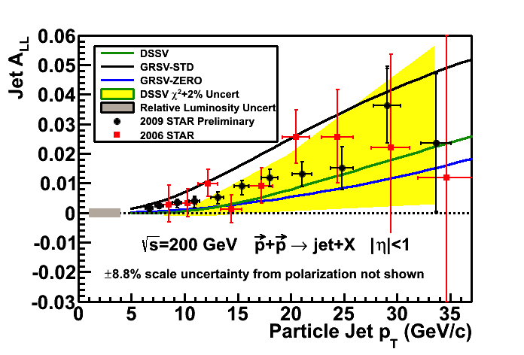
From 2006 to 2009
arXiv:1106.5769
2009 STAR data is a factor of 3 (high-p_{T}) to >4 (low-p_{T}) more precise than 2006 STAR data
Results fall between predictions from DSSV and GRSV-STD
Precision sufficient to merit finer binning in pseudorapidity

Slide 12
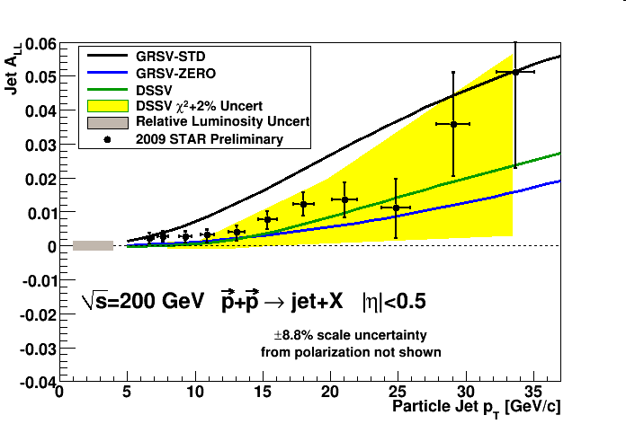
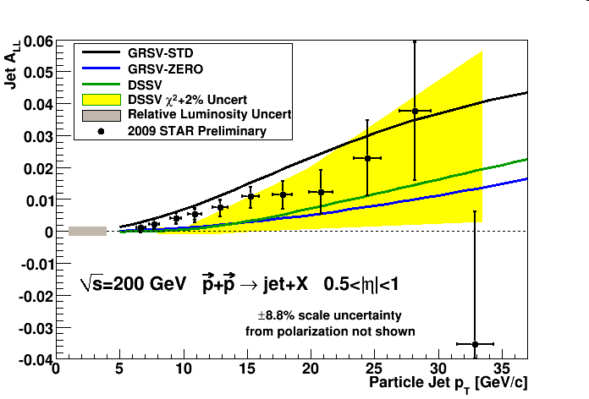
2009 inclusive jet A_{LL}
Mid rapidity
Forward rapidity
A_{LL} separated into two pseudorapidity ranges
Forward jets involve:
  A larger fraction of quark-gluon scattering with:
    Higher x quarks that are more polarized
    Lower x gluons that are less polarized
  Larger |cos(θ*)|, which reduces â_{LL}
A_{LL} falls between the predictions from DSSV and GRSV-STD

Slide 13
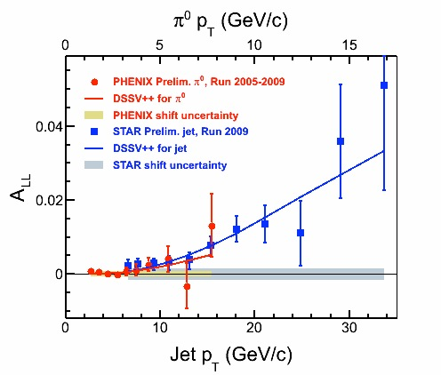
New global analysis with 2009 RHIC data
arXiv:1304.0079
Special thanks to the DSSV group!
DSSV++ is a new, preliminary global analysis from the DSSV group that includes the 2009 RHIC A_{LL} data (STAR inclusive jets and PHENIX π⁰’s)
First experimental evidence of non-zero Δg(x) in RHIC range (0.05 ≤ x ≤ 0.2)

Slide 14
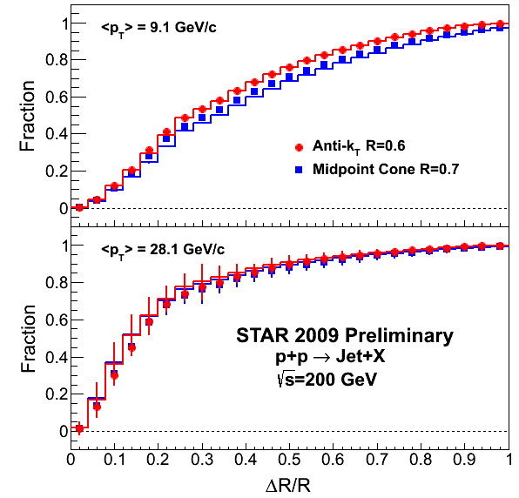
2009: from preliminary towards final
STAR is switching from the mid-point cone algorithm to the anti-k_{T} algorithm for the final 2009 inclusive jet A_{LL} measurement:
  Anti-k_{T} tends to have a more rigid cone
  Reconstructed jet energy is less sensitive to nearby underlying event contributions (and pile-up)
Provides a significant reduction in the systematic uncertainties associated with trigger and reconstruction bias
Final results available soon

Slide 15
Projected sensitivity for future inclusive jet A_{LL}
500 GeV collisions sample smaller x_{T}=2p_{T}/√s
Projected statistical uncertainties
Expected asymmetries are quite small
  Control of systematics (esp. relative luminosity) will be important

Slide 16
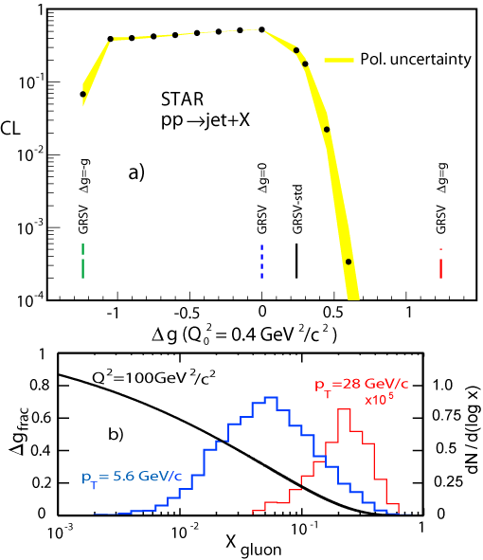
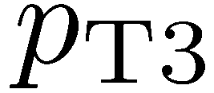
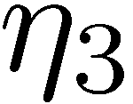
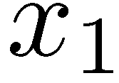

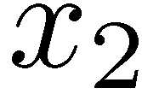
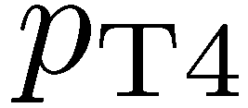
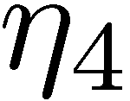
Correlation measurements
Inclusive probes at fixed p_{T} sample broad x range ⇒ global analysis needed to disentangle shape of Δg(x)
Reconstructing dijet final state (jet p_{T} and η) provides information on initial parton kinematics (x_{1,2} and cosθ*) at LO
STAR is well suited for correlation measurements and full jet reconstruction with its large acceptance

Slide 17
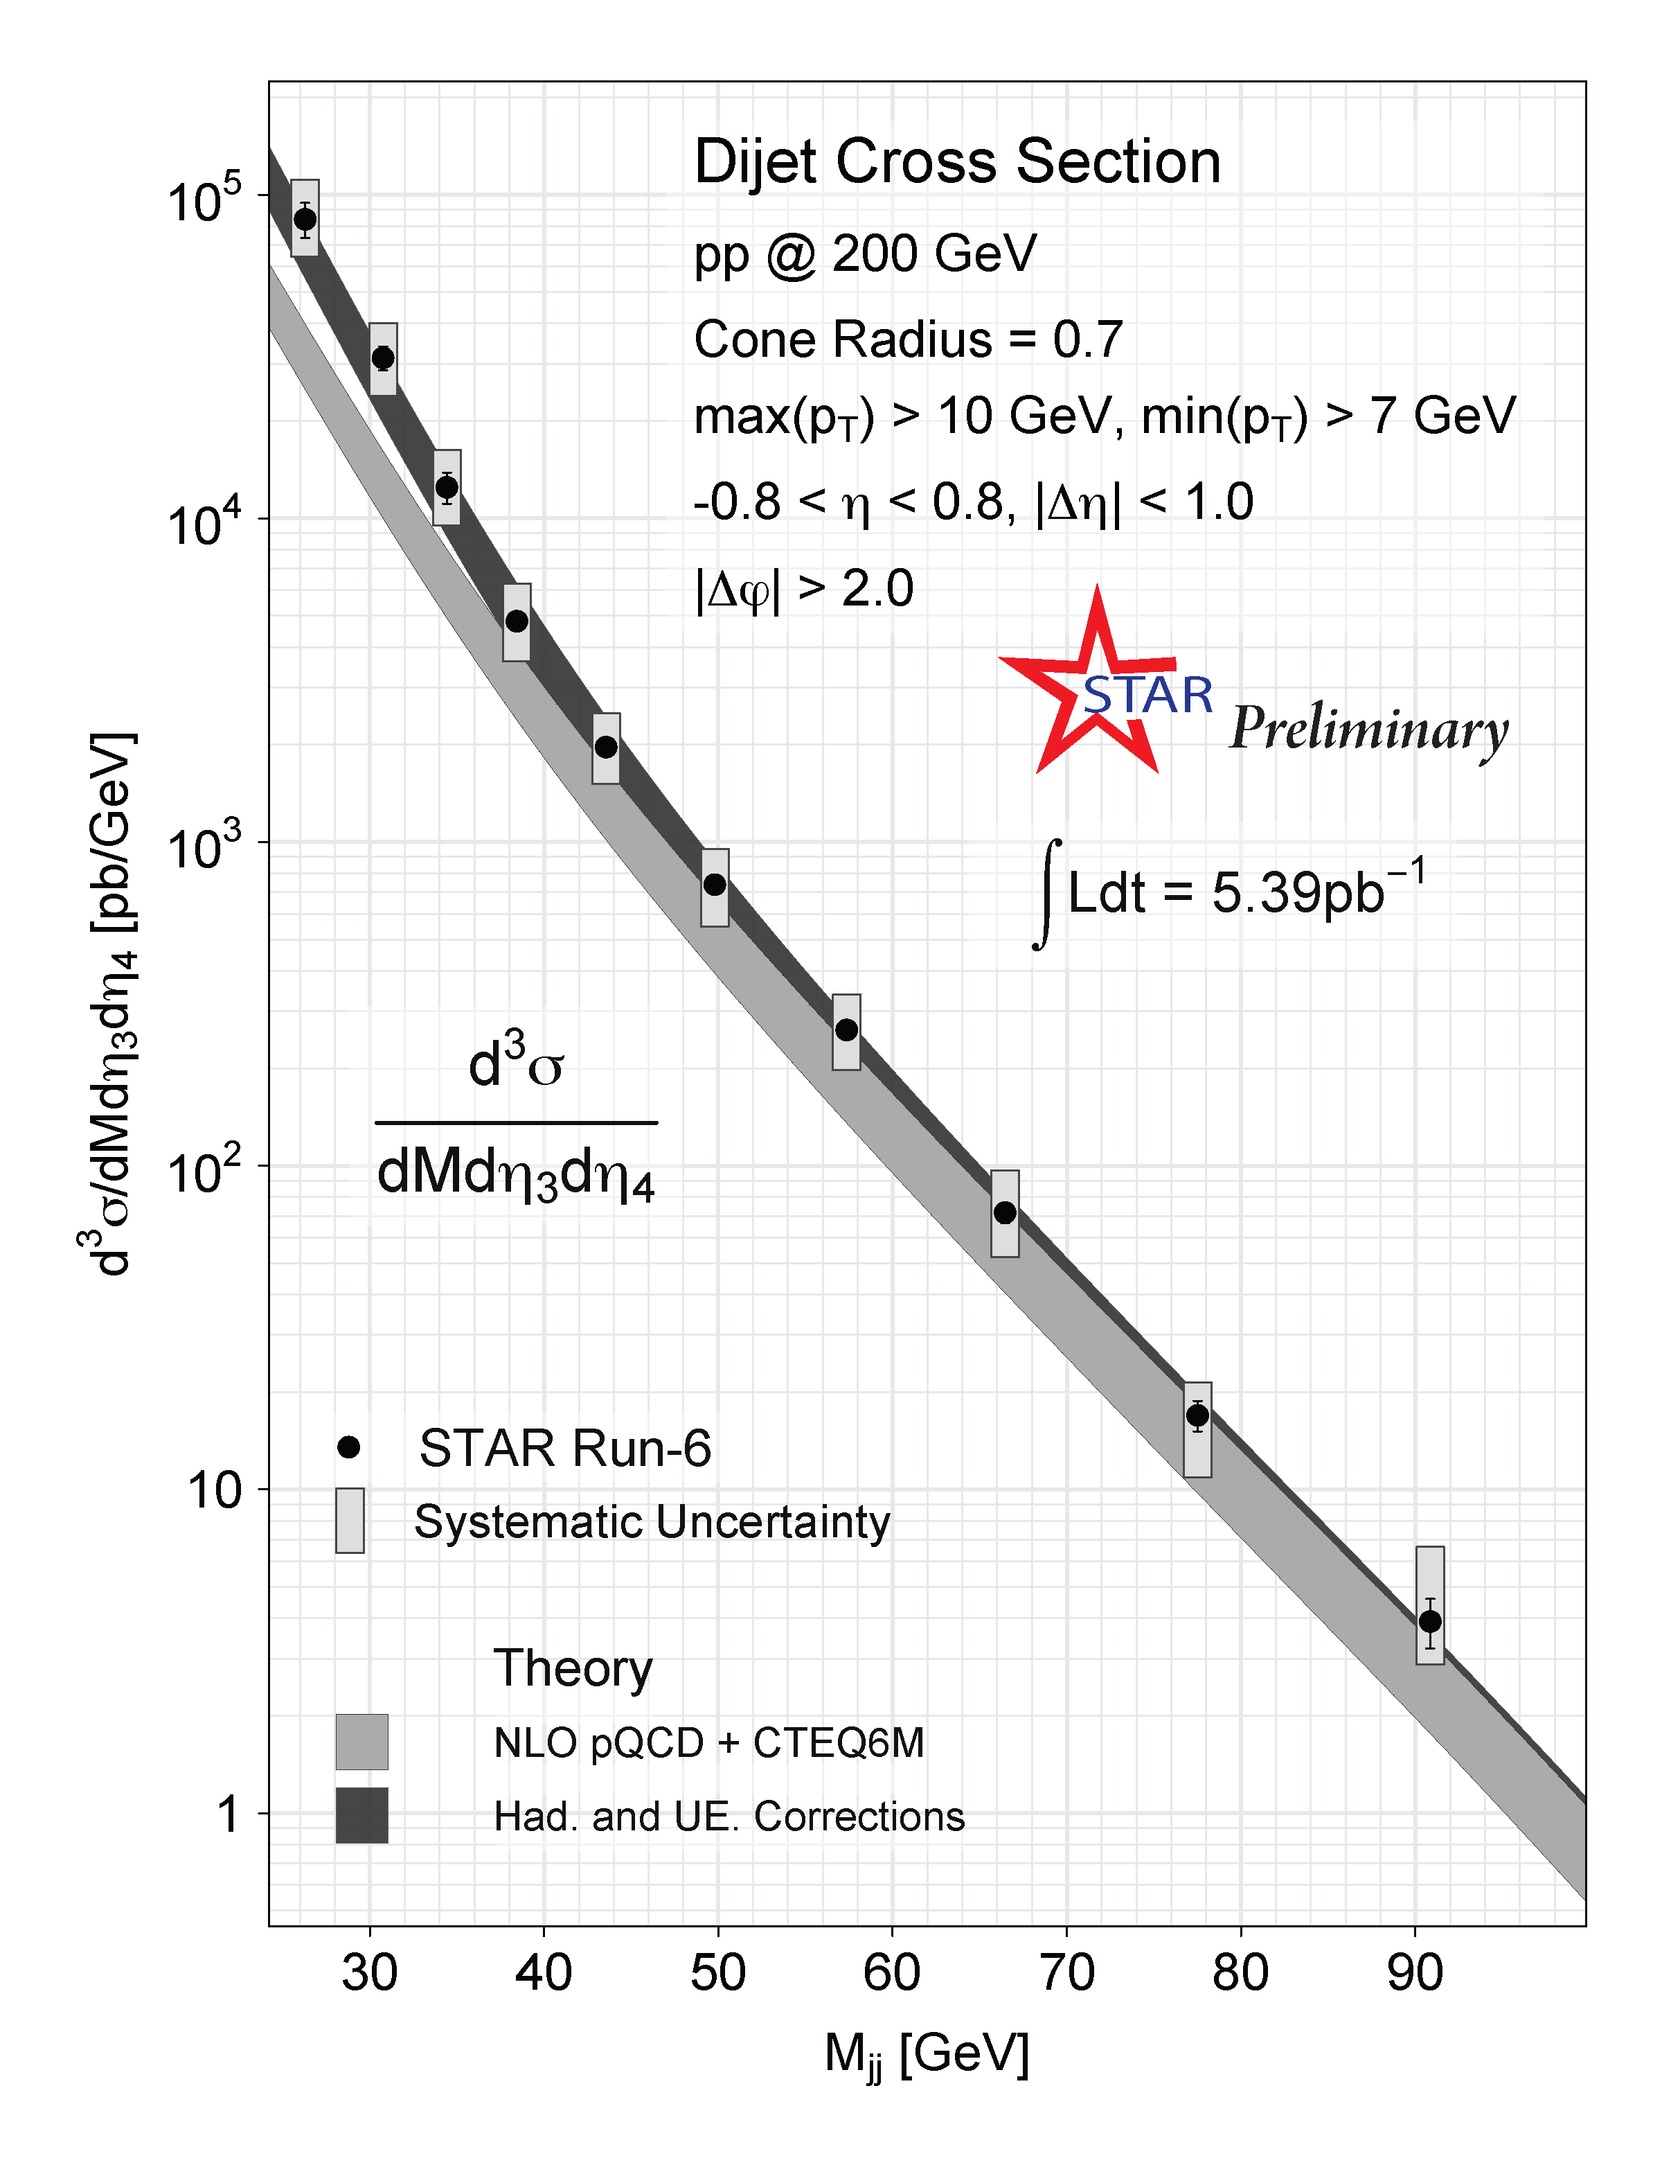
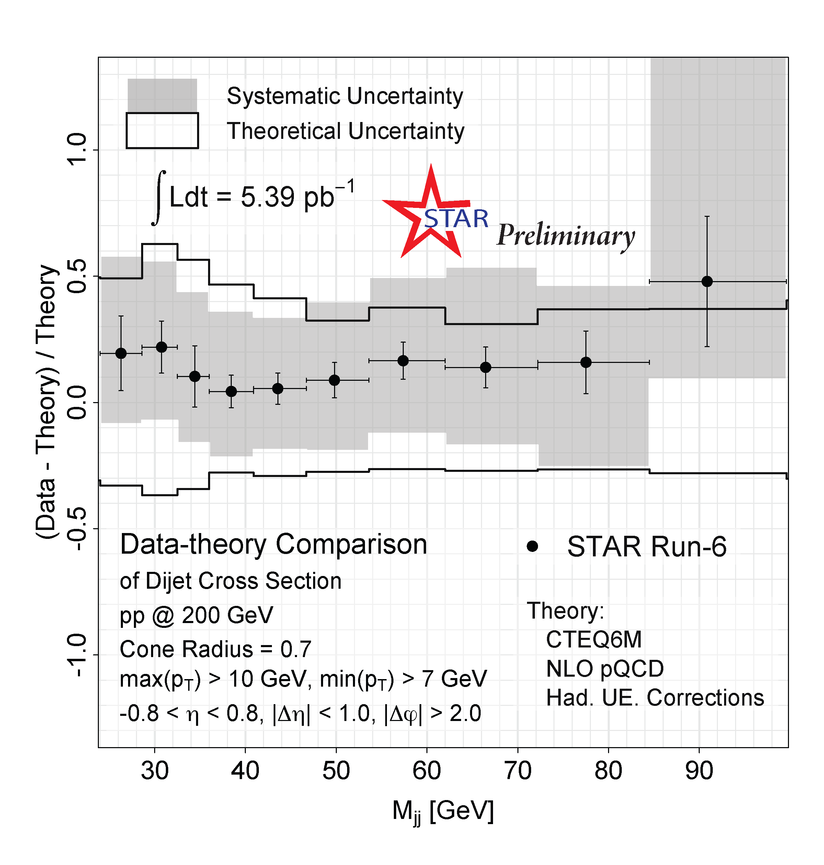
2006 dijet cross section
Data shows good agreement with NLO pQCD + CTEQ6M including Hadronization + Underlying Event Corrections

Slide 18
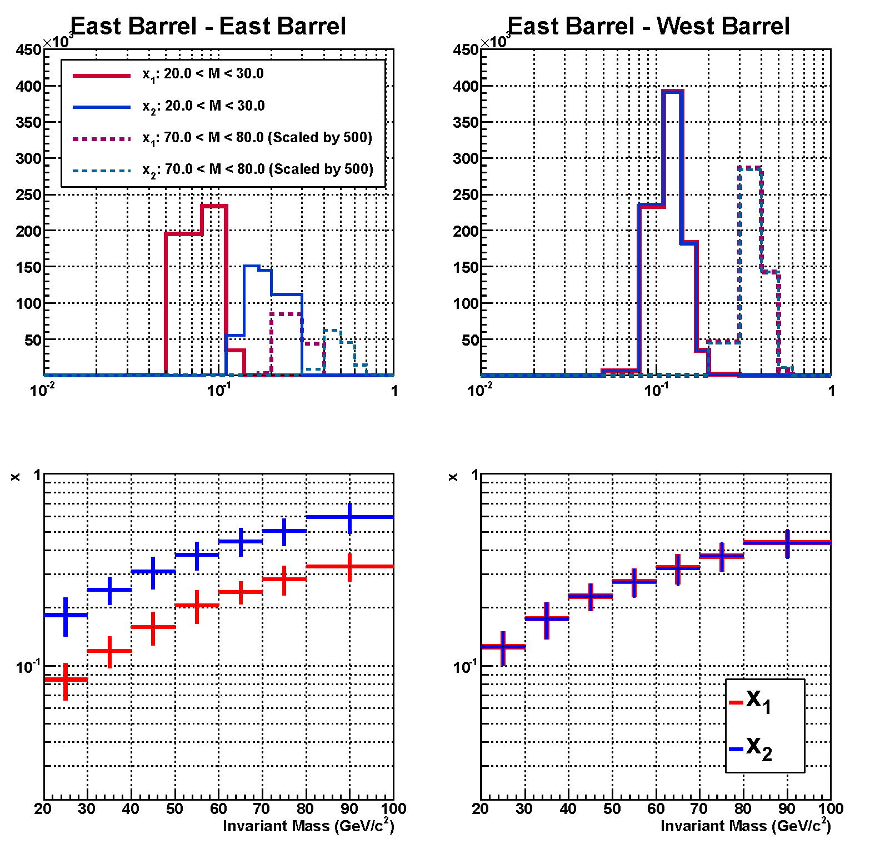
2009 dijet partonic coverage
STAR
x
x

Slide 19
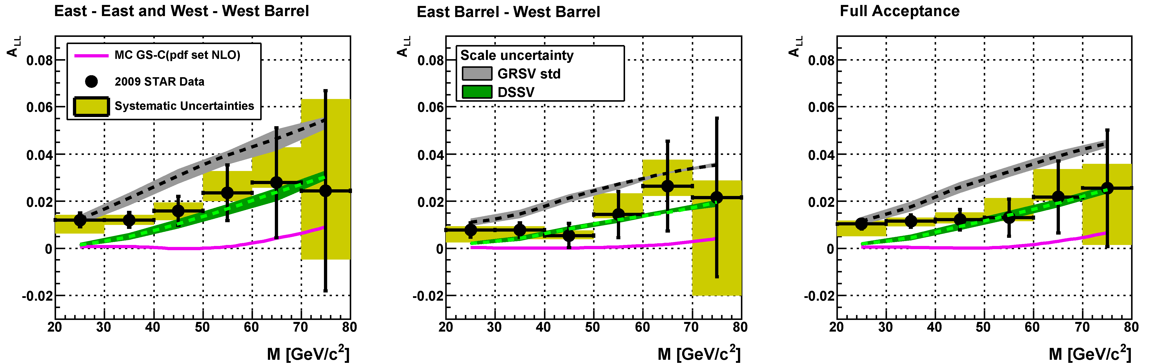
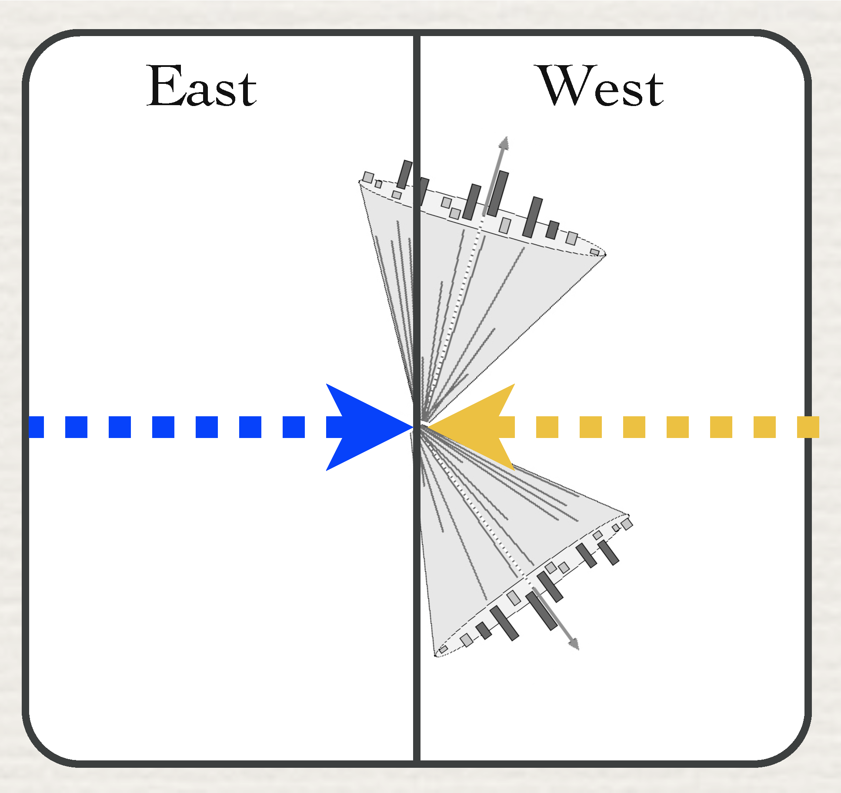
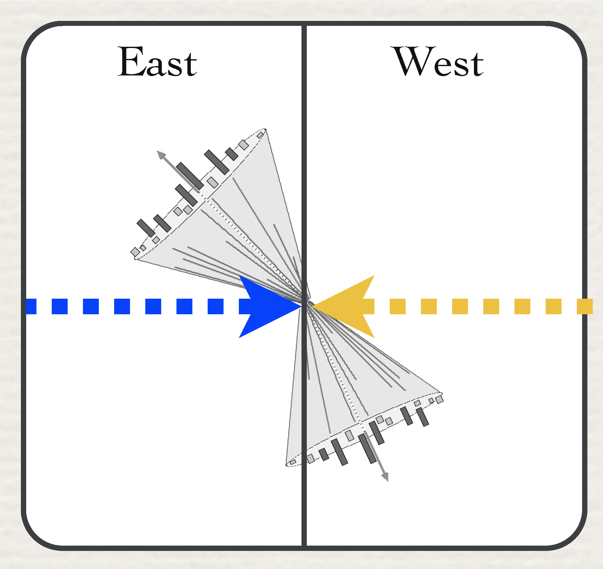
2009 dijet A_{LL}
STAR
arXiv:1107.0917
preliminary
preliminary
preliminary
STAR data fall between predictions of DSSV and GRSV-STD

Slide 20
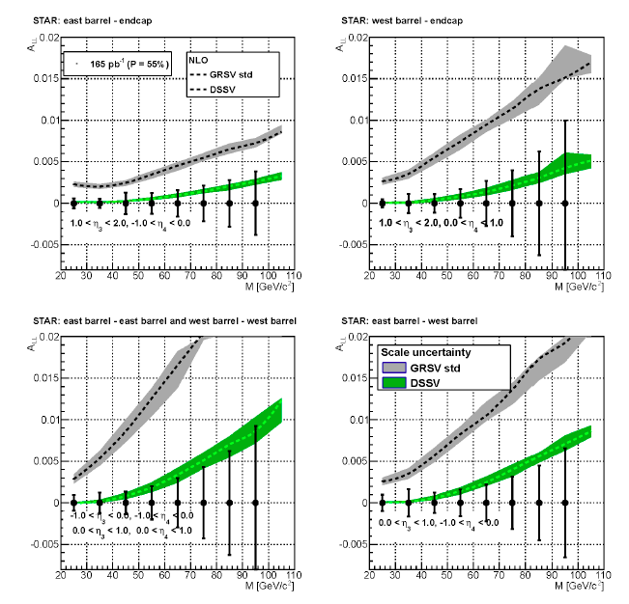
Projected sensitivity for dijet A_{LL} at 500 GeV
Higher energy accesses lower x_{g}
Expect smaller A_{LL}
Projections show expected sensitivity for the ongoing 2013 run

Slide 21
Summary
STAR inclusive jet and dijet cross sections are in good agreement with NLO pQCD calculations when hadronization and underlying event effects are included
STAR inclusive jet A_{LL} from 2006 provides significant constraints on gluon polarization in NLO global analyses
2009 STAR inclusive jet A_{LL} is factor of 3 (high-p_{T}) to >4 (low-p_{T}) more precise than 2006 results
  First experimental evidence for non-zero gluon polarization within the RHIC range (0.05 ≤ x ≤ 0.2)
STAR will provide additional high-precision measurements of inclusive jet and dijet A_{LL} during the next few years

