Slide 1
First measurement of the helicity dependence of ³He photo-reactions in the Δ(1232) resonance region
Susanna Costanza
(INFN Pavia)
on behalf of the A2 Collaboration
International Nuclear Physics Conference INPC 2013
Firenze, 2-7 June 2013

Slide 2
The GDH sum rule
Proposed by Gerasimov – Drell – Hearn in 1966
Fundamental connection between the ground state properties of a particle and a moment of the entire excitation spectrum
Gives a prediction on the absorption of circularly polarised photons by longitudinally polarised nucleons/nuclei:
Anomalous magnetic moment
Spin
Mass
Photon energy
ν_{th} = π production threshold (nucleons)
photodisintegration threshold (nuclei)
Photon spin
Baryon spin
= σ_{a}
= σ_{p}

Slide 3
The GDH sum rule ∙∙
It is derived from very general physical principles (Lorentz and gauge invariance, causality, unitarity)
It allows to:
check our knowledge of the γN interaction and of the physics of strongly interacting systems
access new experimental observables and study the baryon resonances through the helicity dependence of partial channels
test photoreaction channels
A measurement of the GDH integral constitutes a fundamental check of our knowledge of both the photon and the nucleon (nucleus)

Slide 4
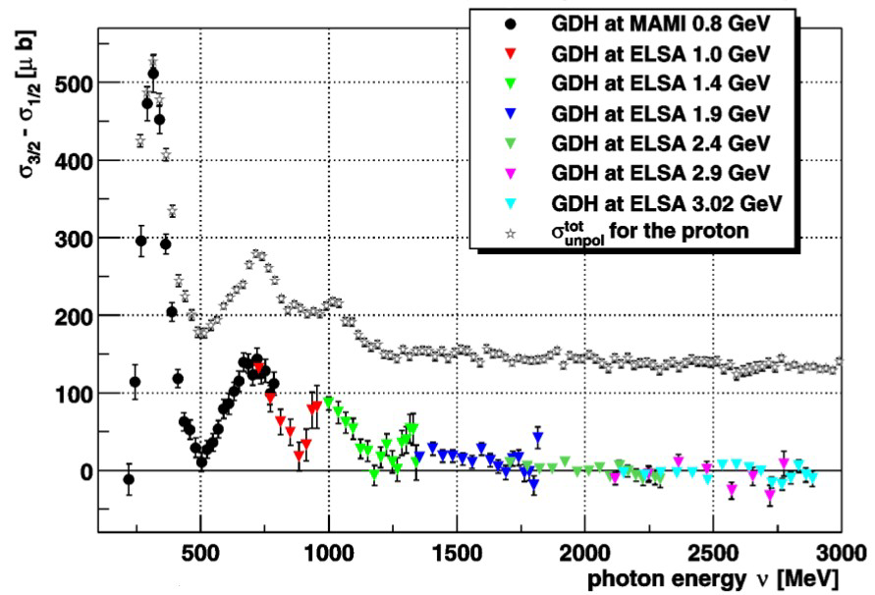
The GDH sum rule on the proton
First experimental evaluation on the proton
(0.2 < E_{γ} < 2.9 GeV)
I_{GDH} (p) = 211 ± 5 ± 12 µb
MAMI data: J. Ahrens et al., PRL 87 (2001) 022003
ELSA data: H. Dutz et al., PRL 91 (2003) 192001, H.Dutz et al., PRL 93 (2004) 032003

Slide 5
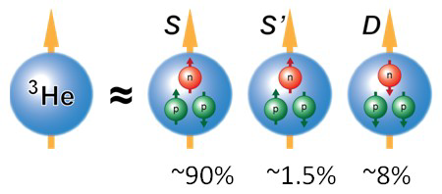
The GDH sum rule on the neutron
The measurement of I_{GDH} (n) is complicated by the lack of free neutron targets
²H:
System of one proton and one neutron with paired spins, in relative s states (96% probability)
µ ≈ µ_{p} + µ_{n}
³He:
System of two protons with spins paired off and an “active” unpaired neutron, in relative s states (∼ 90% probability)
The proton contribution is small: µ ≈ µ_{n}
Allows direct access to the free neutron cross section prevented by nuclear structure effects and FSI

Slide 6
The GDH sum rule on the neutron∙∙
The most accurate evaluation of I_{GDH} (n) comes from ³He
… but nuclear structure effects have to be taken into account
A first experiment to prove the feasibility of a polarised ³He target was carried out at MAMI (Mainz), from π photoproduction threshold up to 500 MeV:
on the total inclusive cross section, to test the GDH sum rule on the neutron
on partial channel measurements to test ³He models

Slide 7
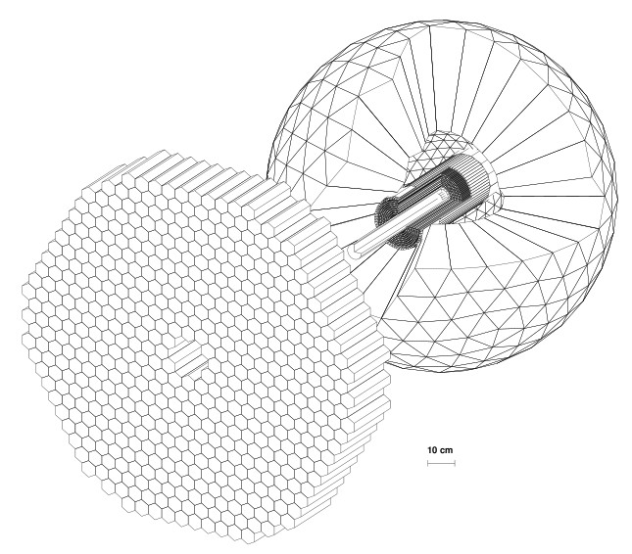
Setup for the polarised ³He exp.
Facility
tagged photon facility of the MAMI accelerator in Mainz
Beam
circularly polarised photons produced by bremsstrahlung of longitudinally polarised electrons
E_{e}- = 525 MeV
200 < E_{γ} < 500 MeV
Detector
the large acceptance (93%)
Crystal Ball (CB) photon
spectrometer in
combination with the
TAPS detector
Target
polarised ³He gas
CRYSTAL BALL
MWPC
PID
TAPS

Slide 8
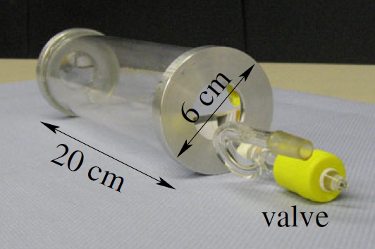
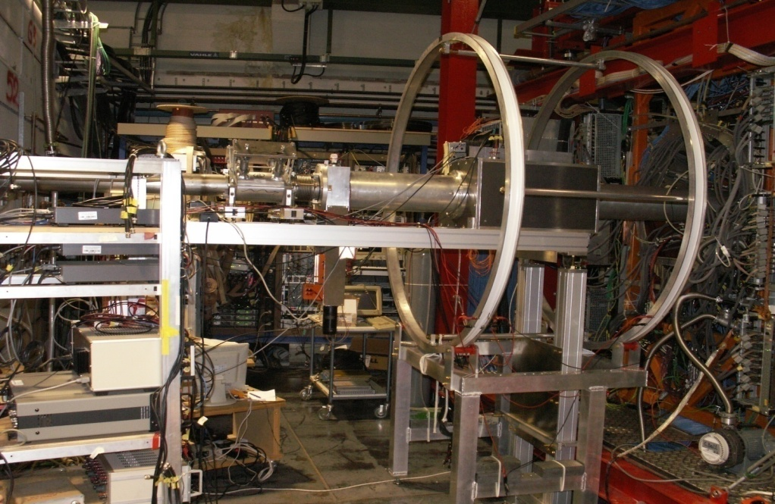
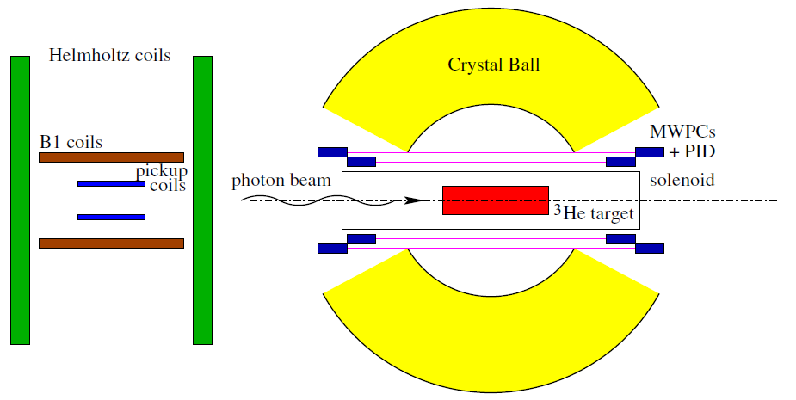
³He target
Cylindrical cell:
length: 20 cm
diameter: 6 cm
Made of quartz glass (thickness: 2 mm)
Titanium enter and exit windows (50 μm)
provide the necessary gas tightness (4 bar)
give long relaxation time (∼20 hrs) of the gas polarisation
³He polarisation measurements carried out via NMR technique; field provided by Helmholtz coils
Developed by P.I. Mainz
γ-beam
Vacuum chamber
Helmholtz coils

Slide 9
Unpolarised cross section on ³He
Total inclusive cross section
Semi-exclusive channels:
γ ³He → π⁰ X
γ ³He → π± X
γ ³He → ppn
Total and differential cross section
…obtained after subtraction of (the big) empty target contribution...

Slide 10
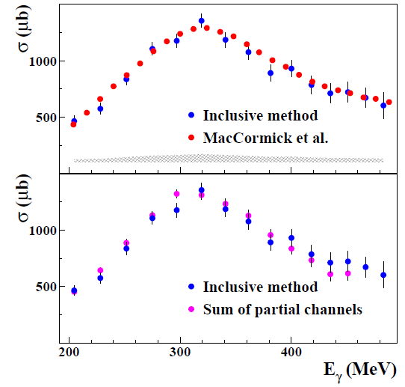
Total inclusive cross section
γ³He → X
“Inclusive” analysis method
(NO partial channel separation)
P. Aguar Bartolomé et al, PLB 723 (2013) 71-77
Good agreement with DAPHNE data

Slide 11
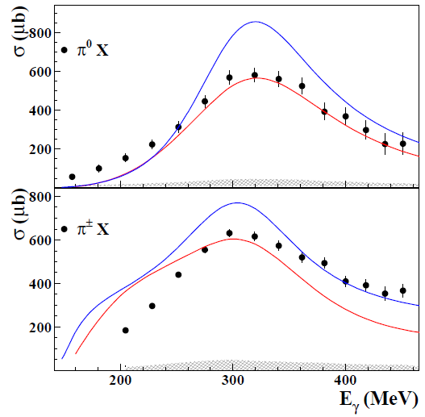
Partial channel I: ³He(γ,π)X
First data
FA (Fix-Arenhövel) model:
Fermi motion + nuclear structure effects
PWIA (Plane-Wave Impulse Approximation) model:
incoherent sum of quasi-free single nucleon contributions (from MAID multipole analysis smeared with Fermi motion)
─── FA model
─── PWIA model
P. Aguar Bartolomé et al, PLB 723 (2013) 71-77
Nuclear structure contribution (FSI, …)
more important for the π⁰X partial channel

Slide 12
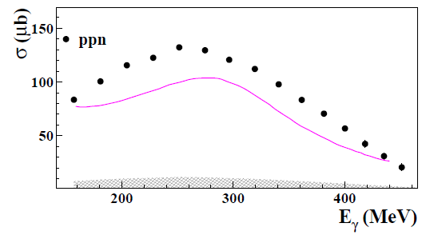
Partial channel II: γ³He→ppn
σ^{3He} = 1.68 · σ^{d}
First data
─── QD (Quasi-Deuteron) model
P. Aguar Bartolomé et al, PLB 723 (2013) 71-77
No model estimation available for ³He
“Quasi-deuteron” approximation (γ ³He → pnp_{s})
evaluated from the Schwamb γd → pn model
Discrepancy between data and Schwamb model
mostly due to 3-nucleon absorption mechanisms

Slide 13
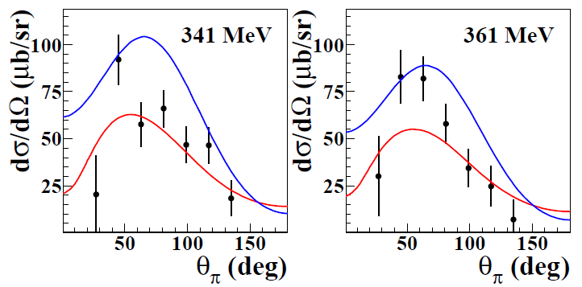
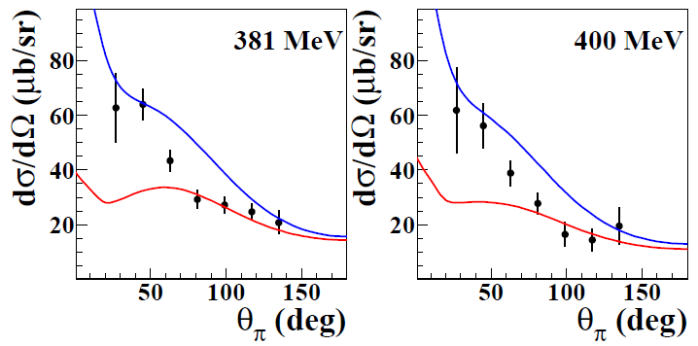
Differential cross section ³He(γ,π)X
π⁰X
First data – preliminary!!
π±X
─── FA model
─── PWIA model

Slide 14
Polarised cross section on ³He
Total inclusive cross section
Semi-exclusive channels:
γ ³He → π⁰ X
γ ³He → π± X
γ ³He → ppn
Total and differential cross section
Same analysis as for unpol
…no subtraction of empty target contribution...

Slide 15
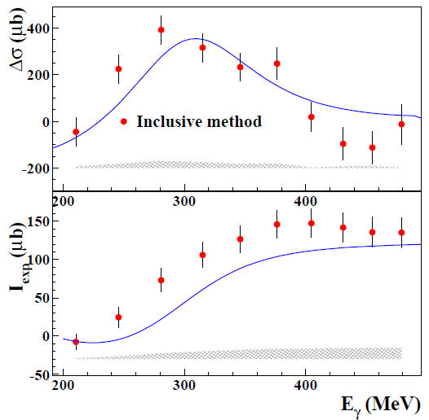
Total inclusive cross section
First data
“Inclusive” analysis method
PWIA predictions:
─── PWIA prediction
• Running I_{GDH} (³He)
─── PWIA prediction
Running I_{GDH} for ³He for E_{γ} = (200, 500) MeV:
I_{GDH} = 135 ± 20 ± 12 µb
≈ I_{p}
P. Aguar Bartolomé et al, PLB 723 (2013) 71-77
Reasonable agreement between data and PWIA predictions

Slide 16
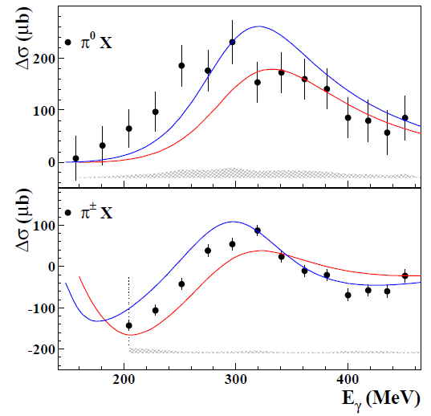
Partial channel I: ³He(γ,π)X
First data
Good agreement between data and PWIA model at higher photon energy values
─── FA model
─── PWIA model
P. Aguar Bartolomé et al, PLB 723 (2013) 71-77
Nuclear structure contribution (FSI, …)
does not have a strong helicity dependence

Slide 17
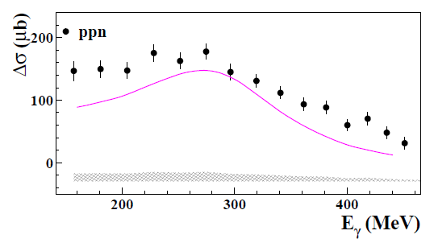
Partial channel II: γ³He→ppn
σ^{3He} = 1.68 · σ^{d}
First data
─── QD (Quasi-Deuteron) model
P. Aguar Bartolomé et al, PLB 723 (2013) 71-77
No model estimation available for ³He
“Quasi-deuteron” approximation (γ ³He → pnp_{s})
evaluated from the Schwamb γd → pn model
Discrepancy between data and Schwamb model
mostly due to 3-nucleon absorption mechanisms

Slide 18
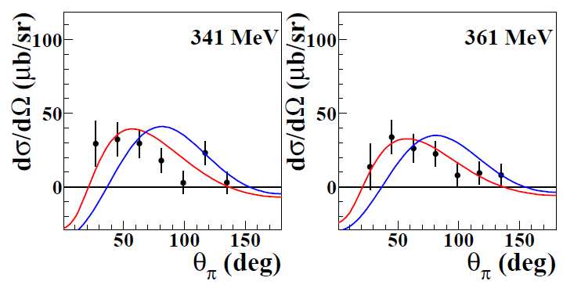
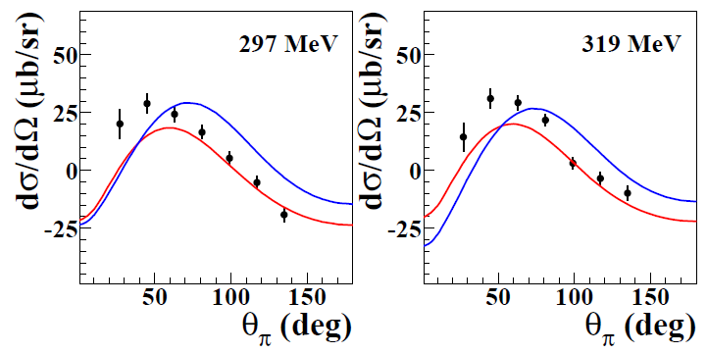
Differential cross section ³He(γ,π)X
π⁰X
First data – preliminary!!
π±X
─── FA model
─── PWIA model

Slide 19
Summary
The helicity dependent total inclusive photoabsorption cross section on ³He and both the unpolarised and polarised partial cross sections for the reactions γ³He→π⁰X, γ³He→π±X and γ³He→ppn have been measured for the first time at MAMI (Mainz) in the energy range 200 < E_{γ} < 500 MeV.
Available state-of-the-art calculations are unable to describe both the unpolarised and the helicity-dependent cross sections for the πX channels.
A simple PWIA model well reproduces the π±X channel for E_{γ} > 350 MeV: nuclear effects play a significant role only close to the π photoproduction threshold.
For the π⁰X case, the agreement with the PWIA model is poorer.
No model is available for the ppn channel.
Further measurements to improve statistics and to investigate a wider energy range, as well as further theoretical investigations, are needed.

Slide 20
Thank you!

Slide 21
Backup slides

Slide 22
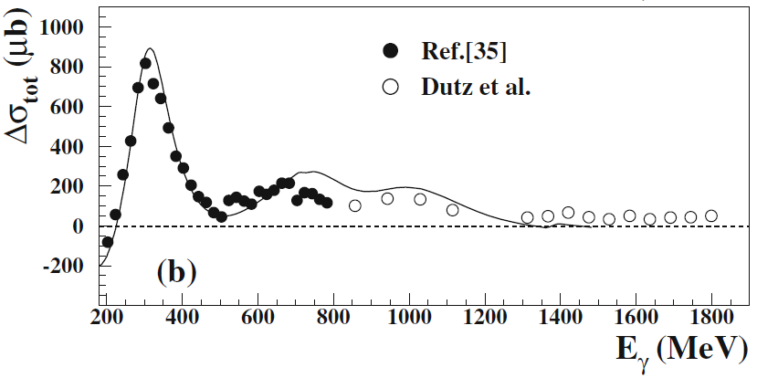
GDH sum rule on the deuteron
Helicity dependent total inclusive cross section: Δσ = σ_{p}-σ_{a} (μb)
GDH Mainz – PLB 672, 328 (09)
GDH Bonn – PRL 94, 162001 (05)
AFS model – PRL 93, 202301 (04)
(AFS: Arenhoevel, Fix and Schwamb)
with:
From GDH sum rule:
200 MeV < E_{γ} < 1800 GeV

Slide 23
The GDH sum rule on the neutron
The most accurate evaluation of I_{GDH} (n) comes from ³He
For ν_{th} > m_{π} (π photoproduction threshold on free nucleon), I_{GDH}(³He) ∼ I_{GDH}(n);
For 8 MeV < ν_{th} < m_{π} (photodisintegration region), contribution of nuclear structure effects to I_{GDH}(³He):
Precise experimental data on ³He are required from break-up threshold upwards:
@ HIγS, from photodisintegration threshold to 60 MeV
@ MAMI, from π photoproduction threshold
to test the GDH sum rule on the neutron and ³He models
both through the inclusive and the partial channel measurements.

Slide 24
³He polarisation
MEOP: Metastability Exchange Optical Pumping
B = 0
B ≠ 0
m_{F} = +½
(F = ½)
2³P₀
Excited state
m_{F} = -½
1083 nm
σ⁺ transition
Simplified!
m_{F} = +½
2³S₁
(F = ½)
Metastable state
m_{F} = -½
Polarisation transfer to the ³He ground state by atomic collisions
1¹S₀
Ground state

Slide 25
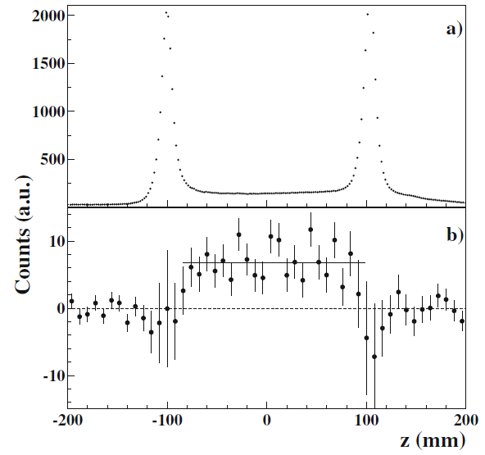
³He target ∙∙
N_{atoms} ∼ 10²¹/cm² → ∼10² times less than in a solid/liquid target
³He target is an “empty” target…
All charged particle events
Ti windows
³He gas
Event difference (P – A)
z–vertex from MWPC analysis
150 MeV < E_{γ} < 500 MeV

Slide 26
Unpolarised cross section on ³He

Slide 27
Partial channel I: ³He(γ,π)X
First data
π⁰ identified via γγ invariant mass
(energy info from CB)
π± identified via dE/dx vs E technique
(energy info from CB+PID, spatial info from MWPCs)
─── FA model
─── PWIA model
P. Aguar Bartolomé et al, PLB 723 (2013) 71-77
Nuclear structure contribution (FSI, …)
more important for the π⁰X partial channel

Slide 28
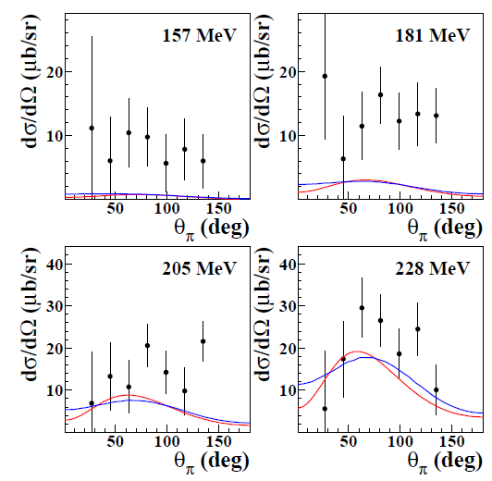
Differential cross section – π⁰X
First data – preliminary!!

Slide 29
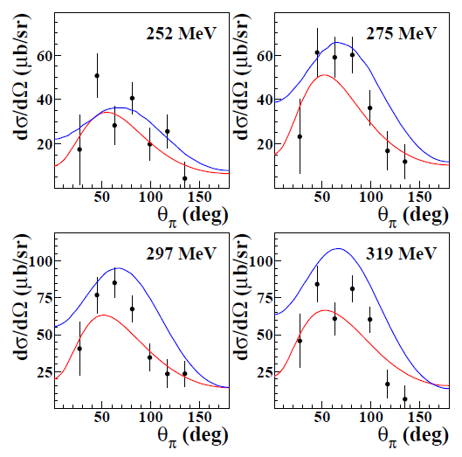
Differential cross section – π⁰X
First data – preliminary!!

Slide 30
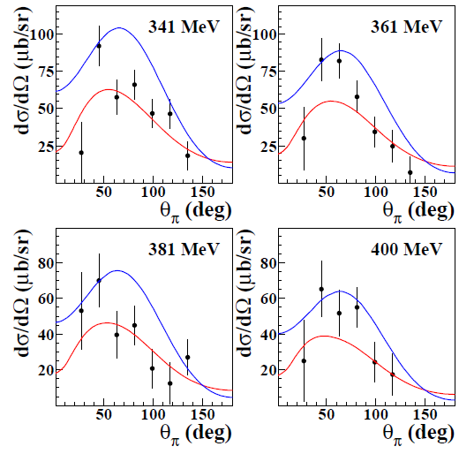
Differential cross section – π⁰X
First data – preliminary!!

Slide 31
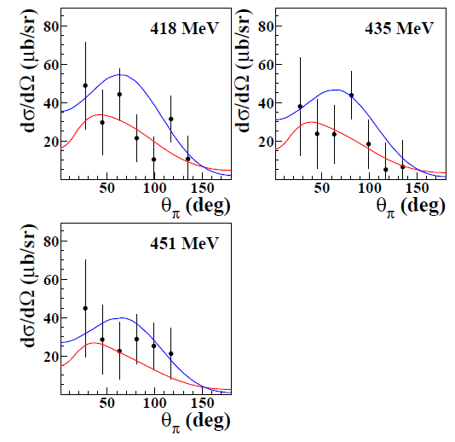
Differential cross section – π⁰X
First data – preliminary!!

Slide 32
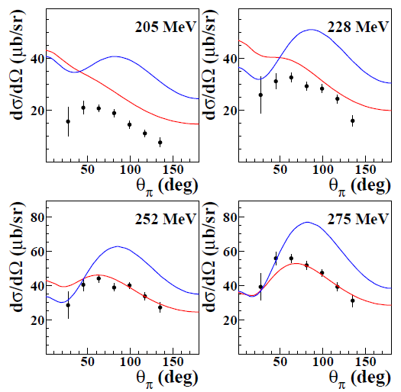
Differential cross section – π±X
First data – preliminary!!

Slide 33
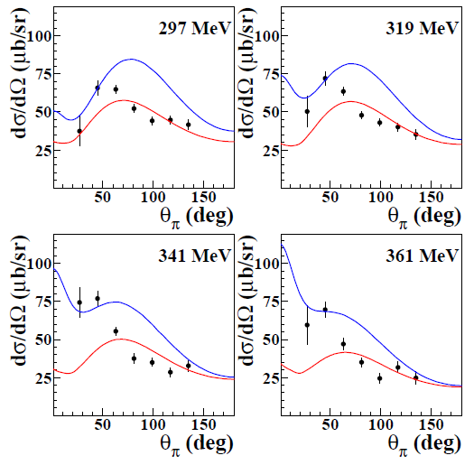
Differential cross section – π±X
First data – preliminary!!

Slide 34
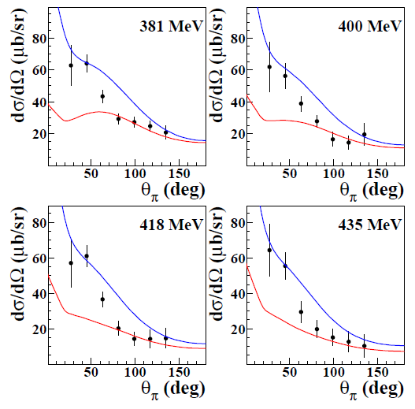
Differential cross section – π±X
First data – preliminary!!

Slide 35
Polarised cross section on ³He

Slide 36
Total inclusive cross section
First data
“Inclusive” analysis method
PWIA predictions:
p_{n} and p_{p} effective degrees of polarisation inside ³He
Δσ_{p(n)} are MAID cross sections smeared out by Fermi motion
─── PWIA prediction
• Running I_{GDH} (³He)
─── PWIA prediction
P. Aguar Bartolomé et al, PLB 723 (2013) 71-77
Reasonable agreement between data and PWIA predictions

Slide 37
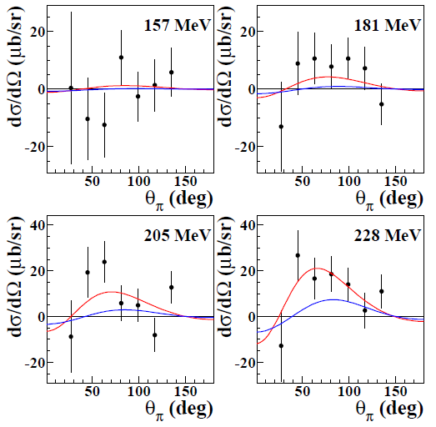
Differential cross section – π⁰X
First data – preliminary!!

Slide 38
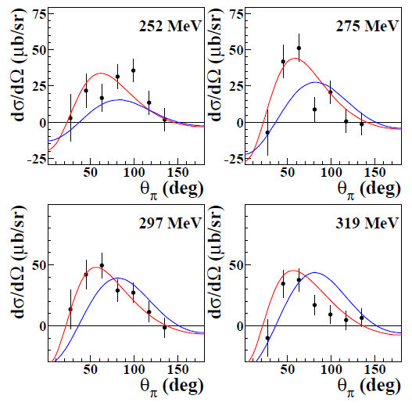
Differential cross section – π⁰X
First data – preliminary!!

Slide 39
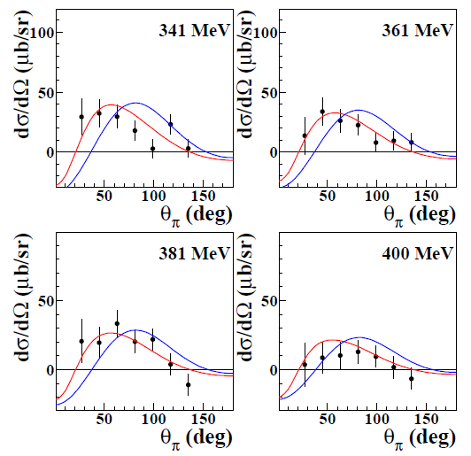
Differential cross section – π⁰X
First data – preliminary!!

Slide 40
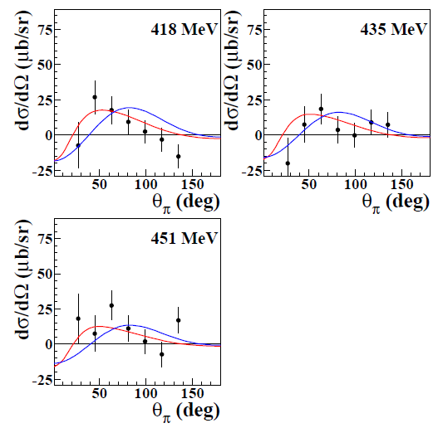
Differential cross section – π⁰X
First data – preliminary!!

Slide 41
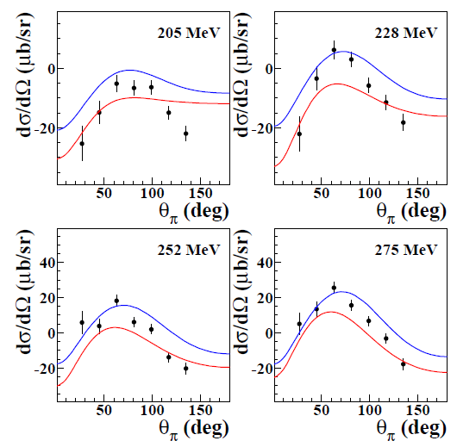
Differential cross section – π±X
First data – preliminary!!

Slide 42
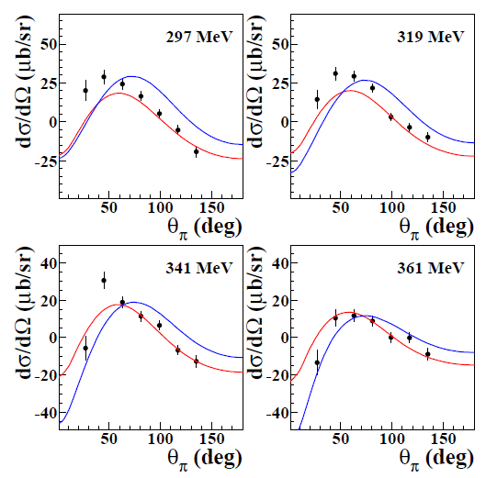
Differential cross section – π±X
First data – preliminary!!

Slide 43
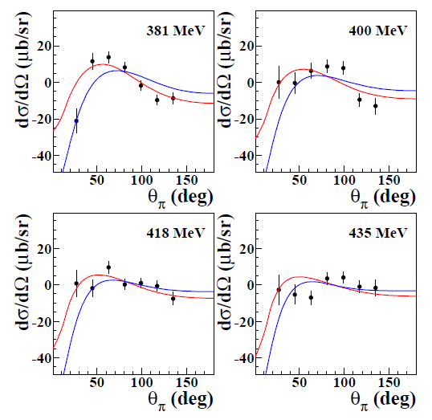
Differential cross section – π±X
First data – preliminary!!

