Slide 1

Quarkonium production in heavy-ion collisions
Roberta Arnaldi
INFN Torino (Italy)

Slide 2
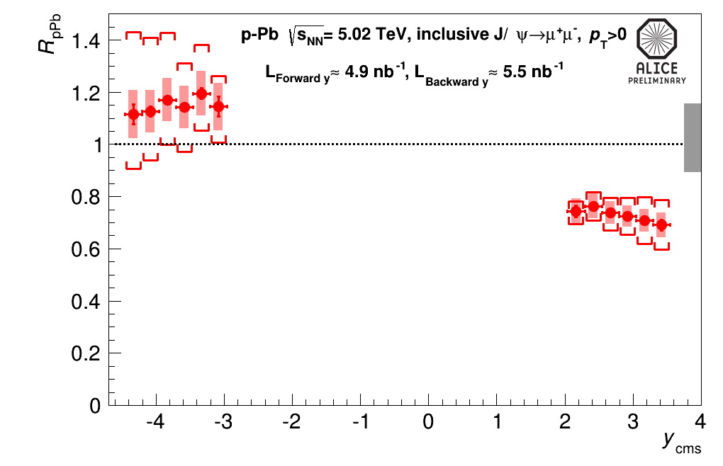
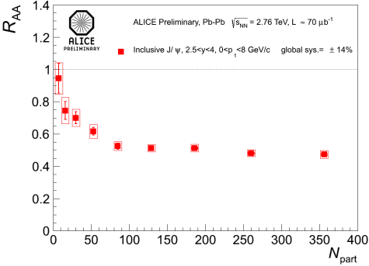
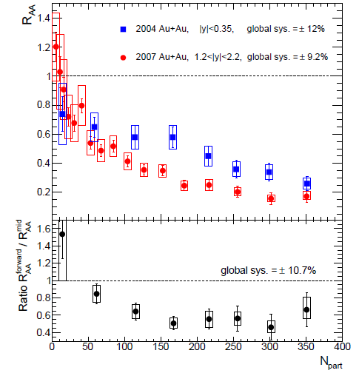
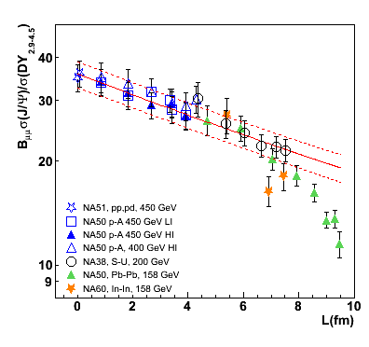
History of heavy-ion quarkonium studies
Quarkonium suppression is, since 25 years, one of the most striking signatures for QGP formation in AA collisions
LHC pA
5020
2760
200
17
LHC AA
√s GeV/c
RHIC
SPS
1986 1990 ~2000 2010 2013
Year

Slide 3
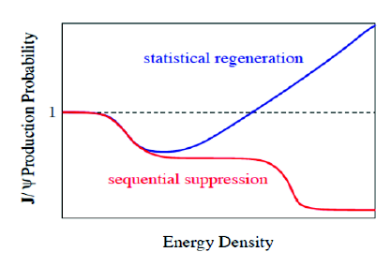
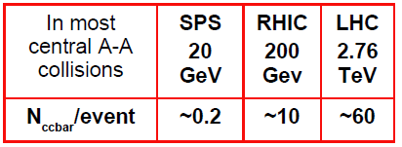
From suppression…to (re)combination
Differences in the binding energies of the quarkonium states lead to a sequential melting of the states with increasing temperature
(Digal,Petrecki,Satz PRD 64(2001) 0940150)
→ thermometer of the initial QGP temperature
T_{c}
T_{c}
T_{c}
T_{c}
ψ(2S)
ψ(2S)
ψ(2S)
ψ(2S)
J/ψ
χ_{c}
J/ψ
J/ψ
ϒ(1S)
ϒ(1S)
ϒ(1S)
T~3T_{c}
T~T_{c}
T<T_{c}
T>>T_{c}
Increasing the energy of the collision the cc pair multiplicity increases
An enhancement via (re)combination of cc pairs producing quarkonia can take place at hadronization or during QGP stage
P. Braun-Muzinger and J. Stachel, Phys. Lett. B490(2000) 196, R. Thews et al, Phys.ReV.C63:054905(2001)

Slide 4
How can we measure medium effects?
Nuclear modification factor R_{AA}:
compare quarkonium yield in AA with the pp one, scaled by a geometrical factor (from Glauber model)
If yield scales with the number of binary collisions
→ R_{AA} = 1
Cold Nuclear Matter effects (CNM):
Nuclear parton shadowing
Parton energy loss
cc in medium dissociation
If there are medium effects
→ R_{AA} ≠ 1
Hot Medium effects:
quarkonium suppression
enhancement due to recombination
knowledge of CNM effects fundamental to disentangle genuine QGP induced suppression in AA
need infos on quarkonium production in pA collisions!

Slide 5
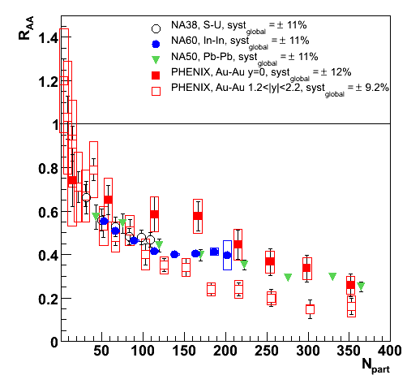
From “low energy” experiments…
Charmonium production deeply investigated at
SPS (NA50, NA60) √s_{NN} = 17 GeV
RHIC (PHENIX,STAR) √s_{NN} = 200 GeV
Eur.Phys.J.C71:1534,2011
Observation of J/ψ suppression
Puzzles from SPS and RHIC
RHIC: stronger suppression at forward rapidities
SPS vs. RHIC: similar R_{AA} pattern versus centrality
Hint for (re)combination at RHIC?
No final theoretical explanation
Decisive inputs expected from LHC results, having access to:
higher energy
larger cc multiplicity
other quarkonium states (bottomonium)

Slide 6
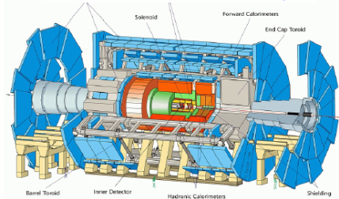

… to LHC data!
Currently available AA and pA results:
R. Averbeck, P. Giubellino, C. Loizides,
G. Roland, P. Steinberg
J/ψ, ψ(2S), ϒ→μ⁺μ⁻ 2.5<y<4
J/ψ→e⁺e⁻ |y|<0.9
ALICE
p_{T} coverage down to p_{T}~0
ATLAS
J/ψ→μ⁺μ⁻ |y|<2.4
p_{T} J/ψ>6.5GeV/c
CMS
J/ψ, ψ(2S)→μ⁺μ⁻ |y|<2.4
p_{T} >6.5GeV/c
ϒ→μ⁺μ⁻ |y|<2.4
p_{T} >0
LHCb
p_{T} coverage down to p_{T}~0
J/ψ→μ⁺μ⁻ 2<y<4.5
(no heavy ion physics program)
Complementary quarkonium results from LHC experiments
Notes:
CMS lowers pt in narrower y regions

Slide 7
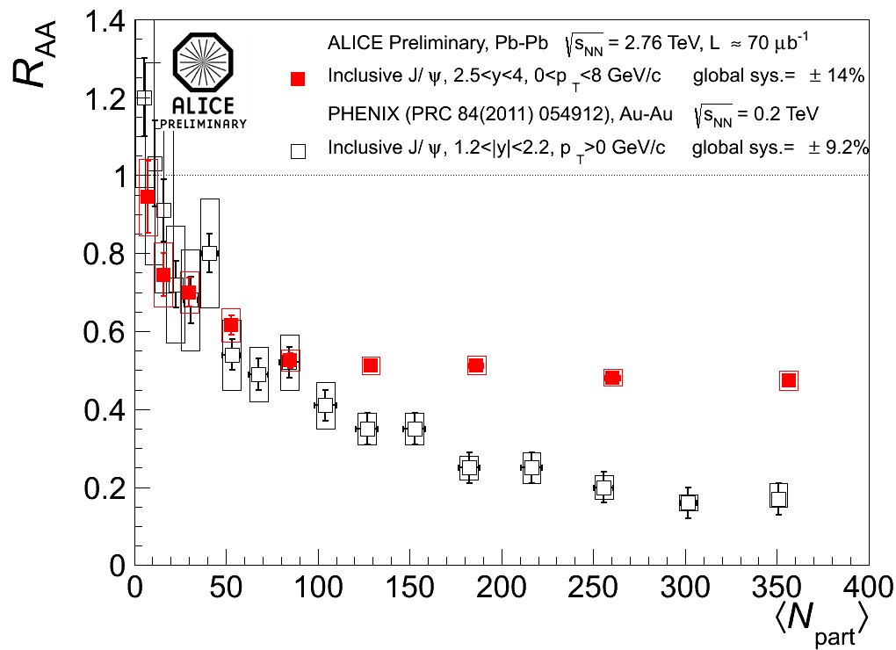
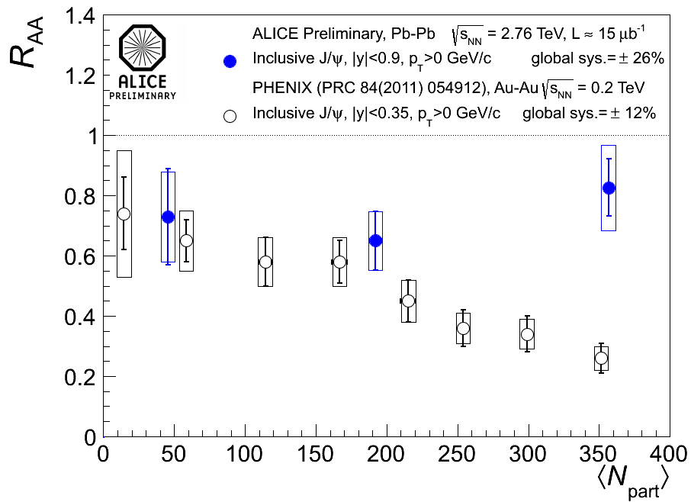
ALICE vs PHENIX
ALICE 2.5<y_{J/ψ}<4
PHENIX 1.2<|y_{J/ψ}|<2.2
ALICE |y_{J/ψ}|<0.9
PHENIX |y_{J/ψ}|<0.35
Nucl.Phys.A (2013), pp. 595-598
Clear J/ψ suppression with almost no centrality dependence above N_{part}~100
Less J/ψ suppression at mid-rapidity wrt forward y for central events
Comparison with PHENIX: ALICE results show weaker centrality dependence and smaller suppression for central events
Is this the expected signature for (re)combination ?

Slide 8
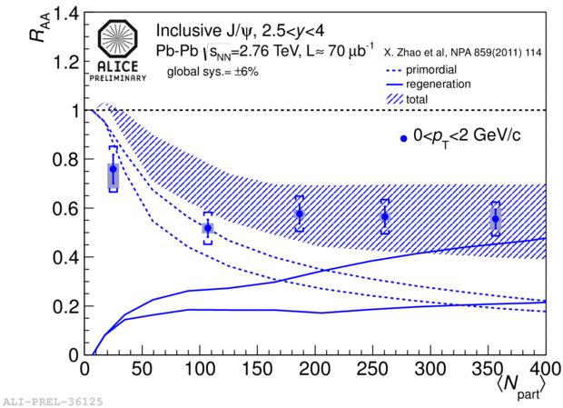
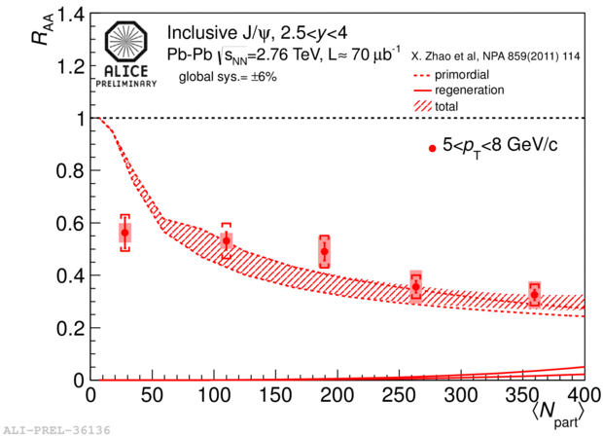
ALICE R_{AA} vs centrality in p_{T} bins
J/ψ production via (re)combination should be more important at low transverse momentum
0<p_{T}<2 GeV/c
p_{T} region accessible by ALICE!
primordial
Different suppression for low and high p_{T} J/ψ
Smaller R_{AA} for high p_{T} J/ψ
recombination
Models: ~50% of low-p_{T} J/ψ are produced via (re)combination, while at high p_{T} the contribution is negligible
→ fair agreement from N_{part}~100 onwards
5<p_{T}<8 GeV/c
primordial
recombination

Slide 9
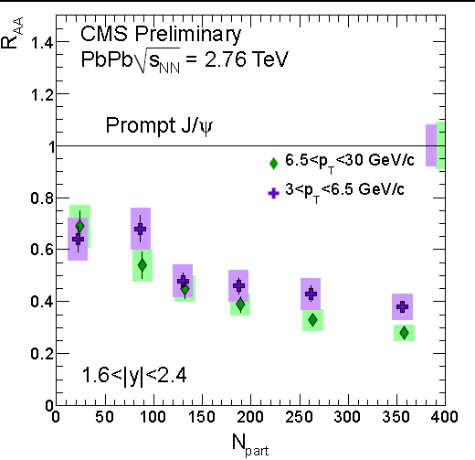
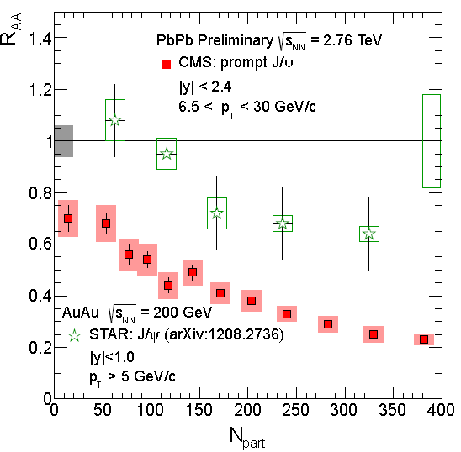
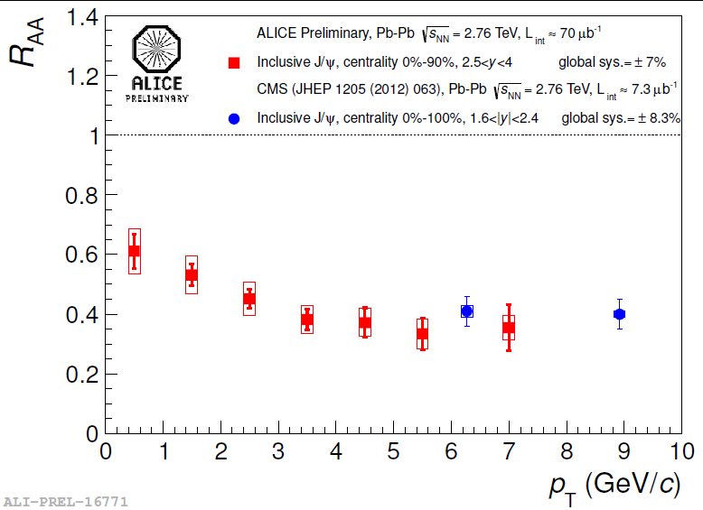
CMS: high p_{T} J/ψ
The high p_{T} region can be investigated by CMS!
Small hint of p_{T} dependent suppression even in the CMS p_{T} range
Good agreement with ALICE (high p_{T}) in spite of the different rapidity range
Stronger high p_{T} J/ψ suppression at LHC wrt to RHIC (re-combination should be negligible)

Slide 10
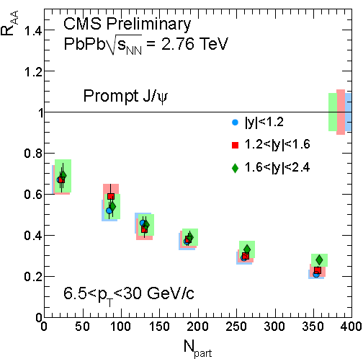
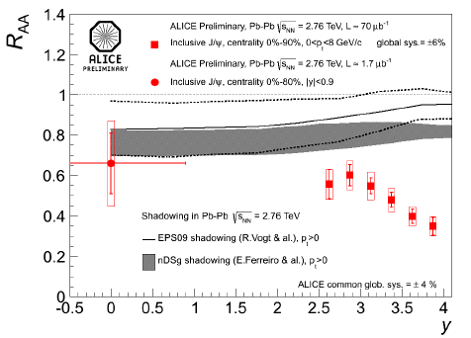
J/ψ R_{AA} vs rapidity
R_{AA} y pattern depends on the J/ψ p_{T}
At high p_{T} (CMS) almost no y dependence in the range |y|<2.4
At low p_{T} (ALICE) R_{AA} decreases by 40% from y=2.5 to y=4
Suppression beyond the current shadowing estimates.
Important to quantify cold nuclear matter effects in p-A collisions
JHEP05 (2012) 063, CMS PAS HIN-12-014
PRL 109 (2012) 072301

Slide 11
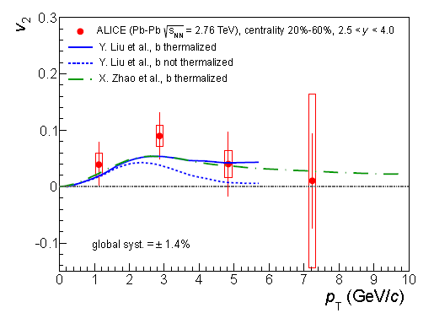
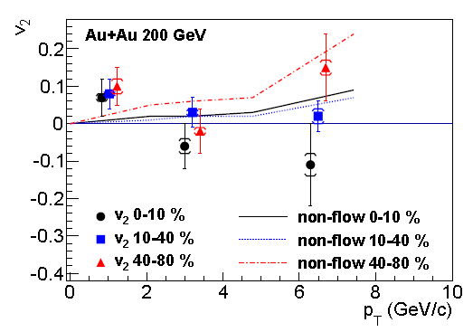
J/ψ flow
The contribution of J/ψ from (re)combination should lead to a significant elliptic flow signal at LHC energy
STAR
arXiv:1303.5880
arXiv:1212.3304
First hint for J/ψ flow in heavy-ion collisions (ALICE, forward y, semi-central collisions), contrary to v₂~0 observed at RHIC!
Significance up to 3σ for chosen kinematic/centrality selections
Qualitative agreement with transport models including regeneration

Slide 12
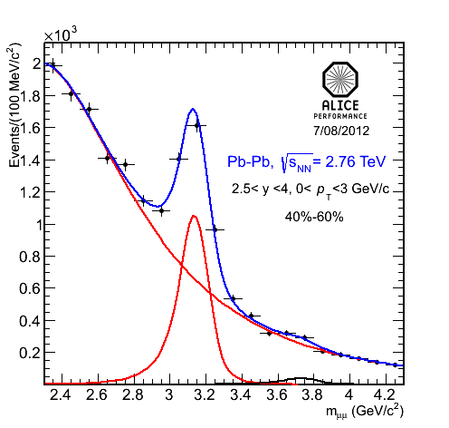
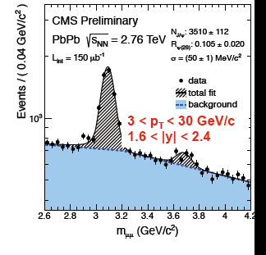
ψ(2S) in Pb-Pb
Study of other charmonium resonances can help constraining theoretical models
ψ(2S) much less bound than J/ψ
Results from the SPS showed a larger suppression than for J/ψ
ψ(2S) studied by both CMS and ALICE, different kinematics

Slide 13
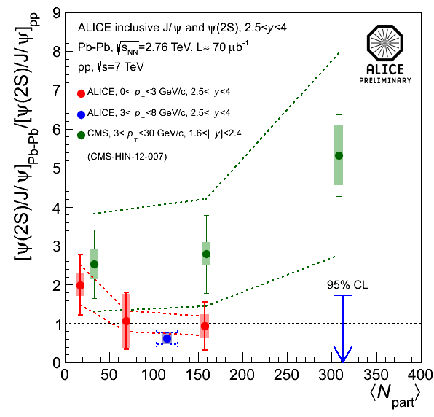
ψ(2S) in Pb-Pb
The ψ(2S) yield is compared to the J/ψ one in Pb-Pb and in pp
At SPS, the ψ(2S)/J/ψ suppression increased with centrality
Overall interpretation is challenging
ALICE excludes a large enhancement
Difference trend in ALICE and CMS: large statistics and systematic errors prevent a firm conclusion on the ψ(2S) enhancement or suppression versus centrality
Nucl.Phys.A 19 (2013), pp. 595-598
CMS PAS HIN-12-007

Slide 14
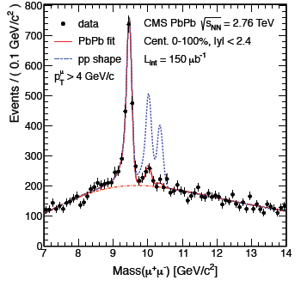
The ϒ family
LHC is the machine for studying bottomonium in AA collisions
Main features of bottomonium production:
no B hadron feed-down
gluon shadowing effect are smaller
(re)combination is less important
Clear suppression of ϒ(nS) in PbPb wrt pp
PRL 109, 222301 (2012)

Slide 15
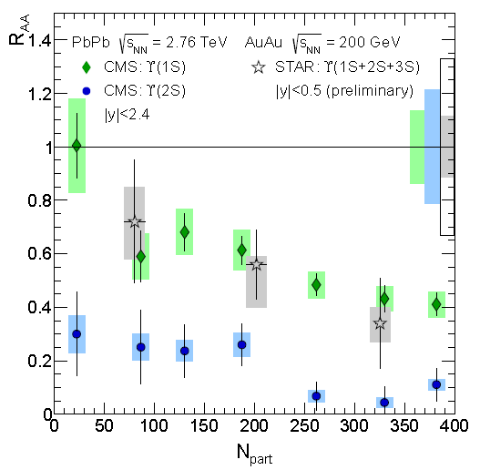
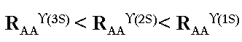
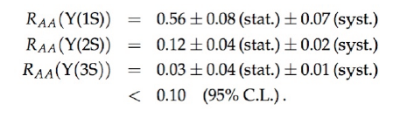
ϒ(nS) R_{AA}
ϒ(nS) suppression increases with centrality
Clear ϒ(2S) suppression even in peripheral collisions
Sequential suppression of ϒ states?
ϒ(1S) suppression might be compatible with excited state suppression (~50% feed-down)?
Compatible with STAR ϒ(1S+2S+3S) (within large errors)(arXiv:1109.3891)
STAR R_{AA}(ϒ(1S+2S+3S)) = 0.56 ± 0.21+0.08-0.16
CMS R_{AA}(ϒ(1S+2S+3S)) ~0.32

Slide 16
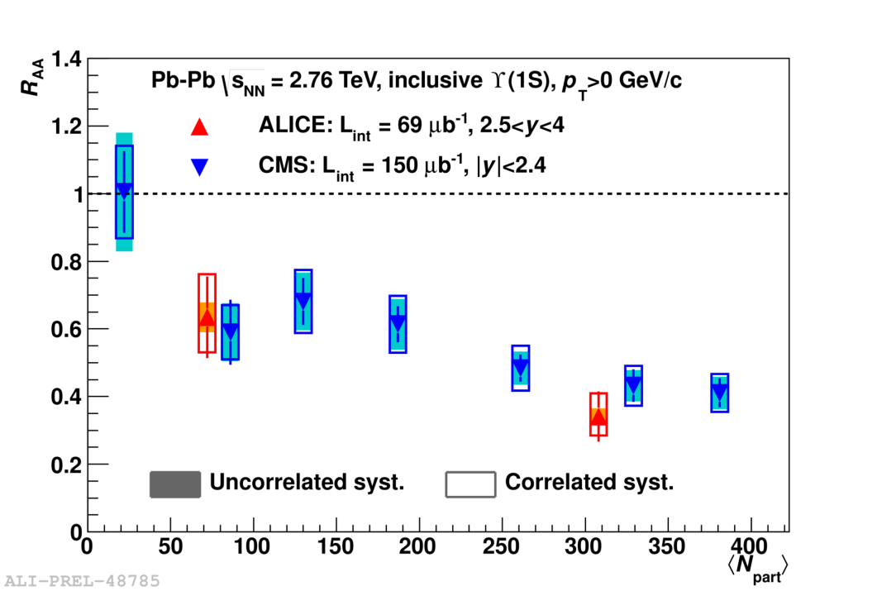
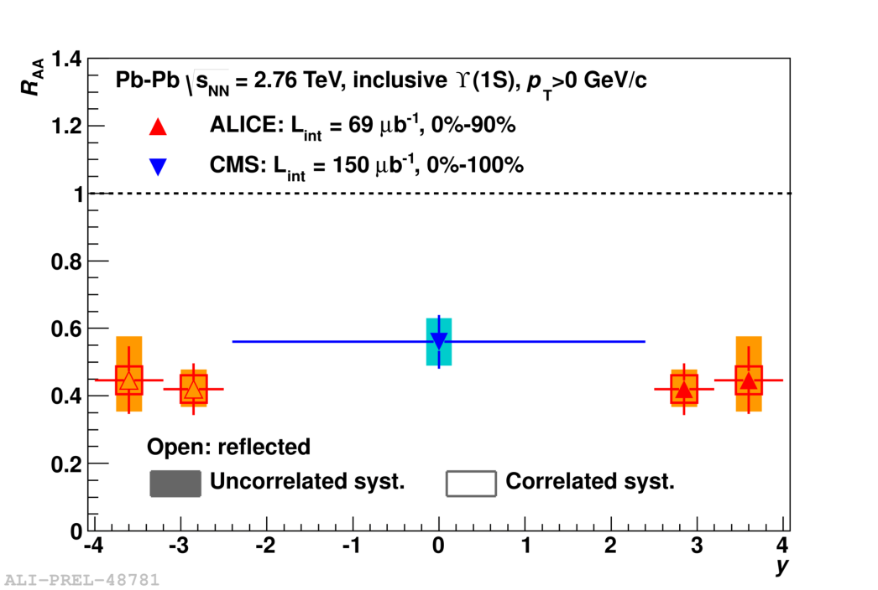
ϒ(1S) ALICE vs CMS
ALICE has measured the inclusive ϒ(1S) R_{AA} in the forward y region
Centrality dependence of CMS and ALICE ϒ(1S) R_{AA} is comparable
Suppression factor is rather constant in the y range covered by ALICE and CMS

Slide 17
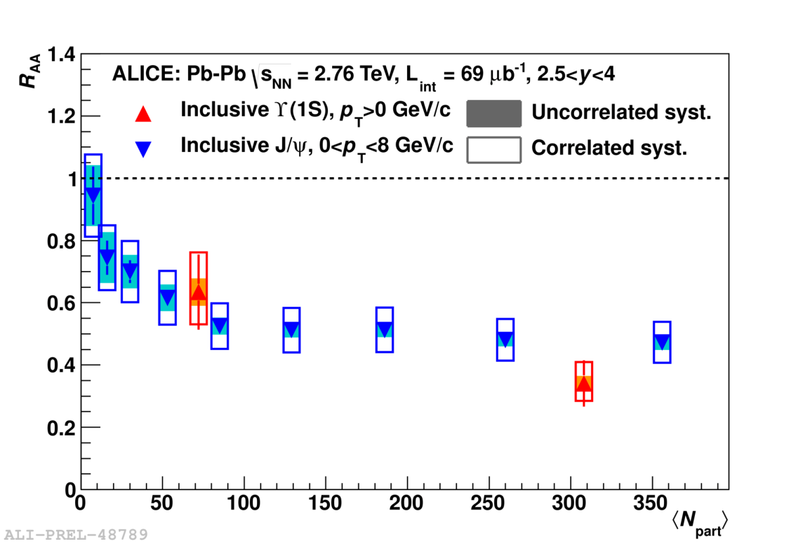
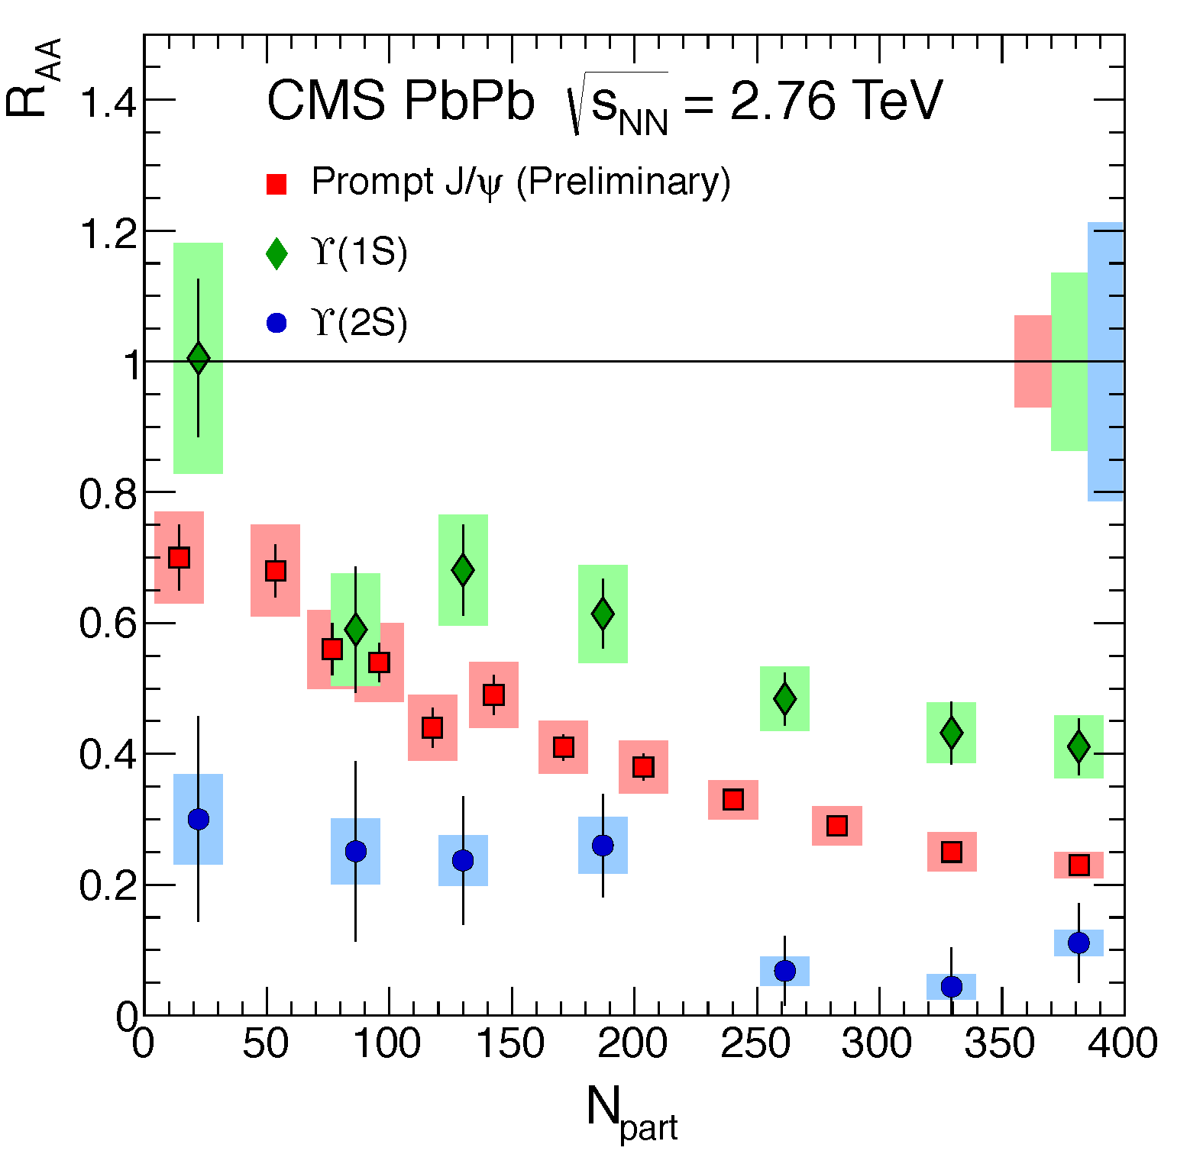
Comparison ϒ and J/ψ
Similar R_{AA} for low p_{T} inclusive J/ψ and ϒ(1S)
Sequential suppression observed for prompt J/ψ and ϒ(nS) at high p_{T}
interplay of the competing mechanisms for J/ψ and ϒ can be different and dependent on kinematics!

Slide 18
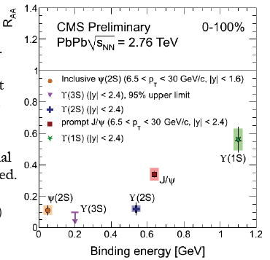
Where are we?
27 years after first suppression prediction, this is finally observed also in the ϒ sector with very good accuracy!
Two main mechanisms at play:
  Suppression in a deconfined medium
  Re-combination (for charmonium) at high √s
can qualitatively explain the main features of the results
R_{AA} vs binding energy: looser bound states more suppressed than the tighter ones
however hot and cold effects not yet disentangled…need pA results!
Nucl.Phys.A 904-905 (2013) 194c-201c

Slide 19
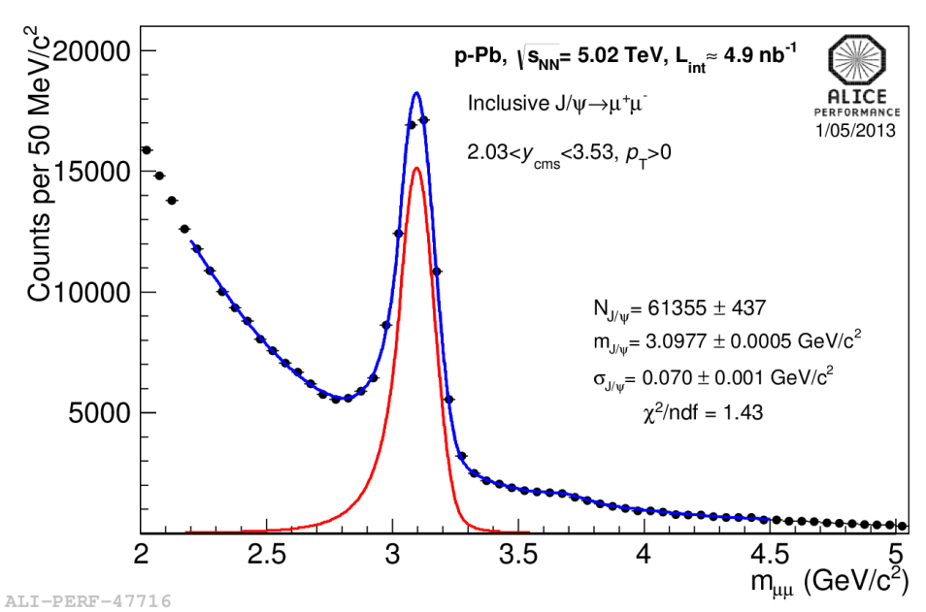
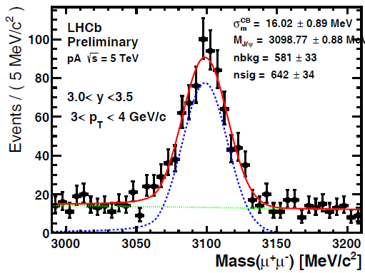
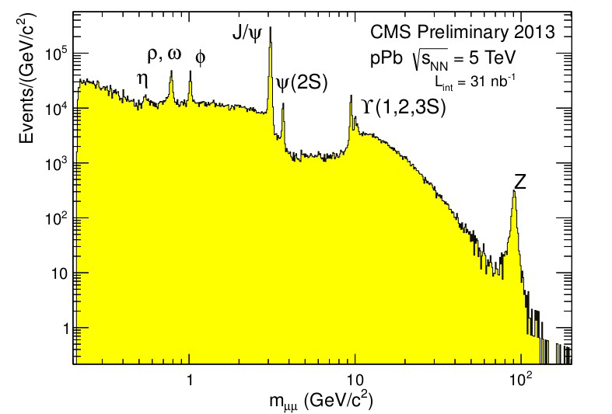
what can we learn from pA?
NEW!
New results from p-Pb data at √s_{NN} = 5.02 TeV
investigate initial/final state Cold Nuclear Matter effects on J/ψ:
shadowing, energy loss, parton saturation effects, cc dissociation in the medium…
provide a reference for AA collisions to disentangle genuine QGP effects

Slide 20
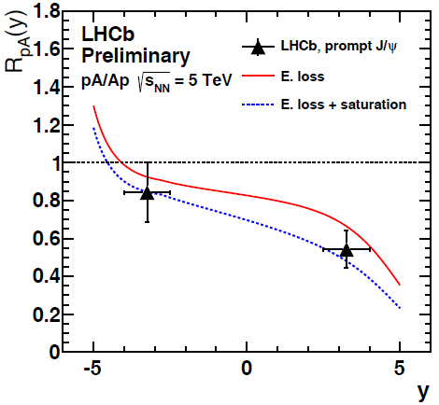
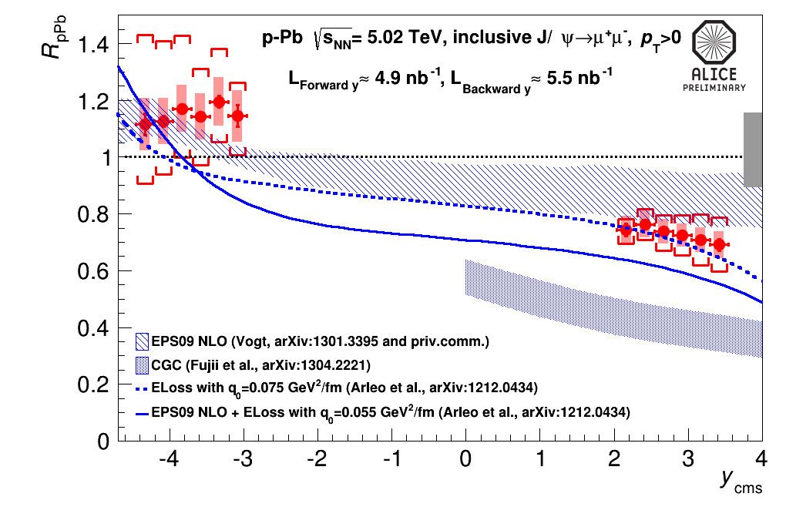
Nuclear modification factor R_{pA}
LHCb-CONF-2013-008
R_{pA} decreases towards forward y
Uncertainty dominated by the pp reference (based on data interpolation)
Theoretical predictions: reasonable agreement with
shadowing EPS09 NLO calculations (R. Vogt)
models including coherent parton energy loss contribution (F. Arleo et al)
CGC description (H. Fujii et al) seems not to be favoured
Comparison ALICE vs LHCb at the edge of the systematic uncertainties

Slide 21
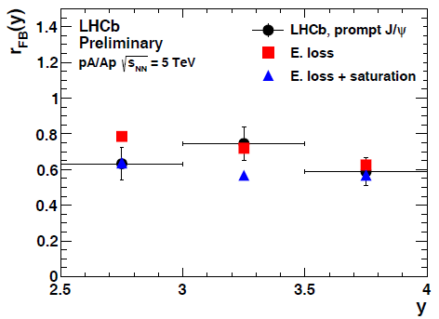
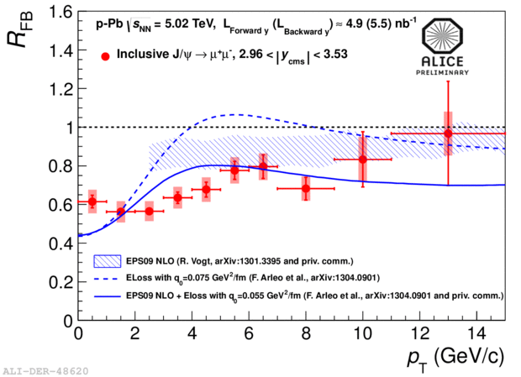
Ratio forward to backward yields: R_{FB}
R_{FB}: free from uncertainties on the pp reference
The R_{FB} ratio shows a rather flat y dependence and a p_{T} dependence with stronger forward to backward suppression at low p_{T}
theoretical predictions including energy loss show strong nuclear effects at low p_{T,} in fair agreement with the data

Slide 22


Conclusions
Quarkonia study in heavy ion collisions is already a 25 years long story!
LHC charmonium and bottomonium results are now complementing the large wealth of data from SPS, RHIC!
the picture is quite complicated because of the interplay of many mechanisms!
…but, hopefully, putting together all
the pieces of the puzzle, the
quarkonium production in AA
collisions will be clarified!
CNM
feed down
SPS
RHIC
sequential
melting
regeneration
J/ψ from B
suppression
LHC
LHC

Slide 23
Backup

Slide 24
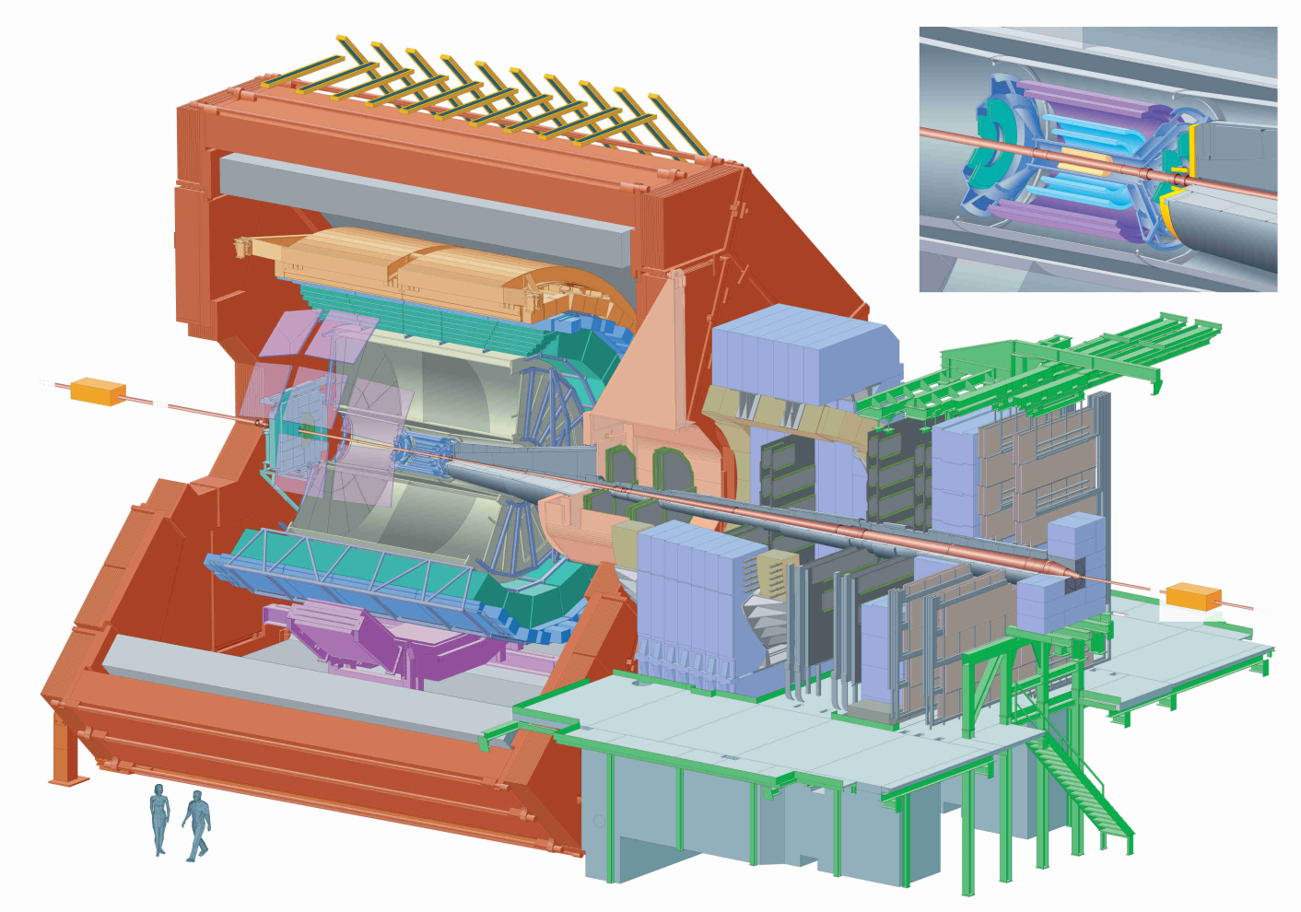
ALICE: low p_{T} J/ψ
Central Barrel J/ψ →e⁺e⁻
(|y_{LAB}|<0.9)
Electrons tracked using ITS and TPC
Particle identification: TPC, TOF, TRD
Forward muon arm J/ψ →μ⁺μ⁻
(2.5<y_{LAB}<4)
Muons identified and tracked in the muon spectrometer
Acceptance coverage in both y regions down to zero p_{T}
ALICE results refer to inclusive J/ψ production
µ⁺
e⁺
e⁻
µ⁻

Slide 25
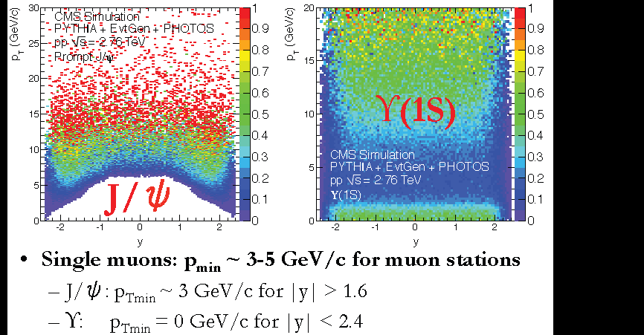
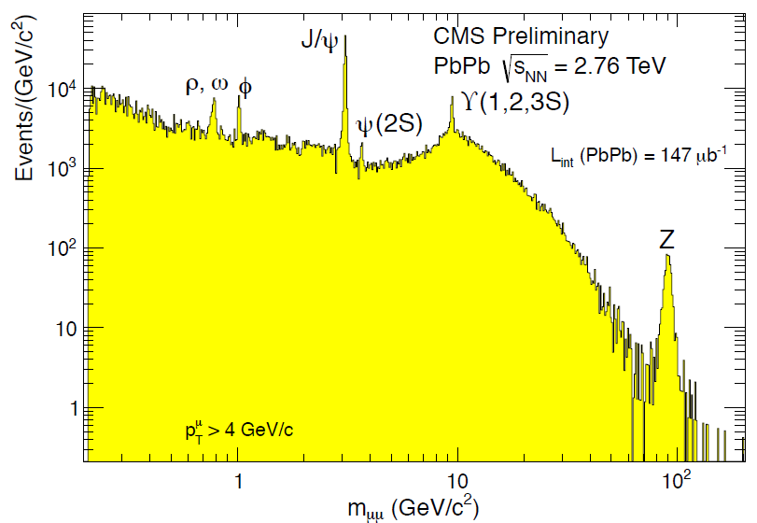
CMS: high p_{T} J/ψ
Muons need to overcome the magnetic field and energy loss in the absorber: p_{min}~3-5 GeV/c to reach muon stations
Limits J/ψ acceptance:
Midrapidity: p_{T}>6.5 GeV/c
Forward rapidity: p_{T}>3 GeV/c
..but not the ϒ one (p_{T} > 0 everywhere)
Prompt and B-decay J/ψ are measured

Slide 26

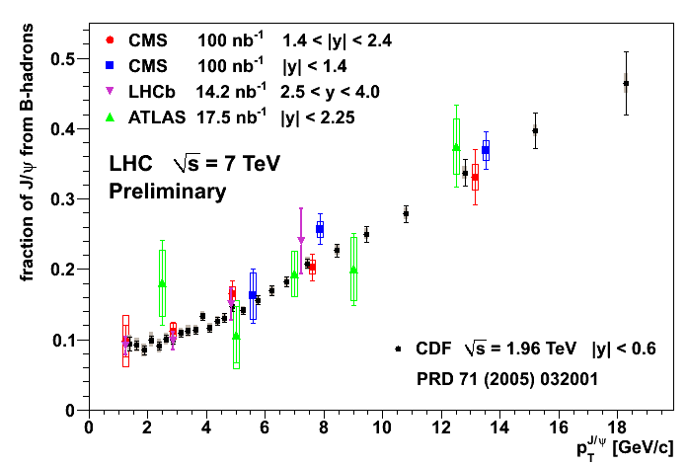
Quarkonium production
Quarkonium production can proceed:
directly in the interaction of the initial partons
via the decay of heavier hadrons (feed-down)
For J/ψ (at CDF/LHC energies) the contributing mechanisms are:
Feed Down
30%
Direct
60%
Direct production
B decay
10%
Prompt
Feed-down from higher charmonium states:
~ 8% from ψ(2S), ~25% from χ_{c}
B decay
contribution is p_{T} dependent
~10% at p_{T}~1.5GeV/c
Displaced
Feed down and J/ψ from B, if not properly taken into account, may affect physics conclusions

Slide 27
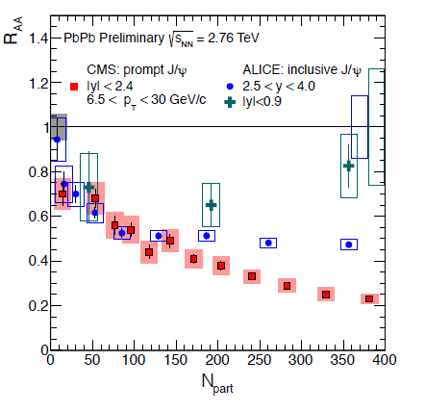
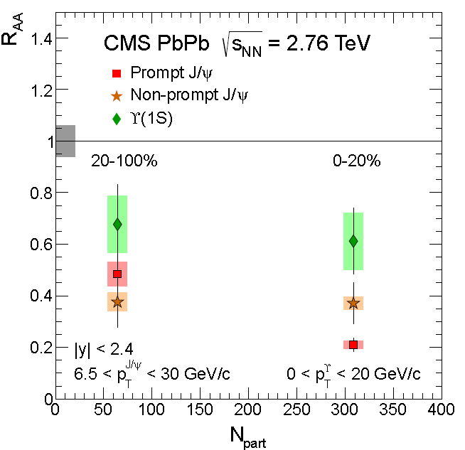
ALICE and CMS J/ψ

Slide 28
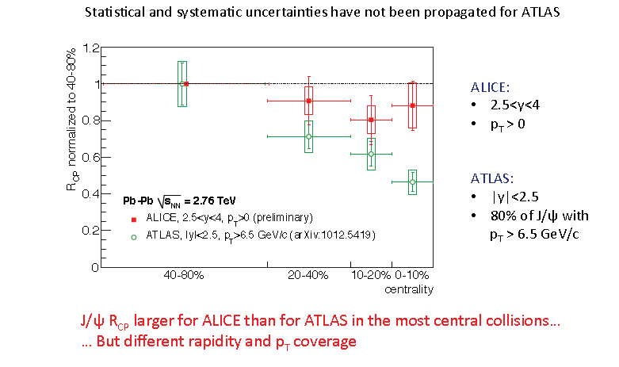
ALICE and ATLAS J/ψ

Slide 29
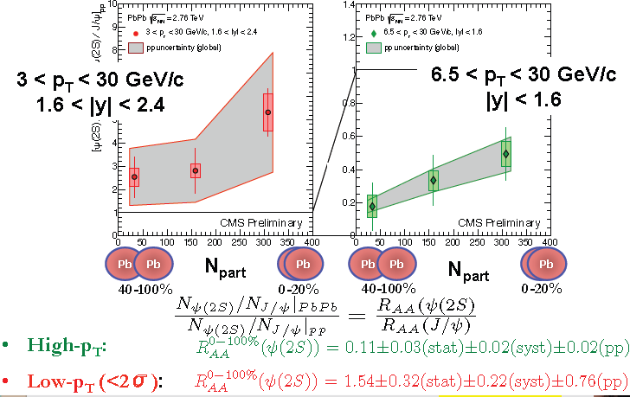
ψ(2S)/ ψ

Slide 30
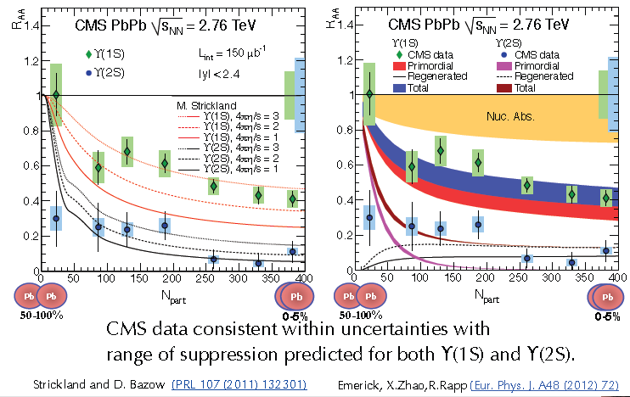
CMS: ϒ theoretical comparison

Slide 31
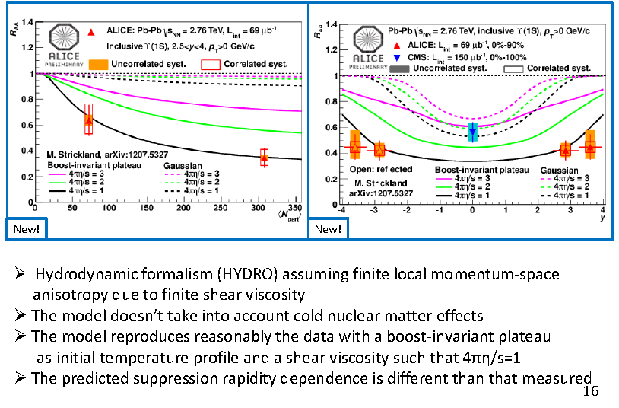
ALICE: ϒ theoretical comparison

Slide 32
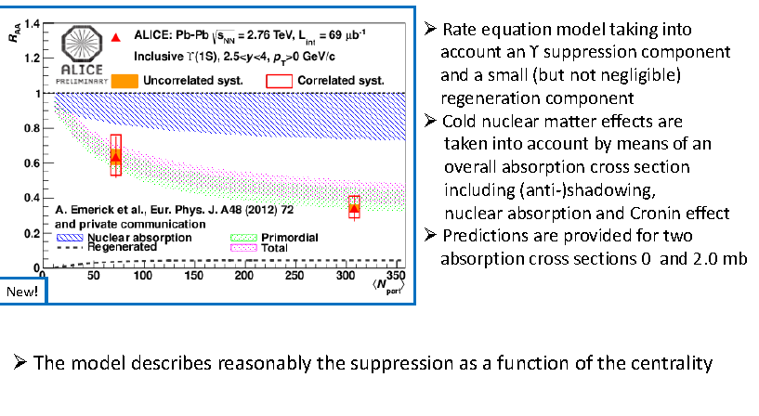
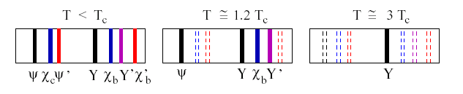
ALICE: ϒ theoretical comparison

Slide 33

ALICE: influence of B feed-down

Slide 34

ϒ(nS)/ ϒ(1S) double ratio
no strong centrality dependence of ϒ(2S)/ϒ(1S) double ratio
upper limit on ϒ(3S): centrality integrated value:

Slide 35

R_{FB}

