Slide 1

Exploring the QCD Phase Diagram through Relativistic Heavy Ion Collisions
Bedanga Mohanty
National Institute of Science Education and Research (NISER)
Outline:
    Phase diagram of QCD
    Theoretical and Experimental status
    Summary

Slide 2
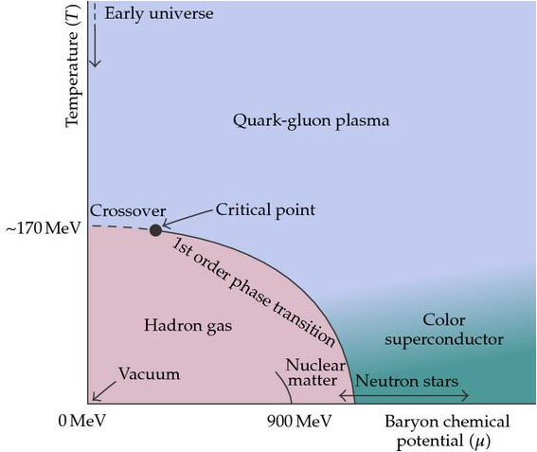
QCD Phase Diagram
Physical systems undergo phase transitions when external parameters such as the temperature (T) or a chemical potential (μ) are varied.
K. Rajagopal and F. Wilczek, Handbook of QCD
Conserved Quantities:
Baryon Number ~ μ_{Β}
Electric Charge ~ μ_{Q} ~ small
Strangeness ~ μ_{S} ~ small
Rich phase structure:
-- Phases QGP & Hadronic
-- Cross over
-- 1st order
-- Critical Point

Slide 3
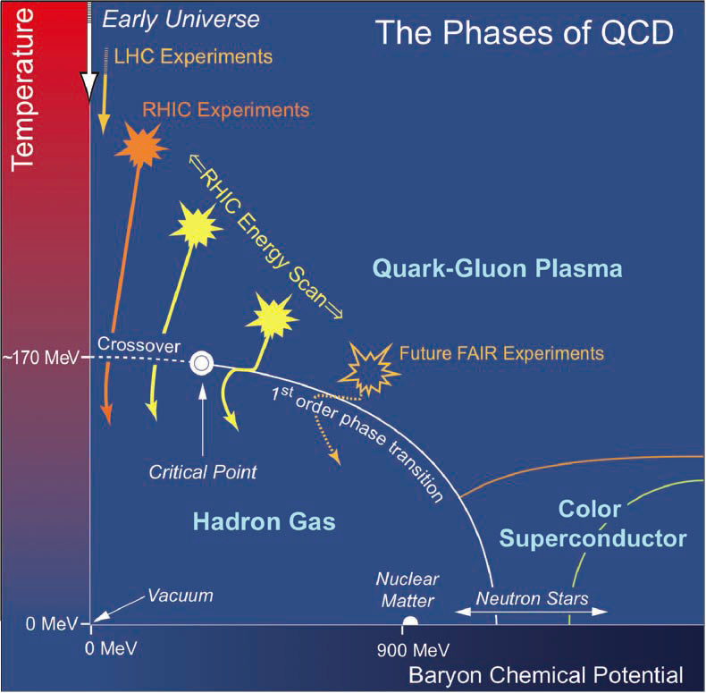
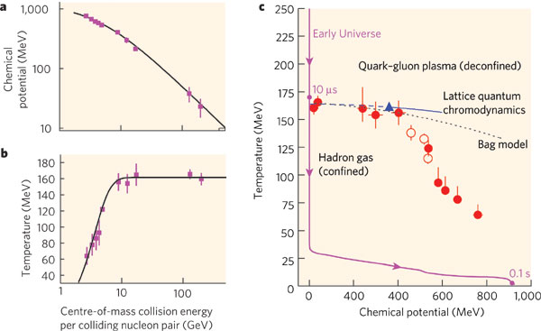
QCD Phase Diagram - Experimental
Conservation in strong interactions
-- Charge
-- Baryon number
-- Strangeness
Vary: T, μ_{B}, μ_{S}, μ_{Q}
Nature 448 (2007) 302
Vary beam energy to change Temperature & Baryon Chemical Potential

Slide 4
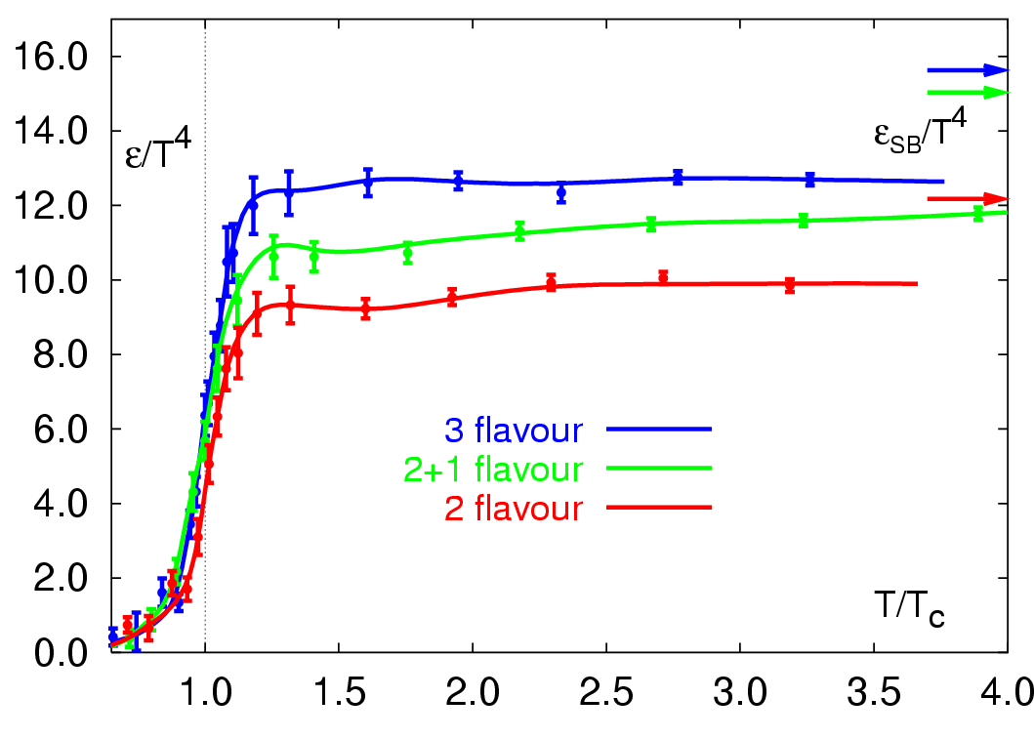
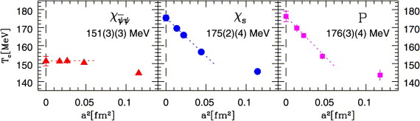
Transition Temperature
Prog. Theor. Phys. Suppl. 153, 106 (2004)
g_{parton} ~ 47
ε/Τ⁴ ~ g (π²/30)
g_{π} ~ 3
Nucl. Phys. A 830 (2009) 805c
High Temperature
De-confined state of quarks
and gluons
Phys.Rev. D85 (2012) 054503

Slide 5
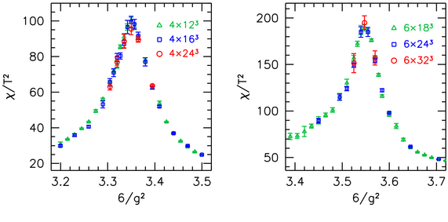
Cross-over
Nature443:675-678,2006
JHEP 1208 (2012) 053
No significant volume dependence
Phys. Rev. Lett. 110, 012302 (2013)
At high T and μ_{Β} = 0 is a cross over.

Slide 6
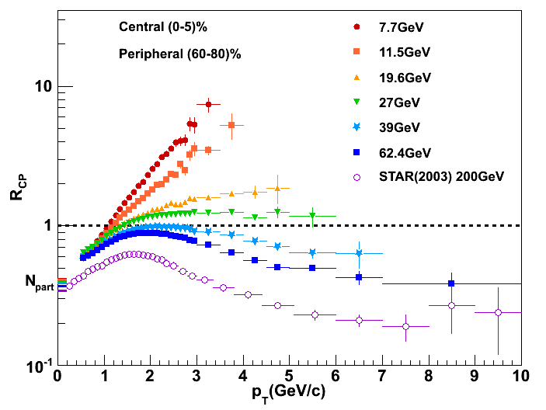
Establishing Quark Gluon Phase
Eur.Phys.J. C72 (2012) 1945
ε_{initial} > ε_{c} (Lattice)
STAR: QM2012
At and below 11.5 GeV – Hadronic interactions dominate. Need pA data for a quantitative statement.
QGP turned off ?
6

Slide 7

Establishing Quark Gluon Phase
Partonic Collectivity
De-confinement
Turned off at low energy ?
7
arXiv:1301.2347

Slide 8
Establishing Quark Gluon Phase
QM2012: STAR
At and below 11.5 GeV – Hadronic interactions dominate.

Slide 9
QCD Phase structure at μ_{B} ~ 0
Close to zero baryonic chemical potential the QCD transition corresponding to a state of de-confined quarks and gluons takes place at high temperature.
First principle QCD calculations suggest it is a cross over.
Transition temperature using chiral condensates ~ 154 MeV, using Susceptibilities and Polyakov loop ~ 175 MeV – width around 15 MeV

Slide 10
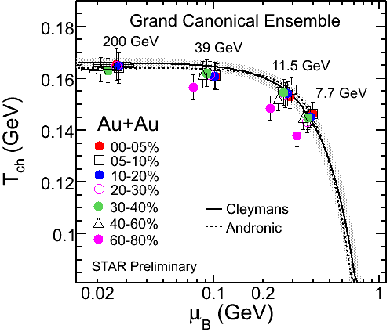
Transition Line - Theory
JHEP 1104 (2011) 001
Width of transition line wide
Freeze-out line close to transition line at Lower μ_{B}
Larger μ_{B} deviations of freeze-out curve from transition line
Interesting T vs. μ_{B} dependence at lower beam energies

Slide 11
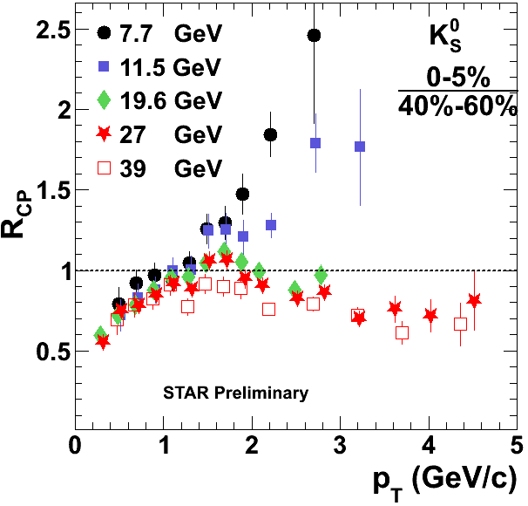
Transition line - Experiment
First step: Locate beam energy (T, μ_{B}) point where the system did not undertake the QCD transition
arXiv:1301.2347
At and below 11.5 GeV – Hadronic interactions dominate. Need higher statistics data for a quantitative statement.
QM2012: STAR

Slide 12
QCD Phase structure at μ_{B} > T
Transition line from lattice QCD has large uncertainties.
Transition line close to chemical freeze-out line at small μ_{B} but deviates at large μ_{B}. Interesting trends of T vs. μ_{B} at lower energies.
Experimental hints towards no QCD transition to de-confined state ~ 11.5 GeV center of mass energy.

Slide 13
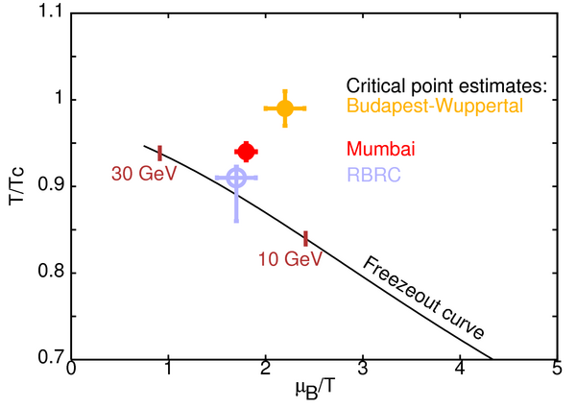
Search for Critical Point - Theory
Numerical QCD calculations difficult at large μ_{B} – sign problem
Techniques: Reweighting, Taylor expansion & imaginary potential
S. Gupta, QM2009
Acta Phys.Polon.Supp. 5 (2012) 825-835
Phys. Rev. D 78, 14503 (2008);
Phys.Rev.D71:114014,2005
JHEP 0404, 50 (2004)
Issues (not common to all) : lattice spacing, physical quark mass,
continuum limit, Volume
Theory still some more work to be done …… need more CPU

Slide 14
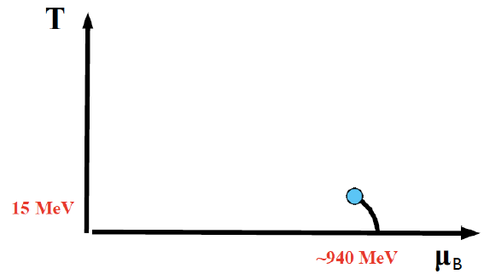



Search for Critical Point - Experiment
Beam Energy Scan Program at RHIC
Nuclear liquid-gas transition with a critical end point
Observables : Related to correlation length or susceptibility
< (δN)²> ~ ξ²
< (δN)³> ~ ξ^{4.5}
< (δN)⁴> - 3 < (δN)²>² ~ ξ⁷
S σ ~ χ_{Β}⁽³⁾/χ_{Β}⁽²⁾
κσ² ∼ χ_{Β}⁽⁴⁾/χ_{Β}⁽²⁾
Phys.Lett. B696 (2011) 459
Phys.Rev.Lett. 107 (2011) 052301
Phys.Rev.Lett. 105 (2010) 022302
Phys. Rev. Lett. 102, 032301 (2009)
Phys. Rev. Lett. 91, 102003 (2003)
Phys. Rev. D 61, 105017 (2000)
No dynamical theoretical estimates exists. Experimentally look for non-monotonic variations with beam energy (T, μ_{B}).
Challenging to measure :
Finite size effects ξ < 6 fm
Critical slowing down, finite time effects ξ ~ 2 - 3 fm

Slide 15
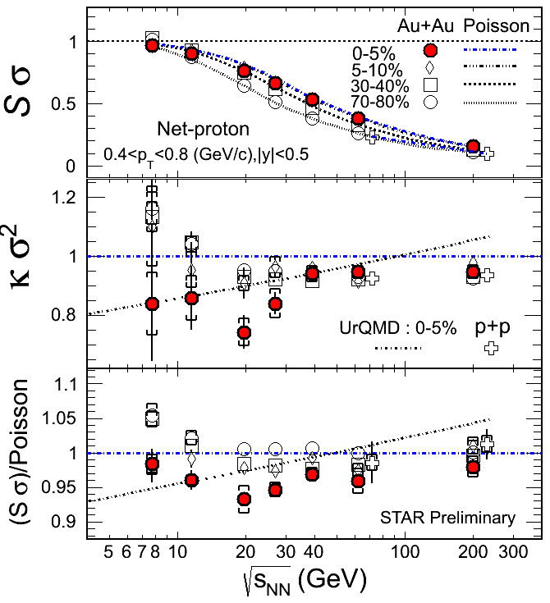
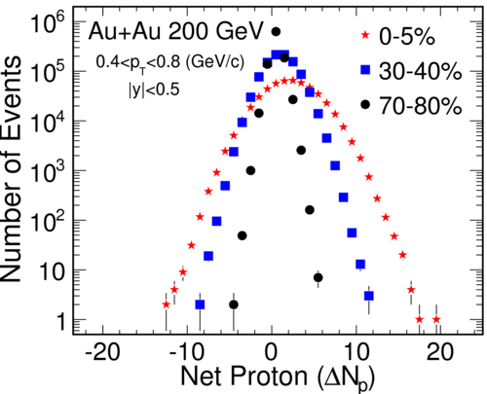
Search for Critical Point - Experiment
Deviations from Poissonian
for 0-5% central collisions
Higher statistics needed at 7.7
& 11.5 GeV + a new data point
around ~15 GeV
STAR: QM2012
Phys.Rev.Lett. 105 (2010) 022302

Slide 16
QCD Phase structure: Critical Point
Theory: Lattice QCD calculations have uncertainties.
Experiment: If signal survives hadronization then ruled out for beam energies > 39 GeV
Promising prospects below 39 GeV.
High statistics data set needed below 39 GeV.
Theory+Experiment: Need quantitative dynamical theory calculations with realistic correlation lengths to compare to data.
Science 332 (2011) 1525-1528

Slide 17
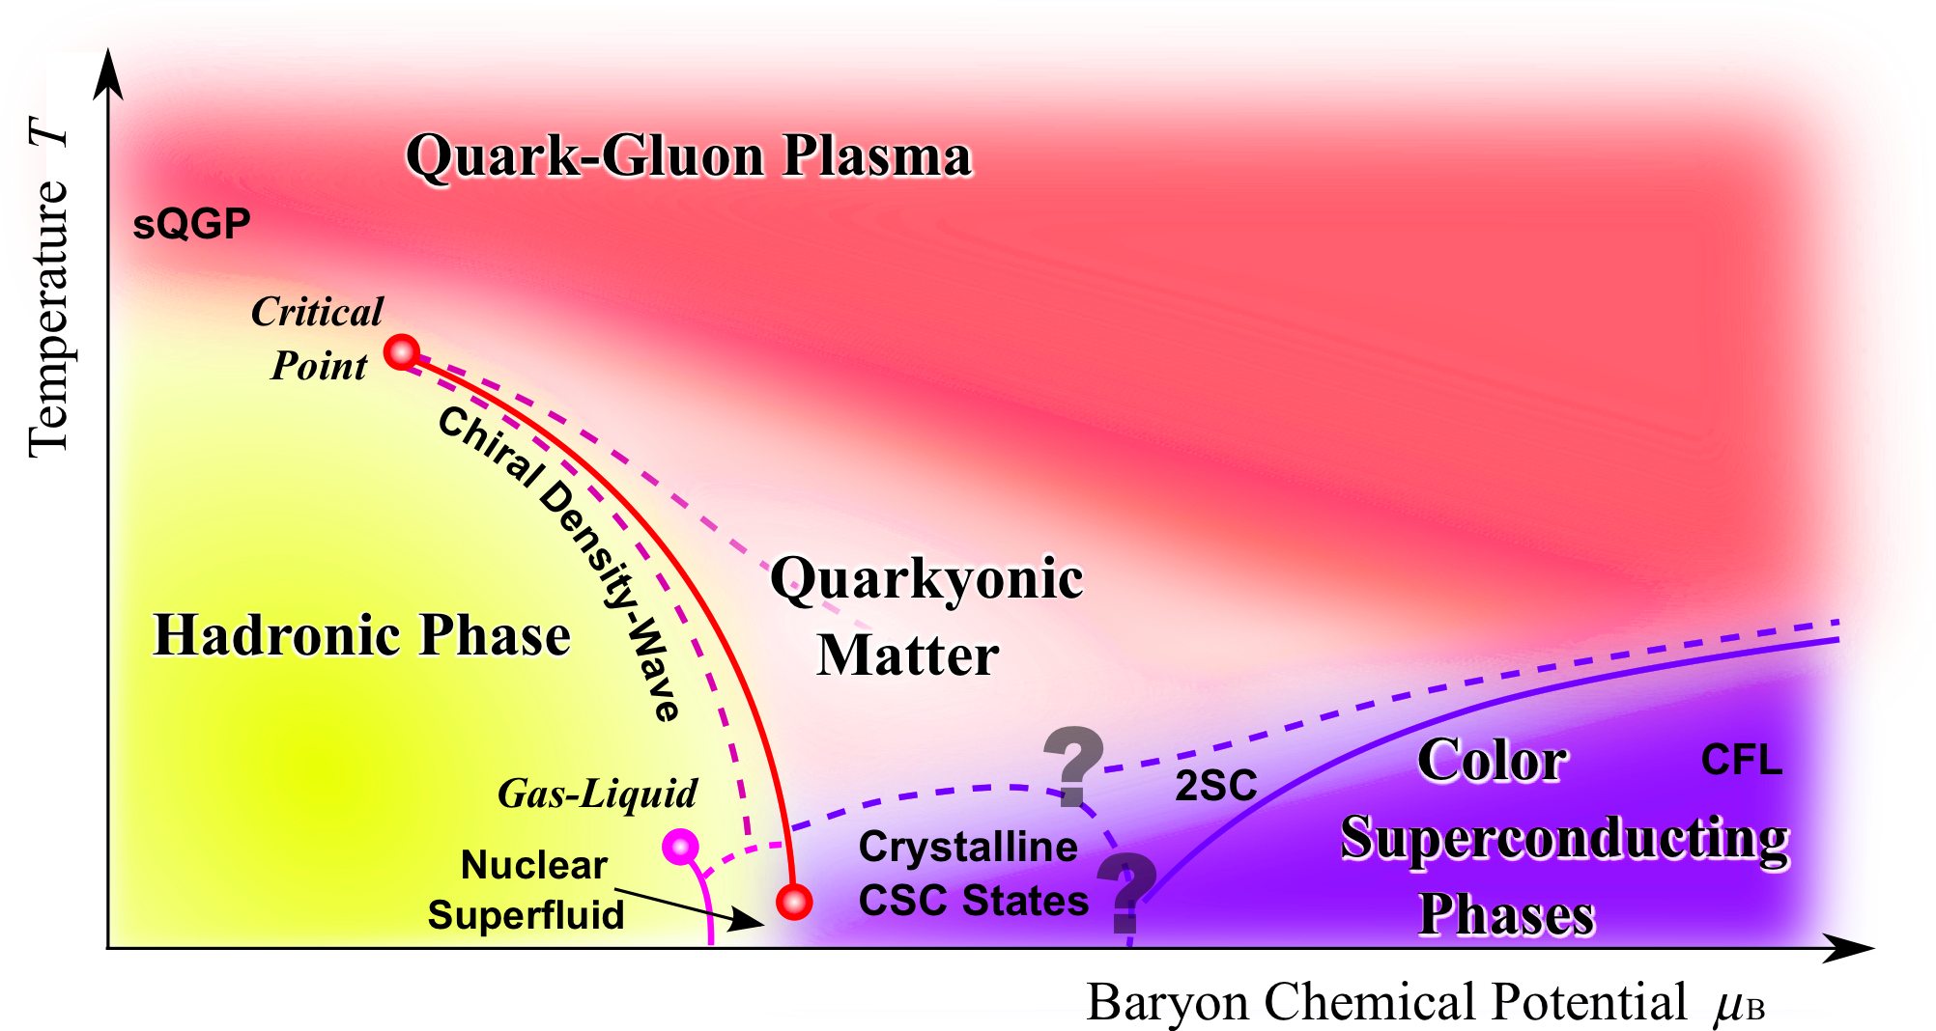
Phase structure: Interesting Possibilities
Rept.Prog.Phys. 74 (2011) 014001
Quarkyonic phase (Theoretical) → Experimental signature
(Baryon correlations, Photons) ?
Nucl.Phys. A830 (2009) 709C-712C
Nucl. Phys. A 796, 83 (2007
arXiv:1302.1119

Slide 18
Summary
What is known about the QCD phase diagram and to what degree ?
De-confined transition: Exists, – Theory & experiment
Cross over: Exists, μ_{B} ~ 0 Theory & experiment (indirectly)
Critical point: Search on, Theory (Uncertain) & experiment (inconclusive)
Transition line: Theory (some uncertainties) & Experiment (indications)
QGP properties: Progress - Theory (EOS at μ_{B} = 0, need better handle for
EOS at large μ_{B} & Experiment tremendous progress
Hadronic properties: Progress - Theory (Freeze-out properties using QCD)
Experiment tremendous progress
Phys. Lett. B 696 (2011) 459 Phys.Rev.Lett. 109 (2012) 192302
New Phases: Theory (Quarkyonic) and experiment (signatures ?)
Theory predicted signals needed.

